Slide 1
Progress toward spin-polarized fusion: Performance of laser-polarized He-3 during permeation into tokamak pellets
Sina Tafti¹, Alexandre Deur², Jie Liu¹, Michael Lowry², Wilson Miller¹, Andrew Sandorfi², Kevin Wei³, Xiangdong Wei², Xiaochao Zheng¹
¹University of Virginia, Charlottesville VA, USA
²Jefferson National Laboratory, Newport News VA, USA
³University of Connecticut, Storrs CT, USA

Slide 2
Motivation and Background
Self-sustained fusion energy production has not yet been reached
Energy spent sustaining the plasma > fusion output energy
The possibility of spin-polarized nuclear fusion gained traction in 1982 with predicted time scales for polarization loss in a plasma that were much longer than the characteristic fuel burn-up period.*
At tokamak energies, fusion reaction of deuterium (D) and tritium (T) proceeds via spin 3/2 resonance state
$D+T→\text{5}\text{He}$ $→α+n$
Spin 1 D and spin 1/2 T will favorably fuse into a 3/2 spin state when their spins are aligned parallel to each other
50 % boost in fusion cross section!!
*Kulsrud, Furth, Valeo & Goldhaber, Phys Rev Lett 49 (1982) 1248.

Slide 3
Motivation and Background
Self-sustained fusion energy production has not yet been reached
Energy spent sustaining the plasma > fusion output energy
The possibility of spin-polarized nuclear fusion gained traction in 1982 with predicted time scales for polarization loss in a plasma that were much longer than the characteristic fuel burn-up period.*
The same enhancement is achieved for isospin-mirrored reaction:
At tokamak energies, fusion reaction of deuterium (D) and tritium (T) proceeds via spin 3/2 resonance state
$$D+\text{3}\text{He}→\text{5}Li→α+p$$
Spin 1 D and spin 1/2 T will favorably fuse into a 3/2 spin state when their spins are aligned parallel to each other
50 % boost in fusion cross section!!
*Kulsrud, Furth, Valeo & Goldhaber, Phys Rev Lett 49 (1982) 1248.

Slide 4
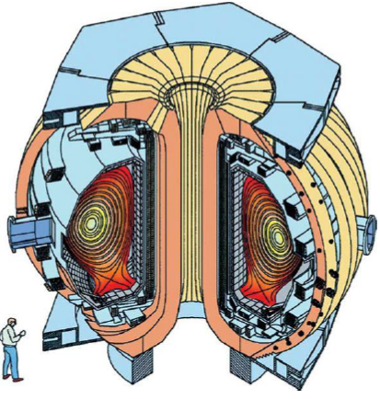
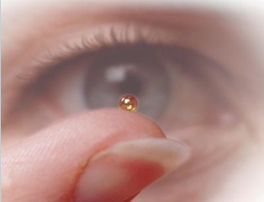
The Challenge
Polarization survival in plasma temperatures of ~ ${10}^{8}$K predicted* for fusion timescales but never experimentally tested!
Preparing and handling of polarized fuels
lack of a method for delivering polarized fuel into the tokamak
Proposed method:
D-III D Tokamak in San Diego
Polarized fusing elements can be delivered to the plasma using hollow polymer shells (~2 mm diameter ICF pellets)
General Atomics
*M. Goldhaber, Proc. Cambridge Philos. Soc. 30, 561 (1934). A.M. Sandorfi et al., Springer Proc. Phys. 187, 115 (2016).

Slide 5
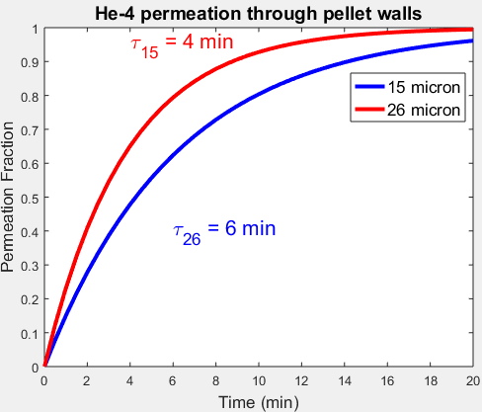
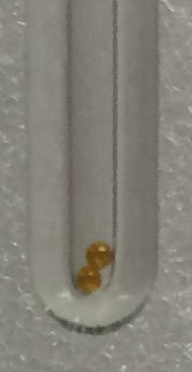
Permeation time constant of $\text{3}\text{He}$ gas into the ICF shells
2 ICF pellets placed inside tube
$D+\text{3}\text{He}→\text{5}Li→α+p$
HD can be permeated into the pellet and polarized inside the shell
$\text{3}\text{He}$ is polarized using hybrid alkali SEOP: Polarize first, then permeate into the pellet polarization loss

Slide 6
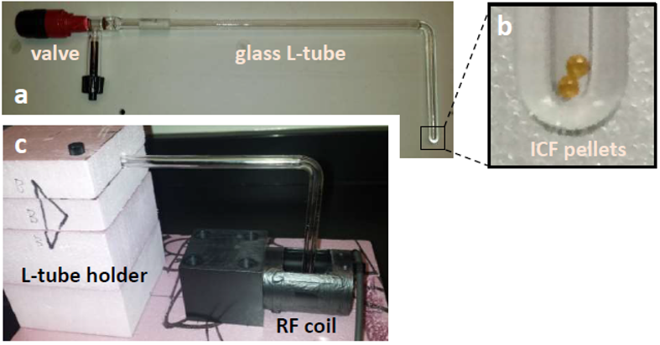
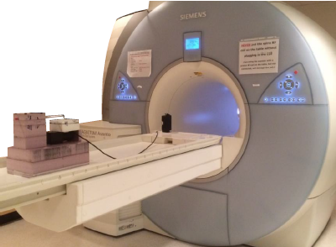
Experimental Setup
Place pellets inside tube
Evacuate tube & pellets
Flood tube w/ 4-8 atms of polarized $\text{3}\text{He}$
Insert tube in custom built radio frequency coil inside a 1.5 T clinical MRI scanner
Image during permeation and decay of polarization
d

Slide 7
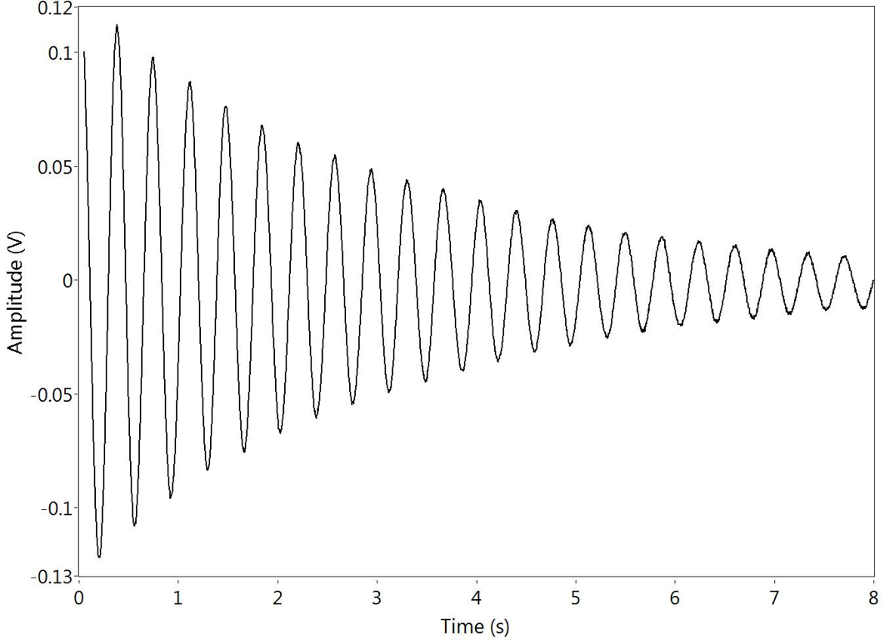
Origin of the MR Signal
Classical picture
Imagine a spin initially aligned with the static magnetic field
If the spin is tipped away from the B axis
The spin and its magnetic field precesses about the axis with frequency $f= γB$
Radiofrequency (RF) coil in the transverse plane
Precessing spin induces a changing voltage in the coil which is the MR signal
B
RF coil
B
MR Signal

Slide 8
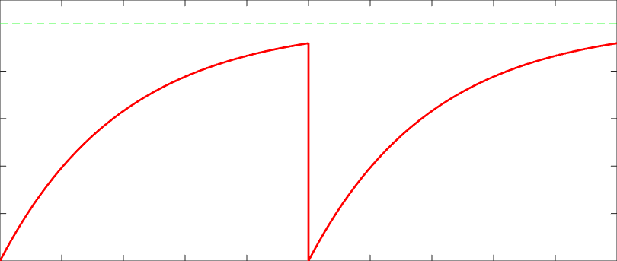
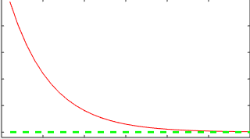
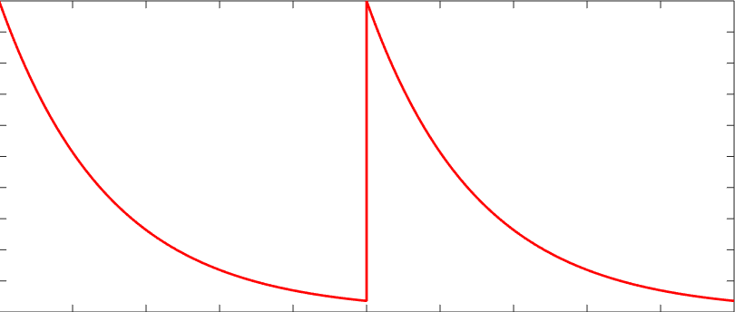
MRI Terminology
After application of RF pulse that tips the magnetization away from the static field axis:
Flip Angle
Longitudinal Magnetization
θ
Longitudinal signal exponentially approaches to thermal equilibrium
$$M_{0}$$
Polarized Gas
$M_{z}$ $∝ \cos{\text{θ} }$
$$M_{z}$$
$$T_{1}$$
$$M_{z}$$
$$T_{1}$$
$$M_{0}$$
Transverse magnetization decays with effective time constant $T_{2}^{∗}$
$$M_{⊥}∝ \cos{\text{θ} }$$
$$M_{⊥}$$
$$T_{2}^{∗}$$
Transverse Magnetization
time
Using low flip angle RF pulses, make several measurements with very little polarization use
$$cos100{1.5\text{°}}\sim 0.96$$
Less than 4% polarization loss for 100 excitations

Slide 9
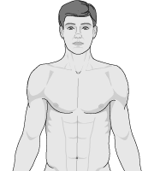
MRI Theory
Spatial Encoding using Magnetic Field Gradients
A gradient is a linear variation in the strength of the scanner’s magnetic field along a particular direction.
The gradient creates a linear mapping between position and resonant frequency:
X gradient
ΔB
ΔB = $G_{x}∙x$
$$0$$
x
$$x_{0}$$
$$f=\frac{γ}{2π}(B_{0}+\text{Δ}\text{B} )=\frac{γ}{2π}(G_{x}∙x+\text{Δ}\text{B} \text{)}$$

Slide 10
MRI Theory
Spatial Encoding using Magnetic Field Gradients
A gradient is a linear variation in the strength of the scanner’s magnetic field along a particular direction.
The gradient creates a linear mapping between position and resonant frequency:
ΔB
Apply gradients in all three dimensions to have a 3D mapping between position and frequency.
ΔB = $G_{x}∙x$
$$0$$
$\vec{G}xyz = G_{x}$ $\hat{x}+G_{y} \hat{y}+G_{z} \hat{z}$
$= \frac{∂B_{z}}{∂x}$ $\hat{x}$+$\frac{∂B_{z}}{∂y}\hat{y}$+$\frac{∂B_{z}}{∂z}\hat{z}$
x
$$x_{0}$$
Define k-space:
$$f=\frac{γ}{2π}(B_{0}+\text{Δ}\text{B} )=\frac{γ}{2π}(G_{x}∙x+\text{Δ}\text{B} \text{)}$$
$\vec{k(t)}≡ \frac{γ}{2π}$ $\int_{t_{0}}^{t}{\vec{G}xyz\left(t^{′}\right)dt^{′}}$

Slide 11
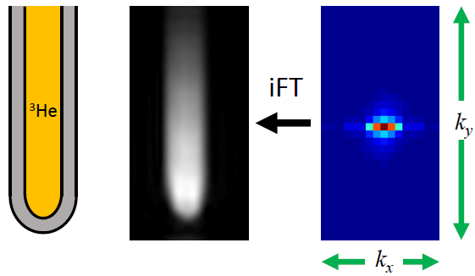
MRI Theory
Image Reconstruction
There is a Fourier relationship between spin density 𝜌 ($\vec{r}$) and k-space signal intensity $S(\vec{k})$:
𝜌 ($\vec{r}$) ∝ $\int{S(\vec{k})e^{2πi\vec{k}\text{∙}\vec{r}}}$
Fourier transform properties:
All k-space pixels contribute to every image space pixel intensity
Central k-space pixels contribute the most

Slide 12
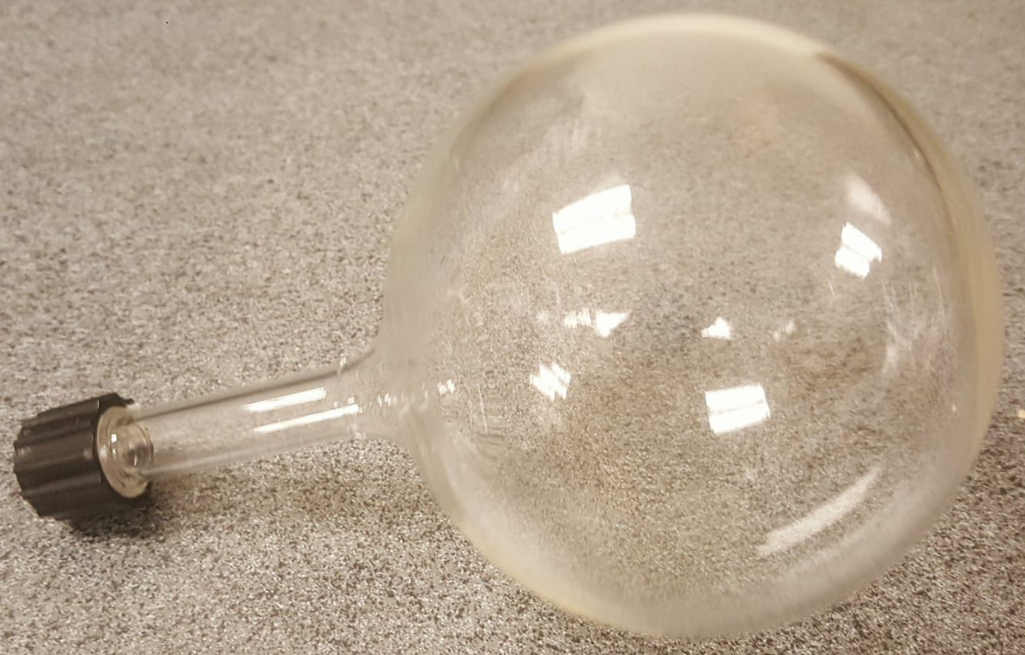
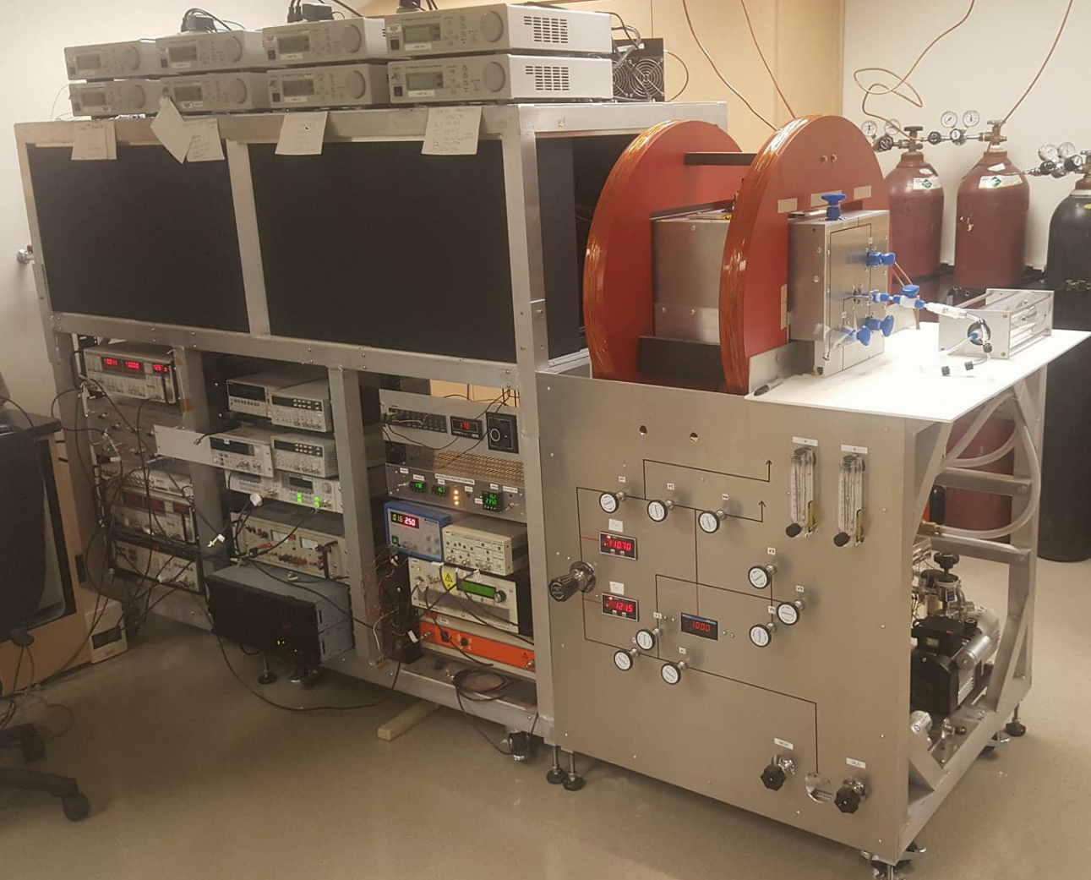
Our Polarizer
Spin Exchange Optical Pumping
Rb + K + ³He
Temperature Controllers and Laser Drivers
Hybrid alkali
Polarize ³He to ~ 60%
5 orders of magnitude higher polarization than thermal equilibrium at body temperature @ 1.5 T
Our polarizer produces ~ 2.5L of polarized gas per batch
Optics
Helmholtz Coils for Static Field
Oven (cell inside)
³He Gas Pluming
Electronics supplying static field and NMR measurement

Slide 13
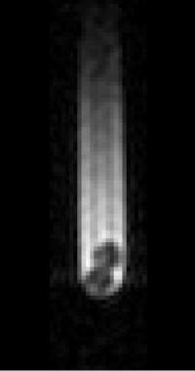
Can we get gas permeation into the pellets w/o complete polarization loss?
Image acquired ~10 min after tube was filled with polarized $\text{3}\text{He}$
2 ICF pellets placed inside tube
Polarization survives permeation??

Slide 14
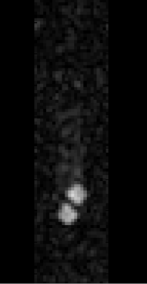
Yes, we can!
Image acquired ~10 min after tube was filled with polarized $\text{3}\text{He}$
Image acquired after evacuating $\text{3}\text{He}$from tube
2 ICF pellets placed inside tube
Polarization survives permeation??
Polarization survives permeation!!

Slide 15
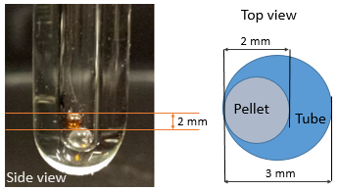
NMR Theory and Imaging
Use slice-selective chemical shift imaging (SS-CSI) pulse sequence to measure polarization concentration in each image pixel
Imaging parameters:
in-plane isotropic spatial resolution = 0.5 mm
slice thickness = 2 mm
and field-of-view = 5 mm
+
Very fine resolution!!
Move to each k-space location and acquire an NMR spectrum by measuring free induction decay (FID) after each excitation
$$k_{y}$$
−
$$k_{x}$$
−
+

Slide 16
NMR Theory and Imaging
Use slice-selective chemical shift imaging (SS-CSI) pulse sequence to measure polarization concentration in each image pixel
Imaging parameters:
in-plane isotropic spatial resolution = 0.5 mm
slice thickness = 2 mm
and field-of-view = 5 mm
+
Very fine resolution!!
Move to each k-space location and acquire an NMR spectrum by measuring free induction decay (FID) after each excitation
$$k_{y}$$
−
$$k_{x}$$
−
+

Slide 17
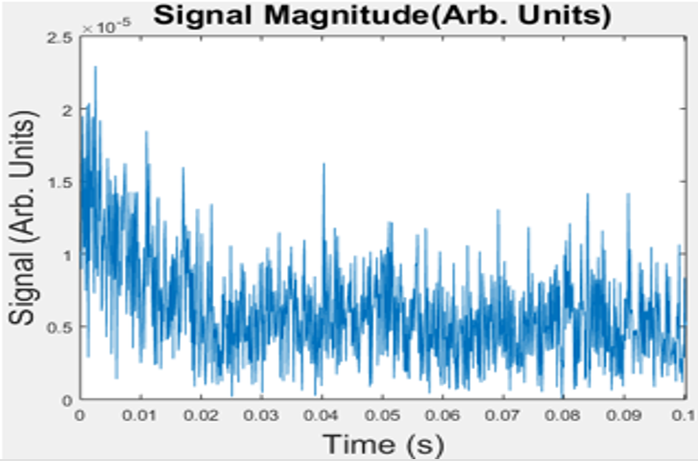
NMR Theory and Imaging
Central location $FID$
+
SS-CSI makes maximum use of long $T_{2}^{∗}$
Boost in SNR
CSI allows us to make many measurements using low flip angles w/o using substantial polarization
$$k_{y}$$
−
$$k_{x}$$
−
+

Slide 18
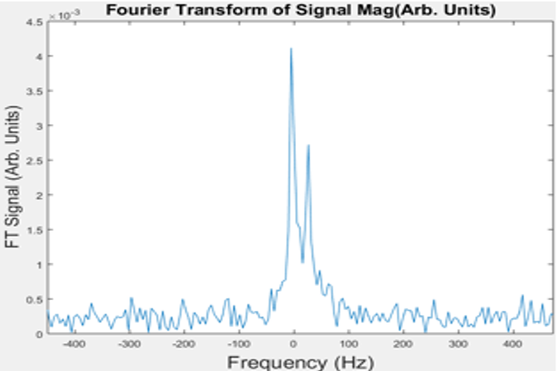
NMR Theory and Imaging
Gas outside the pellet
Gas inside the pellet
Take Fourier Transform
Presence of the tube and the pellets Susceptibility-induced off-resonance effects
Gas inside the pellet has a different precession frequency compared to the gas outside

Slide 19
Calculation of Polarization Concentration
3D SS-CSI data matrix ($k_{x} × k_{y} × Time$)
Take 3D Fourier transform of the matrix to get a $x ×y ×frequency$ matrix
Fourier transform of an FID is a complex Lorentzian
Initial amplitude of the FID is proportional to the area under the Lorentzian in frequency spectrum
FID
Complex Lorentzian
$Ae^{iφ}\frac{1− e^{−t(\frac{1}{T_{2}}+i2π(f−f_{0}))}}{\frac{1}{T_{2}}+i2π(f−f_{0})}$
$$\left[{A e^{{iφ}_{0}}e}^{−t^{′}(\frac{1}{T_{2}}+i2π(f−f_{0}))}\right]$$
$$t$$
Fourier
0
Transform
If there are multiple species of gas, sum of Lorentizan curves represent the frequency spectrum data

Slide 20
Data Analysis
Tube
Pellet
Shoulder

Slide 21
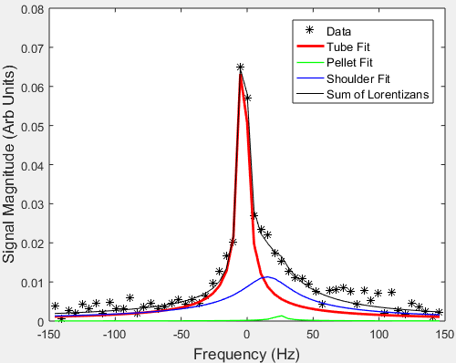
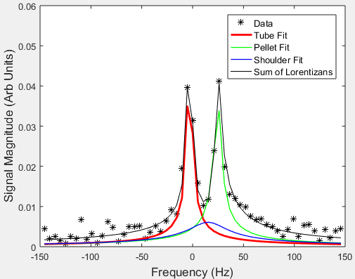
Data Analysis
Yellow Box Spectrum
Red Box Spectrum
Tube
Pellet
Shoulder

Slide 22
Shoulder Peak
Pellet

Slide 23
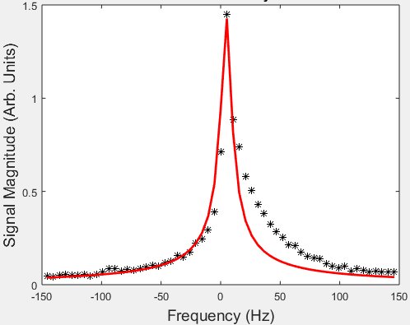
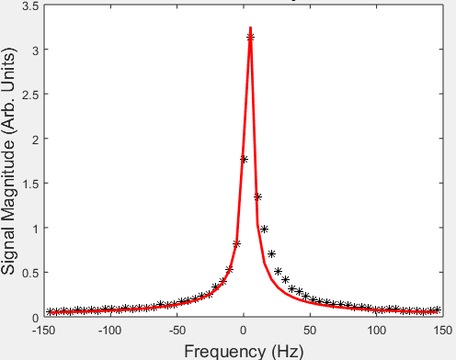
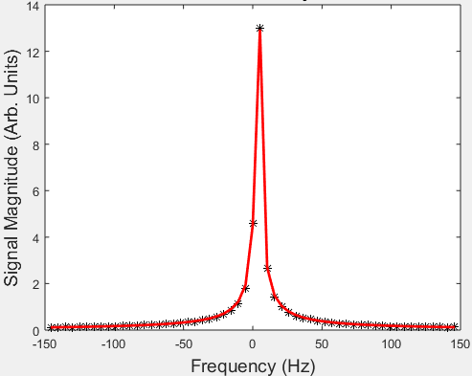
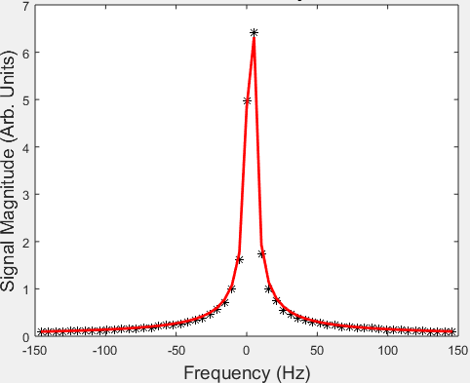
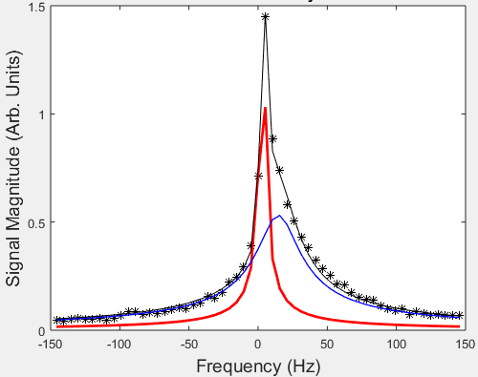
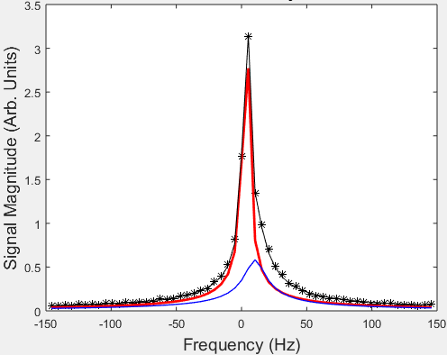
Shoulder Peak

Slide 24
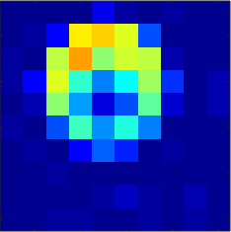
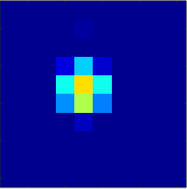
Polarization Maps
Tube
Tube + Shoulder
Total Tube Signal
Pellet
Shoulder
Pellet Signal

Slide 25
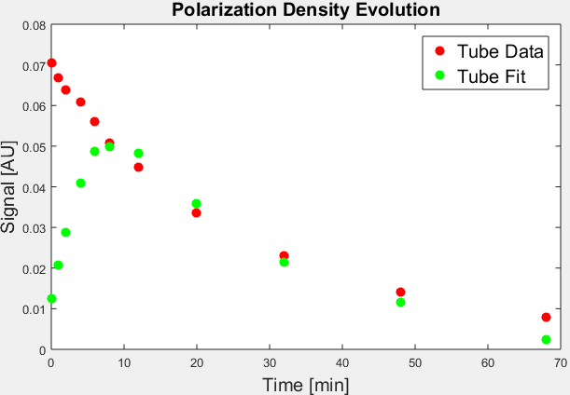
Track Permeation and Polarization Over Time
Tube Signal
Pellet Signal

Slide 26
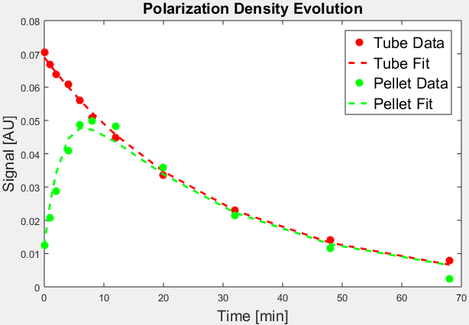
Permeation and Polarization Evolution Model
Permeation of polarization into the pellet since last measurement
Decay of polarization permeated into the pellet since last measurement
Existing polarization in the pellet
$$P_{i}^{tube}=P_{0 }e^{−\frac{T_{i}}{T_{1}^{tube}}}$$
$$P_{i}^{pellet}{=P_{i−1}^{pellet}cos}^{100}\left(θ\right)e^{−\frac{(T_{i}−T_{i−1})}{T_{1}^{pellet}}} + \left(\frac{P_{in}}{P_{out}}\right)P_{0 }\left\{\frac{T_{1}^{tube}}{T_{i}−T_{i−1}}\left(e^{−\frac{T_{i−1}}{T_{1}^{tube}}}−e^{−\frac{T_{i}}{T_{1}^{tube}}}\right)\right\}\left(e^{−\frac{T_{i−1}}{τ}}−e^{−\frac{T_{i}}{τ}}\right)\cos^{50}\left(θ\right)$$

Slide 27
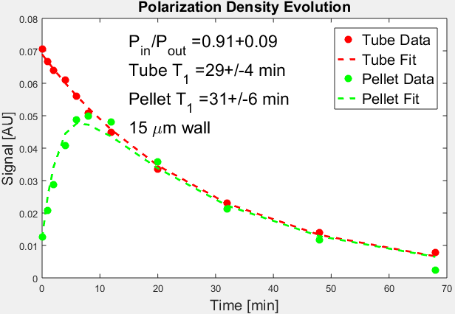
Fit Results
Tube Signal
Pellet Signal

Slide 28
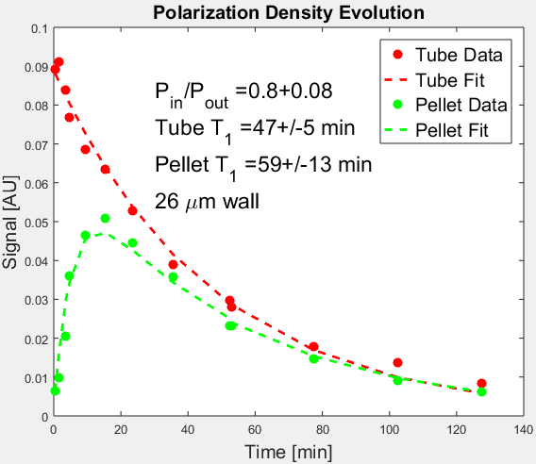
Pellet Wall Thickness and Polarization Loss
Thin wall ~ 90 % polarization retention
Thick wall ~ 80 % polarization retention

Slide 29
Summary of Results
Wall Thickness | 15 micron | 26 micron
P_{in}/P_{out} | 0.91 +/- 0.09 | 0.80 +/- 0.08
T₁^{tube} | 29 +/- 4 min | 47 +/- 5 min
T₁^{pellet} | 31 +/- 6 min | 59 +/- 13 min

Slide 30
Conclusion and Outlook
Permeation of ³He gas into the ICF pellets without loss of polarization is promising
We have developed a robust testbed for measuring polarization loss and decay time
Chemical Shift Imaging: Magnetic susceptibility-induced frequency shifts are ideal for measuring polarization inside and outside the tube independently
Thicker pellet walls result in higher polarization loss
Goal is to perform in-situ test of SPF in General Atomics DIII-D tokamak reactor

Slide 31
Thank You!

