Slide 1
Twist-3 fragmentation contribution
to single transverse-spin asymmetry in polarized hyperon production
Niigata Univ. Kenta Yabe
Collaborators:
Niigata Univ. Y. Koike
Temple Univ. A. Metz
Old Dominion. D. Pitonyak
LANL. S. Yoshida
23nd International Spin Symposium 2018/09/13

Slide 2


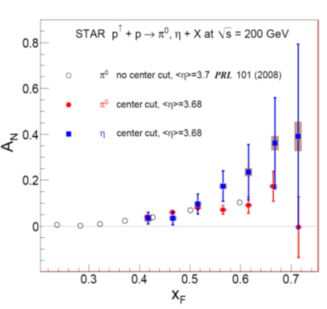
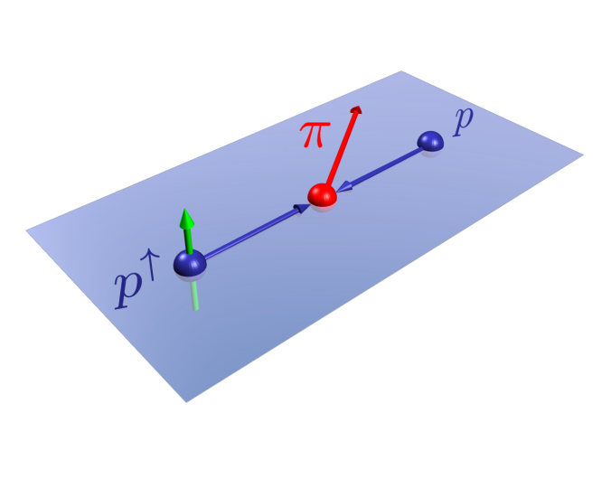
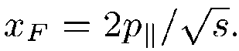
Single Spin Asymmetry (SSA)
: In the high energy scattering process which involves a transversely polarized hadron,
a large spin asymmetry is observed.
[ex] SSA process：
etc.
[ex] SSA for pion production
in the collision of transverse and unpolarized proton：

Slide 3
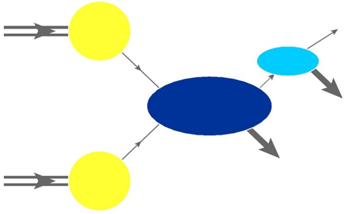


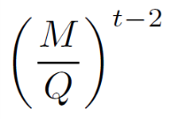
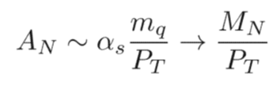
Collinear Twist-3 Mechanism
QCD Factrization
h
Soft part
[cross section]
Hard part
Soft part
~
Soft part
non-perturbative
perturbative
Hard part
Higher twist effect (Twist-3～)
:Reflect the effect of multi parton correlation in hadrons
Hadron mass
Energy scale
(in the high energy process)
Parton model
Twist-3~ contribution
Ex)
Explain the large SSA！
Twist-3
Twist-2
・
There are some processes which have not been calculated yet.
Λ↑ production in the unpolarized proton collision

Slide 4
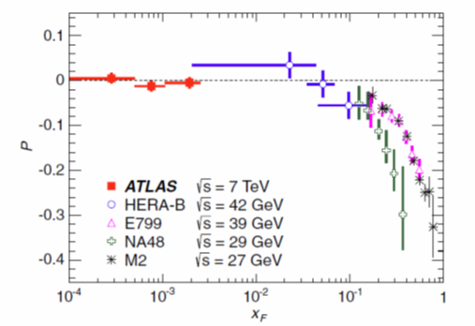

Λ↑ production in the unpolarized proton collision
目的：横偏極ハイペロン生成現象の理解
Vertical axis :
the polarization of
G. Aad et al. (ATLAS Collaboration), Phys. Rev. D 91, 032004
Our aim is
to derive the complete cross section formula for
based on the twist-3 mechanism.

Slide 5
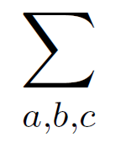


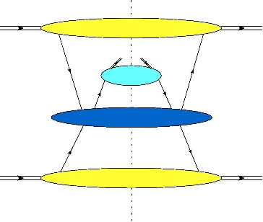
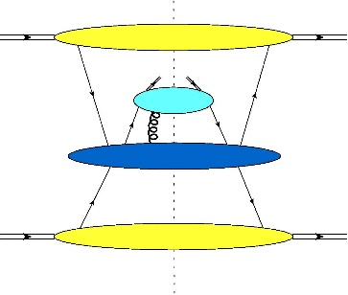
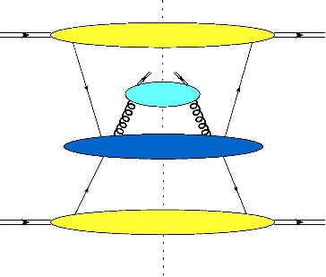
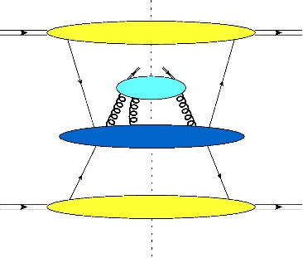
The cross section for hyperon polarization
Twist-3 distribution function(DF)
Twist2 FF
Y. Koike, K. Yabe and S. Yoshida, Phys. Rev. D 92, no. 9, 094011 (2015)
~
Twist2 DF
: parton
＋・・・
Twist-3 fragmentation function(FF)
Quark fragmentation
Gluon fragmentation
＋・・・
Y. Koike, A. Metz, D. Pitonyak, K. Yabe and S. Yoshida,
Phys. Rev. D 95, 114013 (2017)
In this study：
To calculate the cross section from the twist-3 fragmentation function ; (B)term
4

Slide 6
Twist-3 Quark fragmentation contribution
to the Λ↑ production

Slide 7
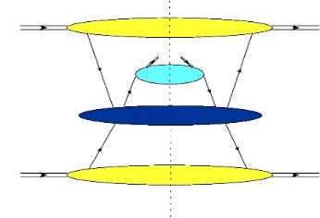
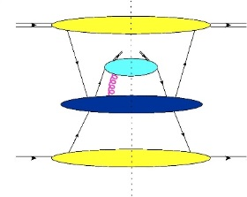
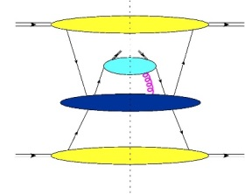
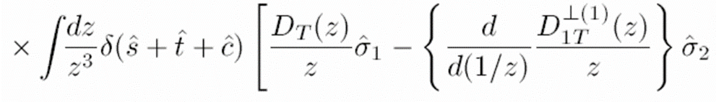



Formalism of twist-3 quark fragmentation contribution
Twist-3 quark fragmentation function
(“intrinsic” and “kinematical function”)
Twist-3 quark-gluon correlation function
(“dynamical function”)
・The cross section from the t-3 quark FFs can be written as
Matrix elements in the gauge invariant form
Hard part (Partonic cross section)
Y. Koike, A. Metz, D. Pitonyak, K. Yabe and S. Yoshida, Phys. Rev. D 95, 114013 (2017)

Slide 8

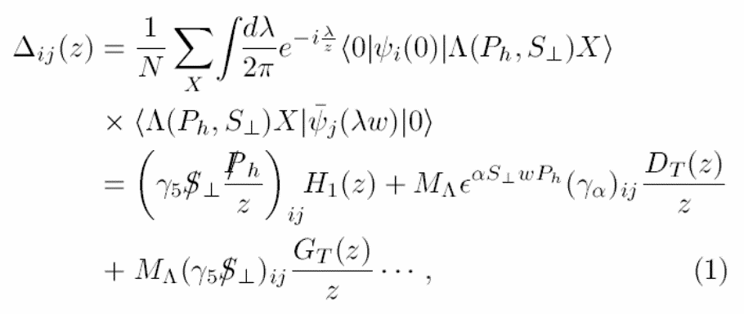

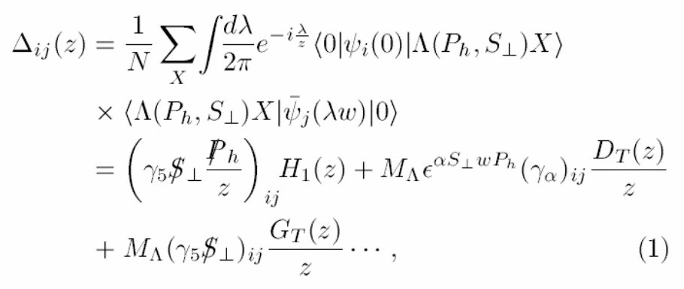
Definition of twist-3 quark fragment functions ①
Quark fragmentation functions
Real
Twist-3 FF

Slide 9

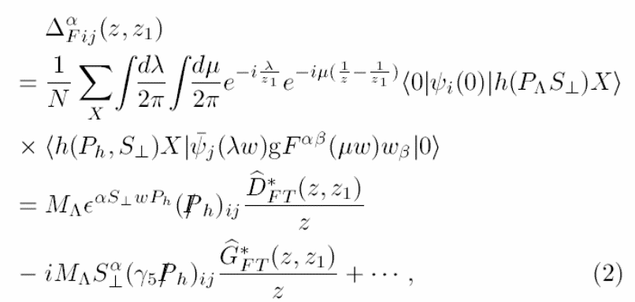
Definition of twist-3 quark fragment functions ②
F-type quark fragmentation functions
Complex
・The relation between F-type and D-type function (which replace “ ” with “ ” )

Slide 10
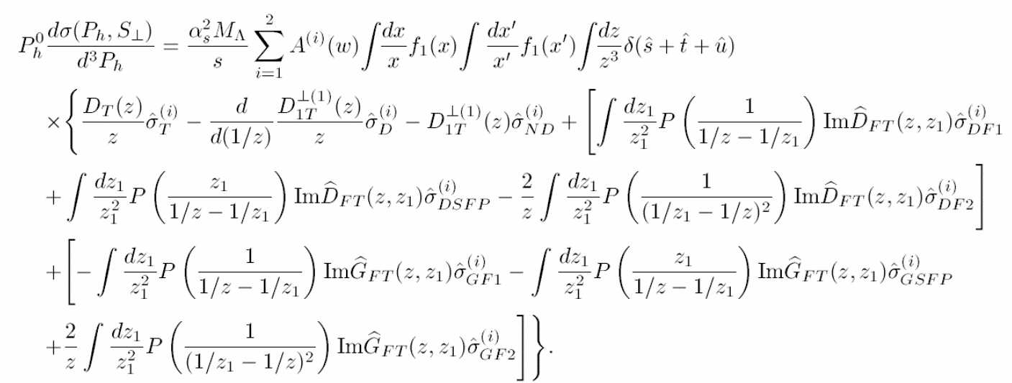

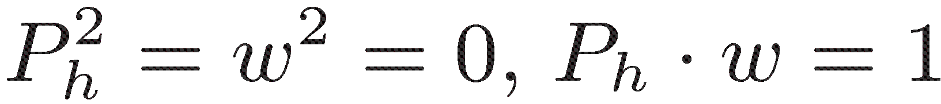
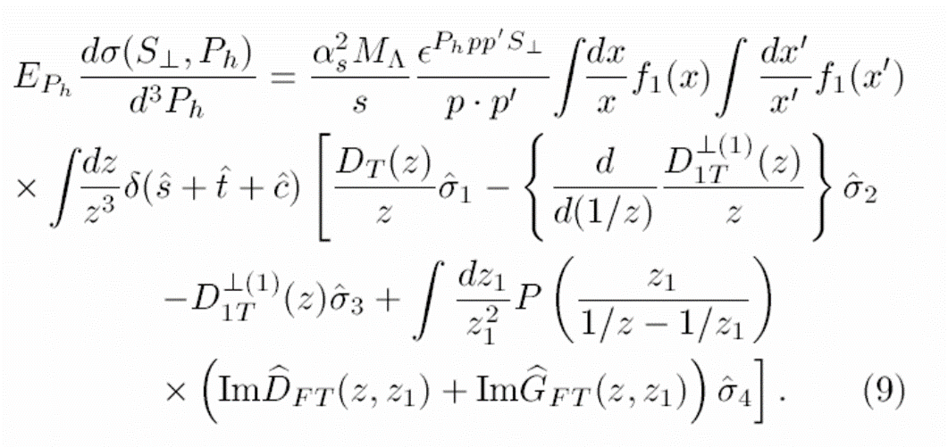
The cross section contributed by the t-3 quark fragmentation①
By substituting the fragmentation functions,
Calculating in 2 types of “ “ to confirm the frame independence.
・
“ ”
and
One of the “A” is vanished and the remain “A” is same expression.
・
The hard parts are not the same→ By using the relations between t-3 FFs, these became the same ！
K.kanazawa, Y. Koike, A. Metz, D. Pitonyak, S. Yoshida, M.shclegel, Phys. Rev. D 93, 054024 (2016)

Slide 11
The relations for the twist-3 fragmentation functions
QCD e.o.m relation
:This relation can be obtained from the QCD e.o.m relation.
Lorentz invariance relation (LIR)
: Based on the identities for the non-local operators for the twist-3 FFs
Fully incorporate the Lorentz invariant property of FFs

Slide 12
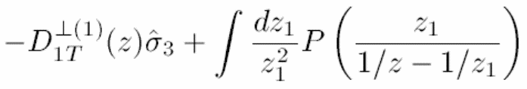
The cross section contributed by the t-3 quark fragmentation②
Rearrange the partonic cross sections by the 2 relations between twist-3 FFs
・
・
We confirmed these partonic cross section is coinsident in the 2 frames (i= 1 or 2).
Frame-independent cross section

Slide 13


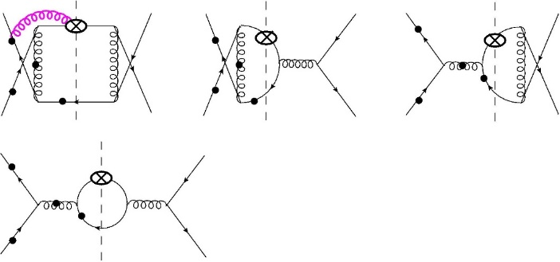
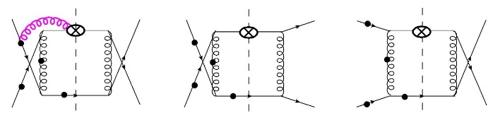

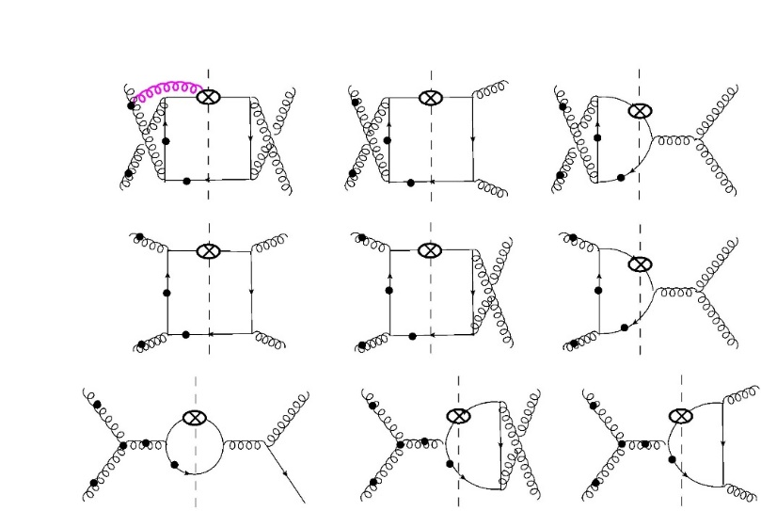
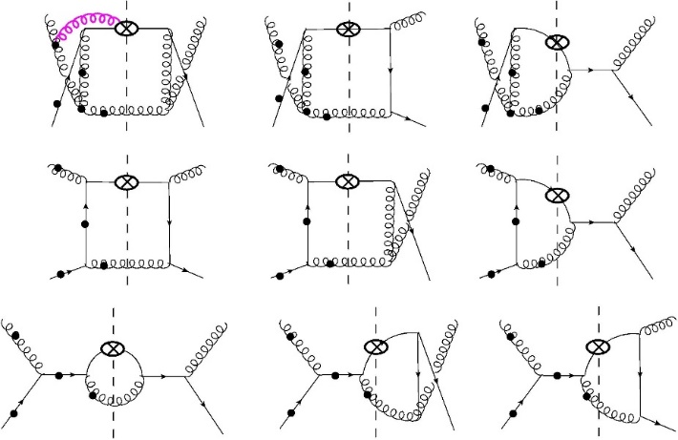
Lowest order diagrams for quark fragmentation

Slide 14


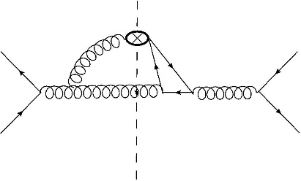
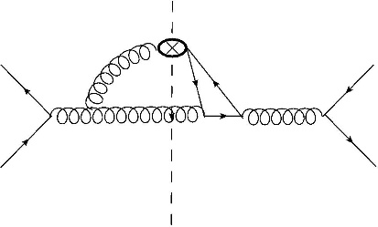
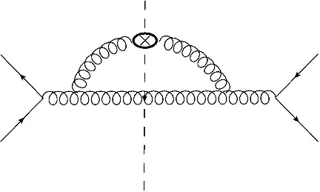
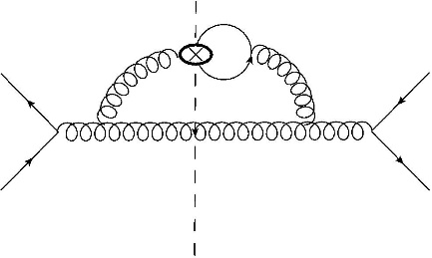
Formalism of twist-3 quark fragmentation contribution ②
・
To complete the contribution from the twist-3 fragmentation functions,
the following diagrams need to be included.
・
By the ward identity, the following diagrams also need to be considered
to satisfy the gauge invariance.
[Gluon fragmentation part]

Slide 15
Twist-3 Gluon fragmentation contribution
to the Λ↑ production

Slide 16
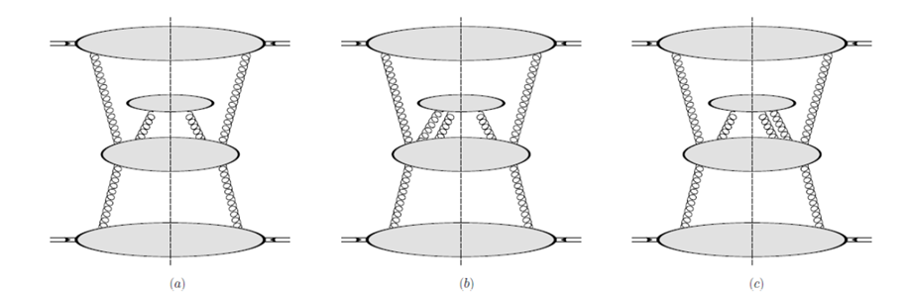

Formalism of twist-3 gluon fragmentation contribution
・The cross section from the t-3 gluon FFs can be written as
Matrix elements in the gauge invariant form
Hard part (Partonic cross section)

Slide 17
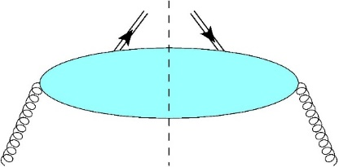
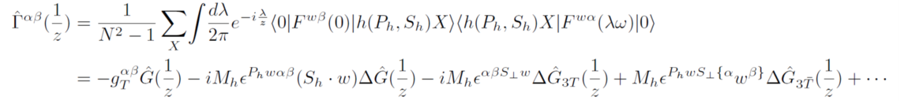
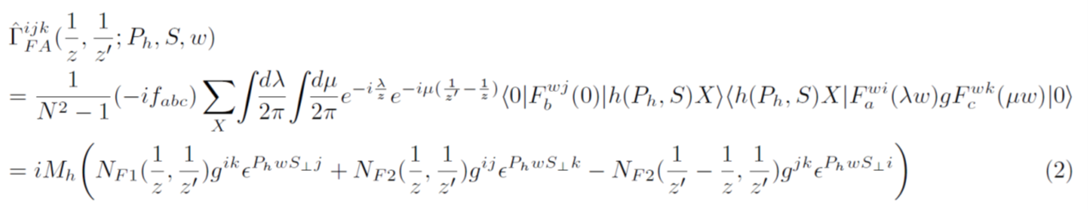
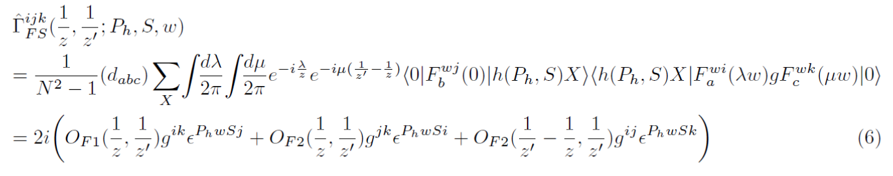

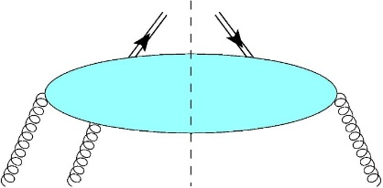
Definition of twist-3 gluon fragment functions
2-gluon fragmentation function
・
F-type 3-gluon fragmentation function
・
・

Slide 18
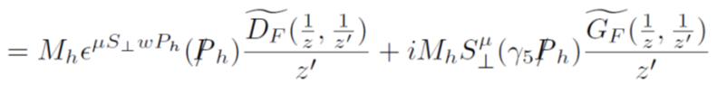
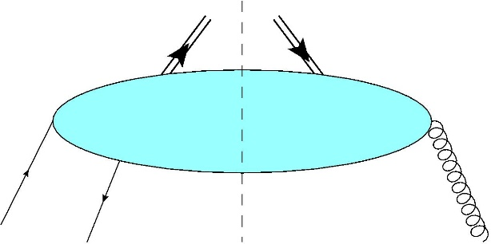
Relation between gluon fragmentation functions
EOM Relation for gluon fragmentation functions
By using
・
図
・LIR for t-3 gluon FFs have not calculated yet
・By using “EOM relation” and “LIR”, we can derive the frame independent cross section for gluon fragmentation and another quark fragmentation part.

Slide 19
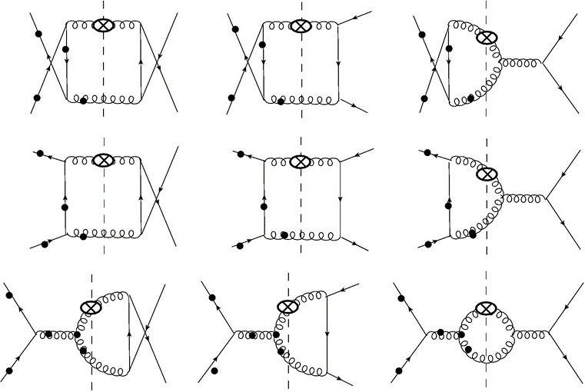
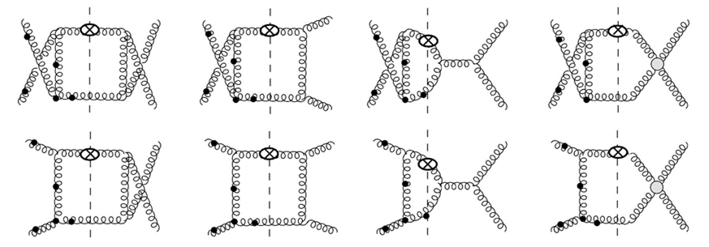
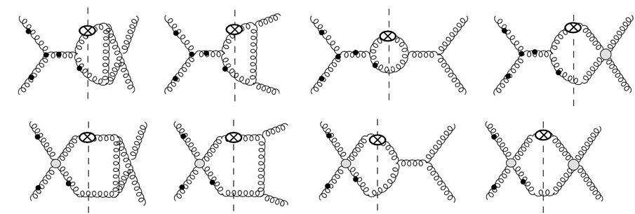
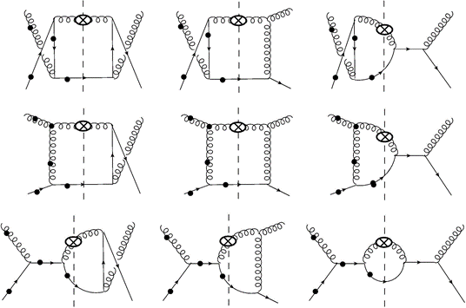
Lowest order diagrams for gluon fragmentation

Slide 20
Summary
・We focused on the twist-3 cross-section coming from the twist3 fragmentation function for the hyperon polarization in unpolarized proton-proton collisions based on the twist-3 mechanism.
・For “quark” fragmentation,
We derive the gauge- invariant and frame-independent twist-3 cross section
・For “gluon” fragmentation,
We formulate the cross section which have the color gage invariant matrix elements and derive the e.o.m relation between twist-3 gluon FFs.
（Frame independent calculation has yet been completed）
Problems
・Derivation of Lorentz Invariance Relation (LIR)
・Calculation of the partonic diagrams for gluon fragmentation channels
・Confirm the frame independence for the cross section
By completed these things, the data analysis of hyperon production has been ready for preparation.

Slide 21
Back up
Notes:
これまで得られているデータや、Superから得られると期待される、より詳細なデータと比較

Slide 22
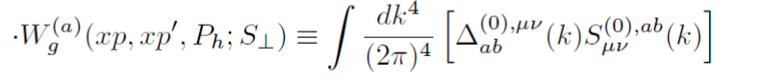
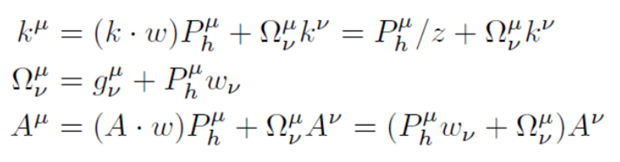
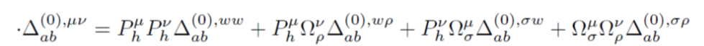
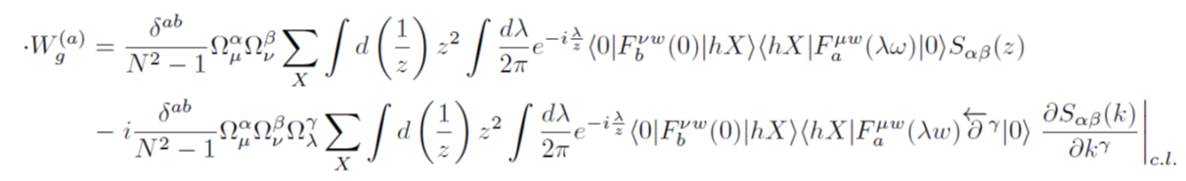
Formalism①：Collinear expansion- 2 gluon frag.
Collinear expansion :
Soft part:
Hard part:

Slide 23
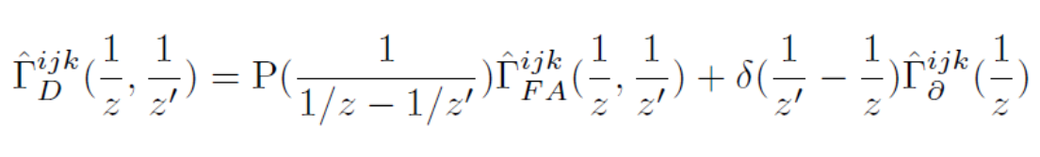
The relation between F-type and D-type gluon FFs
・
・

Slide 24

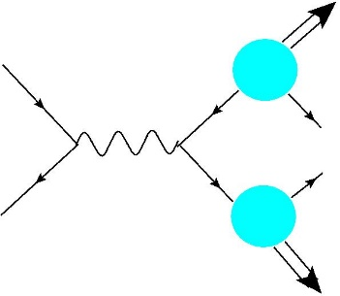
The other t-3 FFs contribution process
Belle :
γ*
↑ Twist-3 FF “ “ is only contributed to this cross section.

Slide 25

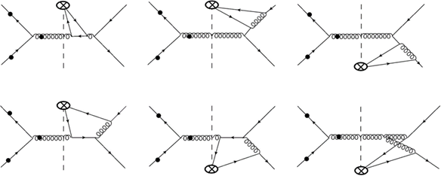




Lowest order diagrams

