Slide 1
MoVe IT
and the radiobiological
rationale for FOOT
F. Tommasino, E. Scifoni
FOOT meeting – Milano, November 2016

Slide 2
Overview
MoVe IT framework
Biological-based ion beam treatment planning
  From absorbed dose to biologically effective dose
  Beyond dosimetry: NTCP and TCP impact
Link to FOOT
  Target Fragments in proton beam irradiation
  Projectile Fragments in Oxygen beam irradiation
Notes:
2

Slide 3
Move IT
Framework

Slide 4
oVe IT
Modeling and Verification for Ion beam Treatment planning
INFN Network - Call group V - funded 2017-2019 PI: E. Scifoni (TIFPA)
Main Goals
Radiobiological implementations in ion TPS:
  Nuclear interactions
  Intra-tumor heterogeneity
  TCP and NTCP models
Experimental Verification:
  New Devices for in-vitro and in-vivo irradiation
  Development and Upgrade of INFN accelerator facilities (Trento, Pavia, Catania)
  Development of advanced beam monitoring systems
http://www.tifpa.infn.it/projects/moveit

Slide 5
oVe IT
Modeling and Verification for Ion beam Treatment planning

Slide 6
Interaction with INFN projects
FOOT
(CSN III)
MoVeIT
MC-INFN
Fragment spectra
FLUKA/GEANT4 tools for beamline description
Assessment of bio impact
and input for experimental design
Radiobiological models for plan recalculation
+ Feed from previous related projects: TPS, RDH, UFSD

Slide 7
Radiobiological
Treatment Planning

Slide 8
Biological-based treatment planning
Bio-TPS for ion beams aims to include as much as possible biological effect information in the planning strategy.
Relevant for plan recalculation but ideally needed for inverse planning.
Substantial for assessing differential benefits of different irradiation modalities and selecting the most suitable choice for a given patient case.
Additional physics data needed, since the different components (E,Z) of the mixed field in a beam should be properly accounted in order to get an overall biological effect.

Slide 9
Biological dose in ion therapy
Absorbed Dose
Biologically effective Dose (RBE weighted)
Biologically isoeffective Dose in the local microenvironment
What is needed:
Physical beam modeling
RBE modeling
Implementation in TPS
Experimental Verification
Intra-tumour
Heterogeneity
revealed by functional imaging
e.g. CT/PET(FMISO)
Horsman NRCO 211

Slide 10
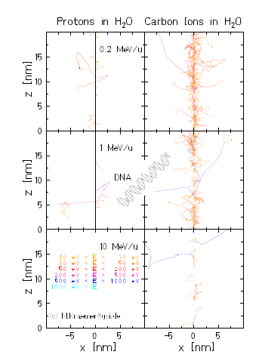
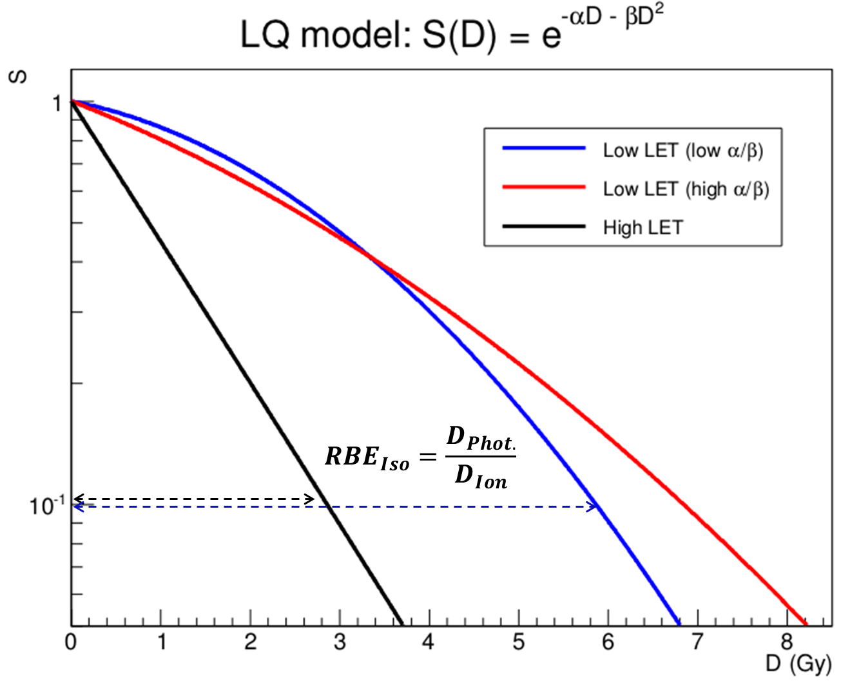
RBE: LET impact on bio damage
Different Secondary electrons distribution
Different track structure
Different density of ionizations
Different severity of damage
Kraemer et al JPCS 2012

Slide 11
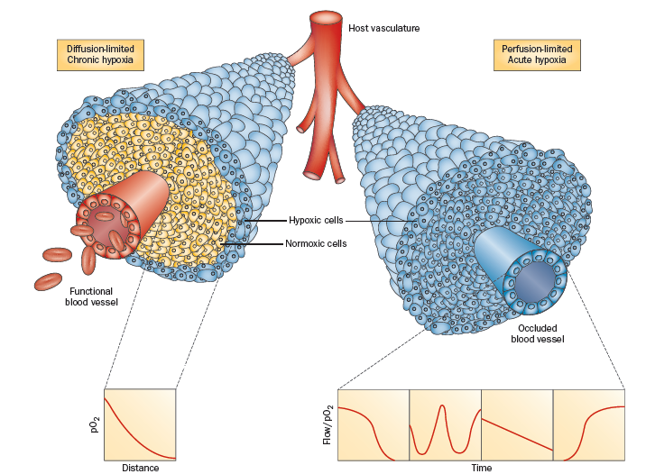
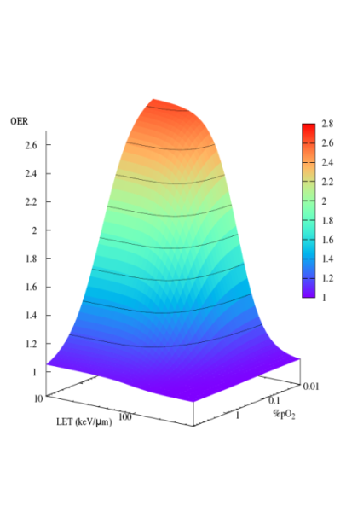
Hypoxia and OER
A special case of dose modification:
Oxygen Enhancement Ratio (OER)
Tinganelli et al. Sci Rep 2015
Tommasino Scifoni Durante Int J Part Ther 2015

Slide 12
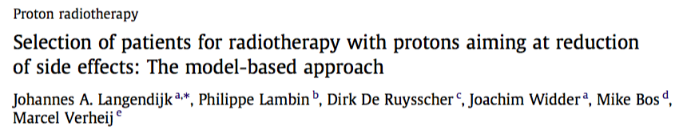
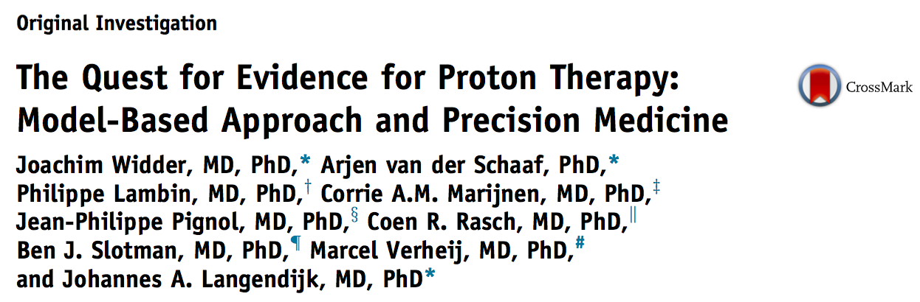
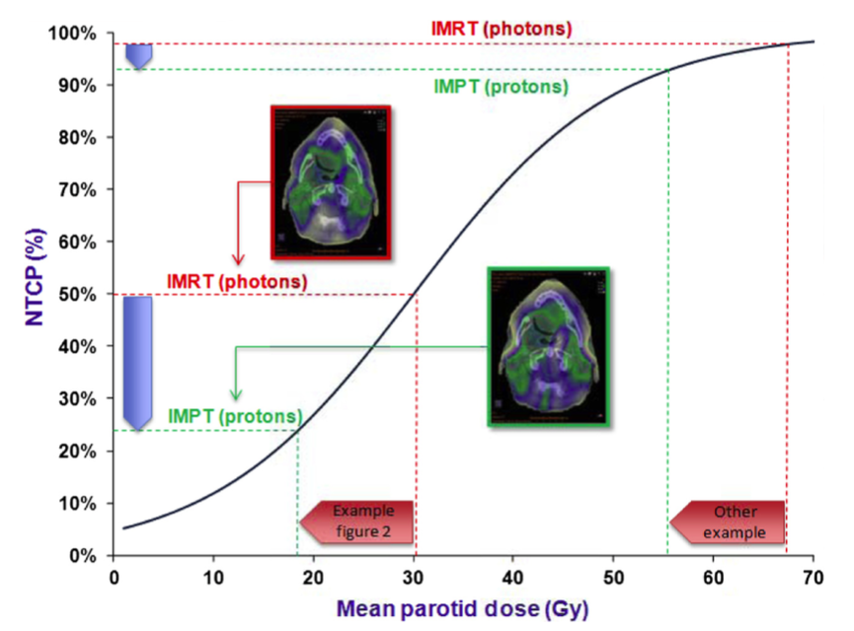
Beyond dosimetry: NTCP/TCP
Radiotherapy and Oncology 2013
Int J Rad Oncol Biol Phys 2016
Physical
Dose
?
NTCP
models
Clinical
Outcome
Protons will lead to improved clinical outcomes (less serious toxicity) if:
Normal tissue sparing can be obtained (Δdose)
Δdose will result in lower clinically significant complication risks (ΔNTCP)
Notes:
Fig. NTCP:
Dose reduction from 30.1 Gy to 18.4 Gy -> NTCP reduction from 50% to 24%
Simiilar Dose reduction at higher doses imply NTCP reduction less than 10%

Slide 13
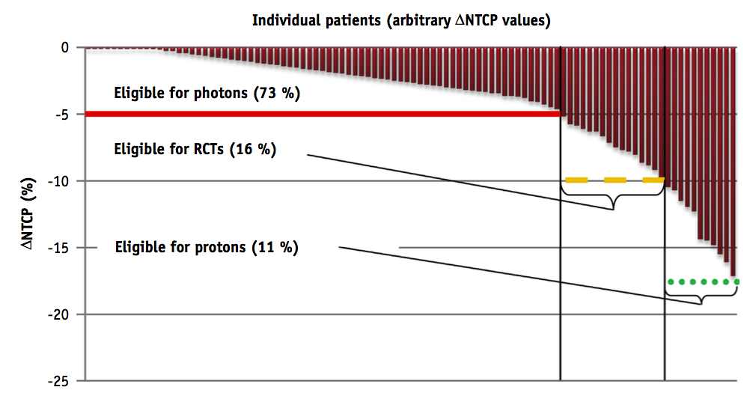
NTCP-based patient selection for high-tech radiation therapy
Limits of unselected Randomized Controlled trials:
If positive: no indications in terms of “quantitative benefit” for single patients
If negative: prohibit treatment for patients who could actually benefit
ΔNTCP patient selection
Radiation therapy
as “precision medicine”
Widder et al
2016 IJROBP
Open issues:
Definition of Ion Specific thresholds
Improvement/Development of reliable NTCP models for ions

Slide 14
Link to FOOT experiment

Slide 15
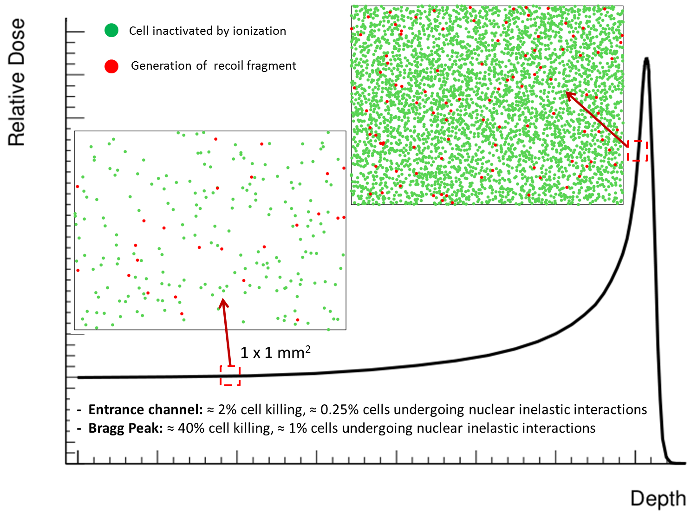
Role of Target fragmentation in proton therapy
About 10% of biological effect in the entrance channel due to secondary fragments
Largest contributions of recoil fragments expected from
He, C, Be, O, N
Heavy fragments have low residual energies and release low doses -> high RBE
Tommasino & Durante 2015 Cancers
Notes:
Entrance channel 0.5 KeV/mum and 0.2 Gy -> about 3% cell killing
Bragg peak 2.5 keV/mum and 2 Gy ‘_ about 60% cell killing

Slide 16
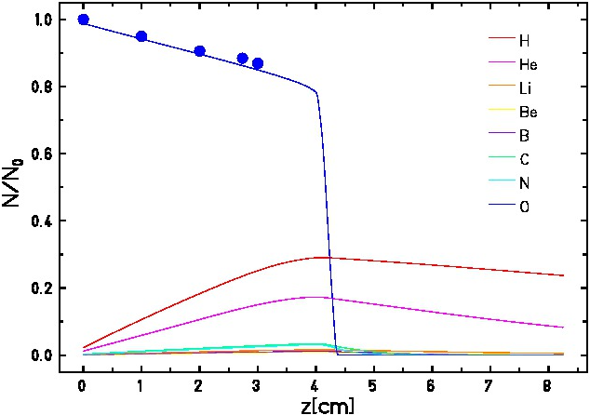
¹⁶O beam in TRiP
Yield of secondary particles with depth
in water for ¹⁶O at 160 MeV/u (TRiP98)
Large number of fragments
Few experimental data available
New data for full spectral characterization are highly needed to assess impact of fragments
Exp attenuation data courtesy of C. La Tessa (BNL)

Slide 17
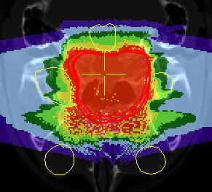
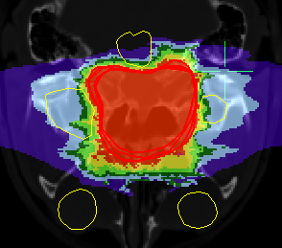
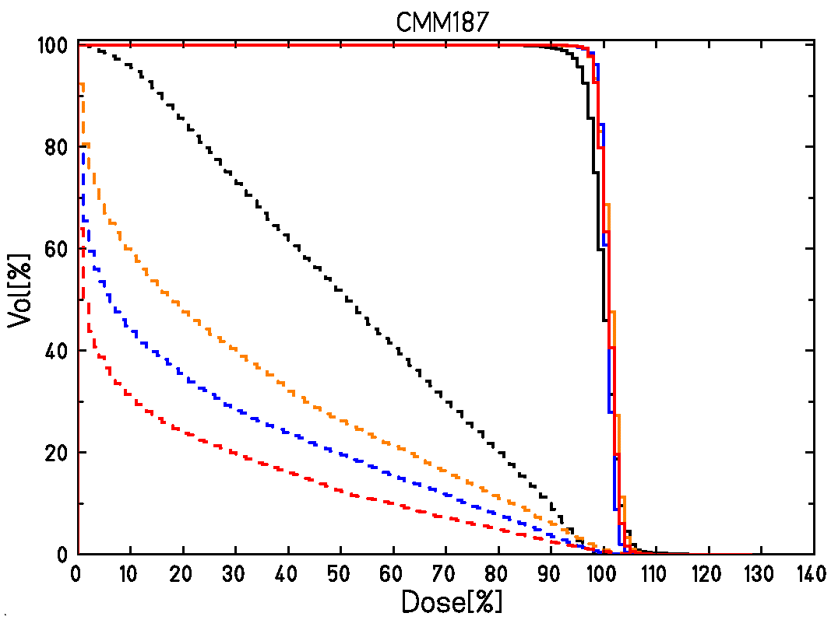
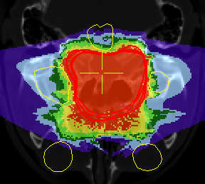
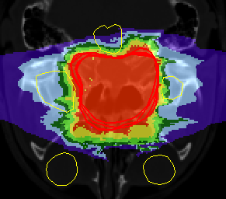
TRiP98 treatment plans comparison: single patient example
¹H
¹²C
¹H
Double-field irradiation of chordoma skull base patient with ¹H, ⁴He, ¹²C
R. Grün et al, Med.Phys. 42, 1037 (2015)
Extended + ¹⁶O (Sokol et al. ICTR-PHE)
¹²C
⁴He
⁴He
¹⁶O
¹⁶O
— 12C chordoma
- - 12C spinal cord
— 4He chordoma
- - 4He spinal cord
— 1H chordoma
- - 1H spinal cord
Due to fragmentation, Oxygen beam is in general less convienient than Carbon leading
to a larger “peak-to-entrance” ratio
Special cases for using oxygen?
— 16O chordoma
- - 16O spinal cord

Slide 18
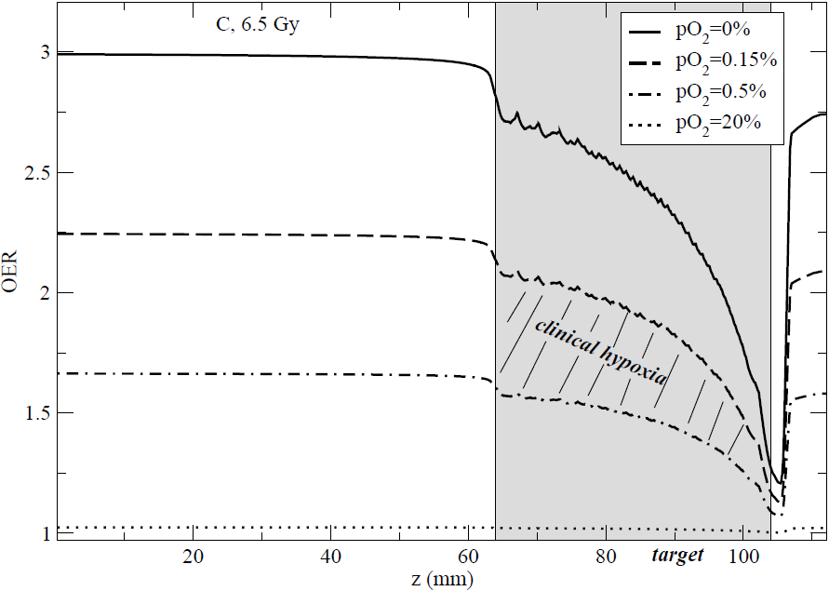
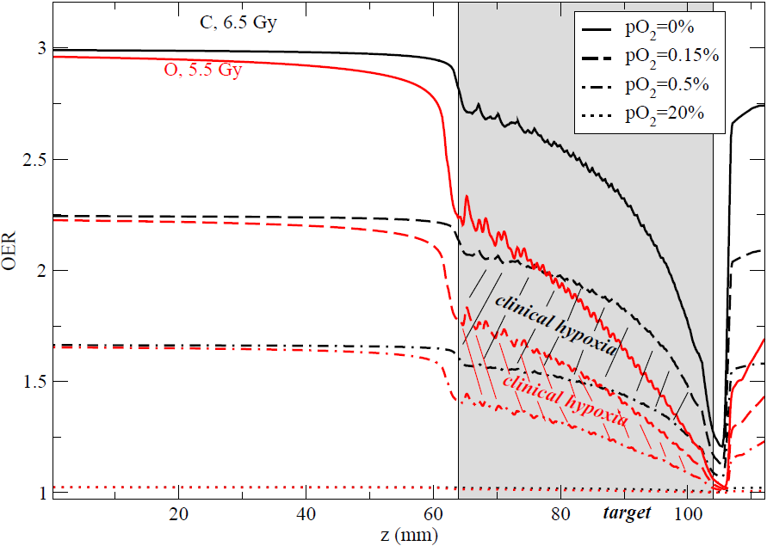
OER profile O vs C
Scifoni et al PMB 2013

Slide 19
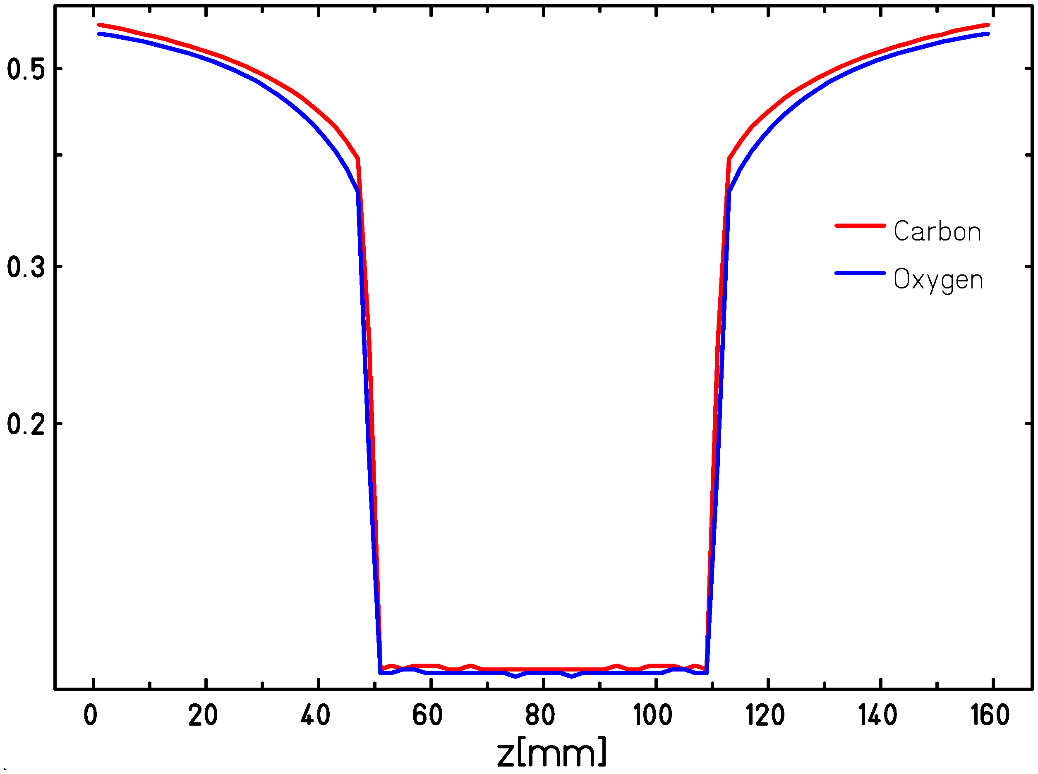
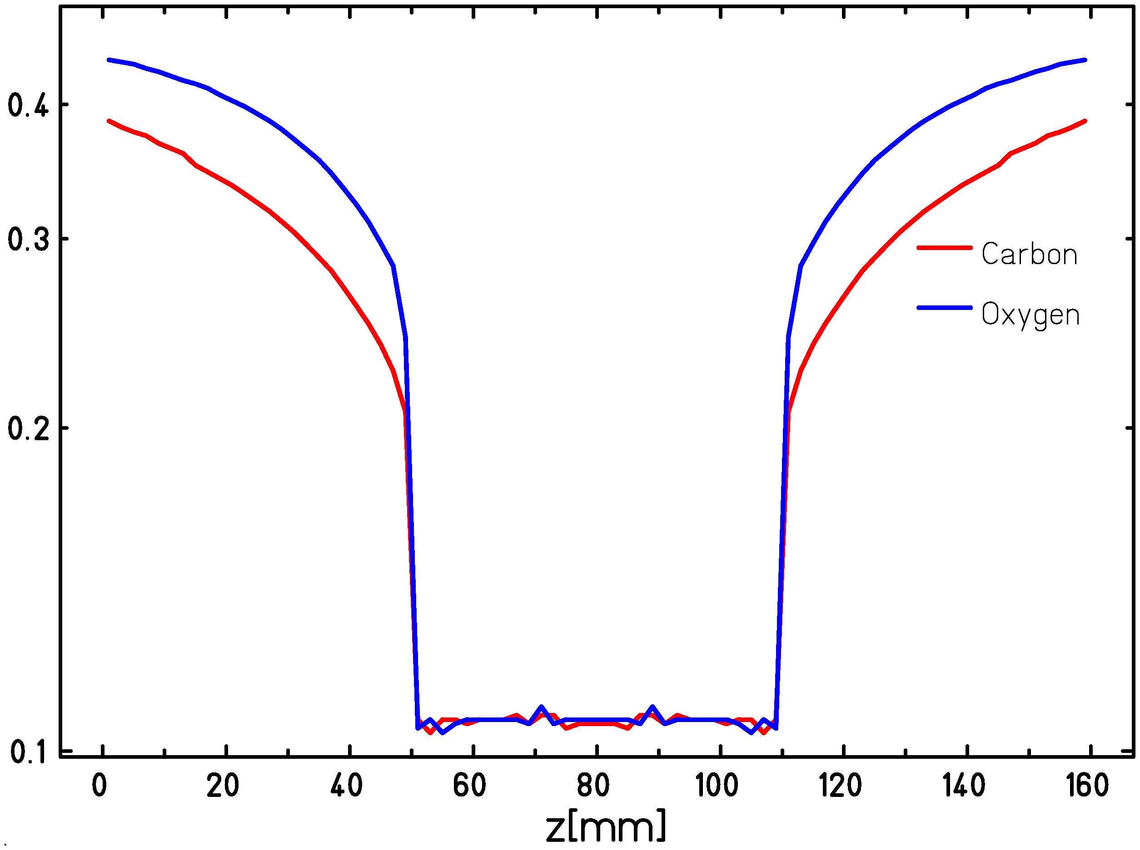
OER optimized plans with O (kill painting)
Normoxic
Variable oxygenation
Survival
Sokol et al. in prep
In case of hypoxia, proper optimization accounting for OER may lead to Inverted peak-to-entrance ratios as compared to a normoxic case
According to actual oxygenation, O beam may overcome the price of larger entrance channel with the LET advantages
Trade-off between better LET distribution and worse Fragmentation in entrance and tail

Slide 20
Desiderata for Protons
Target fragment producton, at 100-200 MeV:
• Heavy fragment (Z>2) production cross section with uncertainty < 5%
• Fragment energy spectrum (i.e. dσ/dE) with energy resolution of ≈1 MeV/u
• Charge ID at the level of 2-3%
• Isotopic ID at the level of 5%
• Not needed accurate angular measurement
• Study light ions production at large angle

Slide 21
Summary desiderata for Oxygen
Fragment producton, at 150-400 MeV/u:
• Cross section of projectile fragments with maximum uncertainty of 5-10%
• Fragment energy spectrum (i.e. dσ/dE) with an energy resolution of ≈1 MeV/u
• Charge ID at the level of 2-3%
• Isotopic ID at the level of 5%
• Angular distribution needed for out-of-field biological dose

Slide 22
Milestones related to FOOT
Milestone | Description | Date
M1.1.1 | Initial RBE description with tentative cross sections | November 2017
M1.1.2 | Final RBE description with FOOT cross sections | July 2019
M2.1.2 | Comparison between proton NTCP estimations | Novemeber 2019
M2.2.1 | NTCP/TCP estimations with different ions, on imported plans | April 2019

Slide 23

Summary
In order to exploit the potential of different ions available, biological treatment planning is needed
“New” data from Physics experiments are essential
Assessment o protons toxicity need full target fragment characterization
Physical characterization of the new ions, especially Oxygen, for full fragment cascade should be completed
In order to assess the models on a proper scale , specific verification tools should be developed

Slide 24
Thank you
H
He
O
C

Slide 25
Discussion Slides

Slide 26
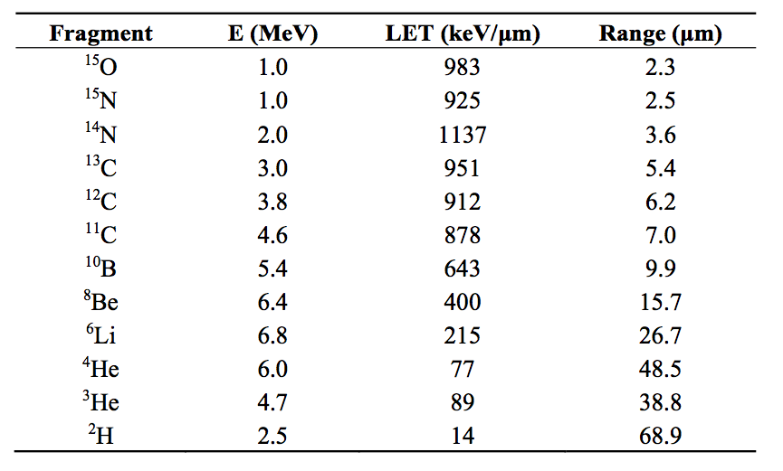
Role of Target fragmentation in proton therapy
Differently from Projectile fragments, their Energy distribution being peaked at very low E
Combines with the peak of RBE at low E
Heavy fragments have low residual energies and release low doses -> high RBE
Tommasino & Durante 2015 Cancers
Notes:
Entrance channel 0.5 KeV/mum and 0.2 Gy -> about 3% cell killing
Bragg peak 2.5 keV/mum and 2 Gy ‘_ about 60% cell killing

Slide 27
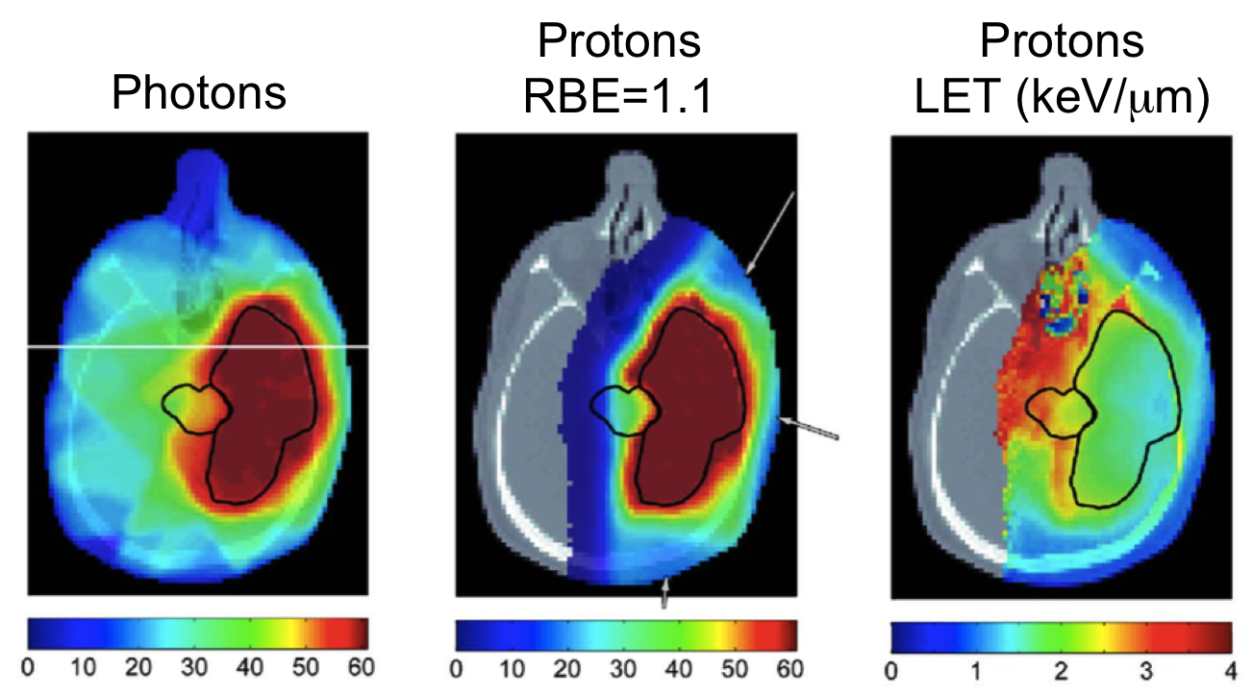
Clinical relevance of p RBE
…are deviations from 1.1 of clinical relevance?
Potential improvements offered by biological optimization
Possible bias when neglecting variable RBE
Sensitivity to RBE model
Only 3 patients considered!
Dose (Gy)
Dose (Gy-RBE)
LET (keV/μm)
Wedenberg 2014 Med Phys
Notes:
- Rischi maggiori con RBE variabile per tronco encefalico (necrosis) e nervo ottico (cecità)
- a/b 10 for the tumor, about 2-3 for brain stem and optic nerve
- 59.4 Gy in 33 fractions

Slide 28
WP1 –Radiobiological modeling for TPS:
Leader: S.Hild (TIFPA)
Task1: RBE modeling for protons (F.Tommasino – TIFPA)
Task2: OER and ITH modeling (E.Scifoni-TIFPA/A. Attili-TO)
OER
Tinganelli et al. Sci.Rep.2015
Wedemberg 2014
LET
pO₂

Slide 29
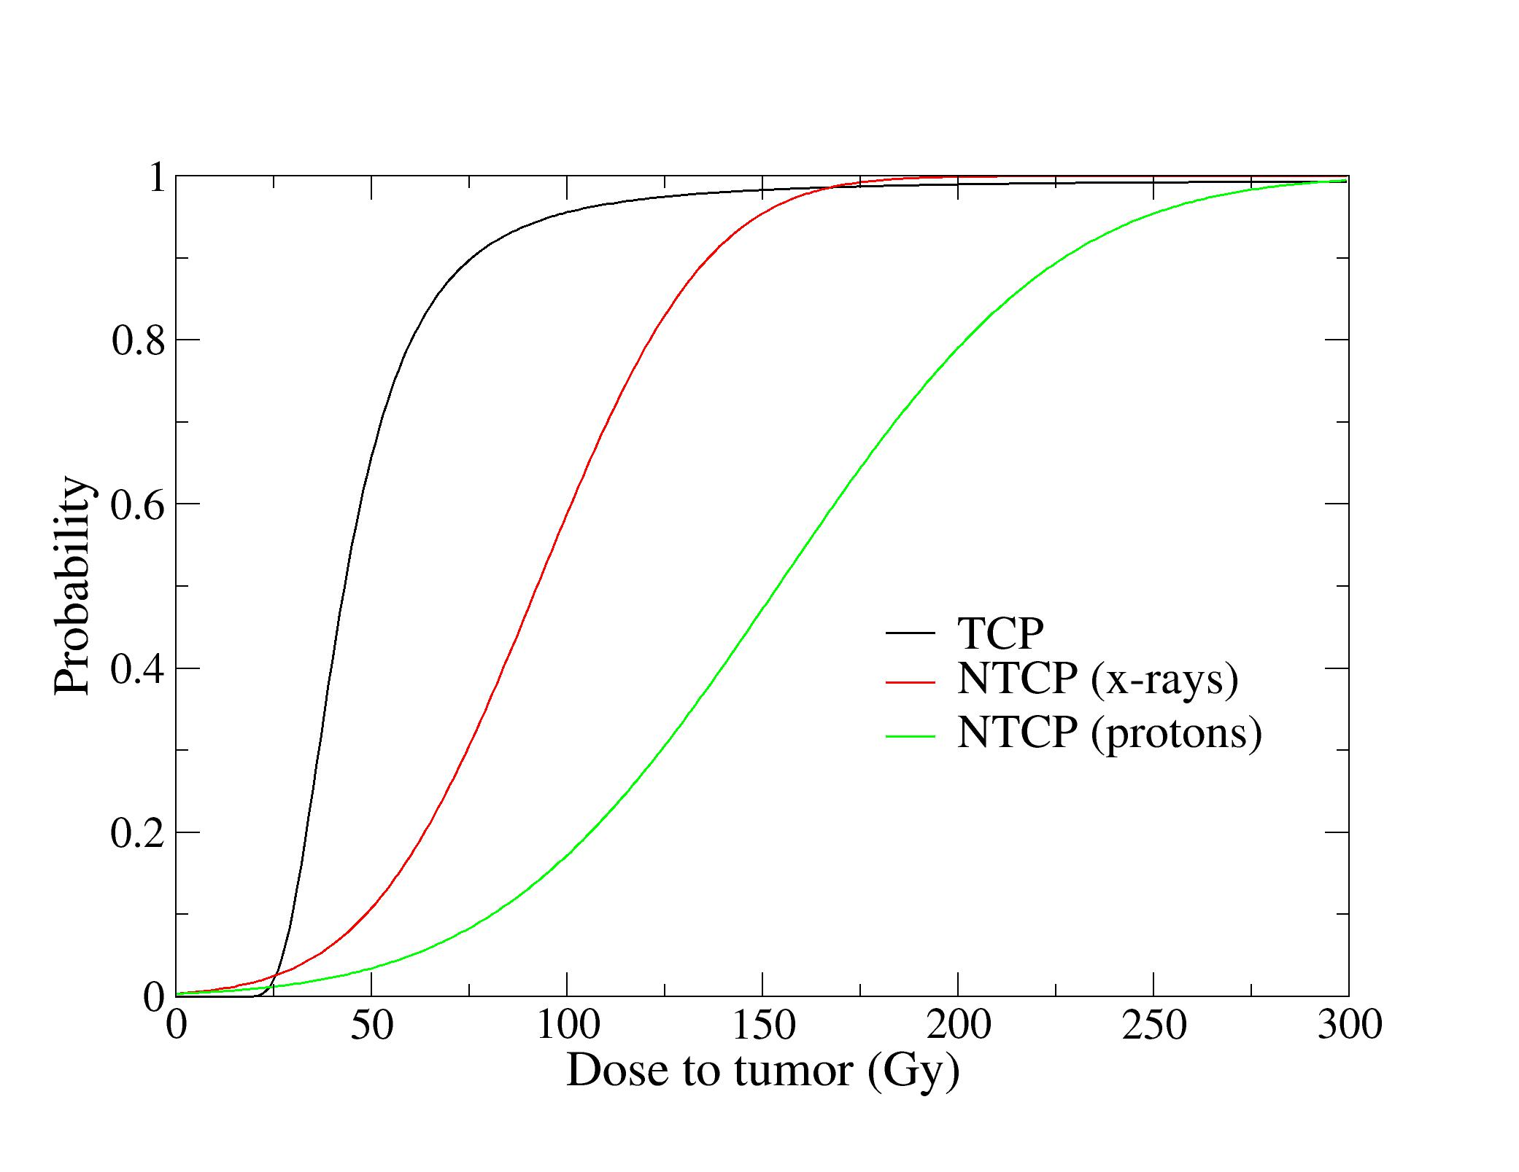
WP2 –NTCP/TCP:
Leader: MG.Pugliese(NA)
Task1: Advanced NTCP models on proton patient data including RBE (L.Cella-NA)
Task2: TCP/NTCP including hypoxia for different ions (L.Cella-NA/E.Scifoni-TIFPA)
Tinganelli et al 2015
Durante et al 2016

Slide 30
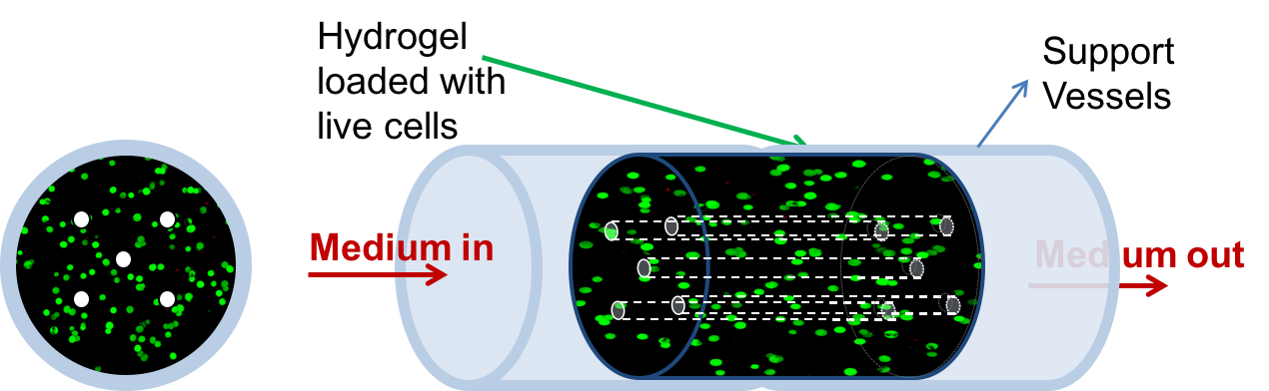
WP3 - Biological dosimetry:
Leader: G.Russo(LNS)
Task1: Development of specific devices for spatially resolved proton RBE measurement (W.Tinganelli-TIFPA/MG.Pugliese-NA)
Task2: Hypoxic, Coculture and Stem cells devices (W.Tinganelli -TIFPA)
Task 3: In vivo and Molecular biomarkers (G.Russo-LNS)
Beamtime request for 2017 already granted at LNS

Slide 31
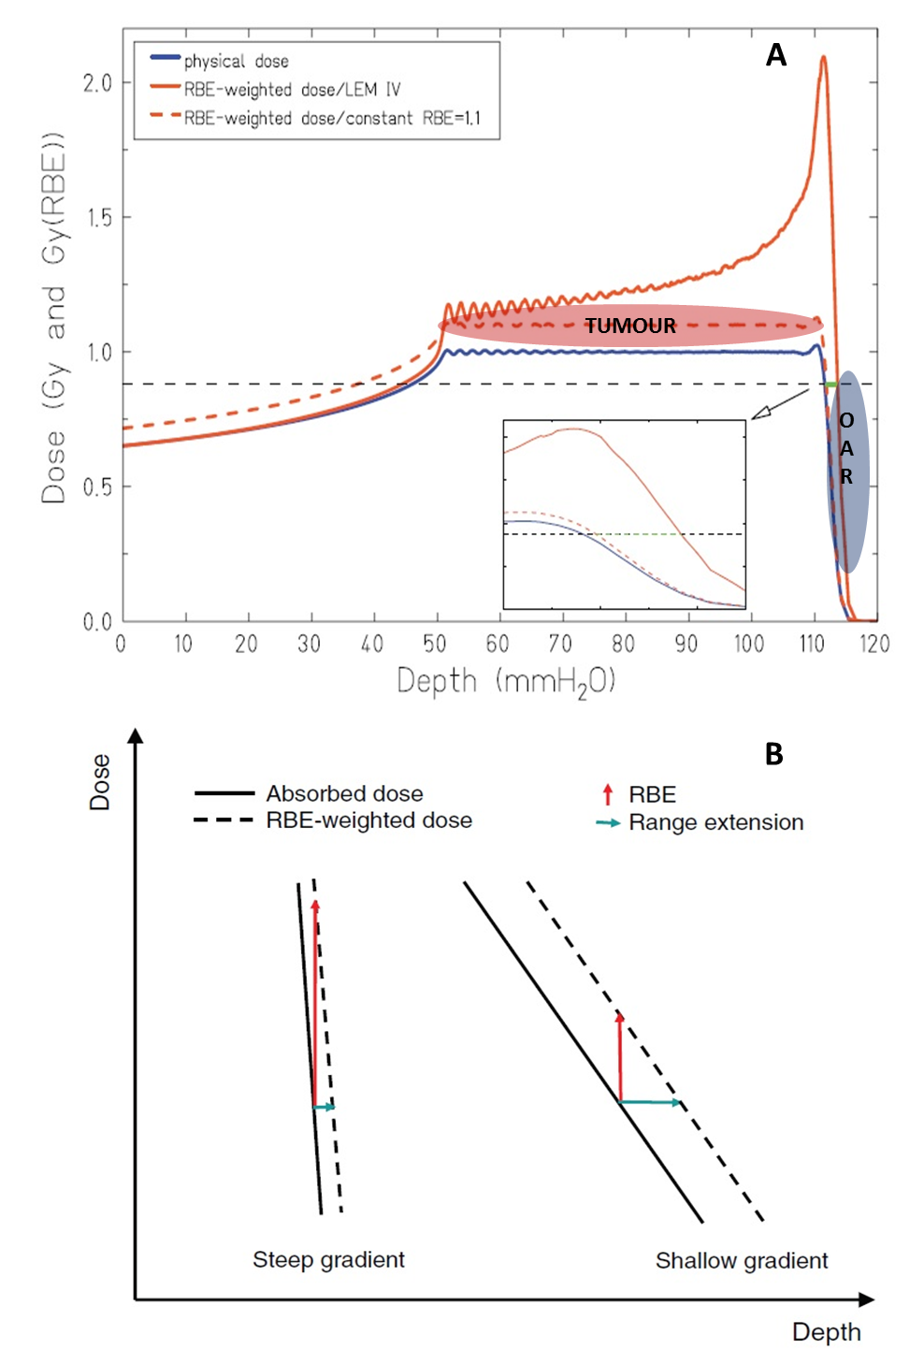
p RBE impact in vivo
PMMA plates
to browse different SOBP points
RBE
1.1

Slide 32
WP4- Facilities :
Leader: P. Cirrone (LNS)
Task1: CNAO/TIFPA/LNS lines development for beam delivering and shaping and setup of common protocols (P.Cirrone-LNS)
Task2: Monte Carlo Simulations for beamlines characterization and Target Stations for in vitro–in vivo experiments (P.Cirrone-LNS/G.Battistoni-MI)
Task4: Detectors for beam flux and beam energy measurement (V.Monaco-TO)

Slide 33
INFN Team & roles
TIFPA -Trento (local coordinator: E. Scifoni, total =3.9 FTE)
M. Durante, F. Tommasino, W. Tinganelli, M.Schwarz, S. Hild, E. Verroi, P. Spinnato
- Radiobiological modeling for TPS, experimental device design and fabrication, proton beam irradiations
LNS - Catania (local coordinator: P. Cirrone, total =6.3 FTE)
G. Cuttone, F. Romano, G. Russo, G. Forte, F. Cammarata, L. Minafra, V. Bravatà
Low Energy facility, beamline development, MC GEANT4 tools, Radiobiology and Animal Facility
INFN-TO (local coordinator: R. Sacchi, total =7.3 FTE)
R. Cirio, S. Giordanengo, A. Attili, F. Fausti, S. Giordanengo, L. Manganaro, V. Monaco, A. Staiano, A. Vignati
- Ultrafast Silicon Detectors, RPLANIT code
INFN-NA (local coordinator: MG Pugliese, total =4.1 FTE)
L. Cella, P. Simoniello, M. Quarto, V. D’Avino, G. Palma
- NTCP modeling, in vivo irradiations, histology, in situ dosimetry
INFN-MI (local coordinator: G. Battistoni, total =0.9* FTE)
- Supervision of CNAO Exp facility, FLUKA support, link to FOOT/MC-INFN
TOT 22.5 FTE
from staff
+2.6 FTE from requested full time postdocs to hire

Slide 34
Milestones related to FOOT
• M1.1.1 Initial RBE description with tentative cross sections 01-11-2017
• M1.1.2: Final RBE description with FOOT cross sections 01-07-2019
• M1.2.1: Translation of functional imaging data in input data 01-05-2017
• M1.2.2: Heterogeneity adaptive treatment planning in TRiP98 01-08-2018
• M1.2.3 RPlanIT implementation with adaptive models 01-01-2019
• M2.1.1 Establishment of relevant toxicity cases to be investigated 01-12-2017
• M2.1.2 Comparison between proton NTCP estimations 01-11-2019
• M2.2.1 NTCP/TCP estimations with different ions, on imported plans 01-04-2019
• M2.2.2 NTCP/TCP Radiobiology modules design for TRiP98 optimization 01-12-2019
• M3.1: Establishment device for proton beam biological dosimetry with high spatial resolution 01-01-2019
• M3.2: Development of a device for hypoxia irradiation with cellular communication 01-06-2019
• M3.3.1 Completed in vivo survey on proton RBE effect 01-06-2018
• M3.3.2 Completed hypoxia in vivo experiments 01-11-2019
• M4.1.1: Upgrade of the beam line facilities at LNS (‘CATANA’ and ‘0 deg’) 01-08-2017
• M4.1.2: Complete update of TIFPA line with monitoring , modulation and scattering 01-03-2018
• M4.1.3: Realization of the target stations at ‘CATANA’, ‘0 deg’, TIFPA and CNAO beam lines 01-05-2019
• M4.2.1: Upgrade, inside the Hadrontherapy application, of the LNS ‘0 deg’ beam line simulation 01-07-2017
• M4.2.2: Redefinition classes for the LET/RBE calculation and for the specific beam energy distributions (LNS and TIFPA beamline) and specific cell lines that will be used in the experiments. 01-02-2018
• M4.2.3: Implementation of the TIFPA and CNAO beam line simulations with all the transport elements 01-11-2019
• M4.3.1: Beam tests of different UFSD test structures, including radiation damage 01-08-2017
• M4.3.2: Design ready of the VLSI chips for the silicon counter, production of UFSD prototypes 01-01-20 18
• M4.3.3: production and test of VLSI chips. Characterization of the UFSD prototypes 01-06-2018
• M4.3.4: Beam tests of detectors + readout. 01-12-2018
• M4.3.5: Final production of VLSI chips and UFSD sensors 01-05-2019
• M4.3.6: Integration and tests of the two detectors at the irradiation lines 01-11-2019

Slide 35
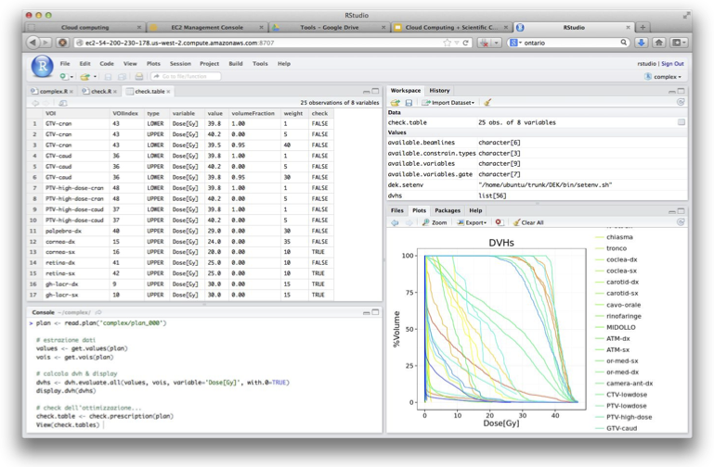
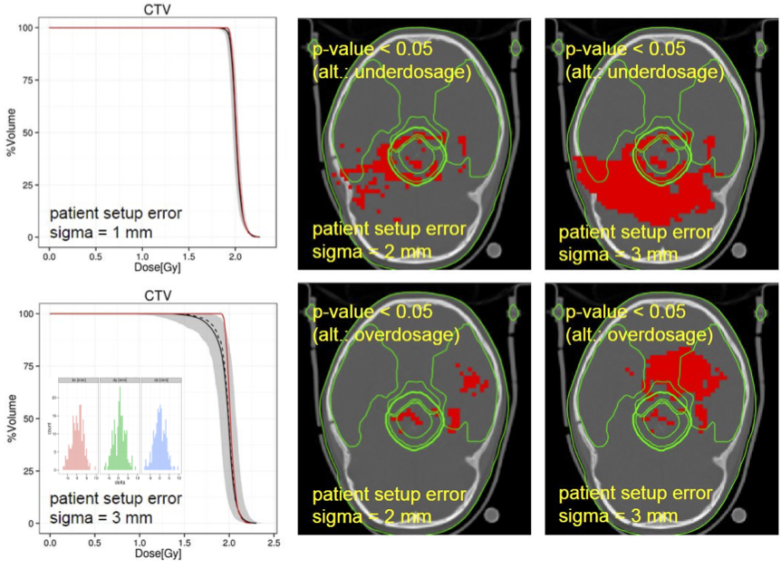
RPlanit
Kernel: pure-DEK (Fork of PlanKIT, INFN developed code, scripting via “R” language )
  Programmable by user (great flexibility for complex analysis)
  Several data analysis and visualization tools
  Several Biological models already included
  Inhomogeneous fractional dose treatments
Accessible via web interface
: https://github.com/planit-group/Rplanit
Cometto et al. PMB 2014
Russo et al. PMB 2016
Courtesy of R.Cirio/A.Attili

Slide 36
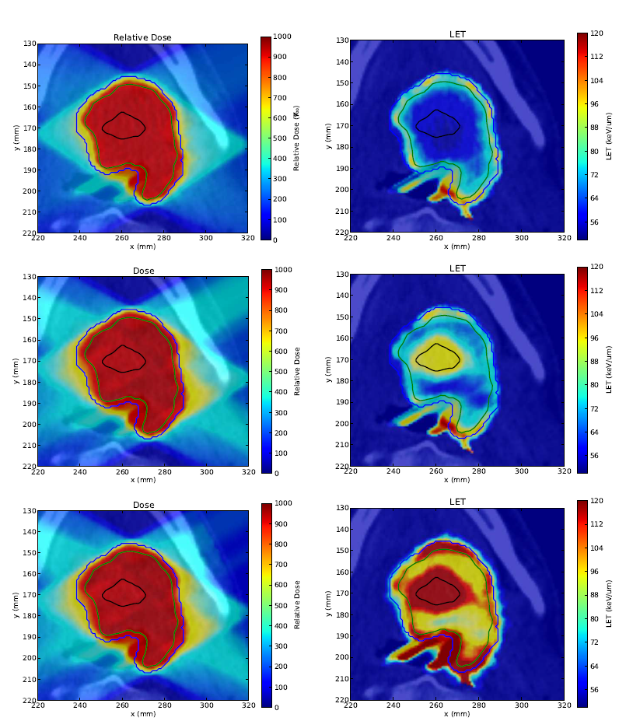
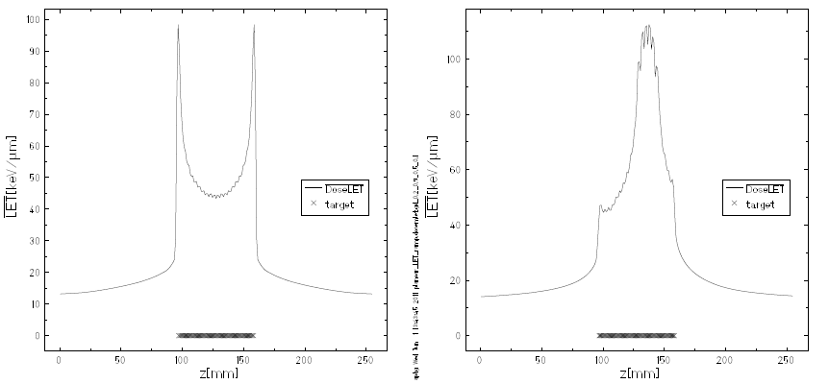
LET painting
  - Redistribution of LET,
  to be maximized
  in a target volume,
  using TRiP98
  with dose ramps
4 Flat
C fields
4 Dose
ramped
C
4 Dose
Ramped
O
Bassler et al. Acta Oncol 2014

Slide 37
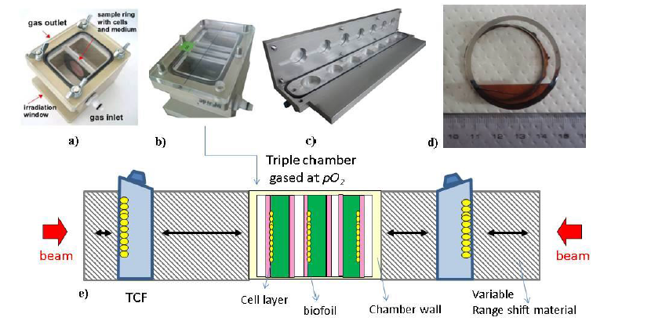
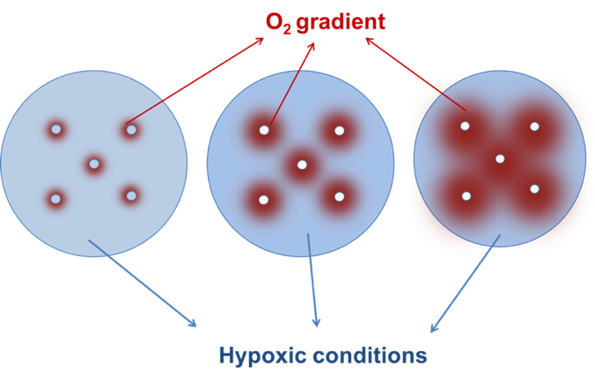
Specific tools for bio plan Experimental verification:
E.g. : Extended Heterogeneous target
In the project, including cellular communication
Tinganelli et al. Sci.Rep.2015

Slide 38

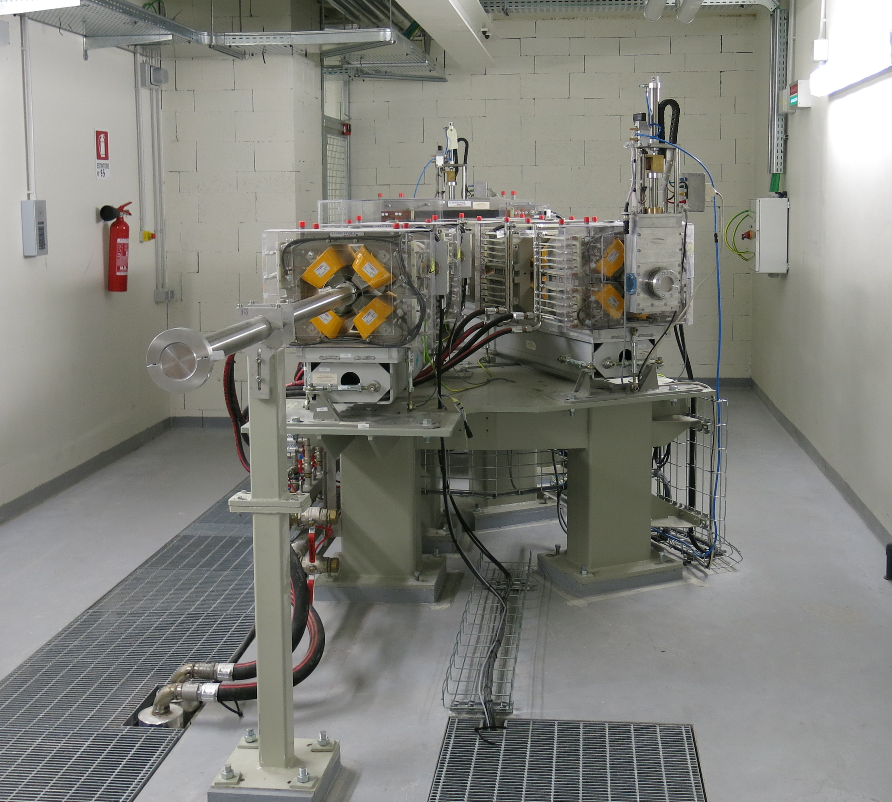
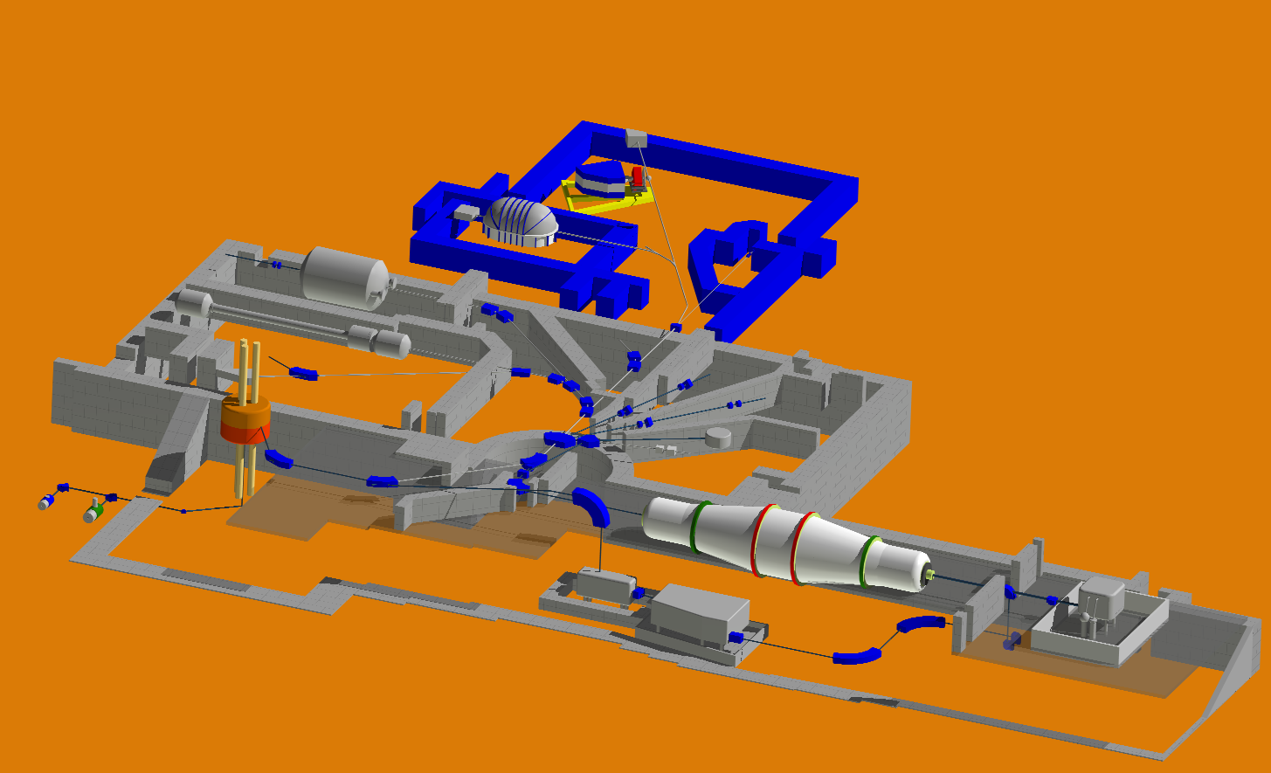
Facilities
TN
PV
p high E ( 70-235 MeV)
C,He,O high E
( 80-400 MeV/u)
LNS
p,C,He,O low E
( 20-80 MeV/u)
CT

Slide 39
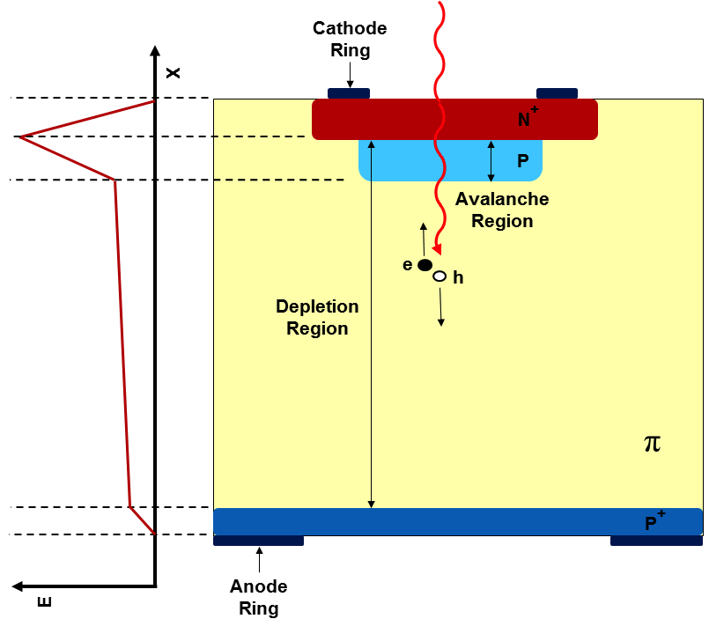
New developments in beam monitoring
Development of innovative Ultra Fast Silicon Detectors (UFSD project in CSN5) @ INFN-TO
UFSD specific advantages:
Enhanced SNR in thin sensors
Excellent time resolutions
  The collection time is determined by
  the detector thickness
  For 50 um thickness -> t_{coll} ~ 1 ns
  (the small signal of thin sensors is compensated by the internal gain)
If properly segmented, the UFSD can
provide high rate counting capability .
For strips with 200 um pitch
f_{max} ~ 10⁸ p/cm² s (pile-up < 1%)
Courtesy of. V.Monaco

Slide 40
Proposed Beam monitoring devices
On line Measurement of the Number of particles over a wide range in beam intensity
and independent of the beam energy.
Thin UFSD sensors (~ 50 μm) with short charge collection time (~ 1 ns)
Segmented in strips (pitch 100 ÷ 200 μm) to mitigate pile-up effects
Measurement of the beam profile in two ortoghonal directions.
Minimum Active area: 3x3 cm²
Custom VLSI chip to count at high rates.
On line Measurement of the beam Energy
Two UFSD pads (2x2 cm²) ~ 1 m apart
Measurement of the time difference and/or correlation of the time structure of the
two signals.
Custom VLSI chip
counter
Courtesy of R. Cirio/V.Monaco

Slide 41
Relevance to INFN CSN5 “core” mission
Detectors development (including bio-radiation detectors)
Accelerators beamline development
Advanced Computation
Interdisciplinary research for Medical Applications
TT output beyond scientific publications: patents, infrastructures, a worldwide unique network of INFN irradiation facilities for TPS verification in hadrontherapy

Slide 42
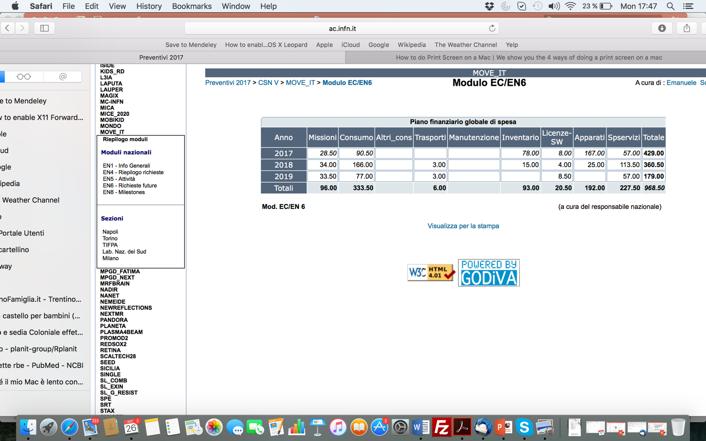

Slide 44
…are deviations from 1.1 of clinical relevance?
Potential improvements offered by biological optimization
Possible bias when neglecting variable RBE
Sensitivity to RBE model
Only 3 patients considered!
Dose (Gy)
Dose (Gy-RBE)
LET (keV/μm)
Wedenberg 2014 Med Phys
Notes:
- Rischi maggiori con RBE variabile per tronco encefalico (necrosis) e nervo ottico (cecità)
- a/b 10 for the tumor, about 2-3 for brain stem and optic nerve
- 59.4 Gy in 33 fractions

Slide 45
4. Facilities
All INFN facilities linked to
therapy centers, to apply directly TPS improvements
Complementary particles/Energy
Different stage of development at present
Generate a network of INFN facilities for hadrontherapy research
LNS

Slide 46
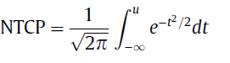

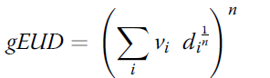
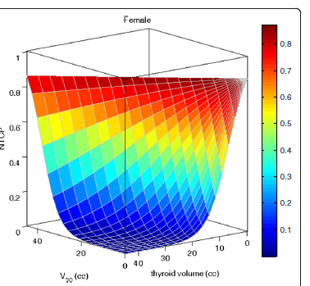

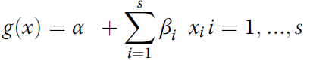
Normal tissue complication probability models
NTCP quantification can provide the link between physical dose distributions and expected radiation-induced morbidity outcomes
  Lyman-Kutcher-Burman
  (parsimonious, dose-volume based)
  Multivariable logistic regression model (multidimensional)
Courtesy of L. Cella

Slide 47
In vivo and molecular analysis
Courtesy of G. Russo

Slide 48
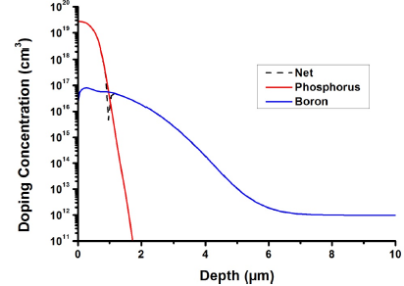
Ultra-Fast Silicon Detectors
Low Gain Avalanche Detectors (LGAD): innovative silicon detectors originally developed by National Center of Micro-Electronics (CNM, Barcellona, Spain) .
Ultra Fast Silicon Detectors (UFSD): LGAD optimized by INFN, Torino, for very accurate time measurements and produced by Fondazione Bruno Kessler (FBK, Trento, Italy)
Silicon detectors with internal charge multiplication in a high local field obtained by adding an additional doping layer. The doping layer is controlled to provide a limited gain (10-20), without breakdown at high voltages.

Slide 49
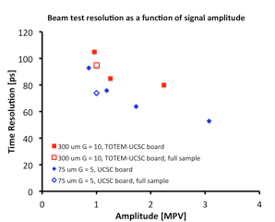
UFSD timing resolution
Effect of gain: thinner detectors, higher gain -> smaller time resolution
300 um, G=10
75 um, G=5
GOAL: ~ 30 ps with 50 um thickness and Gain = 15

