Slide 1

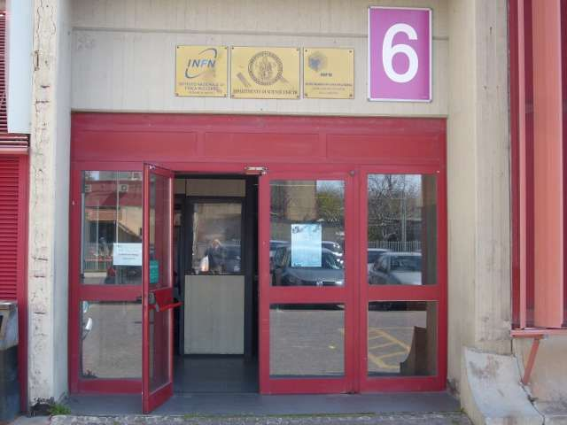



K → πνν, Grossman-Nir Bound, & Dark Bosons
24 Nov 2016, Seminar @ Napoli

Slide 2
K_{L} → π⁰νν Beyond Grossman-Nir Bound
Outline
Intro: Kaon, as old as Particle Physics
… KOTO’s “public neglect”, Until KAON2016 !
Blinding [K⁺ → π ⁺]π⁰: Blessed are the Blind
— K_{L} → π⁰ + Nothing above “GN Bound”? —
III. A Motivated Model (existence proof)
Gauged L_{μ} – L_{τ} related to muon g – 2 + ...
What Then? ― an Illustration of Impact
“Exotic” Rare K & B Decays
V. Dark Boson Connection
Not a Dark Photon: KOTO Unique Probe
VI. Conclusion
CMS → Kaon
What about NA62 ?
Fuyoto, WSH, Kohda, 1412.4397 (PRL’15)
and 1512.09026 (PRD’16)

Slide 3
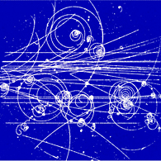

69+
I. Intro: Kaon, as old as Particle Physics
V particles from cosmic
g – 2 = α/π at one loop
But still NP Frontier:
K⁺ → π⁺νν vs K_{L} → π⁰ νν
@ CERN
@ J-PARC

Slide 4
KOTO SP at FPCP2016, Caltech
p. 26
Relative Mute @ ICHEP
p. 14

Slide 5
… KOTO’s public neglect, Until KAON2016 !
p. 26
1609.03637
One Event, 0.34 ± 0.16 BG expected
slightly worse vs E391a
slightly better limit

Slide 6




Grossman-Nir Bound
Grossman and Nir, PLB 398, 163 (1997)
The following model-independent (solid) relation holds
due to isospin symmetry
Using E949 90% CL upper limit,
(“GN bound”)
Much better than E391a 90% CL upper limit
~ 0.5 x KOTO w/ 100h data
Folklore: KOTO will start to probe New Physics only
after the GN bound is reached

Slide 7
Now …
Shaken It Off !
mostly
KOTO @ 100 hrs (2013), paper finally ...
“Blind man blessed by senses.”
Grossman-Nir Limit
@ J-PARC

Slide 8
II. Blinding [K⁺ → π⁺] π⁰: Blessed are the Blind
Or: Stupid is as stupid does.
[used at EPSHEP 2015]

Slide 9
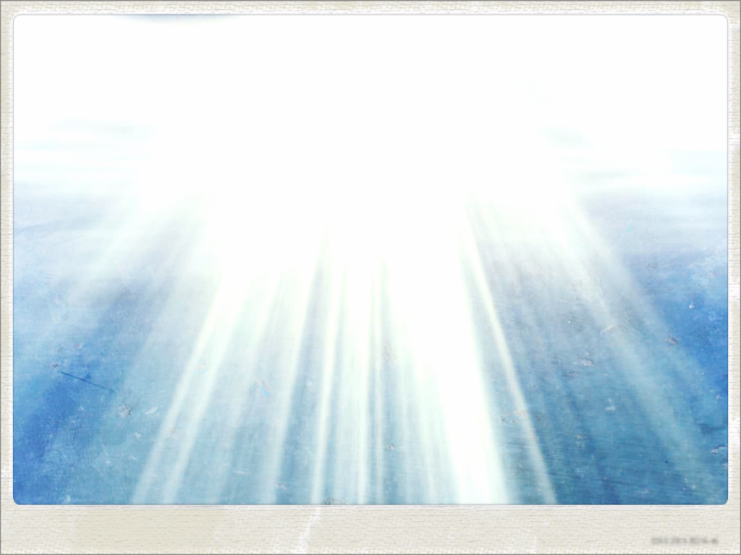

The Blinding K⁺ → π⁺π⁰
I (We) have (all) stared
at this gazillion times,
and became numb.
blinding spot

Slide 10
The Blinding K⁺ → π⁺π⁰
Window basically Same
as E787/949 @ BNL
@ CERN
Kinematic exclusion:
21%
5.6%
1.8%
Kinematic Control:
use K⁺ and π⁺ momenta
to block out blinding zone
See Neither
See Not

Slide 11

The Blinding K⁺ → π⁺π⁰
Not a great limit
stable
1/200 weaker than K⁺ → π⁺νν bound
blinding spot
$$X_{}^{0}$$
X

Slide 12
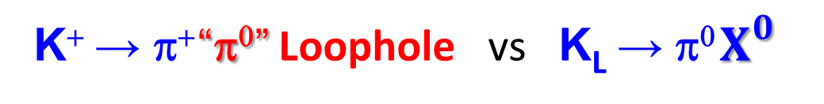


K⁺ → π⁺ “π⁰” Loophole vs K_{L} → π⁰ $X_{}^{0}$
Window basically Same
as E787/949 @ BNL
The KOTO Expt at J-PARC
can discover above
the Grossman-Nir Bound !
K_{L} → π⁰ X⁰
@ CERN
Kinematic exclusion:
“Blessed are the Blind.”
A Surprise ! “Trivial”
K_{L} → π⁰ νν
“Nothing to Nothing” (just γγ)
― Veto Everything !
But: Cannot Veto WILPs.
(Weakly Int. Light Particle)
See Neither
See Not
$$X_{}^{0}$$
$$X_{}^{0}$$
Fuyoto, WSH, Kohda, PRL’15

Slide 13
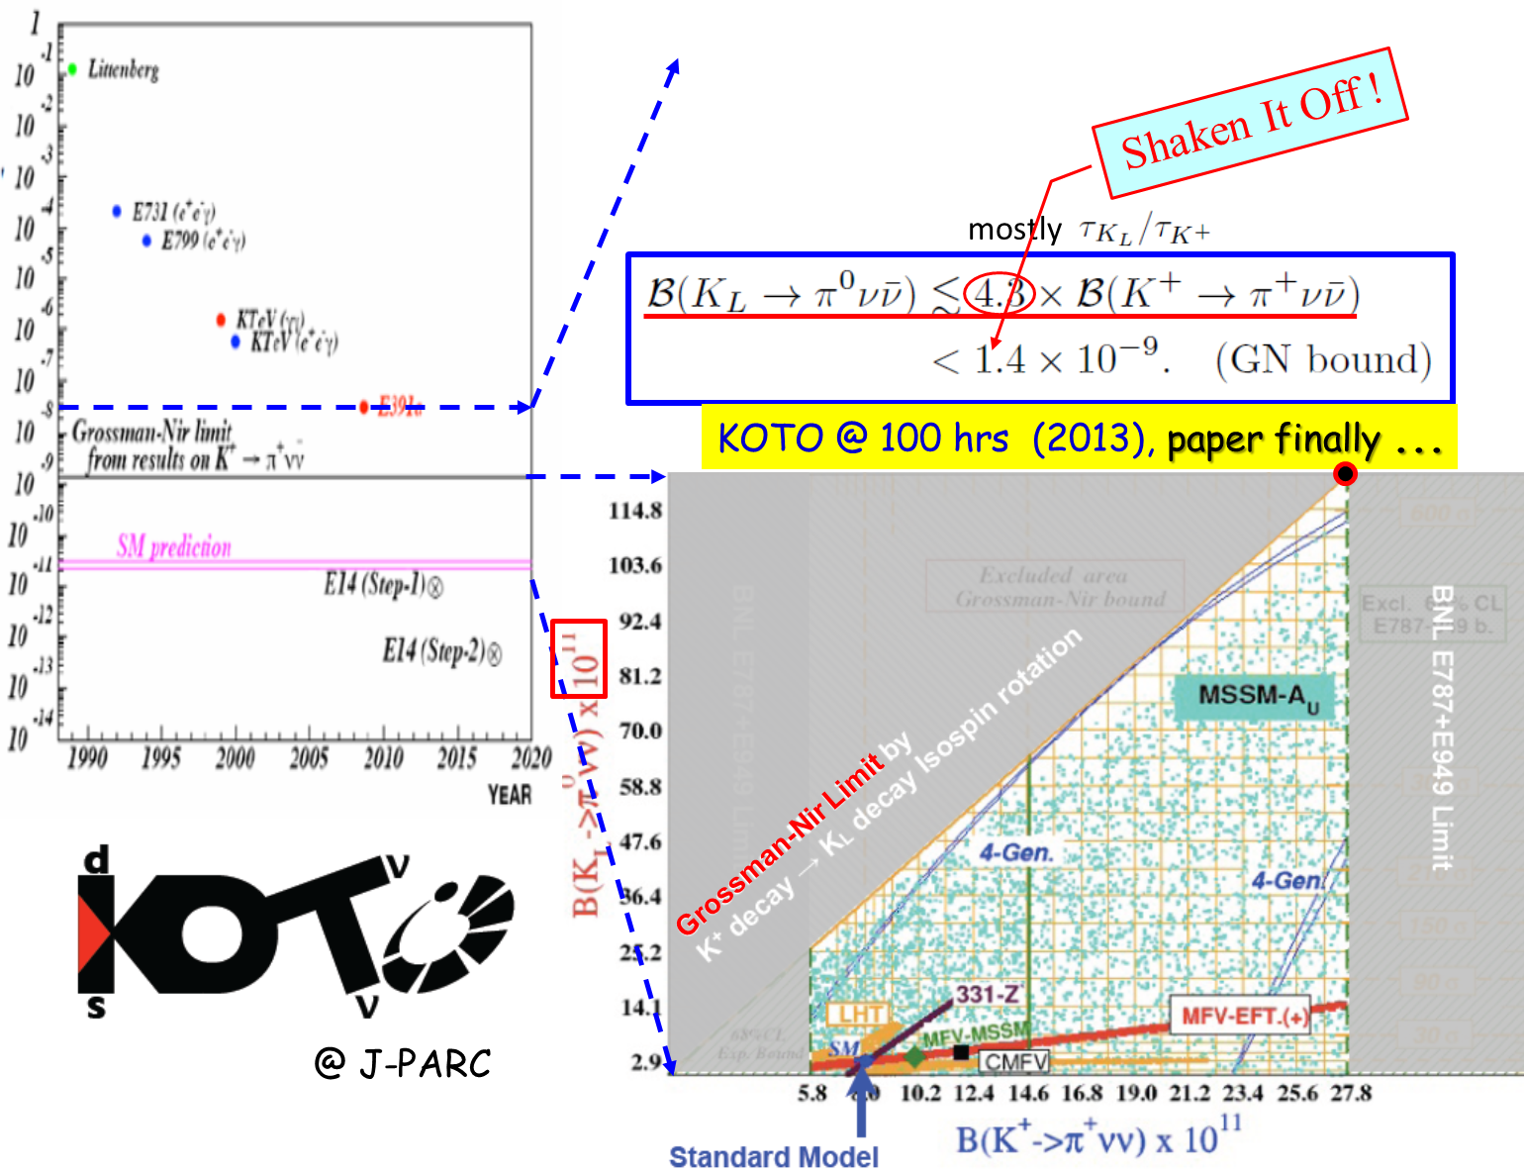
Discovery Starting “Now” !
The KOTO Expt at J-PARC
can discover above
the Grossman-Nir Bound !
K_{L} → π⁰ X⁰
discovery

Slide 14
— K_{L} → π⁰ + Nothing above “GN Bound” ? —
What you learned in “school” not quite right
Seeing the possibility was inadvertent
It all started from CMS & TopCNC Pheno …
A Story of CMS-related work leading to Kaon physics … ☺

Slide 15
III. A Motivated Model (existence proof)
gauged L_{μ} – L_{τ} related to muon g – 2
+ ...

Slide 16


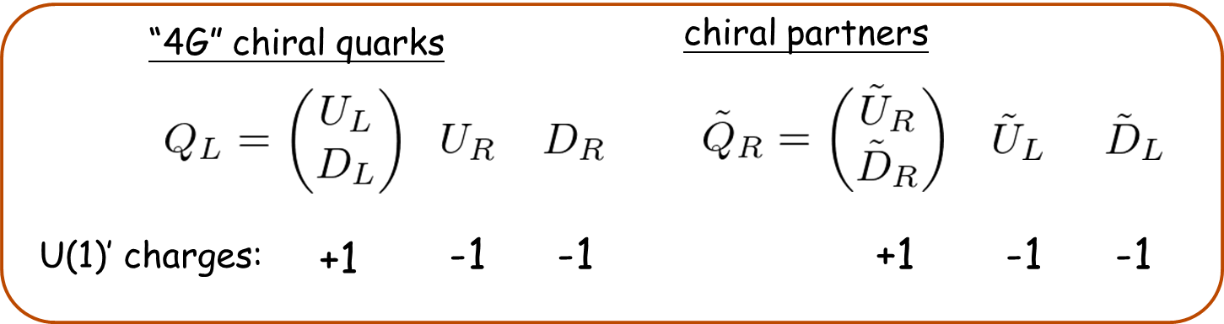
Gauged L_{μ} - L_{τ} model
Altmannshofer, Gori, Pospelov and Yavin, PRD89, 095033 (2014)
• U(1)′: gauging L_{m} - L_{t} (m-number minus t-number)
→ anomaly free within SM particle content
• U(1)′ breaking:
- SM singlet
- U(1)′ charge +1
- Z′ mass:
- L_{m} - L_{t} current:
- Link to Quarks? Introduce New Vector-like Quarks
X.G. He et al., PRD1991
Least Constrained
g.i. mass, plus
Yuk. Mixing w/
SM Quarks

Slide 17

C. Langenbruch @ Moriond EW
B → K*μ⁺μ⁻
3 fb⁻¹
NP? ΔC₉ ~ −1:
heavy Z′
e.g. 1307.5683; 1308.1501;
1310.2478; 1310.3877;
1310.1082; 1311.6729 …
Not Good, Not Bad … Not Too Good …
[3.4σ published]
3.7σ

Slide 18
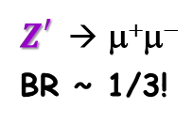
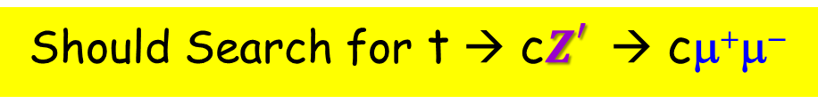

$P_{5}^{′}$-motivated $Z_{}^{′}$induces t → c$Z_{}^{′}$also
B → K*μ⁺μ⁻
Our Original Interest
flow of U(1)′ charge
Q, D, U: vector-like quarks with Z′ charge
“unconstrained”
Should Search for t → c$Z_{}^{′}$→ cμ⁺μ⁻
$Z_{}^{′}$→ μ⁺μ⁻
BR ~ 1/3!
“gauged L_{μ} – L_{τ}”

Slide 19
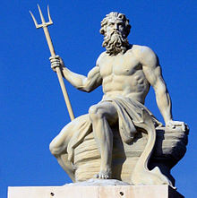
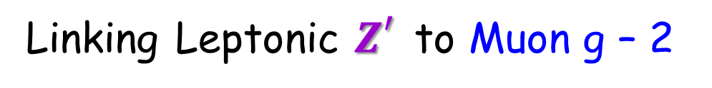


Linking Leptonic $Z_{}^{′}$to Muon g – 2
gauged L_{μ} – L_{τ}
1406.2332
Cannot Affect $P_{5}^{′}$
Altmannshofer, Gori, Pospelov, Yavin [PRD → PRL]
“Neutrino Trident Production”
Quite Weakly
Coupled
“LBNE”
but not DM
Muon g – 2 related $Z_{}^{′}$≲ 400 MeV < m_{K} ?
New Physics from Light Particle !?

Slide 20
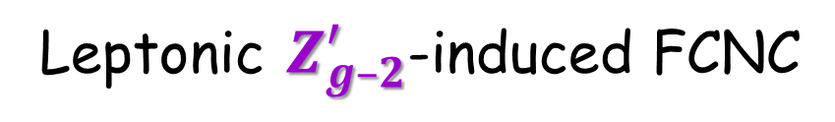

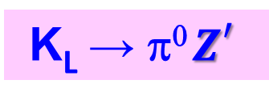
Leptonic $Z_{g–2}^{′}$-induced FCNC
gauged L_{μ} – L_{τ}
flow of U(1)′ charge
Tune away by Z₂ (or just drop)
Q, D, U : vector-like quarks with Z′ charge
〈ϕ〉 : generates Z′ mass
SM-assisted loop
s → dZ′; b → sZ′
Fuyoto, WSH, Kohda, PRL’15
K_{L} → π⁰ $Z_{}^{′}$
Muon g – 2 related $Z_{}^{′}$≲ 400 MeV < m_{K} !
New Physics from Light Particle !?

Slide 21
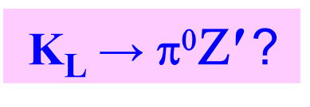

…
A Little Some Work
π (K^{(*)})
K (B)
$Z_{}^{′}$≲ 400 MeV < m_{K}
Aim: allowed t → cZ′ rate
But,
K_{L} → π⁰$\text{Z}\text{′}$ ?
...
Went to chat with Bob Hsiung ...

Slide 22


K⁺ → π⁺ “π⁰” Loophole vs K_{L} → π⁰ $X_{}^{0}$
Window basically Same
as E787/949 @ BNL
The KOTO Expt at J-PARC
can discover above
the Grossman-Nir Bound !
K_{L} → π⁰$Z_{}^{′}$
@ CERN
Kinematic exclusion:
“Blessed are the Blind.”
A Surprise ! “Trivial”
K_{L} → π⁰ νν
“Nothing to Nothing” (just γγ)
― Veto Everything !
But: Cannot Veto WILPs.
(Weakly Int. Light Particle)
See Neither
See Not
$$Z_{}^{′}$$
$$Z_{}^{′}$$
Fuyoto, WSH, Kohda, PRL’15

Slide 23
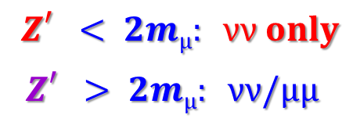
IV. What Then? ― an Illustration of Impact
Circumstantial Hints/Possibilities in Rare B & K Decays
$$Z_{}^{′}< 2mμ: νν only$$
$$Z_{}^{′}> 2mμ: νν/μμ$$

Slide 24
BaBar: mild hint in B⁺ → K⁺νν
N.B. B(B → Kπ⁰) << B(K → ππ⁰)
BaBar’13 (471M BB(bar))
BaBar hint fully covers down to GN Bound !
10 m_{mis} bins
Belle needs to follow up with
the Binned m_{mis} analysis.
(→ Belle II)
driven by lowest bin
Fuyoto, WSH, Kohda, PRL’15

Slide 25
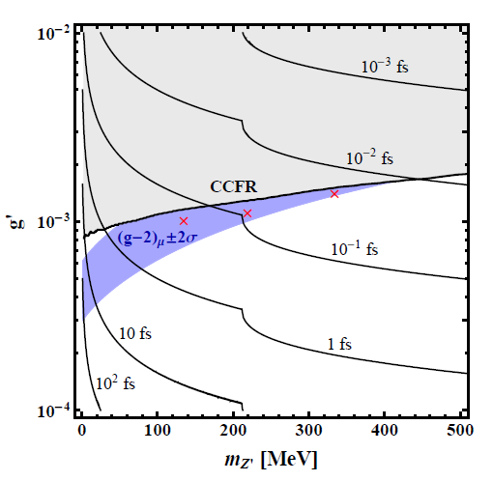



Comment: Light “g-2” Z’ decay is
prompt, even when highly boosted.
Fuyoto, WSH, Kohda, PRD’16

Slide 26
LHCb 1508.04094 [PRL’15 supplementary]
Direct contact with LHCb for details.

Slide 27
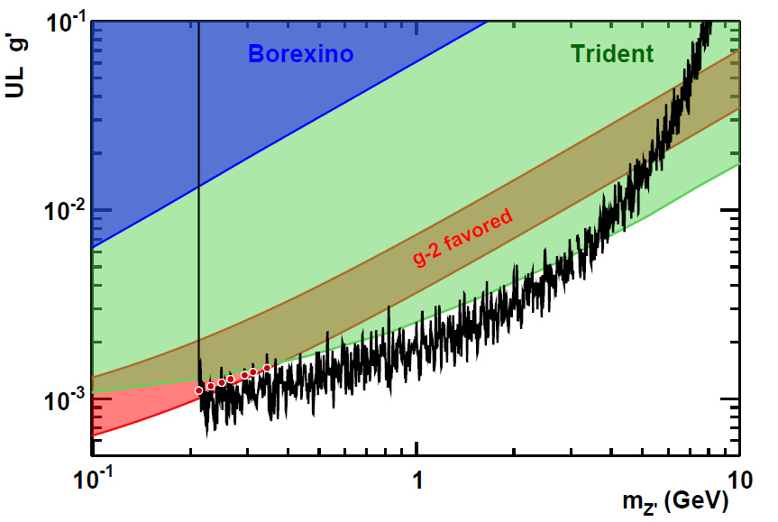
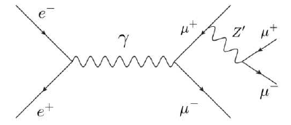
1606.03501
“Pockets” exist, independent of quark side,
but, weaker than LHCb by 2 orders in our model (not in plots).
exclude all but a sliver …
above dimuon threshold

Slide 28

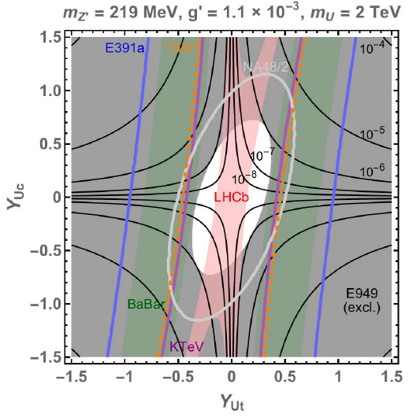




$$Z_{}^{′}> 2mμ: νν/μμ$$
The 2nd Window: “pocket” physics
Practically Excluded
Allowed
334 MeV $Z_{}^{′}$ [LHCb tolerant]
219 MeV $Z_{}^{′}$ [LHCb stringent]
Fuyoto, WSH, Kohda, PRD’16

Slide 29




The Light $Z_{g–2}^{′}$ Landscape (illustration)
Perhaps 100 TeV SPPC/FCChh Needed .... Or not? [50% μμ]
Contour in backdrop is t → c$Z_{g–2}^{′}$
334 MeV $Z_{}^{′}$
135 MeV $Z_{}^{′}$
Opportunity
Y_{Uc} & Y_{Ut} reasonable in strength
Fuyoto, WSH, Kohda, PRL’15
and PRD’16

Slide 30
Now …
Discovery Zone
(2015 Data!)
Shaken It Off !
mostly
KOTO @ 100 hrs (2013), paper finally ...
“Blind man blessed by senses.”
Grossman-Nir Limit
@ J-PARC

Slide 31
V. Dark Boson Connection
Not a Dark Photon: KOTO Unique Probe
What about NA62 ?

Slide 32
Dark Photons: Visible & Invisible
ε
Kinetic mixing
Holdom, 1986
But, What If ... ?
PLB’15
E787/949
Davoudiasl, Lee, Marciano, 2014

Slide 33
A Missing E Beam “Dump” Search
100 GeV e ̶
Nov. 8, accepted PRL
1610.02988
4 wk run ended

Slide 34
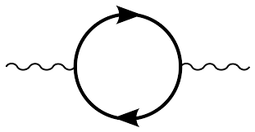
What if No e-coupling? ― Case of L_{μ} - L_{τ}
ε ~ 10 ^{̶ 5}
γ Z′
μ ̶ τ

Slide 35
What if No e-coupling? ― Case of L_{μ} - L_{τ}
ε ~ 10 ^{̶ 5}
γ Z′
μ ̶ τ
μ-beam concept
KOTO can probe this !
(depend on VLQ assumptions)
But any Dark X⁰,
for K_{L} → π⁰ + X⁰
Gninenko, Krasnikov, Matveev, 2014

Slide 36
… What about NA62 ?
Not a great limit
X
1/200 weaker than K⁺ → π⁺νν bound
stable
fac. ~ 6.2 improvement !
(reverse-GN)
attributed to
photon det. ineff.
One Event, 0.34 ± 0.16 BG expected
What is program for
“π⁰ → νν” @ NA62 ?
And phot. det. ineff. ?
1609.03637
slightly worse vs E391a
3.7 X 10⁻⁸

Slide 37
Now …
Discovery Zone
(2015 Data!)
Shaken It Off !
mostly
KOTO @ 100 hrs (2013), paper finally ...
NA62
“Blind man blessed by senses.”
Zone Open
Grossman-Nir Limit
@ J-PARC

Slide 38
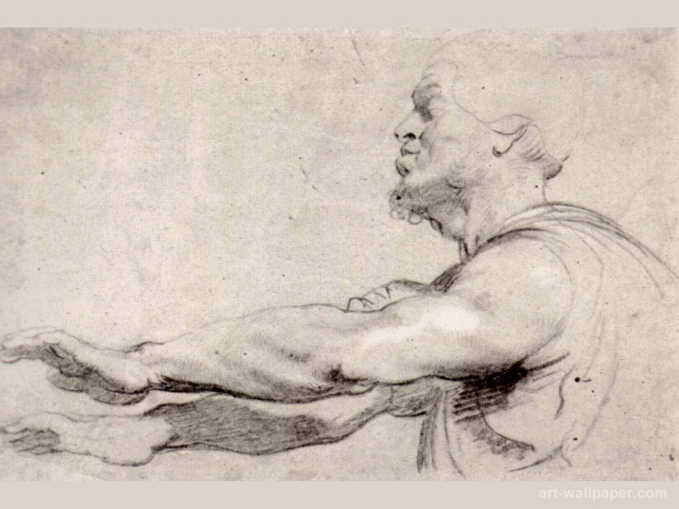
VI. Conclusion
• K_{L} → π⁰ + nothing: can occur above “Grossman-Nir Bound” ➔ KOTO !
If See Early Event(s), Try Hard to Kill ... But Not Overkill.
• If above GN Bound, then likely “π⁰” mass object .
• When KOTO reaches below current “GN Bound”, concept still effective.
➔ KOTO/NA62/Belle(II) (/LHCb) all in game.
(that slips thru NA62)
NA62 should pursue π⁰ → νν
Analyze, KOTO, Analyze !

Slide 39
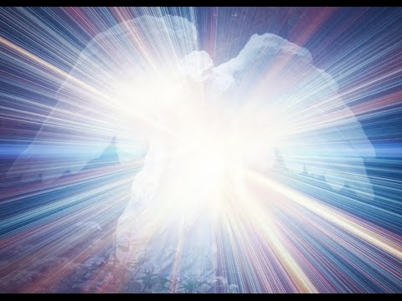
“Blessed are the Blind,
for they shall see the Heavens open.” (Jesus, apocryphal)
Analyze, KOTO, Analyze !
and, ... Dark Connections?

Slide 41
Reducing Neutron BG @ KOTO
One Event, 0.34 ± 0.16 BG expected
Shiomi @ KAON2016
N(KL) ~ 1.6x

Slide 42
Pick up t → cZ' topic at LHCP2014
difference between muon- and tau-lepton number
X.G. He et al., PRD1991
1403.1269
I ask from back of room: “How to Search?”.
Came the reply: “μμ or ττ” mode.

Slide 43

$$Z_{}^{′}> 2mμ: νν/μμ$$
The 2nd Window
285 MeV
OUTDATED BY LHCb DB
260
300
Range of “excess”
“excess” in 1st bin
Can be refined by NA62
Piccini talk this morning
Fuyoto, WSH, Kohda, PRL’15

