Slide 1
Level-1 Trigger
Pam Klabbers
University of Wisconsin - Madison

Slide 2
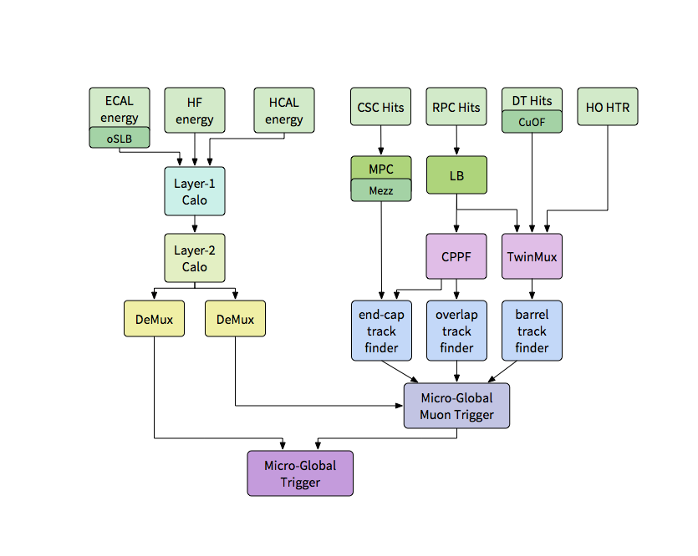
2016/17 CMS Level-1 Trigger
*
*
*
Not shown – fiber optic splitting and patch panels
*install in 2017

Slide 3
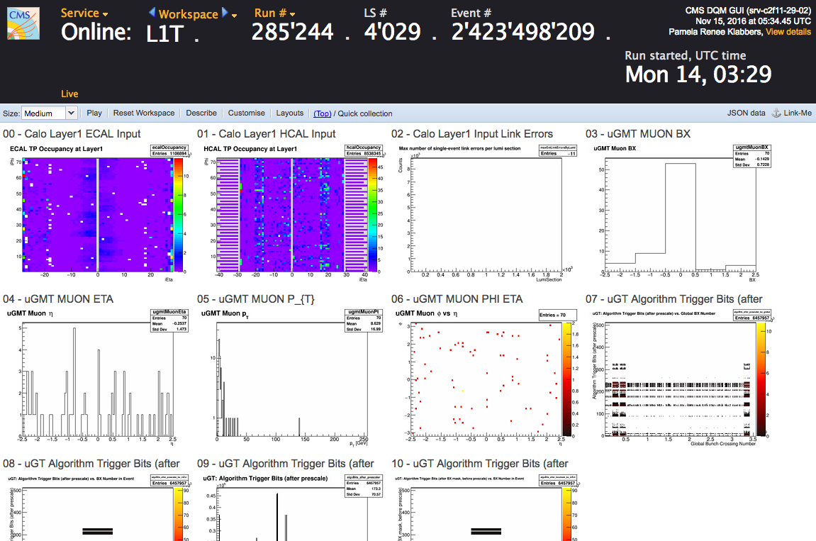
Operations 2016
Started the year with the most of the legacy trigger in for one MWGR, then commissioned a completely new trigger system
  All μTCA format
  Mostly optical interconnections
  In expert mode for most of first half of 2016
    Tools for diagnosis evolved through the year
  Shifters’ and L1 DOCs’ tools changed
Data Quality Monitoring
  Online all new for 2016 subsystems
    Similar plots, but not always easy to find
  Deployed selection to main shifter panel
Hardware enhancements (highlights)
  μGT – now operating in multi-board mode, up to 512 algos possible
  Calo L1,L2 – redundant node functionality, quick switchover if a link goes down
  Muons – Commissioned, Superprimitives (RPC+DT), asst’d improvements

Slide 4
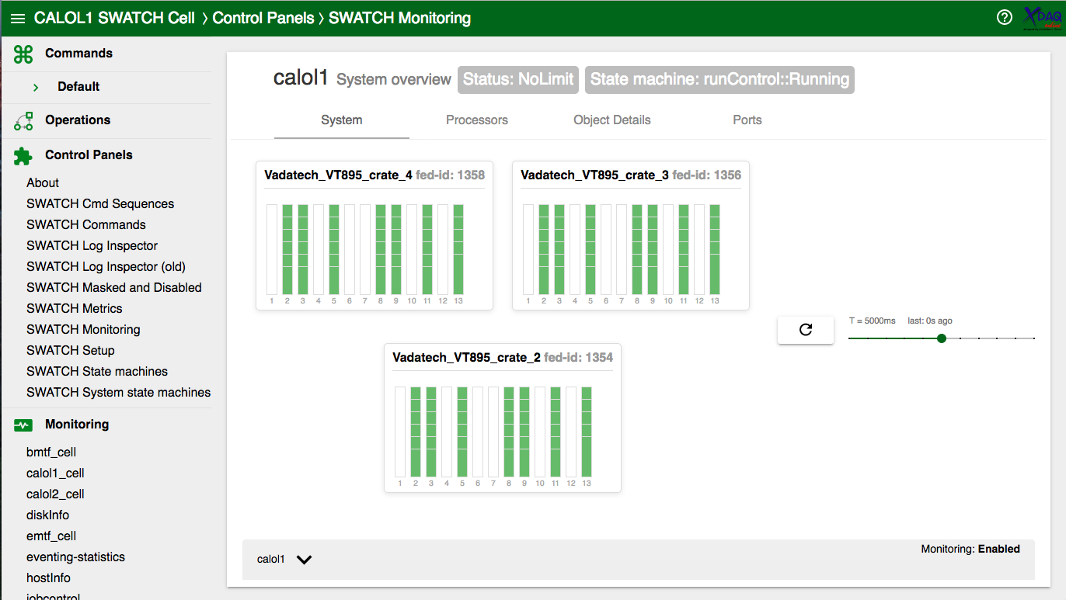
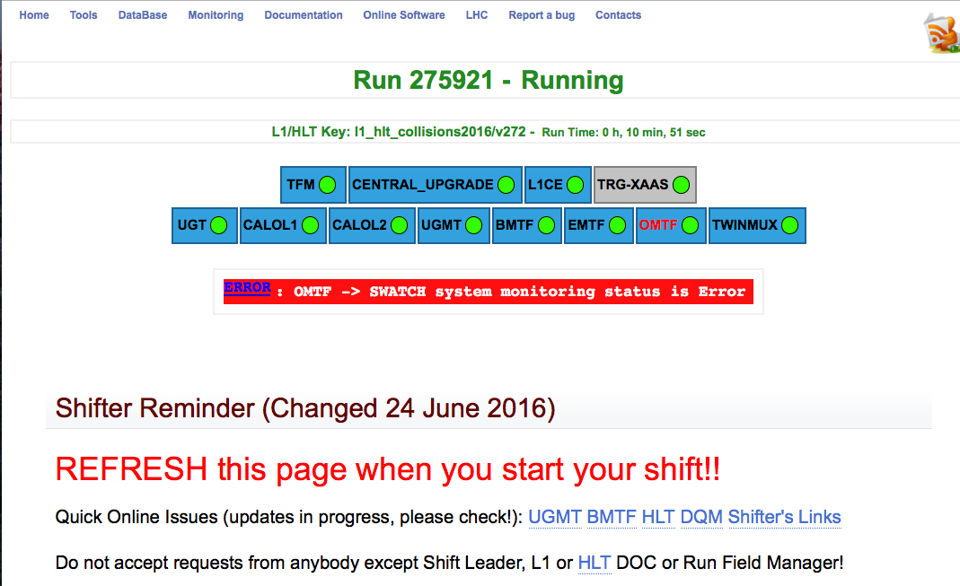
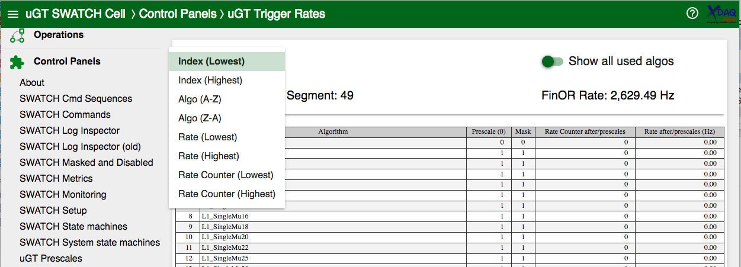
Online Software 2016
  New SWATCH library providing common control software for the L1T upgrade
  New DB schema
  Issues addressed quickly
  Very frequent updates during initial deployment
  Additions throughout the year
    e.g. rates monitoring (below)
  Updated TS JavaScript library
    Drop Dojo, fully moved to Polymer
  Adapted central tools (L1 Page, L1CE) to include new sub-systems

Slide 5
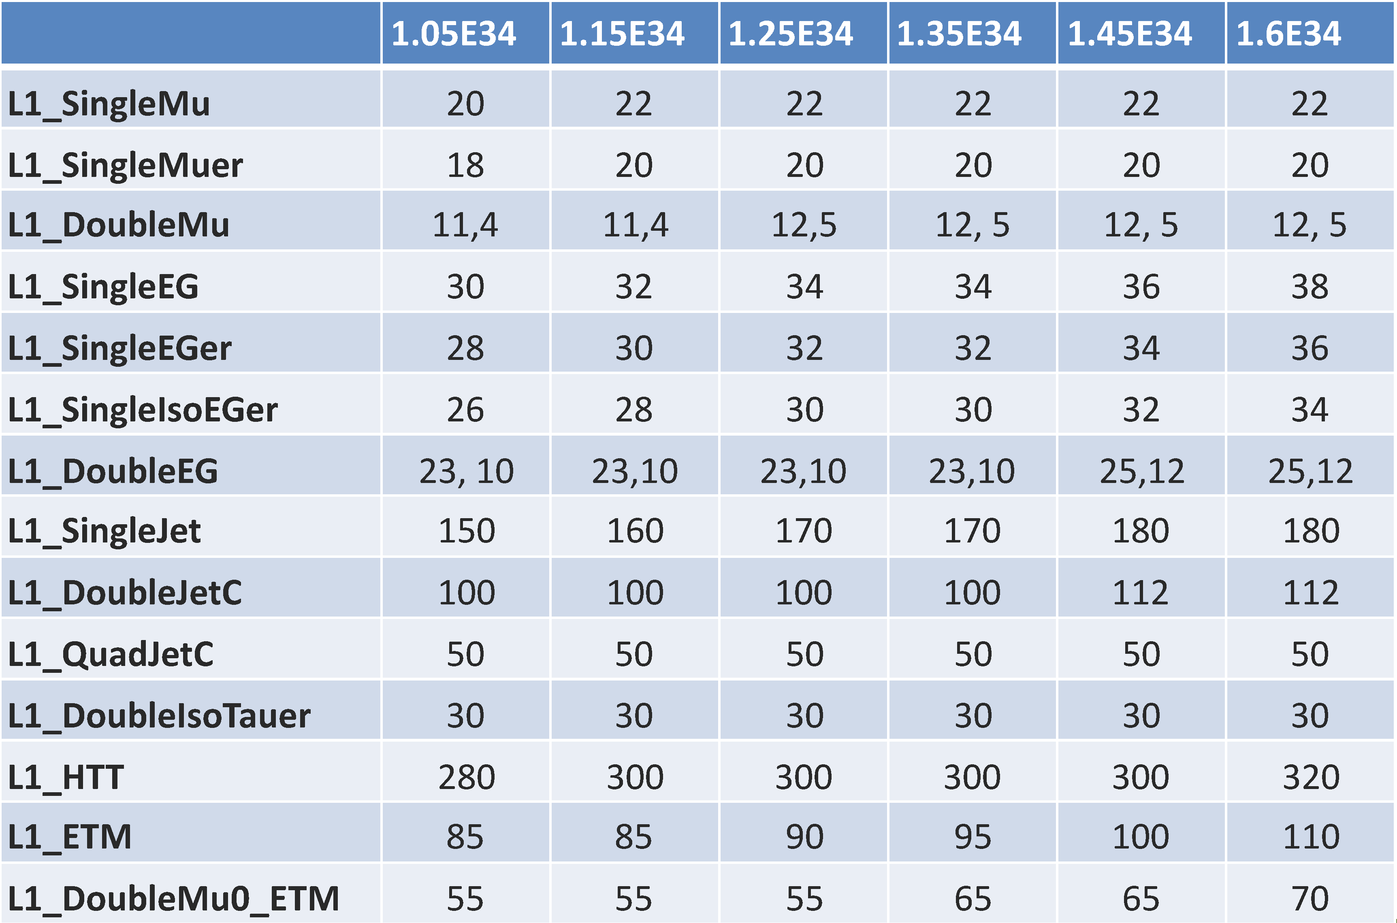
Menu in 2016
Tuned with rates from LS with expected pileup or extrapolated from fits to pileup
Feedback from L1 & HLT used to adjust balance of triggers
Z. Wu

Slide 6
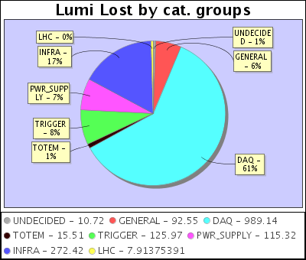
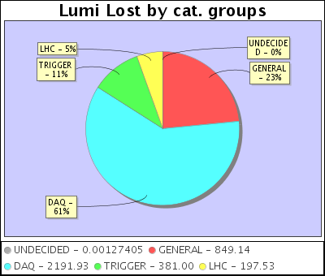
Overall Official* Downtime
pp
pPb
pp Physics
  8% of all downtimes, 126 pb⁻¹ lumi lost (inc. HLT 1.5 pb⁻¹)
  2012: lost 149 pb⁻¹ due to trigger, 14% of all down time!
pPb Physics
  12% of all downtimes
  Bulk due to reconfiguration
*Category TRIGGER in WBM
Notes:
40 fb-1 in 2016 20 fb-1 in 2012!

Slide 7
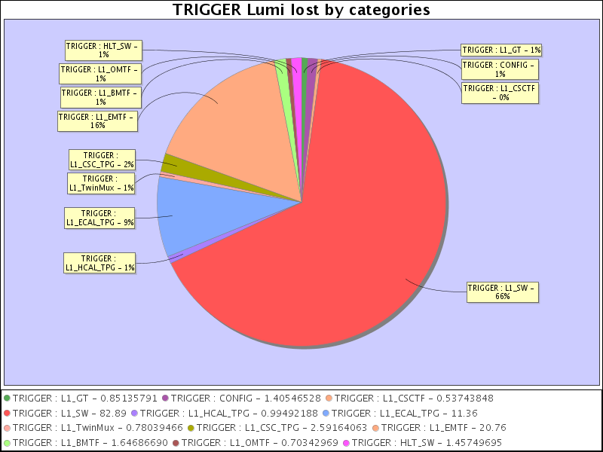
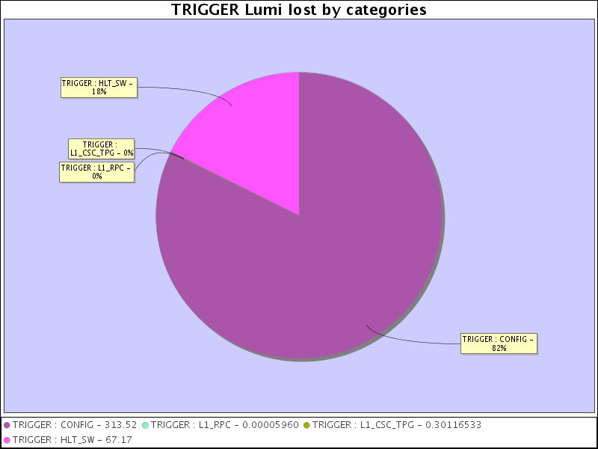
Major Downtimes
pp
pPb
pp Physics
  Calo Layer-2 roll back of software 81 pb⁻¹
  EMTF PC crash 17.5 pb⁻¹
pPb Physics
  Two reconfigurations for vdM scan – 330 μb⁻¹
  New L1/HLT mode for reducing output to 6.5 GB/s – 67 μb⁻¹

Slide 8
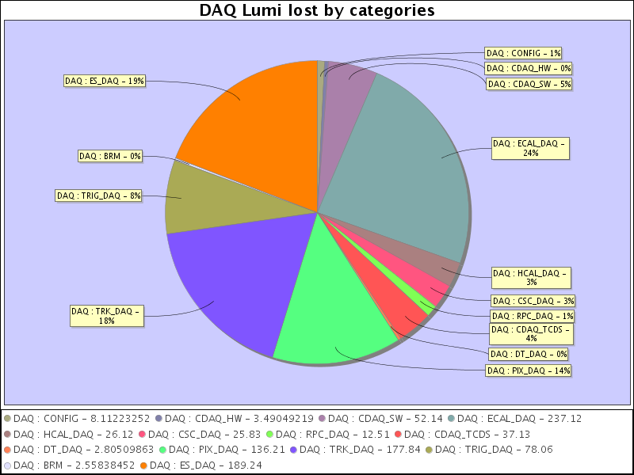
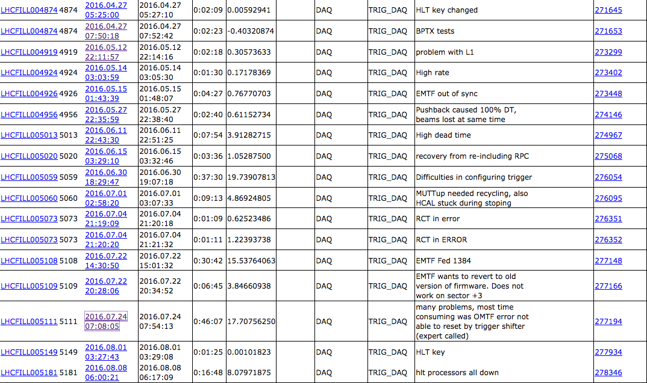
TRIG_DAQ Downtimes
*But don’t get all cozy just yet…another category:
  Dig a little deeper and some issues are classified as DAQ-> TRIG_DAQ
  Without filtering for HLT or unrelated issues, this was ~78 pb⁻¹
    19.7 pb-1 30.6 had trouble configuring, μGMT, OMTF,
      Just not a good start of fill for CMS - other sub-detector problems may be lumped into this
    19.4 pb-1 22.7 EMTF issues, fix for high p_{T} ineff. DAQ r/o prob. Crate power loss.
    17.7 pb-1 24.7 OMTF timeouts, had to call expert for help

Slide 9
Operational Plans 2017
μGT (M. Jeitler et al.)
  Firmware
    Invariant mass, transverse mass, overlap removal, additional objects
    Suppress calibration triggers
      Delayed due to inconsistent BGo definitions between AMC13 and MP7
    Perhaps double-b-tagging – 2 muons in a jet
    Allow use of lead objects of collection only to save resources
  Software
    Streamline – e.g. easier use of BX mask
    Keep Trigger Menu Editor up-to-date with firmware capabilities
    Improve monitoring compare and publish in DQM
      Calo Layer-2 and μGMT output vs μGT input
      AMC13 global FinOR “out” with TCDS FinOR “in”
  Hardware
    3rd MP7 installed (possibly up to 6, depends on available inputs)
    Additional FinOR AMC502 installed
    Additional Patch Panels
    μGT test crate with some fiber inputs

Slide 10
Operational Plans 2017
TwinMux
  Integration of HO – develop algorithm and emulate, implement FW, HO fibers to RPC PP/Splitters
  DAQ Improvements – record 2 output segments, bit denoting chamber-half
  Spy Buffer for DT input
  RPC – tune RPC hit timing (on RPC link boards), optimize cluster size/hit eff.
  Achieve 100% data-to-emulator agreement
BMTF
  New ETTF with finer η resolution running at 160 MHz
  BDT p_{T} assignment at 160 MHz
  These will reduce latency by 2 BX, better η resolution, expect lower μ rate with same eff.
OMTF
  DAQ already working during last pPb runs, currently validating
  Get 100% (currently 99.45%) data-to-emulator agreement
  Algorithm performance improvement

Slide 11
Operational Plans 2017
EMTF
  Training a new MVA for p_{T} assignment – improve performance, optimize use of RPCs
  New FW with RPC inclusion – new DAQ, streamline existing logic
  Continuing CPPF development –transmission tests in 904, iron out the details
CPPF
  Tests ongoing in 904
  Test RPC receiving at P5 (end of Jan)
  Install in P5 in EMTF Sorter crate, RPC fibers reconnected
  SWATCH Development and integration with central cell
μGMT
  Zero Suppression
  Extrapolation of φ to the IP
  Isolation using 5x5 calo sums - studies ongoing, final solution not clear (e.g. DEMUX on calo side)
  Ghost busting/double muons performance

Slide 12
Operational Plans 2017
Calo Layer-1
  Minor improvements to error handling in SWATCH
  Updates to calibrations/scale-factors
  Work with ECAL TP experts regarding two issues
    Link errors at LHC ramp, one single tower error
  HCAL fiber mapping change – change 72 fibers at Layer-1 PP
Calo Layer-2 (G. Iles et al.)
  Firmware and configuration changes :
    Firmware fix for H_{T} saturation
    Possible fix for saturation in other objects
    Possible changes to ME_{T} pending PU dependence studies
    Possible addition of fat jets
    Possible isolation for muons
  Operational changes :
    Updated DQM, including emulator
    Improved firmware validation workflow

Slide 13
DQM and Online Software 2017
DQM
  More general and system-level improvements, faster updates
WBM
  Look into improvements for L1/HLT synchronicity
Move to CC7 and XDAQ 14
  Start testing subsystems TS and SWATCH by mid-Jan
New Configuration Editor and updated database schema
  Aim for just after 2017 MWGR 1 (mid-Feb)
  Tools for xml editing
  Improve current DB schema – tracking, duplication, deprecation
  Restore Run 1 L1CE functionalities
  New modular architecture
L1 Page (Shifter Interface) Update
  Also aiming for MWGR 1
  Modern technologies and design
  Cleaner user interface
    Better alerts, subsystem status, and shifter reminder
Manpower decreasing this year, entering consolidation phase

Slide 14
L1CE

Slide 15
Summary
Muon updates including hardware changes
  Install CPPF, RPC data to EMTF will improve performance
  Second DeMux for muon Isolation, fibers installed, under study
  HO to TwinMux, fibers going in, under study
Numerous updates to μGT planned
Fewer updates to Calo Layer 2 and Layer 1
HCAL Latency Increase (currently 2-3 BX)
2017 needs to be a consolidation year for L1
  Need to be stricter and stick to workflows for
    Updates and improvements (including menus)
    DQM – get updates online more quickly
    WBM – cannot change data formats as in the past
  Software – additional safety checks, monitoring, alarms
  Should aim to make systems less expert in 2017

Slide 16
Backup

Slide 17
EMTF with RPC (CPPF)

Slide 18
L1 Shifts and DOCs
Needs for 2017
  DOC 1
    Three MWGRs: 3 short weeks (3 days, no weekends)
    Weeks 13-50 : 38 weeks
    Full list of volunteers, allocating weeks now…
  DOC 2
    See Takashi’s talk – monitor rates as a function of PU, prompt certification in 24h using express streams
  DOC 3 – Previously called trigger offline shifts
    Monitors detector performance, fills in RR, release validation with RelVal DQM
  Shifts
    Full for first half of 2017 (oversubscribed)
    Next call ~March 2017

Slide 19
Lessons Learned 2016
& Wish List…
Updates and configuration changes
  Even “small” changes caused unexpected behavior
    Not always obvious at first glance
    Test vectors/patterns should be enhanced
    Do tests at end of fill before final deployment
    Some changes were not announced
      Experts need to stay in touch with L1 DOCs and Trig. Tech. Coord.
  Coupling changes not ideal
    e.g. New layer-1 corrections
      Improved tau and e/gamma, but caused PU dependent ME_{T} behavior
  Careful with keys (L1 DOCs and Experts)
    Wrong key used for update, typos in XML, old XML…
    Need better ways to spot problems (“diff”, non-XML view)
      L1 Online SW group is thinking about this
  Be ready to roll back (any change) in case of problems

Slide 20
Lessons Learned 2016
& Wish List…
Updates and configuration changes (continued)
  Menus, including prescale tables, algo mask, BX mask…
    Workflow well defined, started an L1 DOC checklist…
      Lots to update when menu changes, can be confusing
    Mostly smooth, some issues:
      “Compatible” menu had a bit missing, triggers added, no prescales
      Menus tested without warning – errors in HLT, etc.
    Communication is key!
Shifter
  Timing issues not noticed
    Timing plots now in L1T Quick Collection (Trigger shifter view)
    Additional emphasis in tutorial
  Holes in detectors not noticed
    More plots in QC, L1T groups should use main L1T DQM Summary
    Also more emphasis in tutorial
  Rates wish – μGMT input from TFs, could use a more “generic” panel

Slide 21
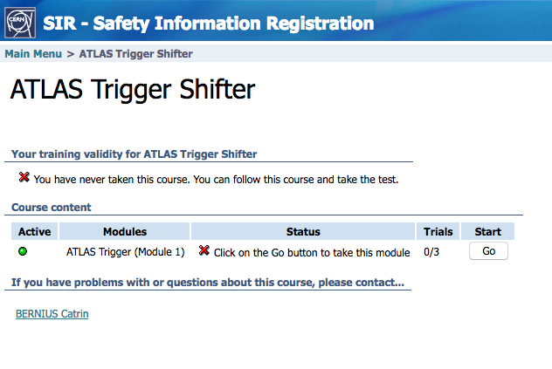
Lessons Learned 2016
& Wish List…
Shifter (continued)
  Wrong prescale column - μGT preserve column between runs?
  Expert Contacts – few subsys. have only a list of names, generic # possible?
  Shifters in general
    Selection more stringent this year
    Trainer a bit burnt out
      Maybe migrate some training to sir.cern.ch
      ATLAS (right) has already done this
      Advantage – quizzes
      Disadvantage – no personal interaction
L1 DOC
  Very difficult to fill for the first part of the year
  Changes not always known to L1 DOC
    Every change needs to go through DOC to RC before action
    If more urgent DOC calls RFMs to get approval
  Do not assume that DOC knows what tools are available!
    Playing “telephone” game with DOCs doesn’t work – write it down!!!

Slide 22
L1/HLT Prescales
(from HLT)
We often had problem with the set of L1 and HLT columns
  The procedure involved 4 players
    L1 DOC
    HLT DOC
    TSG STORM/STEAM group (offline)
    L1 DPG
The regular way of proceeding is
  L1 DPG group proposes a set L1 prescales and columns
  TSG/STEAM elaborate on those, revise and propose modifications, plus compiles the HLT prescales
  STORM implement in confdb and put in the offline menu, i.e. ready for next menu
  FOG apply it online for HLT and passes the Google Doc with prescale to the L1 DOC
    As L1 and HLT DOC con make changes on the fly, many problems are raised when these changes are not communicated back, for example to STORM
We need to think of a possible improvement in the workflow to prevent these kinds of mistakes from happening

