Slide 1
LOW SECONDARY EMISSION SURFACES
FOR MULTIPACTOR SUPPRESSION IN SPACE
G. Troncoso, C. Morales, V.C. Nistor, L.A. González, L. Galán, L. Soriano
Grupo de Recubrimientos, Intercaras y Nanoestructuras (GRIN)
Departamento de Física Aplicada and
Instituto de Ciencia de Materiales “Nicolás Cabrera”
Universidad Autónoma de Madrid
Madrid, Spain

Slide 2
OUTLINE
Background for anti-multipactor coatings in space
Anti-multipactor materials and coatings
Coatings proposed fo.r the M-ERA.net project
Other studies for the M-ERA Net project
Acknowledgments

Slide 3
ELECTRON CLOUD AND MULTIPCTOR
Electron cloud and Multipactor discharge affect severely normal operation of:
High-power RF equipment in communication space satellites
High-energy particle accelerators
Magnetically confined fusion apparatus
High-power RF vacuum devices (klystrons and others)
and may become destructive (Corona discharge) if outgassing is produced
For mitigation, it is always necessary to decrease SEY in critical parts

Slide 4
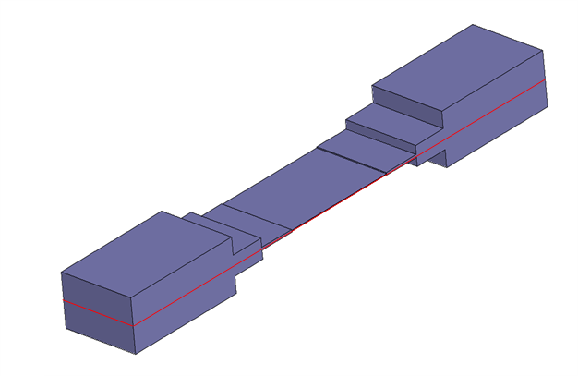
MULTIPACTOR IN SPACE
Multipactor in space is mainly produced by the acceleration of electrons by the RF electric field in the wave guides.
The accelerated electrons impinge the wave-guide walls creating more electrons by secondary emission, thus generating a cascade resulting in an electron cloud
Internal volume space of a multipactor sample: reduced height gap transformer waveguide, WR75 12 GHz. The waveguide is split in two halves In order to facilitate the surface treatment of internal space
In the central part of the wave-guide, in the reduced gap, the electric field is maximum, as it is the multipactor susceptibility.

Slide 5
MULTIPACTOR IN SPACE
secondary emission
wave guide
electromagnetic field
UV light
wave guide
electron trajectory
exponential growth of electron cloud
second mode multipactor discharge
In critical conditions, the electrons impinge the wave-guide surface and more electrons are ejected by secondary emission

Slide 6
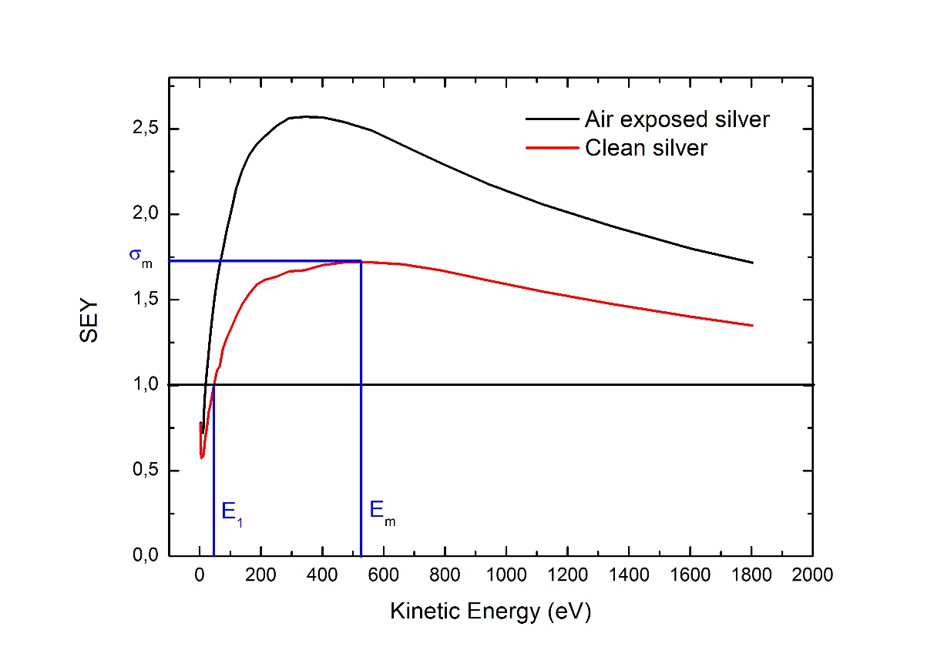
SECONDARY EMISSION YIELD (SEY)
The secondary emission yield coefficient determines the number of emerging electrons per incident electron
The most important parameters for SEY are:
E₁= Cross over energy
σ_{max} = max value of the SEY coefficient
E_{m} = Energy for the maximum SEY value
In order to have only one parameter to define the goodness (low SEY) of a surface, the parameter E₁/ σ_{max} is defined

Slide 7
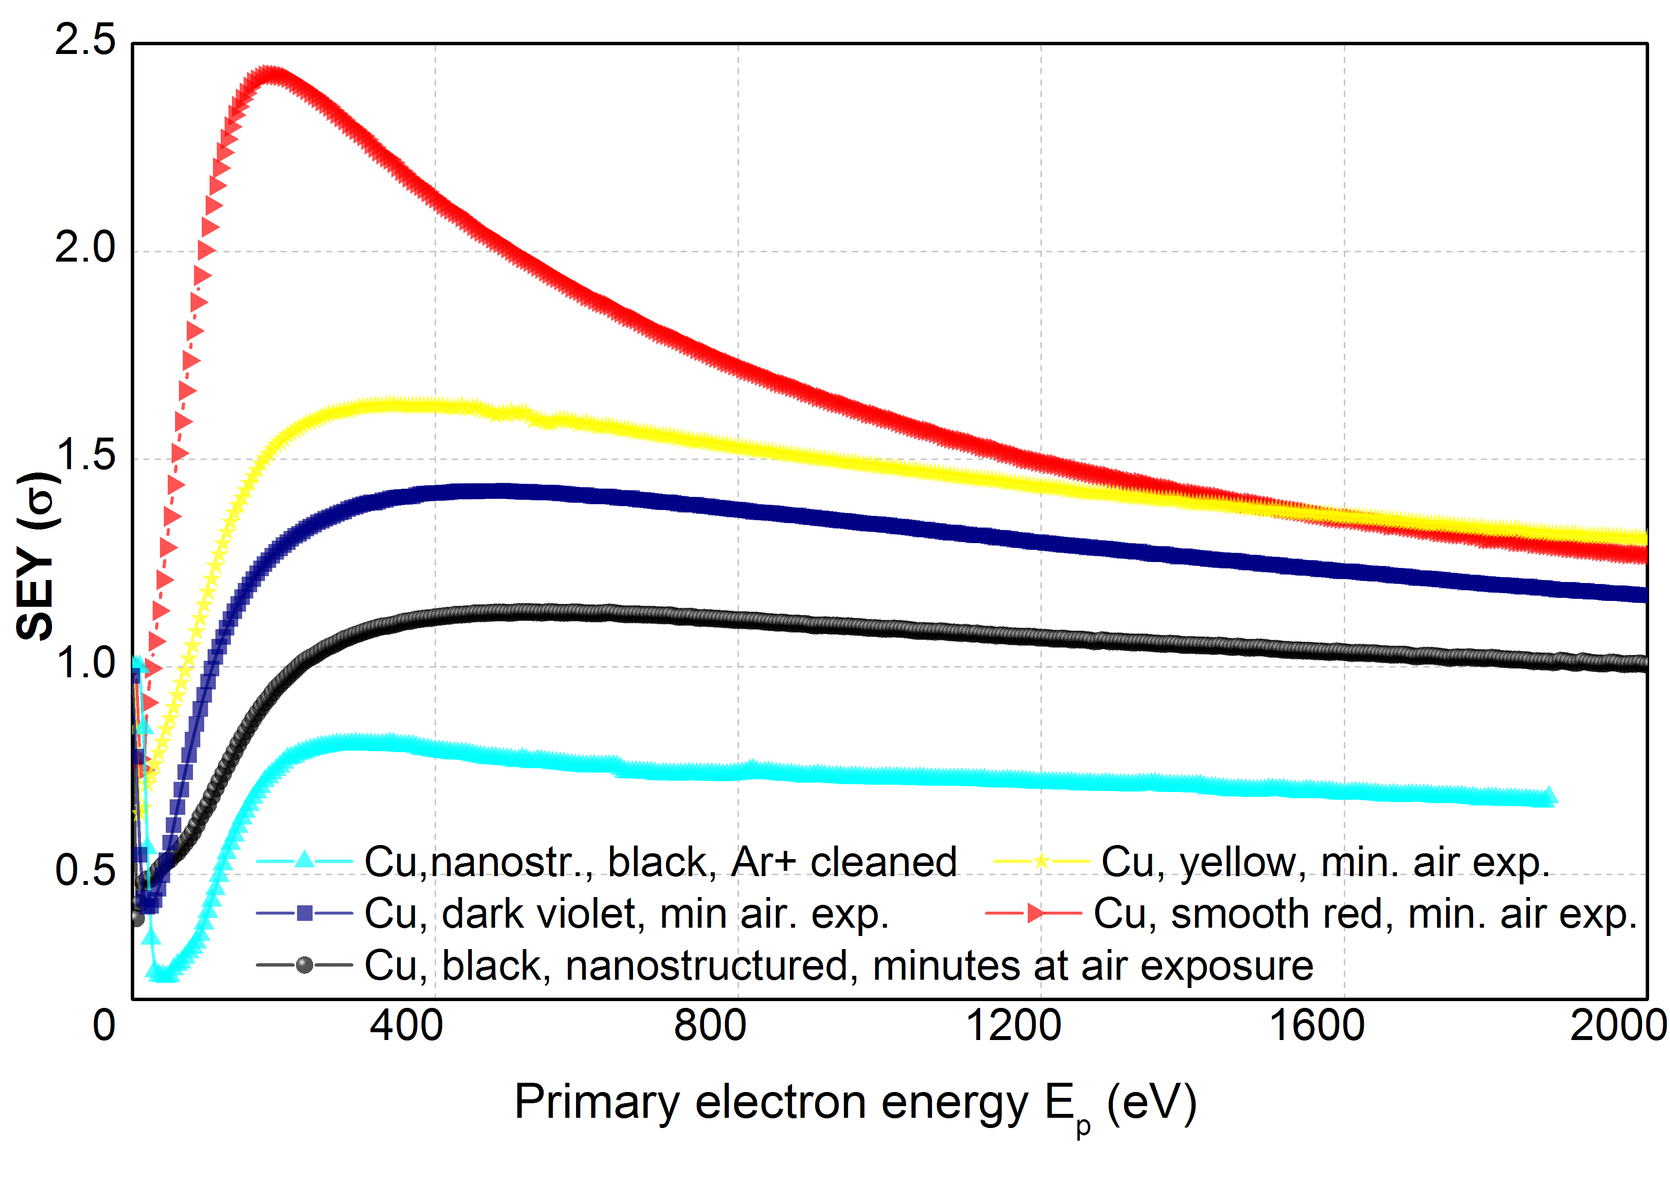
SEY AND MULTIPACTOR
Effect of SEY in Multipactor power level
Simulation results with MEST
multipactor power threshold increases 8 & 12 dB
by nanostructuring Cu surface

Slide 8
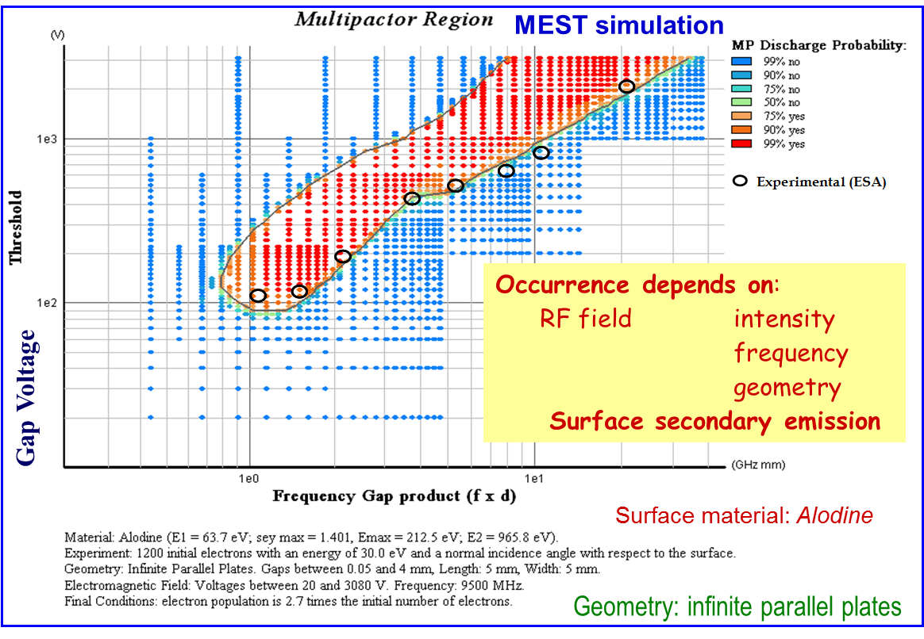
SEY AND MULTIPACTOR FOR ALODINE:
SIMULATION AND EXPERIMENT
Good agreement experiment-simulation

Slide 9
ANTIMULTIPACTOR COATINGS
Requirements for anti-multipactor coatings:
1) low SEY to avoid multipactor
2) low RF surface resistance to avoid insertion losses
3) inertness, stable under exposure to the air, slow aging
4) practical deposition techniques and surface treatments
5) good adhesion
(3) is critical in space applications because no in situ conditioning is possible
(1) and (2) are becoming more demanding

Slide 10
SEY REDUCTION
SEY can be reduced by:
Suitable surface material:
Best materials: do not deteriorate in air (aging)
aging increases SEY and decreases conductivity
have high conductivity
Good materials : Alodine, graphite, TiN, Au, Ag, …
Best a combined approach!
Suitable surface morphology:
high-density high-aspect-ratio pores or roughness
might increase surface RF resistance (skin effect)
however SEY reduction due only to shape of roughness
surface; RF resistance due to size and shape
it is possible to reduce resistance reducing the size

Slide 11
SKIN EFFECT: Why size of roughness has to be reduced?
RF currents are superficial, thus surfaces require good conductivity
Excess of roughness leads to increase of surface resistance
Numerical approximate results
Goal
Δ = rms roughness
Skin depth:
δ_{o}(Ag) = 0.58 μm
δ₁(Au) = 0.69 μm
f = 12 GHz
IL of Au-coated grooved Ag relative to flat Ag

Slide 12
ANTIMULTIPACTOR COATINGS
Reference anti-multipactor coatings for space applications. Multipactor
Approximate experimental reference data from ESTEC - ESA
Multipactor power level increase: 1.8 & 3.0 dB
Device bulk material
Electrolytic Ag plating
Chromate conversion coating
ECSS-E-20-01A

Slide 13
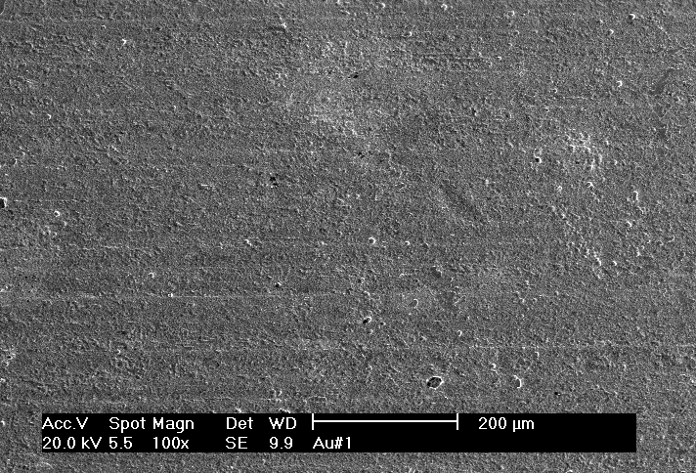
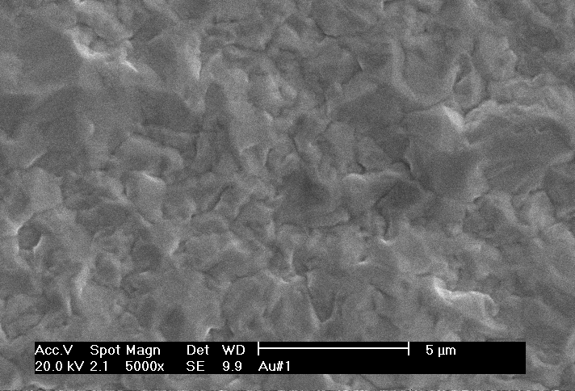
ANTIMULTIPACTOR COATINGS
Reference anti-multipactor coatings for space applications. Roughness
Electrolytic Au plating
Surface morphology
SEM

Slide 14
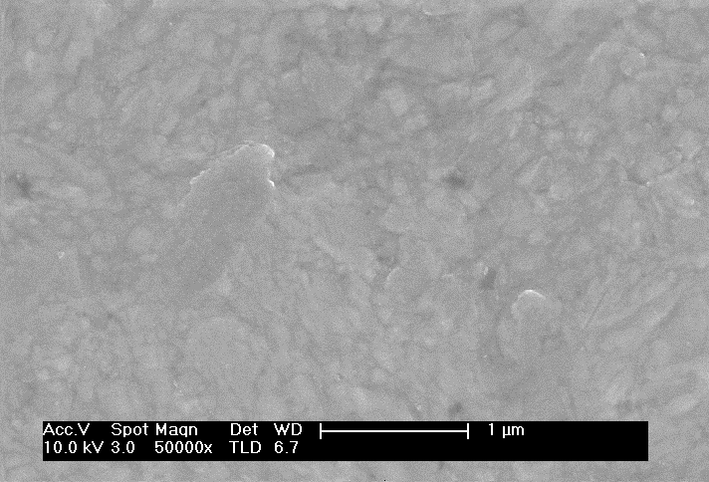
ANTIMULTIPACTOR COATINGS
Reference anti-multipactor coatings for space applications. Roughness
Electrolytic Ag plating
Surface morphology
SEM

Slide 15
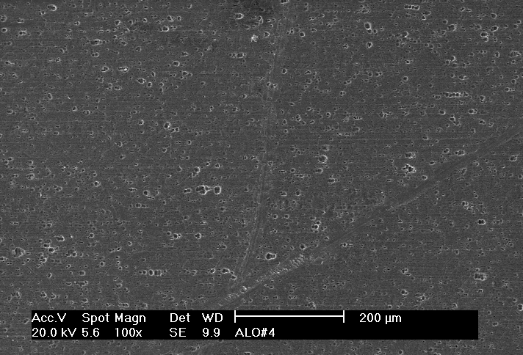
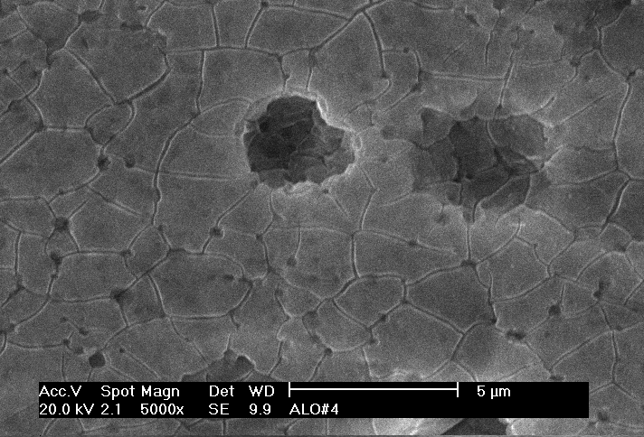
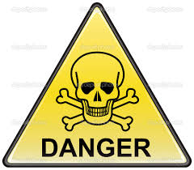
ANTIMULTIPACTOR COATINGS
Reference anti-multipactor coatings for space applications. Roughness
Alodine
Surface morphology
SEM
Composition:
Al oxides and hydroxides (~ 98 %)
Cr oxides and hydroxides (~ 1 %)
Compounds of Al, Cr, O, N, C, Cu,
Zn, Mn, Ca, Ti, Si
Cr ⁶⁺

Slide 16
INSERTION LOSSES
Reference anti-multipactor coatings for space applications. Insertion Loss
For a waveguide, insertion loss IL = 10·log(P_{thruout}/P_{in}) depends on geometry, frequency f, and surface resistance R_{surf} .
IL ∝ R_{surf}
Relative IL and RF surface resistance at 9.5 GHz
Silver 1
Gold 1.24
Alodine 3.8

Slide 17
AGING
Reference anti-multipactor coatings for space applications. Aging
Notes:
17

Slide 18
NEW COATINGS 1
Gold-coated chemically-etched Silver. Structure
Gold
Passivation, conductive
2 μm
Roughness
20 μm
Silver
Conductive
10 μm
Nickel (P)
Adherence
Aluminum alloy
device bulk
Notes:
18

Slide 19
NEW COATINGS 1
Gold-coated chemically-etched Silver. Structure
Gold
2 μm
Magnetron sputt.
Chemical etching
20 μm
Silver
Electroplating
10 μm
Nickel (P)
Electroplating
Aluminum alloy
device bulk
Notes:
19

Slide 20
NEW COATINGS 1
Gold-coated chemically-etched Silver. Structure
Gold
2 μm
20 μm
Silver
10 μm
Nickel (P)
Silver
Aluminum alloy
device bulk
Notes:
20

Slide 21
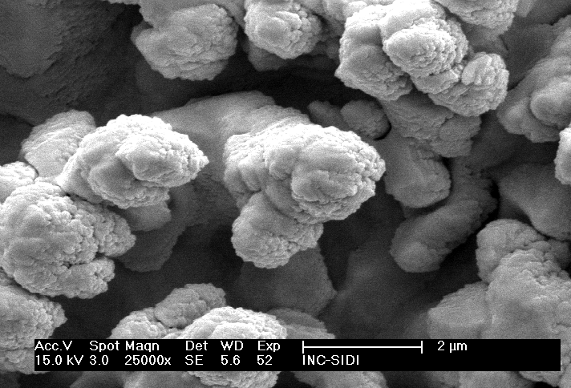
NEW COATINGS 1
Gold-coated chemically-etched Silver. Structure
Gold
2 μm
Gold
20 μm
Silver
10 μm
Nickel (P)
Aluminum alloy
device bulk
Notes:
21

Slide 22
NEW COATINGS 1
Gold-coated chemically-etched Silver. Multipactor and Insertion Loss
Power enhancement = 3.7 - 12.7 dB
Gold
2 μm
20 μm
Silver
10 μm
Nickel (P)
Aluminum alloy
device bulk
Insertion Loss enhancement factor = x 2.6 (12 GHz)
important drawback
Notes:
22

Slide 23
NEW COATINGS 1
Gold-coated chemically-etched Silver. Aging
Very good behaviour in air
Gold
2 μm
20 μm
Silver
10 μm
Nickel (P)
Aluminum alloy
device bulk
Important aging effect
Notes:
23

Slide 24
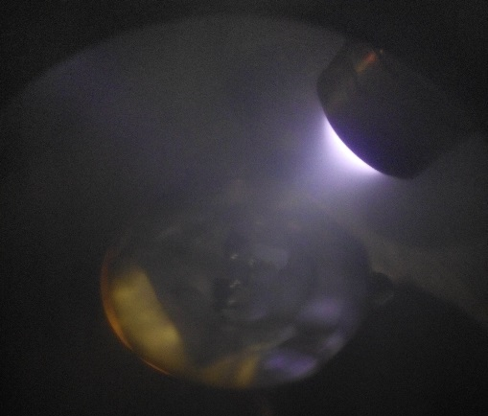
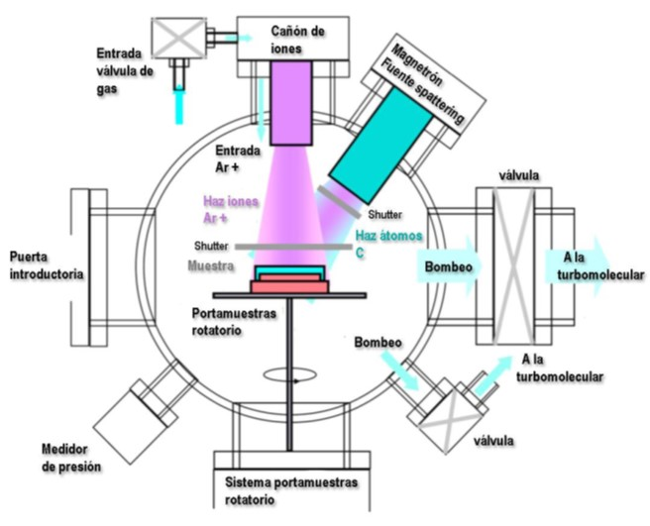
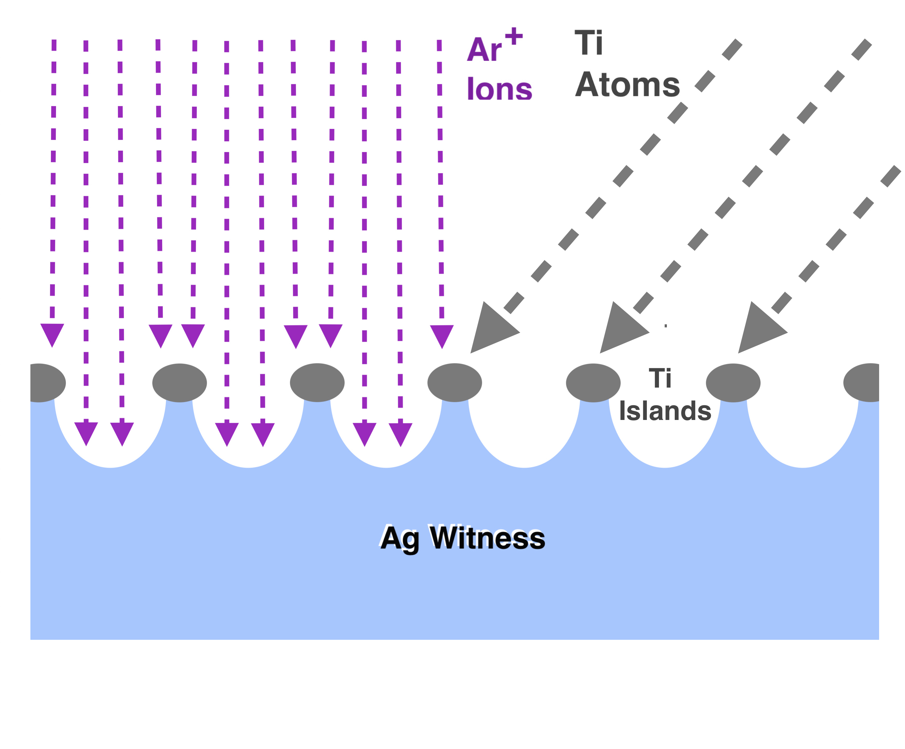
NEW COATINGS 2
Roughened Ag by Masking Double Ion Beam Sputtering. Experimental setup
Substrate: Ag (soft)
Masking material: Ti: (hard)
Notes:
24

Slide 25
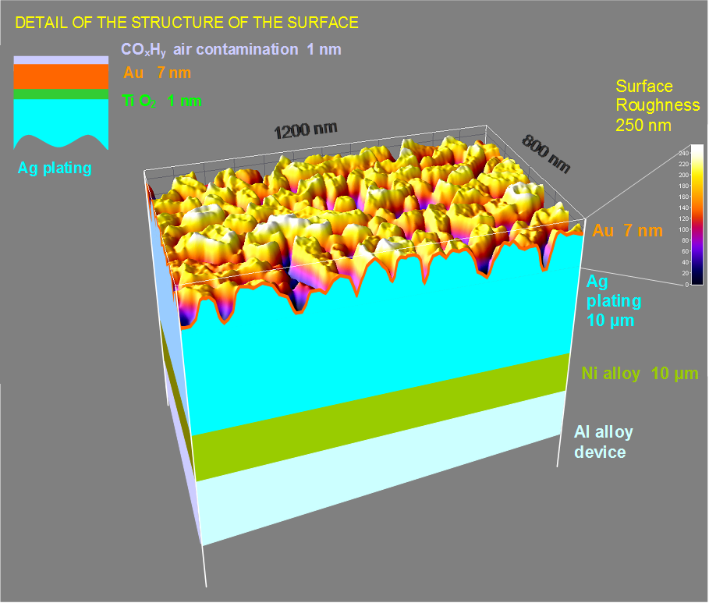
NEW COATINGS 2
Roughened Ag by Masking Double Ion Beam Sputtering. Structure
1st step:
Ag roughened by ion etching while Ti masking by magnetron deposition
2nd step:
Au magnetron deposition
while ion induced diffusion
Notes:
25

Slide 26
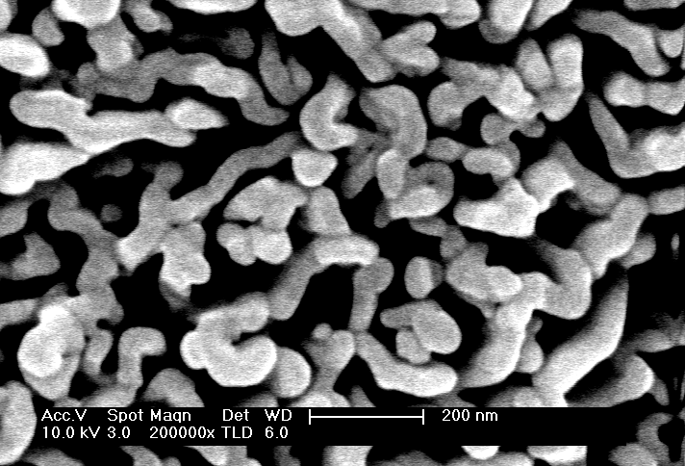
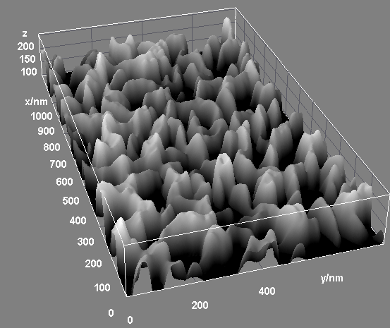
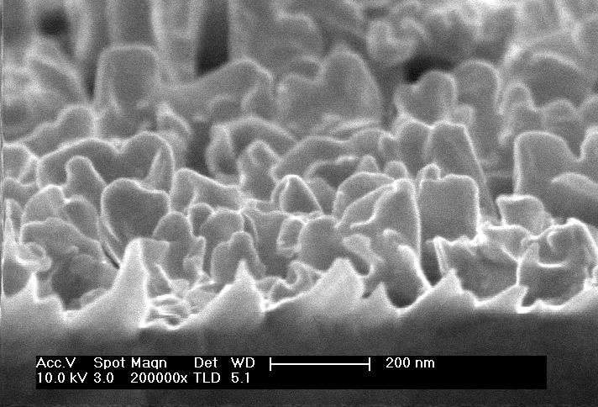
NEW COATINGS 2
Roughened Ag by Masking Double Ion Beam Sputtering. Structure
1st step:
Ag roughened by ion etching while Ti masking by magnetron deposition
2nd step:
Au magnetron deposition
while ion induced diffusion
Notes:
26

Slide 27
NEW COATINGS 2
Roughened Ag by Masking Double Ion Beam Sputtering. Properties
Reference Ag plated harmonic low-pass corrugated filter for 12 GHz
Multipactor power level enhancement = 7 dB: excellent, practical suppression
Insertion Loss enhancement = x 1.1: excellent, in the limit
Aging: apparently not so good
Multipactor power level ≈ 1/time (approx.)
The incorporation of Titanium in the coating and its progressive oxidation in atmosphere (aging) leads to increase both, SEY and surface resistance (insertion losses)
Notes:
27

Slide 28
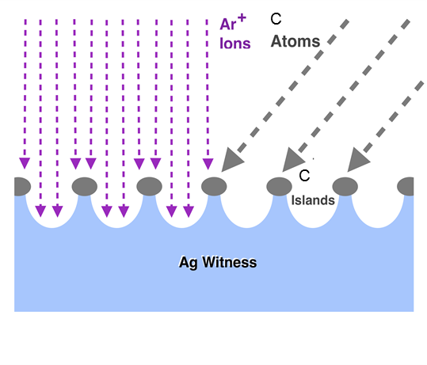
NEW COATINGS PROPOSED FOR M-ERA-Net
New rough Ag anti-multipactor coatings with no insertion loss and aging drawbacks
The method proposed is the same followed before but changing seeding with Carbon instead of Titanium

Slide 29
NEW COATINGS PROPOSED FOR M-ERA-Net
Several reasons exists to substitute Titanium by Carbon for improvement of the anti-multipactor coating:
Carbon is a hard material with very low sputtering coefficient
The intrinsic SEY of Carbon is very low (lower than for Au and Ag)
The electrical conductance of Carbon is acceptable
Carbon is inert material which does not oxidize easily in air, thus no fast aging is expected. Besides, passivation with gold could be avoided

Slide 30
NEW COATINGS PROPOSED FOR M-ERA-Net
The goal is to obtain the best growth parameters to obtain the roughness with the lowest SEY
The main growth parameters for the experimental setup:
Magnetron Power (P_{M}) wat
Ion voltage (V_{ion}) V
Ion intensity (I_{ion}) mA
Etching time (t) min
Gas inlet
Ion gun
Magnetron sputtering
Valve
pump
pump
Other geometrical parameters will be also tested: Ion etching incidence angle, distances to the sample, etc.
Valve
Rotable sample-holder

Slide 31
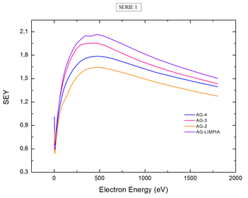
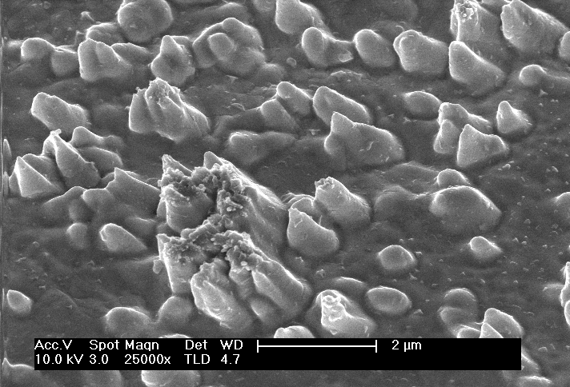
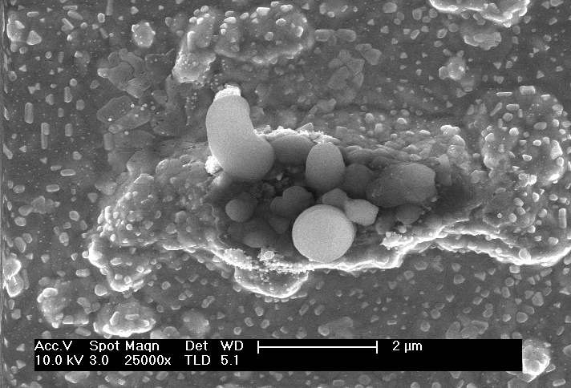
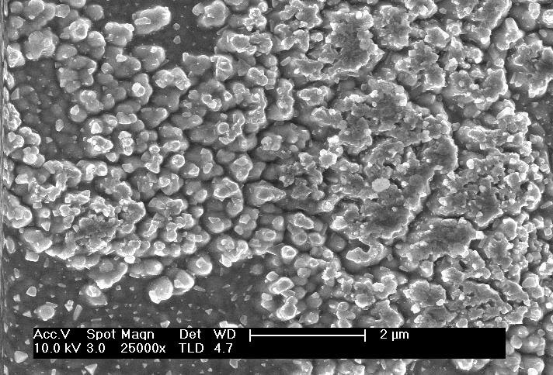
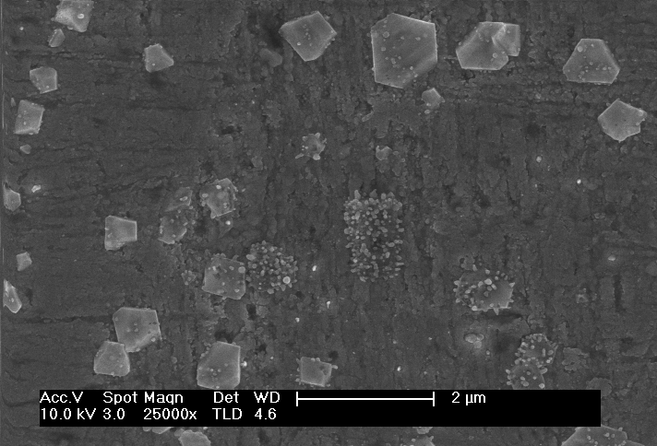
NEW COATINGS PROPOSED FOR M-ERA-Net
Preliminary results:
Lowest SEY

Slide 32
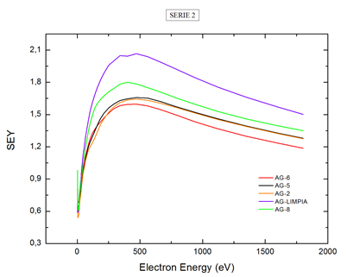
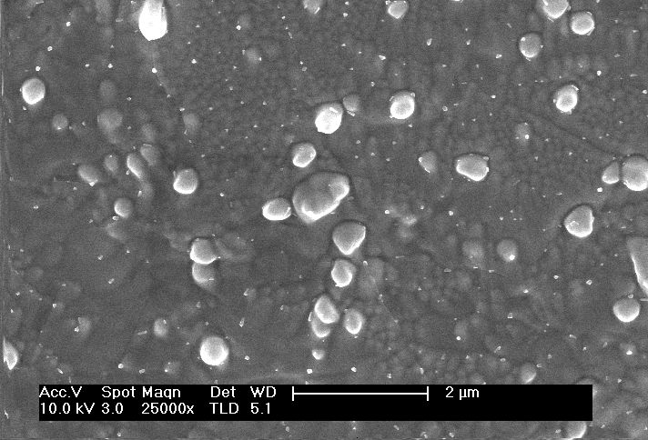
NEW COATINGS PROPOSED FOR M-ERA-Net
Preliminary results:
Lowest SEY

Slide 33
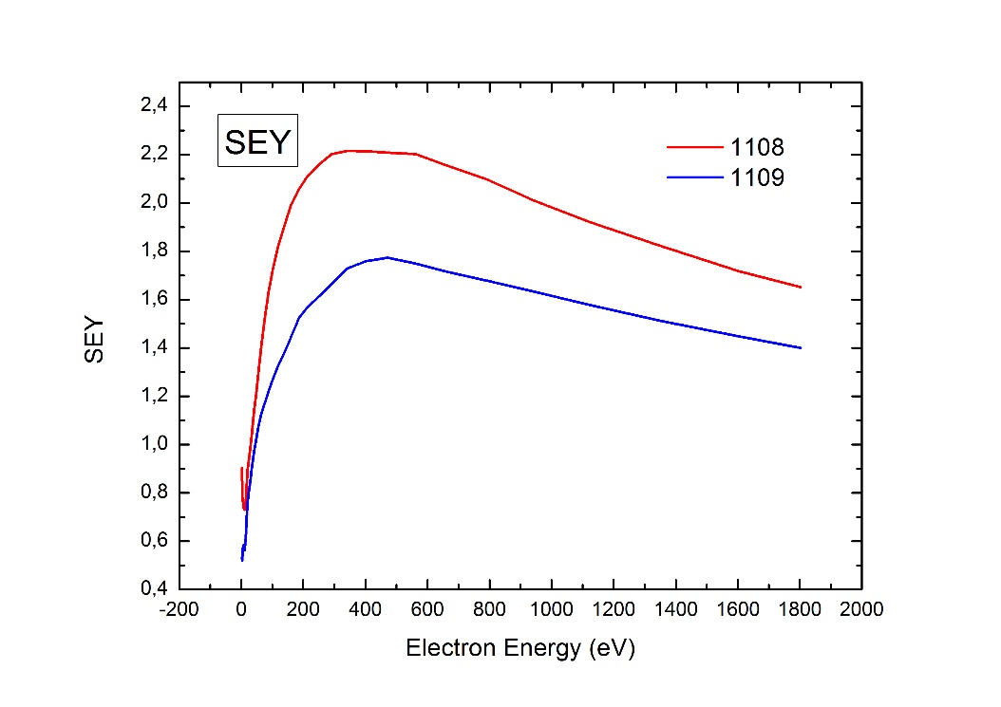
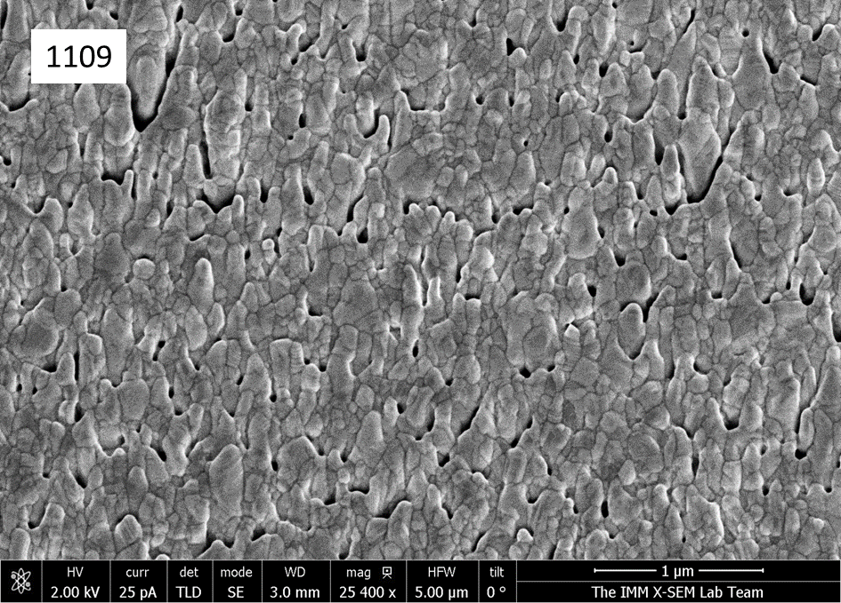
NEW COATINGS PROPOSED FOR M-ERA-Net
Coatings with Ag nano-columns
Growing by magnetron sputtering at grazing angles with respect the sample surface, ordered nano-columns can be obtained
1108

Slide 34
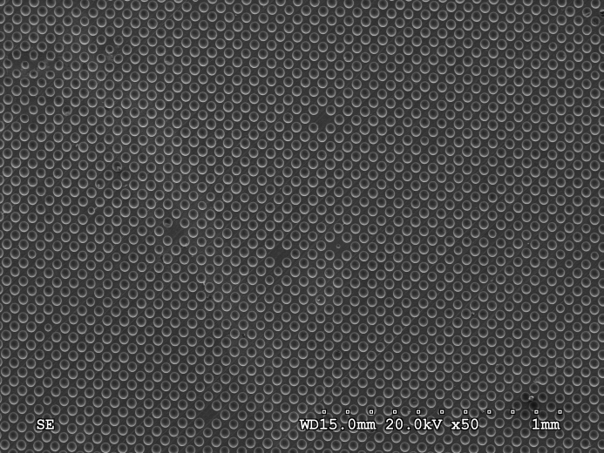
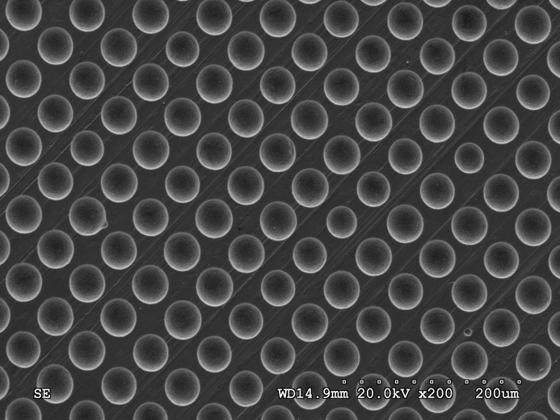
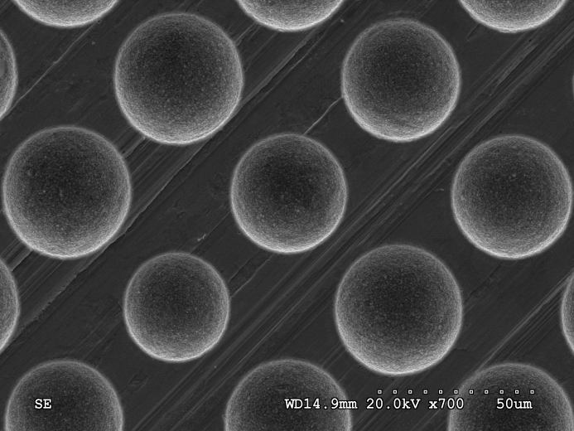
Empirical study of the effects on SEY of surface roughness using model surface geometries
The goal is to obtain model surfaces with controlled aspect ratio to study its influence on SEY
We have used Cu surfaces with pores made by laser lithography:

Slide 35
Empirical study of the effects on SEY of surface roughness using model surface geometries
We have also used Al surfaces mechanically drilled at different depths, i.e. different aspect ratios:
Diameter of the pores: 500µ

Slide 36
OTHER POSSIBLE STUDIES FOR THE MERA-Net
Study of the effect of Graphene on the anti-multipactor sufaces
Study of the effect magnetic nanoparticles on the anti-multipactor sufaces

Slide 37
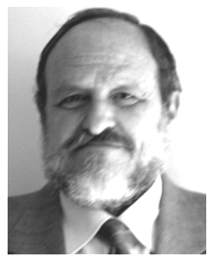

ACKNOWLEDGMENTS
GRIN-Space Group, UAM, Madrid, Spain
Luis Galán
^{Hononary Professor}
Gonzalo Troncoso
^{Undergraduated student}
Carlos Morales
^{PhD student}
Luis Antonio González
^{Post Doc.at CERN}
Valentín Nistor
^{Post Doc.at CERN}

Slide 38
THANK YOU VERY MUCH
FOR YOUR ATTENTION

