Slide 1
Proton Source and LEBT
Luigi Celona & Lorenzo Neri
on behalf the INFN-LNS ESS team
NCFE & Interfaces meeting, INFN-LNS, 17/01/2017

Slide 2
Summary
Schedule versions …
Status of commissioning
Status of the installation and source characterization related to:
Control System
Faraday Cup
Doppler shift measurement
Emittance measurement unit
Criticalities generated by delays and not planned activities
Second Source with minimal second LEBT

Slide 3
Schedule versions 1.0 , 2.0 , 3.0
1.0) In-kind contract
Installation of ICS and diagnostics
Commissioning of the Source and LEBT
RFI date
2.0) Official and not official requests of delay
Delays
Installation of ICS and diagnostics
Commissioning of the Source and LEBT
RFI date
3.0) The reality
Delays
Installation of ICS and diagnostics
Commissioning of the Source and LEBT
RFI date
Commissioning of the instrumentation
The full list of requirements can be satisfied in time for the RFI date? ➔ not all requirements!

Slide 4
Schedule versions
Activity | Schedule 1.0 (In-Kind Contract) | Schedule 2.0 (Paris July 2016) | Delivery | Today
ICS for ISRC | 26/02/2016 | 03/10/2016 | 03/10/2016 | 90%
ICS for LEBT | 26/02/2016 | 20/03/2017 | --- | 35%
Faraday Cup | 01/02/2016 | 03/10/2016 | 15/11/2016 | 100%
Doppler Shift Measurement | 15/03/2016 | 03/10/2016 | 21/10/2016 | 75%
Emittance Measurement Unit | 01/06/2016 | 02/11/2016 | 16/12/2016 | 50%
Notes:
ICS for ISRC delayed of 7 months
DSM delayed of more than 7 months
EMU delayed of more than 6 months
Commissioning of instrumentation is still to be completed thus reducing beam commissioning time

Slide 5
Status of commissioning
Activity | Ready for comm. | Start | End | Comm. done
Phase 1: IS with FC and DSM | 75% | 03/10/2016 | 31/10/2016 | 20%
Phase 2: phase 1 + EMU1 | 50% | 02/11/2016 | 17/03/2017 | 5%
Phase 3: phase 2 + Sol1 + EMU2 + NPM Permanent diagnostic tank |  | 20/03/2017 | 23/06/2017
Phase 4: Full LEBT |  | 26/06/2017 | 29/09/2017
Packaging and shipping |  | 02/10/2017 | 31/10/2017
Phase 3+4: Full LEBT |  | 20/03/2017 | 29/09/2017
Paris schedule 11/07/2017

Slide 6
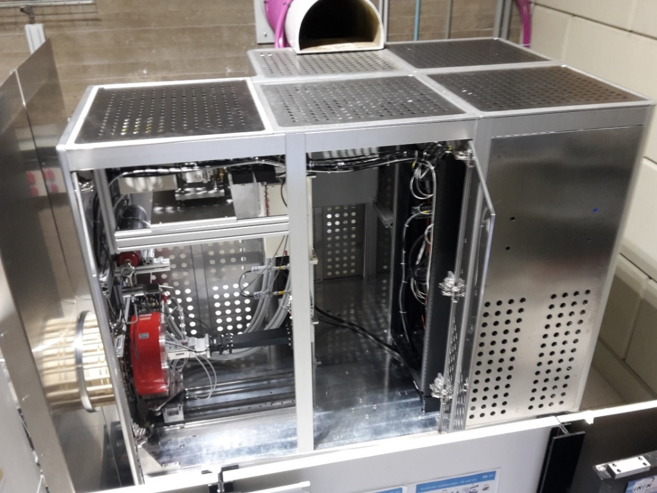
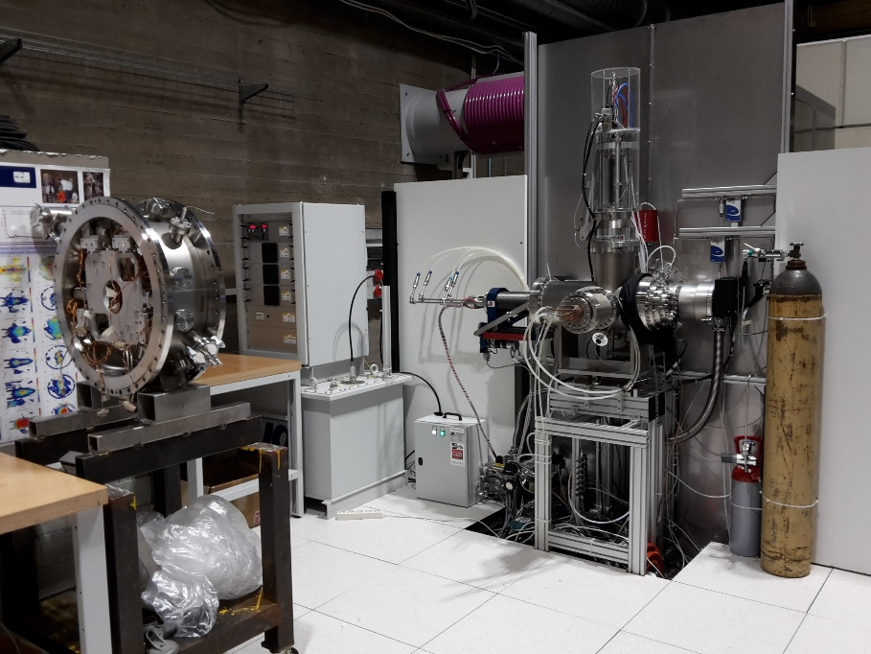
Status of the installation
LEBT is fully assembled and cabled for the beam commissioning phases 1 and 2
Source is fully assembled and cabled
We will be happy to show you more details during the visit

Slide 7
Control System
Done:
GUI 90% completed for phase 1 and 2
PLC security system is 100% working
Archiving system configured at 80%
Iris controls and GUI 100%
Robustness against source discharge was not excellent but no serious problems occurs
Open:
Archiving system need to be configured to acquire all information
Archiving system strategy to save memory occupancy need to be defined
All device are correctly interfaced except the repeller power supply of the Faraday Cup
Some data are missing on the interface
Minor bug fixing is required
Preparation for the next beam commissioning phase didn’t start
MPS is missing
We will be happy to answer to your questions during the visit

Slide 8
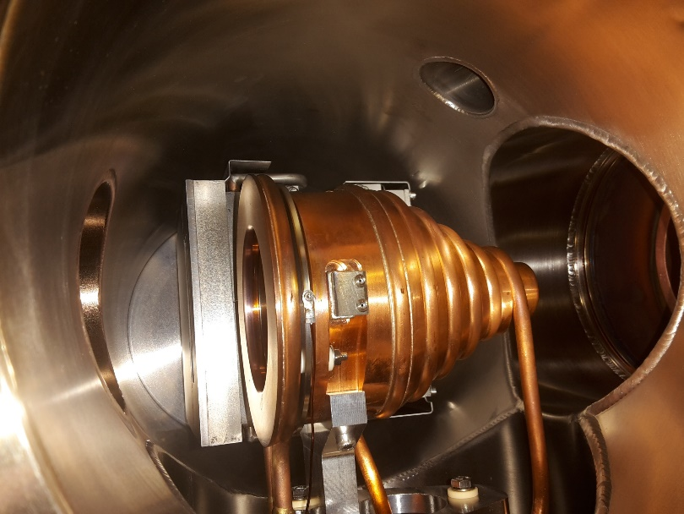
Faraday Cup
Done:
Installation 100%
Controls 100%
PLC 100%
Acquisition is integrated in GUI 100%
Data are stored in the archiving system but not optimized
Serious damages of the acquisition card due to source sparks was completed solved
beam
Open:
Archiving system need to be configured to save memory occupancy
Issues related to the control of repeller power supply need to be solved before phase 3
Ready for requirement verification?
OK

Slide 9
Extracted beam: 82.2 mA Pulse stability: ±1% (< ±2% ESS) Pulse repeatability: ±1.8% (< ±3.5% ESS)
6 ms microwave pulse
14 Hz repetition rate
10,000 consecutive pulses
12 minutes

Slide 10
Doppler shift measurement
Done:
Installation 100%
Controls at 75%
GUI 90%
Archiving of output data 80%
Optics check 75%
Open:
Synchronization with the flattop of the beam pulse is missing
Optical system need to be verified with real geometry and with real beam size
Ready for requirement verification?
Proton fraction comparison between different source configuration can be done (relative measurement)
Absolute measurement can not be done due to optical and time synchronization concerns and because the real radial distribution of the different species are not known

Slide 11
Proton Fraction: 78.3% (> 75% ESS) Proton Fraction: 87.3% (> 75% ESS)
Two different optical aperture of the lens between fiber optics and beam produced two different result with the same source configuration
new optics
old optics

Slide 12
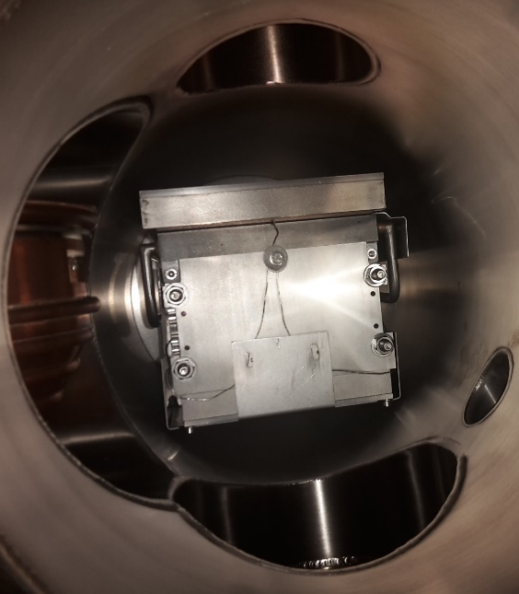
Emittance measurement unit
Done:
Installation 100%
Controls 80%
GUI 90%
Data extraction 75%
beam
Open:
Issues in the data acquisition generate a little distorted beam emittance shape
Issues in the measurement show distorted beam intensity
There are concerns about the alignment of the EMU (internally and externally)
Further test need to be carried out
Ready for requirement verification?
Enough to check the beam emittance area
Not enough to check beam alignment
Not enough to check beam distribution for end-to-end simulation

Slide 13
Beam emittance measurement

Slide 14
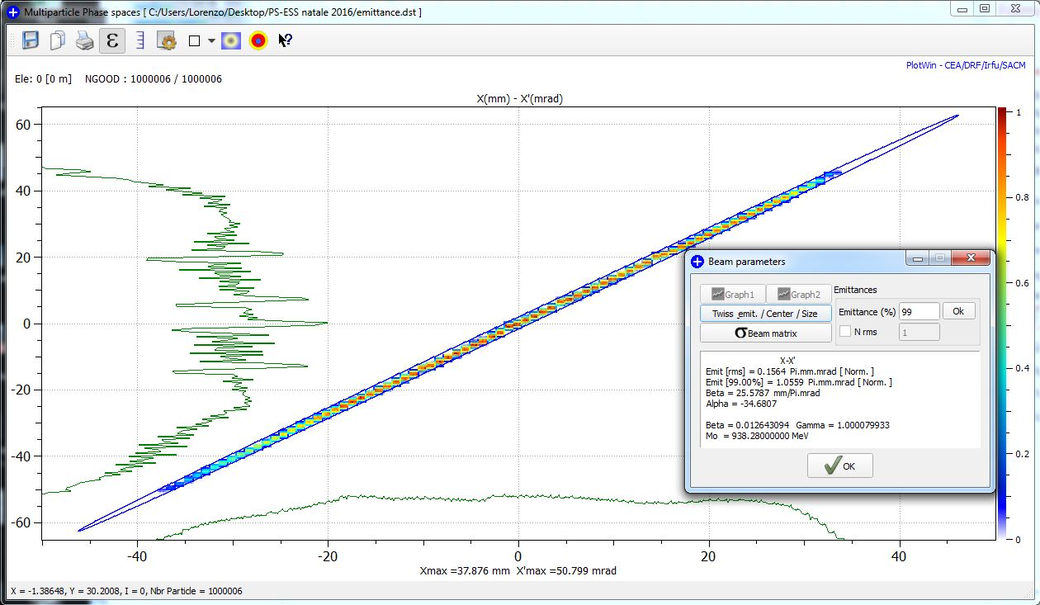
Emittance: 1.06 π.mm.mrad (< 1.8 ESS) Max divergence: 55 mrad (< 80 ESS)

Slide 15
Criticalities generated by delays and not planned activities
Requirements can be satisfied in time for the RFI date? ➔ not all requirements!
The studies done for the design of the source collect excellent confirmation since the beginning
Some beam instrumentation can be not ready in time for the verification requested during the source commissioning
Some software functionalities of the GUI can not be deployed in time to be used during the source commissioning
The source configuration that satisfy the requirement will be probably found in time but full characterization of the source, the reproducibility and the stability will not be fully verified
There is no time for fiducialization and the definition of the alignment strategy compliant with ESS installation

Slide 16
Second Source with minimal second LEBT
Installation of hardware, controls, vacuum and beam instrumentation will be probably subject to delay related to the reduced priority with respect Lund activities
Minimal LEBT is enough to complete the test on the source, but nothing can be done for the analysis of the beam transport issues in the Lund configuration

Slide 17
Activities needed for Lund installation under ESS responsibility
Realization and installation of the HV Cage layout for the source
Check of the LNS cabling scheme, preparation of Lund scheme, and cabling installation inside the tunnel area
The assembling of different macro-parts need some lifting equipment and other tools that need to be provided by ESS
RATS need to be provided as requested
Rack will be sent to Lund, conversion to ESS compliant racks will be carried out by ESS personnel after first source commissioning
Safety prescriptions for radiation issues in the tunnel has to be addressed for electronics, cables and personnel

Slide 18
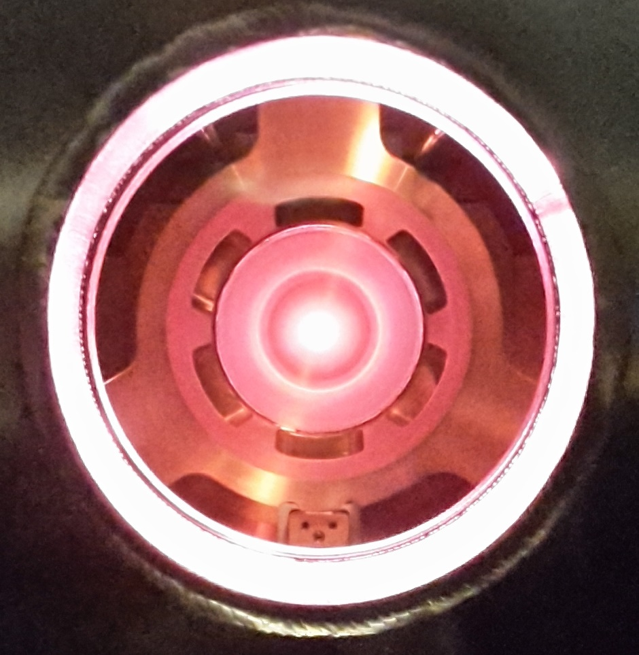
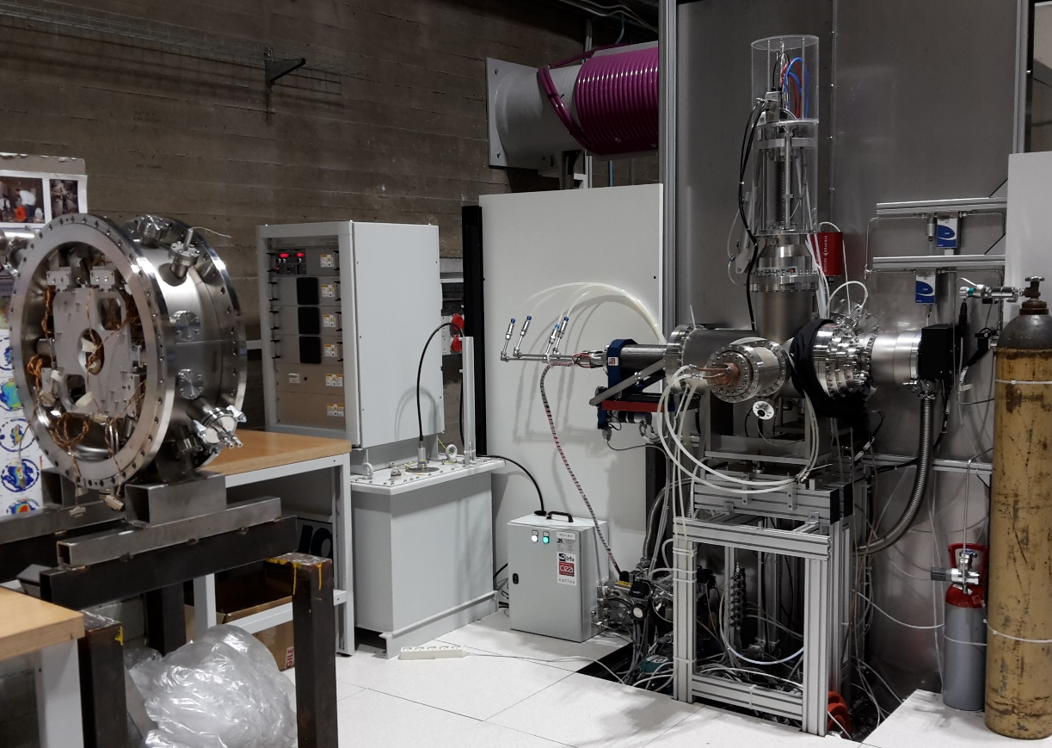
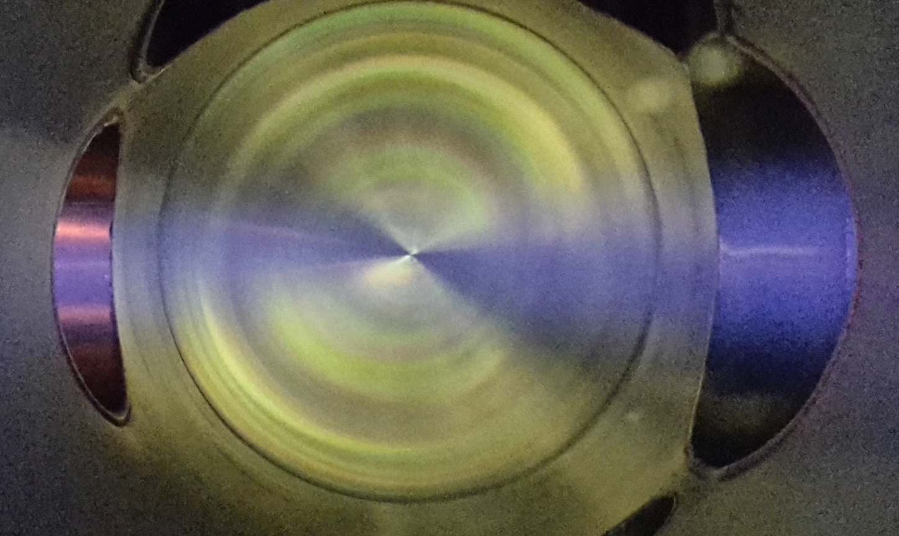
Thanks for your attention
and
Thanks to all INFN-LNS technical staff.

