Slide 1
Accelerator Division
Site Installation
Mats Lindroos, Peo Gustavsson and most from
Dr. Eng. Nick Gazis
Accelerator Installation Manager
on behalf of the AD installation team
www.europeanspallationsource.se
16 January 2017
(Catania, Italy)

Slide 2
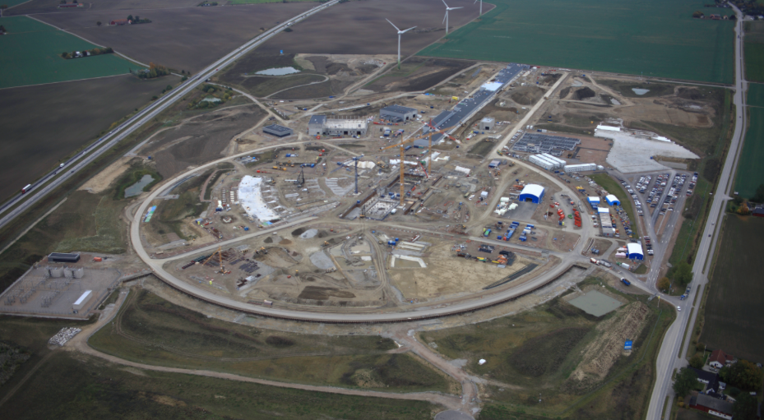
ESS construction

Slide 3
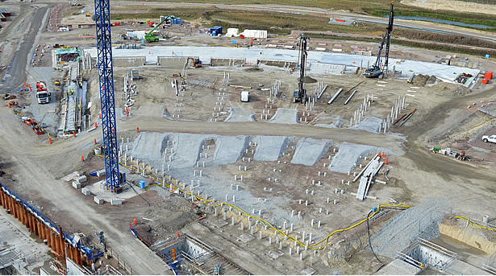
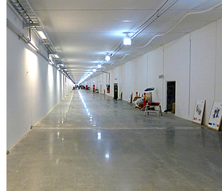
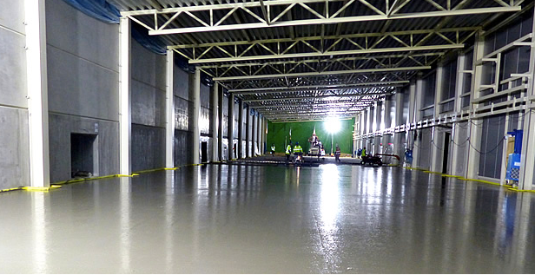
ESS construction

Slide 4
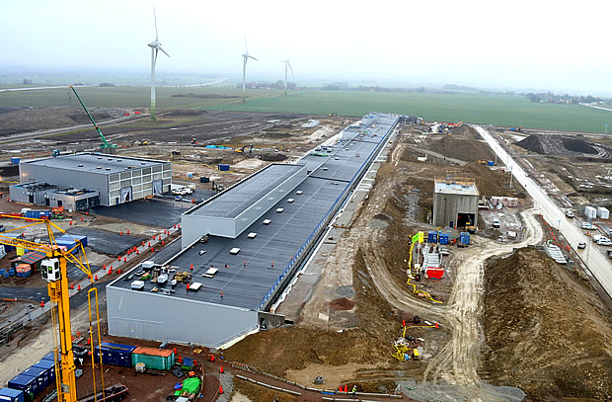
ESS construction

Slide 5
Acc Highlights
First Medium Beta SRF Cavity (CEA) tested and exceeds ESS specifications
Prototype LWU delivered to ESS (STFC)
First plasma in Ion Source (INFN - Catania)
First four elliptical cavity couplers conditioned at CEA
First spoke coupler conditioned by CNRS
First MB-IOT tube tested successfully
Site organization and installation planning continue
2017 budget planning near completion
Operations Cost review completed

Slide 6
Accelerator Project organization 2017
WP# | WP TITLE | WP LEADER | IN-KIND WP | DEPUTY WP LEADERs FOR EXTERNAL WPs | PCC
WP01 | MANAGEMENT | J.G. WEISEND II | NO |  | 110100001 110100002
WP02 | ACCELERATOR PHYSICS | M. ESHRAQI | NO |  | 110200001
WP03 | NORMAL CONDUCTING FRONT END | S. GAMMINO | YES | W. WITTMER | 110300001
WP04 | SPOKE CRYOMODULES | S. BOUSSON | YES | C. DARVE | 110400001
WP05 | ELLIPTICAL CRYOMODULES | P. BOSLAND | YES | C. DARVE | 110500001
WP06 | BEAM DELIVERY SYSTEMS | S. MØLLER | YES | I. ALONSO | 110600001
WP07 | BEAM DIAGNOSTICS | A. JANSSON | MIX |  | 110700001
WP08 | RF SYSTEMS | M. JENSEN | MIX |  | 110800001
WP99 | ACCEL INFRASTRUCTURE & INSTALLATION | D. MCGINNIS | NO |  | 119900001
WP10 | TEST STANDS | W. HEES | MIX |  | 111000001
WP11 | CRYOGENICS | P. ARNOLD | NO |  | 111100001
WP12 | VACUUM | M. JUNI-FERRERA | MIX |  | 111200001
WP13 | SAFETY | L. TCHELIDZE | NO |  | 111300001
WP14 | ACCELERATOR INTEGRATION | H. DANARED | NO |  | 111400001
WP15 | ELECTRICAL SUPPORT | F. JENSEN | NO |  | 111500001
WP16 | COOLING SUPPORT | A. LUNDMARK | NO |  | 111600001
WP17 | POWER CONVERTERS | C. MARTINS | MIX |  | 111700001
WP98 | GENERAL INSTALLATION SUPPORT | N. GAZIS | NO |  | 119800001
Liaison people:
Frank Hellström Fredrik Håkansson
Georg Hulla Felix Schlander
Nuno Elias Ebbe Malmstedt
Collaboration Board:
ESS Technical Director
Project leader
Representatives of all contracted institutes (one elected as chair)
Technical Board (quarterly):
Weekly ESS management team
All WP leaders and deputies
Representatives of all contracted institutes if not already a WP leader
Accelerator Project management team (weekly):
Mats Lindroos, Project leader
John Weisend, Deputy project leader and STS (WP 11,12,15,16)
Håkan Danared, In-kind manager and LINAC systems (WP 3,4,5,6,14)
Lali Tchelidze, Safety including radiation safety (WP13)
Anders Sunesson, RF systems (WP 8,17)
Andreas Jansson, Beams and operation (WP 2,7)
Lena Gunnarsson, Magnus Israelsson, Planners
Matthew Conlon, QA/QC
Peo Gustafsson, IK Manager
Nick Gazis, Installation Manager (WP 98)
N.B. Section leaders are part of the Project management and can be called to participate in the weekly meetings.

Slide 7
Installation work
Aim
AD Installation Roles
  Area Supervisors
  System Leaders
AD site organization & hierarchy
Available AD installation services & support
AD building access milestones &
example of general steps for the tunnel installation

Slide 8
Aim
Aim of these slides is to clarify the AD site organization for installation.
Roles, Responsibilities, Authorities and Accountabilities (R2A2)
of the presented installation titles are available under:
https://ess-ics.atlassian.net/wiki/display/AI/Role+List+for+Accelerator+Installation

Slide 9
Accelerator Division (AD)
– Site Organization
BAS-U framework
ESS management
Accelerator installation
Manager
Nick Gazis
deputy: Edgar Sargsyan
Area Supervisor Gallery (G02)
Marcus Green
AD and ESS central installation services
RATS
Hans Oster
Planning coordination
Edgar Sargsyan
QA/QC
Kent Wigren
Mechanical
Mechanical
Mechanical
Mechanical
Safety Team
Duy Phan
Area Supervisors
and ES&H
Electrical
Area Supervisor Tunnel (G01) and &
FEB (levels 090 & 100)
Dennis de Wit
Utilities
Area Supervisor Cryobuildings (G04)
Ila Sjoholm
Electrical
Utilities
Electrical
Utilities
Area Supervisor
Test stand
(in G02)
Wolfgang Hees
Electrical
Utilities
RF
other..
Indeed everyone is responsible for safety
el
System Leader 1
util
other..
mech
System Leader 2
AREAS
Other..
other
Task masters (Installation Support Team)
System Leader 3, 4..

Slide 10
Statement 1
Area Supervisors
BAS-U/P is the safety responsible person for planning and construction works in a dedicated area, according to the applicable Swedish legislation. The BAS-U/P defines and supervises the implementation of safety rules in the dedicated area.
In this framework, ESS ERIC has agreed to follow the BAS-U/P legislation and rules during all installation, testing and commissioning phases in the ESS site. Accordingly, the ESS AD assesses the safety responsibility following the (partial/full) access definition of its areas. ESS AD has appointed the Area Supervisors as BAS-U/P responsible persons for the accelerator installation, following the ESS ERIC mandate.
NOTE 1: Above mentioned statement is in full accordance with Skanska/C-101 Minor Works definition for on-site coordinated, documents on place, work instructions, BAS-U/P etc…
NOTE 2: AD has already Partial Access in part-of-G02 and G04 with Skanska/C-101 waiting for our (ESS) formal confirmation, to be provided right after this workshop in agreement with ES&H.
Roles, Responsibilities, Authorities and Accountabilities (R2A2)
of the presented installation titles are available under:
https://ess-ics.atlassian.net/wiki/display/AI/Role+List+for+Accelerator+Installation

Slide 11
Area Supervisor
(also BAS-U/P responsible person)
Role appointed by the ESS AD
Maintains the area responsibility on site (he is the Territorial Safety Officer)
Physically present on site during works
Safety responsible for the works/actions performed in his area
Safety responsible for the workers working in his area
Member of the safety team
Specific safety responsibilities e.g. fire safety responsible (hot works education etc. needed)
Generates Area Hazard Analyses (AHA)
included in the Work @ Safety Coordination Plan (WSCP)
Issues/revokes access to his area to all the concerned people
(installation teams, IKCs, contractors, etc.)

Slide 12
Statement 2
System Leaders
The Area Supervisors shall act as “hosts” of their areas with the System Leaders arriving (with their teams and equipment) to perform installation of their respective components of their Work Packages (WP). The Area Supervisor shall inform/implement/supervise all safety rules and regulations related to his area(s) and maintain up-to-date the Area Hazard Analysis (AHA) included in the Work and Safety Coordination Plan (WSCP) of his dedicated area. The Area Supervisor shall check all safety training and certification of all people working in his area. The Area Supervisor will make sure that the dates and timeslots of the Installation Planning (as defined by the deputy installation manager) are respected.
The System Leaders and their WPs are responsible to maintain the action schedule of the installation and comply to the Area Supervisors orders for safety and entering/evacuating the dedicated areas.
It is the System Leaders’ responsibility to educate/train his teams for all safety trainings needed in order to perform installation works. The safety trainings of the teams shall be funded by the WP.
The installation of the different Work Packages (WP) of AD shall be lead by the System Leaders, as appointed by each Work Package Leader. Appointed System Leaders are listed under:
https://ess-ics.atlassian.net/wiki/display/AI/AD+System+Leaders+for+installation
The System Leaders of the WP have to fill-up the Work and Safety Coordination Plan (WSCP) with help from the Area Supervisors prior to any installation work. Primary responsibility of the System Leader is to timely communicate to the Area Supervisors all WSCP documentation, related to the installation works of the System Leader’s WP. System Leader has to fund (via the relevant WP) all requests (for material/personnel/services or other) described and requested in his/hers WSCP.
ESS-0085649: Work and Safety Coordination Plan (WSCP)
https://chess.esss.lu.se/enovia/link/ESS-0085649/21308.51166.50432.55507/valid
Please contact Duy.Phan@esss.se for more details.

Slide 13
System Leader
Also following the BAS-U/P rules and regulations
Role appointed by the WP
Leads and manages the installation team of the relevant WP
Selects and defines techs and installation team members along with their actions
Plays the role of the technical expert on site
(can be physically on site) for the components of the relevant WP
Responsible for performing all on-time scheduled activities
Receives and signs (commissions) the deliveries for his/hers systems of responsibility
Generates Job Hazard Analyses (JHA)
Generates and owns the Work and Safety Coordination Plan
(with help from the Area Supervisors)

Slide 14
AD site organization: installation hierarchy with titles
ESS LINE MANAGEMENT
SITE MANAGEMENT
COST
ESS-wide Centralized Resources
Administration
Technical
SWOCOR
SAFETY
SCHEDULE
Accelerator Installation Coordinator
Installation Area Supervisor
Installation system/package leader
Technicians, Task Masters, IKC resources, Contracted resources, etc./

Slide 15
Installation Services available on-site from the AD Area Supervisors
AD will provide installation services and support on-site to facilitate the WP installations. These resources will be available from the AD Area Supervisors, following the WP’s requests as documented in the WSCP by the System Leaders (for each WP).
Logistics:
The System Leader(s) have to document in the WSCP all needs for logistics and transportation for the WP components. Consequently, establish contact with ESS Logistics (Jorgen.Larsson@esss.se and/or Jan.Lundin@esss.se) to organize the shipment of IKC components from the IKC facility to ESS Lund. All transportation and logistics of the WP shall be supervised/organized by ESS Logistics.
Alignment:
The System Leader(s) have to document in the WSCP all alignment needs for the WP components. Consequently, establish contact with ESS Survey and Alignment Group (Fabien.Rey@esss.se) to detail the realization of alignment process and steps.
Electrical installations:
The System Leader(s) have to establish contact with AD electrical group (Frithiof.Jensen@esss.se) for all electrical-related installation needs/support.
Controls:
The System Leader(s) have to establish contact with ICS (hector.novella@esss.se) for all controls-related installation support.
Installation support*:
The System Leader(s) have to document in the WSCP all all needs/support on technicians, manpower, services and tooling on-site during their installation. Consequently, establish contact with AD Installation team (Nick.Gazis@esss.se and/or Edgar.Sargsyan@esss.se) to detail planning of the installation support needed for each WP.
*Please, refer to next slide for details on the available installation support.

Slide 16
Installation Support available on-site from the AD Area Supervisors – (1/2)
AD will provide installation support on-site to facilitate the WP installations. These resources will be available from the AD Area Supervisors, following the WP’s requests as documented in the WSCP by the System Leaders (for each WP).
Installation teams (manpower):
The System Leader(s) have to document in the WSCP all needs for technicians and manpower for installation of the WP components. Following the WSCP instructions, the Area Supervisors will assign technicians and manpower directly under the command of the System Leaders, during the installation of the relevant WPs.
Installation teams (manpower):
The System Leader(s) have to document in the WSCP all design needs for 2D-drawings and installation maps for the WP components. Following the WSCP instructions, Design Integration workGroup (AD-DIG) will provide the relevant drawings, upon availability of the design engineers.
Electronics, tooling and consumables support:
The System Leader(s) have to document in the WSCP all needs for electronics, tooling and consumables (e.g. network analyzers, hand-tools, bolts & nuts, shims, temporary support frames, air-pads etc.). Basic electronics, tools and consumables will be available on-site, following the WSCP instructions. Please, verify their availability with the Area Supervisors. It is strongly advised to the WPs to organize and come individually with their needed electronics, tooling and consumables – keep in mind that no-workshop/no-electronics lab is available on-site (but it will be available in close proximity).

Slide 17
Installation Support available on-site from the AD Area Supervisors – (2/2)
Industrial machinery support:
The System Leader(s) have to document in the WSCP all needs for industrial machinery (pallet-jacks, lifting devices, truck-rents, scaffolding, etc.). Industrial machinery will be available on-site, following the WSCP instructions. Please, verify availability and use-process with the Area Supervisors. The WP can be requested to fund its specific requests via PCC code, after agreement with the Area Supervisors.
Industrial services support:
The System Leader(s) have to document in the WSCP all needs for industrial services support (storage, workshop, lay-down areas, etc.). ESS central services will be provided by the Area Supervisors (waste management, air supply, WiFi, electricity, storage, workshop, lay-down areas, etc.), following the WSCP instructions.
Shielding and sealing materials:
The System Leader(s) have to document in the WSCP all needs for shielding and sealing (fire or other) material. ESS-approved shielding and sealing materials will be provided by the Area Supervisors, following the WSCP instructions.
Training courses and certifications:
The System Leader(s) have to document in the WSCP all needs for training courses and certification related to installation. The WP have to comply to the certification requested by the Area Supervisors (according to the applicable Swedish legislation and ESS local rules). The WP will fund their training courses, according to their installation needs.

Slide 18
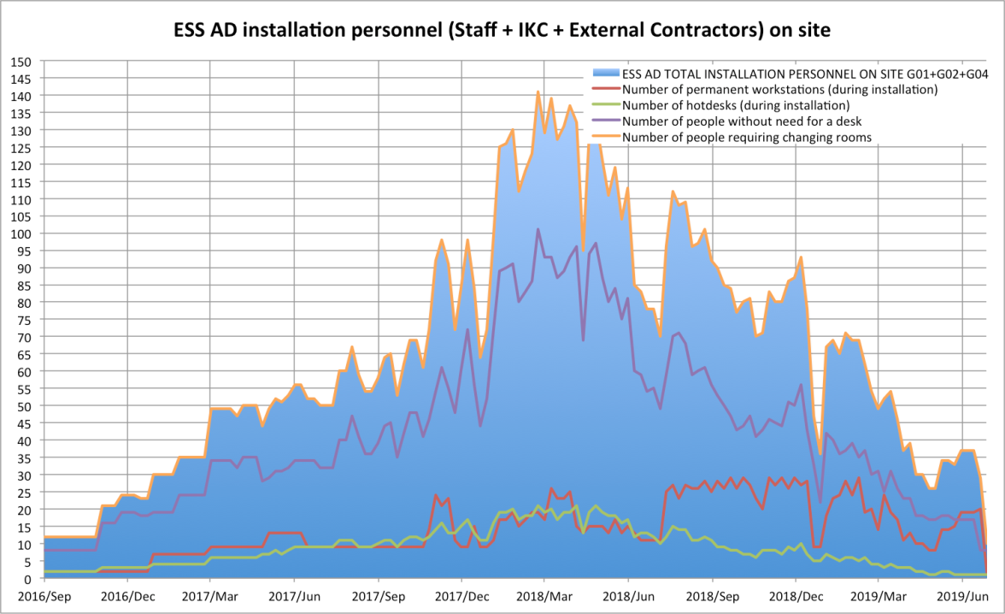
Accelerator Division (AD)
– Building access milestones
AD installation plan ESS-0055889
02-May-2017 Full Access to G01 Linac Tunnel and FEB level 090
27-Feb-2017 Partial Access to G02 Gallery Technical Area
01-Sep-2017 Partial Access to first part of G02 Gallery (FEB level 100) with 4 first stubs
23-Oct-2017 Partial Access to following part of G02 Gallery with the following 6 stubs
01-Jan-2018 Partial Access to following part of G02 Gallery with the following 11 stubs
31 Mar. 2018 Full Access to entire G02
AD preliminary site-office needs
(changing rooms included accordingly)
Starting in January 2017:
21 accelerator staff are gradualy moving on-site and 17 more hotdesks are reserved for installation people needs
Draft –in progress

Slide 19
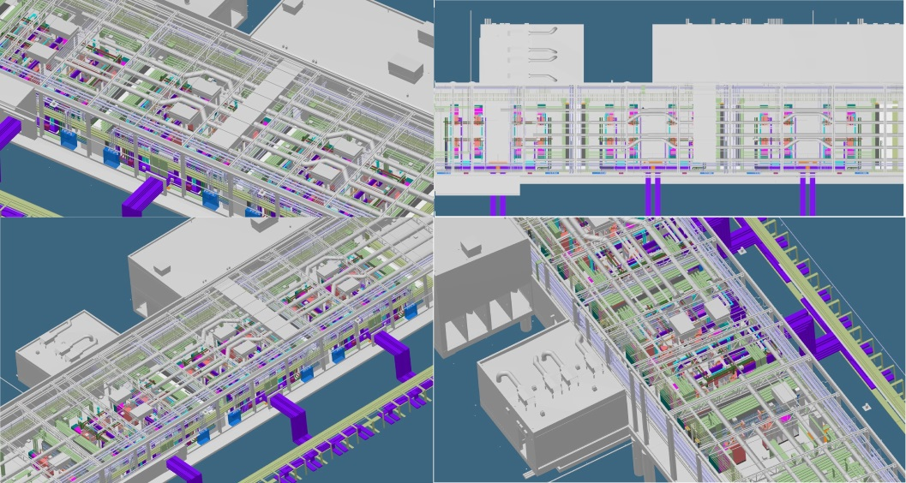
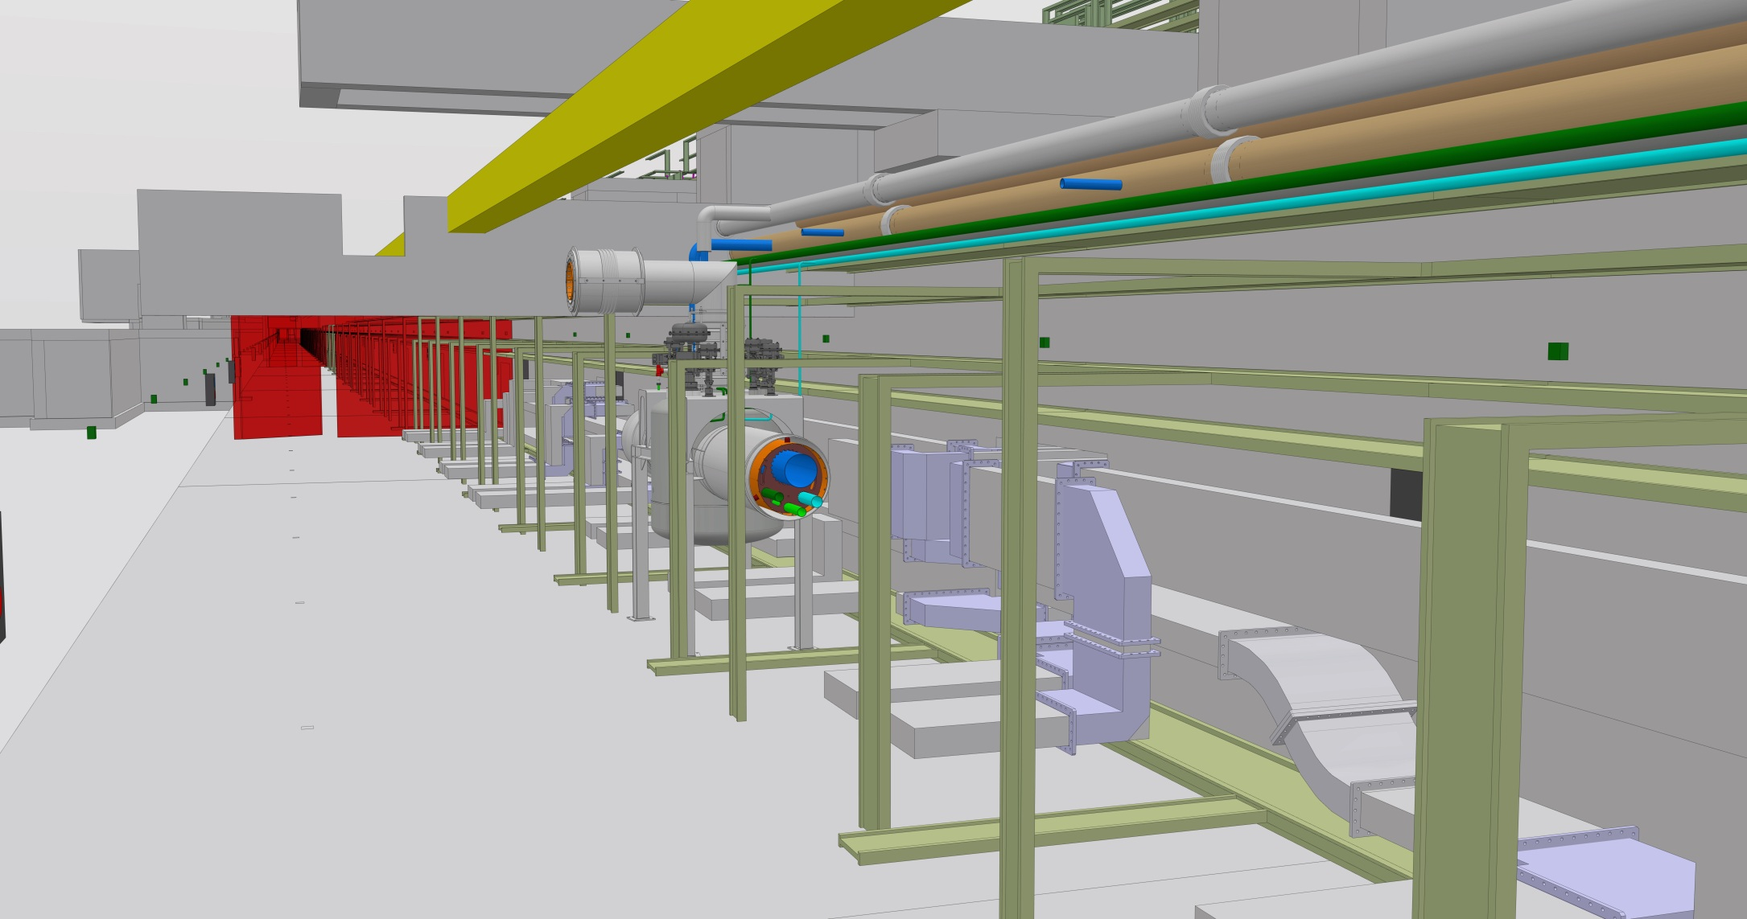
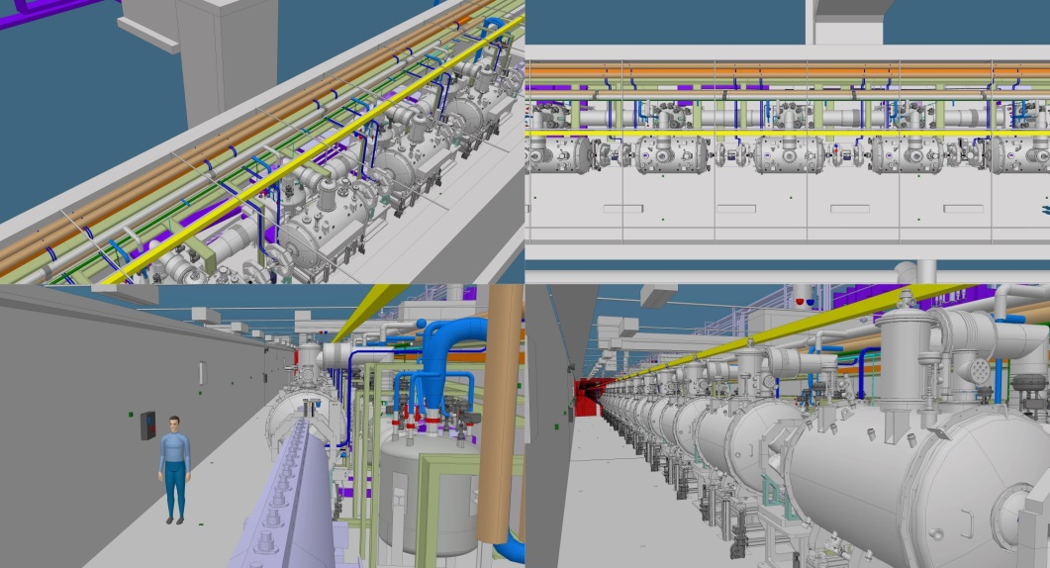
Example:
General steps of tunnel installation
Current tunnel installation sequence:
Marking
Hole Drilling
Water-cooling pipes installation (inclduing dedicated supports)
Cable trays and grounding bus bar installation (inclduing dedicated supports)
Phase Reference Line (PRL) installation
Stubs (trays, waveguides, cables) installation
NCL and CDS
CryoModules (CMs) and LWUs.
High level of complexity is evident so efficient coordination is explicit!

Slide 20
Last slide
Status in a nutshell
Current plan for the ESS accelerator installation foresees 30 consequent months of installation
(started in Jan-2017).
Currently the AD installation team utilizes the AD Test Stand safety procedures according to the “best practice” rule

Slide 21
FC facilitations of Installations
Introduction;
The intention with the presentation is to outline the main principles to set the FC on track to;
  Facilitate the partners description of the installation work, to be documented I in a report. (all interaction)
  Align the expectations in between all involved parties with the objective to be prepared for all eventualities
  Define all needed tools and equipment (expectations on ESS and what to bring)
  Identify potential areas of uncertainties or need for further agreement and descriptions (open issues)
  To prepare partners for delivery and installation of equipment at the ESS
  Prepare for information transfer to Assembly crews
  Define and evaluate need for installation documentation details (assembly drawings, reports, etc are ready).
  Define and Check that partner-partner information is consistent for interfaces and installation.
  Define and document Logistics, Legal, Interfaces, Safety, Manpower and accessories (tools, special requirements,…).

Slide 22
Installations-Commisioning
Installation Strategy and planning (time schedule) - authority
ESS Lund is the main driver and responsible for the over all installation and Commissioning stratgey and imp.
ESS lund will describe and outline the main principels for how the work will be organized
The partner follow given instructions and priorities
The prtaner will be given timeslots for its exequition of installation and comissioning
ESS Lund have an overall installation coordination serving all subproject eg. ACC
ACC have its own installation organization and resources to mange the work
The main roles
  Acc Installation manger
  Insytallation planing manger (time and sequence
  Area coordinator (eg. Tunnel and gallery)
  WP coordinators (specific equipment)
Support functions
  RATS manger
  Resources
  Tools
  Logistics/transportations
ESS lund have specific TRN req and there will be a specific TRN program for all personell entering the site
One of the main objective with the over all installation startegy and plan, is to be abel to depict the work to all involved includinmg SSM (Swedens regulator)
The partner shall be aware thet there is local variations beween the IK – Partners, this is described in the TA
ESS
Partner
Installation Crew (ESS or partner or external)

Slide 23
FC facilitations of Installations
  ESS describe th etop level execution (S&P)
  The IK partener based on TA and descrpition above prepare and depict the intention
  ESS and IK partener agrees and formalise the setup
  All work is done with in the WP structure and the FC facilitae and support including promt the work to describe the execution of Installation and commissioning
ESS to Partner #2
ESS to Partner #1 description
(TA, processes, training, tools, safety, logistics , alignment…)
IK-P (equipment specifics, assembly drawings & processes, instructions, testing, verification during installation, resources & manpower planning, sequence and procedures, tools, requirements that ESS must provide, logistics, interfaces )..
Partner can use external contractors (or ESS provided )
IK- inst supp team (resource teams with specific installation and test tasks)

Slide 24
Installations
Misc. to be evaluated and agreed and prepared by ESS and communicated to the IK P:
Work order and release system
Delimitations and tag outs in support of
  Installation
  Commissioning
Boundaries, hand over between installation to commissioning
  Open issues (How to document)
  Criteria's (for acceptance and when to be closed)
  How to document (formal protocols)
Implementation Plan (high level document for the installation) – Installation and commissioning. Associated to SSM – Swedish Regulatory Authority.
Commissioning Plans – Test program and test procedures/ component/system/ group of systems/plant /plant operational modes
Etc etc etc…………………

Slide 25
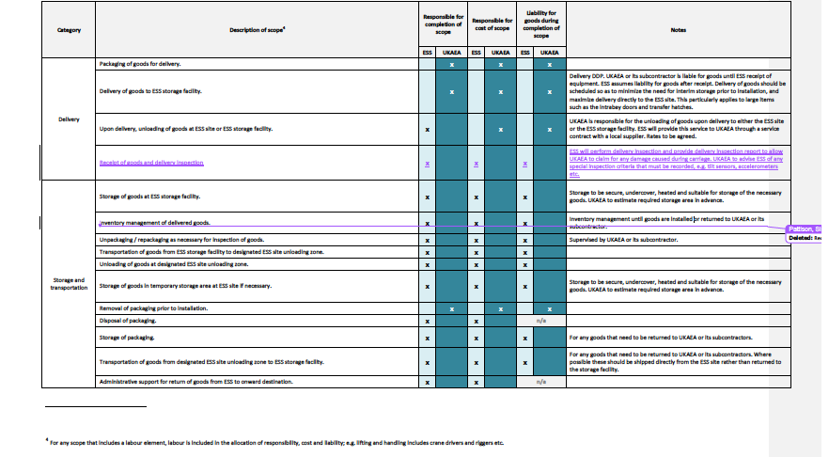
Responsibility matrix (example)

Slide 26
TA Introduction, facts & figures
The work to develop the TA has progressed more or less as expected
at IKRC 10, the target was set to present 10 TA at IKRC 11
TA presented at IKRC 4 All 4 was endorsed (se separate list)
TA Ready UK 2 (LWU and High Beta cavities manu)
TA endorsed offline 2 (Cryo dist line and test stand)
Collab. Agree. developed 2 (Lund, Grid and Aperture Monitors electronics & Aarhus, WS act)
Tot TA 49 (more TA TBD ?)
TA assigned to a partner 41
TA signed 24
Potential IK open 7 (IK to procurement contracts)
IKRC 12 10 (all remaining)

Slide 28
---
Questions

Slide 29
AD installation sequence
SPARE SLIDE
Slide courtesy of Eugene Tanke
Water pipes
Top cable trays
Cryo distribution line
Cryo valve box
Cryo valve box line
Distribution cable trays
Critical Point:
Planning might be compromised,
if the installation sequence is perturbed.
Mitigation:
Maintain the full access dates as agreed
Definition and simulations (3d model) of the installation sequence
Availability of Task Masters and other installation services
Coherent archiving of installation documentation on a central ESS level
Goal:
Ensuring the installation sequence and plan
Bottom cable trays

Slide 30
Accelerator Division (AD)
– Indicative tunnel installation
SPARE SLIDE
Slide courtesy of Eugene Tanke
Phases related to Installation, Testing and Commissioning (ITC) have been defined in ESS-0025640*:
  ITC Phase A: Installation
  ITC Phase B: Local testing without beam and without ICS
  ITC Phase C1: Local testing without beam, with ICS
    Local test including controls, e.g. controlling a power supply
  ITC Phase C2: Integrated testing without beam, with ICS
    End to end test including controls, e.g. controlling a power supply, concomitant magnet, water cooling, interlocks etc
  ITC Phase D1: Testing diagnostics with beam
    Will typically make use of a “probe” beam
  ITC Phase D2: Beam commissioning
    Goal during this phase is to prepare and deliver the required beam

Slide 31
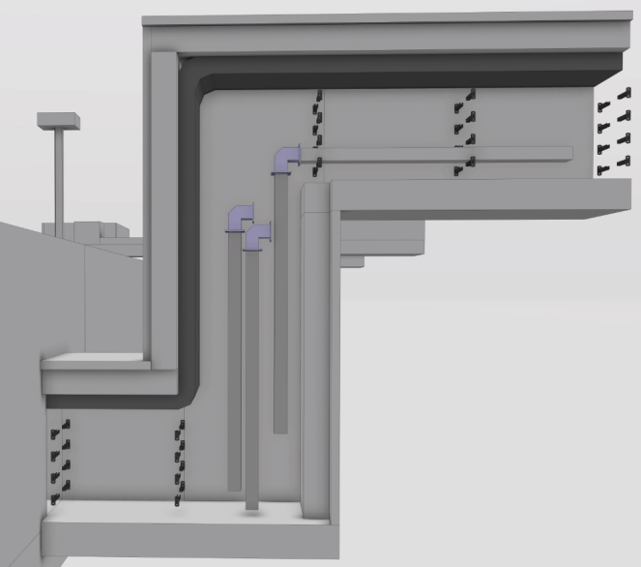
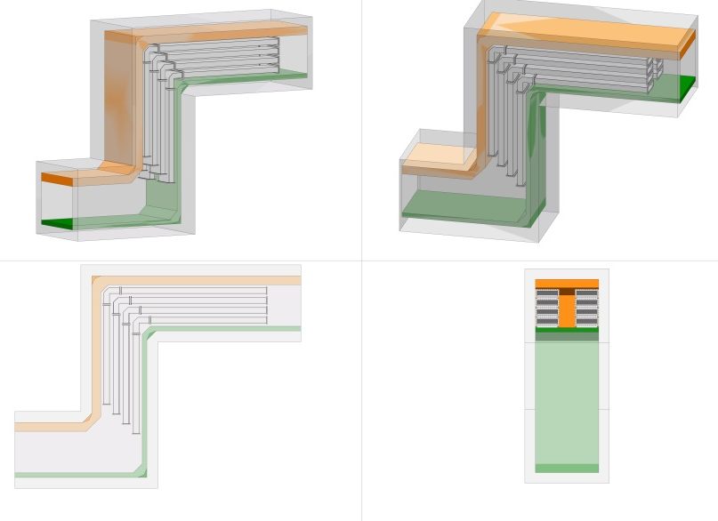
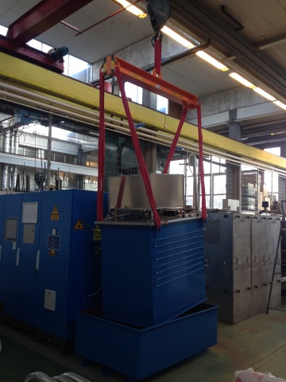
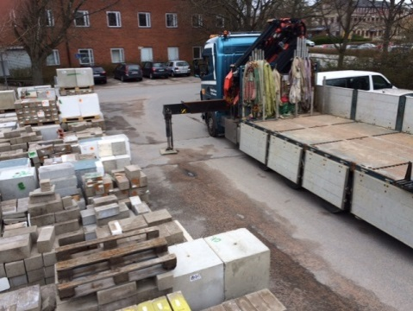
Accelerator Division (AD)
– First Installation Tests
SPARE SLIDE
Already done:
Integration Test Stand:
Logistics tests
(March-May 2016)
Integration Test Stand:
specialized transportation (Ampegon_PPT modulator)
Integration Test Stand:
Testing and generating the first ESS safety procedures and relevant documentation
(JHA, etc.) https://ess-ics.atlassian.net/wiki/pages/viewpage.action?pageId=120193968
Next steps:
First stub test installation
(preliminarily Nov.2016)
Hole drilling tests in the tunnel (2017)
Etc.

