Slide 1
GIF++ 2016
Ezio Torassa
(INFN Padova)
TOP Italy meeting November 29th 2016

Slide 2
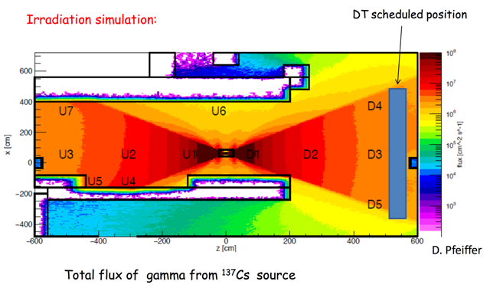
Belle II GIF++ test August 2015
Lens/Fiber Distance Rad measured Rad estimation
source - fiber from 26/8 to 1/9 from 26/8 to 1/9
Position 1 1.5 m 1.75 Gray
Position 2 3.2 m 0.53 Gray
Position 3 5.8 m 0.12 Gray 0.12 Gray

Slide 3
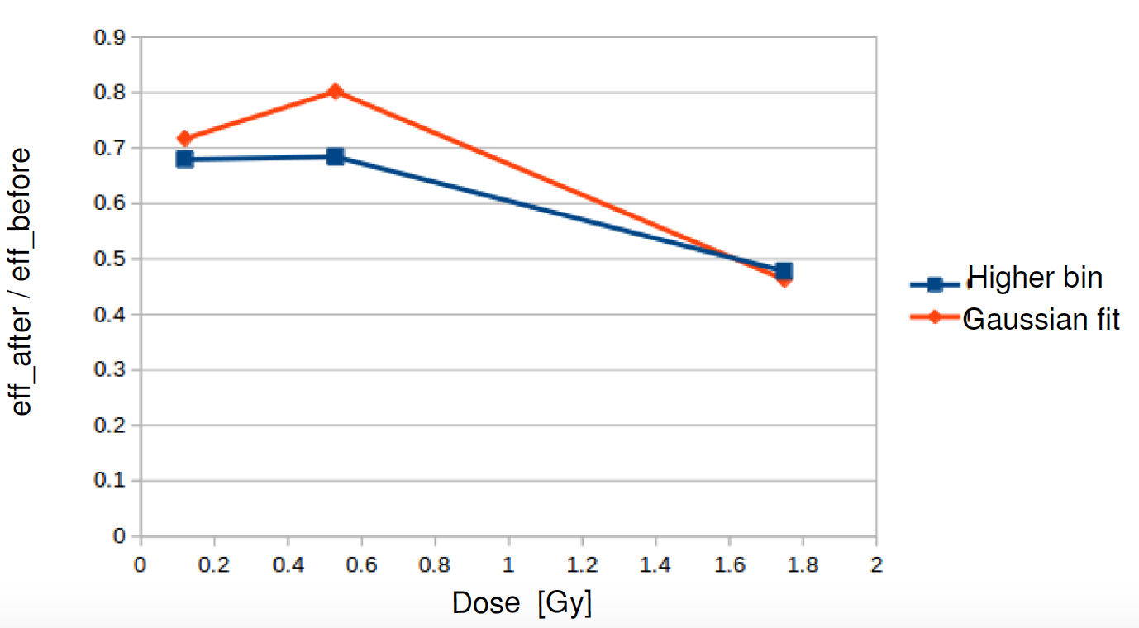
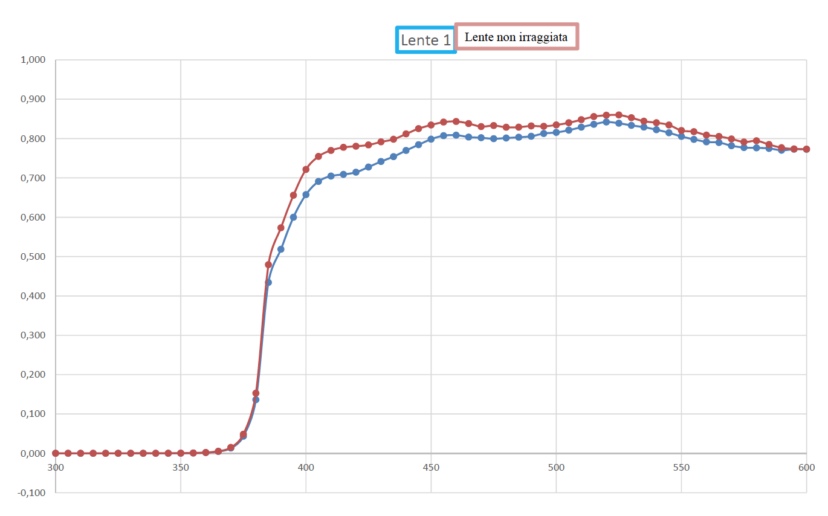
Belle II GIF++ test August 2015
Fiber transparency
Attenuation @1.8 Gray: 28%
Lens transparency
Attenuation @ 400 nm and 1.8 Gray: 7%
Lens producer:
Attenuation @ 400 nm and 10 Gray: 17%
Wavelength (nm)

Slide 4
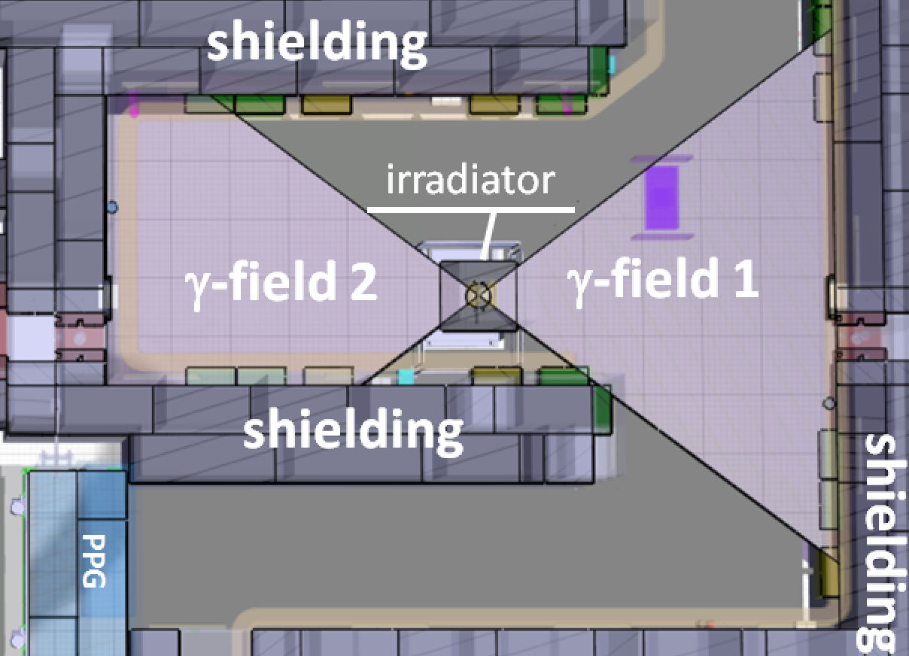
Belle II GIF++ test November 2016
X
Z distance:
1: 0.46 m
2: 2.15 m
3: 3.05 m
4: 5.25 m
2
4
1
3
Z

Slide 5
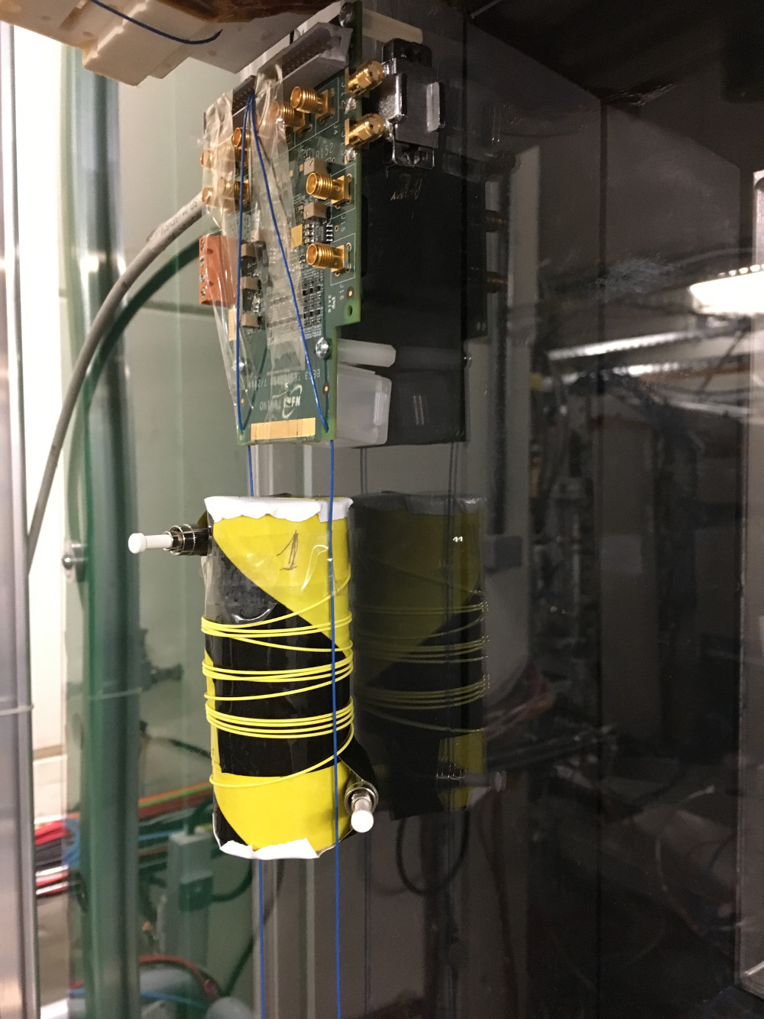
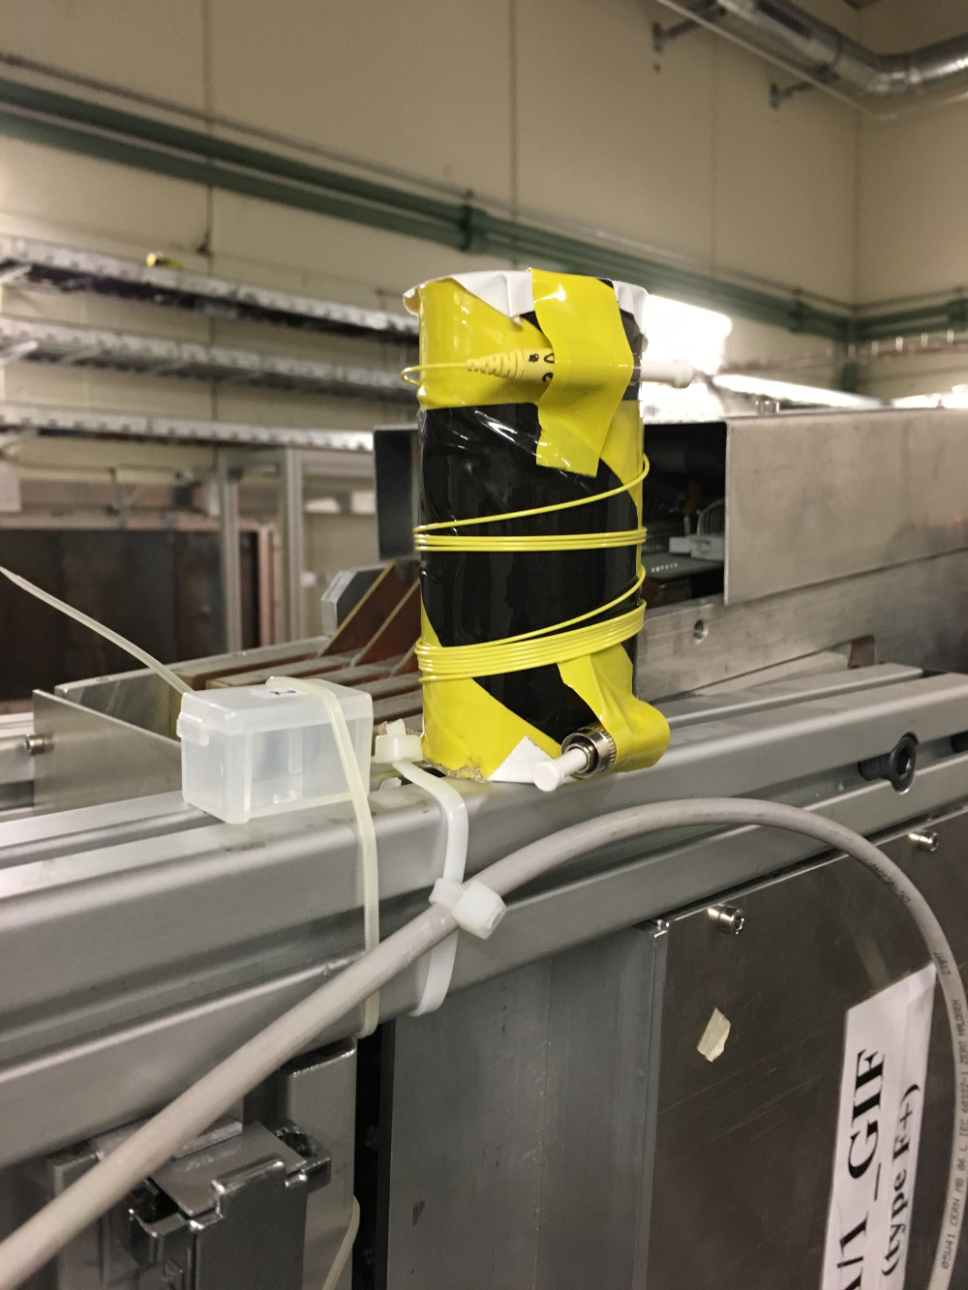
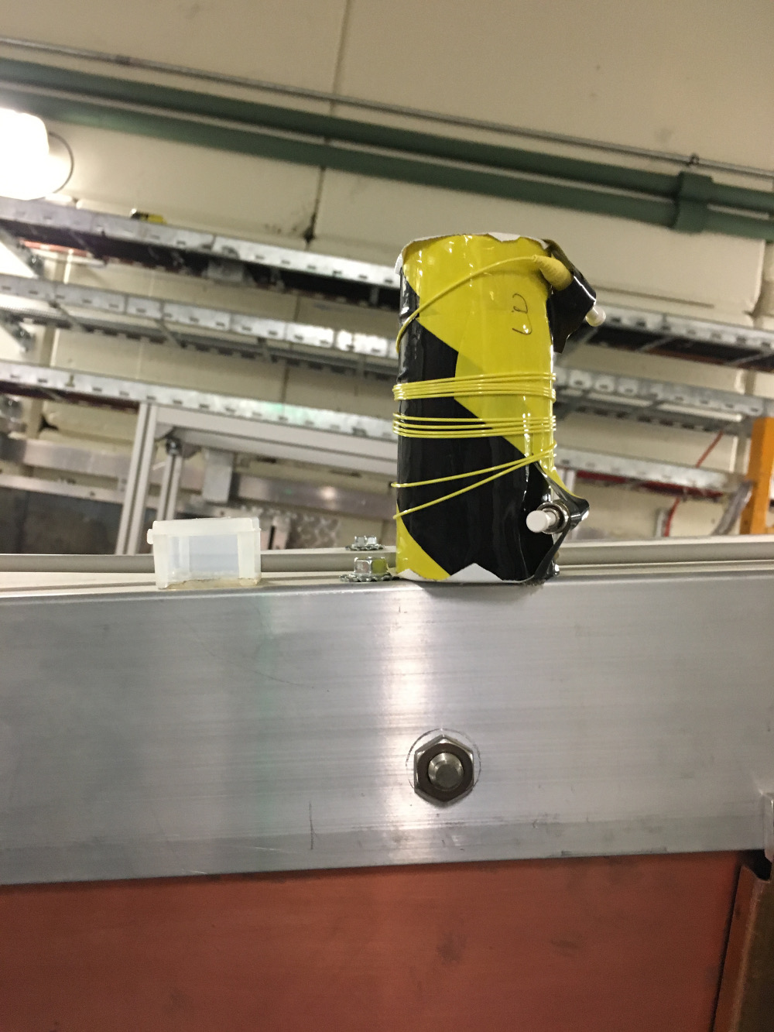
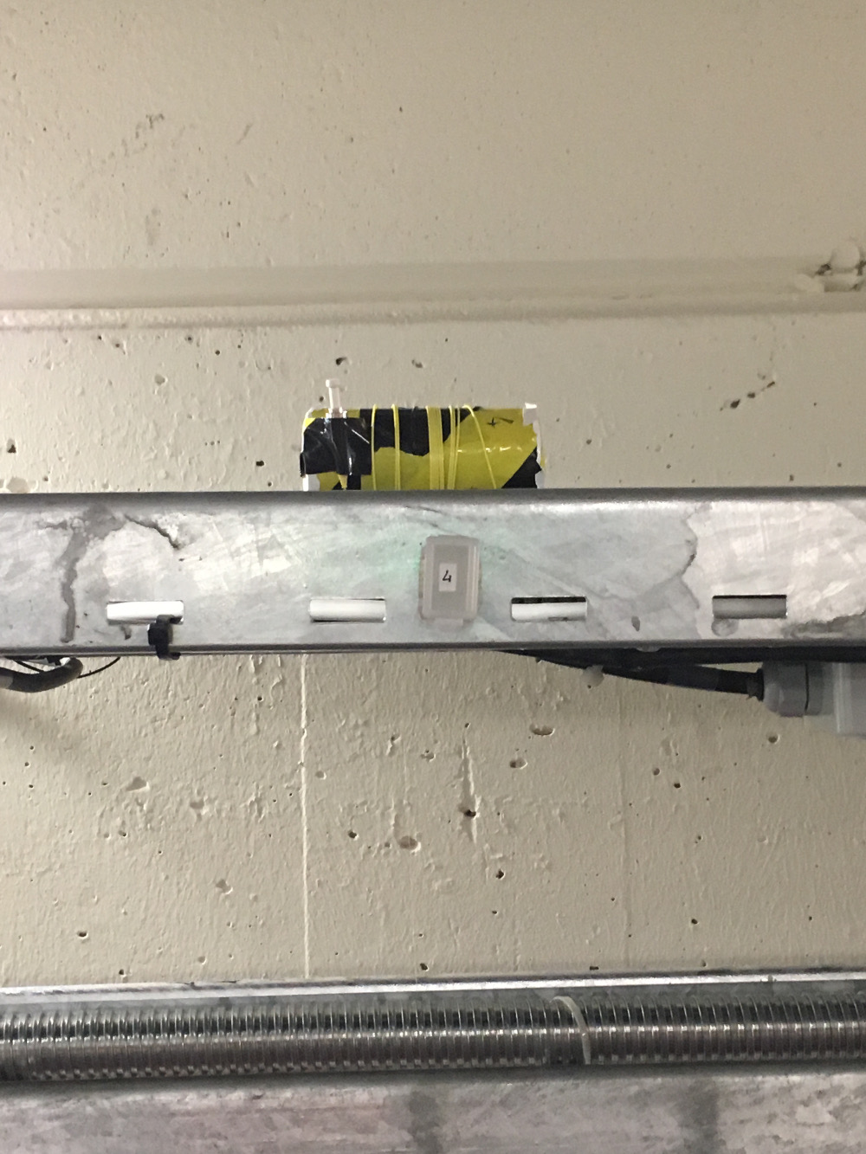
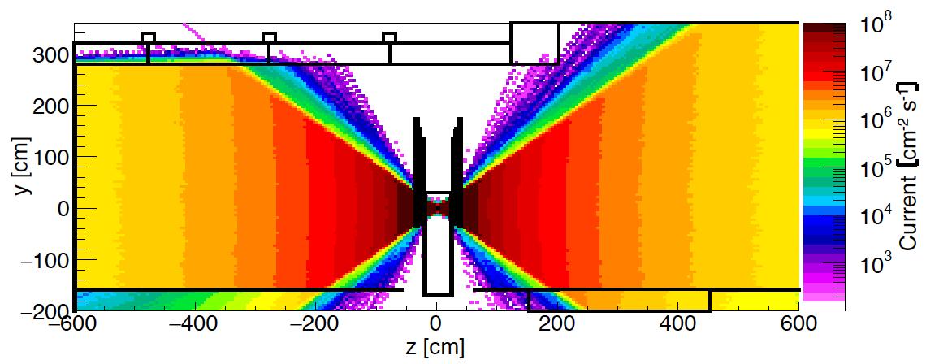
Position of samples
1
2
3
4
Z = 0.46 m
X = 0 m
θ = 0º
Z = 2.15 m
X = 1 m
θ = 25º
Z = 3.05 m
X = -1 m
θ = -18º
Z = 0.46 m
X = 0 m
θ = 0º
Due to the presence of angular correction filters the intensity of the radiation decreases with a factor 1/z² in spite of 1/r²

Slide 6
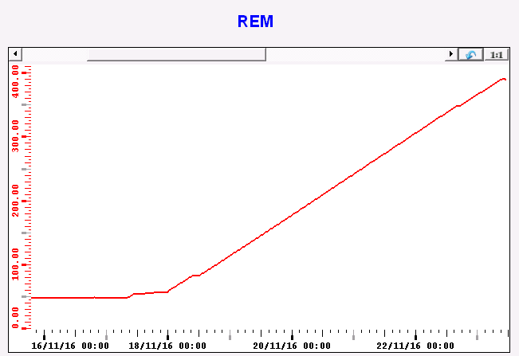
Radiation dose
Radiation measured in position 1: 340 Gray
( integrated from Nov. 16th to Nov. 22° 2016 )
Radiation dose:
1: 340 Gray
2: 15.6 Gray
3: 7.7 Gray
4: 2.6 Gray

Slide 7
Radiation dose errors
Position 1:
The radiation was measured, the error is due to the different position between sensor, lens and fiber roll.
1 cm difference = 5% error for the radiation
Position 2,3,4:
The radiation was extrapolated with the factor 1/z².
In locations with the same absolute value of the z-coordinate, the measured dose rates at various x positions differ up to 20%. (arXiv:1611.00299v1)
Radiation dose:
1: (340 ± 17) Gray
2: (15.6 ± 3.1) Gray
3: (7.7 ± 1.5) Gray
4: (2.6 ± 0.5) Gray

Slide 8
Backup

Slide 9
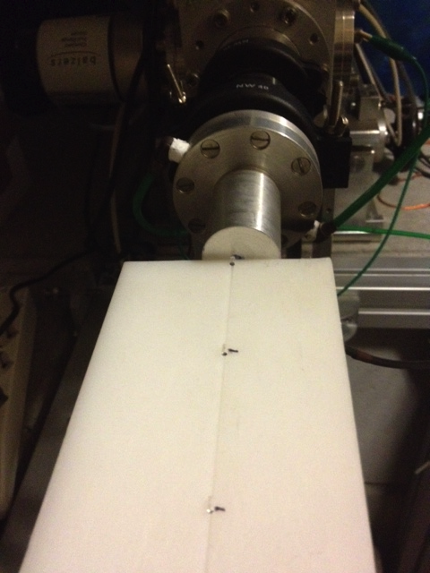
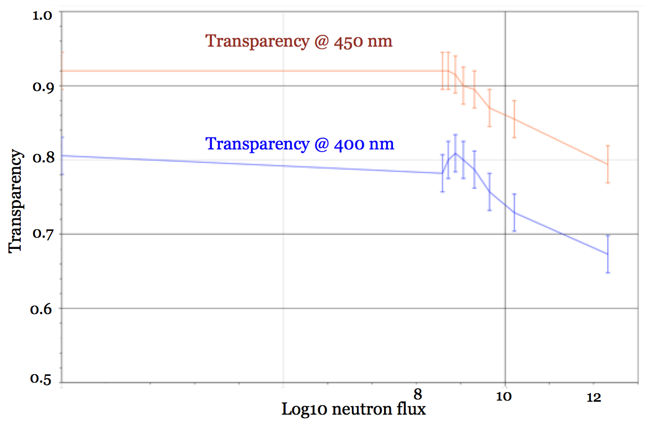
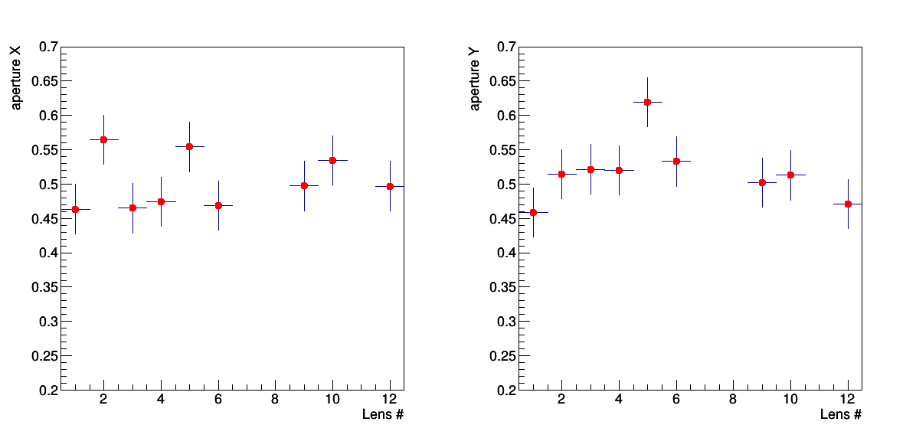
Rad hardness test (neutrons)
LNL June 2015
2H+ beam, Be target
10%
A neutron ux 10³ times larger than expected will produce a transparency reduction of 10%.
2.54 10¹¹
In the backward region of the TOP detector the expected radiation flux is:
10¹⁰ neutrons/cm²/year =
2.54 10⁸ neutrons/lens/year
(section of the lens: 0.0254 cm²)
Numerical aperture not affected by neytron flux
(lens 12 not irradiated, lens 1 higher flux

