Slide 1
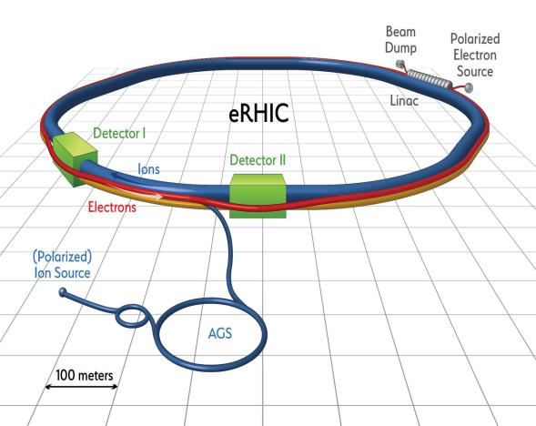

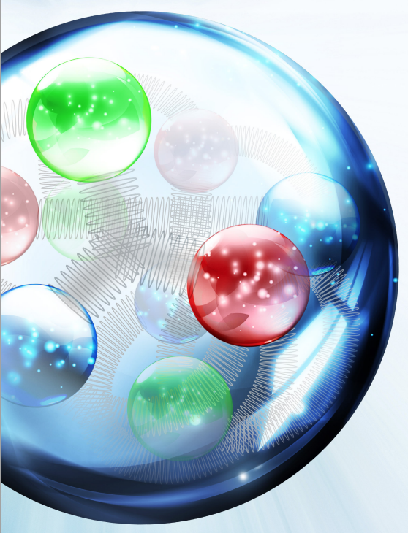
The accelerators for the EIC
Fulvia Pilat, JLAB
Giornata sulle opportunita’ del progetto EIC
Genova, January 17, 2017
eRHIC material: F. Willecke , BNL
Fulvia Pilat

Slide 2
Outline
EIC accelerator parameters and challenges
EIC concepts:
  JLEIC: figure-8 ring-ring (JLAB)
  eRHIC ERL-ring (BNL)
  eRHIC ring-ring (BNL)
EIC accelerator R&D: common and design specific
Collaborative frame, US and international
outlook

Slide 3
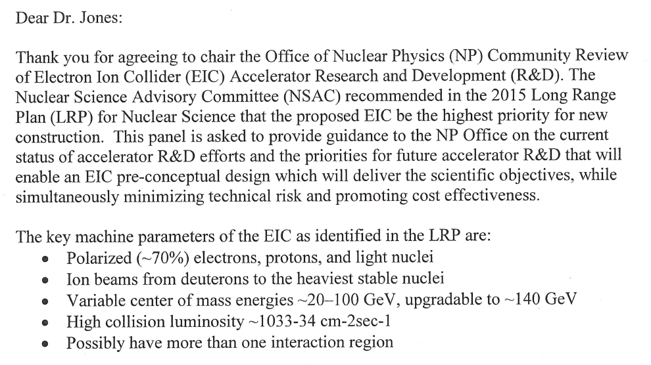
EIC parameters
From the charge letter to the NP Panel Review of EIC design and R&D, December 2016:

Slide 4
EIC unique challenge
High luminosity
High polarization
Over a WIDE RANGE of:
collision energies
collision energy ratios
species ( polarized p, e- and light nuclei, d to heaviest nuclei)
Large detector acceptance

Slide 5
EIC accelerator designs
New e-ring and ion complex
CEBAF full e-energy injector
High initial luminosity
Increase energy reach
New e- ERL or e-ring
RHIC ion complex
High initial collision energy
Increase luminosity

Slide 6
JLEIC design strategy
High luminosity: high collision rate of
short low-charge low-emittance bunches
  Small beam size
    Small β* ⇒ Short bunch length
    Low bunch charge, high repetition rate
    Small emittance ⇒ Cooling
  Similar to lepton colliders such as
  KEK-B with L > 2×10³⁴ cm⁻²s⁻¹
High polarization: Figure-8 rings
  Net spin precession zero
  Spin easily controlled by small
  magnetic fields for any particle
  species
Optimal integration IR and total acceptance detector (including far-forward acceptance)
Technical risk minimization
adopt established technology where possible, focus technology demonstration in few selected areas
Beam Design
High repetition rate
Low bunch charge
Short bunch length
Small emittance
Damping
Synchrotron radiation
Electron cooling
IR Design
Small β*
Crab crossing

Slide 7
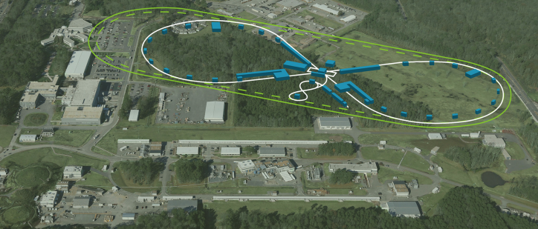
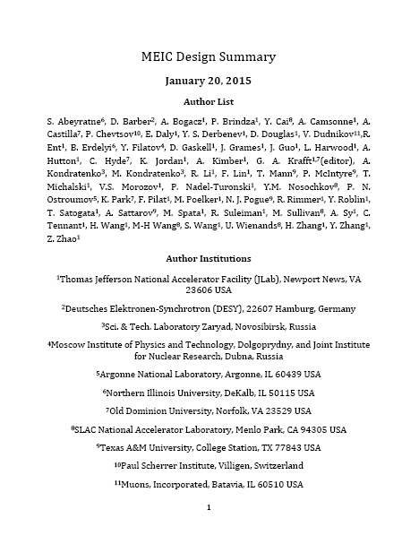
JLEIC baseline
energy range:
e-: 3-10 GeV
p : 20-100 GeV
√s: up to 65 GeV
Range to to √s=100 GeV and √s=140 GeV possible
8-100 GeV
3-10 GeV
8 GeV
Electron complex
  CEBAF
  Electron collider ring
Ion complex
  Ion source
  SRF linac
  Booster
  Ion collider ring
Fully integrated IR and detector
DC and bunched beam coolers
2015
arXiv:1504.07961

Slide 8
High luminosity: electron cooling
ion sources
DC cooler
BB cooler
ion linac
Booster
(0.285 to 8 GeV)
collider ring
(8 to 100 GeV)
Ring | Cooler | Function | Ion energy | Electron energy
 |  |  | GeV/u | MeV
Booster ring | DC | Injection and accumulation of positive ions | 0.11 ~ 0.19 (injection) | 0.062 ~ 0.1
 |  | Emittance reduction | 2 | 1.1
Collider ring | Bunched Beam Cooling (BBC) | Maintain emittance during stacking | 7.9 (injection) | 4.3
 |  | Maintain emittance | Up to 100 | Up to 55
DC cooling for emittance reduction
BBC cooling for emittance preservation against intra-beam scattering

Slide 9
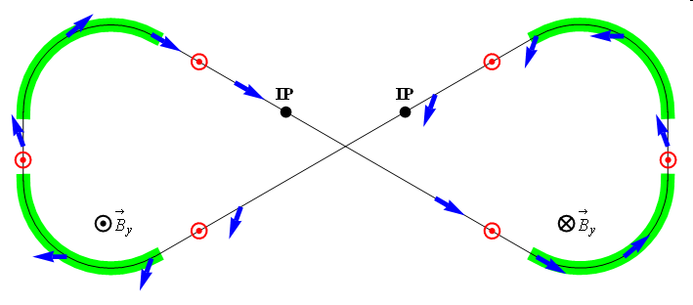
High polarization: Figure-8
Figure-8 concept: spin precession in one arc is exactly cancelled in the other
Spin stabilization by small fields: ~3 Tm vs. ~ 400 Tm for deuterons at 100 GeV
  Criterion: induced spin rotation >> spin rotation due to orbit errors
Polarized deuterons possible
3D spin rotator: combination of small rotations about different axes provides any polarization orientation at any point in the collider ring
No effect on the orbit
Adiabatic spin flips
Spin tracking in progress
Electron polarization
Spin Rotator
Magnetic field
Polarization
IP
e⁻
E- energy (GeV) | 3 | 5 | 7 | 9 | 10
Estimated Pol. Lifetime (hours) | 66 | 5.2 | 2.2 | 1.3 | 0.8
Ion polarization
ν = 0

Slide 10
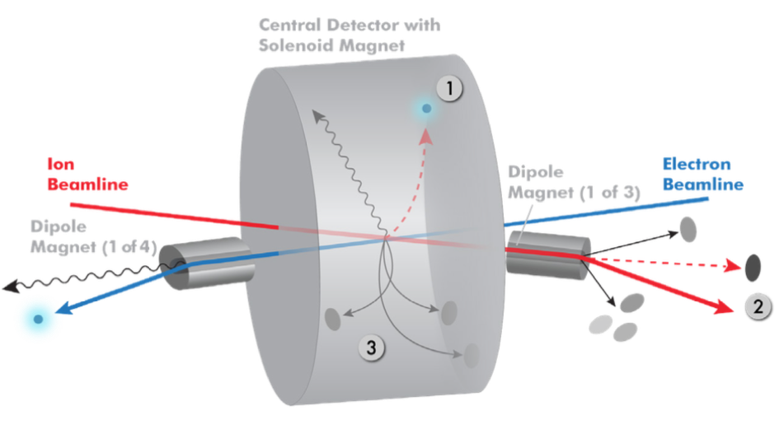
Integration IR: total acceptance detector
Possible to get ~100% acceptance for the whole event
Scattered electron
Particles associated with struck parton
Particles Associated with Initial Ion
Relatively large crossing angle (50 mr) combined with large aperture final focus magnets,
and forward dipoles are keys to this design.

Slide 11
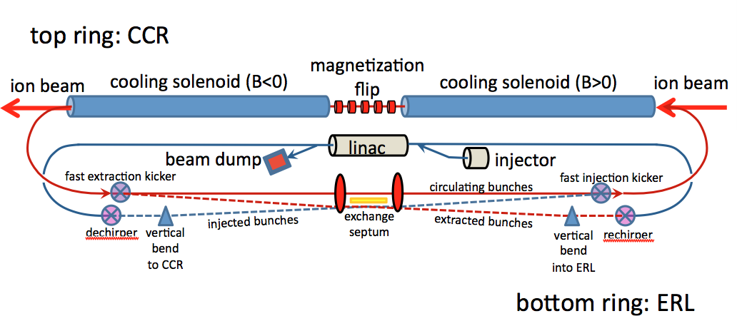
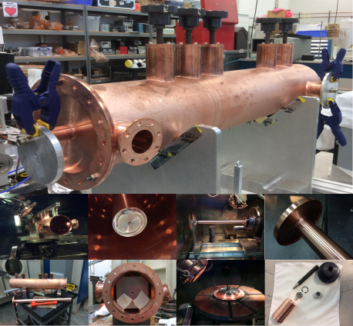
Baseline: strong cooling
ERL cooler +
Multi-turn circulator ring
Enabling technologies :
Fast kickers, risetime <1 nsec
Magnetized source ~75mA
Electron energy | MeV | up to 55
Bunch charge | nC | 3.2
Turns in circulator ring | turn | ~20
Current in CCR/ERL | A | 1.5/0.075
Bunch repetition | MHz | 476
Cooling section length | m | 60
RMS Bunch length | cm | 3
Energy spread | 10⁻⁴ | 3
Cooling solenoid field | T | 1
Cooling section length | m | 2x30

Slide 12
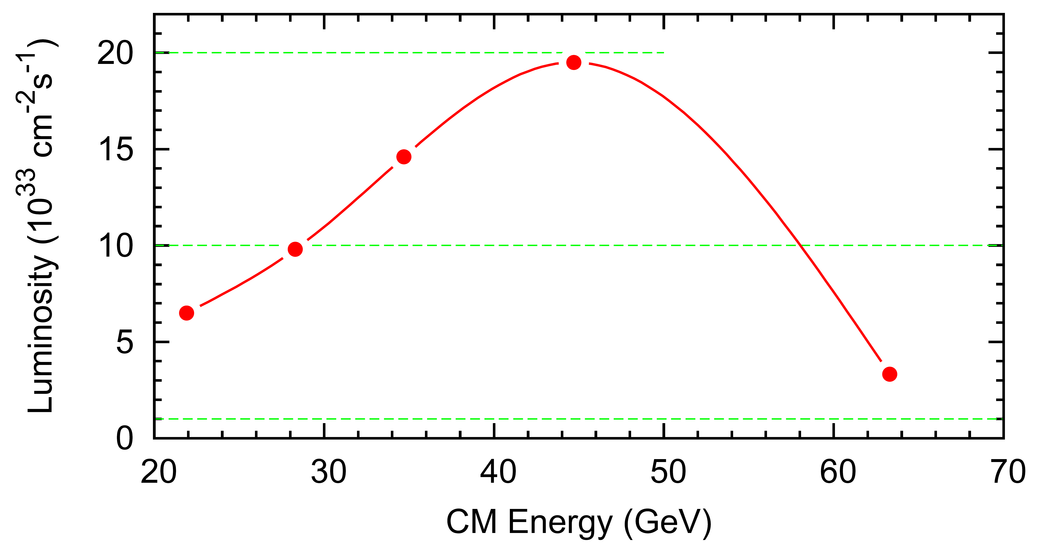
JLEIC baseline Luminosity
10³⁴
√s (GeV) | p energy (GeV) | e⁻ energy (GeV) | Main luminosity limitation
22 | 30 | 4 | space charge
45 | 100 | 5 | beam-beam
63 | 100 | 10 | synchrotron radiation

Slide 13
JLEIC Baseline Parameters
CM energy | GeV | 21.9 (low) |  | 44.7 (medium) |  | 63.3 (high)
 |  | p | e | p | e | p | e
Beam energy | GeV | 40 | 3 | 100 | 5 | 100 | 10
Collision frequency | MHz | 476 |  | 476 |  | 476/4=119
Particles per bunch | 10¹⁰ | 0.98 | 3.7 | 0.98 | 3.7 | 3.9 | 3.7
Beam current | A | 0.75 | 2.8 | 0.75 | 2.8 | 0.75 | 0.71
Polarization | % | 80% | 80% | 80% | 80% | 80% | 75%
Bunch length, RMS | cm | 3 | 1 | 1 | 1 | 2.2 | 1
Norm. emittance, hor / ver | μm | 0.3/0.3 | 24/24 | 0.5/0.1 | 54/10.8 | 0.9/0.18 | 432/86.4
Horizontal & vertical β* | cm | 8/8 | 13.5/13.5 | 6/1.2 | 5.1/1.0 | 10.5/2.1 | 4/0.8
Ver. beam-beam parameter |  | 0.015 | 0.092 | 0.015 | 0.068 | 0.008 | 0.034
Laslett tune-shift |  | 0.06 | 7x10⁻⁴ | 0.055 | 6x10⁻⁴ | 0.056 | 7x10⁻⁵
Detector space, up/down | m | 3.6/7 | 3.2/3 | 3.6/7 | 3.2/3 | 3.6/7 | 3.2/3
Hourglass(HG) reduction |  | 1 |  | 0.87 |  | 0.75
Luminosity/IP, w/HG, 10³³ | cm⁻²s⁻¹ | 2.5 |  | 21.4 |  | 5.9

Slide 14
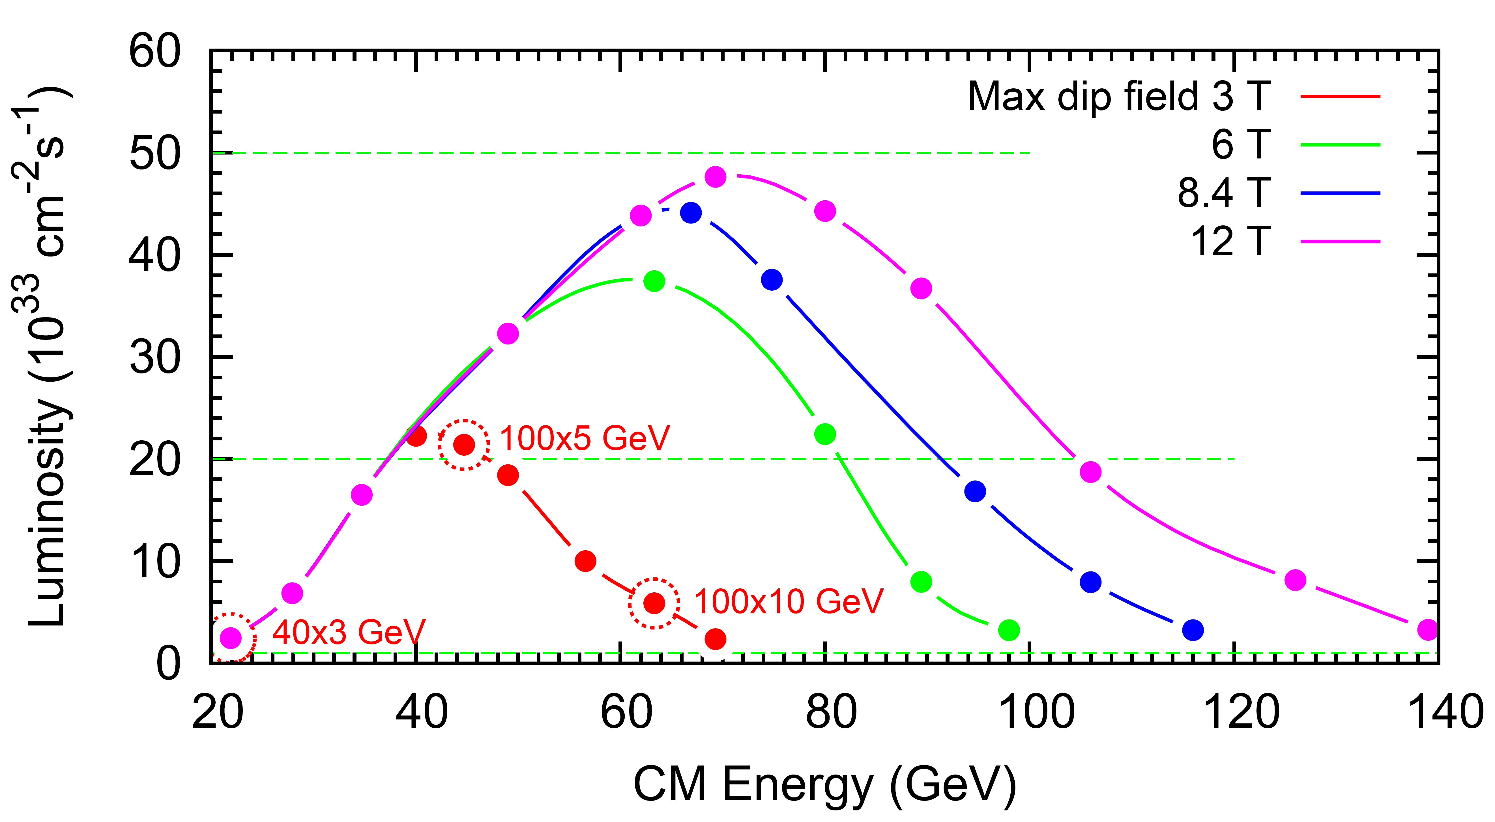
JLEIC energy reach and luminosity
LHC magnets →
10³⁴

Slide 15
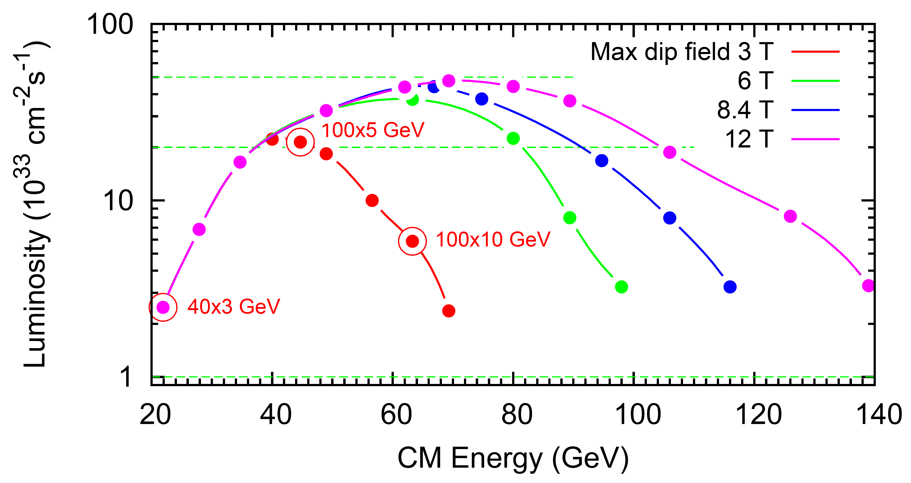
JLEIC energy reach and luminosity
(log)
LHC magnets →
10³⁴

Slide 16
JLEIC possible timeline
Activity Name | 2010 | 2011 | 2012 | 2013 | 2014 | 2015 | 2016 | 2017 | 2018 | 2019 | 2020 | 2021 | 2022 | 2023 | 2024 | 2025
12 GeV Operations
12 GeV Upgrade
FRIB
EIC Physics Case
NSAC LRP
NAS Study
CD0
EIC Design, R&D Pre-CDR, CDR
CD1(Down-select)
CD2/CD3
EIC Construction
pre-project
on-project
Pre-CDR
CDR
CD0 = DOE “Mission Need” statement; CD1 = design choice and site selection (VA/NY)
CD2/CD3 = establish project baseline cost and schedule

Slide 17
JLEIC summary
The basis of the design (ring-ring, high luminosity by high rep-rate, high polarization with Figure-8, full event coverage, and minimization of technical risk) has remained constant since 2005
The baseline delivers 2 x 10³⁴ cm⁻² sec⁻¹
The energy reach can be extended to c.o.m. 100 and 140 Gev with magnets of 6T and 12 T respectively
We have plans to deliver a pre-CDR by CD0 and a CDR by CD1
The overall design risk is low in most areas, technology demonstration is needed primarily for the bunched beam electron cooling
An R&D plan is in place to bring the overall risk level to low in 4 years

Slide 18

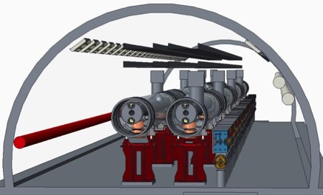
Exploiting RHIC with its
- superconducting magnets, 275 GeV protons
- its large accelerator tunnel and
- its long straight sections
- its existing Hadron injector complex by adding an electron accelerator of 18 GeV in the same tunnel
- high energy reach in e-Ion collisions
- with modest synchrotron radiation, (low operating cost)
- making use of - superconducting LINAC technology - and multi-turn recirculation
- using either the energy recovery (ERL) concept or a high intensity electron storage ring
- achieve high luminosity electron-Hadron collisions over a large range of CM Energies
From F. Willecke, BNL
eRHIC design strategy

Slide 19
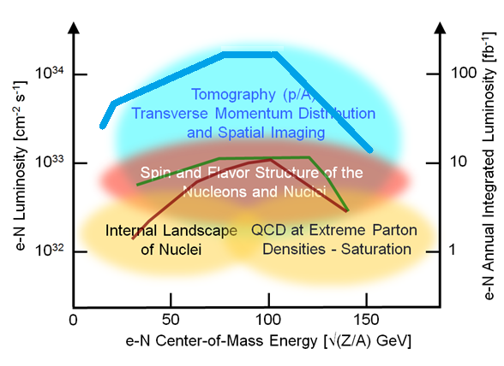
eRHIC luminosity
eRHIC is designed for an ultimate luminosity of L = 10³⁴cm⁻²s⁻¹
but it needs Strong Hadron Cooling to reach full luminosity
Lower luminosity design started to reduce overall technical risk

Slide 20
eRHIC Design Study with lower technical risk
Achievable luminosity with proven technology is in the range of
L = 10³³s⁻¹cm⁻²
The reduced luminosity goal makes a storage ring based collider (RR) an interesting alternative to and multi-turn ERL based concept.
Strategy towards eRHIC Design:
Study simultaneously two solutions, both based on existing technology:
- multi-turn ERL (LINAC-Ring collider , LR)
- storage ring based collider (Ring-Ring collider RR)
carry common R&D elements (e.g. Crab cavity) in parallel
Work on experimental verification of critical, yet to be demonstrated design elements (electron source, superconducting linac)
Carry out value engineering and R&D which might lead to saving cost (FFAG lattice with CBETA, Gatling Gun, Waveguide HOM damper)
Compare the two options in terms of performance, cost and residual risk, and feasibility of high luminosity upgrade
➔ Select a final eRHIC conceptual design as soon as possible
Pursue strategic R&D program addressing coherent electron cooling, to pave the way for a high luminosity upgrade.

Slide 21
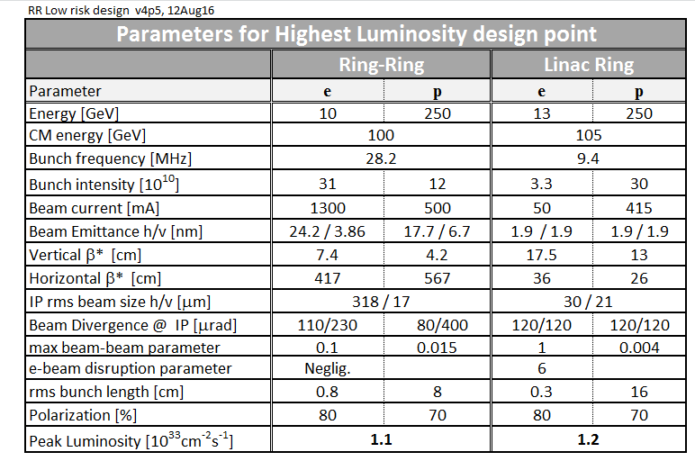
eRHIC Design Parameters

Slide 22
eRHIC Path Forward
Present situation:
Two designs ultimately capable of reaching L=10³⁴cm⁻²s⁻¹ (referred to as LR, RR design).
Linac-Ring design is more mature than Ring-Ring design.
Residual uncertainties need to be resolved.
Big Picture:
LR: 50 mA polarized electron source with 5nC bunch charge needs demonstration.
RR: Design needs to mature, study of beam dynamics issues is required.
Selected intense R&D activities will form the basis for an alternatives analysis, which is required by CD-1.
Criteria for down selection:
Cost, performance, residual risk, schedule, upgradability.
Selection:
Our current preference is the LR design because there is reason to assume that it is the more cost effective design for both construction and operation. The design is also well investigated in many details and its risks are better understood.
However we consider the RR as a viable alternative option which we pursue intensely, since it is based on conventional technology and, at this state of pre-CD-0 development, offers lower technical risk though at likely higher cost.

Slide 23
Main Features of the Recirculating ERL-Based Concept
Superconducting Multi-turn Energy Recovering LINAC
two 1.5 GeV s.c. LINAC 6 return loops➔ 18 GeV (recirculation, energy recovery)
High current polarized electron source:
Eight parallel polarized guns each delivering 6.25 mA electrons 5nC/bunch, 10 MHz bunch frequency, fast switching between them
Low emittance RHIC protons and stochastically-cooled heavy ions, present operating parameters
Crossing angle collision geometry (14 mrad) requiring crab cavities
Spin rotator after injector and pair of spin rotators around IR

Slide 24
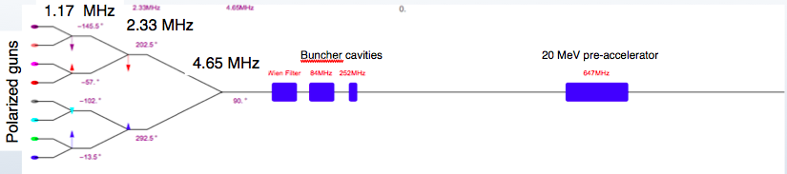
eRHIC LR Schematic
Maximum electron energy: 18 GeV
50 mA polarized electron source employing merging electron current produced by multiple electron guns
Main ERL SRF linac(s): 647 MHz cavities, 3 GeV/turn
Six individual re-circulation beamlines based on electromagnets
No hadron cooling required for e-p in initial design.
Existing stochastic cooling system can be used for e-Au
Luminosity upgrade path to the Utlimate design: adding a cooling system (CeC)
Interaction region design with crab-crossing satisfying detector acceptance requirements
I_{e}=50 mA

Slide 25
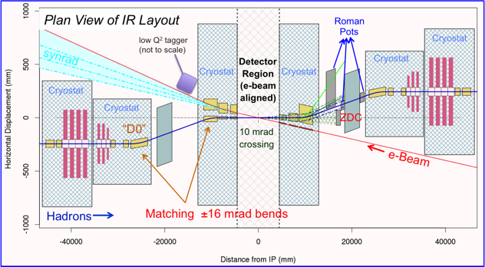
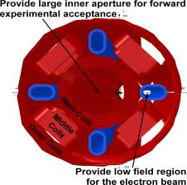
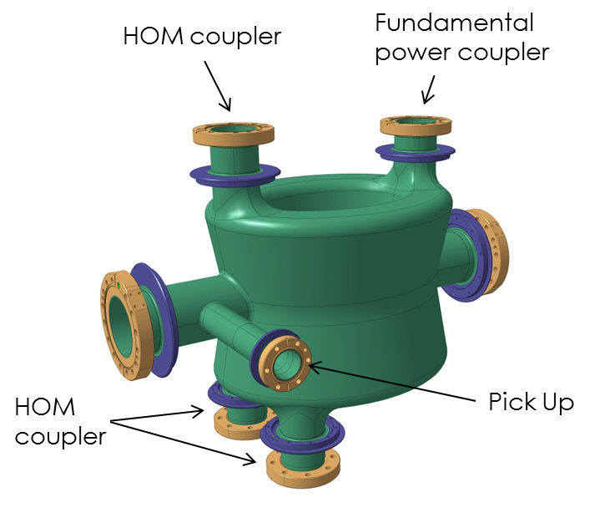
eRHIC High-luminosity, Full Acceptance IR
IR layout for ERL-Ring design
14 mrad
crossing
Crab-cavities
ERL-ring design: “Sweet spot” IR magnet design concept arranges a field-free electron pass between SC coils.
Crab-crossing scheme (14 mrad crossing angle;
140-340 MHz SRF crab cavities)
Special design of SC IR magnets to satisfy forward acceptance requirements and arrange passage of electron beam
Detector elements (Roman Pots, ZDC, luminosity monitor) integrated into the IR design
Soft bending of electron beam within 60 m upstream of the IP to simplify SR protection
Ring-ring design: an outer coil is used to have magnetic flux contained. Utilizing active shielding technique developed for ILC.
400 MHz DQW crab-cavity built
for LHC upgrade

Slide 26
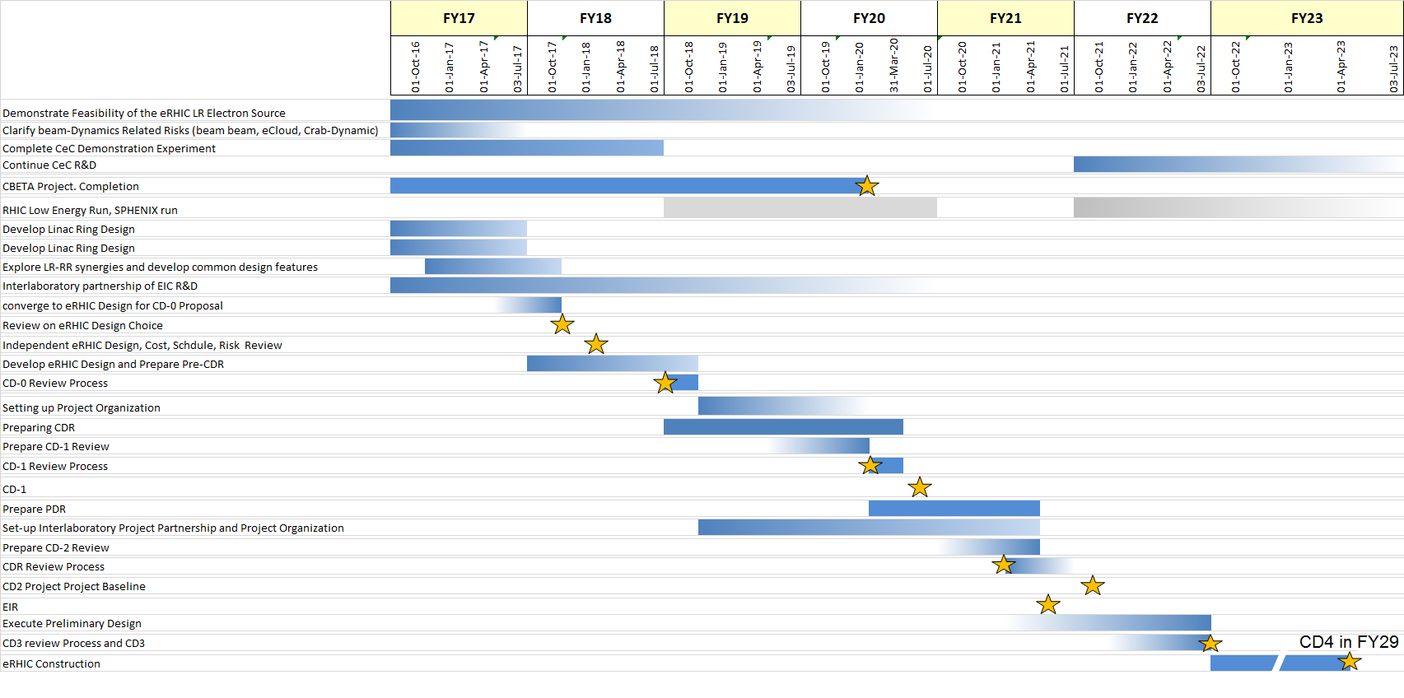
eRHIC possible timeline

Slide 27
eRHIC Summary
eRHIC design covers the complete EIC White Paper science case, provides
L= 10³³ - 10³⁴ s⁻¹ cm⁻² luminosity and is highly cost effective.
Two design options studied at present:
- ERL-Ring eRHIC design worked out which combines high performance and relatively low technical risk with high energy efficiency.
- Ring-Ring eRHIC design, meets high performance requirements using existing technology.
While developing cost estimates for final comparison and design choice carry out critical R&D 50 mA electron source, on Crab cavities, as well as value engineering which could enable substantial cost savings
Cost effective upgrade to ~ 10³⁴ s⁻¹ cm⁻² luminosity ERL-Ring design possible for both options.
Crucial R&D programs underway demonstrate new hadron cooling techniques which will enable higher luminosity (CeC)
Efforts to improve organization of Design and R&D process and well aligned with development of EIC physics case

Slide 28
EIC accelerator R&D

Slide 29
EIC R&D common areas
Ion cooling
development of alternative solutions to cooling: coherent electron cooling and bunched beam electron cooling can be adopted by any concept if successfully demonstrated
IR magnets
Detector background and IR vacuum
SRF systems for ERL linac and ERL cooler
Crabbing systems
Beam dynamics in general. i.e:
Beam-beam
Spin tracking

Slide 30
JLEIC R&D areas
R&D activities Higher priority topical areas for EIC R&D funding | Electron Cooling ECL 8 CTE | Magnets MAG 6 CTE | SRF R&D SRF 3 CTE
Bridge design and R&D Executed on base, LDRD and selected EIC R&D funding | Injectors R&D INJ 6 CTE | Interaction Regions IRS 3 CTE | Beam dynamics and diagnostics BDD 8 CTE
Guiding principles
Adopt mature technology where applicable
Focus R&D in critical areas (i.e electron cooling)
look at a 4-5 years timeline
move technical readiness from “low” to “medium” in critical areas
properly identify high priority R&D (judgment call based on technology readiness
and impact on performance and cost)

Slide 31
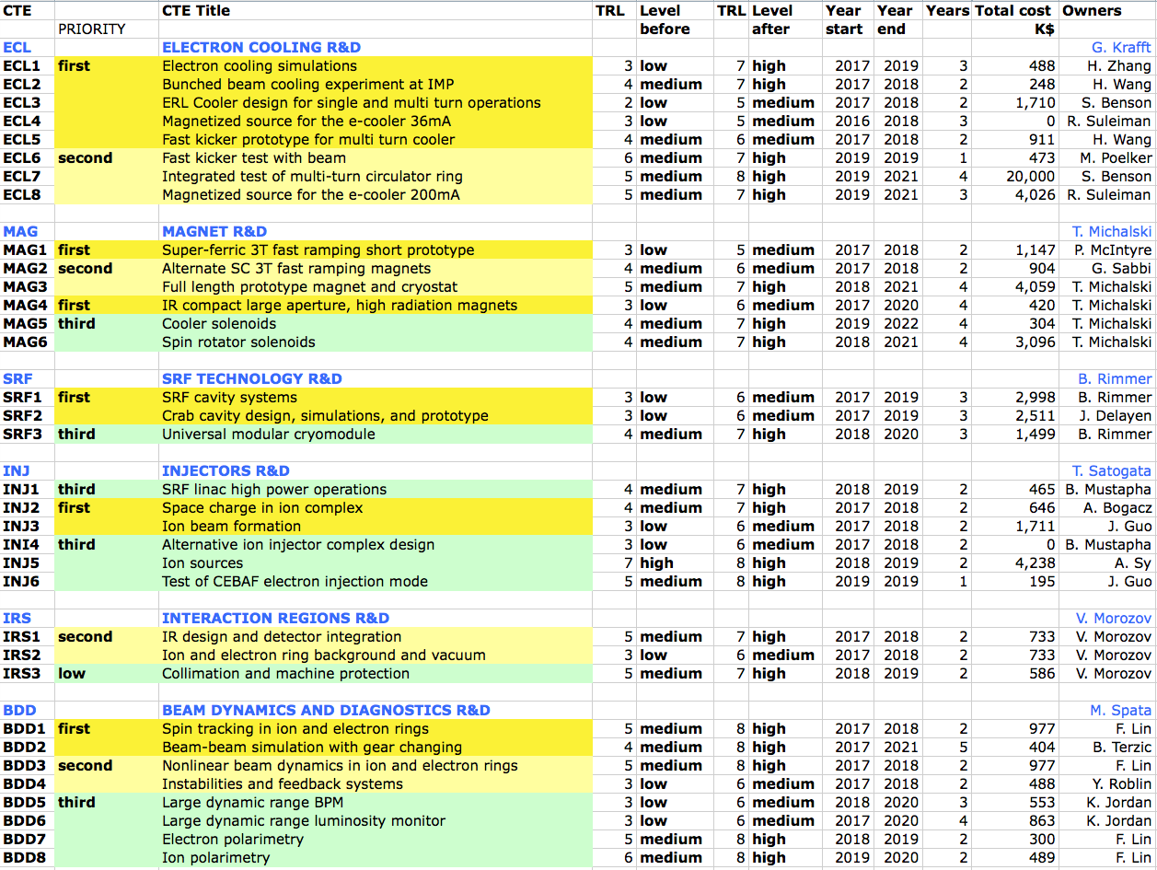
Overview of JLEIC R&D
JLAB LDRD
ANL LDRD

Slide 32
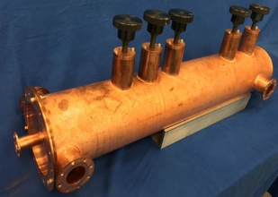
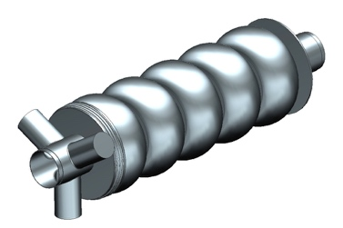
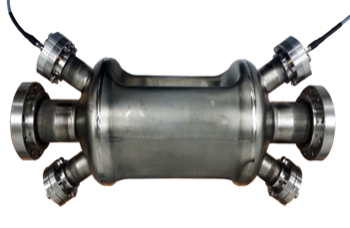
JLEIC R&D progress
ECL1 e-cooling simulation, beta-cool and new code development
ECL2 bunched beam electron cooling at IMP, demo in May 2016
ECL3 cooler design, preliminary design single-turn cooler
ECL4 magnetized source, first magnetized beam by early 2017
ECL5 fast harmonic kicker – ½ size prototype tested successfully
MAG1 short prototype, mock up winding for 1.2m
MAG 3 IR magnets, initial designs started
SRF1 ERL cavity, design completed, prototype started
SRF2 crab cavity, design started
BDD1 spin tracking, p and e simulations validating Figure-8
BDD2 beam beam, GHOST code development progressing

Slide 33
JLEIC R&D Schedule and Funding Profile
2017
2018
2019
2020
2021
Electron cooling:
ECL first
ECL second
ECL re-circulator ring test
Magnets
MAG first
MAG second
MAG third
SRF R&D
SRF first
SRF second
First priority
Second priority
10 M$
Third priority
Multi-turn circulator cooler
5 M$
33

Slide 34
Overview LINAC-Ring R&D/Design Activities
Highest Priority
R&D and Prototyping on the 6.2 mA polarized guns
R&D on Bunch combiner scheme for the 50 mA electron source
R&D on low energy high bunch charge beam transport
Study of beam dynamics with crab cavities, with realistic imperfections
Value Engineering
Prototyping of an FFAG based ERL (CBETA). Project in collaboration with Cornell
R&D on waveguide HOM coupler (saves cost and reduces the Linac footprint)
Continuation of R&D of the Gatling gun
Long Term Design Efforts
Conceptual design & prototype of the 647 MHz cavity for 18 MV/m CW operation
Design and prototyping of the eRHIC LR crab cavity
Design and prototyping of IR magnets for LR
Luminosity Upgrade Related R&D
Complete ongoing Coherent electron Cooling (CeC) demonstration experiment
Coherent Electron Cooling (CeC) start to end simulation studies
Next phase of CeC demonstration project
In-situ Cu coating of RHIC cold beam pipe (type C for RR)
Design & simulation of space charge compensation for protons below 200 GeV

Slide 35
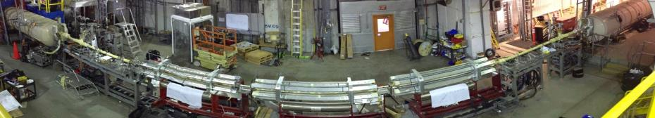
eRHIC R&D Goals, Luminosity Upgrade
R&D items addressing ultra high luminosity L=10³⁴cm⁻²s⁻¹
Coherent Electron Cooling R&D
CeC proof of principle experiment (in progress)
- First commissioning of the e-source and the beamline
- Needs for improvements revealed, implementation in progress
- 2nd commissioning run in 2017
- Proof of Principle demonstration in 218

Slide 36
Project development and collaborations
JLAB and BNL have been developing their designs in close collaboration with other US laboratories and Universities for 10+ years
The Long range Plan endorsement of the EIC has motivated an increased collaboration in the US and a reach to expand the collaboration internationally
An 800+ member international EIC Users Group has been established, next meeting in Trieste in July 2017
The EIC accelerator community is encouraging international (italian !) collaboration

Slide 37
Conclusions
The recognition in the US of the EIC as the highest priority for new construction in nuclear physics has set firm foundations to build this challenging accelerator
We are looking forward to engaging the national and international scientific communities
Contact info for Fulvia and Ferdinand
Fulvia Pilat, JLAB, pilat@jlab.org
Ferdinand Willecke, willecke@bnl.gov

Slide 38
back-up material

Slide 39
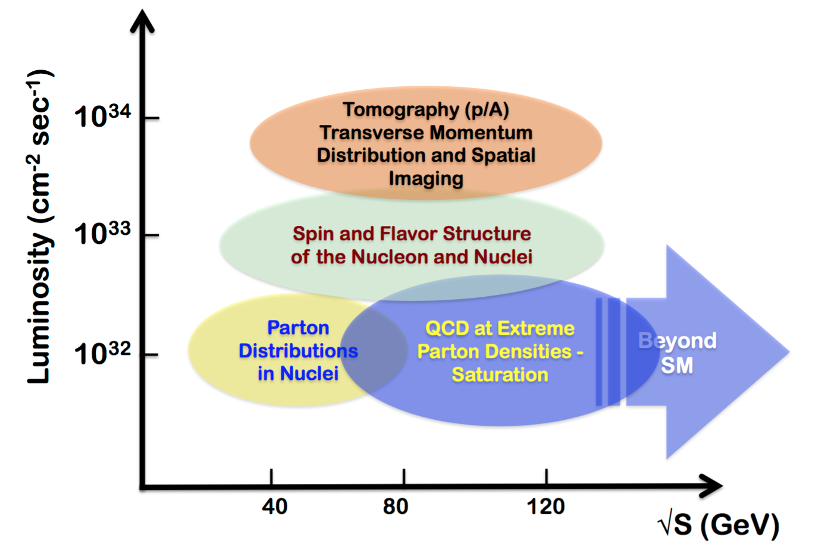
JLEIC upgrade
eRHIC upgrade

Slide 40
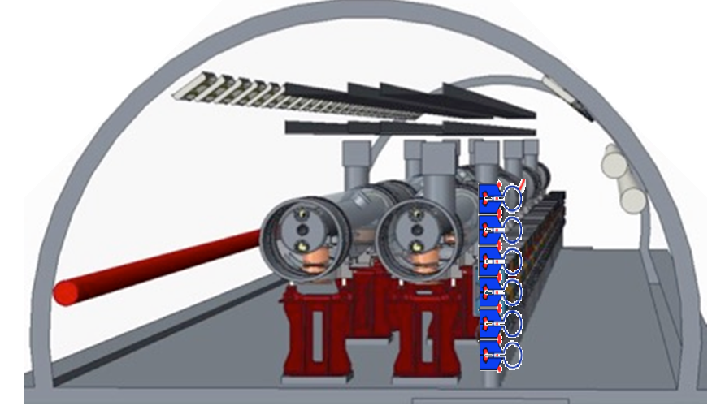
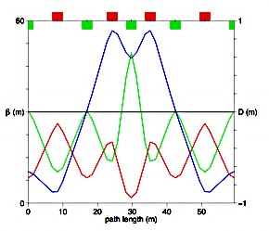
Superconducting Multi-turn Energy Recovering LINAC
2 x {1.5 GeV SC Linac, 200m long, 18 MV/m 36 cryo-modules, 6 turns } ➔ 18 GeV
6 vertically stacked isochronous return loops in the RHIC Tunnel
Beam current 600 mA (50mA/turn), 3mm bunches, Bunchpatterns optimized to minimize BBU
> 463 kW HOM power with beam-pipe HOM dampers (demonstrated at KEK and Cornell)

Slide 41
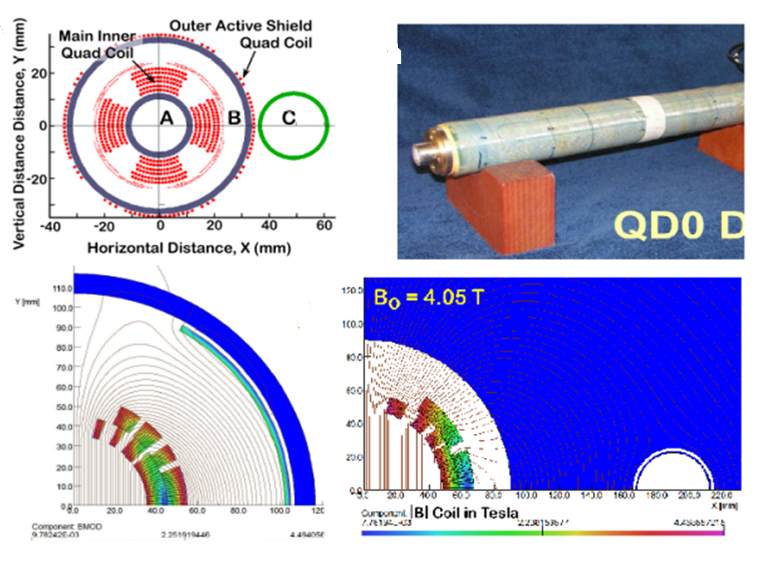
Ring-Ring Interaction Region
More challenging since electron maximum beta should not become too large
Interleaved electron and hadron low beta quadrupoles
Need actively shield coil to cancel unwanted stray fields
Magnet design study performed with direct wound coil like for
Full acceptance for Neutrons and p_{T}
Large Luminosity gain (by a factor 2.6) for limited p_{T} acceptance

Slide 42
Ring-Ring: Achieving High Electron Polarization
The accelerator technology to achieve high polarization at high energies includes:
highly efficient orbit correction,
beam-based alignment of Beam Position Monitors relative to quadrupole field centers
harmonic spin matching
well controlled betatron coupling
spin matching of spin rotator insertion
eRHIC
Beam polarization requirement determines the injector features:
Full energy injector
To provide the complex spin pattern
Frequent electron bunch replacement (up to 1Hz replacement rate)
To have average beam polarization above 70%.
Low average current, high bunch charge polarized e-source (similar to a SLAC polarized source)
Considered injector options:
  650 MHz SRF linac, consistent with following upgrade to the Ultimate ERL-Ring
  Recirculating linac based on XFEL/LCLS-2 cryo-modules.
Sokolov-Ternov self-polarization time vs energy

Slide 43
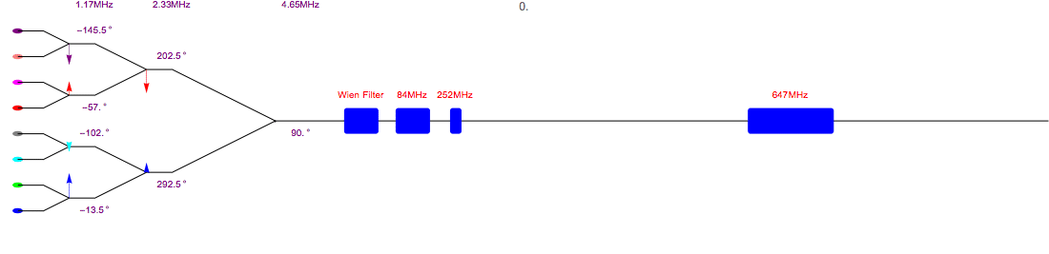
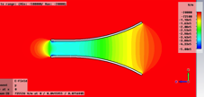
ERL-Ring Polarized Source Using Merging Scheme
4 mA polarized electron beam current was demonstrated in dedicated experiments in JLab
Although the Jlab gun design is not optimal for high bunch charge mA scale operation: small cathode size, no cathode coolingLowered risk eRHIC polarized source employs eight JLab-like guns (possibly with improved gun geometry, cathode size and cathode cooling) and combining scheme to produce up to 50 mA current at the source exit
1.17 MHz
2.33 MHz
4.65 MHz
Buncher cavities
20 MeV pre-accelerator
Polarized guns
The 10 MeV injector includes the eight beam combining scheme, spin rotator, buncher and pre-accelerator.
The frequency of the combiner and phase of the RF are listed.
  Detailed 3D simulations of high-charge bunch transport through all injector components are underway
  Experimental studies of single cathode lifetime dependencies (using a Gatling gun prototype)
  Measurements of surface charge limit for SL cathodes using cathode preparation system.
  A prototype gun is being designed, and will be built next year
Field distribution of copper plate deflector,
used in combining scheme

Slide 44
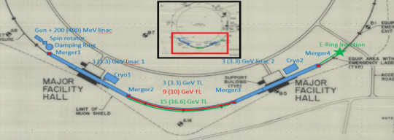
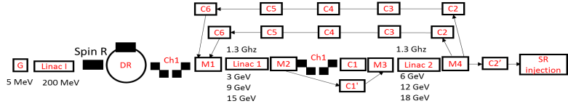
Electron injector
Recirculating linac pulsed RF
- XFEL/LCLS-2 modules, With two 2.25 GeV linacs in two adjacent RHIC straights, 3 re-circulations 4 passages to 18 GeV or
- Alternatively 18 x 650MHz cryo-modules operated at 25 MV/m (makes the designs more compatible and easier interchangeable)

Slide 45
Main Feature of the Ring-Ring Design Option
Full Energy, Polarized Electrons injected and stored in a Storage ring
To reach high luminosity operate with many bunches and high electron beam current, flat beams
IR geometry and detector that can accept the larger electron beam emittance.
Crossing angle collision geometry (22 mrad) requiring crab cavities
Bunch-to-bunch spin sign control by full energy injector and frequent electron bunch replacement
Injector based on low current polarized gun, small accumulator ring recirculating s.c. linac for low beam current (4mA), runs at 1Hz , doesn’t need energy recovery
RHIC hadron beams
Electron beam current limited by synchrotron radiation at high electron energies power need 10 MW RF power (high cost)

Slide 46
Ring-Ring Design: Reaching High Luminosity
High electron beam current
( up to 1.3 A)
Demonstrated at B-factories;
Linear SR power load < 4 kW/m
    Luminosity is defined by beam-beam limits:
    ξ_{p} < 0.015, ξ_{e} < 0.1.
    Split arc dipoles are used to enhance radiation damping at lower electron energies
    Increased number of RHIC hadron bunches (by factor 3 from present)
  Injector system upgrade; (~10 nsec kicker risetime)
  Copper coating of RHIC beam pipe.
  In-situ coating methods are being developed
  Electron cloud and associated heating load is being evaluated
Robinson wigglers in straight sections: to provide proper electron emittance control for matching hadron beam size at IP at different hadron energies
Split arc dipole geometry and their field
e-ring lattice

