Slide 1
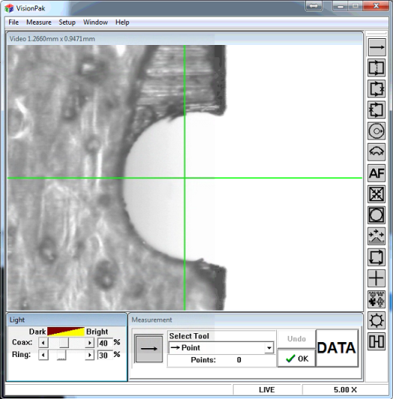
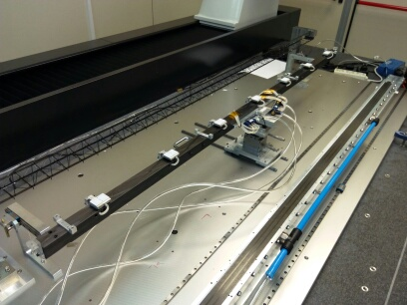
Activities in Clean Room
Writing Assembling Procedure Document;
Camera is working well after repair;
Measuring of Reference Systems: Al bar and Ruby;
CP Planarity with vacuum;
Rotation of the HB on Tower 2;
Alignement of HS below the SF;
module assembly skipped
Two technical problems:
Not perfect planarity of the HB on Tower 2;
FPC holes not perfectly centered;

Slide 2
CP Planarity with vacuum
average | -0.002
stdev | 0.016
max | 0.114
min | -0.033
delta | 0.147

Slide 3
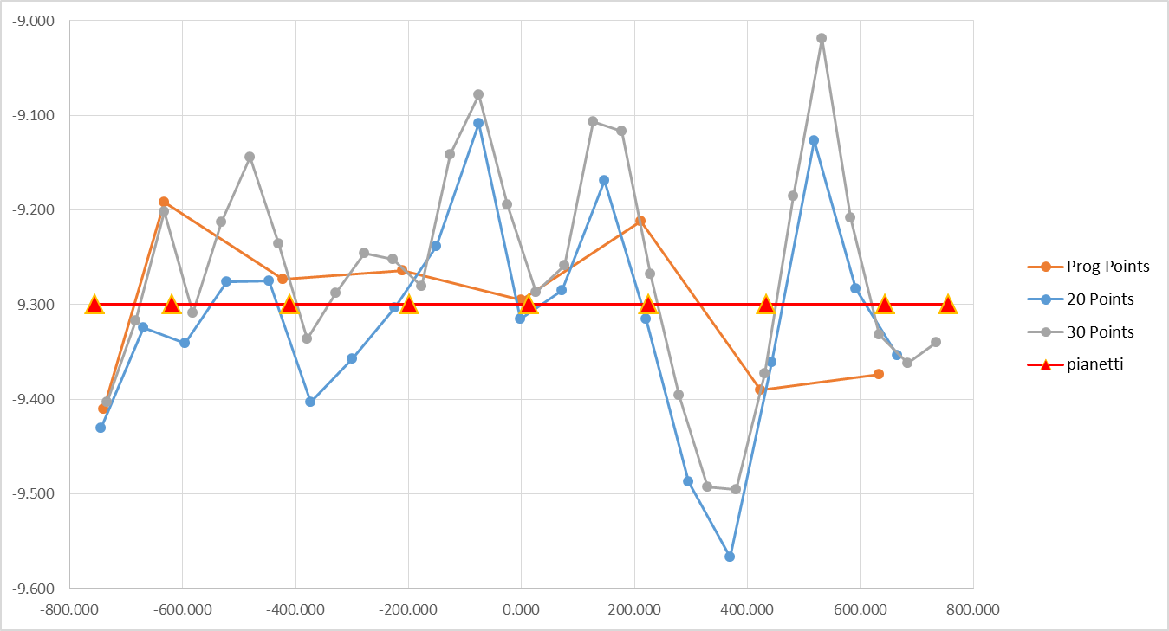
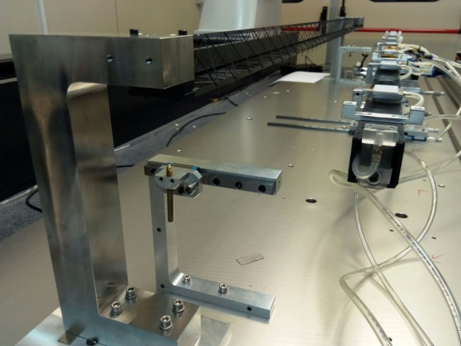
HS planarity in nominal position
adjustement by lateral screws
 | Nom. |  | Nom.* | 20 Samp | 30 Samp
Average | -9.301 | 0.000 |  | -9.316 | -9.263
StDev |  | 0.079
Max |  | 0.102 | 0.102 | -9.108 | -9.019
Min |  | -0.134 | -0.068 | -9.567 | -9.495
Delta |  | 0.236 | 0.170 | 0.459 | 0.476

Slide 4
Others Tasks
Vacuum system: Ricci is buying the inverter for the new pump;
Fake modules should arrive Thursday;

