Slide 1
Status Report ALICE ITS @ LNF
Schedule
Welding tests ----------------------
Assembly Report (Emiliano)
Quark Matter 2018
News from the ALICE CB (Valeria)
Federico Ronchetti, INFN-LNF
ALICE ITS Meeting 25/10/2016

Slide 2
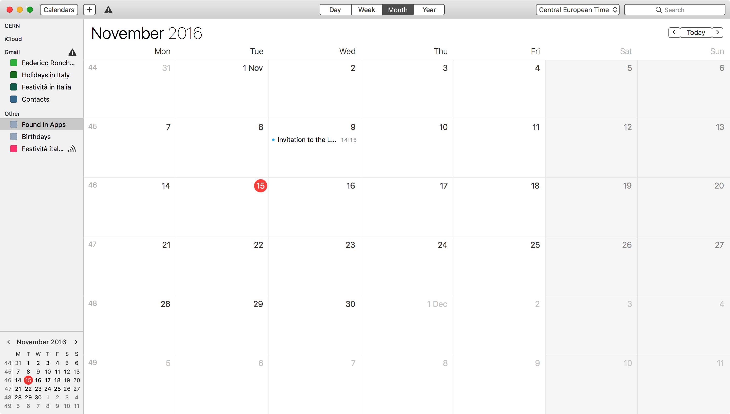
Vitrinite Dummies to start Module Alignment
Bari for MOSAIC Eleuterio, Marco T, Pavel
Bari for Glass Dummies Daniele, Marco T.
Full Mechanical Stave Alignment w/ Stefania Beole’

Slide 3
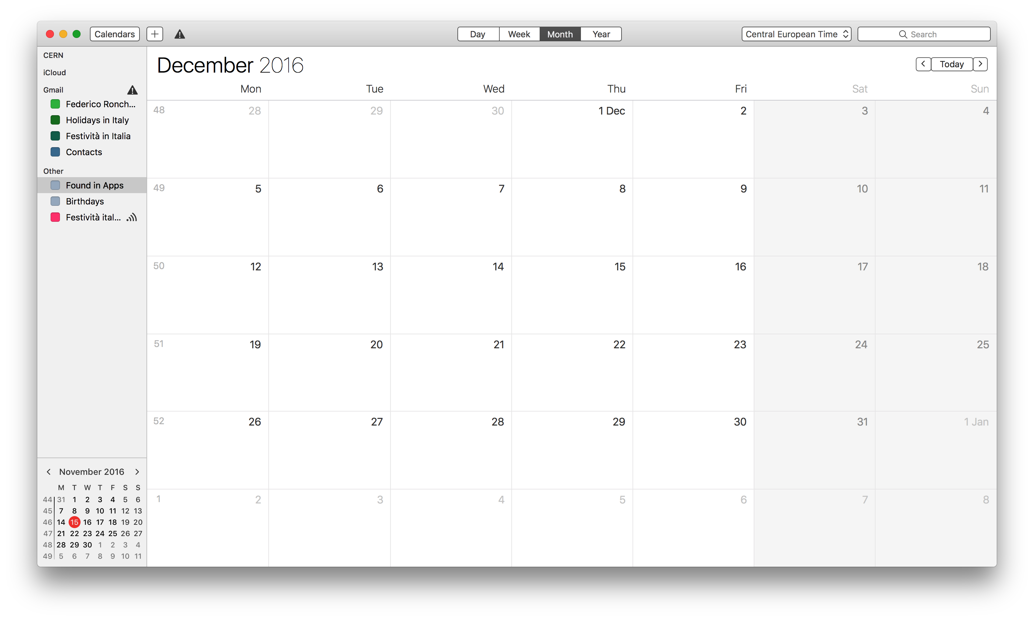
Full Mechanical Stave Alignment w/ Stefania Beole’
ITSU Plenary

Slide 4
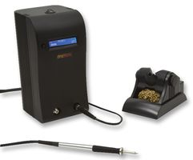
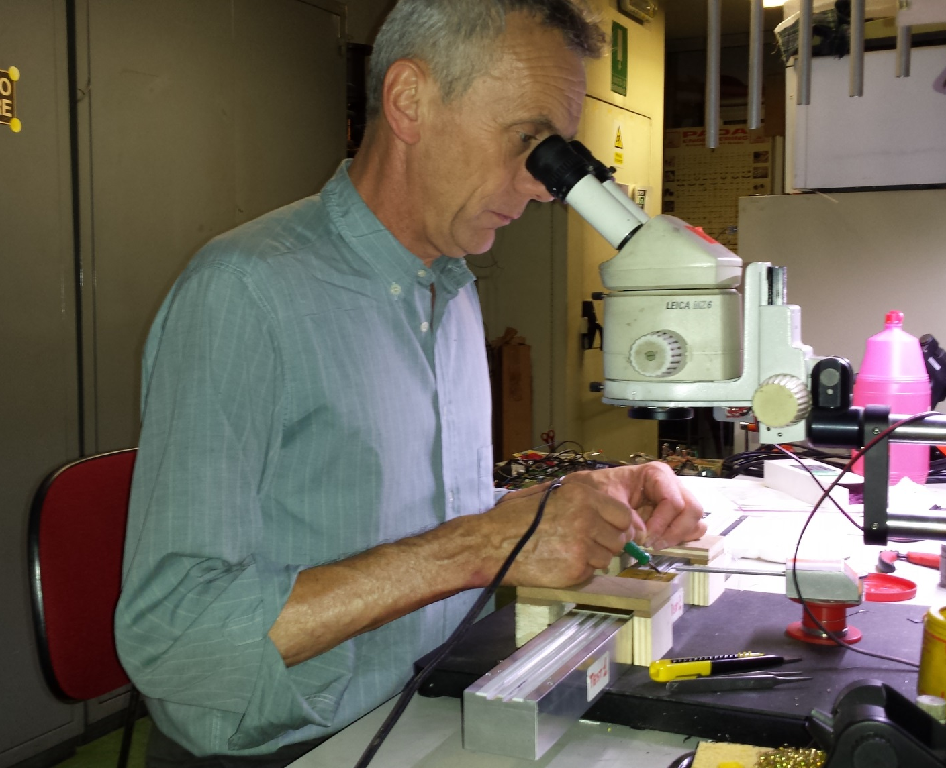
Leica MZ6 binocular microscope:
FoV: $\sim$50°
Real FoV: 10 $÷$50 mm
Soldering machine:
METCAL MX-PS5000 with
MX-H2-UF handpiece
Working height
$$\sim 14 cm$$
Hand supports
Vacuum rail

Slide 5
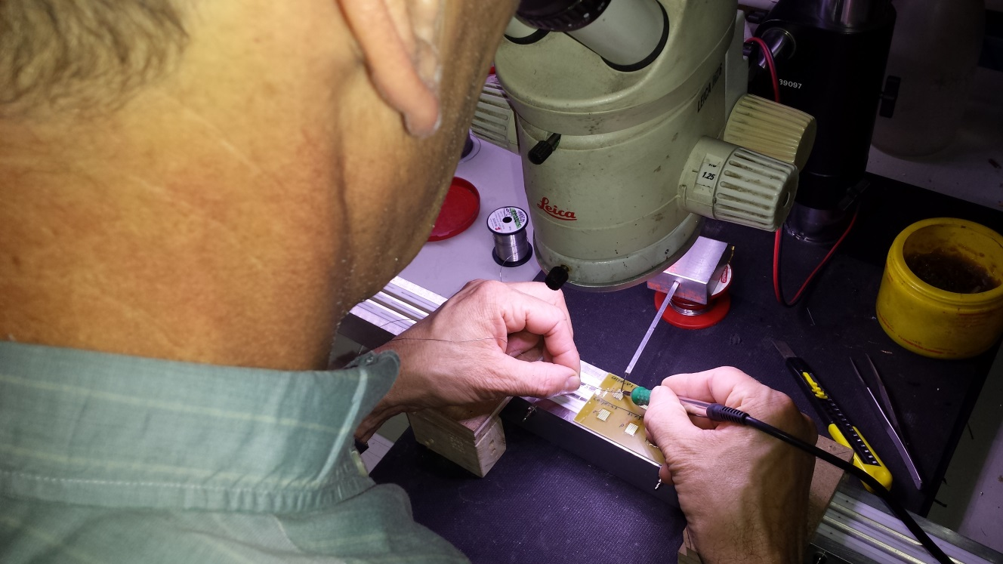
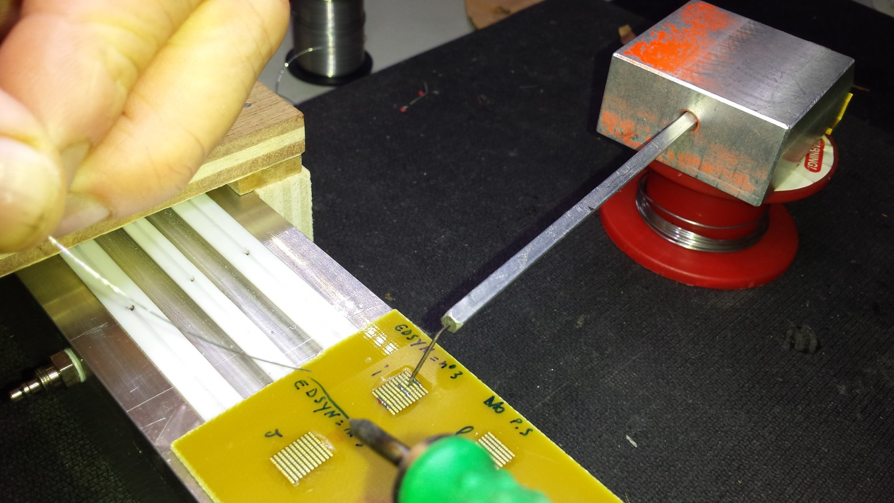
Raw setup in our lab (2)
Home-made tool to block the bridge

Slide 6
Solder wire and tip details
Solder wires used:
Metaux Blancs Ouvres (MBO): Sn63Pb37 ø=0.35 mm T= 183˚C
RS 756-8907 : Sn60Pb40 ø=0.38 mm T= 183-188˚C
EDSYN : Sn62Pb36Ag2 ø=0.35 mm T= 183˚C
LOCTITE C51196SC :Cu95.5Ag3.5 ø=0.23 mm T= 217˚C
Tips used ( all T=412˚C)
UFTC-7CNB04 (ø=0.4 mm) (Tip 04)
UFTC-7CN02 (ø=0.2 mm) (Tip 02)
UFTC-7CN01 (ø=0.1 mm) (Tip 01)

Slide 7
Soldering quality evaluation
Electrical test (ET): measure bridge resistance with multimeter before stripping
Mechanical test (MT): visual inspection of each pad after stripping
Example
ET=good, MT=bad (2 fails)
ET=good, MT=good
ET=bad, MT=bad (1 fail)
ET=good, MT=bad (1 fail)

Slide 8
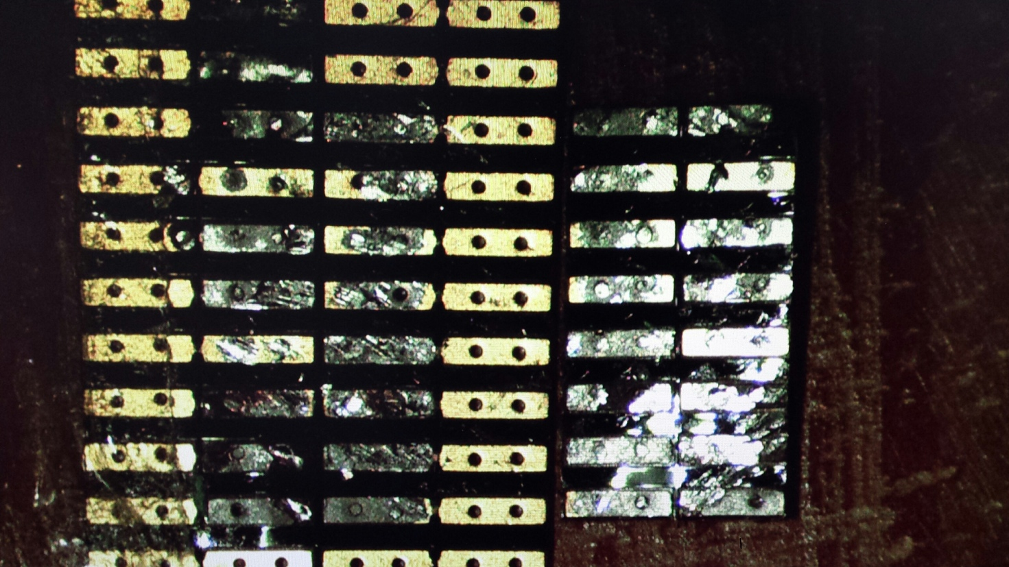
LNF: Soldering quality evaluation
LNF

Slide 9
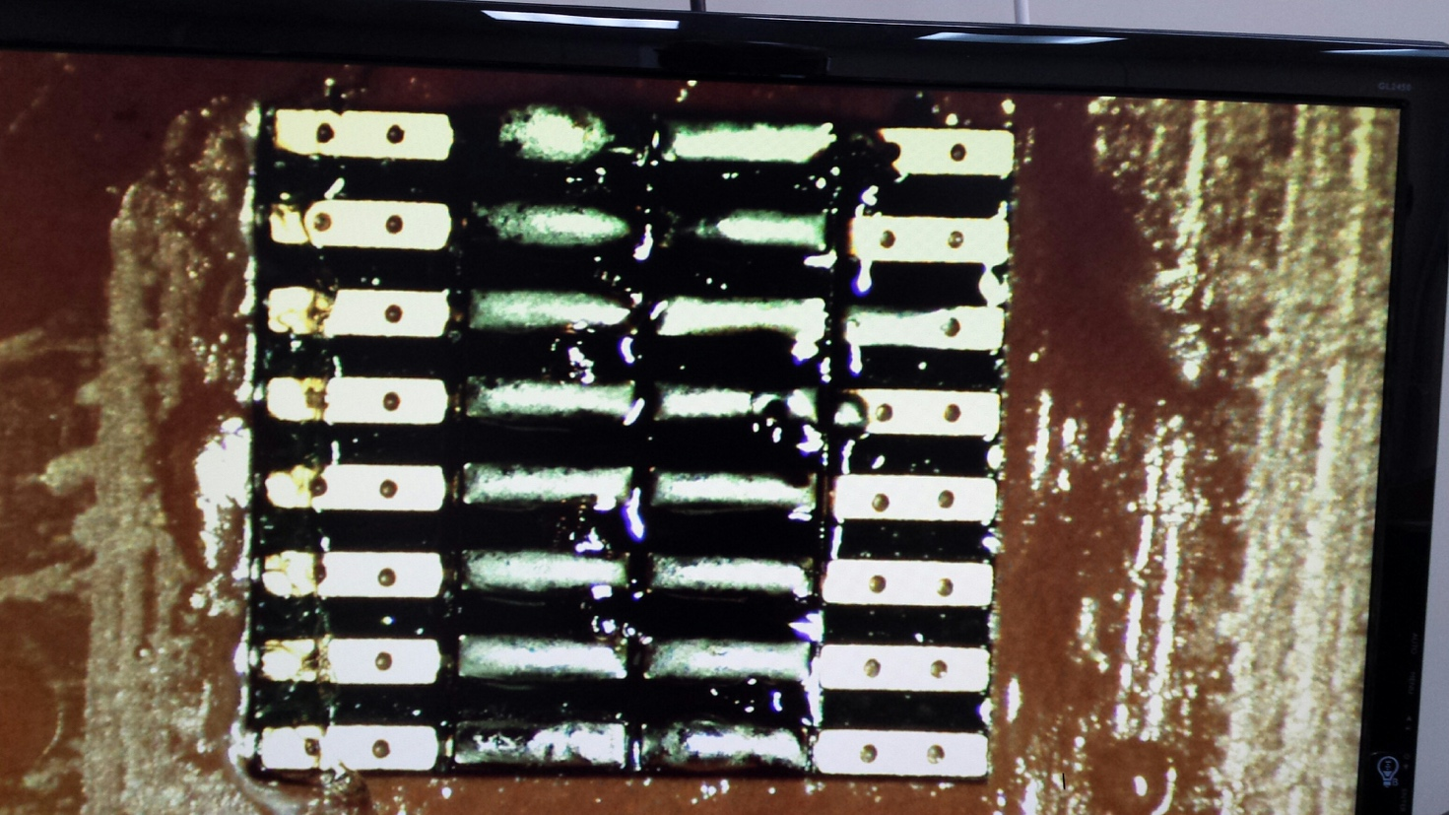
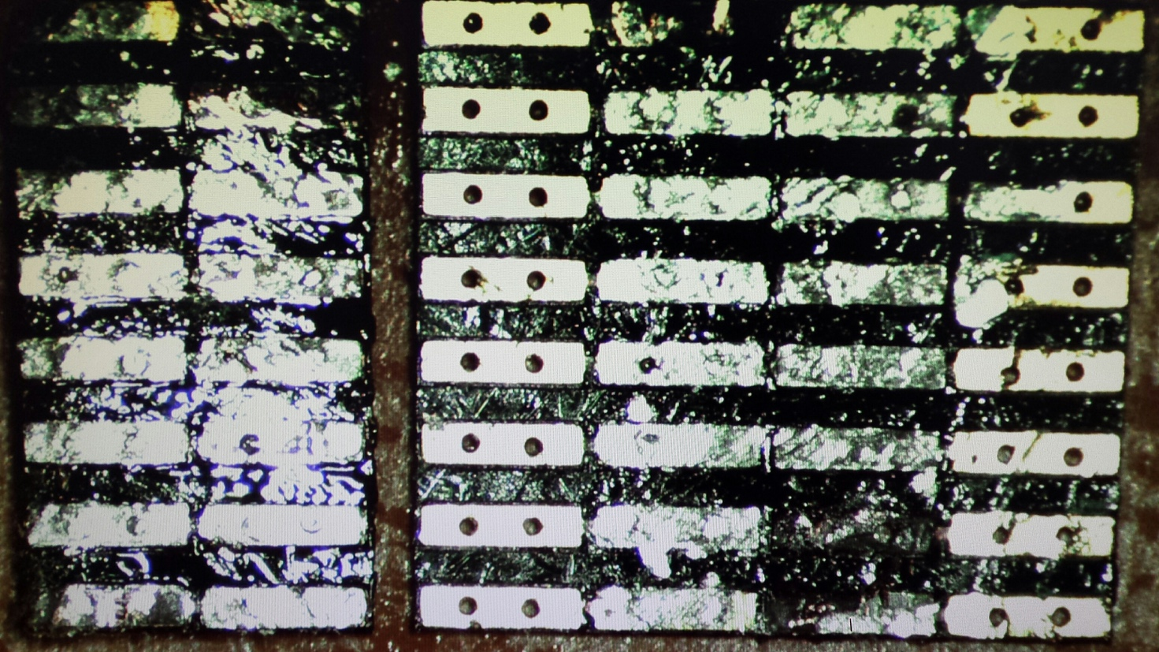
LNF: Tests with fluxing liquid
LNF

Slide 10
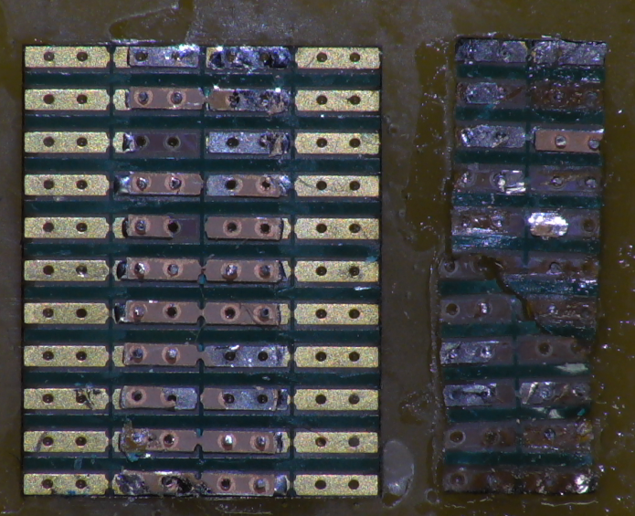
Test with tip 02 - EDSYN – tip deoxidizer Y/N (stripping)
i - No Deox
l - No Deox
m - No Deox
n - No Deox
Tot ET fails = 0, Tot MT fails = 4
o - Yes Deox
p - Yes Deox
q - Yes Deox
r - Yes Deox
Tot ET fails = 0, Tot MT fails = 0

Slide 11
Conclusions (TO + LNF)
Best tip : UFTC-7CN02 (ø=0.2 mm) (Tip 02)
Best solder wire: EDSYN (Sn62Pb36Ag2 ø=0.35 mm T= 183˚C)
Best tip cleaning technique: using solder tip deoxidizer
Note: remember to position the bridge with the trace between the pads on the bottom side. (This guarantee a faster and better soldering of the bridge)
Remove hole from bottom pad
Make slimmer bridge with half hole to allow “soldering knee” as suggested by Luciano
Redesign of test structures ongoing in TO
More tests and tooling ongoing at LNF

