Slide 1

WP3 (status&update)
COSA f2f Meeting
INFN-CNAF Bologna
3/11/2016

Slide 2
Outline
Cluster
Operations
Tests
Todo

Slide 3
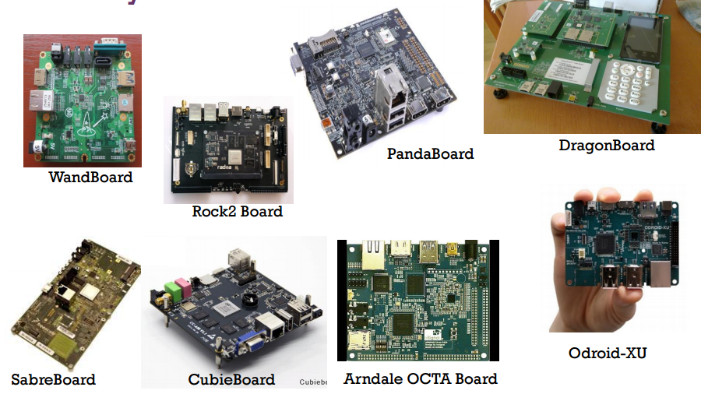
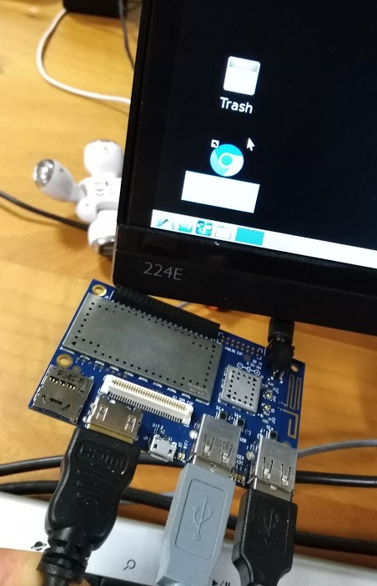
Boards@CNAF

Slide 4
Cluster@CNAF (22 nodi!)
Nodo del cluster
X86_64
ARMv7
ARMv8
Xeon
Atom
Pentium
Tegra K1
Q2/2014
Tegra X1
Q2/2015
Broadwell
Q1/2015
14nm
Silvermont
Q3/2013
22nm
Airmont
Q1/2015
14nm
2.8
HS06/W
<2.8
HS06/W
4 core
10W
28 HS06
4 core
15W
20/28 HS06
D-1540
8 core
90 W
151 HS06
C2750
8 core
25W
55 HS06
N3700
4 core
7W
28 HS06
1.89
HS06/W
2.20
HS06/W
4
HS06/W

Slide 5
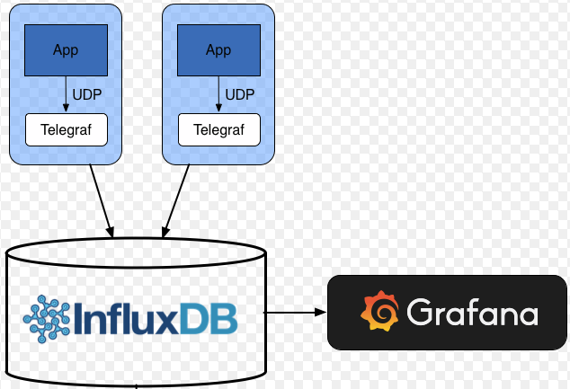
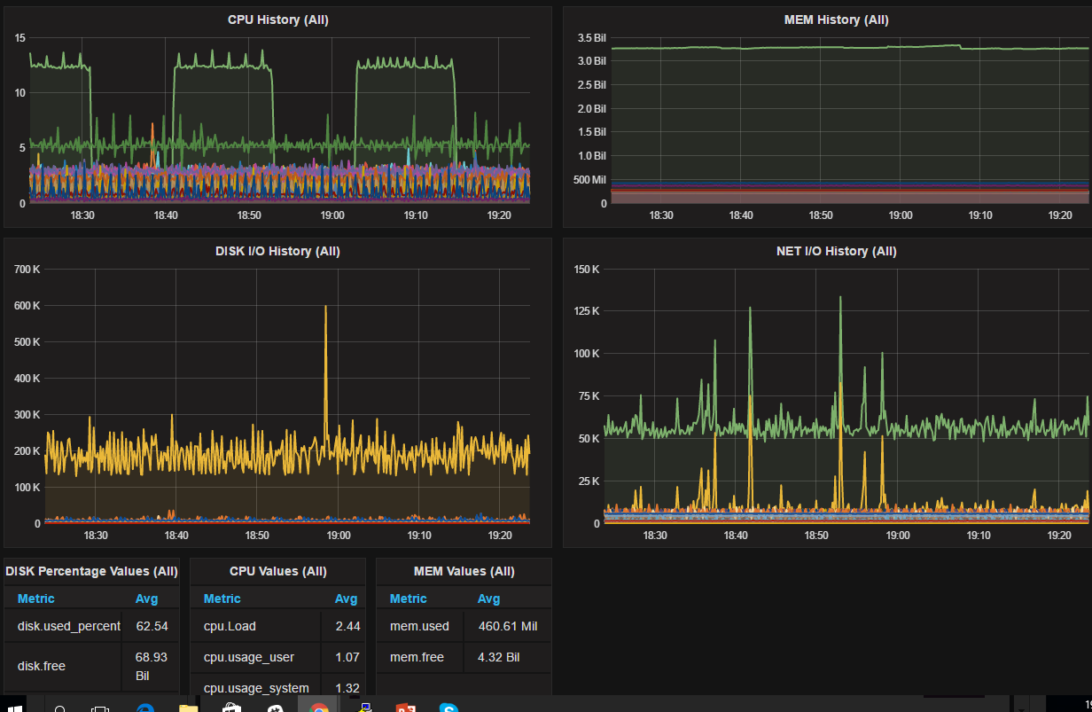
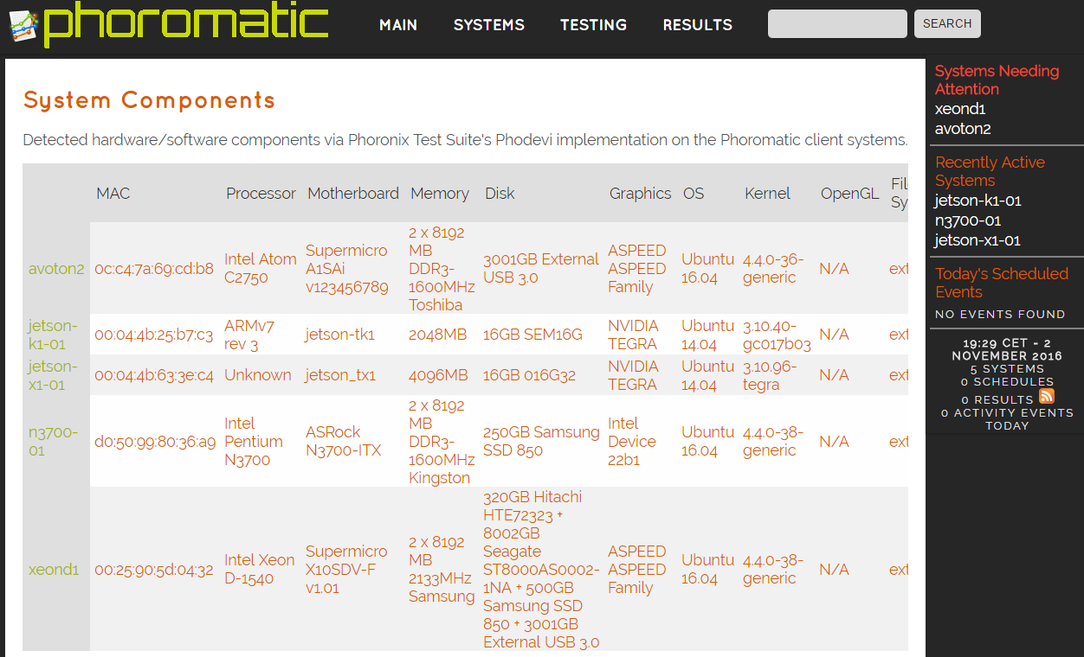
Cluster low-power (operations)
CONFIGURATION
  Ansible
MONITORING
  Telegraf/InfluDB,Grafana
TEST SUITE
  Phoronix

Slide 6
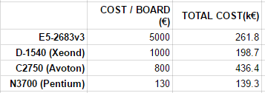

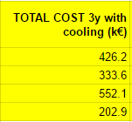
Osservazioni sull’HW lowpower
CPU ARM deludente dopo entusiasmo iniziale (solo Nvidia K1/X1…)
Intel sul low-power ha recuperato il gap su ARM (vedi Pentium N3700)
Intel copre ogni esigenza per cluster da laboratorio (da Pentium a Xeon-D)
Intel (tutto a parte Pentium) permette di utilizzare schede di rete a bassa latenza
Pentium N3700 conveniente come consumi, prezzo per board e ratio performance/consumo
Simulazioni tecnico-economiche hanno senso solo tra CPU Intel (in un mondo ideale per un datacenter sarebbe conveniente un economico Pentium N3700!!!) ← no ECC, no multi PSU, no PCIe, no AVX2, etc.

Slide 7
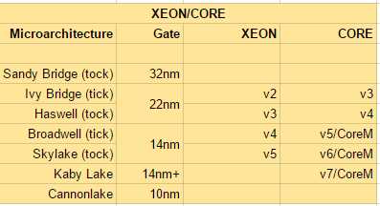
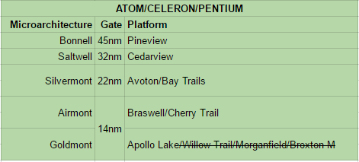
Il marketing Intel fa di tutto per complicare le cose…
E.G. Core-M hanno cambiato nome da Skylake a Kaby Lake (ora si chiamano di nuovo Core i5, Core i7)

Slide 8
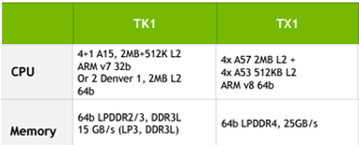
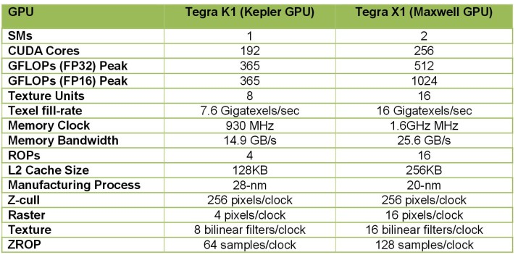
Tegra X1 vs K1
SORPRESA !!!!
X1 con CPU piu’ lenta (1.7Ghz vs 2.2GHz)
X1 ha interconnessioni ethernet 1GB con bridge USB !!!
  è orientata al mondo automotive/imaging non HPC
  installata scheda Planet 10Gb/s (ricompilato driver)
X1 sui test condotti (PI, Primes, CT reconstruction, staucc) fino ad ora non ci ha impressionato

Slide 9
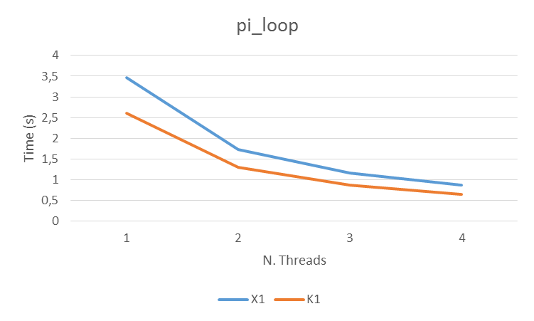
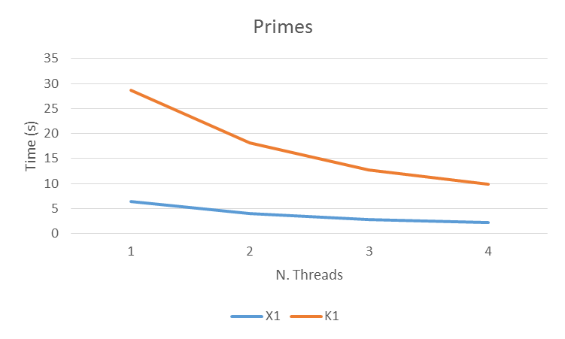
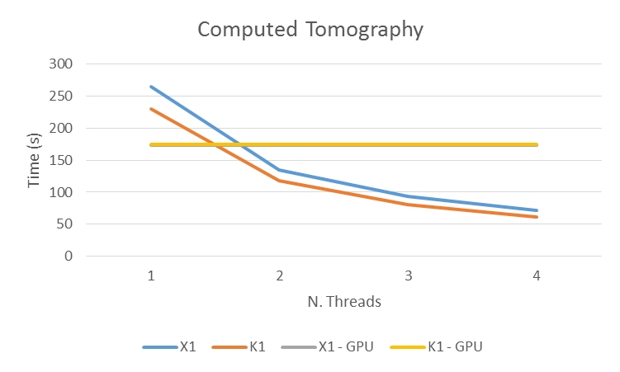
Tegra X1 vs K1
K1 2.2GHz, X1 1.7GHz
GPU very similar with the CT application

Slide 10
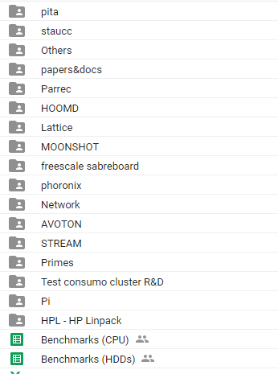
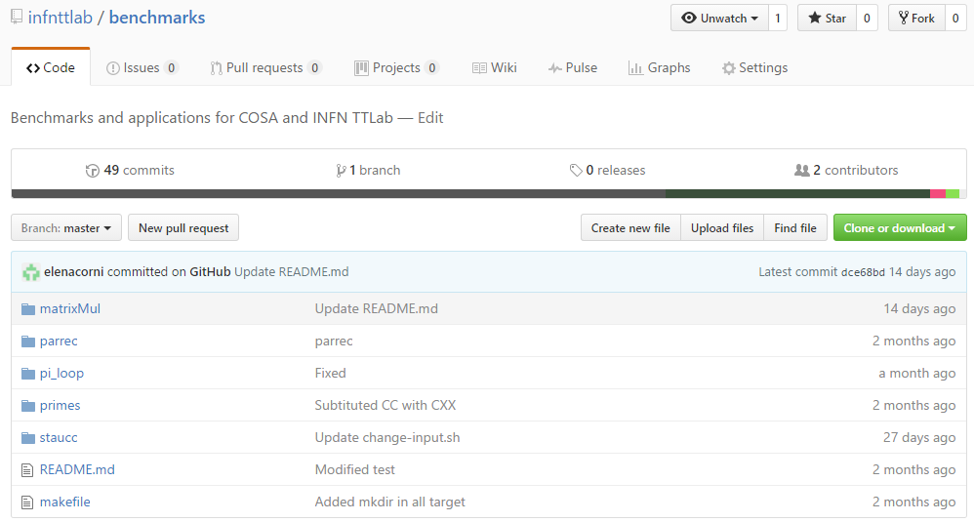
Benchmarks
Risultati ed osservazioni in Google Drive
Sorgenti in github

Slide 11
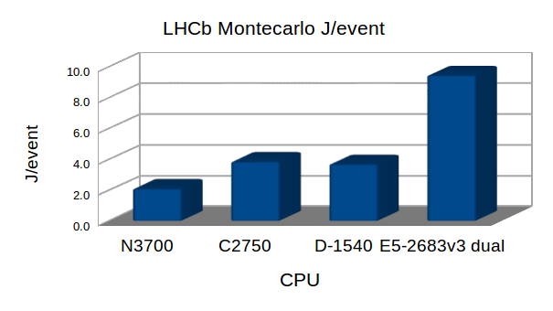
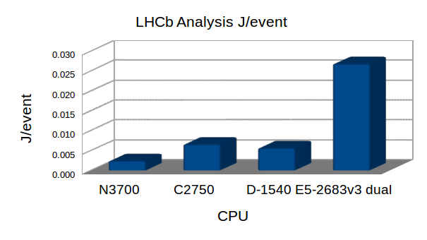
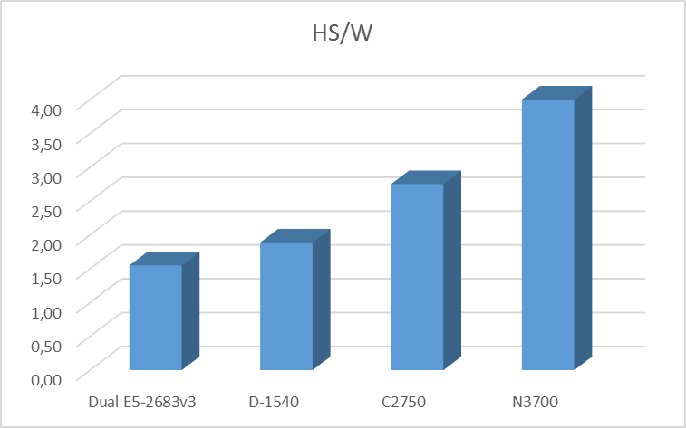
LHC offline benchmarks
A.Falabella
LHCb
HEPSPEC06
Pentium N3700 16GB
=
130€ !!!

Slide 12
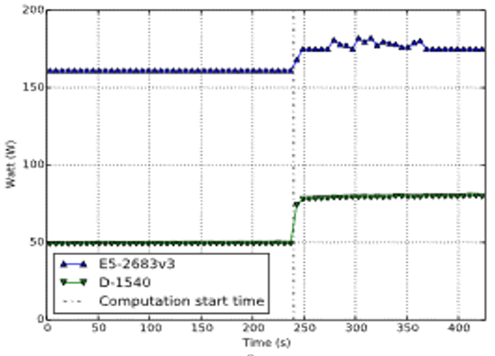
LHC online benchmarks
M.Manzali
LHCb event building
  Sw designed to simulate the event building on a InfiniBand based network
D-1540@COSA vs E5-2600@Tier1
  Same performances (not shown)
  D-1540 requires a third of the power consumption of the E5-2600

Slide 13
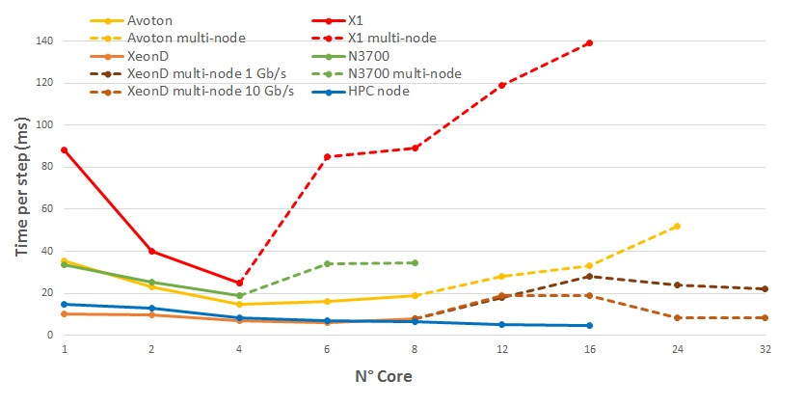
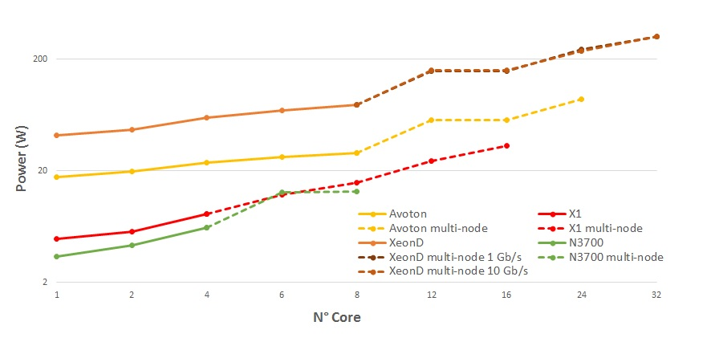
Implementation of space-aware stochastic simulator on low-power architectures.
E.Corni
L.Morganti
Implementig of a variant of a membrane system, called dynamical probabilistic P systems (DPPs), in which probabilities are associated with the rules , and such values vary during the evolution of the system according to a prescribed strategy.
Code Implementations:
Sequential
MPI
CUDA

Slide 14
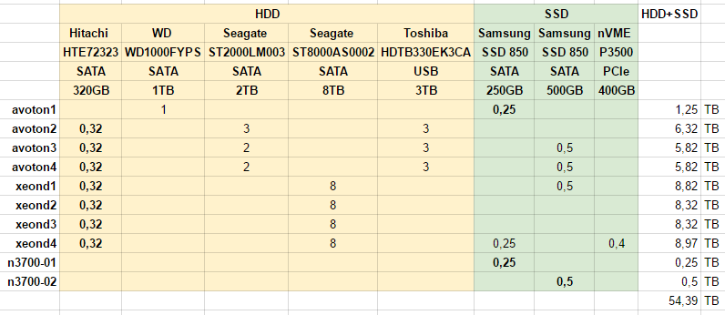
Storage benchmarks
Test DAS (Direct Attached Storage) di HDD/SDD/eNVE
Test file system distribuiti

Slide 15
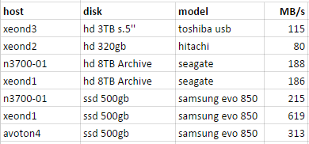

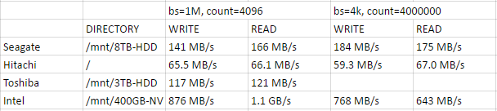
Storage (test DAS)
WRITE (dd)
READ(dd)
XEOND WRITE/READ

Slide 16
Preliminary distr. FS tests
hadoop jar hadoop-mapreduce-client-jobclient-2.7.2-tests.jar TestDFSIO -read -nrFiles 10 -fileSize 1000MB
hadoop jar hadoop-mapreduce-client-jobclient-2.7.2-tests.jar TestDFSIO -write -nrFiles 10 -fileSize 1000MB
----- TestDFSIO ----- : write
Number of files: 10
Total MBytes processed: 10000.0
Throughput mb/sec: 20.2
Average IO rate mb/sec: 20.3
IO rate std deviation: 1.75
Test exec time sec: 80.8
----- TestDFSIO ----- : read
Number of files: 10
Total MBytes processed: 10000.0
Throughput mb/sec: 68.9
Average IO rate mb/sec: 121.2
IO rate std deviation: 2.7
Test exec time sec: 44.7
Distributed FS to test:
HDFS (installed)
  10 Intel nodes
BEEGFS (installed, to reinstall)
  10 Intel nodes
LUSTRE (to install ???)
HDFS&BEEGFS convivono bene assieme

Slide 17
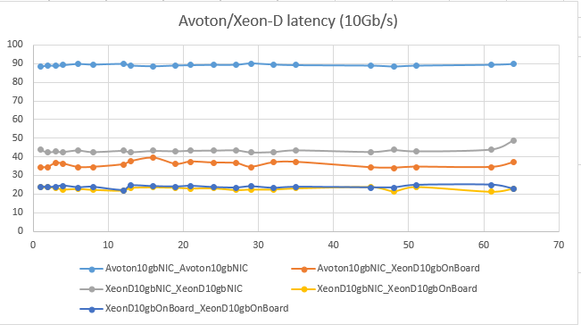
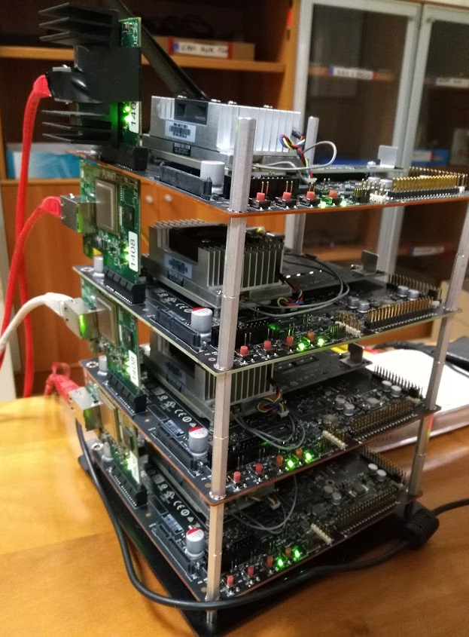
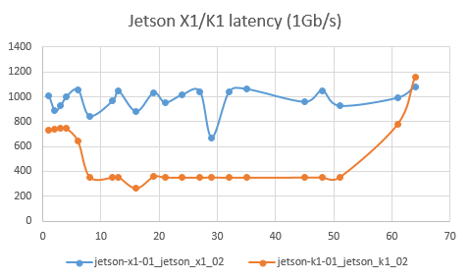
Network latency
10Gb/s for X1
La network latency è alta per tutti (IB < 2micros)
Intel meglio di ARM
X1 molto peggio di K1!!!
Installata NIC 10Gb/s (latency <100micross)

Slide 18
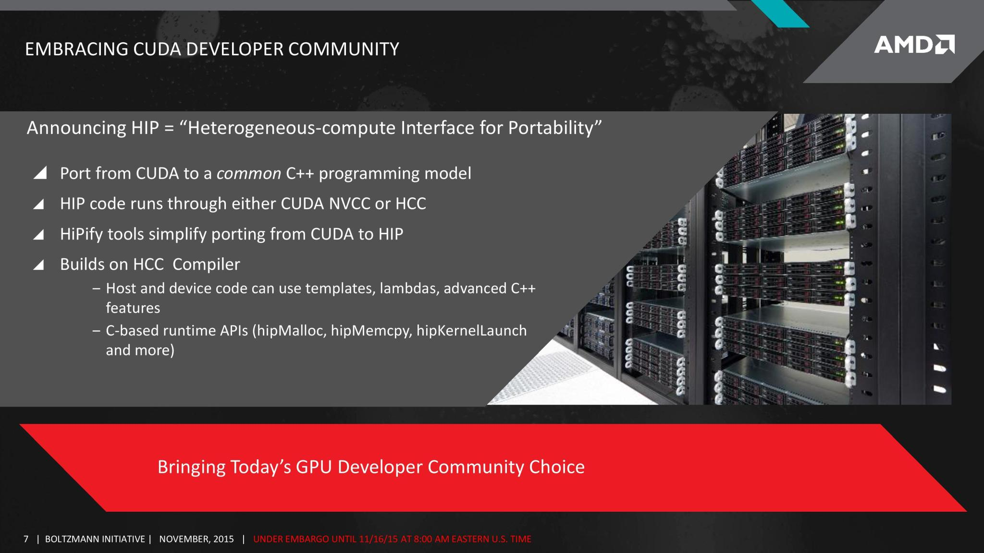
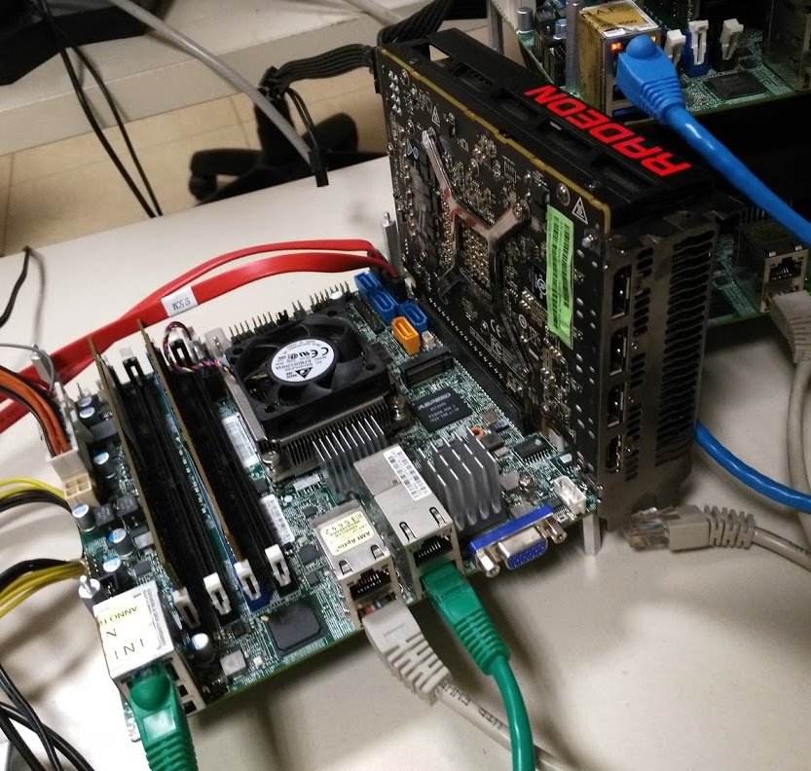

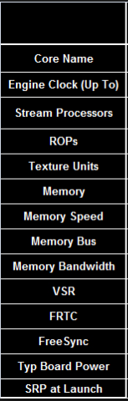
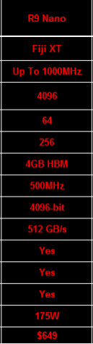
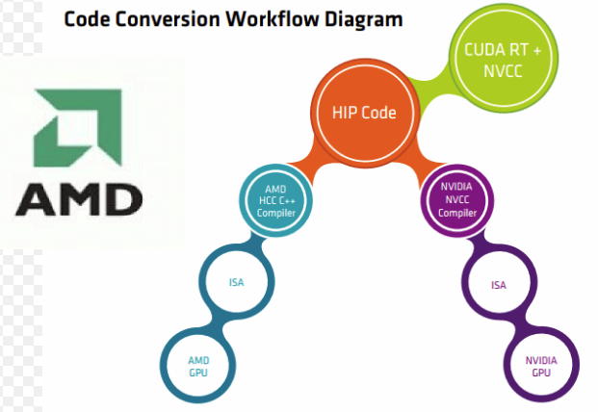
Not only CUDA (but not OpenCl)
AMD HIP
U

Slide 19
TODO 2017
Previsione attività 2017 al CNAF
Continuazione porting applicazioni e benchmarking nuove architetture low power
Benchmarking XEON PHI (acquisto a settembre 2016 già finanziato)
Benchmarking GPU AMD HIP
Benchmarking GPU Pascal (acquisto 1H 2017 finanziato)
Benchmarking fabric OMNIPATH ( finanziato)

