Slide 1

Stato progetto COSA 2016
http://www.cosa-project.it

Slide 2
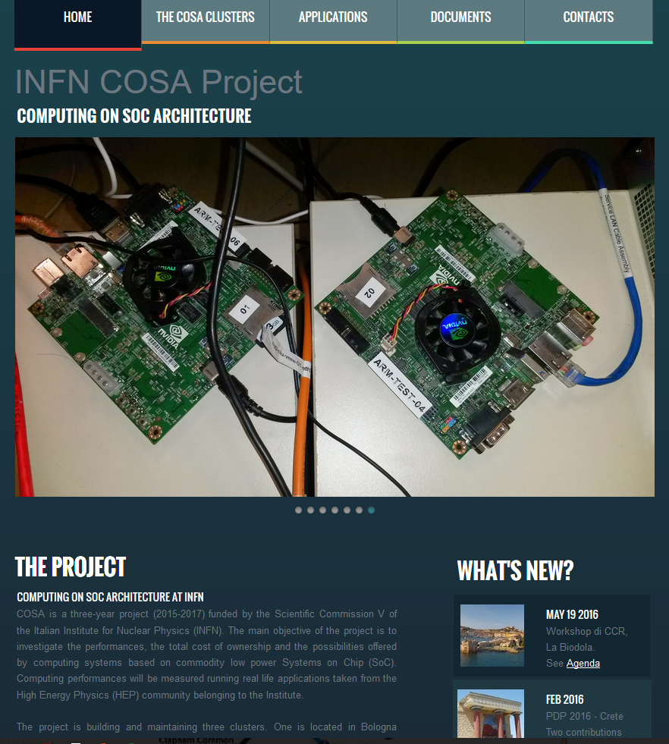

Slide 3
INFN COSA project
COSA: Computing On SOC Architecture
Duration: 3 years from January 2015
Departments: 7 INFN
  CNAF, PI, PD, ROMA1, FE, PR, LNL
BUDGET :53 kEu Year1, 53kEu Year2, 46 kEu Year3
  Funded by INFN CSN5

Slide 4
Objectives
Acquire know-how
  Porting and benchmarking of low power/low cost System on Chip
  Operations of Linux system on SoCs
  Benchmarking hybrid architectures
Unification of INFN HW testing activities
  Continuation of the COKA project
    Computing on Knights Architecture
    Porting on traditional accelerator (GPU/MIC)
  Continuation of the HEPMARK projects
    X86 benchmarking
Study of custom low latency interconnection built with ARM+FPGA devices
Prepare H2020 proposals on LowPower computing calls

Slide 5
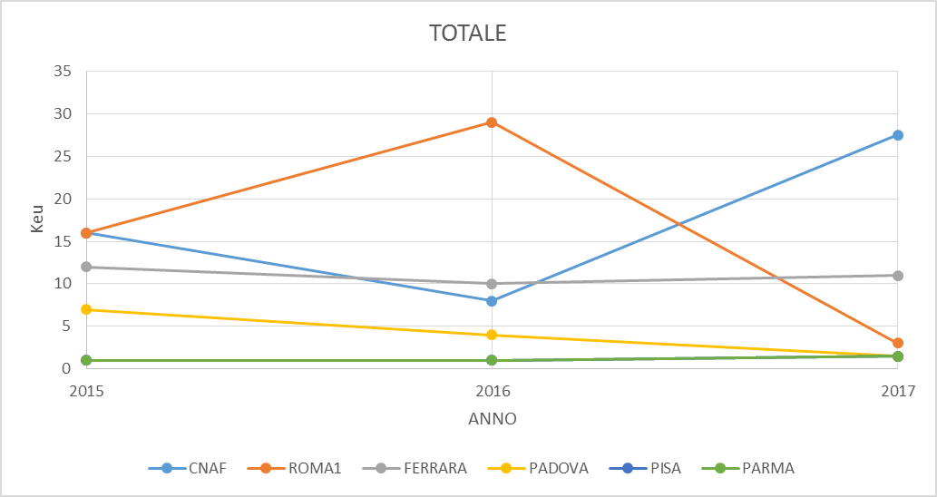
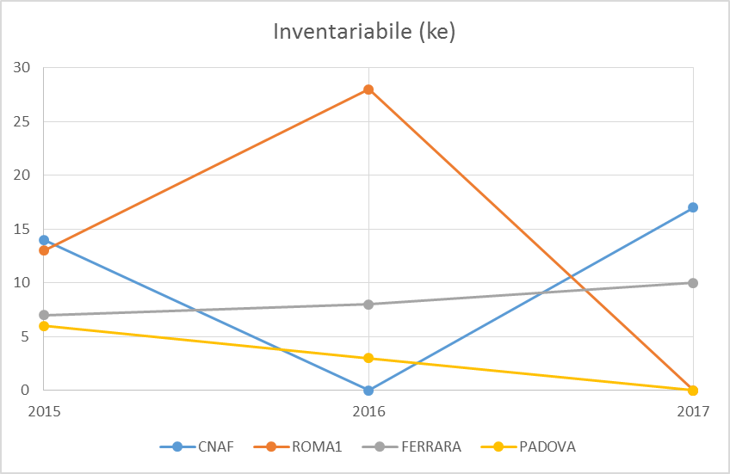
Assegnazioni
Assegnazioni 2017:
FE INV: sistema PASCAL (10 keu)
CNAF INV: switch omnipath, schede omnipath pci, 3k schede SoC low power, picoitx (17keu)
CNAF SW: rinnovo compilatore intel (6keu)

Slide 6
Inventariabile 2015/2016
2015
  RM1 – 13k Switch di rete per cluster APEnet e acquisizione PCIe Fabric switch di AVAGO
  CNAF – 14k nodi cluster + 2 switch 1gb + 1 switch 10gb + schede 10gb + HDs vari + RAM varie + alimentatore
  FE – 7k co-finanziamento con UNIFE di un cluster di 32+5 schede NVIDIA-K80, ovvero 64+10 GPU
  PD - intel Xeon D 1540 8core con HT, AMD A1100 che e' un ARM A57 8core, 16GB di RAM
2016
  CNAF: 4x jetson TX1 (fondi cnaf), 1.6 keu da spendere (consumo)
  RM1: FPGA Altera (Arria10 /Sratix10) ? + jetson x1 ? inv cnaf?
  FE: xeon PHI KNL? (preventivi disponibili)
  PD: arm64?

Slide 7
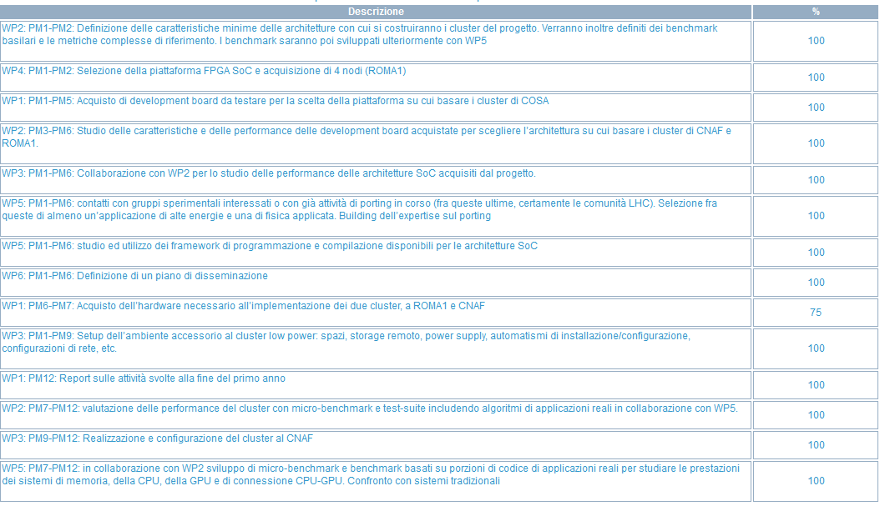
Milestones 2015

Slide 8
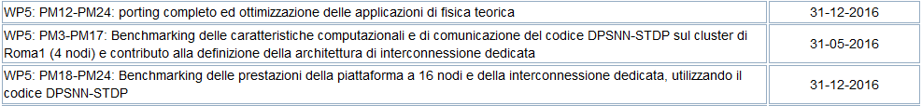
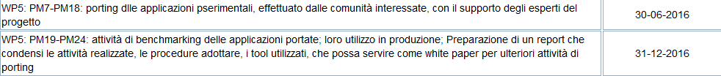
Milestones 2016/2017
+2017: valutazione interconnessioni Omnipath

Slide 9
Afferenze

Slide 10
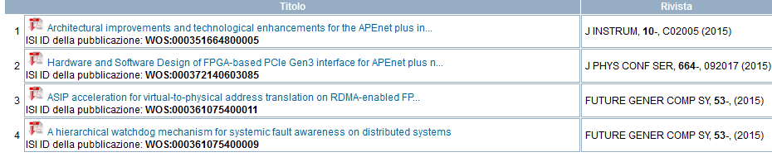
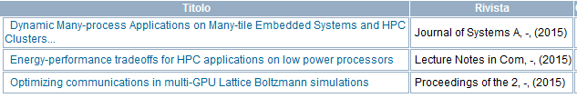
Pubblicazioni 2015
RM1 2015
FE 2015
CNAF 2016
X-Ray Computed Tomography Applied to Objects of Cultural Heritage: Porting and Testing the Filtered Back-Projection Reconstruction Algorithm on Low Power Systems-on-Chip - PDP 2016, 369-372, 2016
​
Evaluating Systems on Chip through HPC Bioinformatics and Astrophysics Applications – PDP 2016, 541-544, 2016
Manzali/falabella/Giacomini LHCb Event Building on cosa cluster 2 pubblicazioni

Slide 11
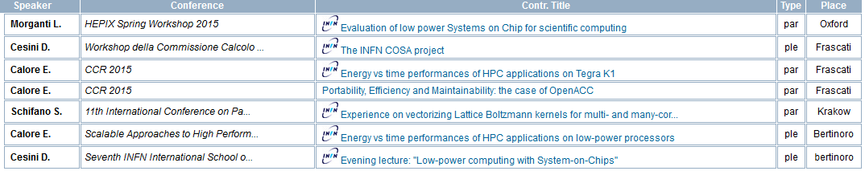
Conferenze
2015:
2016:
Presentazioni COLA WS
X-Ray Computed Tomography Applied to Objects of Cultural Heritage: Porting and Testing the Filtered Back-Projection Reconstruction Algorithm on Low Power Systems-on-Chip - PDP 2016 ​
Evaluating Systems on Chip through HPC Bioinformatics and Astrophysics Applications – PDP 2016
LHCb Event Building on low power systems @ SIF Genova
ALTRO??

Slide 12
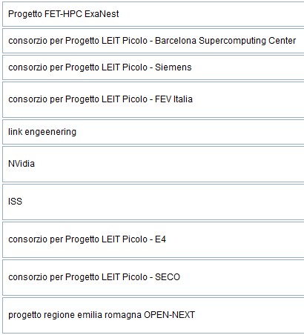
Collaborazioni 2015/2016
progetto Hercules http://hipert.unimore.it/hercules/
CIRI-ICT UNIBO MICREL LAB
Altro ??

