Slide 1
Gluon Sivers Function And Linearly Polarized Gluons In J/ψ Production In ep Collision
Sangem Rajesh
in collaboration with Asmita Mukherjee
IIT Bombay, India
TRANSVERSITY- 2017, Frascati, Italy

Slide 2
Outline
Gluon TMDs
Quarkonium Models
Sivers Asymmetry
Cos2φ Asymmetry
Summary

Slide 3
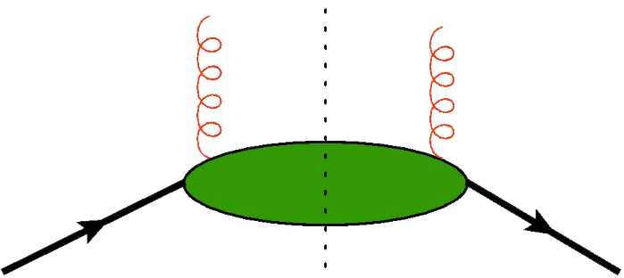
Gluon Correlator
P. J. Mulders and J. Rodrigues PRD 63 094021(2001)
Parameterization of gluon correlator at “leading twist ”

Slide 4
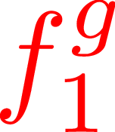
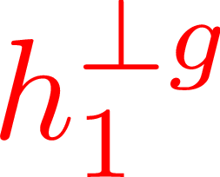
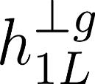
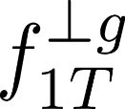
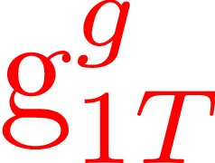
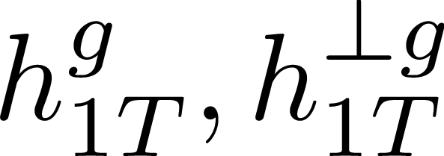
Leading Twist Gluon TMDs
Gluons Target | Unpolarized | Circularly | Linearly
Unpolarized
Longitudinal
Transverse
Boer-Mulders
Kotzinian-Mulders
Pretzelosity
Helicity
Sivers
Worm-gear
R. Angeles-Martinez et al, APhyPolB.46.2501 (2015)

Slide 5
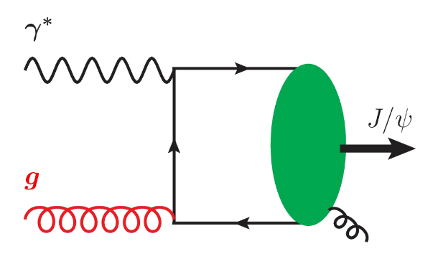
Quarkonium Production
Quarkonium is a bound state of
Color Singlet Mechanism (CSM)
Color Octet Mechanism (COM)
Color Evaporation Mechanism (CEM)
In quarkonium production , a heavy quark pair initially is produced in a definite
quantum state which can be calculated using perturbation theory.
Later, the produced heavy quark pair transform into physical quarkonium state by
emitting or absorbing soft gluons which happens at the scale below .
G. T. Bodwin et al, PRD51 (1995)
n is the color, spin and total angular momentum quantum number

Slide 6
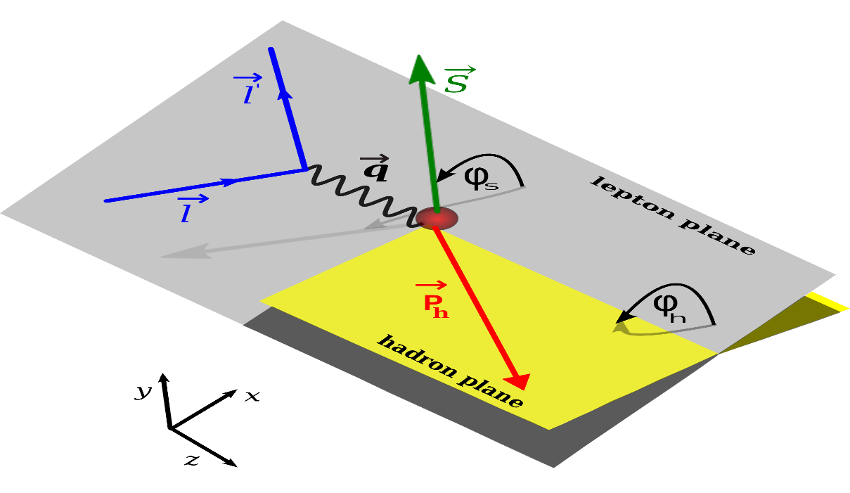
SIDIS Process
We consider a frame in which the proton and virtual photon are moving along
-z and +z axes respectively
The initial and final electron momenta have +, - and transverse components

Slide 7
Color octet states amplitudes
The amplitude for quarkonium production is given by
P. L Cho et al, Phys. Rev. D53, 6203 (1996)
is the eigenfunction of orbital angular momentum L
Clebsch-Gordan coefficient projects the orbital angular momentum
The SU(3) Clebsch-Gordan coefficient projects out the color state of heavy quark pair
either in color singlet or octet state
Spin projection operator
with for singlet (S=0) and for triplet state (S=1)
is the amplitude for the above Feynman diagrams without the external heavy
quark legs. color octet states are considered.

Slide 8
Sivers Asymmetry
Following the approach in C.Pisano et al, JHEP 10(2013)024 for heavy quark pair production,
we write the differential cross section for the process
Sivers asymmetry is defined as
The numerator term
The denominator term
A. Mukherjee, SR arXiv:1609.05596 to appear in EPJC

Slide 9
TMD Parametrization
TMDs exhibit Gaussian distribution
U. D’Alesio et al, JHEP 09, 119 (2015), 1506.03078
First time gluon Sivers function has been extracted form RHIC data by U. D’ Alesio et al.
and they reported two set of parameters “SIDIS1” and “SIDSI2”.
M. Anselmino et al, have also extracted the quarks and anti-quarks Sivers function from
latest SIDIS data. We use up and down quark Sivers function best fit parameters for
gluon Sivers function as the following (“BV-a” and “BV-b”)
M. Anselmino et al, JHEP 04, 046 (2017), 1612.06413
Boer and Vogelsang PRD 69, 094025 (2004)
M. G. Echevarria et al, have extracted quarks Sivers function in TMD evolution
approach using SIDIS data. Up and down quark Sivers function parameters are used for
gluon Sivers function as defined above (“TMD-a” and “TMD-b”).
M. G. Echevarria et al, PRD89, 074013 (2014), 1401.5078

Slide 10
TMD Evolution
In Collins-Soper-Sterman (CSS) evolution formalism, TMD pdfs depend
on
J. Collins, Foundations of Perturbative QCD, 2011 S. M. Aybat et al. PRD 85 034043 (2012)
Collins-Soper equation and RGE for TMD
Talk by “T. Rogers”, “L. Gamberg”
and “A. Prokudin”
After solving these equations, the unpolarized TMD PDF in b-space is
The derivative of Sivers function follows the same evolution as that of unpolarized
TMD

Slide 11
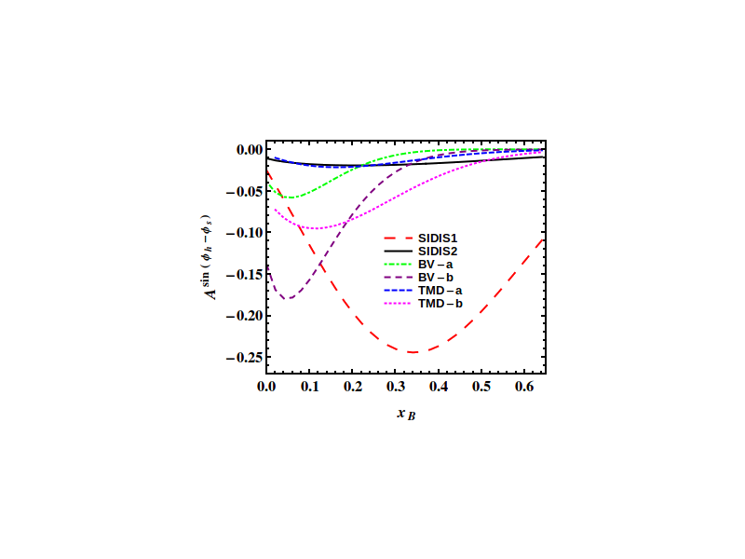
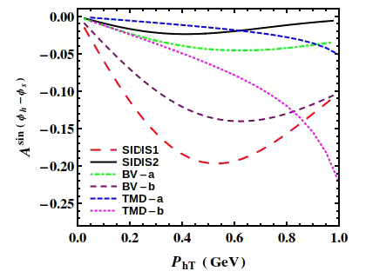
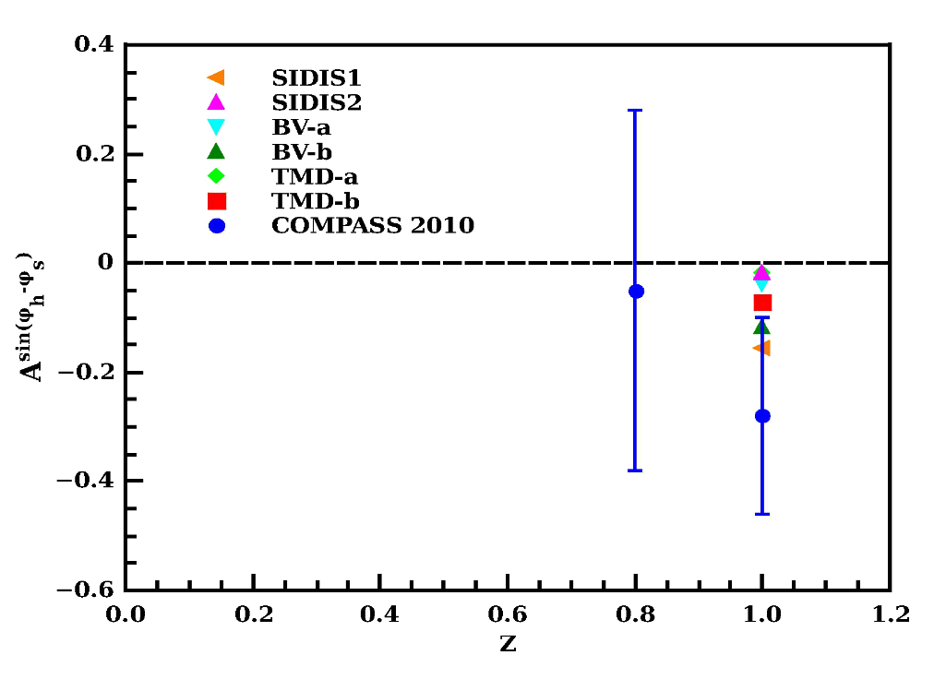
Sivers Asymmetry at COMPASS
COMPASS
A. Mukherjee, SR arXiv:1609.05596
to appear in EPJC
Data from J. Matousek (COMPASS), J. Phys. Conf. Ser. 678, 012050 (2016)

Slide 12
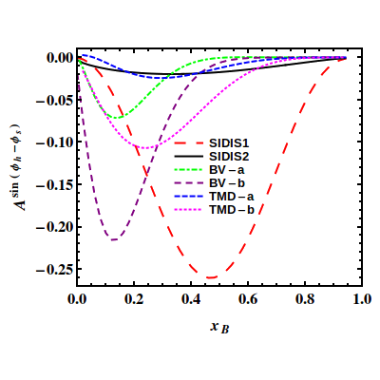
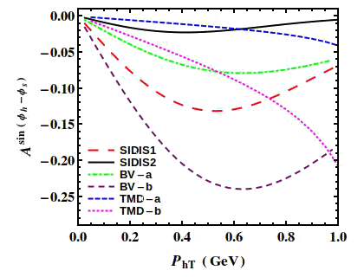
Sivers Asymmetry at EIC
EIC
A. Mukherjee, SR arXiv:1609.05596 to appear in EPJC

Slide 13
Cos2φ Asymmetry in
Assuming the TMD factorization holds, the unpolarized differential cross section
After contracting over the Lorentz indices, we get the below expression
The cos2φ asymmetry is defined as the following
Parametrization of linearly polarized TMD PDF
D. Boer et al, PRL 108, 032002 (2012)
Here r is the parameter having

Slide 14
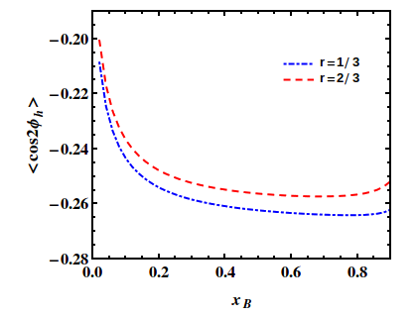
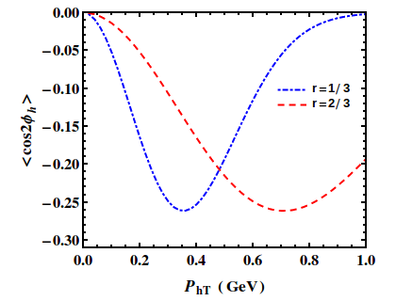
Cos2φ Asymmetry at EIC
EIC
A. Mukherjee, SR arXiv:1609.05596 to appear in EPJC

Slide 15
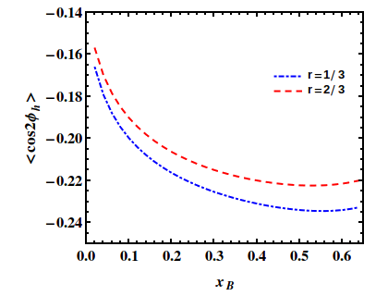
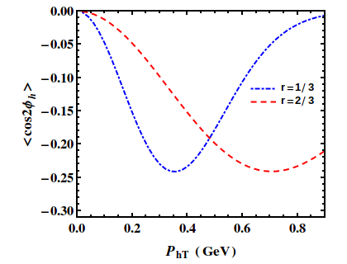
Cos2φ Asymmetry at COMPASS
COMPASS
A. Mukherjee, SR arXiv:1609.05596 to appear in EPJC

Slide 16
Summary
Sivers and Cos2φ asymmetries have been studied in J/ ψ production
in SIDIS process using COM at LO.
The Sivers asymmetry is found to be sizable and negative, which is in
good agreement with COMPASS data at z=1.
Sizable Cos2φ asymmetry is estimated as function of Bjorken variable and
transverse momentum of J/ψ .
By measuring the Cos2φ asymmetry at COMPASS, the universality
property can be tested.
The sizable asymmetries indicate that J/ψ production in SIDIS process
is a promising channel to probe the and .

Slide 17
THANK YOU

