Slide 1
LHCb Velo RF foil studies
N.Biancacci, F.Carra, M.Ferro-Luzzi, E.Métral, B.Salvant, J.Valenzuela
Beyond the LHCb Phase-1 Upgrade Workshop Elba, 30th May 2017
Acknowledgements:
G.Arduini, S.Atieh, F.Caspers, R. De Maria, M.Doets, G.Favre, W.Funk, P.Maurin, M.Migliorati, B.Popovic, S.Tavares, W.Vollenberg, M.Williams.

Slide 2
Outline
Introduction
Velo impedance studies
Resonant modes and RF heating
Broadband impedance and beam stability
Bench measurements
Investigation on alternative RF foil solutions
Conclusions and outlook

Slide 3
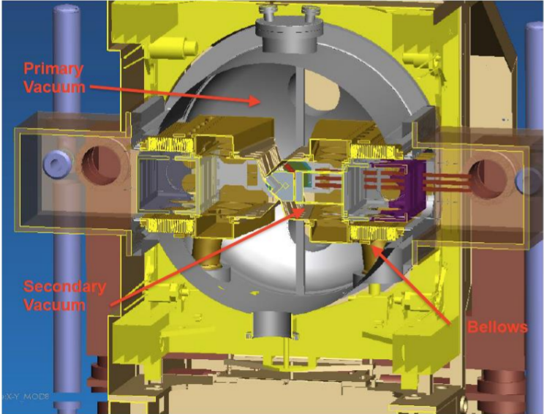
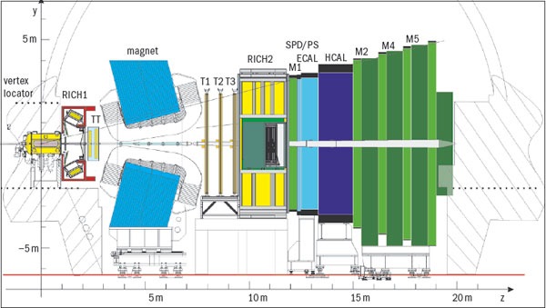
Introduction
LHCb – Ve(rtex)lo(cator)
LHCb detector
Al RF box
Velo
Picture from P. Collins, 2nd RF foil checkpoint Meeting, March 2017

Slide 4
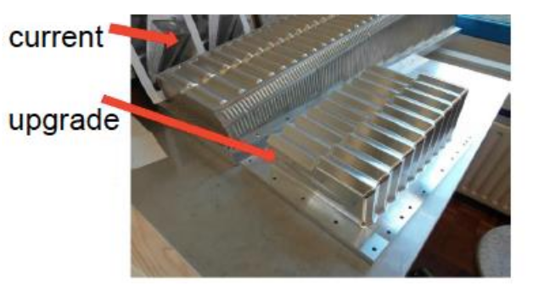
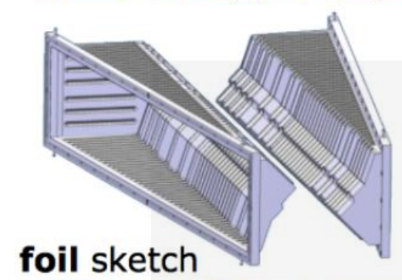
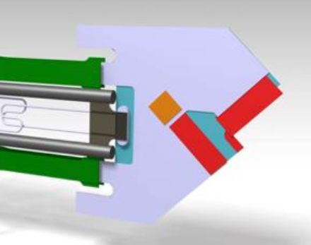
Introduction
The LHCb Velo detector will be upgraded in order to increase the resolution.
For the phase I upgrade a change in RF box shape is needed to host the new Velo pixel detectors.
New pixel sensor modules
Pictures from P. Collins, 2nd RF foil checkpoint Meeting, March 2017

Slide 5
Introduction
The LHCb Velo detector will be upgraded in order to increase the resolution.
For the phase I upgrade a change in RF box shape is needed to host the new Velo pixel detectors.
New pixel sensor modules
What is the impact on impedance and beam stability?
Pictures from P. Collins, 2nd RF foil checkpoint Meeting, March 2017

Slide 6
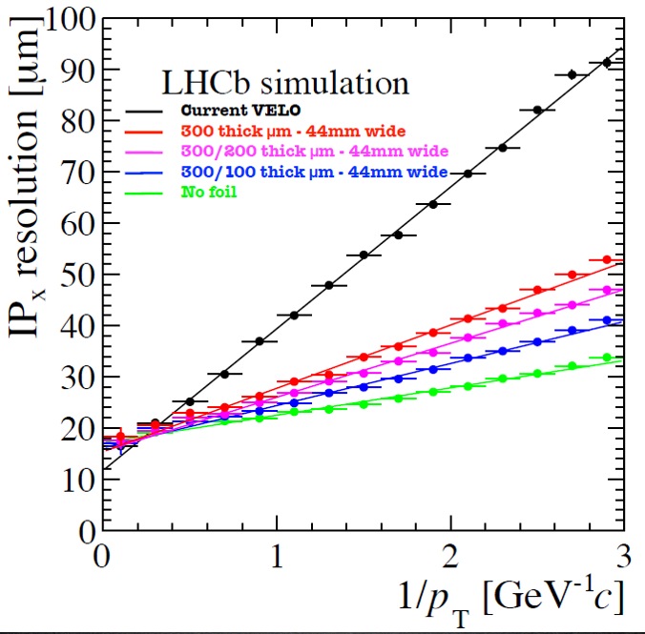
Introduction
One of the main limitation in the detector resolution is represented by the amount of multiple scattering the particle have in the Al RF box.
One solution currently explored is to reduce the Al thickness from 350um to 150um in the RF box sensitive areas.
M. Ferro-Luzzi, LHC TREX 4-12-2014

Slide 7
Introduction
One of the main limitation in the detector resolution is represented by the amount of multiple scattering the particle have in the Al RF box.
One solution currently explored is to reduce the Al thickness from 350um to 150um in the RF box sensitive areas.
Are there alternative scenarios (even for the Velo upgrade of the upgrade)?
M. Ferro-Luzzi, LHC TREX 4-12-2014

Slide 8
Outline
Introduction
Velo impedance studies
Resonant modes and RF heating
Broadband impedance and beam stability
Bench measurements
Investigation on alternative RF foil solutions
Conclusions and outlook

Slide 9
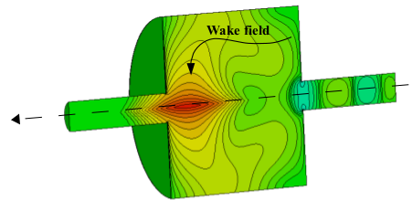
Some word about impedance
The impedance is a parameter that gathers the information on the interaction of the particle beam electromagnetic field with the surrounding space.
It is a complex function of frequency:
Resonator model: due to resonant High Order Modes (HOM) in the structure.
Broadband model: for example, due to image currents in the structure walls.
It is mainly referred as:
Longitudinal impedance -> Heating, Single and Coupled bunch instabilities in longitudinal plane.
Transverse impedance -> Single and coupled bunch instabilities in transverse plane.
It can be one of the major source of beam instabilities (together with e-cloud, beam-beam effects, …)
Cured by careful device design (prevention) and machine equipment to fight instabilities (cures) like feedbacks, octupoles, Landau cavities, etc.

Slide 10
A “fresh” instability example
B1V feedback kicker modules tripped yesterday at 21:05 during machine injection.
Vertical instability in B1 builds up with coherent intra-bunch motion leading to beam dump.
Courtesy of LHC-OP and HSC instability team

Slide 11
Some word about impedance
The impedance is a parameter that gathers the information on the interaction of the particle beam electromagnetic field with the surrounding space.
It is a complex function of frequency:
Resonator model: due to resonant High Order Modes (HOM) in the structure.
Broadband model: for example, due to image currents in the structure walls.
It is mainly referred as:
Longitudinal impedance -> Heating, Single and Coupled bunch instabilities in longitudinal plane.
Transverse impedance -> Single and coupled bunch instabilities in transverse plane.
It can be one of the major source of beam instabilities (together with e-cloud, beam-beam effects, …)
Cured by careful device design (prevention) and machine equipment to fight instabilities (cures) like feedbacks, octupoles, Landau cavities, etc.
A new design should exhibit low impedance without compromising its function

Slide 12
Outline
Introduction
Velo impedance studies
Resonant modes and RF heating
Broadband impedance and beam stability
Bench measurements
Investigation on alternative RF foil solutions
Conclusions and outlook

Slide 13
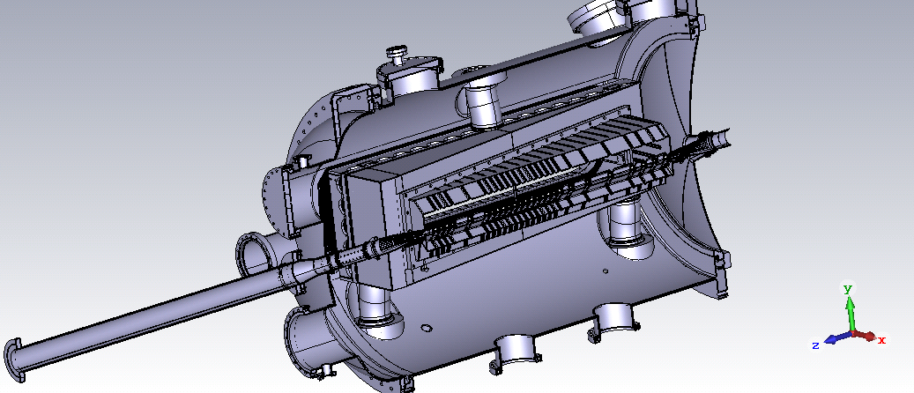
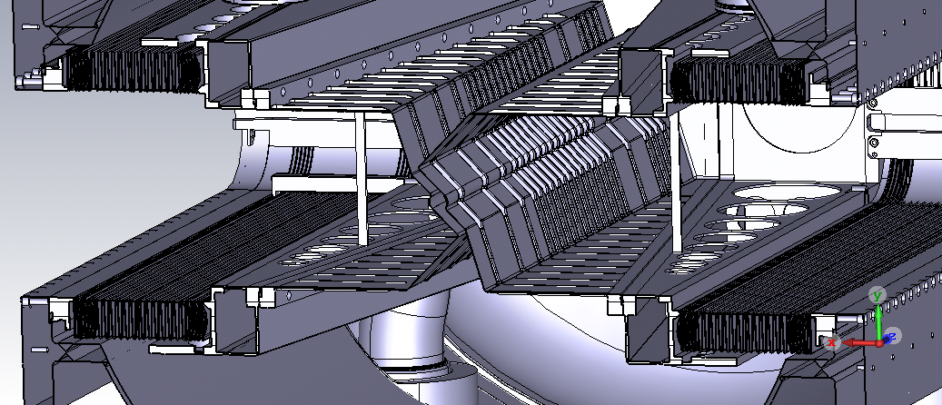
Velo impedance studies
Electromagnetic problem addressed with the help of CST Eigenmode Solver (to study HOMs) and Wakefield Solvers (to study impedance)
Past simulations and CAD simplifications made by B. Salvant (2nd RF foil meeting, March 2017)
RF box embedded in a large empty volume: presence of resonant modes.
Corrugations very close to the beam -> large impact on impedance

Slide 14
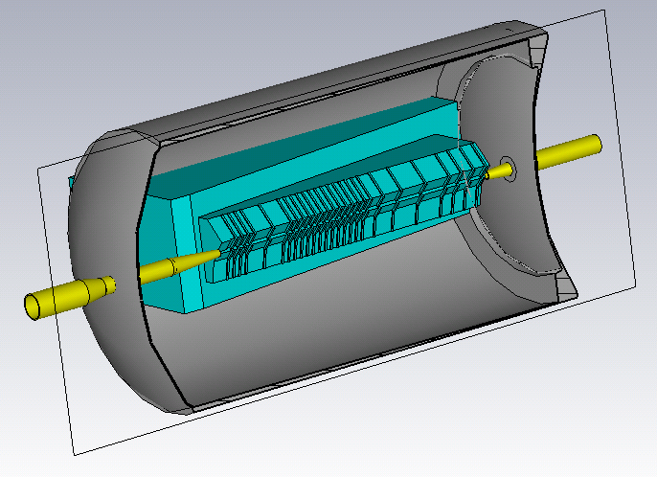
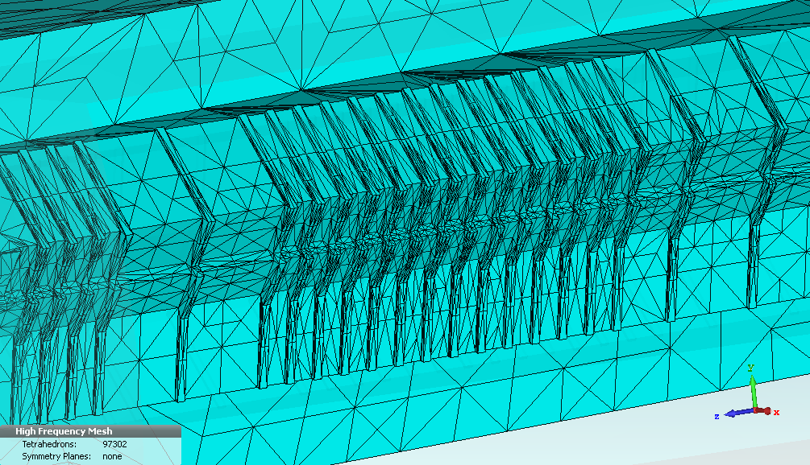
Resonant modes
Approximations made (need to resolve high spatial frequency in large volume)
Corrugations re-modeled as series of step-in/step-out,
No blending for mesh reduction.
Flat surface on the RF box remaining sides.
Wakefield suppressor (pipe in contact in close position)

Slide 15
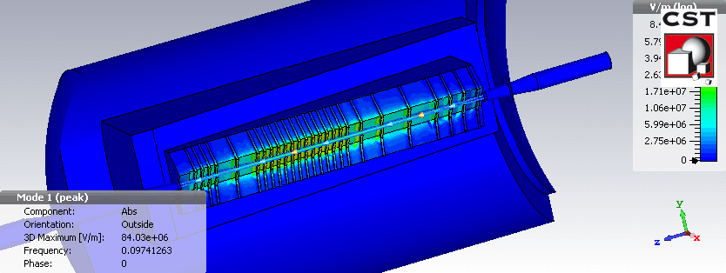
Resonant modes
CST Eigenmode solvers can give access to the impedance resonant modes parameters:
resonant frequency $f_{r}$,
shunt impedance $R_{sh}$,
Q-factor.

Slide 16
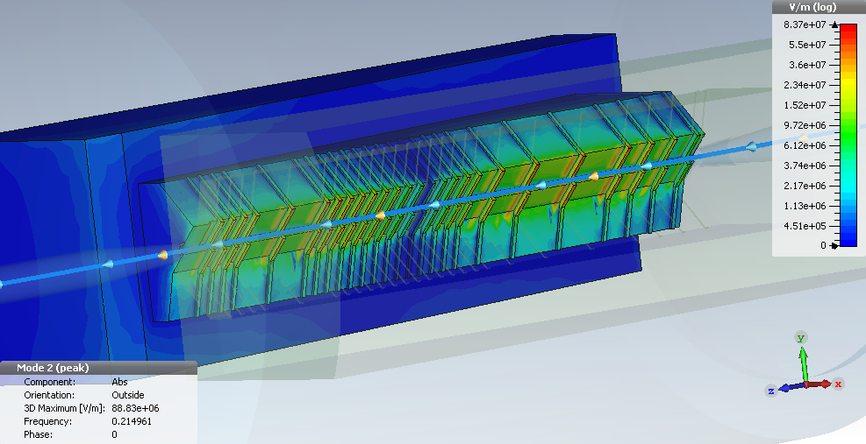
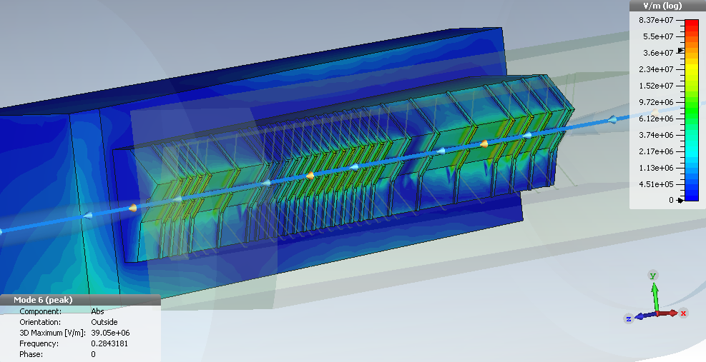
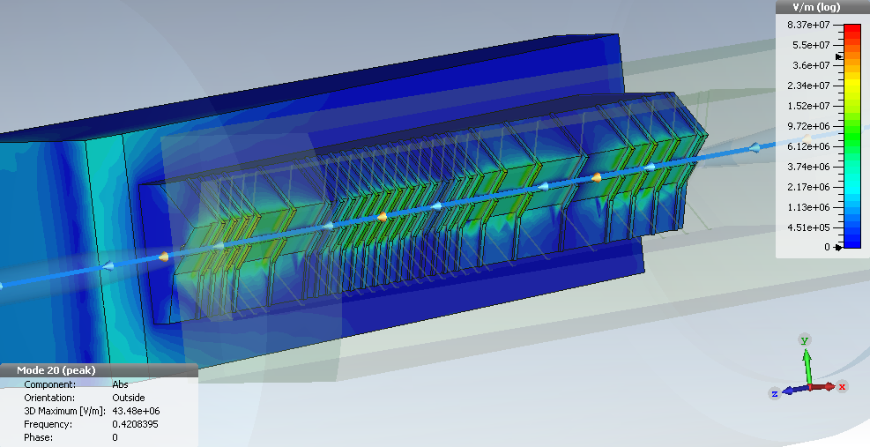
Resonant modes
Higher order multiples in frequency present in the corrugated part couple mostly with the beam.

Slide 17
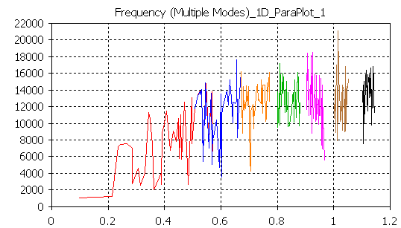
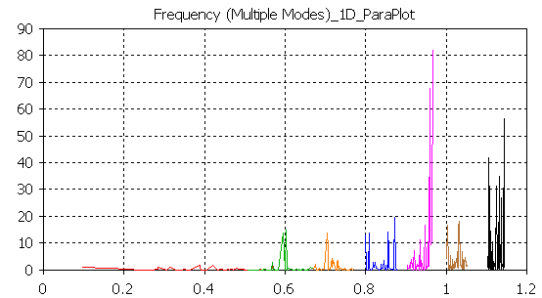
Resonant modes
Q factor
Longitudinal Shunt impedance
$$Q−factor$$
$$R_{sh} [LinacΩ]$$
GHz
GHz
Modes simulated up to 1.2GHz (beam power spectrum at -50dB).
$Q∈\left(1k, 10k\right)$
$Longitudinal R_{sh}<50 Ω$

Slide 18
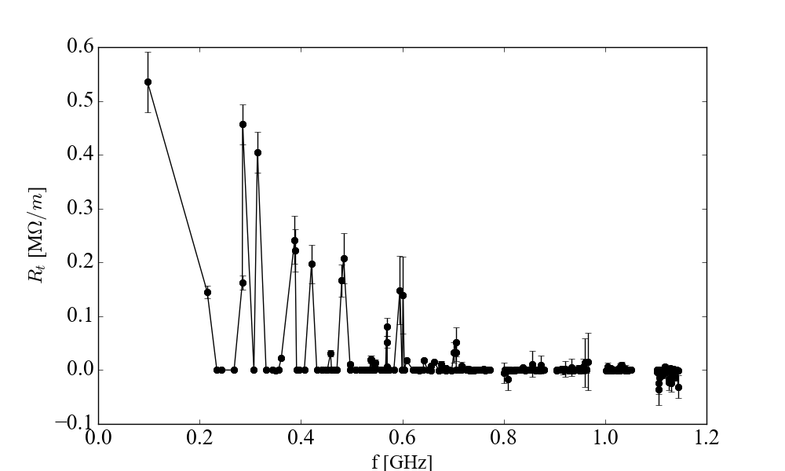
Resonant modes
Q factor
Transverse Shunt impedance
$$Q−factor$$
$$R_{sh} [MΩ/m]$$
GHz
GHz
Modes simulated up to 1.2GHz (beam power spectrum at -50dB).
$Q∈\left(1k, 10k\right)$
$Longitudinal R_{sh}<50 Ω$
$Transverse R_{sh}<500 k Ω$/m

Slide 19
Resonant modes
Q factor
Transverse Shunt impedance
$$Q−factor$$
$$R_{sh} [MΩ/m]$$
GHz
GHz
Modes simulated up to 1.2GHz (beam power spectrum at -50dB).
$Q∈\left(1k, 10k\right)$
$Longitudinal R_{sh}<50 Ω$ -> Coupled bunch instabilities not expected (threshold at $1.7 MΩ$) [1]
$Transverse R_{sh}<500 k Ω$/m -> Coupled bunch instabilities not expected (threshold at $10 MΩ/m$) [2]
[1] See B.Salvant et al. “Impedance aspects of Crab cavities”, HiLumi Workshop 2014
[2] See N.Biancacci, HL-LHC TC Meeting CERN, 05-11-2015. NB the shunt impedance is not weighted by the $β$ function (conservative approach)

Slide 20
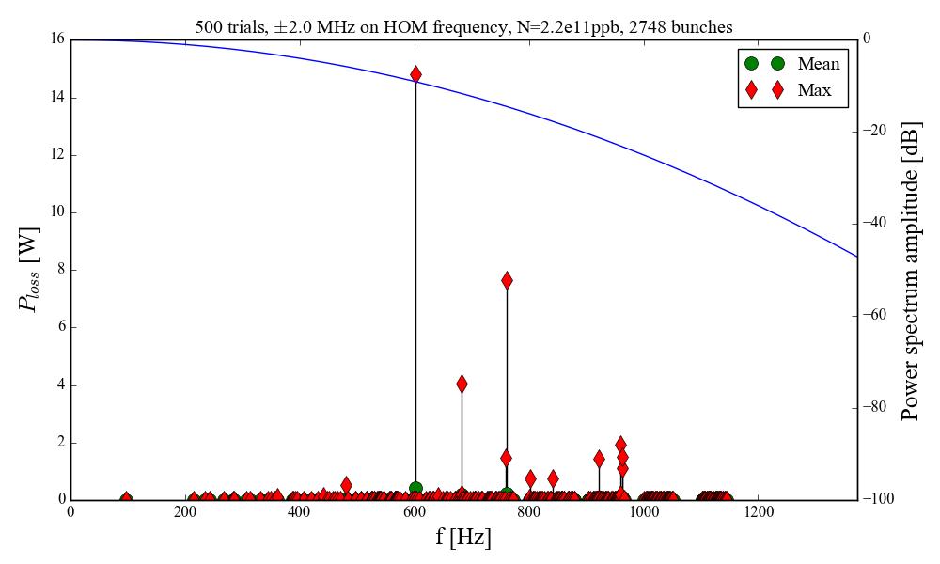
RF heating
Statistical power loss calculation assuming mode frequencies is within +/- 2MHz
Not an issue concerning heating, few W maximum from HOM.
Need to cross-check with bench measurements and/or more refined simulations reducing approximations!

Slide 21
Outline
Introduction
Velo impedance studies
Resonant modes and RF heating
Broadband impedance and beam stability
Bench measurements
Investigation on alternative RF foil solutions
Conclusions and outlook

Slide 22
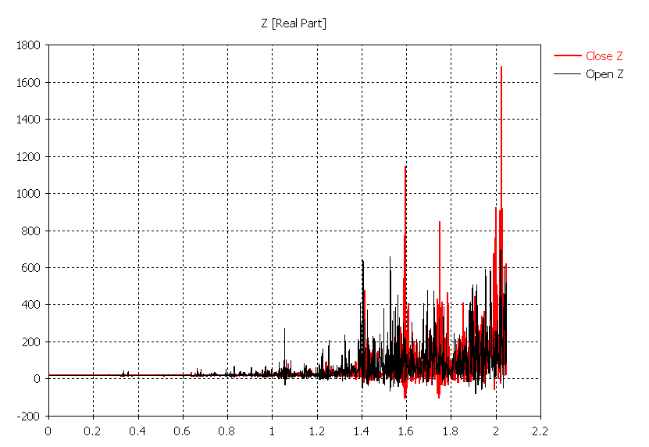
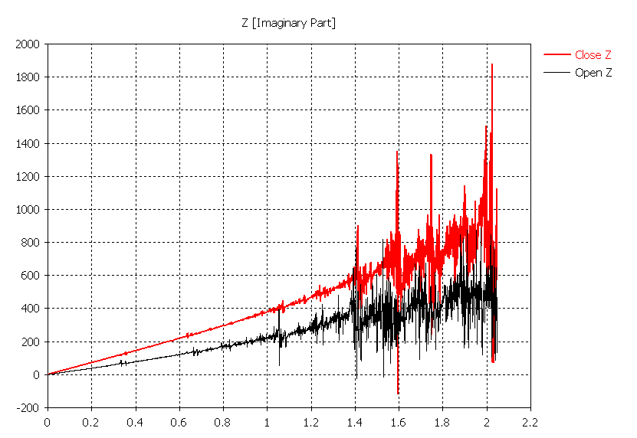
Longitudinal impedance
Real part
Imaginary part
Wakefield Solver
GHz
GHz
Similar mode pattern in both open/closed position.
Broadband impedance induces to ~20W power loss due to wall losses.
Inductive impedance due to array of cavity-like structure. Factor 2 reduction close -> open.
Impact is ~5mOhm on the total HLLHC longitudinal impedance budget of 91mOhm.

Slide 23
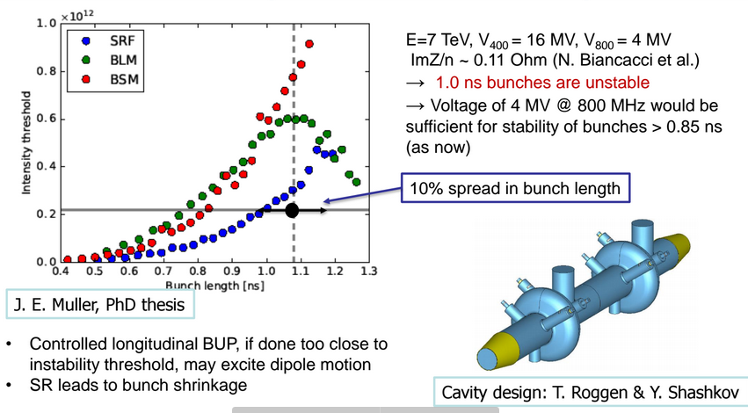
Longitudinal impedance
E. Shaposhnikova, WP2 23/09/2016
With HL-LHC bunch length update to 1.2ns, more margin allowed and LHCb 5% impact can be accepted.

Slide 24
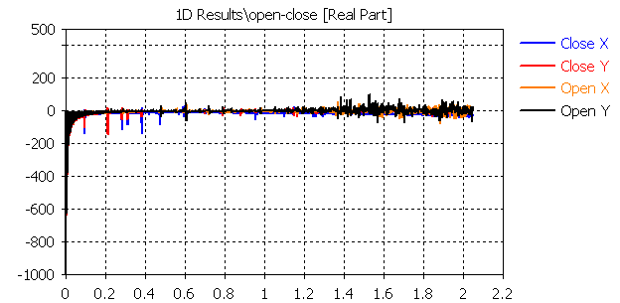
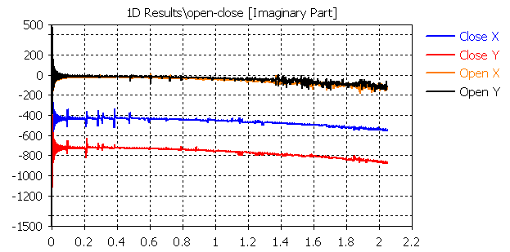
Transverse impedance
Real part
Imaginary part
CST-Wakefield simulation. Beam displaced of Δ=-1mm
GHz
GHz
Up to 1 MOhm/m broadband impedance in closed position.
Velo has low $β$ function with respect to the rest of the lattice: $β_{VELO}=26m$ if $β_{IP8}^{}=1m$ which gives 37% reduction in impedance.
0.37MOhm/m over the HL-LHC impedance budget of ~20MOhm/m -> Acceptable
Comparable to a single collimator impedance -> Could be measured also with beam performing IN/OUT movements and looking at the betatron tune variation.

Slide 25
Outline
Introduction
Velo impedance studies
Resonant modes and RF heating
Broadband impedance and beam stability
Bench measurements
Investigation on alternative RF foil solutions
Conclusions and outlook

Slide 26
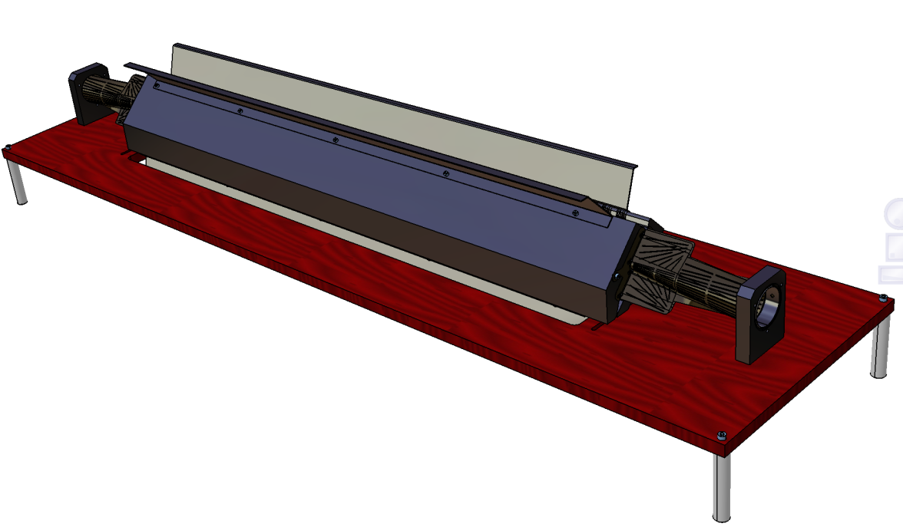
Impedance measurements
Many assumptions hidden in the simulated models.
Bench impedance and bead pull measurements highly recommended to avoid surprises.
Mockup requested and being designed (M.Doets - NIKHEF) and simulated (B.Popovic - CERN).
Courtesy of M. Doets (NIKHEF)

Slide 27
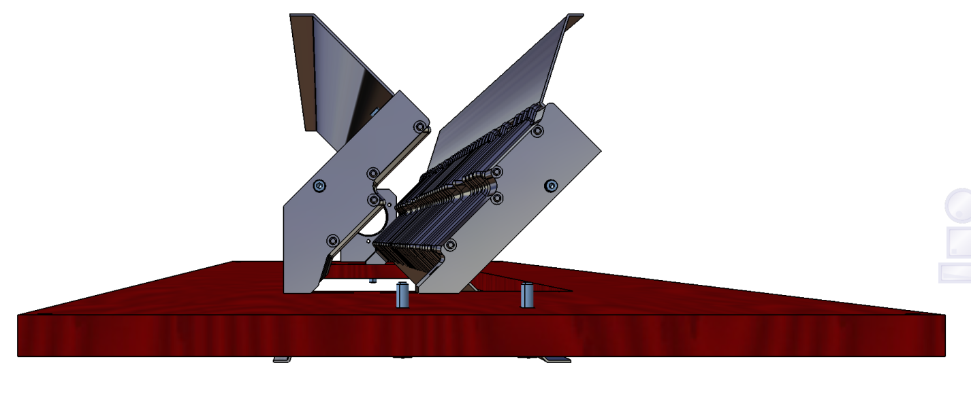
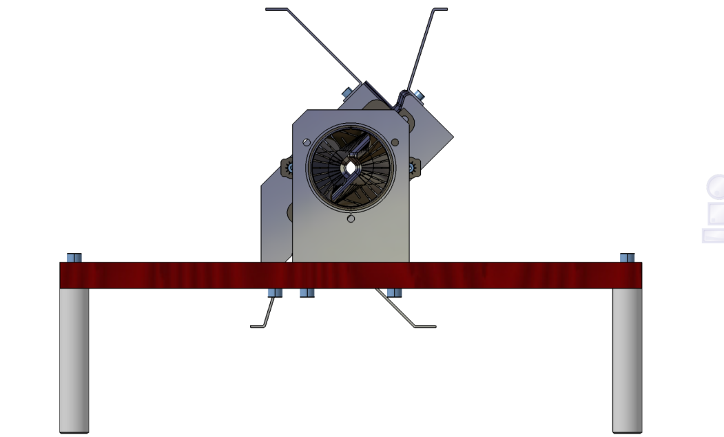
Impedance measurements
Open gap (30mm)
Close gap (3.5mm)
We can verify:
Impact of modes located between corrugations.
Effect of wakefield suppressor.
Effect of corrugation blends.
Effect of gap closed/open.
The structure would radiate in air -> can only benchmark modes developing within the foils gap.
Courtesy of M. Doets (NIKHEF)

Slide 28
Outline
Introduction
Velo impedance studies
Resonant modes and RF heating
Broadband impedance and beam stability
Bench measurements
Investigation on alternative RF foil solutions
Conclusions and outlook

Slide 29
Alternative scenarios for RF foil
Main requirements on the RF foil:
As thin/light as possible (improves detector impact parameter)
Mechanical stability to 10um
Vacuum leak tightness
Temperature resistant (-40C to 180C bake-out).
Should withstand 10mbar pressure difference if primary/secondary vacuum are kept.
Withstand radiation doses of up to 1000 Mrad (from TDR of LS2 upgrade)
Low impact on impedance
Low impact of RF interference

Slide 30
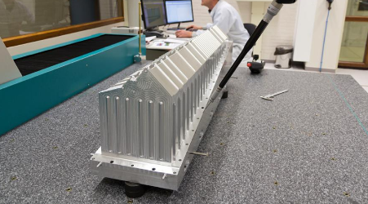
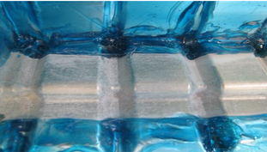
Alternative scenarios for RF foil
Al RF foil thinning by etching
Baseline option for phase-I upgrade being followed up with NIKHEF.
Promising results of chemical etching down-to 250um, being tested to get 150um.
Extensive description of etching tests in P.Maurin, 2nd RF foil checkpoint Meeting
Courtesy of P.Maurin, 2nd RF foil checkpoint Meeting, March 2017
Courtesy of W. Hulsbergen, 2nd RF foil checkpoint Meeting, March 2017

Slide 31
Alternative scenarios for RF foil
Al RF foil thinning by “polishing”
Discussed with CERN experts G.Favre and S.Atieh.
Novel technique for surface polishing down to order of 10nm.
Uses water polishing with diamond particles.
Polishing for longer time scales would provoke surface erosion similarly to etching.
An Al RF box window could be provided for testing.

Slide 32
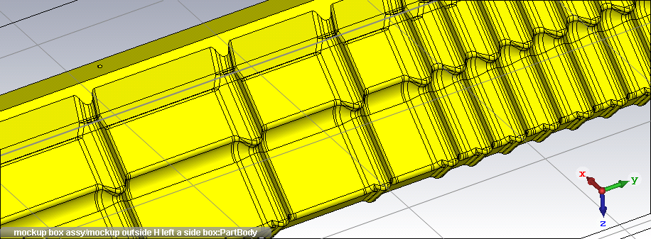
Alternative scenarios for RF foil
Al RF screen with Al thin foil in sensitive areas.
The foil could be prepared as thin as 10 um and soldered to the rest of the (thicker) Al box by means, for example, of continuous resistance welding.
The soldering procedure is not straightforward and cannot ensure leak tightness.
Similar design could be tried with MgAl alloys (no expertise at CERN, need to outsource)

Slide 33
Alternative scenarios for RF foil
Metal coating on polymers.
An option could be using PEKEKK polymers (high temp. melting point ~380 C).
Expertise with polymers already present at CERN and currently being investigated (S.Tavares).
Transparent to particles.
Possibility to mill halves to approach more the detectors.
Need to be coated to screen RF fields (50-100um Cu)
Could reconsider the presence of foil corrugations.
Already done at CERN in the past for a crab cavity mokup (P.Maurin)
Detector
Detector
Polymer
Coating

Slide 34
RF interference
100 um
1uΩ.m
100nΩ.m
40 MHz
10nΩ.m
1nΩ.m
The foil screening efficiency against RF interference can be quantified looking at the skin depth versus frequency for different materials.
For 25ns spacing, the first spectral line falls at 40 MHz and fields resonances are above ~100MHz.
A good screening requires ~3 times the skin depth (penetrating field amplitude at 5%)
For Cu coatings we can accept ~50 um (1 skin depth) to ~100um (3 skin depth)

Slide 35
Alternative scenarios for RF foil
No RF foil
Would be the best option to improve resolution (see also P.Owen talk yesterday)
Need to make detectors and electronics/cables compatible with LHC primary vacuum (discussion on going with vacuum experts)
Cannot imagine absence of path for beam image currents -> huge resonant modes in the whole geometry (large pillbox), fields at the detectors, edge effects, heating, …
Wire-cage structure may ensure partial screening.
RF field coupling inside could be removed by ad-hoc All Mode Couplers.
Engineering questions: wire path, spacing, orientation, radius?

Slide 36
Outline
Introduction
Velo impedance studies
Resonant modes and RF heating
Broadband impedance and beam stability
Bench measurements
Investigation on alternative RF foil solutions
Conclusions and outlook

Slide 37
Conclusions and outlook
The phase-I upgrade geometry of the LHCb Velo represents a challenge for mechanical realization and from the impedance evaluation point of view.
Velo CST impedance simulations have been updated improving the Electric field sampling necessary for shunt impedance calculation -> Required careful setup of the simulations / tricks to ensure convergence.
Longitudinal and transverse resonance shunt impedances are low and within thresholds-> but the model is idealized (no corrugation blendings, simpler wakefield solver, etc..)
Longitudinal broadband impedance of 5mOhm (5% of HL-LHC budget) is not negligible but acceptable as we have gained margin with new bunch length HL-LHC baseline of 1.2ns.
Heating from resistive wall impedance is ~20W; resonant modes give few W.
Transverse impedance is ~300kOhm/m accounting for beta function reduction factor (1.5% of HL-LHC budget): acceptable
Mockup measurements being defined with NIKHEF to confirm or not these results.
Alternative RF box solution proposed for the detector upgrade of the upgrade:
Surface thinning by etching (current one)
Surface thinning by novel polishing technique (promising, mokup needed for testing)
Al/Mg thin foils in selected areas (to be proved leak tightness)
Coated polymer (promising, 50um-100um Cu needed as a first evaluation for RF interference clearing)
Wire cage (vacuum compatibility – wire spacing, radius, shape to be studied)
Feasibility to meet all the constraints still to be demonstrated and being followed up.

Slide 38
Many thanks

Slide 39
Appendix

Slide 40
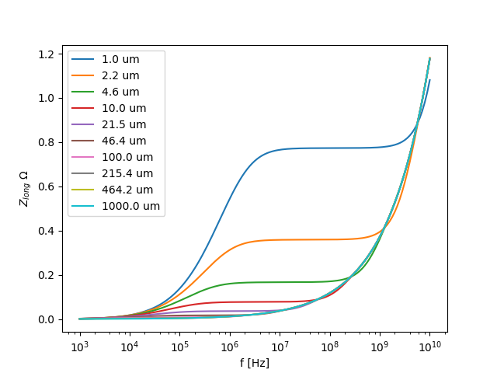
RF interference
Longitudinal impedance Vs coating thickness
SS340L
50cm
Vacuum
Cu
3.5mm
Vacuum
Beam
40 MHz
Verified in a simple flat symmetric geometry: two separated layers of Cu and SS340L.
The impedance ‘’sees’’ only the copper layer if a coating of 50-100 um is used.
Next steps:
Quantify Shielding Efficiency (SE) from absorbed and reflected waves at the coating interface.
Effect of Cu coating on Impact parameter (denser but thinner than present Al material).
Compare with electromagnetic interference tolerance on detectors.

Slide 41
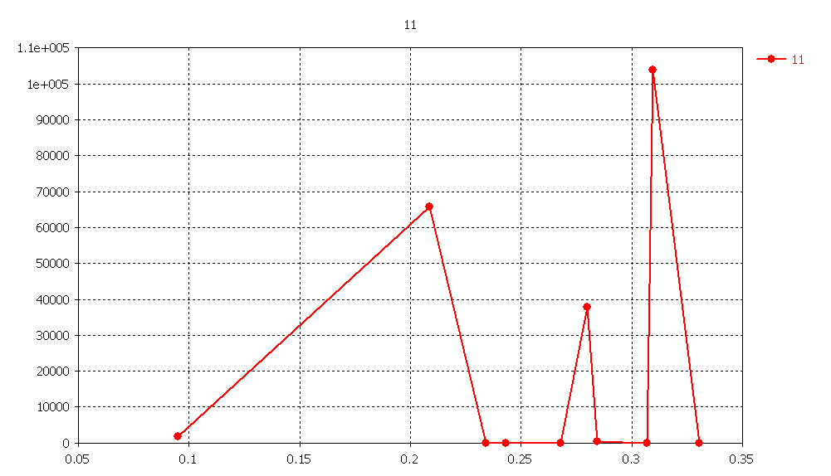
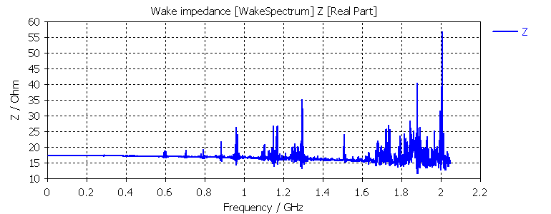
First simulations
Eigenmode Solver
Wakefield Solver
Eigenmode field post-processing allows for automatic calculation of shunt impedance.
Shunt impedances in the order of 10-100kOhm: worrying for longitudinal stability.
Not seen as high in the Wakefield Solver -> hint of potential issue!

Slide 42
Mesh improvement
Higher sampling on the convolution areas can improve the field quality.
The CST-Eigenmode Solver convergence tests are done in frequency which is a global parameter (i.e. depends on the full geometry).
A change in a small detail does not affect too much the result.
The field (i.e. the eigenvector) is a function of the 3D space and may have strong values in narrow regions -> dense mesh needed to describe these details.
Achieved with local higher meshes in sub-volume -> 200k mesh

Slide 43
Post processing
Auto sampled
1mm sampled
Sampling with 1mm, the filed variation looks much smoother

Slide 44
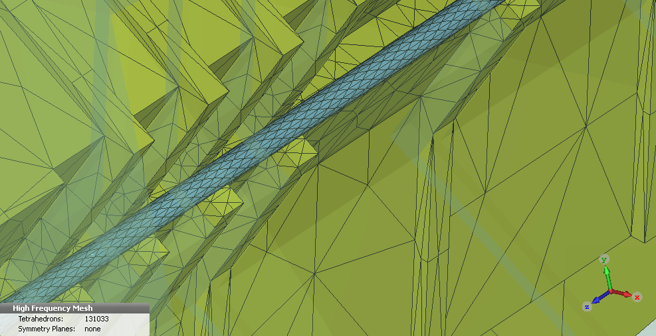
Resonant modes analysis
As the field changes quite abruptly between the convolutions, it is important to sample enough the electric field on axis when computing the shunt impedance.
A solution is found using a cylinder where the mesh is regular equispaced.
Still convergence checks being made…

Slide 45
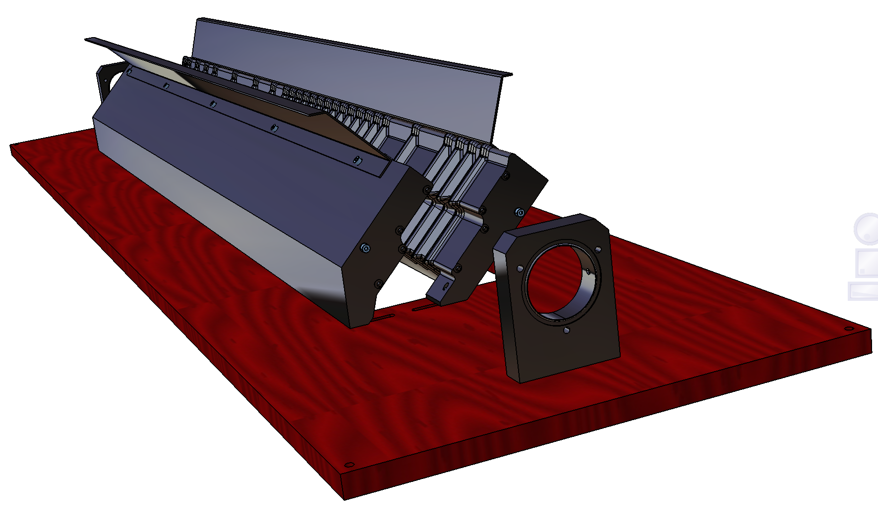

Slide 46
Closed position
30mm
30mm
Large washers
for M6 bolts
Open position

Slide 47
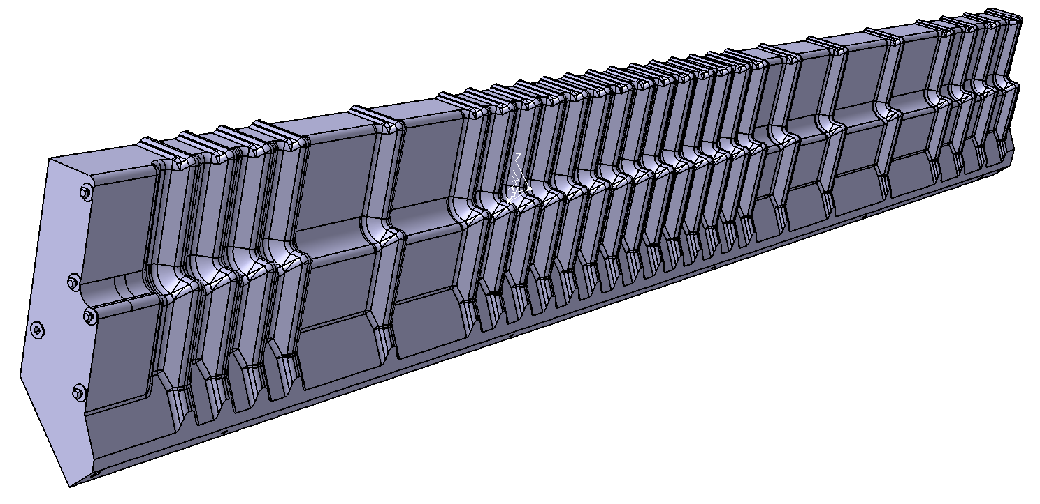
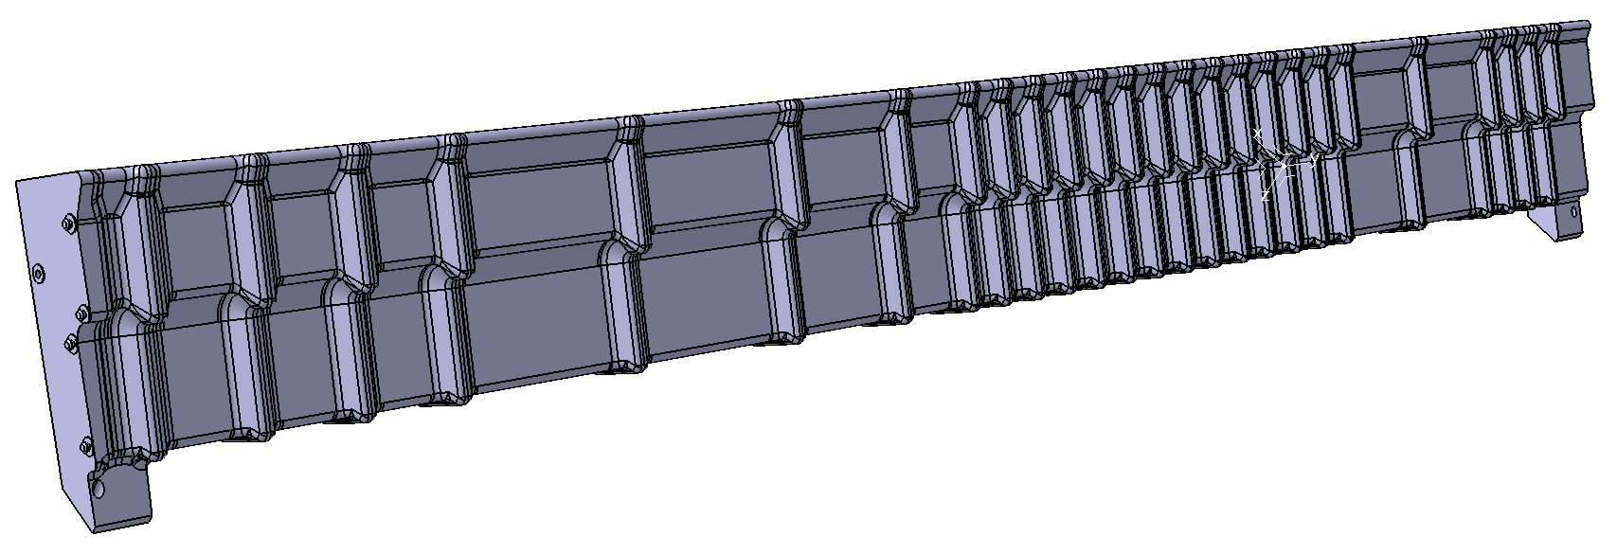

Slide 48
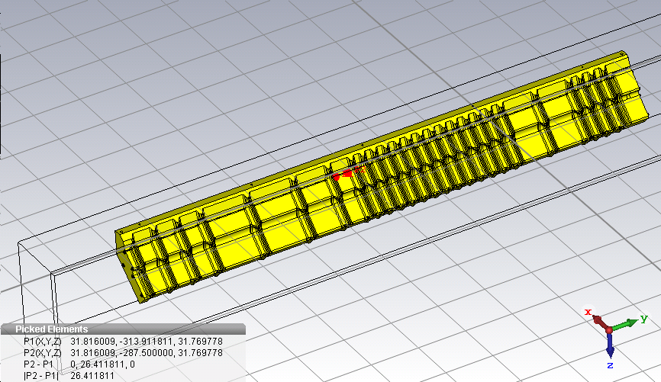
Alternative scenarios for RF foil
~1m
100mm
25mm
31mm

Slide 49
Alternative scenarios for RF foil
10x31
25x31
100x31
10x31
100x31
25x31
100x31
Can we solder thin foils (50um) of Al with these dimensions on a thicker envelope (350um)?

Slide 50
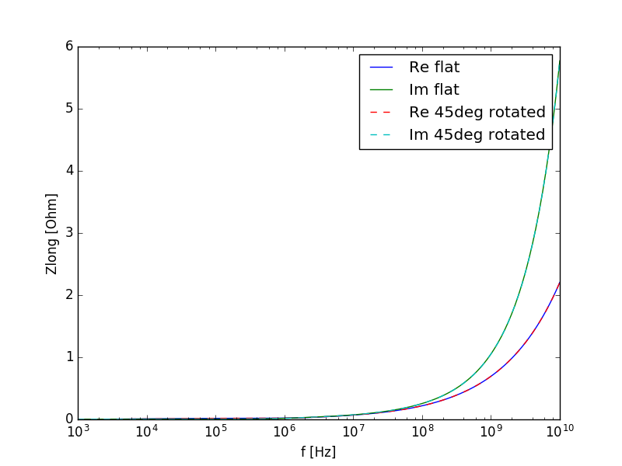
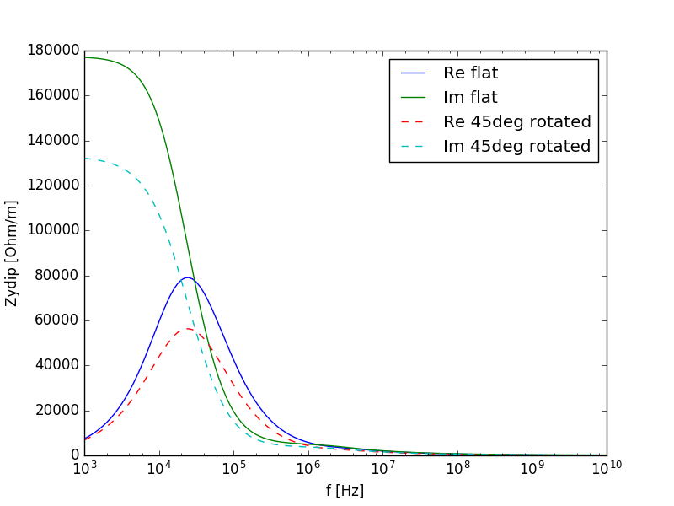
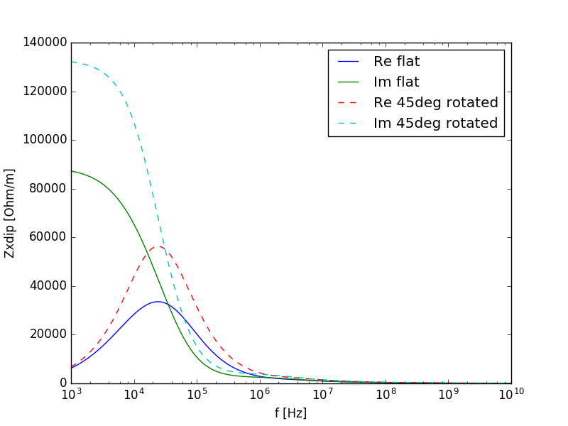
IW2D simulations

Slide 51
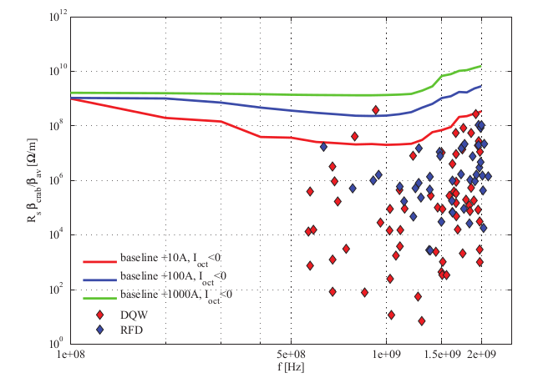
Transverse stability limits
The transverse HOM shunt impedance should be less than 10 MOhm/m* to be negligible.
* In reality the threshold is a complex function of frequency. We take here the most conservative parameter adapted to HOMs at 1GHz frequency.

Slide 52
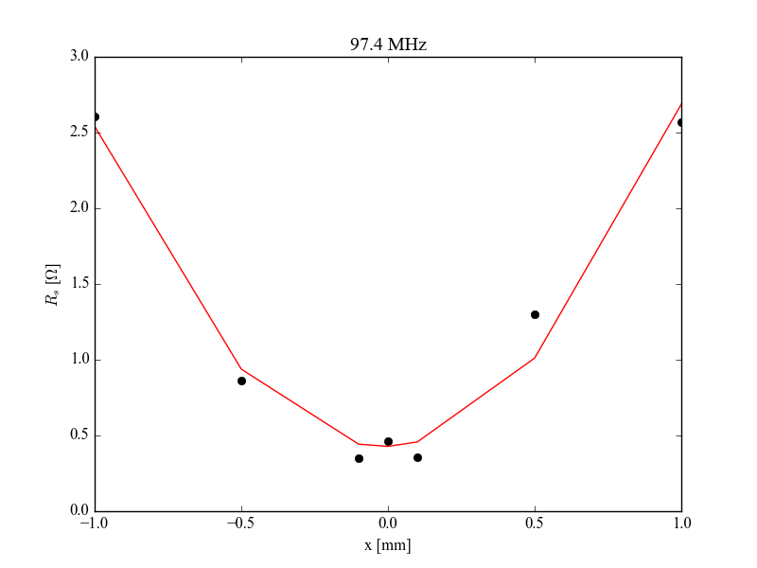
First transverse HOM

Slide 53
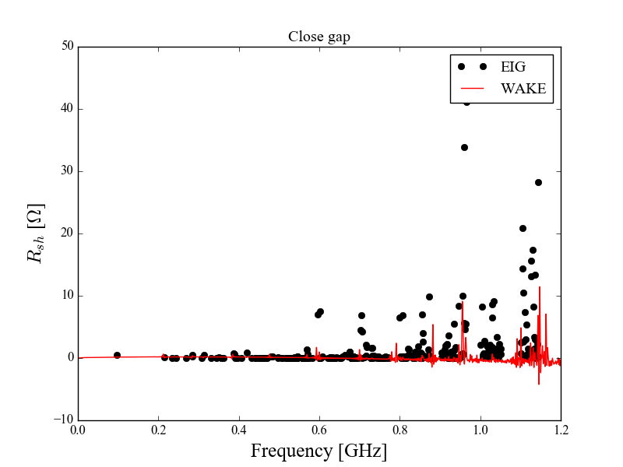
Comparison EIG/WAKE CST solvers

