Slide 1

SESAME: A Source of Light in the Middle East
SESAME
Zehra Sayers
Director Foundations Development Program, Sabanci University,
Chair SESAME Scientific Advisory Committee

Slide 2
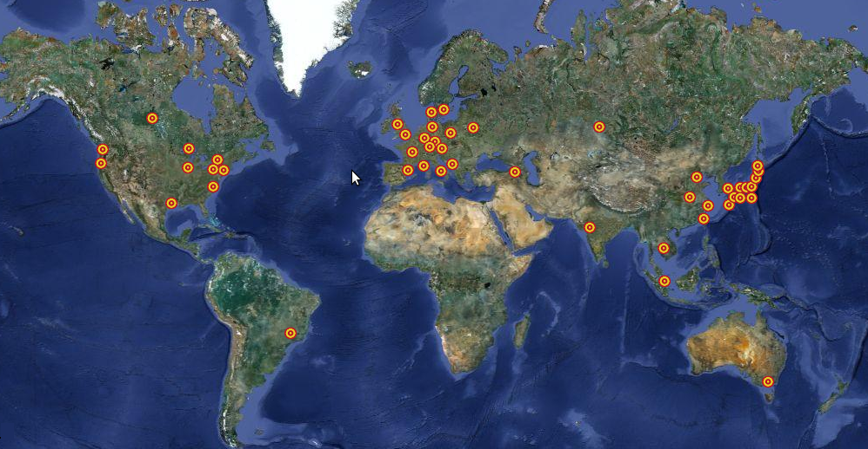
SESAME
SESAME: Synchrotron Light for Experimental Science and Applications in the Middle East
A synchrotron light source located near Amman, Jordan.
www.sesame.org.jo
There are more than 60 light sources around the world;
None in the Middle East.

Slide 3
SESAME
SYNCHROTRON RADIATION (SR)
EM Field
EM Force
BM source
Electron orbit
Synchrotron radiation
-High intensity: 10¹³ photons on the sample
-Narrow band width
-Tunable; infrared to X-rays
-Pulsed time structure
Sources: Bending magnet and insertion devices

Slide 4
SESAME
SYNCHROTRON RADIATION (SR)
Archaeology
Chemistry
Medicine
Arts
Synchrotron Radiation
Energy
Science
Physics
Materials
Science
Environmental
Science
Cross-talk among disciplines

Slide 5
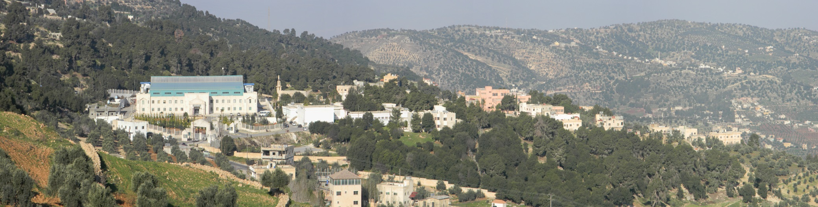
SESAME
SESAME’S MISSION
Foster excellence in science and technology in the Middle East.
Reverse brain drain in the region.
Enhance regional science and technology infrastructure.
Contribute to improved understanding among peoples of diverse backgrounds through peaceful scientific cooperation.
Buildings can also be used for high-quality Middle East Scientific meetings

Slide 6
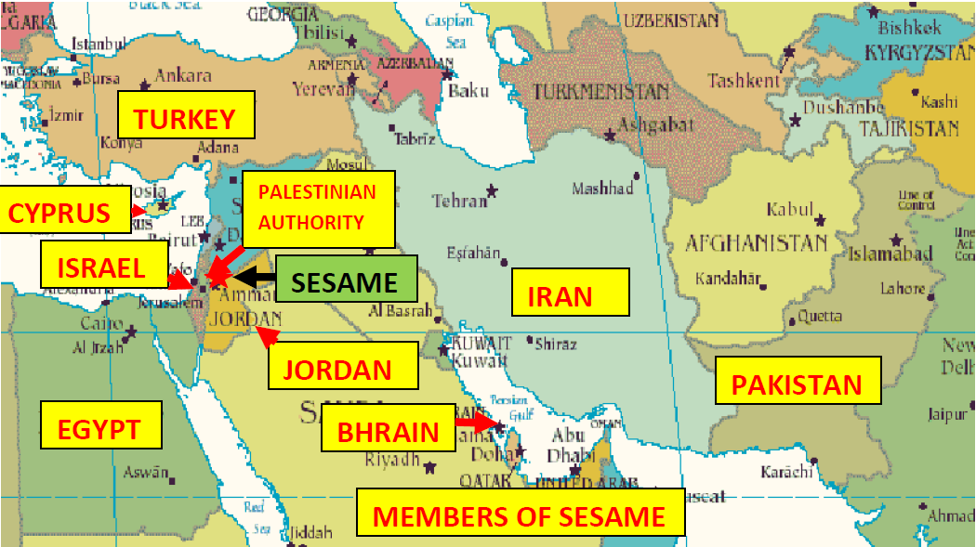
SESAME
SESAME: Members and Observers
Observers: Brazil, China, EU, France, Germany, Greece, Italy, Japan, Kuwait, Portugal, Russian Federation, Spain, Sweden, Switzerland, UK, USA
BAHRAIN
Members
Operating budget, capital funding
Observers
Advice (Advisory Coms.), equipment (BL donations), training, cash (EU, Italy)

Slide 7
A VERY BRIEF HISTORY OF SESAME
SESAME
Convergence of two ideas – build a light source in the Middle East (Abdus Salam – early 1980s) + foster projects that cross divides
Original proposal (1997) - rebuild old 0.8 GeV Berlin Synchrotron (BESSY 1) in the Middle East, as basis for a new international organisation, modelled on CERN
1999 - (Interim) Council established: followed by international advisory committees
2002 - decision to build a new 2.5 GeV ring (still using BESSY booster)
competitive 3rd generation facility
Ground breaking (2003); completion of building (2008)
Vigorous training programme and growing potential user community
Commissioning – start November 2016. Opening by HM King Abullah II in May.

Slide 8
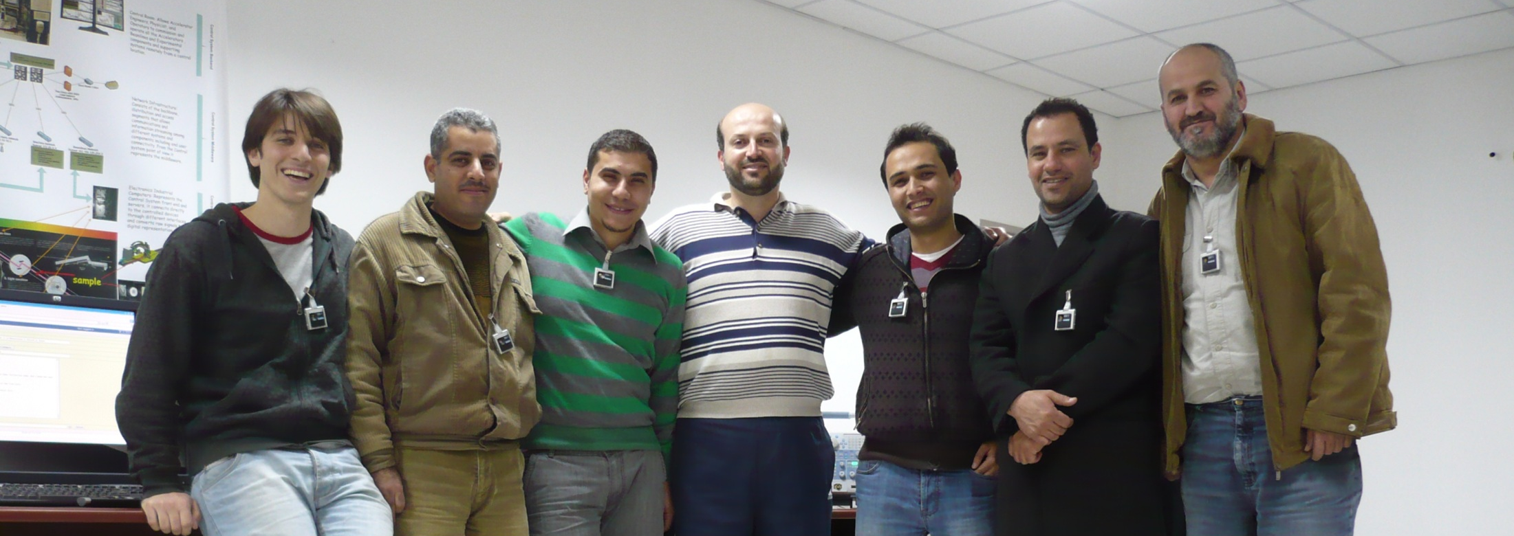

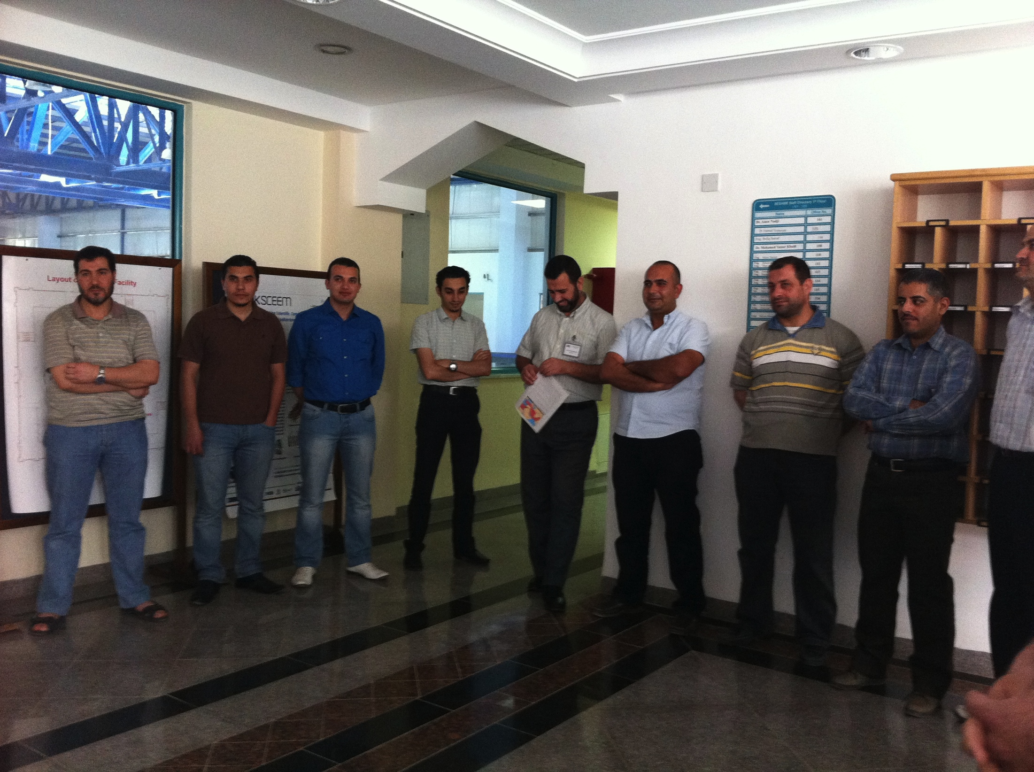
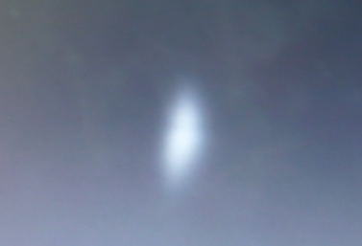

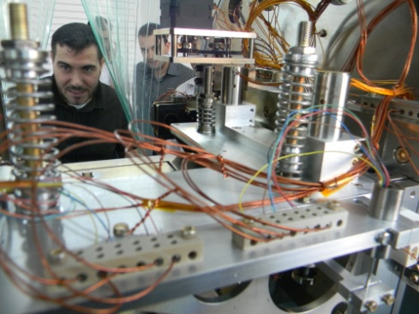
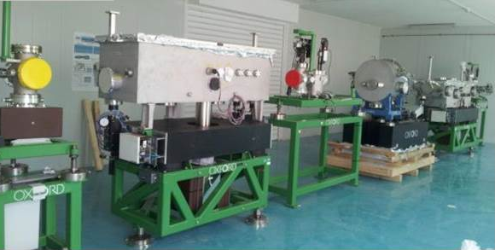
TECHNICAL AND SCIENTIFIC STAFF
Booster became operational in 2014
Currently more than 30 engineers and scientists are employed by SESAME to build the storage ring and the beamlines.

Slide 9
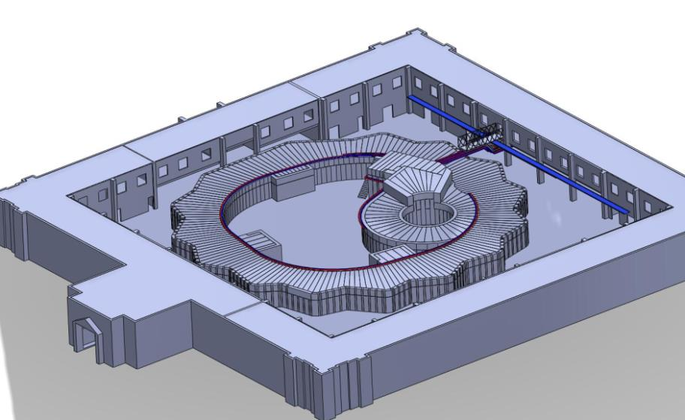
SESAME
INSIDE SESAME EXPERIMENTAL HALL
Intense beams of light (infra-red to X-rays) generated by circulating electrons exit through ports in the shielding
Shielding houses electron accelerator and storage ring
Shielding houses electron source, pre-accelerator and booster synchrotron

Slide 10
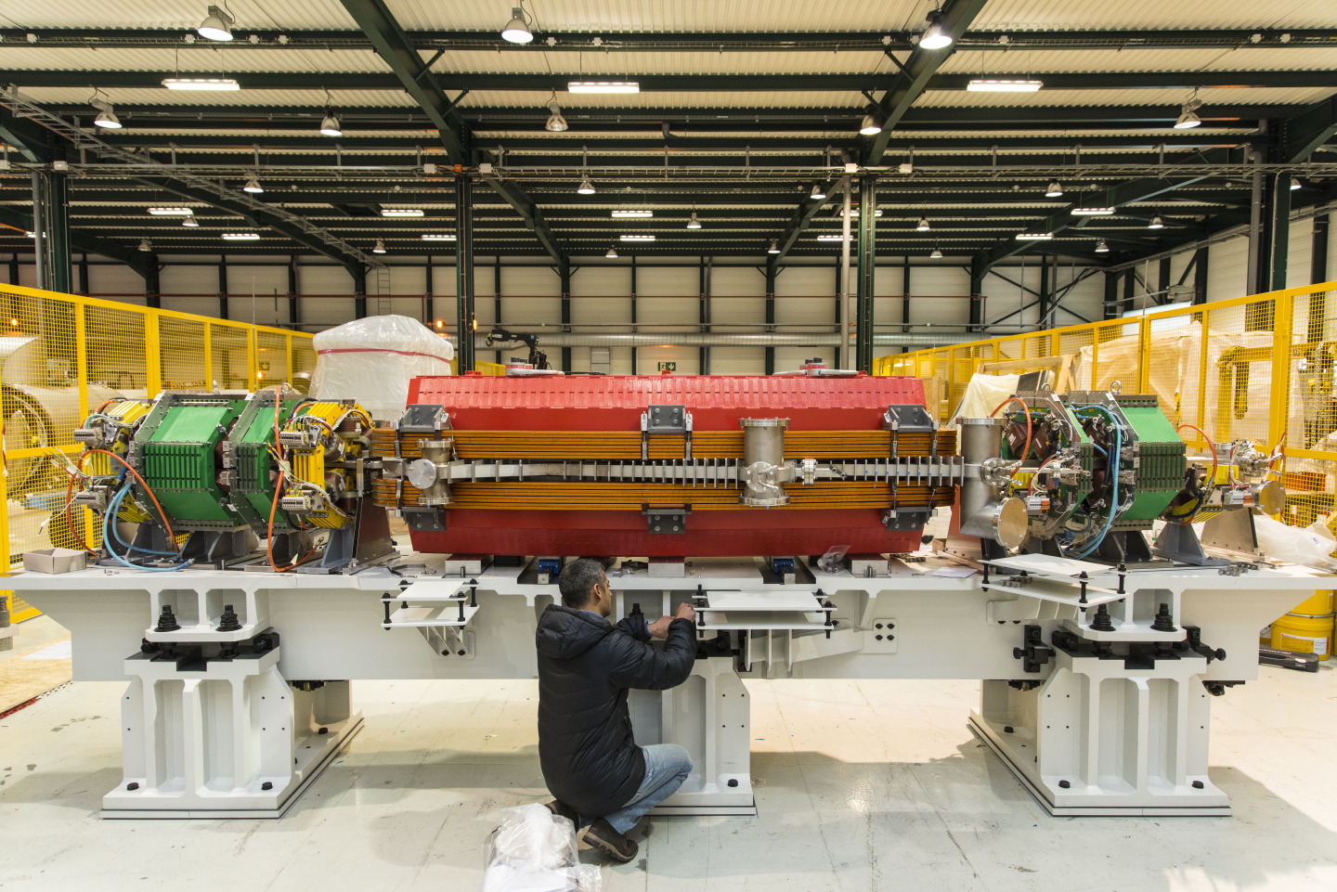
THE NEW STORAGE RING
SESAME
Collaboration between CERN, SESAME Members and Observers – funded by EU
Spain : quadrupoles
France : sextupole coils
UK : dipoles
Germany: vacuum chambers
Turkey : quadrupole coils
In Addition
Pakistan : sextupoles
Cyprus : sextupoles
Italy : Dipoles power supply
Switzerland: controllers + correctors power supplies
Israel : power supplies for quadrupole sand sextupoles
Spain girders

Slide 11
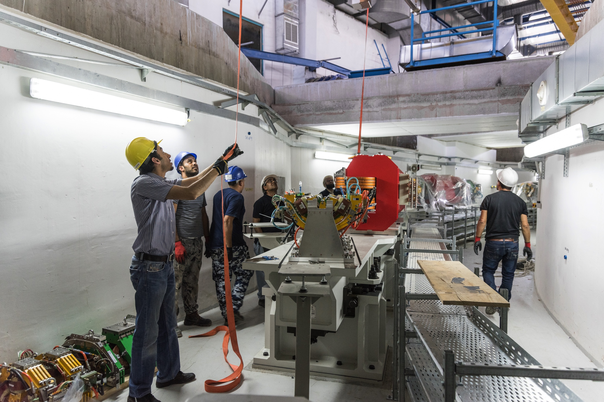
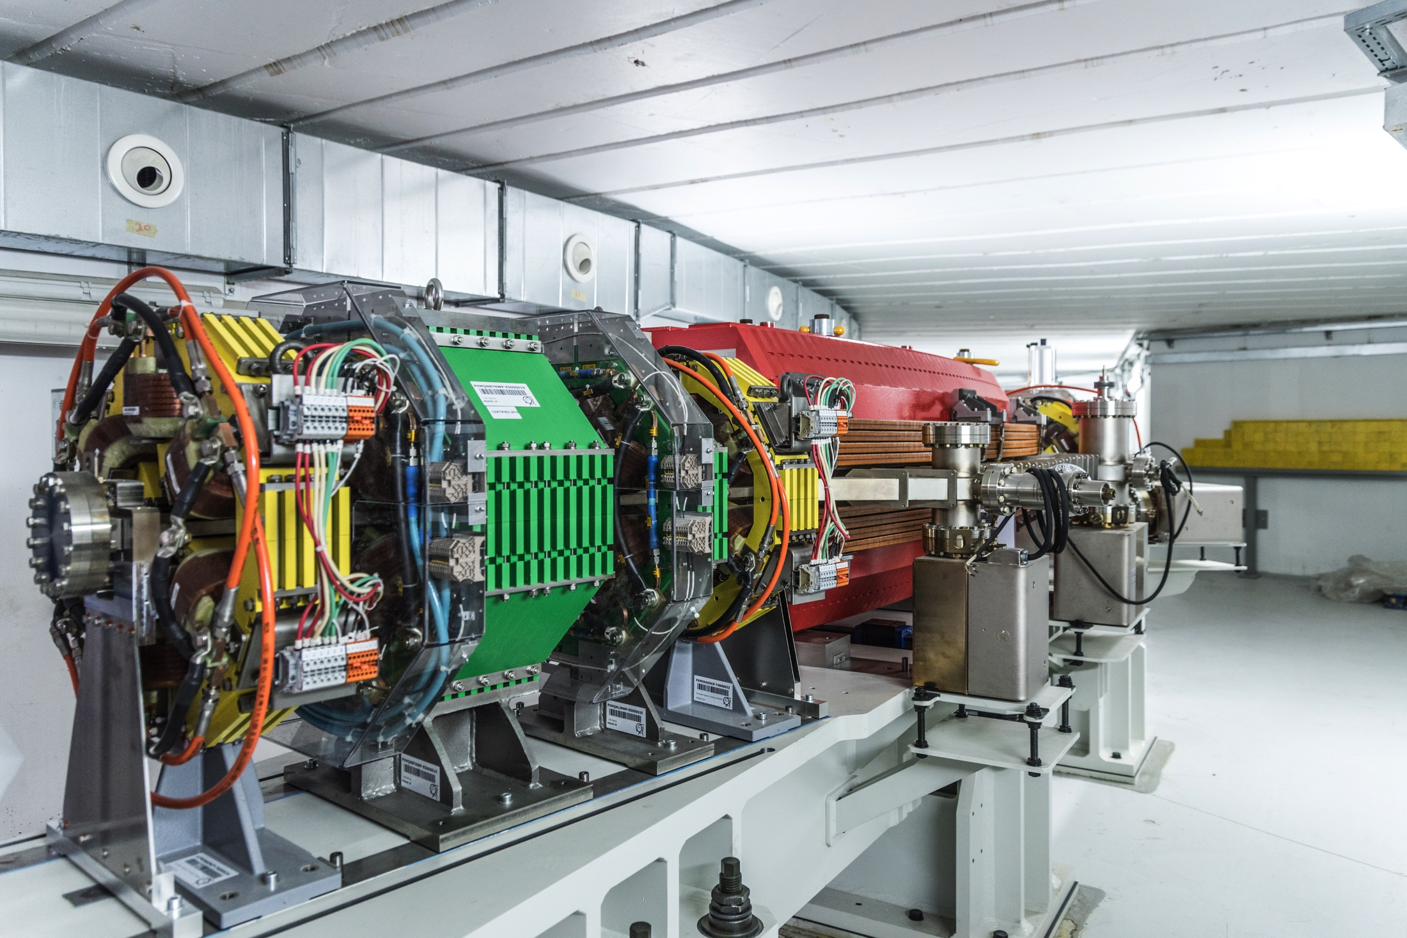
THE NEW STORAGE RING
SESAME
As of 02. 03. 2017 SESAME is operating with
ring energy 2.2 GeV @ 1 mA.

Slide 12
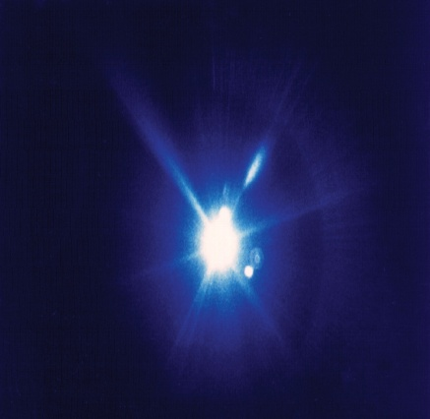
SESAME’s SCIENCE: Regional Relevance
SESAME
  Drug design targeting common pathogens and diseases in the region.
  Natural products for pharmaceutical and therapeutic use.
Life Sciences
Materials Science
  New materials, e.g. semiconductors.
  Energy.
  Catalysis.
  Extreme conditions (P/T).
Environmental
Science
  Air, soil and water pollution.
  Determination of metals in soil and plants.
SESAME
2.5 GeV
25 beamlines
Cultural Heriatge
  Non-destructive structural analyses of archeological objects.
  Chemical composition.
  Imaging.

Slide 13
PHASE 1 BEAMLINES
SESAME
Beamline | Energy Range | Source
X-ray Absorption Fine Structure/X‐ray Fluorescence Spectroscopy (XAFS/XRF) | 4-30 keV | Bending magnet
Infrared spectromicroscopy (IR) | 0.01-1 eV | Bending magnet
Materials Science (MS) | 3-25 keV | Multi-pole wiggler
Macromolecular Crystallography (MX) | 4-14 keV | Bending magnet
Small Angle and Wide Angle X-ray Scattering (SAXS/WAXS) | 8-12 keV | Bending magnet
Extreme Ultraviolet spectroscopy (EUV) | 10-200 eV | Bending magnet
Soft X-ray/Vacuum Ultra-Violet (VUV) | 0.05-2 keV | Elliptically polarized undulator
Beamlines Chosen by USERS (Users’ Meeting 2003)

Slide 14
DAY 1 BEAMLINES
SESAME
X-ray Fluorescence and Absorption beamline (BASEMA) (4-30 keV)
Non-invasive measurements of absorption edge and fluorescence emission spectra. Elemental composition and physical properties of inorganic and biological materials can be determined at at μm scale. A very flexible technique used in materials science, biology and cultural heritage.
Infrared Microspectroscopy beamline (EMIRA) (0.01-1.0 eV)
Measurements are based on vibrations of bonds that absorb in the IR region. A powerful tool for identifying/mapping components of cells/tissues with different chemical properties, e.g. lipids, carbohydrates , proteins and nucleic acids. Offers possibilities for time-resolved imaging of living cells.
Materials science beamline (3-25 keV)
Studies of ordered and disordered/amorphous material on the atomic scale, the evolution of nano-scale structures and materials in extreme conditions of pressure and temperature, developing and characterizing new smart materials.

Slide 15
OTHER PHASE I BEAMLINES
SESAME
Protein crystallography beamline (4-14 keV)
Structural molecular biology provides a basic understanding of biological mechanisms at atomic level and insight for developing new drugs and therapies. Such studies have led to four Nobel Prizes since 1997
Small and wide angle X-ray scattering beamline (8-12 keV)
Measurement of diffuse scattering from large macromolecular assemblies and noncrystalline systems. Provides shape information and allows for time resolved measurements to monitor structural changes during protein-protein interactions. Applications in molecular biology and materials science.
Extreme ultraviolet beamline (10-200 eV)
Atomic and molecular physics; behavior of atmospheric gases. Characterization of the electrical and mechanical properties of materials, surfaces and interfaces. (Photoabsorption and photoemission).
Soft X-ray vacuum ultraviolet beamline (50-2000 eV)
Atomic, molecular and condensed matter physics. Applications in surface science e.g. behavior of catalysts and how they can be improved.

Slide 16
SESAME
POSSIBLE PHASE II BEAMLINES
Suggestions based on vision to meet needs of the region and grand challenges of 21st century:
Photon in/photon out spectroscopy (energy/water problem)
Soft and/or hard X-ray Microscopy (nanoscience)
Coherent Scat./Imaging (biology, correlated system)
Mag. circular dichroism photoemission electron microscopy (magnetism)
Micro-Probe/diffraction (materials, archeology)
High Pressure (materials)

Slide 17
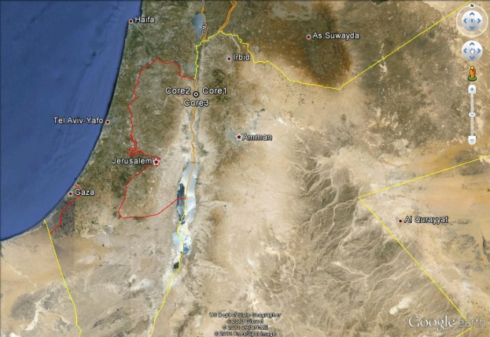
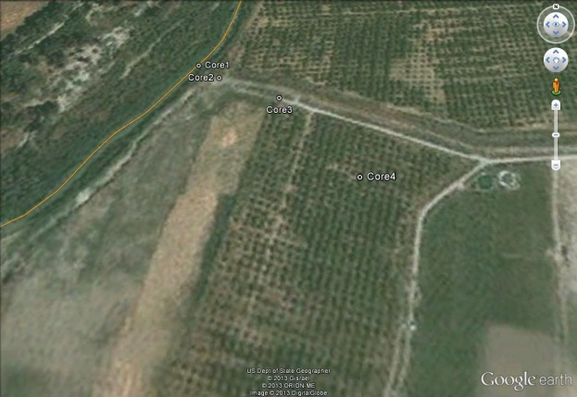
XRF/XAS PROJECTS @SESAME
Regional Relevance
SESAME
  Adsorption and mobility of heavy metals in soils in the vicinity of Jordan and Yarmouk rivers (SESAME and Jordan)
Samples are collected from Jordan and Yarmouk Rivers at different depths for XAFS analyses to monitor levels of all heavy metals.
XAFS data collected at Elettra (Italy) and BESSYII (Germany).
Jordan river sample collection sites
  Synchrotron Based XRF-XAFS Techniques in Tracking Pollution (Air/Soil) in Some Arab Regions (SESAME, Egypt, Jordan)
Coordinated Research Projects supported by IAEA
Notes:
a broad scientific programme, with particular strengths dependent on the proposals that the users submit

Slide 18
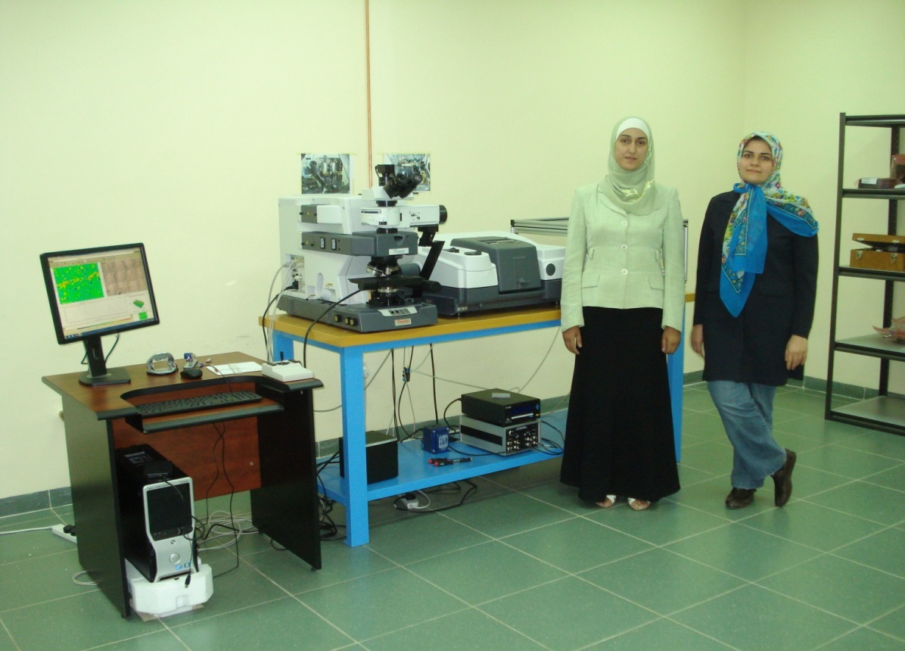
SESAME
SCIENCE BEGAN IN 2012: IR MICROSCOPE
11 Proposals aproved
e.g. Study of breast cancer by
Fatemeh Elmi, Assistant Professor, University of Mazandaran, North Iran + Randa Mansour and Nisreen Dahshan, PhD students in the Faculty of Pharmacy, University of Jordan
Programme with synchrotron-radiation will begin in 2017
Notes:
study of a hepatitis C genotype which is prevalent in the Middle East, in which a group has expressed interest;

Slide 19
SESAME SCIENTIFIC COMMUNITY
SESAME
Interim Users’ Executive Committee: scientists from all SESAME members
Users’ Meetings: starting in 2002 once yearly (except for 2010)
13th meeting: November 25-26, 2015 (Amman-Jordan).
Workshops: since 2001, individually or associated with Users’ Meetings
Specialized topics: materials science, structural biology and bionformatics, IR spectroscopy, XAFS/XRF.
Training schemes for individual scientists: visits (long and short term) to synchrotron labs in Brazil, France, Germany, Italy, Japan, Portugal, Spain, Sweden, Switzerland, NSRRC located in Taipei, UK, USA.
Funding from international organizations: IAEA, UNESCO, ICTP, DoE, EU.
Organizations in Members: Cyprus, Egypt, Iran, Israel, Jordan, Turkey
Scientific bodies: APS + EPS + IOP + DPG + ACS+JSPS+IUPAP+SIF+SCF+SFP.
Companies: Gentech, Ox Diffraction, PANanalytical, Jordanian Phosphate Mining co.
Foundations: Canon, Lounsbery.
MORE THAN 300 SCIENTISTS HAVE BEEN SUPPORTED

Slide 20
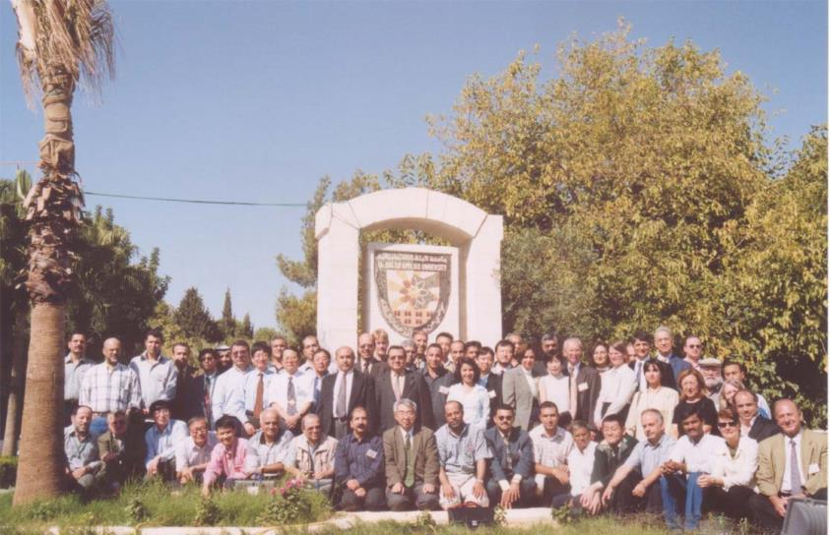
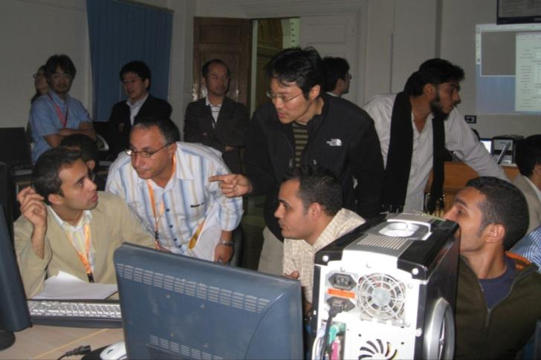
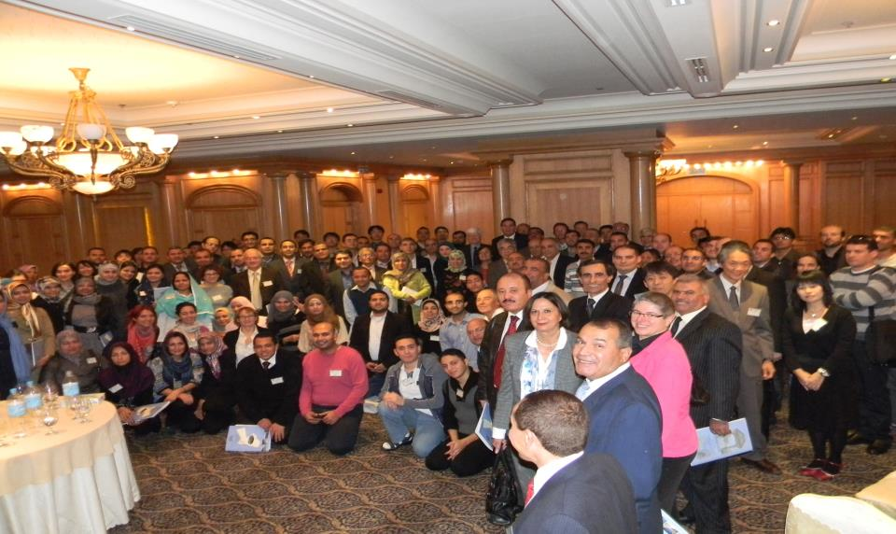
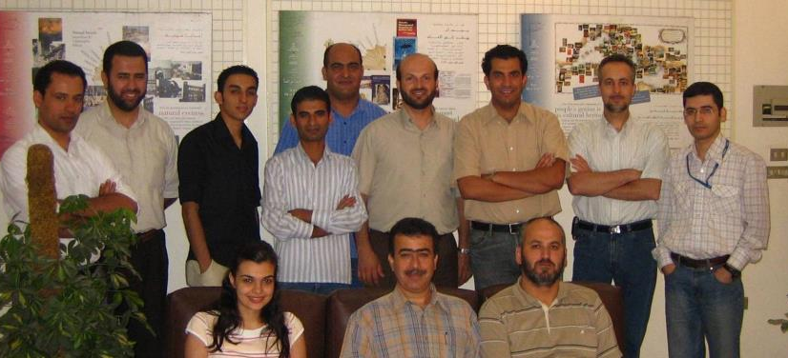
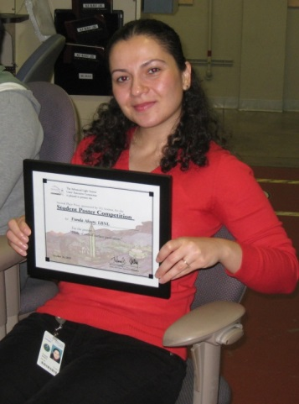
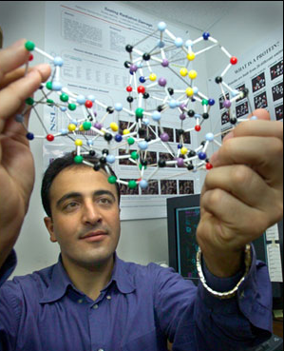
TRAINING PROGRAM (external support)
SESAME
Users Meetings and Workshops
1st Users’ Meeting Amman 2002
10th Users’ Meeting Amman 2012
SESAME-JSPS School Cairo 2008
Trained accelerator experts
Training Scientists
Left @ Advanced Light Source Users’ Meeting, Right @ NSLS
Members of SESAME Accelerator Group, 2007

Slide 21
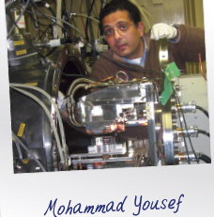
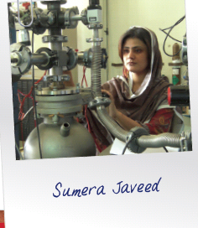
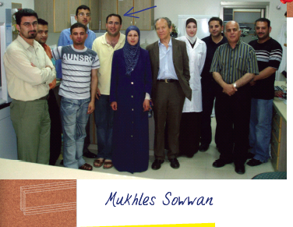
SESAME SCIENTIFIC COMMUNITY
SESAME

Slide 22
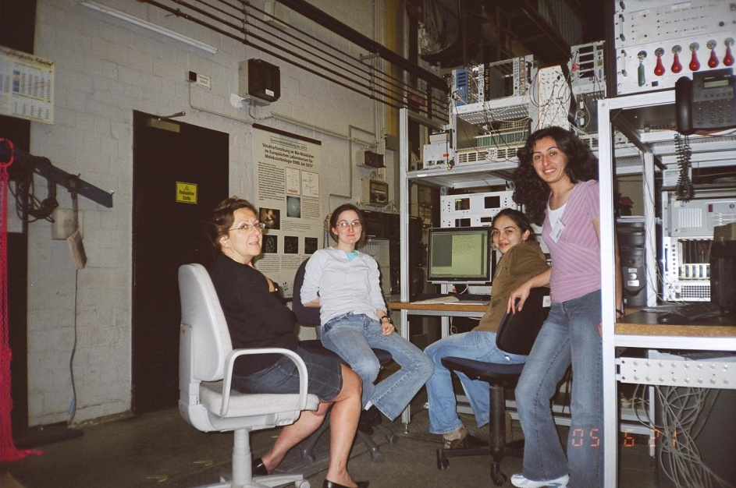
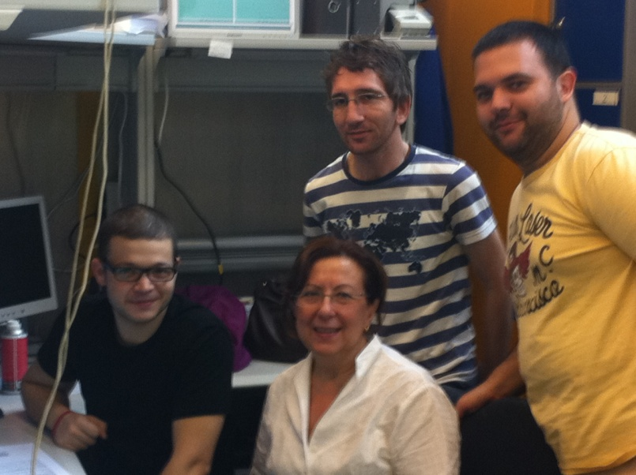
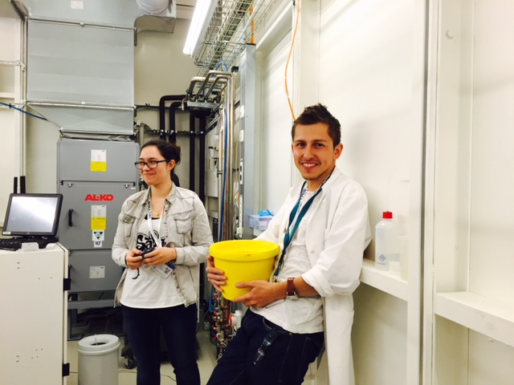
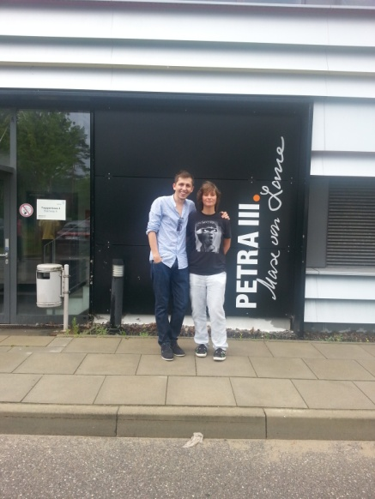
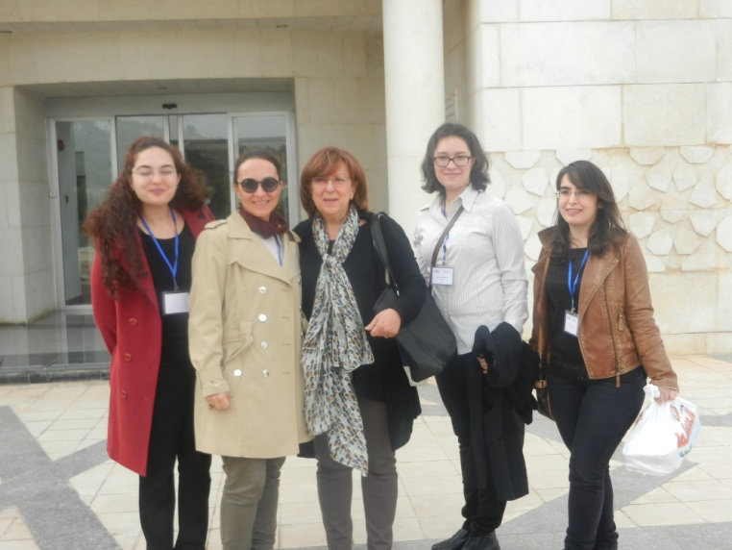
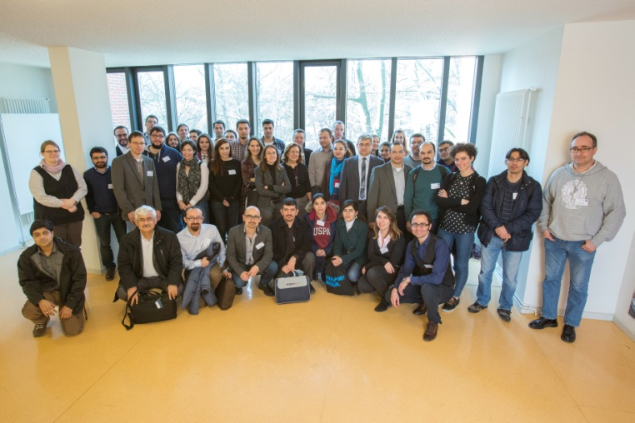
WHAT DOES SESAME MEAN TO ME?
A LAB FOR NEXT GENERATIONS!

Slide 23
SESAME
THANK YOU
www.sesame.org.jo

