Slide 1


Gianluigi Cosentino
Proton Recoil Telescope

Slide 2
Proton Recoil Telescope per la misura della
sezione d’urto della reazione ²³⁵U(n,f) @ 10 MeV – 1 GeV
The ²³⁵U(n,f) cross section is adopted as a standard at thermal neutron energy and between 0.15 MeV and 200 MeV. Despite the importance of the high-energy region, at present no data exist on neutron-induced fission above 200 MeV, and one has to rely on theoretical estimates.
High interest from IAEA on data in this region
Thanks to its very wide neutron energy spectrum, which extends from thermal energies up to more than 1 GeV, the n_TOF facility offers the unique opportunity to perform such a measurement for the first time ever, relative to the n-p elastic scattering reaction.

Slide 3
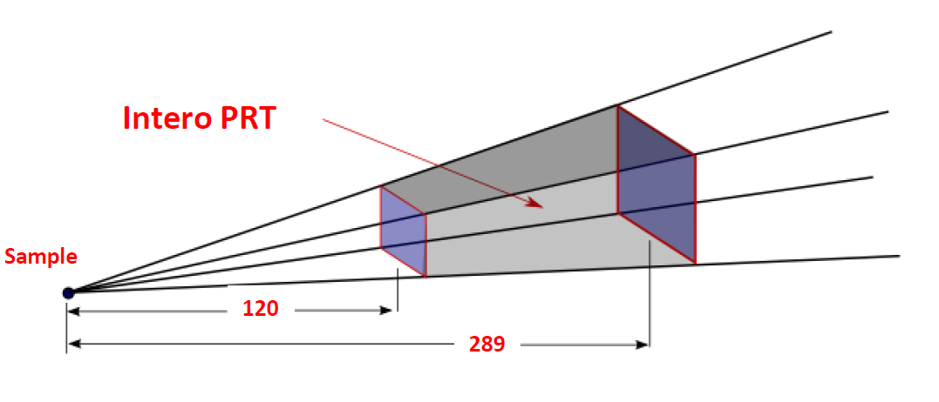
Sezione d’urto della reazione ²³⁵U(n,f): 10 MeV – 1 GeV
Misura del flusso di neutroni tramite scattering elastico n-p in un target di polietilene.
Telescopio di silici e Scintillatori plastici
To discriminate recoil protons from other light charged particles, e.g. deuterons and tritons
Target di polietilene
The measurement would be performed by combining such PRT with Parallel Plate Avalanche Counters, operated in coincidence mode, equipped with a sample of ²³⁵U.

Slide 4
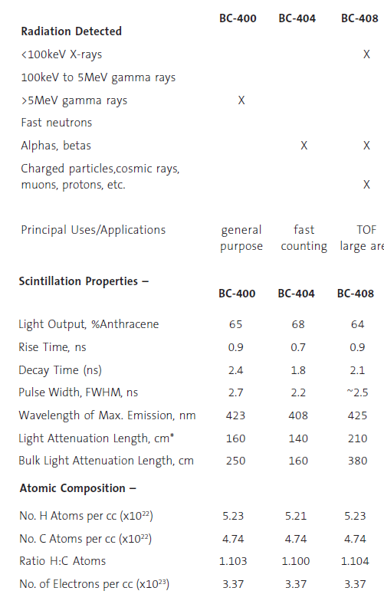
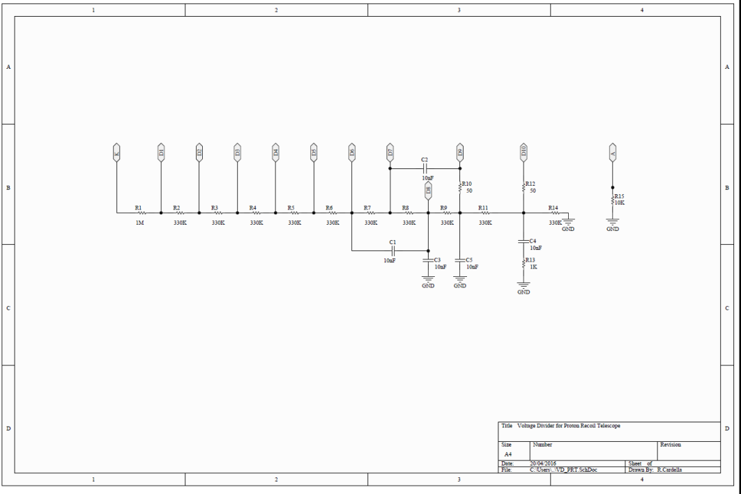
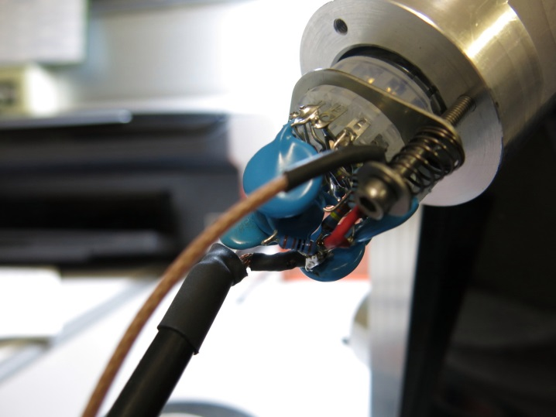
PRT -> Scintillatore plastico (BC408) & VD

Slide 5
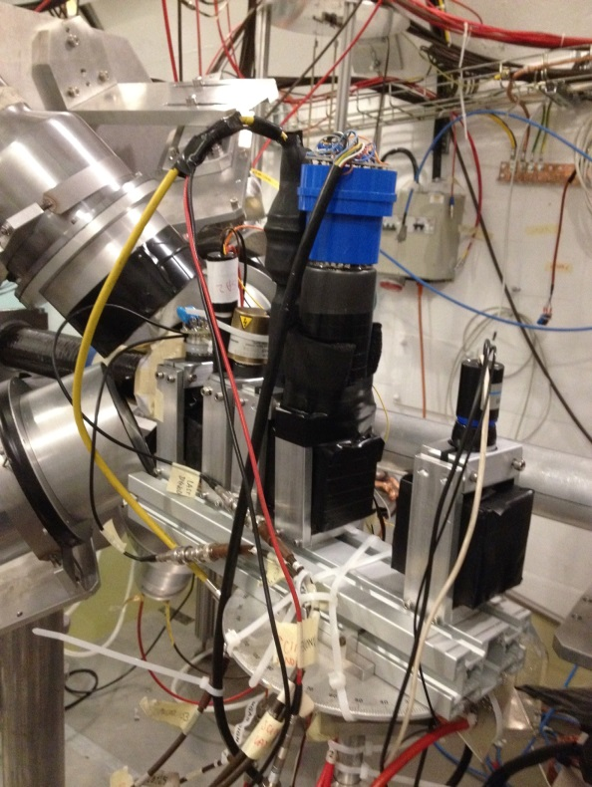
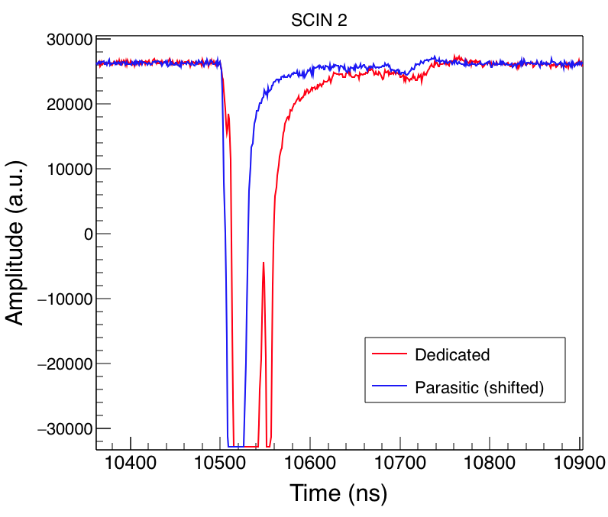
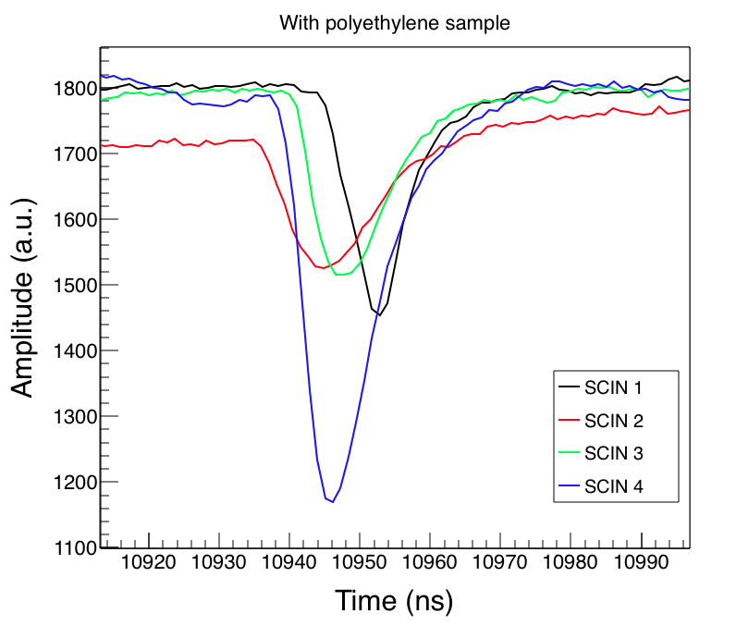
TEST prototipo @EAR1 - ottobre 2015
10÷15 ns
~50 ns
1GeV ToF – T_{gflash} ̴ 100ns

Slide 6
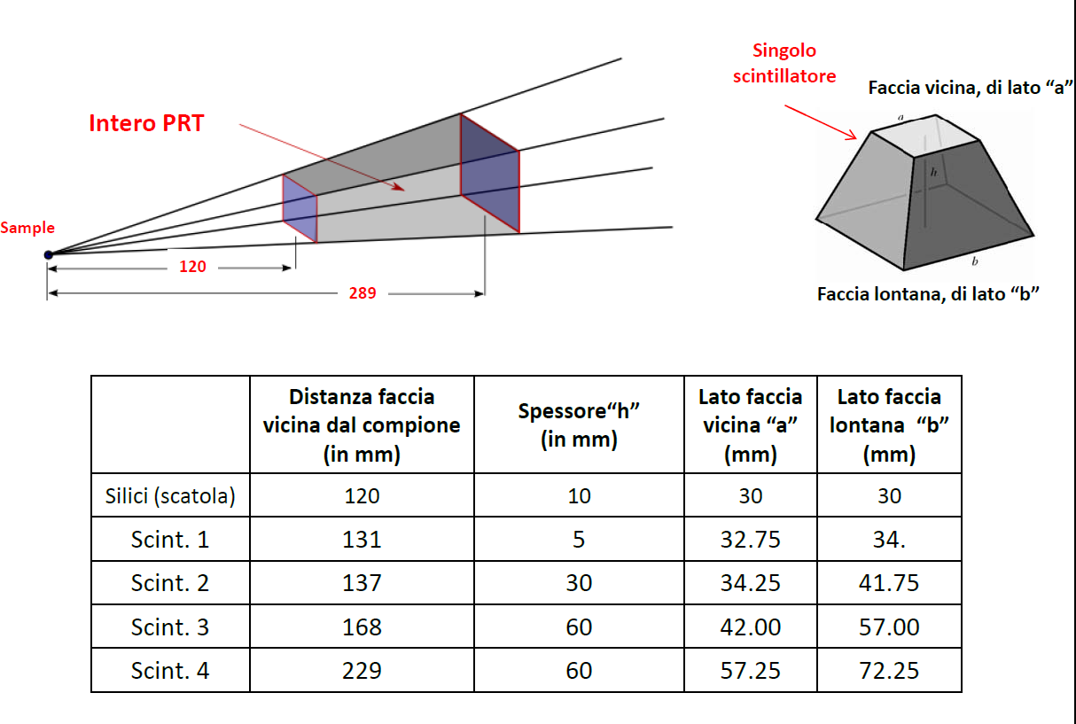
Costruire il PRT con il supporto di simulazioni MC
per coprire il range 10 MeV – 1 GeV
2 silici 300 μm
4 scintillatori plastici BC408 – spessore totale 15.5 cm

Slide 7
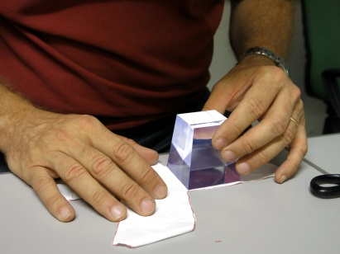
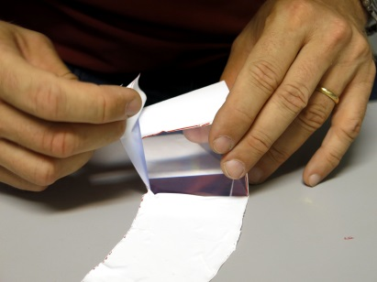
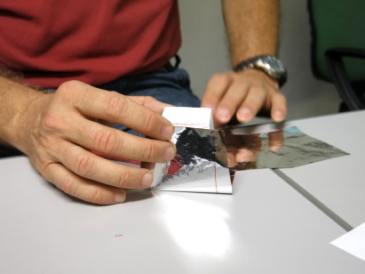
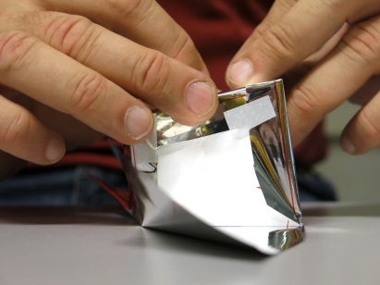
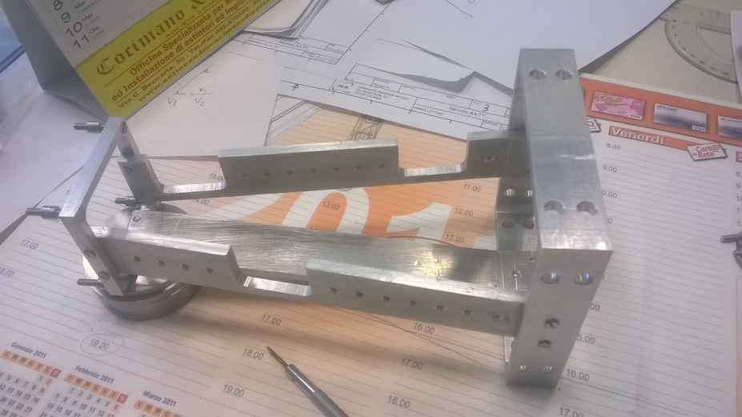
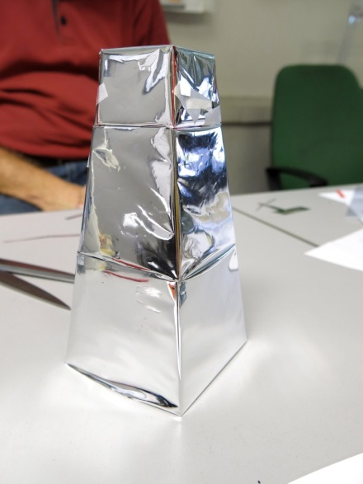
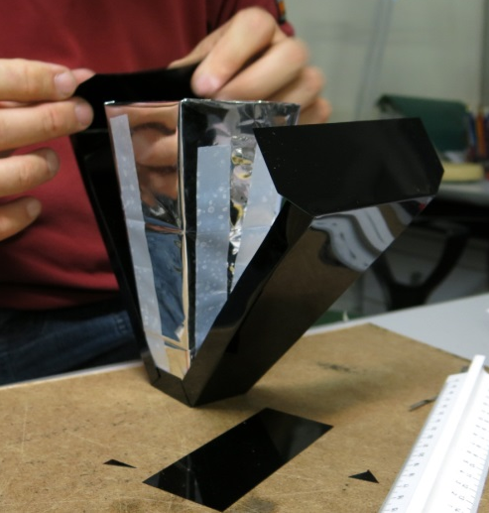
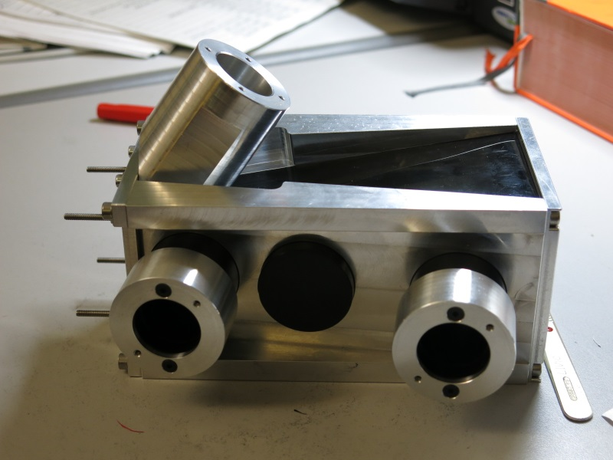
Preparazione misura settembre 2016
Assemblaggio a Trieste – Agosto
LNS
Sez. Ts

Slide 8
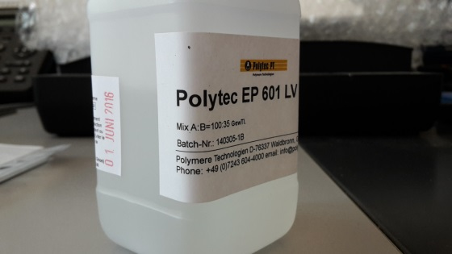
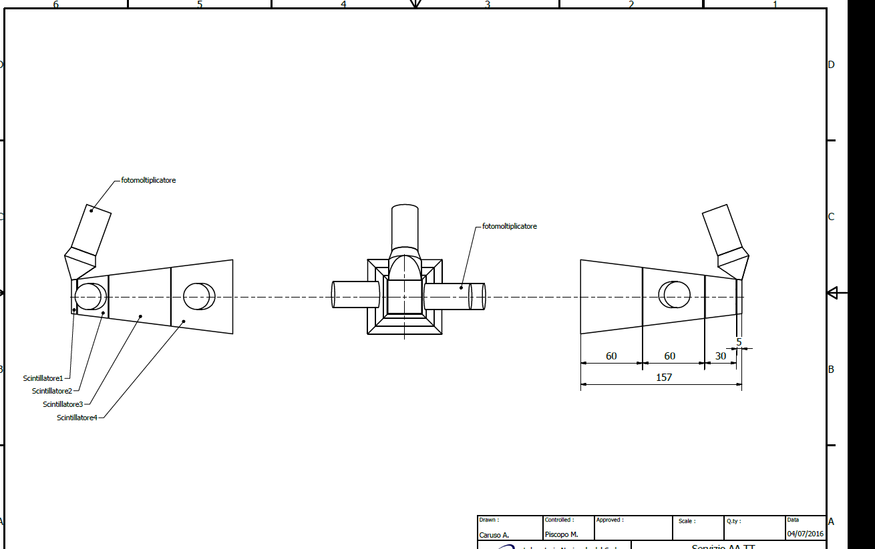
Meccanica LNS

Slide 9
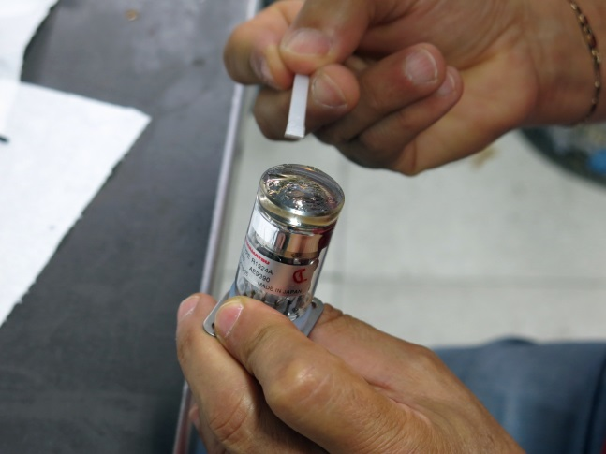
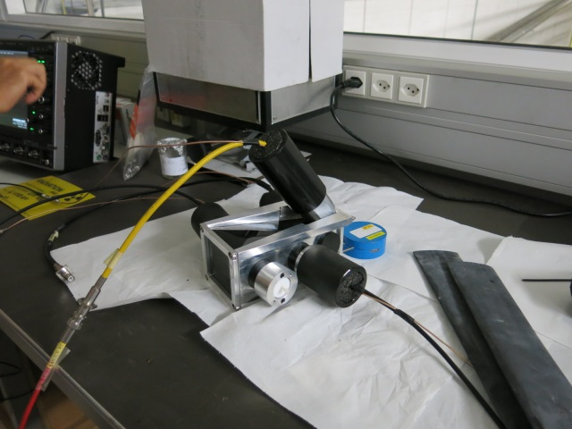
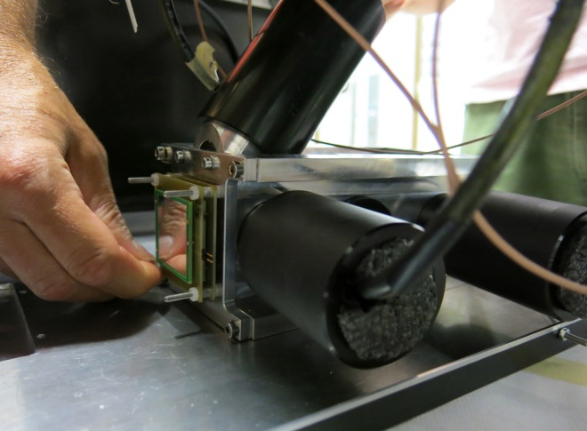
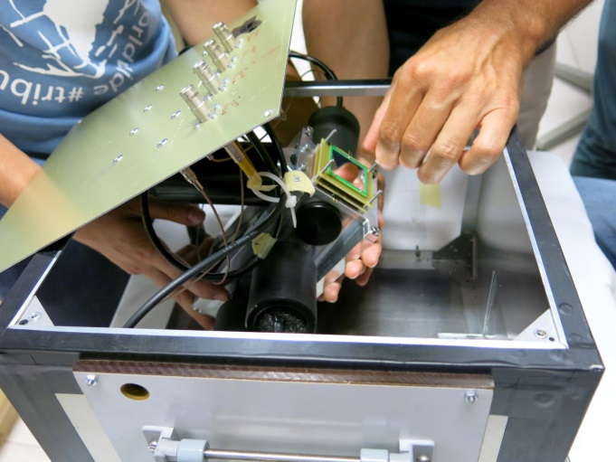
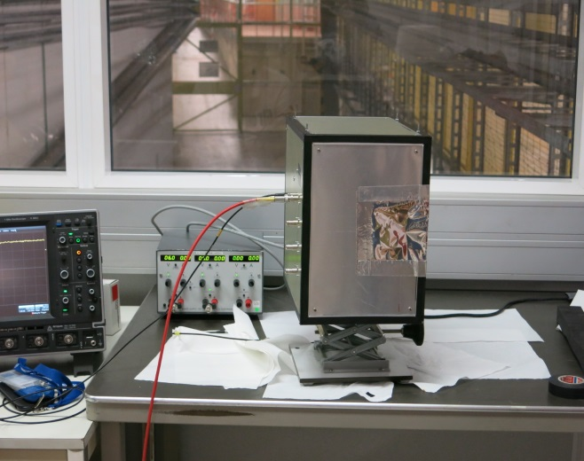
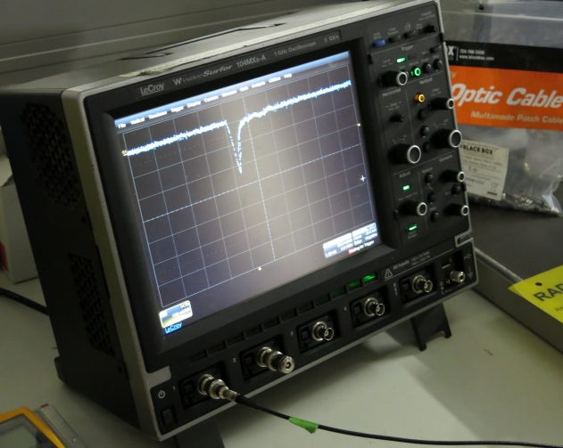
Assemblaggio al CERN – Settembre

Slide 10
Eproton | Si 300µm | Si 300µm | Scint1 5mm | Scint2 30mm | Scint3 60mm | Scint4 60mm
Ep=10 MeV | 2.76 | 4.08 | 3.15 | 0 | 0 | 0
Ep=100 MeV | 0.41 | 0.41 | 3.8 | 26.1 | 69.2 | 0
Ep=150 MeV | 0.31 | 0.31 | 2.8 | 17.8 | 42.8 | 85.9
Ep=250 MeV | 0.22 | 0.22 | 2 | 12.3 | 25.9 | 28.1
Ep=500 MeV | 0.16 | 0.16 | 1.4 | 8.5 | 17.2 | 17.4
Ep=1000 MeV | 0.13 | 0.13 | 1.1 | 6.8 | 13.6 | 13.7
 |  |  | 800 V | 680 V | 700 V | 660 V | HV
 |  |  | 5 MeV | 30 MeV | 70 MeV | 90 MeV | Full energy range
 |  |  | 300 mV | 70 mV | 50 mV | 70 mV | ¹³⁷Cs max signal
The light yield of BC408 is such that 1 MeV cosmic ray = 1.2 MeV proton
Impostazione HV usando ¹³⁷Cs source e cosmic rays:
Rigore scientifico o supercazzole?

Slide 11
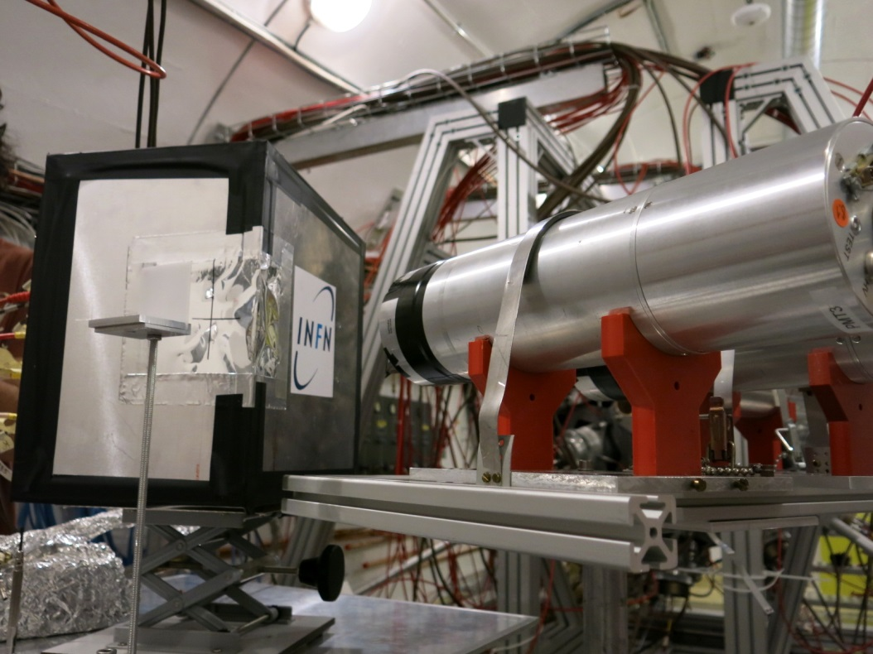
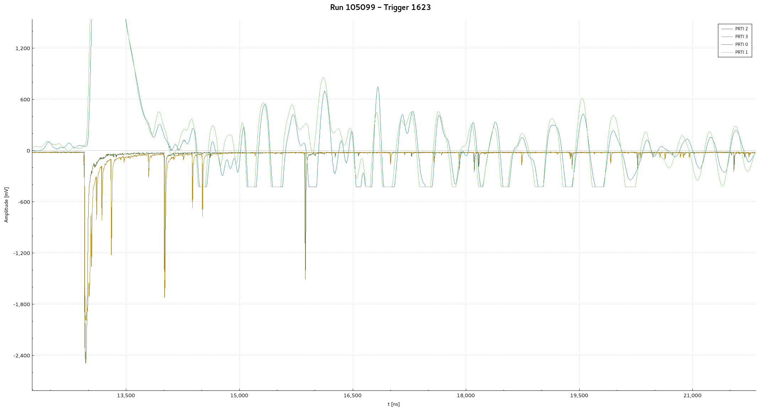
In Linea!!!
(ma funziona…!?)

Slide 12
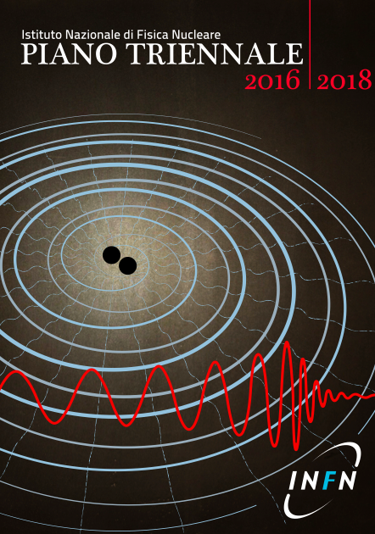
n_TOF è un esperimento INFN?

