Slide 1
Synchrotron Radiation studies at LNF DAFNE-L laboratories:
Reflectivity / photoelectrons /photo induced desorption.
R. Cimino on behalf of DAΦNE-L, LNF
the Existing XUV Bending Magnet beamlines and laboratory.
What can be done with the existing setup.
What could be implemented.
When and … how much??

Slide 2
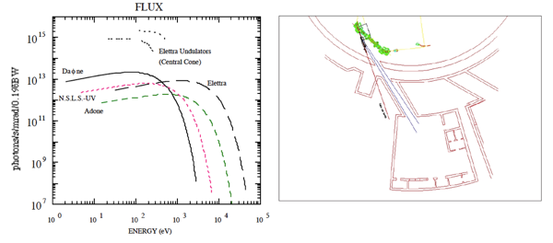
Bending Magnet source for UV and XUV
and its Laboratory

Slide 3
Bending Magnet source for UV and XUV
and its Laboratory
This is the energy range where:
most of the photo-chemistry take place!
Dominate photo induced desorption!
Perfectly covers the photo energy range of (HL)- LHC
Well matching the FCC-hh SR spectrum
Monchromatic
20 –1000 eV
“White light”
4 –1000 eV

Slide 4
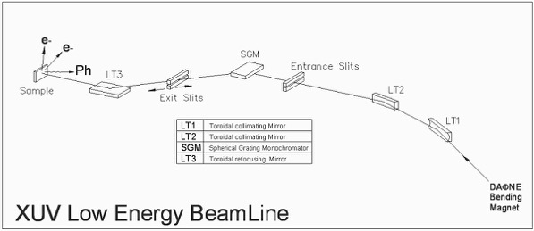
XUV1: 30-200 eV. About 17 mRad horizontal
Spot:
2 x 2 mm

Slide 5
XUV1: 30-200 eV. About 17 mRad horizontal
Monochromator 20- 200 eV
Focus vertically entrance to exit slit
Collimate to
a parallel beam
Spot:
2 x 2 mm
ReFocus:
exit slits to Sample
Focus:
Vert. to Entrance slits
Hor . To exit slits

Slide 6
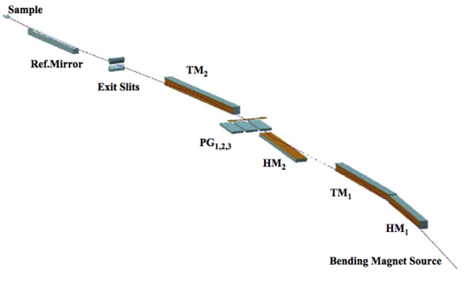
XUV2: 60 -1000 eV. About 8 mRad horizontal
Spot:
1 x 1 mm

Slide 7
XUV2: 60 -1000 eV. About 8 mRad horizontal
Monochromator 60- 1000 eV
Plane grating and mirror
Spot:
1 x 1 mm
Collimate to
a parallel beam
ReFocus:
exit slits to Sample
Focus:
Vert. to Entrance slits
Hor . To exit slits

Slide 8
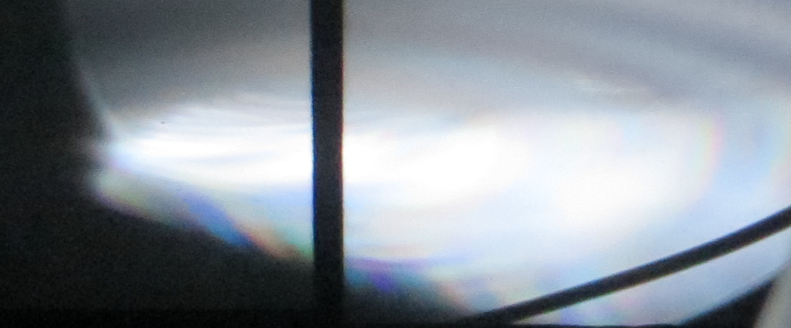
XUV2: 60 -1000 eV. About 8 mRad Horizontal
~ 30 mm
Spot:
1 x 1 mm
~ 10 mm
WL
observed
(6-10-2016)

Slide 9
Time scale
A collimated WL beam is already available in the laboratory.
A commissioning phase is actively ongoing. Light (mono and WL) will be characterized and optimized on photodiodes at sample position. Than the experimental set-ups will be moved in, at focus. ( 5 to 9 months activity)
Than one can measure on small spot (1x1 mm) not at grazing angle: min. ~ 10° :
PY and SEY
Photo desorption (with the new “Ad hoc” Mass spec)
Photo scrubbing (SEY and PY variation vs Photon doses)
Photo induced Chemical modification (XPS) (possibly at LT)
}
@ 10 K
to
300 K

Slide 10
Comments:
The WL reaching the sample position in a small spot (1x1 mm) is focused so can not be used to perform very grazing experiments (need of collimated beam) even using an “ad hoc” set-up. It can not be used on long samples!
The WL reaching the laboratory is a parallel collimated beam and can be used to perform very grazing experiments on long samples. Need an “ad hoc” set-up.

Slide 11
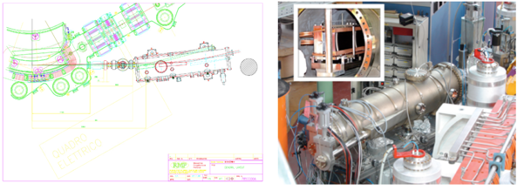
Present situation: pre-optics in the ring
Parallel
Beam
~ 3.5 m
~ 30 mm
remotely
controlled optics
in DAΦNE hall
Divergent Beam
σ_{v}~2 mrad
σ_{h}~8 mrad
~ 10 mm

Slide 12
Present situation: existing beamlines in the lab
~ 30 mm
~ 10 mm

Slide 13
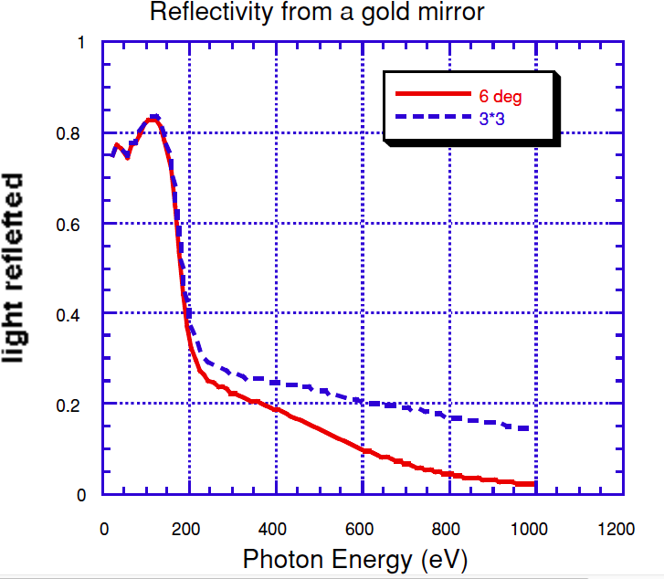
Present situation: existing beamlines in the lab
Geometrical
Acceptance
(~8hx2v mrad)
~ 30 mm
~ 10 mm

Slide 14
Host a new beam line to irradiate long (2<L<4m) pipes for grazing R, PY and ph-desorption.
> 2-4 m
~ 30 mm
~ 10 mm
Shift existing beamline
extra (removable) mirror
(4-6° incidence)

Slide 15
Host a new beam line to irradiate long (2<L<4m) pipes for grazing R, PY and ph-desorption.
Shift existing beamline
~ 30 mm
~ 10 mm
> 2-4 m
extra (removable) mirror
(4-6° incidence)

Slide 16
Conclusion:
From March/ June 2017 it will be possible to use existing beamlines in the framework of a CERN-INFN collaboration agreement.
It is conceivable at reasonable costs and time to open a new WL beamline compatible with the existing activities and fully dedicated to irradiate long (2<L<4 m) pipes for grazing Reflectivity, PY and desorption (eventually at Low T). Irradiations will take place in the lab with full accessibility during studies rendering the system flexible and easy to use. Anka-like systems can be hosted/ duplicated/upgraded at will.
The richest scientific output will come by a combination of WL – long pipes with WL-monochromatic light on small samples.

Slide 17
Very preliminary cost estimates for small size focussed beam experiment:
Item | cost | LNF-INFN | This MoU
Maintenance of existing apparatus and Beamlines (4% of value) | 100 k€ / year | 50%? | 50%?
New ad hoc mass spectrometer | 50 k € | 100%
New LT close cycle manipulator for small samples | 130 k € | 100%
consumable | 50 k € / year | 50%? | 50%?
Travel for the collaboration | 20 k € / year | 50% ? | 50%?
Dedicated fellow | 50 k€ / year |  | 100%
Dedicated (non parasitic) use of Dafne for this experiments (10 days/ year) | 100 k€ / year | 50% ? | 50% ?
Personnel (at 20%) | 150 k€ / year | 100%
Total | 180 k€ Inventory + 430 k€ / year + personnel 200 k€ / year | 180 k€ Inventory + 135 k€ / year + personnel 150 k€ / year | 0 k€ Inventory + 135 k€ / year + personnel 50 k€ / year

Slide 18
Very preliminary cost estimates to build a new dedicated WL beam line:
Item | cost | LNF-INFN | This MoU
Optics and UHV chamber to bring collimated WL beam into the lab | 60 k € | 50% | 50%
Experimental system for long beam pipes studies (3m?) | 150 k € | 33% | 66%
consumable | 50 k € / year | 50%? | 50%?
Dedicated fellow | 50 k€ / year |  | 100%
Dedicated (non parasitic) use of Dafne for this experiments (10 days/ year) | 100 k€ / year | 50% ? | 50% ?
Personnel (at 20%) | 150 k€ / year | 100%
Total | 260 k€ Inventory + 150 k€ / year + personnel 200 k€ / year | 80 k€ Inventory + 75 k€ / year + personnel 150 k€ / year | 130 k€ Inventory + 75 k€ / year + personnel 50 k€ / year

Slide 19
Very preliminary cost estimates for small size focussed beam experiment and WL new beamline:
Item | cost | LNF-INFN | This MoU
Maintenance of existing apparatus and Beamlines (4% of value) | 100 k€ / year | 50%? | 50%?
New ad hoc mass spectrometer and New LT close cycle manipulator for small samples | 180 k € | 100%
Optics and UHV chamber to bring WL beam into the lab | 60 k € | 50%? | 50%?
Experimental system for long beam pipes studies | 150 k € | 33% | 66%
consumable | 50 k € / year | 50%? | 50%?
Travel for the collaboration | 20 k € / year | 50% ? | 50%?
Dedicated fellow | 50 k€ / year |  | 100%
Dedicated (non parasitic) use of Dafne(15 days/ year) | 150 k€ / year | 50% ? | 50% ?
Personnel (at 30%) | 225 k€ / year | 100%
Total | 440 k€ Inventory + 320 k€ / year + personnel 275 k€ / year | 260 k€ Inventory + 160 k€ / year =personnel 225 k€/y | 130 k€ Inventory + 160 k€ / year + personnel 50 k€/y

