Slide 1
DAΦNE-L end stations
of interest for the CERN-LNF collaboration
R. Larciprete
CNR-Istituto del Sistemi Complessi, Roma
e
LNF-INFN Frascati
Meeting CERN-LNF , Frascati 14/10/16

Slide 2
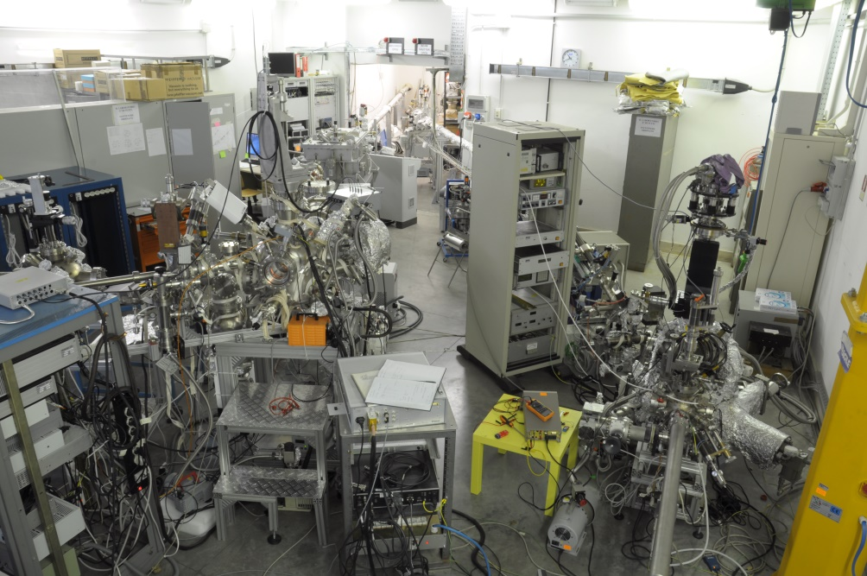
Experimental hall
XUV1
60-1000 eV
XUV2
30-200 eV
Meeting CERN-LNF
R. Larciprete

Slide 3
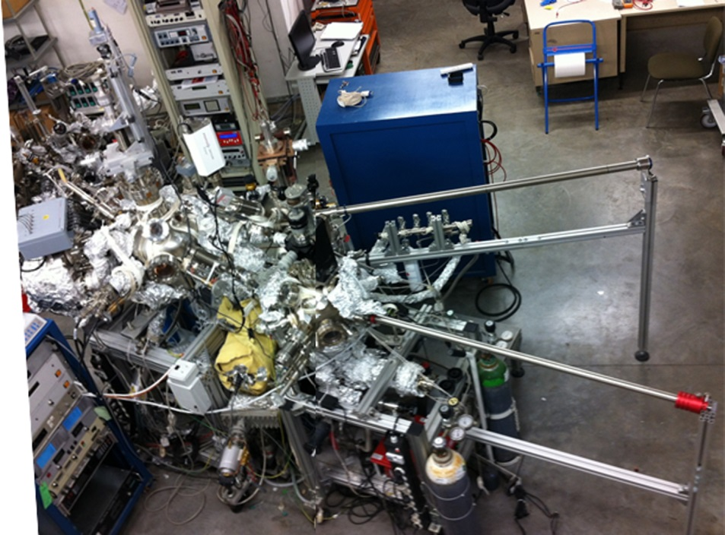
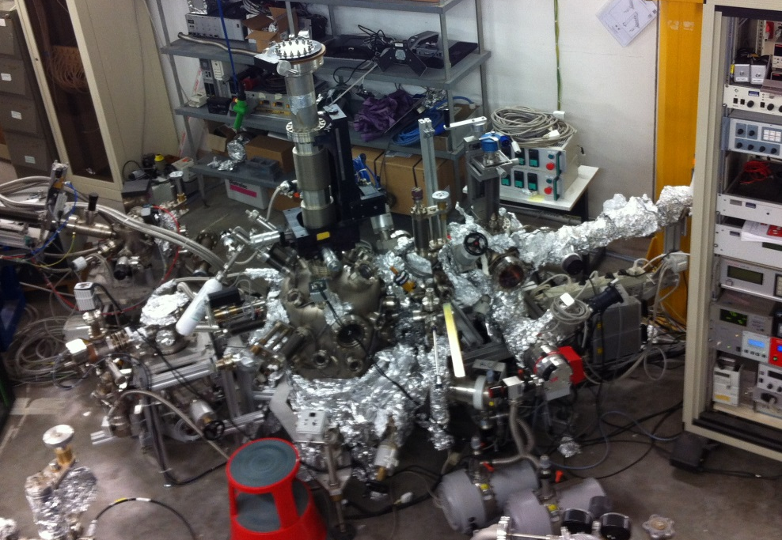
Material Science Laboratory @ INFN-LNF
ultra high vacuum systems
background pressure 1x10⁻¹⁰ mbar
small area (1x1 cm²) sample
Meeting CERN-LNF
R. Larciprete

Slide 4
Material Science Laboratory @ INFN-LNF
preparation
chamber
main chamber
fast-entry lock
Meeting CERN-LNF
R. Larciprete

Slide 5
Material Science Laboratory @ INFN-LNF
secondary electron yield
Meeting CERN-LNF
R. Larciprete

Slide 6
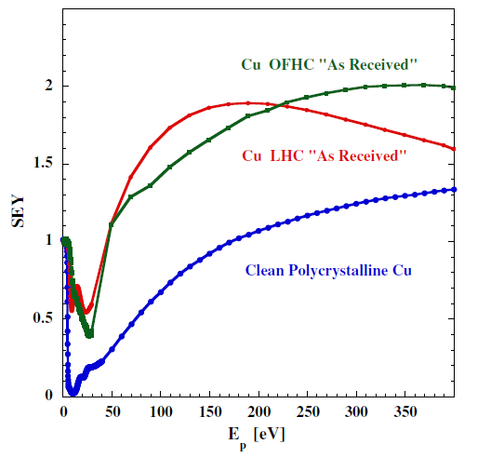
SEY measurements
Equipment : Electron gun, Faraday cup
Technical samples and
atomically clean surfaces
R. Cimino et al. Phys. Rev. ST 18, 051002 (2015)
Meeting CERN-LNF
R. Larciprete

Slide 7
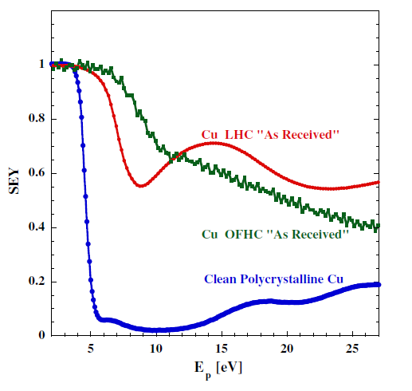
SEY measurements
Equipment : Electron gun, Faraday cup, cryostat
Technical samples and
atomically clean surfaces
Low-energy SEY
R. Cimino et al. Phys. Rev. ST 18, 051002 (2015)
Meeting CERN-LNF
R. Larciprete

Slide 8
SEY measurements
Equipment : Electron gun, Faraday cup, cryostat
Technical samples and
atomically clean surfaces
Low-energy SEY
R. Cimino et al. Phys. Rev. ST 18, 051002 (2015)
LA Gonzales et al. AIP Adv. 6, 095117 (2016)
Meeting CERN-LNF
R. Larciprete

Slide 9
SEY measurements
Equipment : Electron gun, Faraday cup, cryostat
Technical samples and
atomically clean surfaces
Low-energy SEY
R. Cimino et al. Phys. Rev. ST 18, 051002 (2015)
LA Gonzales et al. AIP Adv. 6, 095117 (2016)
Meeting CERN-LNF
R. Larciprete

Slide 10
Material Science Laboratory @ INFN-LNF
secondary electron yield
10 K closed-cycle refrigerator
Meeting CERN-LNF
R. Larciprete

Slide 11
SEY measurements
Equipment : Electron gun, Faraday cup, cryostat
Ar
Cu
Technical samples and
atomically clean surfaces
Low-energy SEY
Low-temperature SEY
15
R. Cimino et al. Phys. Rev. ST 18, 051002 (2015)
LA Gonzales et al. AIP Adv. 6, 095117 (2016)
Meeting CERN-LNF
R. Larciprete

Slide 12
SEY measurements at 10 K
Ar
Cu
Meeting CERN-LNF
R. Larciprete

Slide 13
SEY vs. thermal desorption
Meeting CERN-LNF
R. Larciprete

Slide 14
Material Science Laboratory @ INFN-LNF
secondary electron yield
UV photoeletron
spectroscopy
X-ray photoeletron
spectroscopy
Meeting CERN-LNF
R. Larciprete

Slide 15
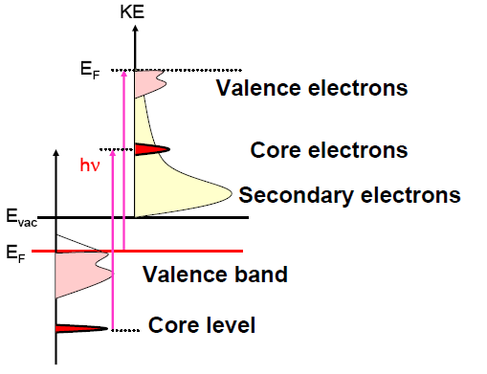
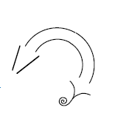
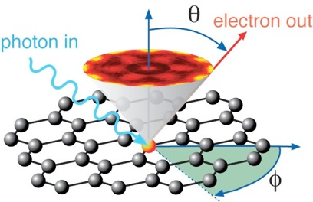
Photoelectron spectroscopy @ LNF
XUV1 exp. station
AlKα (1486 eV) and MgKα (1253 eV)
HeI (21.2 eV) and HeII (40.8 eV)
Electron energy analyser
X-ray and UV Photoelectron Spectroscopy
XPS and UPS
XUV1 exp. station
HeI (21.2 eV) and HeII (40.8 eV)
Monochromatized
Angle resolved electron energy analyser
Angle Resolved
PhotoElectron Spectroscopy ARPES
KE=hv-BE-φ
KE: kinetic energy
φ: work function
BE: binding energy
electron
analyzer
Meeting CERN-LNF
R. Larciprete

Slide 16
Surface characterization by XPS and SEY
Cu 3p_{3/2}
C1s
O1s
metal
O-C
O-Cu
oxide
C-C sp³
C-H
C-O
R. Cimino et al. Phys. Rev. Lett. 109, 064801 (2012)
R. Larciprete et al. Phys. Rev. ST 16, 011002 (2012)
Meeting CERN-LNF
R. Larciprete

Slide 17
Surface characterization by XPS and SEY
E=500 eV
I=5μA
Q=1.2x10⁻³ C/mm²
Cu 3p_{3/2}
C-C
C1s
O1s
metal
O-C
O-Cu
oxide
C-H
C-O
R. Cimino et al. Phys. Rev. Lett. 109, 064801 (2012)
R. Larciprete et al. Phys. Rev. ST 16, 011002 (2012)
Meeting CERN-LNF
R. Larciprete

Slide 18
Surface characterization by XPS and SEY
E=500 eV
I=5μA
Q=1.2x10⁻³ C/mm²
Cu 3p_{3/2}
C-C
C1s
O1s
metal
O-C
O-Cu
oxide
C-H
C-O
R. Cimino et al. Phys. Rev. Lett. 109, 064801 (2012)
R. Larciprete et al. Phys. Rev. ST 16, 011002 (2012)
Meeting CERN-LNF
R. Larciprete

Slide 19
Material Science Laboratory @ INFN-LNF
secondary electron yield
material growth
UV photoeletron
spectroscopy
X-ray photoeletron
spectroscopy
Meeting CERN-LNF
R. Larciprete

Slide 20
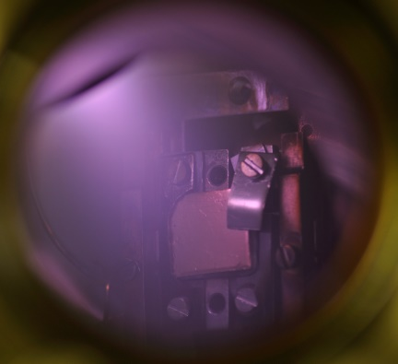
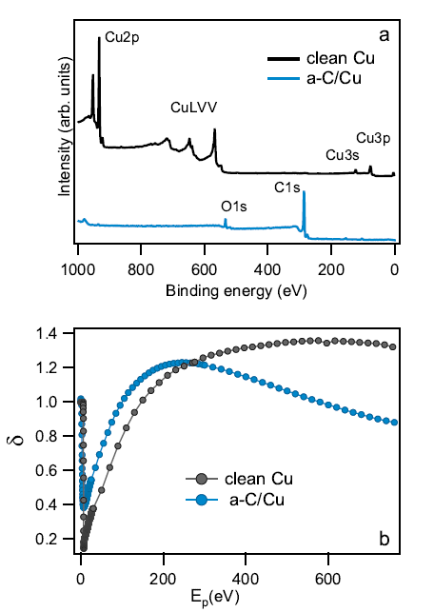
SEY vs. graphitization for a-C films
RF magnetron sputtering 50W p(Ar) 6x10⁻² mbar
a-C (~ 20 nm)/ poly Cu
SEY
Larciprete et al. Appl. Surf. Sci 328, 356 (2015)
Meeting CERN-LNF
R. Larciprete

Slide 21
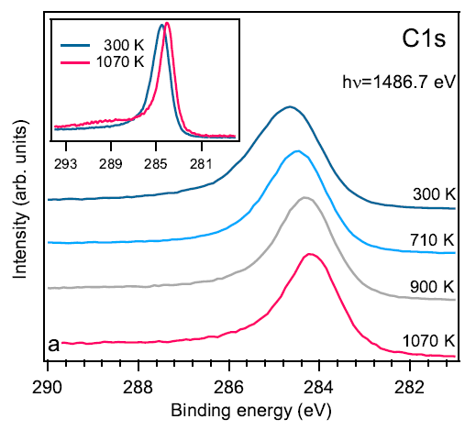
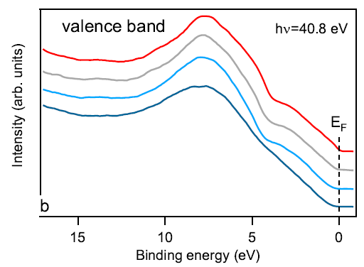
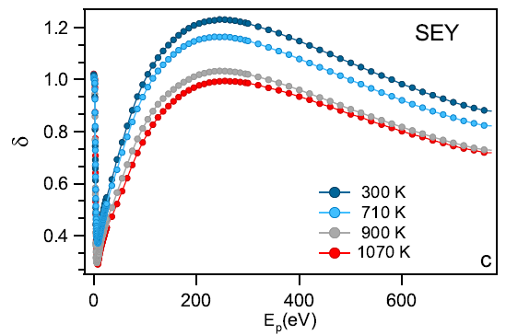
SEY vs. graphitization for a-C films
Larciprete et al. Appl. Surf. Sci 328, 356 (2015)
Meeting CERN-LNF
R. Larciprete

Slide 22
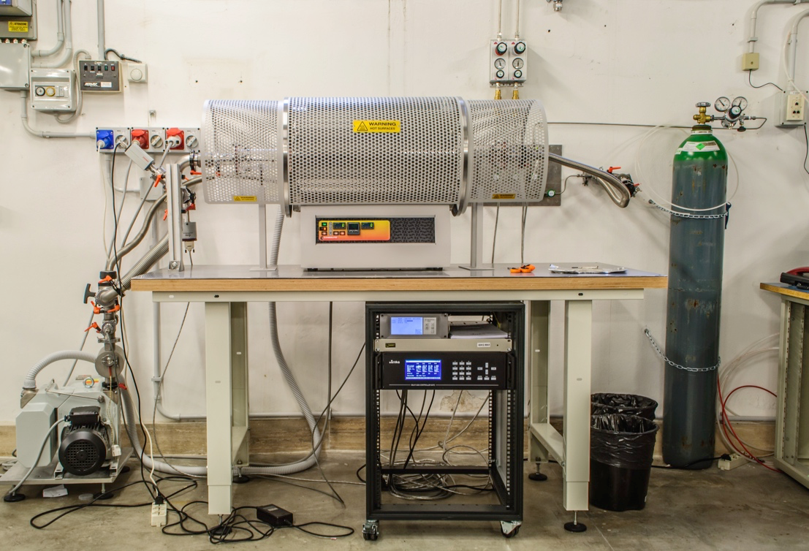
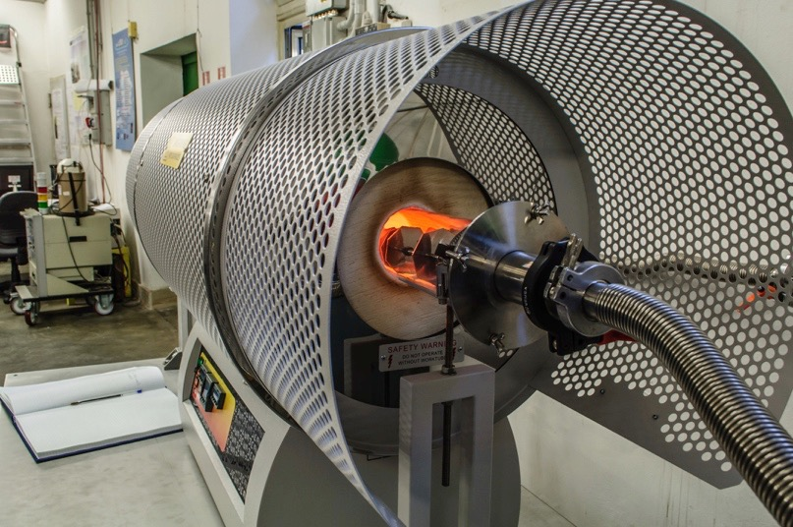
Tube furnace for material growth
Pressure
Controller
3-zone furnace T_{max} 1200°C
P
Vacuum
Quartz Tube
Gas inlet
Meeting CERN-LNF
R. Larciprete

Slide 23
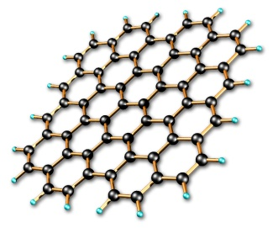
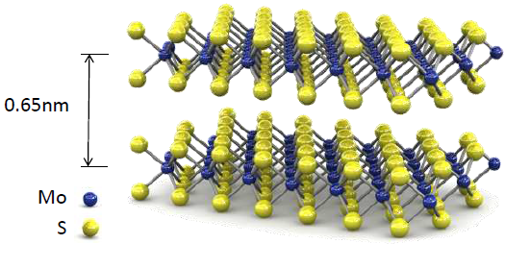
Tube furnace for material growth
gas phase precursors
CH₄ + H₂+Ar
Graphene monolayers on Cu foils
S0lid precursors
S + MoO₃ powder
MoS₂ mono and multi-layers on
Si and SiO₂ substrates
High pressure material growth
Controlled annealing processes of large scale samples
Meeting CERN-LNF
R. Larciprete

Slide 24
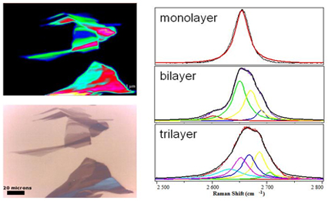
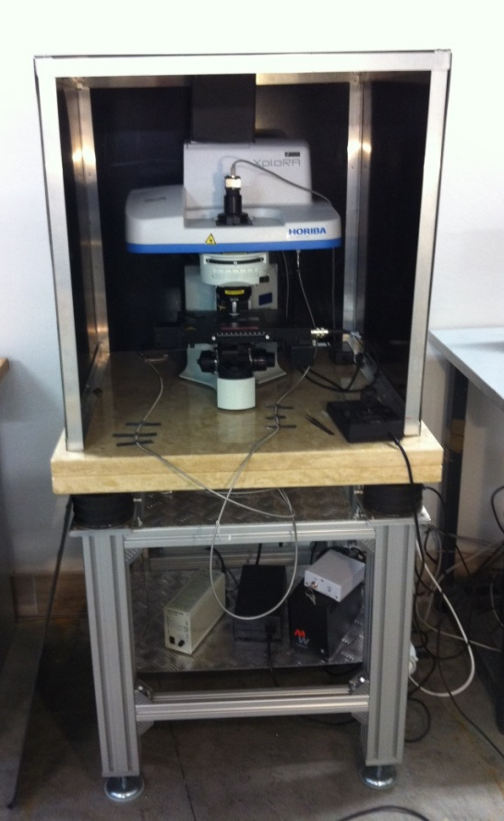
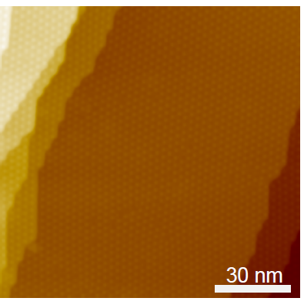
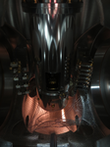
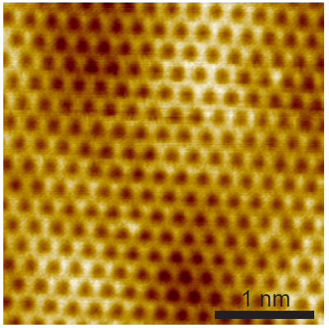
Material Science Laboratory @ INFN-LNF
scanning tunneling/atomic force
microscope STM/AFM
Raman microscope
2D band
Raman image
optical image
Meeting CERN-LNF
R. Larciprete

Slide 25
Feasible experimental activity
Material tests and characterization
(in UHV: SEY, XPS, UPS, STM/AFM; in air: Raman)
In UHV:
Radiation (electrons, photons, ions) induced surface modification
Thermal programmed desorption (combined with XPS)
Photon induced desorption (conventional sources)
Film growth for SEY optimization
In the tube furnace:
High pressure material growth
Controlled annealing processes of ‘large’ scale samples
With the DAΦNE beam available:
X-ray beam induced surface chemistry
X-ray beam induced desorption
Meeting CERN-LNF
R. Larciprete

Slide 26
People
Tecnical staff of DAΦNE-L
Antonio Grilli
Marco Pietropaoli
Agostino Raco
Giacomo Viviani
Vittorio Sciarra
Vinicio Tullio
PhD students, post-doc and associated collaborators
Mario Commisso
Davide Remo Grosso
Roberto Flammini
Luis Gonzales
Antonio Di Trolio
Alessandra Di Gaspare
Marco Angelucci
Eliana La Francesca
Meeting CERN-LNF
R. Larciprete

Slide 27

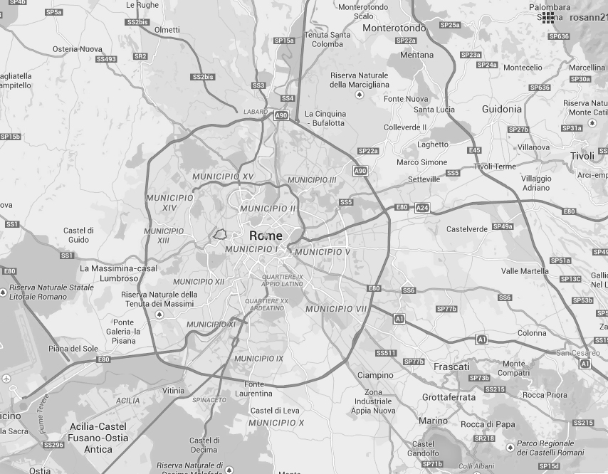
Collaborations
Sin generali che con Garfield
CNR Istituto dei sistemi Complessi
IMM
IFN
Thanks for your attention!
ENEA - Frascati
UNI Napoli
Uni Luis
CNR
ENEA
UNI

