Slide 2
CERN Vision & Strategy
Medium term plan guiding principle
Driven by Science and aiming at implementation of European Strategy for Particle Physics.
Takes into account technical feasibility and financial affordability.
Adequate resources for maintenance and consolidation of scientific and general infrastructure, and for compliance with safety requirements.
Next 10 years dominated by construction of High Luminosity LHC project (HL-LHC) ~950 MCHF.

Slide 3
CERN Vision & Strategy
Three main scientific pillars
Full exploitation of the LHC:
  successful Run 2, LS2, and Run 3 start-up.
  construction and installation of LIU; on-track construction of HL-LHC.
Scientific diversity programme serving a broad community:
  ongoing experiments and facilities at Booster, PS, SPS and their upgrades.
  participation in accelerator-based neutrino through CERN Neutrino Platform.
Preparation of CERN’s future:
  vibrant accelerator R&D programme exploiting CERN’s strengths and uniqueness.
  design studies for future accelerators: CLIC, FCC (includes HE-LHC).
  future opportunities of diversity programme: “Physics Beyond Colliders”.
Important milestone: update of the European Strategy for Particle Physics (ESPP) in 2019-2020.

Slide 4
CERN Vision & Strategy
European Strategy – HEP master schedule
1980
1985
1990
1995
2000
2005
2010
2015
2020
2025
2030
2035
Constr.
Physics
LEP
Design
Proto
Construction
Physics
LHC
Design
Construction
Physics
HL-LHC
~20 years
Future Circular Collider (FCC)
Design
Proto
Construction
Physics
Must advance fast now to be ready for the period 2035 – 2040
Goal of phase 1: CDR by end 2018 for next update of European Strategy

Slide 5
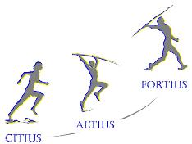
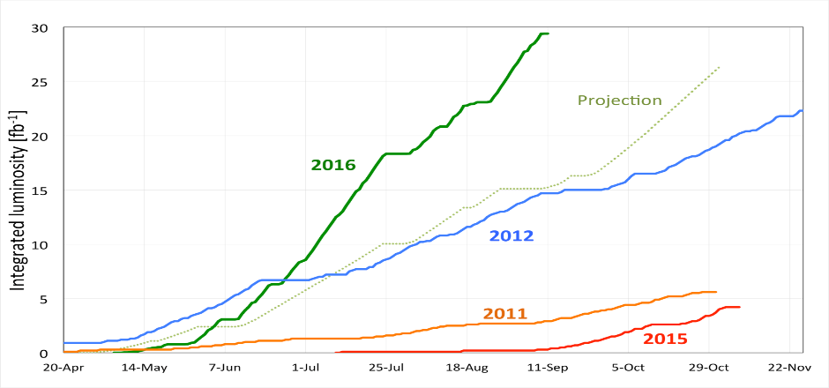
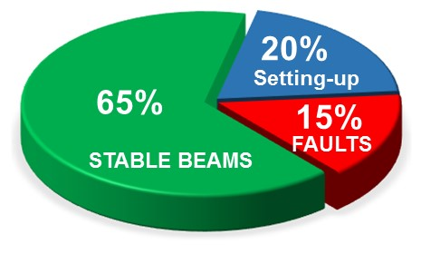
2016 goals
Peak luminosity > 1.35 x 10³⁴ cm⁻²s⁻¹
Over 25 fb⁻¹ in both ATLAS and CMS ☺
Progress represents a phenomenal ongoing effort by all the teams involved

Slide 6
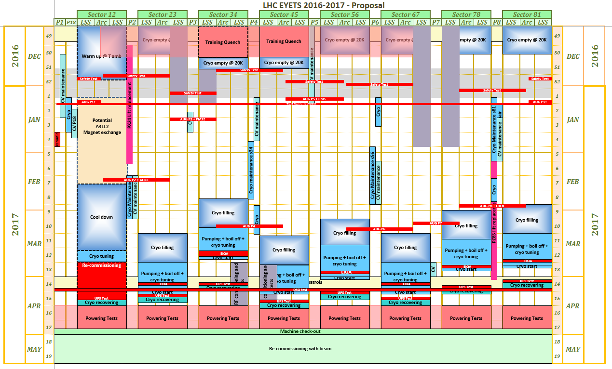
LHC EYETS approved on 31st August 2016
Same EYETS end date

Slide 7
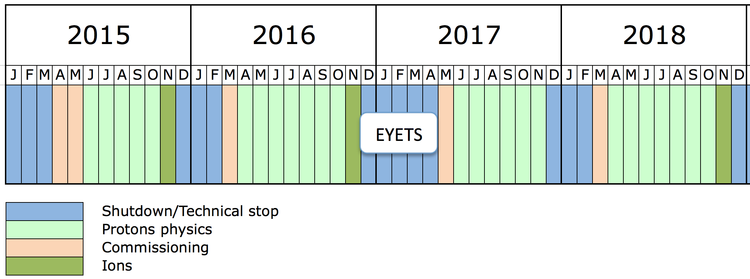
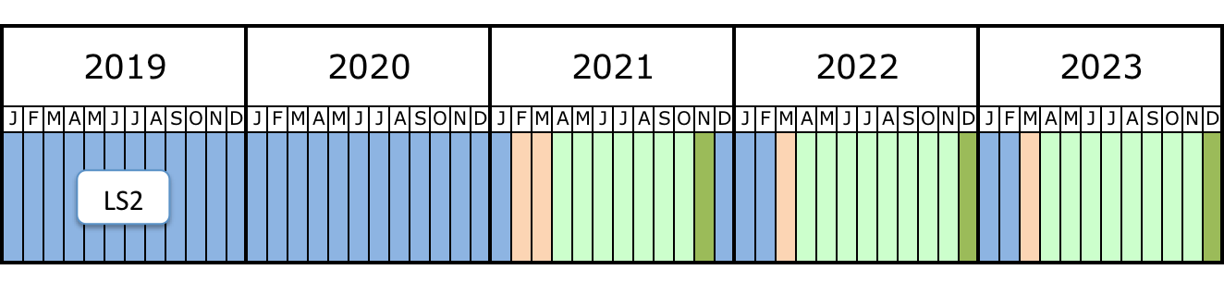
Run 2
Ion runs in 2016 (p-Pb) and 2018 (Pb-Pb)
>100 fb⁻¹
300 fb⁻¹
~ 40-45 fb⁻¹/year in 2017 and 2018 (goals will be fixed at Chamonix 2017)
Prepare for HL-LHC and post-LS2 LIU era
Prepare for 7 TeV operation

Slide 8
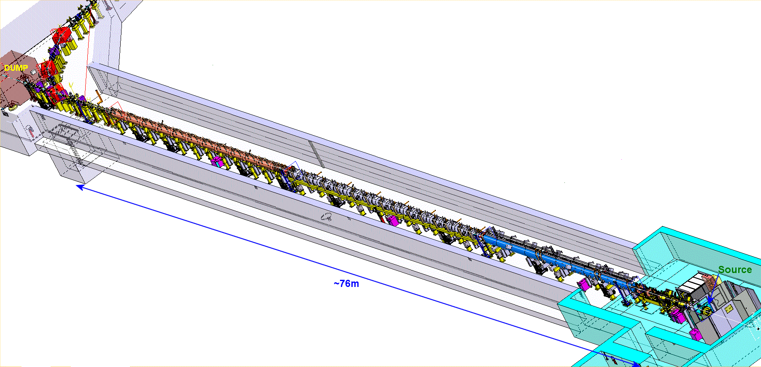
Linac4: Status of Commissioning / Installation
LINAC4 machine layout- 352MHz
Pre-injector (9m) |  | DTL (19m) |  | CCDTL (25m) |  |  | Π-mode (23m)
3MeV |  | 50 MeV |  | 100 MeV |  |  | 160 MeV
SOURCE | RFQ | 3 Tanks 3 Klystrons : 5 MW |  | 7 Modules 7 Klystrons : 7 MW |  |  | 12 Modules 8 Klystrons: 12MW
Beam Commissioning stages
45 keV | 3 MeV | 12 MeV | 50 MeV |  | 105 MeV | 160 MeV
Not yet the final source – details later (50mA standalone) (30mA-Nov15)***** | Chopping validated (10mA- Aug 14) (30mA-oct 15) (20mA-Nov15) | Completed (10mA- Aug 14) (20mA – Nov15) | November 2015 (20mA – Nov 15) |  | June 2016 (20mA – June16) | October 2016
Courtesy Maurizio Vretenar

Slide 9
The HL-LHC Project
New IR-quads Nb₃Sn (inner triplets)
  New 11 T Nb₃Sn (short) dipoles
  Collimation upgrade
  Cryogenics upgrade
  Crab Cavities
  Cold powering
  Machine protection
  …
Major intervention on more than 1.2 km of the LHC

Slide 10
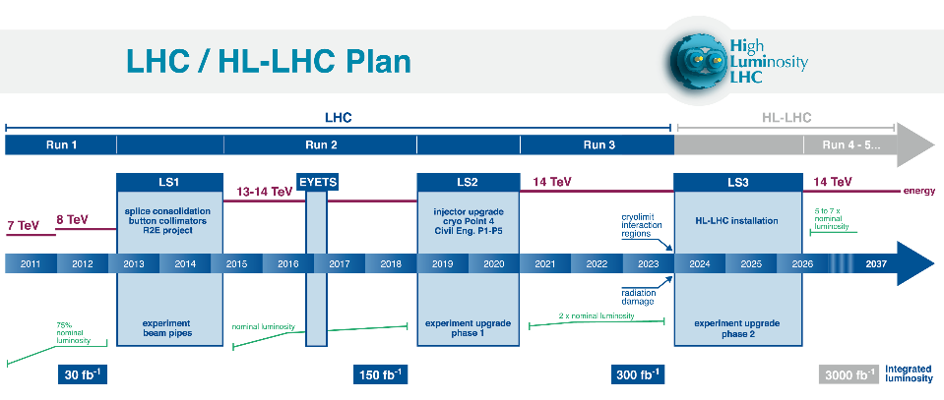
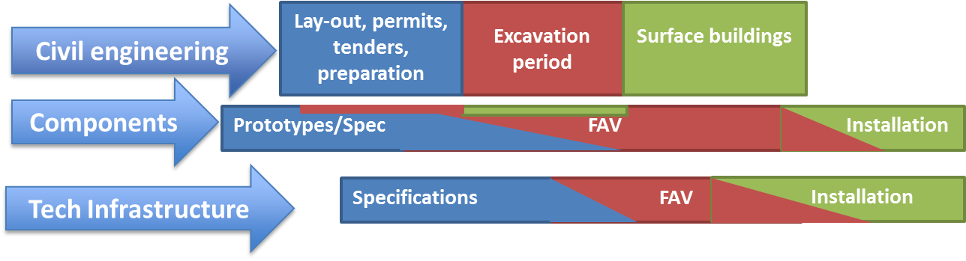
Run I
Run II
Run III
Run IV, V…
FAV = Fabrication, Assembly and Verification

Slide 11
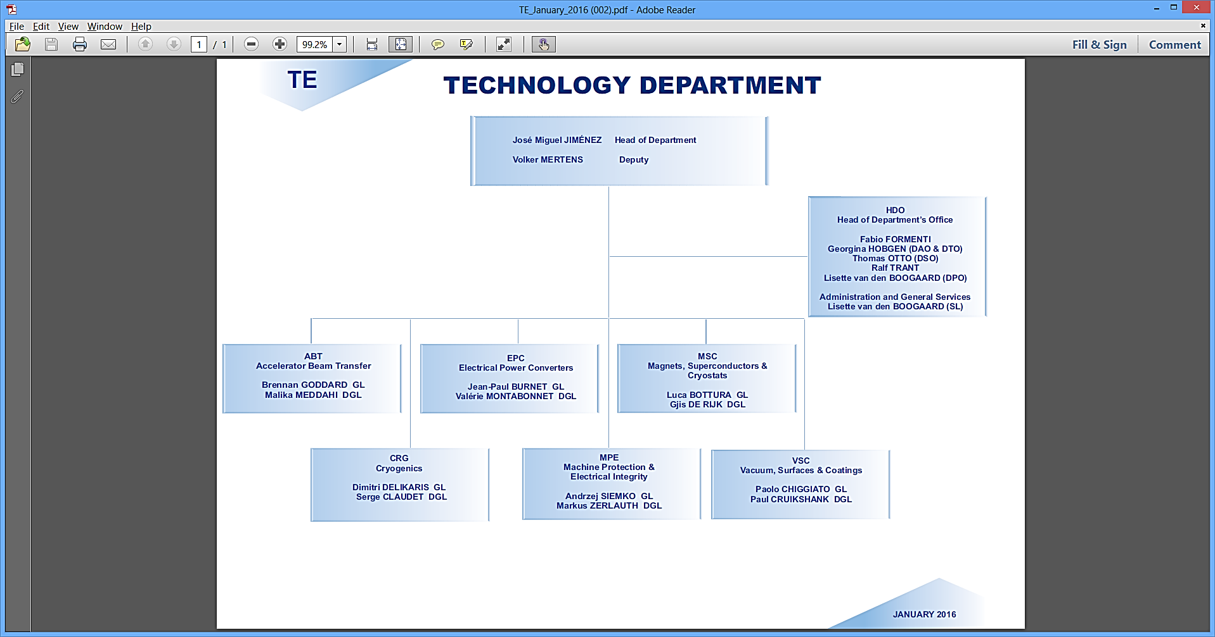
TE Mandates & Structures
Structure as of January’16
15 Staff
56 Staff
74 Staff
103 Staff
78 Staff
41 Staff
76 Staff

Slide 12
TE Mandates & Structures
Accelerator & Beam Transfer (ABT) Group Mandate
The ABT group is in charge of the design, development, construction, installation, exploitation and maintenance of injection and extraction related equipment:
  Fast pulsed magnets with associated high voltage pulse generators and transmission lines;
  Electrostatic and magnetic septa, including high voltage power supplies for electrostatic septa;
  Protection devices;
  Associated equipment-level control systems and software.
The group also conceives, studies and designs injection and extraction processes and systems in the accelerator complex, and beam transfer lines between accelerators and up to targets. It contributes to operational follow-up of beam transfer systems, and is in charge of the commissioning of the LHC transfer lines, injection and beam dumping systems together with their potential upgrades.

Slide 13
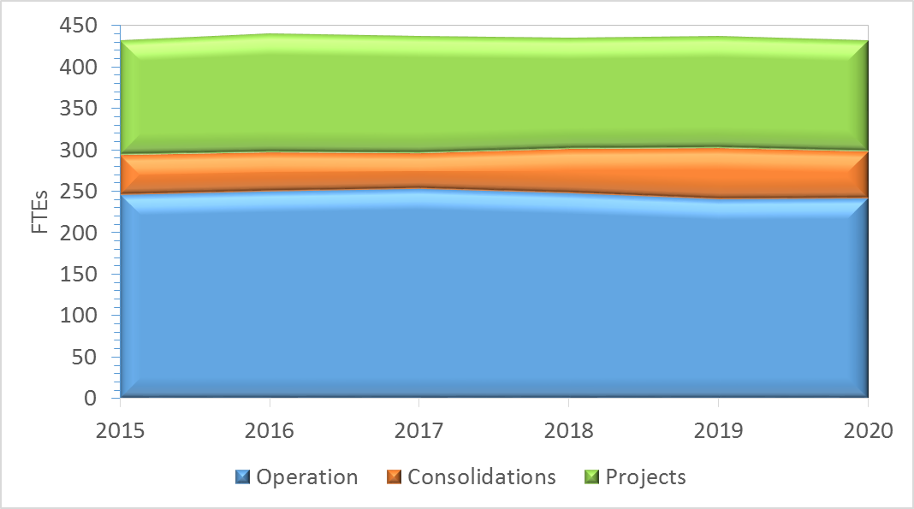
TE in few numbers
Manpower plan (MPP) 2015-2020

Slide 14
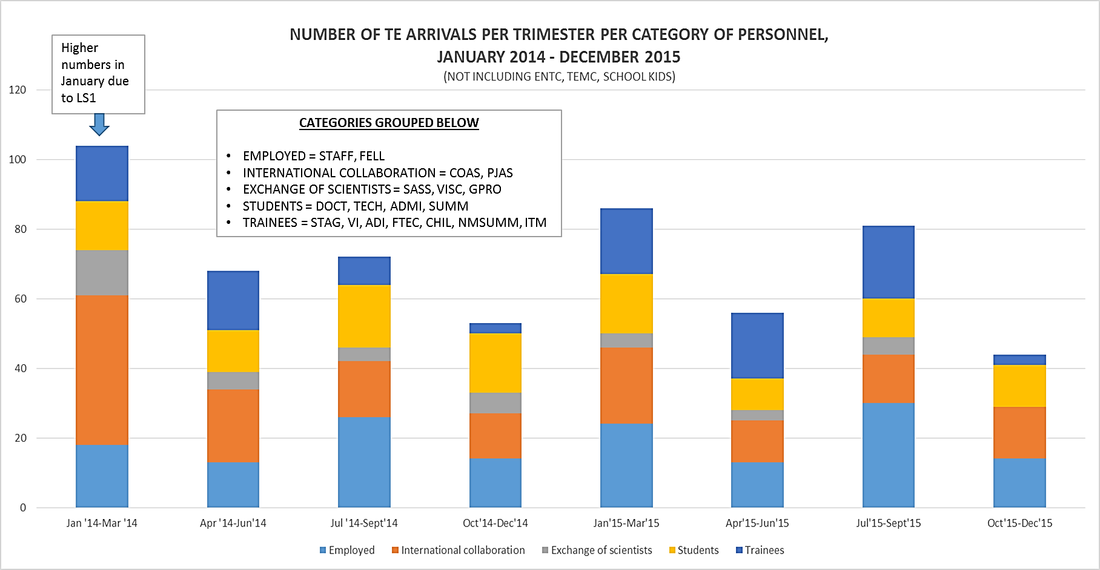
TE Mandates & Structures
Manpower turnover handled by HDO-AGS (all categories)
Important turnover in all programs… implies significant Staff efforts!

Slide 15
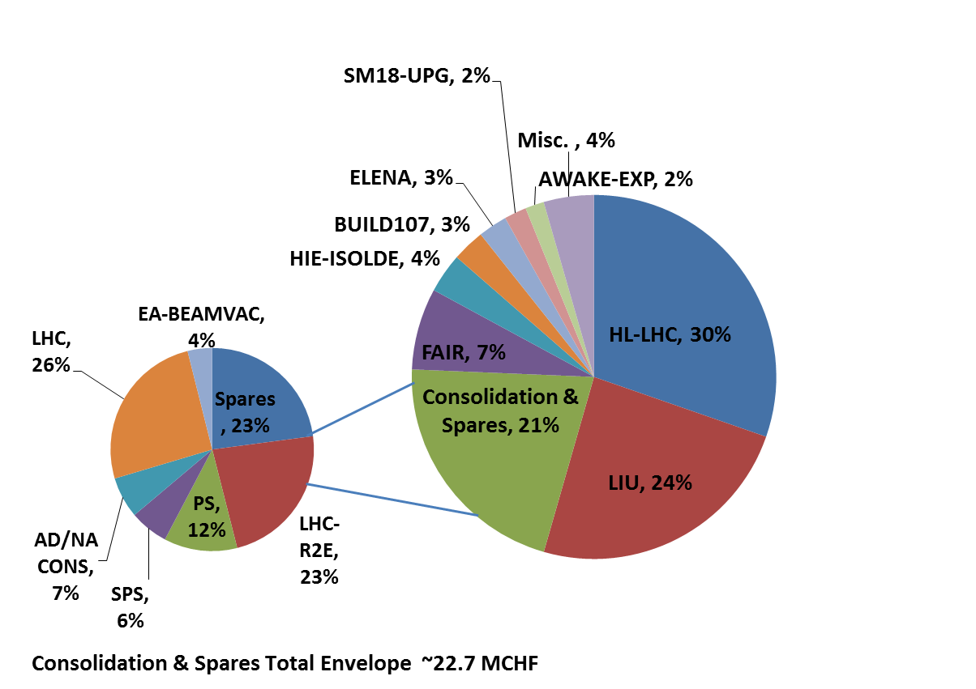
TE Medium Term Plan (MTP) 2015-2025
2016 Preliminary Projects Budget
~107 MCHF

