Slide 1




Recent results in Nuclear Astrophysics @ n_TOF, CERN
Tagliente Giuseppe
Istituto Nazionale Fisica Nucleare, Sez. di Bari
(on behalf of the n_TOF collaboration)

Slide 2
The n_TOF Collaboration

Slide 3
The n_TOF Collaboration
(~100 Researchers from 30 Institutes)
CERN
Technische Universitat Wien Austria
IRMM EC-Joint Research Center, Geel Belgium
Charles Univ. (Prague) Czech Republic
IN2P3-Orsay, CEA-Saclay France
KIT – Karlsruhe, Goethe University, Frankfurt Germany
Univ. of Athens, Ioannina, Demokritos Greece
INFN Bari, Bologna, LNL, LNS, Trieste, ENEA – Bologna Italy
Univ. of Tokio Japan
Univ. of Lodz Poland
ITN Lisbon Portugal
IFIN – Bucarest Rumania
CIEMAT, Univ. of Valencia, Santiago de Compostela,
University of Cataluna, Sevilla Spain
University of Basel, PSI Switzerland
Univ. of Manchester, Univ. of York UK
Notes:
Motivazioni Zr, Mg / Misure precedenti Os (orela ’80) / Proprietà nucleari (average level spacing, average radiative width, average neutron strength) / ISO 2919

Slide 4
n_TOF Scientific Motivations
  Neutron cross sections relevant for Nuclear Astrophysics
  Measurements of neutron cross sections relevant for Nuclear Waste Transmutation and related Nuclear Technologies (ADS)
  Neutrons as probes for fundamental Nuclear Physics

Slide 5
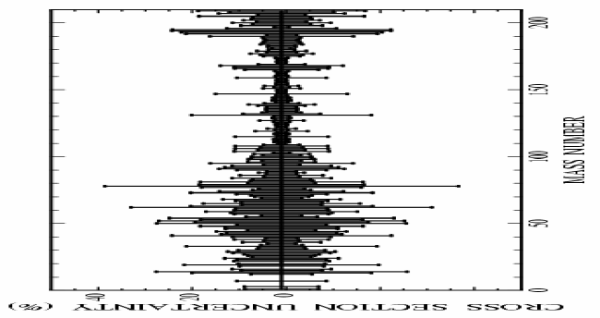
n_TOF Goal
*** cross section uncertainties <5%
*** safe control of systematic uncertainties

Slide 6
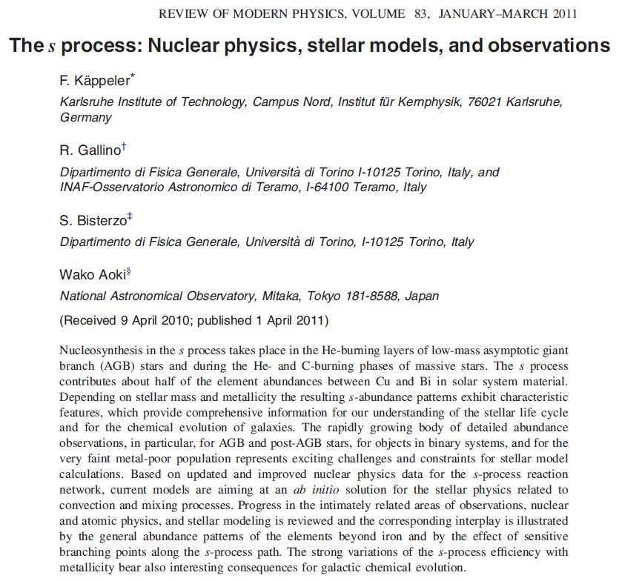
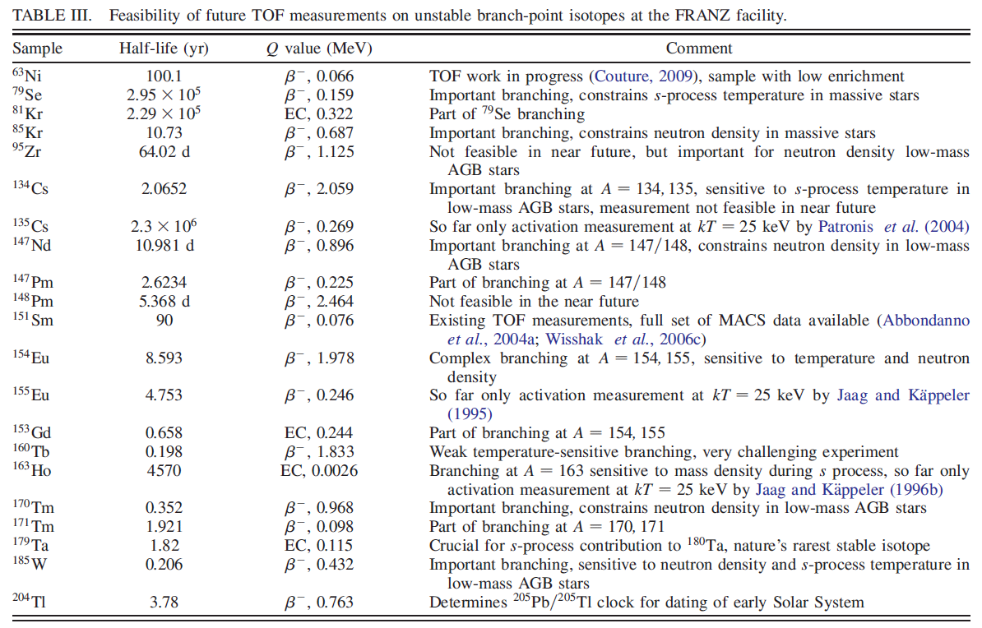
n_TOF Goal

Slide 7
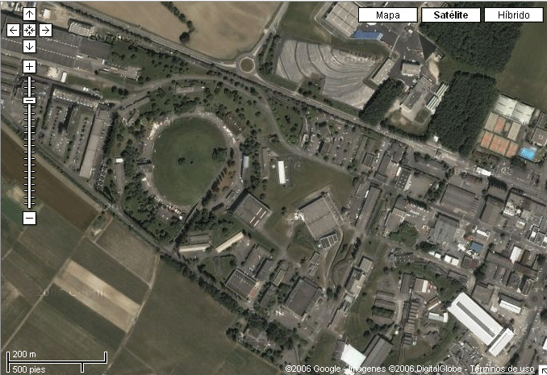

The CERN n_TOF Facility
n_TOF 200m Tunnel
Sample
Pb Spallation Target
Proton Beam
20GeV/c
7x10¹² ppp
Booster
1.4 GeV
Neutron Beam
10º prod. angle
Linac
50 MeV
PS 20GeV

Slide 8
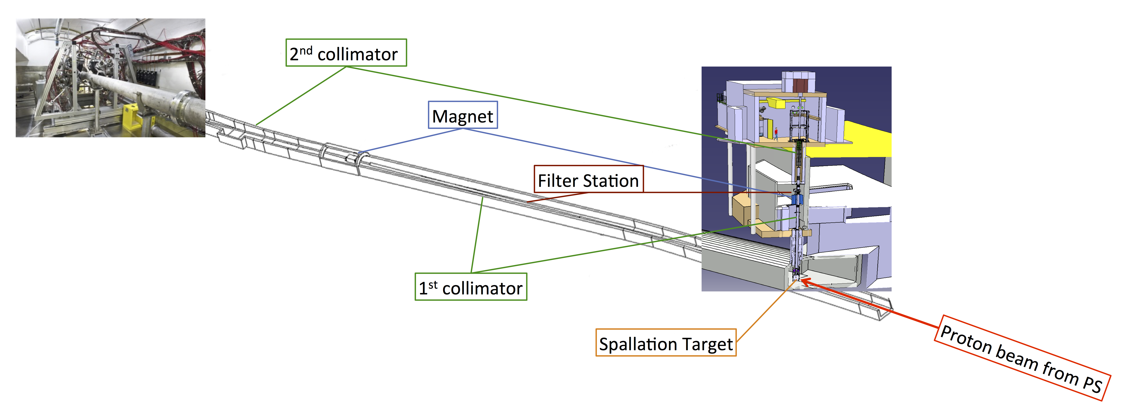
The n_TOF Facility: Beam lines
Both beam lines have:
1st collimator for halo cleaning and first beam shaping
Filter station
Magnet to minimize the charged particle background
2nd collimator for beam shaping
EAR-2:
Vertical flight path of 18.2 m
EAR-1:
Horizontal flight path of 184.2 m

Slide 9
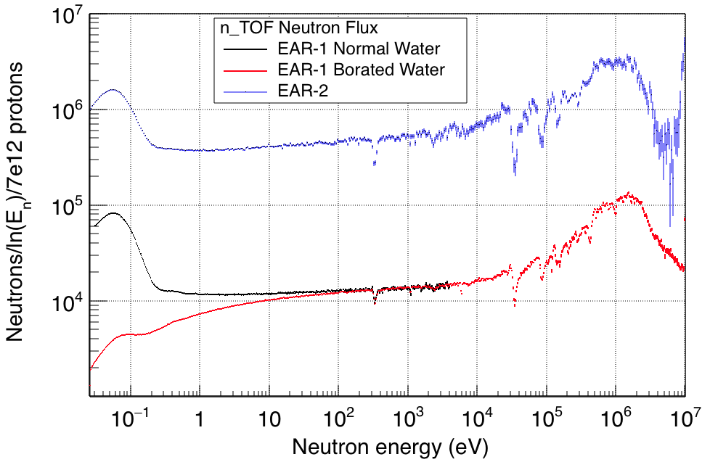
The n_TOF Facility: Main features
 | EAR-1 | EAR-2
Wide energy range | 25 meV<E_{n}<1 GeV | 25 meV<E_{n}<300 MeV
Extremely high instantaneous neutron flux | 10⁵ n/cm²/pulse | 10⁶ n/cm²/pulse

Slide 10
The n_TOF Facility: Main features
 | EAR-1 | EAR-2
Wide energy range | 25 meV<E_{n}<1 GeV | 25 meV<E_{n}<300 MeV
Extremely high instantaneous neutron flux | 10⁵ n/cm²/pulse | 10⁶ n/cm²/pulse
Low repetition rate | <0.8 Hz (1 pulse/2.4 s maximum)
High resolution in energy | ΔE/E=10⁻⁴ (E_{n} < 10 keV) | ΔE/E=10⁻³ (E_{n} < 10 keV)
Unique facility for measurements of radioactive isotopes and low cross-sections:
Branch point isotopes (astrophysics)

Slide 11
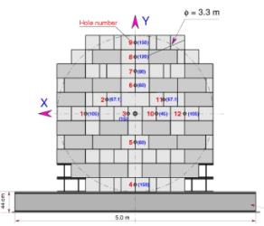
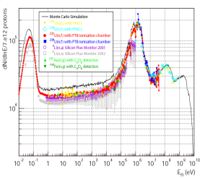
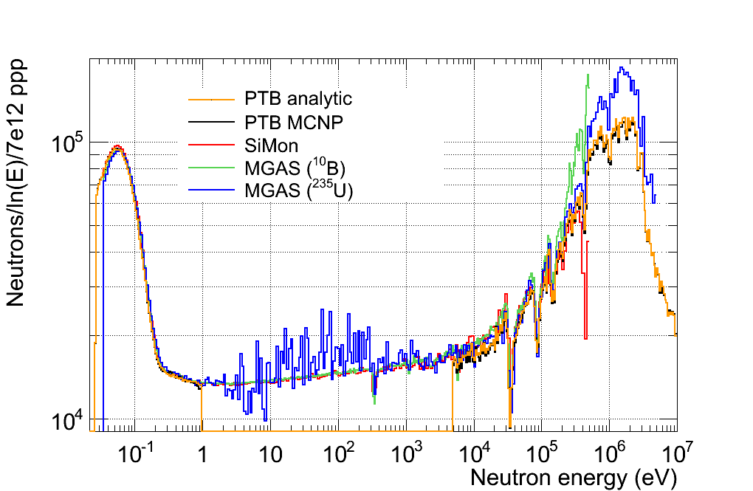
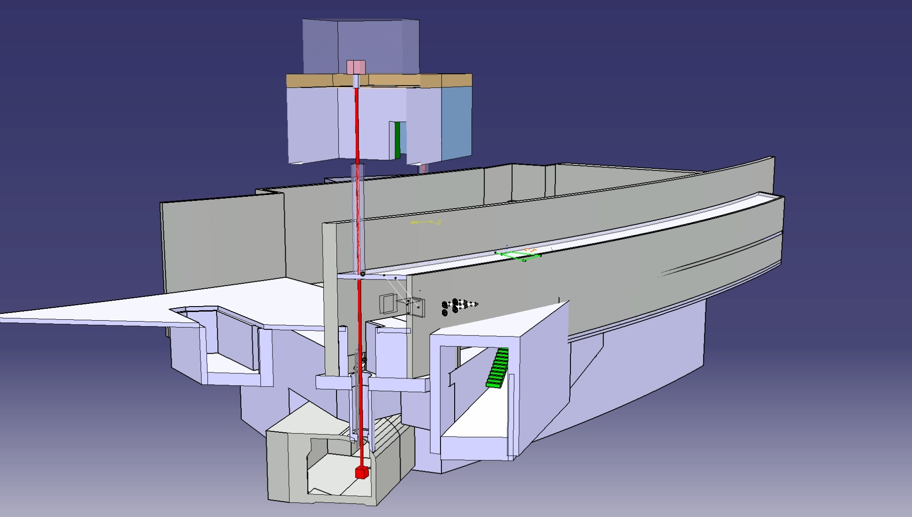
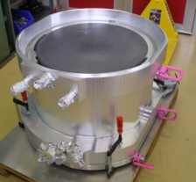
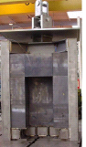
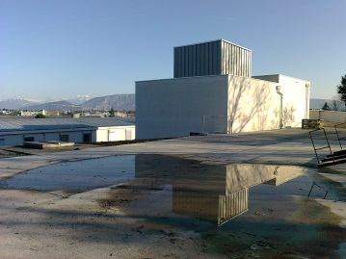
n_TOF Time line
TARC experiment
2000
Commissioning
Commissioning
Commissioning
Problem
Investigation
July 2014
1995-1997
May 2009
Feasibility
CERN/LHC/98-02+Add
2004-2007
2010
Upgrades:
Borated-H₂O
Class-A
Second Line
2015
Phase-3
May 1998
1996
2016
Construction
started
1999
Phase I
Isotopes
Capture: 25
Fission: 11
Phase II
Isotopes
Capture: 14
Fission: 3
(n,cp): 2
EAR2
Design and
Construction
Aug 1998
Proposal
submitted
New Target
construction
2011
2008
Concept
by C.Rubbia
CERN/ET/Int. Note 97-19
2001-2004
2009 - 2012
1997

Slide 12
The experimental activity at n_TOF: Ph I
¹⁵¹Sm
^{204,206,207,208}Pb^{,209}Bi
^{24,25,26}Mg
^{90,91,92,94,96}Zr, ⁹³Zr
¹³⁹La
^{186,187,188}Os
Cross sections relevant in
Nuclear Astrophysics
    s-process: branchings
    abundancies in presolar grains
    Magic nuclei
    Isotopes of particular interess
In the period 2002-2004 measured long-needed capture and fission cross-sections for 36 isotopes, 18 of which radioactive.
The unprecedented combination of excellent resolution, unique brightness and low background has allowed to collect high-accuracy data, in some cases for the first time ever.

Slide 13
The experimental activity @ n_TOF: Ph II
^{54,56,57}Fe
^{58,60,62}Ni,⁶³Ni
²⁵Mg
⁹³Zr
Cross sections relevant in Nuclear Astrophysics
    s-process: seeds isotopes
In the period 2009-2012 measured long-needed capture and fission cross-sections for 22 isotopes, 14 of which radioactive.

Slide 14
AstroPhysics program @ EAR I & EAR II: Phase III
Isot. | R | Comments
^{70,72,73}Ge | (n,γ) | s-process flow
¹⁷¹Tm,²⁰⁴Tl | (n,γ) | Branching points
⁸⁸Sr, ⁸⁹Y | (n,γ) | Neutron Magic, 1st s-process peek
Isot. | R | Comments
¹⁴⁷Pm | (n,γ) | Branching point
²⁶Al | (n,p/α) | ²⁶Al galactic abundance
⁷Be | (n,p/α) | n capture in light nuclei

Slide 15
Conclusions
There is need of accurate new data on neutron cross-section for astrophysics.
Since 2001, n_TOF@CERN has provided an important contribution to the field, with an intense activity on capture and fission measurements.
Several results of interest for stellar nucleosynthesis (Sm, Ni, Os, Zr, Fe, Mg etc…).
High resolution measurements performed in EAR1 in optimal conditions (borated water moderator, Class-A experimental area, etc…).
The EAR2 has opened new perspectives for frontier measurements on short-lived radionuclides.

Slide 16
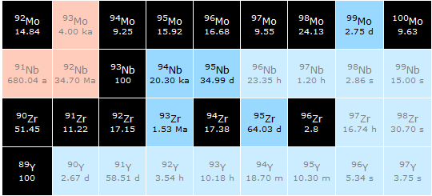

Slide 17
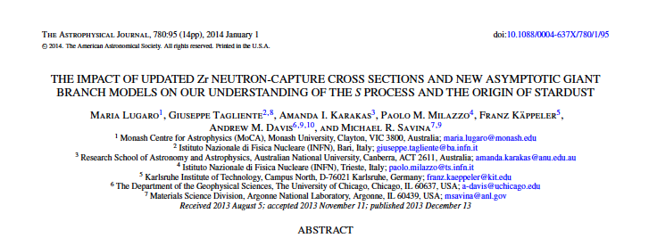
The experimental results: Zr isotopes
Courtesy of R. Gallino and S. Bisterzio
Nucleus | N_{ʘ} Normalized to N(Si)=10⁶ atoms | N_{s}/ N_{ʘ} % Old | N_{s}/ N_{ʘ} % n_TOF
⁹⁰Zr | 5.546 | 0.789 | 0.844
⁹¹Zr | 1.21 | 1.066 | 1.024
⁹²Zr | 1.848 | 1.052 | 0.981
⁹⁴Zr | 1.873 | 1.217 | 1.152
⁹⁶Zr | 0.302 | 0.842 | 0.321
Solar abundances, N, from Lodders 2009, accuracy 10%
The s-abundances, N_{s}, are calculated using the TP stellar model for low mass AGB star (1.5 - 3 M).

Slide 18
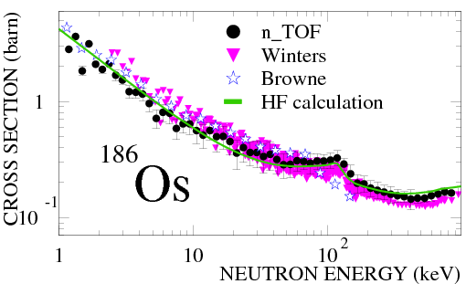
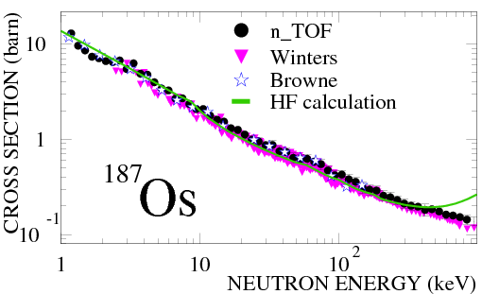
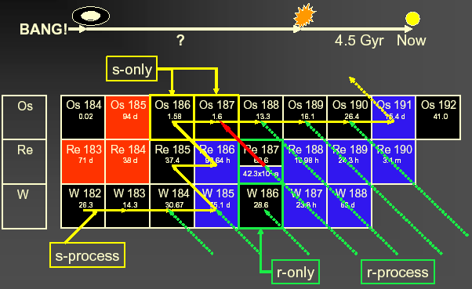
The experimental results: ^{186,187}Os

Slide 19
The experimental results: ^{186,187}Os
Cosmological way
Astronomical way
Nuclear way: Re/Os clock Th/U clock
13.7 ± 0.2 Gyr
14 ± 2 Gyr
14.9 ± 2 Gyr(*)
14.5 ± 2.5 Gyr
(*) 0.4 Gyr uncertainty due to cross-sections

Slide 20




The experimental results: ¹⁵¹Sm
Laboratory t_{1/2} = 93 yr
reduced to t_{1/2} = 3 yr @ s-process site
¹⁵²Gd
¹⁵⁴Gd
¹⁵¹Eu
¹⁵²Eu
¹⁵³Eu
¹⁵⁴Eu
s-Process
¹⁵⁰Sm
¹⁵¹Sm
¹⁵²Sm
¹⁵³Sm
The branching ratio for ¹⁵¹Sm depends on:
  Termodynamical condition of the stellar site (temperature, neutron density, etc…)
  Cross-section of ¹⁵¹Sm(n,γ)
  ¹⁵¹Sm used as stellar thermometer !!

Slide 21
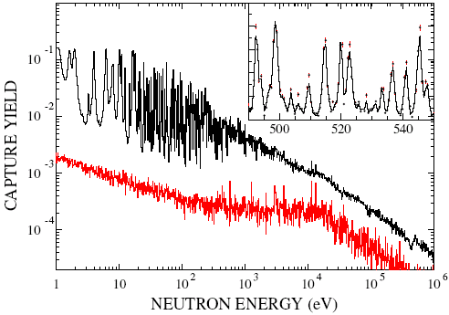
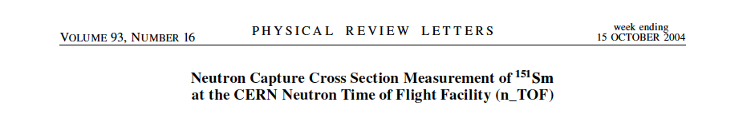
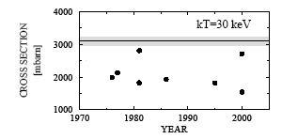
The experimental results: ¹⁵¹Sm
background
Measured for the first time at a time-of-flight facility
Resonance analysis with SAMMY code.
Maxwellian averaged cross-section experimentally determined for the first time
s-process in AGB stars produces 77% of ¹⁵²Gd,
23% from p process
Maxwellian averaged (n,γ) cross section of the ¹⁵¹Sm and previous calculation (symbol)
NO PREVIOUS MEASUREMENTS!

Slide 22
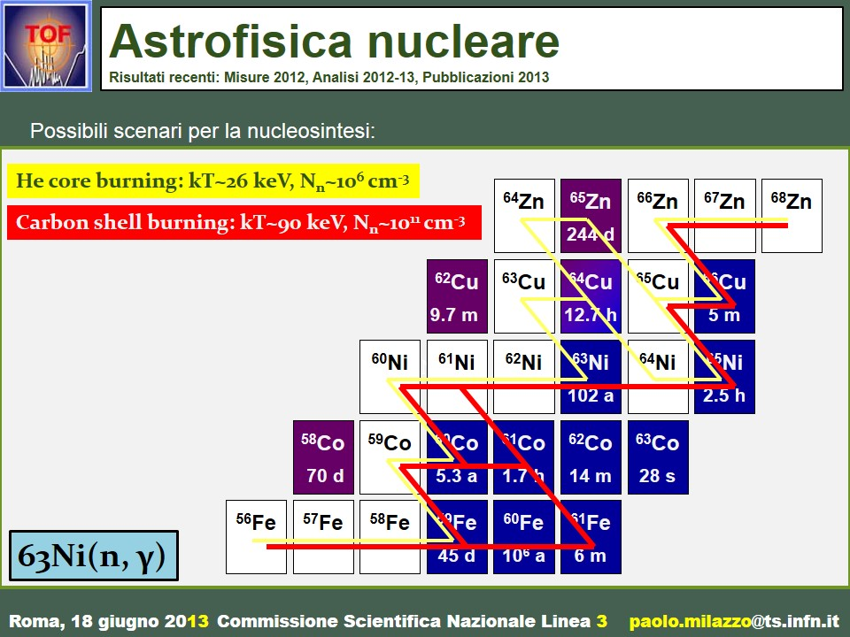
The experimental results: ⁶³Ni
Scenarios
in massive stars

Slide 23
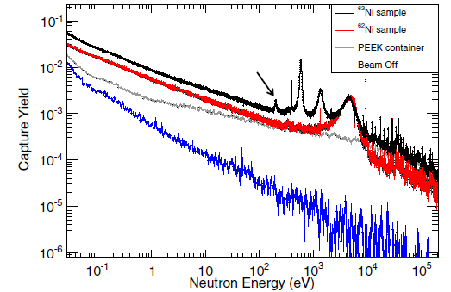
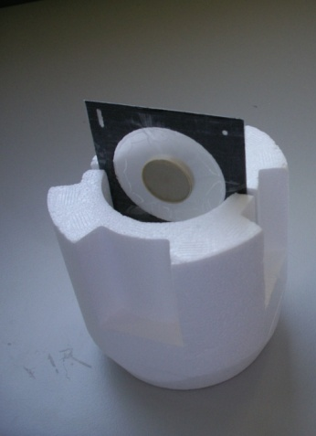
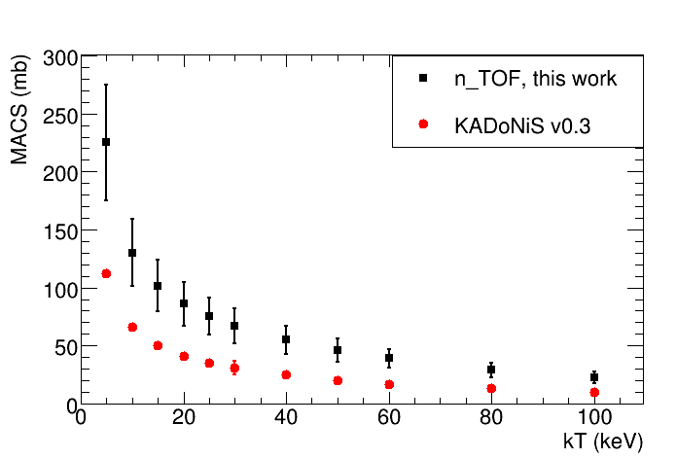
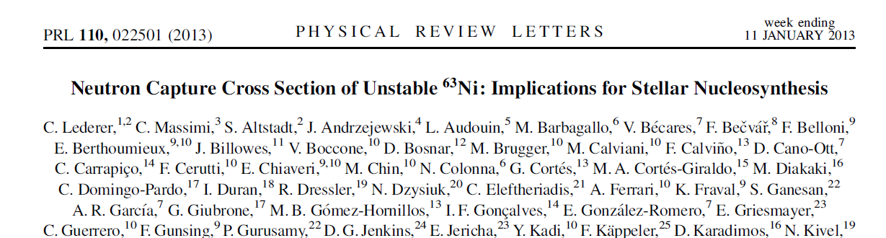
The experimental results: ⁶³Ni
⁶³Ni (t_{1/2}=100 y) represents the first branching point in the s-process, and determines the abundance of ^{63,65}Cu
⁶²Ni sample (1g) irradiated in thermal reactor (1984 and 1992), leading to enrichment in ⁶³Ni of ~13 % (131 mg)
In 2011 ~15.4 mg ⁶³Cu in the sample (from ⁶³Ni decay).
After chemical separation at PSI, ⁶³Cu contamination <0.01 mg
First high-resolution measurement of ⁶³Ni(n,γ) in the astrophysical energy range.

Slide 24
The experimental results: ¹⁷¹Tm(n, γ)
MACS @30 keV (mb)
Isotope production @ILL
¹⁷¹Tm: ¹⁷⁰Er(n, γ)¹⁷¹Er (β⁻, 7.5h)¹⁷¹Tm (enrichment 1.8%)
3.6 mg of ¹⁷¹Tm (1.9 y) [1.3x10¹⁹ atoms]
Chemical separation and sample preparation @PSI
¹⁷¹Tm (97.9%) + ¹⁶⁹Tm (2.1%) + ¹⁷⁰Tm(0.07%)
1400
1332
1200
1000
800
637
600
KADoNiS = 486
400
399
200
309
243
1975
1980
1985
1990
1995
2000
2005
YEAR
¹⁷¹Tm deposit (20 mm diameter)
Aluminum (7 μm) backing
Frame (50 mm diameter)
Mylar (5 μm)

Slide 25
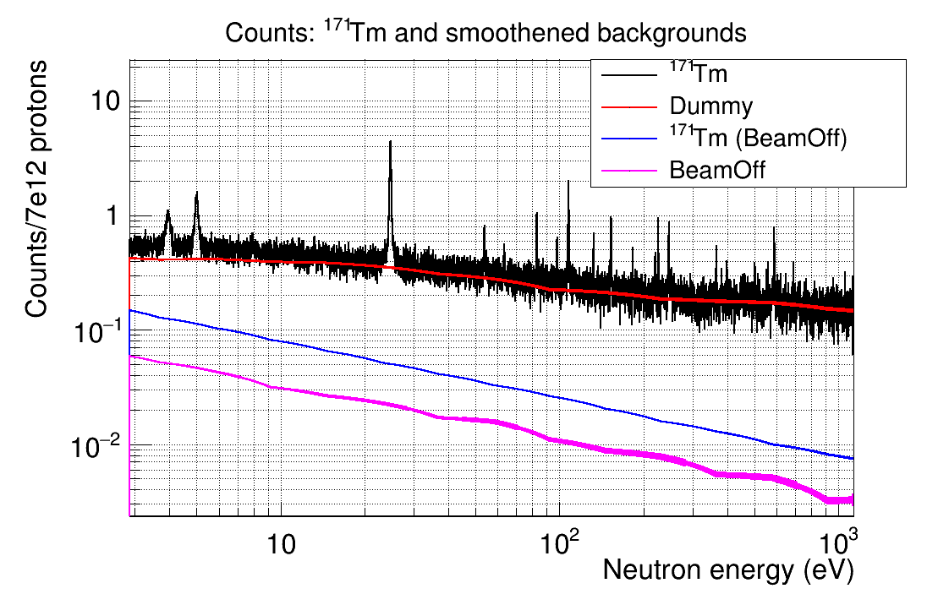
The experimental results: ¹⁷¹Tm(n, γ)
First
experimental measurement
VERY PRELIMINARY RESULTS
data: J. Lerendegui

Slide 26
The experimental results: Ge(n, γ)
The neutron capture cross section on Ge
affects the abundances
for a number of heavier isotopes
up to a mass number of A = 90.

Slide 27
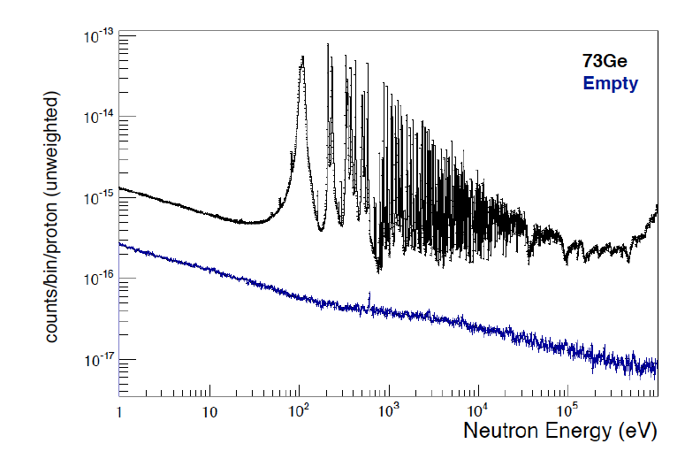

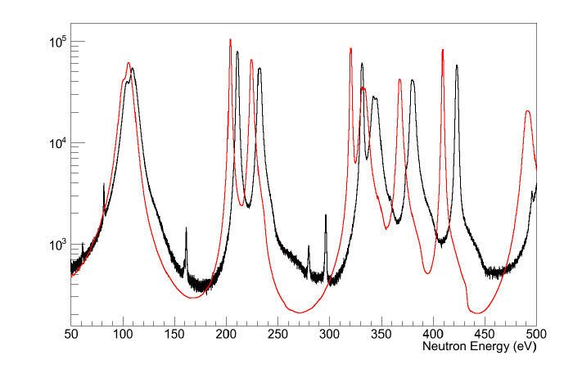
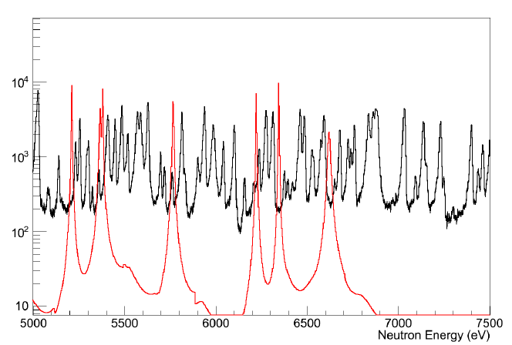
The experimental results: ⁷³Ge(n, γ)
ENDF/B-VII
n_TOF
ENDF/B-VII
n_TOF
VERY PRELIMINARY RESULTS
data: C. Lederer

Slide 28
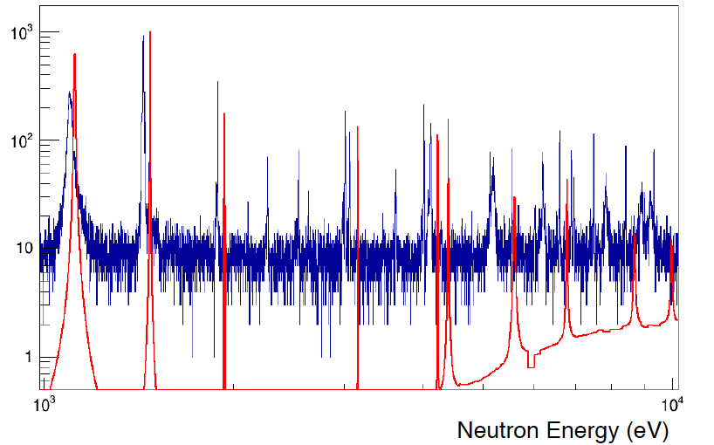

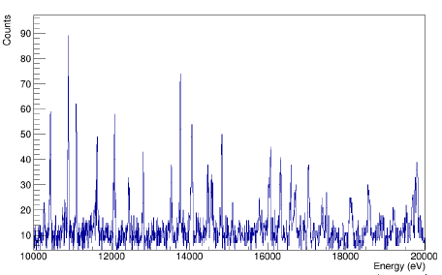
The experimental results: ⁷⁰Ge(n, γ)
Counts
ENDF/B-VII
n_TOF
VERY PRELIMINARY RESULTS
data: C. Lederer

Slide 29
²⁶Al(n, p), (n, α)
Observation of the cosmic ray emitter ²⁶Al is proof that nucleosynthesis is ongoing in our galaxy.
The neutron destruction reactions ²⁶Al(n, p) and ²⁶Al(n, α) are the main uncertainties to predict the galactic ²⁶Al abundance.
There are only few experimental data on these reactions and they exhibit severe discrepancies.

Slide 30
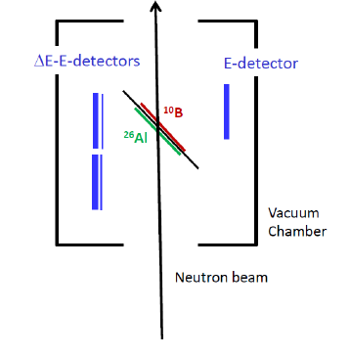
²⁶Al(n, p), (n, α)
The sample was produced by IRMM in collaboration with LANCSE
The p and α will be detected by double sided silicon strip detectors arranged as E –ΔE telescope
The neutron fluence will be monitored by a ¹⁰B sample

Slide 31
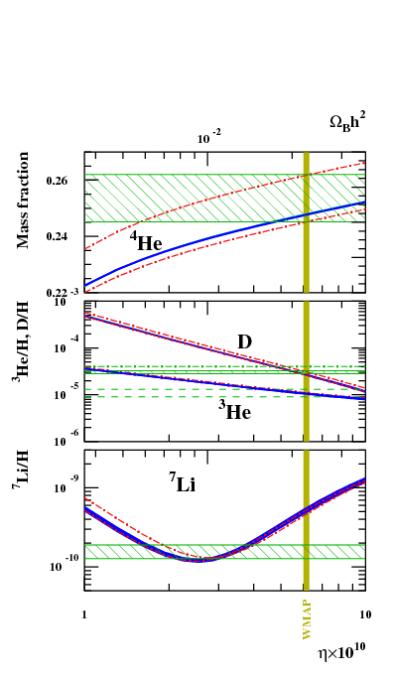
⁷Be(n, p), (n, α)
BBN successfully predicts the abundances of primordial elements such as ⁴He, D and ³He
A serious discrepancy (factor 2-4) between the predicted abundance of ⁷Li and the value inferred by measurements
Cosmological Lithium Problem

Slide 32
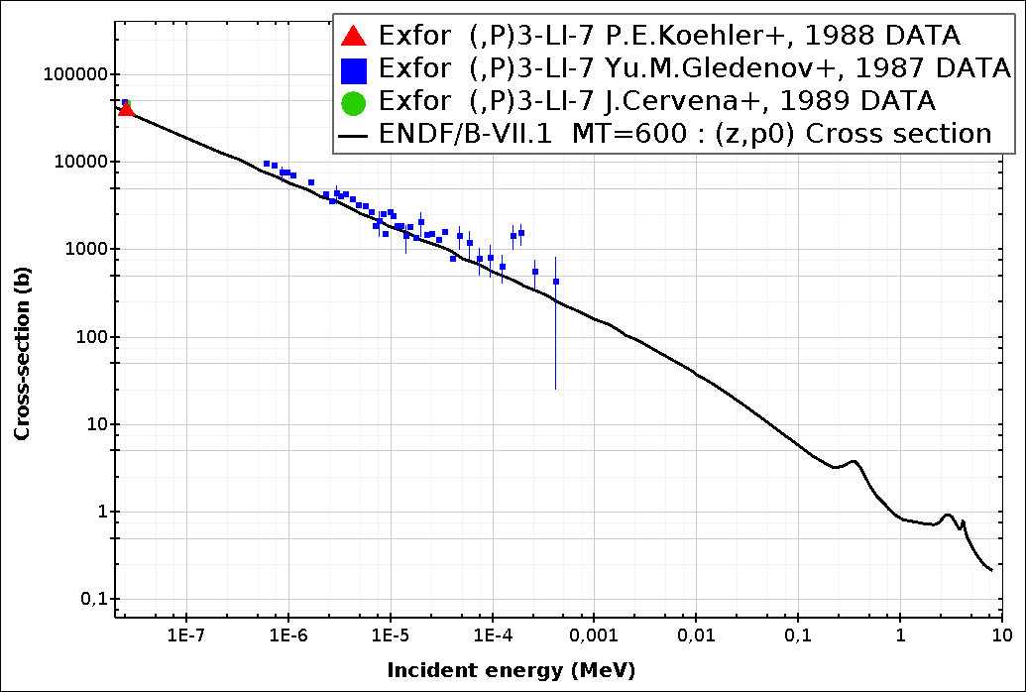
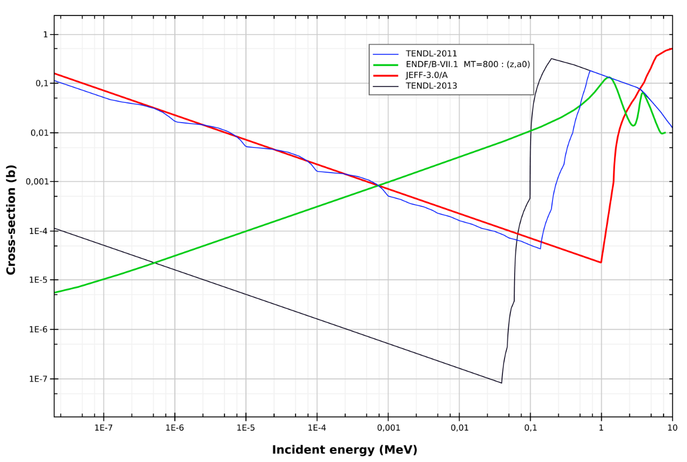
⁷Be(n, p), (n, α)
Approximately 95% of primordial ⁷Li is produced from the electron capture decay of ⁷Be (T_{1/2}=53.2 d)
⁷Be is destroyed via (n,p) (≈97%) and (n, α) (≈2.5%) reactions
A higher destruction rate of ⁷Be can solve or at least partially explain the Cosmological Lithium Problem
Only one direct measurement
(P. Bassi et al., 1963, @ 0.025 eV)
⁷Be(n, p)
⁷Be(n, α)

Slide 33
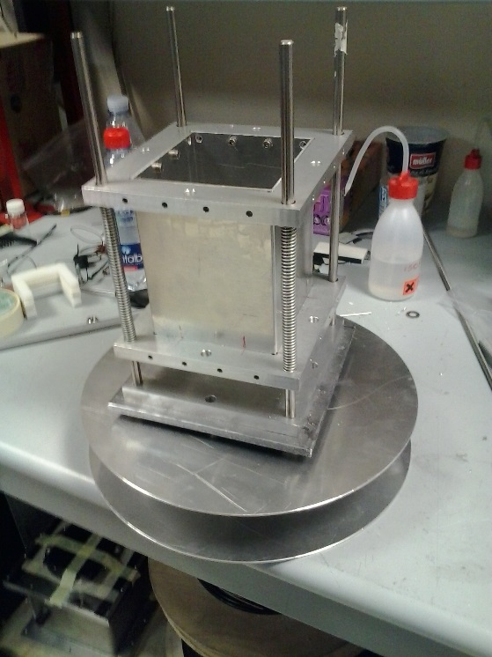
⁷Be(n, α) ⁴He
Intrinsic difficulty of the measurement
low cross section
extremely high specific activity: 13 GBq/μg
available in small quantity
short half-life: 53.3 days
Sandwich of silicon detectors directly inserted in the beam
Detection of both alpha particles (E≈9 MeV)
Coincidence technique:
Strong rejection of background
Silicon 1
sample
neutrons
Silicon 2
Sample:
1.4 μg of ⁷Be from water cooling of SINQ spallation target.
(activity of 478 keV γ-rays)
Isotopic composition: 1:1 ⁷Be-¹⁰Be 1:5 ⁷Be-⁹Be

Slide 34
⁷Be(n,α) cross-section
Accepted by PRL
Courtesy of M. Barbagallo
1/v behaviour of the ⁷Be(n,α)⁴He reaction cross-section.
The only previous measurement (@0.025 eV) is in good agreement with new data

Slide 35
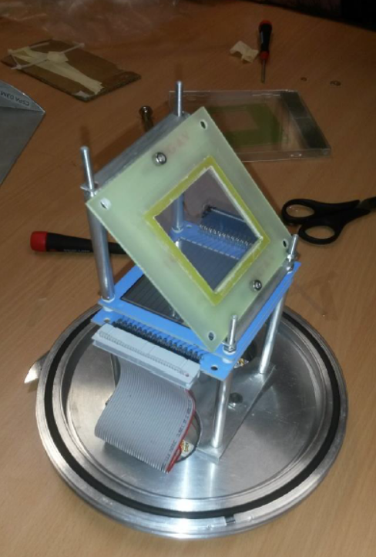
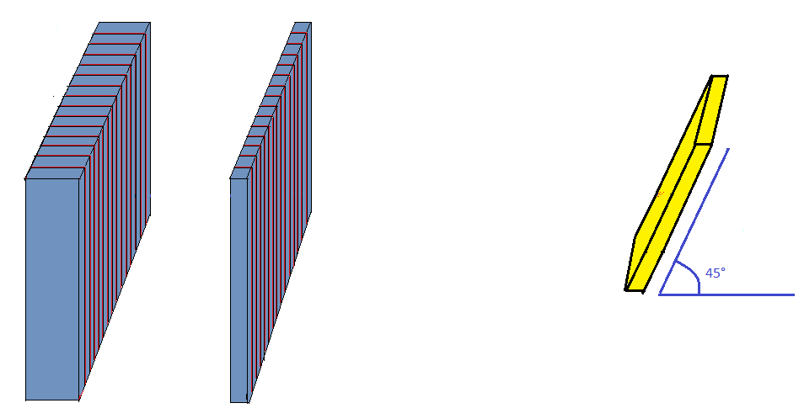

⁷Be(n, p)
Telescope of silicon detectors (E – DE)
Detected proton (E≈1.6 MeV)
p
$$E ∆E$$
High purity sample needed:
PSI+ ISOLDE
1.1 GBq activity of the sample
Neutron beam

Slide 36
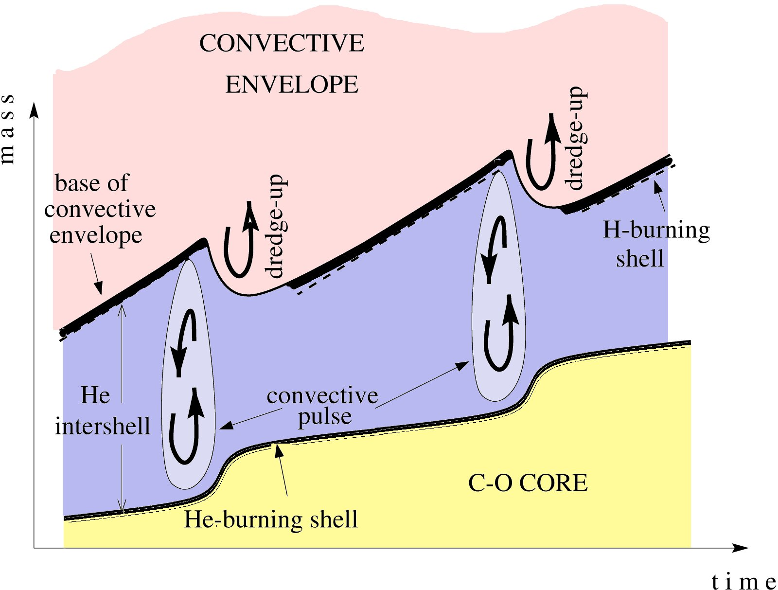
neutron density
neutron density
time
10⁻⁴
time
proton diffusion
¹³C(α,n)¹⁶O
- C
²²Ne(α,n)²⁵Mg
Notes:
Low mass AGBs Intermediate mass AGBs
Lower temperature ~4.5 M Higher temperature
Larger intershell mass Smaller intershell mass

Slide 37
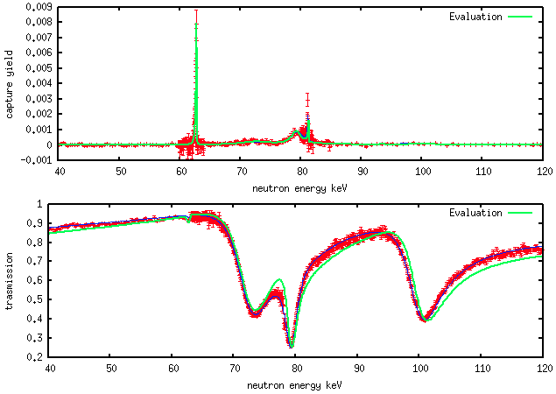
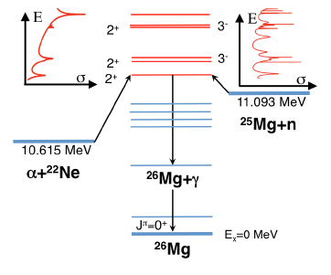
The experimental results: ²⁵Mg(n, γ)
The ²⁵Mg is one of the most important neutron poison in the s-process path.
The ²²Ne(α,n) is one of the main source of neutrons for the s-process. Extremely difficult to measure (very low cross section). Reaction rate very uncertain because of the poorly known property of the states in ²⁶Mg.
Resonance Analysis: simultaneous analysis of transmission (GELINA) and capture data (n_TOF)
Spin assignment and constraints for ²²Ne(α,n)²⁵Mg
Library
E_{R}=72 keV, J^{π}=2⁺
E_{R}=79 keV, J^{π}=3⁺
This work
E_{R}=72 keV, J^{π}=2⁺
E_{R}=79 keV, J^{π}=3⁻

