Slide 1
The CERN n_TOF facility: a unique tool for nuclear data measurement
Federica Mingrone
on behalf of the n_TOF Collaboration
CNR*15 – Tokyo, Tuesday 22nd October 2015

Slide 2
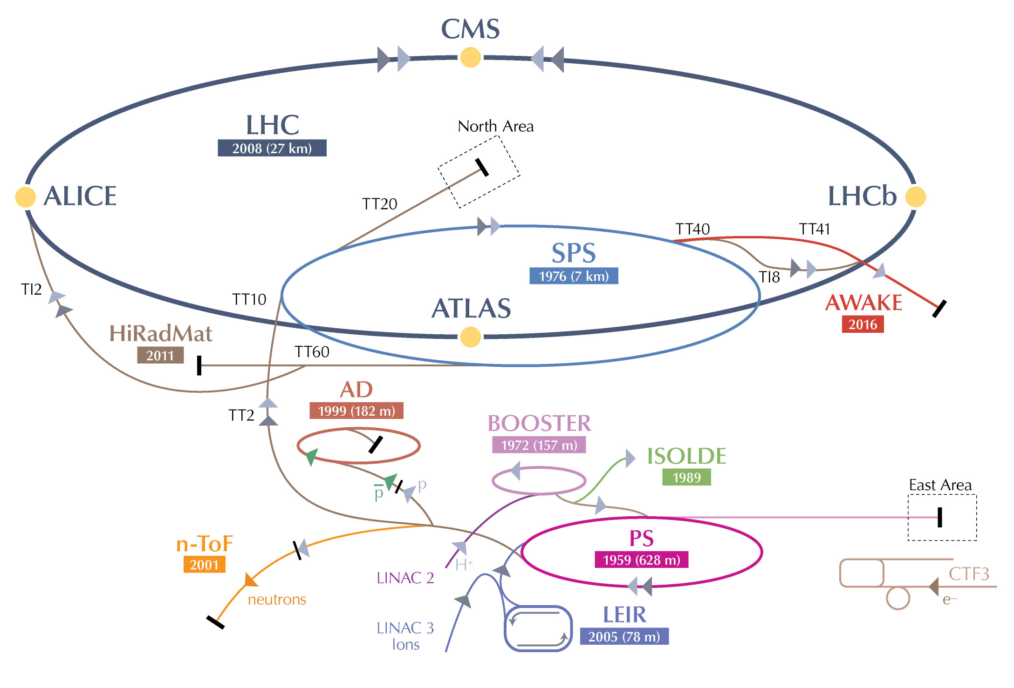
The CERN accelerator complex
CERN: European Organization for Nuclear Research (Geneva, Switzerland)
Since 1954
Various accelerator complex
Most recent discovery:
2012 Higgs Boson

Slide 3
The n_TOF facility @ CERN
CERN: European Organization for Nuclear Research (Geneva, Switzerland)
Since 1954
Various accelerator complex
Most recent discovery:
2012 Higgs Boson
Netron Time Of Flight facility: n_TOF

Slide 4
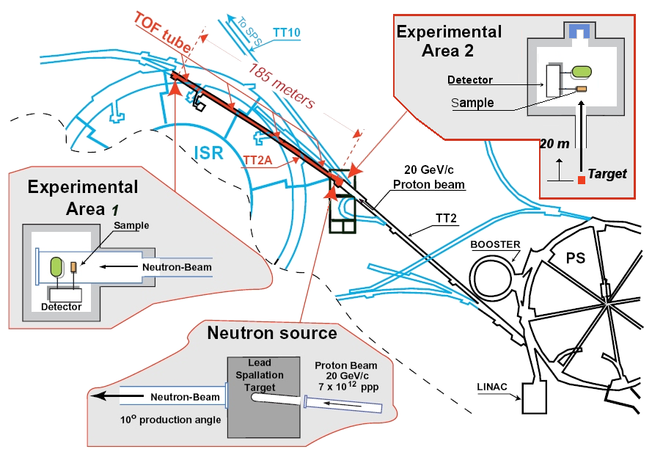
The n_TOF facility @ CERN
CERN: European Organization for Nuclear Research (Geneva, Switzerland)
Since 1954
Various accelerator complex
Most recent discovery:
2012 Higgs Boson

Slide 5
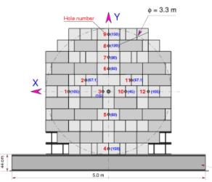
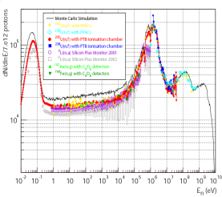
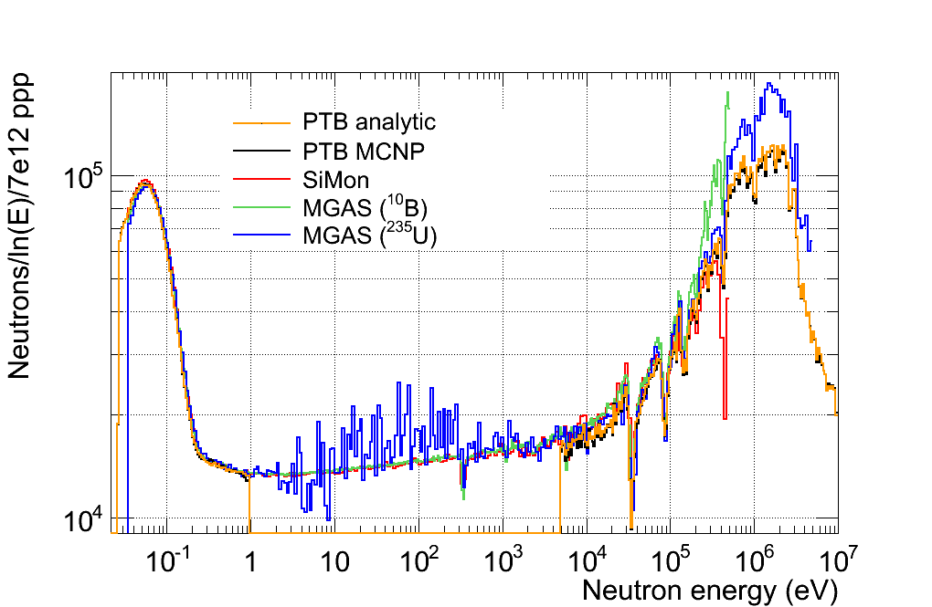
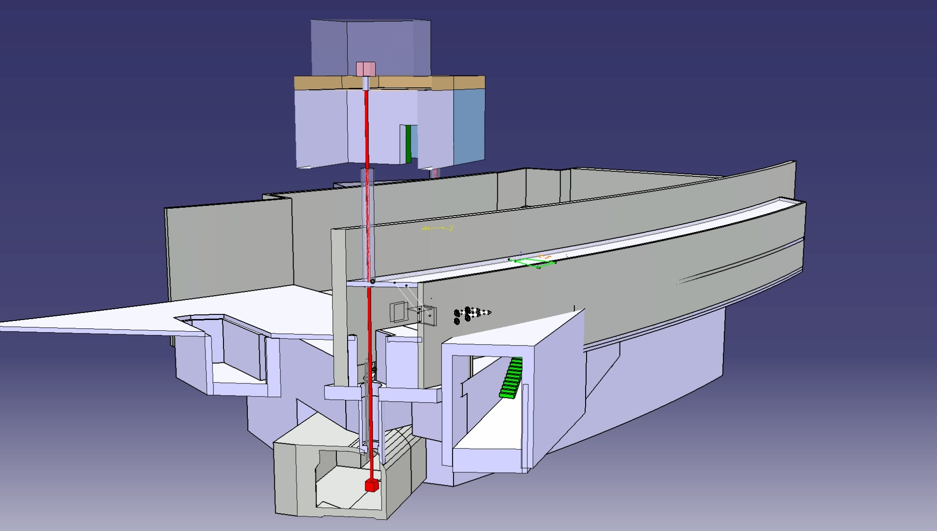
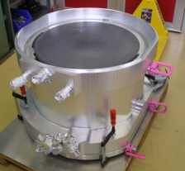
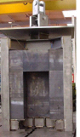
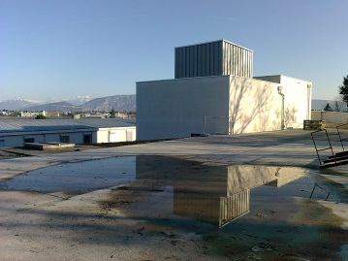
n_TOF Timeline
TARC experiment
2000
Commissioning
Commissioning
Commissioning
Problem
Investigation
July 2014
1995-1997
May 2009
Feasibility
CERN/LHC/98-02+Add
2004-2007
2010
Upgrades:
Borated-H₂O
Class-A
Second Line
2015
Phase-3
May 1998
1996
2015
Construction
started
1999
Phase I
Isotopes
Capture: 25
Fission: 11
Phase II
Isotopes
Capture: 14
Fission: 3
(n,cp): 2
EAR2
Design and
Construction
Aug 1998
Proposal
submitted
New Target
construction
2011
2008
Concept
by C.Rubbia
CERN/ET/Int. Note 97-19
2001-2004
2009 - 2012
1997

Slide 6
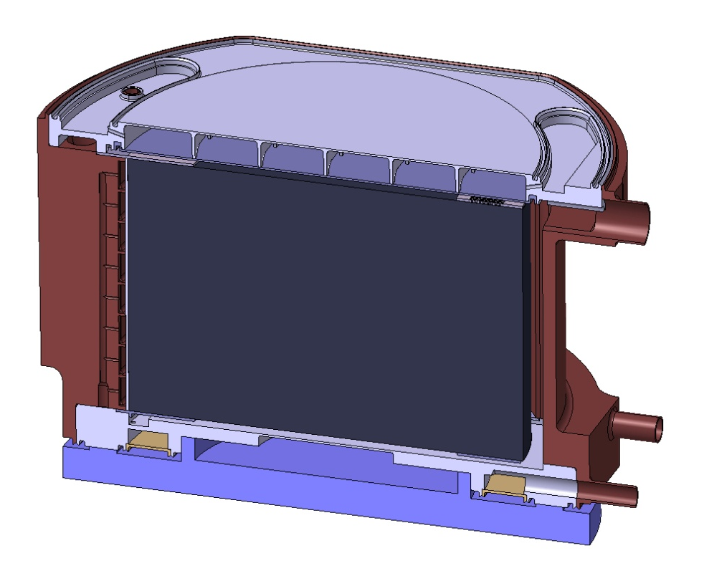
The n_TOF facility:
The Pb spallation target
Dimensions: d=60 cm, h=40 cm
Intensity in dedicated mode of 7×10¹² 20 GeV/c protons/pulse
~ 400 FAST (MeV-GeV) neutrons per proton @ target
  Moderator layer of 5 cm (energy spectrum from meV to GeV):
  EAR-1: 1 cm of normal water + 4 cm ¹⁰B-water (H₂O + 1.28% H₃BO₃)
  EAR-2: 5 cm of normal water
Neutrons to EAR2
Neutrons to EAR1
Proton beam
Pb
20 GeV/c
Cooling (1 cm)
“Moderator” (4 cm)

Slide 7
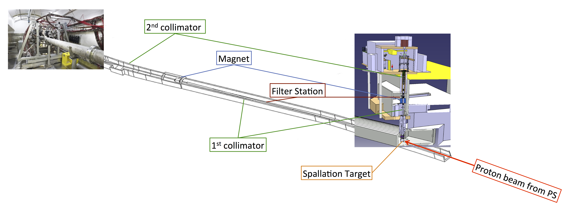
The n_TOF facility:
Beam lines
Both beam lines have:
1st collimator for halo cleaning and first beam shaping
Filter station
Magnet to minimize the charged particle background
2nd collimator for beam shaping
EAR-2:
Vertical flight path of 18.2 m
EAR-1:
Horizontal flight path of 184.2 m

Slide 8
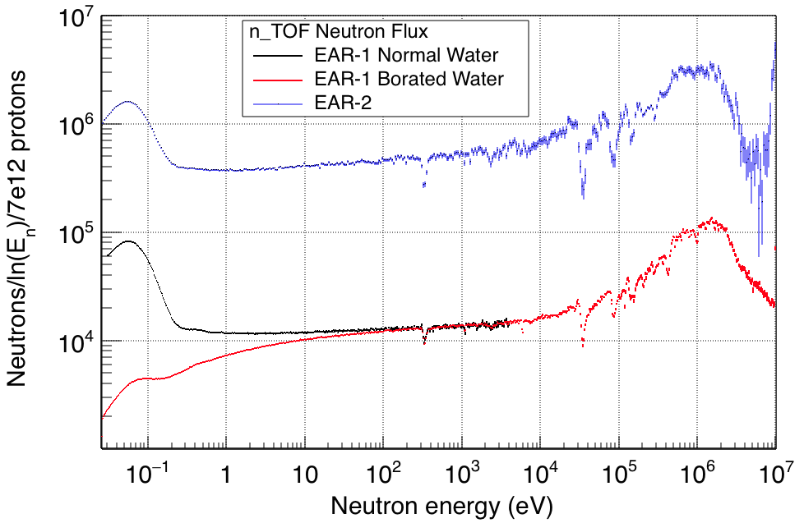
The n_TOF facility:
Main features
 | EAR-1 | EAR-2
Wide energy range | 25 meV<E_{n}<1 GeV | 25 meV<E_{n}<300 MeV
Extremely high instantaneous neutron flux | 10⁵ n/cm²/pulse | 10⁶ n/cm²/pulse

Slide 9
The n_TOF facility:
Main features
 | EAR-1 | EAR-2
Wide energy range | 25 meV<E_{n}<1 GeV | 25 meV<E_{n}<300 MeV
Extremely high instantaneous neutron flux | 10⁵ n/cm²/pulse | 10⁶ n/cm²/pulse
Low repetition rate | <0.8 Hz (1 pulse/2.4 s maximum)
High resolution in energy | ΔE/E=10⁻⁴ (E_{n} < 10 keV) | ΔE/E=10⁻³ (E_{n} < 10 keV)
Unique facility for measurements of radioactive isotopes and low cross-sections:
Branch point isotopes (astrophysics)
Actinides (nuclear technology)

Slide 10
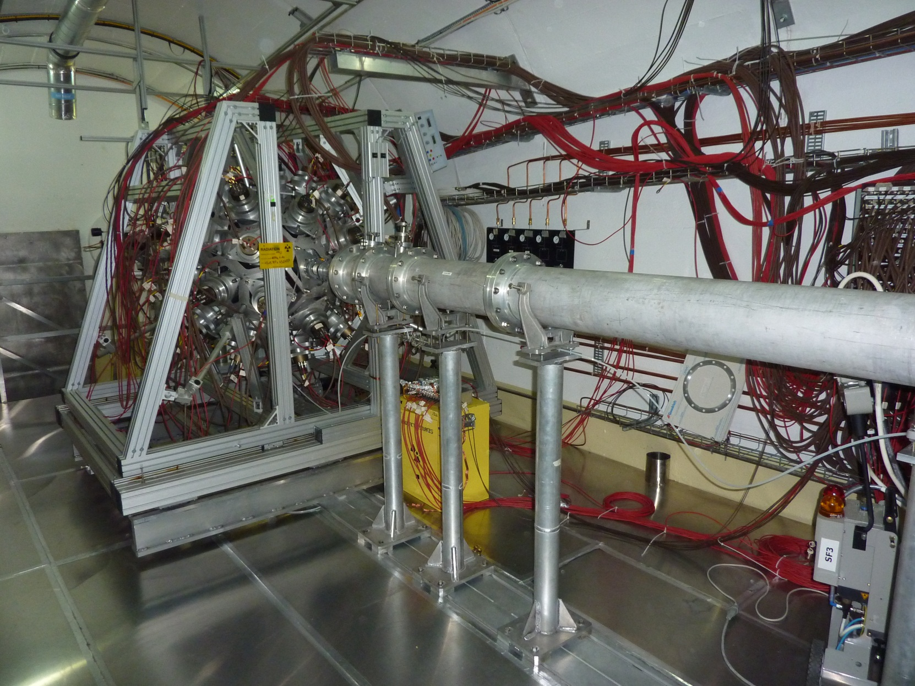
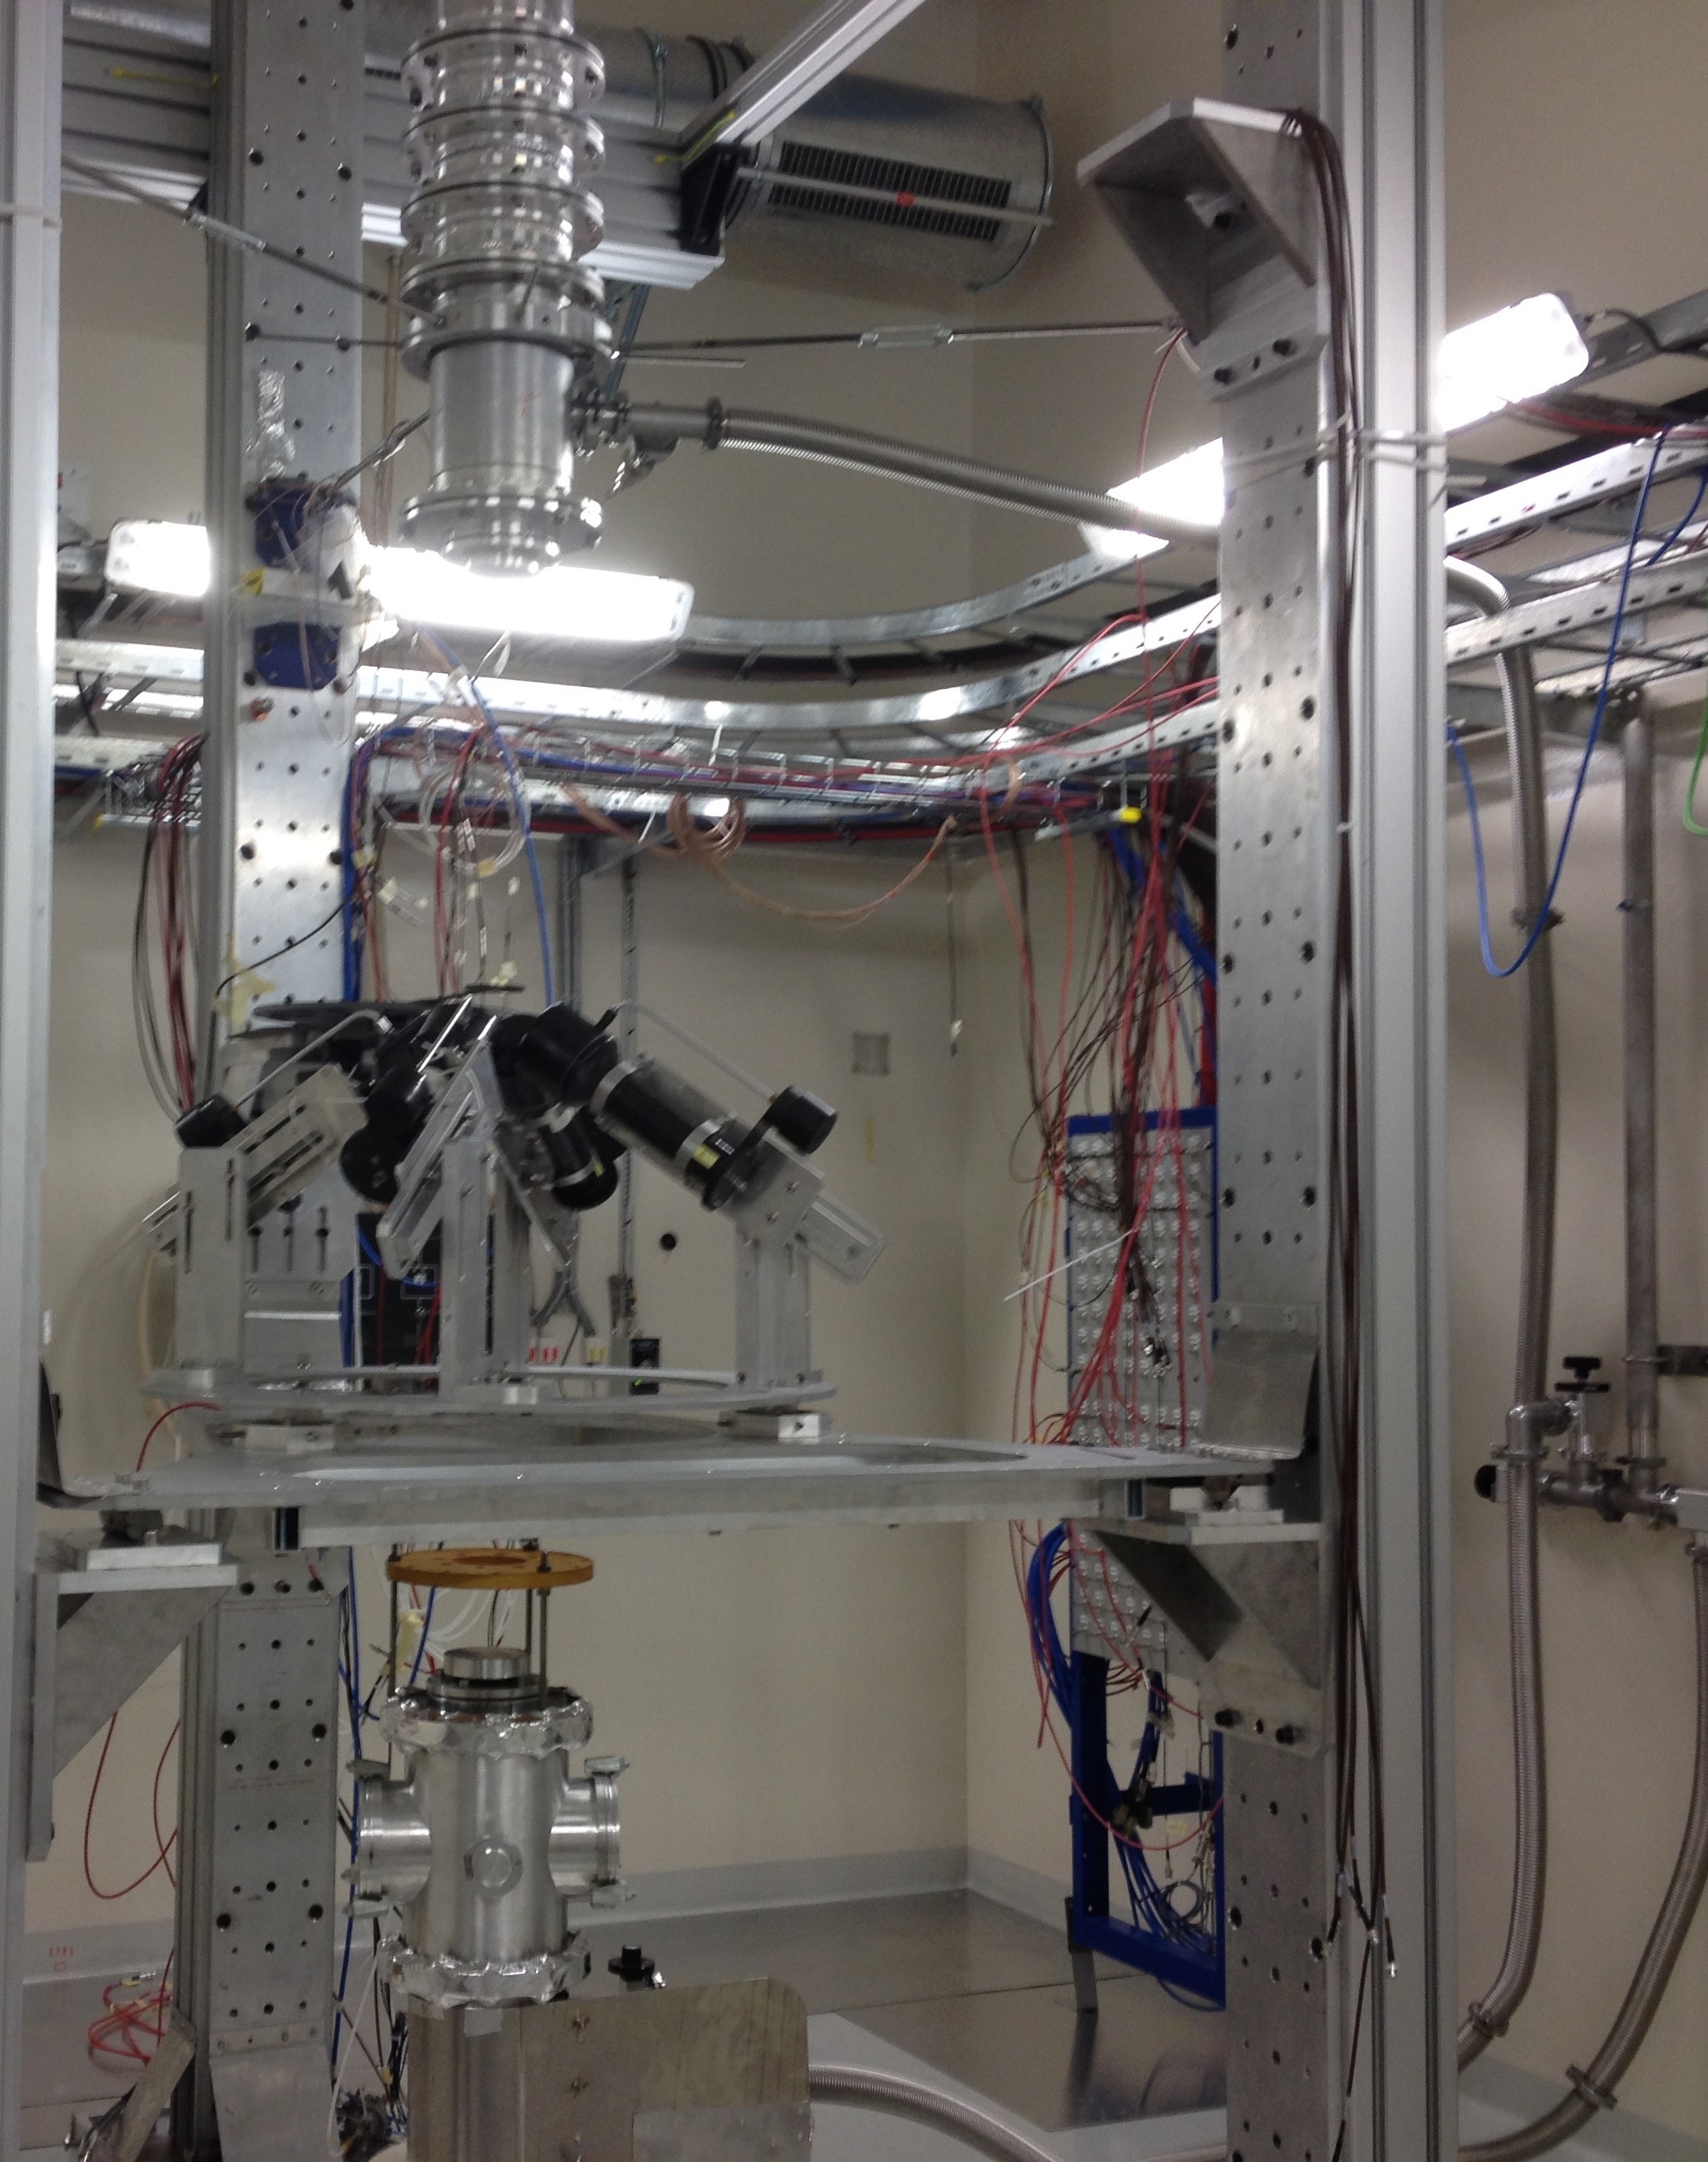
The n_TOF facility:
Class-A laboratories
Work Sector Type A: use of non-encapsulated radioactive samples allowed (since 2010 in EAR-1, since 2014 in EAR-2)

Slide 11
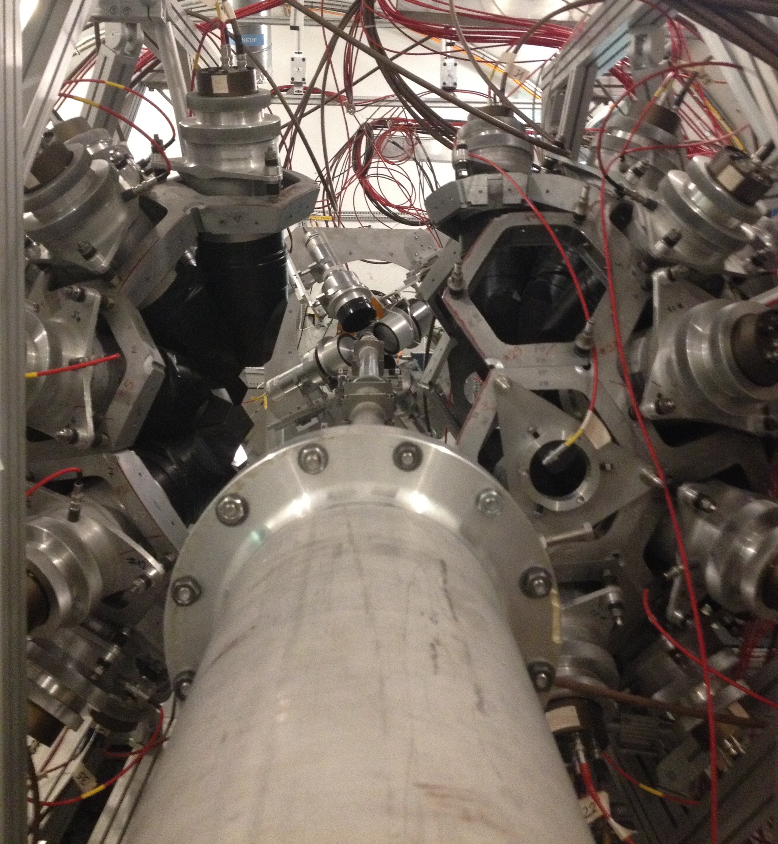
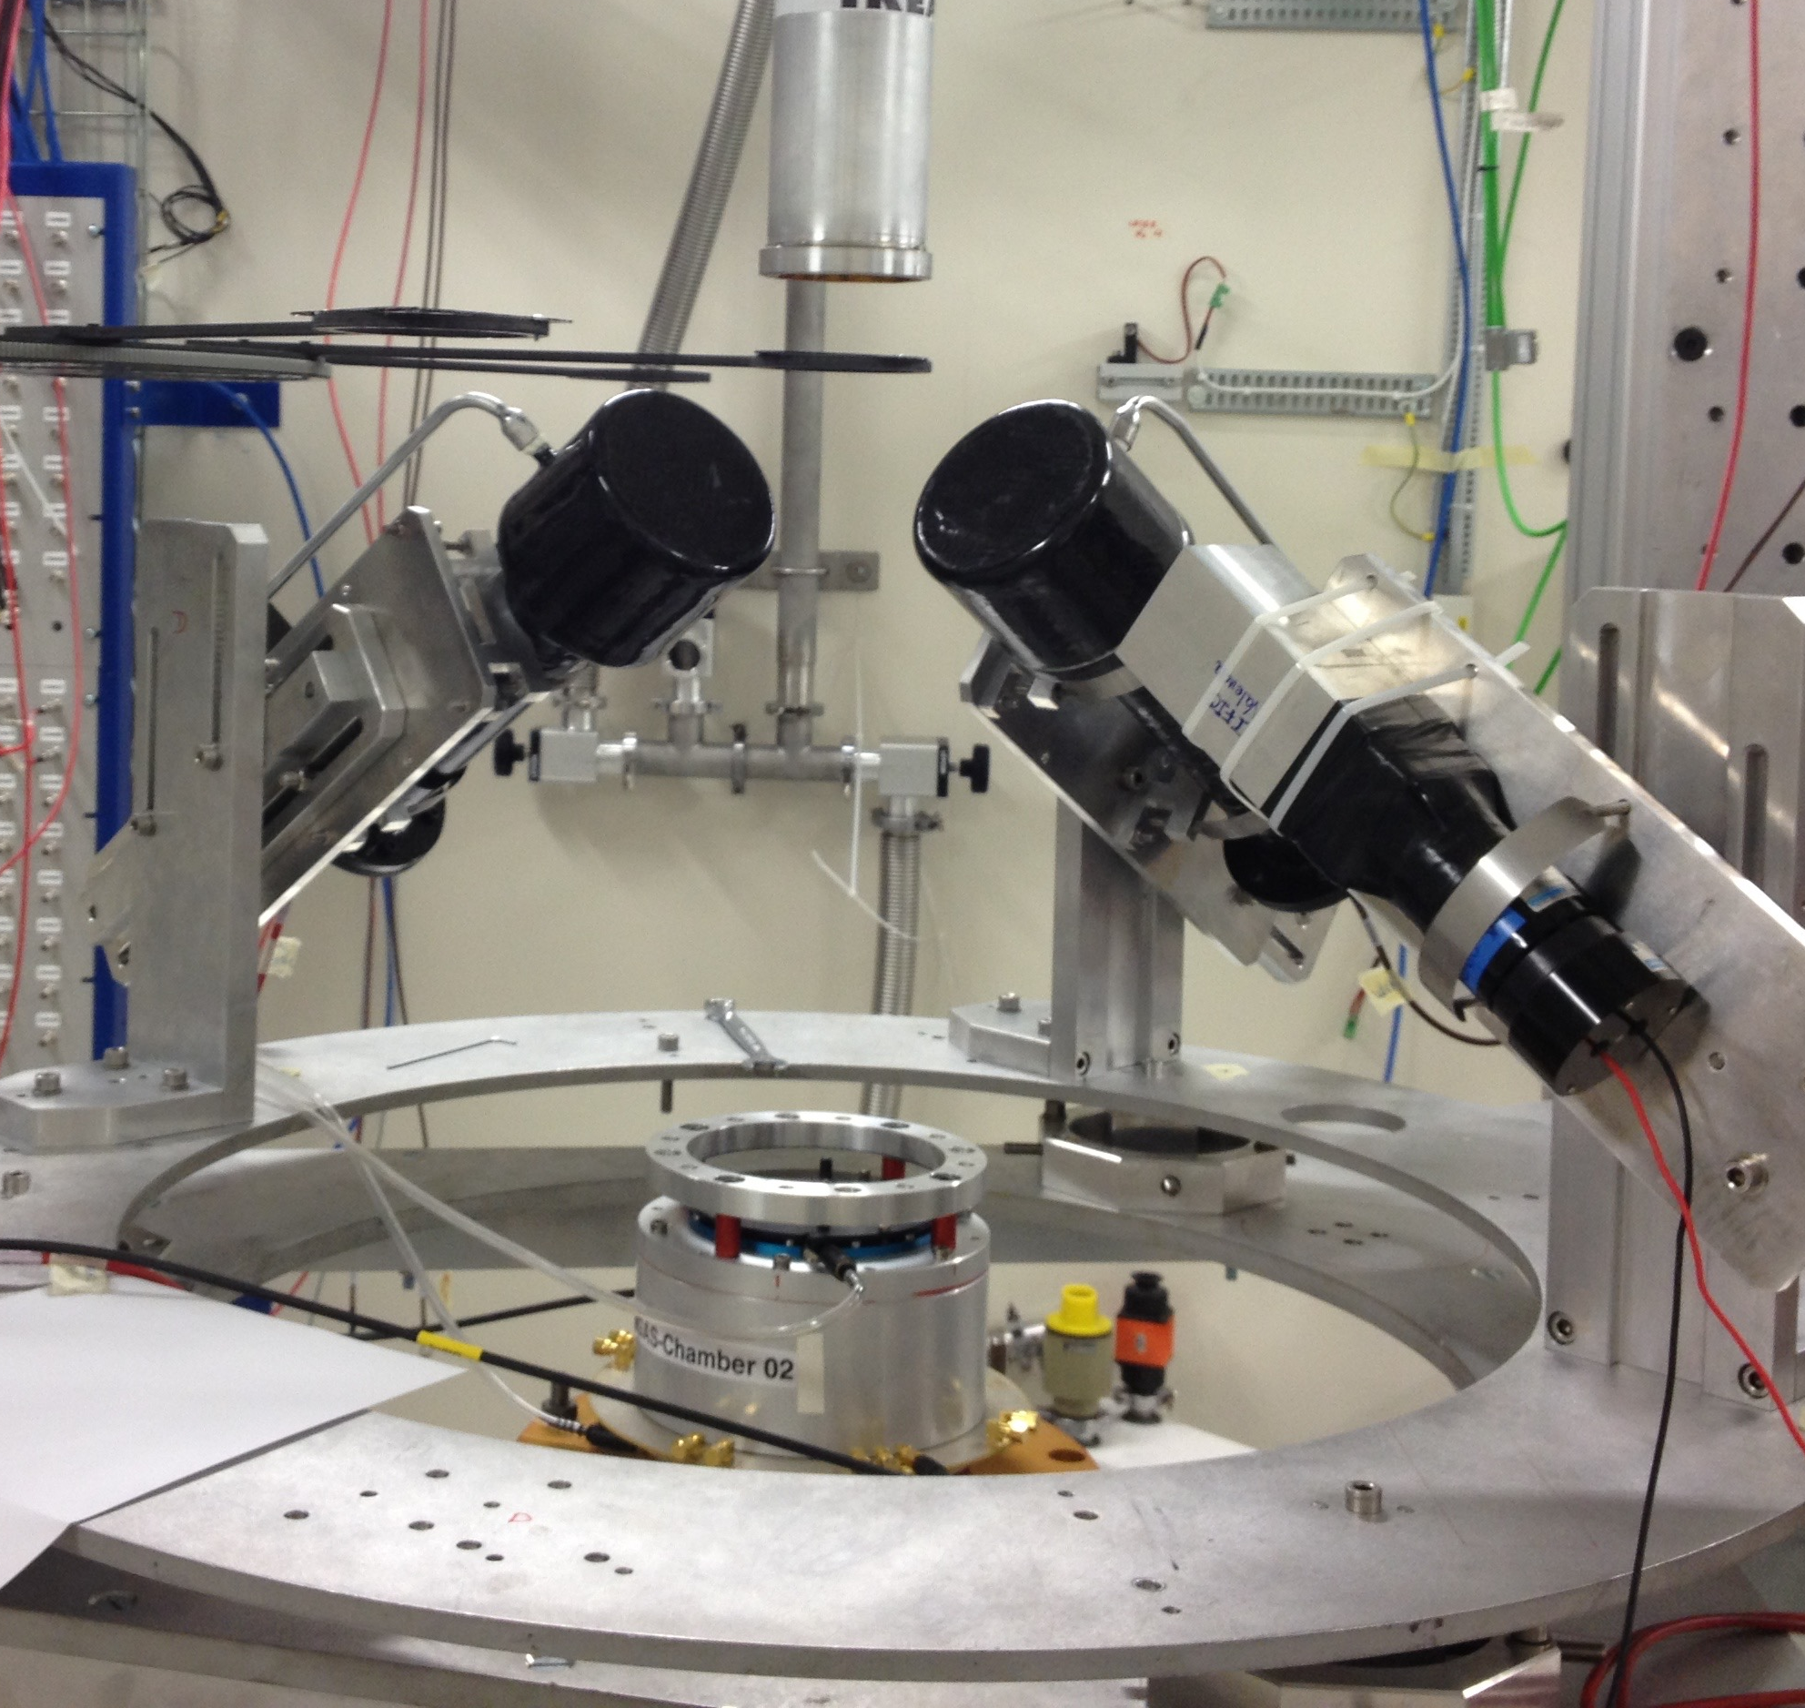
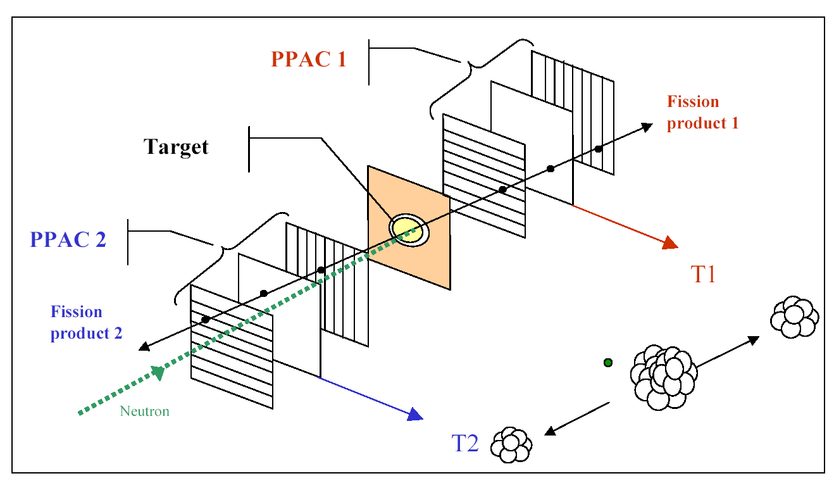
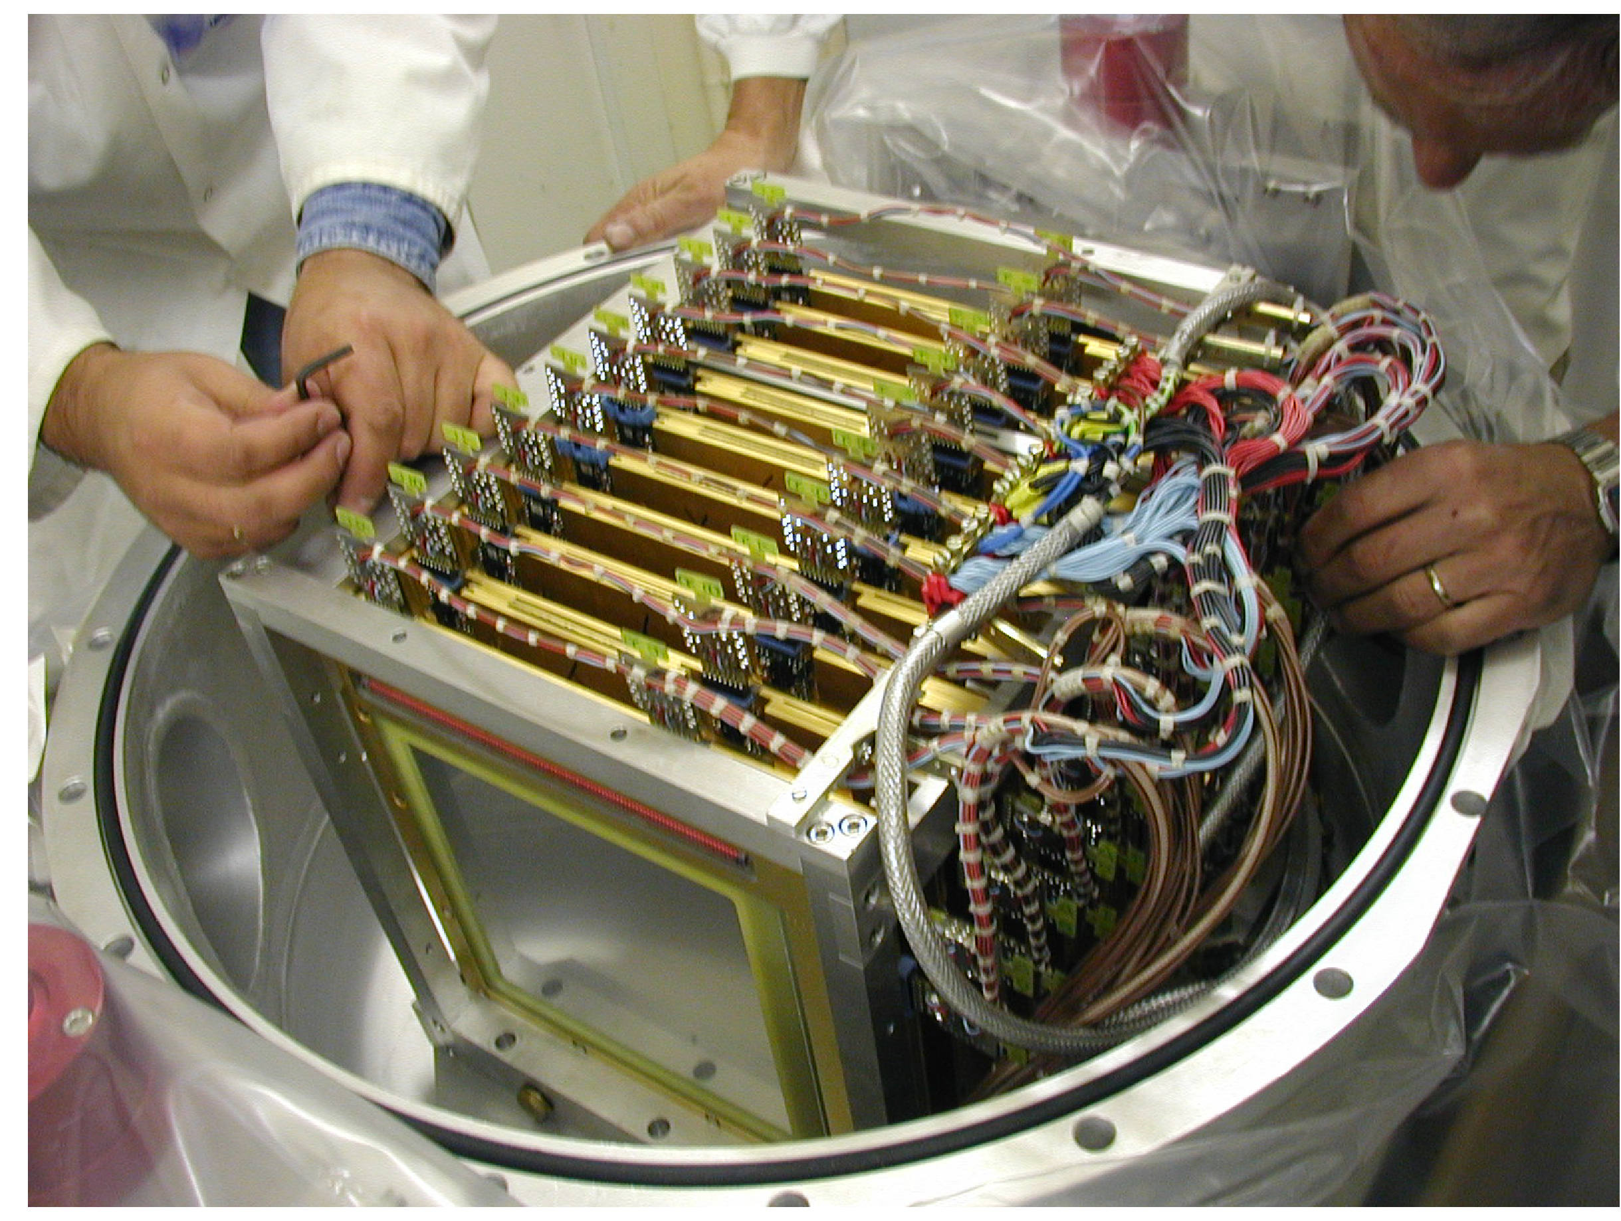
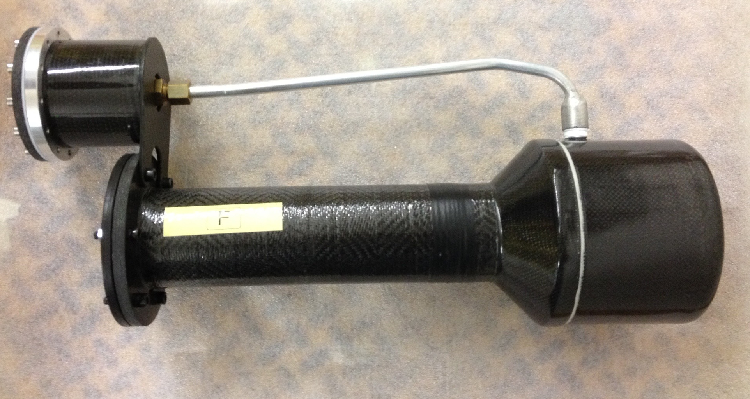
The n_TOF facility:
Detectors
Total Absorption Calorimeter (TAC)
Parallel Plate Avalanche Chamber (PPAC)
Scintillators

Slide 12
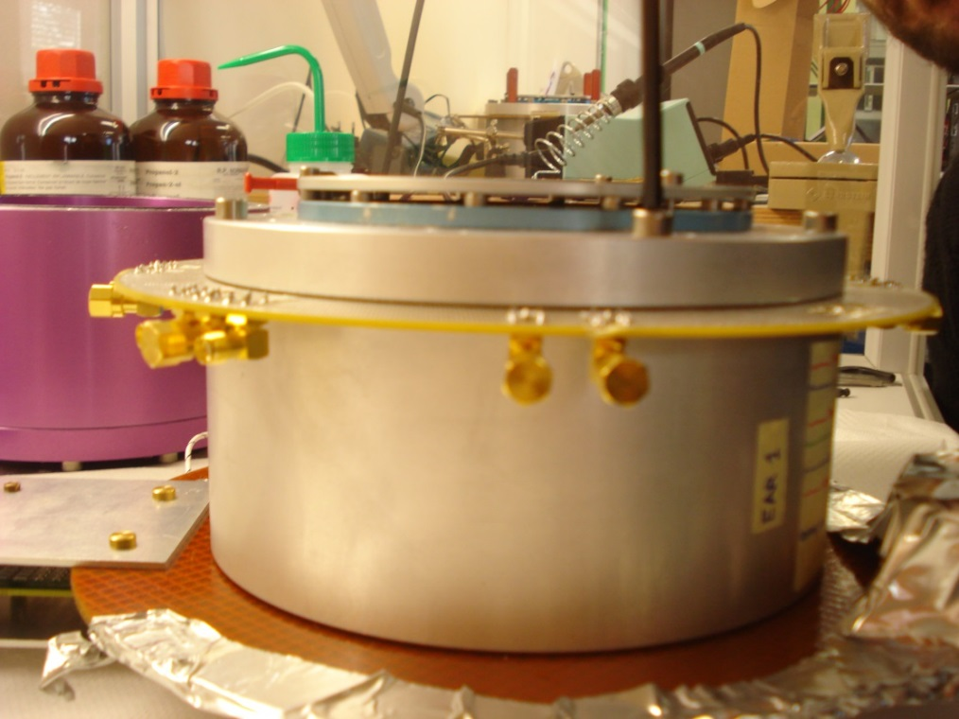
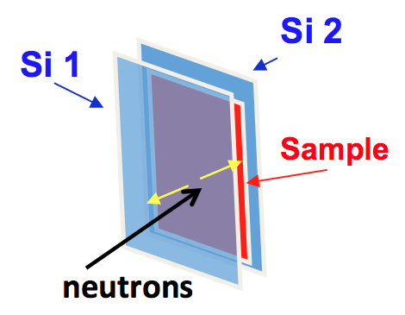
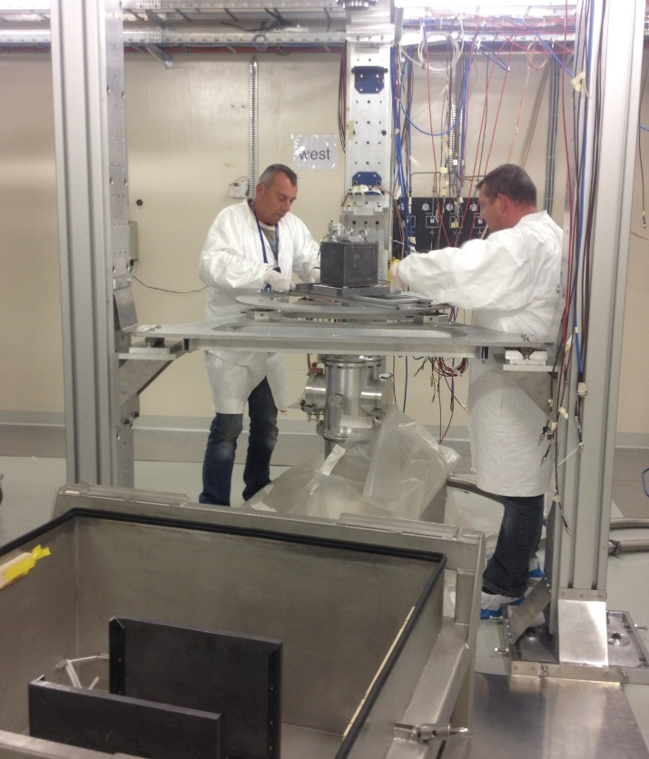
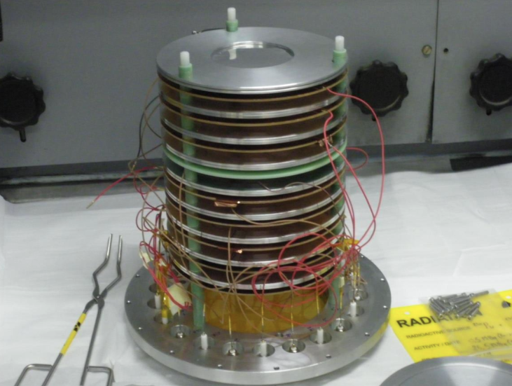
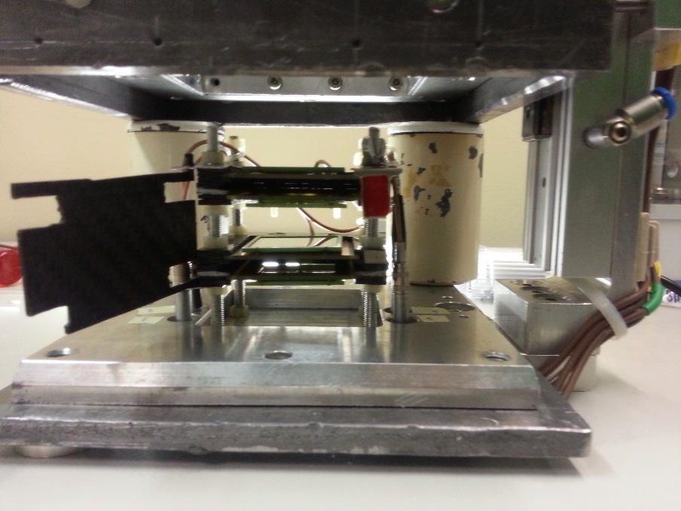
The n_TOF facility:
Detectors
MicroMegas
Silicon sandwich
Courtesy to Massimo Barbagallo

Slide 13
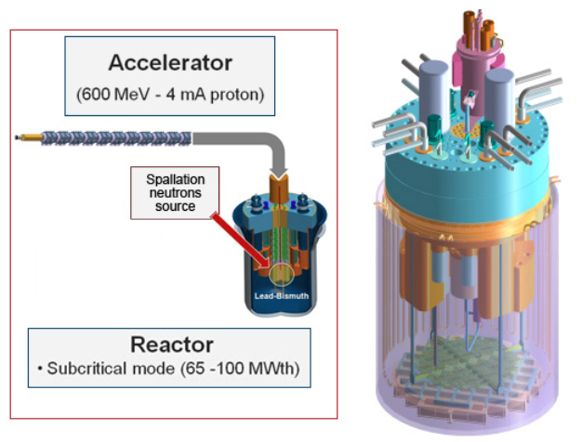
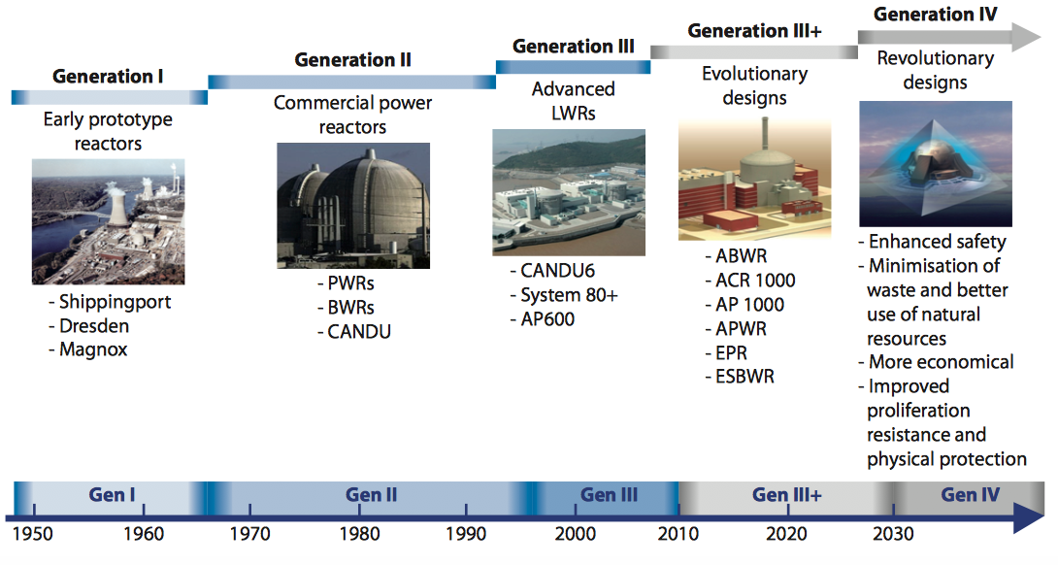
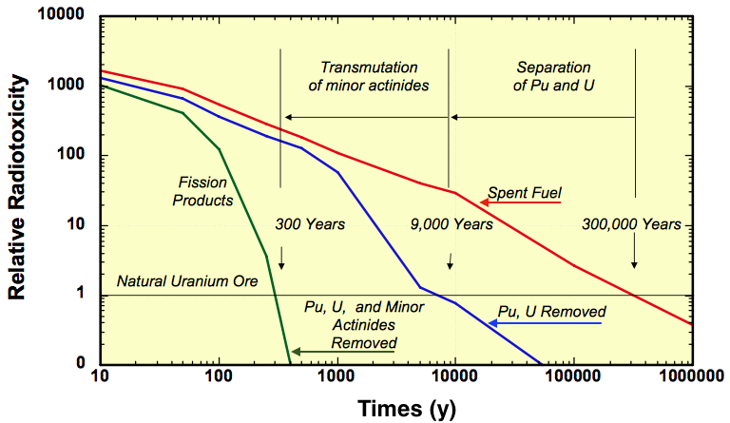
The n_TOF facility:
Physics cases
The n_TOF Collaboration:
30 Research Institutions from Europe, Asia and USA
NUCLEAR TECHNOLOGIES – ADS, Gen-IV and Th/U fuel cycle: Neutron capture and fission cross sections of Actinides in the thermal (meV), epithermal (eV-keV) and fast (MeV) energy regions.
Source: Nuclear Energy Today © OECD/Nuclear
Energy Agency 2012

Slide 14
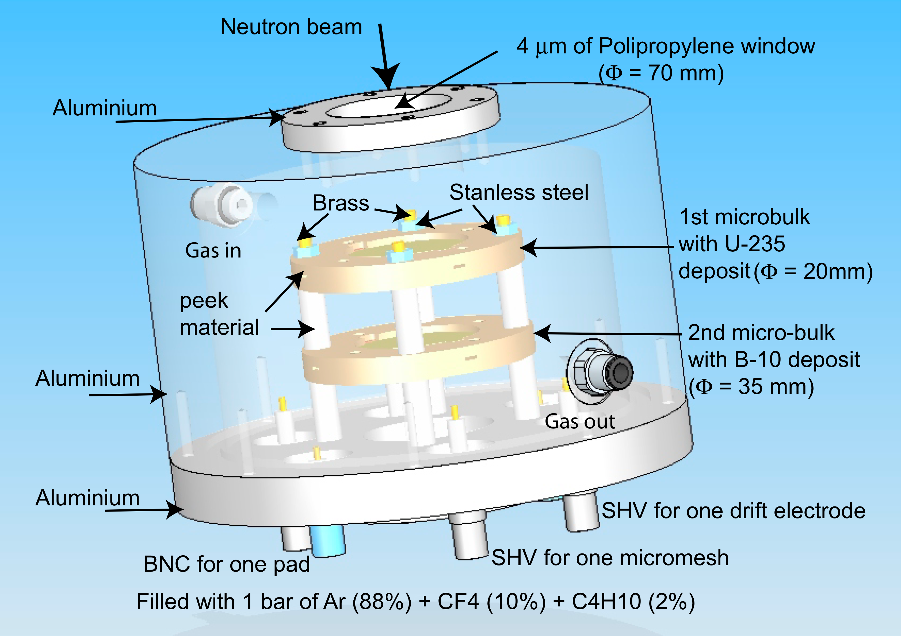
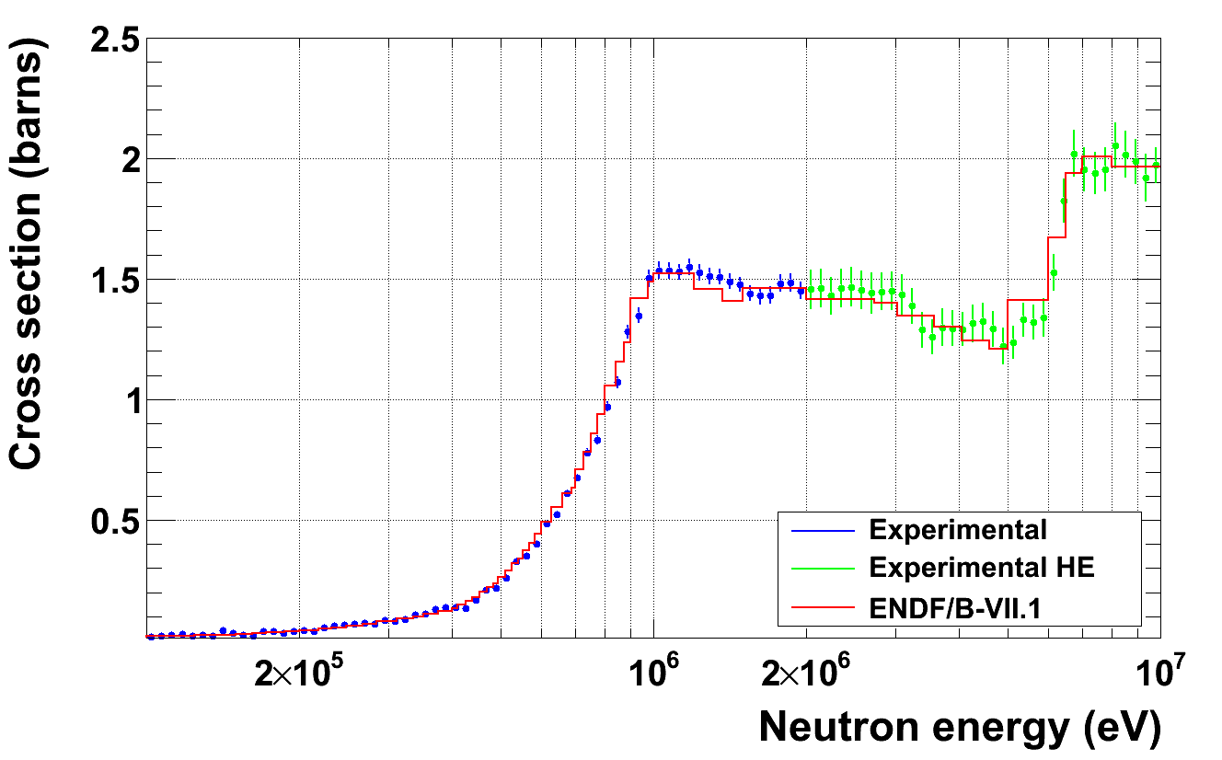
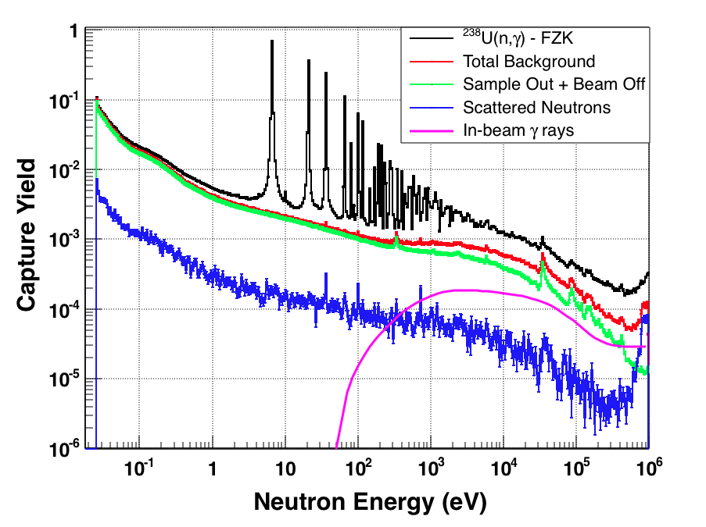
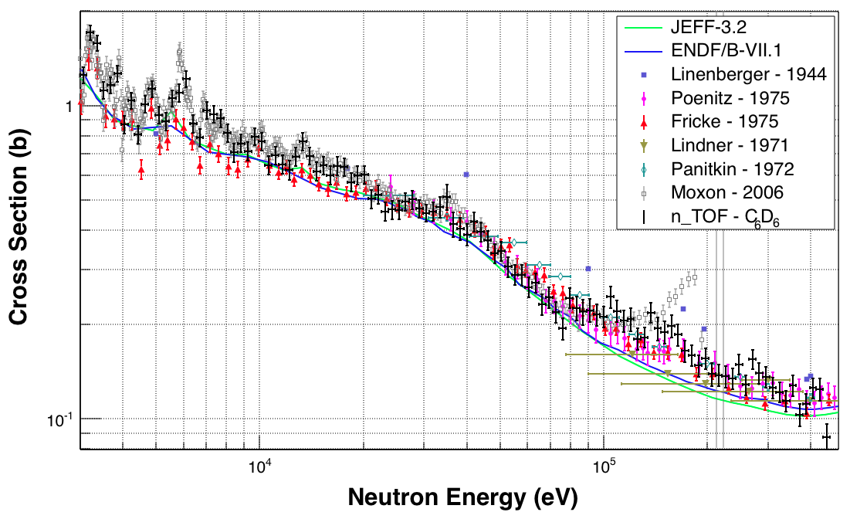
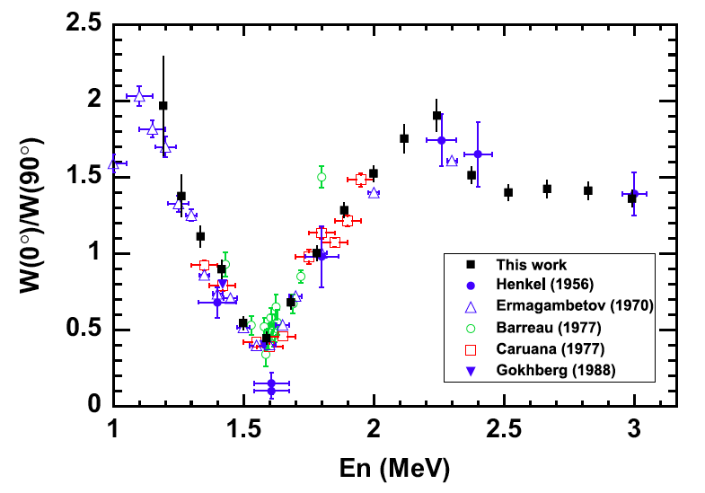
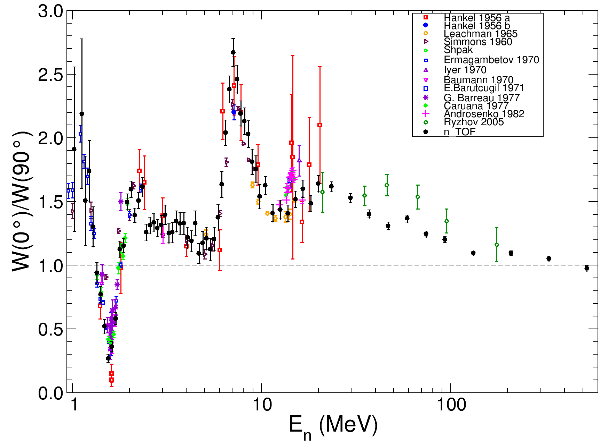
The n_TOF facility:
Physics cases
NUCLEAR TECHNOLOGIES – ADS, Gen-IV and Th/U fuel cycle: Important Results
F. Mingrone et al., Measurement of the ²³⁸U Radiative Capture Cross Section with C6D6 at the CERN n_TOF Facility, Nuclear Data Sheets 119 (2014) 18-21
A. Tsinganis et al., Measurement of the 242Pu(n,f) Cross Section at the CERN n TOF Facility, Nuclear Data Conference, New York 2013
Data analysis ongoing
D. Tarrio et al., Measurement of the angular distribution of fission fragments using a PPAC assembly at CERN n_TOF, NIMA 743, 79-85 (2014)
L.S. Leong, to be published

Slide 15
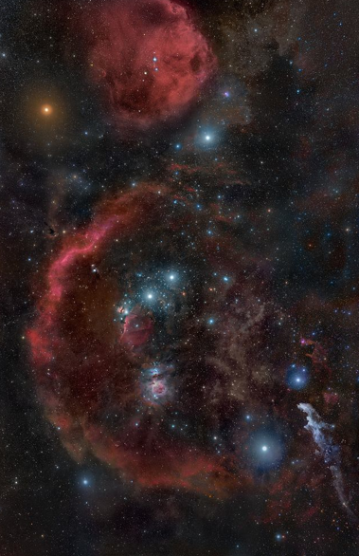
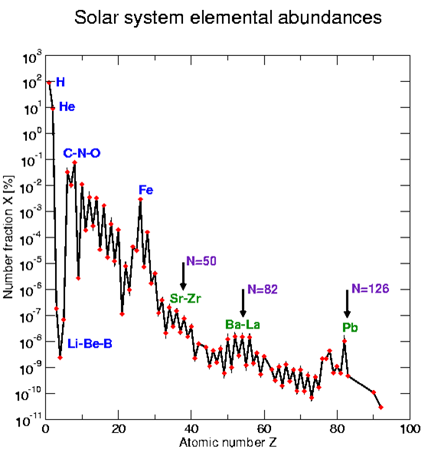
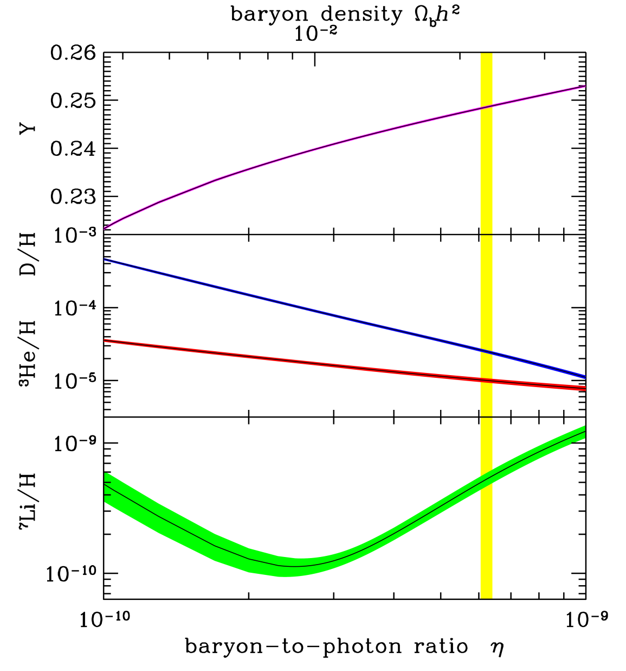
The n_TOF facility:
Physics cases
The n_TOF Collaboration:
30 Research Institutions from Europe, Asia and USA
NUCLEAR ASTROPHYSICS – stellar nucleosynthesis: Neutron capture and (n,α) cross sections of stable and unstable isotopes playing a role in the s- and r-processes and in the Big Bang nucleosynthesis (100 eV to 500 keV)
Y=He/(H+He)
HST/NASA

Slide 16
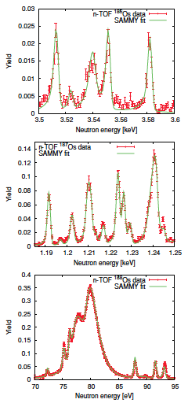
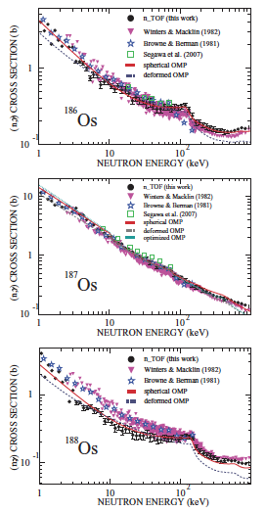
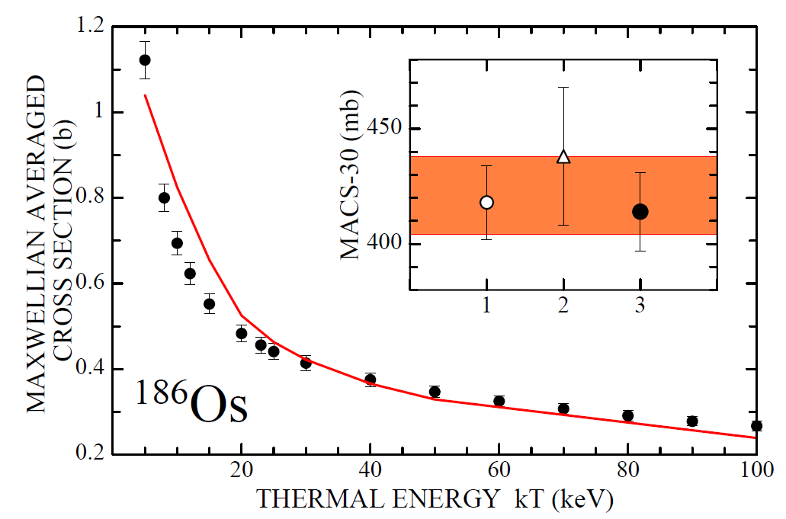
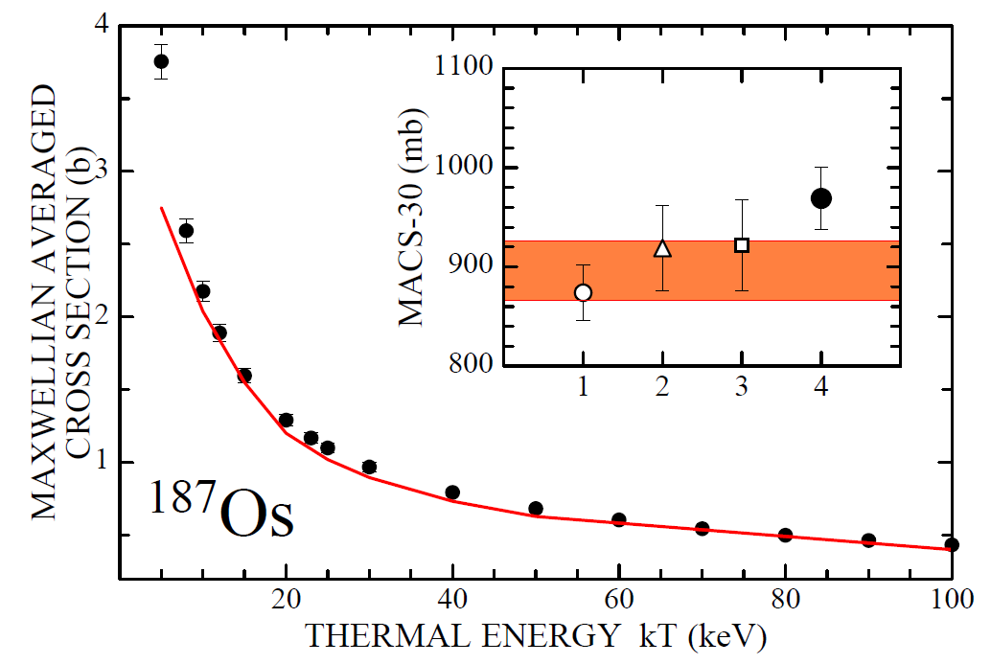
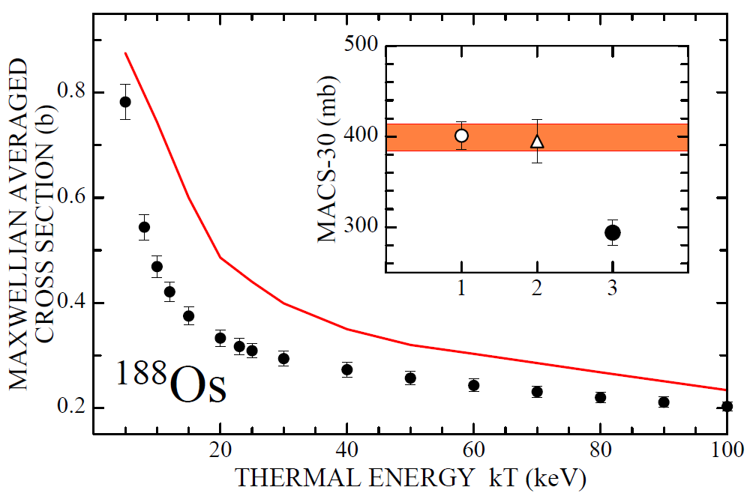
The n_TOF facility:
Physics cases
NUCLEAR ASTROPHYSICS – stellar nucleosynthesis: Important Results
M. Mosconi et al., Neutron physics of the Re/Os clock. I. Measurement of the (n,γ) cross sections of ^{186,187,188}Os at the CERN n_TOF facility, Phys. Rev. C 82 (2010) 015802 (and the two subsequent publications)
Resolved resonance region
Unresolved resonance region
Maxwellian Average Cross Sections (MACS)

Slide 17
The n_TOF facility:
Physics cases
NUCLEAR ASTROPHYSICS – stellar nucleosynthesis: Important Results
M. Mosconi et al., Neutron physics of the Re/Os clock. I. Measurement of the (n,γ) cross sections of ^{186,187,188}Os at the CERN n_TOF facility, Phys. Rev. C 82 (2010) 015802 (and the two subsequent publications)
Resolved resonance region
Unresolved resonance region
Maxwellian Average Cross Sections (MACS)
Age of the Universe from nuclear cosmocronometer: 14.9 ± 0.8 ± 2 Gyr
Reduced uncertainty due to nuclear data

Slide 18
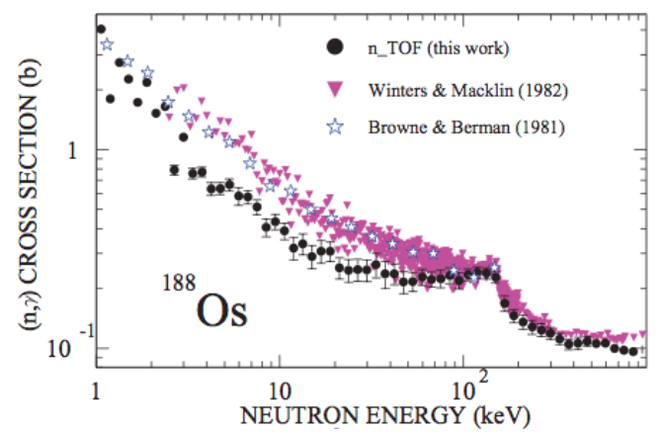
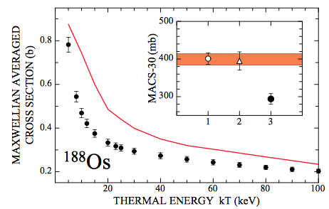
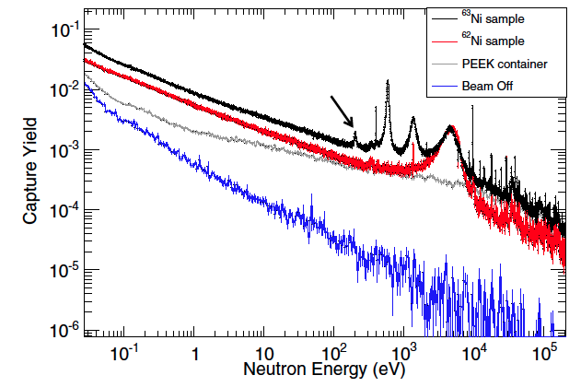
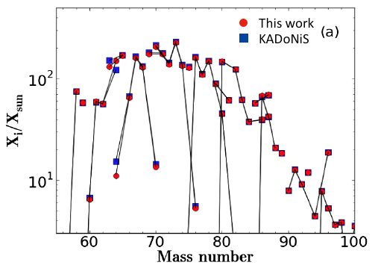
The n_TOF facility:
Physics cases
NUCLEAR ASTROPHYSICS – stellar nucleosynthesis: Important Results
M. Mosconi et al., Neutron physics of the Re/Os clock. I. Measurement of the (n,γ) cross sections of ^{186,187,188}Os at the CERN n_TOF facility, Phys. Rev. C 82 (2010) 015802 (and the two subsequent publications)
Age of the Universe from nuclear cosmocronometer: 14.9±0.8±2 Gyr
Reduced uncertainty due to nuclear data
C. Lederer et al., Neutron Capture Cross Section of Unstable ⁶³Ni: Implications for Stellar Nucleosynthesis, Phys. Rev. Lett. 110 (2013) 022501

Slide 19
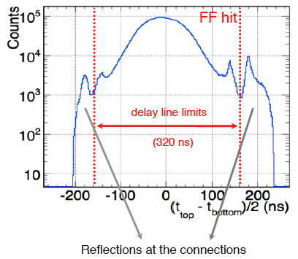
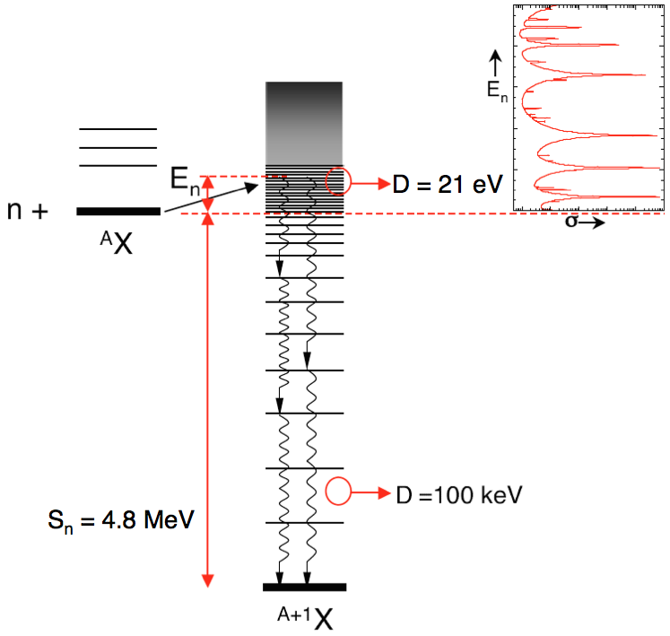
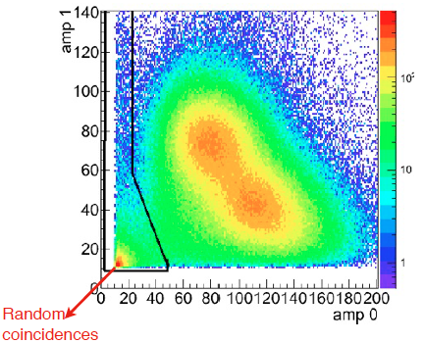
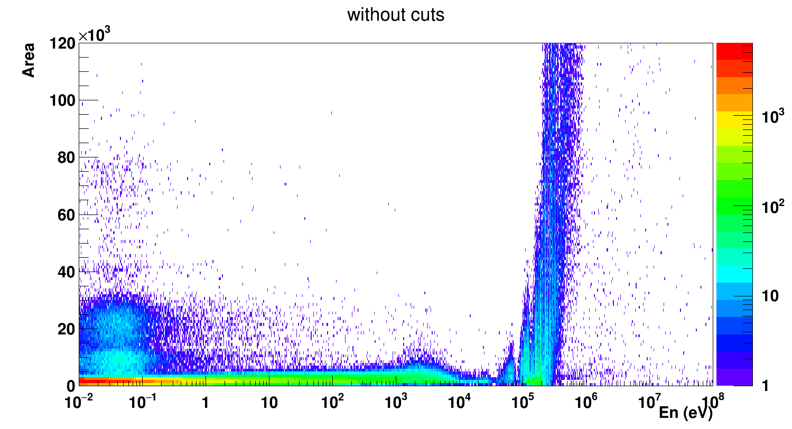
The n_TOF facility:
Physics cases
The n_TOF Collaboration:
30 Research Institutions from Europe, Asia and USA
BASIC NUCLEAR PHYSICS – levels densities, γ-ray strength functions and angular distributions: Time-of-Flight measurements with dedicated detectors providing valuable information on basic nuclear physics quantities.
(n,γ) reactions
C6D6 scintillators
TAC
(n,cp) reactions
Silicon detectors
μMegas
(n,f) reactions
PPAC

Slide 20
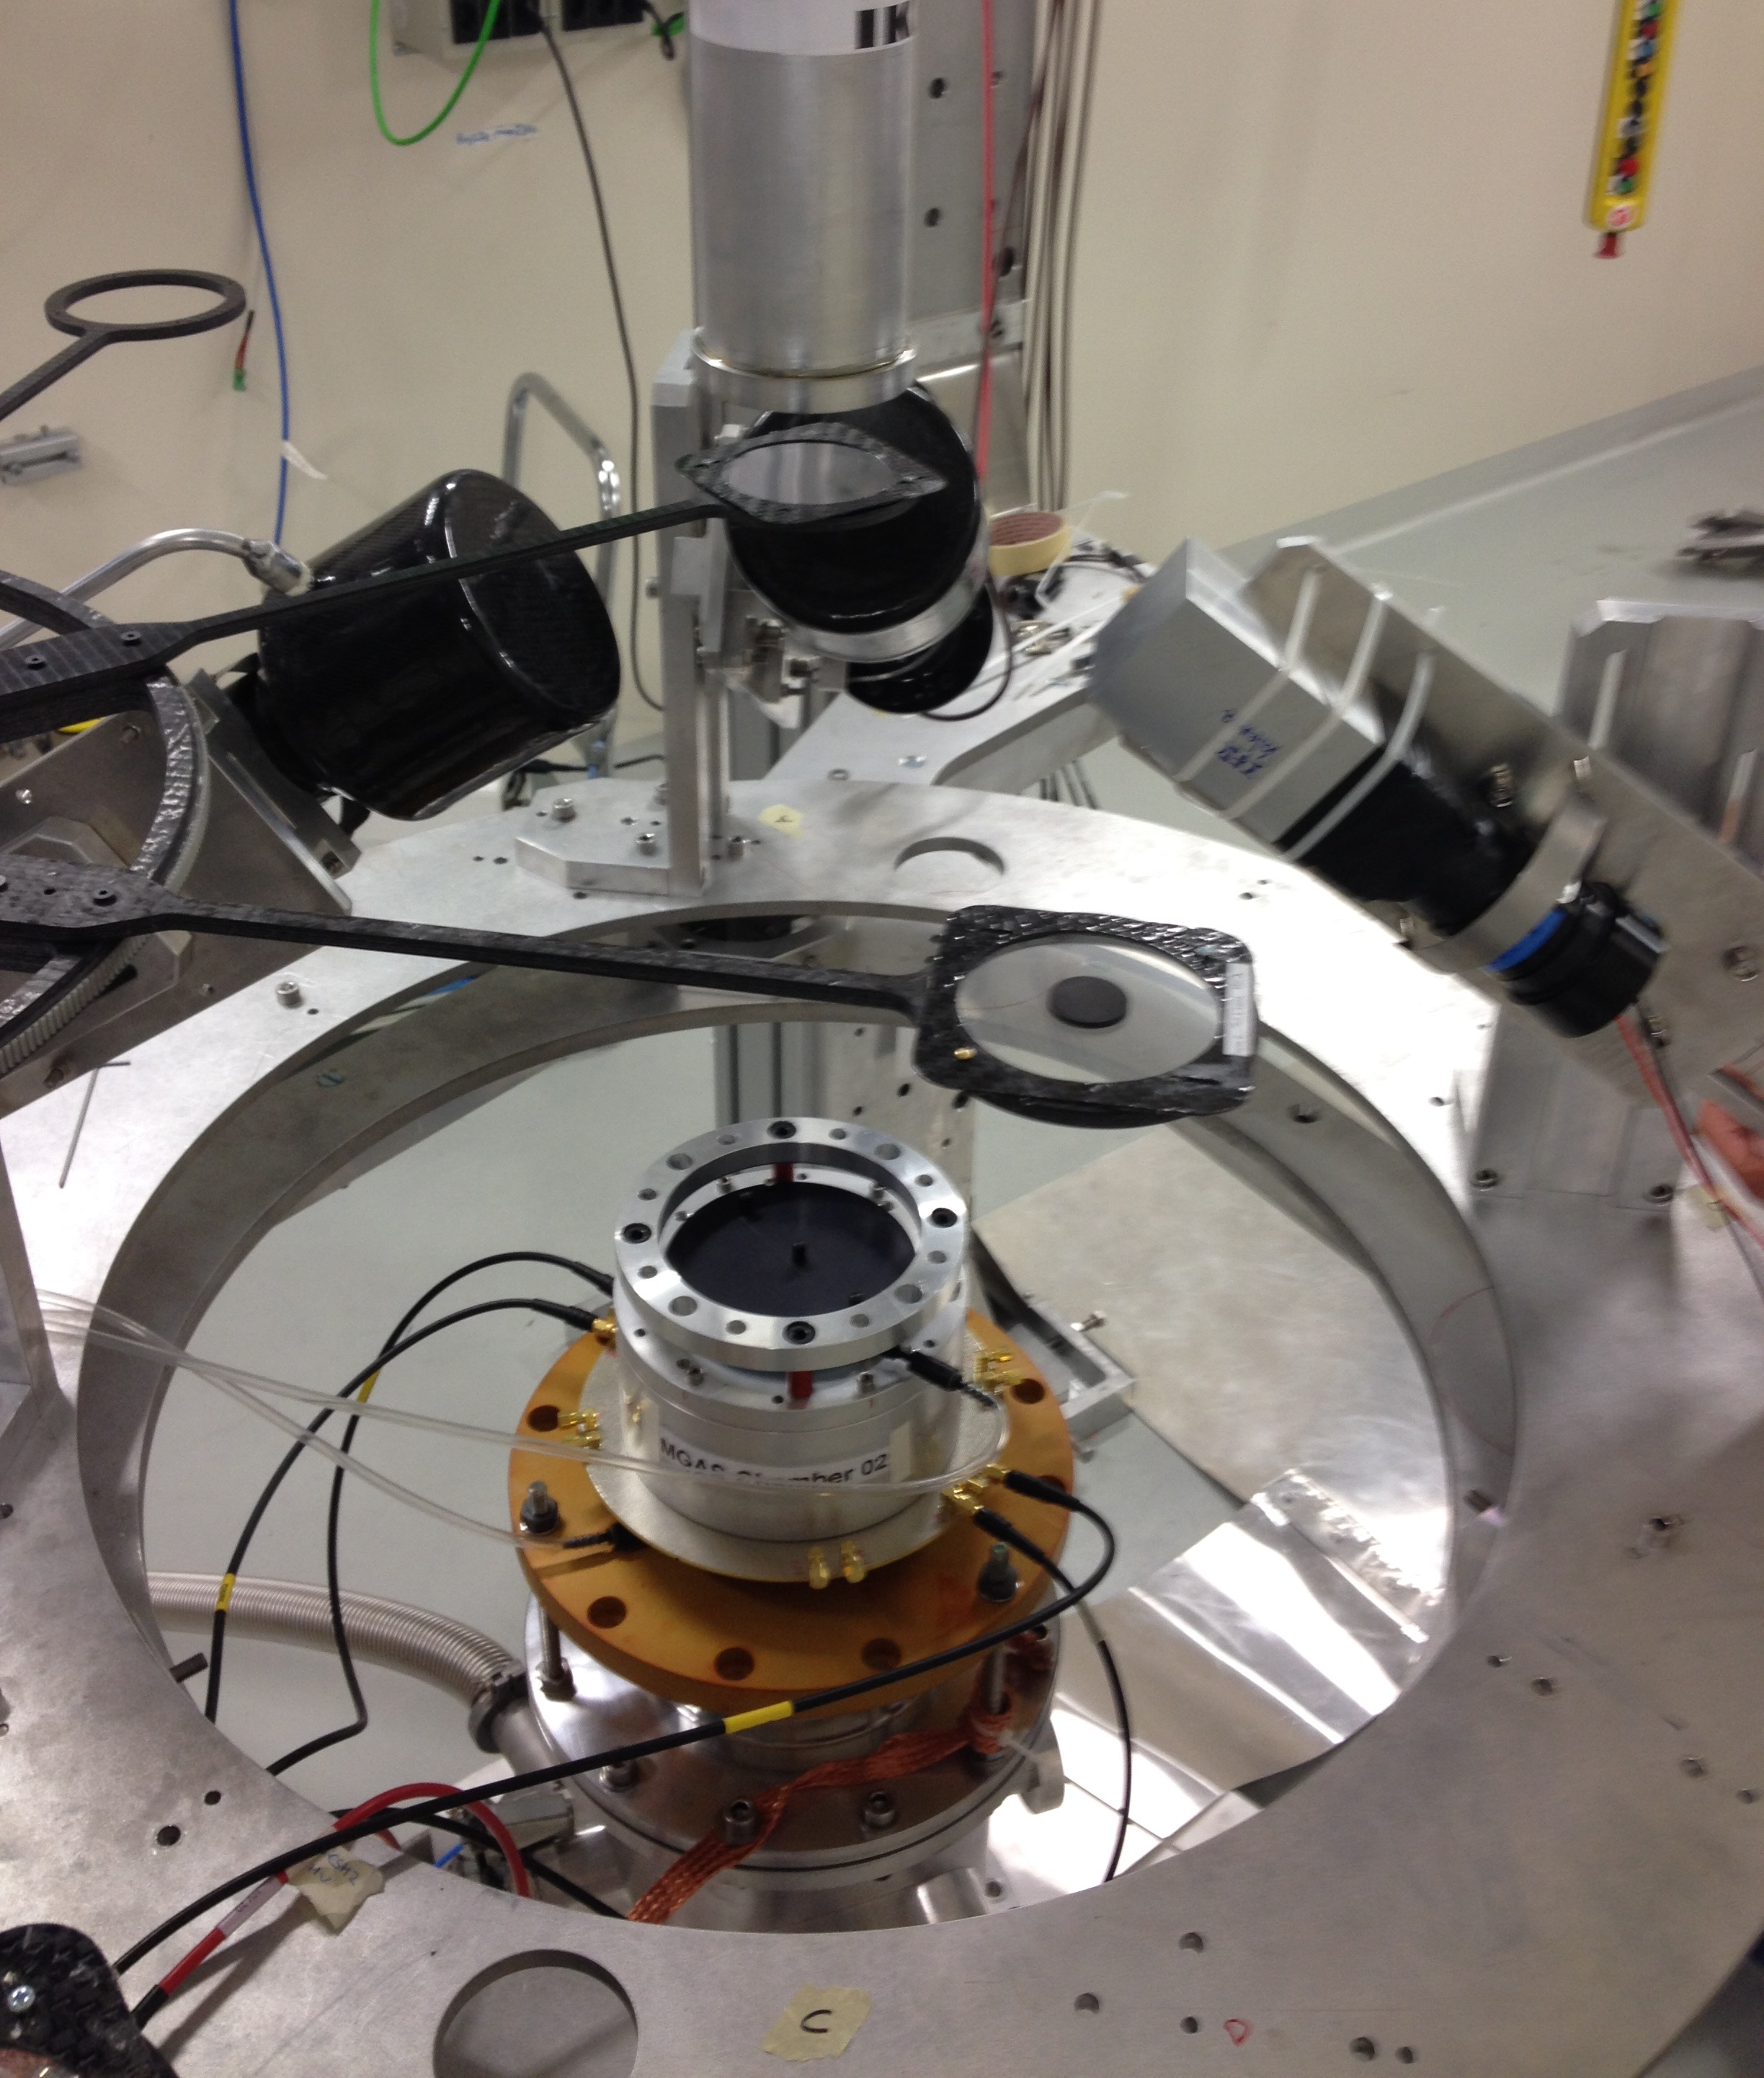


(n,γ) reactions
(n,γ) measurements with C₆D₆ scintillators
  Optimized for a low neutron sensitivity (i.e. sensitivity to background from scattered n)
  Only one γ ray detected per event
    Total Energy Detection Technique with Pulse Height Weighting Technique (PHWT)
EAR-2
EAR-1
EAR-1 Phase-2

Slide 21




(n,γ) reactions
(n,γ) measurements with C₆D₆ scintillators: ²⁵Mg(n,γ)
Resonance Shape Analysis: simultaneous analysis of transmission and capture data

Slide 22
(n,γ) reactions
(n,γ) measurements with C₆D₆ scintillators: ²⁵Mg(n,γ)
Resonance Shape Analysis: simultaneous analysis of transmission and capture data
²²Ne(α,n)²⁵Mg reaction:
Main source of neutrons for the s-process nucleosynthesis
Extremely difficult to measure (very low cross section)
Reaction rate very uncertain because of the poorly known property of the states in ²⁶Mg. From neutron measurements the J^{π} of ²⁶Mg states can be deduced
Spin assignment and constraints for ²²Ne(α,n)²⁵Mg

Slide 23

(n,γ) reactions
(n,γ) measurements with C₆D₆ scintillators: ²⁵Mg(n,γ)
Resonance Shape Analysis: simultaneous analysis of transmission and capture data
Only natural-parity states in ²⁶Mg can participate in the ²²Ne(α,n)²⁵Mg reaction
Spin assignment and constraints for ²²Ne(α,n)²⁵Mg
Element | J^{π}
²²Ne | 0⁺
⁴He | 0⁺
J^{π} = 0⁺, 1⁻, 2⁺, 3⁻, 4⁺ …

Slide 24

(n,γ) reactions
(n,γ) measurements with C₆D₆ scintillators: ²⁵Mg(n,γ)
Resonance Shape Analysis: simultaneous analysis of transmission and capture data
Only natural-parity states in ²⁶Mg can participate in the ²²Ne(α,n)²⁵Mg reaction
Spin assignment and constraints for ²²Ne(α,n)²⁵Mg
States in ²⁶Mg populated by ²⁵Mg+n reaction:
s-wave →J^{π}= 2⁺, 3⁺
p-wave →J^{π}= 1⁻, 2⁻, 3⁻, 4⁻
d-wave →J^{π} = 0⁺, 1⁺, 2⁺, 3⁺, 4⁺, 5⁺

Slide 25
(n,γ) reactions
(n,γ) measurements with C₆D₆ scintillators: ²⁵Mg(n,γ)
Resonance Shape Analysis: simultaneous analysis of transmission and capture data
Spin assignment and constraints for ²²Ne(α,n)²⁵Mg
Previous evaluation
E_{R}=72 keV, J^{π}=2⁺
E_{R}=79 keV, J^{π}=3⁺

Slide 26
(n,γ) reactions
(n,γ) measurements with C₆D₆ scintillators: ²⁵Mg(n,γ)
Resonance Shape Analysis: simultaneous analysis of transmission and capture data
Spin assignment and constraints for ²²Ne(α,n)²⁵Mg
Previous evaluation
E_{R}=72 keV, J^{π}=2⁺
E_{R}=79 keV, J^{π}=3⁺
This work
E_{R}=72 keV, J^{π}=2⁺
E_{R}=79 keV, J^{π}=3⁻

Slide 27
Summary
The n_TOF facility at CERN since 2001 is at the cutting edge for neutron induced reaction measurements
Since July 2014 a second experimental area (EAR-2) with unique characteristics for high radioactive samples and low cross section measurements
Several detection system available to investigate the compound nucleus studying (n,γ), (n,cp) and (n,f) reactions
Important result assigning constraints on the levels of ²⁶Mg that can be populated by ²²Ne(α,n)²⁶Mg reaction (s-process neutron source)

Slide 28
Thank you for your attention
Federica Mingrone
federica.mingrone@cern.ch

Slide 29
Backup

Slide 30


(n,γ) reactions
(n,γ) measurements with the Total Absorption Calorimeter
  40 BaF₂ crystals in a 4π geometry
  Detects the entire γ cascade
    Total Absorption Detection Technique
  To decrease the scattered neutron background: spherical neutron absorber around the sample

Slide 31


(n,γ) reactions
(n,γ) measurements with the Total Absorption Calorimeter
  To decrease the sensitivity to scattered neutrons: Fission Tagging Technique with mMegas detector

Slide 32

(n,γ) reactions
(n,γ) measurements with the Total Absorption Calorimeter
  To decrease the sensitivity to scattered neutrons: Fission Tagging Technique with mMegas detector: ²³⁵U(n,γ)
Fission tagging efficiency:
Calculated:
By applying different conditions in deposited energy and multiplicity
In different resonances
Courtesy to Javier Balibrea

Slide 33

(n,γ) reactions
(n,γ) measurements with the Total Absorption Calorimeter
  To decrease the sensitivity to scattered neutrons: Fission Tagging Technique with mMegas detector: ²³⁵U(n,γ)
Fission tagging efficiency:
Calculated:
By applying different conditions in deposited energy and multiplicity
In different resonances
Courtesy to Javier Balibrea

