Slide 1
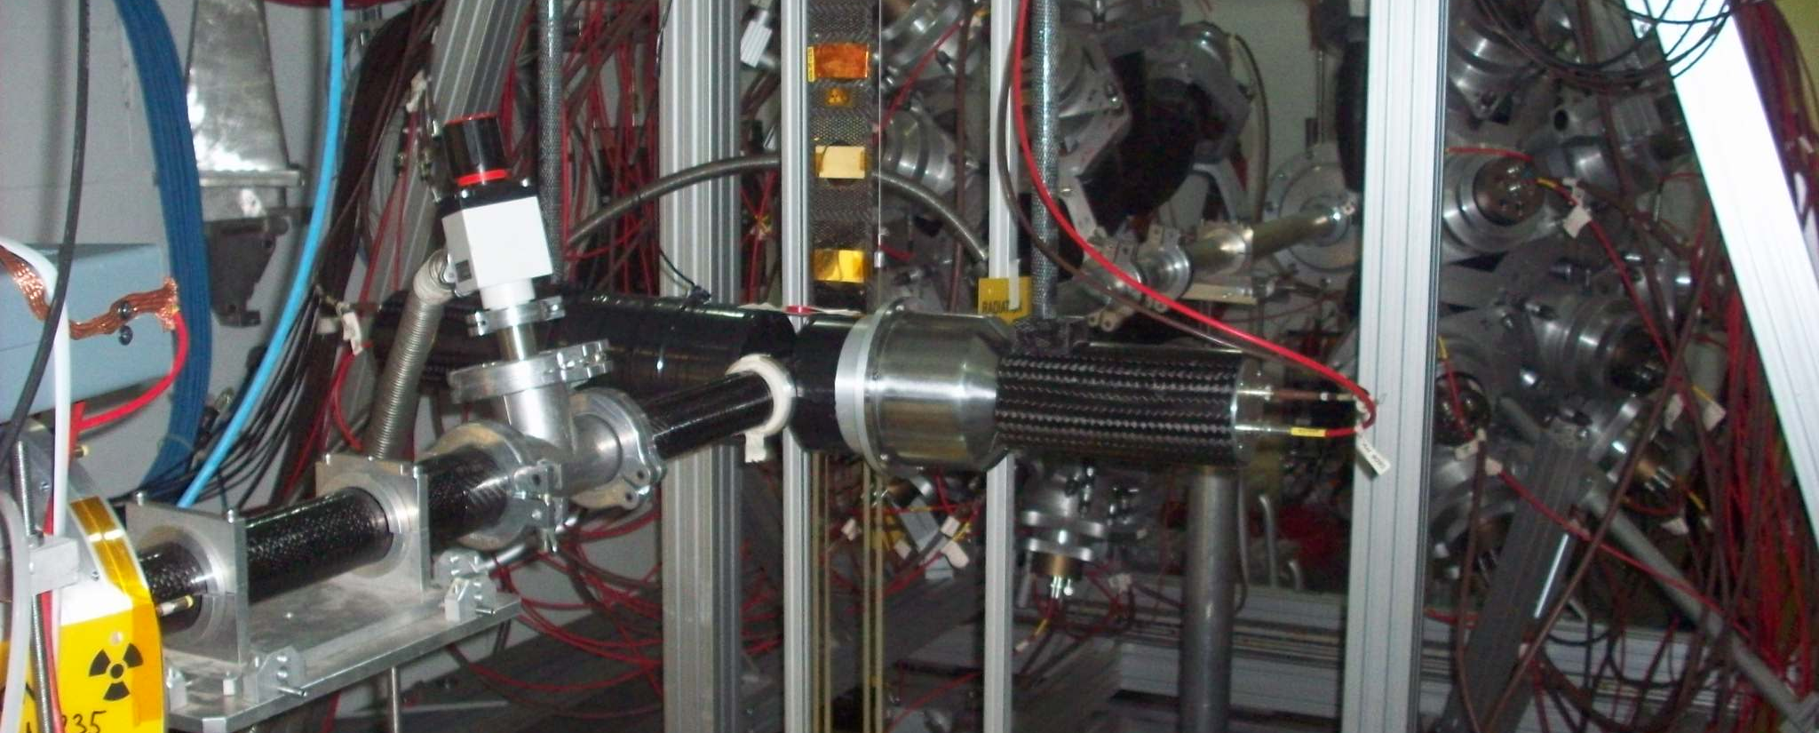
High precision measurement of the radiative capture cross section of ²³⁸U at the n_TOF CERN facility
F. Mingrone on behalf of the n_TOF Collaboration

Slide 2
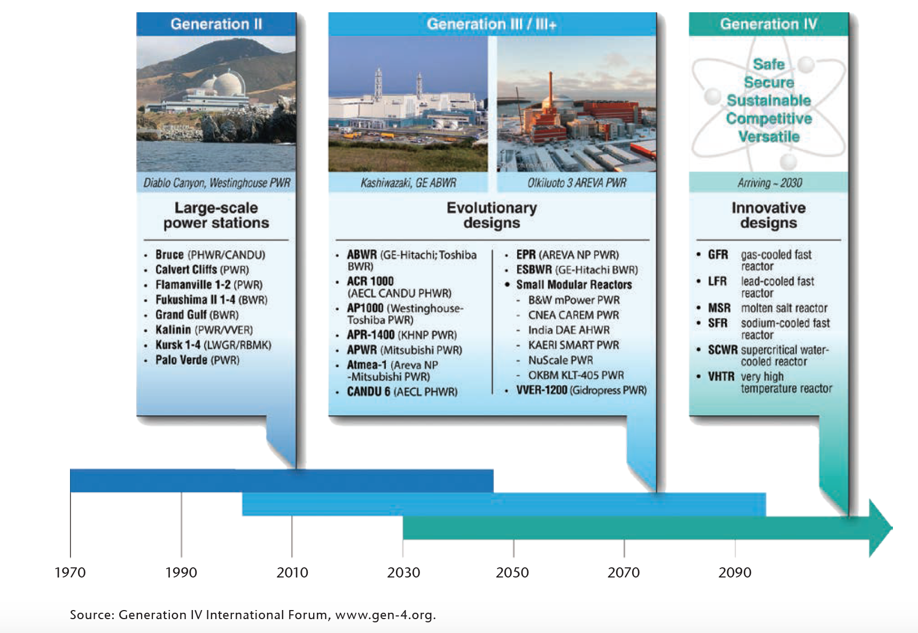
Motivations: Nuclear Reactors
+ ADS
Advanced design of existing reactors to improve the safety standard and the efficiency.
Benefit of the new reactor concepts:
Fast reactors and ADS: multirecycling of the fuel, which leads to
  better use of the fuel (the energy production can be up to 60 times more efficient)
  Improving the waste management (reduction of the long-term radiotoxicity of the ultimate waste)
VHTRs: passive safety features and the ability to provide very-high-temperature process heat (used ad example in the massive production of hydrogen)

Slide 3
Motivations: Role of the radiative capture of ²³⁸U
Fast and thermal reactor systems: uncertainties (%) due to ²³⁸U capture cross section
 | Reactor | k_{eff} (%) | Reactivity (%) | Power Peak (%)
Fast nuclear reactors | ABTR | 0.26 | – | –
 | SFR | 0.07 | 1.24 | –
 | GFR | 0.41 |  | 0.30
 | LFR | 0.25 | – | –
Thermal nuclear reactors | PWR | 0.26 | – | –
 | VHTR | 0.19 | – | –
Uncertainty on Pu isotope density at the end of the fuel cycle:
1.1% for ²³⁹Pu
0.2% for ²⁴⁰Pu
0.1% for ²⁴¹Pu
Source: Final Report – Subgroup 26 of Organization for Economic Co-operation and Development (OECD) and Nuclear Energy Agency (NEA)

Slide 4
Motivations: Role of the radiative capture of ²³⁸U
EXFOR DATABASE: more than 25 datasets in the resolved resonance region and a few less in the unresolved BUT still inconsistencies for the capture cross section up to 15%
ENDF/B-VII evaluation: some small (but higher than the uncertainty) modifications to the standards capture result in the high energy region
 | Neutron energy range | Current Accuracy | Target Accuracy
PWR | 22.6 – 454 eV | 2% | 1%
 | 9.12 – 24.8 keV | 9% | 5%
Fast reactors | 2.04 – 24.8 keV | 3-9% | 1.5-2%
NEA High Priority Request List
UNCERTAINTY IN THE CROSS SECTION DOWN TO 1-5%
EC-JRC Gelina with C₆D₆ detection system (25 meV < E_{n} < 80 keV) Kim, H. I. et al., Eur. Phys. J. A 52, 170 (2016)
n_TOF with TAC detection system (1 eV < E_{n} < 90 keV)
n_TOF with C₆D₆ detection system (1 eV < E_{n} < 700 keV)
EC-FP7
PROJECT ANDES

Slide 5
Motivations: Role of the radiative capture of ²³⁸U
EXFOR DATABASE: more than 25 datasets in the resolved resonance region and a few less in the unresolved BUT still inconsistencies for the capture cross section up to 15%
ENDF/B-VII evaluation: some small (but higher than the uncertainty) modifications to the standards capture result in the high energy region
 | Neutron energy range | Current Accuracy | Target Accuracy
PWR | 22.6 – 454 eV | 2% | 1%
 | 9.12 – 24.8 keV | 9% | 5%
Fast reactors | 2.04 – 24.8 keV | 3-9% | 1.5-2%
NEA High Priority Request List
UNCERTAINTY IN THE CROSS SECTION DOWN TO 1-5%
EC-JRC Gelina with C₆D₆ detection system (25 meV < E_{n} < 80 keV) Kim, H. I. et al., Eur. Phys. J. A 52, 170 (2016)
n_TOF with TAC detection system (1 eV < E_{n} < 90 keV)
n_TOF with C₆D₆ detection system (1 eV < E_{n} < 700 keV)
EC-FP7
PROJECT ANDES

Slide 6
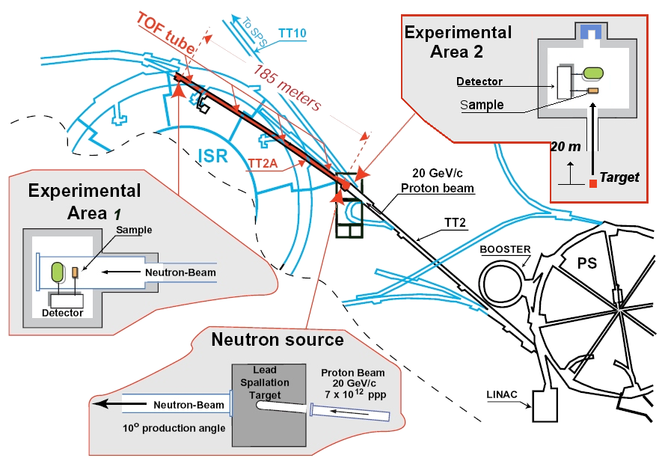
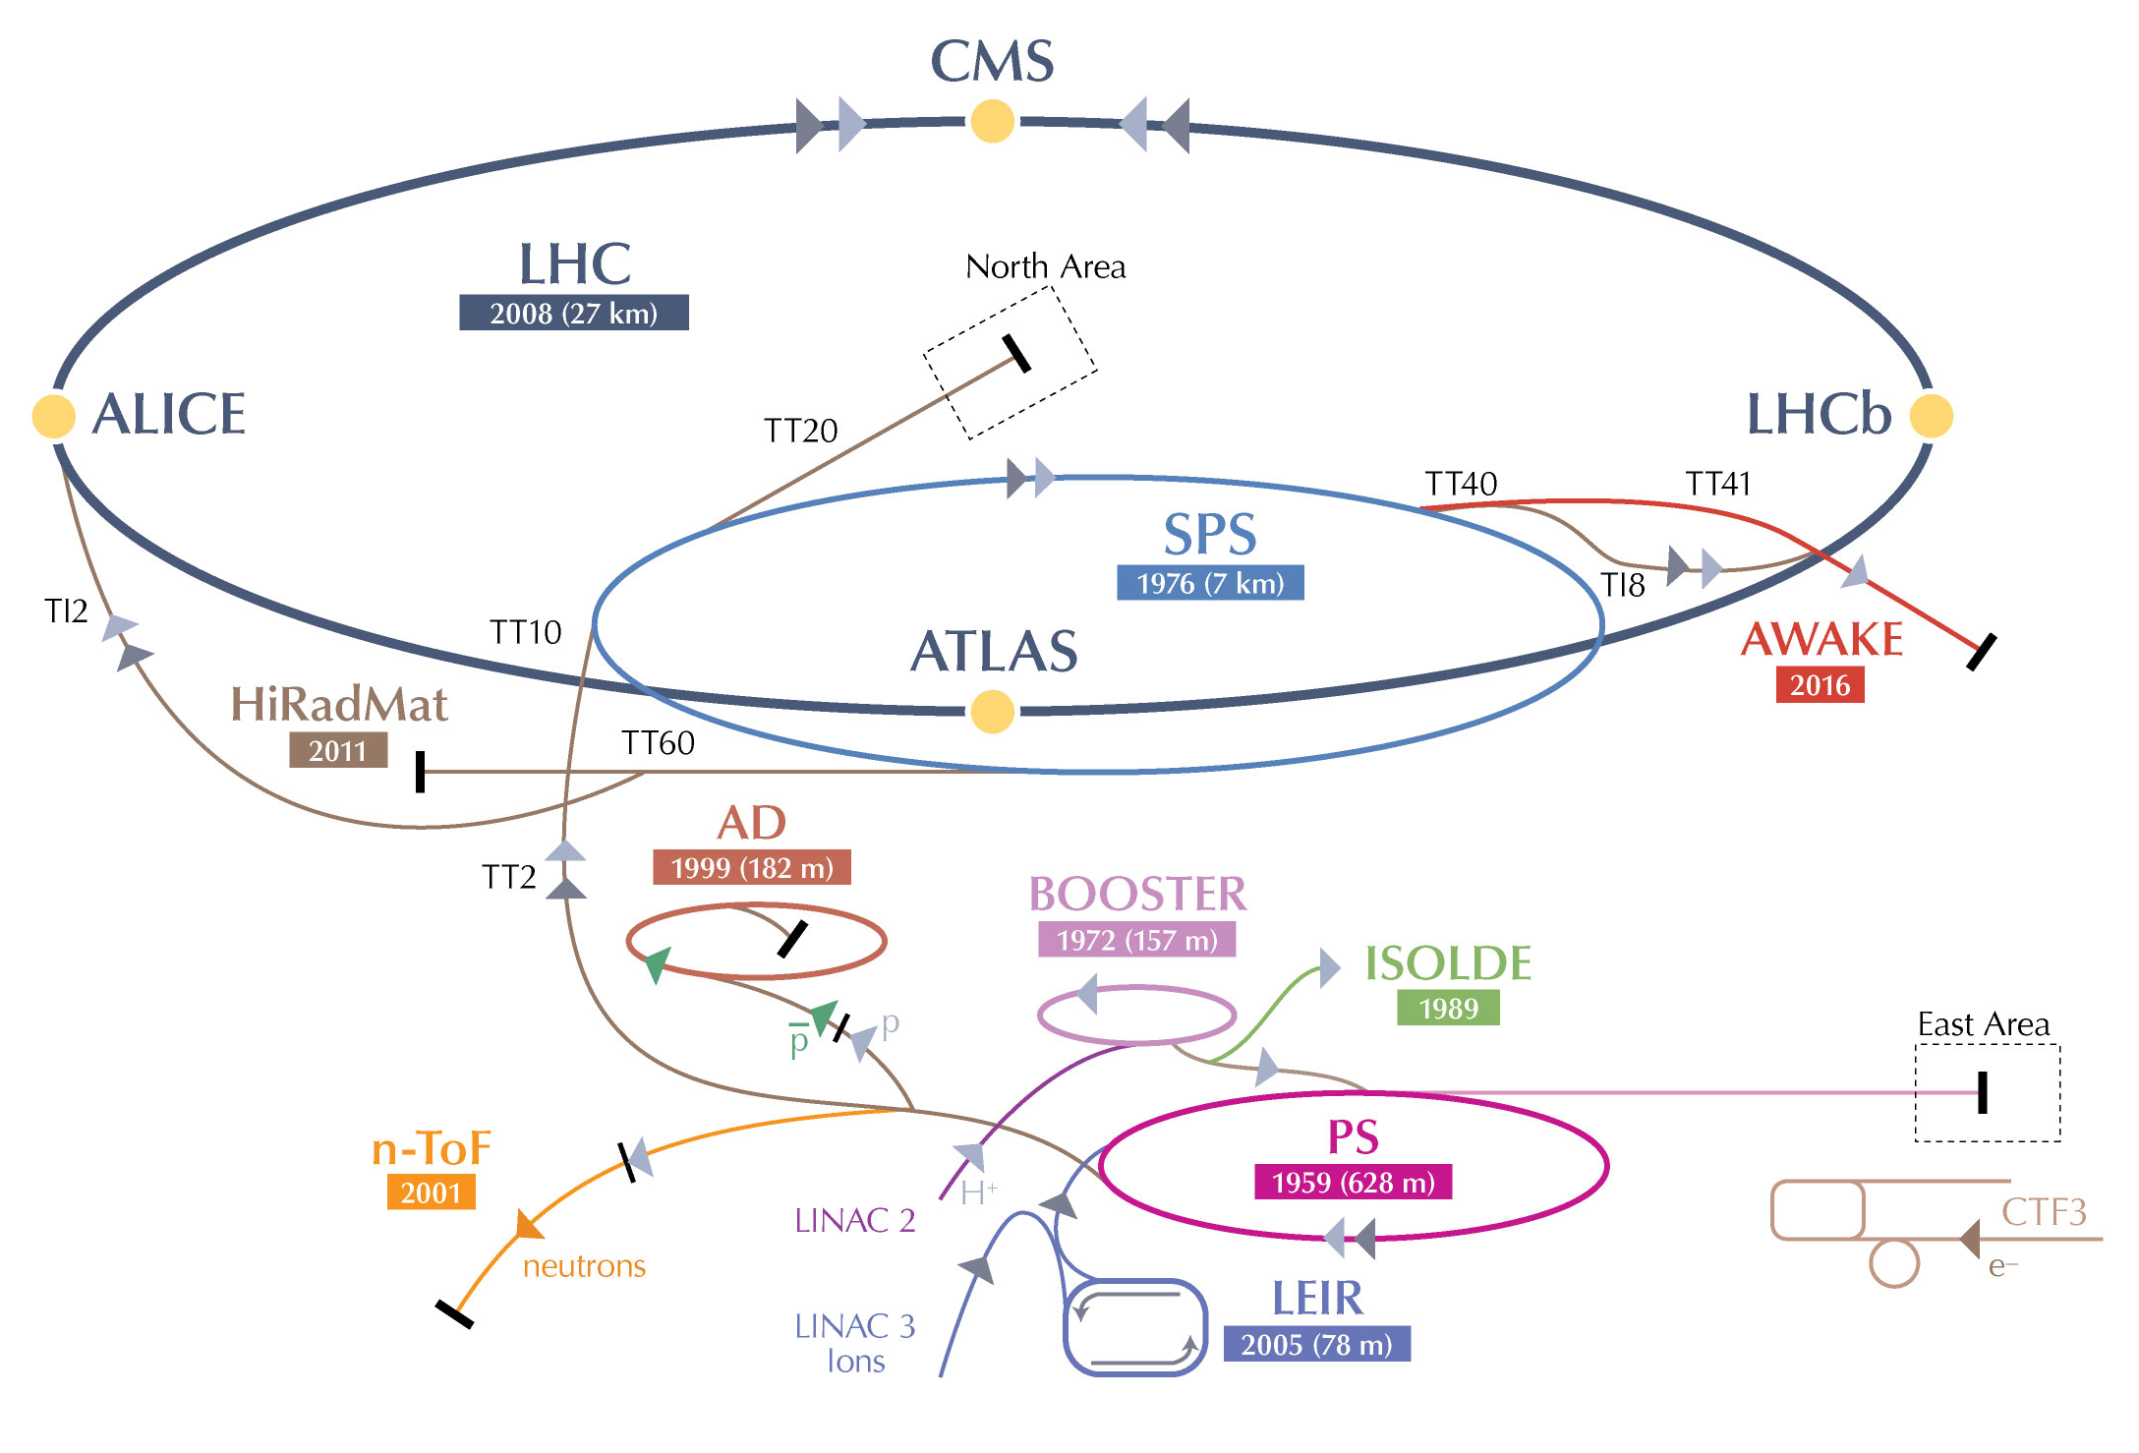
The n_TOF CERN facility

Slide 7
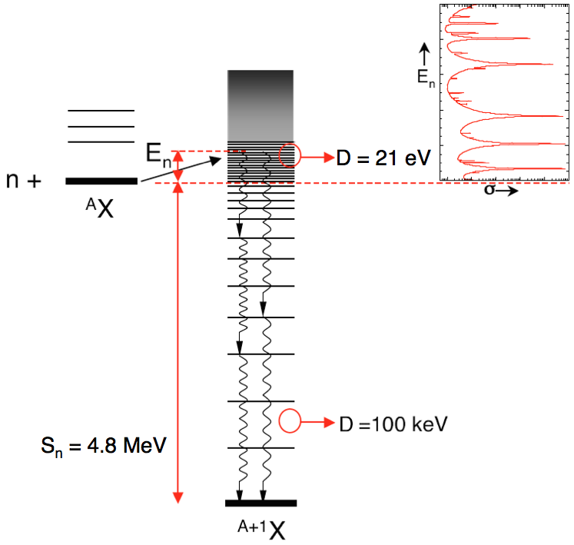
Experimental technique
Using a Time of Flight (TOF) technique, capture cross section is determined through the measurement of the reaction yield Y_{R}(E_{n}):
D ~ eV
N: normalization factor
C: capture counts
B: background counts
Φ: incident neutron fluence
ε = k × E_{c}: detection efficiency
A: area of the sample

Slide 8
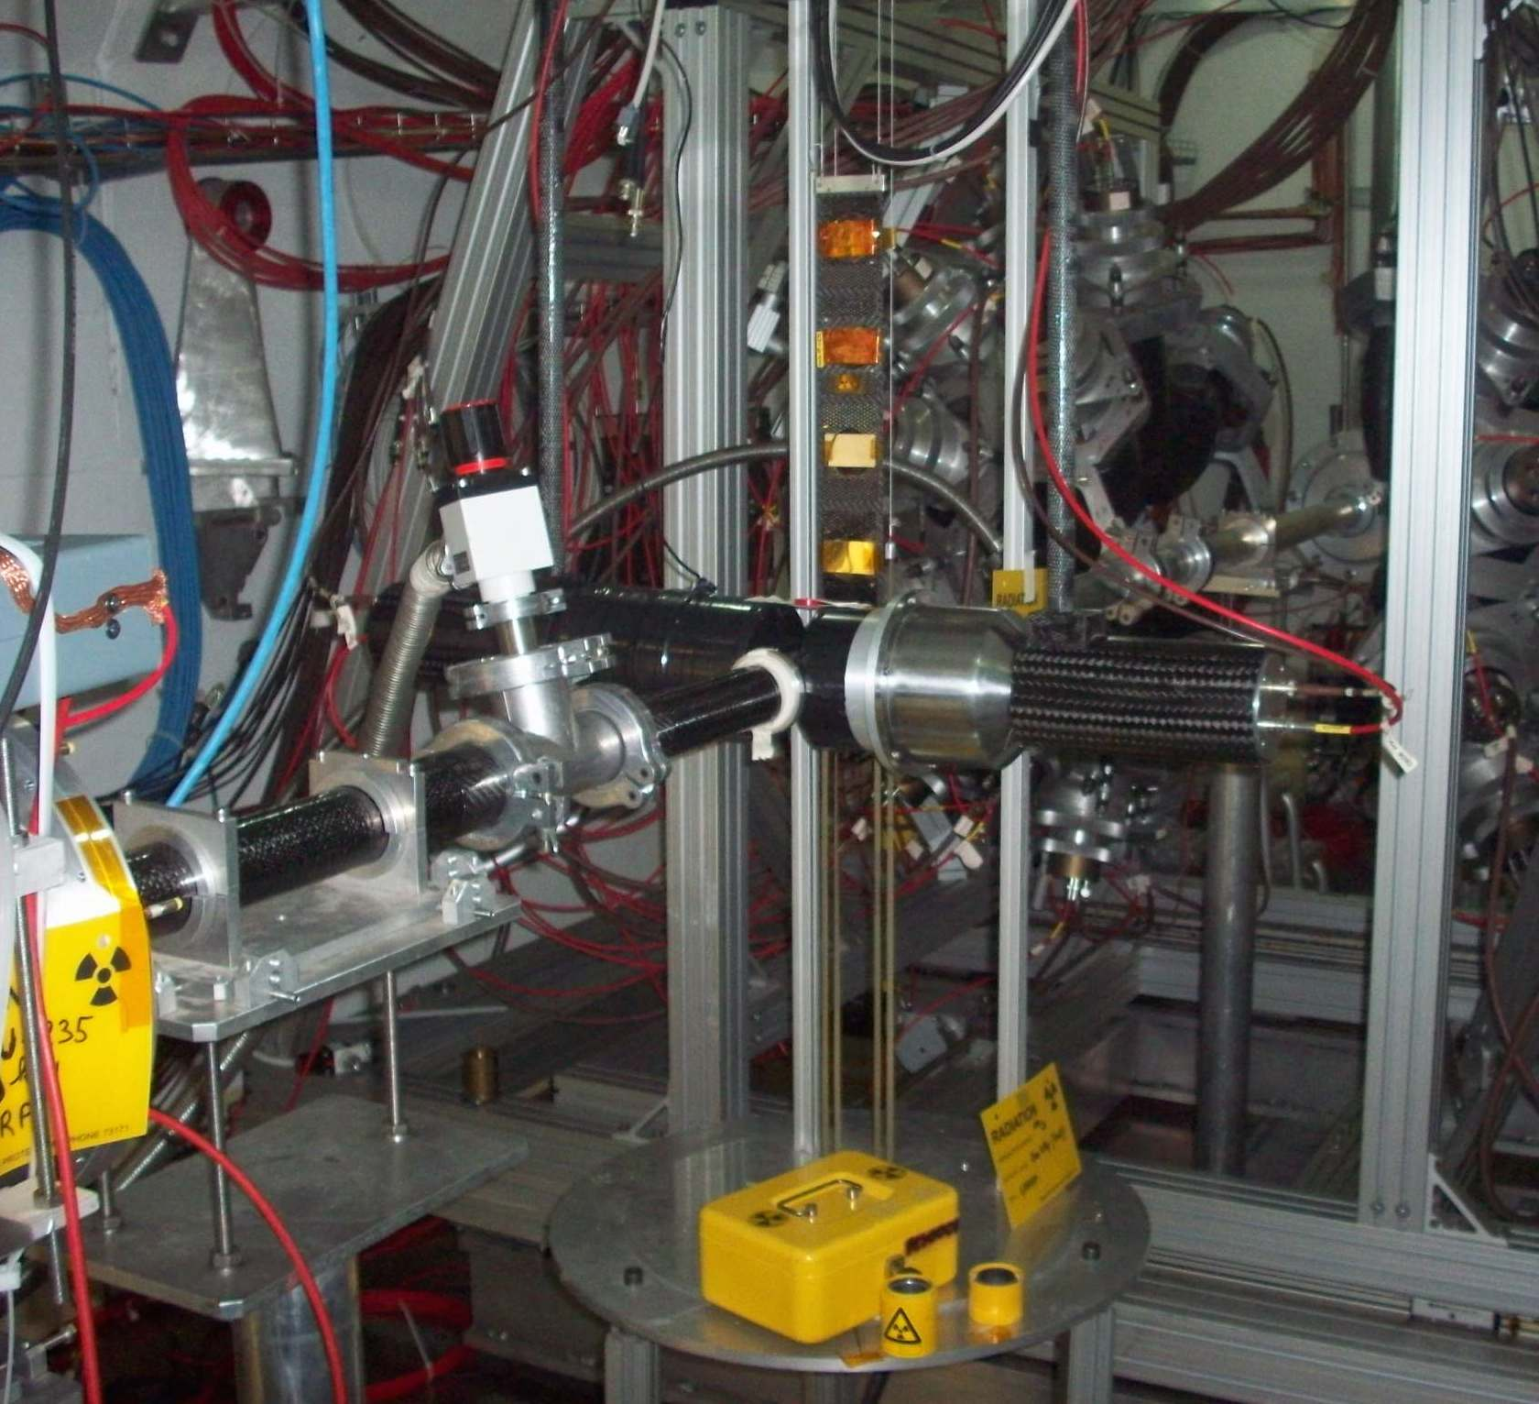
²³⁸U(n,γ): Experimental setup
2 different setups for capture measurements:
Total Absorption Calorimeter (TAC)
  40 BaF₂ crystals in a 4π geometry
  Detects the entire g cascade
  Total Absorption Detection Technique
Two C6D6 scintillation detectors
  Optimized for a low neutron sensitivity (i.e. sensitivity to background from scattered n)
  Only one γ-ray detected per event
  Total Energy Detection Technique with Pulse Height Weighting Technique (PHWT)
C₆D₆
NEUTRON BEAM

Slide 9
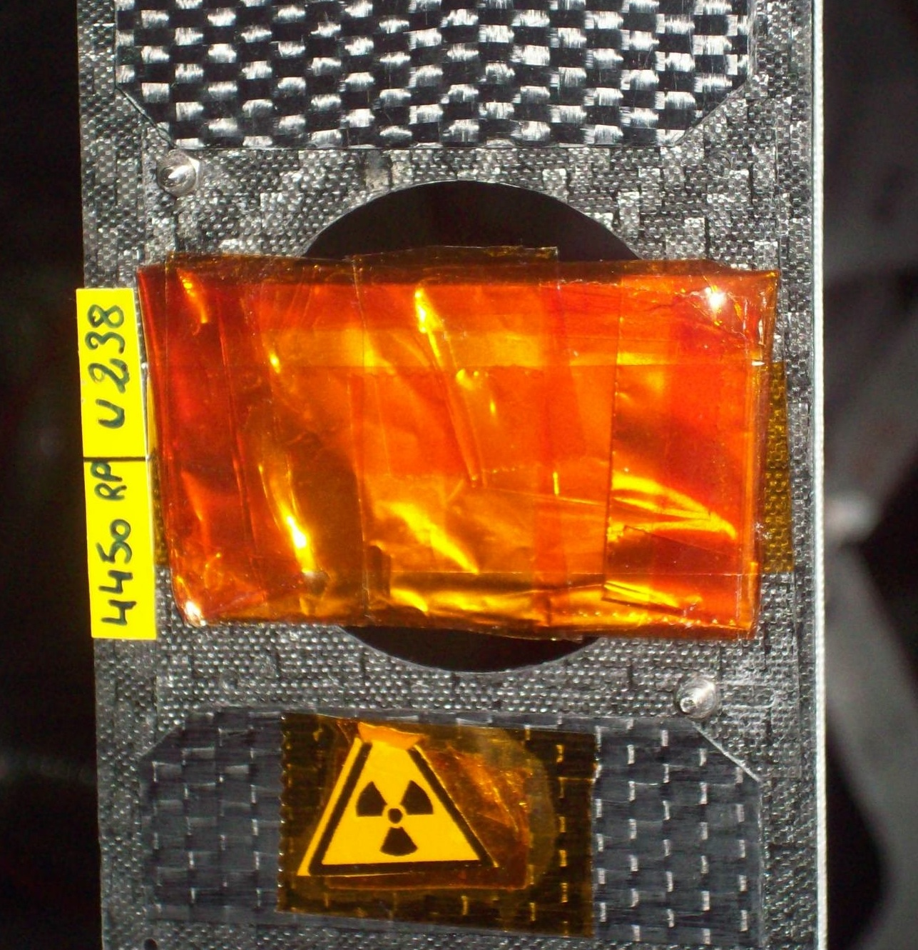
²³⁸U(n,γ): Sample
Enriched metallic uranium rectangular plate (53.825 x 30.12 μm², 235 μm thick) enveloped inside a 20 mm aluminum and a 25 mm kapton thick foils.
Provided by the EC-JRC Geel
Mass | 6.125 ± 0.002 g 9.56×10⁻⁴ atoms/barn
% ²³⁸U | 99.99 %
% ²³⁵U | < 11 ppm
% ²³³⁻²³⁴⁻²³⁶U | < 1 ppm each
Radioactivity | 12.4 kBq/g (76 kBq)
Isotopic and physical analysis done @ EC-JRC Geel in 1984

Slide 10
²³⁸U(n,γ): Data reduction
Analysis from raw data to experimental yield
Stability of the detection system. The stability has been checked both for neutron flux and for the scintillators. Runs which show a deviation of more than the 3.5% have been rejected.
flash-ADC channels to energy calibration + energy resolution of C₆D₆. Weekly calibration measurements with ¹³⁷Cs (661.7 keV), ⁸⁸Y (0.898 and 1.836 MeV) and Am/Be (4.44 MeV). 6 calibration lines have been extracted to take into account small gain changes in the scintillators.
Weighting functions. The detector responses have been simulated with the GEANT4 toolkit, and convoluted with the experimental resolution. Two WF have been produced: one considering an homogenous z-emission, the other considering an exponential attenuation to take into account the the neutron transport within the sample.
Background subtraction.
Neutron flux evaluation. n_TOF evaluated flux (M. Barbagallo et al., The European Physics Journal A 49, 156 (2013))
Normalization.
FOR DETAILS SEE
F. Mingrone et al., Nuclear Data Sheets 119 (2014) 18-21
F. Mingrone et al., INPC 2013 - VOL. 1 Book Series: EPJ Web of Conferences 66 (2014) 03061
Notes:
accurate study of the calibrations between the flash-ADC channels and the deposited energy was performed on a weekly basis using three standard sources: ¹³⁷Cs (661.7 keV), ⁸⁸Y (0.898 and 1.836 MeV) and Am/Be (4.44 MeV).
Comparing the different calibration spectra for each isotope, we notice that they are not stable, and for this reason we extracted six calibration lines from the different measurements made.

Slide 11
²³⁸U(n,γ): Data reduction
Analysis from raw data to experimental yield
Stability of the detection system. The stability has been checked both for neutron flux and for the scintillators. Runs which show a deviation of more than the 3.5% have been rejected.
flash-ADC channels to energy calibration + energy resolution of C₆D₆. Weekly calibration measurements with ¹³⁷Cs (661.7 keV), ⁸⁸Y (0.898 and 1.836 MeV) and Am/Be (4.44 MeV). 6 calibration lines have been extracted to take into account small gain changes in the scintillators.
Weighting functions. The detector responses have been simulated with the GEANT4 toolkit, and convoluted with the experimental resolution. Two WF have been produced: one considering an homogenous z-emission, the other considering an exponential attenuation to take into account the the neutron transport within the sample.
Background subtraction. Validation of the background level through black-resonance filters.
Neutron flux evaluation. n_TOF evaluated flux (M. Barbagallo et al., The European Physics Journal A 49, 156 (2013)).
Normalization. Saturated-resonance method.
Notes:
accurate study of the calibrations between the flash-ADC channels and the deposited energy was performed on a weekly basis using three standard sources: ¹³⁷Cs (661.7 keV), ⁸⁸Y (0.898 and 1.836 MeV) and Am/Be (4.44 MeV).
Comparing the different calibration spectra for each isotope, we notice that they are not stable, and for this reason we extracted six calibration lines from the different measurements made.

Slide 12
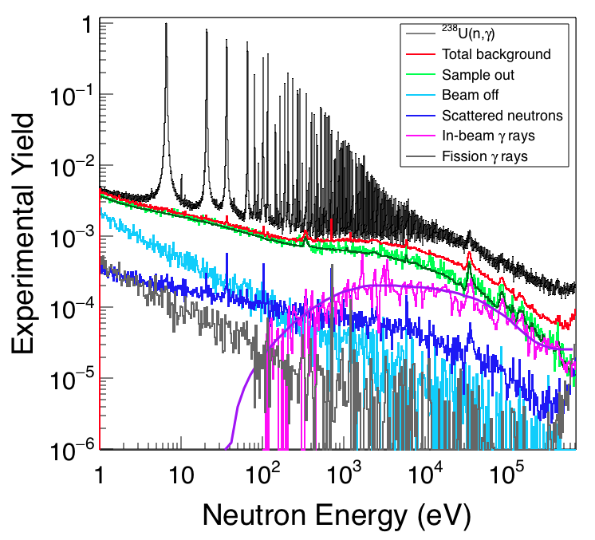
²³⁸U(n,γ): Background subtraction
All the background components have been evaluated singularly:
  Beam off: time independent, from natural and sample radioactivity and air activation
  Sample out: main component of the beam-related background, evaluated without any sample in beam
  Scattered neutrons: γ-rays coming from sample-scattered neutrons captured in the ambient material. Evaluated by GEANT4 simulations as in P. Zugec et al., NIM A 760, 57 (2014).
  In-beam γ rays: very important in the keV energy region. Evaluated by means of a n+^{nat}Pb measurement.
  γ rays from fission events: prompt γ-ray emission or from fission fragment decays. Evaluated with GEANT4 simulations

Slide 13
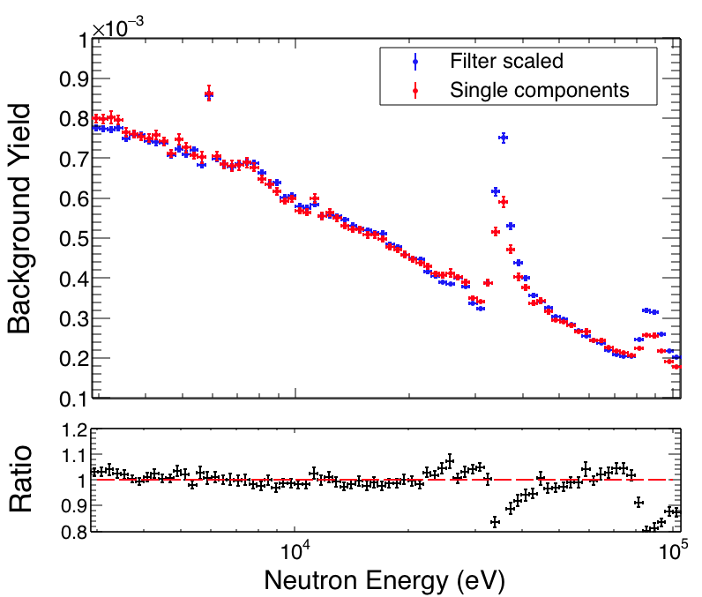
²³⁸U(n,γ): Background subtraction
The background level has been evaluated exploiting Ag, W, Co and Al black-resonance filters in beam.
The resulting background has been properly scaled to take into account the attenuation of both the neutron beam and the in-beam photons.
The two background yields agree for 3 < E_{n} < 100 keV within the 5%
In the neighborhood of the Al resonances the estimation is not reliable because the amount of aluminum in the windows of the beam line is not precisely known

Slide 14
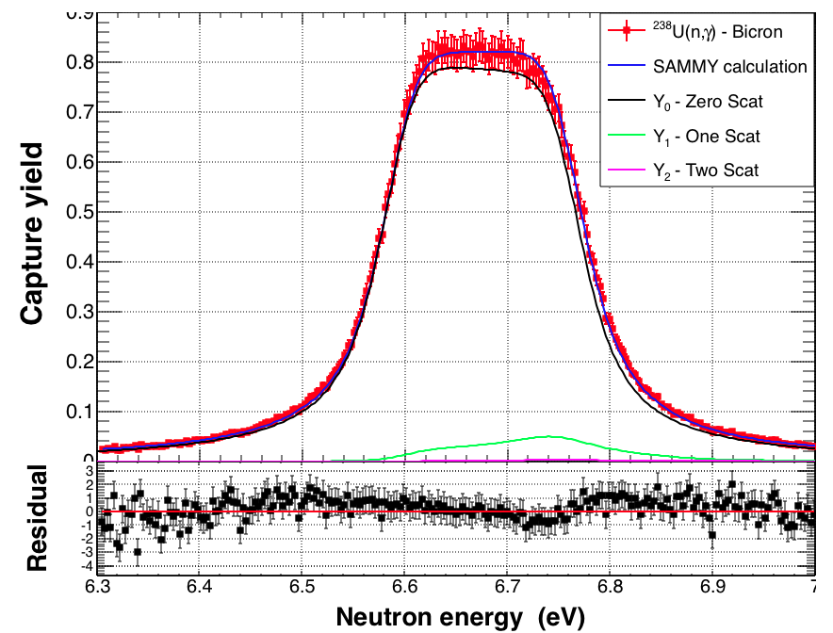
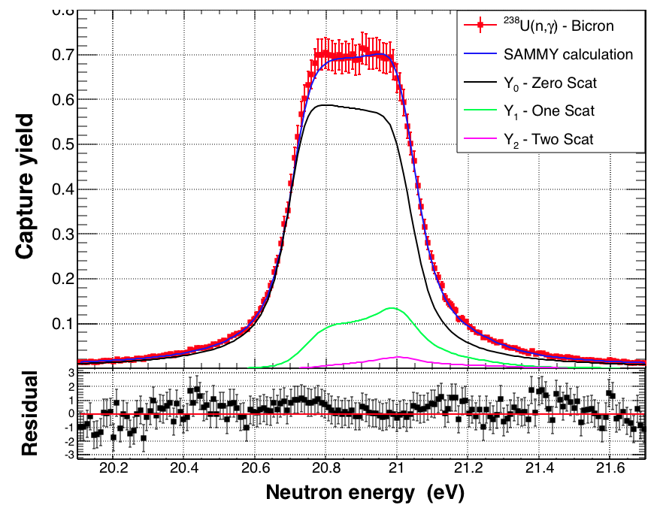
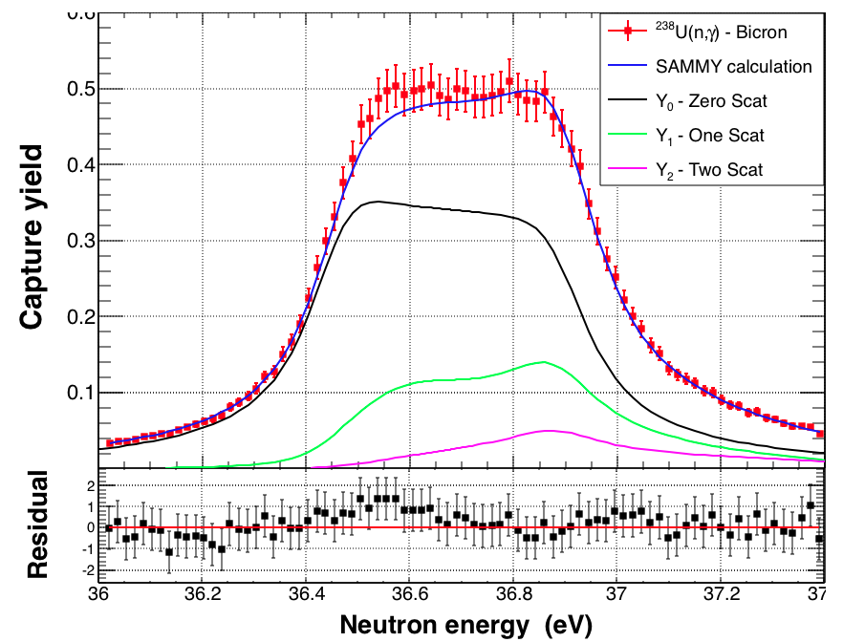
²³⁸U(n,γ): Yield normalization
Saturated resonance technique applied to the first 3 resonances
DETECTOR | NORMALIZATION FACTOR |  |  | PERCENTAGE DEVIATION
 | N₁ | N₂ | N₃ | N₁/N₂ | N₂/N₃ | N₁/N₃
BICRON | 0.842 | 0.843 | 0.850 | 0.03% | 0.9% | 1%
 | N_{bic} = 0.845 |  |  | ΔN_{bic}/N_{bic} = 1%
FZK | 1.008 | 0.995 | 1.001 | 1% | 0.6% | 0.6%
 | N_{fzk} = 1.002 |  |  | ΔN_{fzk}/N_{fzk} = 1%

Slide 15
²³⁸U(n,γ): Correlated uncertainties
SOURCE OF UNCERTAINTY | UNCERTAINTY RRR | UNCERTAINTY URR
Sample mass | 0.1% | 0.1%
Neutron flux – shape* | 1-2% | 3 < E_{n} < 100 keV: 4-5% 100 < E_{n} < 480 keV: 2%
Normalization | 1% | 1%
Background subtraction | 1-2% | 3 < E_{n} < 100 keV: 3% 100 < E_{n} < 480 keV: 7%
Total | 2-3% | 3 < E_{n} < 100 keV: 5-6% 100 < E_{n} < 480 keV: 8%
*M. Barbagallo et al., The European Physics Journal A 49, 156 (2013)

Slide 16
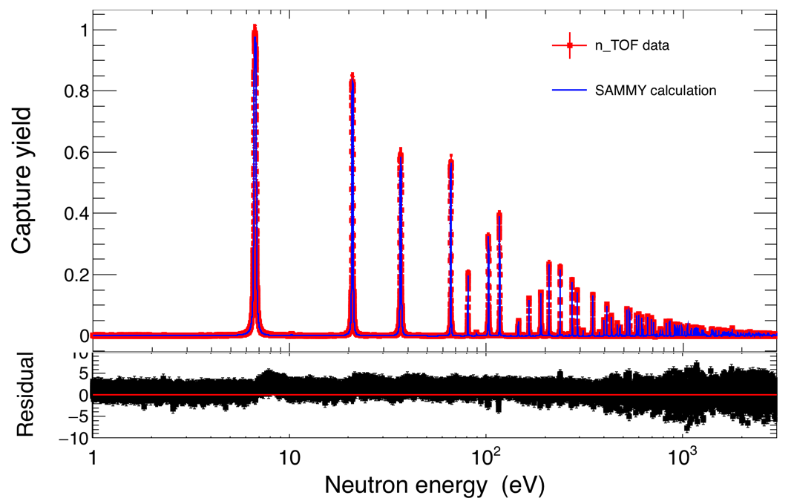
²³⁸U(n,γ): Capture yield

Slide 17
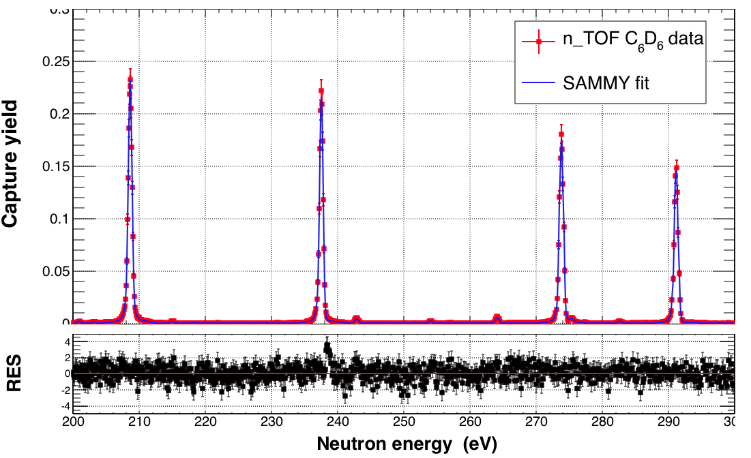
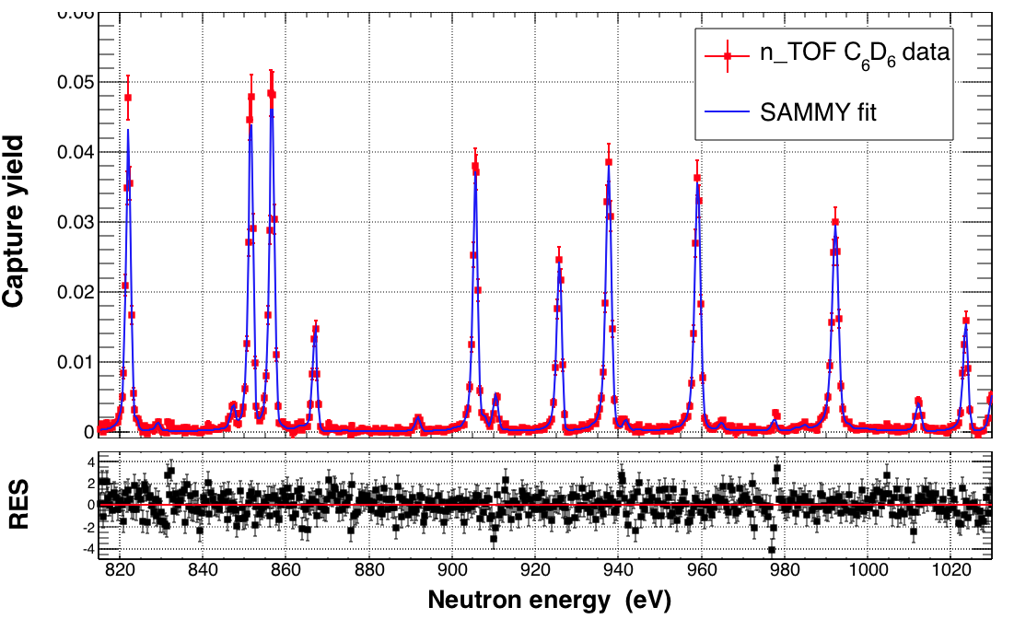
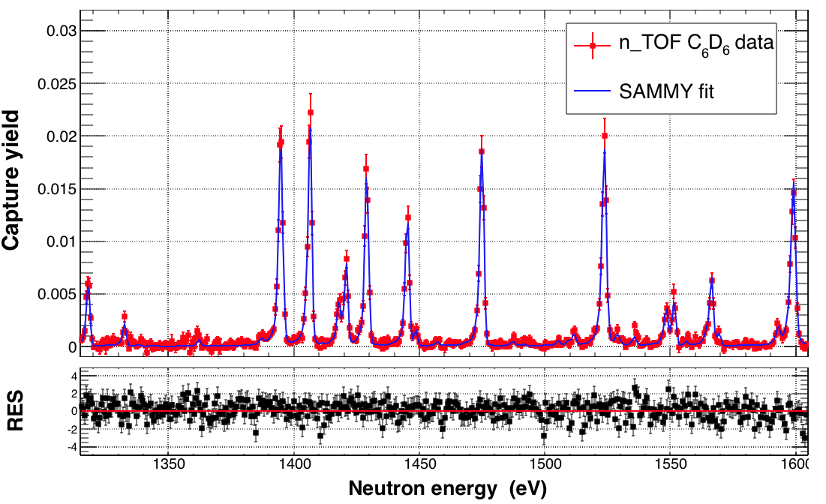
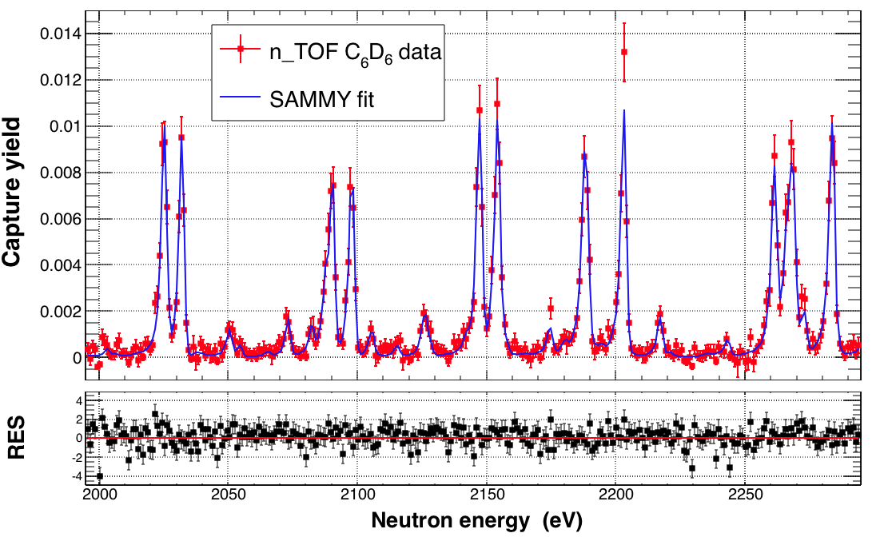
²³⁸U(n,γ): Capture yield

Slide 18
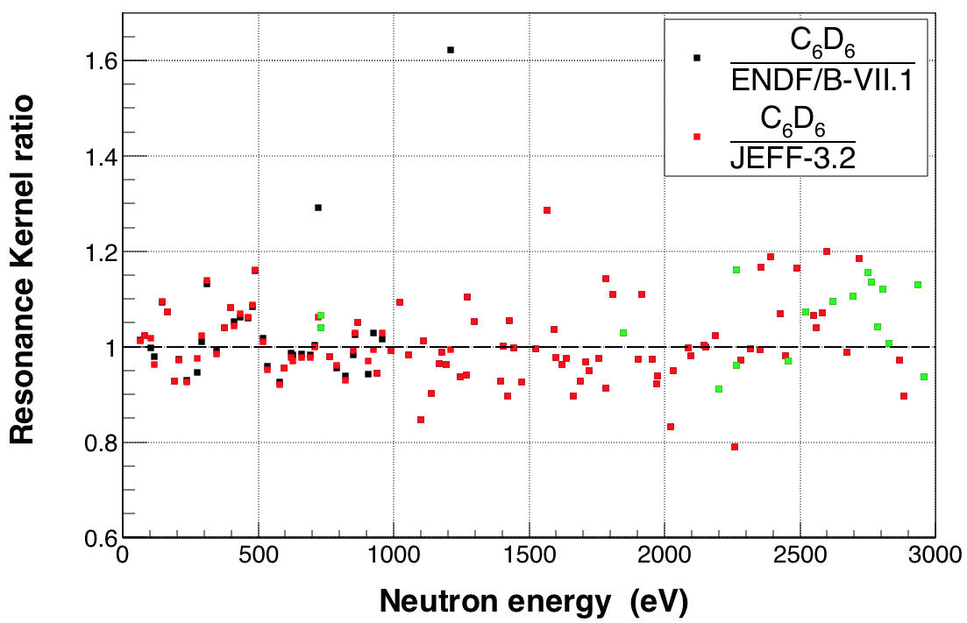
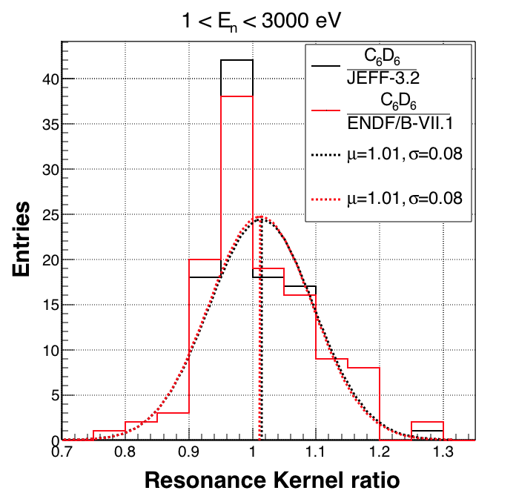
²³⁸U(n,γ): Resonance Shape Analysis
  RSA can be performed only up to 3 keV due to the degradation of the signal-to-background ratio with the neutron energy
  The multilevel multichannel R-matrix code SAMMY has been used to fit the resonances, starting from the parameters of JEFF-3.2.
  The resonance kernel has been used in the comparison with the evaluated libraries

Slide 19
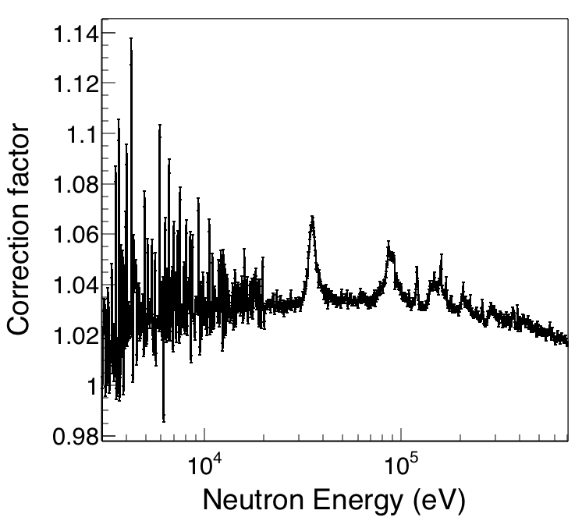
²³⁸U(n,γ): Unresolved Resonance Region
  The sample-related effects, i.e. self-shielding and multiple scattering followed by capture, are taken into account applying a correction factor obtained from MCNP6 simulations.

Slide 20
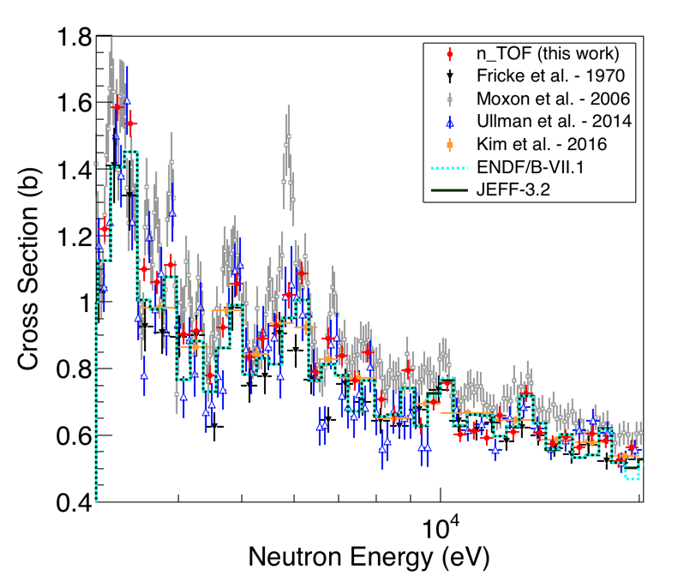
²³⁸U(n,γ): Unresolved Resonance Region
  The sample-related effects, i.e. self-shielding and multiple scattering followed by capture, are taken into account applying a correction factor obtained from MCNP6 simulations.
  3 < E_{n} < 20 keV: fair agreement with libraries
50 bin/decade, dE/E~2%

Slide 21
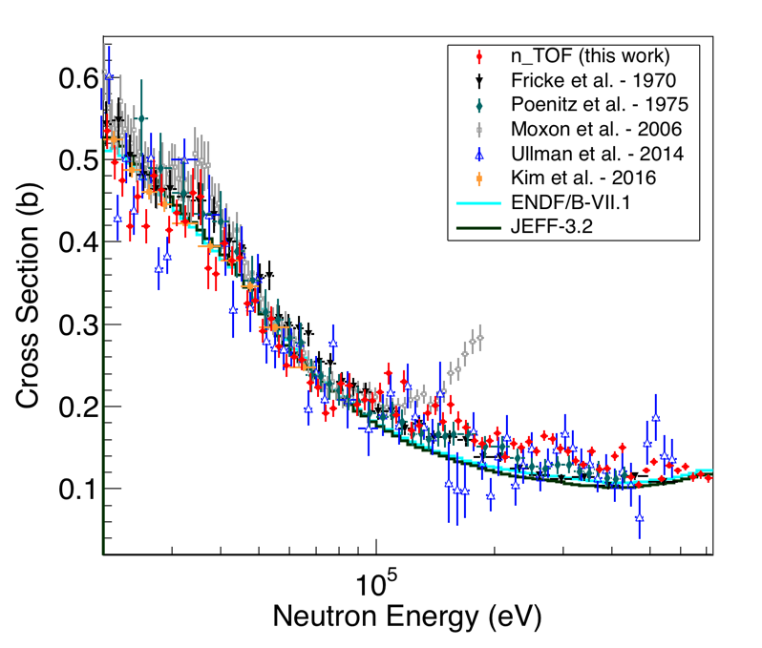
²³⁸U(n,γ): Unresolved Resonance Region
  The sample-related effects, i.e. self-shielding and multiple scattering followed by capture, are taken into account applying a correction factor obtained from MCNP6 simulations.
  3 < E_{n} < 20 keV: fair agreement with libraries
  20 < E_{n} < 80 keV: CS slightly below evaluated libraries and other measurements
  80 < E_{n} < 700 keV: CS 15 to 25% higher than the ENDF/B-VII.1 evaluation, and 21 to 32% higher than the JEFF-3.2 evaluation.
50 bin/decade, dE/E~2%

Slide 22
Summary and conclusions
The radiative capture cross-section of ²³⁸U has been measured at the n_TOF facility using an array of two deuterated benzene scintillators.
The capture yield has been extracted with very low correlated uncertainties, which goes from 2-3% in the RRR to 5-8% in the URR, depending on the energy range.
The RSA has been performed up to 3 keV, showing a fair agreement with the evaluated libraries apart from few resonances.
In the URR the cross section has been extracted up to 700 keV. Results from this work are in fair agreement with evaluated libraries up to 20 keV, show minor differences from 20 to 80 keV, and yield to about a 20% increase in the cross section from 80 to 700 keV

Slide 23
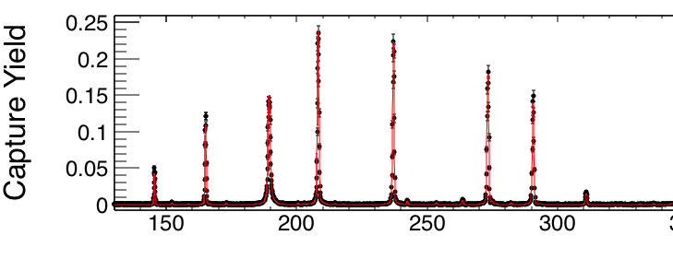
THANK YOU FOR YOU ATTENTION
Federica Mingrone
federica.mingrone@cern.ch

Slide 24
BACKUP SLIDES

Slide 25
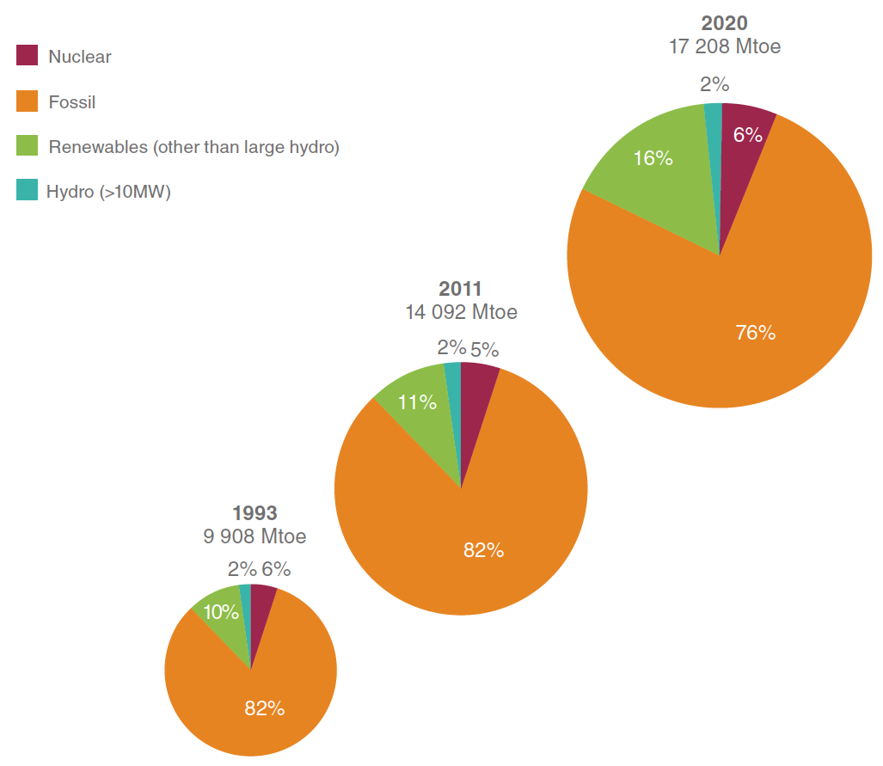
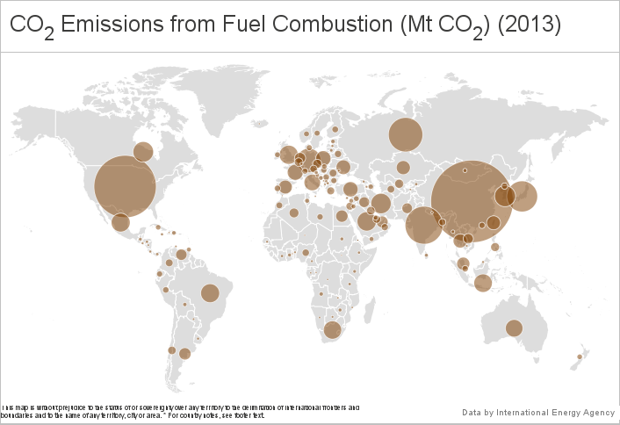
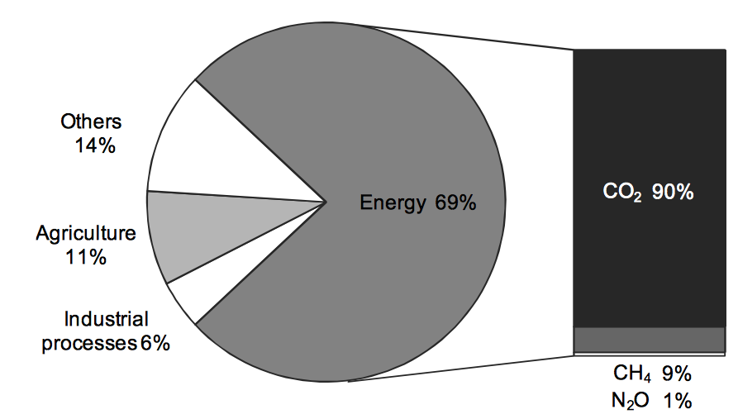
Motivations: World energy outlook
IEA Energy Atlas
Data from IAEA, latest data available from 2013
Shares of global anthropogenic greenhouse-gas
Total Primary Energy Supply by resource
International Energy Agency, CO2 Emissions from Fuel Combustion - Highlights,
Paris, 2014
World Energy Council, World Energy Resources, 2013 Survey, London, 2013

Slide 26
Motivations: Nuclear Reactors
+ ADS
Benefit of the new reactor concepts
Fast reactors and ADS: multirecycling of the fuel, which leads to
  better use of the fuel (the energy production can be up to 60 times more efficient)
  Improving the waste meanagement (reduction of the long-term radiotoxicity of the ultimate waste)
SCWR: higher efficiency and plant simplification, which lead to an improved economics
VHTRs: passive safety features and the ability to provide very-high-temperature process heat (used ad example in the massive production of hydrogen)

Slide 27
Motivations: Nuclear Reactors
+ ADS
Deployment of Gen IV reactors: not before 2030
For many decades they will be deployed alongside Gen III+
R&D and demonstration projects needed to bring concepts towards commercialization, in particular in the areas of fuels and materials that can withstand higher temperatures, higher neutron fluxes or more corrosive environments.
Construction and operation of Gen IV prototypes in the period 2020-2030. Prototype development and testing is seen as particularly important.

Slide 28
The n_TOF CERN facility
 | EAR-1 | EAR-2
Energy range | Thermal < E_{n} < 1 GeV | Thermal < E_{n} < 300 MeV
Instantaneous neutron flux | 10⁵ n/cm²/pulse | 10⁶ n/cm²/pulse
Repetition rate | <0.8 Hz (1 pulse/2.4 s maximum)
Proton pulse width | 7 ns
Cooling and moderation system | 1 cm water (cooling) + 4 cm borated water (moderator) | 5 cm water (cooling and moderator)
Energy resolution | DE/E=10⁻⁴ (E_{n} < 10 keV) | DE/E=10⁻³ (E_{n} < 10 keV)

Slide 29
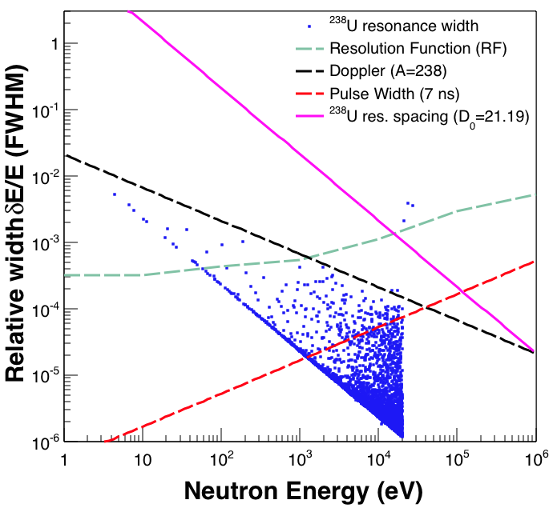
The n_TOF CERN facility
 | EAR-1 | EAR-2
Energy range | Thermal < E_{n} < 1 GeV | Thermal < E_{n} < 300 MeV
Instantaneous neutron flux | 10⁵ n/cm²/pulse | 10⁶ n/cm²/pulse
Repetition rate | <0.8 Hz (1 pulse/2.4 s maximum)
Proton pulse width | 7 ns
Cooling and moderation system | 1 cm water (cooling) + 4 cm borated water (moderator) | 5 cm water (cooling and moderator)
Energy resolution | DE/E=10⁻⁴ (E_{n} < 10 keV) | DE/E=10⁻³ (E_{n} < 10 keV)
Data from ENDF/B-VII.1
~15 keV

Slide 30
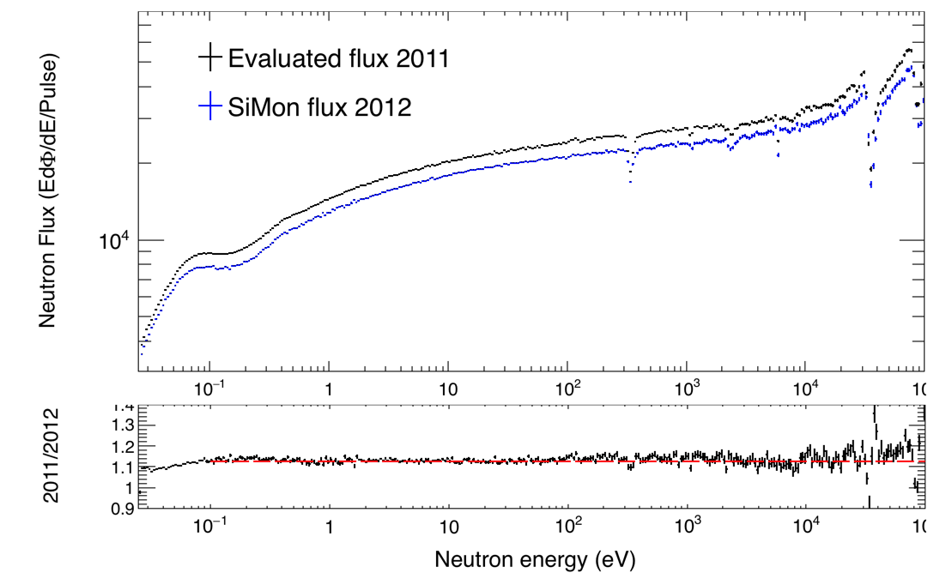
n_TOF neutron flux
50 bin decade
Constant ratio @ 1.128 from 0.1 eV to 100 keV
Difference in the thermal region due to a change on the ¹⁰B density in the moderator

Slide 31
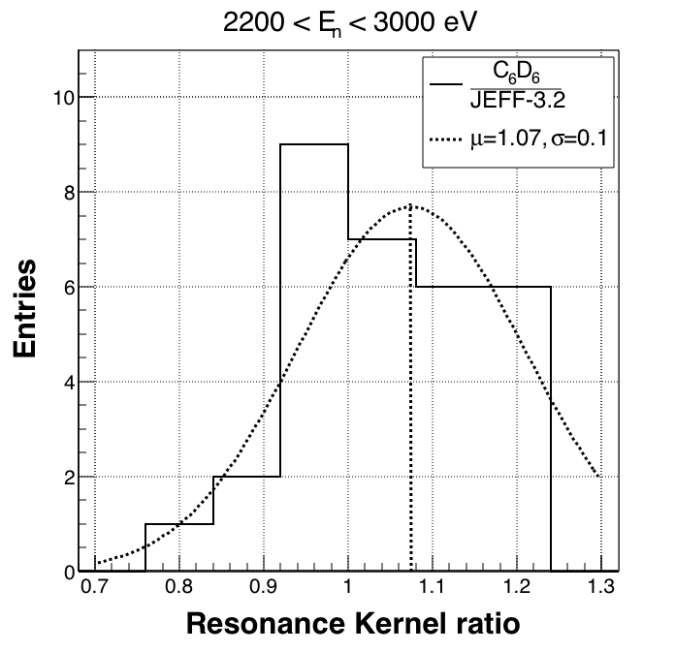
²³⁸U(n,γ): Resonance Shape Analysis
  RSA can be performed only up to 3 keV due to the degradation of the signal-to-background ratio with the neutron energy
  The multilevel multichannel R-matrix code SAMMY has been used to fit the resonances, starting from the parameters of JEFF-3.2.
  The resonance kernel has been used in the comparison with the evaluated libraries
  For E_{n}>2.2keV kernel from this work are systematically higher than the ones reported in the evaluated libraries
2.2 keV

Slide 32
²³⁸U(n,γ): Resonance Shape Analysis
  RSA can be performed only up to 3 keV due to the degradation of the signal-to-background ratio with the neutron energy
  The multilevel multichannel R-matrix code SAMMY has been used to fit the resonances, starting from the parameters of JEFF-3.2.
  The resonance kernel has been used in the comparison with the evaluated libraries
  3 resonances below 2.2 keV which differs from the evaluated libraries for more than 20%
2.2 keV
This work |  |  | ENDF/B-VII.1 | JEFF-3.2
E_{r} (eV) | κ(meV) | Δκ/κ (%) | κ (meV) | κ (meV)
721.68 | 1.45 0.09 | 6 | 1.12 | 1.36
1211.32 | 6.5 4 | 61 | 4.01 | 6.54
1565.54 | 6.1 0.7 | 12 | 4.71 | 4.71

