Slide 1

Status Report
ALICE ITS @ LNF
OB HIC Recap
FPC Recap
OB Assembly Status
Quark Matter 2018
Federico Ronchetti,
INFN-LNF
ALICE ITS Meeting 11/00/2016

Slide 2
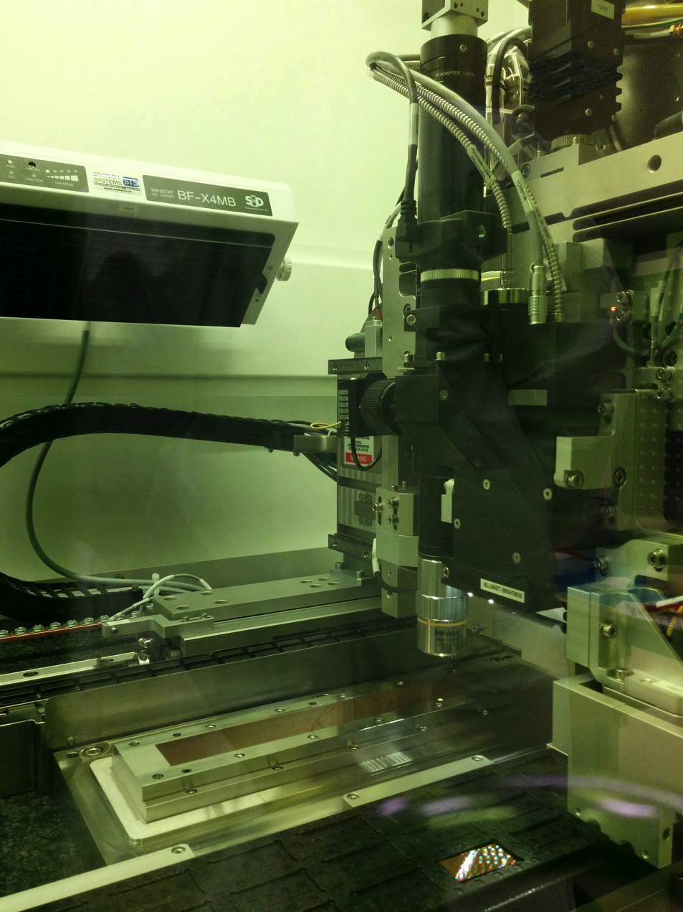
OB HIC: First assembly tests at CERN
After the good results obtained at CERN with the assembly of 2 IB modules equipped with working chips (0 chips in short out of 18), we decided to change our plans and try the assembly of an OB module with the ALICIA machine.
First action: replacing the IB assembly table with the last version of the OB table (produced by AMC).

Slide 3
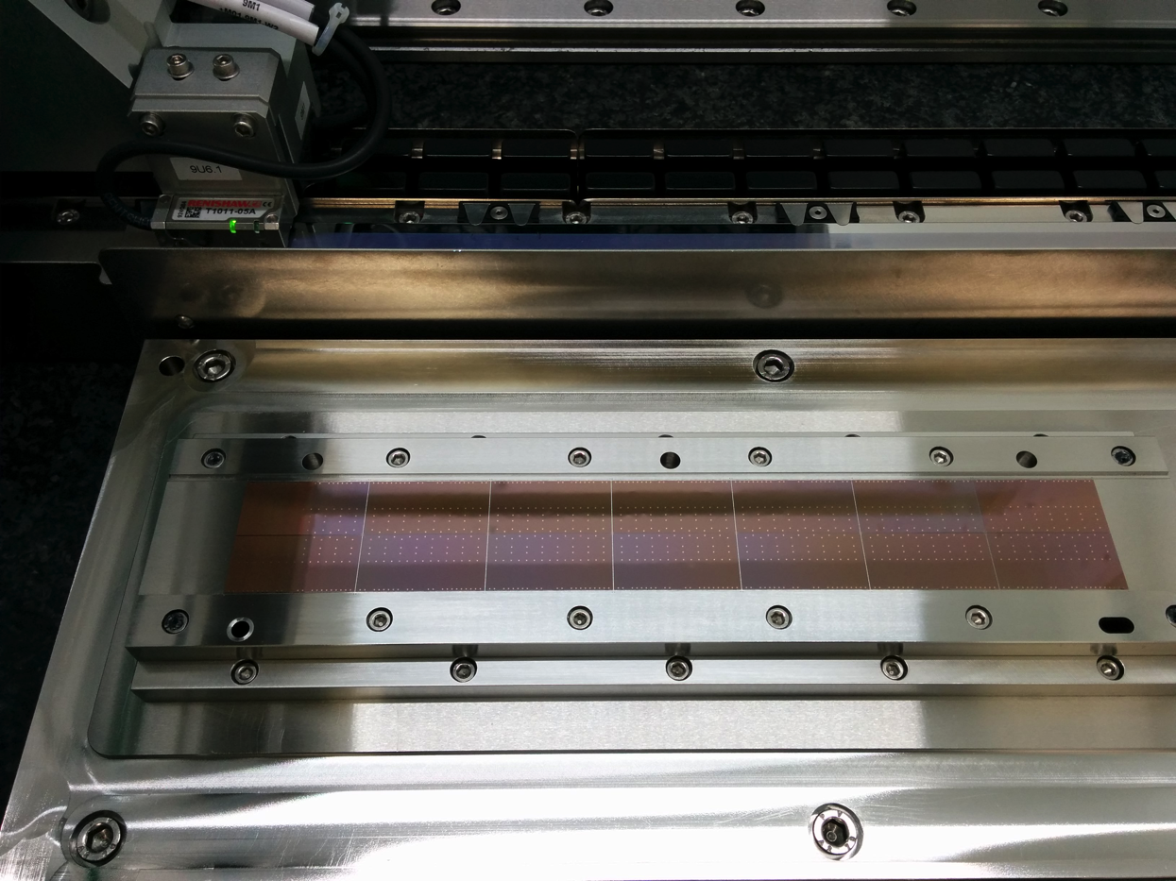
OB HIC: First assembly tests at CERN
Three weeks ago we aligned the first OB module using the ALICIA machine.
We started with a dummy module in order to check the tooling and to confirm the procedure developed in Bari.

Slide 4
OB HIC: Status and Plans
Produced module equipped with ALPIDE chips the past week
Continue the production of dummy modules in Bari with our current procedure and with the ALICIA-3 machine starting from the last week of October
4 dummy modules are now available and can be shipped to different labs
(3 available in Bari and 1 at CERN)

Slide 5
FPC Tests

Slide 6
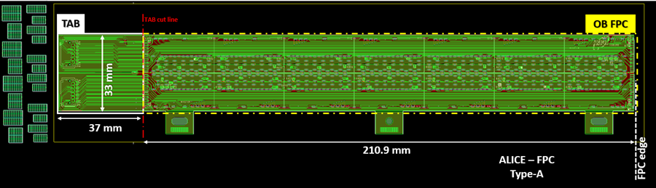
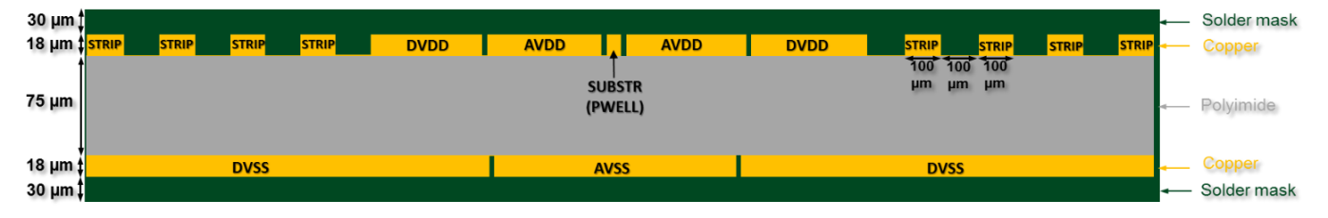
FPC Production
→General structure of the OB FPC.
Reference point: dowel pin hole center
Reference bridges
→Stack-up of the OB FPC (not in scale)

Slide 7
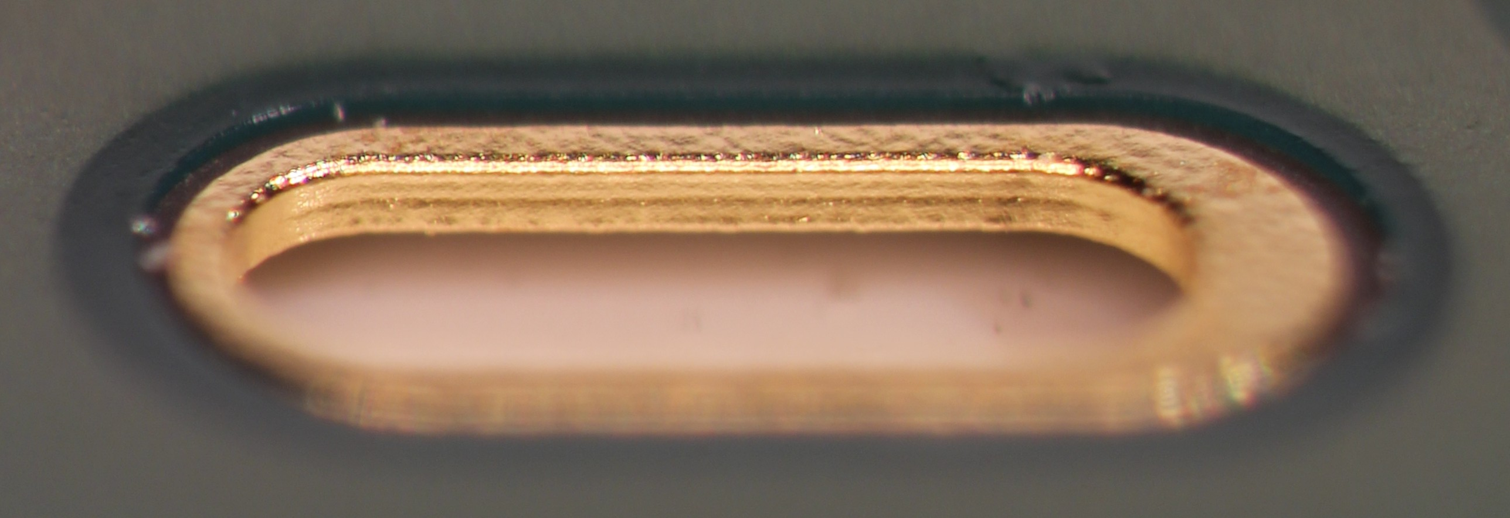
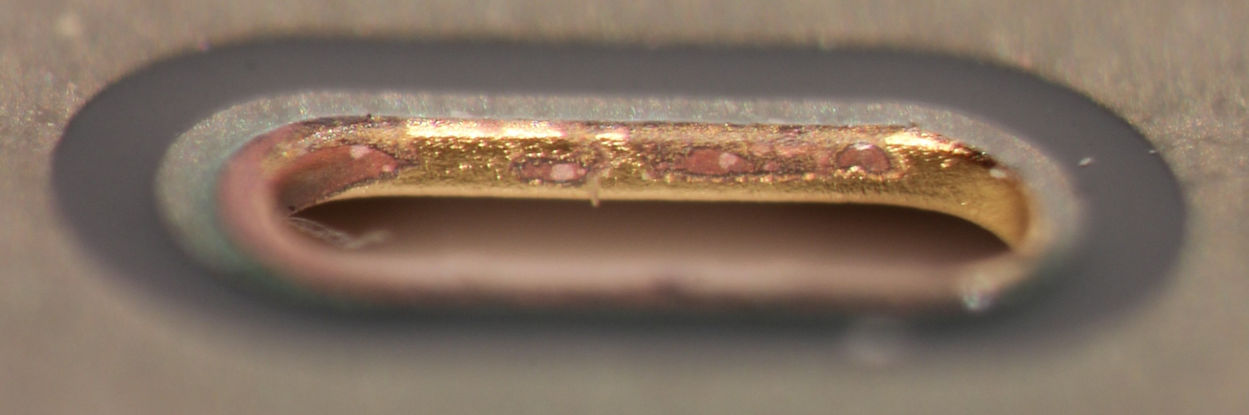
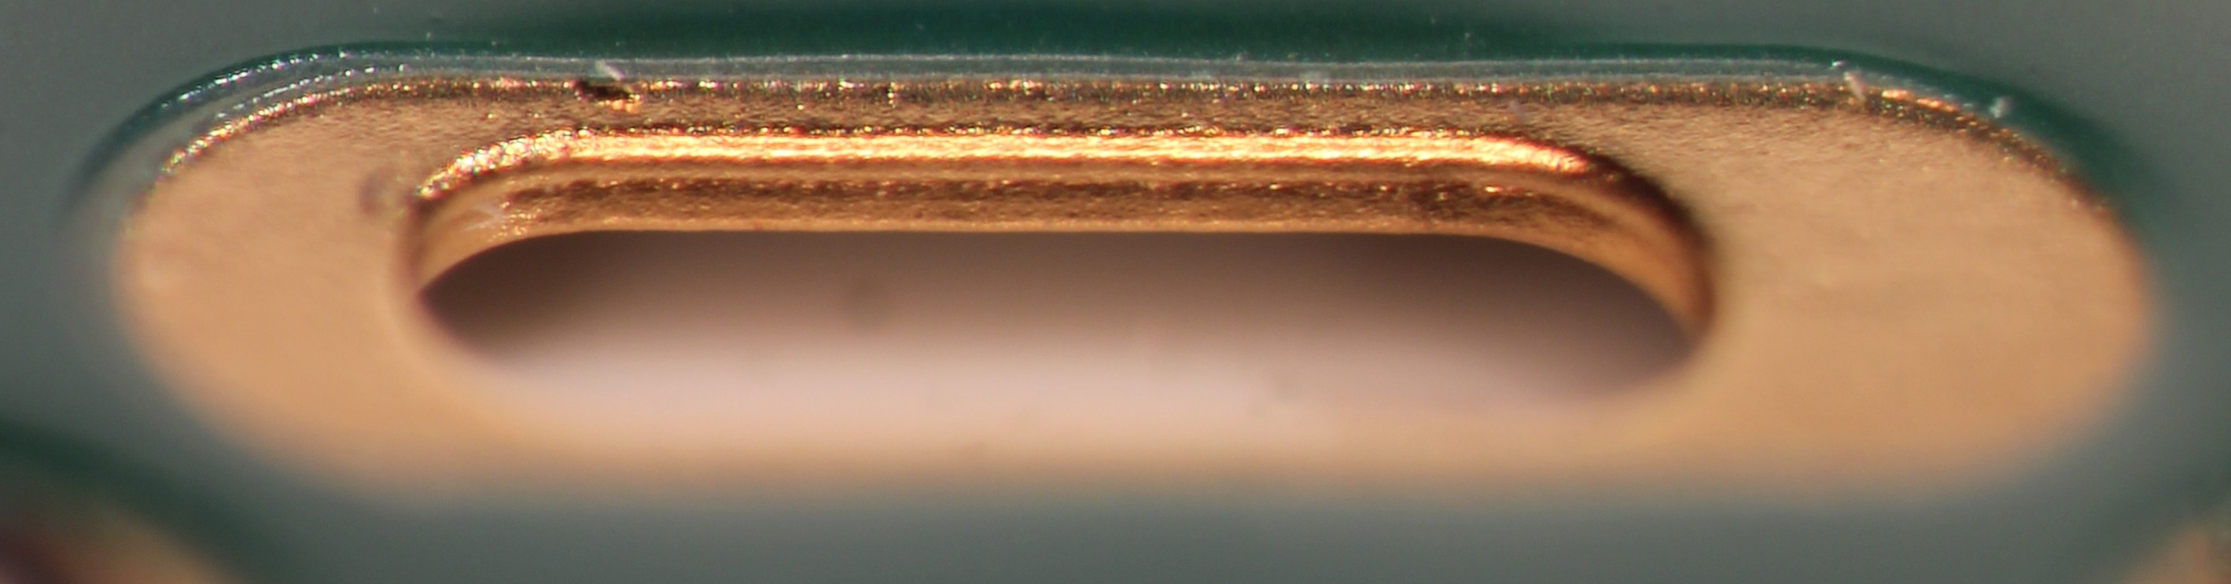
Vis. Insp: via metallization/metal “wall” quality
FPC Tests: Visual Inspection
Pictures by Miljenko Šuljić
Swiss: very good quality and planarity of the nickel-gold plating
Swiss-PCB
Eltos: bad quality of the nickel-gold plating that is missing in certain areas
Eltos
Contag: very good quality and planarity of the plating
Contag

Slide 8
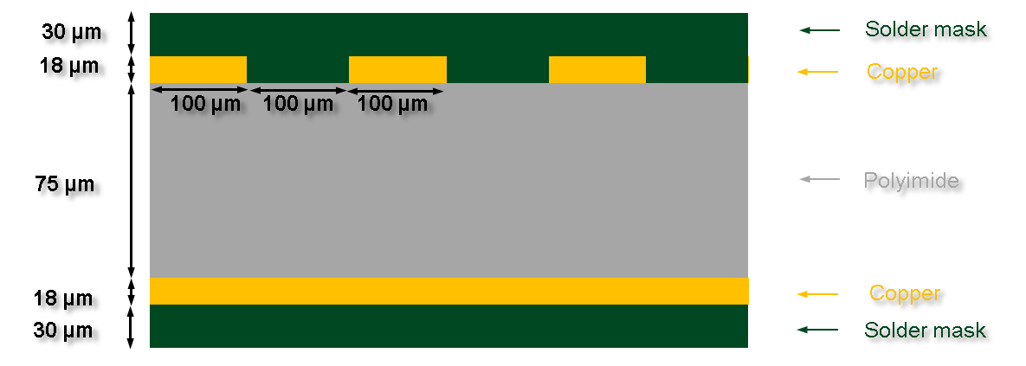
FPC Stack-up
Materials:
Pyralux (polyimide core 75 um, double-sided, copper-clad laminate, Cu thickness 18 um) or similar
(Swiss&Eltos, ~Contag)
Layer | Thickness | Tolerance
Dielectric substrate | 75 μm | ±10 %
Copper | 18 μm (final) except around holes | ± 2 μm
Solder mask | 30 μm | ± 5 μm

Slide 9
FPC Stack-up
Copper:
18 +- 2um final (except @ holes)
Eltos, S.P., Contag
Still Under evaluation (more tests needed! To understand if fluctuations or syst. )
Layer | Thickness | Tolerance
Dielectric substrate | 75 μm | ±10 %
Copper | 18 μm (final) except around holes | ± 2 μm
Solder mask | 30 μm | ± 5 μm
Finishing: ENIG
(Wire Bonding, soldering, smd mounting)
Ni layer: 3-5 um
Au layer: of 60-100 nm
SP, Eltos (strong quality fluctions), Contag

Slide 10
FPC Stack-up
Solder Mask:
30um on top of Cu
Main requirement: flatness
S.P., Eltos (u.ev.), Contag
Layer | Thickness | Tolerance
Dielectric substrate | 75 μm | ±10 %
Copper | 18 μm (final) except around holes | ± 2 μm
Solder mask | 30 μm | ± 5 μm

Slide 11
FPC Stack-up
ELTOS – Quality of this batch far from the previous productions
Contag – Cu and Solder Mask very thick
Swiss PCB – Cu thickness not uniform
Results based on 1 FPC per manufacturer
Testing more FPCs to have statistics
Technical specifications frozen.
Layout minor modifications possible until contract signature
Tendering procedures started
Approval for tendering expected mid of October

Slide 12
OB Assembly

Slide 13
OB Assembly

Slide 14
OB Assembly

Slide 15
OB Assembly

Slide 16
OB Assembly

Slide 17
OB Assembly

Slide 18
OB Assembly

Slide 19
Quark Matter 2018
Quark Matter 2018 si svolgerà al Lido di Venezia. Le date sono 13-19 maggio 2018. Il Comitato Organizzatore (OC) sara’ formato da persone di tutti i gruppi italiani legati alla fisica di QM,

