Slide 1

Confindustria Ancona @ CERN:
Commesse industriali e sfide tecnologiche nel settore meccanico al CERN
30/09/2016 - CERN, Geneva (CH)
M. Garlaschè on behalf of EN-MME

Slide 2
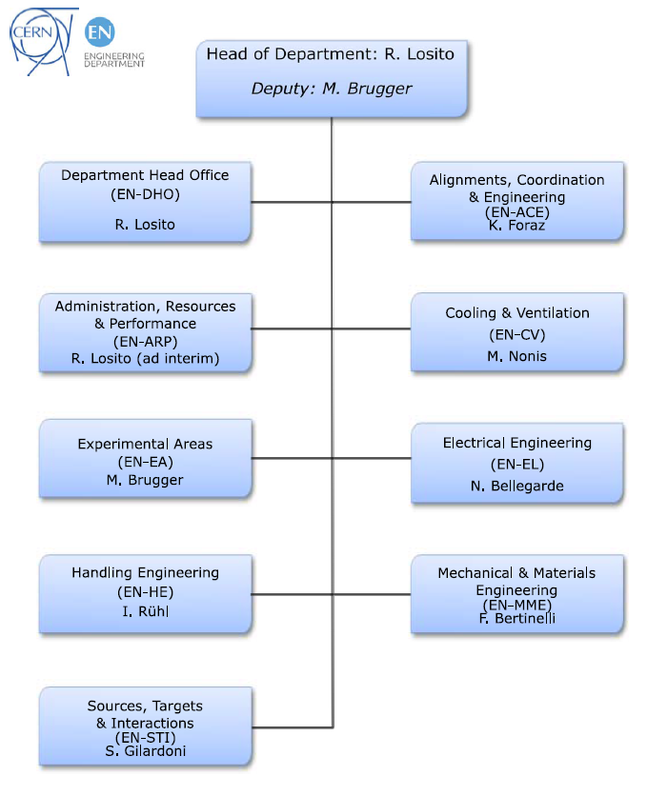
Engineering Dept. Structure
Infrastructures
Engineering
Coordination
Production

Slide 3
EN-MME: Mechanical & Materials Engineering Group
Engineering & Design
Production
Materials & Metrology
Design Office:
  40 designers and engineers
  CATIA / SmarTeam, ANSYS, LS-Dyna...
Experimental Mechanics Lab.
Mechanical workshop (4000 m²):
  50 technicians and engineers
  CNC machining
  Assembly & metal forming
  Welding (TIG, MIG, electron beam, laser, vacuum brazing)
Technical Subcontracting Service
Material science consultancy:
  metallurgical analyses, microscopy, mechanical tests
NDT: US, radiography, tomography
Metrology: 350 m² lab. equipped with CMM.

Slide 4
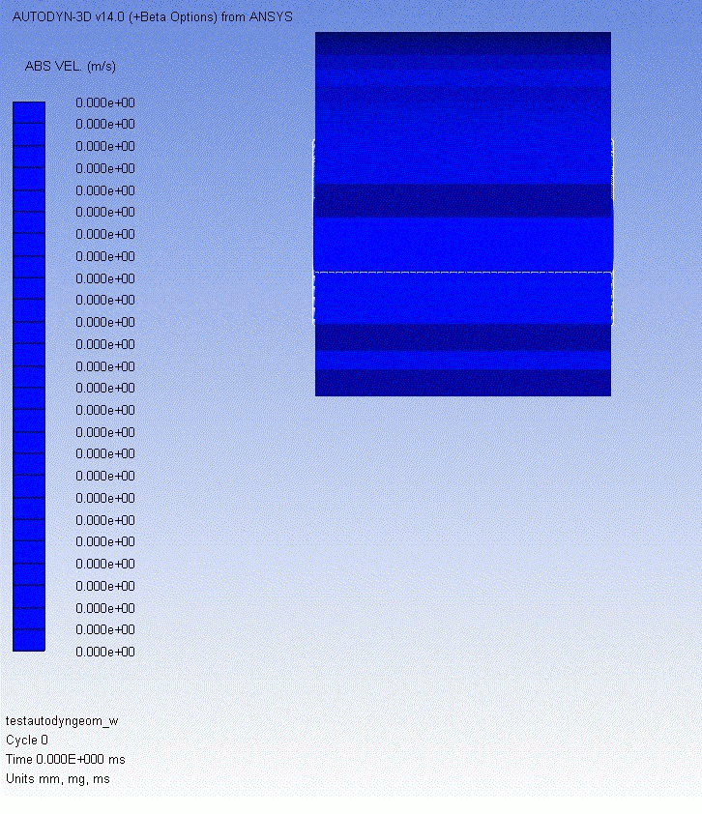

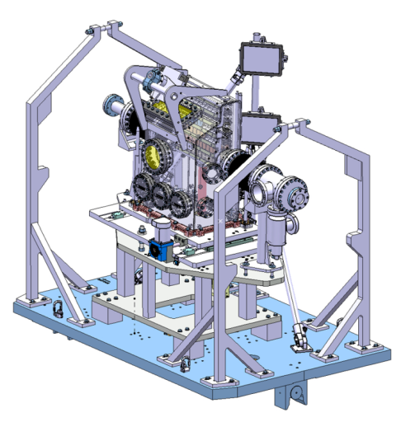
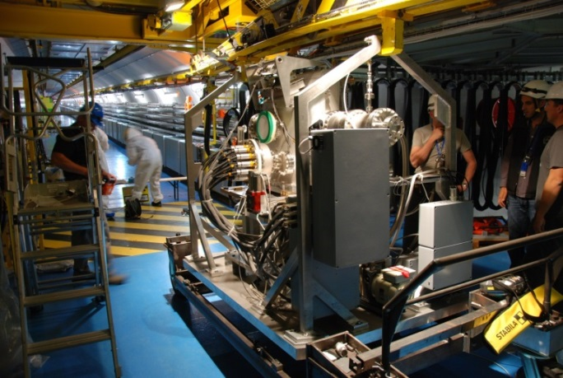
EN-MME Mandate:
The mandate of the MME group is to provide to the CERN community specific engineering solutions combining mechanical design, production facilities and material sciences. This group owns, maintains and develops the 30 years old know-how on the mechanical construction of beam accelerators and physics detectors.
  Particle Beam Impact : comparison between simulation and experiment
Live Acquisition system by Mech. Lab
Beam
F.E. Calcs
Design
Manufacturing

Slide 5
EN-MME: Mechanical & Materials Engineering Group
Engineering & Design
Production
Materials & Metrology
Design Office:
  40 designers and engineers
  CATIA / SmarTeam, ANSYS, LS-Dyna...
Experimental Mechanics Lab.
Mechanical workshop (4000 m²):
  50 technicians and engineers
  CNC machining
  Assembly & metal forming
  Welding (TIG, MIG, electron beam, laser, vacuum brazing)
Technical Subcontracting Service (MME-FS)
Material science consultancy:
  metallurgical analyses, microscopy, mechanical tests
NDT: US, radiography, tomography
Metrology: 350 m² lab. equipped with CMM.

Slide 6
Subcontracting Service:
 | Invoiced Jobs
 | 2011 | 2012 | 2013 | 2014 | 2015
Subcontracting MME-FS (MCHF) | 5.9 | 7.0 | 7.9 | 9.0 | 8.2
~2000 contracts/year in close collaboration with FP Dept.
Quota represents ~ 40% of overall production for mechanical components @ CERN
Subcontracting:
  ~ 35% of semi-finished parts
  ~ 65% of finished / turnkey components

Slide 7
MME Subcontracting Service:
Core & recent activities Europe wide
Notes:
Recent production from DK

Slide 8
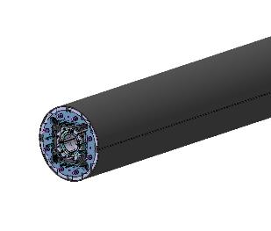
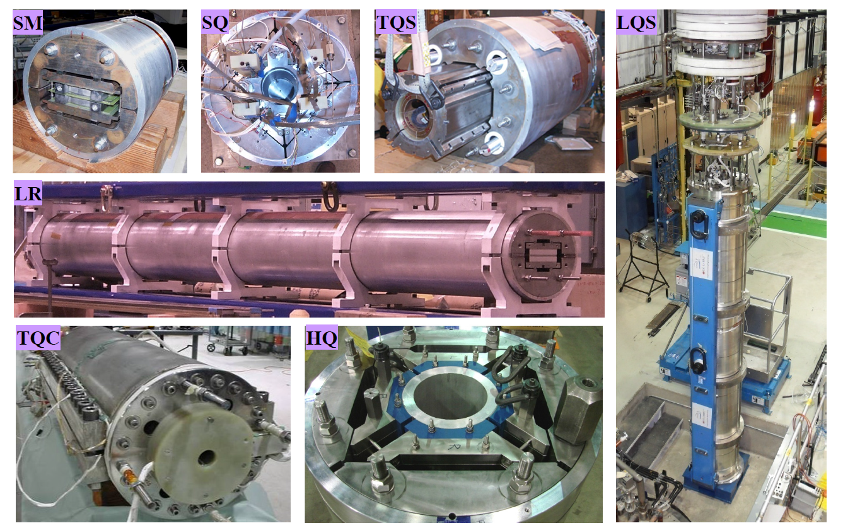
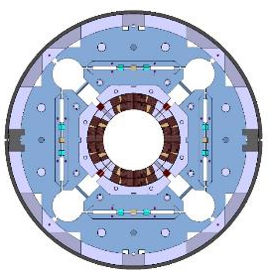
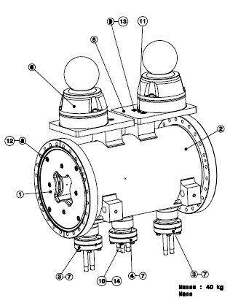
Magnets
L = 7m
MQXF
Magnet
Superconducting
ELENA – Series production of electrostatic quadrupoles (x60).
Synergy between EN-MME Workshop
and NO-RS suppliers.
Prototypes & small series of different magnets
High precision CNC of small to large equipment
Stamping, wire cut of laminations
Cryostats

Slide 9
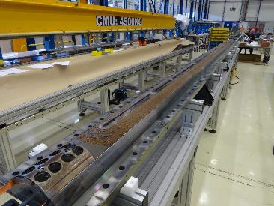
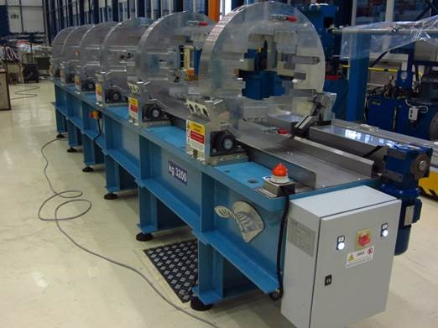
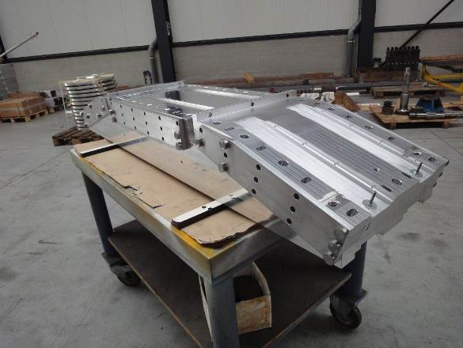
SC Magnets: Tools
MQXF
Large Precise Tools for Magnet assembly
Rotating Table or SC magnets assembly
FRESCA: Magnet impregnation tool.
(BE Supplier)
Notes:
Recent production from DK

Slide 10
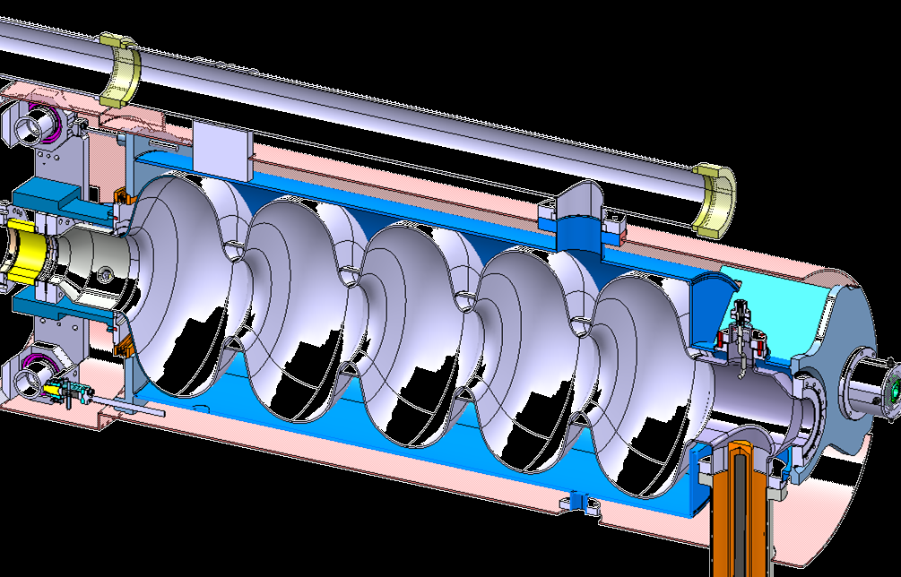
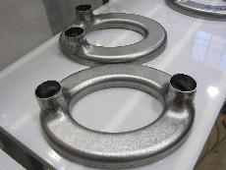
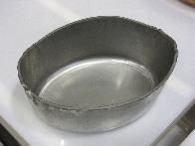
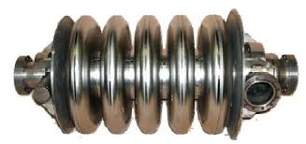
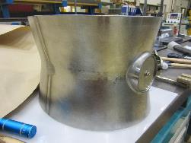
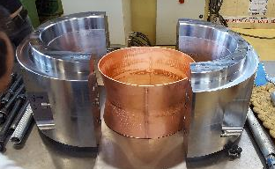
Superconducting RF Cavities
Forming of Niobium Sheets
Precision and surface quality of utmost importance for cavity performance
500mm
SPL Cavity
..Spinning..
CRAB Cavity
..Punching, extrusion, deep drawing by MME..
Precise Tools

Slide 11
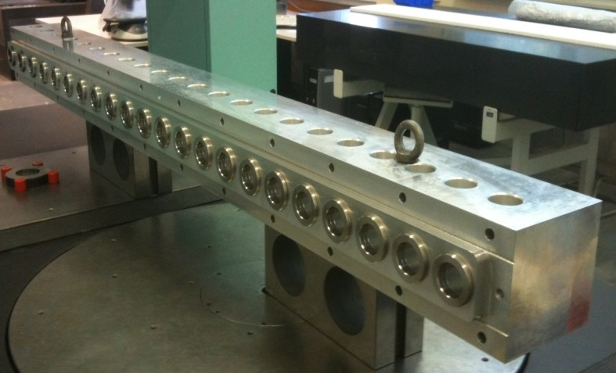
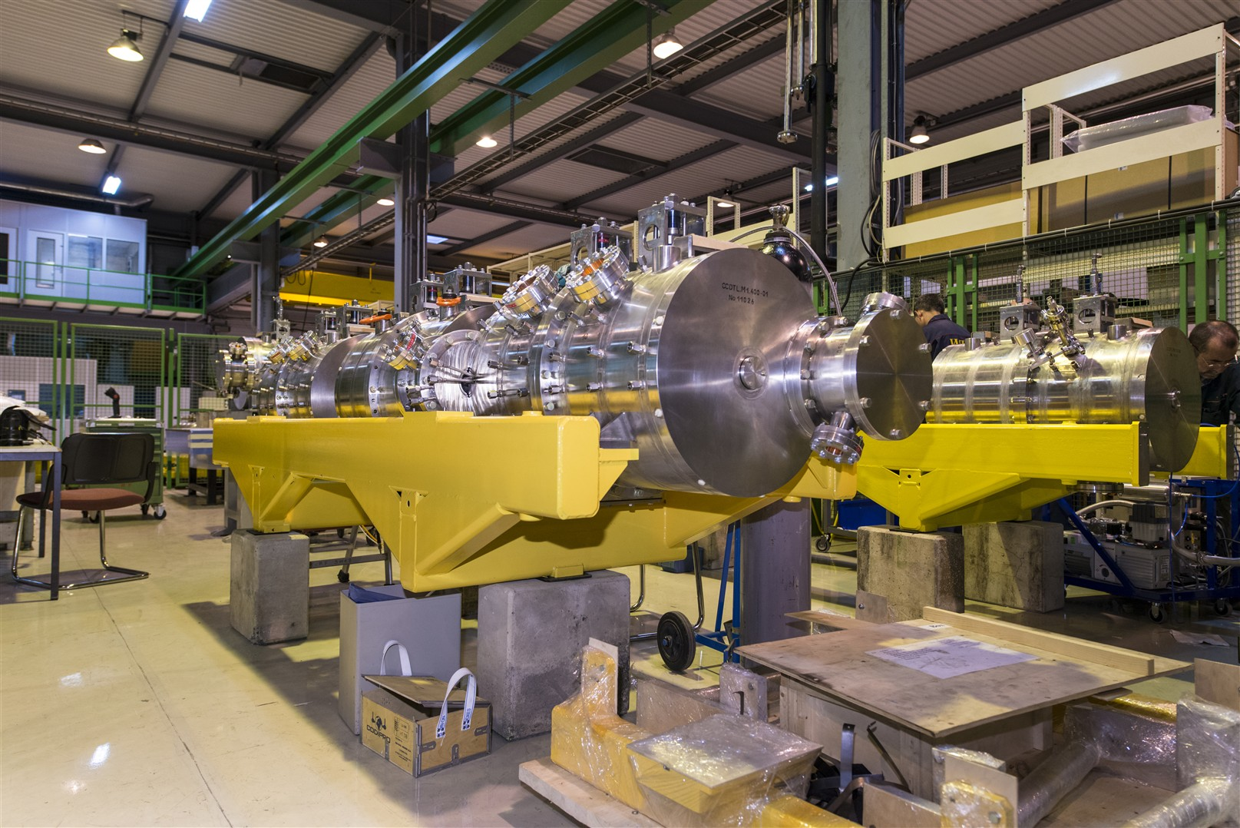
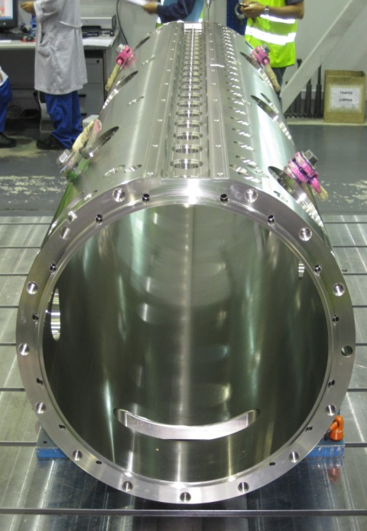
Warm RF Cavities
First DTL girder
Precise Machining of Large Equipment
First full scale DTL
tank segment (~2 m)

Slide 12
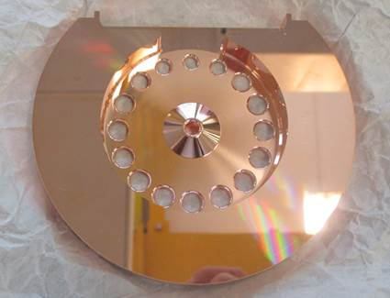
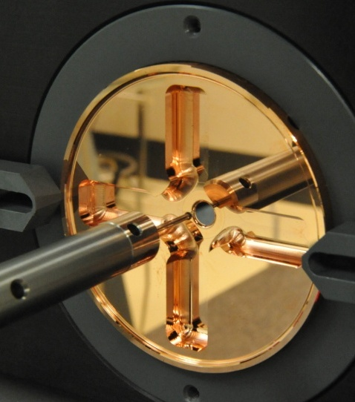
Ultra precise machining
The design involves coupled RF cavities to transfer energy from a high-current, low-energy drive beam to a low-current, high-energy beam to be used in collisions.
RF in
RF out
Ultra Precise machining of RF cells for R&D on future Medical Accelerators
Notes:
UP machining

Slide 13
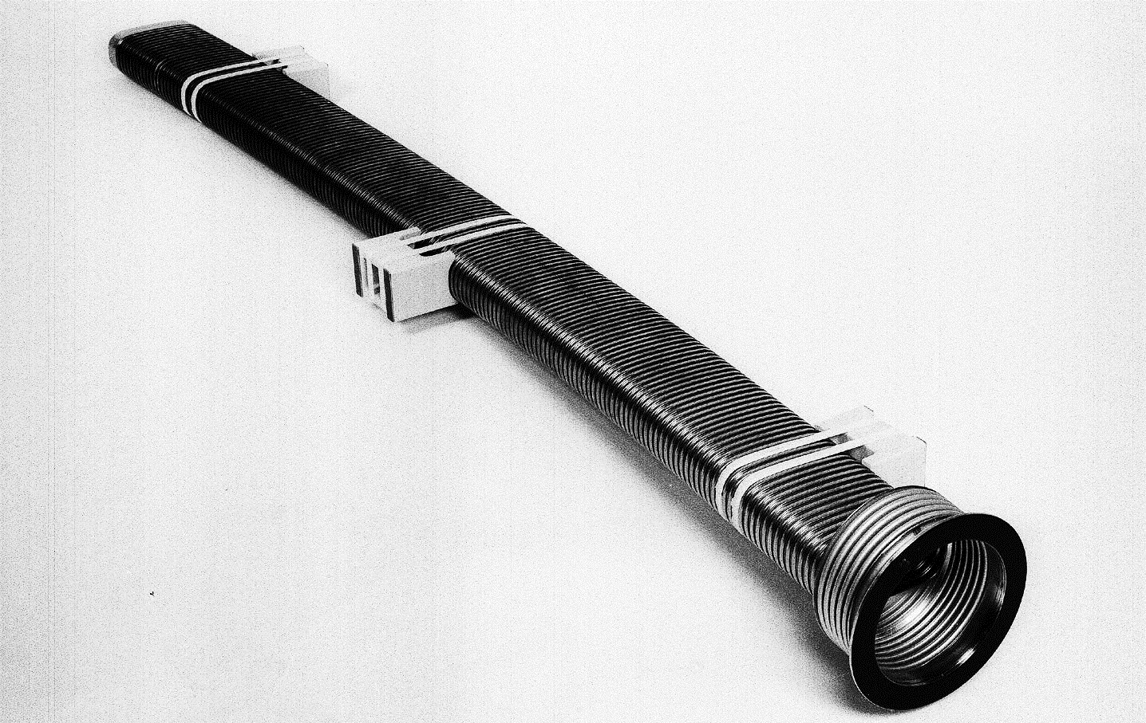
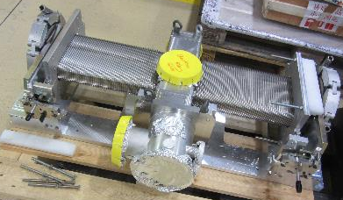
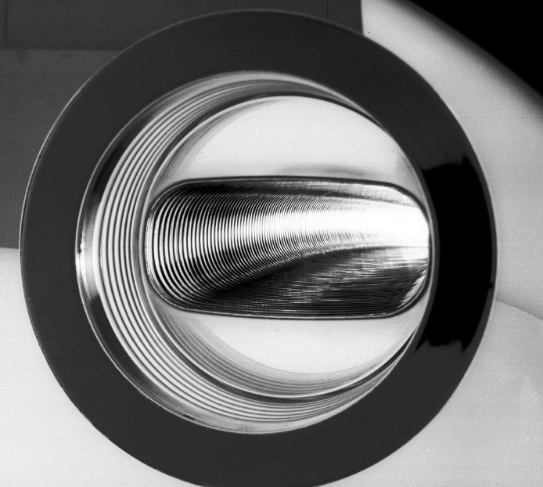
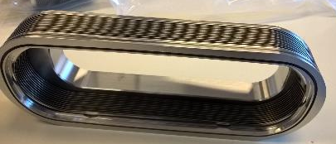
Vacuum Chambers
Precise Shaping of Inconel & SS alloys into chambers of different sizes
UHV Compliant Manufacturing
~ 2 mt.
PSB Ring
~ 0.5 mt.
PSB Injection
Hippodrome Edge welded bellows

Slide 14
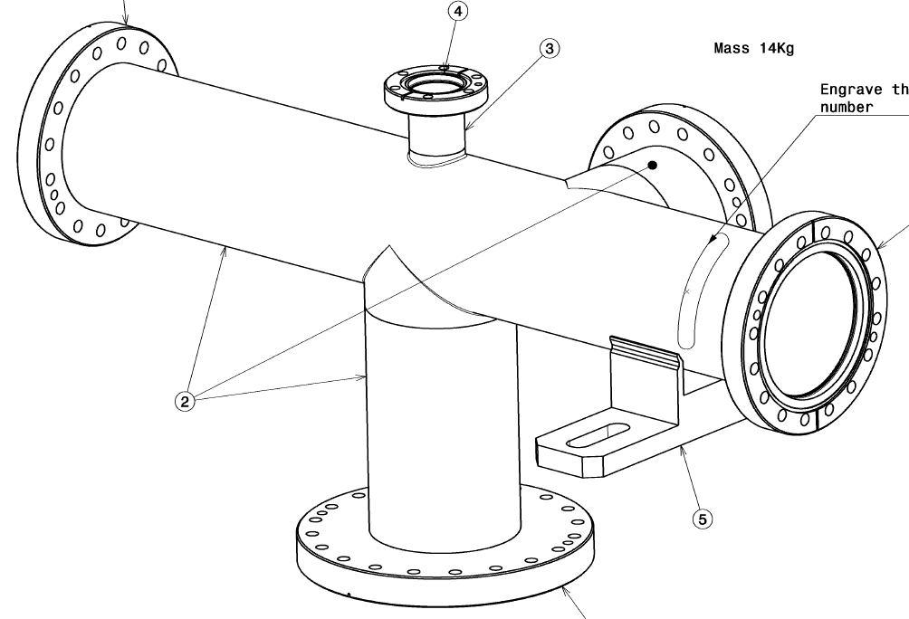
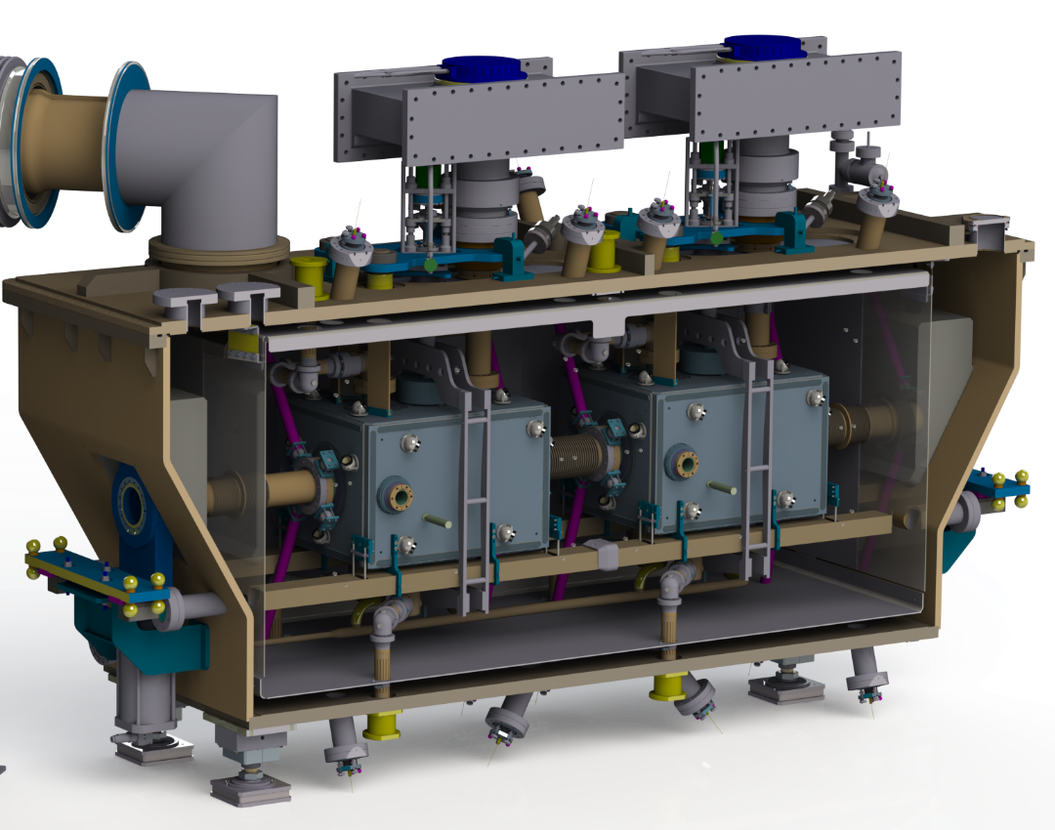
Vacuum Chambers
Shaping / Extrusion / Welding of UHV
Stainless steel Chambers & Vessels
Crab Cavity Cryo Vessel
L =

Slide 15
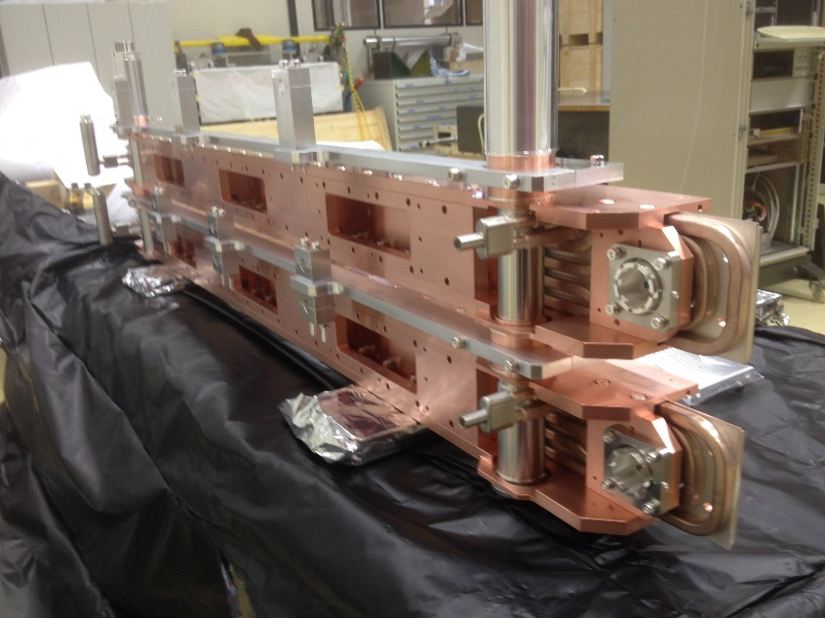
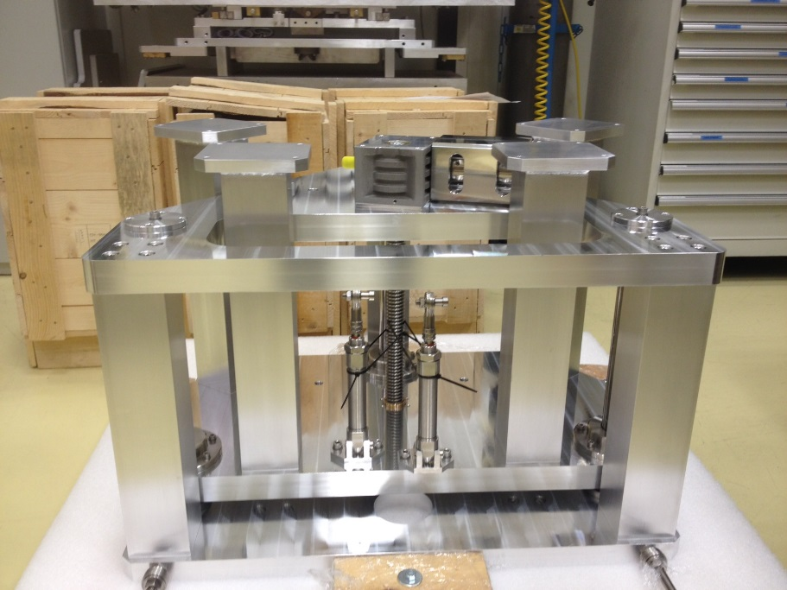
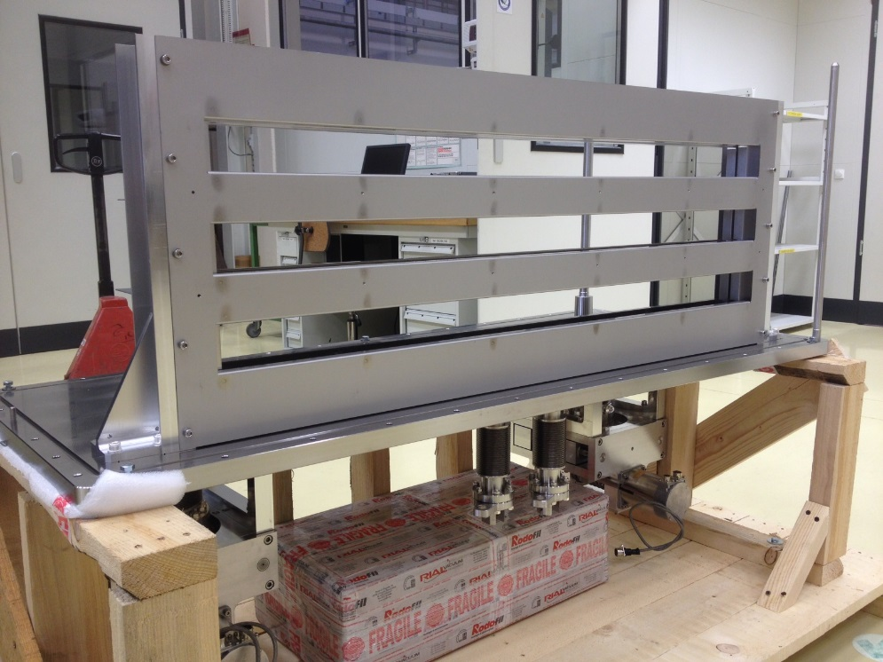
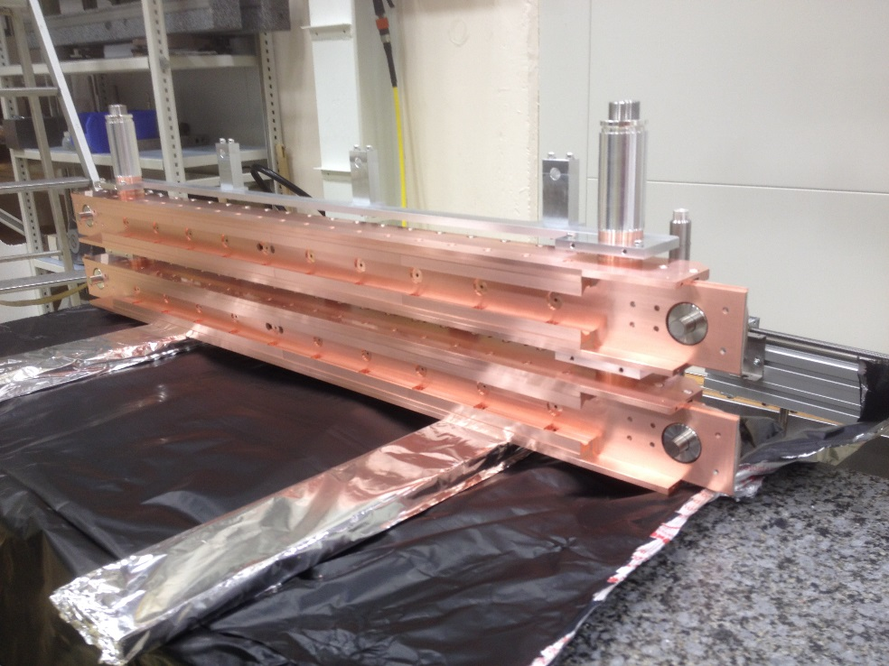
Collimators:
New HiRadMat Experiment for future HL-LHC Collimators
Notes:
Recent production from DK

Slide 16
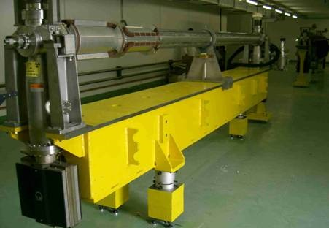
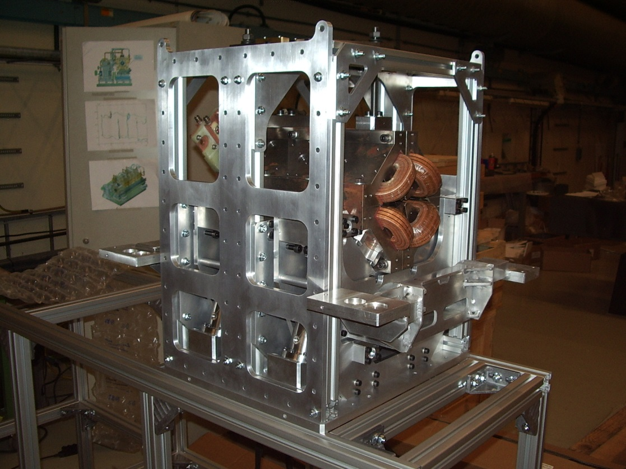
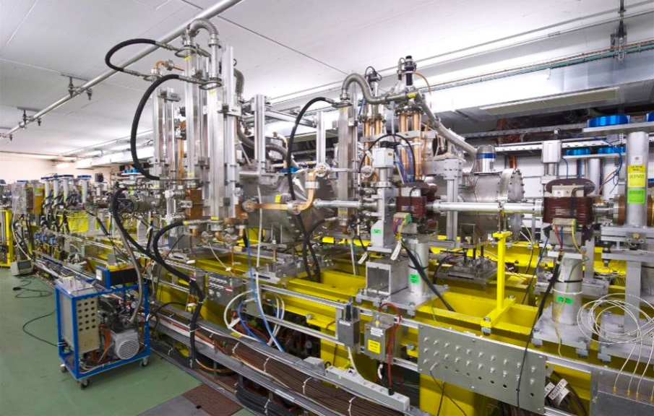
Beam Lines & Positioning Systems
Alignment for small particle detector

Slide 17
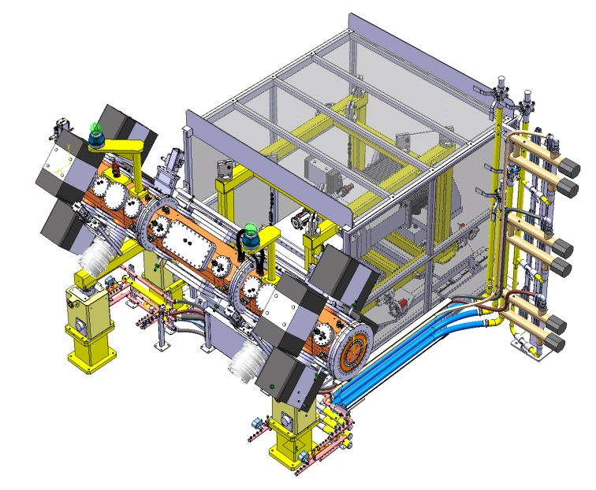
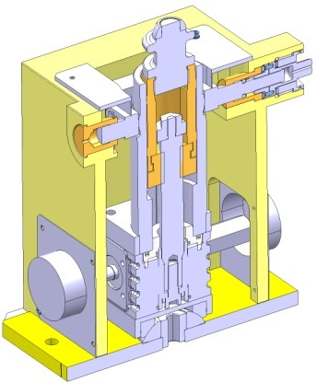
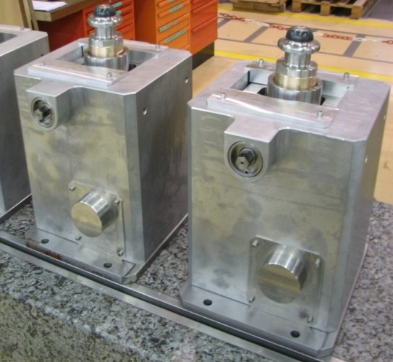
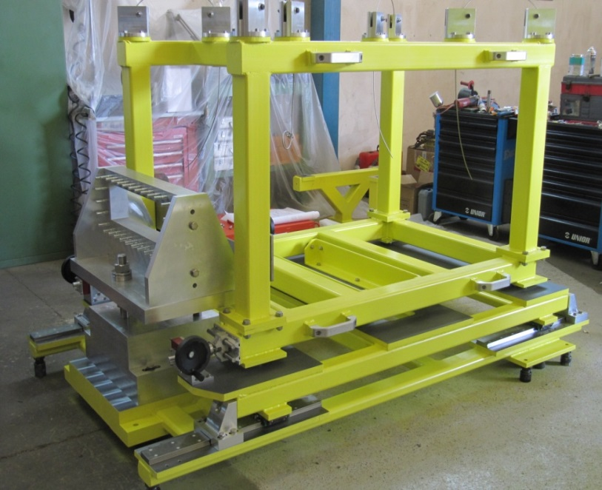
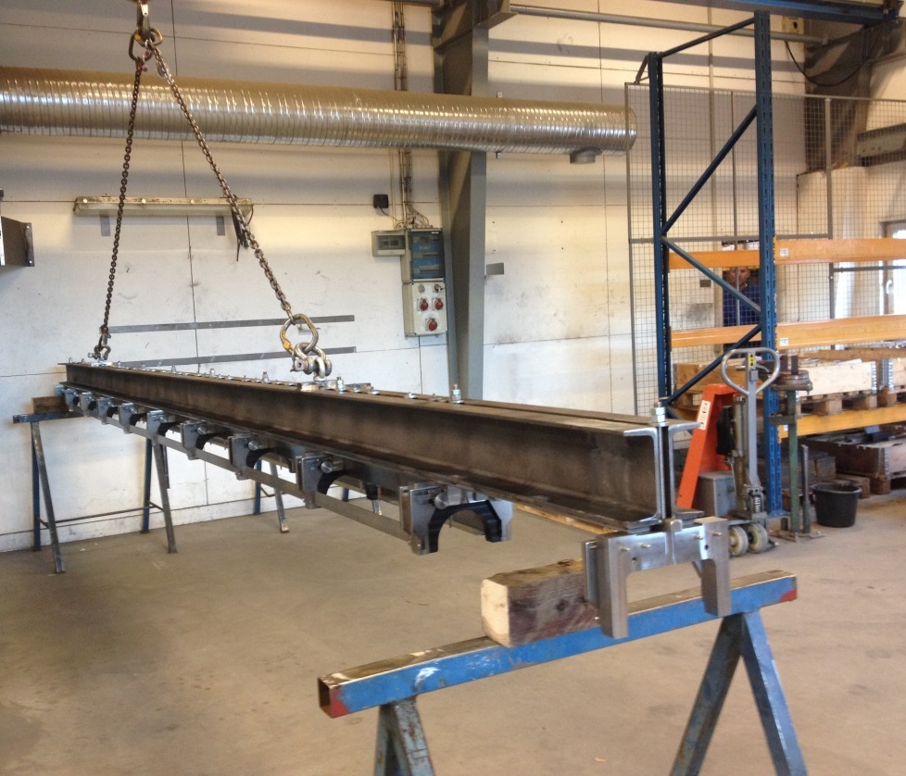
Transport & Support Systems
RFQ detailed assembly including ridge-line support
and cooling distribution
Linac 4 jacks
Lifting tool for magnets
Notes:
Exemples of recent fabrications performed via subcontracting Europewise

Slide 18
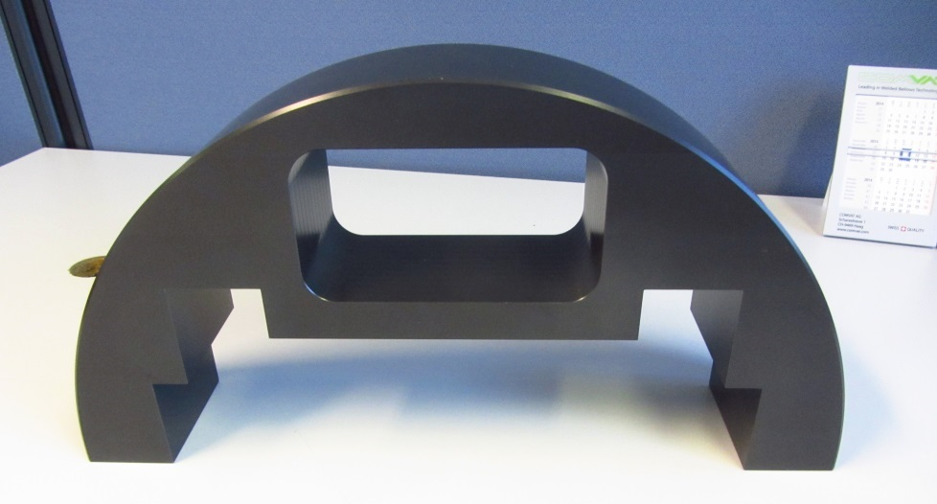
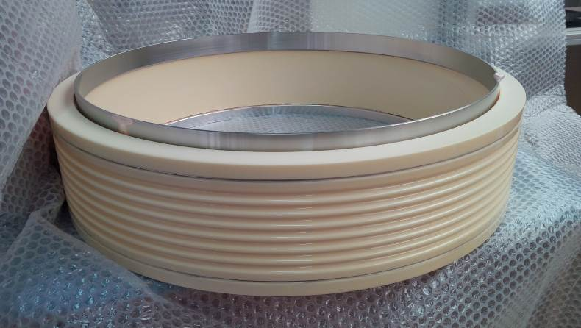
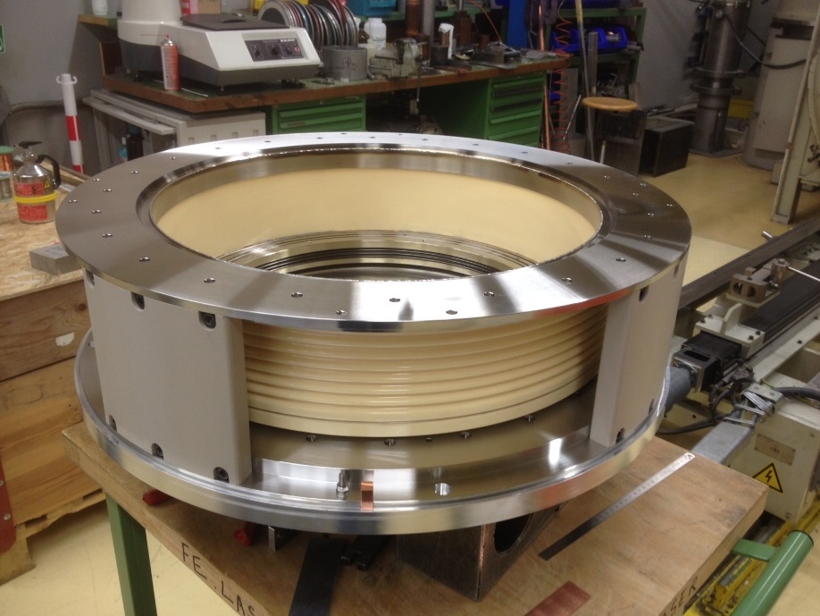
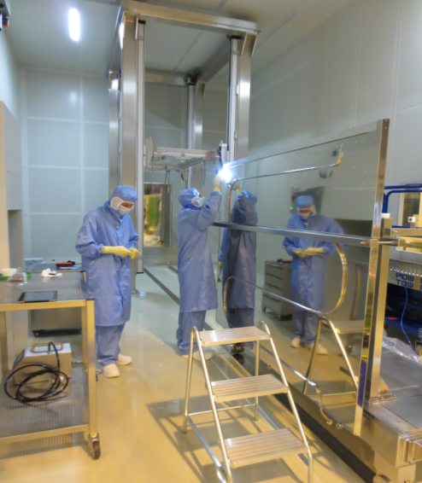
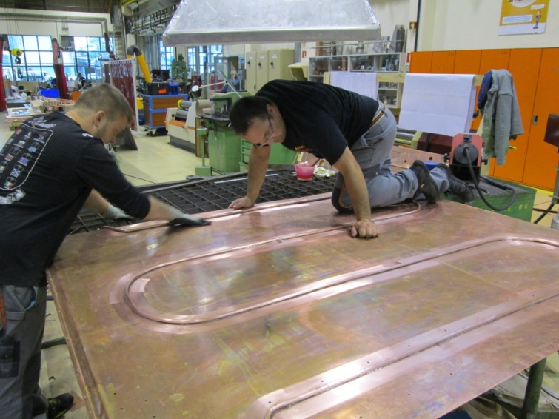
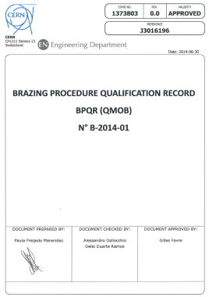
MME Subcontracting Service: recent activities Europe wide
Linac4 H- Source Insulator
Brazing by EN-MME
HIE-ISOLDE Thermal Shield.
Produced by EN-MME (Design TE-MSC).
Ni-Plating in collaboration with FR firm
Notes:
Exemples of recent fabrications performed via subcontracting Europewise

Slide 19
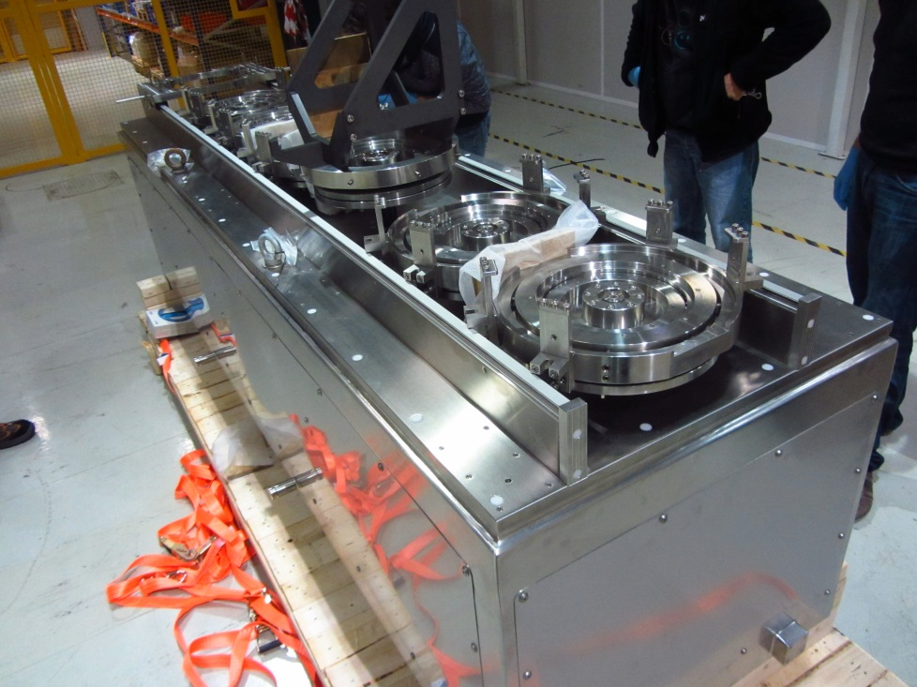
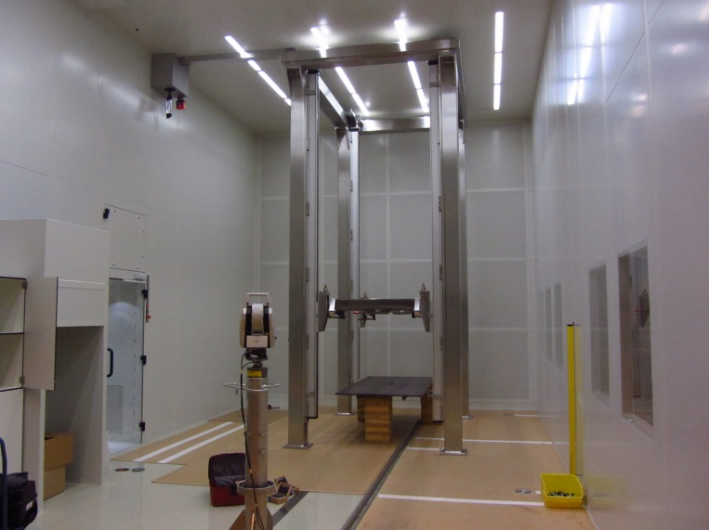
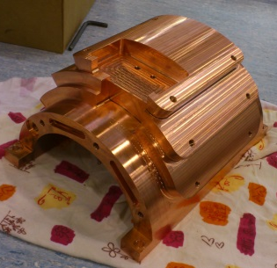
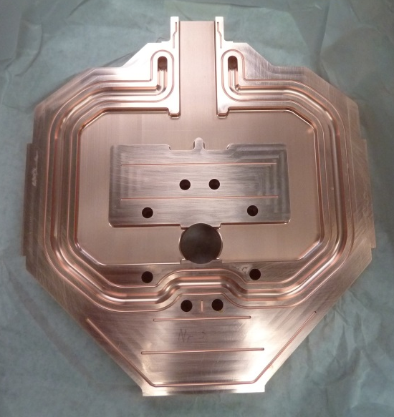
MME Subcontracting Service: recent activities Europe wide
Large trolley for HIE-ISOLDE RF cavities installation into the clean room
High precision copper machining
Large structure for clean room (HIE-ISOLDE project)
Notes:
Recent production from DK

Slide 20



MME Subcontracting Service: recent activities Europe wide
RF Pulse Compressor on Cu OFE 3D forged
Notes:
Recent production from DK

Slide 21



MME Subcontracting Service: recent activities Europe wide
Beam Instrument
High-precision machining of 316LN
LINAC4 Beam Instrumentation tank
Notes:
Recent production from DK

Slide 22

MME Subcontracting Service: what kind of skills are we looking for?
Machining
High precision machining on large/very large components (Steel, Stainless steel, Al, Cu Alloys, Ti, W, Mo, Nb…)
Ultra precise machining on small/medium size components (Stainless steel, Cu Alloys, Al,)
Production and machining of ceramics and plastics (small, medium, large size)
EDM (wire erosion): all technologies providing precise tolerances and complex shapes.
Welding/Brazing
TIG/MIG Welding of stainless steel (316, 316L/LN, 304) Welding of aluminium Welding of Cu/Brass and Cu Allloys Welding of Titanium
Laser welding
Electron beam welding
Explosion bonding
Soldering
Vacuum brazing
Various
Additive Manufacturing (especially with metals)
Thermal treatment (large components)
Surface treatments (cleaning, UHV cleaning, Ni coating, Si coating, Cu coating, anodization…)
Die forming (casting)
Pressure vessels: (construction, EU machine directive)
Lifting equipment : customized lifting equipment (calculation, detailed design, construction, CE certificate)
Metal Forming
Forging: particularly customized forged pieces (Stainless steel 316LN, Cu alloys, Al alloys…)
Extrusion
Casting (Iron and Aluminum)
Spin forming (Al, Cu, SS, Nb)
Punching, Fine Blanking, Deep Drawing

Slide 23
Thank you for your attention

Slide 24

MME Subcontracting Service: recent activities Europe wide
Notes:
Recent production from DK

Slide 25
Back-up Slides

Slide 26
CERN Procurement Guidelines
Requests up to 1 kCHF | 1 bid by Technical Officer Purchase Requisition (DAI)
Requests between 1 and 5 kCHF | 1 written bid by Technical Officer Purchase Requisition (DAI) Validated by Procurement Officer
Requests between 5 and 10 kCHF | Price enquiry by Technical Officer or Procurement Officer Minimum of 3 bids requested Purchase Requisition (DAI) made to the lowest compliant bidder
Requests between 10 and 50 kCHF | Technical specification provided by Technical Officer Price enquiry made by Procurement Officer 3 to 5 bids requested Purchase Requisition (DAI) made to the lowest compliant bidder
Requests between 50 and 200 kCHF | Departmental Request Price enquiry by Procurement Officer 3 to 5 bids requested Purchase Requisition (DAI) made to the lowest compliant bidder
Requests between 200 and 750 kCHF | Departmental Request Market Survey followed by Invitation to Tender
Requests above 750 kCHF | Departmental Request Market Survey followed by Invitation to Tender Finance Committee approval
A. Dallocchio - 11/06/2015

Slide 27





MME Workshop
A. Dallocchio - 11/06/2015

Slide 28




MME Metrology
CONTACT PROBE MACHINE
  Ferranti
  Olivetti
  Leitz Infinity
OPTICAL PROBE MACHINE
  Wegu
  Mahr
PORTABLE 3D MEASURING ARM
  Romer
ROUGHNESS – TOPOGRAPHY – PROFILE
  MITUTOYO SJ 301 (Portable)
  MITUTOYO FORMTRACER SV-C3100 H4
NON-CONTACT INTERFEROMETRY
  VEECO NT 3300
OTHER MEASURES
  Linear measurements, straightness, flatness, squareness, …
PROFILE PROJECTOR
  BATY R770
A. Dallocchio - 11/06/2015

Slide 29

Metrology: Infinity
Measuring Range
10.12.7 | 1200 x 1000 x 700 mm³
Accuracy (according to ISO 10360)
MPE E MPE P MPE THP | 0.3 + L/1000 µm 0.4 µm 1.2 µm / 59s
Some References
Modus, USA Sandia, USA Nano Precision Products, USA Bosch, Germany
Metrologic Principle:
“Closed frame - moving table”
A. Dallocchio - 11/06/2015

Slide 30




MME Metallurgy
Scanning Electron Microscopy
LEICA STEREOSCAN 360
LEO (Zeiss) 430
Optical Microscopy
LEICA Q600 (Quantimet) Image Processing
LEICA MZ 16 Stereomicroscope
Mechanical Testing
UTS 200, Tensile Testing at room temp.
UTS 200, Tensile Testing at 1.9 K.
Macro Hardness testing
Micro hardness testing
Siemens D-5000 X-RayDiffractometer
Non-destructive Testing
Ultrasonic Test (USIP)
USN60
USOUND (immersion)
Radiography
Ultrasonic swinger device
A. Dallocchio - 11/06/2015

