Slide 1
CERN Site Engineering
-
Opportunità nell’ingegneria civile al CERN
Dr. Ing. Luigi Scibile
Head of the Site Engineering Group
Site Management and Buildings Department
GENEVA 30th September 2016

Slide 2
CERN/SMB-SE – Civil engineering
Introduction
Existing CERN Infrastructure and brief history
Scope of work
Organization: Services and projects.
Site planning and development
Examples of planned projects
Opportunities at CERN for Consultancy firms & Contractors

Slide 3
Existing CERN Infrastructure and brief history
CERN/SMB-SE – Civil engineering

Slide 4
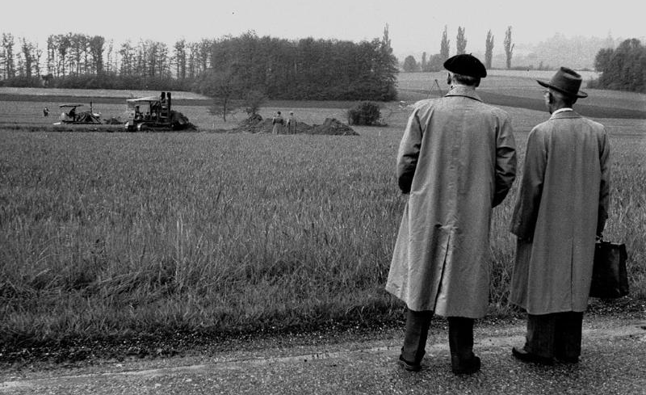
1954 – Day 1

Slide 5
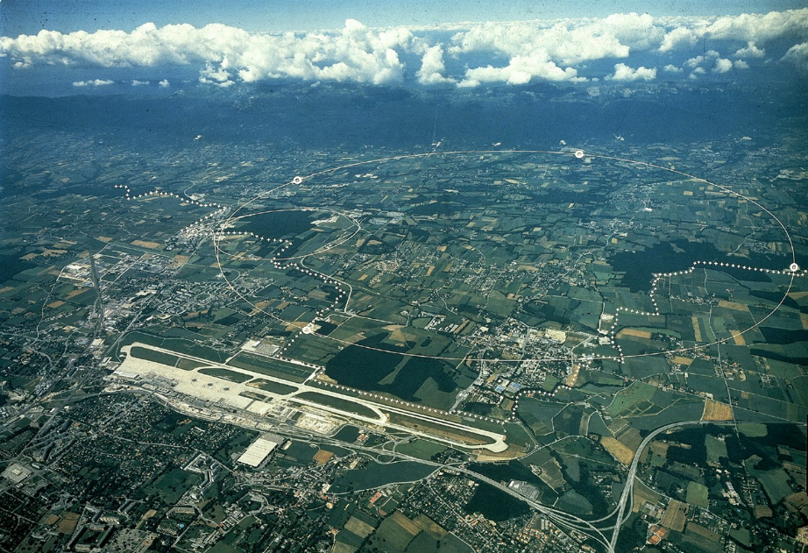
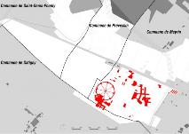
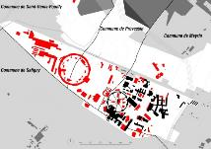
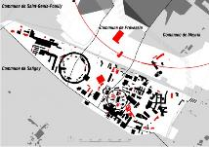
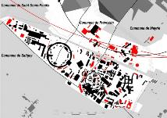
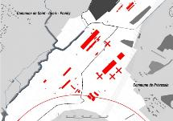
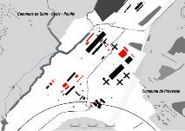
Two sites with a story
MEYRIN
1950-60
1960-75
1975-85
1985-10
PREVESSIN
1970-80
1980-10

Slide 6
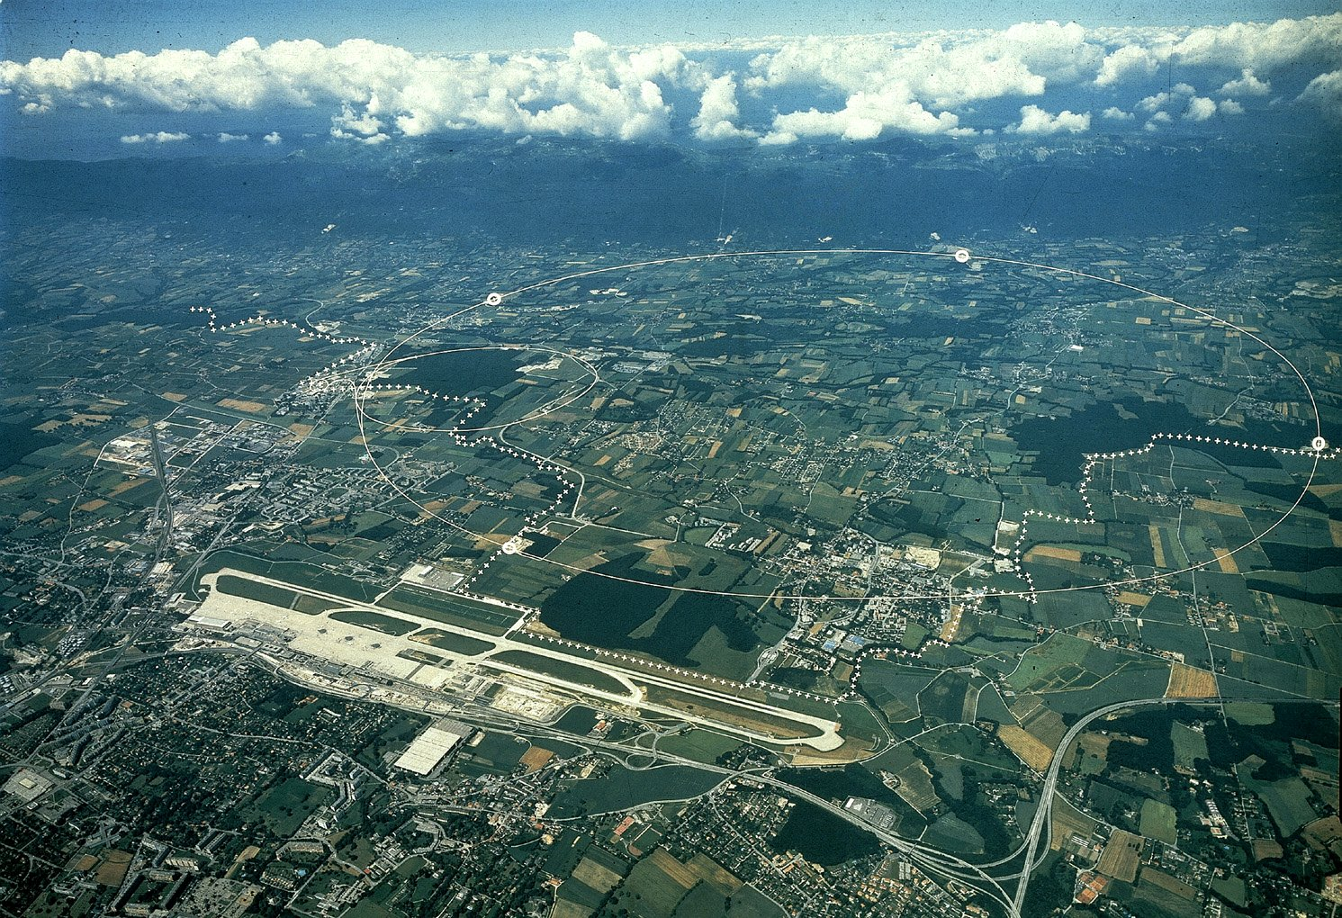
CERN Area
Prévessin (FR) Campus
Meyrin (CH) Campus
(it extensds in French
LHC
Border
Geneva Airport

Slide 7
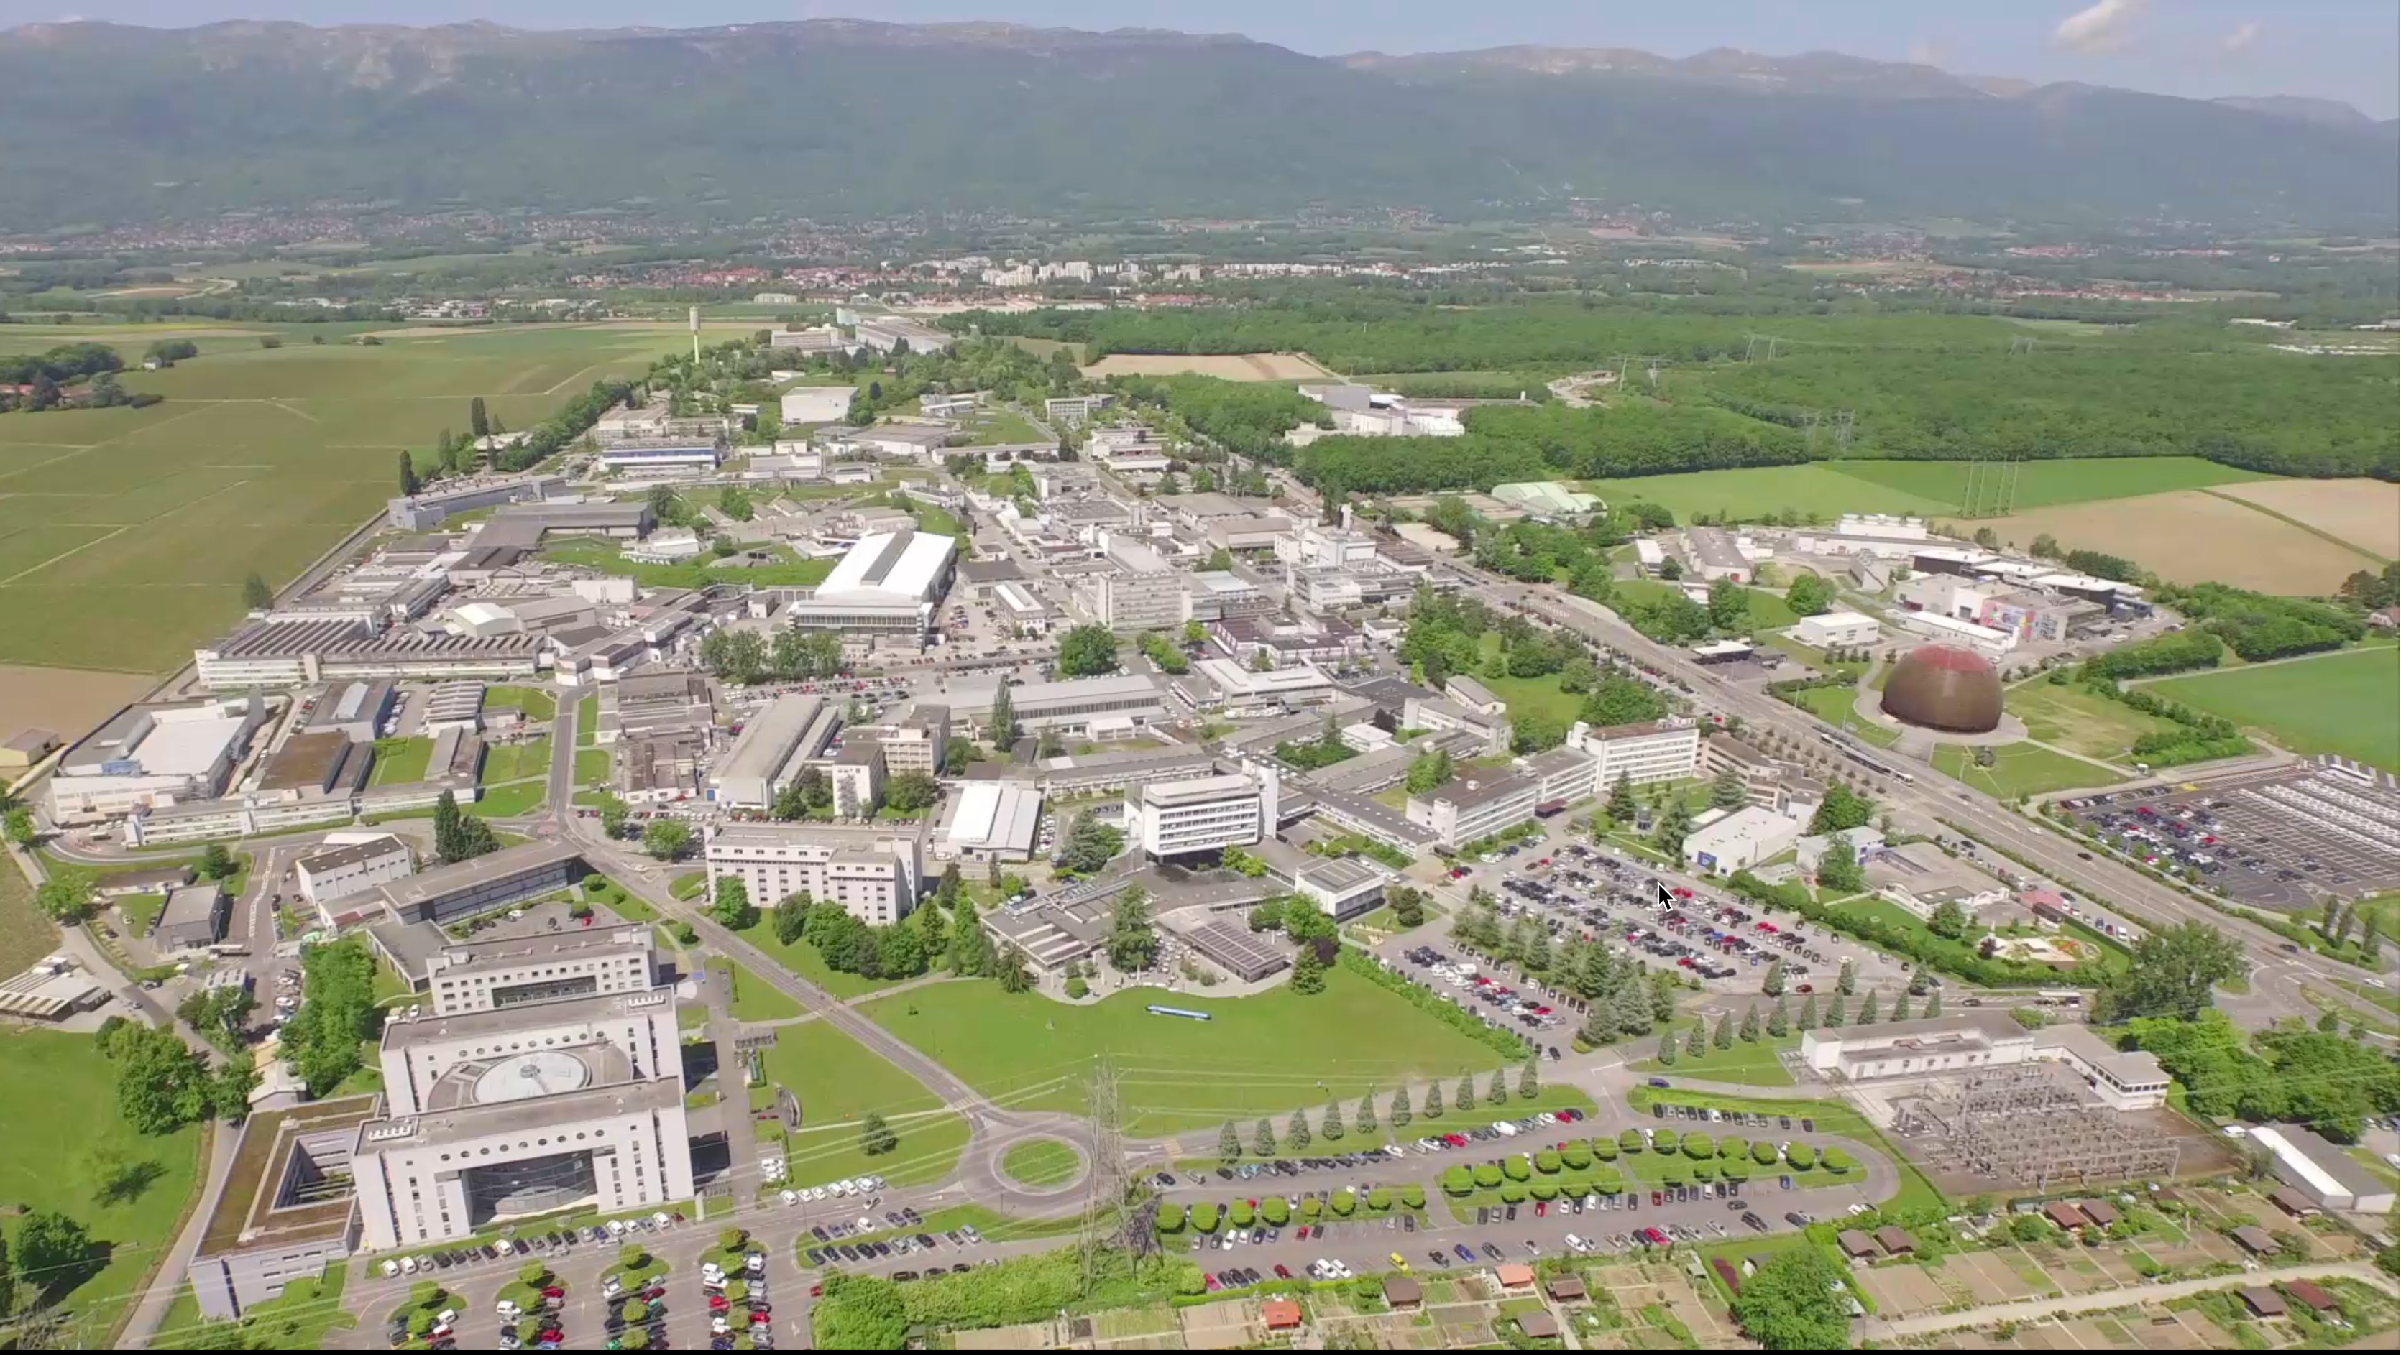
Meyrin Site

Slide 8
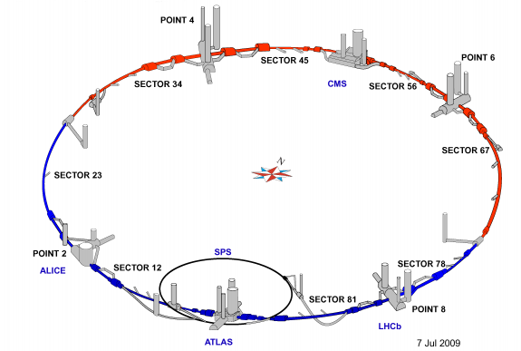
Current underground infrastructure
Tunnels:
27 km long
100 m approx. below grade
̴ 60km total length of tunnels

Slide 9
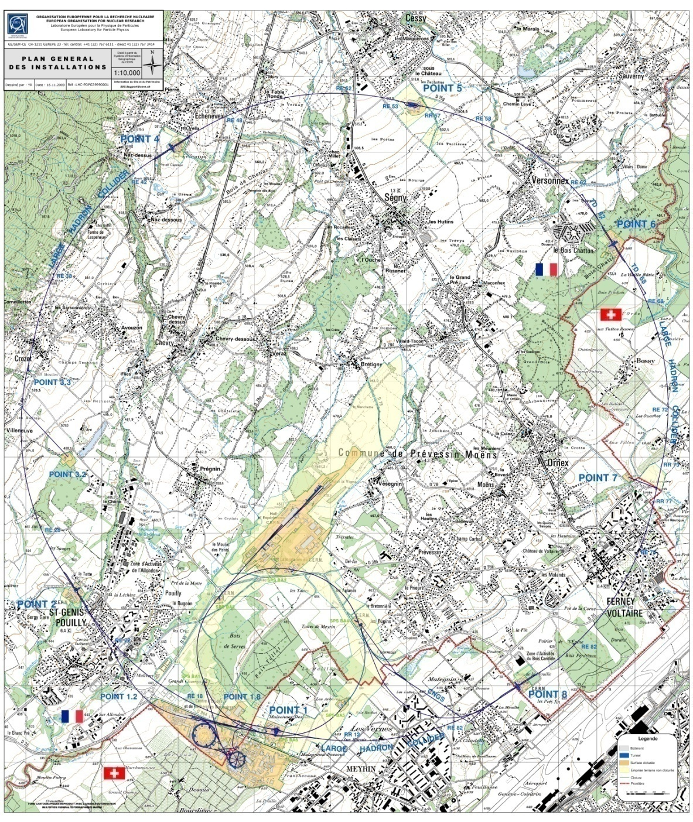
Overall key figures
GENERAL LAYOUT
Two main sites :
Meyrin (CH-FR) : 80 hect.
Prévessin (FR) : 83 hect
15 satellite sites
Number of buildings : ̴ 674
10m² up to 20.000m² , 425,000 m² of surface
60% of the buildings are 30+ years old
Tunnel lengths : ̴ 60 km
30 km of roads
1000 km of buried services
Total CERN fenced territory : 208 hect.
Total CERN unfenced territory : 418 hect
  fenced territory - CH: 51 hect.
  unfenced territory - CH : 59 hect.
  fenced territory - F : 157 hect.
  unfenced territory - F: 359 hect.
494 hostel rooms in Meyrin Site
̴ 2300 Staff
̴ 700 Fellows and Paid Assoc.
̴ 10’000 Users
----------------------------------------------
9’500 people every day at CERN
CONFINDUSTRIA, Geneva 30.09.2016, L. Scibile, EDMS: 1702197

Slide 10
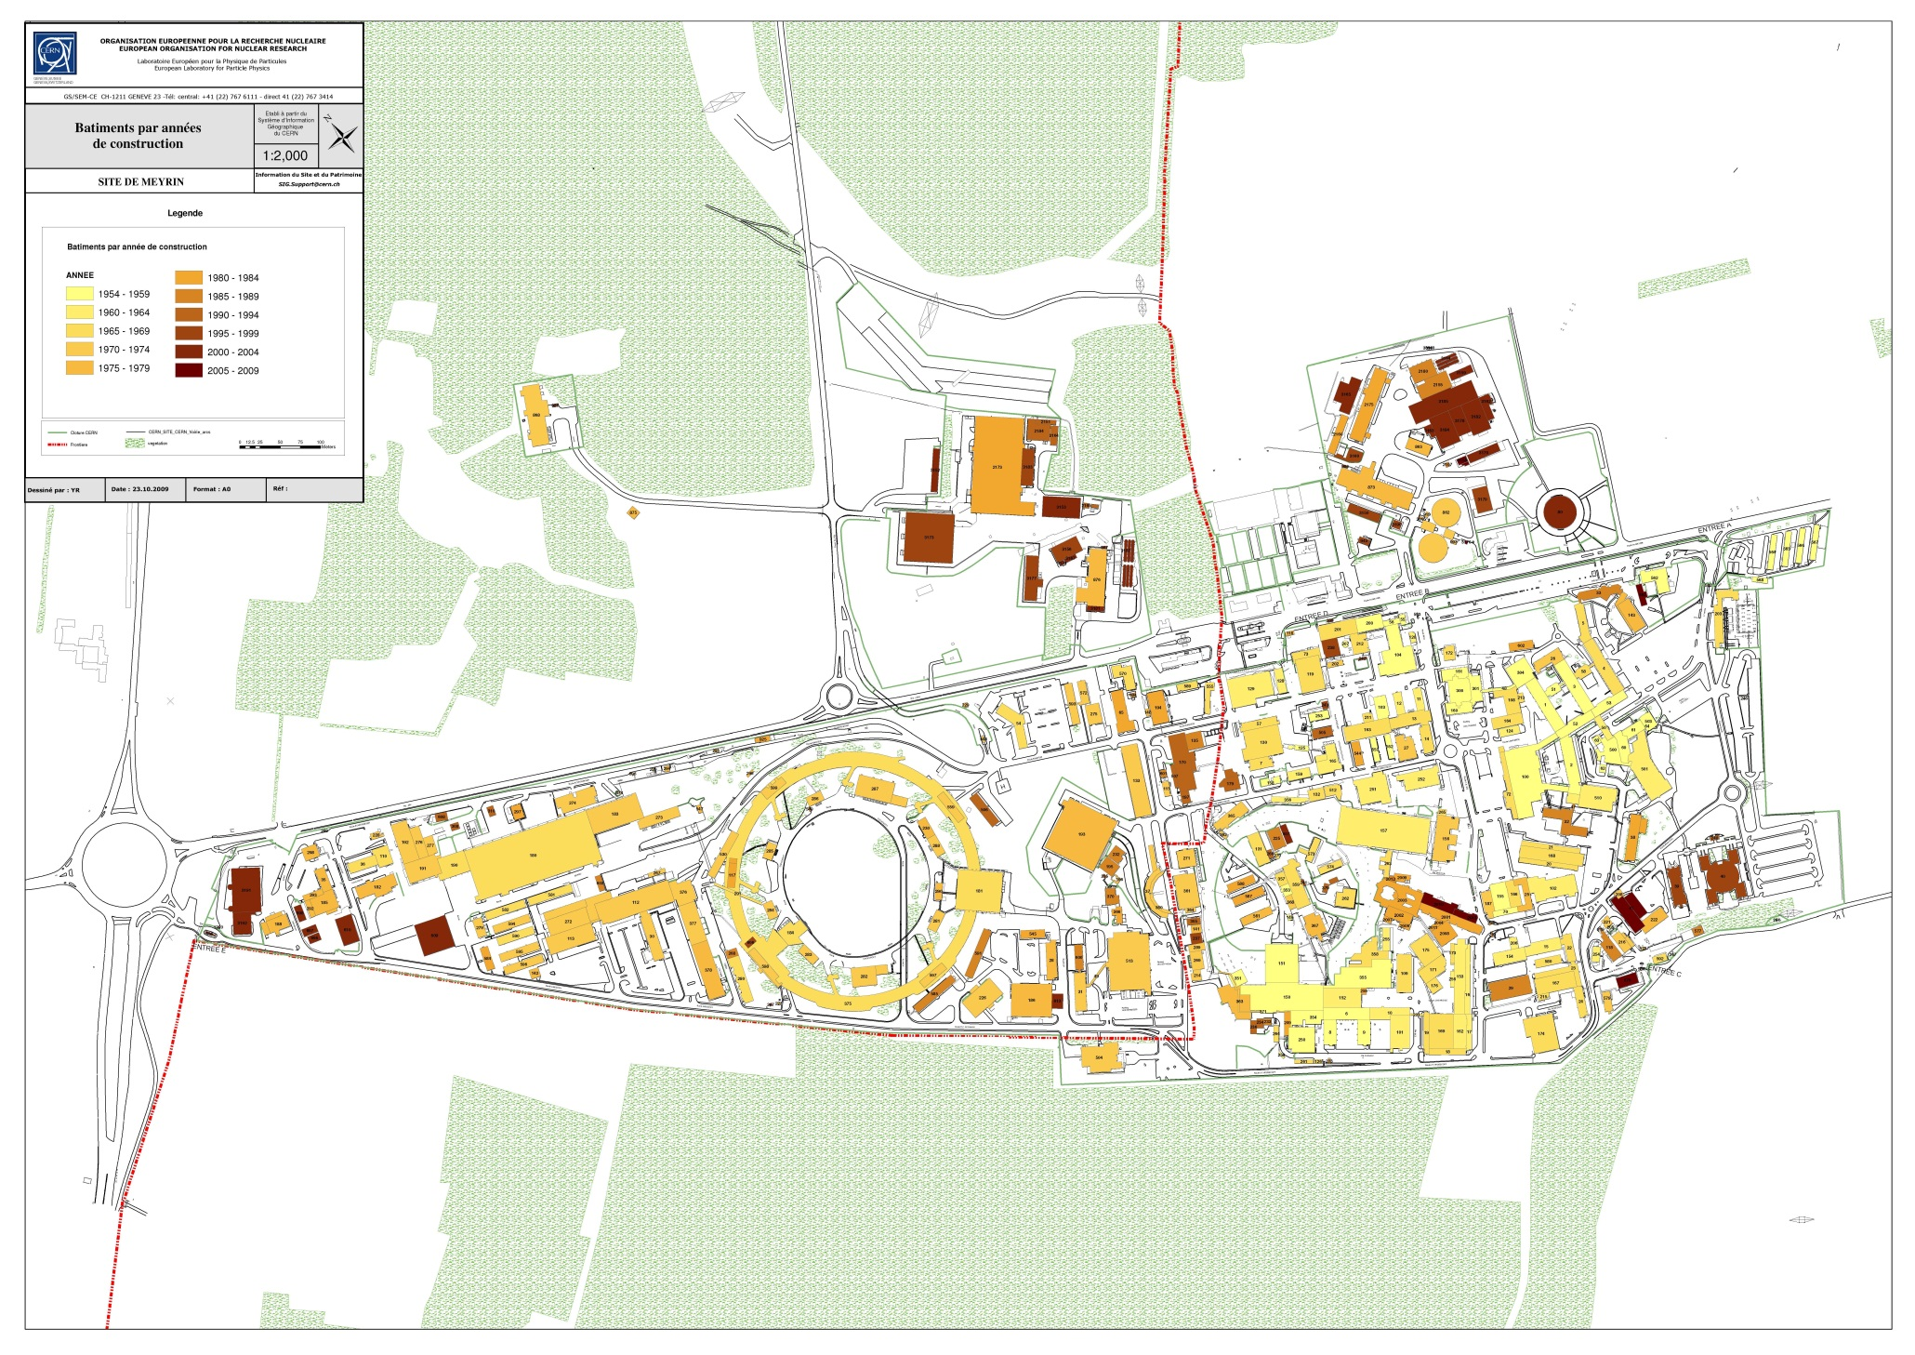
CERN – Meyrin Layout (surface buildings)
Age of buildings
FRANCE
SWISS
CONFINDUSTRIA, Geneva 30.09.2016, L. Scibile, EDMS: 1702197

Slide 11
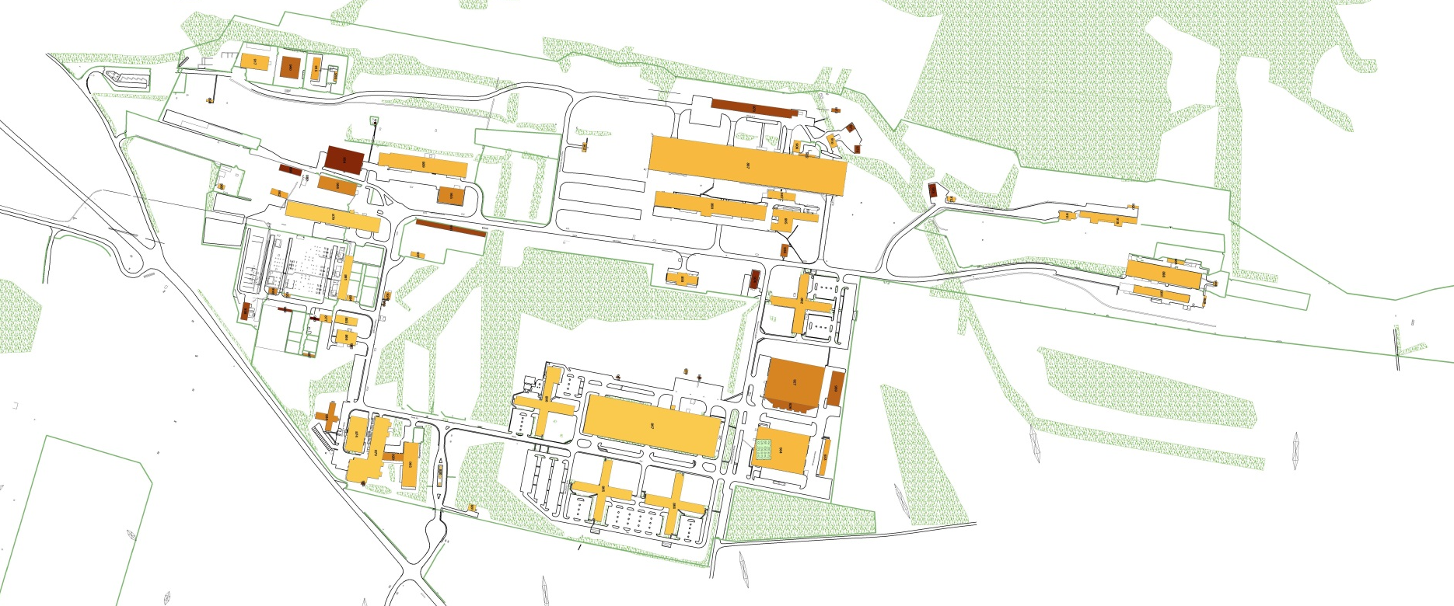

CERN – Prévessin Layout (surface buildings)
Age of buildings
FRANCE
CONFINDUSTRIA, Geneva 30.09.2016, L. Scibile, EDMS: 1702197

Slide 12
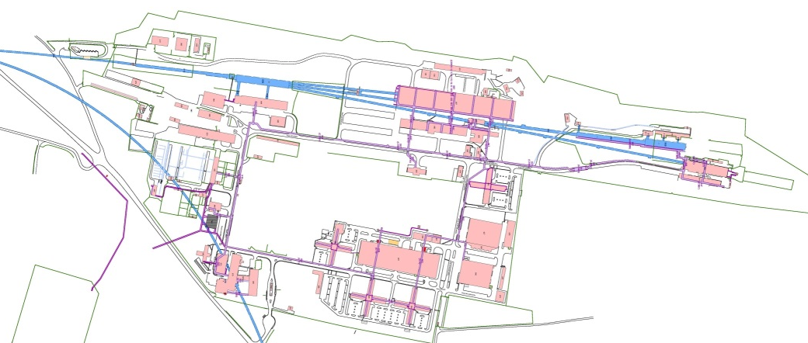
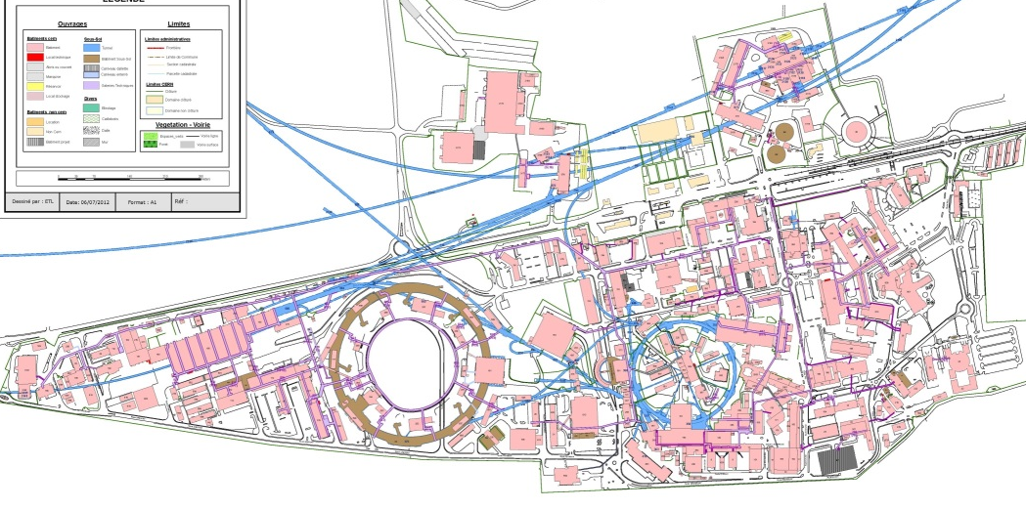
CERN – Meyrin and Prévessin Layout
(with tunnels and galleries) – Explaining the “chaotic” development of the sites
CONFINDUSTRIA, Geneva 30.09.2016, L. Scibile, EDMS: 1702197

Slide 13
Site Engineering Group
The Site Engineering Group is responsible for :
  Design of all new buildings & civil engineering structures on CERN Site. Feasibility studies more often done in-house with outsourced consultancy services for more detailed design.
  Project Management for execution (with Consultants for larger projects)
  Maintenance of all buildings and underground structures
  Renovation Works
  HVAC & Electrical installation and maintenance for ‘tertiary’ buildings
  Patrimony data management
Group consists of approximately :
  10 engineers/architects
  10 draughtsman/designers
  25 technicians
Annual Group Budget approximately
  50+MCHF for Projects & Operation / Renovation Works
CONFINDUSTRIA, Geneva 30.09.2016, L. Scibile, EDMS: 1702197

Slide 14
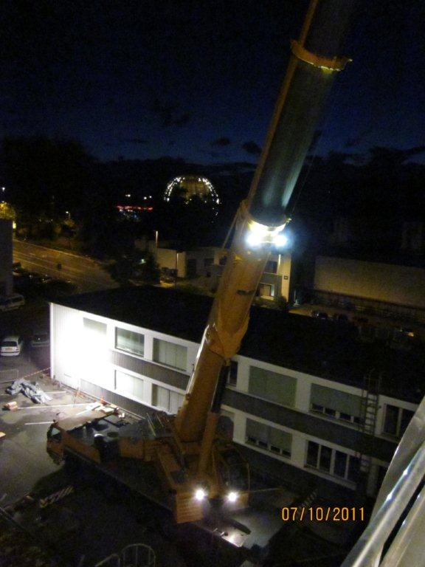
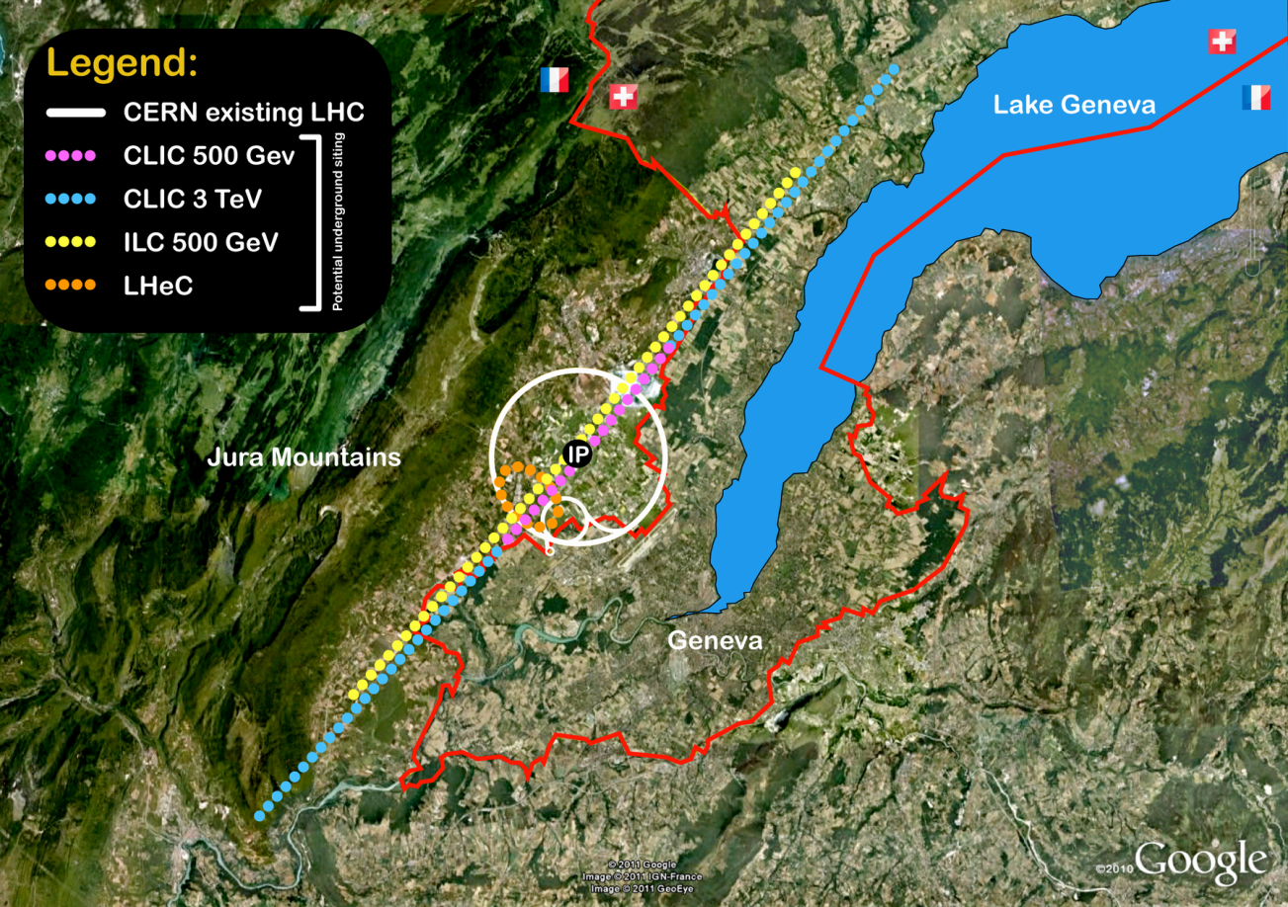
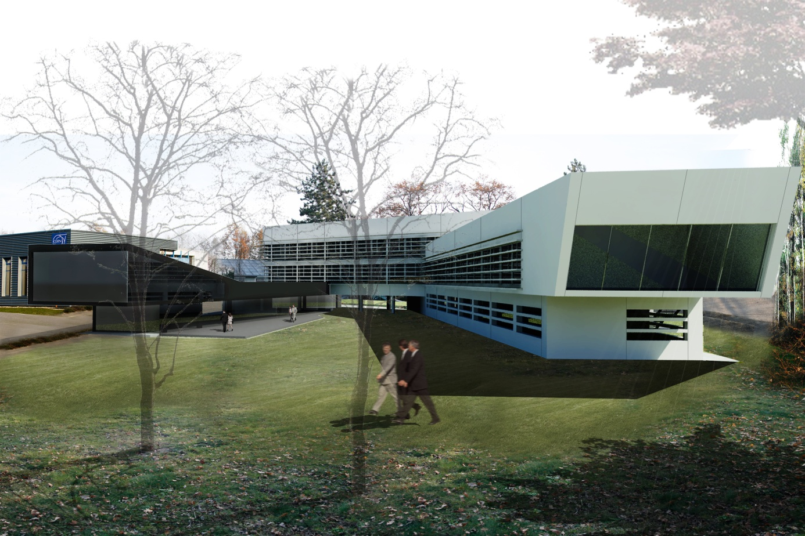
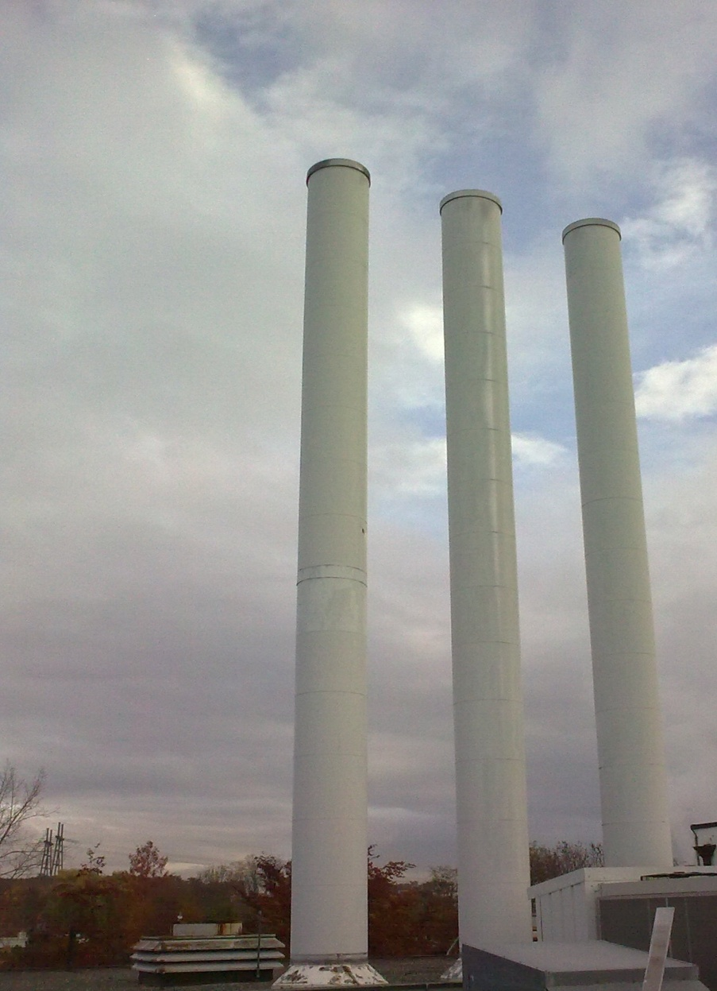
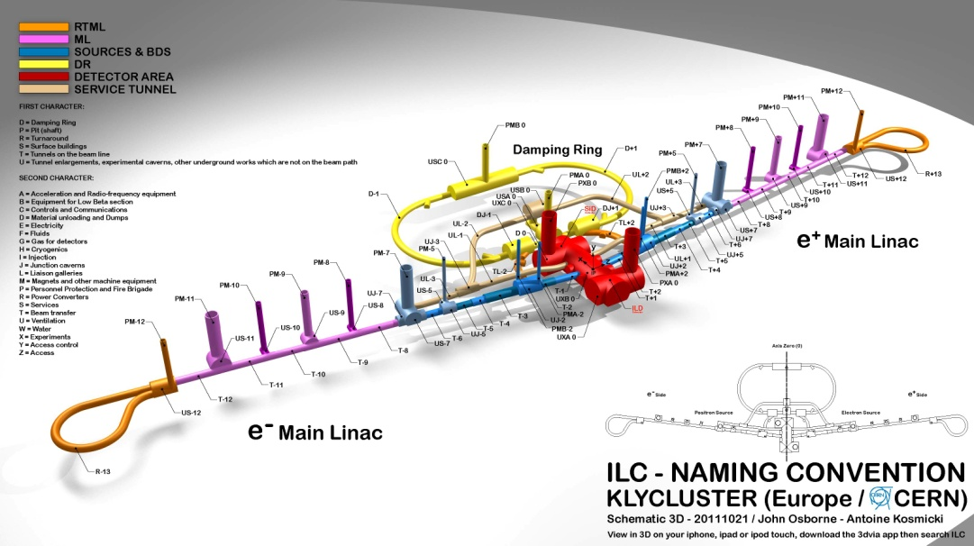
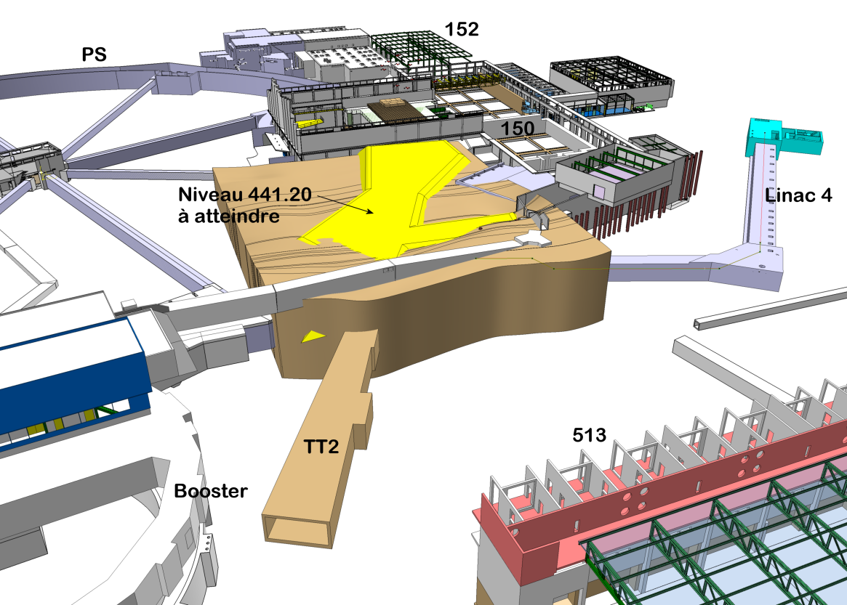
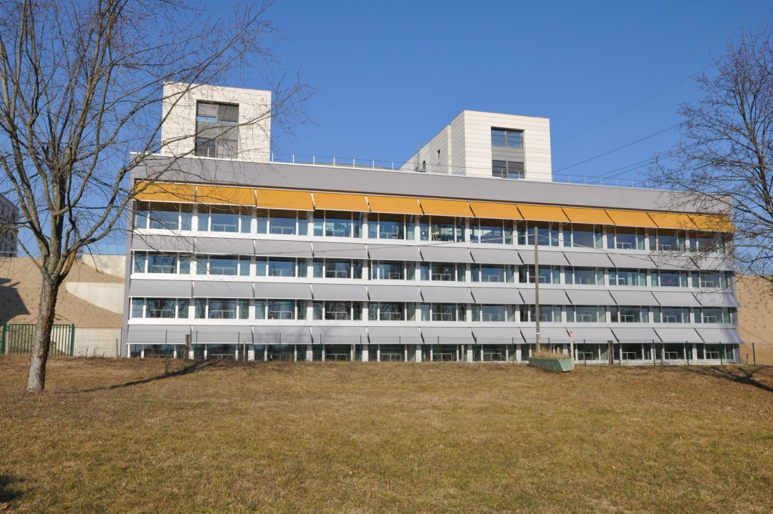
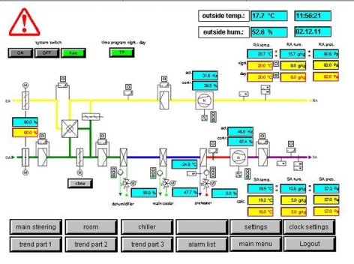
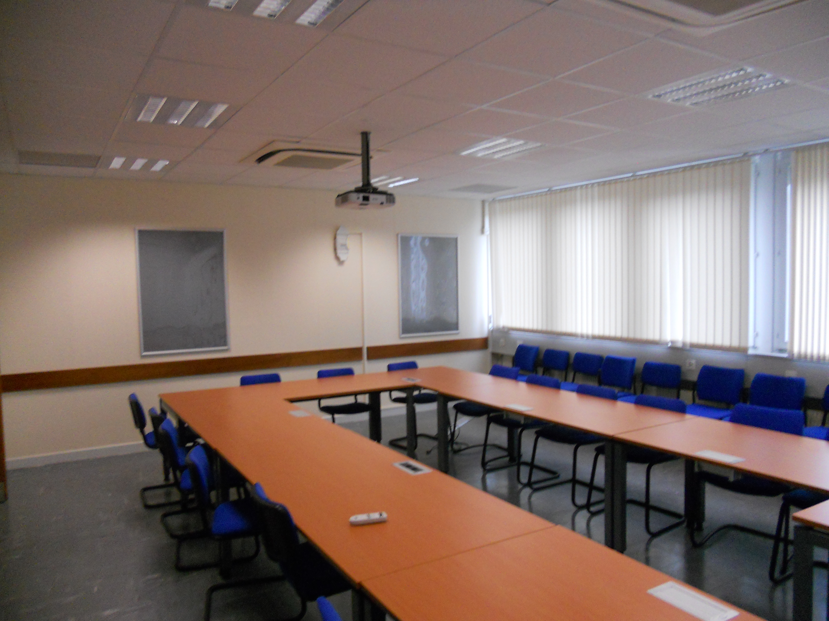
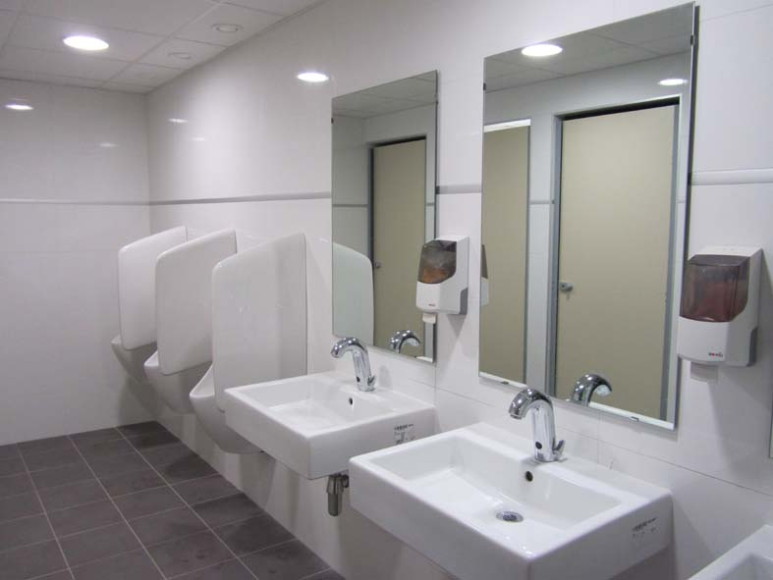
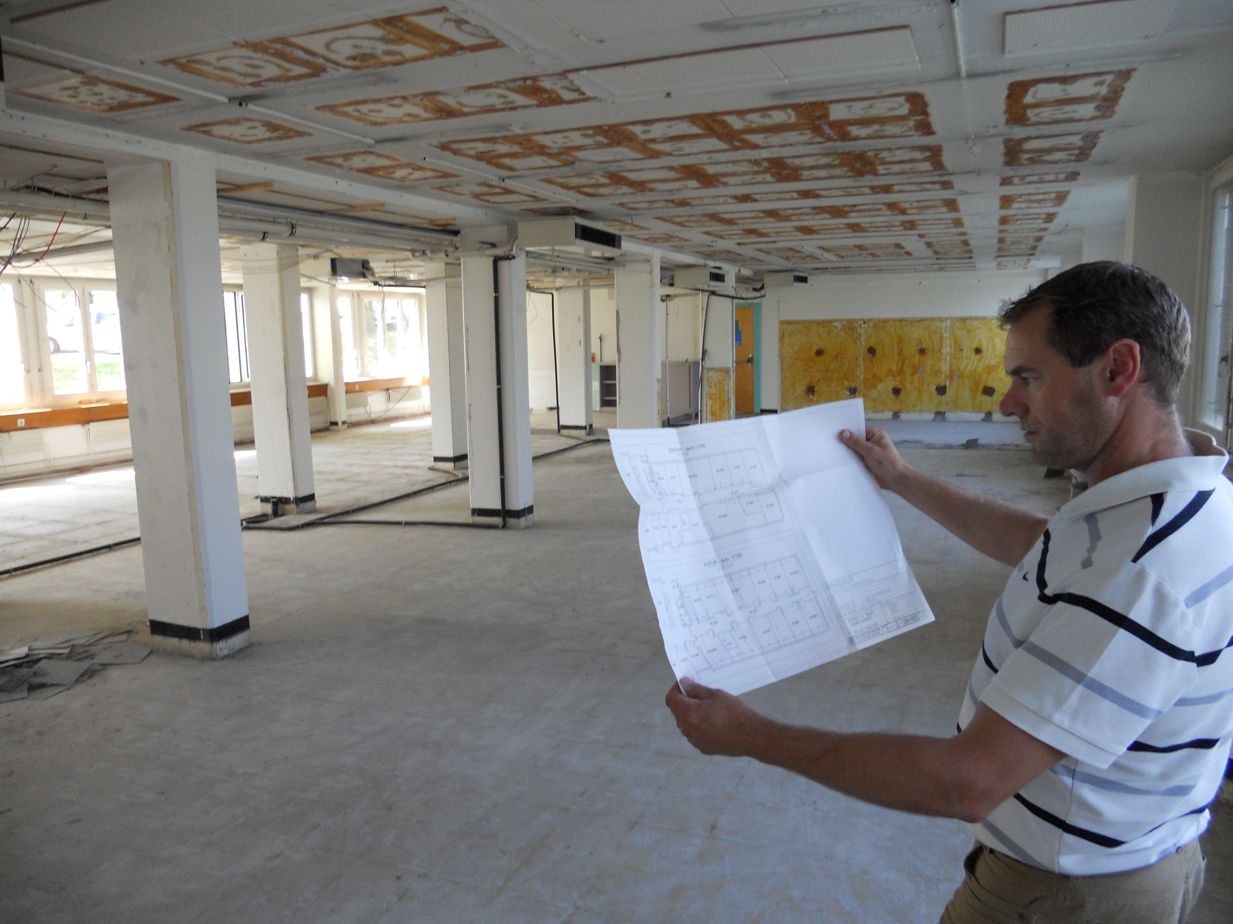
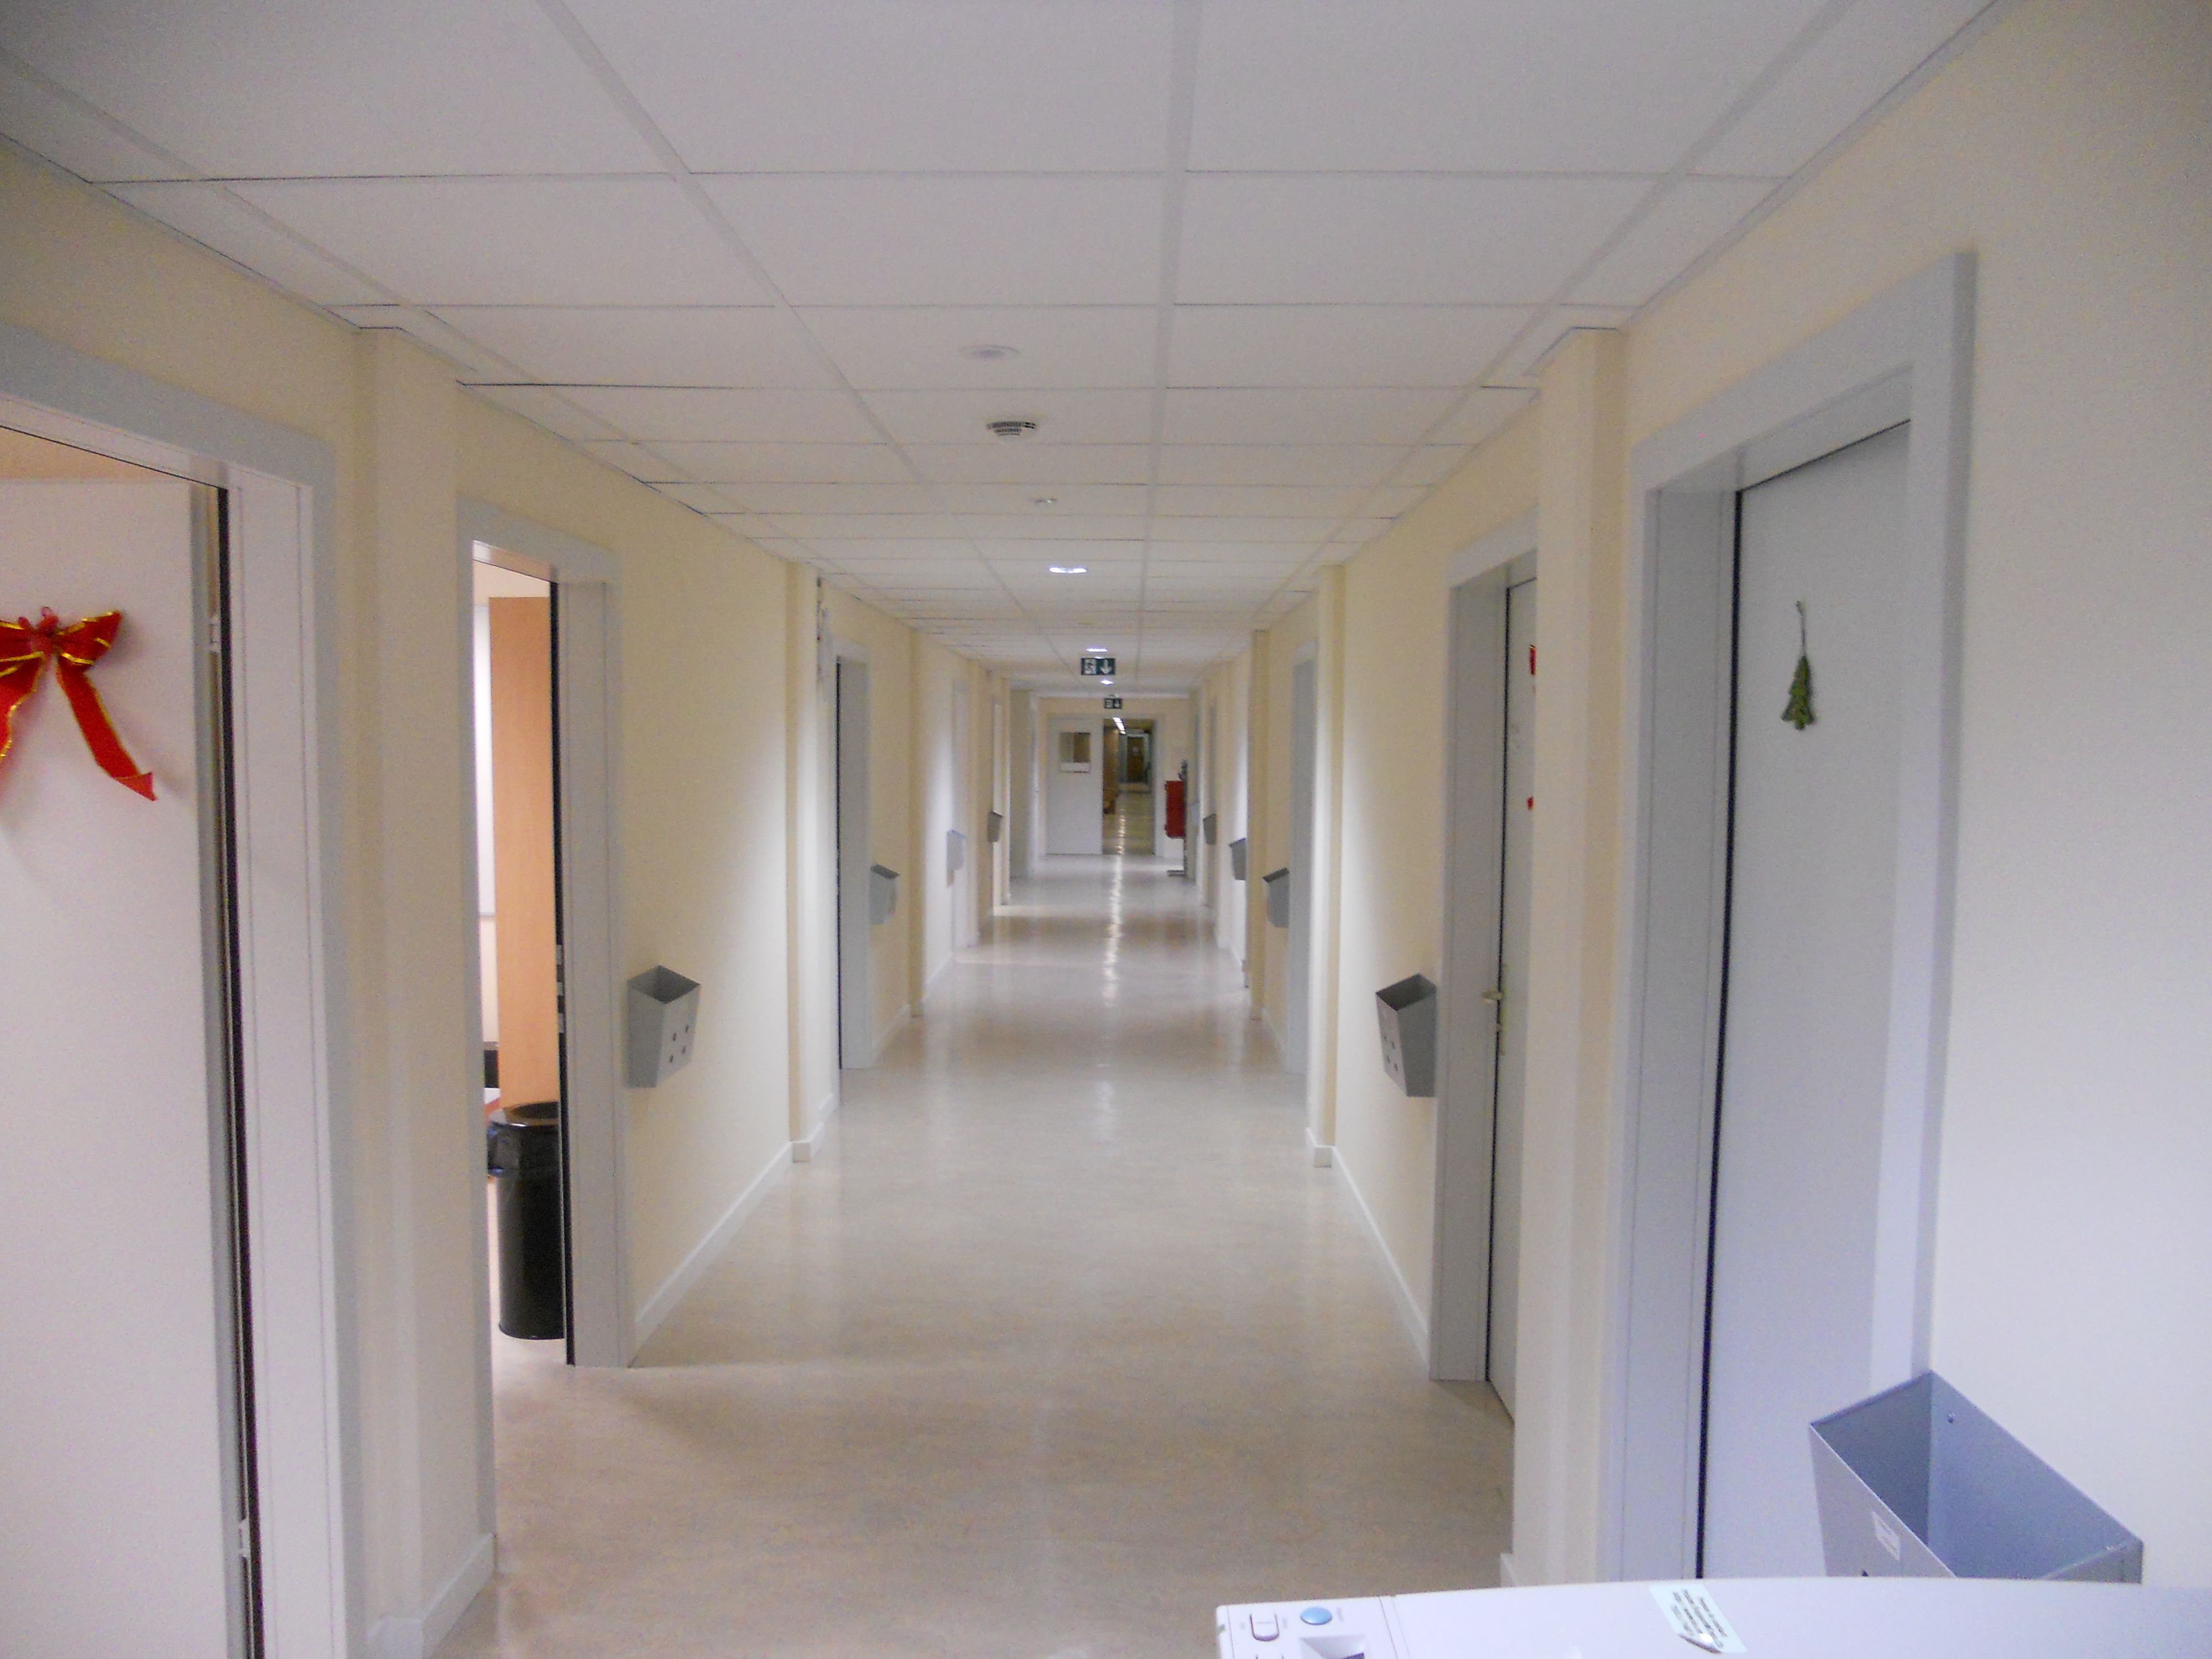
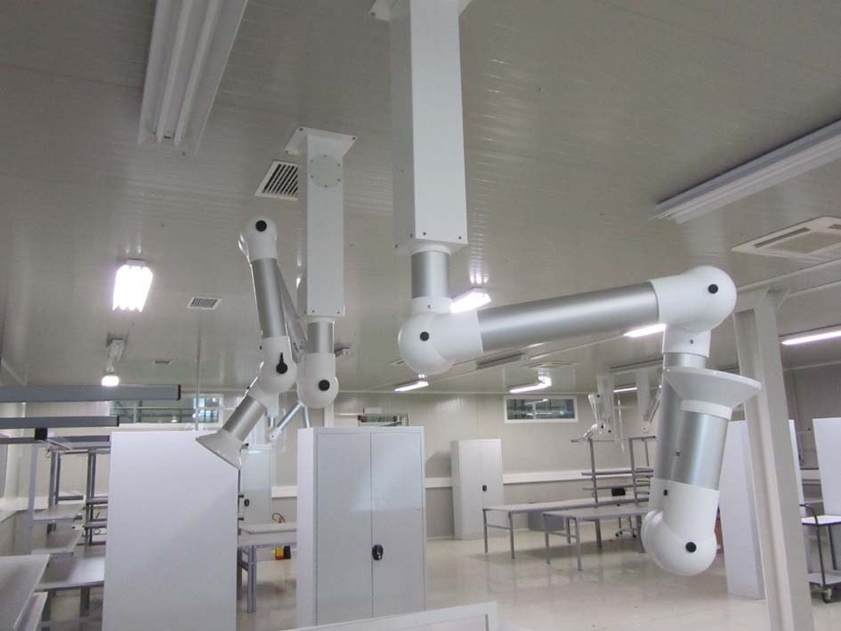
Group scope
to large projects
COMPLEXITY
and Operation
& Maintenance
From Design
to construction
TIME
From minor works
CONFINDUSTRIA, Geneva 30.09.2016, L. Scibile, EDMS: 1702197

Slide 15
Organization
  Service oriented approach for
    Maintenance interventions
    Small works
    Design studies
    Patrimony
  Project oriented approach for
    Large renovations (consolidation program)
    New buildings or change of usage
    Underground civil engineering
Tools:
- InforEAM
- ServiceNOW

Slide 16
Services
Services
  Building, tunnels and road maintenance, repairs, minor works
  HVAC maintenance and works for tertiary buildings
  Electricity maintenance and works for tertiary buildings
  Patrimony and GIS
  CERN district heating operation and maintenance
  Barracks management and rental
  Engineering support
  Green spaces
Service Desk
  Access to most the group services is via the Service Desk and it is integrated in the ServiceNow tool: https://cern.service-now.com/
In the last 12 months, ~8000 incidents and ~5000 requests were carried out.

Slide 17
Projects
  Machine projects
  (linked to the functioning of the accelerator)
  Tertiary projects
  (linked to the functioning of the site)

Slide 18
Some examples of recent projects
Projects

Slide 19
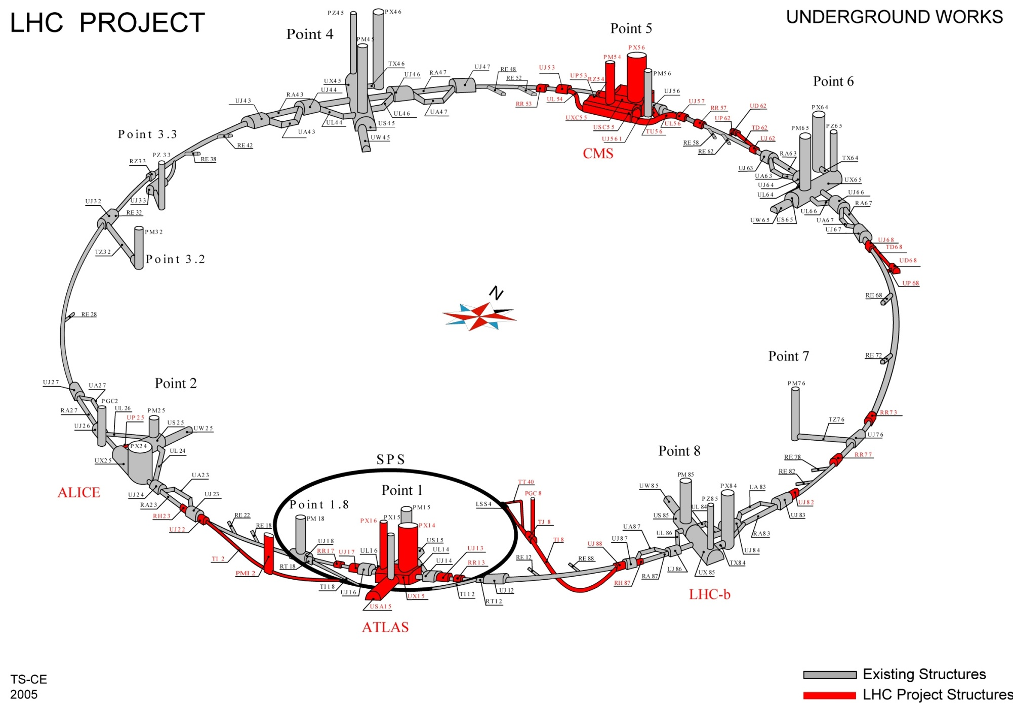
LHC Project

Slide 20
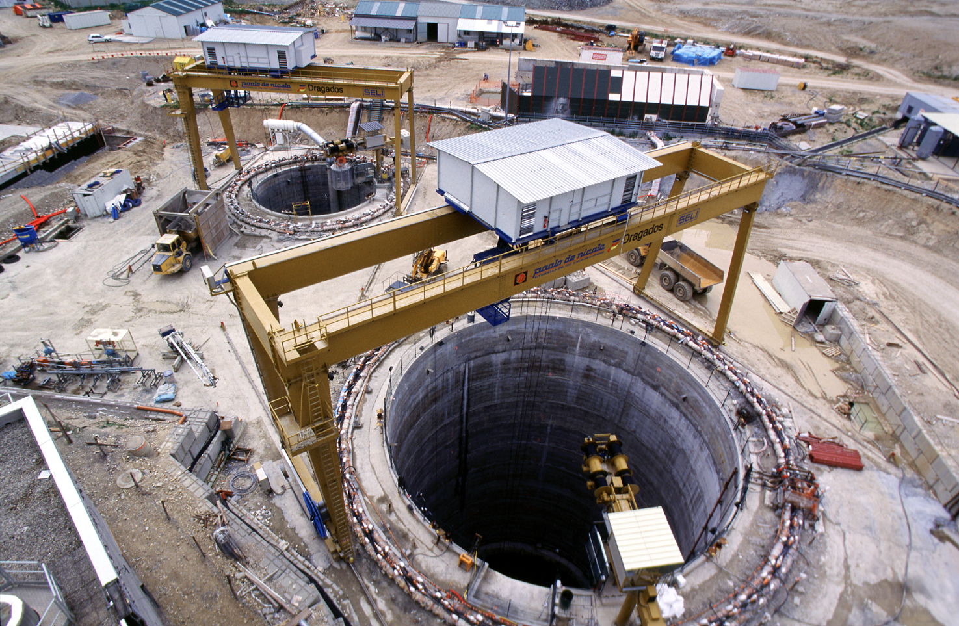
LHC – Point 5
Shafts 12.1m and 20.5m diameters, both approx. 100m deep
2001

Slide 21
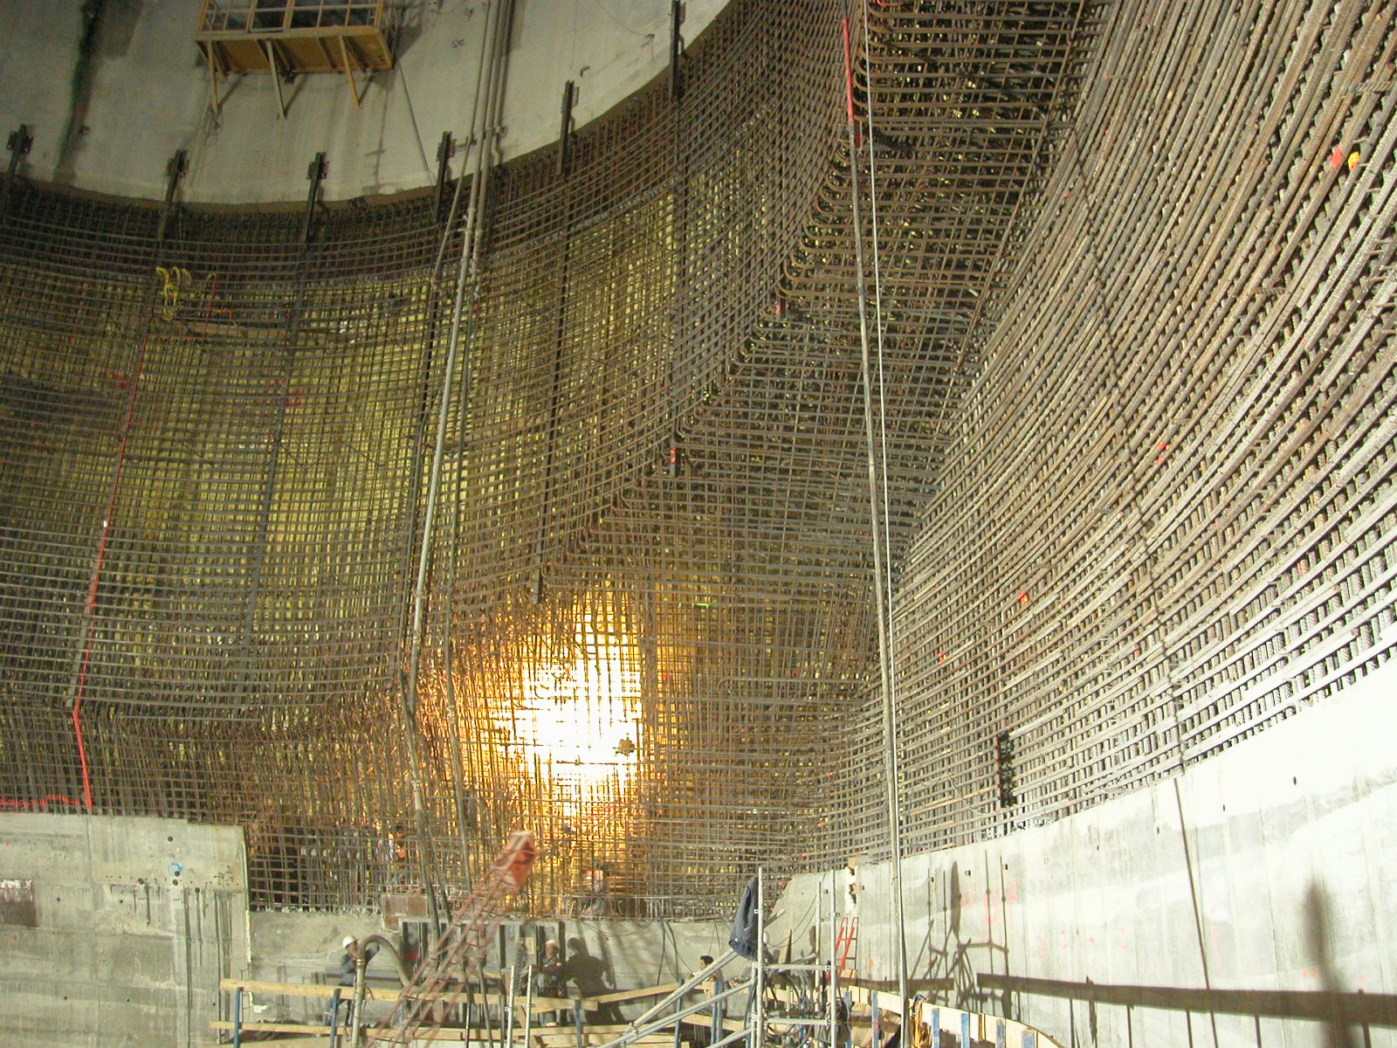
2004

Slide 22
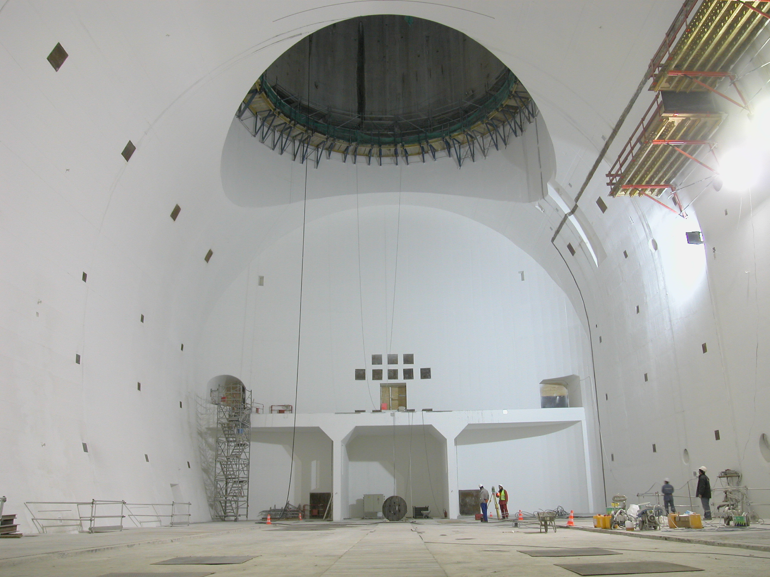
CMS cavern 53m long, 27m wide by 25m high
2005

Slide 23
Building 42
Major achievements 2011
Tertiary Building - officies
Surface gross area : 3200 m2
Delivered : february 2013
Notes:
23

Slide 24
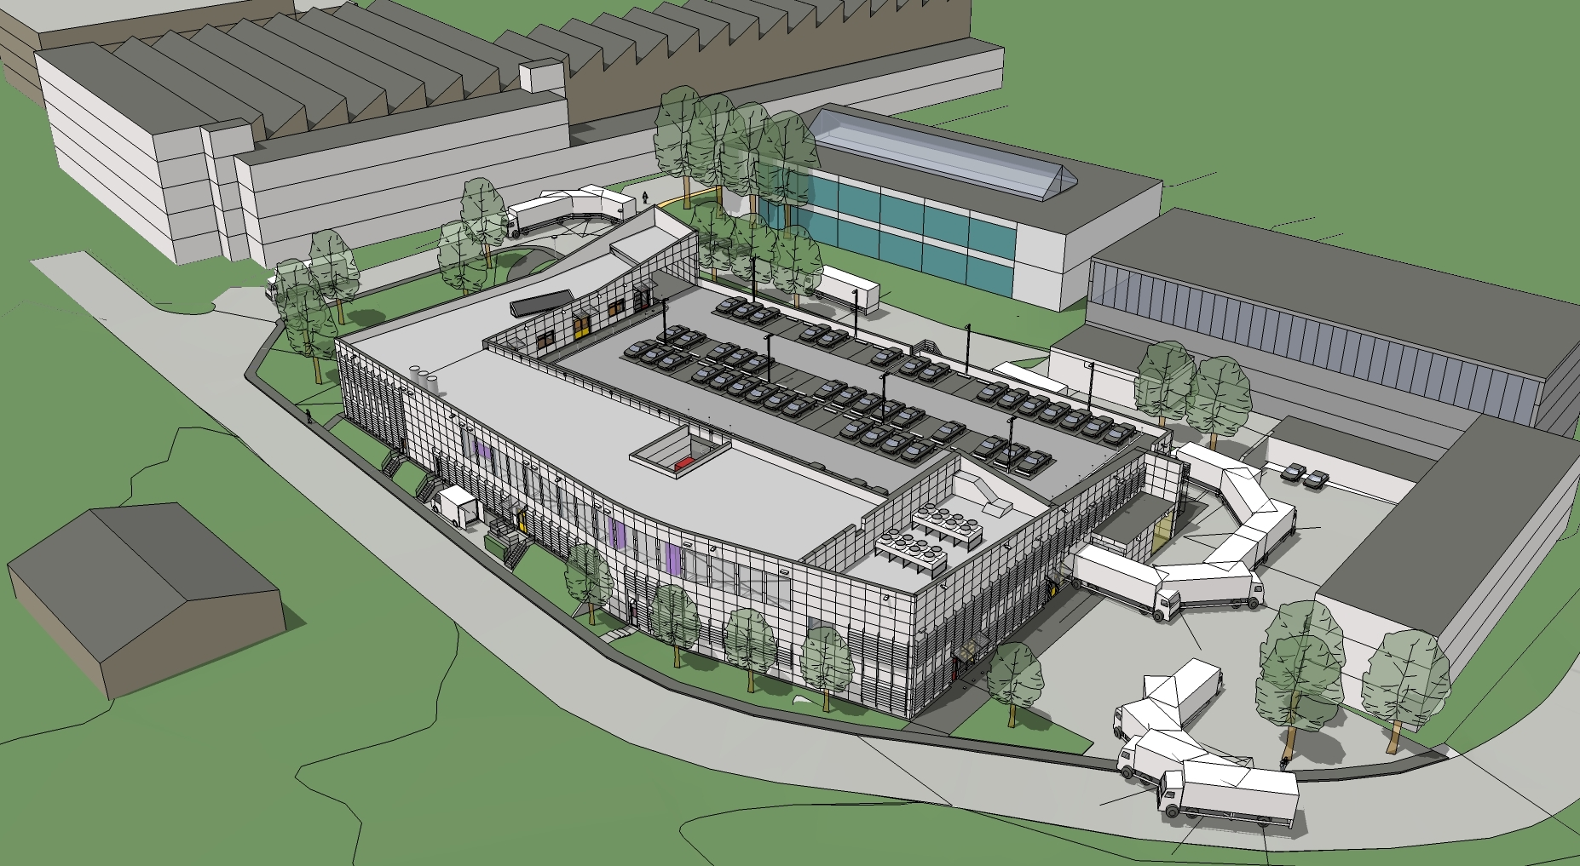
Recent Projects – Building 107
GS-SE Review 2011
Bld 107 : New Chemical Surface Treatment Facility
Industrial Building
Surface finishing
Printed Circuit Boards
Electronic Modul design
̴ work in progress

Slide 25
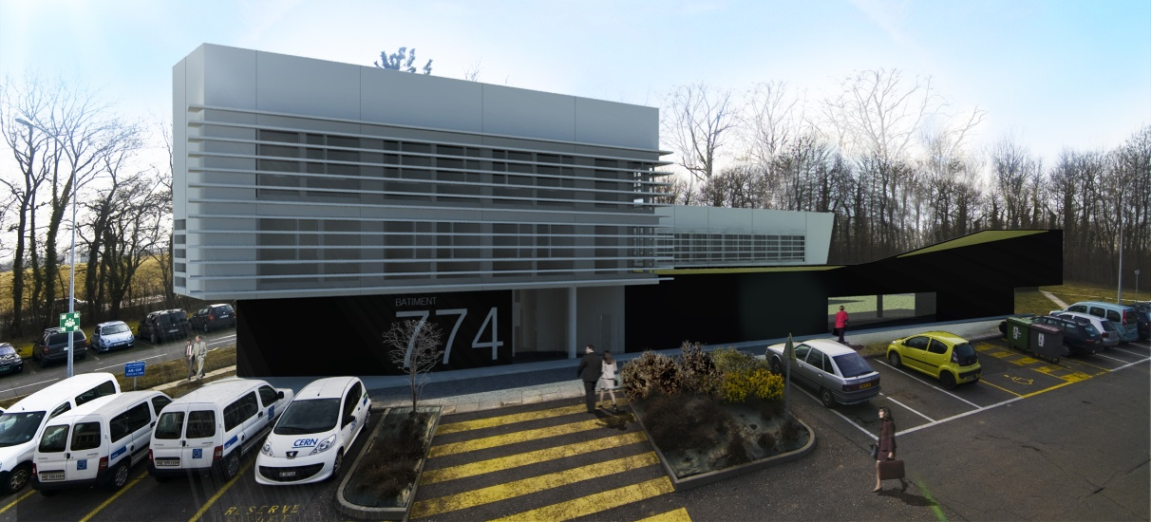
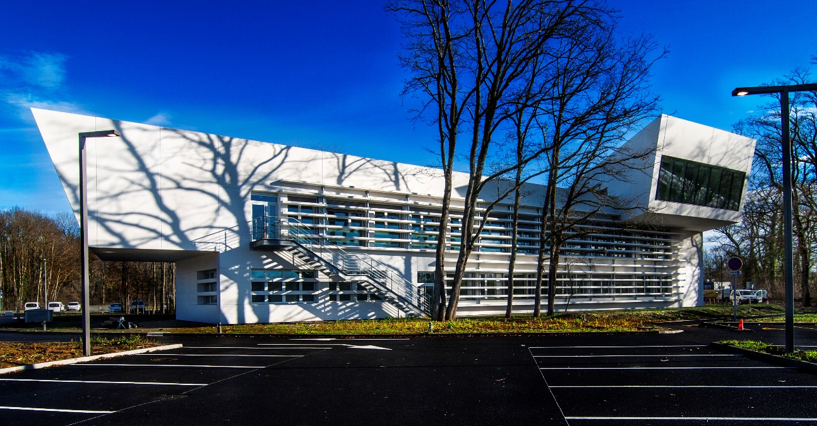
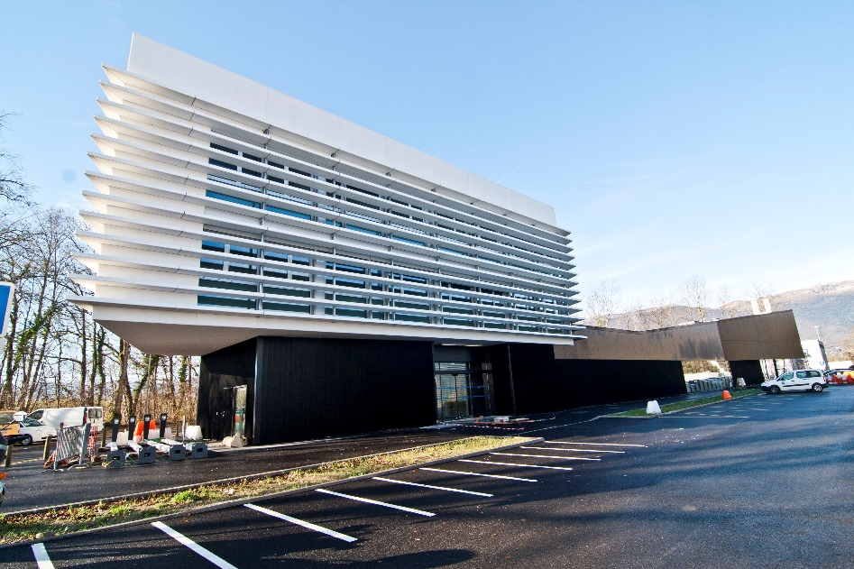
Building 774
Major Objectives 2012
Tertiary Building : officies and labs
Surface gross area : 3950 m2
Delivered : february 2015
Notes:
25

Slide 26
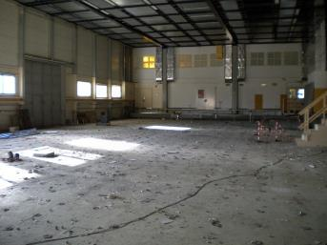
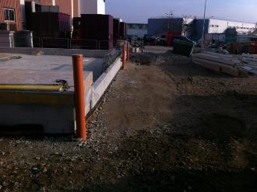
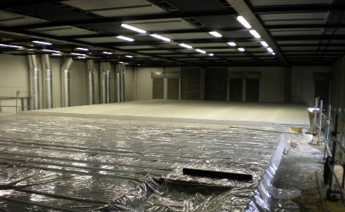
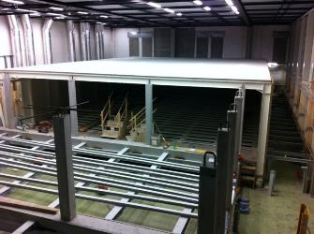
Computer Centre Upgrade

Slide 27
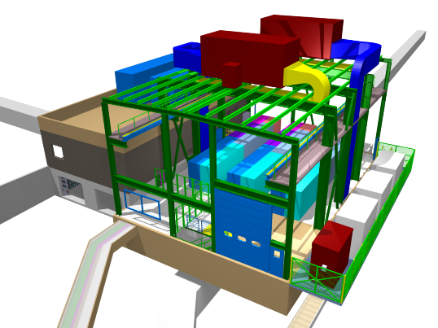
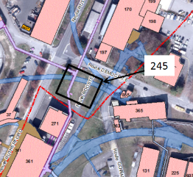
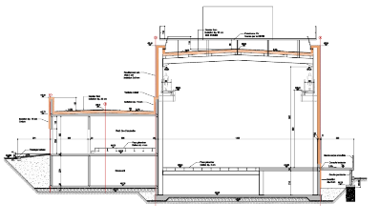
LIU-Booster – New Building 245 MPSB
Machine Building
Delivered : June 2016

Slide 28
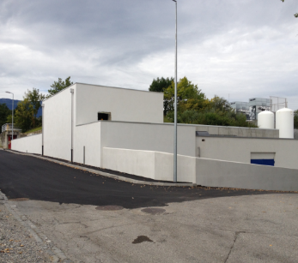
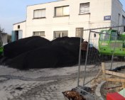
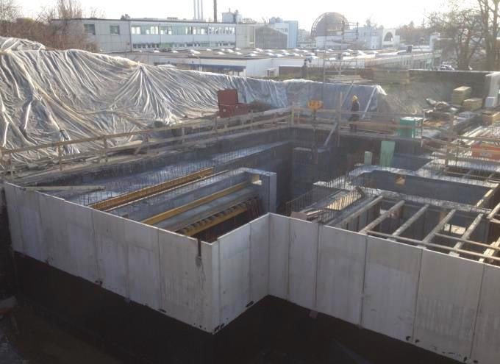
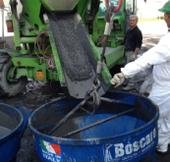
MEDICIS works
Addition of experimental area
Special shielding
Cross-border difficulties
Magnetite ore
Magnetite concrete high density 3.9 kg/dm3 (normal concrete 2.2 kg/dm3)
Preparation

Slide 29

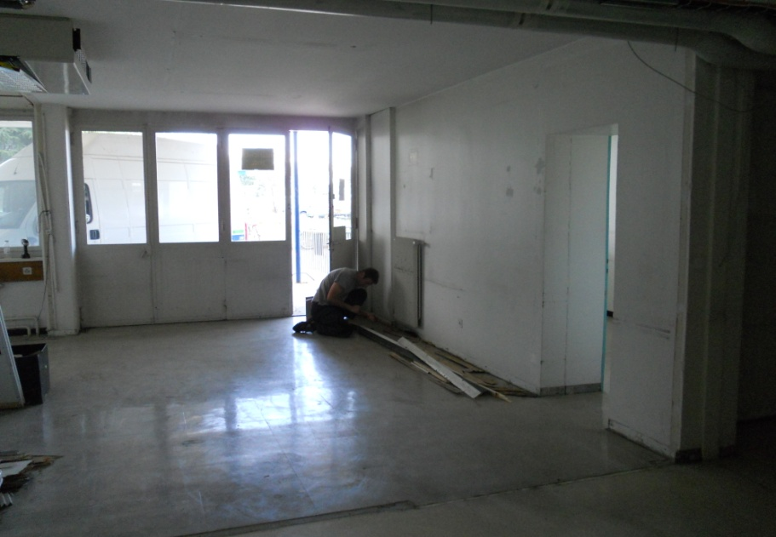

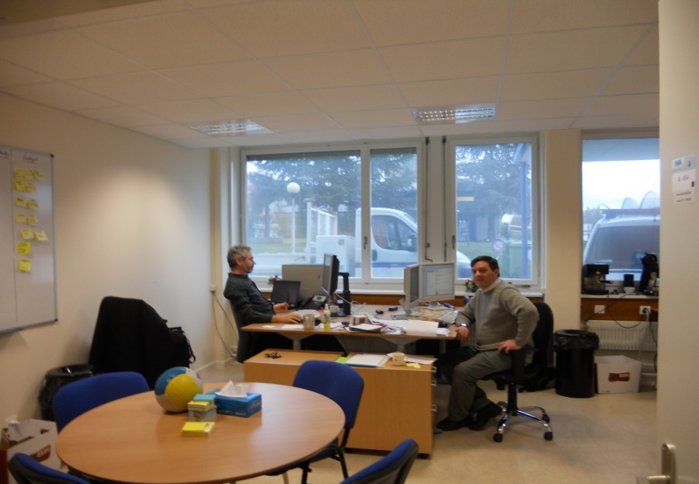
Renovation works : Offices
Notes:
What are the challenges for the next 12 months?
1 slide

Slide 30


Renovation works : Hotels

Slide 31

Renovation works : Main Hall
Notes:
Given the vision and the short term issues; how does this translate in objectives for the next 12 months
1 to 3 slides?

Slide 32

Renovation Works: Main auditorium

Slide 33
Site planning and development
CERN/SMB-SE – Civil engineering
CONFINDUSTRIA, Geneva 30.09.2016, L. Scibile, EDMS: 1702197

Slide 34
CERN 2030 Urban Masterplan
Déclaration d’intentions :
« Le Masterplan CERN 2030 vise à répondre aux besoins d’un laboratoire global, offrant à ses utilisateurs des zones fonctionnelles bien définies, desservies par des infrastructures et des services efficaces, permettant de garantir un fonctionnement opérationnel durable, tout en s’intégrant dans le développement du Projet d’agglomération franco-valdo-genevois .»
TLEP

Slide 35



CERN 2030 Masterplan
TLEP

Slide 36
Opportunities at CERN
For Consultancy firms & Contractors
Call for tender for ‘Framework’ Contracts
Call for tender for specific Projects.
CONFINDUSTRIA, Geneva 30.09.2016, L. Scibile, EDMS: 1702197

Slide 37
Future and ongoing “Call for Tender” 1/2
Accelerator’s related (2017-2022)
    ~6 Contracts 3500kCHF ÷ 10000kCHF
    ~10 Contracts 200kCHF ÷ 750kCHF
HL-LHC (2017-2022):
    2 construction contracts 45000kCHF ÷ 60000kCHF

Slide 38
Future and ongoing “Call for Tender” 2/2
Implementation of the Consolidation of the infrastructure program and new buildings (2017-2022):
    ~ 3 contracts 3500 KCHF to 10000 KCHF
    ~ 15 contracts 750 KCHF to 2500 KCHF
    ~ 45 contracts 200 KCHF to 750 KCHF
Hotels interior renovation (2017-2022):
    ~ 3 Contract ~ 2000 KCHF
Renewal of frame contracts (2017-2019):
    ~5 contracts 1000 KCHF/Y to 8000 KCHF/Y

Slide 39
Examples of on-going and planned projects
CERN/SMB-SE – Civil engineering

Slide 40




Extension Building 887
Lower slabbing
Cam view
3D Model
Pits earthworks

Slide 41



New Building 311 for magnetic measurements
Machine Building : magnet measurement hall
Surface gross area : 1250 m2
Starting of the works : march 2016

Slide 42


New Building 90 – Flex space
Tertiary Building : officies and labs
Gross area : 5490 m2
To be delivered : decembre 2019
+ entire renovation of the main building

Slide 43

Underground works –
HL-LHC Points 1 & 5
High Luminosity LHC (HL-LHC)

Slide 44

Future Accelerators
FCC

Slide 45
Conclusions
Opportunities for medium and large companies
Different specialties (underground and buildings)
Special attention to be paid to:
  The location and local rules (CH/F)
  The local prices (materials, wastes, workforce, etc.)
  CERN framework (Radiation, Worksites, Safety rules, etc.)

Slide 46
Thank You for your attention

