Slide 1
Trasferimento technologico e opportunita’ per le imprese G. Anelli, Head of KT Group 30.09.2016

Slide 2
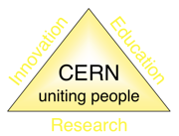
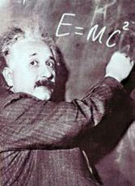
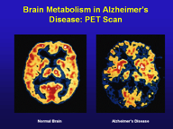
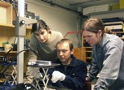
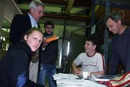
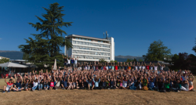
The Mission of CERN
Push back the frontiers of knowledge
E.g. the secrets of the Big Bang …what was the matter like within the first moments of the Universe’s existence?
Develop new technologies for accelerators and detectors
Information technology - the Web and the GRID
Medicine - diagnosis and therapy
Train scientists and engineers of tomorrow
Unite people from different countries and cultures
Notes:
2

Slide 3
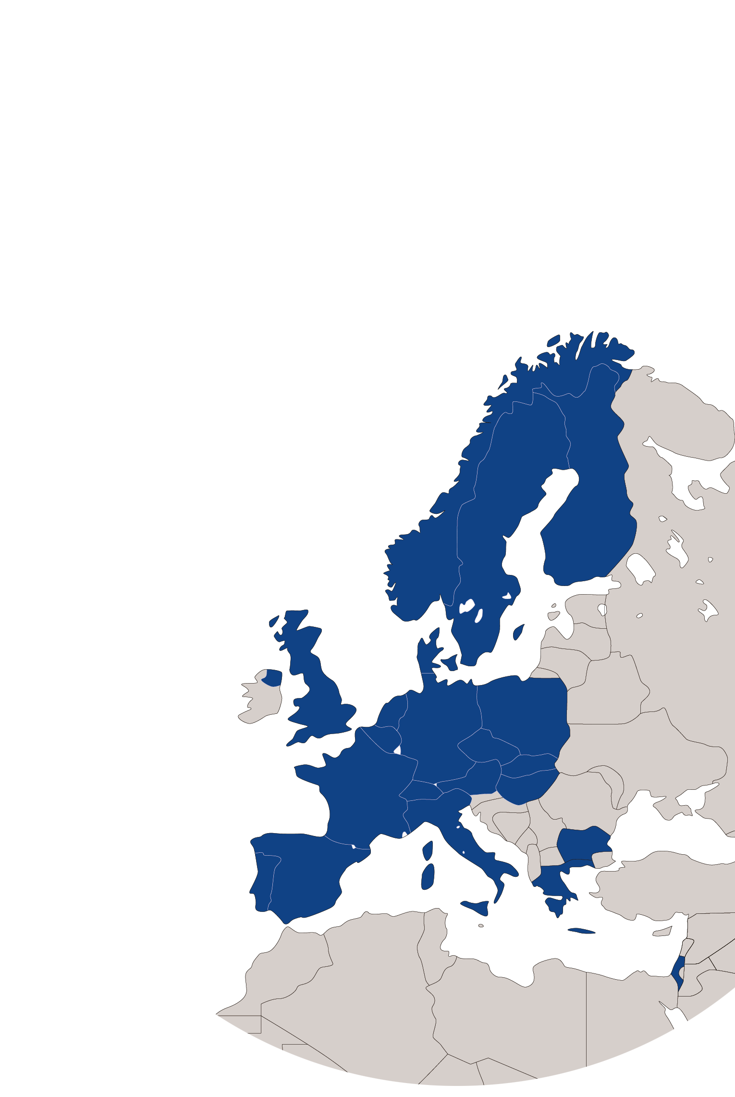
KT Mission
Maximize the technological and knowledge return to society, in particular through Member States industry
Promote CERN’s image as a center of excellence for technology and innovation
Demonstrate the importance and impact of fundamental research investments
Key words are dissemination and impact

Slide 4
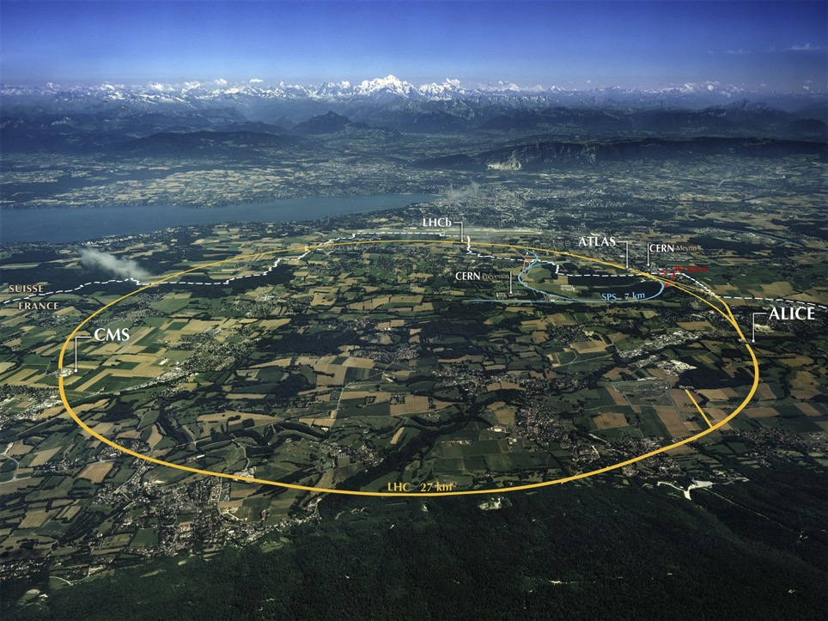

Slide 6
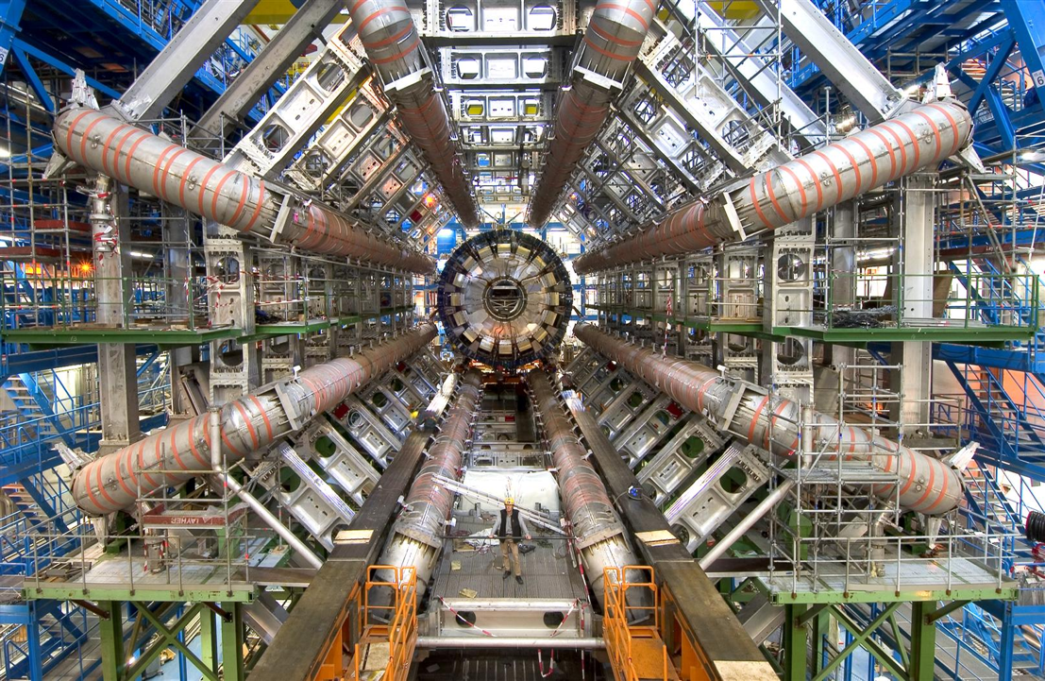

Slide 8
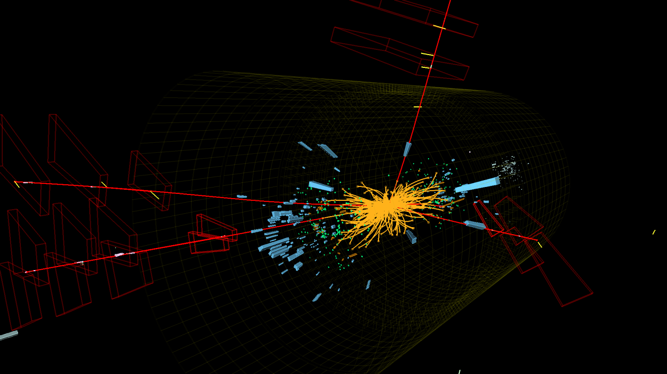

Slide 10
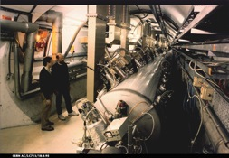
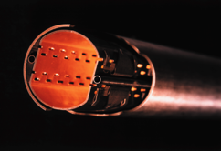
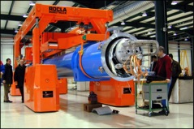
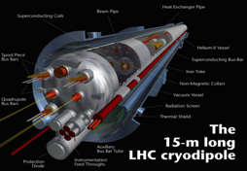
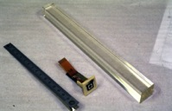
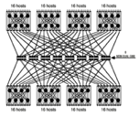
CERN Core Competences
Super-conductivity
(13kA, 7MJoules)
Vacuum
(10⁻¹² Torr)
Cryogenics (1.9 K)
Very high performance
detectors and electronics
Magnets
(10 T)
Data processing

Slide 11
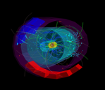
KT Modes
Easy Access IP
Licensing
Open Source Software
Open Hardware
Business Incubation
Procurement
Service and Consultancy
EU Projects
Training
R&D Collaborations
Notes:
I often use this slide as it gives a good overview of what we do.
Licensing, Service and Consultancy and R&D Collaborations are the contracts we do.
Business Incubation → introduces the network of Incubators
Easy Access IP, Open Hardware and Open Source Software: alternative ways (some created by us) to disseminate our technos.
EU Projects: a good vehicle to disseminate our Know how to industry.

Slide 12
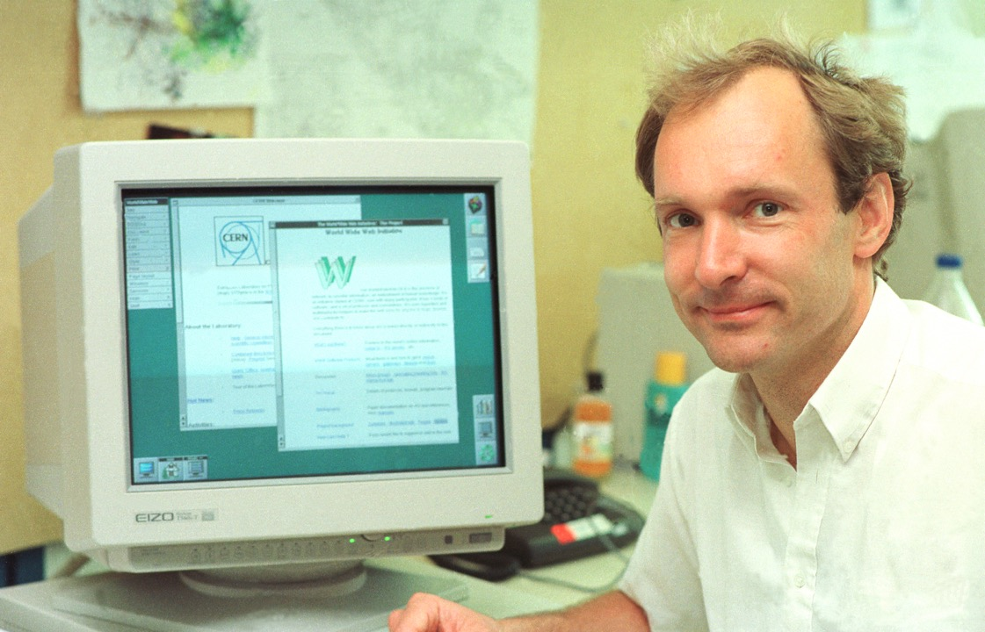

Slide 13
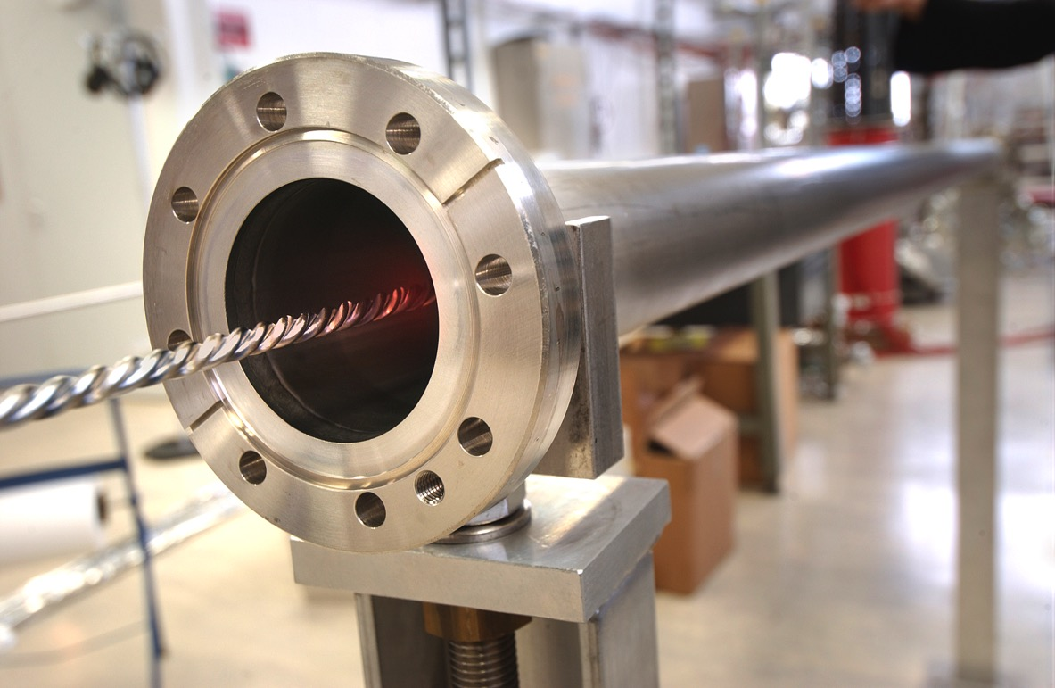

Slide 15
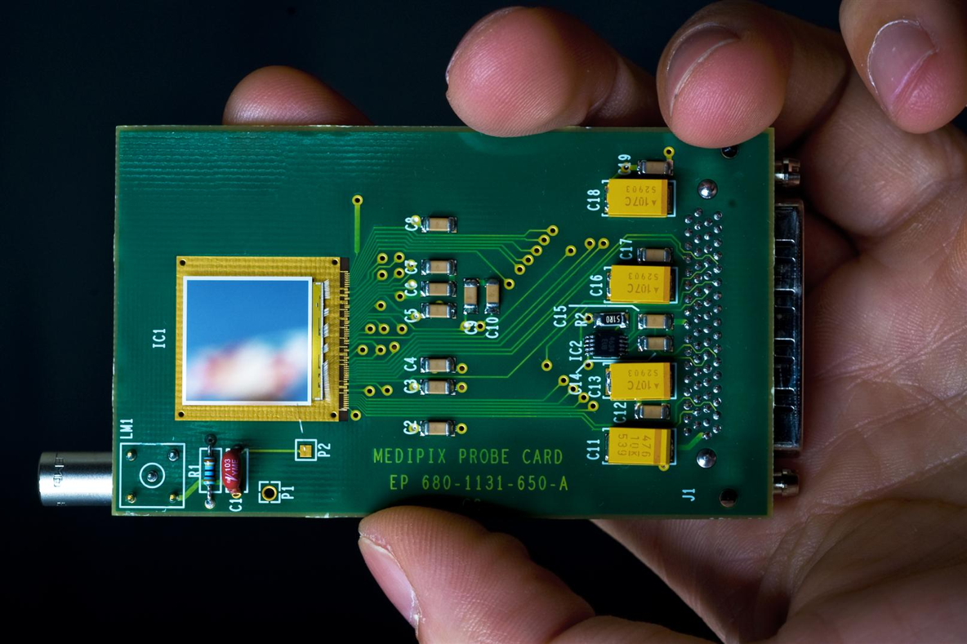

Slide 16
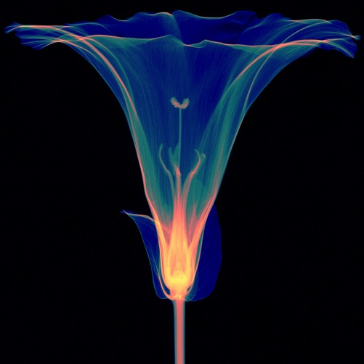
Credit: Simon Procz

Slide 17
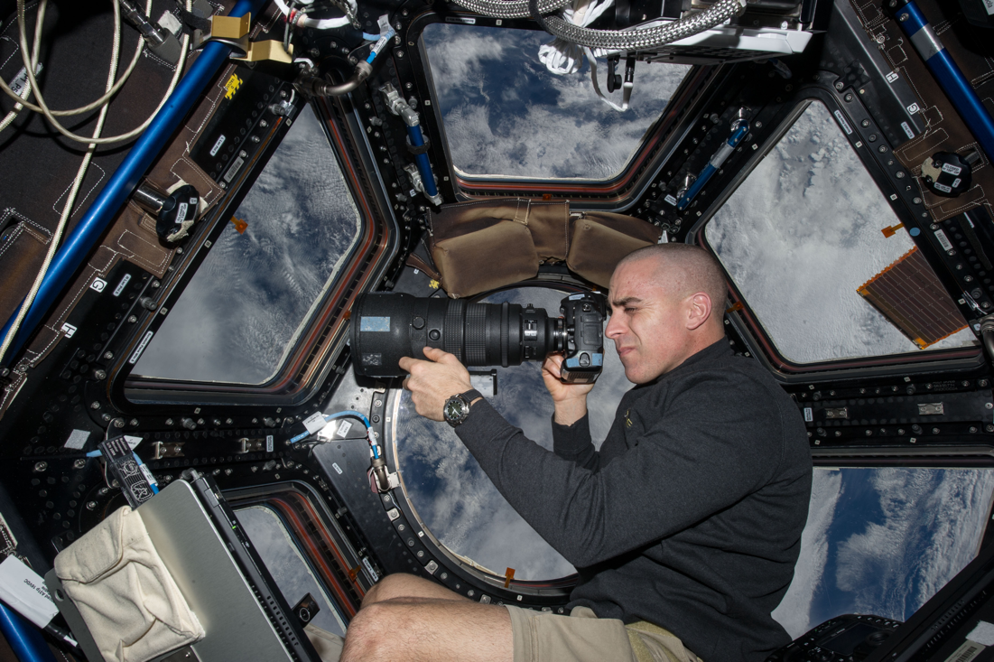

Slide 18
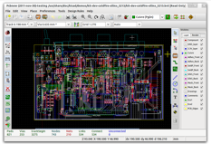
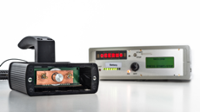
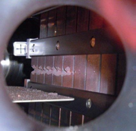
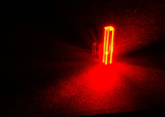
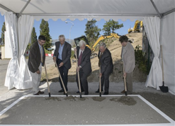
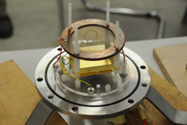
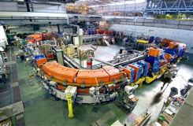
The KT fund
CERN’s incentive scheme to help transferring our Knowledge and Technologies
Projects selected by a committee composed by the Heads of Department and KT
32 projects have been financed so far

Slide 19
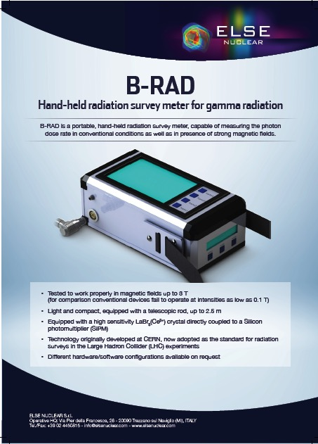
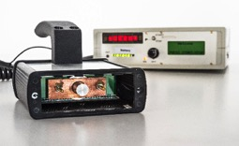
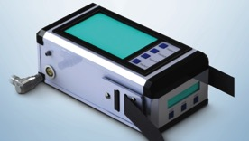
KT Fund Examples – B-Rad
Funded:
Prototype of a hand-held radiation survey meter operable in high magnetic fields
The KT Fund has catalysed the creation of
Off-the-shelf industrial-grade radiation survey meter by a company from a member state

Slide 20
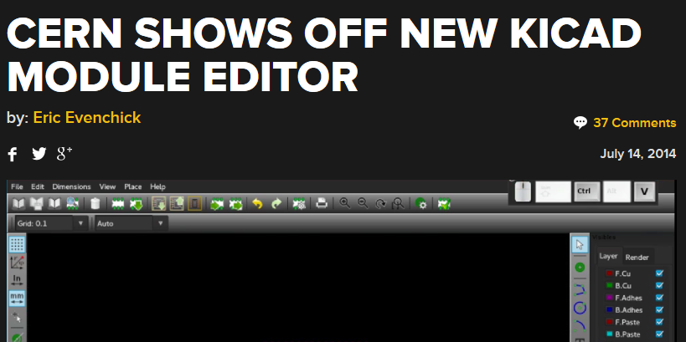
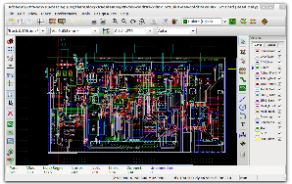
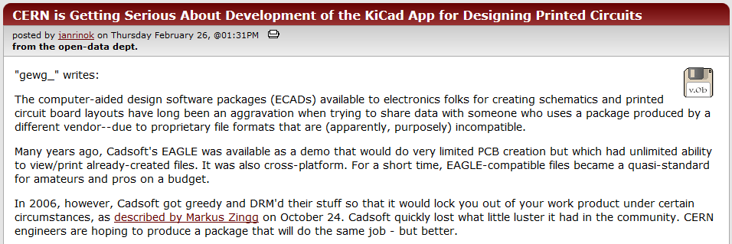
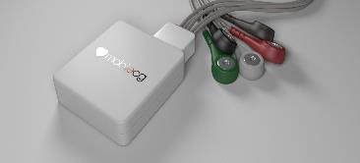
KT Fund Examples - KiCAD
Funded:
Development of additional functionality for open source Electronic Design Automation tool (KiCAD)
The KT Fund has catalysed the creation of
Access by the worldwide electronic design community to a free alternative to professional tools, thereby fostering creation and dissemination of new designs.

Slide 21
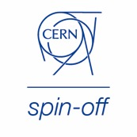
KT implementation ways
Market Pull
Transfer to Existing Companies
Technology Push
Creation of New Companies
Spin-Off Support

Slide 22
CERN Business Ideas Accelerator
External financial resources
CERN IP (Technologies)
Entrepreneurs
CERN
Pre-Incubator
STFC CERN BIC
National BIC
National BIC
National BIC
National BIC

Slide 23
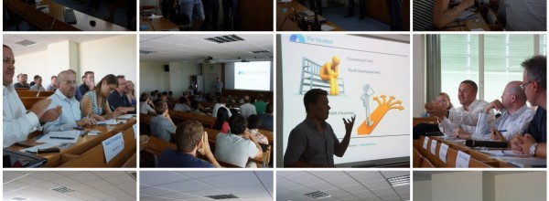
Entrepreneurship Development
Fostering an Entrepreneurship Culture
Facilitating CERN Spin-Off creation

Slide 24
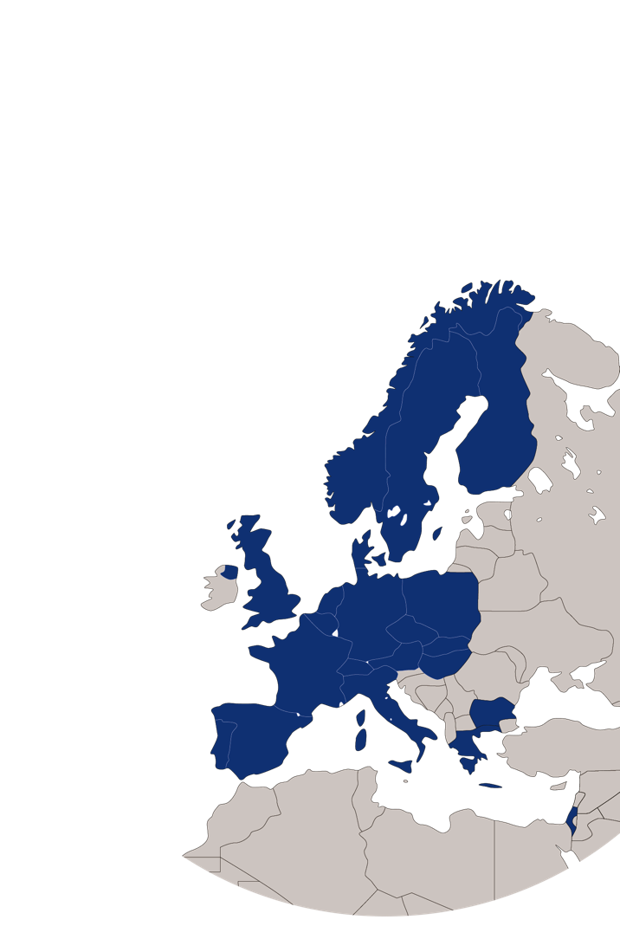
CERN BIC Network
Established incubators:
UK – STFC-CERN BIC
Netherlands – NIKHEF-CERN BIC
Norway – NTNU BIC of CERN Technology
Greece – Technopolis BIC of CERN Technology
Austria – Austria BIC of CERN Technology
France – InnoGEX BIC of CERN Technology
Finland – Finnish BIC of CERN Technology
Spain – Spanish BIC of CERN Technology
Italy – Italian BIC of CERN and INFN Technology

Slide 25
Network of BIC’s of CERN Technologies
STFC-CERN BIC (UK, 2012)
NTNU BIC of CERN Tech. (NO, 2014)
NIKHEF CERN BIC (NL, 2014):
Austria BIC of CERN Tech. (AT, 2014):
InnoGex (FR, 2015):
CamsTech Ltd

Slide 26
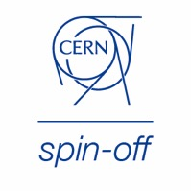
TIND Technologies
http://tind.io

