Slide 1
Crystal-assisted collimation at the LHC
18/10/2016 – PhD Seminars
Roberto Rossi
Home institusion supervisor: Gianluca Cavoto
CERN supervisors: Stefano Redaelli, Walter Scandale

Slide 2
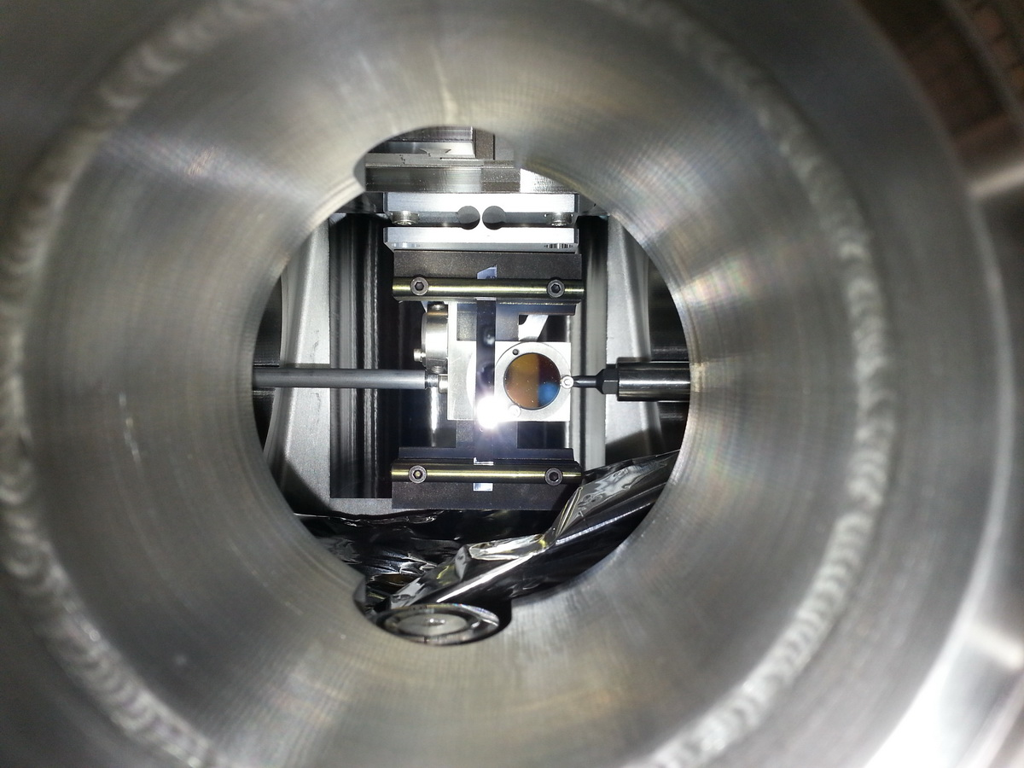
Outline
Introduction
Hadron beam collimation
  collimation system
  crystal-assisted collimation
Scope of my PhD
Experimental results LHC
  Protons tests
  Ions tests
Simulations and semi-analytical studies
  B2 installation
  Energy ramp functions
  LHC & SPS simulation
Conclusion
Strip silicon crystal. Installed on the horizontal goniometer in LHC.

Slide 3
Outline
Introduction
Hadron beam collimation
  collimation system
  crystal-assisted collimation
Scope of my PhD
Experimental results LHC
  Protons tests
  Ions tests
Simulations and semi-analytical studies
  B2 installation
  Energy ramp functions
  LHC & SPS simulation
Conclusion

Slide 4
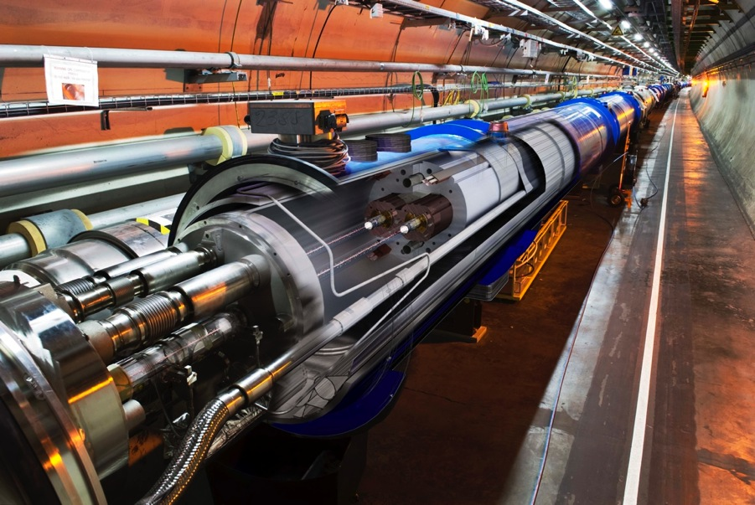
Motivations
Superconducting magnets:
T = 1.9 K
quench limit ~ 15-50mJ/cm³
Aperture: r = 17/22 mm
Factor ~ 10⁹-10¹⁰ ➔ Collimation system is needed!
Stored energy in the machine:
LHC 2016: 280 MJ
LHC design: 360 MJ
For the HL-LHC is foreseen:
Increased beam stored energy: 362MJ → 700MJ at 7 TeV
  Collimation cleaning versus quench limits of superconducting magnets
Larger bunch intensity (I_{b}=2.3x10¹¹p) in smaller emittance (2.0 μm)
  Collimation impedance versus beam stability
Operational efficiency is a must for HL-LHC! Collimators: high precision devices that must work in high radiation environment
Upgraded ion performance (6 x 10²⁷cm⁻²s⁻¹, i.e. 6 x nominal)

Slide 5
Outline
Introduction
Hadron beam collimation
  collimation system
  crystal-assisted collimation
Scope of my PhD
Experimental results LHC
  Protons tests
  Ions tests
Simulations and semi-analytical studies
  B2 installation
  Energy ramp functions
  LHC & SPS simulation
Conclusion

Slide 6
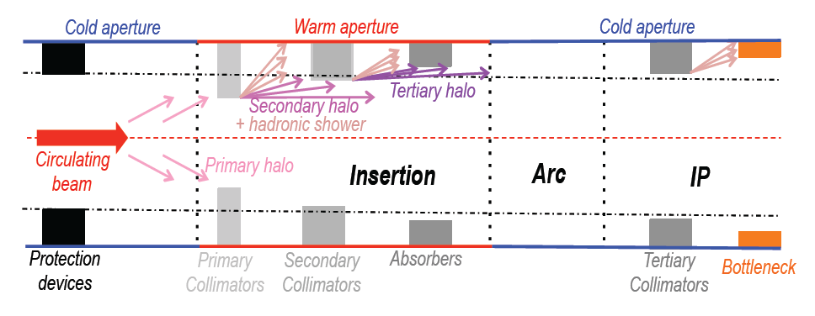
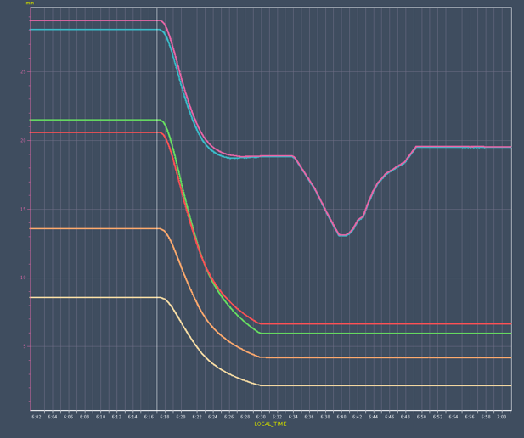

Collimation System @ LHC
Halo cleaning: reduce the risk of magnet quenches
Concentration of losses/activation in controlled areas
Avoid many hot locations around the 27km-long tunnel
Optimize background in the experiments
Minimize the impact of halo losses on (no big issue for the LHC)
Injection
Ramp
Squeeze
Collision
Absorbers
Tertiaries
Secondaries
Collimator gap [ mm ]
Multistage system of 50 collimators per beam.
LHC: only machine where collimation must be used continuously in operation
Primaries
Notes:
- collimation system clean the beam halo by mean of MCS with several collimation stages (hierarchy)
cleaning, losses, background
loss maps and local cleaning
diffractive :particle with different momentum lost on dispersion peak ( 10^-2, 2m, 2 cm pipe)

Slide 7
Collimation System @ LHC
The cleaning efficiency measured in the LHC is with the present system up to 10⁻⁴
TCP
TCSG
TCLA
Main limitations
Proton beam
  Single diffractive events
  small deflection & non-negligible δp/p ➔ escape from insertion and are lost in the IR7-DS if δp/p > 10⁻²
  Impedance
  Big number of collimators at small gap ➔ 90% contribution to whole machine impedance
Lead beam
  Fragmentation and dissociation events
  particles with different magnetic rigidity (q/m)➔ lost in the IR7-DS reducing of two order of magnitude the collimation system performance wrt to proton collimation
DS
D. Mirarchi
B. Salvachua
Limitations to be assesed during Run III
Notes:
- collimation system clean the beam halo by mean of MCS with several collimation stages (hierarchy)
cleaning, losses, background
loss maps and local cleaning
diffractive :particle with different momentum lost on dispersion peak ( 10^-2, 2m, 2 cm pipe)

Slide 8
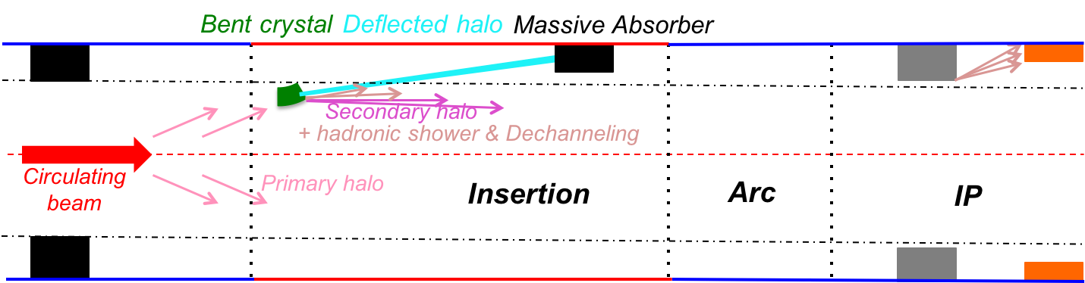

Crystal-assisted collimation
Promises of crystal collimation at the LHC:
Improve collimation cleaning (by a factor 10);
  Reducing off-momentum losses in DS
Lower impedance;
  Less collimators at larger gaps
Similar performances with both p and Pb;
  Main outcome for lead ion operation
Amorphous (0.6 m of C)
<θ>MCS ~ 3.4 μrad (7 TeV)
<θ> ~ 50 μrad (7 TeV)
Crystal
(Channeling)
(4 mm Si)
310 T equivalent magnetic field!
Can we use crystal collimation to improve the LHC collimation performance?
Notes:
MCS vs CH
layout of the system
improve cleaning and impedance
2 cry installed and tested in LHC

Slide 9
Outline
Introduction
Hadron beam collimation
  collimation system
  crystal-assisted collimation
Scope of my PhD
Experimental results LHC
  Protons tests
  Ions tests
Simulations and semi-analytical studies
  B2 installation
  Energy ramp functions
  LHC & SPS simulation
Conclusion

Slide 10
Can crystal be used in LHC?
For the future HL-LHC an upgrade of the actual collimation system is required
request | baseline solution | drawback
Improve cleaning performances | 11 T dipole with embedded collimator | very expensive
Reduce impedance | New materials for collimators
Crystal collimation can improve the cleaning and reduce the impedance and is one of the R&D subject
Still different challenges has to be addressed
Can we have a sufficient angular accuracy?
  The acceptance angle for channeling is 2.5 μrad @ 6.5 TeV ➔ goniometers with accuracy of 0.1 urad are required also stable throughout dynamic machine operation
Can crystal collimation improve the cleaning achieved with the actual system?
Are crystal robust enough to maintain the same efficiency during a year of operation?
  NA62 and HiRadMat showed no damage for an equivalent 2 year LHC operation exposition
New tests on HiRadMat foreseen for the next year and will give more detail
Can a single collimator absorb all the channeled beam energy?
  High energy confined in a small spot ➔ a mini-dump is under investigation by collimation team

Slide 11
Where are we?
In recent years several PhD works have been completed in order to provide feasibility studies (simulations and/or measurements):
V. Previtali: CERN-THESIS-2010-133 (2010, PhD) simulation code for SixTrack
D. Mirarchi: CERN-THESIS-2011-136 (2011, master) measurements on SPS
CERN-ACC-2015-0143 (2015, PhD) improvement of simulation tools and benchmark, design of the crystal system prototype installed in the LHC
R. Rossi: CERN-THESIS-2014-187 (2014, master); measurements on single pass for simulation benchmark
The setup for the PhD is built on those works, especially for the simulation tool that I’m using every day

Slide 12
Goals of PhD thesis
Now
The current work is aimed to measure the performances of the Crystal Collimation prototype installed in the LHC and results comparison with the simulation routines. The final goal is to provide the layout for a Crystal Collimation system for a future upgrade of the LHC.
The work can be sumerized as
Experimental assessment of crystal collimation performance in the LHC
Understanding of experimental results in simulation
Design of crystal-based systems for the LHC

Slide 13
Outline
Introduction
Hadron beam collimation
  collimation system
  crystal-assisted collimation
Scope of my PhD
Experimental results LHC
  Protons tests
  Ions tests
Simulations and semi-analytical studies
  B2 installation
  Energy ramp functions
  LHC & SPS simulation
Conclusion

Slide 14
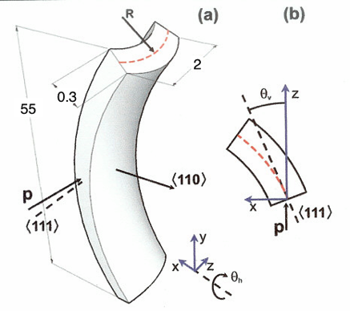
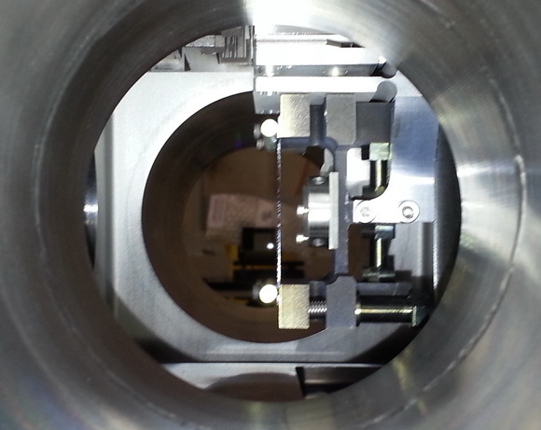
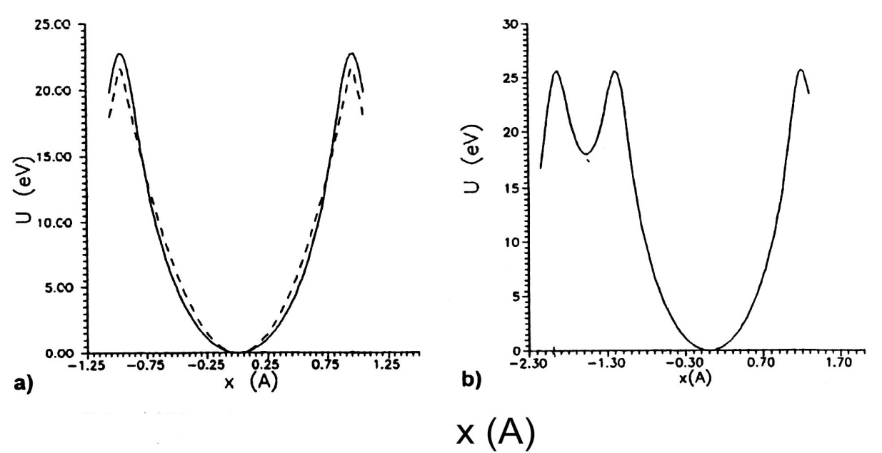
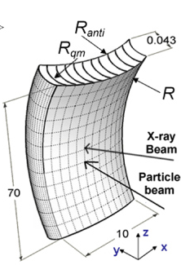
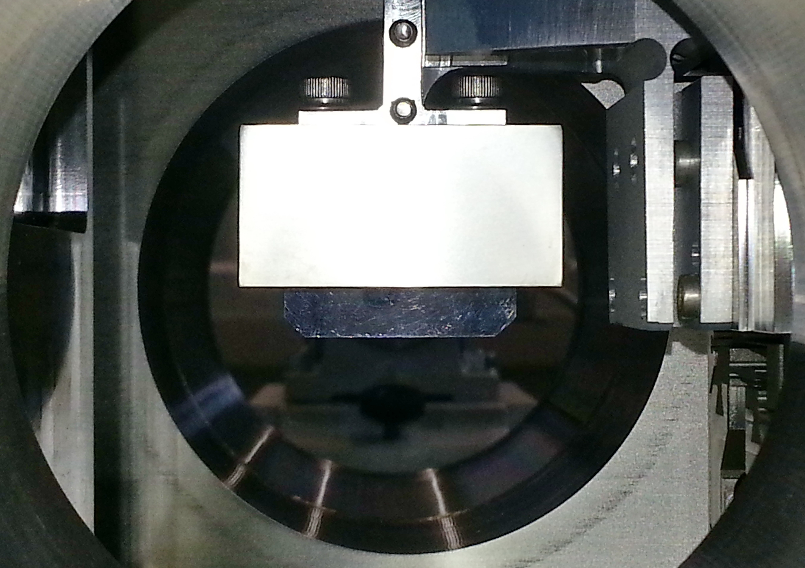
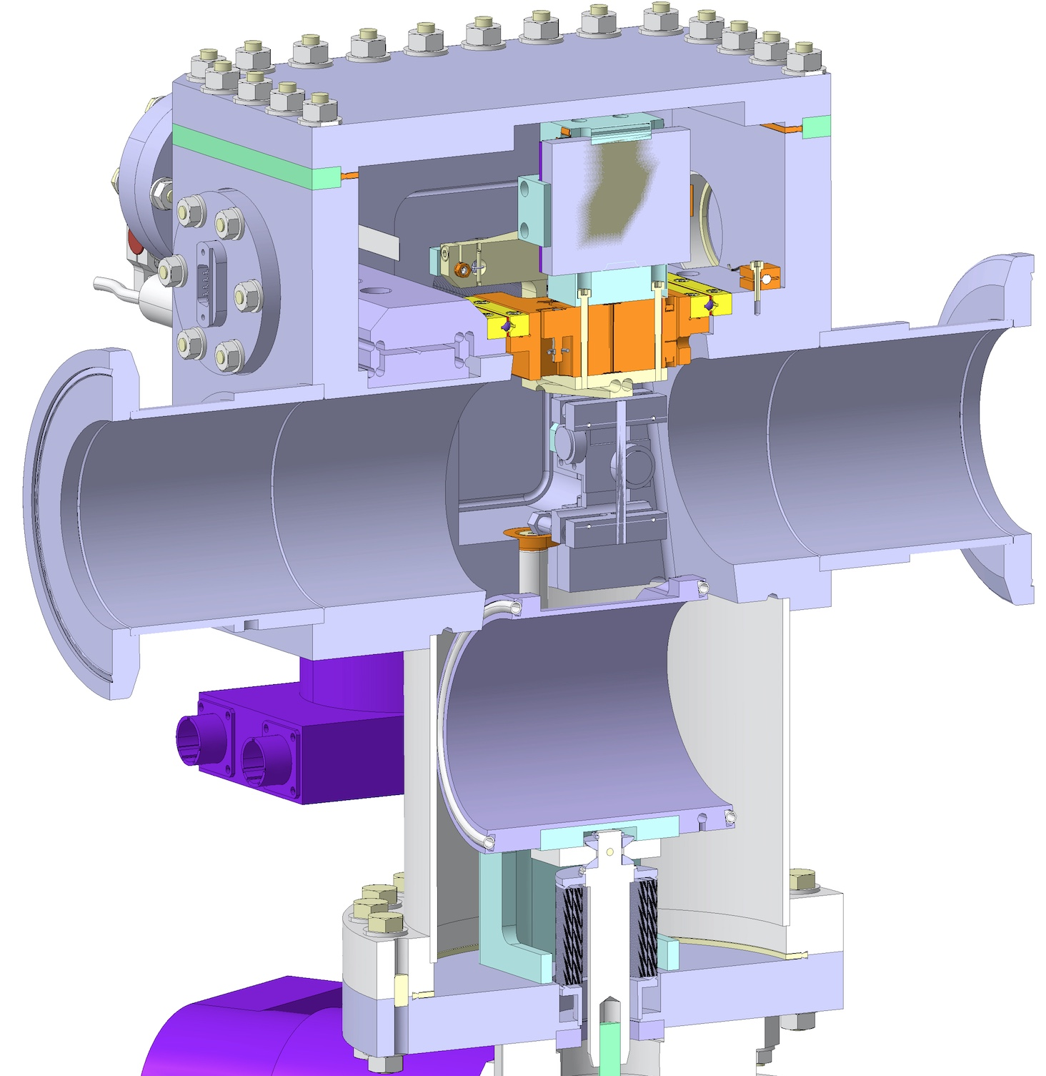
LHC Crystals
Prototype system has been integrated in the LHC collimation layout
Two goniometers (one horizontal and one vertical) were installed in 2014 in positions where a secondary collimator could be used as absorber
ST
Potential (110)
QM
Potential (111)
The goniometers are based on piezo-electric technology, and are able to achieve 0.1 μrad of accuracy
The bending for strip (ST) given by mean of anti-clastic forces. Quasi-Mosaic (QM) exploit the quasi-mosaicity effect.
Notes:
-anti-clastic. Those effect arise when a crystalline structure, as silicon, get a primary macroscopic curvature, with a mechanical device.
-QM

Slide 15

Horizontal Angular Scan @ 6.5 TeV
First observation of channeling at 6.5 TeV ➔ World Record!
Crystal @ 5.39 σ
In July both vertical (QM) and horizontal crystal (ST) were tested at flat top showing a reduction similar reduction factor
RF 24.0
Losses recorded with BLM at goniometer position normalized to beam flux and to loss rate in amorphous
RF 23.5
RF 25.5
Notes:
1 sigma at coll = 270 micron, crystal retracted of 50 micron

Slide 16
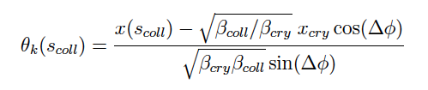
Horizontal Scraping @ 450 GeV
Losses recorded with BLM at goniometer position normalized to beam.
The X axis is converted in deflection angle using
The error function fit gives info about the channeled beam properties as deflection angle and beam sigma
Crystal @ 5.43 σ
Reduced Colls Config
New investigations are ongoing to include the difference between nominal and measured beta function

Slide 17
Ions Angular Scans @ 450 Z GeV
Reduction of inelastic interaction at crystal 6
Reduction of inelastic interaction at crystal 4
Losses recorded with BLM at goniometer position normalized to beam flux and to loss rate in amorphous orientation

Slide 18
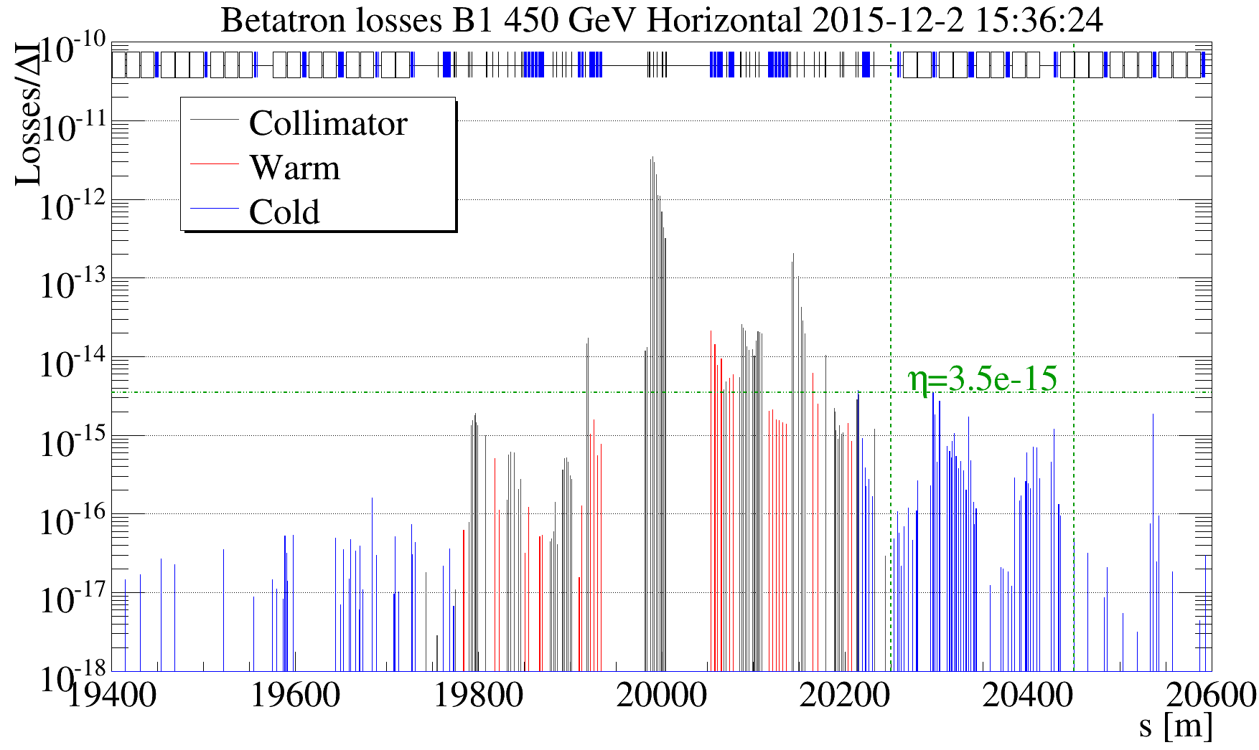
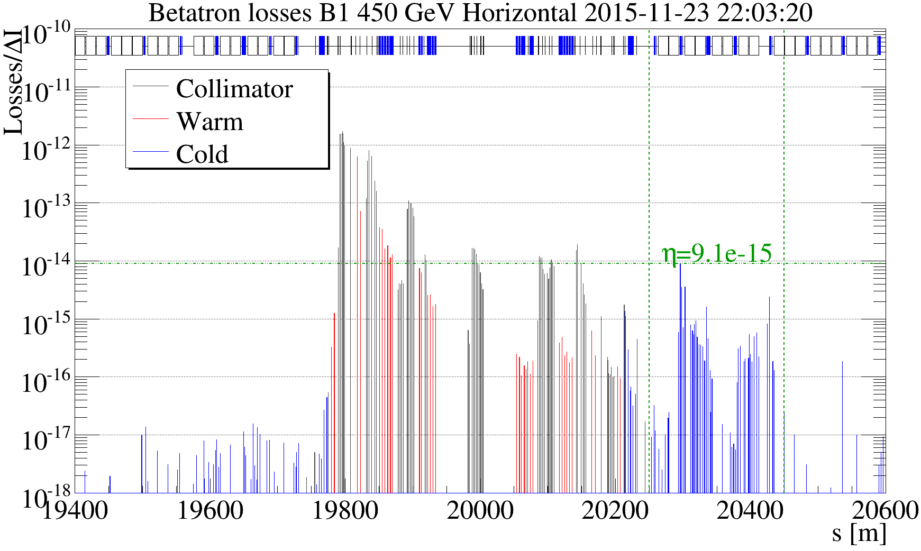
Ions Loss Maps @ 450 Z GeV
Loss maps measurements was performed as during standard collimation tests
TCSG.B4L7
crystal
standard
crystal
the leakage to IR7-DS is evaluated normalizing the BLM losses to the charges lost per second
the leakage to IR7-DS improves by a factor of about 2.6
better results are expected improving the clearance between crystals and TCSGs
note: the system is optimized for 6.5 TeV!
Notes:
normalized to charge lost per second
leakage already improved at injection, while system is optimized for top energy
the clearance is given by the actual system in which the crystal are inserted (transparent for standard operation)

Slide 19
Outline
Introduction
Hadron beam collimation
  collimation system
  crystal-assisted collimation
Scope of my PhD
Experimental results LHC
  Protons tests
  Ions tests
Simulations and semi-analytical studies
  B2 installation
  Energy ramp functions
  LHC & SPS simulation
Conclusion

Slide 20
Crystal installation on beam 2
Semi-analytical studies has been provided to find the best location to install the crystal on beam 2 line.
The possible available location where evaluated wrt the clearance obtained at the absorber collimator
crystal
absorber
Two locations have been found and installation is foreseen for this winter shutdown
absorber
crystal
In figures the grey line represent the envelope channeled beam extract from a 50 μrad bent crystal.
The lighter line represent the kick plus (and minus) a critical angle, hence the channeled beam size envelope is represented

Slide 21
Energy ramp function for tests
In the next LHC MD crystal will be tested during the energy ramp of LHC
During the last MD of July the channeling orientation and the linear alignment has been measured
 | Injection |  | Flat Top
crystal | Linear [mm] | Angle [μrad] | Linear [mm] | Angle [μrad]
H | 46.55 (5.71 σ) | 2066.9 | 52.72 (5.53 σ) | 2035.3
V | 44.8 (5.68 σ) | 2275.7 | 50.25 (5.47 σ) | 2219.3
The energy ramp function was used to evaluate how the orientation angle and the linear stage has to vary to keep the crystal in the channeling condition during the E ramp

Slide 22
Simulations plan
To benchmark the simulation routines the scenarios of the measurements taken in LHC will be reproduced with the SixTrack code, as showed for the first flat top scan.
- Exp. Data
• CRYSCOLL sim.
Simulations most important results are undergoing
Angular scans of crystals
Linear scans with absorber collimators
Loss maps in Channeling and with standard system
Of course each bullet has to be considered for both energy (injection and flat top) and for both plane (H & V)
Benchmarking the simulation code is the fundamental step to begin the studies on the final layout for a possible crystal collimation system for HL-LHC
    Also UA9 SPS results will be used to benchmark the simulation code

Slide 23
Conclusion
First part of thesis focused on data taking and experimental results:
  Channeling observed for the first time at the LHC with protons and ions at 450 GeV
  Channeling observed with protons at 6.5 TeV (world record)
  Tests with ions showed a reduction of particle leakage on dispersion suppressor in IR7, already at 450 Z GeV
  Energy ramp functions for operation cycle produced to be tested soon
Goals for the next year:
Continue experimental activities and finalize open issue in data analysis
  The most important will be the test with ion beam @ 6.37 Z TeV (this december)
Complete simulations to benchmark code with experimental data
Detailed design work for the LHC not yet started (final part of the thesis).
However, applied tools for a first new design layout for B2
to be implemented at the end of this year

Slide 24
BACKUP

Slide 25
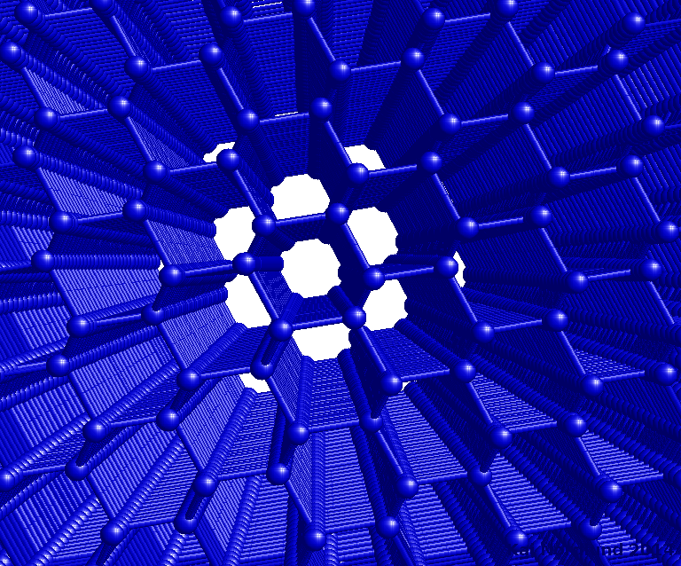



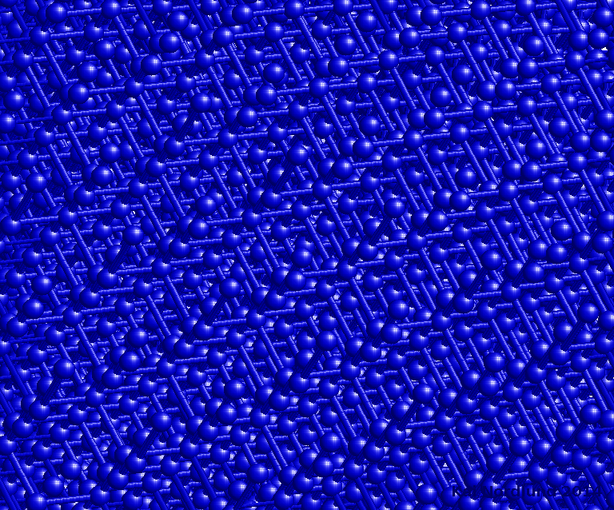
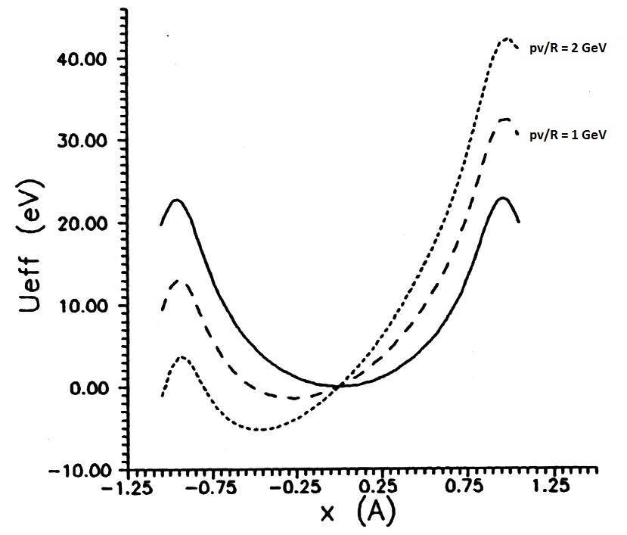
Crystal Channeling
Lindhard: “In the ipothesis of low impact angle, the potential generated by the crystalline plane can be approximated by a continouns potential.”
planes
Channeling : Tansverse momenta < potential well
The channeling condition can be defined as
So we can define a condition to undergo channeling condition
Critical angle
channel
The particles are trapped in the channel, hence if a curvature is given to the lattice the particles direction will be modified by θ_{b} = l/R
amorphous
Notes:
looking at specific orientation crystals shows channels
for collimation purpose is more suitable to use crystalline planes
Lindhard, transverse momenta, critical angle
the idea now is to bent the channels and keep the particle trapped to give them a deflection

Slide 26
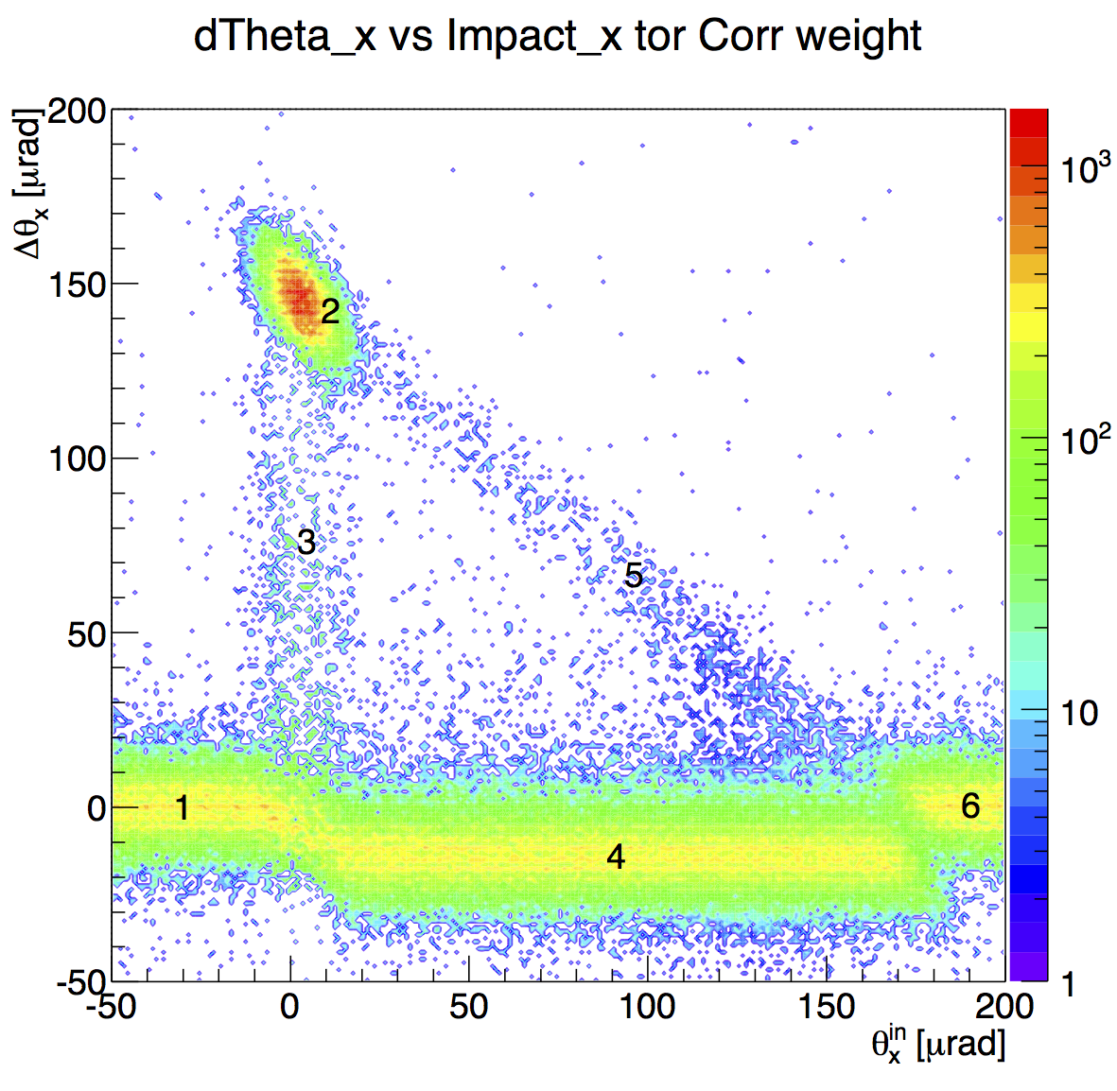
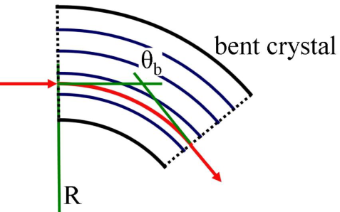
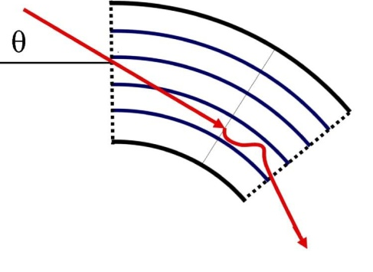
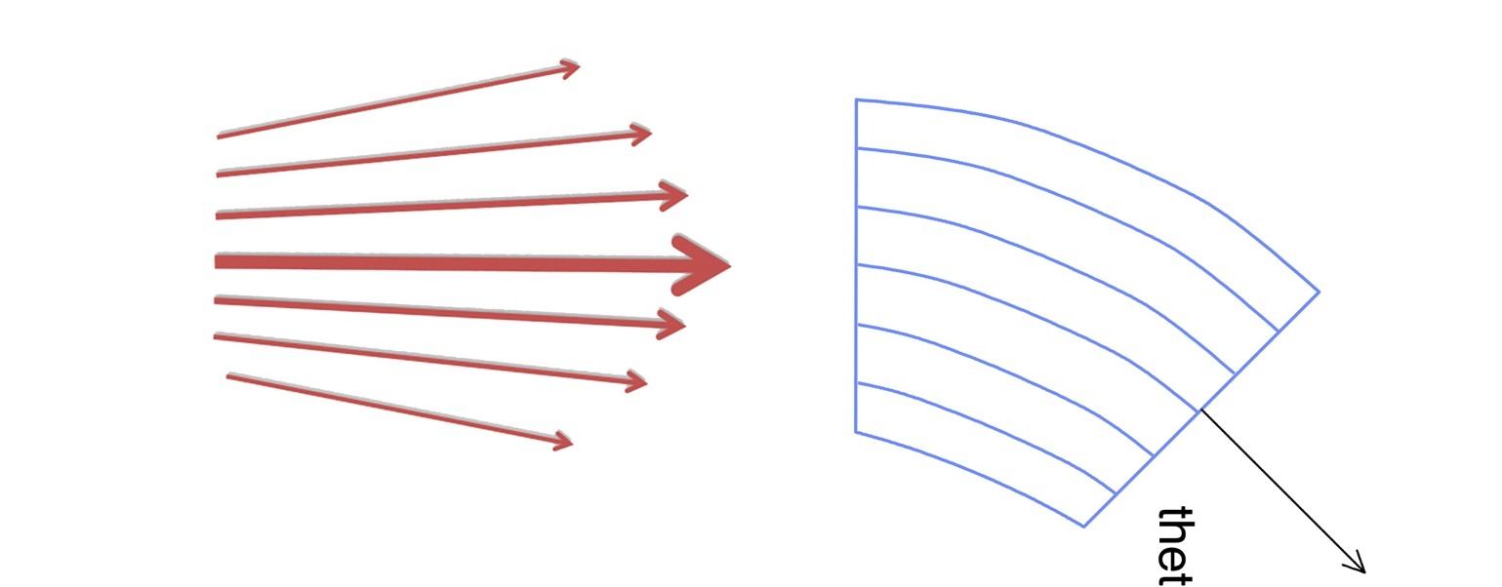
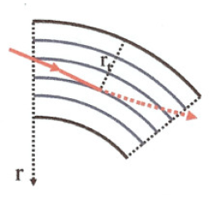
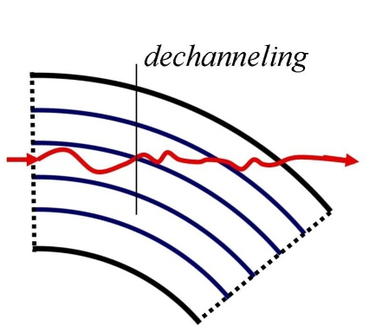
Coherent effect in bent crystals
Planar channeling (PC)
Particles are channelized, if impact angle is lower then the critical one, and deflected
Volume Capture (VC)
Particles are channelized at a certain depth in crystal volume
(1) & (6) amorphous
(2) channeling
(3) dechanneling
(4) volume reflection
(5) Volume capture
Volume Reflection (VR)
Particles are deflected by the potential well, at a certain depth in crystal colume.
The VR deflection is opposit to CH deflection and it’s about 1.6*θ_{c}
Single pass measurements with 400 GeV protons.
During an angular scan the crystal shows different choerent effect due to the bending.
In this case a strip crystal (110) with a 2 mm lenght anlong the beam and a curvature of 144 μrad.
Dechanneling (DC)
Particles exit from channeling condition at a certain depth in crystal and get a lower deflection

Slide 27
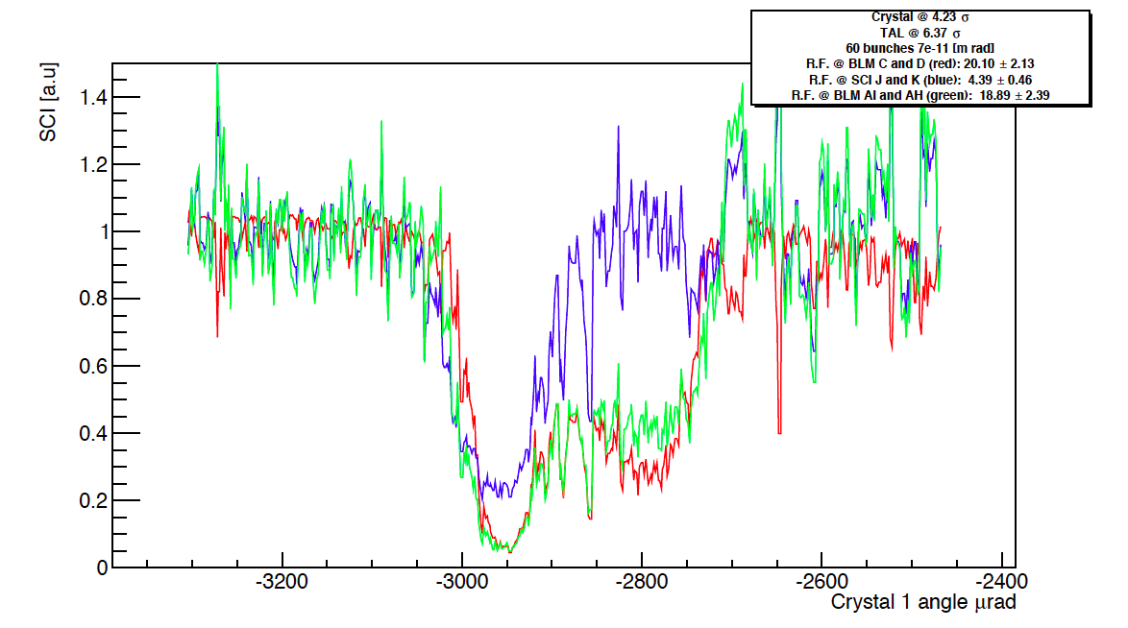
UA9 Experiment
The UA9 Collaboration investigates how tiny bent crystals could assist and improve the collimation process in the Large Hadron Collider (LHC) at CERN in view of future ultra-high luminosity operation.
Recap of results relevant for LHC beam tests
Principle of crystal-assisted collimation is investigated at the CERN SPS with stored beams of protons or lead (Pb) ions.
Characterization of coherent interaction between high-energy particles and bent crystals performed in SPS H8 extraction line.
Notes:
Ua9 is trying to investigate the feasibility of the crystal assisted collimation
the collaboration is active in several areas, the mains for LHC studies are H8 and SPS

Slide 28
UA9 SPS collimation
Instrumentation Layout in LSS5 in the SPS
Well established hardware and layout
Fast alignment
Clear loss reduction in CH orientation
AM
Initially used to prove crystal channeling in circular machines;
now useful test bench for detailed collimation studies in the LHC
Reduction Factor = Losses AM
Losses CH
CH

Slide 29
List of measurements
Fast angular scan on whole goniometers range
  Identification of channeling orientation
detailed angular scan around angles determined with the measurement above
  indication of optimal channeling orientation, scans repeated in different fills to test the system stability
  measurement of nuclear interaction rate at the crystal, characterization of local losses for different working regimes
  measurement of reduction of nuclear interaction rate (AM/CH) and measurement of crystal bending angle (extension of VR region)
Crystal placed in optimal channeling orientation and linear scans with selected TCSG is performed
  study the extracted beam profile, deflection angle, and multiturn channeling efficiency
  validation of expected crystal orientation
Loss map with reduced set of collimators in IR7 (all collimators upstream the crystal retracted of … sigma)
  validation of working principle with reduced number of collimators
  comparative studies w.r.t. present collimation system
Beam
Angular Scan
Crystal
Absorber Scan
Absorber

Slide 30
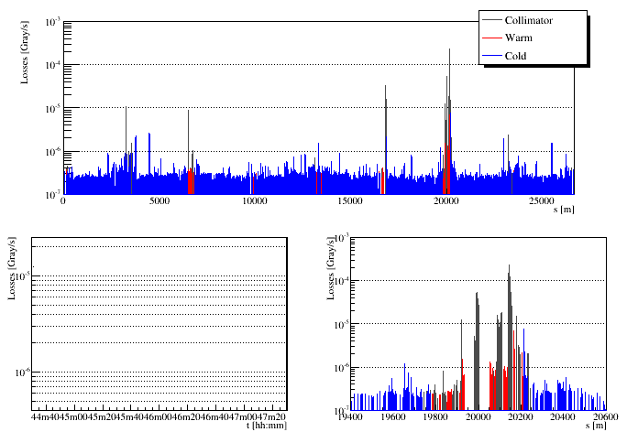
Loss Map Horizontal plane
Raw data
The picture shows losses on the whole machine during an angular scan, with the reduced settings of collimators.
Preliminary – pending detailed calibration
Daniele Mirarchi

Slide 31
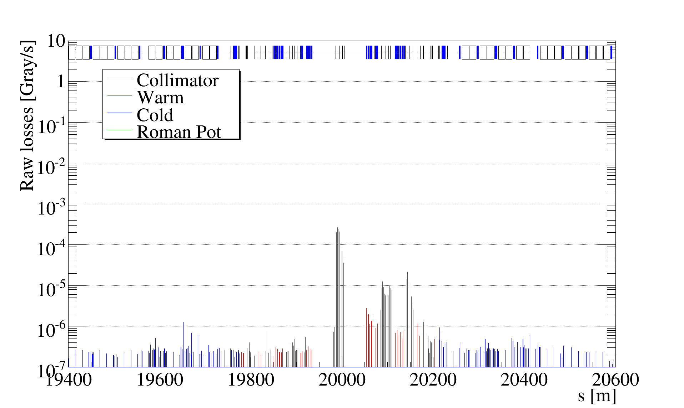
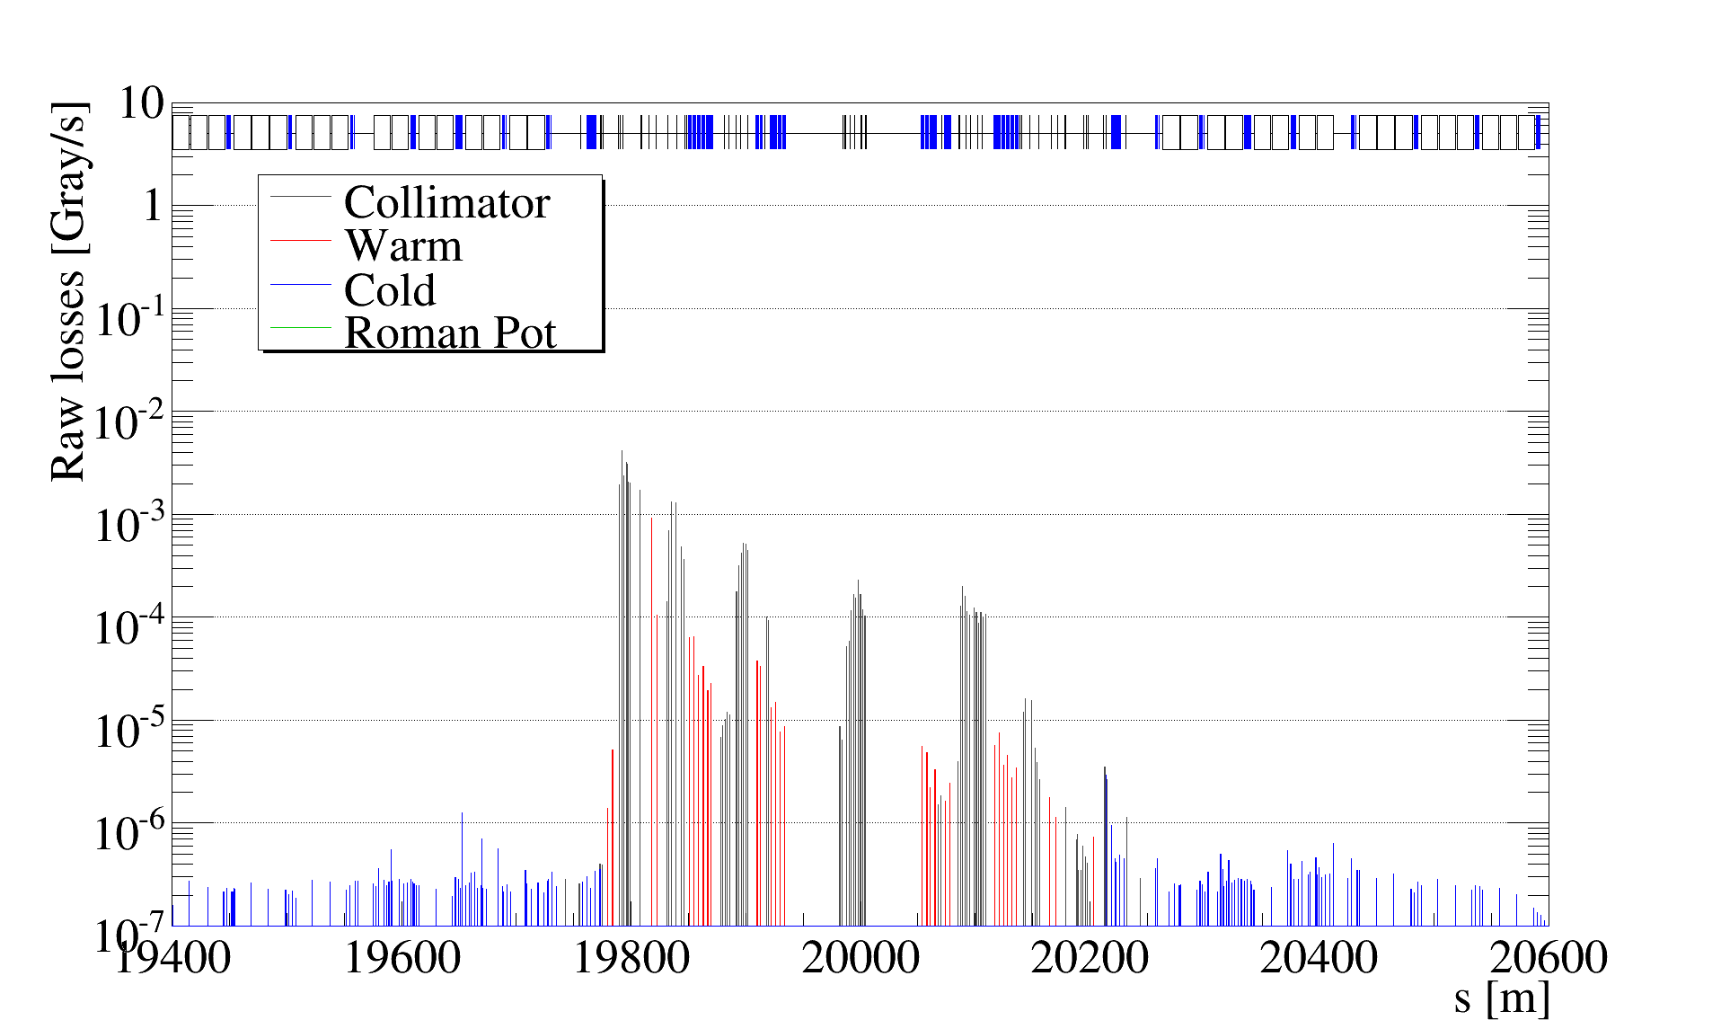
Loss Map comparison
Preliminary – pending detailed calibration

Slide 32
Ions Channeled Beam Linear Scans
Losses recorded with BLM at each collimator position normalized to beam flux

Slide 33
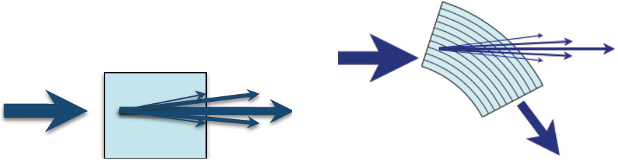
Introduction
UA9 collaboration is studying the possibility of steering particle beam with bent silicon crystal to improve the actual LHC collimation system.
Various studies are required to achive this goal :
  Interaction characterization of charged particle with bent crystal
  Development of simualtion routine
  Experimental study of a crystal-assisted collimation system on SPS
  New detector development for beam flux measurment
UA9 just launched a working group with the CERN Extraction team to study an SPS beam extraction system with bent crystals.

Slide 34
H8 Crystal test Beam
The UA9 collaboration is studying techniques to steer ultra-relativistic beams with bent crystals to improve the collimation of proton and heavy ion beams at the LHC.
Measurements of key crystals properties (bending angle, channeling efficiency, etc..) are performed on the SPS extraction line (H8) with 400 GeV/c protons before testing crystals with circulating beams.
Data analysis main goal:
Consistently analyze all the crystals tested in H8 (total of 15 between 2010-2012).
- Compile a comprehensive statistical treatment of different crystals
- Identify “fine” systematic effects (e.g., transitions)
- provide inputs to crystal code developers
Immediate goal: compile list of experimental data for comparison with crystal simulations.
http://lhc-collimation-upgrade-spec.web.cern.ch/LHC-Collimation-Upgrade-Spec/H8_input.php
Notes:
Dopo diversi anni di presa dati alla linea h8, si è reso necessaria l’analisi sitematica dei dati raccolti per avere un quadro generale dei vari cristalli analizzati
Inoltre questo lavoro si propone anche di effttuare analisi più dettagliate su aspetti più fini, al fine di migliorare I modelli utilizzati nelle simulazioni.

Slide 35
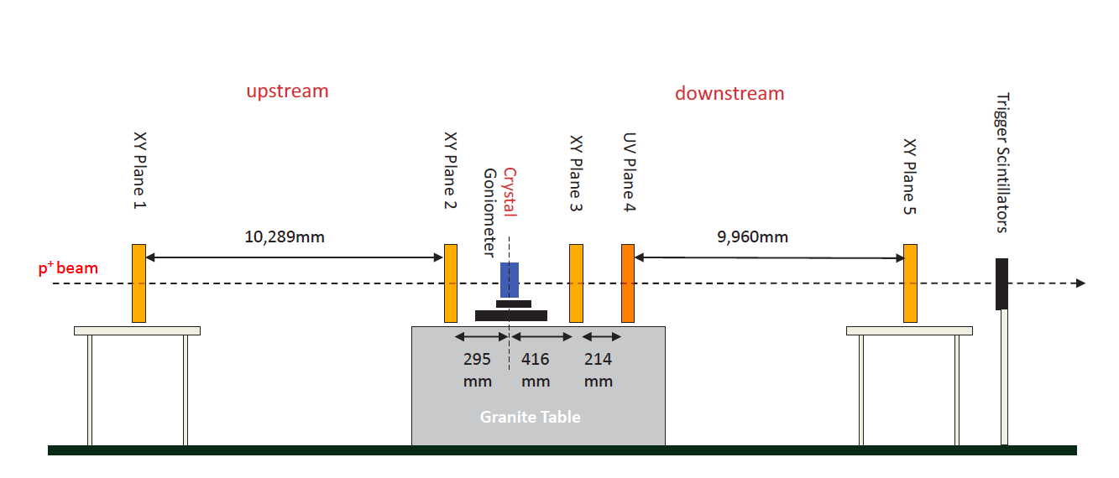
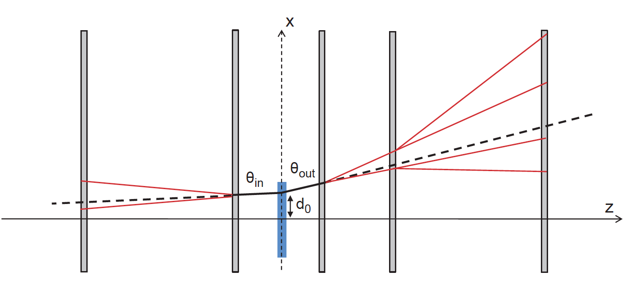
H8 experimental Layout
Five silicon micro-strip sensors (active area 3.8x3.8 cm² in the x-y plane) are used to track the particles in the plane orthogonal to the beam direction before and after passing through the crystal.
High precision goniometer is used to modify the crystal plane orientation with respect to the beam direction.
Notes:
Inserire referenza articolo mark
SR: magari dopo questa slide puoi aggiungerne una in cui dai la lista dei tipi di cristalli testati, introducendo QM e ST.

