Slide 1
PHD Theses at DAΦNE
Catia Milardi
on behalf of the DAΦNE Team
PHD Theses, Oct 2016, La Sapienza, Roma

Slide 2
Outline
DAΦNE overview
DAΦNE contribution to the development in the field of Particle Accelerator Physics
Crab-Waist Collision Scheme
Present situation and future programs
PHD Theses

Slide 3
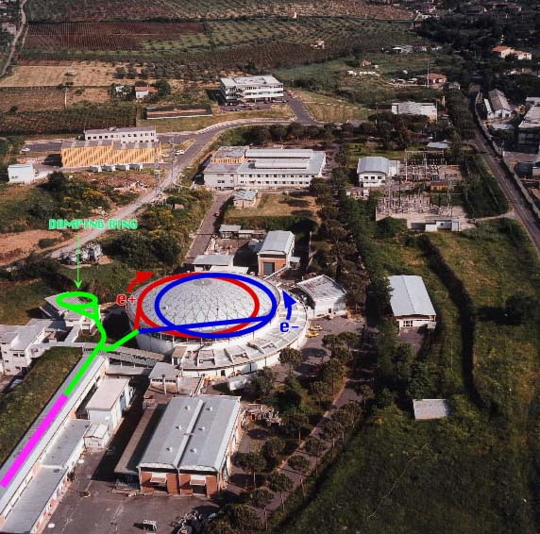
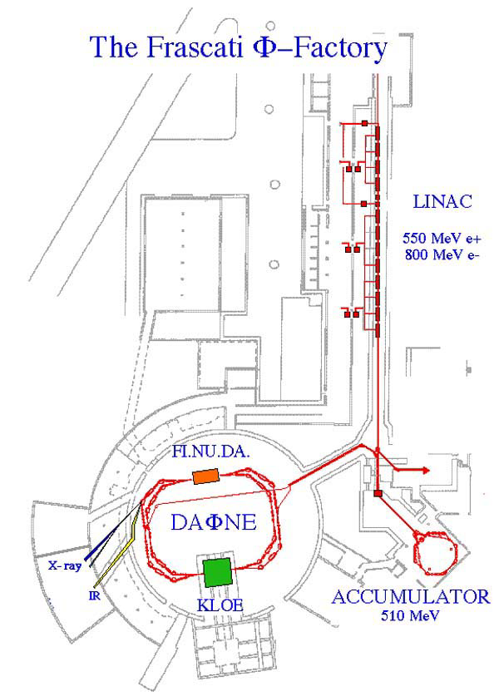
The DAΦNE Accelerator Complex
e⁺ e⁻
C ≈ 97 m
E_{CM} = 1.02 GeV (Φ)
Frascati National Laboratories (LNF)
FINUDA
BTF
UV 2 - 10 eV
X-ray 900 - 3000 eV
IR 1.24 meV - 1.24 eV
LNF are also part of the European
synchrotron light Infrastructures

Slide 4
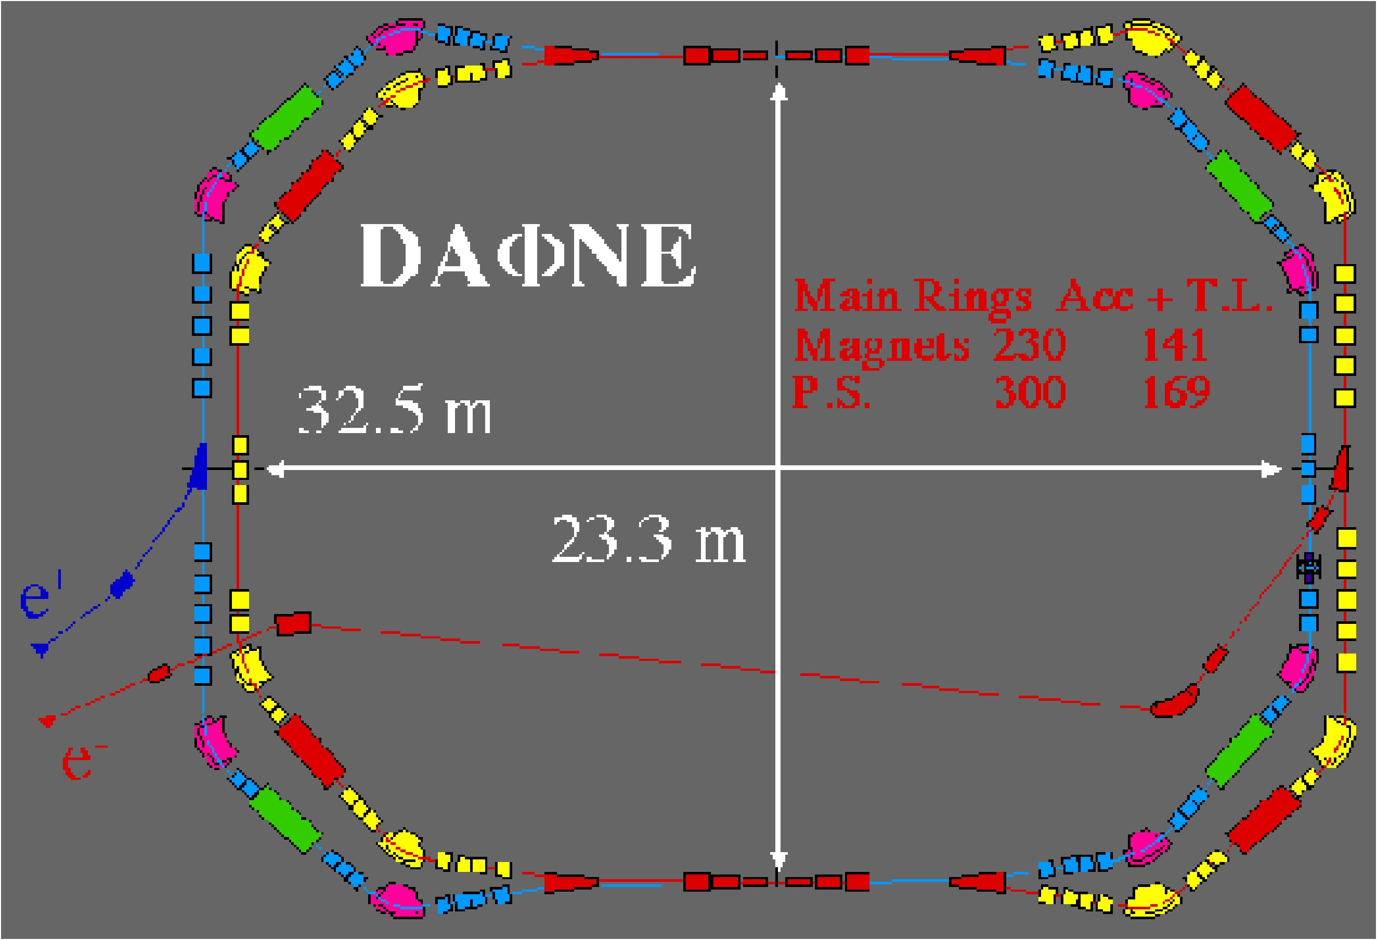
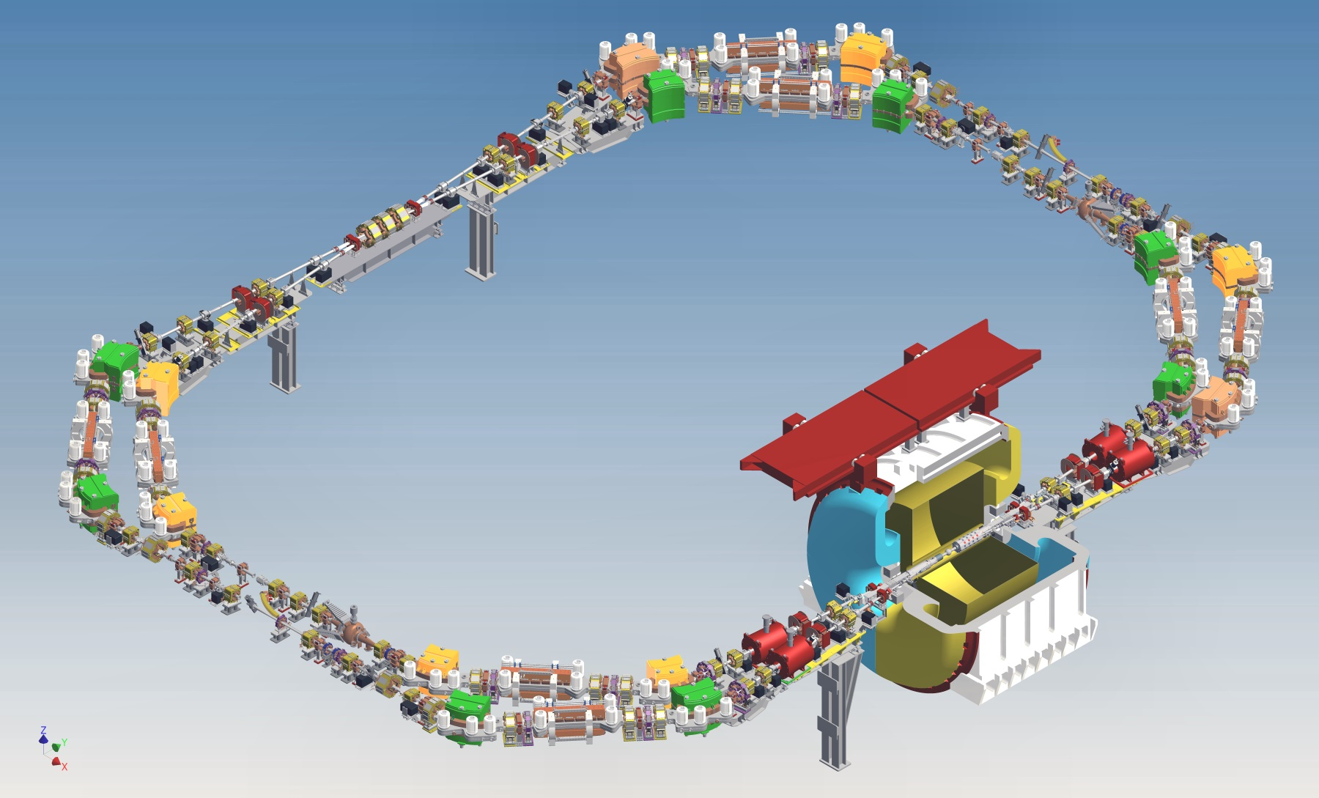
DAΦNE parameters
 | DAΦNE native | DAΦNE Crab-Waist
Energy (MeV) | 510 | 510
θ_{cross}/2 (mrad) | 12.5 | 25
ε_{x} (mmxmrad) | 0.34 | 0.26
β_{x}* (cm) | 160 | 26
σ_{x}* (mm) | 0.70 | 0.26
Φ_{Piwinski} | 0.6 | 1.9
β_{y}* (cm) | 1.80 | 0.85
σ_{y}* (μm) low current | 5.4 | 3.1
Coupling, % | 0.5 | 0.5
Bunch spacing (ns) | 2.7 | 2.7
I_{bunch} (mA) | 13 | 13
σ_{z} (mm) | 25 | 20
N_{bunch} | 110 | 110
L (cm⁻²s⁻¹) x10³² | 1.6 | 5
KLOE
FINUDA (DEAR)
“Proposal for a Φ-factory”, LNF-90/031 (IR),1990.
Colliding beams have:
low E
high currents
short bunch spacing
long damping time
Notes:
In 2007 the DAΦNE accelerator complex has been upgraded in order to implement a new collision scheme based on large Piwinski angle, low–β and Crab-Waist compensation of the synchro-betatron resonances
The upgrade took ~ five months
Since May 2008 DAΦNE is delivering luminosity to the SIDDHARTA experiment.

Slide 5
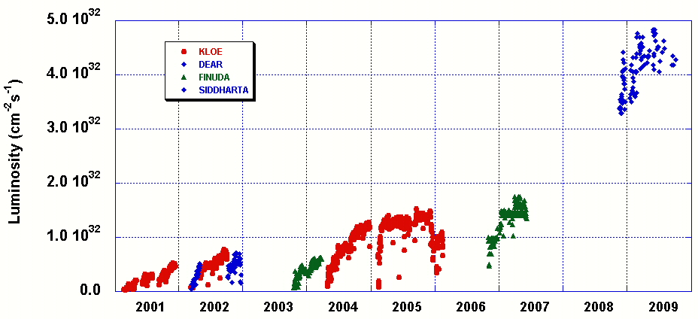
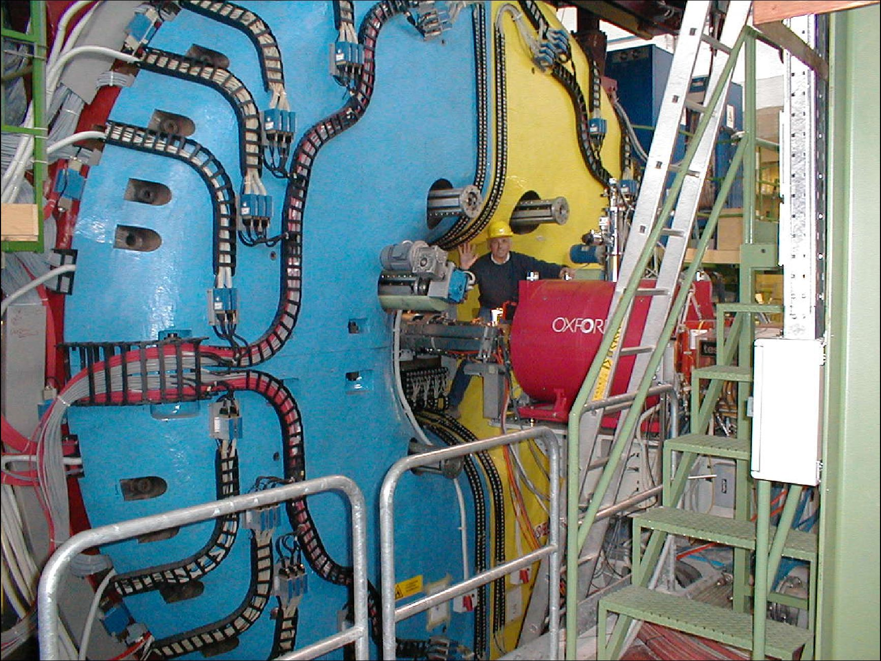
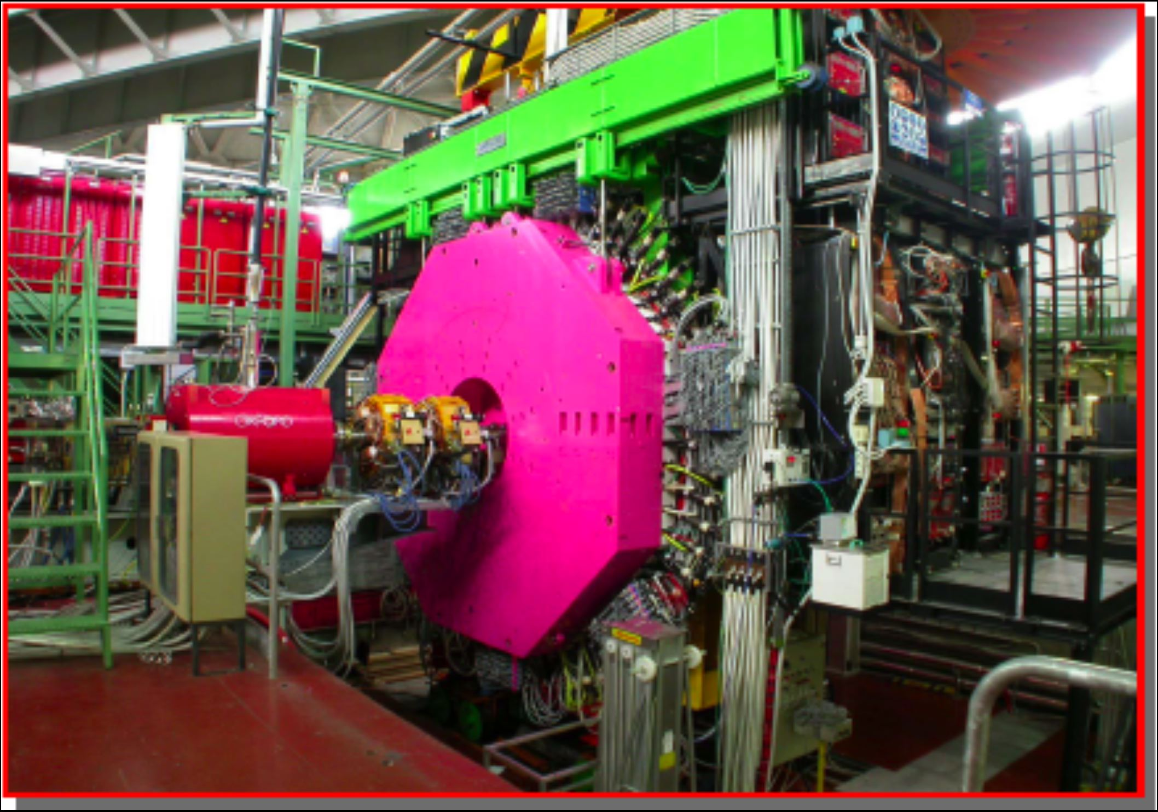
Luminosity at DAΦNE 2001 ÷ 2009
Design Goal
Crab-Waist COLLISION SCHEME
KLOE
FINUDA
SIDDHARTA (DEAR)
Notes:
4.5 fb^-1 acquired before the CW upgrade

Slide 6
Contributions to particle accelerator physics
Ideas and studies aimed at improving beam dynamics and beam-beam performances:
Low impedance vacuum chamber components
innovative bunch by bunch feedback systems
short pulse PS for injection kickers
non-linearities mitigation in magnet fields especially in wigglers
collisions with negative momentum compaction
parasitic crossing compensation by current carrying wires
collisions with very high crossing angle
strong RF focusing
crab Waist collisions
electrodes for e-cloud compensation
Proposals:
DANAE (1.02 GeV ÷ 2.4 GeV)
Bunch lenght modulation experiment
DAFNE-VE (0.6 GeV ÷ 3 GeV with CW)

Slide 7
DAΦNE achievements
luminosity achieved at DAΦNE is by two orders of magnitude higher than the one obtained at other colliders operating in the same energy range
Impedance budget is a factor 80 lower than in similar storage ring (EPA)
Collisions with negative momentum compaction gave a 25% gain in terms of specific luminosity at low current without sextupoles
Longitudinal feedback kicker designed for DAFNE has been adopted at: KEKB, BESSYII, PLS, SLS, HLS, ELETTRA, KEK Photon Factory, PEP II …
Maximum current stored in the DAFNE electron ring, 2.45 A, is the higher ever achieved in the world
DAΦNE is the only collider operating routinely with, and thanks to the electrodes for e-Cloud mitigation
Crab-Waist collision scheme has become a basic design concept for future new projects

Slide 8
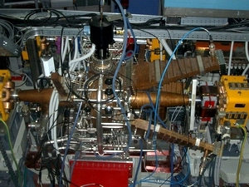
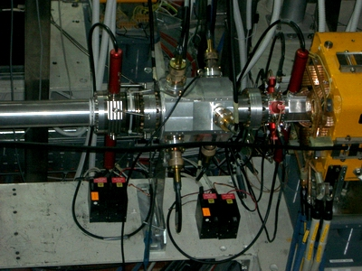
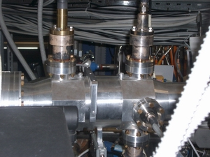
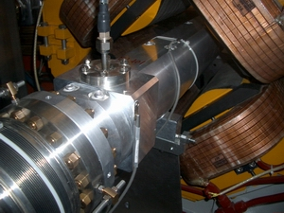
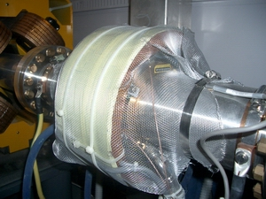
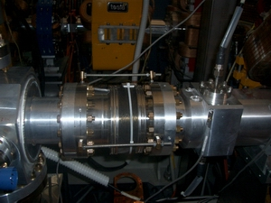
HOM Damped Vacuum Chamber Elements
RF CAVITY
LONGITUDINAL
KICKER
TRANSVERSE
KICKER
INJECTION
KICKER
WALL CURRENT &
DCCT MONITOR
SHIELDED
BELLOWS

Slide 9
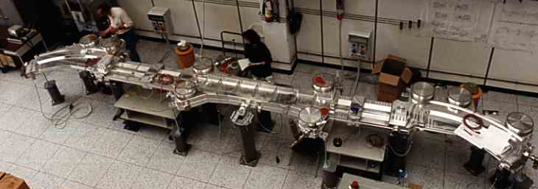
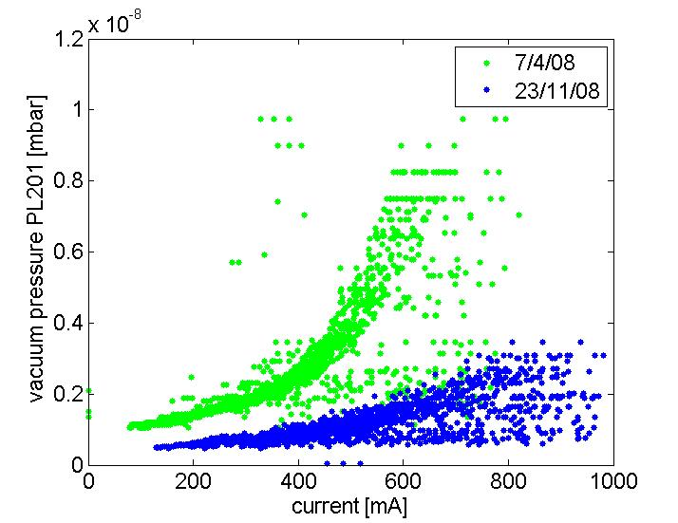
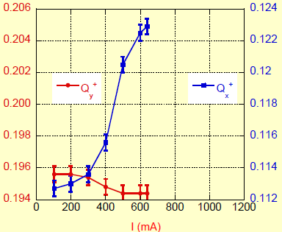
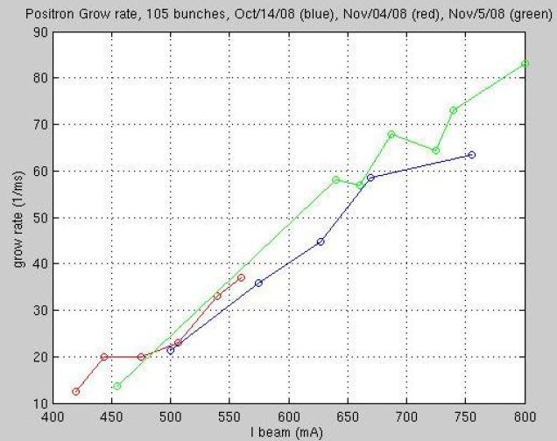
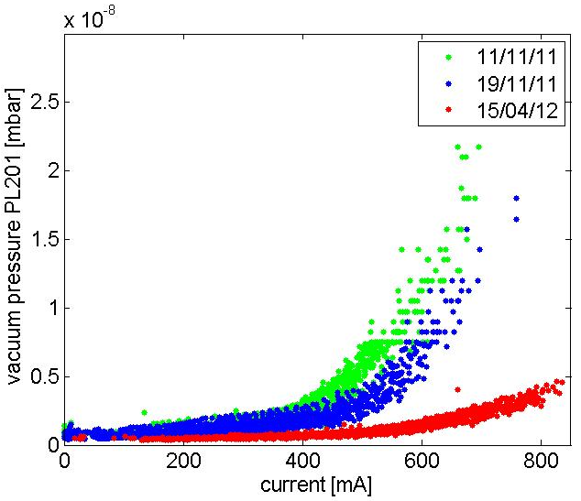
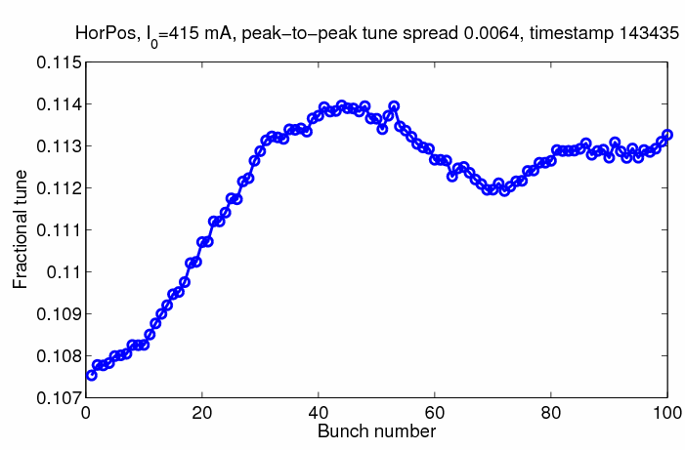
e-Cloud at DAΦNE
The worst case:
Aluminium vacuum chamber
Shortest bunch separation of 2.7 ns
Al wiggler and dipole chamber
anomalous vacuum pressure rise
larger positive tune shift
Very fast horizontal instability not explainable by parasitic HOMs
tune shifts along the bunch train

Slide 10
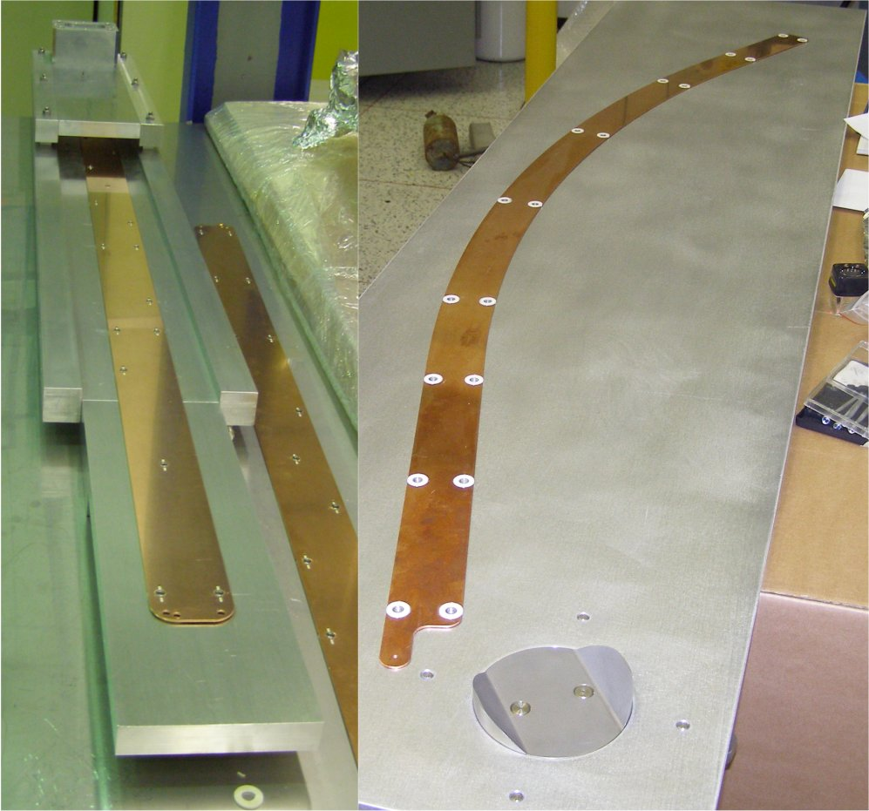
Electron Clearing Electrodes
To mitigate the e-cloud instability copper electrodes have been inserted in all dipole and wiggler chambers of the machine and have been connected to external dc voltage generators.
The dipole electrodes have a length of 1.4 or 1.6 m depending on the considered arc, while the wiggler ones are 1.4 m long.
(Courtesy of D. Alesini)

Slide 11
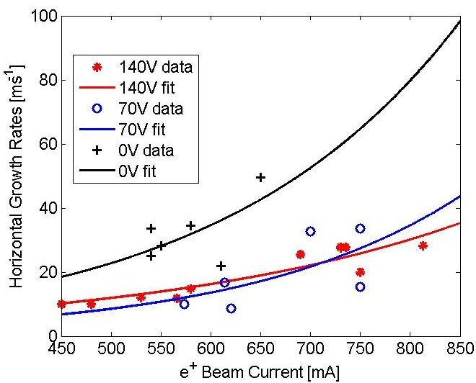
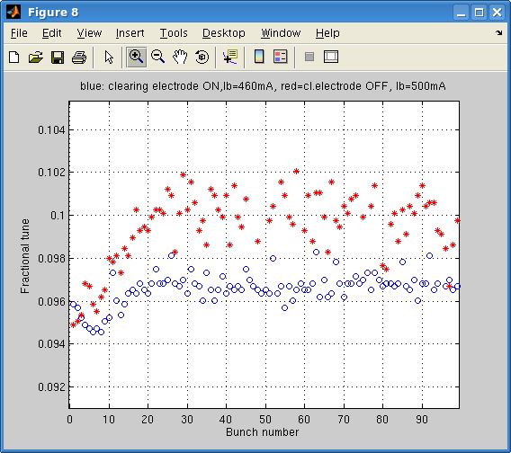
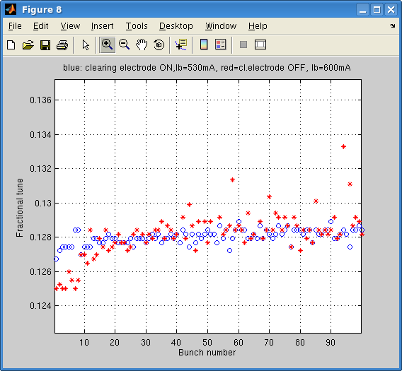
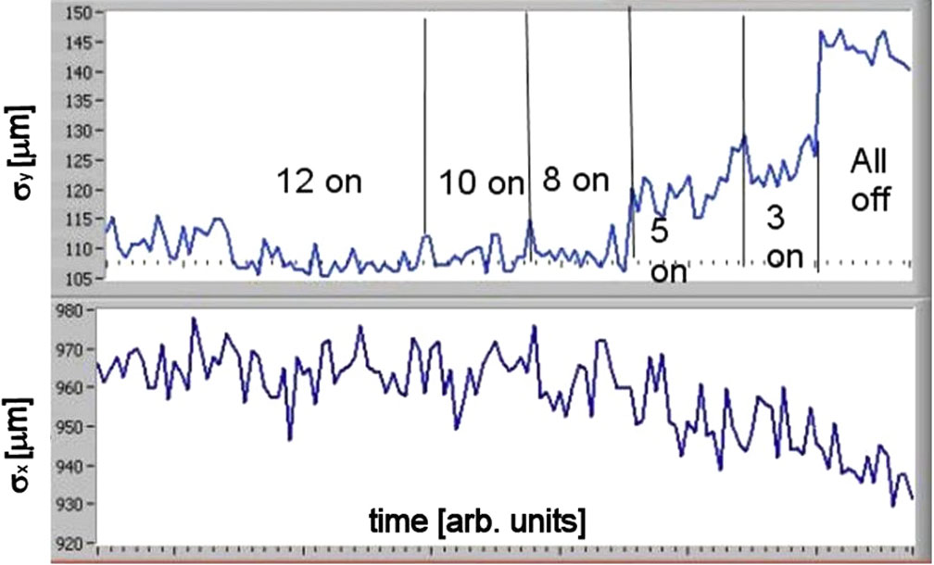
Clearing electrodes for e-cloud suppression
DAΦNE is the first collider operating routinely with long electrodes, for e-cloud mitigation.
Electrodes let more stable operation with the positron beam, and allowed unique measurements such as: e-cloud instabilities’ growth rate, transverse beam size variation, and tune shifts along the bunch train, demonstrating their effectiveness in restraining e-cloud induced effects.
(D. Alesini et al, Phys. Rev. Lett. 110, 124801 (2013)
Horizontal Instability Growth Rate measured busing bunch-by-bunch feedback as a function of the electrode voltage
Tune Spread measurements
Δν^{x}₁₋₁₀₀ ~ 0.006 (off)
Δν^{x}₁₋₁₀₀ ~ 0.003 (on)
<Δν^{x} > ~ 0.0065 (on/off)
Δν^{y}₁₋₁₀ ~ 0.002 (on/off)
Beam Dimension

Slide 12
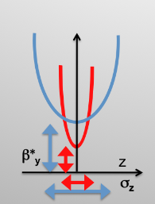
Crab-Waist Collision Scheme
A new collision scheme has been designed and implemented on the DAΦNE collider, the Crab-Waist collision scheme to overcome limitation in L due to:
hourglass effect β*_{y} ~ σ_{z}
LRBB interactions
beam transverse sizes enlargement due to BB interaction
Crab-Waist is based on:
Large Piwinski angle Φ
β*_{y} comparable with overlap area
Crab-Waist transformation by two Sextupoles
Hourglass effect
P. Raimondi , 2° SuperB Workshop, March 2006
P.Raimondi, D.Shatilov, M.Zobov, physics/0702033
C. Milardi et al., Int.J.Mod.Phys.A24, 2009
M. Zobov et al., Phys. Rev. Lett. 104, 2010
large θ
small σ∗_{x}
L gain with N
low ξ_{x}
ξ_{y} decrease with Y oscillation amplitude
L geometrical gain
lower ξ_{y}
Y Synchro-betatron resonances suppression
L geometrical gain
lower ξ_{y}
X-Y Synchro-betatron resonances suppression
Notes:
Bety cannot be much smaller than rms longitudinal beam dimension sigz without incurring in hourglass effect
Bety variation along the bunch length causes relevant luminosity reductions
Moreover shortening the bunch in high current ring is very difficoult without exciciting instabilities driven by collective effects

Slide 13
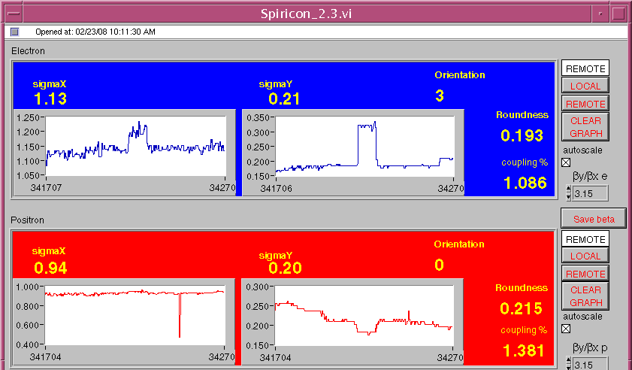
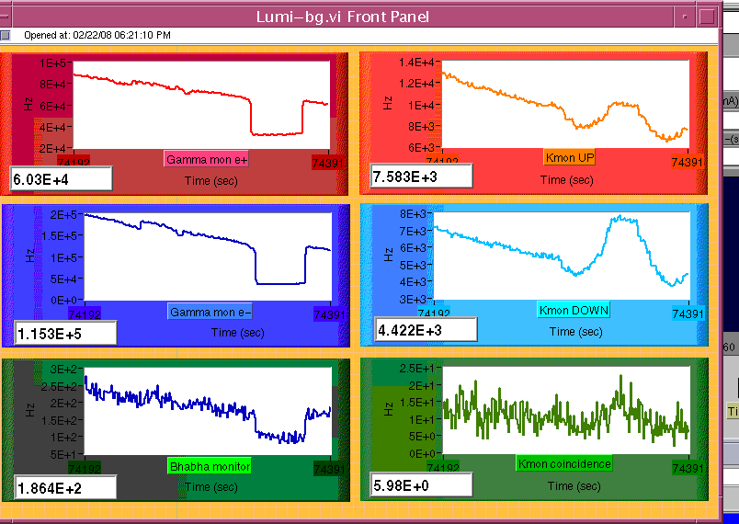
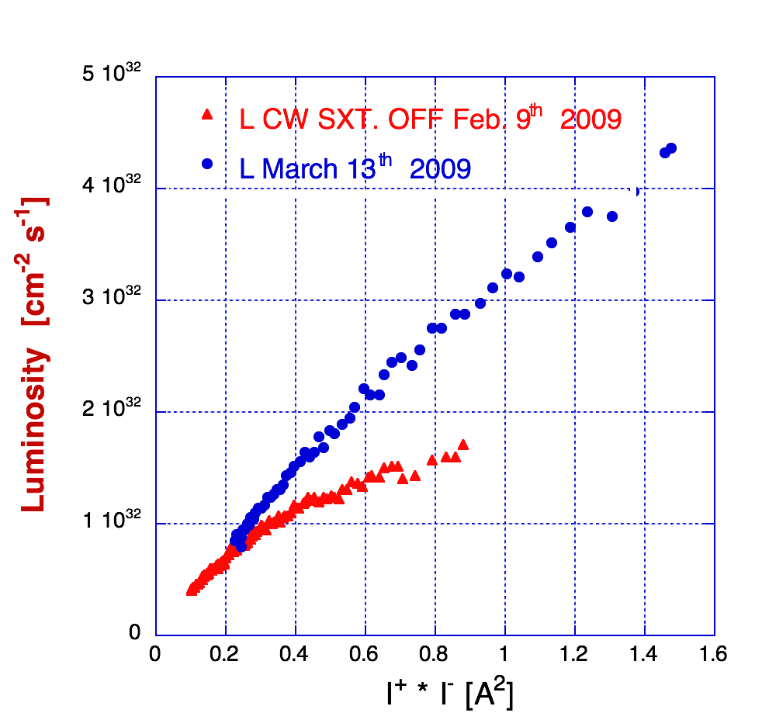
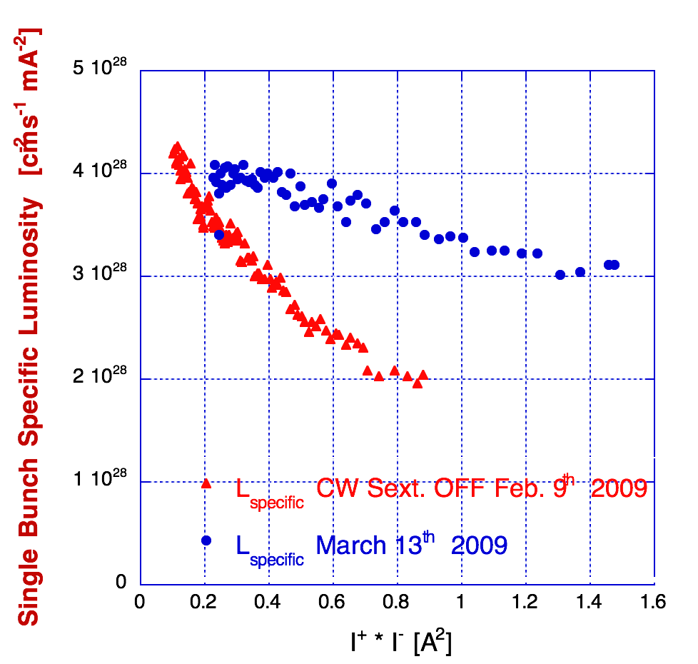
Crab-Waist Compensation First Experimental Evidence
Beam transverse size measured at the SLM
Luminosity from 2 different monitors
CW SXT OFF
{
e⁻
CW SXT OFF
{
{
{
CW SXT OFF
CW SXT OFF
e⁺
CW SXT OFF
{
Transverse sizes (left) and luminosity (right) dependence on the CW-Sextupole excitation in the e⁻ ring
Luminosity as a function of colliding currents
CW-Sextupole excitation

Slide 14
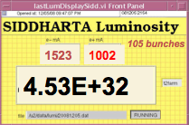
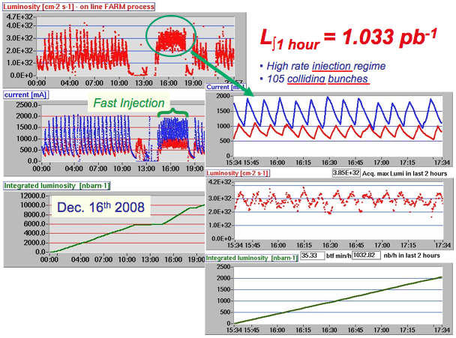
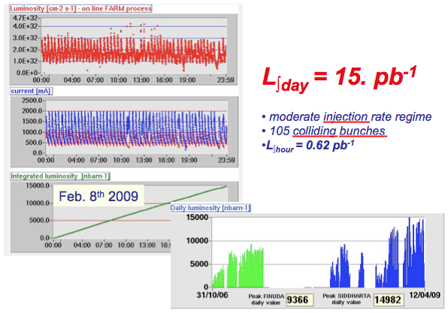
Crab-Waist collision scheme and SIDDHARTA
Large crossing angle and Crab-Waist scheme proved to be effective in increasing luminosity, a factor 3 higher than in the past
The DAΦNE collider, based on a new collision scheme including Large Piwinski angle and Crab-Waist, has been successfully commissioned and has delivered:
L_{peak}= 4.5*10³² cm⁻² s⁻¹
L_{∫1 day}= 15.0 pb⁻¹
L_{∫1 hour} = 1.033 pb⁻¹
L_{∫run}~ 2.8 fb⁻¹ (SIDDHARTA detector)

Slide 15
KLOE-2 run
Integrating the high luminosity collision scheme with a large experimental detector introduces new challenges in terms of:
IR layout
optics
beam acceptance
coupling correction
Crucial Points:
IR optics complying with:
Low-β
Crab-Waist collision scheme
Coupling compensation
Beam trajectory control
IR mechanical design allowing:
Large crossing angle
Early vacuum pipe separation after IP inside the detector

Slide 16
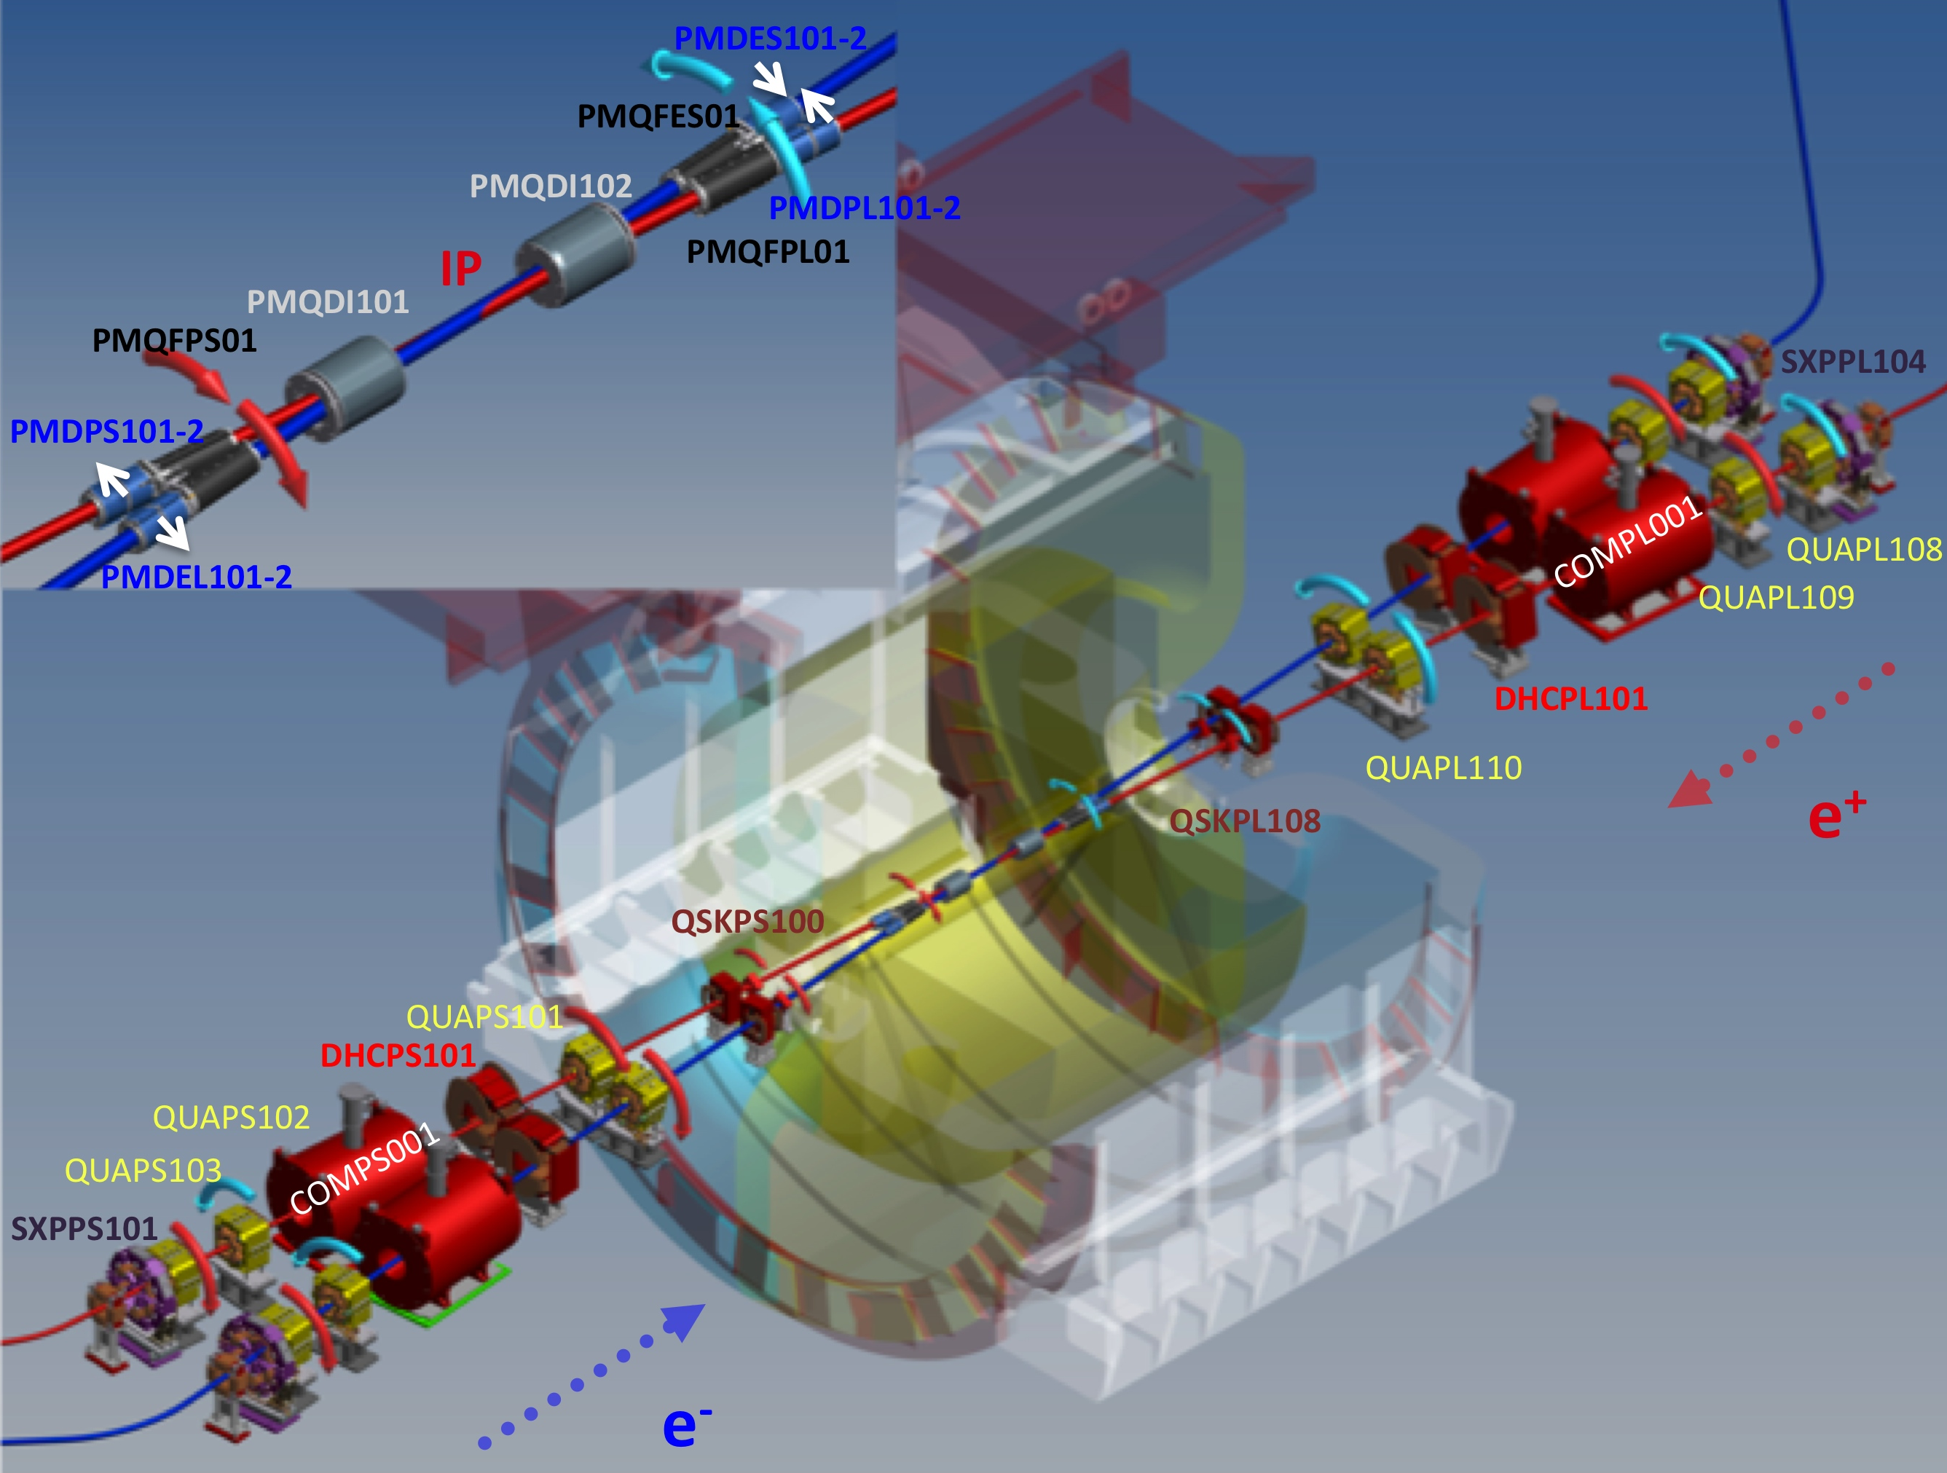
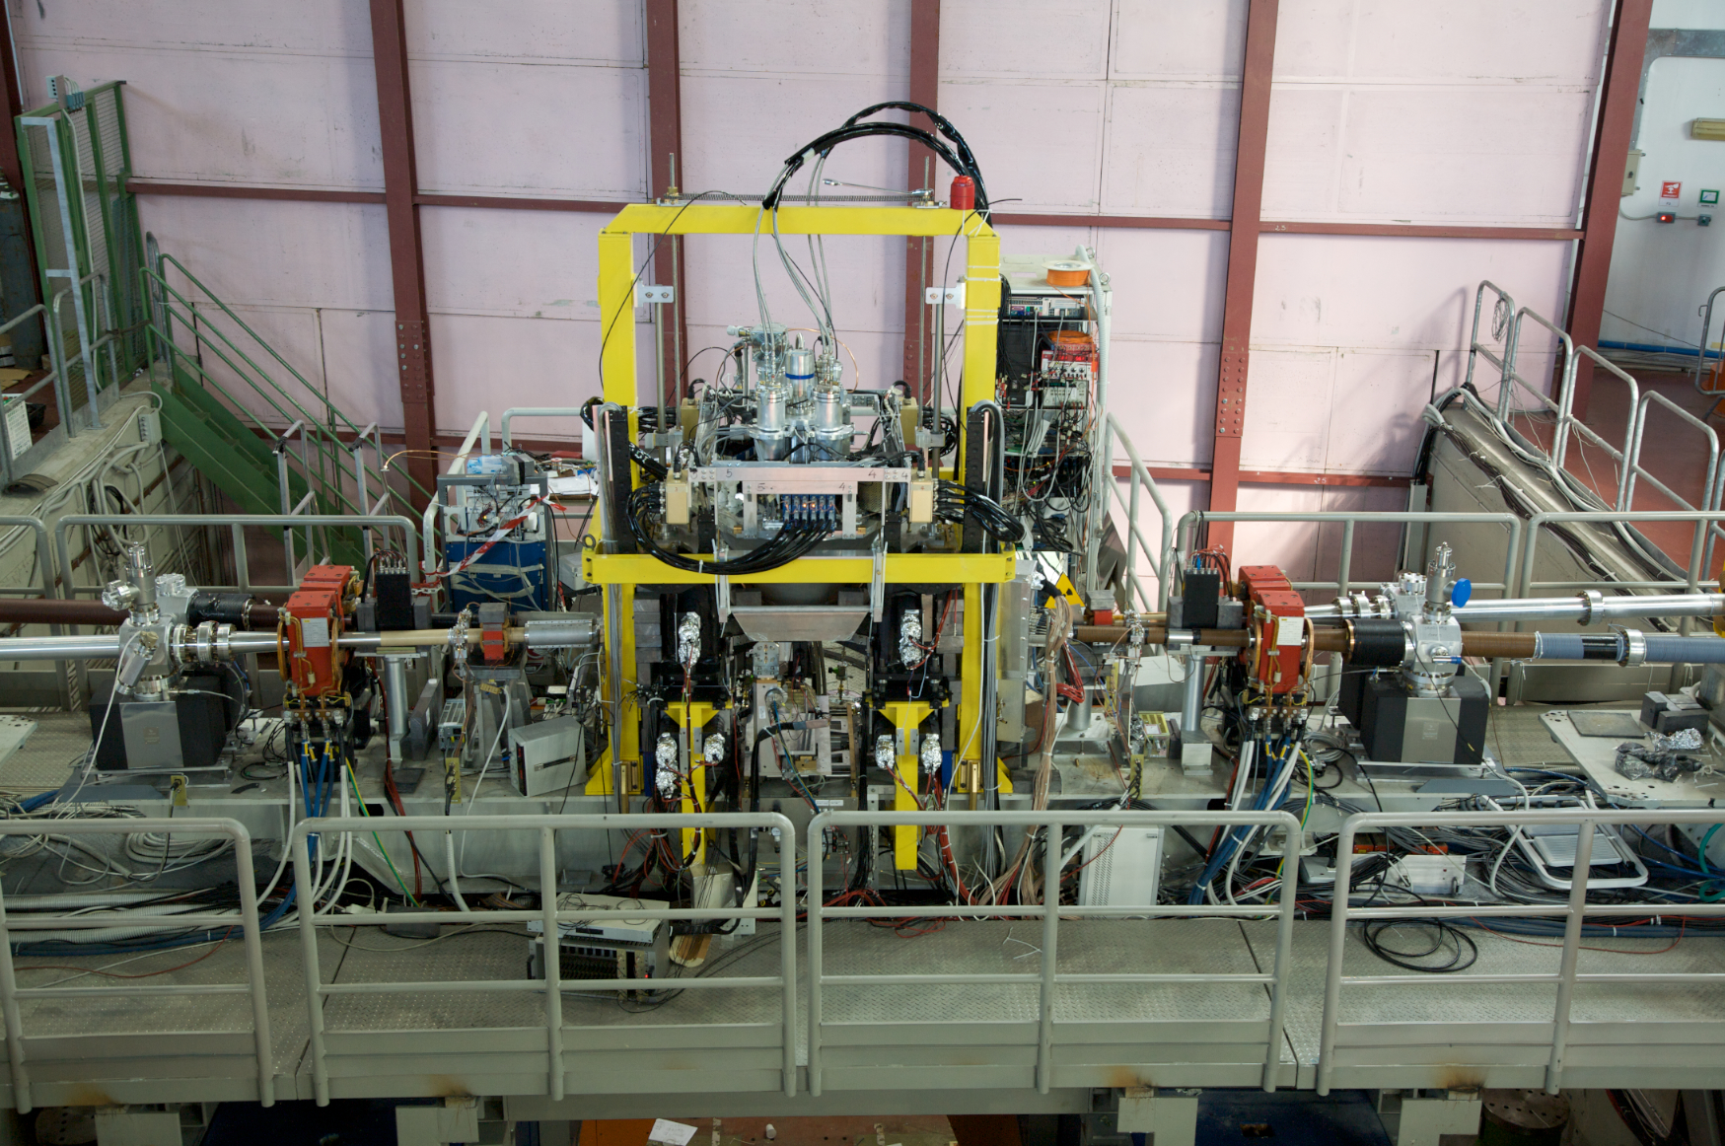
KLOE-2 IR
low-β
10 m
C. Milardi et al 2012 JINST 7 T03002.
SIDDHARTA IR

Slide 17
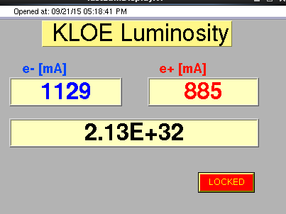
Peak Luminosity during the KLOE-2 run
Still the full potential of the new CW collision scheme has not been completely exploited
105 bunches
 | DAΦNE CW upgrade SIDDHARTA (2009) | DAΦNE CW KLOE-2 (2016)
L_{peak} [10³² cm⁻²s⁻¹] | 4.53 (5.0) | 2.13
L_{∫day} [pb⁻¹] | 14.98 | 14.03
L_{∫1 hour} [pb⁻¹] | 1.033 | 0.62
I⁻_{MAX} in collision [A] | 1.52 | 1.129
I⁺_{MAX} in collision [A] | 1.0 | 0.885
N_{bunches} | 105 | 105
The new collision scheme including Large Piwinski angle and Crab-Waist compensation of the beam-beam interactions has proved to be a viable approach to increase the luminosity of the DAΦNE collider even in presence of a large detector equipped with a high intensity solenoidal field.

Slide 18
Total Integrated Luminosity

Slide 19
Crab-Waist Colliders
Colliders | Location | Status
DAΦNE | Φ-Factory Frascati, Italy | In operation
SuperKEKB | B-Factory Tsukuba, Japan | Commissioning starts in first months of 2016
SuperC-Tau | C-Tau-Factory Novosibirsk, Russia | Russian mega-science project
FCC-ee | Higgs-Factory CERN,Switzerland | 100 km, CW baseline design option
CEPC | Higgs-Factory China | 54 km, local double ring option with CW
LHC Upgrade | LHC CW Option CERN,Switzerland | LHC with very flat beams (low priority)

Slide 20
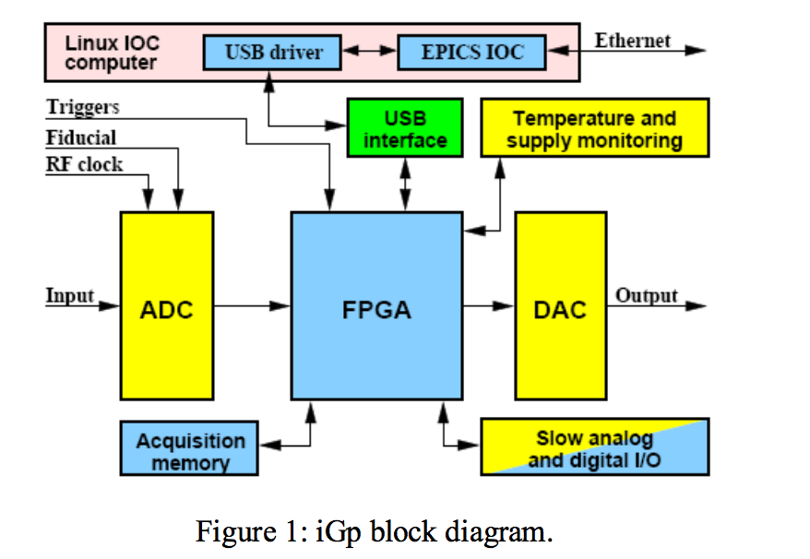
Bunch by bunch Feedback systems
Used to damp coupled bunch instabilities both in the longitudinal and transverse plane
DAFNE FBKs are based on iGp (Integrated Gigasample Processor) an innovative digital bunch-by-bunch hardware developed by a KEK / SLAC / INFN-LNF joint collaboration.
Processing unit can sample at 500 MHz and compute the bunch-by-bunch output signal for up to ~5000 bunches.
The FBK gateware code is implemented inside just one FPGA chip, a Xilinx Virtex-II.
The FPGA implements two banks of 16-tap FIR (Finite Impulse Response) filters. Each filter is realtime programmable through the operator interface. At DAΦNE, the Frascati Φ-Factory, two iGp units have been
(A.Drago, “Trends in Fast Feedback R&D”, arXiv:0806.1864 , Jun 12, 2008)
Notes:
(Field Programmable Gate Array)

Slide 21
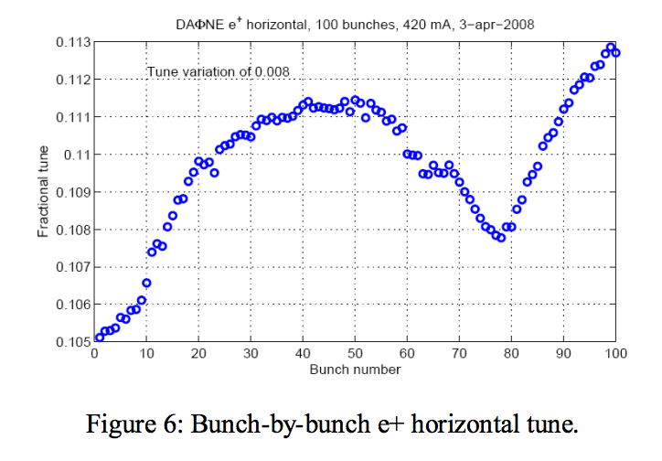
Feedback systems
Maintaining high current stable and efficient operations requires a continuous effort aimed at upgrading and developing FBKs systems.
Noise effects must be carefully kept under control.
Transverse FBKs have been equipped with new horizontal kickers having doubled strip-line length and providing larger shunt impedance at the low frequencies typical of the unstable modes. This allows doubling the FBK damping rate for the same setup (gain, power amplifier, etc.).
New software and gateware revisions have been implemented in the four iGp units and tested with the beams.
The EPICS client package, for Linux environment, has been installed in a powerful dual core personal computer used as dedicated interface for the operators in control room
This revision allowed to develop powerful measurement tools.
Notes:
as, for instance, betatron bunch-by-bunch tune spread, as shown

Slide 22
Open points & possible solutions
Trimming rotation of IR quadrupoles
More bunches
Higher chromaticity
Higher lattice momentum compaction factor
Stronger CW sextupoles
Nonlinear dynamics optimization
Vacuum conditioning and beam scrabbing
Feedback noise improvement
....
betatron coupling fine tuning
e-cloud effects
Microwave single bunch instability
TMCI single bunch instability
....
Complete this plan requires a huge program involving: machine studies, beam measurements and simulation.

Slide 23
Thesis about Beam Dynamics at DAΦNE, and not only … (C. Milardi LNF - INFN)
"Beam dynamics in present and future circular lepton colliders ”
The proposed PHD thesis aims at studying beam dynamics and its interplay with the beam-beam interaction for the DAΦNE configuration based on the Crab Waist collision scheme.
The purpose of this work is twofold: to push DAFNE luminosity to its ultimate limit, and achieve a detailed comprehension of the collider limiting factors.
The experimental studies undertaken at the Frascati Φ-factory will be of primary interest for all the other communities working at the design of future colliders based on the Crab Waist approach.
The research program includes experimental and simulation activities to be done at the Frascati laboratories (LNF) of INFN.

Slide 24
These about Feedback Systems at DAΦNE (A. Drago LNF - INFN)
"Development of a simulation code for design and optimization of bunch-by-bunch feedback systems dedicated to circular lepton accelerators”
FBK thesis n. 1 is suitable for candidates having theorical skill in accelerator physics and interested in developing software models for stored beams instabilities and cures.
"Development of a real time bunch by bunch feedback system based on FPGA technology aimed at stabilizing beam motion in circular lepton accelerators”
FBK thesis n. 2 is intended for candidates interested in hardware development, firmware, and software design, better if already aware of FPGA components and code.

Slide 25
FBK Thesis n. 1
The proposed work aims at developing a model to study the behaviour of lepton beams under the effect of bunch-by-bunch feedback.
The beam model will be based on parameters from future or existing circular accelerators.
It will implement circular accelerator concepts for describing beam evolution and instability.
The feedback model will be used to design a system able to damp the instabilities based on F.I.R filter theory.
Both models should be most likely implemented in Matlab and/or Simulink language.
Interfaces to other models written in FORTRAN or C/C++ are possible.
Some knowledges of dynamic system theory is desirable
Feedback stability criteria as well as zero-pole-gain model should be known
Matlab Control System Toolbox can be used as basic development tool. Linux and C/C++ working knowledge is also welcome.

Slide 26
FBK Thesis n. 2
The goal of the thesis work is to develop a real time feedback system based on FPGA technology.
Signals from each bunch are acquired, digitally converted and stored in dedicated memory space to produce individual feedback correction kick at each bunch passage.
FIR (Finite Impulse Response) filters have to be implemented in FPGA based boards to stabilize the beam motion.
Digital electronics, FPGA programming, VHDL and/or Verilog, C/C++, Matlab languages will be used.
Linux working experience is welcome.

Slide 27
Thank you for your attention

