Slide 1
Report of research activity
Doctoral school in Accelerator Physics (Year III)
-
Study and implementation of beamlines and devices
for the acceleration, transport and manipulation
of laser-accelerated particle beams
Massimiliano Scisciò
Varennes 6.9.2016
Examen Doctoral
Scientific supervisors: L. Palumbo, P. Antici
Rome, Oct. 17th 2016
Massimiliano Scisciò

Slide 2
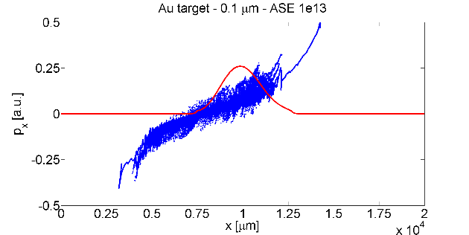
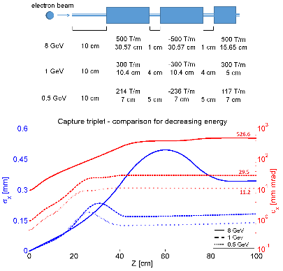
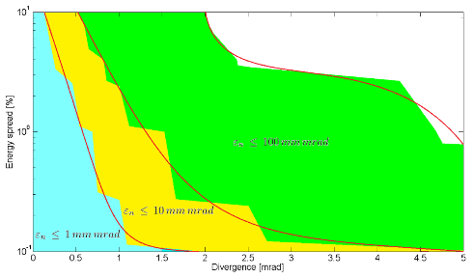
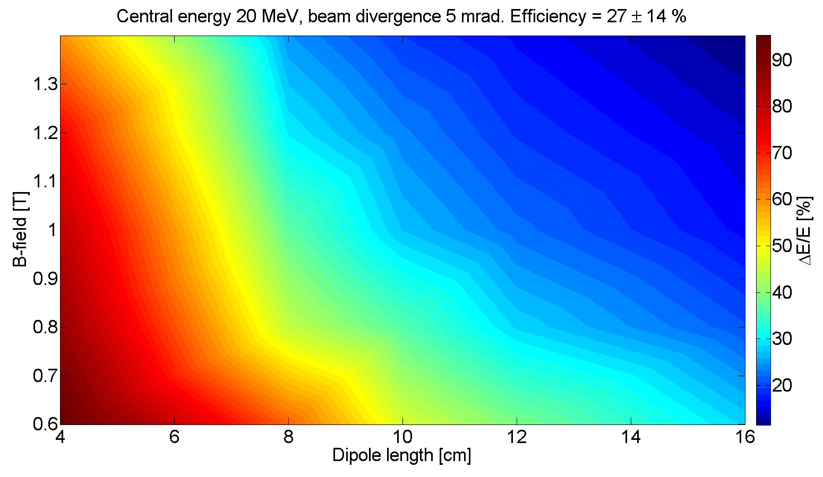
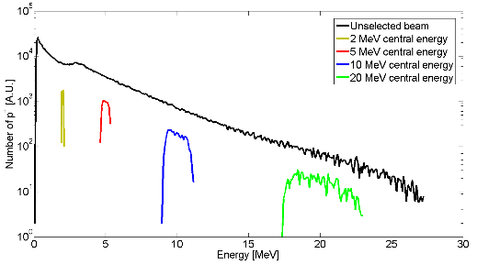
Laser driven acceleration mechanism
Laser driven electron beam line
Laser driven proton beam line
Research activities - Summary
PIC simulations for ultra-thin targets
modeling of exploded targets with hydrodynamic codes
PIC simulations for CSA acceleration
M. Scisciò, E. D'Humières, S. Fourmaux, J. C. Kieffer, L. Palumbo, and P. Antici, Phys. Plasmas 21, 123104 (2014)
P. Antici, E. Boella, S.N. Chen, M. Barberio, J. Böker, F. Cardelli, J.L. Feugeas, M. Glesser, P. Nicolaï, L. Romagnani, M. Scisciò, M.Starodubtsev, O. Willi, J.C. Kieffer, V. Tikhonchuk, H. Pépin, L. O. Silva, E. d’Humières, J. Fuchs, submitted to Phys. Rev. Lett., Oct. 2016
particle tracking simulations of different transport lines
high- and low-energy electron beam
evaluation of acceptable initial beam
parameters
M. Scisciò, L. Lancia, M. Migliorati, A. Mostacci, L. Palumbo,
Y. Papaphilippou, and P. Antici, J. Appl. Phys. 119, 094905 (2016)
20 MeV
parametric study with particle tracking code (energy selector)
optimization with focusing elements
assembling
experimental calibration
Paper on theoretic study in preparation

Slide 3
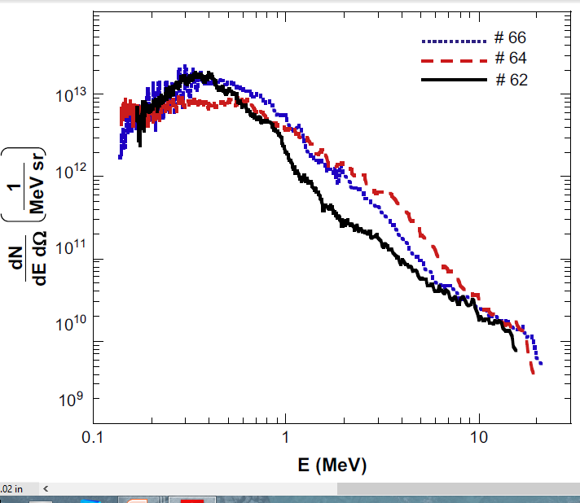
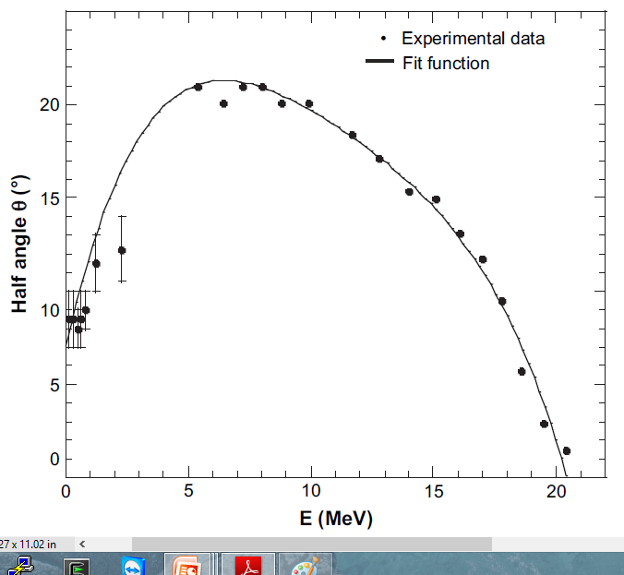
TNSA acceleration mechanism
Dominant laser-driven acceleration mechanism on commercial TW-class lasers: Target Normal Sheath Acceleration (TNSA)
Surface contaminant (H₂O)
Bulk Target (Al)
Accelerating field up to TV/m
Proton energy up to a few tens of MeV
High bunch charge (up to hundreds of nC)
Energy spread of almost 100%
Protons are accelerated within a cone of tens of degrees
-
-
-
H⁺ ion
+ -
+ -
+ -
+ -
e⁻
E
Energy selection device

Slide 4
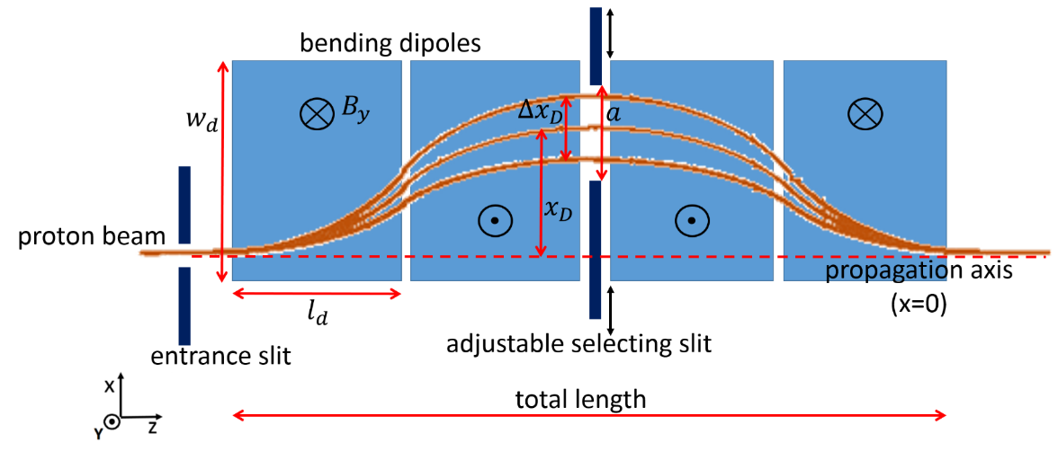
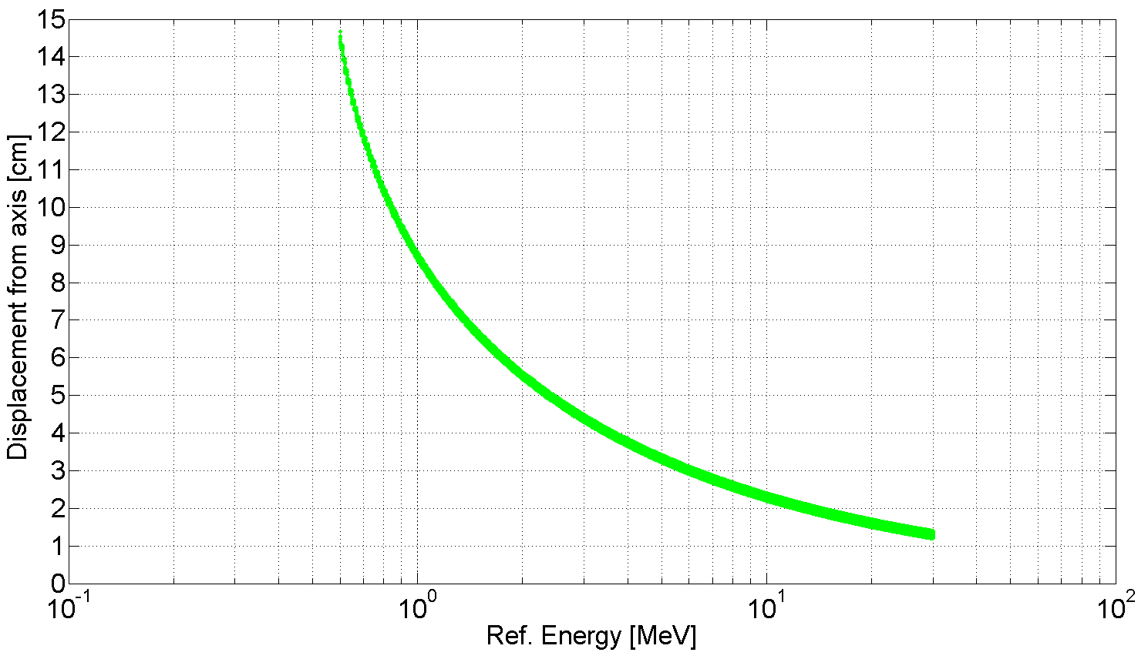
Energy selection device (ES)
Passive energy selection device based on magnetic dipoles
Displacement is a function of the
proton energy: spatial beam selection
Particle tracking simulations with TSTEP:
selection slit
Particle tracking simulations varying:
dipole length $l_{d}$
magnetic field $B_{y}$
slit aperture $a$
entering beam divergence

Slide 5
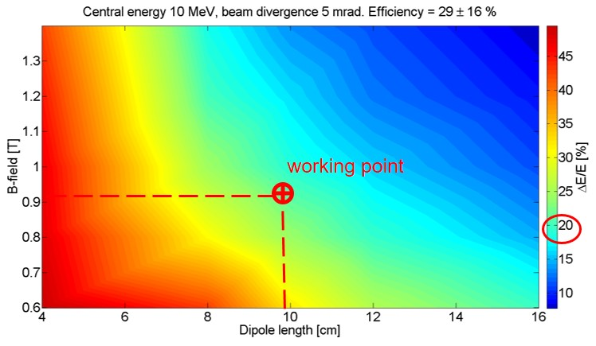
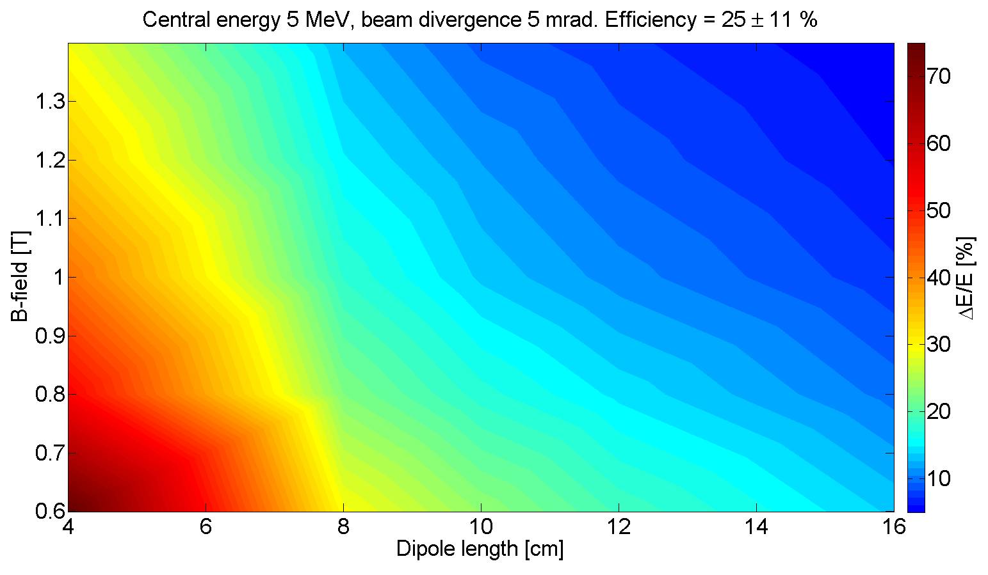
Optimization of the ES – particle tracking simulations
Data interpolation from numerous simulations: “working point maps”
10 MeV selected energy
Field strength
of the dipoles [T]
Energy spread of
the final beam [%]
Length of the dipoles [cm]
2 MeV
20 MeV
Optimization for the range 1-20 MeV
final energy spread <20 %
compact dimensions
high efficiency
Applications in material science: nano-structures and nano-crystals growth, IBA analysis, stress test of materials etc.

Slide 6
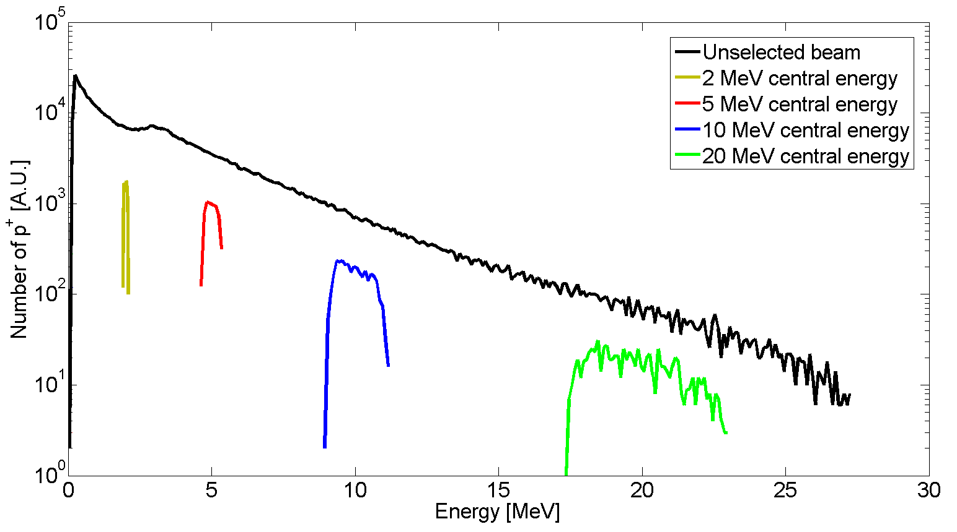
Optimized ES – particle tracking simulations
Particle tracking simulation of the optimized ES
Optimized parameters for energy selection
Features
dipole length $l_{d}=10 cm$
dipole width $w_{d}=8 cm$
magnetic field ${ B}_{y }≈0.9 T$
slit aperture $a=500 μm$
dimensions $∼48 x 18 x 12 cm$
energy range from 1 to 20 MeV
energy spread $≤20$% (FWHM)
efficiency $∼20$%
beam transverse dimensions
in the mm range

Slide 7
ES efficiency
TNSA proton source
Optimized energy selection
20% efficiency
5 mrad initial divergence

Slide 8
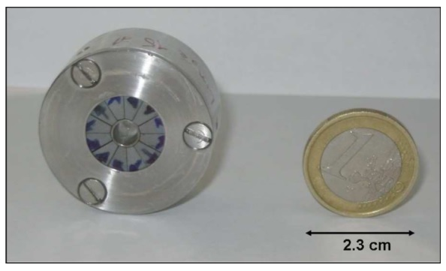
Laser driven proton beam line: Focusing + Energy selection
Proton beam line for beam focusing and energy selection
Focusing beam line stage based on
permanent magnet quadrupoles (PMQ)
Energy selector
magnetic dipoles + slit
requires a few mrad initial divergence
compact dimensions (cm)
high focusing field gradient
(up to 500 T/m)
easy to implement
T. Eichner et al., Pys. Rev. Spec. Topics – Accel. Beams 10, 082401 (2007)

Slide 9
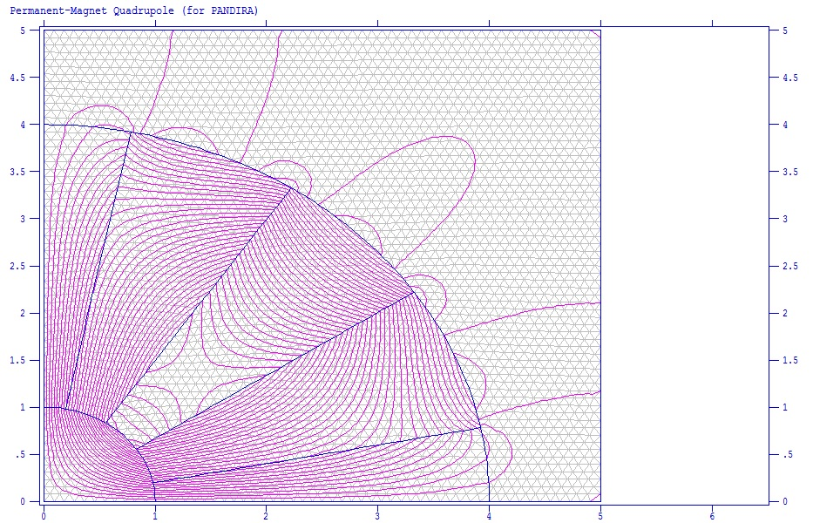
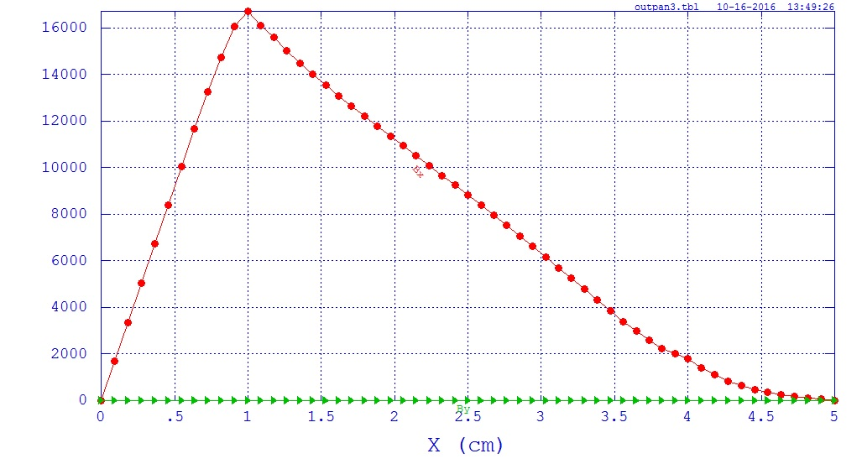
Permanent Magnet Quadrupoles: magnetic field simulations
Magnetic field simulations with PANDIRA (SuperFish)
Commercial rare-earth material
(NeFeB)
compact dimensions (cm)
Two types of PMQ:
160 T/m for low energy
350 T/m for high energy
Bx (Gauss)

Slide 10
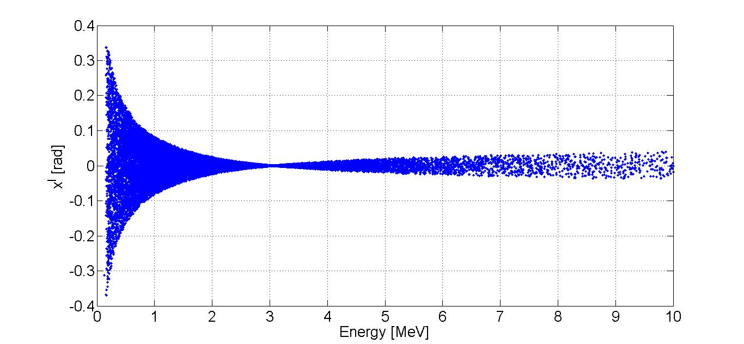
Focusing PMQ-line: beam optics + particle tracking simulations
PMQ focusing line for the 3 MeV central energy case
Magnetic field gradient: ±160 T/m
Length: 3 cm
Bore radius: 1 cm
Outer radius: 4 cm
Proton beam
Q_{F}
Q_{F}
Q_{D}
Q_{D}
Q_{F}
3.5 cm
1 cm
8 mm
2 mm
2 mm
Phase space E-x’ : the PMQ array collimates the beam at the central energy

Slide 11
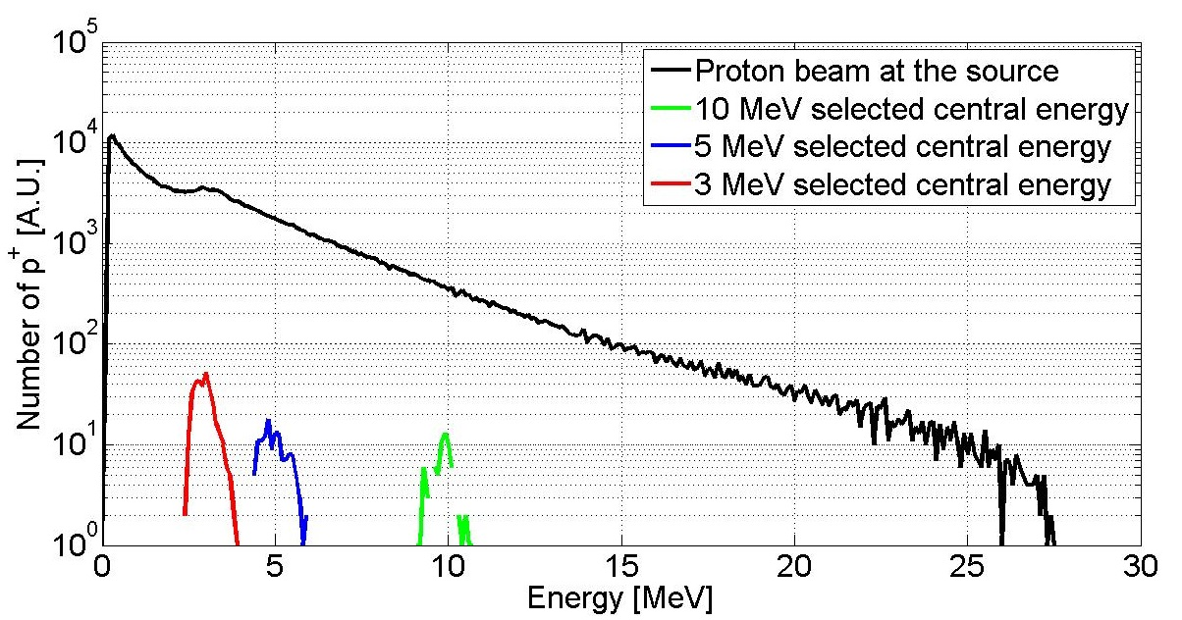
Laser driven proton beam line – Start-to-end simulation
Proton beam line for beam focusing and energy selection: case of 3 MeV central energy
3 MeV proton beam line
Start-to-end particle tracking simulations
Focusing PMQ: improved efficiency
For different energies: same PMQs, different spacing
20 MeV focusing configuration: work in progress
Final energy spread < 20 %
Start-to-end efficiency 1%

Slide 12
Conclusions and future prospects
Numerical work for beam line optimization:
Beam optics and particle tracking simulations for the beam line analysis and optimization
Paper about the numerical results is in preparation
Manufacturing/assembling of the beam line components:
Energy selection device
PMQ for beam focusing
Experimental campaign:
PW laser TITAN @ LLNL (USA), August 2016 : first testing and calibration of the ES
500 TW laser ALLS @ INRS (Canada), winter 2016-17
@ LULI (France), April 2017

Slide 13
Experimental run at LLNL: ES assembly
August 2016:
ES assembled and tested at the TITAN laser facility (LLNL, USA).

Slide 14
Experimental run at LLNL: Exp. Setup
Experimental setup
Laser parameters:
Wavelength $λ_{0}=1.053 μm$
Energy $∼200 J$
On-target spot size $∼10 μm$
On-target intensity $∼{10}^{20}W⋅cm^{−2}$
Pulse duration $∼700 fs$
Thompson parabola
Energy selector
p+ beam
Un-focused
laser beam
Au foil 15µm
Focused laser beam
Off-axis parabola

Slide 15
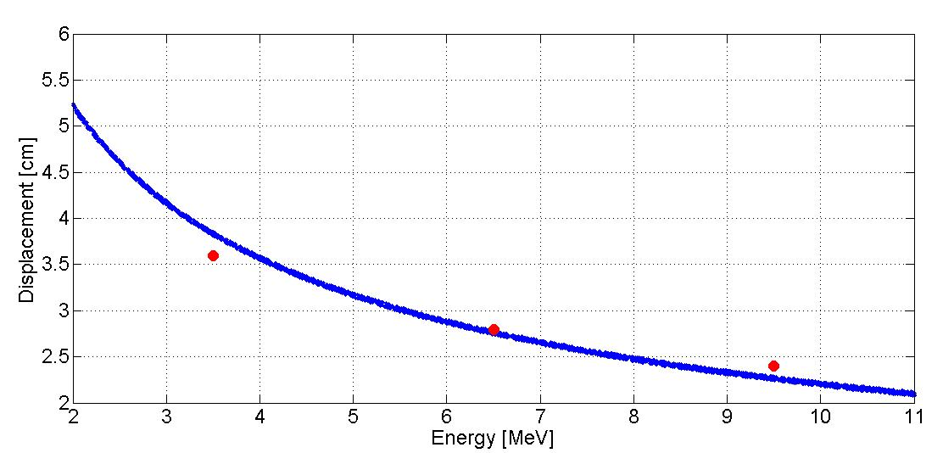
Experimental run at LLNL: Dipole calibration
RCF stack for monitoring beam dispersion between the 2nd and 3rd dipole
for beam dispersion measurements
$$∼3.5 MeV$$
3.6 cm
$$∼6.5 MeV$$
2.8 cm
Simulation (TSTEP)
Experiment (RCF)
$$∼9.5 MeV$$
2.4 cm

Slide 16
Massimiliano Scisciò
Varennes 6.9.2016
Examen Doctoral
Thank you for the kind attention.
Massimiliano Scisciò

