Slide 1
PhD activity Report
Stefano Romeo
October, 22 2015
La Sapienza, University of Rome

Slide 2
Plasma Wakefield Acceleration Beam Driven
Plasma Wakefield acceleration is a new kind of device that utilizes the wakefield produced by an electromagnetic pulse inside plasma to accelerate a beam
In PWFA beam driven the wakefield is generated by the coulombian repulsion of a charged beam
The beam driven acceleration scheme consist in a driver (or multiple drivers) that looses energy inside plasma and a witness gaining energy

Slide 3
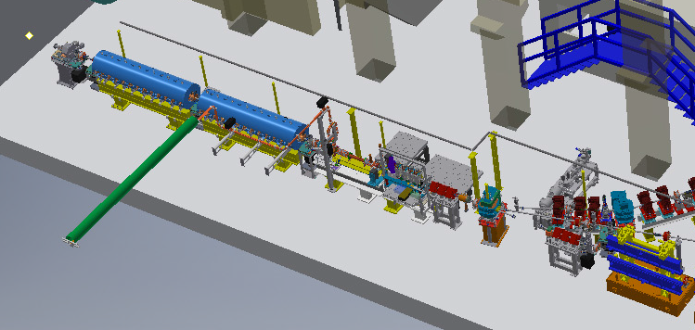
SPARC_LAB Layout
$$E≅120 MeV$$
$$ε≅0.3−4 mm mrad$$
$$σ_{E}<0.1\%$$
$$σ_{z}=4−75μm$$
Beam diagnostic
High quality PWFA
Photoinjector that allows to create trains of high quality electron bunches
2 S band accelerating cavities
(velocity bunching injection phase)
C band accelerating cavity
FEL

Slide 4
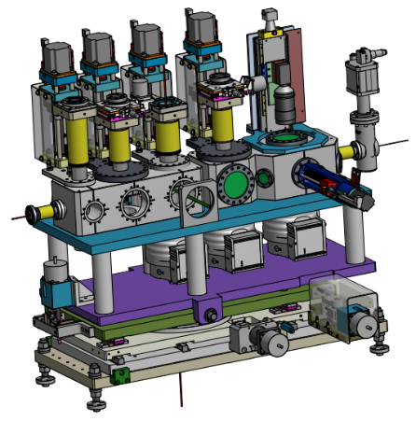
Acceleration experiment @SPARC_LAB
$$E≅150 MeV$$
$$ε≅1−2 mm mrad$$
$$σ_{E}<1\%$$
Permanent magnets final focus system
$$σ_{x}<3μm$$
Effective accelerating gradient
$$≅1 GV/m$$
Pre ionized plasma
(gas inside a capillary ionized by discharge)
Low energy beams
Resonant Wakefield Acceleration Scheme
Beam driven acceleration
High quality beams
Quasi non linear regime

Slide 5
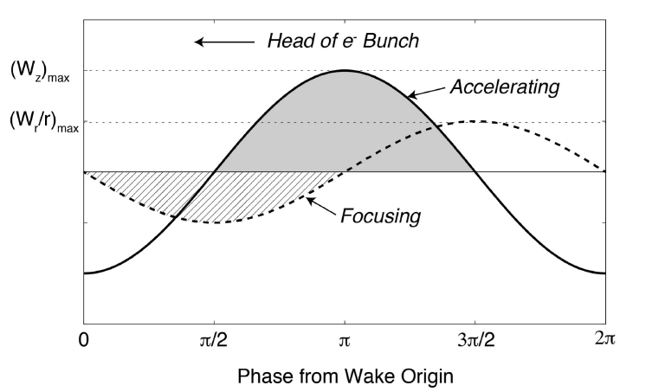
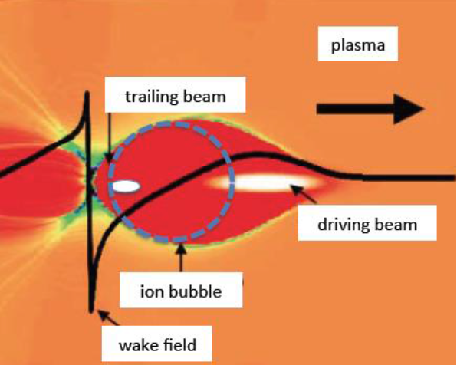
Linear/Bubble regime
$$n_{b}≪n_{0}$$
$$n_{b}>n_{0}$$
Linear field
It is possible to inject a beam in the crest region
Non linear dependency of the focusing
Accelerating field depends on transverse position
Lower field
Blow out field
No crest region -> Spike on field
Linear dependency of the focusing
Accelerating field doesn’t depend on transverse position
Higher field

Slide 6
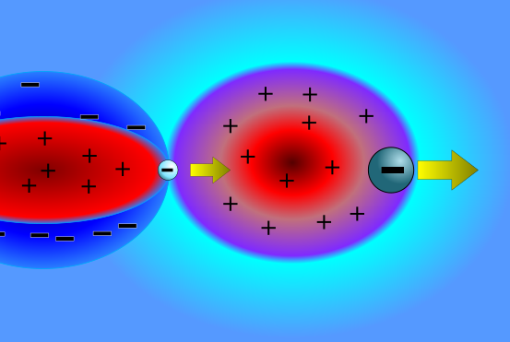
New concept: Linear/non Linear
The driver generates a linear field
The witness can be injected in the zone of maximum field
Minimum energy spread
Maximum gradient
The focusing is guaranteed by a beam loading effect
The field generated by the witness is non linear
Increased witness stability
Simple matching

Slide 7
Hollow driver scheme
Short witness
Witness compression by velocity bunching
Witness emittance growth
Lower compression
Hollow Driver
Velocity bunching
Very short and low emittance witness
High emittance driver
Courtesy of R. Pompili

Slide 8
Proposal: Hollow driver scheme+Linear/non Linear
Velocity bunching
Hollow driver scheme
Linear/non Linear
Short and high current witness
Short, high current witness and high brilliance witness
Requires low quality driver and high brilliance witness
Lower brilliance
Lower quality driver

Slide 9
High quality witness requirements: Driver
A driver that follows the matching conditions guarantee a field that varies slowly (with a frequency very lower than the betatron frequency of witness)
Ion column (non linear) $σ_{x}=\sqrt[4]{\frac{2}{γ}}\sqrt{\frac{ε_{n}}{k_{p}}}$
$$β_{x}=\frac{\sqrt{2γ}}{k_{p}}$$
Driver transverse matching
1D-linear theory (linear) $σ_{x}=\sqrt[4]{\frac{2}{αγ𝒵(0) }}\sqrt{\frac{ε_{n}}{k_{p}}}$
$$β_{x}=\frac{1}{k_{p}}\sqrt{\frac{2γ}{α𝒵(0)}}$$
$$𝒵\left(ξ\right)=\sqrt{\frac{π}{2}}k_{p}σ_{z}e^{k_{p}^{2}σ_{z}^{2}/2}Im\left[e^{ik_{p}ξ}erfc\left(\frac{ξ}{\sqrt{2}σ_{z}}+i\frac{k_{p}σ_{z}}{\sqrt{2}}\right)\right]$$

Slide 10
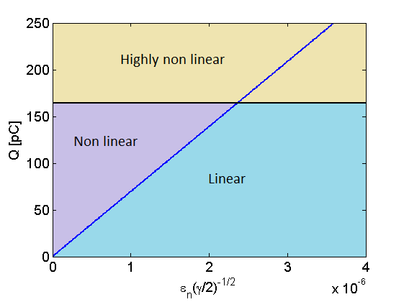
High quality witness requirements: Driver
Matched beams
$$ℓ=\frac{Q}{e}\frac{k_{p}}{{\left(2π\right)}^{3/2}σ_{z}ε_{n}n_{0}}\sqrt{\frac{γ}{2}}$$
$ℓ≫1$ non linear field
$ℓ≪1$ linear field
Non linear driver treshold
Within the acceleration $\frac{\sqrt{γ}}{ε_{n}}$ decreases for:
Deceleration
Beam depletion
Head erosion
$$\frac{Q}{e}\frac{k_{p}^{3}}{n_{0}}<1$$
QNL treshold
Within acceleration the bubble can be destroyed by driver erosion
High
Quality
Low

Slide 11
High quality witness requirements: Driver outside of matching
It is difficult to inject both the driver and the witness at the matching conditions
Driver is usually injected with a spot size that is higher than the matching condition
$$ℓ≫1$$
$$ℓ≪1$$

Slide 12
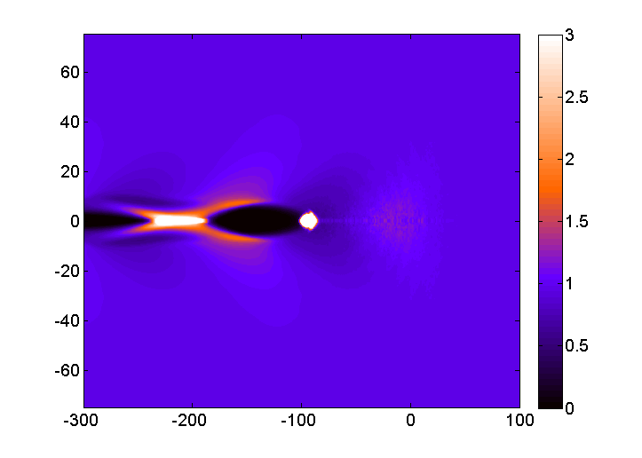
High quality witness requirements: Driver outside of matching
Linear field crest zone:
Guarantees the maximum accelerating field
Has a local electron plasma density that is independent from bunch density
Has a negligible focusing field
Enhanced witness beam loading creates a focusing field such that matching condition is
$$σ_{x}=\sqrt[4]{\frac{1}{γ}}\sqrt{\frac{2ε_{n}}{k_{p}}}$$
$$β_{x}=\frac{2\sqrt{γ}}{k_{p}}$$

Slide 13
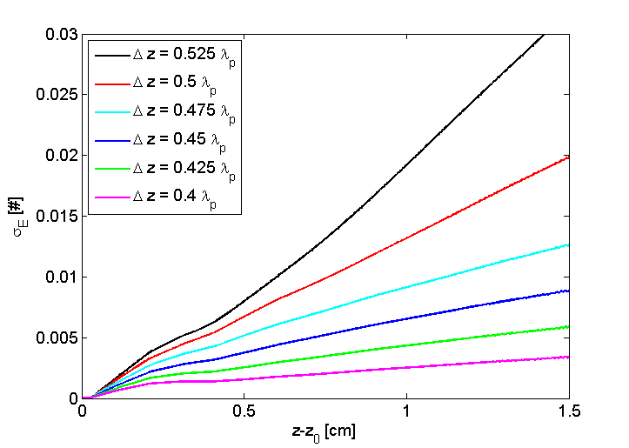
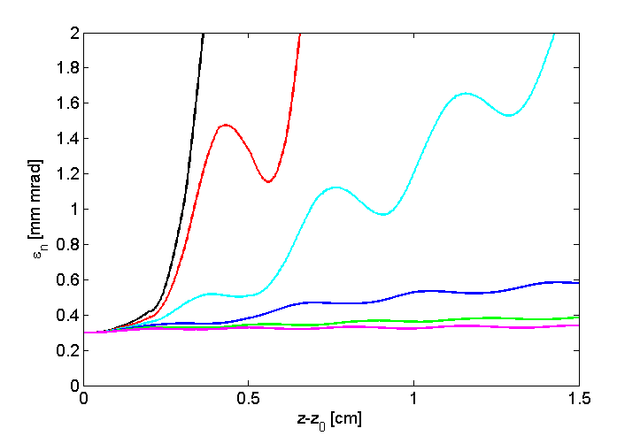
High quality witness requirements: Witness matching
2 required scans:
Injection phase optimizes energy spread and emittance (rough tune)

Slide 14
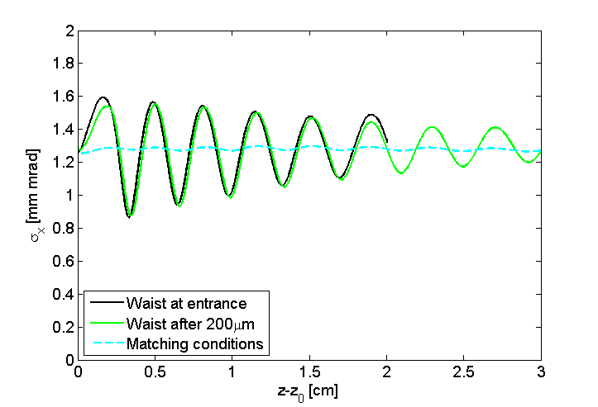
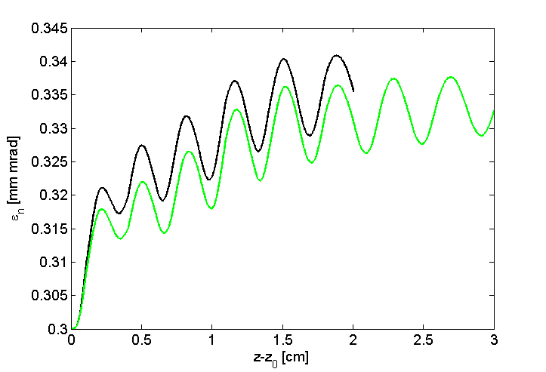
High quality witness requirements: Witness matching
Witness waist position optimizes emittance (fine tune)

Slide 15
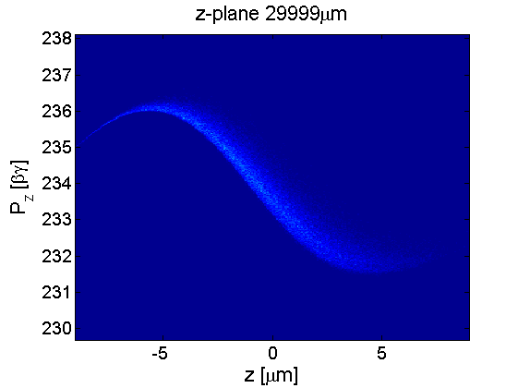
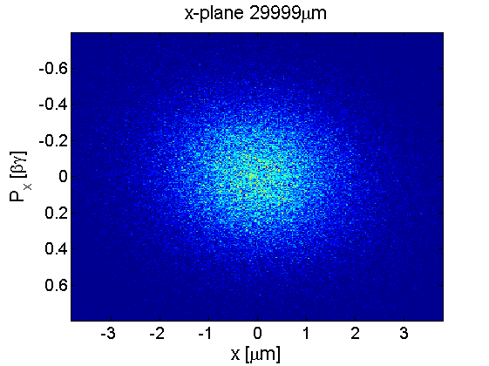
Witness phase space after acceleration
Accelerating gradient: 600 MV/m

Slide 16
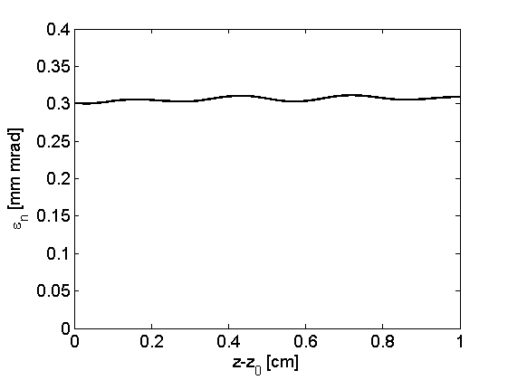
1 GV/m working point
Driver
Witness
$$Q=200pC$$
$$Q=15pC$$
$$σ=\left(\begin{matrix}13 & 0 & 0 \\ 0 & 13 & 0 \\ 0 & 0 & 38\end{matrix}\right)μm$$
$$σ=\left(\begin{matrix}1.25 & 0 & 0 \\ 0 & 1.25 & 0 \\ 0 & 0 & 5.3\end{matrix}\right)μm$$
$$ε=\left(\begin{matrix}20 & 0 \\ 0 & 20\end{matrix}\right)mm mrad$$
$$ε=\left(\begin{matrix}0.3 & 0 \\ 0 & 0.3\end{matrix}\right)mm mrad$$
$$γ=200$$
$$γ=200$$
$$σ_{E}=0.1\%$$
$$σ_{E}=0\%$$
Accelerating gradient: 1 GV/m

Slide 17
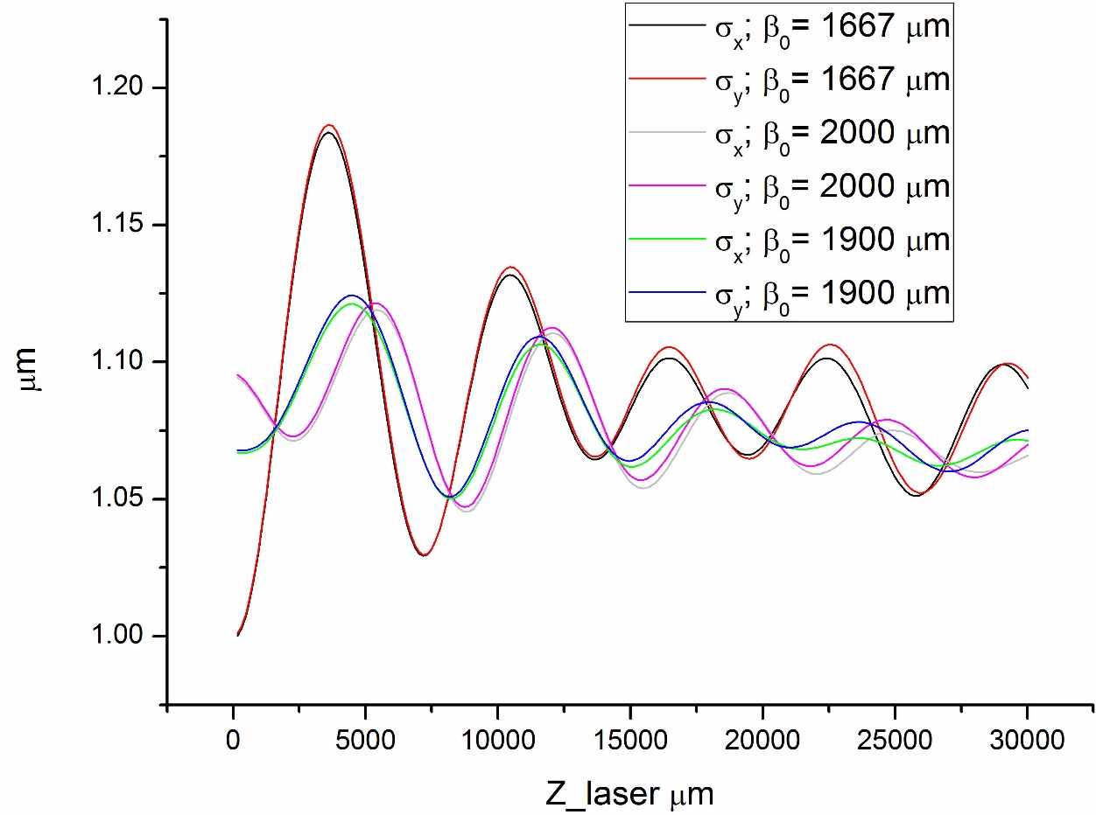
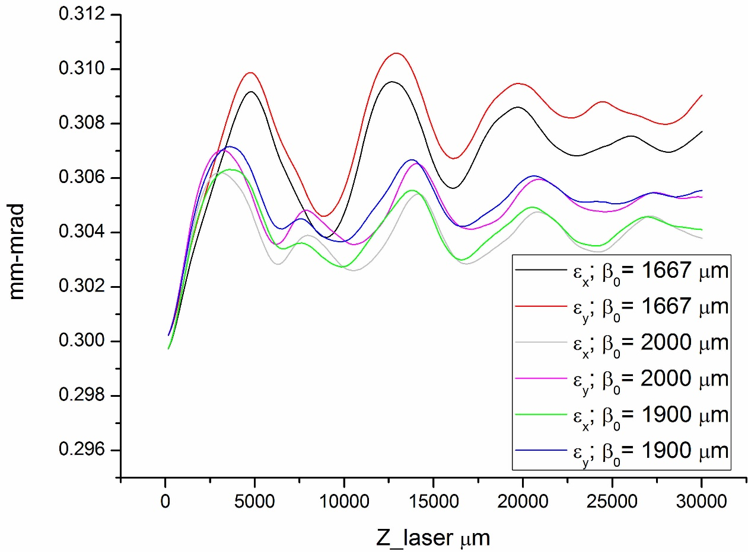
LWFA ExIn

Slide 18
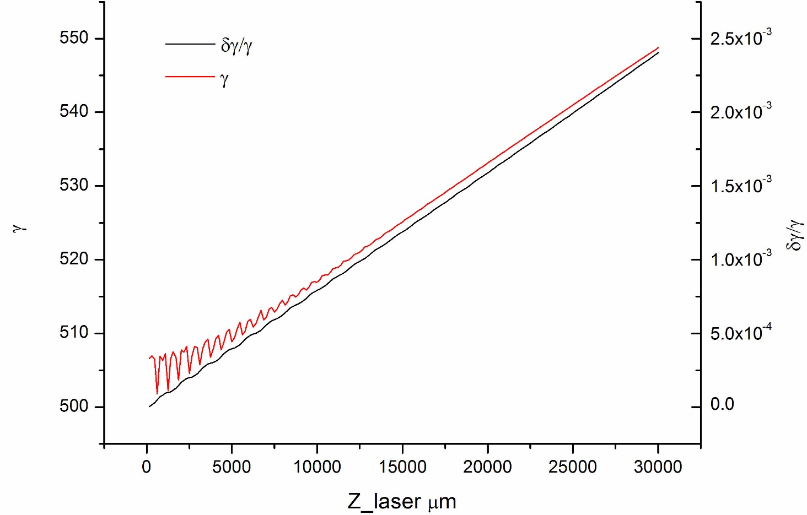
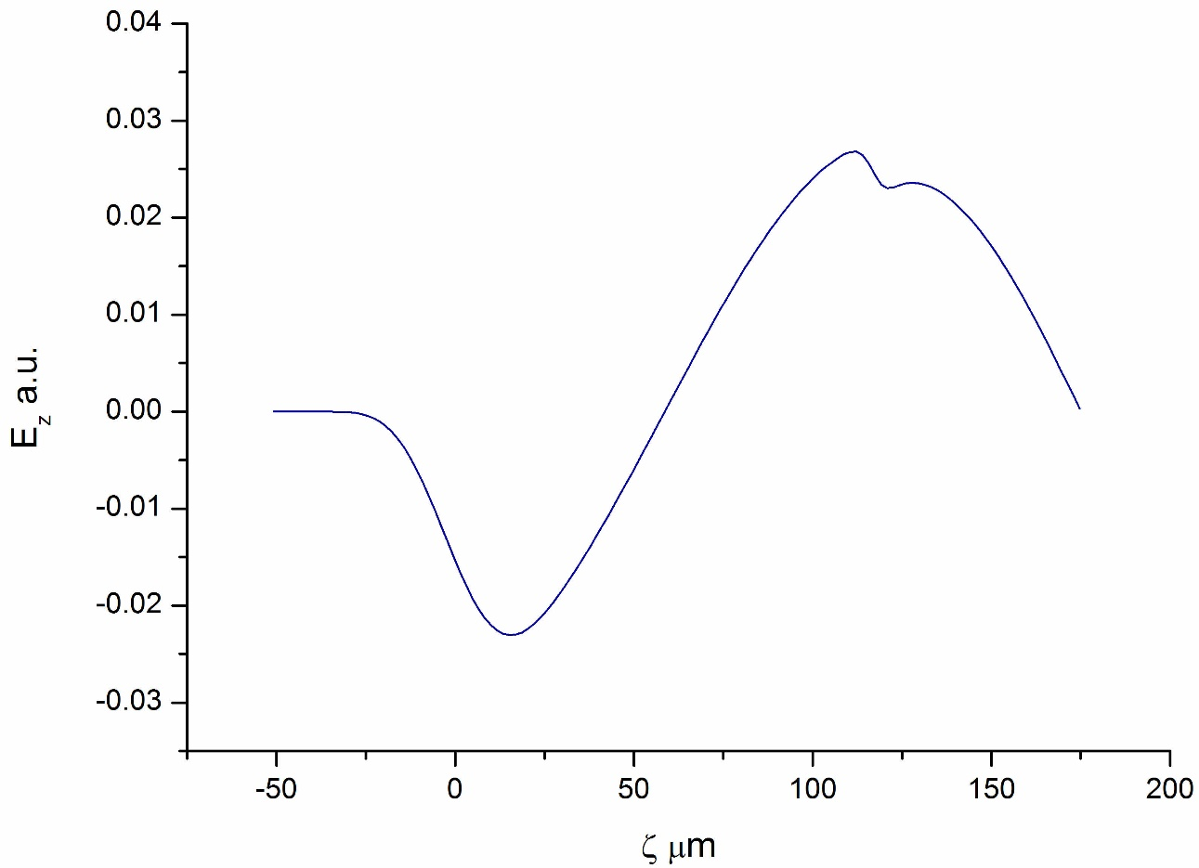
LWFA ExIn

Slide 19
Conclusions
During my PhD work I focused on beam dynamics inside plasma in order to obtain high quality witness at the exit
The study of beam dynamics required to develope scaling laws for PWFA
Using the scaling laws I was able to find a way to create a new kind of PWFA scheme

