Slide 2
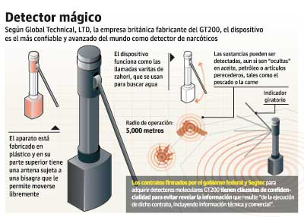

Slide 3
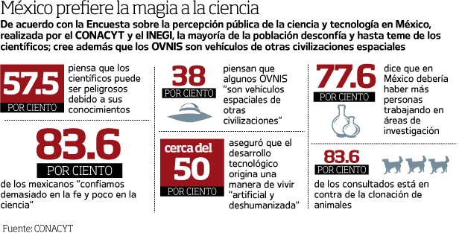

Slide 4
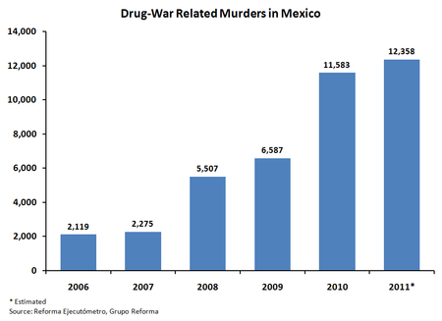

Slide 7
Problems for science journalism…
Lack of places to get training
Lack of schools and subjects
Lack of professionalization
Lack of media to work as a science journalist
Lack of competitive salaries
Lack of support from media to get training
Lack of support to travel to get training
Lack of critical (science) journalism
Lack of interest in science journalism in general

Slide 8
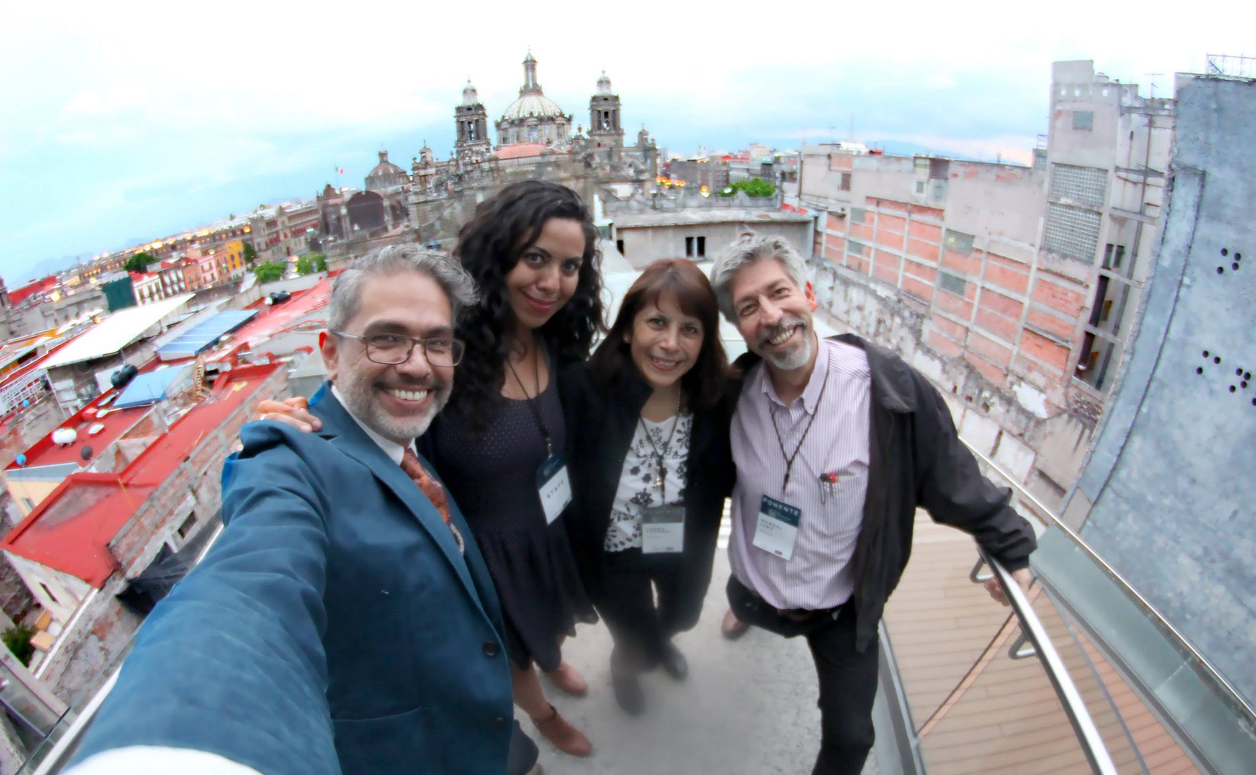

Slide 10
