Slide 2
The Museum of Tomorrow
is an initiative of Rio de Janeiro’s Municipal Government,
devised and achieved with Roberto Marinho Foundation. The IDG (the Management Development Institute) is responsible for the administration of the museum.

Slide 3
The Museum of Tomorrow engages its visitors in a journey that explores the time of great changes in which we live and the many possible paths opening up for the next fifty years. A journey through tomorrows that may result from the choices we make each day, as individuals, as a society, as Humans.

Slide 4
MUSEUM OF TOMORROW IS
A NEW KIND OF MUSEUM

Slide 5
WITH A KEY MESSAGE
TOMORROW IS TODAY

Slide 6
TWO ETHICAL VALUES
SUSTAINABILITY AND CONVIVIALITY

Slide 7
THREE KINDS OF INTERACTION
HANDS ON,
MINDS ON AND HEARTS ON

Slide 8
AND A MAIN EXHIBITION WITH
FIVE BIG QUESTIONS

Slide 9
Where do we come from?
Cosmos

Slide 10
Who are we?
Earth

Slide 11
Where are we?
Anthropocene

Slide 12
Where are we going?
Tomorrows

Slide 13
How do we want to get there?
Us

Slide 14
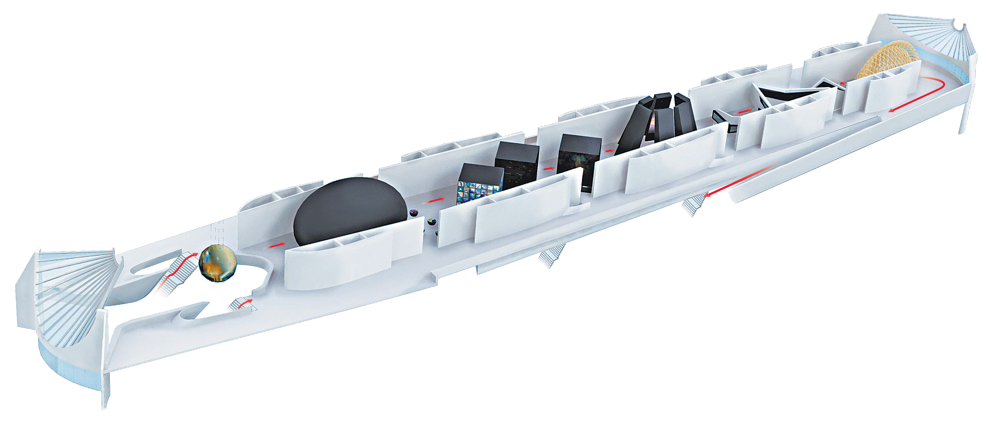
US
How do we want to get there?
ANTHROPOCENE
Where are we?
COSMOS
Where do we come from?
TOMORROWS
Where are we going?
EARTH
Who are we?

Slide 15
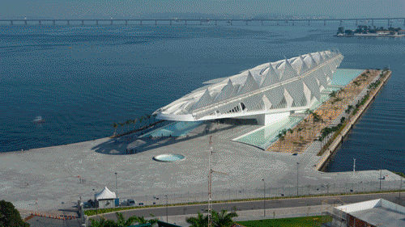
+ 1.8 million visitors since December 2015
41% are cariocas
40% are from other states
17% are from RJ state
3% are foreigners

Slide 16
31% visited museums this year
21% last month
21% more than one year ago
15% more than five years ago
12% for the first time
Dados de nov. 2016

Slide 17
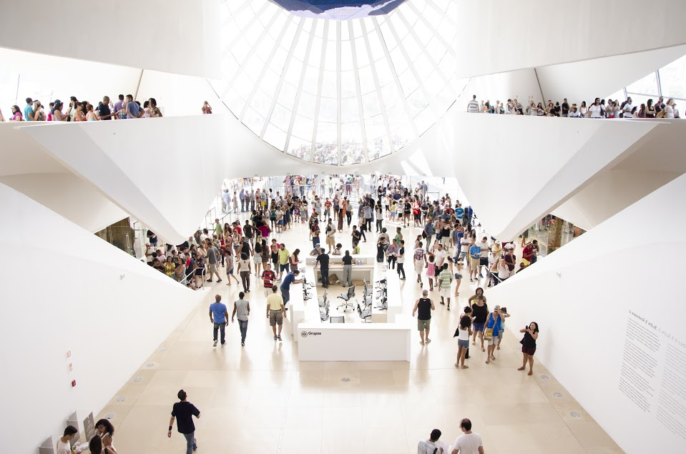

Slide 18
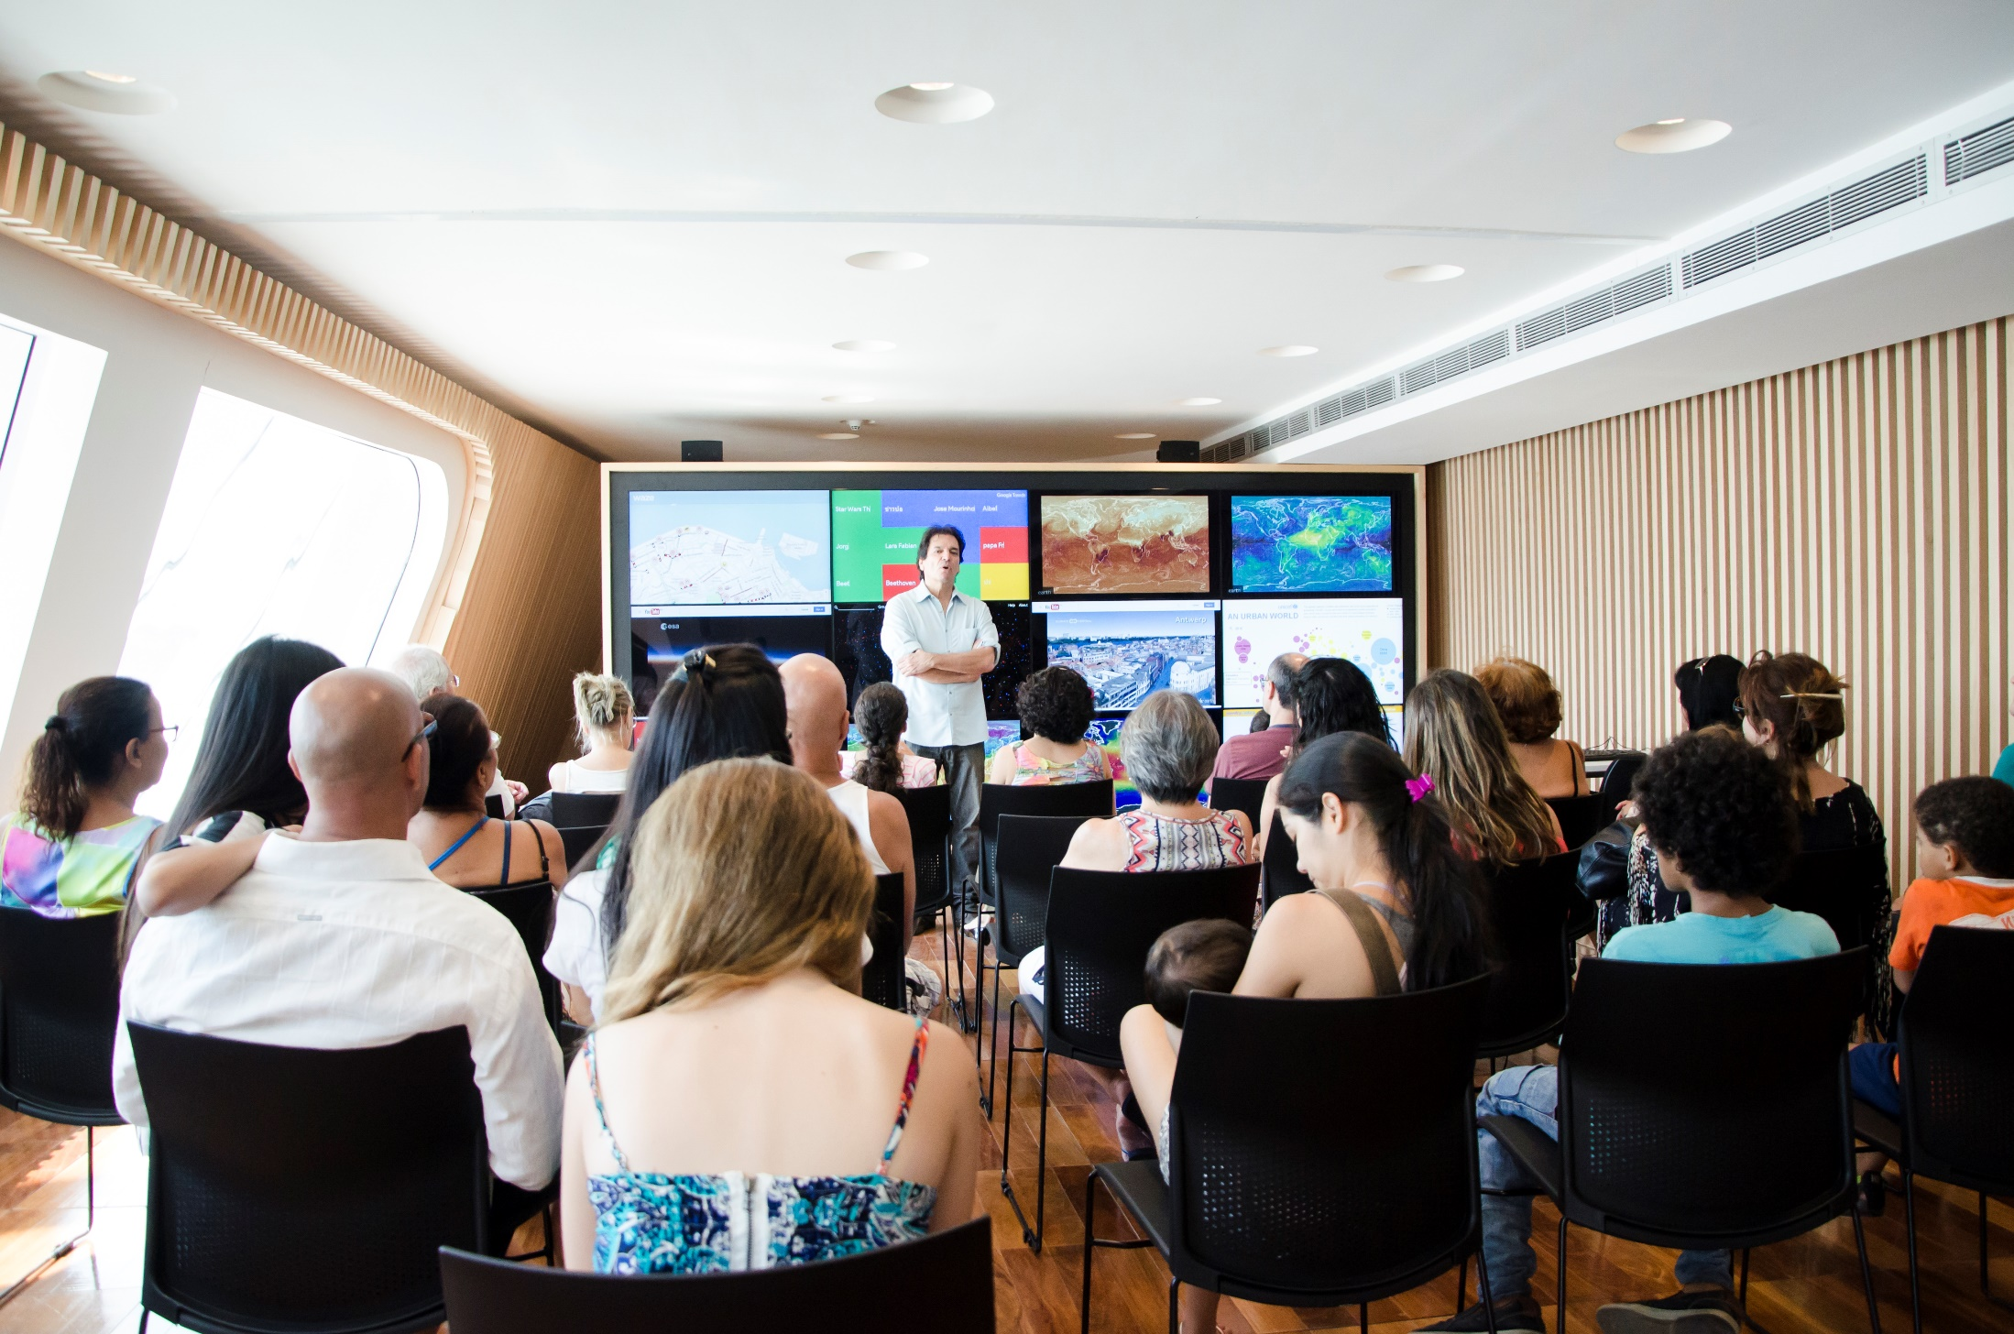

Slide 19
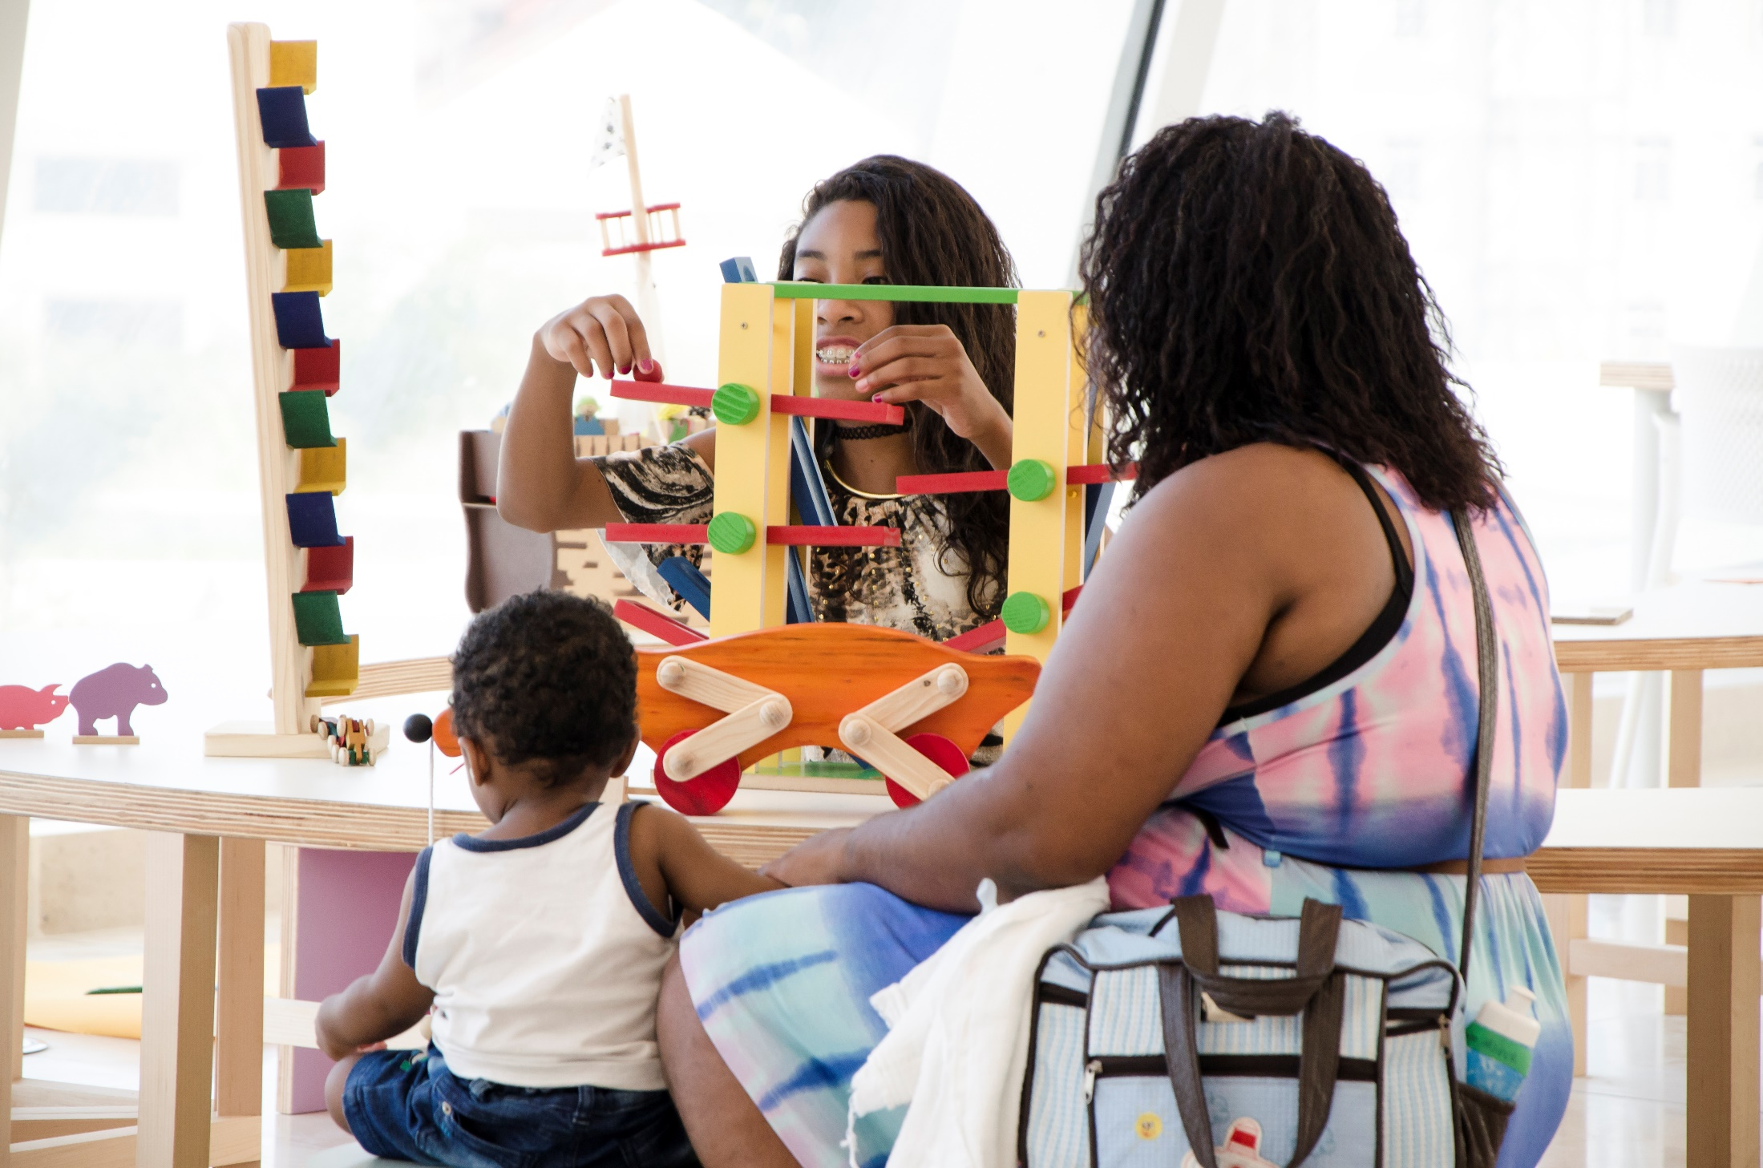

Slide 20
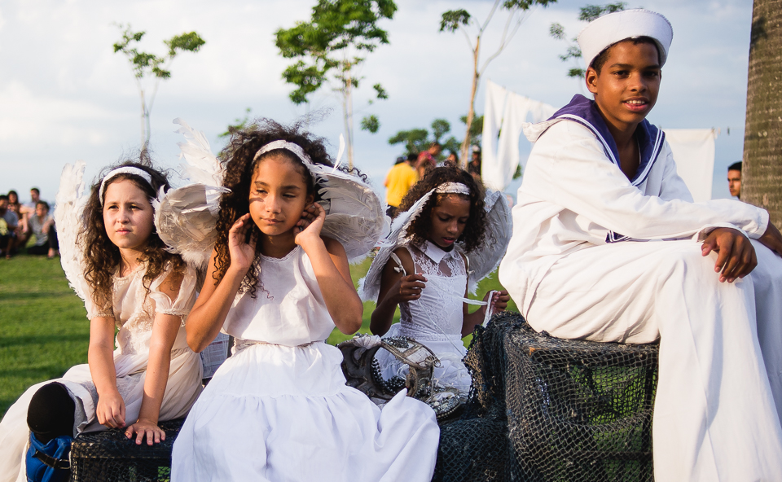

Slide 21
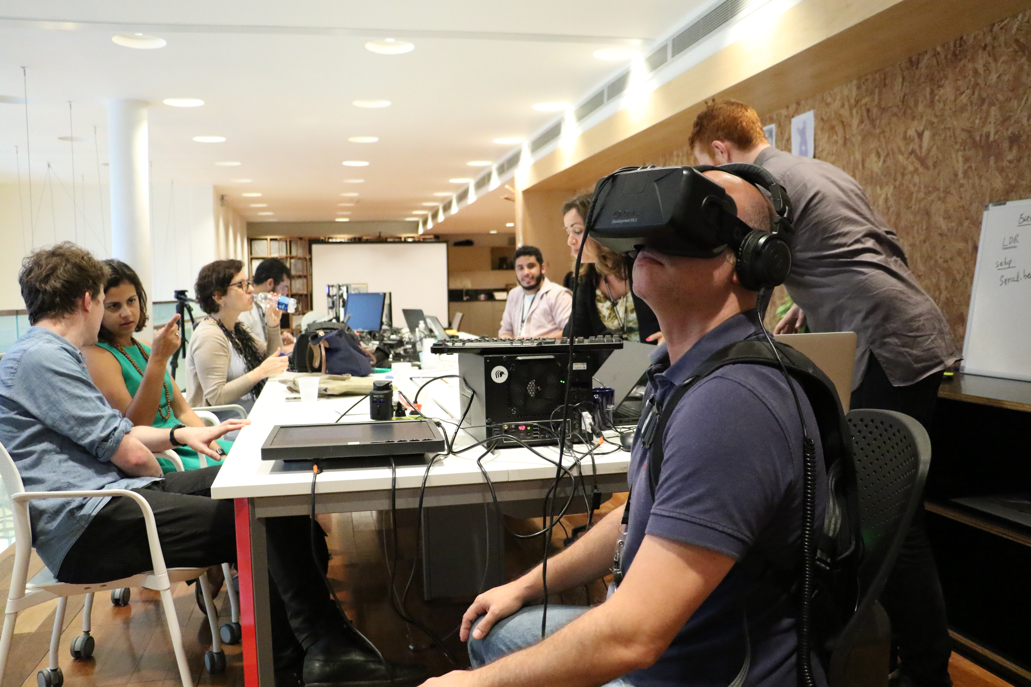

Slide 22
SCENARIO |
SCIENCE COMMUNICATION IN BRAZIL

Slide 23
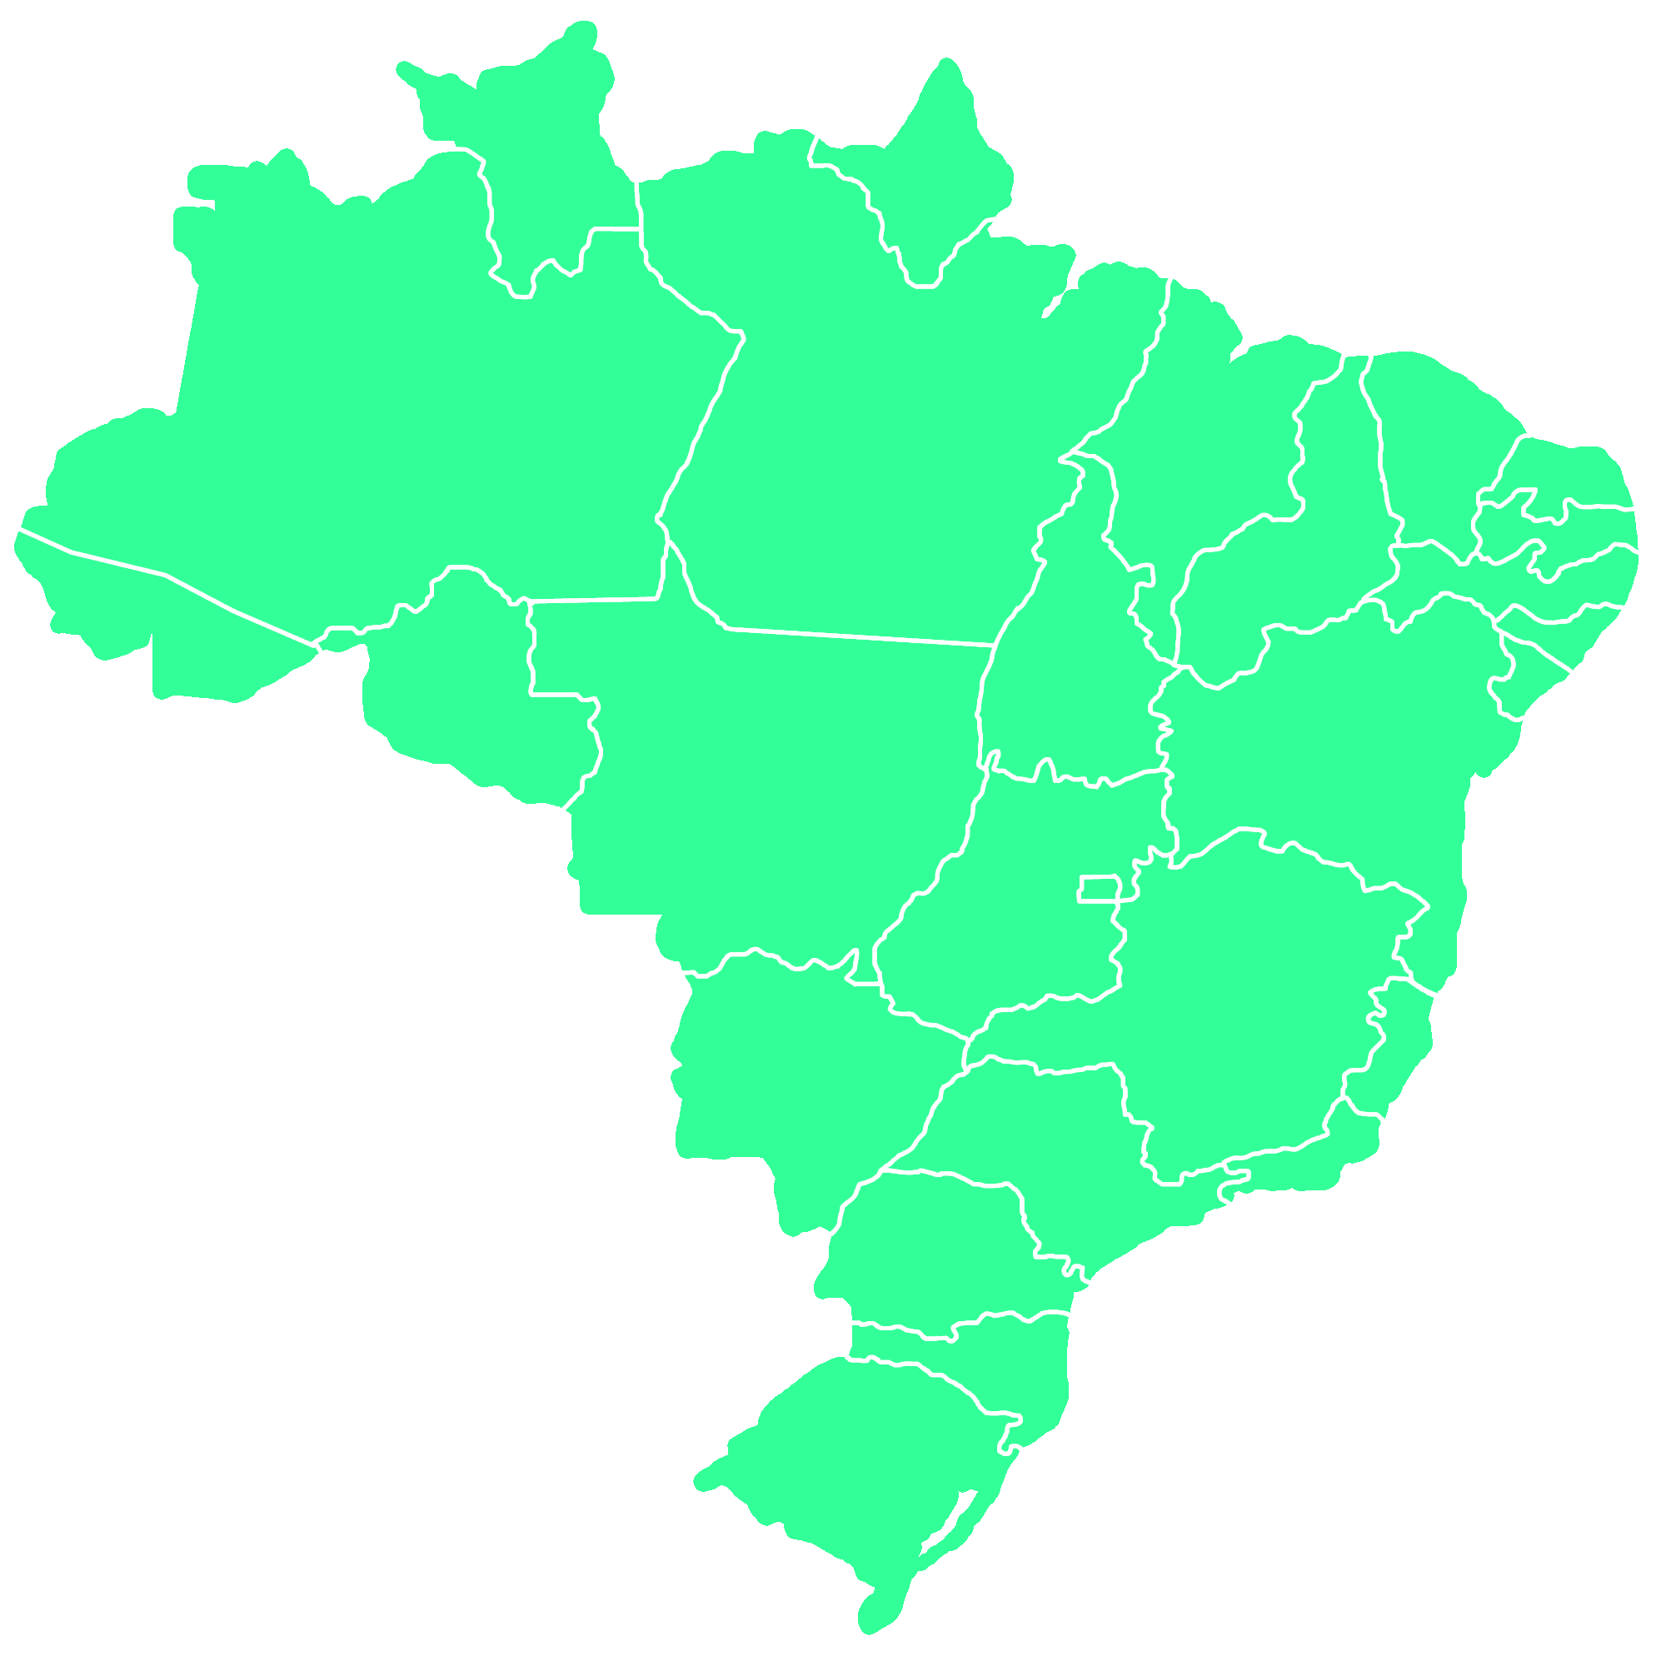
BRAZIL
2015
200 million inhabitants
24 states + federal district
5.570 municipalities
9th most powerful economy in the world
79th in a list of 187 countries classified by the Human Development Index (HDI).
Inequalities remains as a huge challenge.
Source GDP/International Monetary Found ; HDI United Nations (2015)

Slide 24
SCIENCE MUSEUMS AND CENTERS
OFFER
In 2015, there were 268 active spaces. It represents an increase of 41% when compared to 2009, when 190 units were registered, and an increase of 146% when compared to 2005, when there were less than a 100 of those spaces in Brazil.
Source The Guide of Museums and Science Centers of Brazil (2015; 2009; 2005)

Slide 25
SCIENCE MUSEUMS AND CENTERS
DISTRIBUTION
Among 268 spaces in activity, 155 are in the Southeast, while other 44 are in the South, 43 of them are in the Northeast, 15 are in the Midwest and 11 are in the North.
North
Northeast
11
4.10%
43
16.04%
Midwest
15
5.60%
Southeast
155
57.84%
South
44
16.42%
Source Guide of Museums and Science Centers of Brazil (2015)

Slide 26
SCIENCE MUSEUMS AND CENTERS
INEQUALITY
For example, in this distribution, São Paulo state has 79 spaces while Piauí and Maranhão states, in the Northeast, have only one, and the states of Acre, Rondônia and Tocantins, in the Northern region, have no science museums.
Maranhão
1
Piauí
1
Acre
0
Rondônia
0
Tocantins
0
São Paulo
79
Source The Guide of Museums and Science Centers of Brazil (2015)

Slide 27
SCIENCE MUSEUMS AND CENTERS
DEMAND
The inequality in the offer of science museums and centers does not reflect an inequality in demand for more access to science and technology. The highest expansion in audience happened in the North region, followed by the Midwest, South, Northeast, and finally, in the Southeast.
2010 – 2015
North – 10.9% (from 4% to 14.9%)
Midwest – 9% (from 8.7% to 17.7%)
South – 6.8% (from 7.8% to 14.6%)
Northeast – 4% (from 5.8% to 9.8%)
Southeast – 1.6% (from 10.2% to 11.8%)
Source Public Perception of Science, Technology and Innovation (2015)

Slide 28
SCIENCE MUSEUMS AND CENTERS
PUBLIC PERCEPTION
Brazilians have interest in science (61% said to be interested or very interested), but go less frequently to museums and science centers (12% visited one in Brazil in 2015) and seldom look for information about this subject (49% hardly ever look for scientific information against 21% who get well informed).
REASONS
Among the surveyed,
32.2% said they didn’t have time to go to science communication facilities
31.1% said there are no such facilities in the region where they live
14.2% were not interested, 8.7% think these centers are too far from them
7.7% didn’t know where such spaces were and 6.1% presented other arguments
Source Public Perception of Science, Technology and Innovation (2015)

Slide 29
CHALLENGES
Despite the fact that the number of museums and science centers have increased, the inequality in the offer of spaces reproduces Brazilian socioeconomic inequalities, including access to science and education.
Despite the interest in science notified, there is a lack of the social engagement in science communication spaces, as science museums and centers.
Source The Guide of Museums and Science Centers of Brazil (2015)

Slide 30
SOLUTIONS
Considering such scenario, it is necessary to allocate more public resources to such spaces, create new lines of financial aid and mechanisms to support the participation of the private sector to increase the number of science museums and center in Brazil, reducing inequality in the offer of such spaces and, at the same time, following the increase of audiences in different regions.
It is also important to expand the Brazilian science communication network by articulating science centers and museums and with other actors engaged in the popularization of science, such as schools, non-governmental organizations, companies and media.
Source Public Perception of Science, Technology and Innovation (2015)

Slide 31
PROJECT |
NEW HORIZONS

Slide 33
PROJECT
The Museum of Tomorrow will create an online exhibition on Google Arts & Culture inspired by Cosmology and Space Research news in collaboration with students and teachers from public schools in Port Region of Rio de Janeiro, who will draw and write the scientific content their own way, supported by researchers and consultants.
As requested by the participating schools, students and teachers of different subjects, grades and ages will work together to increase interdisciplinarity, knowledge exchange and friendship.

Slide 34
LOCAL CONTEXT
The Port Region of Rio de Janeiro is a historical area of the city. Today, there is a deeper knowledge of political, social, economical and cultural local processes from the
past until contemporary times. It was the world’s biggest entry port for about two million enslaved Africans.
With this forced migration, in the past, this area has also received a large number of Europeans and Brazilians from several regions of the country, mainly the Northeast. In the last five decades, migration flows decreased.
Nowadays, this area has a population of approximately 30,000 inhabitants marked by considerable socioeconomic vulnerability. They are distributed in three districts and four
hills that characterize the area, including Morro da Conceição with great historical relevance, and Morro da Providência, Rio’s first favela. Today, there are different social
and economic problems: poverty, hunger and health among them.

Slide 35
OBJECTIVE
To engage youth in a science communication project that will be offered to students of Rio de Janeiro public schools by the Museum of Tomorrow. The aim is to create a set of experiences by using this exciting news to motivate young people to expand their skills through scientific information.
The idea is to these students that they are the Mars Generation to engage them in these brand new knowledge about the Universe and use it on their own universes.

Slide 36
ONLINE INITIATIVE
Google Arts & Culture is an online platform through which the public can access exhibitions from a hundred of museums. Using their mobile phones, visitors can see museums’ galleries, explore physical and contextual information about artworks and compile their own virtual collection.
It is an opportunity to create a content with these schools that everyone in every place can see.

Slide 37
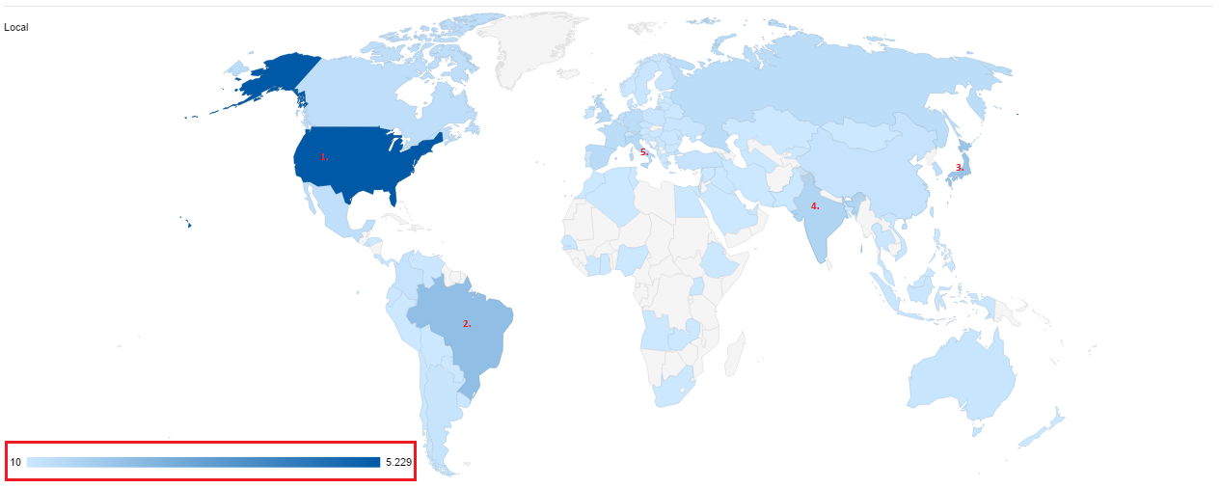
VISIBILITY
In five mouths, between December 2016 and May 2017 we had more than 20,000 visitors from the whole world. As positive as the number of visits is the great diversity of countries from which visitors have accessed our exhibitions:
1. United States: 5,229 visitors
2. Brazil: 1,546
3. Japan: 1,298
4. India: 716
5. Italy: 573
Spain, France, United Kingdom and Germany has an average of 450 visitors.
Feb - May 2017

Slide 38
INSPIRED BY NASA
NASA will lead informal education projects to help inspire the youth regarding science, technology, engineering and math (STEM) studies and careers as the agency progresses on its Journey to Mars.
The projects will create a new Mars exploration exhibit, offer educator professional development on space science topics and engineering technology, pilot Mars-themed lesson plans in regional school districts, expand regional afterschool and summer camp opportunities, and develop community programs related to space exploration. [...] Museums and out-of-school time providers are in a unique position to provide STEM engagement through hands-on experiences".

Slide 39
INSPIRED BY UNITED NATIONS
In addition to being a science communication activity, this exhibition is inspired by the importance of working with youth in what the World Health Organization calls Life Skills: critical thinking, creative thinking, effective communication, decision-making and problem solving, self-knowledge, interpersonal relationships, empathy, coping with feelings and coping with stress.

Slide 41
NARRATIVE
Students will be invited to participate in two space exploration missions: one on Mars, where they will research the possibilities for our life, another in Next B, an exoplanet, where they will investigate possibilities of life different from ours.
Both missions require preparation. Participants should know about the main formation and composition of the Cosmos, distances inside and outside the Solar System, where space exploration has already led us and where it can lead us in the next decades.
It is also an strategy for the students and teachers engagement.

Slide 42
CONTENT
The cosmos, Earth and us
The formation and composition of the cosmos; cosmic chemistry; the celestial bodies and the dynamics between them; age of the Earth and the age of our species
Our stellar address
Solar System; Current stage of knowledge about Mars; Current stage of knowledge about exoplanets
Achievements of space exploration
The Arrival on the Moon; Around the planet onboard the International Space Station; The arrival of the Mars Express spacecraft to Mars; Rosetta and the manned missions; Satellites in orbit of planets, Voyager I and II; The discovery of Proxima B; The discovery of water feathers in Europe; The discovery of the Moon of Jupiter; Hubble and the exoplanets
Methodology
These content will be explained in lectures and activities using softwares by Nasa and Google. Art classes will be offered to support creative project and narrative design. All these activities will happen at the Museums and schools.

Slide 43
THE FIRST-TIME ASTRONAUT GUIDE
DRAFT
Title
Presentation
Logos
Description of celestial bodies
and artifacts
E1
E2
E3

Slide 44
Illustration of celestial bodies and artifacts
Accompanied by description of distances and
Of human presence in the Cosmos
I1
I2
I3

Slide 45
VISUALS POSSIBILITIES

Slide 48
NARRATIVE POSSIBILITIES
Open paths to the Cosmos are composed of panels with content on the spacecraft, the launch and what they will take in the ship;
From the window of my spacecraft is composed of content of the different celestial bodies;
My extraterrestrial friend is made up of content from what they imagined to be extraterrestrials;

Slide 49
davi.bonela@museudoamanha.org.br

