Slide 1
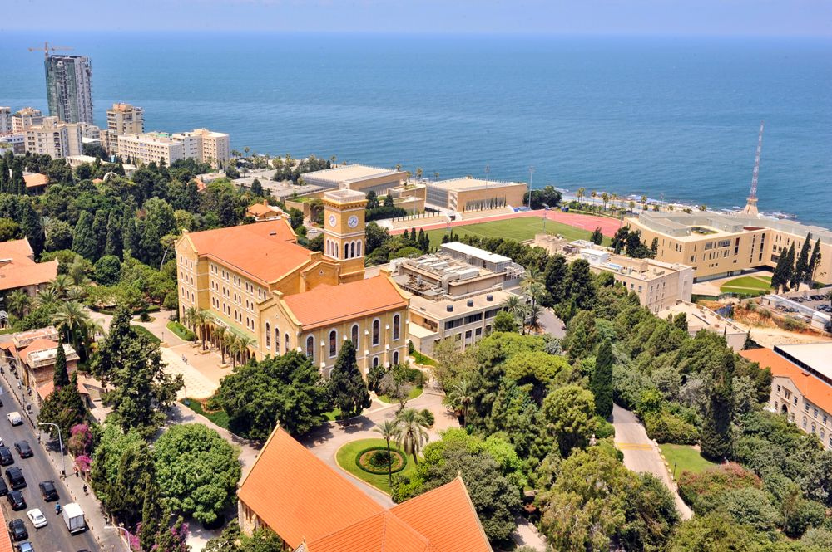
What can Lithium tell us about the early universe?
Tahani R. Makki
Ph.D student at American University of Beirut

Slide 2
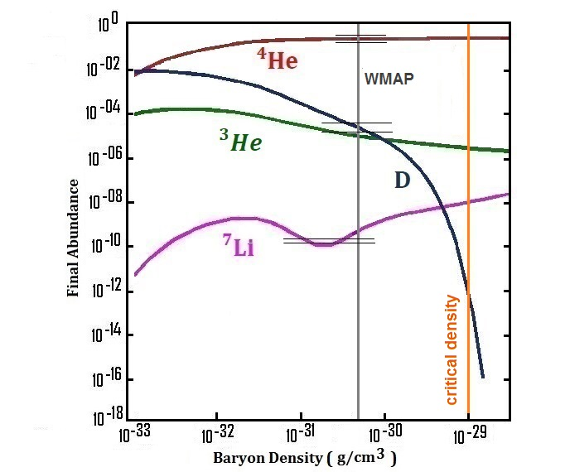
Big Bang Nucleosynthesis (BBN)
The BBN which have taken place between 1s and 3 minutes after Big Bang is the responsible of the formation of light elements : Deuterium (D), Helium-3 $({}_{2}^{3}{He})$, Helium-4( ${}_{2}^{4}{He}$) and lithium $({}_{3}^{6,7}{Li})$.
As seen in Fig.1, the only free parameter controlling the primordial light element abundances is the baryon to photon ratio $η=\frac{n_{B}}{n_{γ}}\sim 6.19{×10}^{−10}$ determined by WMAP (Wilkinson Microwave Anisotropy Probe).
All elements produced by BBN are in good agreement with observations except for Lithium…
Fig.1 : Elements abundances as function of Baryon Density. Horizontal lines represents observations.

Slide 3
The most important point in BBN is to understand the competition between cosmic expansion rate and reactions rates .
The expansion rate of the universe acts as a “shut-off” for nuclear reactions, so that when it becomes faster than the lifetime of a reaction rate, the corresponding reaction will freeze out.
The expansion rate of the universe is given by Friedmann equation as a function of radiation density :
$({\frac{\dot{a}}{a})=H}^{2}=\frac{8πG}{3}ρ (1)$
Where $ρ=ρ_{rad}≡\frac{π^{2}}{30}g_{∗}T^{4} (2)$
relativistic degrees of freedom for photons , $e^{±}$ and Neutrinos species.

Slide 4
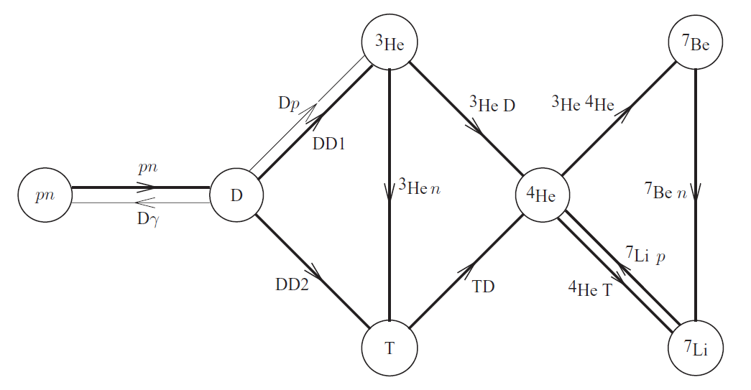
The Weak interaction processes responsible for the equilibrium between neutrons and protons:
$\left\{\begin{aligned}n+ν_{e}↔p+e^{−} \\ n+e^{+}↔p+{\overline{ν}}_{e} \\ n↔p+e^{+}+{\overline{ν}}_{e}\end{aligned}\right.$ (3)
Where neutrons and protons are still in equilibrium: $\frac{n}{p}=exp[−\left(Q/T\right)]$ (4)
Where ${Q=m}_{n}−m_{p}=1.293 Mev.$
As a result of expansion the weak interaction processes will stop at $T≈0.77Mev$ where the equilibrium between protons and neutrons is no longer available.

Slide 5
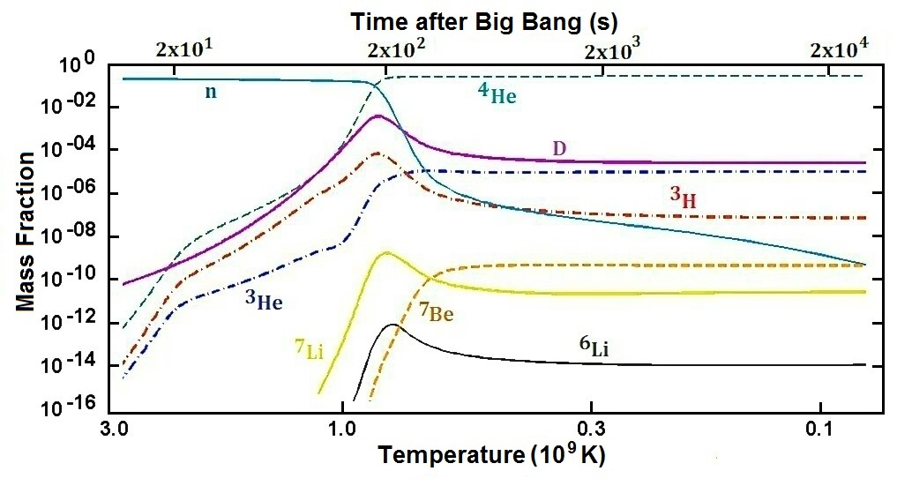
D bottleneck
Fig.2 : elements abundances as function of temperature.
Before many neutrons could decay into protons, they begun to combine with protons to form Deuterium.
As far as the temperature remains high, deuterium is easily destroyed by gamma-rays. Then, formation of ${}_{}^{3}{He} ,{}_{}^{4}{He}$ is blocked till Deuterium reaches its maximum $D/H≈3.6×{10}^{−3}$, which is called Deuterium bottleneck (see Fig.2).

Slide 6
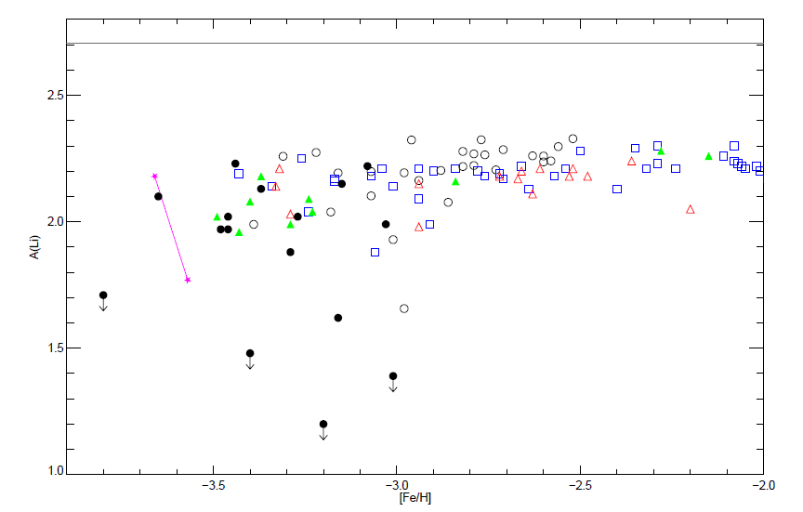
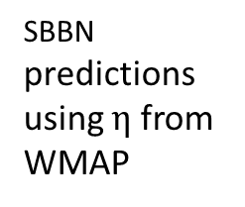
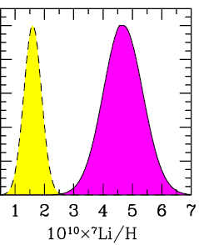
The Lithium Problem
Observations of Metal poor stars indicate :
Overproduction of ${}_{}^{7}{Li}$ by SBBN
Strong variation at very low metallicity (see Fig.3)
This is called now “Li Problem” !
Plateau
Fig. 3: Different measurements of Lithium-7 abundance as a function of metallicity [F/H]=log(Fe/H)_{star} -log(Fe/H)_{Sun}

Slide 7
How to resolve the Lithium Problem?
Three directions maybe considered:
Astrophysical aspects
Nuclear aspects
Non-standard physics
Astrophysical aspects:
Are the observed Li-abundances accurate enough to confirm predictions of SBBN?
The Lithium abundance determined from metal poor stars are sensitive to the physical conditions taken in the model atmosphere.
Any mechanism leading to a depletion of ${}_{}^{7}{Li}$ in very metal poor stars should not affect the plateau at high metallicity and should keep certain abundance of ${}_{}^{6}{Li}$.
Astrophysical solutions seems not to work!!

Slide 8
Nuclear physics Aspects :
${}_{}^{3}{He}(α,γ){}_{}^{7}{Be}$ : plays an important role in ${}_{}^{7}{Be}$ production. To resolve ${}_{}^{7}{Li}$ problem this reaction should be less by a factor of 3-4 but this is not confirmed by experiments and should be confirmed by solar neutrinos.
${}_{}^{7}{Be}$ will transform to ${}_{}^{7}{Li}$ by electron capture through the reaction ${}_{}^{7}{Be}(e^{−},ν){}_{}^{7}{Li}$ which will be added with collaboration with Busso , Tripella et al.
${}_{}^{7}{Be}(n,α){}_{}^{4}{He}$ will be updated also with collaboration with Barbagallo et al.
It is important to see the effect of these modifications together with non-standard scenarios.

Slide 9
Solutions beyond the Standard Big Bang Nucleosynthesis (SBBN)
Examples:
Effect of non-standard Neutrinos properties
Effect of dark matter
Particle decaying during BBN
Variation of fundamental constants
Modification of the velocity distribution of nucleons during BBN…
We focus here on the first and second scenarios keeping in mind the observational constraints on ${}_{}^{4}{He}$ and D.
Non –standard Neutrinos properties
Effect of varying Neutrinos chemical potential
Chemical potential of neutrinos (represented by degeneracy parameter $β=μ/T$) will have two main effects :
Increasing the expansion rate by modifying the radiation density :
$ρ_{f}+ρ_{\overline{f}}=\frac{7π^{2}}{120}gT^{4}\left[1+\frac{{30β}^{2}}{7π^{2}}+\frac{{15β}^{4}}{7π^{4}}\right]$
Affecting the weak rates and this is limited to $ν_{e} :$
$\frac{n}{p}=exp[−\left(β_{ν_{e}}+Q/T\right)]$

Slide 10
Equating $β_{ν_{e}}=β_{ν_{μ}}=β_{ν_{τ}}$ (including neutrinos oscillations), the effect of $β_{ν_{e}}$ will be dominant and it will violate observational constraints.
Adding $β_{ν_{e}}≠β_{ν_{μ}}(β_{ν_{τ}})$ together will lead to ${}_{}^{7}{Li}$ depletion without violating observational constraints (see table 1).
Varying neutrinos temperature alone will lead to some Lithium depletion (Recent paper by Galvez and Sherrer 2017).
An extension of this scenarios by varying neutrinos temperature
and chemical potentials have more effect on lithium as shown in the
Bottom of table 1.
SBBN predictions of ${}_{}^{7}{Li}$/H is 4.7$×{10}^{−10}$
Table 1 : effect of varying neutrinos chemical potential and temperature. 𝜑 refers to equal
degeneracy parameter of three neutrinos species, and 𝛼 represents the variation of neutrinos temperature ($T_{ν}=α∗T_{ν}\left(SBBN\right)$). Number in parenthesis are power of ten.
 | X(${}_{}^{4}{He}$) | D/H | $${}_{}^{3}{He}/H$$ | $${}_{}^{7}{Li}/H$$
$$β_{ν_{e}}=0.28 ,β_{ν_{μ}}=β_{ν_{τ}}=2$$ $$α=1$$ | 2.22(-1) | 3.36(-5) | 1.13(-5) | 2.81(-10)
𝜑=0 ,𝛼 =1.25 | 2.88(-1) | 3.91(-5) | 1.20(-5) | 3.24(-10)
$φ$=0.11 ,$α=1.25$ | 2.25(-1) | 3.42(-5) | 1.14(-5) | 2.79(-10)

Slide 11
Is it possible to consider dark energy and dark matter as a same and unique dark fluid?
dark energy density
Adding dark component
Dark entropy
dark matter is not well known.
Adopting a unified adiabatically expanded fluid or dark energy and dark matter can be considered as two different aspects of the same component. (Arbey, A. and Mahmoudi, F. 2008) and (Arbey, A. 2005).
To illustrate this model, temperature-dependent dark energy and entropy density are added as follows :
$ρ_{D}\left(T\right)=k_{ρ}ρ_{rad}\left(T_{0}\right){\left(\frac{T}{T_{0}}\right)}^{n_{ρ}}$
$${ s}_{D}\left(T\right)=k_{s}s_{rad}\left(T_{0}\right){\left(\frac{T}{T_{0}}\right)}^{n_{s}}$$
Or/and
$$T_{0}=1Mev$$
Hubble expansion rate
Energy conservation Equation
$${\left(\frac{\dot{a}}{a}\right)}^{2}=H^{2}=\frac{8πG}{3}\left(ρ_{rad}+ρ_{D}\right)$$
$$\frac{d}{dt}\left(ρ_{tot}a^{3}\right)+P_{tot}\frac{d}{dt}\left(a^{3}\right)+T\frac{d}{dt}\left(s_{D}a^{3}\right)=0$$
$k_{ρ}$<1 and $n_{ρ}$>4 to ensure radiation dominated era during BBN.

Slide 12
Let’s see some results :
Adding dark density alone will not have effect on Lithium, in contrary it will increase Lithium, Helium, and D.
Adding dark density along with varying neutrinos chemical potential will slightly decrease in Lithium as shown in table 2.
Adding dark entropy will have more effect on Lithium as shown in table 3.
table 2 : Effect of adding ${ ρ}_{D}(T)$ with $k_{d}=0.1$and $n_{d}$=6.5, and $φ$=0.5.
table 3 : Effect of adding ${ s}_{D}(T)$ with $k_{s}=5.5×{10}^{−4}$and $n_{s}$=5.
table 3 : Effect of adding ${ s}_{D}(T)$ with $k_{s}=5.5×{10}^{−4}$and $n_{s}$=5.
X(${}_{}^{4}{He}$) | D/H | $${}_{}^{3}{He}/H$$ | $${}_{}^{7}{Li}/H$$
2.388(-1) | 2.574(-5) | 1.026(-5) | 4.217(-10)

Slide 13
Conclusions
The primordial Lithium problem becomes challenging because observations are extended to very low metallicity in very metal poor stars.
To resolve this fundamental problem, it seems it cannot be done in SBBN as I have tried to outline and this will give more insight of physical conditions under which light elements were formed.
Theoretical predictions are certainly very useful but they have to match observations especially when we talk about early universe.

Slide 14
Acknowledgment:
I wish to express my gratitude to my advisor Prof. Mounib El Eid, for his inspiring guidance and accurate advice. I would thank Prof. Maurizio , Dr. Oscar and Dr. Sarah for their generous and prompt help.
Thank you

