Slide 1
High resolution abundance work: the details that no one wants to hears dff
Chris Sneden, University of Texas at Austin
I have many friends who collaborate with me on chemical composition analyses
Melike Afşar, Gamze Böcek Topcu, Zeynep Bozkurt – Ege University, Izmir
George Preston – Carnegie Observatories, Pasadena
John Cowan, University of Oklahoma, Norman
Jim Lawler, Betsy Den Hartog, Mike Wood – University of Wisconsin, Madison
Dan Jaffe, Greg Mace – University of Texas, Austin
Raffaele Gratton, Sara Lucatello – Padova Observatory INAF
Angela Bragaglia, Eugenio Carretta – Bologna Observatory INAF
Davide Magurno, Giuseppe Bono – University of Rome
Inese Ivans, University of Utah, Salt Lake City
Jennifer Sobeck, University of Washington

Slide 2
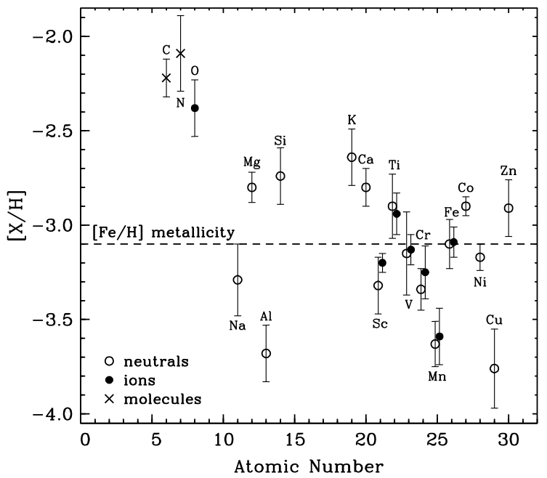
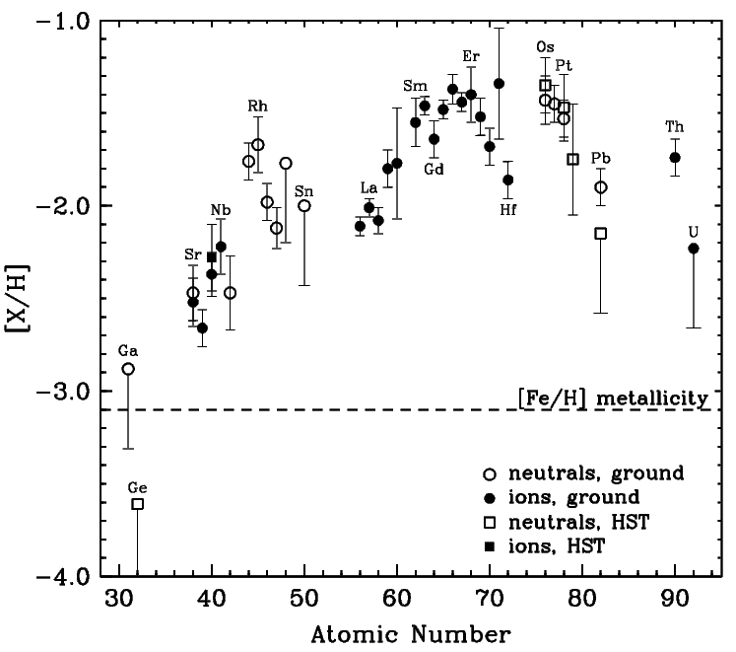
An example of the desired output from chemical composition analyses
log ε = log(N_{Fe}/N_{H}) + 12
[X/Y] = log(N_{X}/N_{Y})_{star} – log(N_{X}/N_{Y})_{Sun}
Sneden et al. 2003

Slide 3
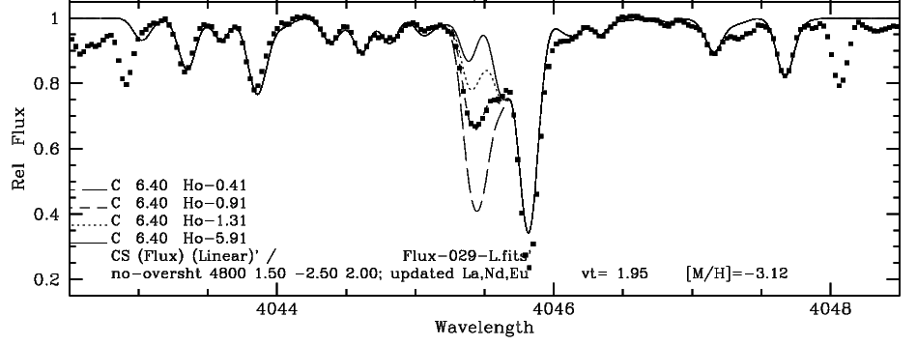
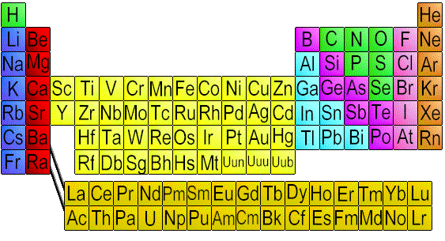
But how practically does determine any abundance? Example: the holmium abundance from 4045.5Å Ho II; this needs spectrum synthesis
Must have “high quality” spectra for this work:
R = λ/(Δλ) ≥ 40K ; S/N > 50±
Ho = holmium, Z=67, rare earth

Slide 4
desired result: holmium from 4045.5Å Ho II
Line identifications begin with Moore, Charlotte E.; Minnaert, M. G. J.; Houtgast, J.
1966, The solar spectrum 2935 A to 8770 A, NBS Monograph
Co I
Zr II
CH
Fe I
Fe I
Ce II
Fe I
CH
Zr II
unknown
unknown
unknown
CH
Fe I
Fe I
Ho II

Slide 5
desired result: holmium from 4045.5Å Ho II
Abundances in the syntheses: ALWAYS log ε units (WHY???)
Description of observations
Description of model atmosphere

Slide 6
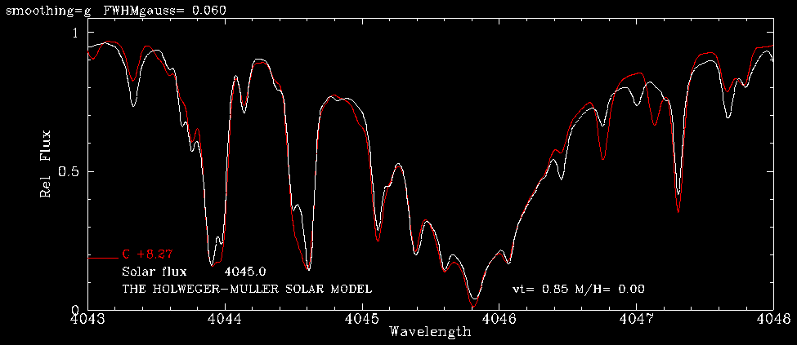
We start by synthesizing the Sun
White line is solar flux atlas; red line is synthetic spectrum with “original” line list
How do we make a line list that we can believe?

Slide 7
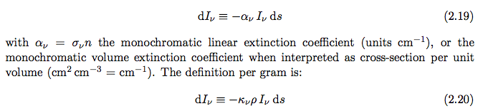





Reminder of the basics
R. J. Rutten, “Radiative Transfer in Stellar Atmospheres:
http://www.staff.science.uu.nl/~rutte101/

Slide 8
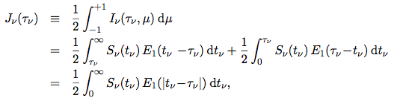
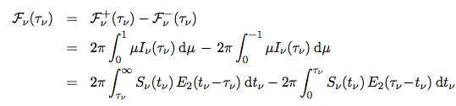

Reminder of the basics

Slide 9
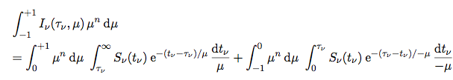

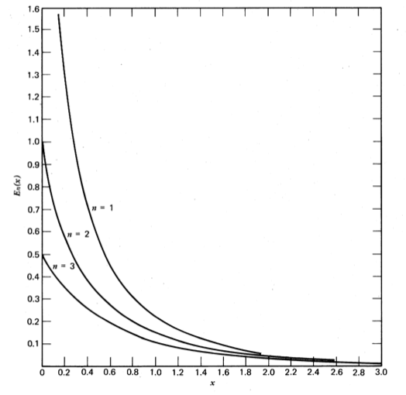

Reminder of the basics
Where the exponential integral is:

Slide 10
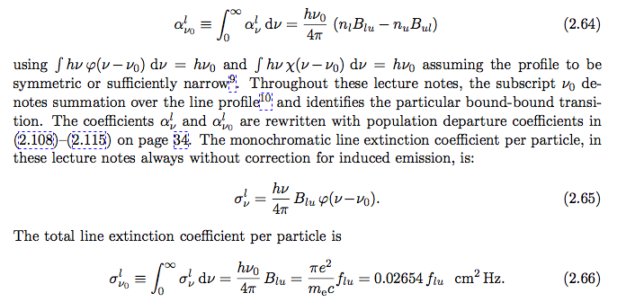

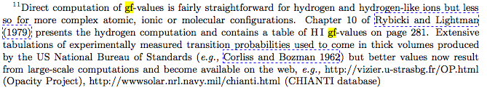
Reminder of the basics

Slide 11
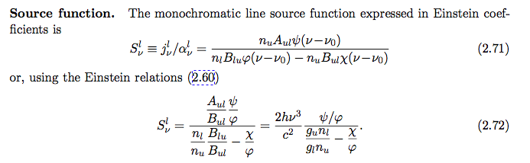
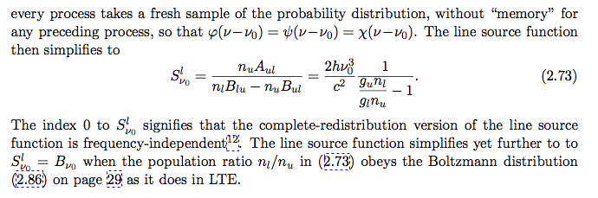

Reminder of the basics

Slide 12


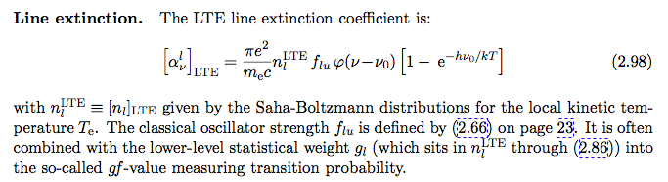
Reminder of the basics:
Boltzmann/Saha electronic state populations
No stellar abundance can be better than the input transition probability (gf-value)

Slide 13
Requirement for chemical composition analyses
A grid of model stellar photospheres:
Kurucz ATLAS: http://kurucz.harvard.edu/grids.html
Gustafsson MARCS: http://marcs.astro.uu.se
Hauschildt NEXTGEN: http://hobbes.hs.uni-hamburg.de/PAPERS/NextGen/ms.html
Typical model atmosphere computation output:
TEFF 3500. GRAVITY 0.00000 LTE
TITLE SDSC GRID [+0.0] VTURB 0.0 KM/S L/H 1.25
OPACITY IFOP 1 1 1 1 1 1 1 1 1 1 1 1 1 0 1 0 0 0 0 0
CONVECTION ON 1.25 TURBULENCE OFF 0.00 0.00 0.00 0.00
ABUNDANCE SCALE 1.00000 ABUNDANCE CHANGE 1 0.91100 2 0.08900
READ DECK6 72 RHOX,T,P,XNE,ABROSS,ACCRAD,VTURB
1.92081317E-02 2162.9 1.918E-02 3.953E+05 6.942E-06 1.304E-03 0.000E+00
2.55242080E-02 2185.4 2.549E-02 5.259E+05 7.141E-06 1.219E-03 0.000E+00
3.37376143E-02 2204.8 3.370E-02 6.928E+05 7.301E-06 1.118E-03 0.000E+00
4.44603299E-02 2223.3 4.441E-02 9.084E+05 7.451E-06 1.024E-03 0.000E+00
5.84449198E-02 2243.2 5.838E-02 1.191E+06 7.631E-06 9.457E-04 0.000E+00
7.66163984E-02 2264.8 7.653E-02 1.561E+06 7.847E-06 8.769E-04 0.000E+00
1.00122149E-01 2288.2 1.000E-01 2.047E+06 8.106E-06 8.122E-04 0.000E+00
1.30562972E-01 2308.0 1.304E-01 2.662E+06 8.320E-06 7.329E-04 0.000E+00
1.70060206E-01 2328.6 1.699E-01 3.462E+06 8.564E-06 6.653E-04 0.000E+00
...

Slide 14
Requirement for chemical composition analyses
Line analysis code:
Kurucz WIDTH: http://kurucz.harvard.edu/programs/WIDTH/
Kurucz SYNTHE: http://kurucz.harvard.edu/programs/SYNTHE/
Hubeny TLUSTY: http://nova.astro.umd.edu/
Plez TURBOSPECTRUM:
http://www.pages-perso-bertrand-plez.univ-montp2.fr/
Sneden MOOG: http://www.as.utexas.edu/~chris/moog.html
Other personal programs not generally available to public
WHICH CODE TO USE? WHO CARES! KEEP FOCUSED ON WHAT YOU WANT
These codes all have tradeoffs between convenience, speed, and sophistication of basic physics:
Allowance for scattering in continuum opacities & source functions
LTE or “better”
How much atomic/molecular information comes with code
Plane-parallel or spherical geometry
User friendliness
Common-sense outputs that help user avoid stupidities

Slide 15
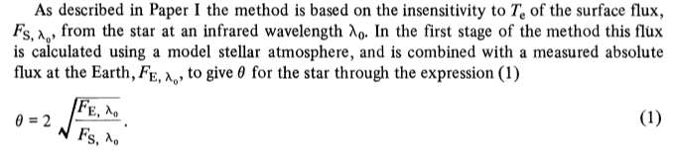
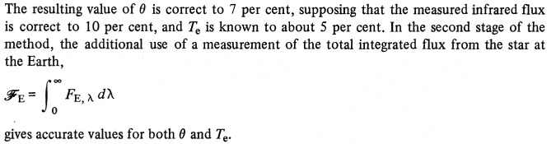
Requirement for chemical composition analyses:
“reliable” model atmosphere parameters
Effective temperature T_{eff}: colors and/or spectral line data
Colors: usually B-V, V-I, V-K, J-K
Calibrated with “infrared flux method”
Blackwell et al. 1979

Slide 16
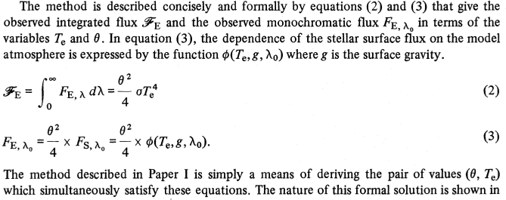
Infrared flux method
Blackwell et al. 1979

Slide 17
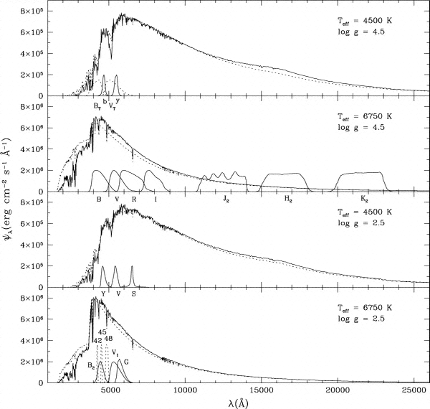
The dominant photometric passbands are:
V-K is usually the best photometric temperature indicator; why?
Hey! Need to add Sloan system
Ramirez & Melendez 2005

Slide 18
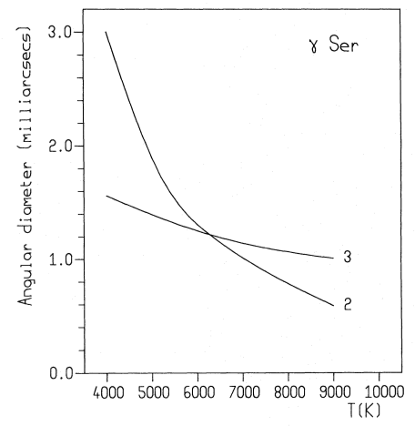

Infrared flux method
What about the gravity dependence? Happily, it is a 2nd-order effect; still must be calibrated for most accurate work
Blackwell et al. 1979

Slide 19
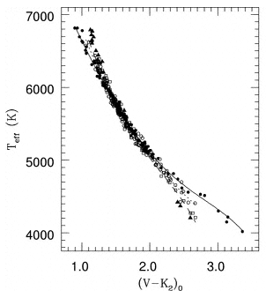
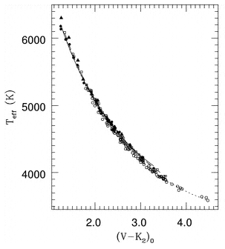
Application of IR flux method
dwarf
giant
-0.5 < [Fe/H] ≤ +0.5 (filled circles), -1.5 < [Fe/H] ≤ -0.5 (open circles), -2.5 < [Fe/H] ≤ -1.5 (squares), and [Fe/H] ≤ -2.5 (triangles). The lines corresponding to our calibration for [Fe/H] = 0.0 (solid line), -1.0 (dotted line), and -2.0 (dashed line) are also shown.
Ramirez & Melendez 2005

Slide 20
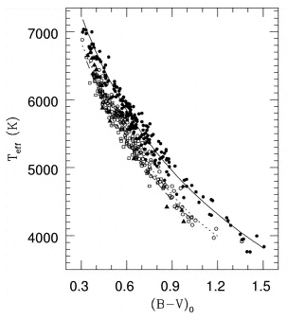
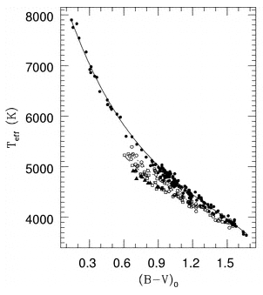
Application of IR flux method
dwarf
giant
Ramirez & Melendez 2005

Slide 21
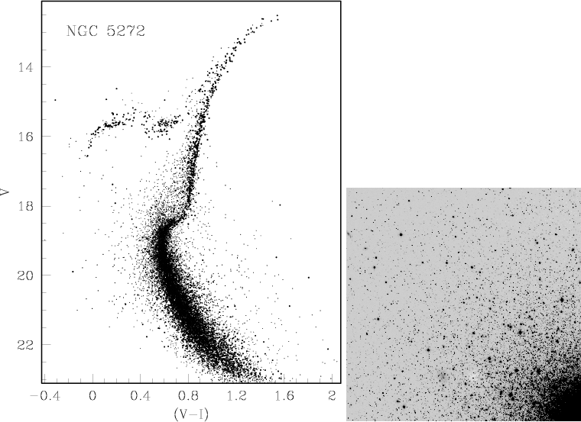
Requirement for chemical composition analyses:
“reliable” model atmosphere parameters
Surface gravity log g: cluster, physical, and/or spectral line data
Cluster:
Easiest method in theory
Want L/L_{sun}
Need good reddening E(B-V)
Usually must assume R_{V} = A_{V}/E(B-V)
Must derive true distance modulus V-M_{V}
Rosenberg et al. 2000

Slide 22

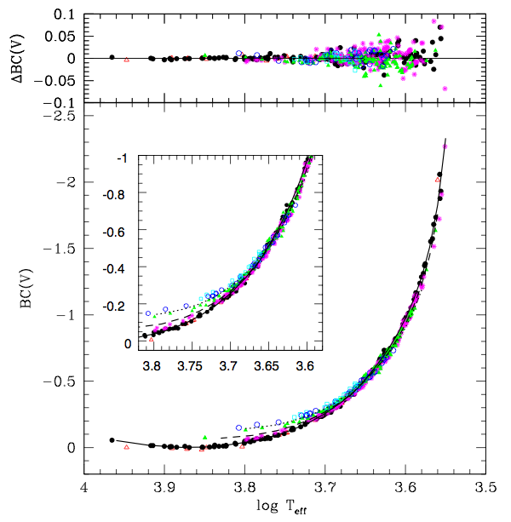
Gravity, continued
Surface gravity log g: cluster, physical, and/or spectral line data
Cluster and/or physical:
from photometry (IR flux method)
or rough estimate (good enough)
assumed (guessed);
Stellar isochrones
cluster color-mag;
parallax (HIPPARCOS);
spectral type;
guesses from colors
as discussed above
Alonso et al 1999

Slide 23
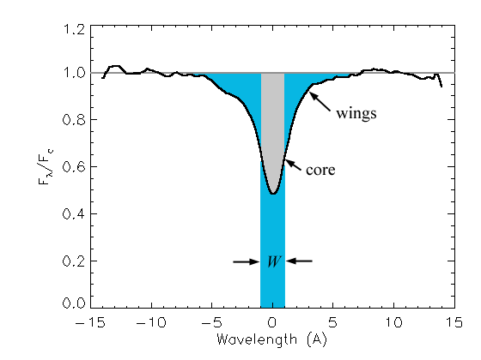
The alternative approach to stellar parameters: equivalent width (W or EW) analyses; essentially a Boltzmann-Saha argument
And of course we define:
Log(RW) = log(EW/λ)
This particular figure deliberately chosen to illustrate:
Continuum choice
Possible blending
Line profile assumptions
The “personal equation is much more serious than one imagines
http://web.njit.edu/~gary/321/Lecture6.html

Slide 24
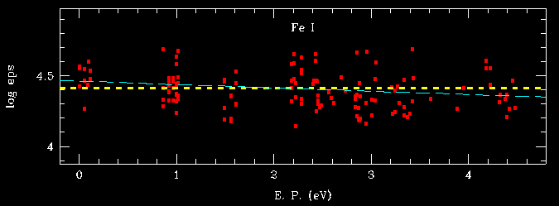
T_{eff} from Boltzmann argument: want no trend with excitation energy
In practice, only Fe I lines have the excitation range necessary
SO! How would you change the assumed T_{eff} to fix the slope?

Slide 25
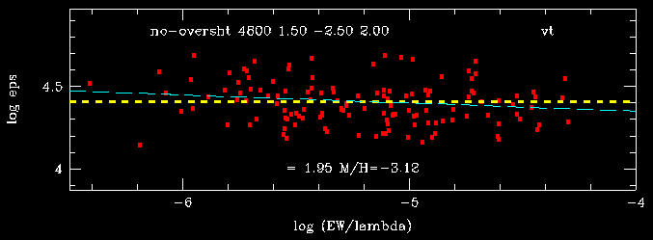
Microturbulent velocity argument: want no trend with line strength
What’s the cure for this slope?
What are the difficulties in assuming that v_{micro} is the problem here?

Slide 26
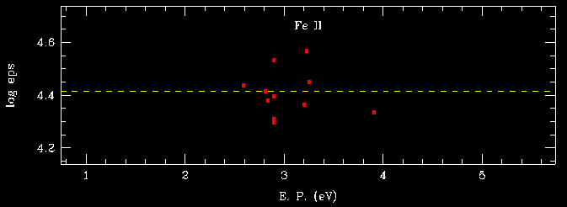
Gravity (Saha) argument: want same abundances from neutral & ionized lines of same element
All OK here, how would you change log g if the abundance from Fe II was say 0.2 dex larger?

Slide 27
Requirement for chemical composition analyses: synthetic spectrum line lists (or lists of lines for EW analysis) must be developed
Ideal: high-quality laboratory data for all transitions
  Wavelengths (!), excitation energies, transition probabilities
  damping constants, partition functions
  Hyperfine structures, isotopic wavelength shifts
Reality: many transitions have little or no lab data
  Very few lab atomic/molecular physicists
    Wisconsin, Liege, Lund, London
  This work is of little interests to most physicists
Typically start with “semi-empirical” line lists
Iteration of lists with high-quality spectra of a couple of stars
  Sun, Arcturus, maybe Procyon
  Adjustment of wavelengths & transition probabilities
  Guessing at relative contributions to blended features
  Adding fake lines!
    Declared as Fe I, χ= 3.5 eV, log (gf) set to match observed line

Slide 28
Lab data where possible: radiative liefetimes
The excited state of an atom has an intrinsic lifetime due to radiative decay given by:
where Nj is the population in the excited state (j) and the Aji's are the Einstein spontaneous emission coefficients for all of the radiative transitions originating from level j. The negative sign is because the rate decreases with time. Intergrating this equation produces:
where Nj(t) is the excited-state population at any time t, Nj(0) is the initial excited-state population at t=0, and j is the radiative lifetime defined as:
Strong atomic transitions have Aji's of 108 to 109 s-1, so lifetimes are 1 to 10 ns. The above expressions give only the radiative lifetime. Lifetimes can be shortened by collisions or stimulated emission.
http://www.files.chem.vt.edu/chem-ed/spec/atomic/theory/lifetime.html

Slide 29
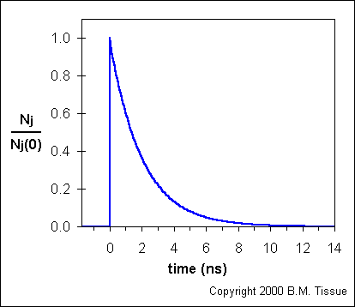
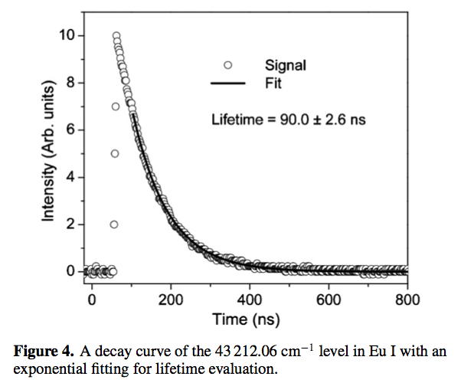
Lifetime decay curves
idealized
Real data
Wei Zhang et al. 2011, J Phys B

Slide 30
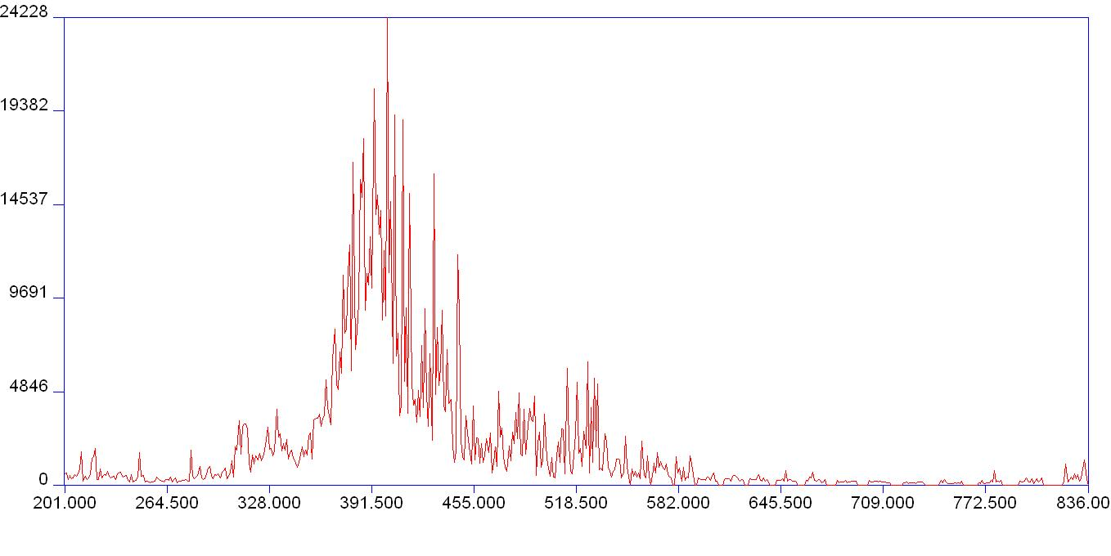
The lifetimes must be combined with branching ratios (fractions) to get gf-values
(A_{ij} is what we want)
http://www.uwindsor.ca/people/rehse/16/what-is-laboratory-astrophysics

Slide 31
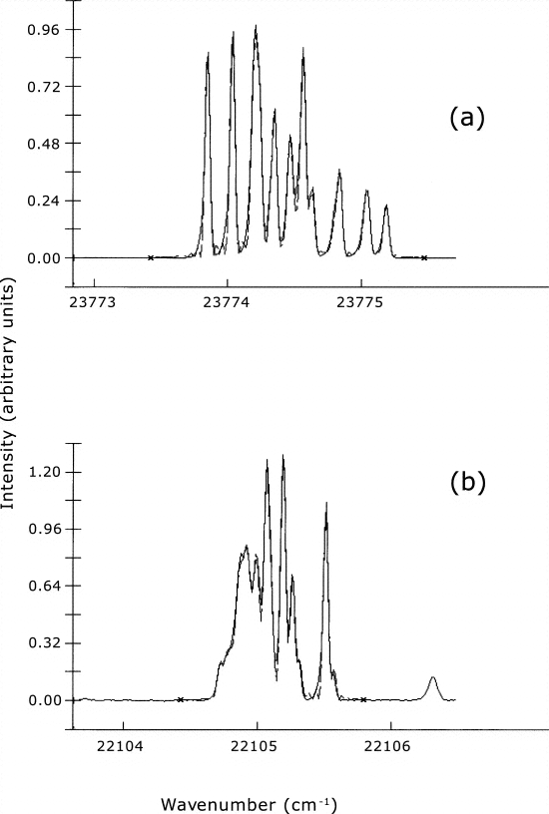
Same lab emission spectra can do hyperfine and isotopic substructure
FTS spectra of the Eu II lines at (a) 23774.28 cm-1 and (b) 22105.07 cm-1 with nonlinear least-squares fits superposed. Only the line center position and line amplitude are free parameters in these least-squares fits. The hyperfine constants are fixed using the most accurate values from Table 4, and the isotope shifts are fixed using the recommended (REC) values from Table 5. All subcomponents are well matched by the fits. Least-squares fits for the other Eu II lines are in similar agreement with our FTS data.
Lawler et al. 2001

Slide 32
the rare earths: results of lab initiatives
Wisconsin/Texas lab/solar/stellar studies of rare-earth ionized-species transitions: log gf and hyperfine/isotopic structure
Den Hartog et al. 2003
Den Hartog et al. 2003
(well studied in literature)
Lawler et al. 2000a
Lawler et al. 2000b
Sneden et al. 2009
Sneden et al. 2009
Sneden et al. 2009
Lawler et al. 2009
Lawler et al. 2006
Sneden et al. 2009
Sneden et al. 2009
Lawler et al. 2007
Lawler et al. 2001
Lawler et al. 2008
Lawler et al. 2004
(unstable element)
Ba
La
Ce
Pr
Nd
Pm
Sm
Eu
Gd
Tb
Dy
Ho
Er
Tm
Yb
Lu
Hf
14
45
5
46
36
14
20
2
13
3
8
3
1
1
4
Sun: # transitions used in analysis
4
15
32
15
37
55
9
32
7
29
13
21
6
1
8
CS 22892-052 : # transitions used in analysis

Slide 33
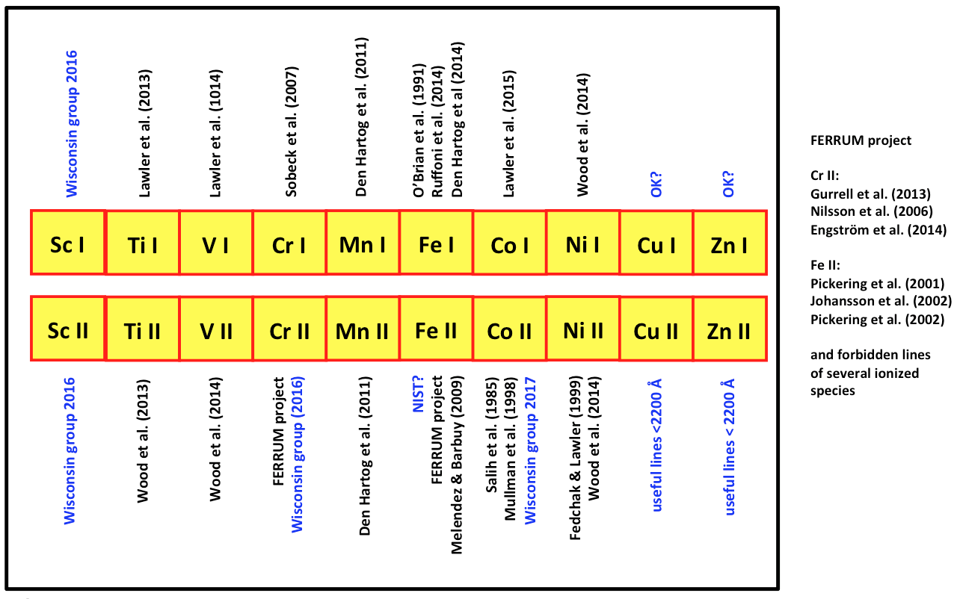
There is lab progress also on the Fe group

Slide 34
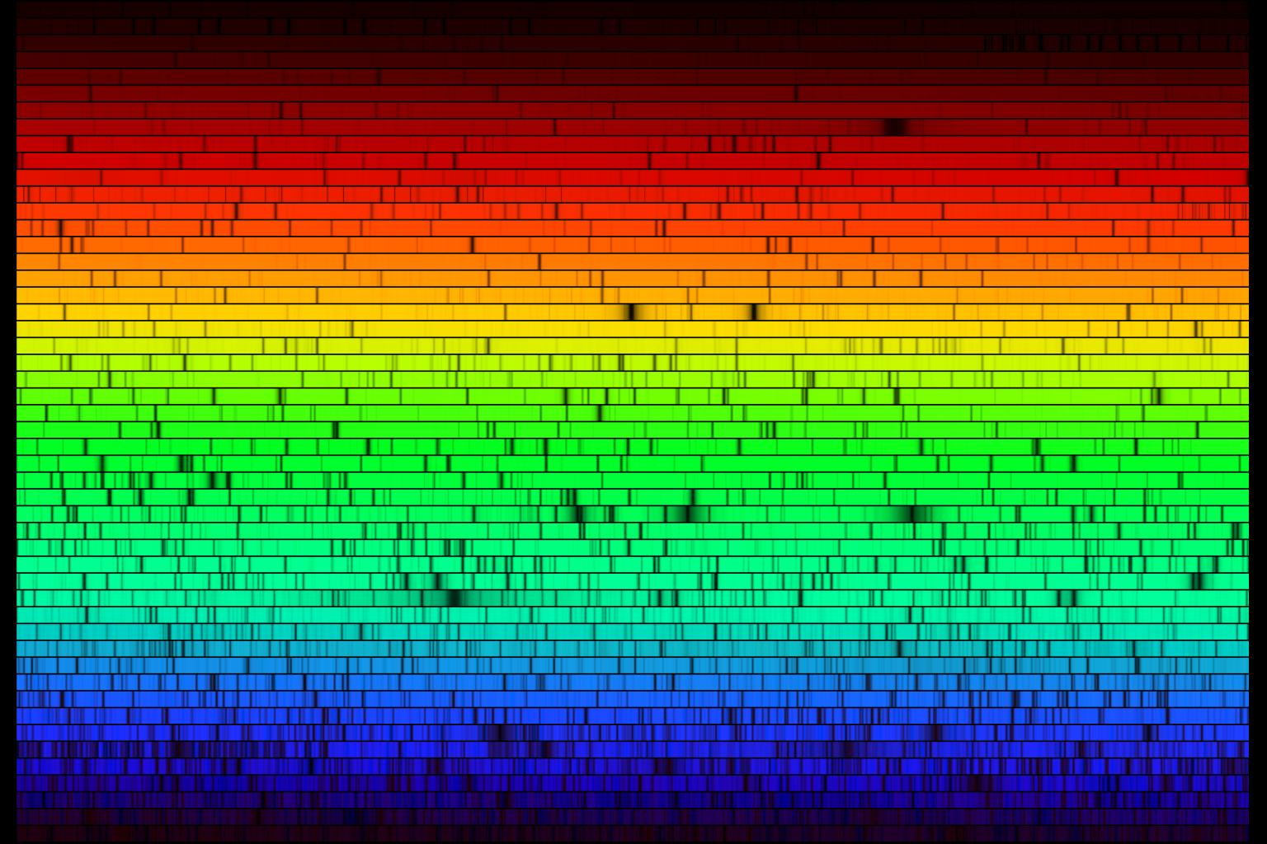
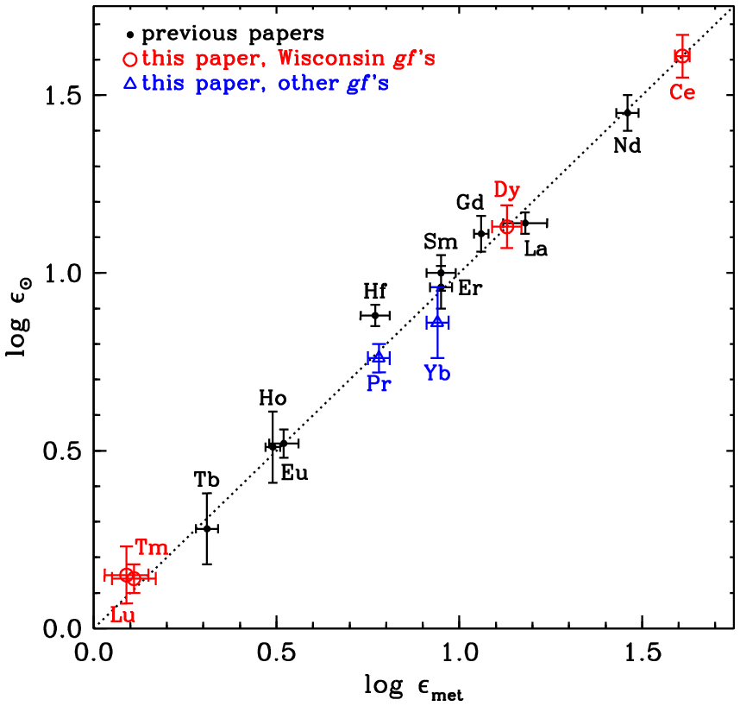
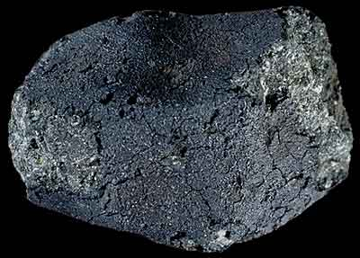
Not the most exciting work, but it pays off
Sneden et al. 2009

Slide 35
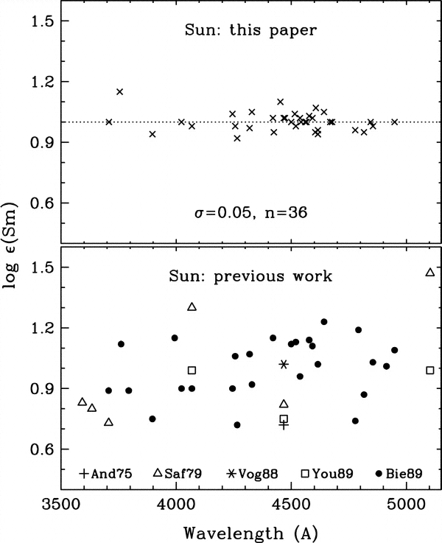
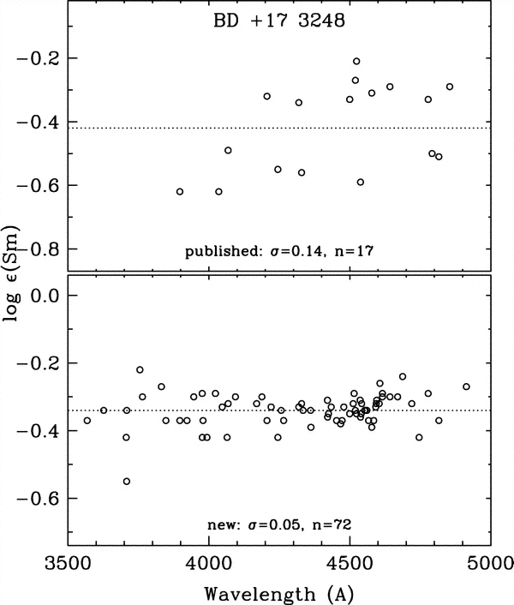
The careful laboratory work applied: an example of Sm (Z=62)
Lawler et al. 2006

Slide 36
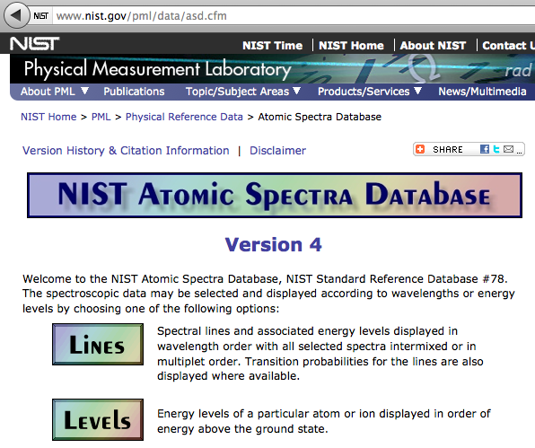
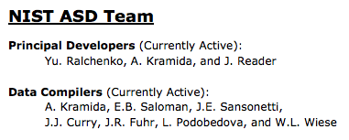
A good summary site for lab atomic data
(these are often gf’s that are “normalized” in some way)

Slide 37
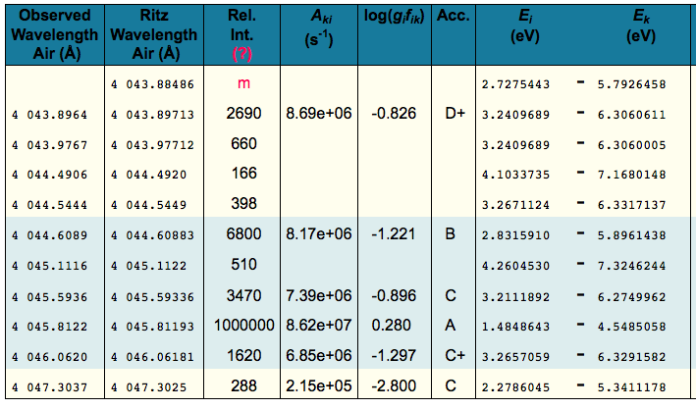
NIST entries for Fe I near 4045Å: 6 lines
Acc. = their estimated accuracies for lab values; be wary of “C” and worse

Slide 38
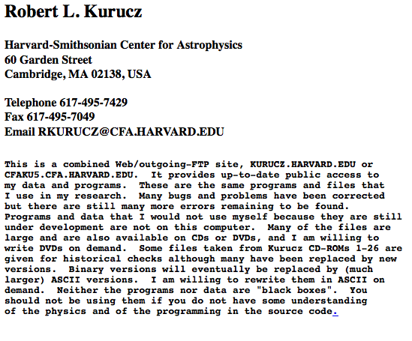
But my line list has 30 Fe I lines; they come from semi-empirical line databases

Slide 39
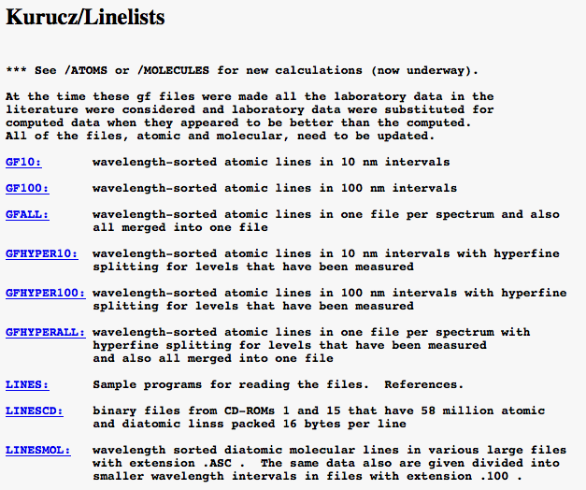
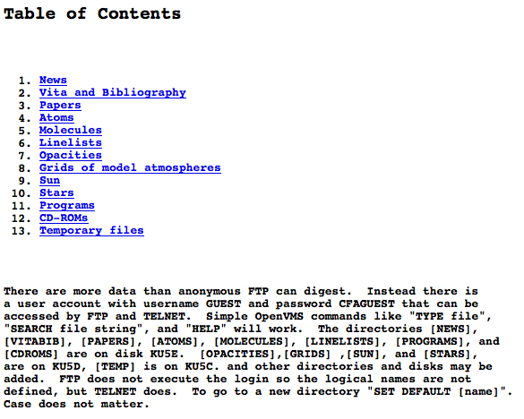
The Kurucz web site

Slide 40
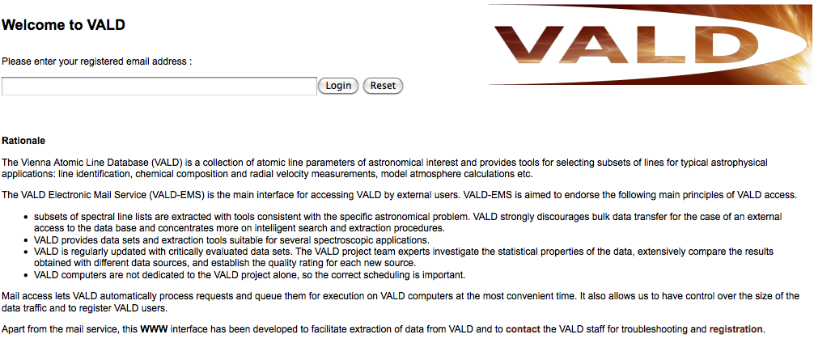
A good alternate “compilation” site; more tools for applications to stellar spectra but be careful of multiple gf sources
http://vald.astro.uu.se/

Slide 41
Remember our starting spectrum synthesis
White line is solar flux atlas; red line is synthetic spectrum with “original” line list

Slide 42
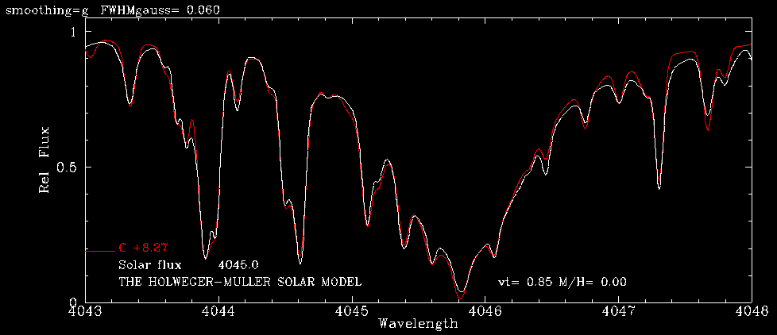
Remember our starting spectrum synthesis
Lab λ‘s and gf’s: adopted without change
Identified (or guessed-at) lines without lab data: changed λ‘s and gf’s to fit Sun
Unknown lines: added fake lines (Fe I, χ= 3.5 eV, log (gf) set to match observed line)

Slide 43
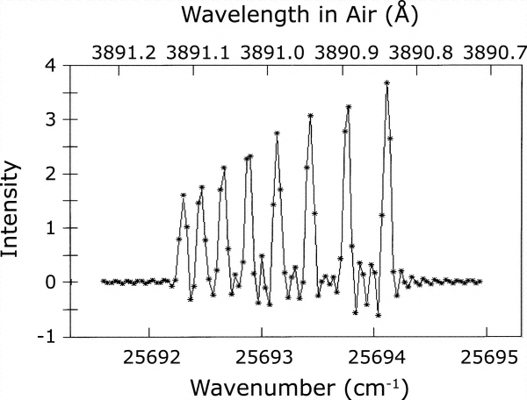
Odd-Z heavy elements often have significant hyperfine structure; again lab data are needed (this is from NOAO Solar Telescope FTS)
Lawler et al. 2004

Slide 44
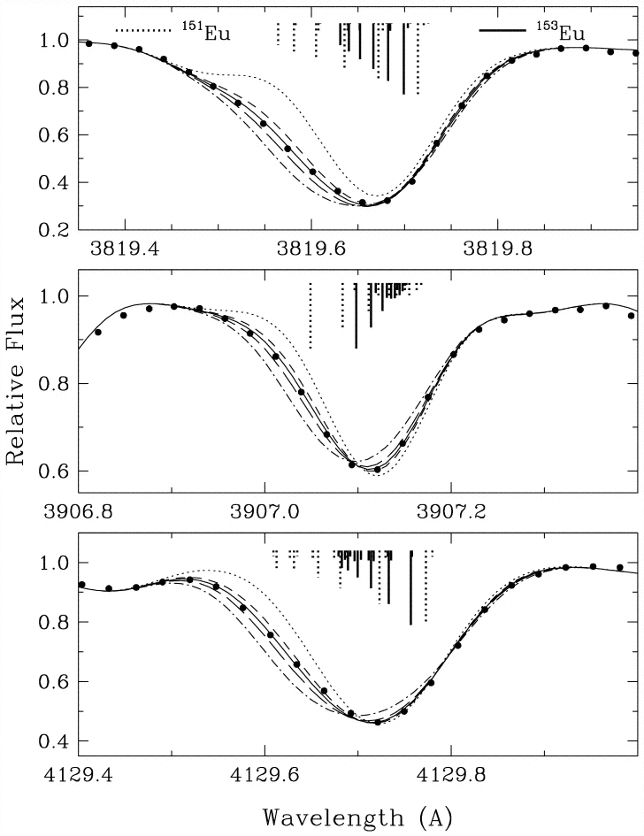

Makes sense out of strange spectra: isotopes
Vertical line sizes give relative strengths of hyperfine components
Sneden et al. 2002

Slide 45




The one isotopic analysis that can be done well with atomic lines: Eu
http://atom.kaeri.re.kr/

Slide 46

Note the hyperfine vs isotopic structures for rare earths
Z = 69
Z = 67
Z = 65
Z = 63
Z = 61
Z = 59
Z = 57
http://atom.kaeri.re.kr/

Slide 47

Less obvious isotopic results
Naturally occurring isotopes are represented by the gray squares. The figure highlights the naturally occurring isotopes of neodymium (Nd, Z=60 ), samarium (Sm, Z=62 ), and europium (Eu, Z=63 ); promethium (Pm, Z=61 ) has no naturally occurring isotopes. We also show the predicted percentage of r-process material in the S.S. abundance for each isotope as given by Cowan et al. (2006). This figure illustrates the pathways by which the s and r-processes operate and the resulting differences in the s or r fraction of S.S. material.
Roederer et al. 2008

Slide 48

Less obvious isotopic results
pure-s- and pure-r-syntheses are indicated by dot-dashed and dashed lines; observed spectrum is represented by the histogram. The point at which the pure-s and pure-r-process syntheses intersect is defined to be the point of insensitivity to the isotopic mix. We adjust the wavelength of the synthetic spectra so that the point of insensitivity coincides with the center of the nearest pixel in the observed spectrum. The isotopic fraction can then be measured using the fitting algorithm. The vertical lines represent the positions and relative strengths of the individual hyperfine components; solid lines represent the 152Sm and 154Sm isotopes, while dashed lines represent the remaining five isotopes.
Roederer et al. 2008

Slide 49

Neodymium? We tried!
Sm II 4424 Å in HD 175305. Observed spectrum = open squares. Panel a shows an (O-C ) plot for the pure-s and pure-r-process syntheses shown in panel b. Panel b, shows syntheses for the pure-s and pure-r-process (dot-dashed and short-dashed curves). Panel c shows the synthesis of our best fit, represented by the solid curve, and the 3 σ uncertainties. The vertical lines represent the positions and relative strengths of the individual hyperfine components; solid lines represent the two heaviest isotopes, while dashed lines represent the lighter five isotopes. We measure a Sm isotopic fraction of f_{152+154}=0.55^{+0.14}_{-0.13} for this line, which suggests an r-process origin.
Roederer et al. 2008

Slide 50

MUCH more difficult: barium isotopes
Isotopic mix | 130 | 132 | 134 | 135 | 136 | 137 | 138
Solar (mostly “s) | 0.1% | 0.1% | 2.4% | 6.6% | 7.9% | 11.2% | 71.7%
Pure “r” | 0.0% | 0.0% | 0.0% | 40.0% | 0.0% | 12.2% | 47.8%
Sneden et al. 2008

Slide 51



Solid line: f_{odd} = 0.31
Dashed lines: changing f_{odd} by ±0.21
Lambert & Allende Prieto 2004

Slide 52


MUCH more difficult: barium isotopes
The Sun
A mildly metal-poor star
Mashonkina et al. 2006

Slide 53
Ni isotopes can be detected in some near-IR Ni I lines and can be accounted for
Sneden et al. 2014

Slide 54

Isotopic ratios can be done for molecular features
Let’s talk about molecular equilibrium …
Gay & Lambert 2000

Slide 55
simplified molecular equilibrium: H-C-N-O
P(H) = p(H) + 2p(H2) + p(CH) + p(NH) + p(OH) + 2p(H2O) + …
P(C) = p(C) + p(CH) + 2p(C2) + p(CN) + p(CO) + p(CO2) + …
P(N) = p(N) + p(NH) + p(CN) + 2p(N2) + p(NO) + …
P(O) = p(O) + p(OH) + p(CO) + p(NO) + 2p(O2) + 2p(CO2) + …
But (happily!) the importance of each depends on abundance of the element(s) and the molecular dissociation energy
P(H) = p(H) + 2p(H2) + … (H cares only about itself)
P(C) = p(C) + p(CO) + … (C cares only about O)
P(N) = p(N) + 2p(N2) + … (N cares only about itself)
P(O) = p(O) + p(CO) + … (O cares only about C)

Slide 56

A sample isotopic analysis
Spectrum of HD 23439A from 5134.0 to 5136 Å and from 5138 to 5140.5 Å. The observed spectrum (circles) is shown. Synthetic spectra are shown for the isotopic ratios 24Mg : 25Mg : 26Mg = 100 : 0 : 0 (dashed lines), 78 : 13 : 9 (solid lines, best fit to the recommended features), and 72 : 16 : 12 and 83 : 10 : 6 (dotted lines).
Gay & Lambert 2000

Slide 57


Fundamental problem: is LTE a good assumption?

Slide 58



Fundamental problem: is LTE a good assumption?

Slide 59

First issue when facing departures from LTE: continuum scattering
When scattering is important, you can’t use the simple integral radiative transfer solution

Slide 60

Situation is better for warmer stars
Can go into deep UV before scattering is important

Slide 61

Here is an example of a spectrum warning
Preston et al. 2006

Slide 62

The abundances appear to be superficially normal, but why the scatter in silicon abundances?
Like compared to Ca I or Ti II????

Slide 63

Change of axes reveals the problem

Slide 64

Turns out this problem had not been “unnoticed” in earlier data sets
Sneden et al. 2008

Slide 65


Surely this is a non-LTE symptom; energy-level diagrams give clues
The 3905Å line is almost the only line used for Si abundances in very metal-poor stars
Sneden et al. 2008

Slide 66

Grotrian diagram for Si I
Moore & Merrill 1956

Slide 67
We even have trouble deriving the solar oxygen abundance
Choices for analysis:
[O I] 6300.3 Å (χ=0.0eV) and more rarely 6363.7Å (χ=0.0eV)
O I triplet 7771.9, 7774.2, 7775.4 Å (χ=9.2eV)
  more rarely a triplet near 6156Å (χ=10.7eV)
OH vibration/rotation bands in the infrared
OH electronic/vibration/rotation bands in near-UV
NO: CO because this molecule is more sensitive to carbon abundance
Headaches
[O I] lines 0.0eV should be best (why?) but are very weak in Sun & dwarfs
O I triplets are very high excitation (so what?) and have LTE departures
OH is minor part of oxygen; IR bands not strong
OH electronic/vibration/rotation bands are in the very crowded near-UV
Sun: partial pressures (arbitrary units) of major oxygen components at τ ~ 0.5
log p(O I) = 1.9 log p(CO) = -0.3 log p(OH) = -1.2 log p(O₂) = -4.7
log p(ON) = -3.5 log p(H₂O) = -4.7 log p(CO₂) = -7.5

Slide 68

Grotrian diagram for O I
Moore & Merrill 1956

Slide 69
A major solar oxygen revision, a major headache
Allende Prieto et al. 2001: “We show that the solar line is a blend with a Ni I line, as previously suggested but oftentimes neglected. Thanks to accurate atomic data on the [O I] and Ni I lines, we are able to derive an accurate oxygen abundance for the Sun:
log ε(O) = 8.69 ± 0.05 dex, a value at the lower end of the distribution of previously published abundances ...” Previous oxygen standard (Anders & Grevesse 1989): log ε(O) = 8.92 (two times larger)
Antia & Basu 2005: There have been recent downward revisions of the solar photospheric abundances of oxygen and other heavy elements. These revised abundances along with OPAL opacities are not consistent with seismic constraints. In this work we show that the recently released Opacity Project opacity tables cannot resolve this discrepancy either. While the revision in opacities does not seem to resolve this conflict, an upward revision of neon abundance in the solar photosphere offers a possible solution to this problem.
Drake & Testa 2005: agreement between helioseismology and theoretical solar models is not consistent with the downward revision of the solar abundances of elements C, N, O. Models with new abundances incorrectly predict the convection zone depth, the sound speed and density, and helium abundance. We measured Ne/O in a sample of nearby solar-like stars, using their X-ray spectra. The abundance ratios are all very similar and substantially larger than the recently revised solar value.

Slide 70

much easier is a species with lots of closely spaced levels
Nd II
http://physics.nist.gov/cgi-bin/ASD/lines1.pl

Slide 71
Slide heading

Slide 72

Some support for standard stellar abundance analyses
See recent update by Asplund et al. 2009
Sneden & Lawler 2005

Slide 73


Where do the strongest lines occur?
Sm II
Lawler et al. 2006
“strength” = log(εgf) – θχ
where θ = 5040/T
This is a RELATIVE strength that works well when comparing lines of a single species, OR comparing lines of DOMINANT species of different elements
Sneden et al. 2009

Slide 74


Compared to older abundances
Carbonaceous (C) chondrites include some of the most primitive known meteorites. C chondrites represent only a small proportion (4.6%) of chondritic meteorites.
Several groups of carbonaceous chondrites contain high percentages (3% to 22%) of water, as well as organic compounds. They are composed mainly of silicates, oxides and sulfides. The presence of volatile organic chemicals and water indicates that they have not undergone significant heating (>200°C) since they formed, and their compositions are considered to be close to that of the solar nebula.
Sneden et al. 2009
http://en.wikipedia.org/wiki/Carbonaceous_chondrite

Slide 75

All you ever want to know …

Slide 76

A small sample of Kurucz database entries in the 4045Å region

