Slide 1
Helwan University
Space Weather Monitoring Center (SWMC)
Notes:
Hello,
I will present a short talk about the signatures of GCR events of Magnetar flares.

Slide 2
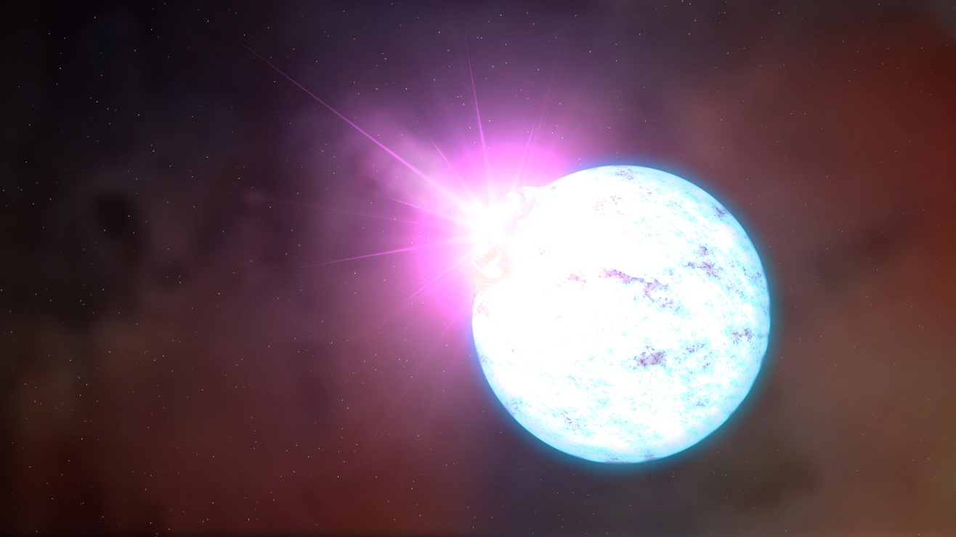
Neutron stars ------------------
Credit: NASA
Notes:
When a massive star ran out of fuel, the outer shells explode in a form of supernova. At the inner shells, electrons degenerate with protons forming neutrons, then creating a new star called Neutron star have 2-3 Solar mass.
The diameter of NS is about 10-20 Km where the original star have a diameter of tens to hundreds millions Kilometers.
During the collapsing process, the Magnetic Field is conserved, so, the magnetic field of a huge star now concentrated in a few kilometers which mean that, the NS have an extreme MF.

Slide 3
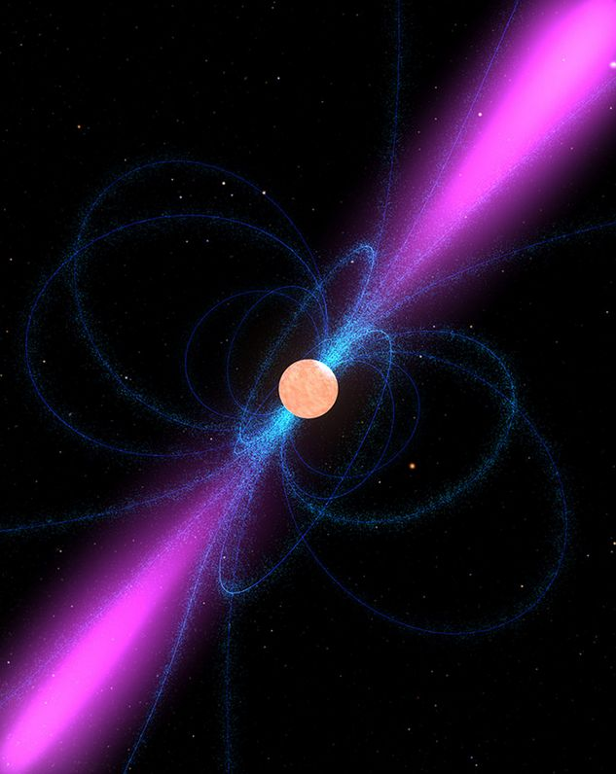
Magnetars ---------------------------
Type of Neutron Stars
Rotating slower ( 1 to 10 sec )
Typical NS ~ < 1 sec
Extreme Magnetic Field
10⁸ – 10¹² Tesla
Sun = 0.5 Tesla LHC = 8 Tesla
X-rays & γ-rays emitter
Credit: Phys.org
Extremely powerful γ-rays flare emissions recorded on Earth since 1979.
Explained and confirmed as sources of Soft Gamma Repeaters (SGRs) and Anomalous X-ray Pulsars (AXPs).
We only know of about 10 Magnetars
in our galaxy.
Notes:
Magnetars are sub-class of neutron stars, which have slower rate of rotation, about 1 to 10 second which the typical neutron star have a rotation period less than 1 second. Magnetars even have stronger Magnetic field than typical neuron stars. Magnetars have MF of --- to --- Tesla compared with Sun’s which has MF of 0.5 Tesla or the LHC the biggest manmade machine ever which have MF of 8 Tesla. The Extreme MF of Magnetars leading to powerful emission of X-ray and Gamma-ray radiation, the first one detected in 1979 when the first Magnetar had been discovered.
And confirmed as sources of soft gamma-ray repeaters and Anomalous X-rays.
The mechanism of radiation that the energetic particle drift toward the open areas of Magnetic field which are the poles then emitting the radiation in two reversed beams. This called “Lighthouse model”, when the beam in the direction of the Earth, we detect it!. We only know 10 Magnetars in our galaxy.

Slide 4
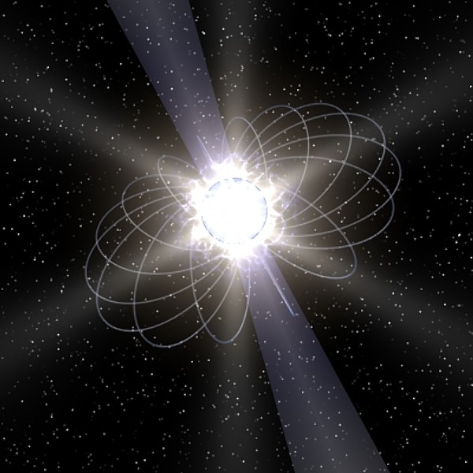
SGR J1550-5418 ------------------
Discovered in 1980
AXP 1E 1547-5408
Properties:
Magnetic field = 10¹¹ Tesla
Known as X-rays Source
1000 times more than regular NS bursts
Rotation period ~ 2.1 sec
In 2008 & 2009 Named by NASA as SGR J1550-5418
Previously known as AXP 1E 1547-5408 or PSR J1550-5418
turbosquid.com
Notes:
The specific Magnetar of this study called “ SGR 1550 “ SGR stand for Soft Gamma-ray Repeaters. Discovered in 1980 by Einstein X-ray telescope. Have MF of --- Tesla which make him known as Anomalous X-rays source. The X-ray burst of SGR 1550 is 1000 times stronger than a burst of a regular neutron star.
Have rotation period about 2.1 second which considered one of the fastest known Magnetars.
After it’s first activity in 1980, the Magnetar woke again in 2008 and 2009 and named by NASA as SGR 1550-5418. when it discovered named as AXP 1E----- and PSR -----.
So, we have 3 different names for the same object! This rise a main problem in Magnetars analysis, the rare activities and the poor knowledge of them made a confusion in determine the events and if there are the same object or not.

Slide 5
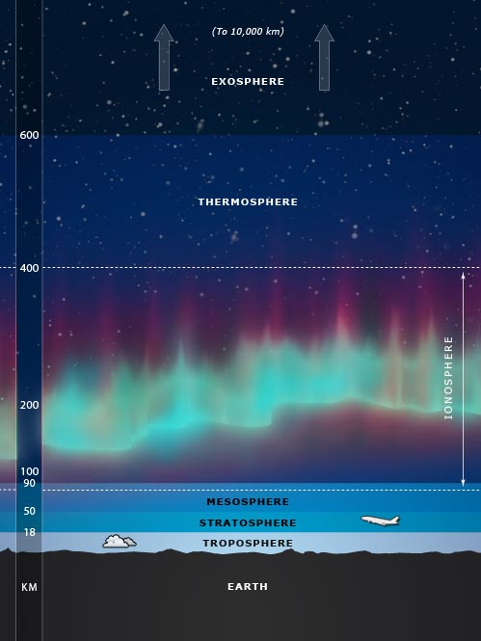
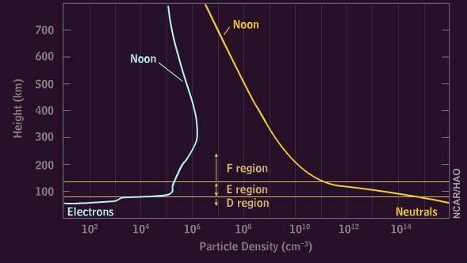
Earth’s atmosphere ------------------
And Ionosphere layer
Altitudes of 70 – 1000 km
Formed due to Sun 's UV radiation
Partly ionized plasma (0.1% or less)
D-region and most of E-region is formed by the GCR.`
Above 100 km, X-ray and UV radiations dominates.
Notes:
How that radiation affected on the Earth!? – Well Earth’s have a neutral atmosphere and ionized one, the ionized called “Ionosphere”. Ionosphere extended from 70 to 1000 Km consist of 4 layers, from the bottom D, E, F1, and F2. Ionosphere layer formed due to Solar activity mainly Ultra-Violet UV radiation. Which cause partially ionized plasma of 0.1% or less Every sub-layer of ionosphere sensitive to specific energy spectrum. So, The D region formed by GCR interaction, and above this Sun’s radiation is dominant. The Ionosphere considered as a gigantic detector that responding to the ionizing high-energy radiation of astrophysical phenomena.

Slide 6
SGR J1550-5418 Woke on October 2008
October 2008
Swift Burst Alert Telescope (BAT)
Fermi Gamma Ray Burst Monitor (GBM)
------------------- Triggered by high bursts -------------------
Sudden peak of luminosities range from 10³⁰ to 10⁴⁰ joule/s.
SGR J1550-5418, Confirmed as SGR and AXP source.!
Notes:
On October 2008, Magnetar SGR 1550 woke! With high intensity burst detected by two satellites ------- (BAT] and ---- (GBM). Caused a sudden energetic luminosity peak of --- to --- joule/sec.
That confirmed that this Magnetar is a source of SGR and AXR radiation. Then NASA named it as Soft Gamma-ray Repeater J1550.

Slide 7
SGR J1550-5418 SHOW OFF 22 January 2009
More active during large number of bursts Several satellites detected Swift BAT, Fermi GBM, Konus-Wind, and RHESSI.
1 - Swift triggered at 01:32:41 UT and X-ray observation started after 50 min later.
2 - The peak of emission occurred ~ 5 h after swift triggered.
3 - A hardening of the spectrum in the 10 keV band (HXR).
4 - The brightest burst occurred at 06:45:13 UT And peaked flux in the 25 KeV–2 MeV.
Absorbed in D-layer of ionosphere
5 - Total of 125 bursts emitted from 04:30 to 07:00 UT.
Notes:
On 22 January 2009. The Magnetar SHOW OFF.
With even more active event than 2008. with large number of burst and long duration.
This time, many satellites recorded this event, … , …, …., and RHESSI.
1- Swift triggered the event at ------, and the observation of X-ray started after 50 minutes later.
2- ------------------------- 3- ----------------------------------- which is Hard X-ray band. 4- ----------------------------------, this range of energies extend from Hard x-ray band to low gamma-ray band which absorbed in D-layer of ionosphere. 5- during the peak duration. Total ---------------.

Slide 8
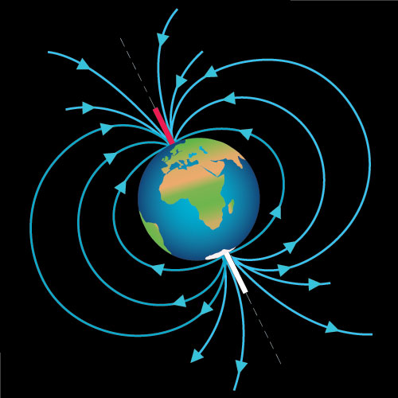
Response and Previous work
gamma rays deposit their energies in the lower ionosphere.
Caused a moving Ionized Plasma.
Traveling Ionospheric Disturbance (TID)
Notes:
Several authors studied this event of Magnetar, but their work focused on the temporal and sudden variation of ionosphere over a specific location.
But when High energy radiation ionozed the ionosphere, that change the density of plasma content. So, the plasma moved to balance this change. This movement called “ Traveling Ionospheric Disterbunance (TID) “. When the energetic particles hit the earth, they travel along MF lines and enter from Poles, then ionized plasme. The plasma move in Travelling Ionospheric Disturbance in Equator-ward direction to equalize the plasma content. This is a regular solar event. But, what if the we got a Trvelling Ionospheric Disturerbance in Pole-ward direcrion which the plasma moved toward poles!?
Then, this obviosly a Exra-teresserial source! Like a Magnetar.
We indroduce here the spatial variation of Ionosphere.

Slide 9
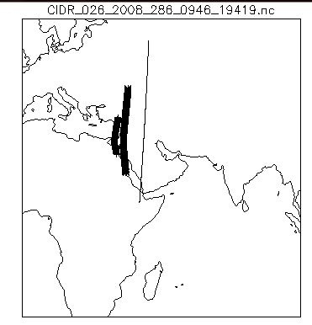
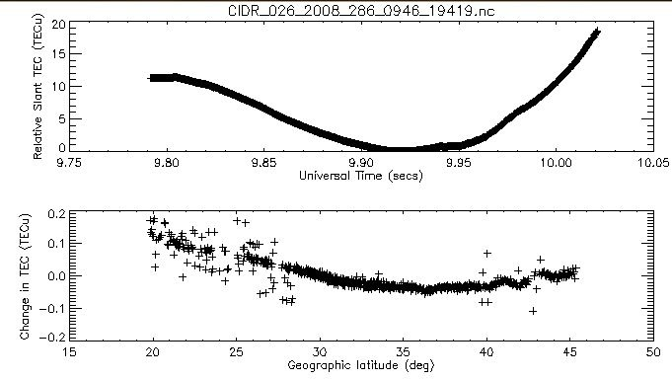
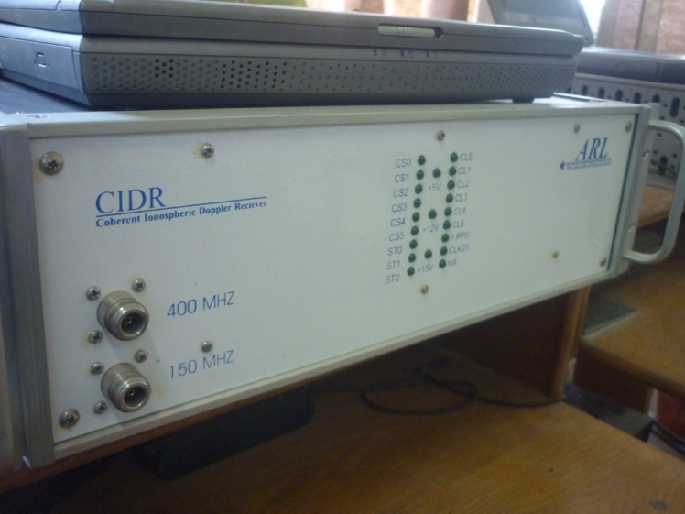
Coherent Ionospheric Doppler Radars (CIDR)
Developed by the Applied Research Laboratories, University of Texas at Austin.
operation as of CIDR global chain at SWMC in 2008.
Radio receivers transmit VHF (150 MHz) and UHF (400 MHz).
CIDRs observe the feedback of Doppler shifting of signals from LEO radio satellites.
The satellite crosses rapidly the receiver’s field-of-view quickly in 20 min.
lead to spatial variation measurements of TEC within the ionosphere .
Notes:
This could be done by Cohere---------------- (CIDR)

Slide 10
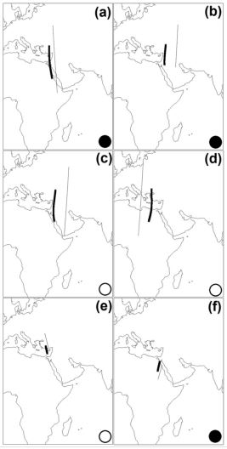
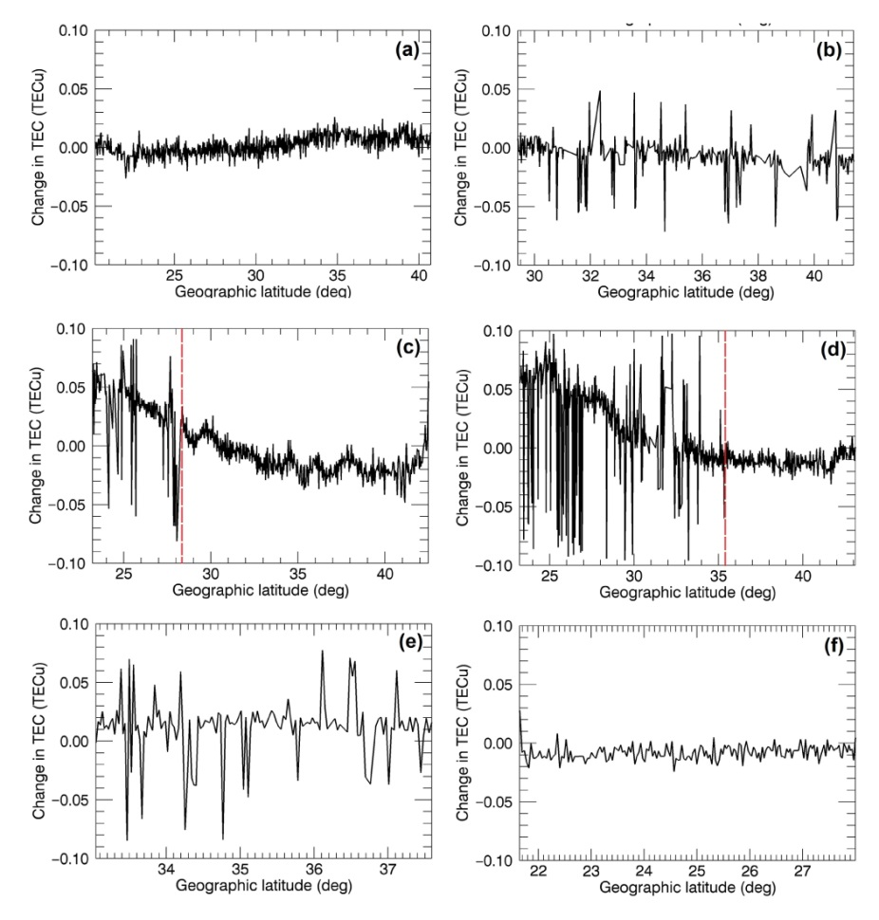
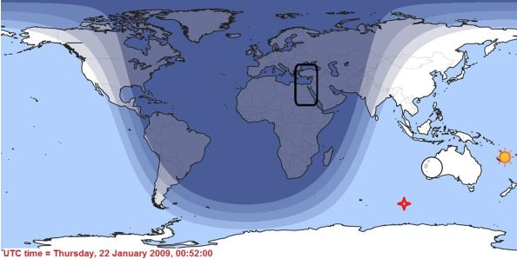
Results |
Record Started at 02:46 The brightest burst occurred at 06:45:13
01:21 02:56
12:48 14:36
23 Jan
15:44 04:10
Day
Night
Notes:
We studied the event over Egypt.
To make sure that the event doesn’t related to the Sun. Fortunately, at onset of the event , it was night at Egypt. And this map shows the position of Sun, Moon, and Magnetar at the time of event.
Ok, That’s a good news.
-------------------------------------- The event started at 2:46 UT. This the path of the satellite. And this the relative change of TEC versus latitude. Before the onset of event, apparently there is no change. The change started with Onset of the event. And still night over Egypt. The change become greater as the event going to peak at 6:45. then a recovery of Plasma content. ----------------------------------------------- In panels C and D. The change comes from the lower latitude toward high latitude, toward poles. It comes from the back of the satellite path direction. Which mean we have a TID in Pole-ward direction. So, it’s a Extra-Terrestrial source!

Slide 11
This paper published by Prof . A. Mahrous on 07 March 2017.
Conclusion ----------------------
Present evidence that the source SGR J1550–5418 caused signiﬁcant ionospheric disturbances by enhancing TEC via High Energy Radiation.
The nighttime , ∆TEC/ ∆t ⋝ 0.05 TEC/s, synchronized with the onset time of event.
The daytime , ∆TEC/ ∆t ⋝ 0.10 TEC/s, during the daytime 6 h after the main phase.
These ionospheric perturbations resembled an unusual pole-ward TID caused by an extraterrestrial source.
The TID’s velocity was 385.8 m/s, with ∆TEC/ ∆t ~ 0.10 TEC/s
which consistent with the ionizing radiation of X-ray emitted by SGR J1550–5418

Slide 12
Notes:
Future: 1 - analysis of the recent AXPs /SGRs data detected from both satellites and observatories. نجيب الايفنتات و القياسات ونبدأ ندور
2 - searching for the ionospheric perturbations which are synchronized with the distinguished AXPs /SGRs bursts
3 - In this task, the ionization profiles at different levels of the atmosphere will be computed using CORIMIA model and CORSIKA . The measured energy spectrum at Task (1) will be the trigger of the simulation codes. The estimated ionization profiles will be compared with TEC and ionosonde in Task (2).

