Slide 1
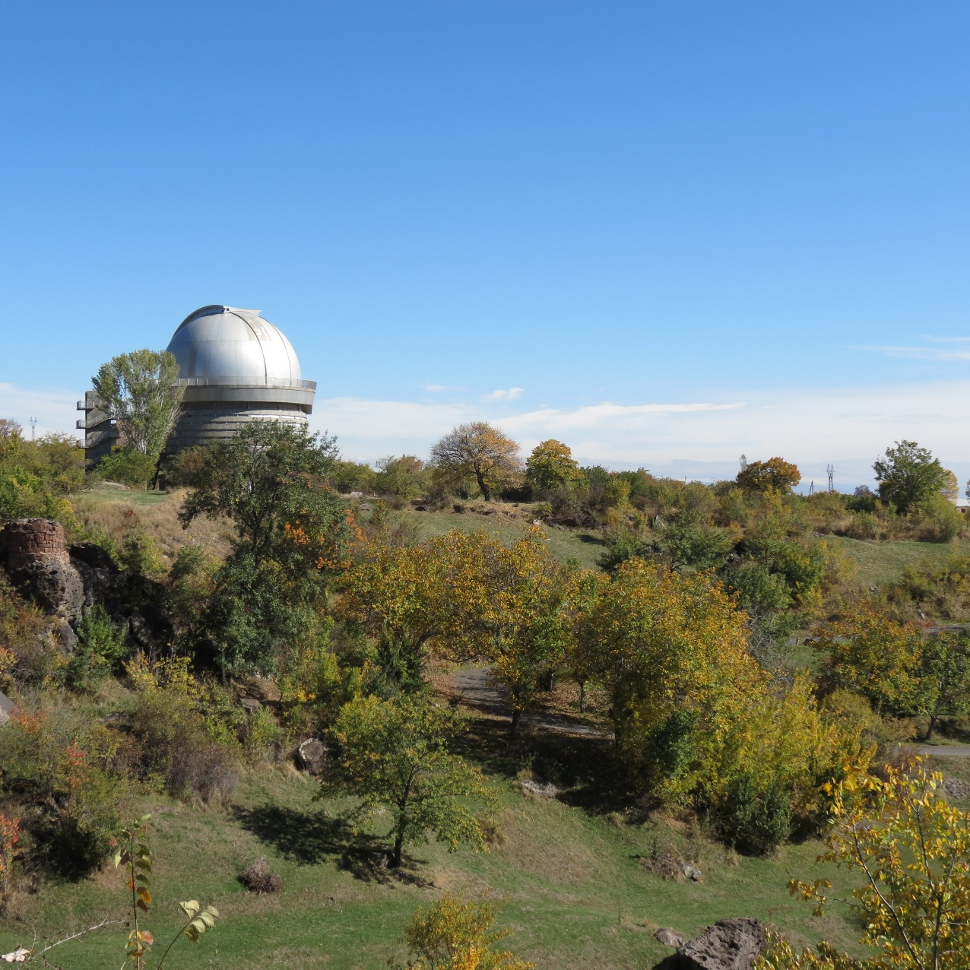
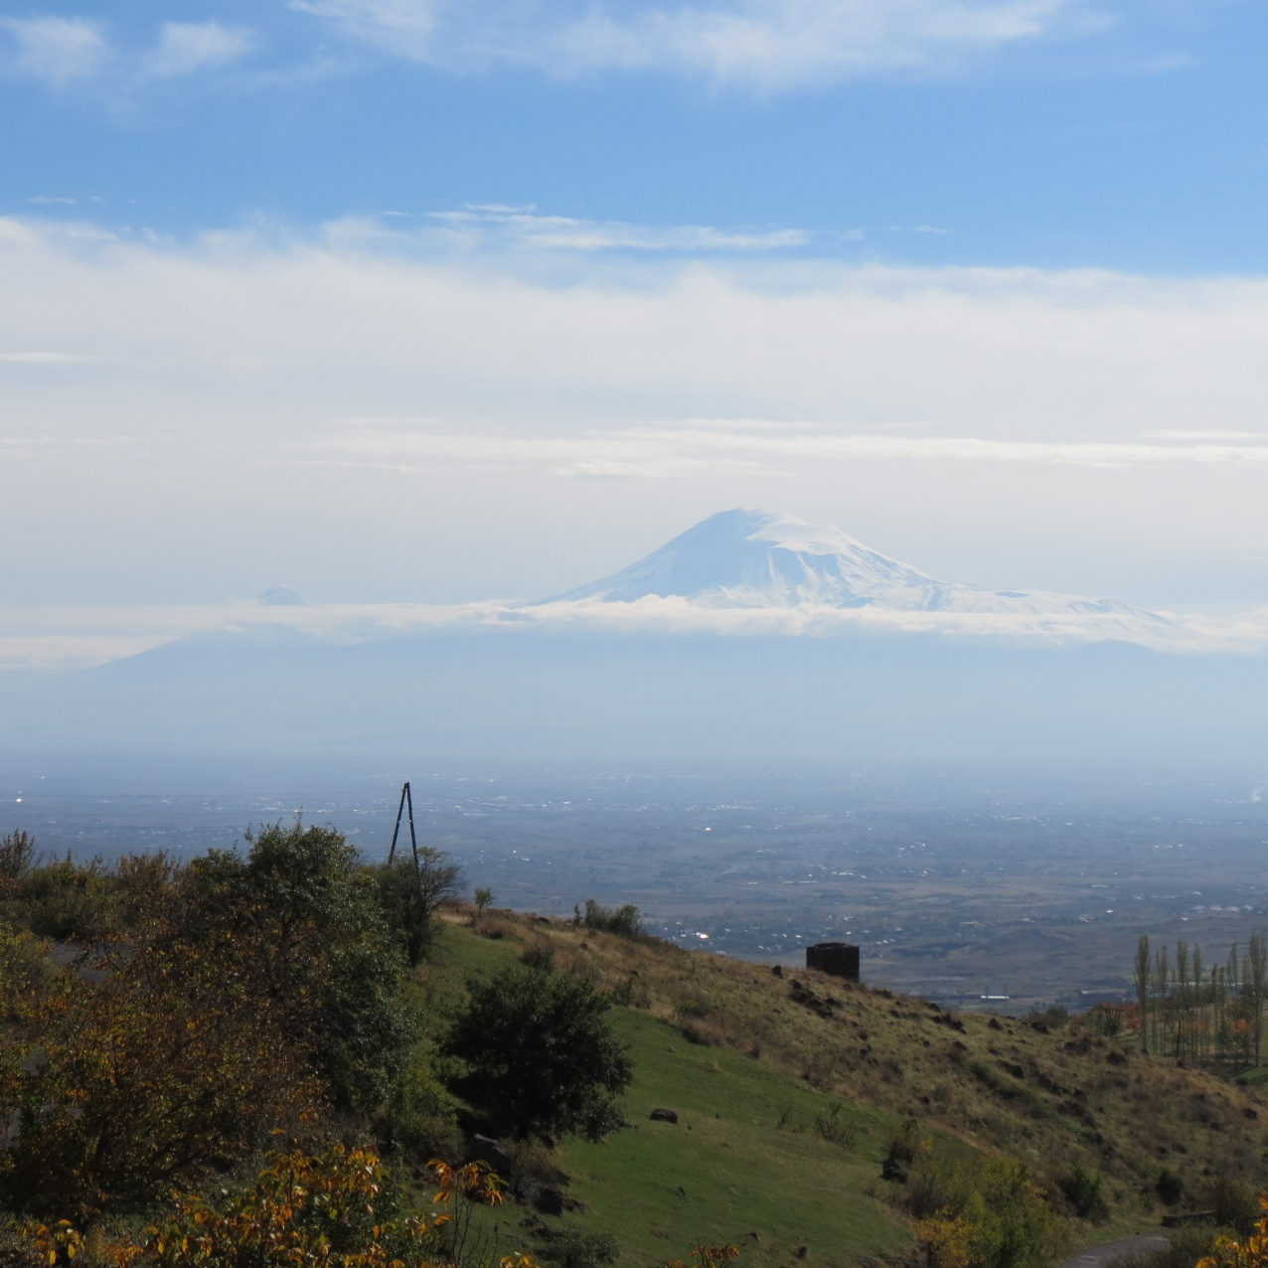
BYURAKAN ASTROPHYSICAL OBSERVATORY

Slide 2
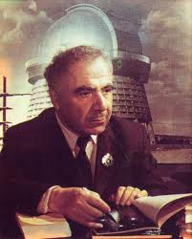
Byurakan Astrophysical Observatory (BAO) was founded in 1946 on the initiative of academician Victor Ambartsumian, who became the first director of the observatory.
Byurakan Observatory's main telescope is a 2.6 m, along with a 1 and 1.5 m Schmidt camera as well as other smaller telescopes.

Slide 3
New Powerful outburst of the unusual young star v1318 CYg S
Abstract. Young double star V1318 Cyg has very unusual photometric and spectral behavior. We analyze its historical lightcurve and show, that the southern component V1318 Cyg S after being rather bright (13-14 magnitude in V) in 70ies started to lower brightness and in the 1990 became practically invisible in optics and very faint in IR. After its reappearance in the second half of 90ies the star very slowly raised its bright-ness. In 2016 we found that V1318 Cyg S again brightened up to 7 magnitudes in visible light. We present the new photometric data and discuss its spectrum. V1318 Cyg S can be an extreme case of EXors or even belong to some intermediate class between EXors and FUors.

Slide 4
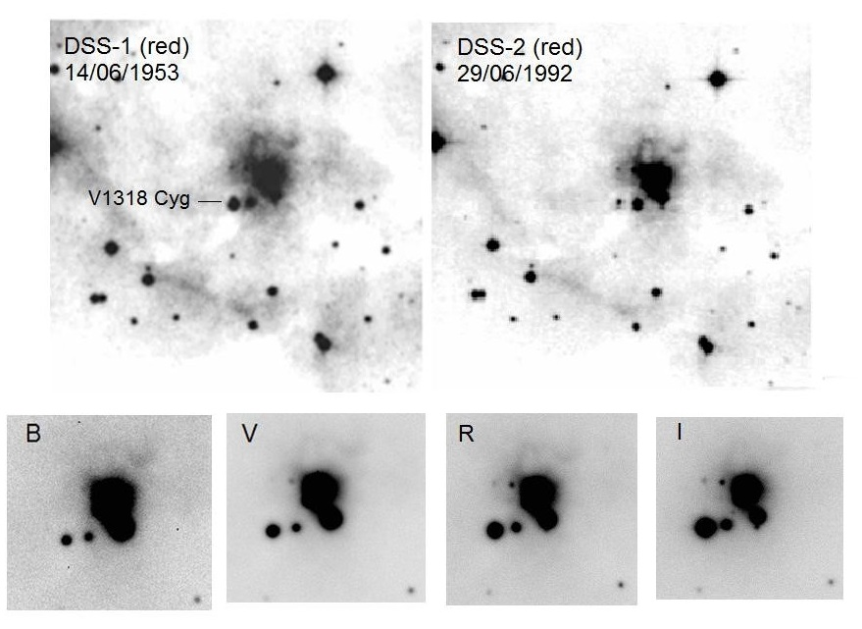
During our observations in 2015 October with Byurakan 2.6 m telescope and SCORPIO spectral camera we found that V1318 Cyg S underwent new powerful outburst. According to our further observations, it still keeps this maximum level up to the fall of 2016. To give impression about the amplitude of the outburst we present the V1318 Cyg S photometric data for the 2016 March:
B=18.81; V=14.01; R=12.25; I=10.50

Slide 5
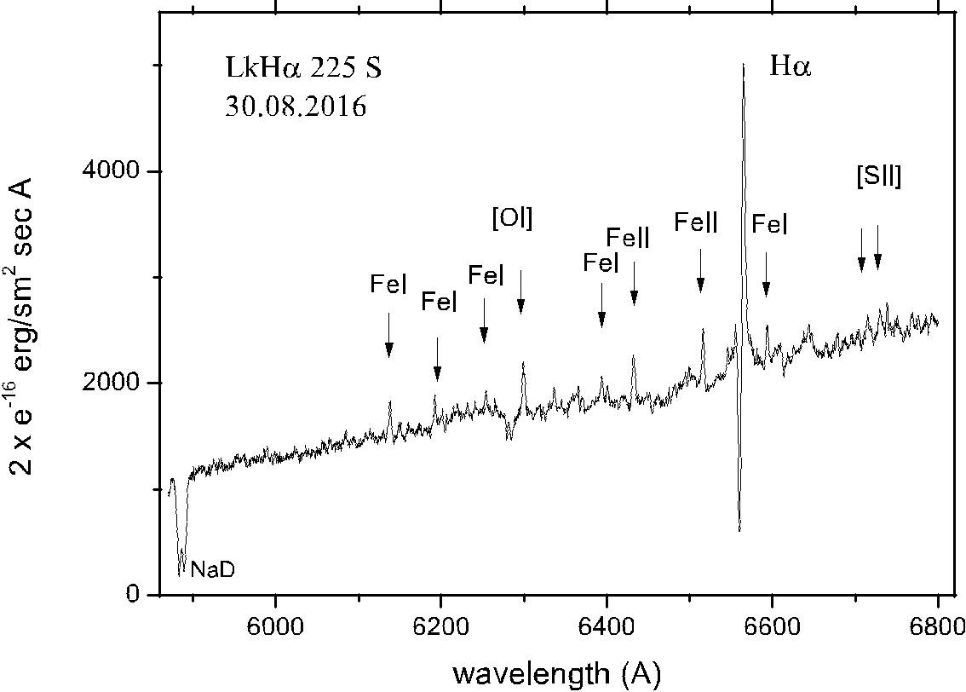
In the 2016 June we obtained the spectrum of V1318 Cyg S with 2.6 m telescope. As can be seen, it can be classified as the T Tau type spectrum. However, it has some remarkable features: P Cyg profile of Hα line with a strong absorption component, blueshifted NaD absorptions and large number of low-excitation FeI emission lines.

Slide 6
HASMIK ANDREASYAN
Byurakan Observatory NAS Armenia, Byurakan, Aragatsotn prov., Armenia
hasmik.andreasyan@gmail.com
Thank You! Grazie mille!

