Slide 1



DUAL MODALITY IMAGING WITH A ULTRASOUND-GAMMA PROBE FOR ONCOLOGY
Claudia Polito
PhD Student - Morphogenesis and Tissue Engineering– Curriculum CELL and TISSUE BIOPHYSICS
Sapienza University of Rome, Italy

Slide 2

Introduction
Equipment and Methods
Results
Conclusion
State of the Art
Importance of Multi Modality Imaging
Why UltraSounds?
Background (ECORAD Project)
STATE of THE ART
MOLECULAR
IMAGING
Modern tools of molecular and cell biology
Advanced technology for non-invasive imaging
These approaches should help to lead better methods for studying biological processes, diagnosing and managing diseases as well as in the translation of preclinical research to clinical applications
US
CT
MRI
PET
SPECT
1/15

Slide 3
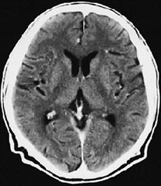
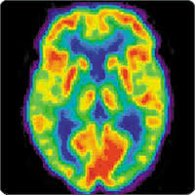
Introduction
Equipment and Methods
Results
Conclusion
State of the Art
Importance of Multi Modality Imaging
Why UltraSounds?
Background (ECORAD Project)
Morphological Imaging
Functional Imaging
IMPORTANCE OF MULTI MODALITY IMAGING
look inside the body with amazing accuracy
no trauma and risk related to the exploratory surgery
define with high precision the anatomical details.
reveal physiological activities within a certain tissue or organ employing tracers and reflecting their spatial distribution within the body.
claudia.polito@uniroma1.it
2/15

Slide 4

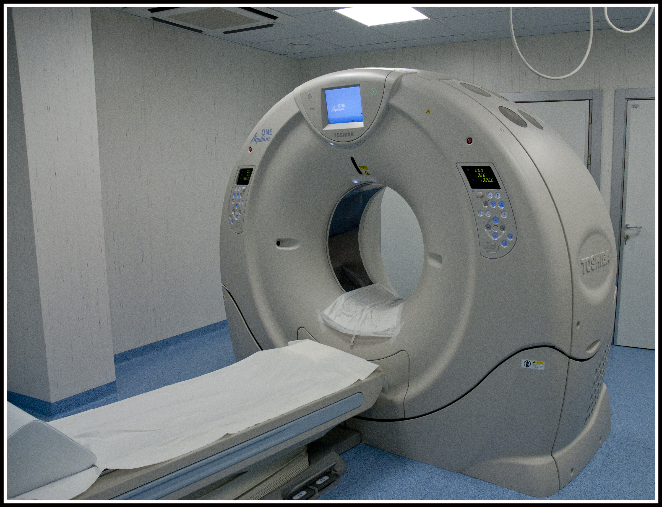
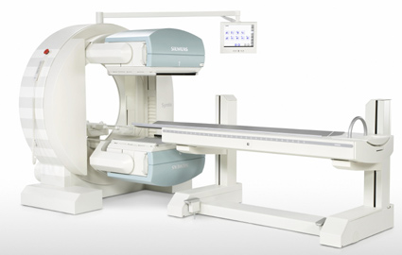
Introduction
Equipment and Methods
Results
Conclusion
State of the Art
Importance of Multi Modality Imaging
Why UltraSounds?
Background (ECORAD Project)
Morphological Imaging
Functional Imaging
IMPORTANCE OF MULTI MODALITY IMAGING
The great size of these scanners does not satisfy the growing request of handheld detectors or dedicated devices (es. preclinical trials or small animal imaging).
claudia.polito@uniroma1.it
2/15

Slide 5

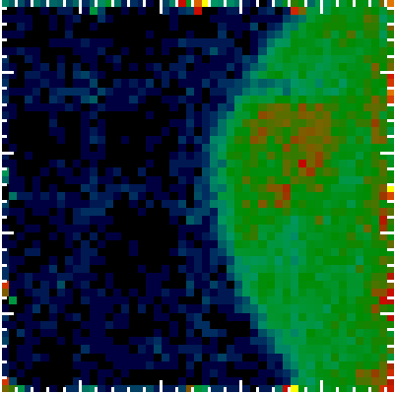
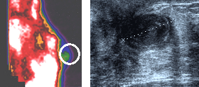
Introduction
Equipment and Methods
Results
Conclusion
State of the Art
Importance of Multi Modality Imaging
Why UltraSound?
Background (ECORAD Project)
WHY ULTRASOUNDS?
Real time acquisition
High Spatial Resolution
Moderate costs
Absence of dose to the patient
Possibility to realize handheld detectors
Example of suspected breast lesion
Scintigraphy (High Resolution Camera)
Ultrasound
Scintigraphy
An accurate diagnosis is necessary to define an efficient therapeutic strategy
claudia.polito@uniroma1.it
3/15

Slide 6


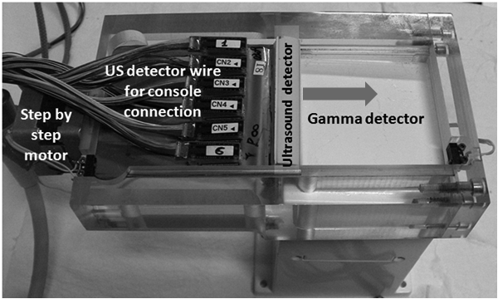
Introduction
Equipment and Methods
Results
Conclusion
State of the Art
Importance of Multi Modality Imaging
Why UltraSound?
Background (ECORAD Project)
BACKGROUND (ECORAD PROJECT)
Probe initially developed under INFN ‘ECORAD’ Project.
Patent AP/A17495
International Extension
PCT/IT2015/000130
Small FoV gamma camera based on LaBr₃:Ce scintillation crystal
US probe lodged on a shifting bad moving across the gamma device FoV (the arrow indicates the direction of the US probe movement on the gamma detector FoV)
claudia.polito@uniroma1.it
4/15

Slide 7
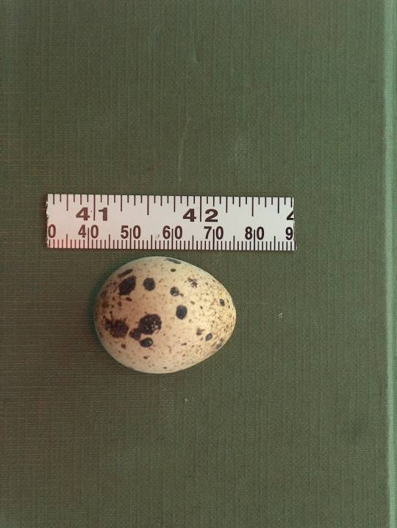
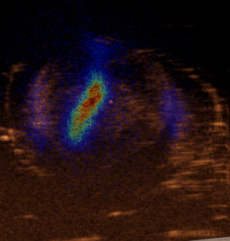
Introduction
Equipment and Methods
Results
Conclusion
State of the Art
Importance of Multi Modality Imaging
Why UltraSound?
Background (ECORAD Project)
BACKGROUND (ECORAD PROJECT)
“Biological Experiment”
Quail egg
claudia.polito@uniroma1.it
4/15

Slide 8
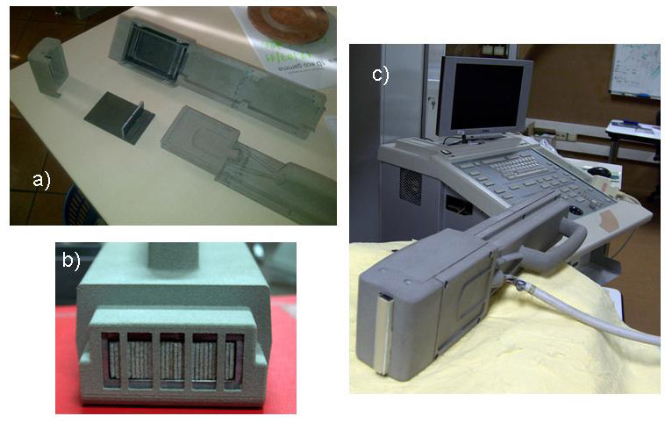

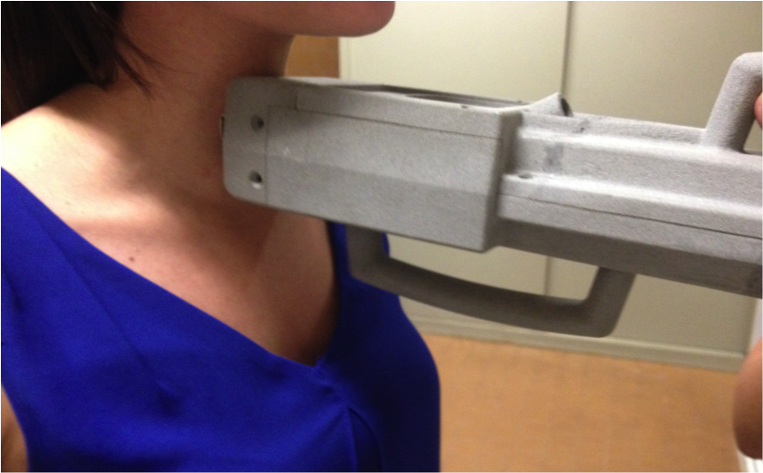
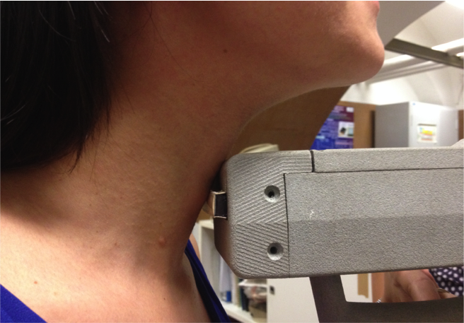
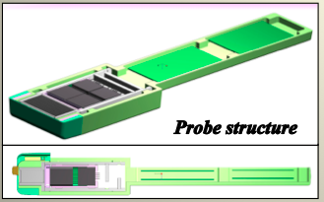
Introduction
Equipment and Methods
Results
Conclusion
Integrated Probe
US Probe
Gamma Probe
US-Gamma Probe Features
INTEGRATED PROBE
A small size device can easily handheld by the medical staff for clinical and surgical applications, providing a very effective localization method!
APPLICATIONS
Small organs located at short depths
(as thyroid)
*Pani et al., “Integrated ultrasound and gamma imaging probe for medical diagnosis” (2016). JOURNAL OF INSTRUMENTATION, doi: 10.1088/1748-0221/11/03/C03037.
claudia.polito@uniroma1.it
5/15

Slide 9
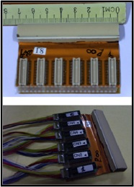
Introduction
Equipment and Methods
Results
Conclusion
Integrated Probe
US Probe
Gamma Probe
US-Gamma Probe Features
US PROBE
Ultrasound
Probe
CUSTOMIZED ULTRASOUND LINEAR PROBE B-MODE
(192 piezoelectric crystals)
Y Axix
Operating Frequency:7.5-10 MHz
The thickness of Back-Suppressor is minimized (about 6 mm) to reduce the gamma attenuation.
Size 70x10x12 mm x mm x mm
Cables system designed to reduce obstruction, realized with 200 shielded cables.
crystal
X Axix
PMT
Slit
Collimator
claudia.polito@uniroma1.it
6/15

Slide 10
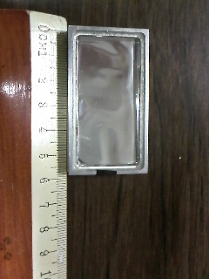
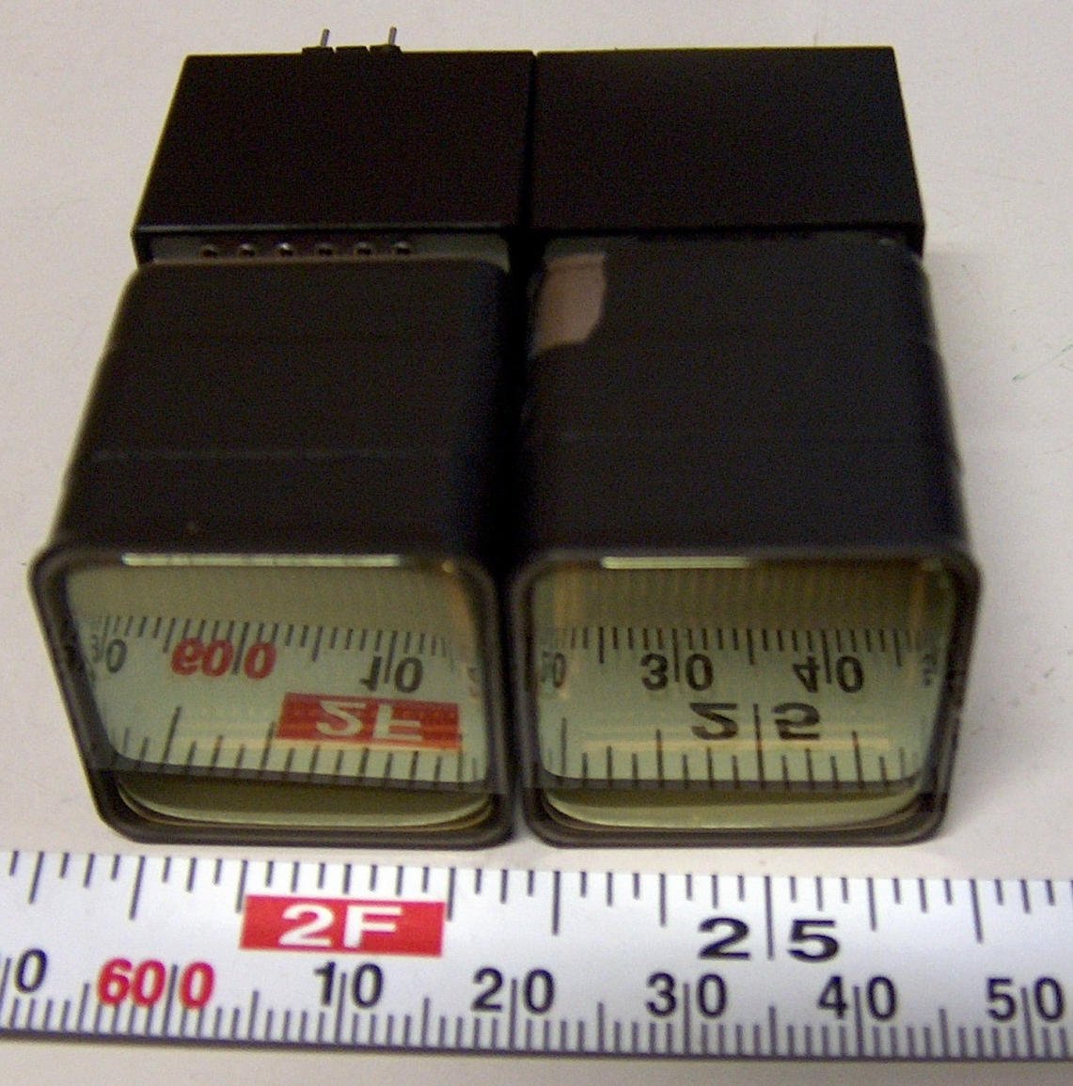
Introduction
Equipment and Methods
Results
Conclusion
Integrated Probe
US Probe
Gamma Probe
US-Gamma Probe Features
GAMMA PROBE
2 PSPMT MULTI ANODE R8900-M16 Hamamatsu (1.5mm glass window, number of anodes=4x8 array, 6.08mm pitch)
Dead zone
≈3mm
Readout Electronics (32 independent channels)
Planar Scintillation crystal: NaI:Tl (58x32x4.2 mm³), glass window thickness 2 mm.
Overall dimensions chosen in order to optimize SR and Position Linearity and to maximize the efficiency performing a gamma image in few seconds!
Slit Collimator (0.2 mm septum, 1.5 mm pitch)
claudia.polito@uniroma1.it
7/15

Slide 11

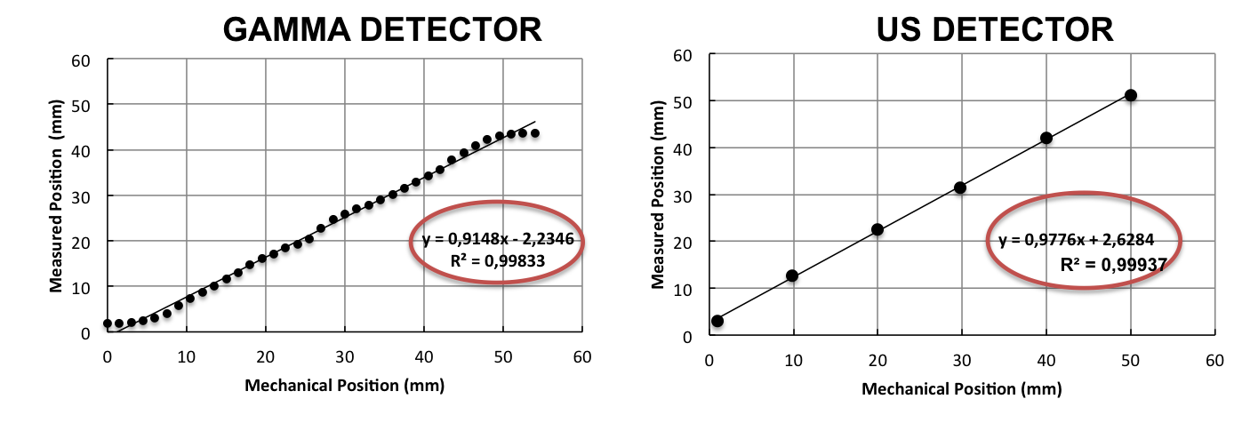
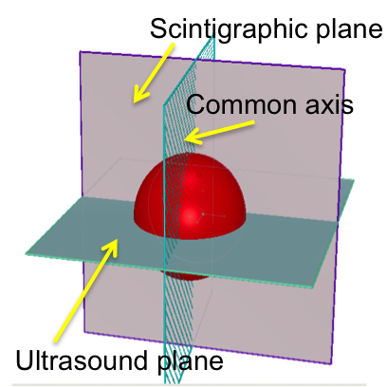
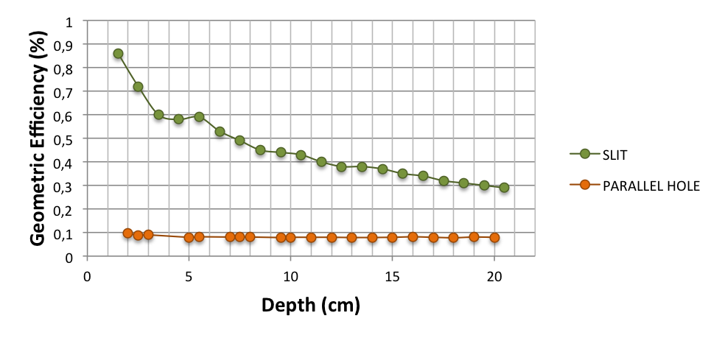
Introduction
Equipment and Methods
Results
Conclusion
Integrated Probe
US Probe
Gamma Probe
US-Gamma Probe Features
US-GAMMA PROBE FEATURES (I)
Orthogonal planes (gamma image profile overlapped on the structure highlighted by US)
Slit Efficiency is 10 times more than one from general purpose parallel hole at 5 cm SCD
The US and gamma images have to be compared on the same spatial resolution and position linearity for the right overlap
claudia.polito@uniroma1.it
8/15

Slide 12
Introduction
Equipment and Methods
Results
Conclusion
Integrated Probe
US Probe
Gamma Probe
US-Gamma Probe Features
US-GAMMA PROBE FEATURES (I)
Orthogonal planes (gamma image profile overlapped on the structure highlighted by US)
Slit Efficiency is 10 times more than one from general purpose parallel hole at 5 cm SCD
The US and gamma images have to be compared on the same spatial resolution and position linearity for the right overlap
claudia.polito@uniroma1.it
8/15

Slide 13
Introduction
Equipment and Methods
Results
Conclusion
Integrated Probe
US Probe
Gamma Probe
US-Gamma Probe Features
US-GAMMA PROBE FEATURES (I)
Orthogonal planes (gamma image profile overlapped on the structure highlighted by US)
Slit Efficiency is 10 times more than one from general purpose parallel hole at 5 cm SCD
The US and gamma images have to be compared on the same spatial resolution and position linearity for the right overlap
claudia.polito@uniroma1.it
8/15

Slide 14
Introduction
Equipment and Methods
Results
Conclusion
Integrated Probe
US Probe
Gamma Probe
US-Gamma Probe Features
US-GAMMA PROBE FEATURES (II)
0.4 mm Tc^{99m} Collimated Source
with US probe
without US probe
0mm
6
12
18
24
31.5
39mm
US probe
Counts
PMT
PMT
Channels
Attenuation evaluated with flood field = 0,55
Position (mm) | 0 | 6 | 12 | 18 | 24 | 31.5 | 39
Probe/ no probe (%) | 0.60 | 0.58 | 0.62 | 0.59 | 0.59 | 0.59 | 0.73
claudia.polito@uniroma1.it
9/15

Slide 15
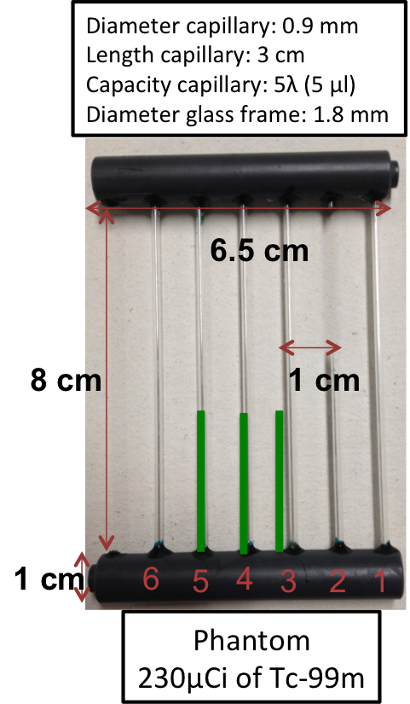
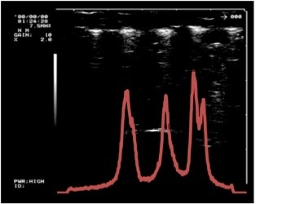
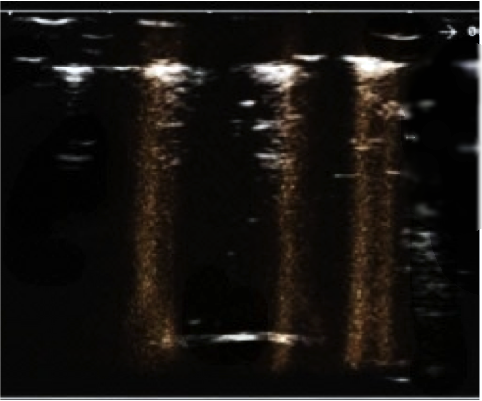
Introduction
Equipment and Methods
Results
Conclusion
Integrated Images (I)
Integrated Images (II)
INTEGRATED IMAGES (I)
C
US
Gamma
A
B
Spot | SR UltraSound (mm) | SR Gamma (mm) | Position US (mm) | Position Gamma (mm)
A | 1.6 | 1.6 | 20.5 | 19.7
B | 1.8 | 1.4 | 31.6 | 32.2
C | 1.8 | 1.8 | 40.9 | 40.5
claudia.polito@uniroma1.it
10/15

Slide 16
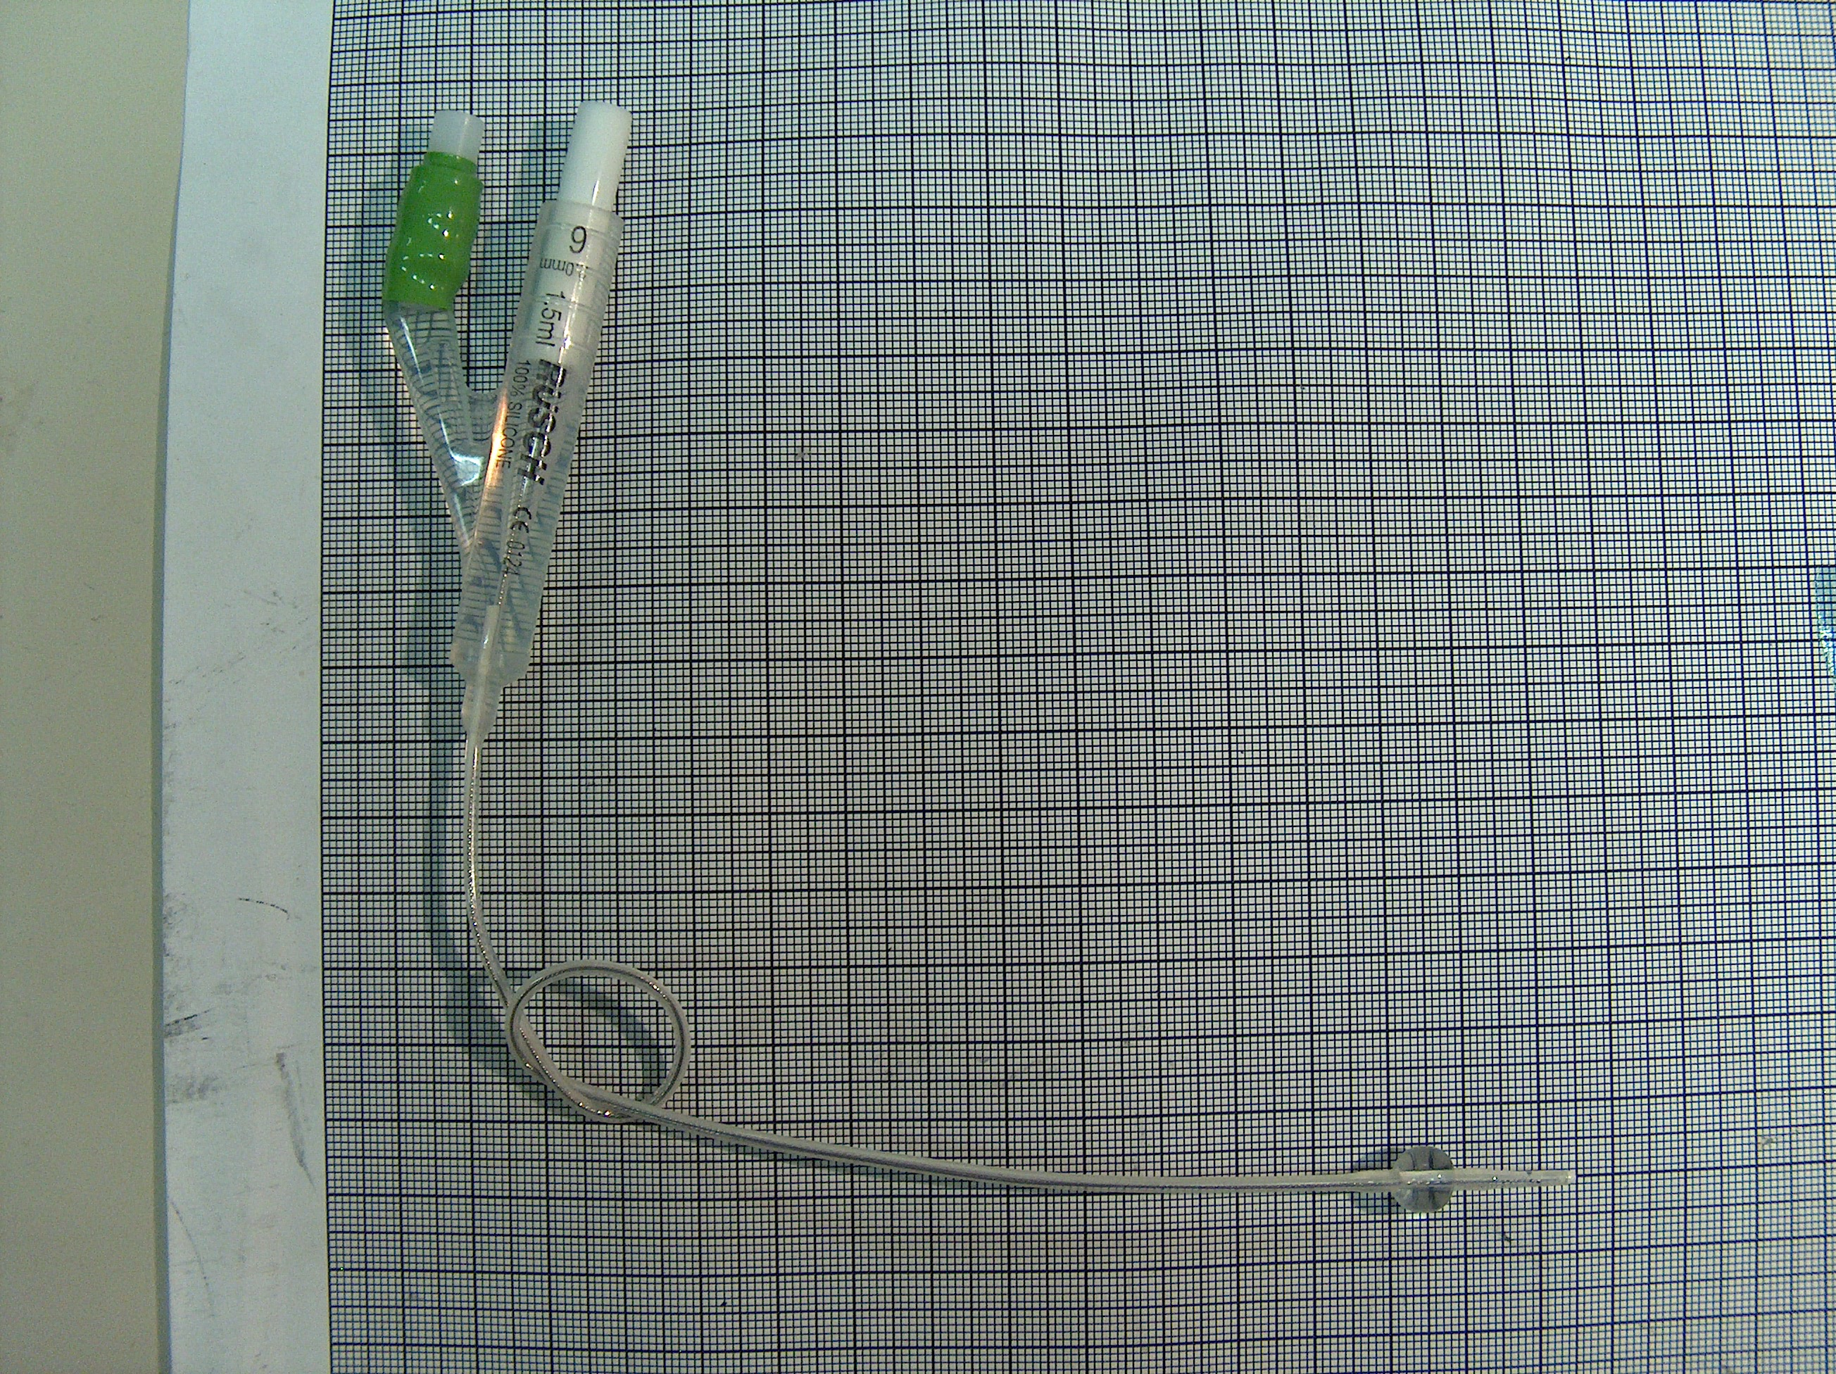
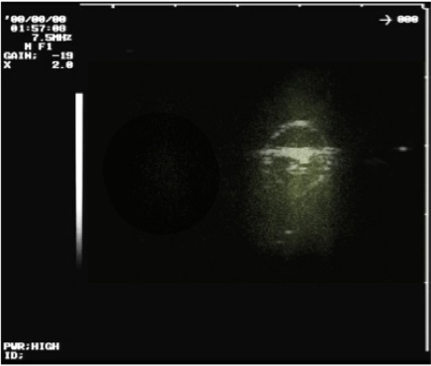

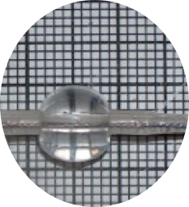
Introduction
Equipment and Methods
Results
Conclusion
Integrated Images (I)
Integrated Images (II)
INTEGRATED IMAGES (II)
FOLEY (500 μCi of Tc-99m in 1c.c.)
Size ch. 2.0 mm
Length 31 cm
1.5 ml
2 cm
7 mm
US
Gamma
FWHM
SR UltraSound (mm) | SR Gamma (mm) | Position US (mm) | Position Gamma (mm)
6 | 6.4 | 3 | 2.8
claudia.polito@uniroma1.it
11/15

Slide 17

Introduction
Equipment and Methods
Results
Conclusion
Conclusion
Near Terms Objective
CONCLUSION
Integration of US and Gamma devices allows an excellent co-registration of images providing accurate diagnosis
Perfectly superimposed information
(both in position and in resolution)
Simultaneous acquisition in short times
Accurate diagnosis and possible applications for moving organs
Compact design
claudia.polito@uniroma1.it
12/15

Slide 18
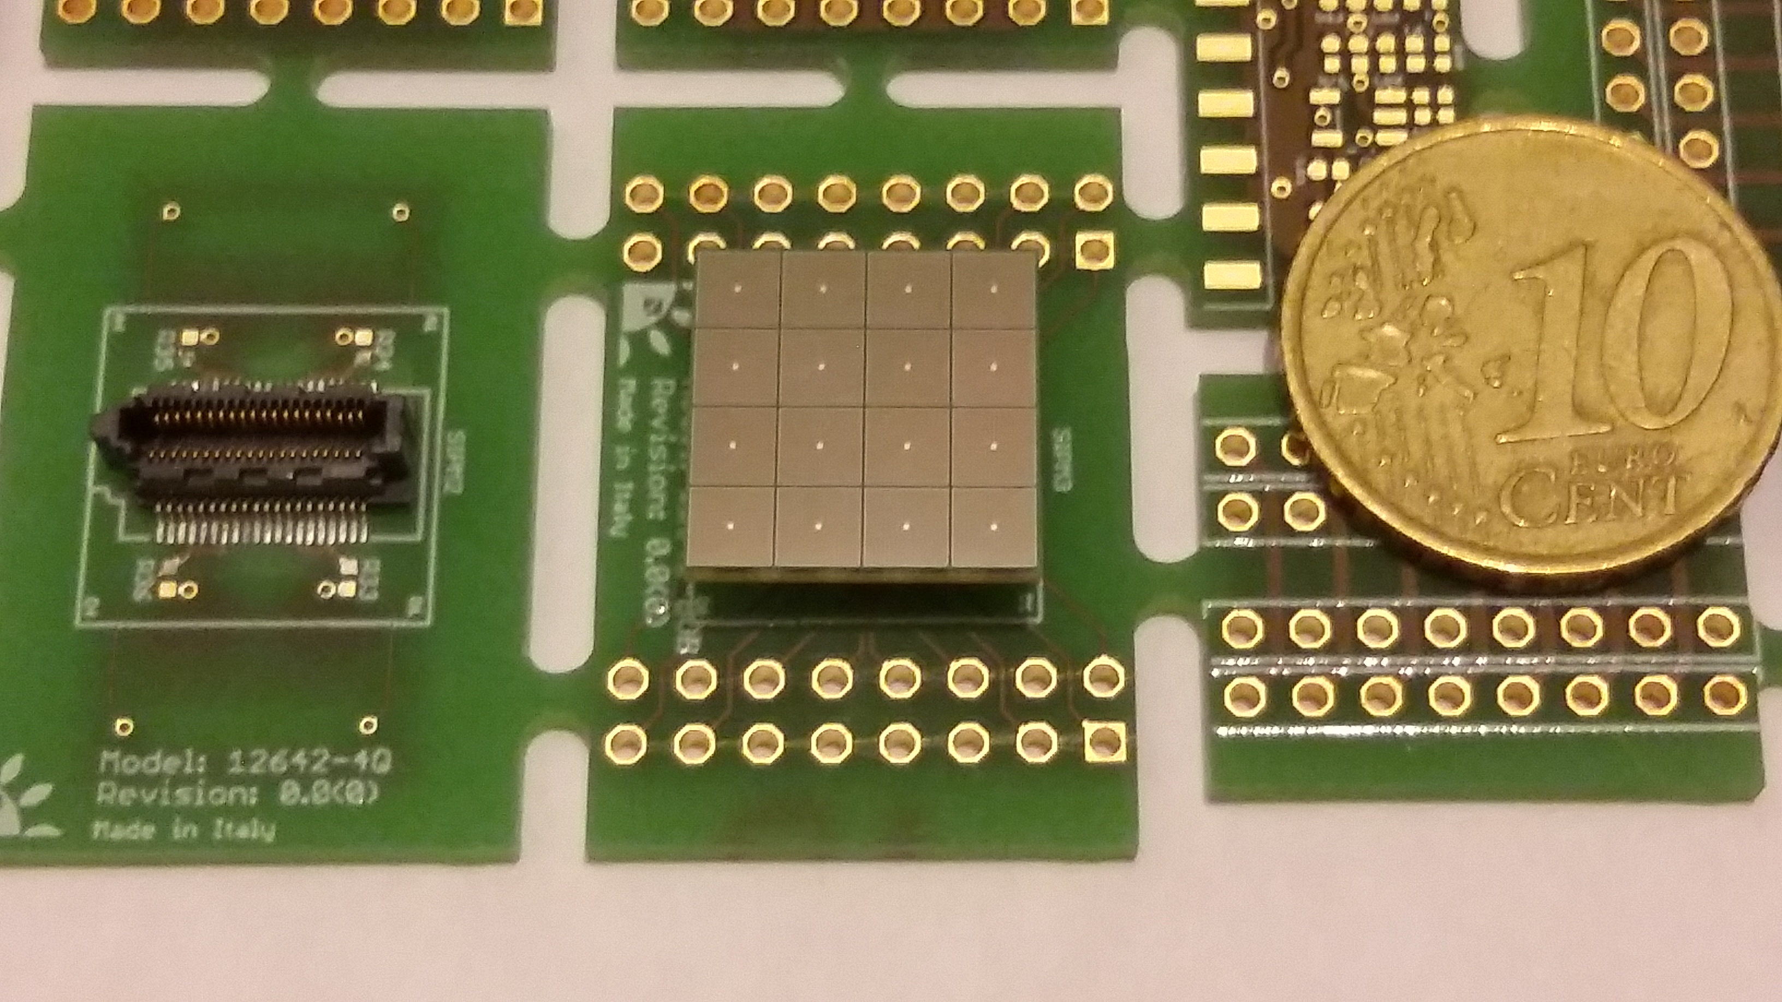

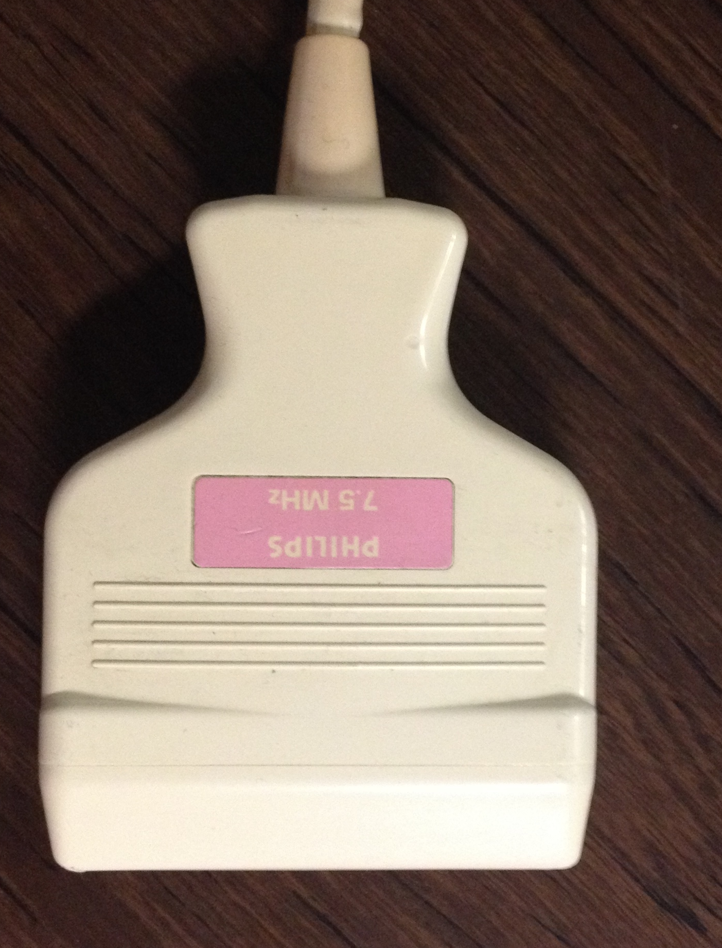

Introduction
Equipment and Methods
Results
Conclusion
Conclusion
Near Terms Objective
NEAR TERM OBJECTIVE
Probe Miniaturization
8 mm
SiPM
Active area for channel: 3mm
50μm pitch
Gain: 1.2 * 10⁶
PDE 35%
claudia.polito@uniroma1.it
13/15

Slide 19
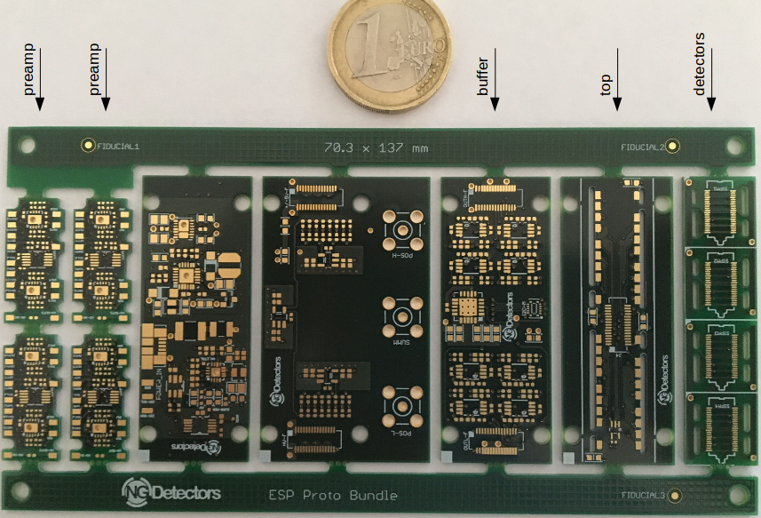
Introduction
Equipment and Methods
Results
Conclusion
Conclusion
Near Terms Objective
NEAR TERM OBJECTIVE
Probe Miniaturization
Small Size Readout Electronics
High gain
Linearity
High photo-detection efficiency
Low dark count level
Excellent timing resolution
Lower voltage: 30V
claudia.polito@uniroma1.it
14/15

Slide 20
Introduction
Equipment and Methods
Results
Conclusion
Conclusion
Near Terms Objective
NEAR TERM OBJECTIVE
Probe Miniaturization
 | NaI:Tl | CRY019
Density(g/cm3) | 3,67 | 7,1
Photon Yield (kph/MeV) | 40 | 28
Decay Time (ns) | 230 | 41
Emission (nm) | 415 | 420
Index of Refraction | 1,85 | 1,81
Energy Resolution@622 keV (%) | 5,6 | 8,5 (661 kev)
Hygroscopic | yes | no
Scintillation Crystals
Fast decay time
Great Resolution
Non hygroscopic
claudia.polito@uniroma1.it
15/15

Slide 21

THANK YOU
FOR LISTENING
Claudia Polito
XIV Seminar on Software for Nuclear, Subnuclear and Applied Physics, Alghero 04 – 09 June 2017

