Slide 1





ALICE ITS Upgrade
Status and Plans
ITS News
Ongoing activities
2016 planning
Federico Ronchetti,
INFN-LNF
ALICE ITS Meeting 27/09/2016

Slide 2
ITS Activities @ LNF Until EOY

Slide 3
ALPIDE4 Tests on Preseries
5 chips 100krad work fine but as for ALPIDE3 threshold start to decrease (20%) proposal: relax threshold and irradiate again until 1 MRad is accumulated (how long does it take?)
2 chips up to 340 kRad: analog supply current down by x2
thresholds saturate at lower level:
  takes 1 year to go back
  try accelerated annealing by heating on some chips
  SEU x-section for periphery memory (same value found at PSI)
next week heavy ion test

Slide 4
ALPIDE4 Tests on Preseries

Slide 5
ALPIDE4 Tests on Preseries
ALPIDE pre-series chips
2+2 chips for HI tests
5 chips tested at 100 kRad
2 chips 350 kRad
10 available for testing: 21 total
ALIPDE production 3 weeks delay PPR, postponed 1 month -> 24th of October - end of October availability of modules is on critical path need to produce ALPIDE4 HICs (next weeks)
IB
1 alu-FPC available friday - monday
get batch with 4 FPC next week
OB
2 dummy modules produced, found some issues swissPCB
2 modules with working chips tue - wed

Slide 6

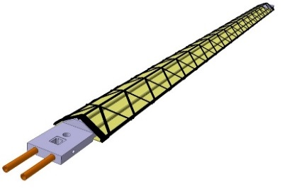
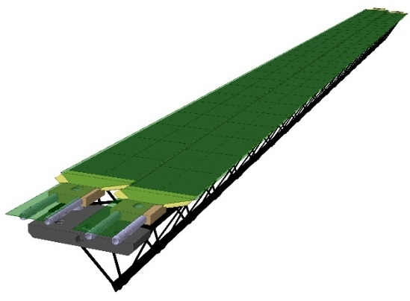
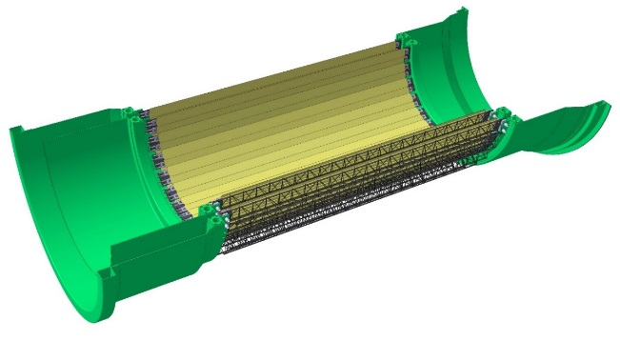
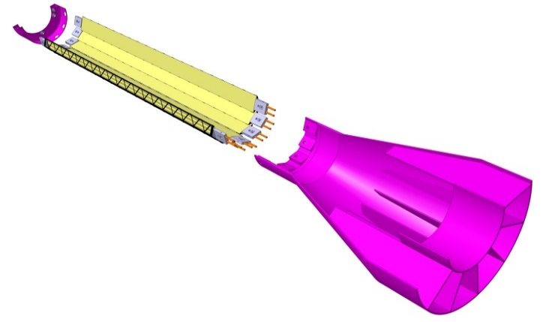
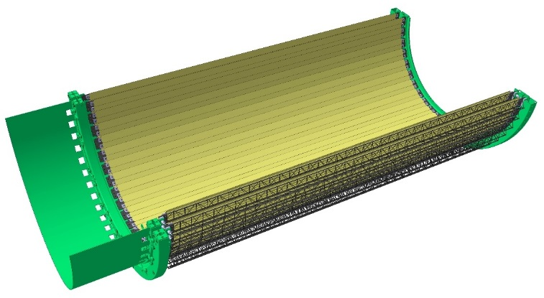
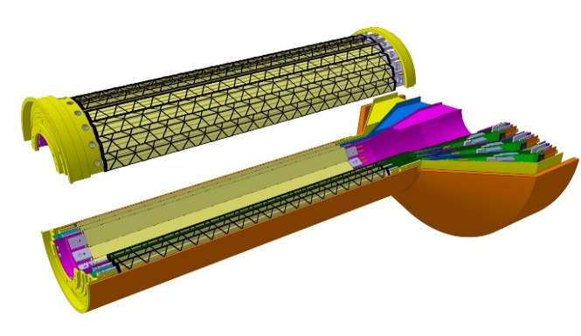
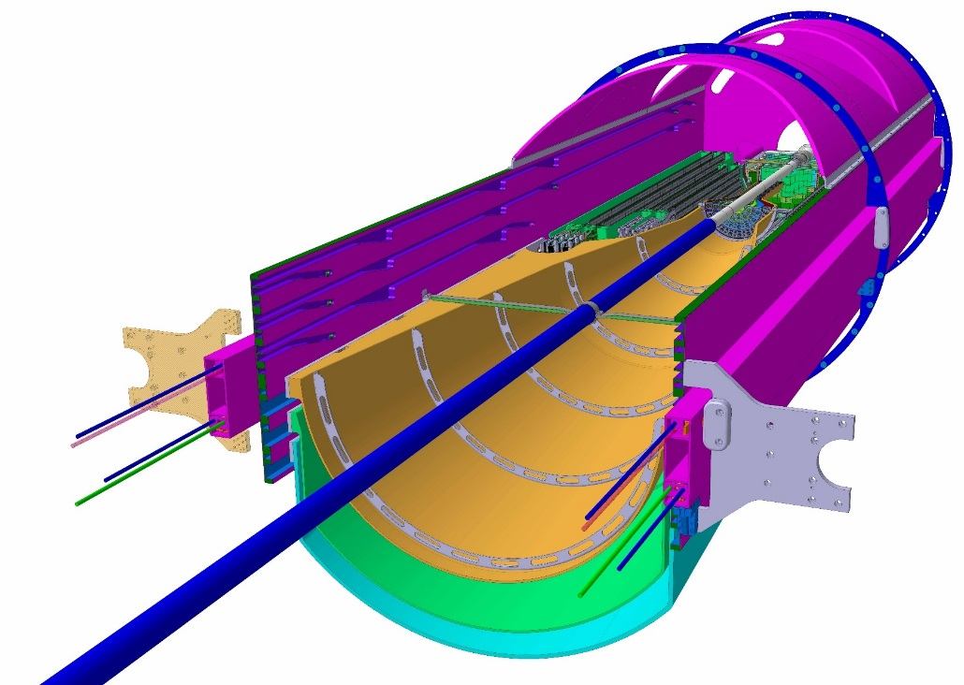
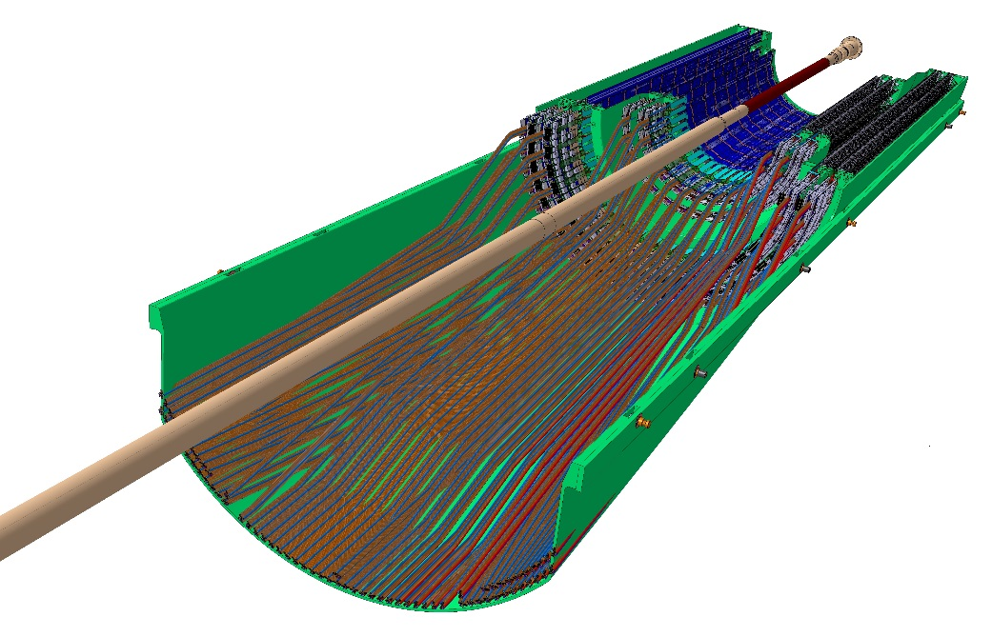
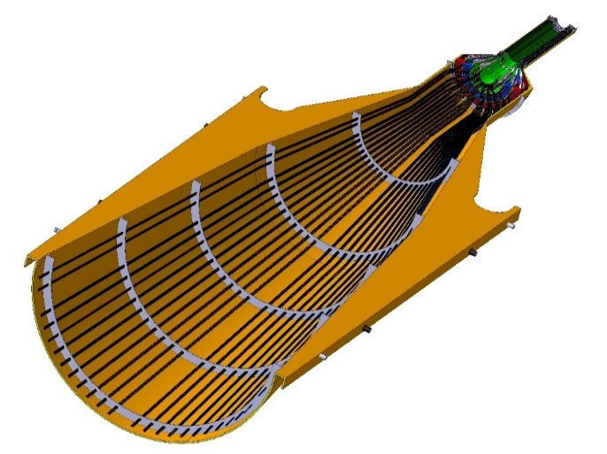
Detector / Service Barrel Mechanics EDR/PRR
Inner Barrel
Outer Barrel
End wheel
2 Middle Layers
Stave
End wheel
Stave
EDR 3 May 2016
PRR Dec 2016
2 Outer Layers
Inner Detector Barrel
3 Inner Layers
Outer Detector Barrel
EDR 20 July 2016
EDR 20 July 2016
PRR Nov 2016
PRR Nov 2016
Cage
ITS IB
Service Barrels and Cage
ITS OB
EDR Nov 2016
IB Service Half Barrel
MFT
PRR Feb 2017
OB Service Half Barrel

Slide 7
ITS Activities @ LNF Until EOY
Stave mechanical assembly (ED/DP/AR)
Federico, Marco T, Pavel, Marco I, Massimo (2016)
rest of the team entter training beginning of 2017
FPC-FPC welding tests
Aldo, Luciano, Daniele, Alessandro …
Glass Dummy production
Luciano, Daniele, Alessandro ….
Dummy alignment and gluing tests
Emiliano, Alessandro, Daniele + selected operators from step 1
Stave mechanical assembly
Emiliano, Alessandro, Daniele + selected operators from step 1
In parallel: preparation of the procedure documents (Daniele/Stefano)
Tentative

Slide 8
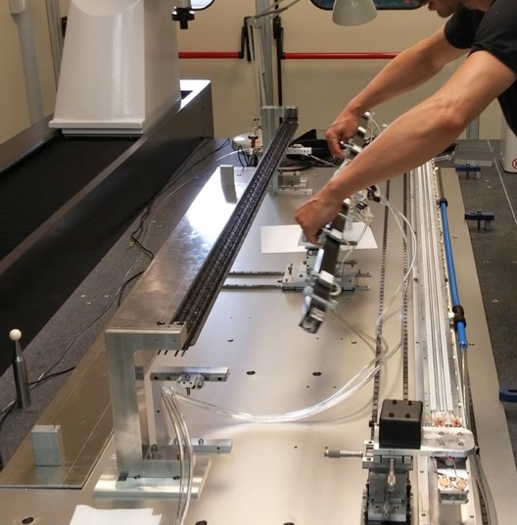
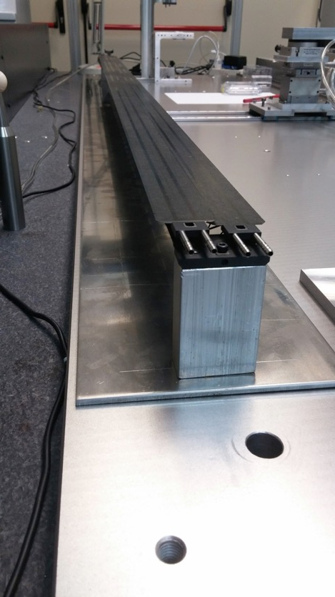
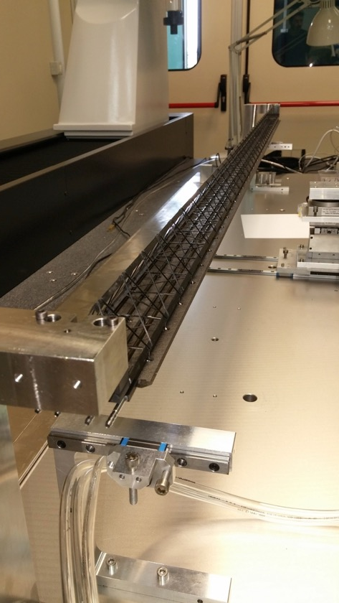
Training on handling bar
Stave Mechanical Assembly
Assembled stave

Slide 9
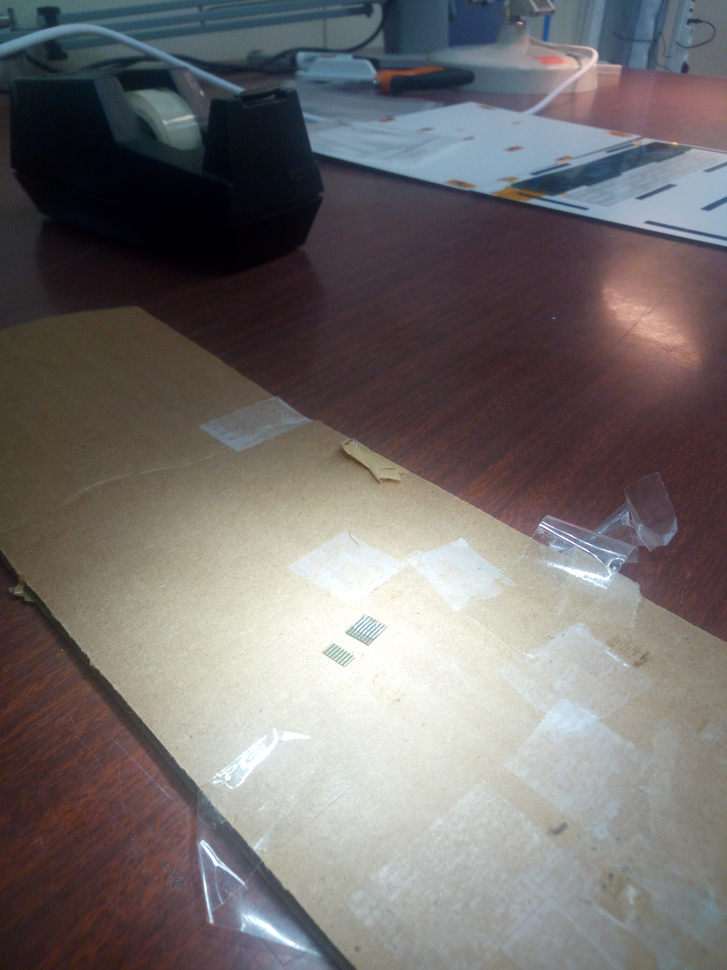
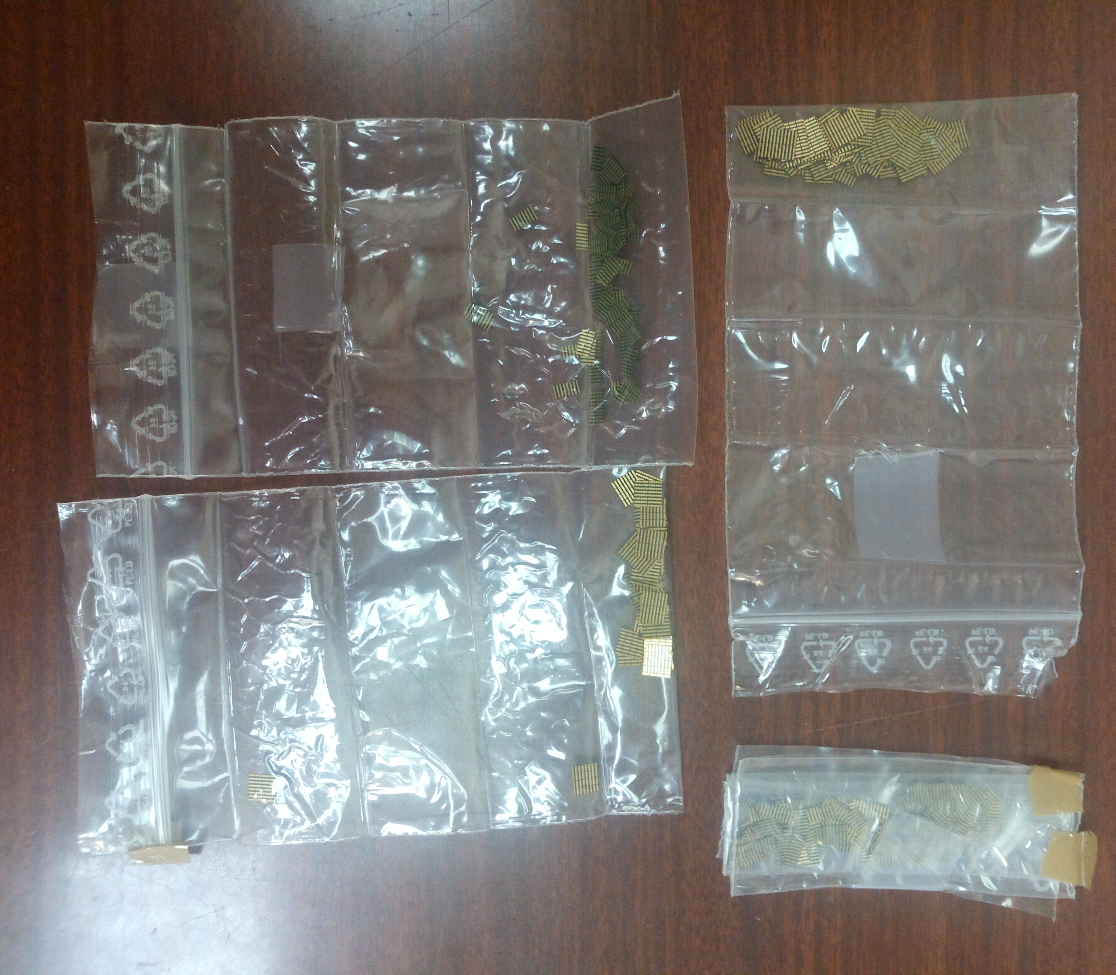
FPC-FPC Welding Tests

Slide 10
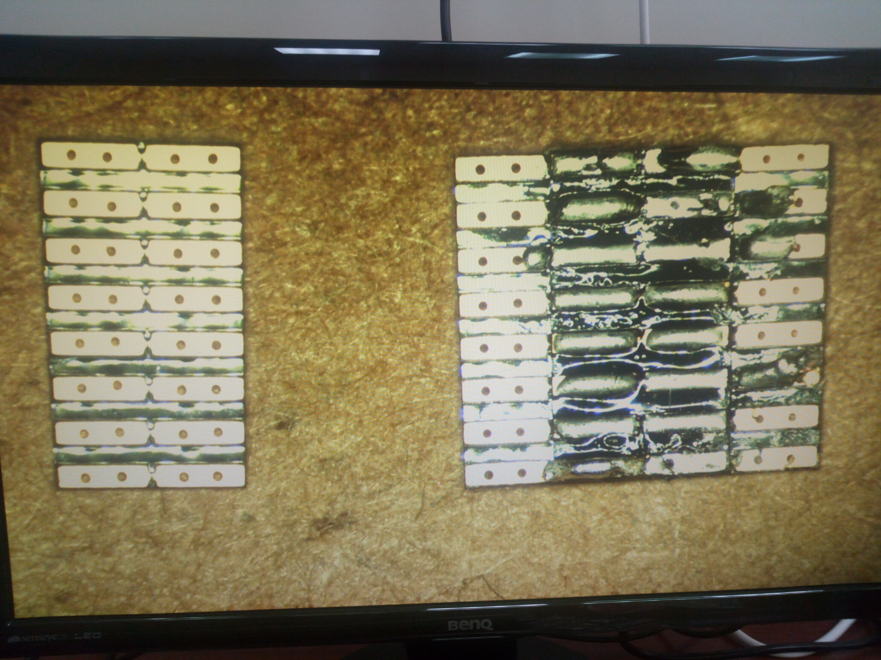
FPC-FPC Welding Tests

Slide 11
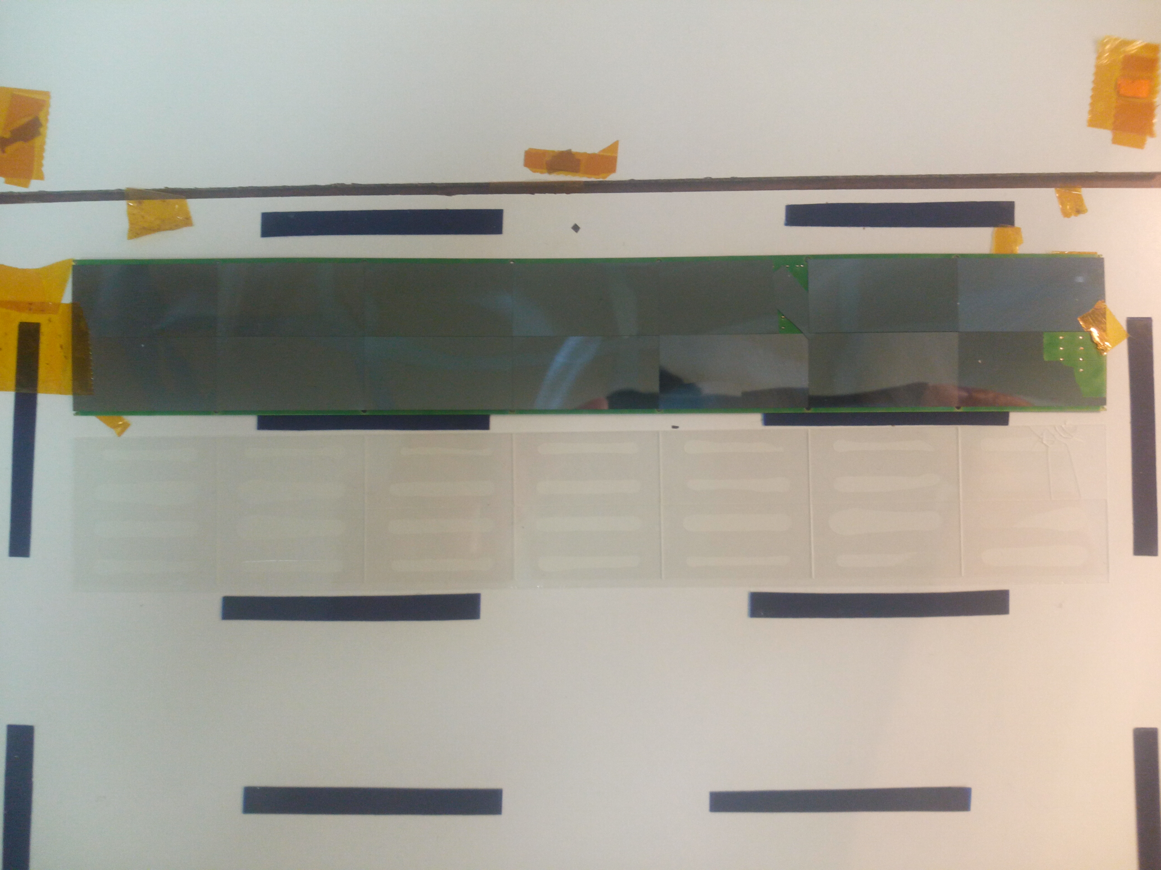
Module Dummy Tests

Slide 12
Module Dummy Tests
+
+
+
+
Strategy is to use the glass dummy both for alignment and gluing tests

Slide 13
Milestones
week | S Dry Assembly | Dummy HIC | S Assembly w/ DHIC | Note
39 | Federico, Marco (Dry) | Glass tiles at LNF | N/A
40 | Marco T, Marco I | Find Plexi base with marks | N/A | No Federico (CERN)
41 | Marco I, Marco T | Produce glass dummy prototype | N/A | No Daniele (CERN)
42 | Massimo, Marco I | Produce glass dummies | N/A
43 | Massimo, Marco T |  | N/A | No Daniele, Alessandro
44 |  | Align dummies | N/A
45 |  |  | N/A | No Federico, Valeria (AW)
46 | Federico, Pavel | Gluing tests | N/A
47 | Federico, Pavel |  | N/A | Validation with Torino
48 |  |  | Operators TBD | No Marco T (Test Beam)
49
50 | 1 Stave assembled with glass dummies
51 | contingency
52

