Slide 1
The BELINA neutron beam facility at CN- LNL P. F. Mastinu¹, R. Capote Noy⁵,F. Gramegna¹, ,G. Martín Hernández² , J. Praena³ and G. Prete¹ ¹ Laboratori Nazionali di Legnaro, INFN, Italia. ² CEADEN, La Habana, Cuba. ³Universidad de Sevilla, CNA, Spain. ⁵International Atomic Energy Agency Nuclear Data SectionDivision of Physical and Chemical Sciences Department of Nuclear Sciences and Applications A-1400 Vienna, Austria
1
LNL User Community Annual Meeting 2016 P. Mastinu-INFN-LNL

Slide 2
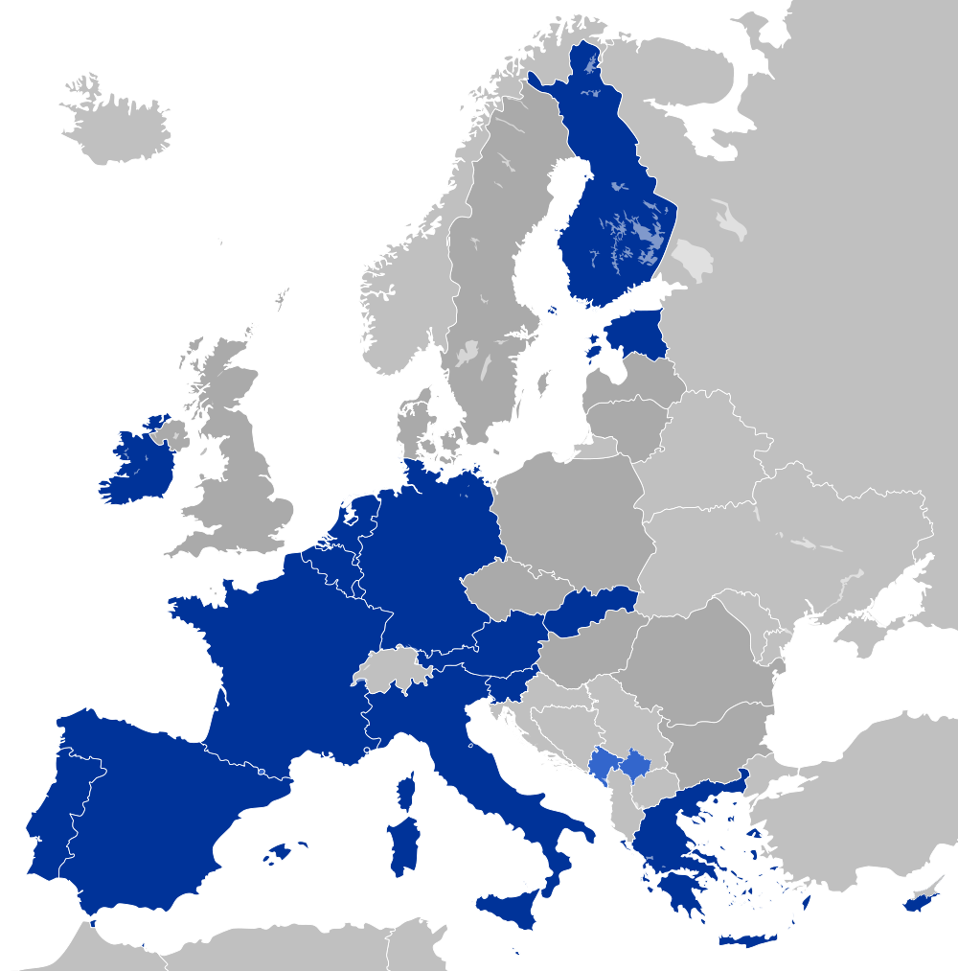
TOF facilities in Europe:
At present strong needs of low energy facility with suitable pulsed beam for neutron TOF measurement. Legnaro Unique in Europe for the next 3 years
PTB
New tandem ordered
n_TOF CERN, not suitable proton beam
(n,g), (n,f)
JRC-IRMM
Upgrading of accelerator
GEEL
LNL-INFN
7 MV VdG accelerator
Modification of the fixed 3 MHz repetition rate
LNL User Community Annual Meeting 2016 P. Mastinu-INFN-LNL

Slide 3
LNL User Community Annual Meeting 2016 P. Mastinu-INFN-LNL

Slide 4
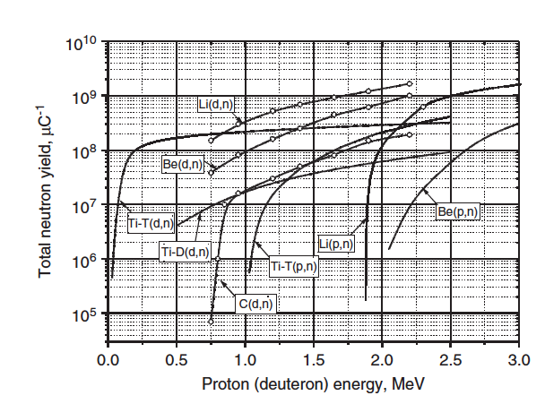
Neutron Yields for Various Charged-Particle induced Reactions
LNL User Community Annual Meeting 2016 P. Mastinu-INFN-LNL

Slide 5
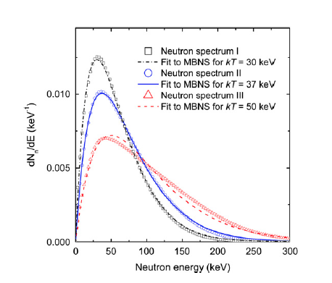
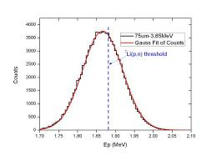
Maxwell-Boltzmann Neutron Spectra (30-70 keV)
Integral cross-sections in MBNS can also be used for the validation of evaluated data for the next IRDFF-2 database.
MACS of large number of istopes meets the need in different fields (Nuclear astrphisycs, nuclear data for fast reactors, medical physics….)
THE METHOD
Proton
Energy Shaper
Lithium
Protons
NEUTRONS
Shaped Proton distribution. Dot line: ⁷Li(p,n) threshold (1.88 MeV)
ARI 70 (2012) pg 1583-1589
P.F. Mastinu et al., NIM A 601, 333 (2009).
There are several combinations of proton energy, shaper thickness and material suitable for this method, as well as target to sample distance.
The first measurement is focused in the production of MBNS at kT=30 keV with Ep=3.666 MeV, 75 um thickness Al as proton energy shaper.
LNL User Community Annual Meeting 2016 P. Mastinu-INFN-LNL

Slide 6
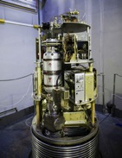
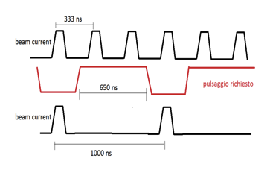
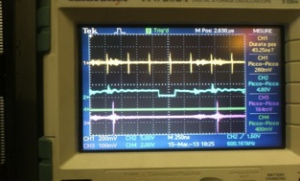
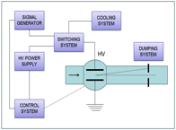
LENOS facility: CN 7 MV Van der Graaf.
Pulsed beam:
3 MHz rf pulsing system on the high voltage terminal.
1 ns pulse width.
Only 3 MHz operating: no adequate for neutron TOF measurement in the energy range of interest.
We have developed, installed and tested a switching system able to provide 1 ns pulse at 1 MHz, 625 kHz…. (*) low Rep rate available now for TOF measurements
[*] P. Mastinu et al., TALES Report (2013).
LNL User Community Annual Meeting 2016 P. Mastinu-INFN-LNL

Slide 7
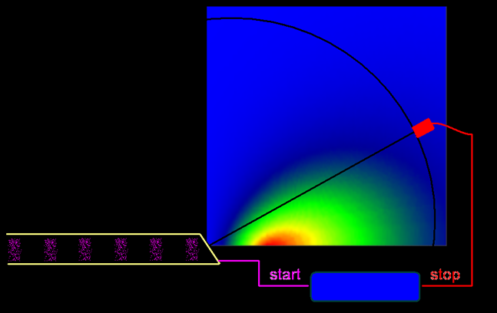
Parameter | Value
Beam line | 0 degree (BELINA setup)
Target | Natural Li metal
Beam | H+
Pulse width | <2 ns
Pulse frequency | 100 Hz-600 kHz-1 MHz
Flight path | 70 cm
Proton current | 50-110 nA (averaged)
Beam diameter | <3 mm
LNL User Community Annual Meeting 2016 P. Mastinu-INFN-LNL

Slide 8
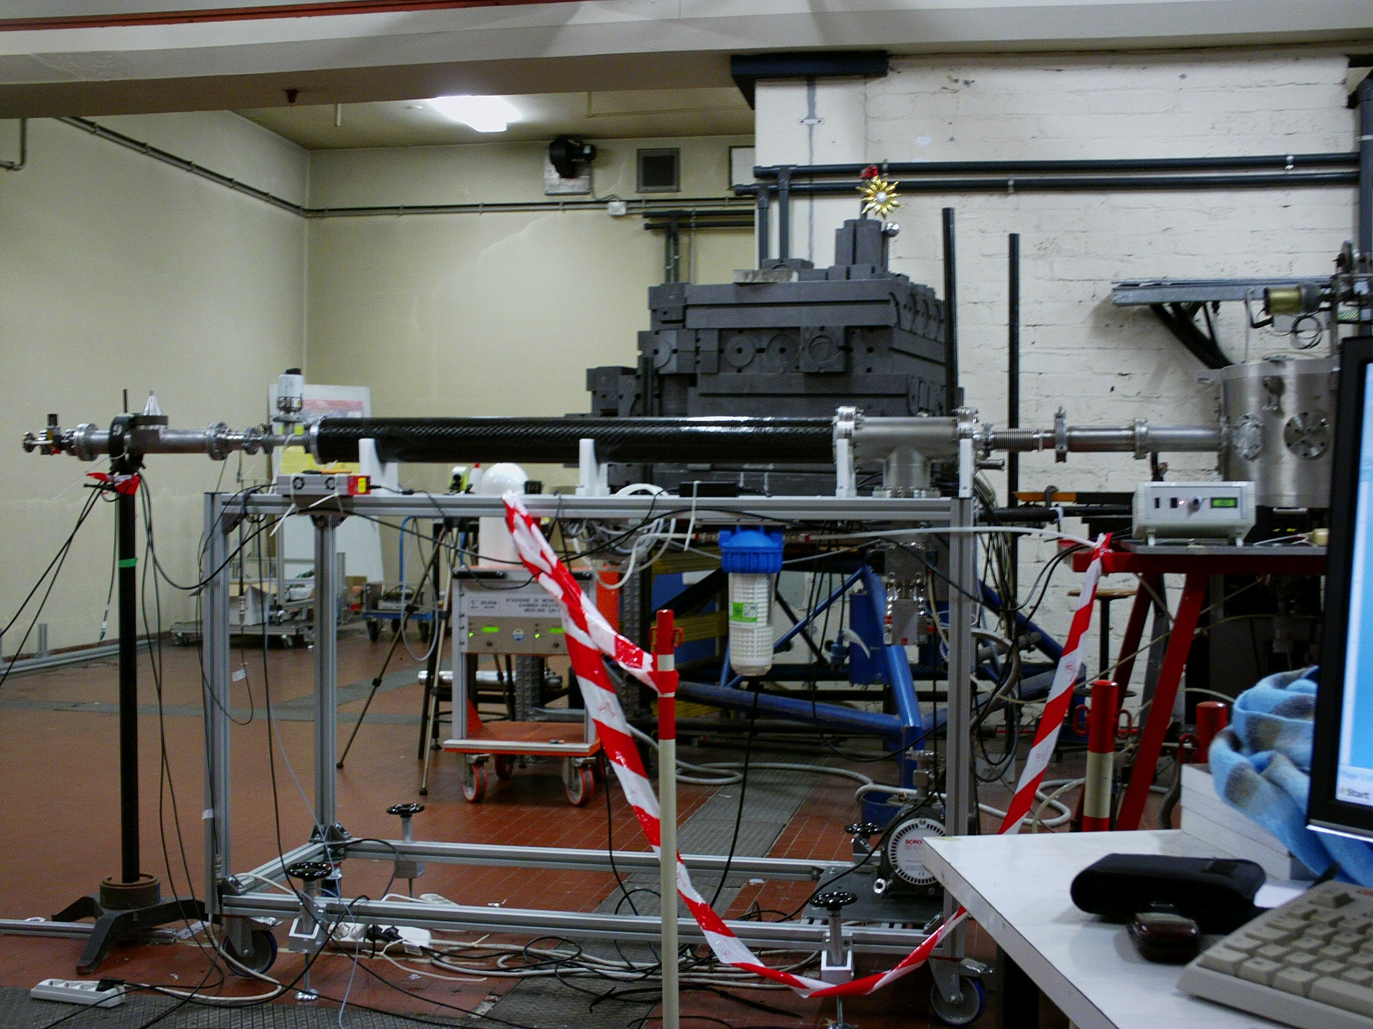
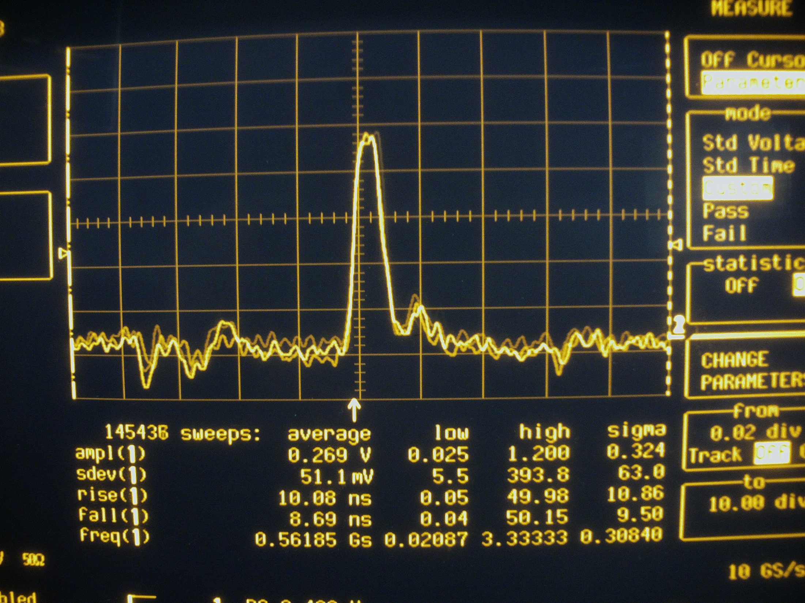
CN Performances
On-line TOF measurement of proton beam energy distribution (13m FP)
Low mass setup
1-2 ns time resolution of proton beam
Achievable energy resolution about 0.1% (about 200 ps time resolution)
LNL User Community Annual Meeting 2016 P. Mastinu-INFN-LNL

Slide 9
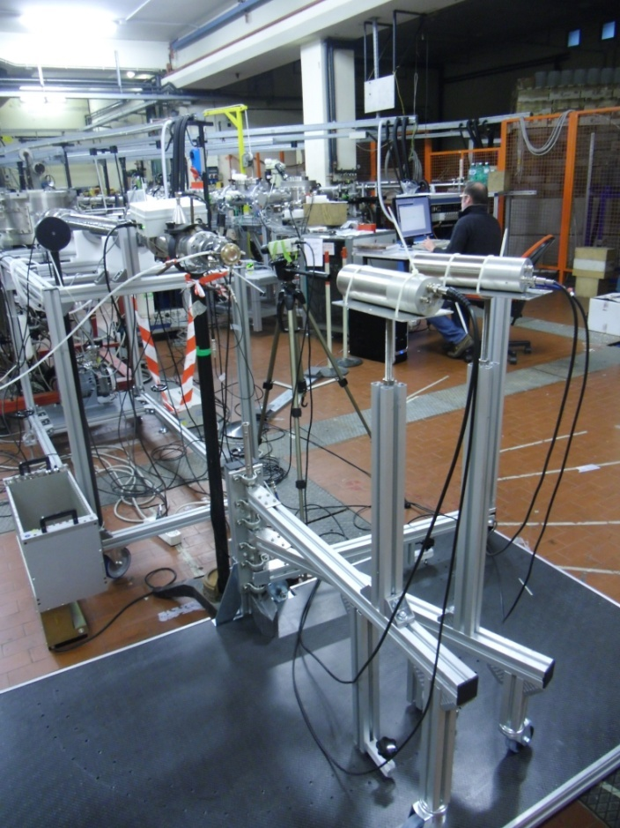
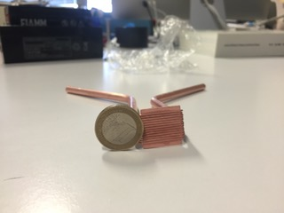
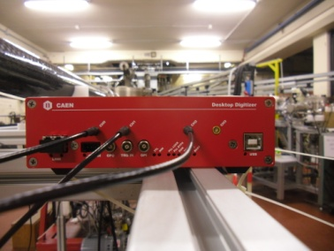
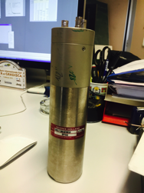
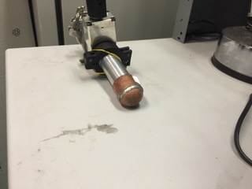
LENOS: neutron beam line at CN VdG
We have constructed the different parts of the setup and the DAQ system:
¹⁰B-BaF₂ detector, ⁶Li-glass detector, Li evaporation system, self made low mass metal Li-Target
DAQ based on CAEN Digitizer (1-2 GHz sampling rate).: waveform or list mode
Low mass neutron beam line and goniometer
Up to 5 MeV neutron energy collimator with different apertures
Different detectors available:
⁶Li-Glass of different thickness
BC501a
BF₃
LNL User Community Annual Meeting 2016 P. Mastinu-INFN-LNL

Slide 10
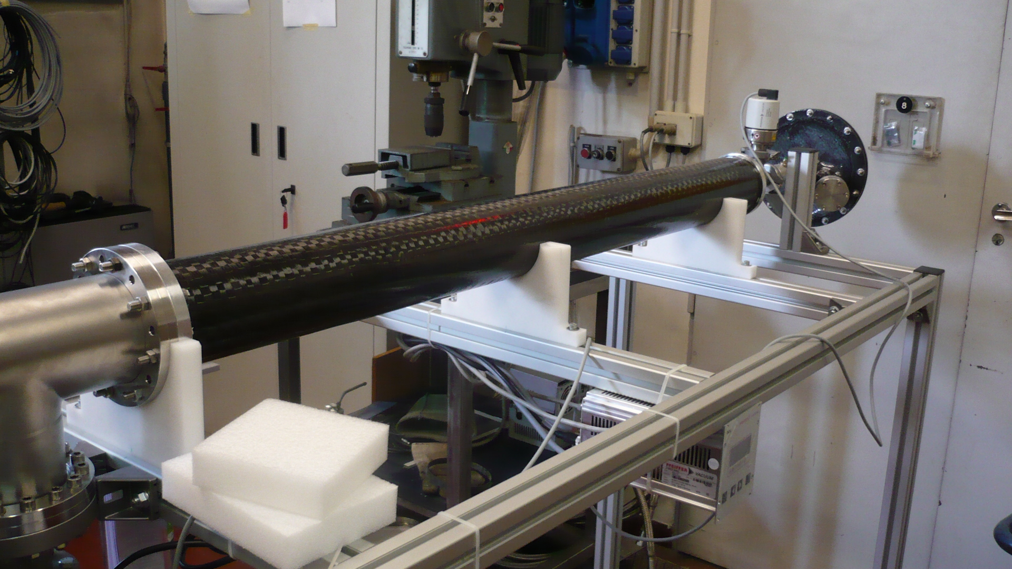
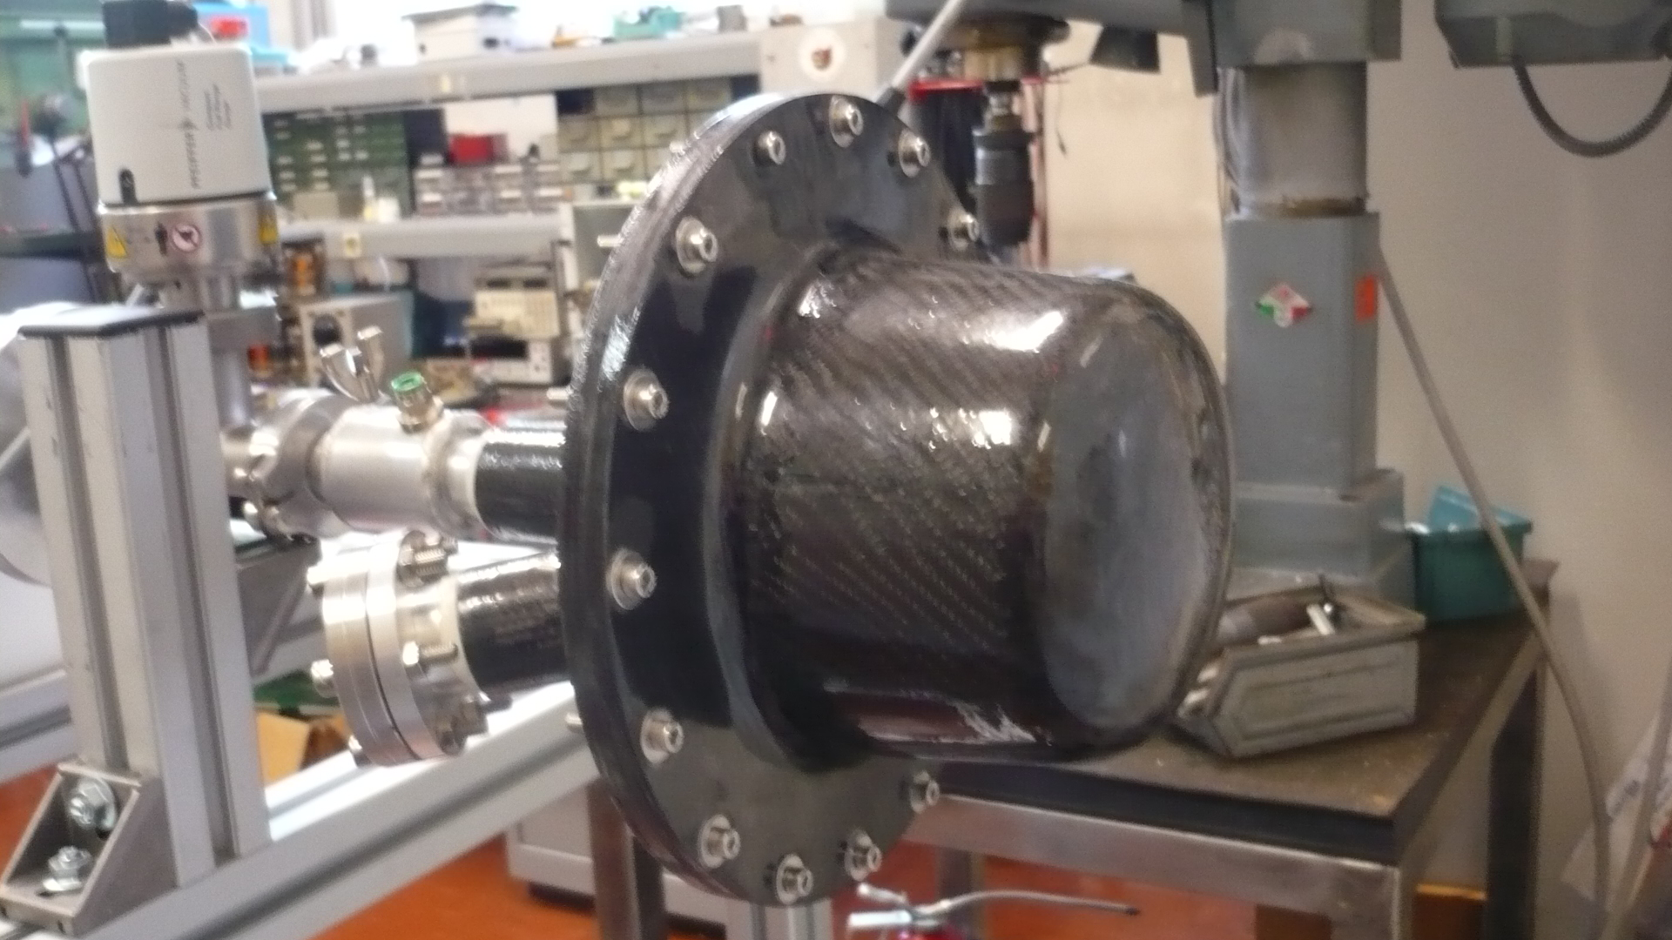
Lithium Target Assembly in CF
1 m long beam pipe in CF
Water cooled collimator
CF LTA
Cold trap
ZnSe window for temperature mapping
LNL User Community Annual Meeting 2016 P. Mastinu-INFN-LNL

Slide 11
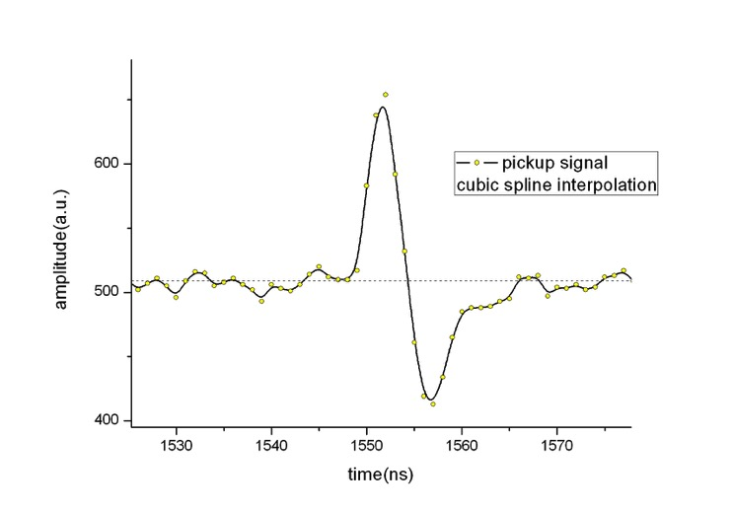
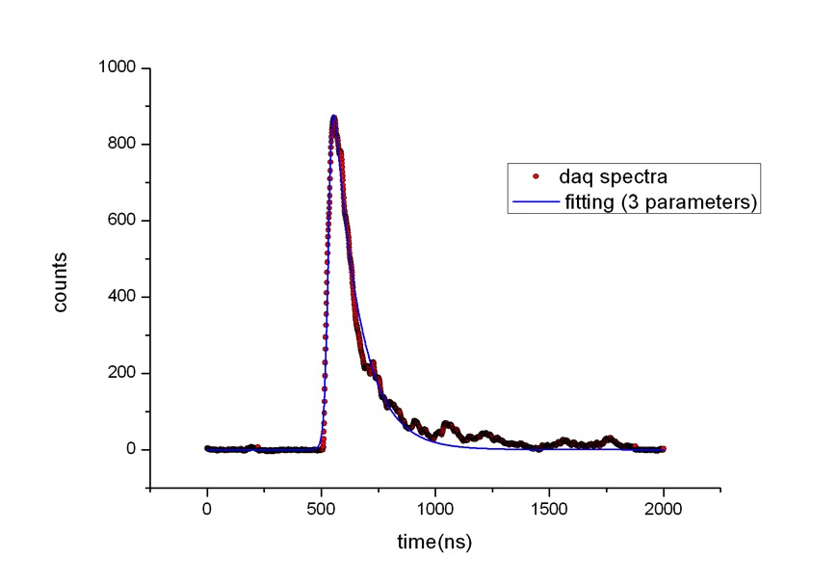
LENOS: MBNS at kT=30 keV. DAQ signal fitting.
Pickup signal. Cubic Spline fitting. Base line crossing taken as time mark
Li-glass Detector Signals shaped and amplified (Ortec TFA)
Detector signal fitted (minuit D506 CERNLIB)
Time at half maximum taken as time mark
LNL User Community Annual Meeting 2016 P. Mastinu-INFN-LNL

Slide 12
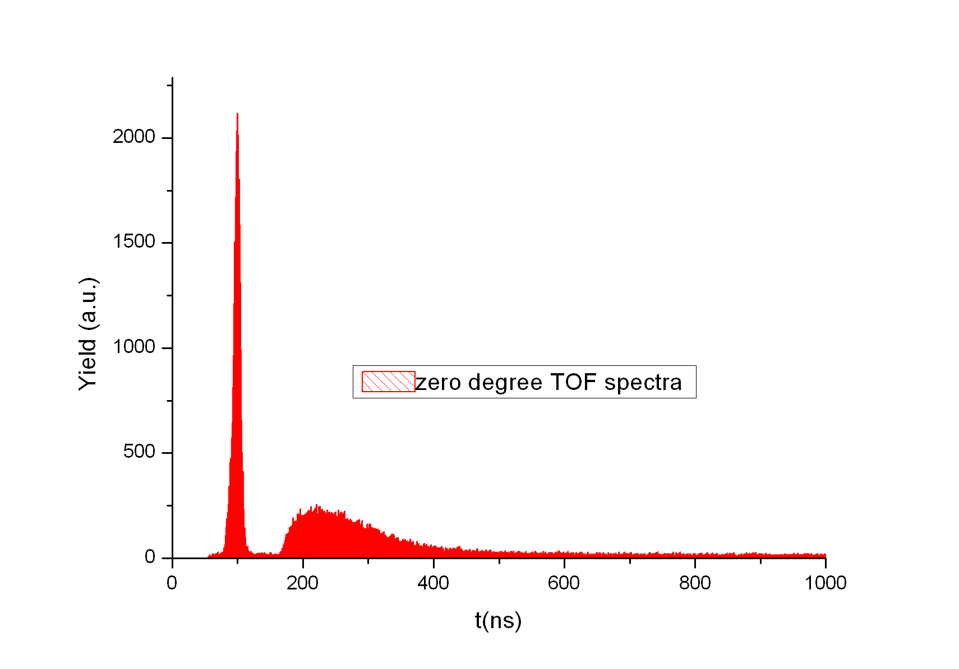
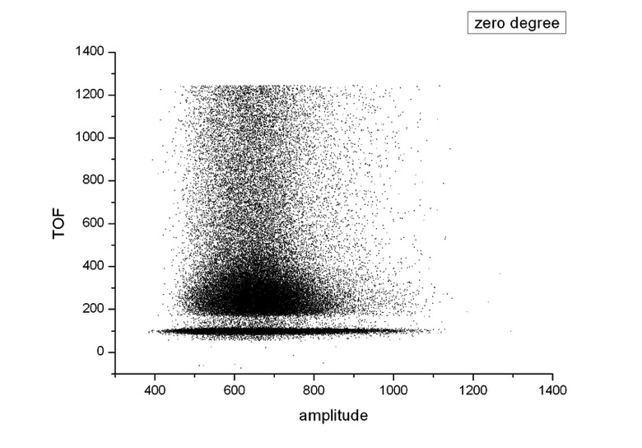
Measurement MBNS at kT=30 keV: 0⁰ spectra.
Good discrimination of gamma and neutrons.
8 ns width the gamma-flash peak.
Flat background.
Unfortunately low statistics (integrated current 15 nA!)
LNL User Community Annual Meeting 2016 P. Mastinu-INFN-LNL

Slide 13
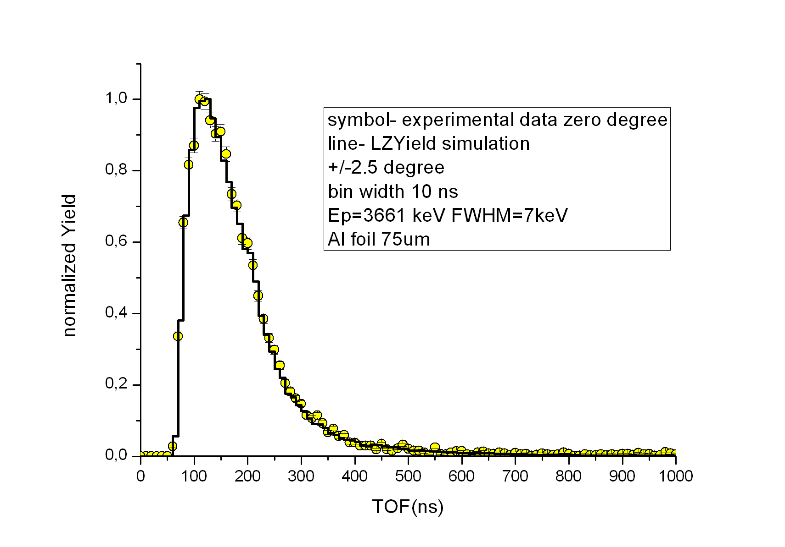
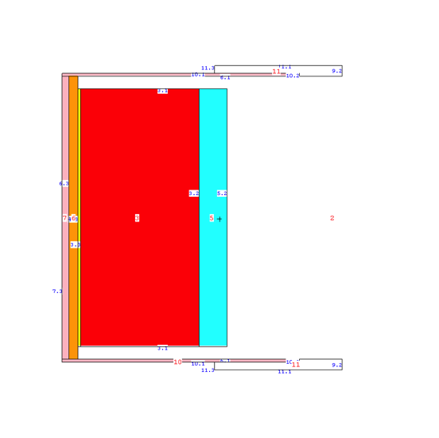
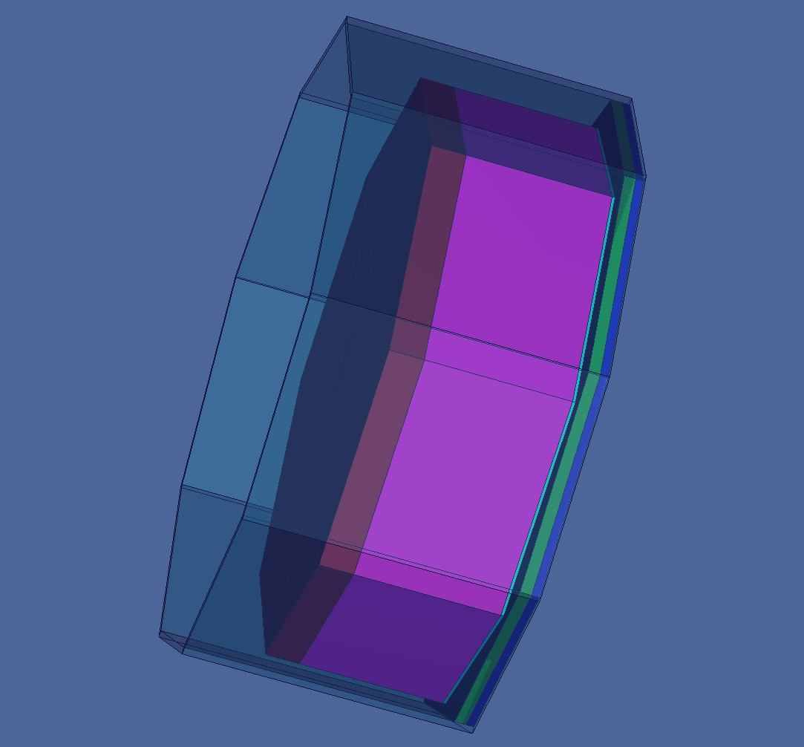
Experimental data: 0⁰ time spectra.
Yellow points are our experimental data at 0⁰.
Black line is the simulated neutron spectra with our code LZYield/MCNPX.
detailed MCNPX geometry of the setup.
LNL User Community Annual Meeting 2016 P. Mastinu-INFN-LNL

Slide 14
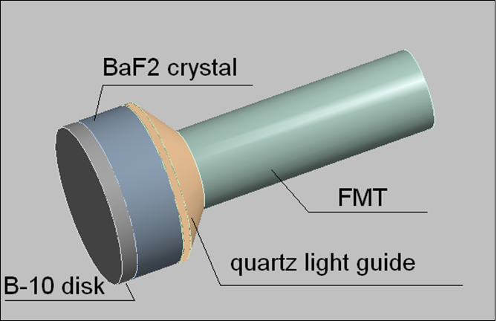
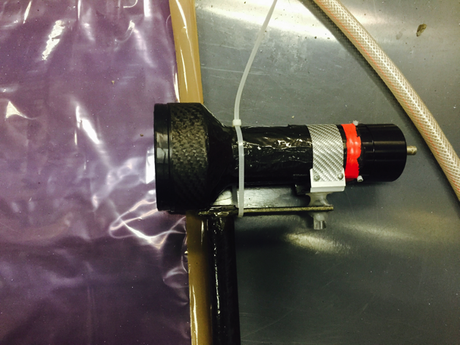
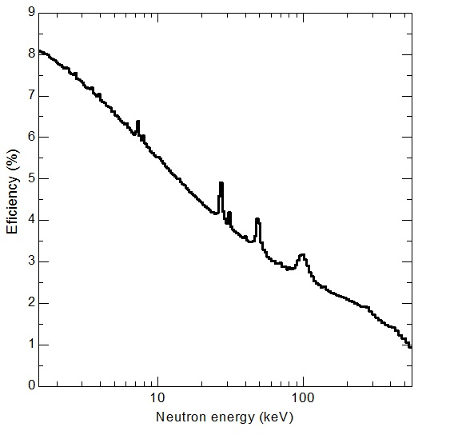
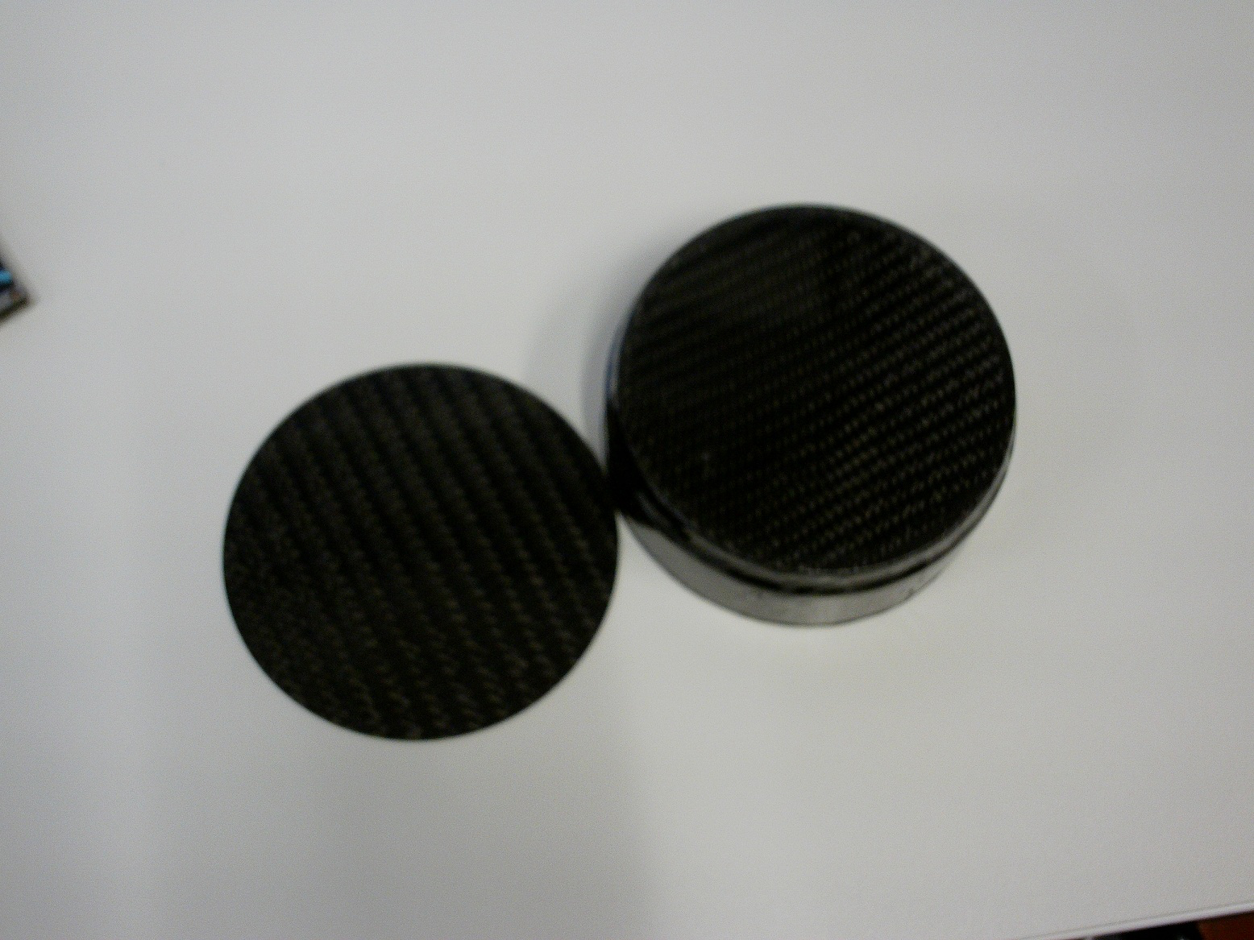
LENOS: The new, High efficiency, High resolution TOF neutron detector
If the accelerator current will not be restored to the usual value we will be forced to use our new developed detector
Detector: BaF₂ with ¹⁰B removable capsule. Neutrons detected via 480 keV gamma from ¹⁰B capture. High efficiency
LNL User Community Annual Meeting 2016 P. Mastinu-INFN-LNL

Slide 15
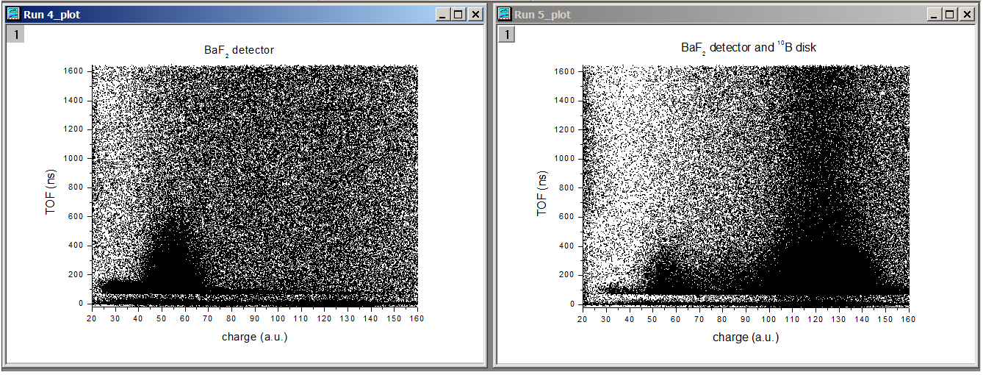
Setup and routine for data analisys ready
We have already characterized tested and used out new detector, since we have already performed a similar TOF experiment at CN-LNL
NO ¹⁰B capsule
(background mesurement only)
With ¹⁰B capsule
(neutrons selected trought 480 keV energy line)
LNL User Community Annual Meeting 2016 P. Mastinu-INFN-LNL

Slide 16
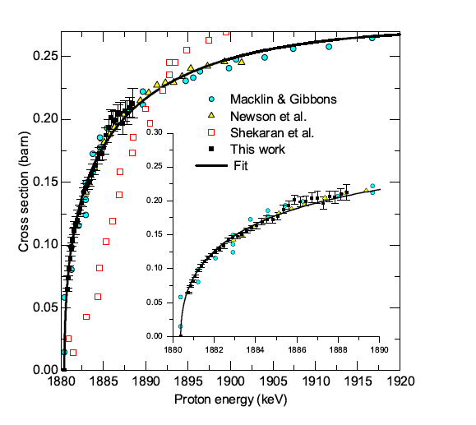
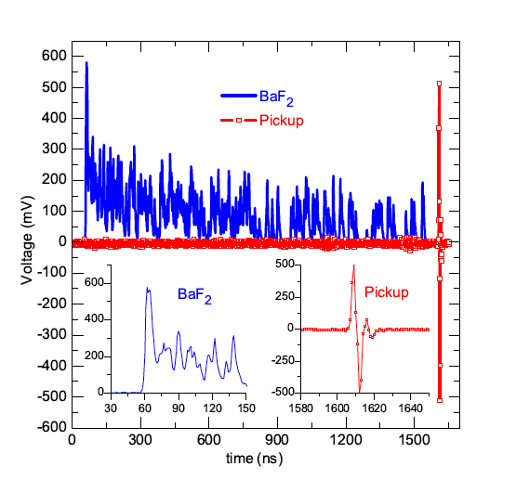
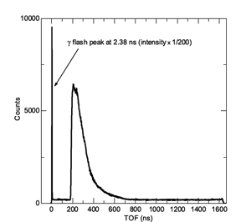
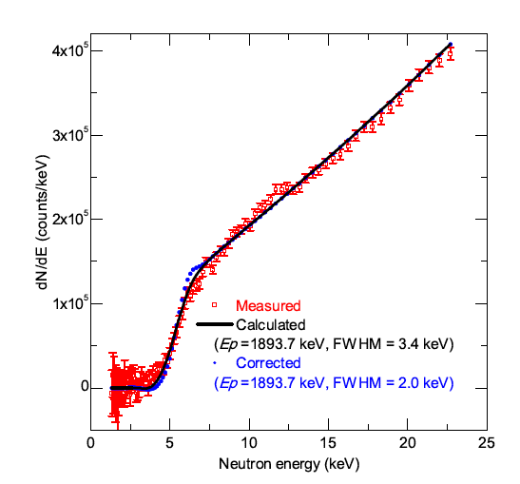
Near treshold ⁷Li(p,n) reaction exitation function shape and neutron spectra
Phys RevC 94 034620
LNL User Community Annual Meeting 2016 P. Mastinu-INFN-LNL

Slide 17
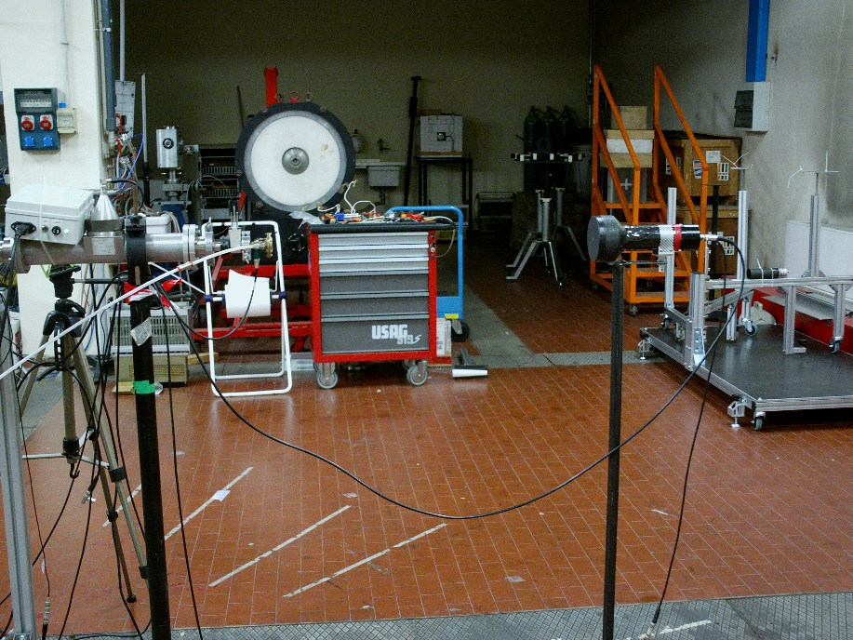
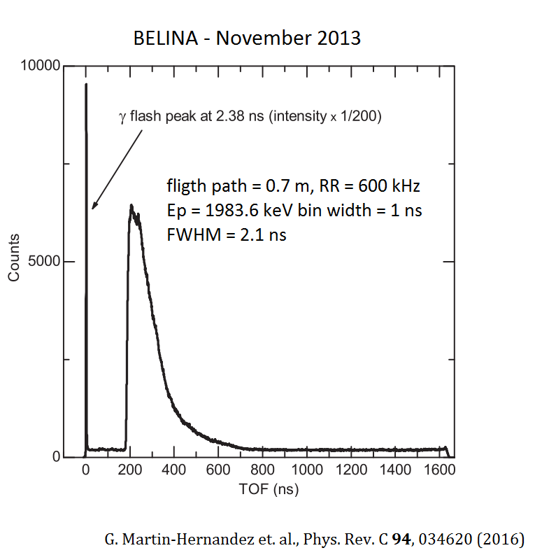
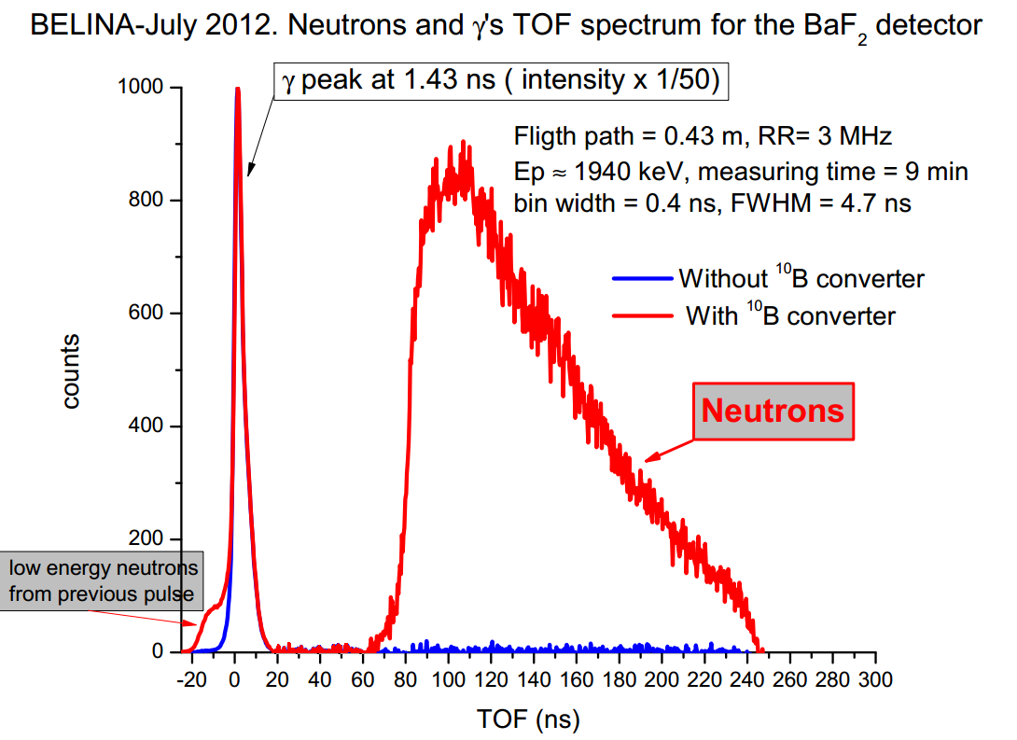
Actual problems

Slide 18
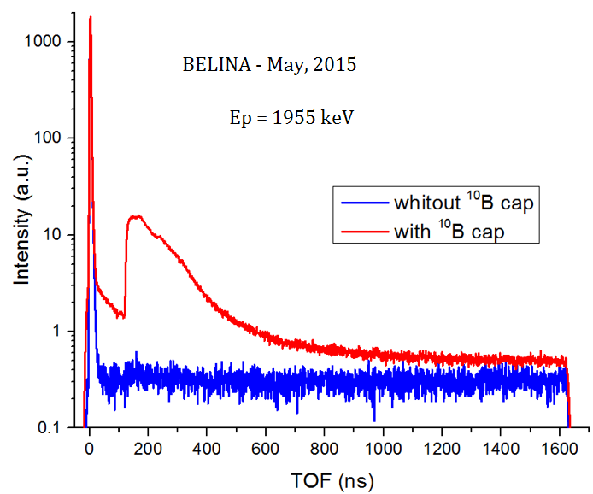
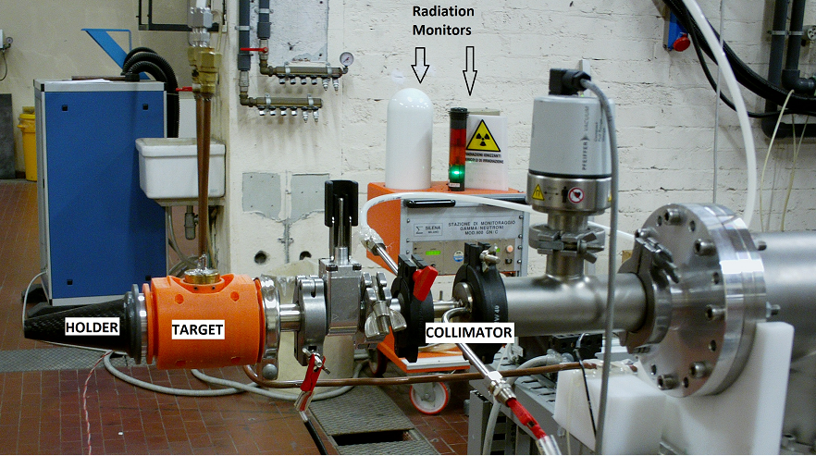
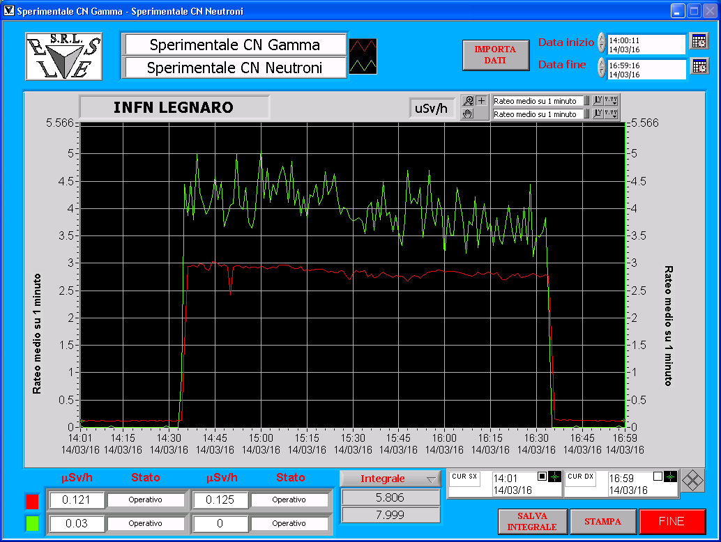
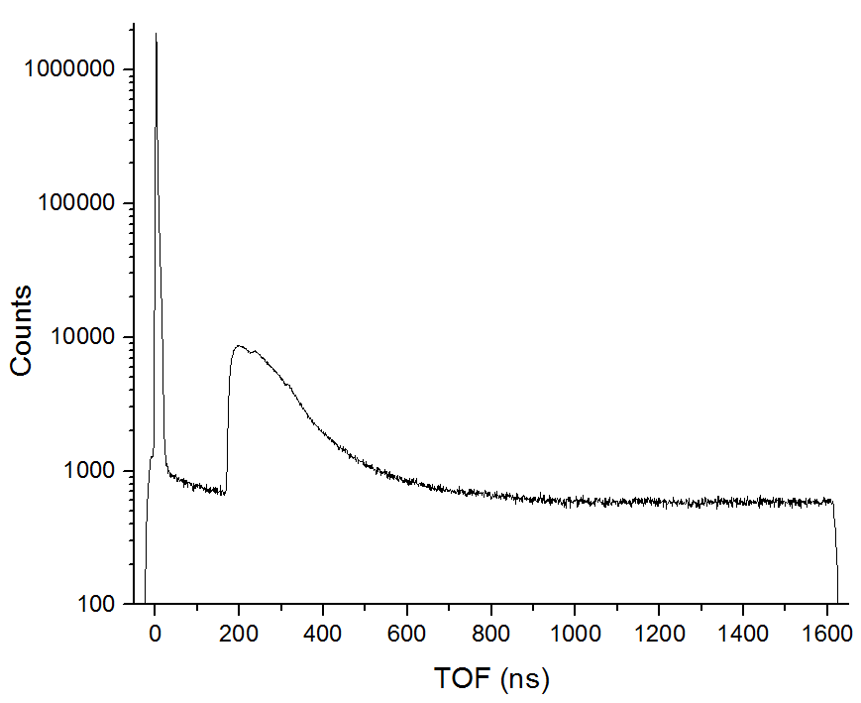
Ep = 1898.5 keV
March 2016

