Slide 1


Misura della violazione di CP nel settore leptonico nell'esperimento T2K: stato e prospettive
Gabriella Catanesi
Istituto Nazionale di Fisica Nucleare (INFN) Bari –Italy
Bologna , 28 Ottobre 2016

Slide 2
Outlook
Brevi cenni sulle oscillazioni di neutrino
T2K in a “Nutshell”
T2K “δcp Discovery Potential” e limiti delle misure in corso
Prospettive a medio termine (2020-2025)=> T2K-II
  JPARC High intensity neutrino beam (0.75-> 1.2MW)
  Upgrade ND280 + Attivita’ di R&D alla Neutrino Platform del CERN
  1Km Detector + SK-GD
Cenni sulle prospettive a lungo termine (>2025)
  HYPERK (T2HK)
  Confronti e complementarieta’ con Dune

Slide 3
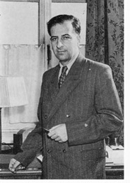
Oscillazioni di Neutrino
Se gli autostati elettrodeboli e di massa sono differenti:
  Il neutrino e’ prodotto in un determinato autostato “debole”
  Viaggia a una distanza L come autostato di massa
  Puo’ essere rivelato con un differente autostato “debole”
Bruno Pontecorvo
1969

Slide 4
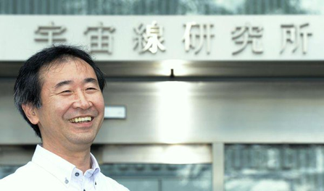

T.Kajita (Nobel Prize 2015)
_{L/E ≈ 1000 (KM/GeV)}
Long-Baseline

Slide 5




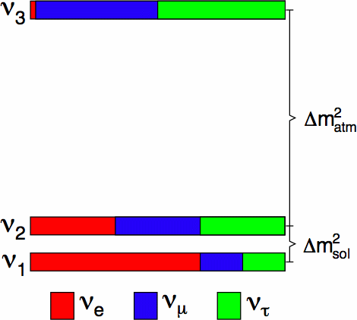
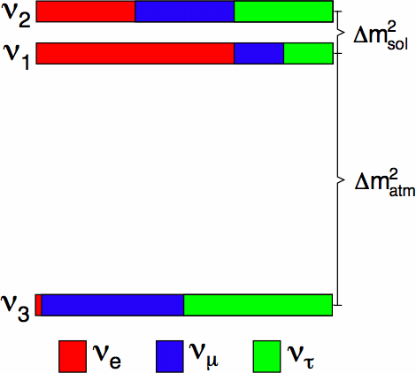
La matrice Pontecorvo-Maki-Nakagawa-Sakata (PMNS) < 2011
atmosferic ν
accelerator ν
SBL reactor ν
accelerator ν
solar ν
LBL reactor ν
interferenza
Sorgenti di neutrini
Sorgenti naturali ( neutrini solari e atmosferici)
Neutrini da reattori
Neutrini da acceleratori («Long Baseline»)
Normal Hierarchy
Inverted Hierarchy

Slide 6
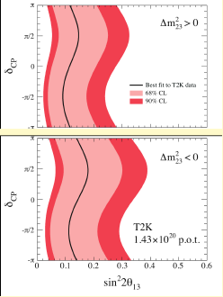
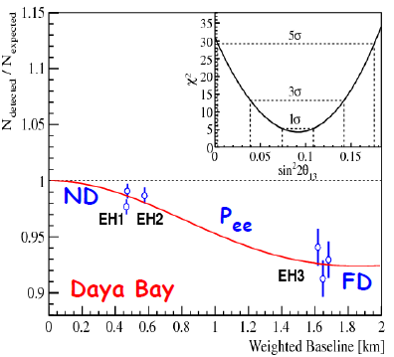
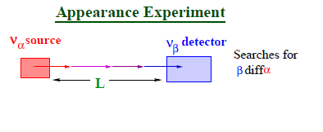
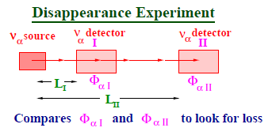
Tutto cambia nel 2011/2012
T2K

Slide 7
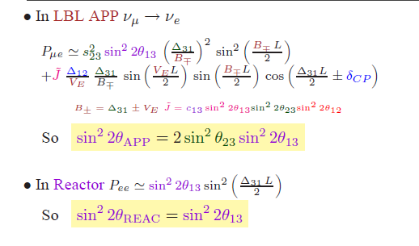
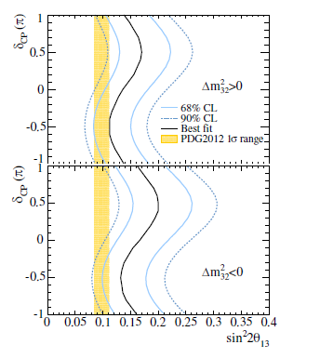
ν Experiments: LBL vs Reactors
T2K 2013
Concha Gonzalez-Garcia

Slide 9
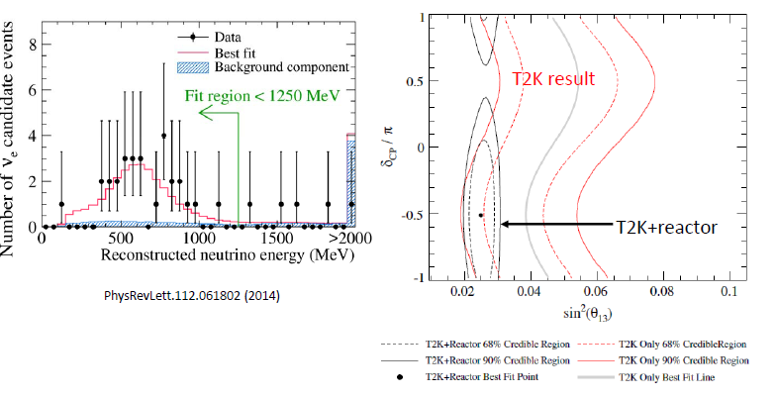
ν_{e appearance by T2K}

Slide 10

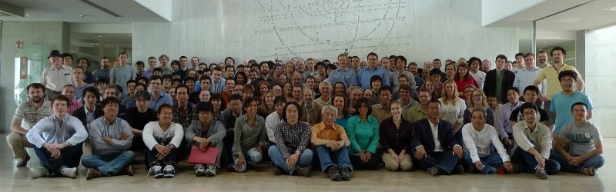
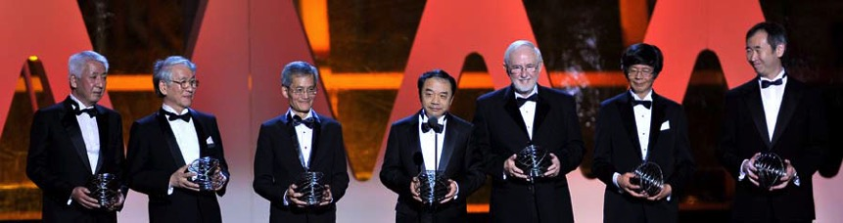
Word’s bigger LBL neutrino running experiment
May 2011
~500 physicists, 58 institutions, 11 nations, 3 continents
  Breakthrough prize 2015 (Nishikawa-san +T2K collaboration) for their role in the discovery and study of neutrino oscillation.

Slide 11
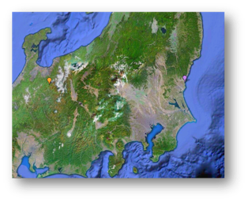
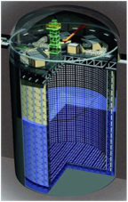
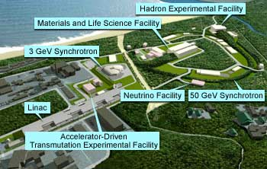

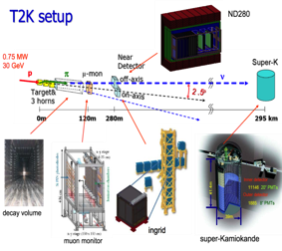
The Tokai to Kamioka (T2K) Experiment
Super-K Detector
J-PARC Accelerator
ν
295 km
30
The T2K experiment searches for neutrino oscillations in a high purity νμ beam
A near detector located 280 m downstream of the target measures the un-oscillated neutrino spectrum
The neutrinos travel 295 km to the Super-Kamiokande water Cherenkov detector
Near Detector
  νe appearance
  νμ disappearance
  δ_{cp}
  X-section + exotics

Slide 12
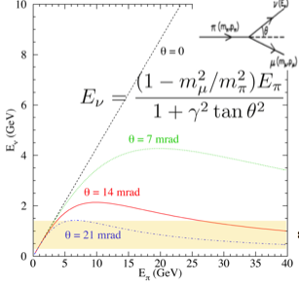
Off-Axis Beam

Slide 13
( 20% of the final sample )

Slide 16
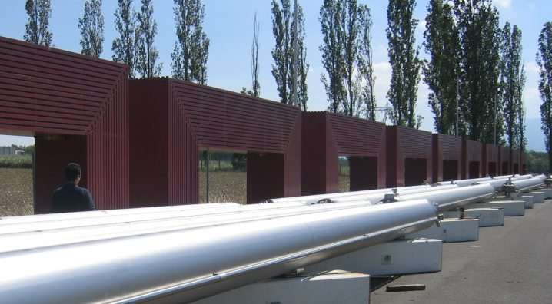
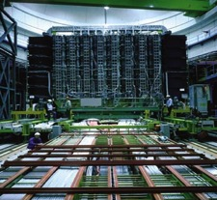
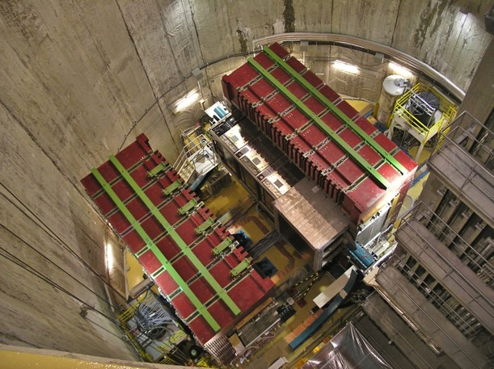
ND280
CERN-2007 ➔
UA1 Magnet@CERN
(beginning 80’)
ND280 Installation =>
νμ event
@ ND280
νμ event
@ ND280
νμ event
@ ND280
νμ event
@ ND280
νμ event
@ ND280
νμ event
@ ND280
νμ event
@ ND280

Slide 17
ND280

Slide 18
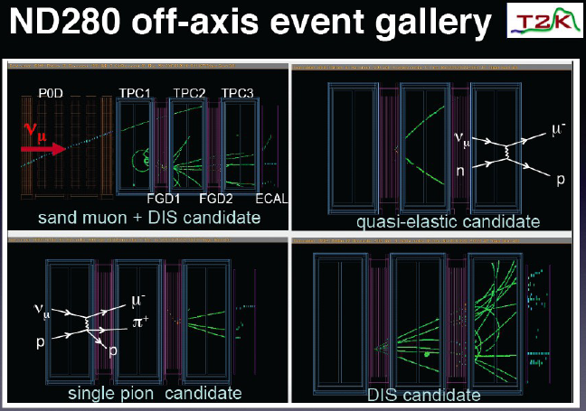

Slide 20
Neutrino Flux @ ND280

Slide 21
The Far Detector…

Slide 22
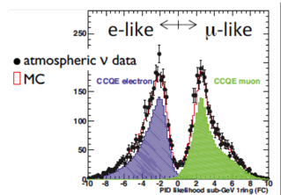
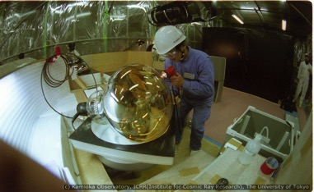
Super-Kamiokande
Neutrino interaction in Super-Kamiokande
ε > 80%
Probability that a muon is identified as an electron is < 1%
One of the 10.000 photosensors of SK

Slide 28
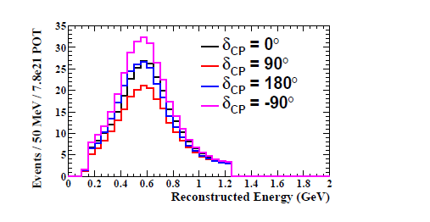
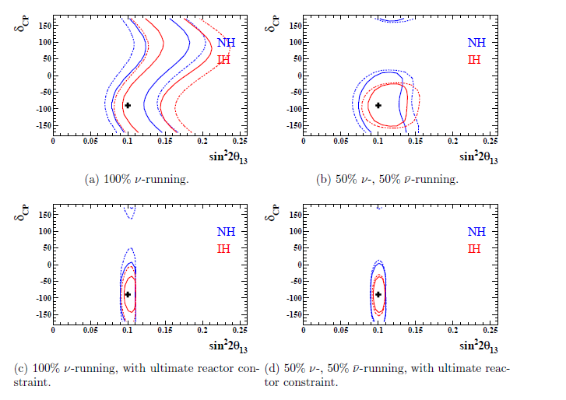
δcp discovery potential
T2K alone full statistic
(7.8 x 10²¹ p.o.t.⁾
≈2020
PTEP 2015 (2015) no.4, 043C01, arXiv:1409.7469

Slide 29
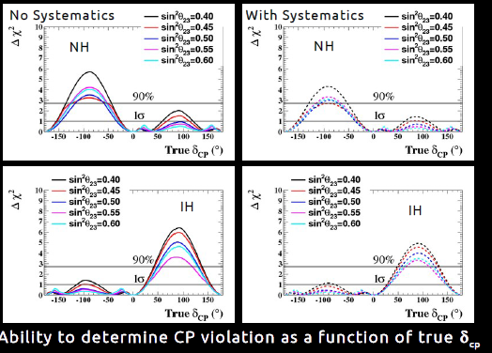

Slide 30
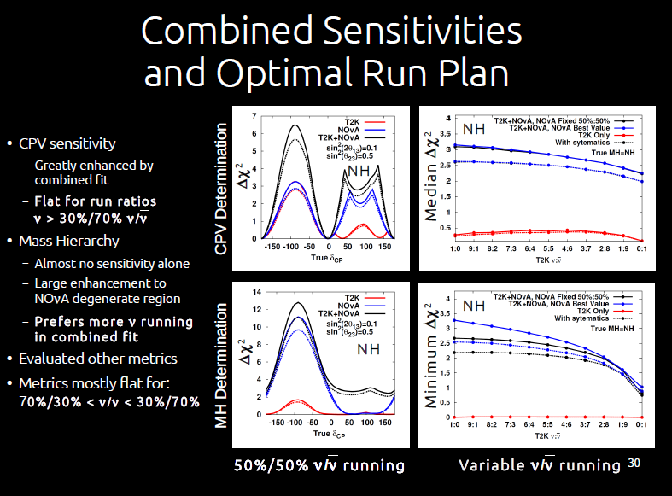
T2K+Nova (2020)

Slide 31
T2K-II: Oltre T2K verso HyPERK (la prossima generazione…)
Ridurre l’errore statistico:
  Protoni,protoni, protoni (alta intensita’)
    => JPARC beam upgrade (1.2 MW)➔T2K-II
  Massa Massa Massa (cerchiamo effetti di subleading)
    => HYPERK (> 2025)
Ridurre gli errori sistematici (5.8% oggi➔ ≤ 4%)
  Studio dei meccanismi di produzione (MEC etc. etc.)
    Upgrade ND280
  ND/FD ratio
    1Km detector (WC)
  Misure di Neutrino x-sec (possibilmente stesso bersaglio Far/Near)
    ND280,1Km
Riduzione dei fondi (S/B) : sviluppo algoritmi piu’ performanti
  (lo stiamo gia’ facendo)

Slide 32
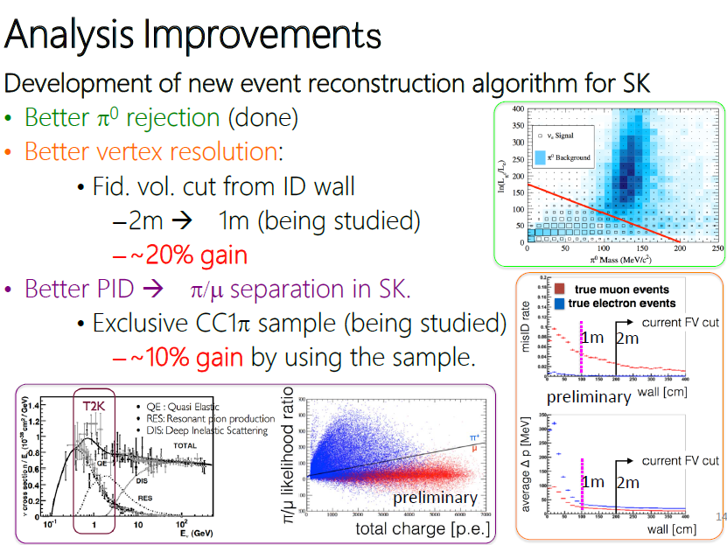
ICHEP 2016

Slide 33
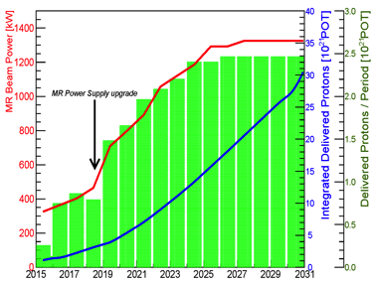
Beam Upgrade
*
T2K aim to reach the number of approved POT (7.8×10²¹) in ~2021.
Begin phase II in ~2021 up to 2026, before expected start of Hyper-K (~2026)
Beam performance upgrades:
Approved main ring power supply upgrade & horn current increase (250 kA → 320 kA) in 2018 → 750 kW
Accelerator & beamline upgrade (double the spill frequency (2.4s -> 1.3s)) in 2021 → 1.3 MW

Slide 34
T2K phase II (T2K-II)
Data Taking : 2020-2025
(≈ 30º Resolution)
Statistic x 3 = 20 x 10²¹ p.o.t
Sys. Errors 2/3 reduction (6% -> 4%)
LOI: 01/2016, Proposal submitted 07/2016
Stage I Approved (Sep. 2016)
(arXiv:1609.04111)
TDR in preparation(2017)

Slide 35
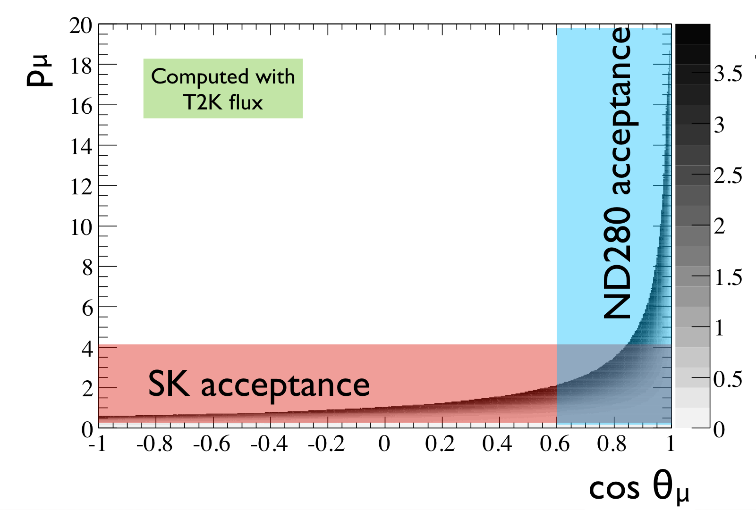
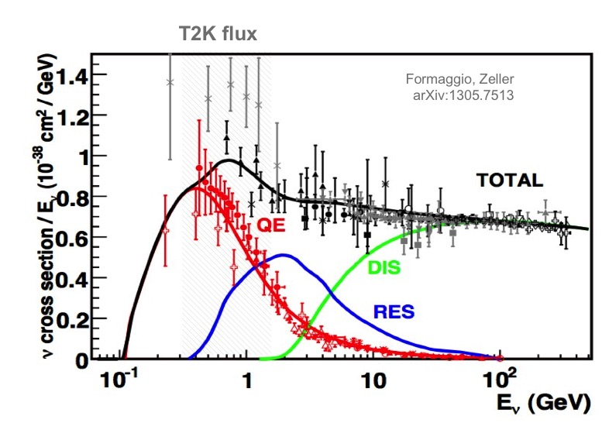
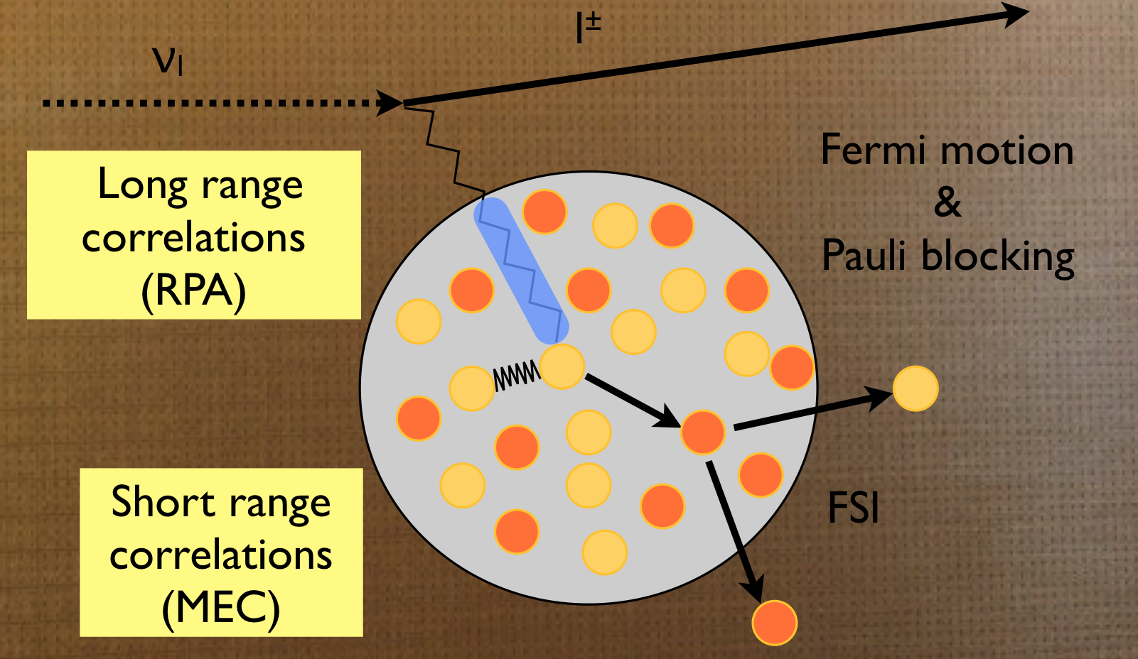
Sorgenti di errori sistematici
Differenza accettanza Near/Far detector
Sezioni d’urto non conosciute a a bassa energia
Bersaglio differente Near/Far (CH/H₂0)
Discrepanze modelli teorici

Slide 37
New Horizontal TPCs
NEXT STEPS
Very thin FieldCage
Design Report of the ND280 upgrade by the end of the year
2017: detailed design of the detectors/setting up the project and funding
2017-18 Neutrino Platform tests (with HPTPC)
2018-2020 construction/installation

Slide 38
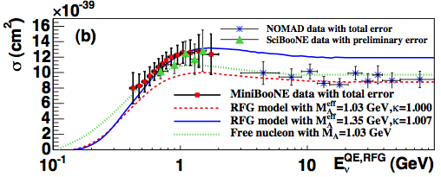
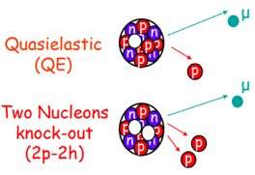
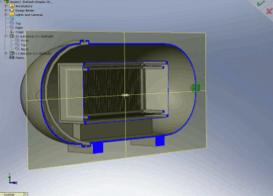
Near Detectors (High Pressure TPC)
2) Add new detectors in the 280m pit: High pressure TPC to study low momentum final state particles and in particular resolve vertex
HPTPC detector design to reduce xsec systematics
arXiv:1002.2680 [hep-ex]
Significant discrepancies on proton multiplicity and momentum distributions
Need low momentum thresholds to reduce xsec systematics
Important difference lie below threshold for liquid detectors
T2K has pioneered (~1 bar) gas TPCs for accelerator neutrinos
Need a path to high pressures for sufficient statistics
Generic to next generation LBL experiments

Slide 41
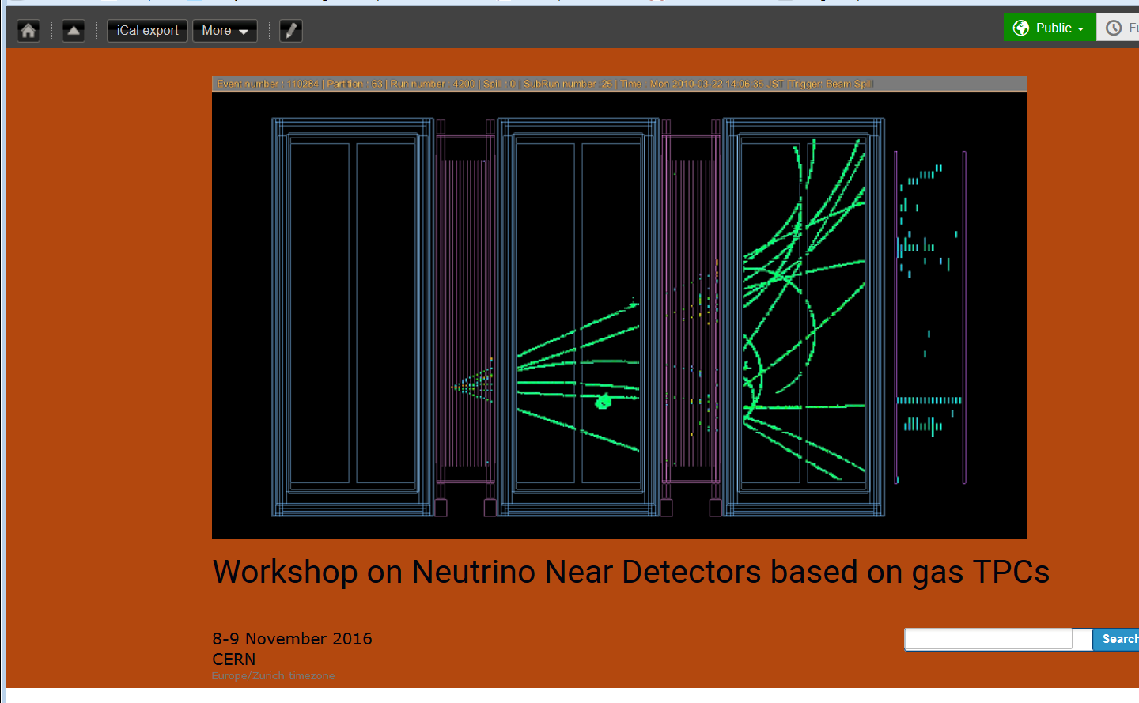
Next generation of TPC based on MPGD
R&D Program based at CERN (Neutrino Platform) to develop both TPC and HPTPC for neutrino experiments
Side subjects as Dark Matter searches or Double Beta Decay can be accommodated in case of common developments
Not only “state of art” but also new ideas….
CERN 8-9 November 2016
https://indico.cern.ch/event/568177/timetable/
High pressure TPC to study low momentum final state particles and in particular resolve vertex
TPC detector design to reduce xsec systematics
For the next generation LBL experiments

Slide 42
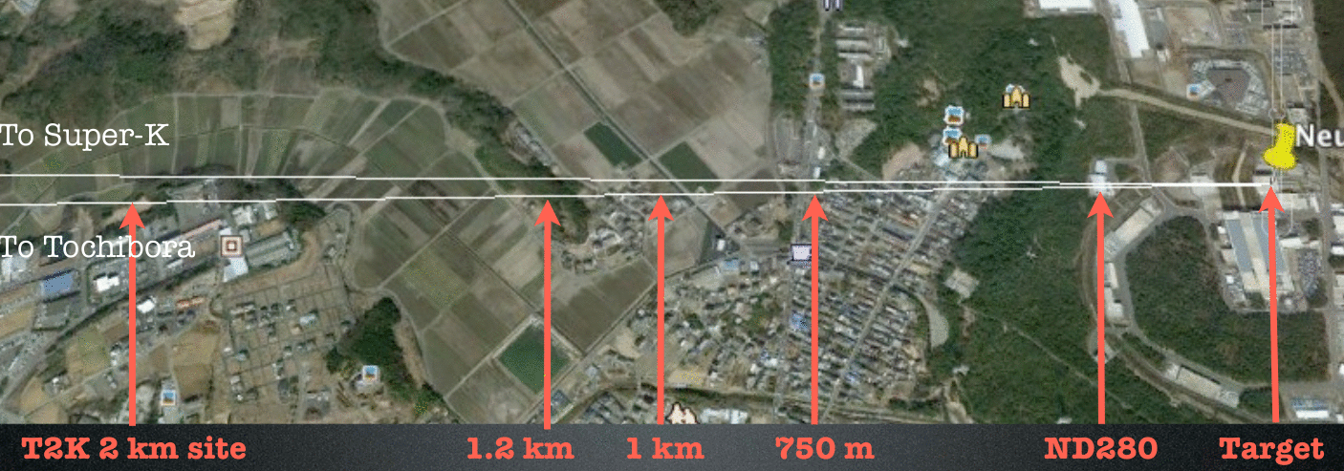
“Intermediate Detector”
2007 project

Slide 43
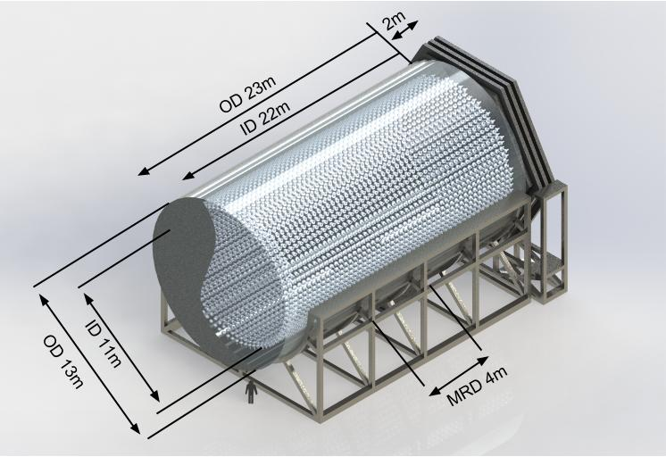
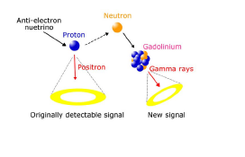
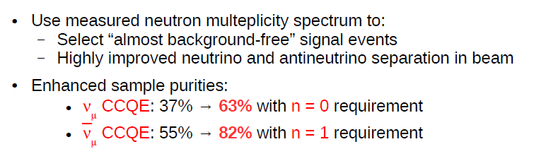
TITUS
Tokai Intermediate Tank for Unoscillated Spectrum ”TITUS” (~2 km)
Baseline design includes:
    2 ktonne water Cherenkov tank
    0.1% Gadolinium-doping
    Partly enclosed by Muon Range Det.
          Fe & plastic scintillator
          End: 100 or 150 cm Fe
          Side: 50 cm Fe (up to 75% coverage)

Slide 44
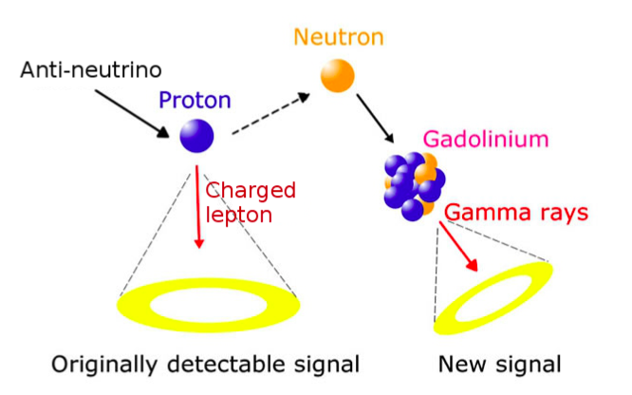
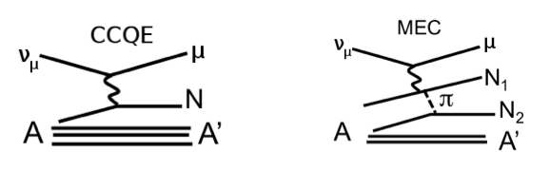
Gadolinium doping:
Neutron capture on Gadolinium:
  Cross section of 49,000b compared to 0.3b for H
  8MeV gamma cascade with 4-5MeV visible energy
  0.1% Gd doping: ∼90% of neutrons capture on Gd
New signal to distinguish ν / ν events and different interaction modes:
  ν_{μ} CCQE: ν_{μ} + n → μ⁻ + p 0 neutrons
  (anti)ν_{μ} CCQE: ν_{μ} + p → μ⁺ + n 1 neutron
  ν_{μ} MEC: ν_{μ} + (n+n) → μ⁻ + p + n 0.2 neutrons (av)
  (anti)ν_{μ} MEC: ν_{μ} + (p + p/n) → μ⁺ + n + p/n 1.8 neutrons (av)
Greatly enhanced sample purities:
  ν_{μ} CCQE: 36% → 67%
  (anti)ν_{μ} CCQE: 63% → 88%
Feasibility of Gd in water Cherenkov detector being tested in EGADS

Slide 45
TITUS
Physics Programme
Measure intrinsic ν_{e} component of J-PARC beam
Neutron multiplicity measurements
    Provide input to neutrino generator models
    Distinguish CCQE from other modes
    Measure main background for proton decay searches
Cross-section measurements
    Inclusive NCπ⁰ – sub-dominant ν_{e} appearance background
    Charged current cross section measurements (CC0π, CC1π etc.)
Sterile neutrino searches
    Compare CC & NC rates at 280 m & ~2 km to look for ν active disappearance
Supernova burst neutrinos
    Approx. 650 events expected from SN burst (570 ν_{e} IBD + 80ν_{e} ES)
    Evaluating feasibility as an independent alarm for the SNEWS network

Slide 46
SK-GD Upgrade
Alla fine di una lunga sperimentazione con EGADS…. La collaborazione SK ha deciso che dopera il detector col Gadolinio entro pochi anni (2019)

Slide 50
Tokai to HyperK (T2HK)
CDR sottomesso al SCJ marzo 2016
Outcome gennaio 2017
MEXT Road Map 2018

Slide 53
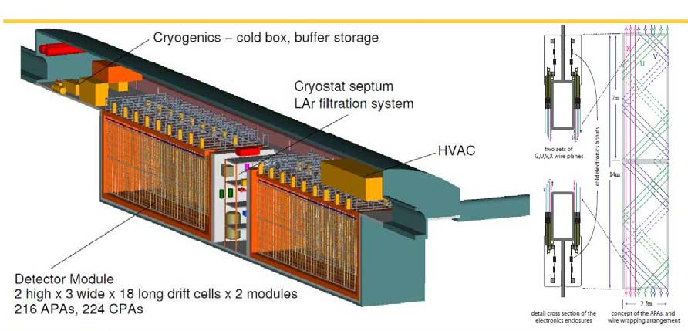
**next-next: HyperK vs Dune
Experiment | Status | E_{ν} (GeV) | L (Km) | E/L (eV²) | ν beam | ν type
DUNE | Future (2026) | 5 | 1300 | 3.8x10⁻³ | Fermilab newbeam | ν_{μ} /anti-ν_{μ}
HYPERK | Future (2025-26) | 0.6 | 295 | 2x10⁻³ | KEK J-PARC (improved) | ν_{μ} /anti-ν_{μ}
HyperK: 520KT WC
Dune: 40KT Liquid Argon

Slide 54
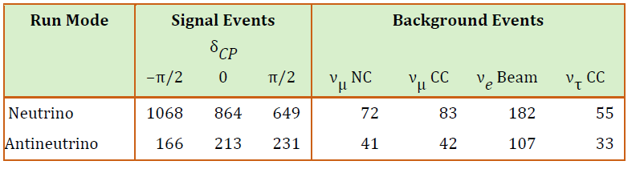
HyperK
HyperK ha un vantaggio nella ricerca di CP che gli viene dalla grande massa
DUNE
Dune ha una notevole sensibilita’ alla gerarchia delle masse che gli viene dalla “baseline” maggiore
Ambedue dovranno contenere gli errori sistematici < 3%

Slide 55
In sintesi ….se tutto va come si spera..
2030
2025
2020
**HyperK 10 y, Dune 7y full conf.

Slide 56
Conclusioni
Negli ultimi 15 anni il campo della ricerca delle oscillazioni di neutrino si e’ rivelato di grande soddisfazione in considerazione del gran numero di risultati di prima grandezza ottenuti
In particolare δ_{cp} diverso da zero potrebbe spiegare la differenza fra materia e antimateria nell’universo
Gli esperimenti in Giappone hanno dato un contributo fondamentale a questo settore e attualmente T2K e’ l’esperimento leader nella ricerca diδ_{cp} .
T2K, T2K-II e nel futuro HyperK potrebbero essere determinanti in questa nuova scoperta.

Slide 57
SK-Event-display-Online
F. Di Lodovico @Neutrino 2016

Slide 58
backup

Slide 62
MultiPMT
Entrambi i progetti prevedono:
Gadolinio
MultiPMT

