Slide 1
SiPM camera R&D for LHAASO-WFCTA
Shoushan Zhang
for LHAASO collaboration
Institute of High Energy Physics, Beijing, China
7th workshop, 30/11/2016 - 02/12/2016

Slide 2
Countries and institutes contribution to SiPM camera R&D
China: IHEP, Sichuan University, Yunnan University
Switzerland : Geneva University
Italy: INFN

Slide 3
Outline
Introduction
LHAASO-WFCTA SiPM camera R&D
Conclusion and discussion

Slide 4
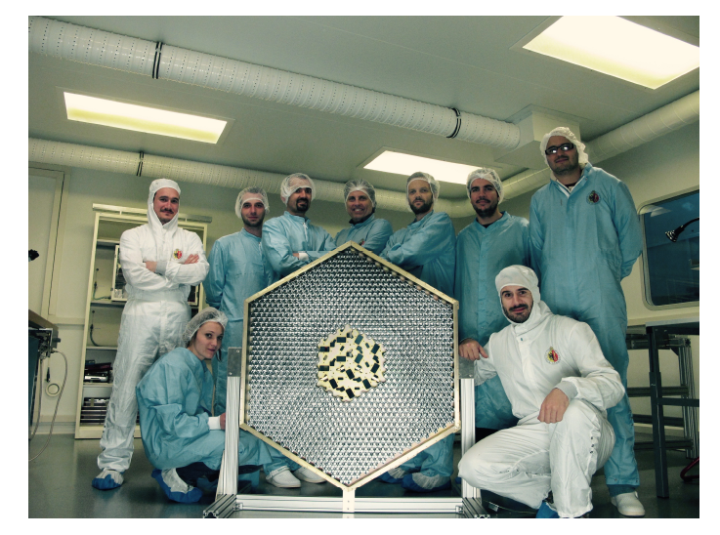
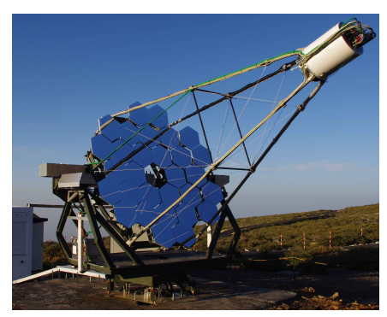
Why choose SiPM?
Advantages: single photon response, high detection efficiency, high gain at low bias voltage，no aging due to light exposure and no sensitive to magnetic fields.
Because SiPM not aging due to light exposure, SiPM-based camera can be operated in moon conditions, thus achieve a longer exposure time than PMT-based camera. The exposure time of SiPM-based camera is about 30%, while the PMT is only 10%.
The first G-APD Cherenkov telescope (FACT): La Palma, Canary Islands, Spain，2011
CTA: High energy Cherenkov telescopes (Single mirror small size telescope), Schwarzschild-Couder telescope
A SiPM camera prototype of CTA
FAST

Slide 5
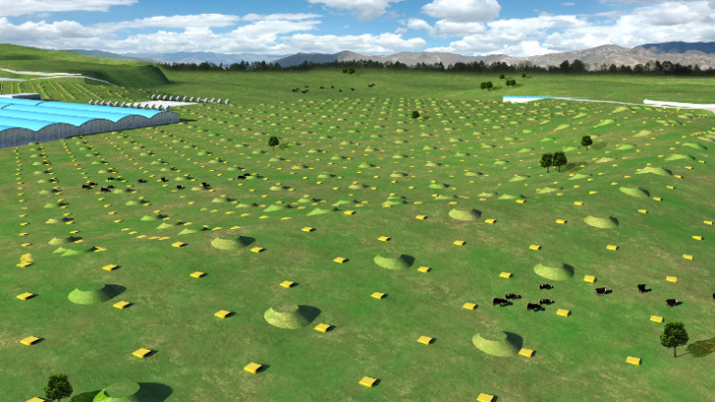
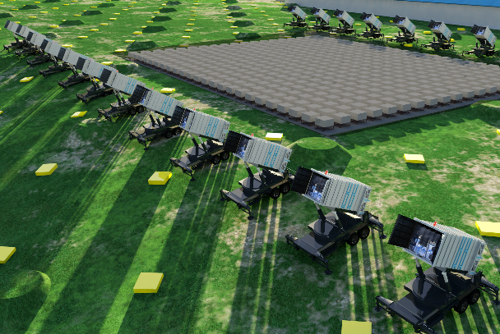
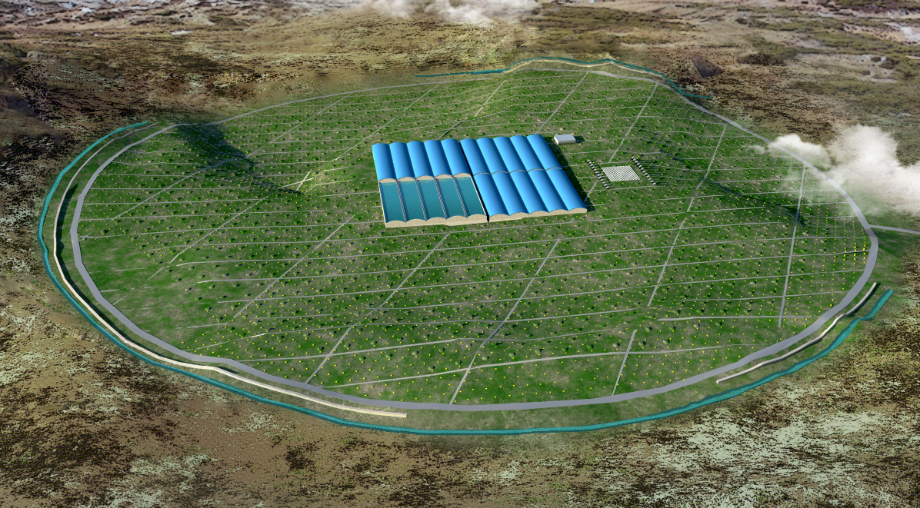
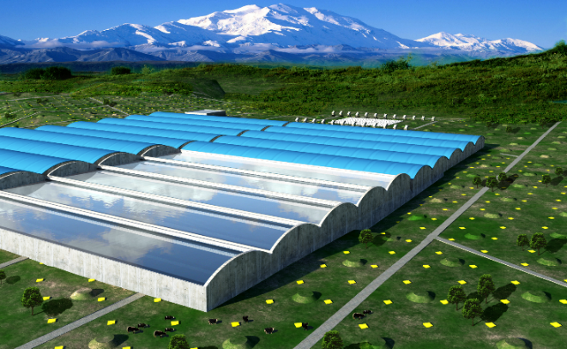
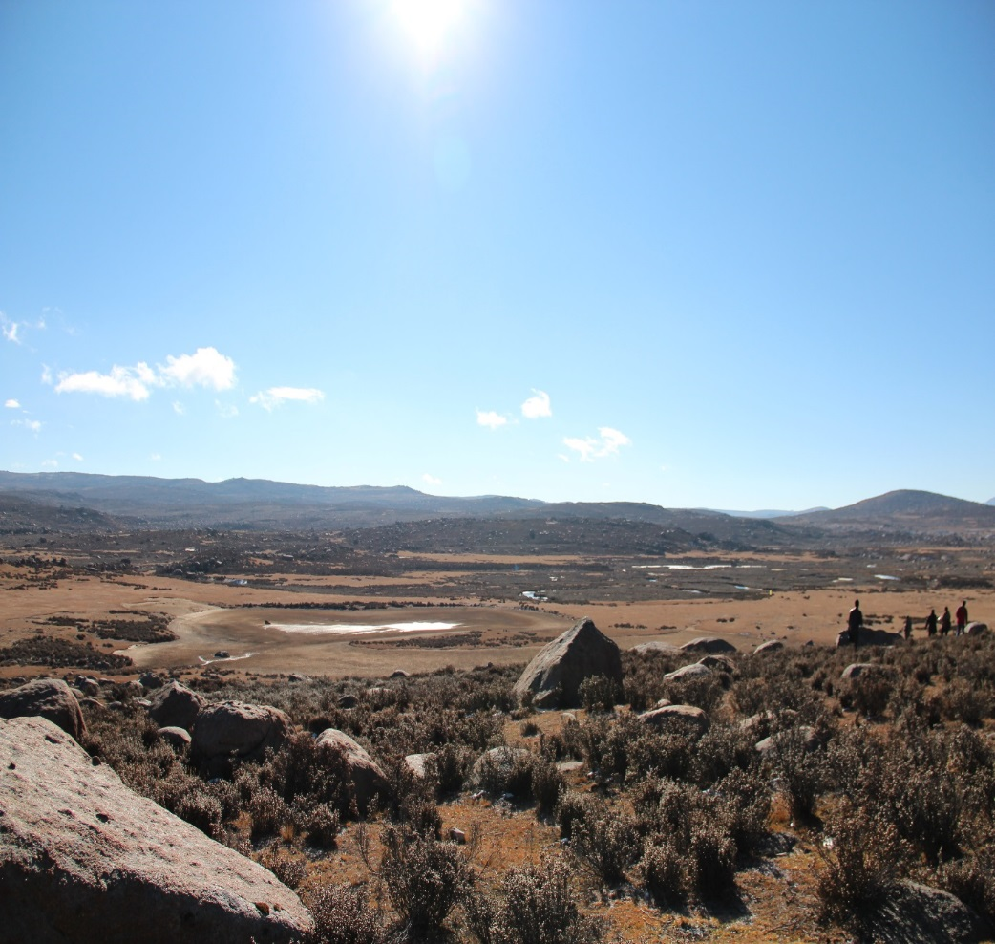
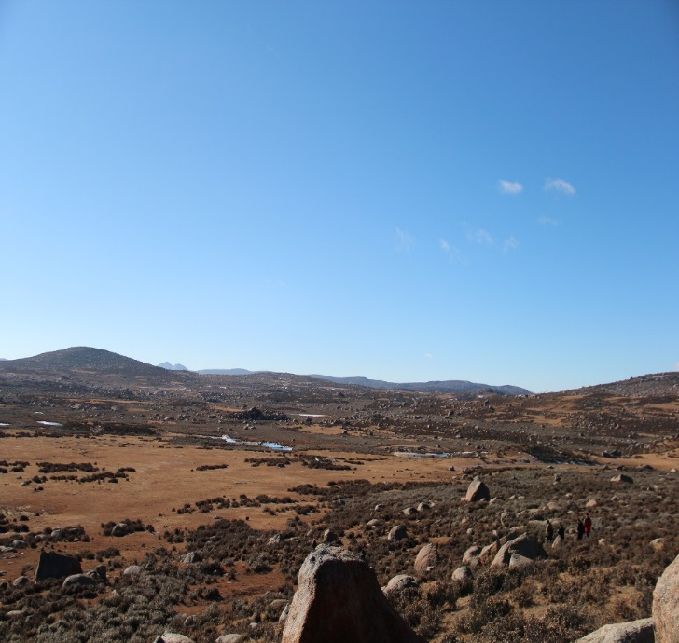
LHAASO
KM2A:
5195 EDs
1171 MDs
WFCTA:
18 Cherenkov telescopes (1024 pixels/telescope)
WCDA:
3000 cells (25m²/cell)
Daochen, Sichuan (29º21’ 31” N, 100º08’15” E, 4410 m a.s.l., 600 g/cm)

Slide 6
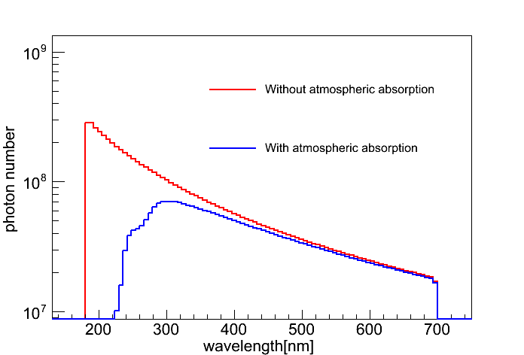
LHAASO-WFCTA vs. CTA
 | CTA-SSTs | LHAASO-WFCTA
Energy range | 5 TeV – 300 TeV | 30 TeV – 1 EeV (Cherenkov mode: 30TeV – 10 PeV, 10PeV-100PeV; Fluorescence mode: > 100PeV)
Diameter of mirror | ~ 4 m | ~ 2.3 m
Pixel size | ~ 0.25 | ~ 0.5
Number of pixels | 1296 | 1024
Dynamic range | 1 pe - 2000 pe | 10 pe – 32000 pe
Light pulse duration | 6 ns - 50 ns | 6 ns - 3 μs
Observation mode | Cherenkov light | Cherenkov and Fluorescence light
Air shower Cherenkov light spectrum
Fluorescence light spectrum

Slide 7
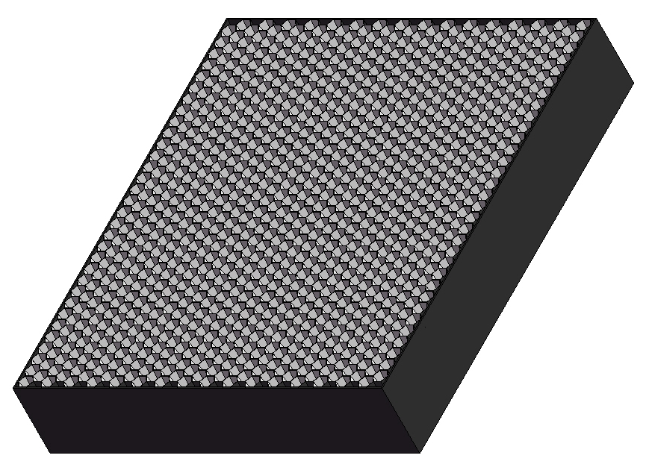
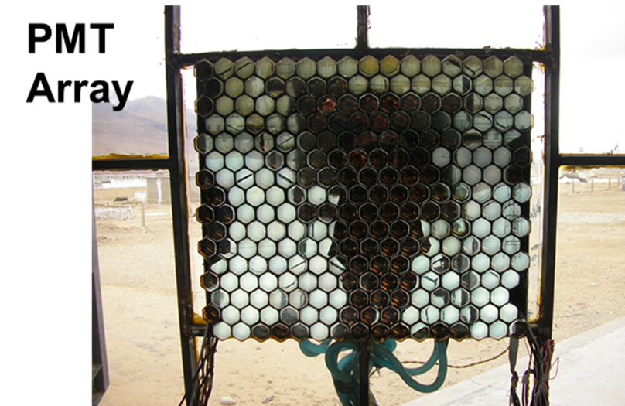
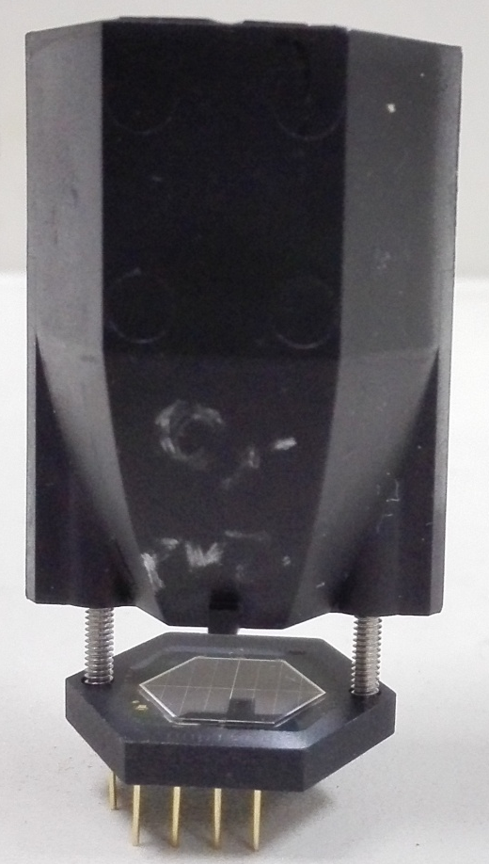
Wide Field of View Cherenkov Telescope (WFCTA)
5m² spherical mirror；
32×32 SiPMs array
Pixel size 0.5°；
FOV: 14°× 16°.
instead of
SiPM camera
A prototype of WFCTA

Slide 8
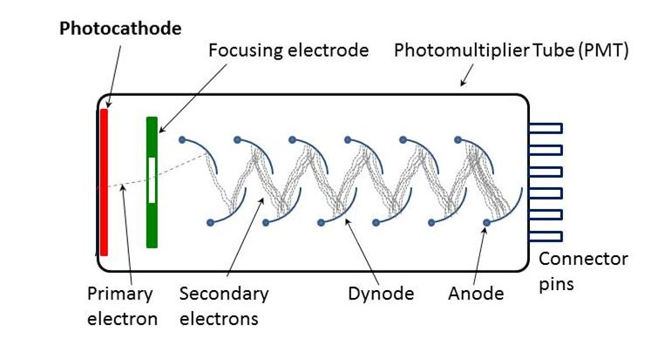
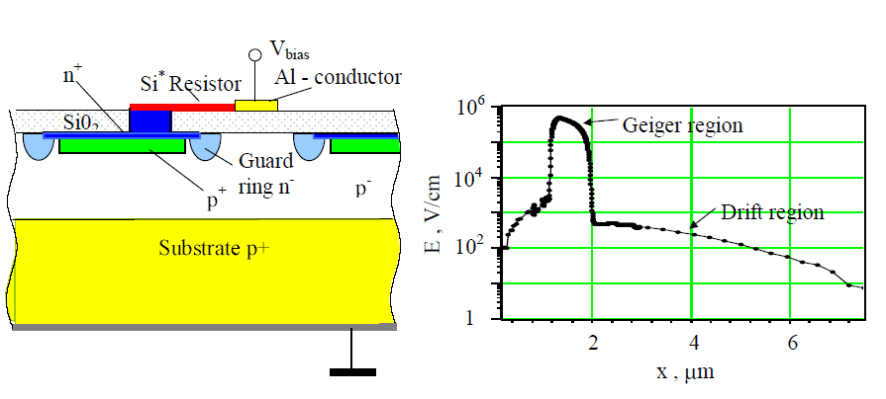
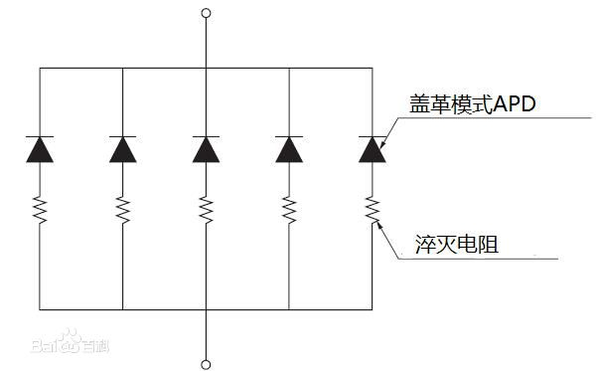
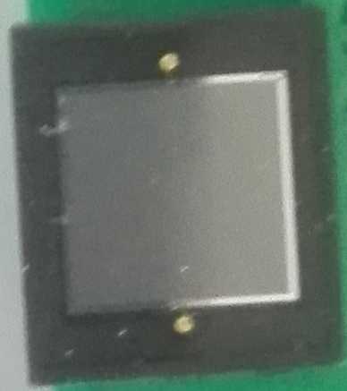
PMT：
SiPM：
Is made of an (APD + quenching resistor ) array
APD: operates in Geiger mode, the output signal is 0 and 1 analog signal
APD size: 15 μm – 100 μm
1600 APDs/mm² （25μm）

Slide 9
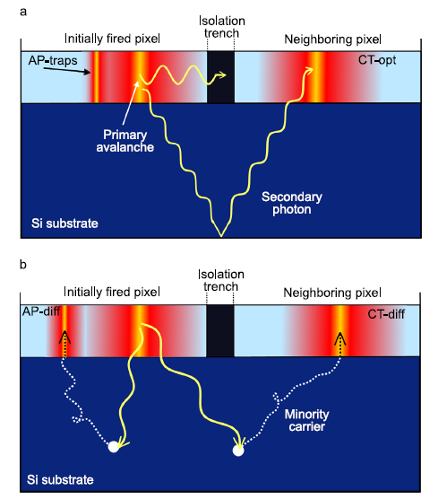
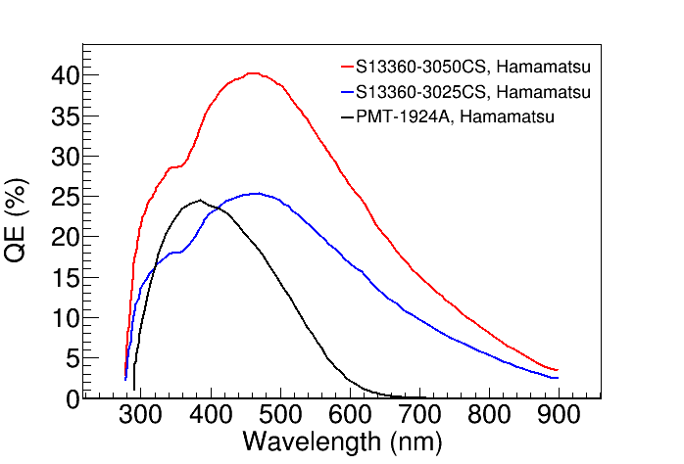
Optical Cross talk & After pulse
PDE=Qe(APD) × fill factor
PDE
Fill factor=74%
Qe
Fill factor=47%

Slide 10
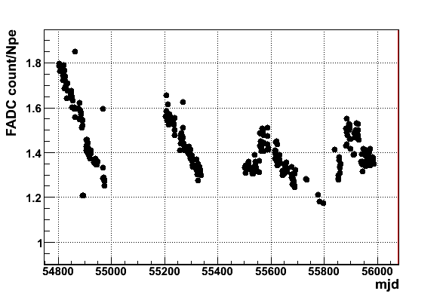
 | SiPM | PMT
Dynamic range | Proportional to total number of APD cells | Dependent on PMT type, HV distribution and readout method
Photon counting | Yes | No
Charge resolution | 12-13%@100pe，4%@1000pe | 12%@100pe, 4%@1000pe
Pulse duration | 20 - 50 ns | ~6 ns
Dark count rate | 80 kHz/1 mm² @ thrd=0.5 pe | <1kHz @ thrd=0.5 pe
Aging | No aging | Aging
Magnetic fields | No sensitive | Sensitive
Gain | 1×10⁶ @ several tens volts | 1×10⁶ @ >1000 V
Temperature | ~1.5%/℃ | ~0.2%/℃
Optical cross talk | 3% - 15% | No
PMT aging with time
LHAASO-WFCTA prototype (PMT array)

Slide 11
LHAASO-WFCTA SiPM camera R&D
Performance of SiPM
  SiPM candidates: HAMAMATSU and FBK
  Dynamic range： 10 pe – 32000 pe
  Charge resolution
  The long light pulse response： 6 ns - 3 μs
  Gain vs. temperature
  Dark count rate
SiPM array design
  Square SiPM array
  Hexagonal SiPM array
Cluster

Slide 12
FBK vs. Hamamatsu
 | FBK (25 μm) | Hamamatsu （25 μm）
PDE | 36%@400 nm | 23%@400 nm
Fill factor | 72% | 47%
Dark count rate | ~80kHz/mm² | ~50k/mm²
Optical cross talk | ~15% | ~1%
Gain | ~2×10⁶ | ~0.7×10⁶
Break down voltage | ~26.5V | ~53V
Gain vs. temperature | ~1.5%/℃ | ~1.5%/℃
Break down voltage vs. temperature | ~26 mv/℃ | ~54 mv/℃

Slide 13
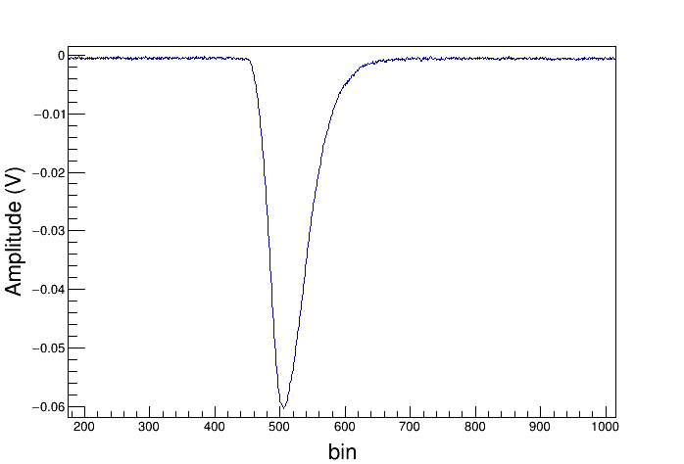
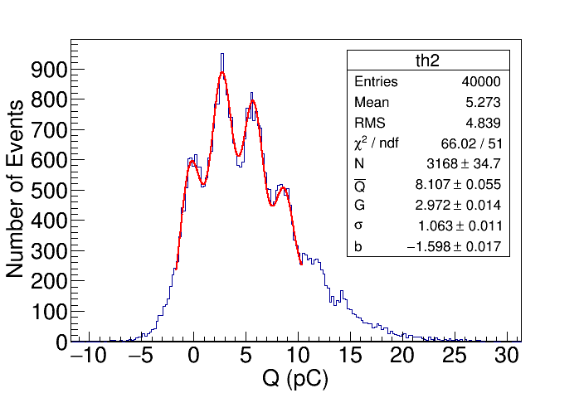
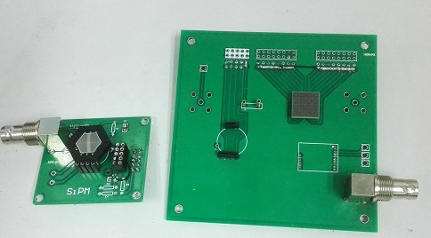
HAMAMASTU
v_{cc}
R0
C1
R2
Pulse duration
~43ns
SiPM
Output
-
+
(ns)
SiPM testing board
CTA customized hexagonal SiPM
Commercial：
12 mm×12mm
Low light intensity response

Slide 14
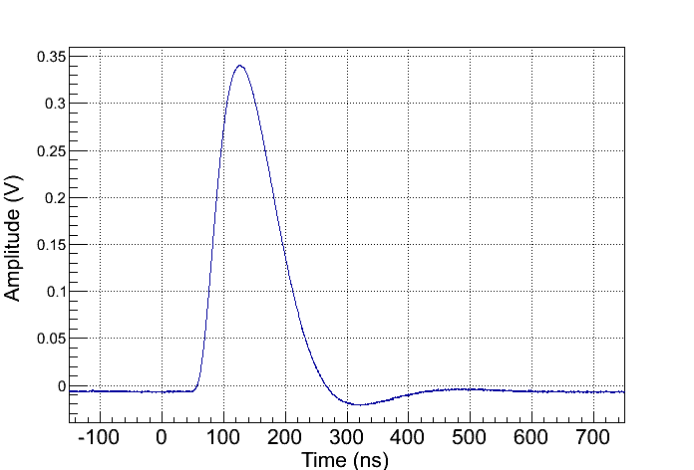
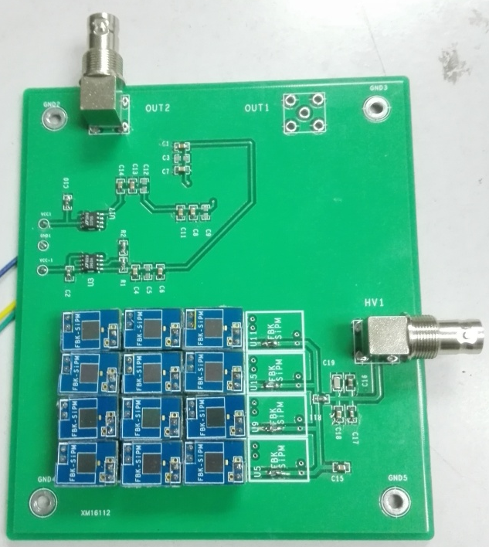
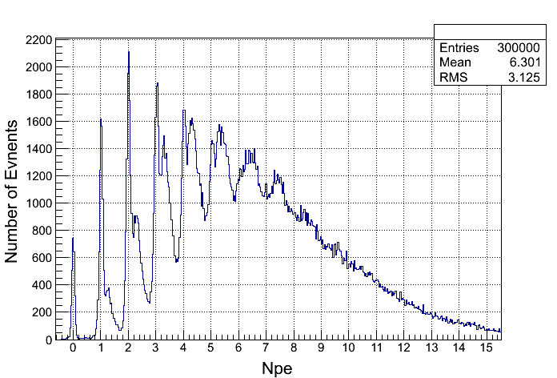
v_{cc}
R0
C1
R3
Pulse duration
~100 ns
SiPM
R2
-
+
R1
OPA 846
Low light intensity response
12 pieces× 5mm×5mm=300 mm²
SiPM & pre-amplifier board

Slide 15
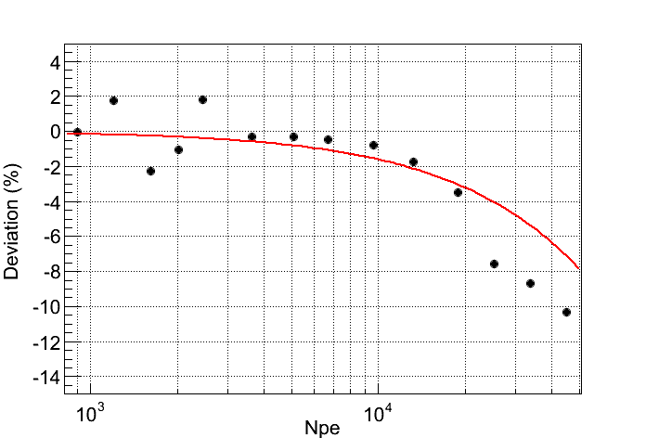
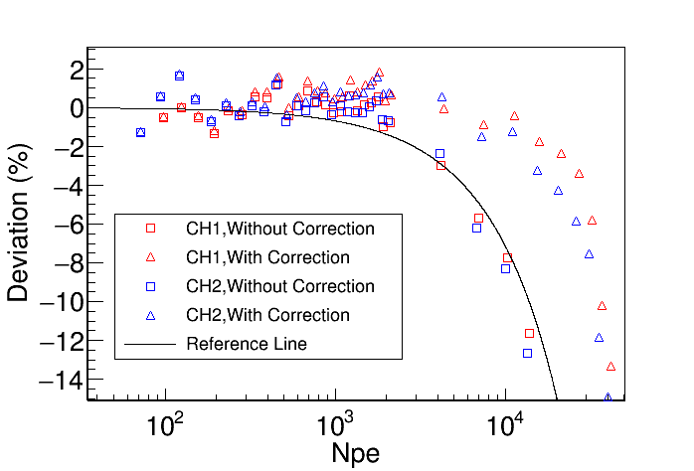
FBK: 25mu
12×5 mm×5 mm
  HAMAMASTU: 12 mm ×12 mm
N_{cell} =57,600，50 μm
N_{cell} =480,000，25 μm
The dynamic range of the SiPM is proportional to the total number of cells.
  At least 200,000 cells is required for 32,000 pe.
  Larger area SiPM has a bigger DCR.
  The small cell pitch: will produce small fill factor and then small PDE.

Slide 16
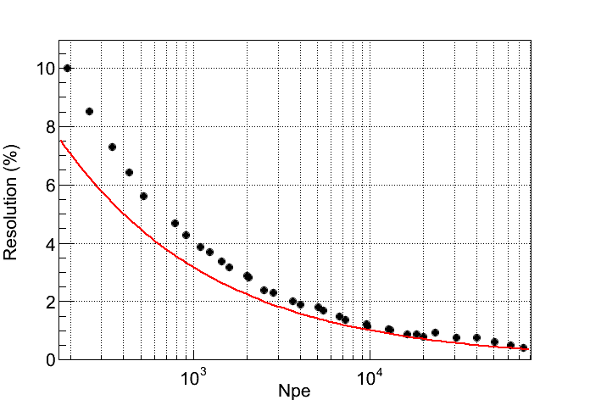
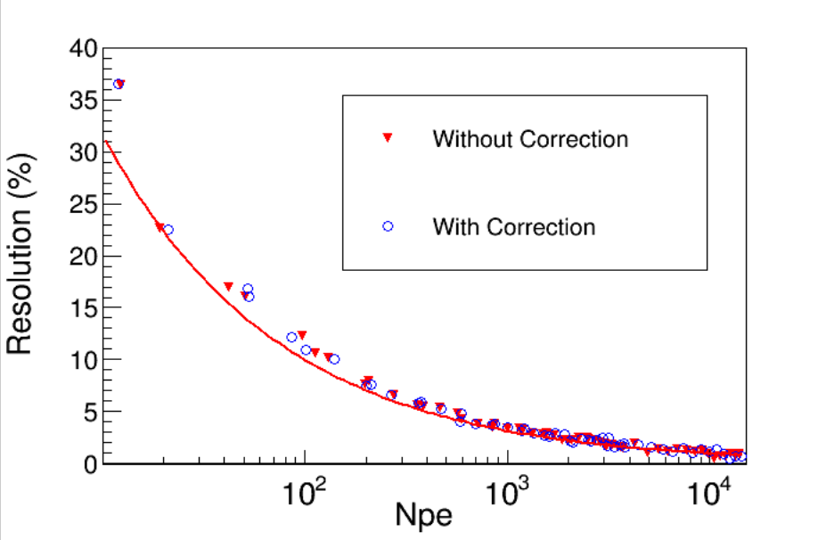
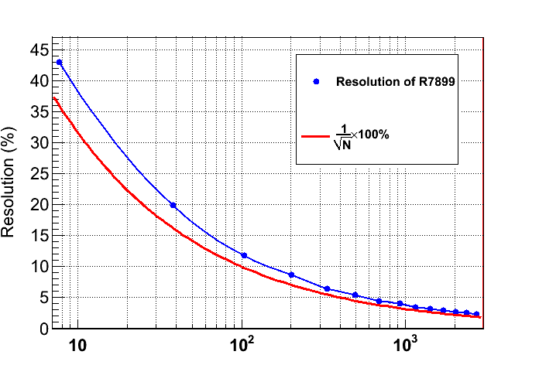
  HAMAMASTU: 12 mm ×12 mm
FBK: 25mu
12×5 mm×5 mm
PMT
Charge resolution:
  SiPM: 12-13%@100pe, 4%@1000pe
  PMT: 12%@100pe, 4%@1000pe

Slide 17
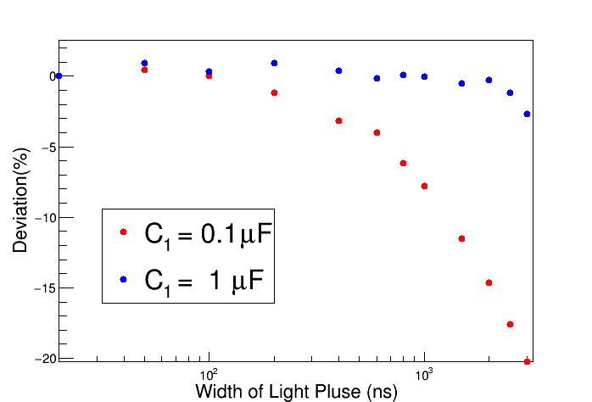
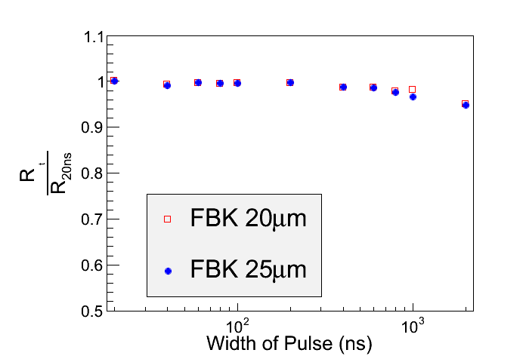
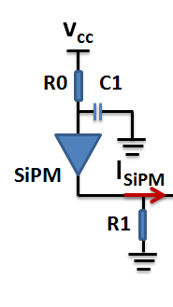
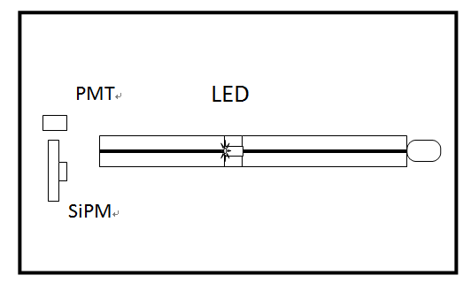
The long light pulse response
C1=1 μF
  HAMAMASTU
The relative deviation is less than 3% with C1=1 μF.

Slide 18
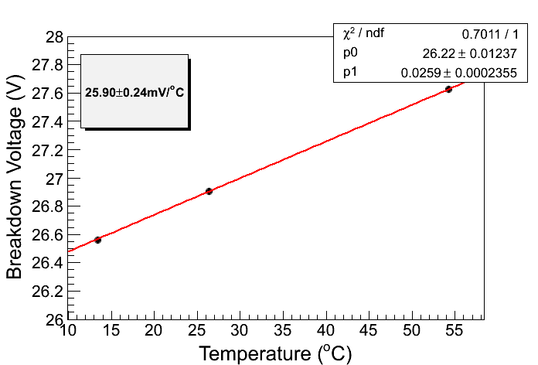
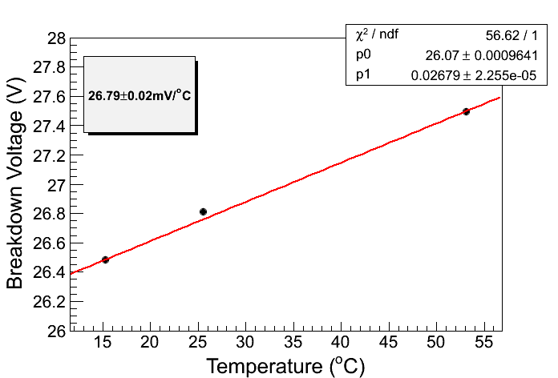
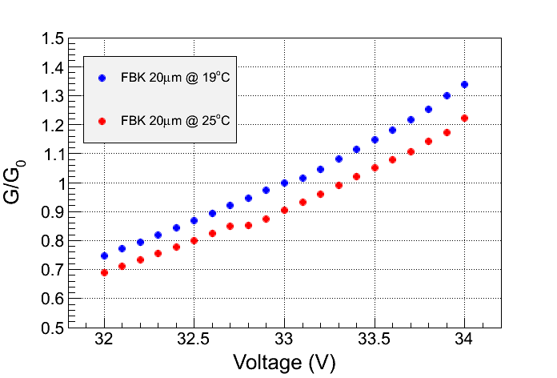
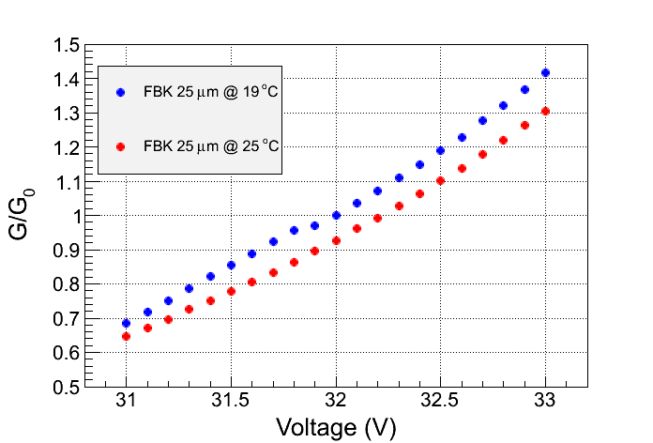
20μm
25μm
20μm
25μm
Breakdown voltage vs. temperature: ~26 mv/℃
Gain vs. temperature：~1.5%/ ℃

Slide 19
LHAASO-WFCTA SiPM camera R&D
Performance of SiPM
  SiPM candidates: HAMAMATSU and FBK
  Gain vs. temperature
  Dynamic range： 10 pe – 32000 pe
  Charge resolution
  The long light pulse response： 6 ns - 3 μs
  Dark count rate
SiPM array design
  Square SiPM array
  Hexagonal SiPM array
Cluster

Slide 20
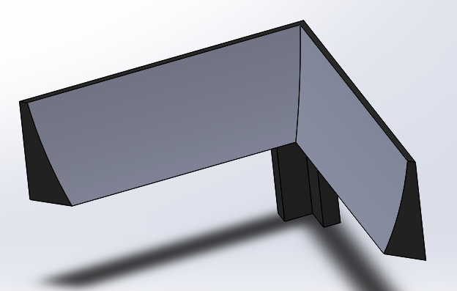
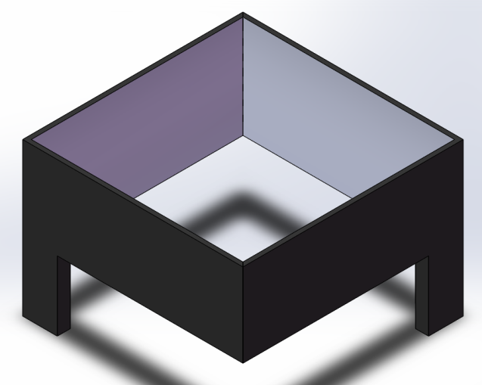
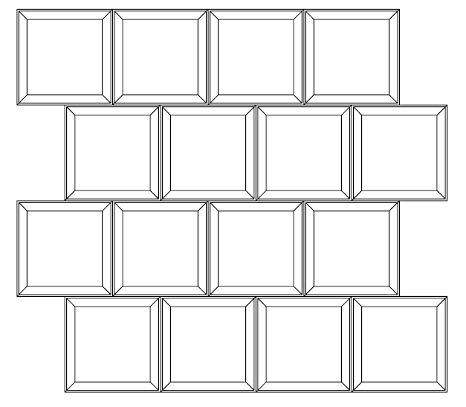
  Square SiPM array：20 mm×20mm
0.9
0.8
Pixel size: 25.4 mm × 25.4 mm
SiPM size: 20 mm × 20 mm
0
10
20
30
40
50
60
EXIT：20mm×20mm
ENTRANCE:24.4mm×24.4mm
HEIGHT:9.6mm

Slide 21
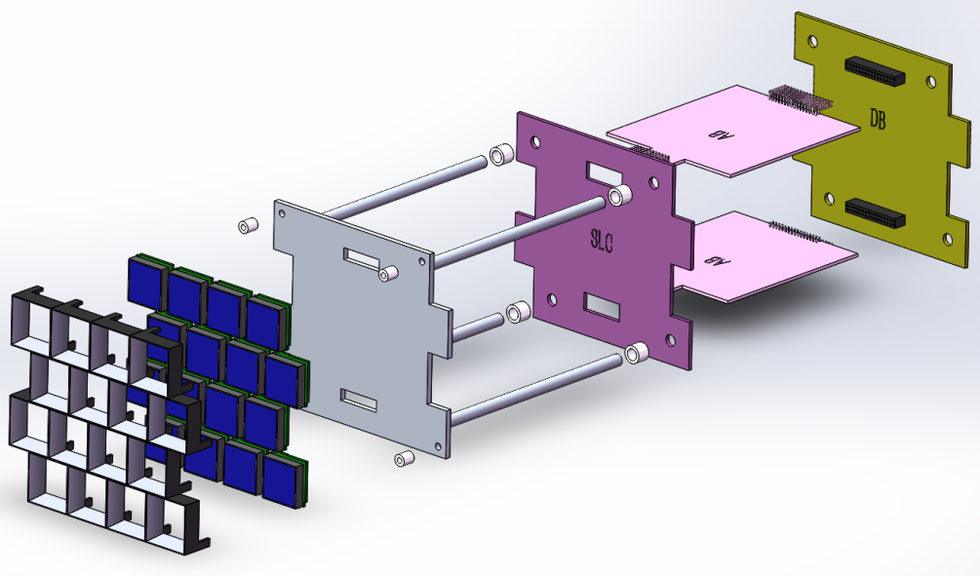
  Square SiPM array：20 mm×20mm
Slow control board
Analog Board
Digital Board
Metal frame
SiPM board
Winston cone
Light concentrator: is to increase the effective area of the SiPM
SiPM base board: 16 SiPMs, 16 temperature sensors (embedded in the SiPM chip ), and 16 pre-amplifiers
Slow control board:
  16 temperature and high voltage compensation loops;
  16 channels of high voltage power supply.
Analogue board: 16 channels of amplifier (high gain and low gain) and shaping circuit
Digital board: 50 MHz FADC and FPGA

Slide 22
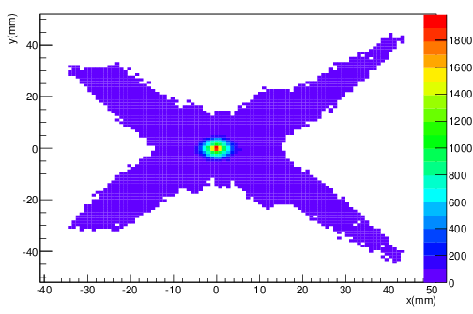
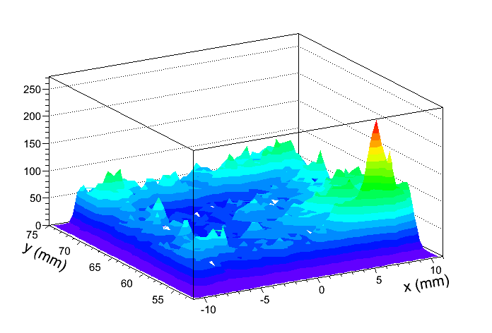
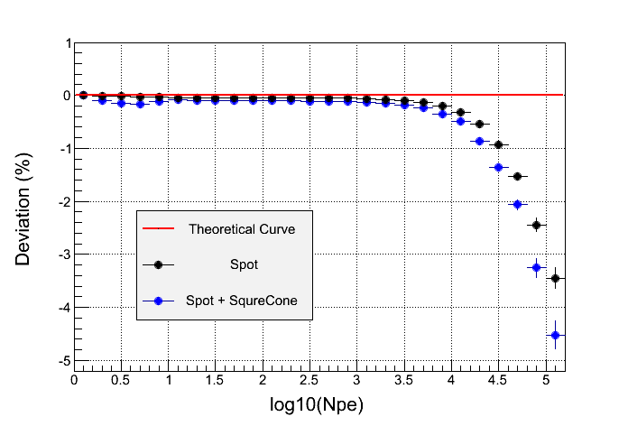
Light spot from the reflective mirror
Light distribution output from the cone
Estimate the non-linearity from the nonuniform light distribution cause by the light spot and the light concentrators

Slide 23
16 ×
Data
DB
Trigger & Data Buffer & Communication Board
4 × 4 SiPMs & Preamplifiers
Low
gain
50M 14 bit FADC
FPGA
Single trigger
Synchronizing
High
gain
50M 14 bit FADC
Event trigger
Temperature
High
voltage
AB
Slow Control Board
BDB
64 ×
The architecture
of SiPM camera
readout electronics
TCP/IP
Low voltage power supply
Switch
TCP/IP
Service
SiPM pulse duration：20 ns – 50 ns

Slide 24
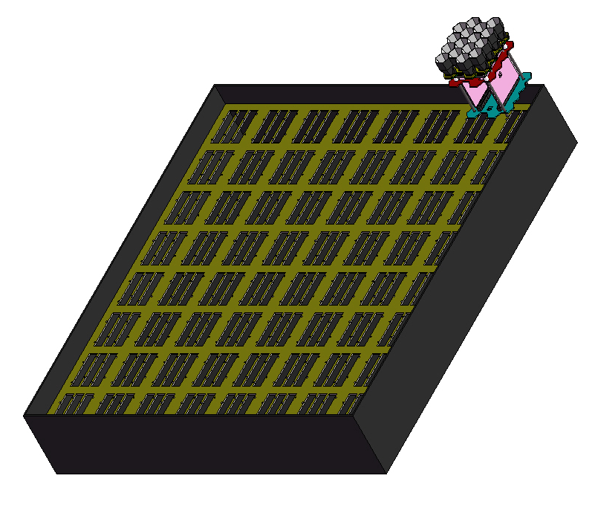
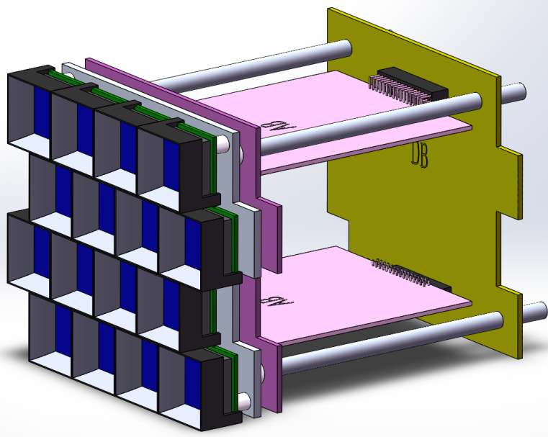
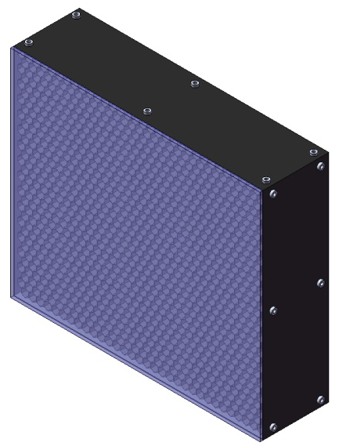
Schematic diagram of SiPM camera assembly
64 ×
AB2
AB1
Cluster
A module has 4×4 SiPMs.
SiPM camera box
DB
SiPM camera：32×32 SiPMs
Optical filter

Slide 25
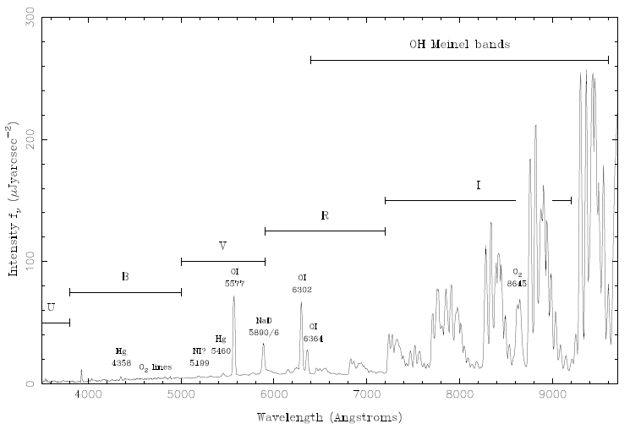
Sky background light spectrum
in the moon less night

Slide 26
Data from Geneva University group

Slide 27
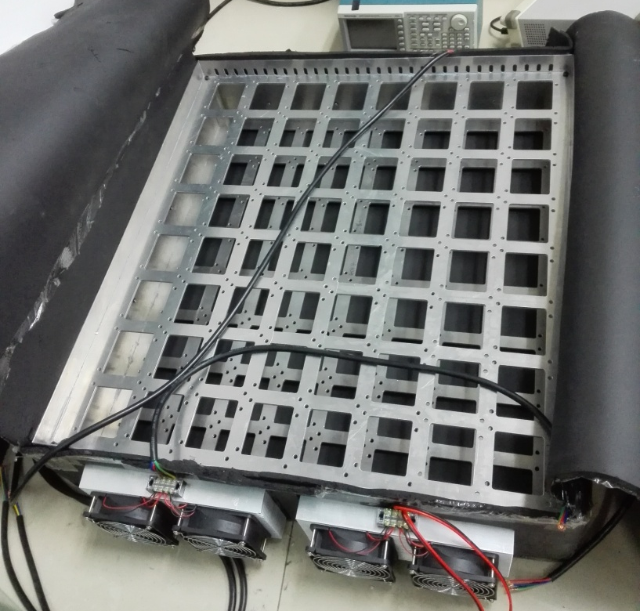

Cooling System
Aluminum alloy framework
Refrigeration semi-conductor

Slide 28



  Hexagonal SiPM array
13.28 mm
7.2 mm
Effective
photosensitive
area

Slide 29



Schematic diagram of SiPM camera assembly
Digital board
Entrance window: Side to side length is 25.4 mm
Exit window: Side to side length is 12.12 mm
Slow control board
metal frame
light concentrators
Analogue board
SiPM base board
A module has 4×4 SiPMs.
Light concentrator: is to increase the effective area of the SiPM
SiPM base board: 16 SiPMs, 16 temperature sensors (embedded in the SiPM chip ), and 16 pre-amplifiers
Slow control board:
  16 temperature and high voltage compensation loops;
  16 channels of high voltage power supply.
Analogue board: 16 channels of amplifier (high gain and low gain) and shaping circuit
Digital board: 50 MHz FADC and FPGA

Slide 30






8°
0°

Slide 31


Light spot from the reflective mirror
Light distribution output from the cone
Estimate the non-linearity from the nonuniform light distribution cause by the light spot and the light concentrators

Slide 32

Schematic diagram of SiPM camera assembly
64 ×
AB2
AB1
Cluster
A module has 4×4 SiPMs.
SiPM camera box
DB
SiPM camera：32×32 SiPMs
Optical filter

Slide 33
16 ×
Data
DB
Trigger & Data Buffer & Communication Board
4 × 4 SiPMs & Preamplifiers
Low
gain
50M 14 bit FADC
FPGA
Single trigger
Synchronizing
High
gain
50M 14 bit FADC
Event trigger
Temperature
High
voltage
AB
Slow Control Board
BDB
64 ×
The architecture
of SiPM camera
readout electronics
TCP/IP
Low voltage power supply
Switch
TCP/IP
The SiPM gain (break down voltage) is sensitive to the temperature.
Slow Control Board: temperature & high voltage compensation loop.
Service

Slide 34
Three proposals of SiPM array
 | Square SiPM 20mm×20mm | Hexagonal（side length=7.2mm） | Square SiPM 12mm×12mm
SiPM | Collaboration with INFN (FBK) | Hamamatsu（customized） | Hamamatsu（commercial）
PDE | 36%@400 nm | 23%@400 nm | 23%@400 nm
Fill factor | 72% | 47% | 47%
Inlet to outlet ratio of Winston cone | 1.49 | 4.42 | 4.13
Cell size | 25μm | 25μm | 25μm
Area | 400 mm² | 134.7 mm² | 144 mm²
Relative deviation | 4%@32000pe | 4%@32000pe | 5%@32000pe
Charge resolution | 13%@100pe | 12%@100pe | 12%@100pe
Dark count rate | 32 MHz | 7MHz | 7.2MHz
Sky background noise | ~46 MHz | ~30 MHz | ~30 MHz

Slide 35

Relative PDE
25 μm
-cross talk
 | FBK (25 μm) | Hamamatsu （25 μm） | PMT
Relative PDE | 36%@400 nm | 23%@400 nm | 16%@400 nm
20 mm×20 mm （400 mm²） : ~46 MHz vs. 32MHz
Hexagonal （~135 mm²） ：30M vs. 7MHz

Slide 36
Conclusion and discussion
Three proposals of SiPM array are designed and can meet the requirements of LHAASO-WFCTA
  First choice: Square 20 mm× 20 mm SiPM array
  Backup choice:
    Square 12 mm × 12 mm SiPM array
    Hexagonal SiPM array
FBK SiPM vs. Hamamatsu SiPM
  FBK: better PDE but worse DCR
  Hamamatsu: worse PDE but better DCR
  Both of them can meet the requirements of LHAASO-WFCTA

Slide 37
Thank you for your attention!

Slide 38
Aluminum alloy framework
Refrigeration semi-conductor

Slide 39




Slide 40
SiPM specifications for LHAASO-WFCTA
parameter | requirement
PDE | >25%@400nm, >20%@350nm, >10%@310nm;
Wavelength range | 300 nm – 550 nm
Dynamic range | 10 pe – 32000 pe
Cell Size | 25μm or 35 μm
Number of cell size | > 200,000
Charge Measurement Precision | <45% @ 10 photoelectrons, <15%@100 photoelectrons, <5%@ 1000 photoelectrons;
Dark noise counting rate | <90k/mm^2 @ threshold=0.5pe @ 25℃;
Form Factor | Hexagon or square

Slide 41




  I-V curve for breakdown voltage and quenching resistor
Linear fit
Breakdown voltage: 53.3 mv/℃
Gain: ~1.5%/℃

Slide 42



SiPM candidates from Italy
From the paper of
Claudio Piemonte
in Fondazione Bruno Kessler (FBK), Italy
Cross talk: ~6%
The PDE of 15 μm cell pitch is about 29%, the PDE of 20 μm cell pitch is about 34%, when the dark count rate is around 60 kHz. The PDE and DCR of these two devices can fit our requirements. We also pursue a higher PDE under the condition that the dynamic range satisfies the requirement. So, I prefer to the 20 μm cell pitch.
1 mm²
1 mm²
4 ×4 mm²
1 mm²
The fill factor is improved by the narrow guard region around the SPAD.

Slide 43





Slide 44




cross talk

Slide 45
SiPM
Hexagonal （side length=7.2） | 134.68 mm²
DCR | ~7 MHz
PDE | 23%@400 nm
Dynamic range | 10 pe – 32000 pe
Relative deviation | <2%@ 8000 pe, 11%@32000pe; after correction: <4%@32000pe
Charge resolution | 12%@100pe，4%@1000pe
Gain | ~7×10⁵
Gain vs. temperature | ~1.5%/℃
Sky background noise：~30 Mhz vs. 7MHz

Slide 46
SiPM
Area | 20mm×20mm=400 mm²
DCR | ~32 MHz
PDE | 36%@400 nm
Dynamic range | 10 pe – 32000 pe
Relative deviation | <2%@ 10000 pe, 6%@32000pe; after correction：<4%@32000pe
Charge resolution | 13%@100pe，4%@1000pe
Gain | ~2×10⁶
Gain vs. temperature | ~1.5%/℃
Sky background noise： ~46 Mhz vs. 32MHz

Slide 47




12 pieces 5mm×5mm，25μm
V_{brk} vs. T：
31 - 26 mv/℃
DCR：2MHz/25mm²
=80kHz/mm²
Break down voltage
G=2×10⁵ @ 33V

