Slide 1

Inverse Compton Sources, Overview, Theory, Main Technological Challenges – Photonic Colliders
Luca Serafini – INFN-Milan and University of Milan
4 Lecture Outline
Overview of Projects/Proposal for ICS’ and Applications
Classical e.m. and Linear Quantum Theory of Inverse Compton Sources (ICS) and Paradigms for ICS
Photon-Photon Colliders at low energy for Breit-Wheeler and photon-photon scattering experiments
Hadron-Photon Colliders as muon photo-cathodes for TeV photons, neutrino and pion/muon low emittance beam generation

Slide 2
Inverse Compton Sources, Overview, Theory, Main Technological Challenges – Photonic Colliders
New Generation of X/γ ray beams via electron-photon beam collisions for advanced applications in medicine/biology/material science/cultural heritage/national security and fundamental research in nuclear physics and high energy physics (e-γ, γ-γ colliders, pol. e⁺ beams, hadron. physics, etc)
Inverse Compton Sources (ICS) are e⁻/photon colliders aimed at producing secondary beams of photons
Several Test-Facilities world-wide: after a decade of machine test&development we are entering the era of User Facilities in X-ray imaging and γ-ray Nuclear Physics and Photonics

Slide 3
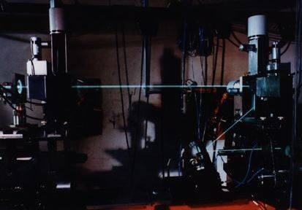
Inverse Compton Sources, Overview, Theory, Main Technological Challenges – Photonic Colliders
Hadronic Physics was the original motivation for Compton back-scattering experiments (cfr. Ladon at INFN-LNF, Graal at ESRF, etc): single photon per bunch collision at energies > 50 MeV with tagging (quite popular decades ago)
Recent Proposals (R.Hajima et al., PRAB 19, 020702, 2016 ) for high flux (5000 / s) GeV photons using FELs and 7 GeV e⁻ storage rings
Combination at this Lab (CERN, SPS and LHC) of TeV-class proton beams and (possible) X-ray FELs ⇒ TeV-class photons (the role in beam-beam collisions of beam phase space quality on TeV photon spectra and fluxes (100 / s))

Slide 4
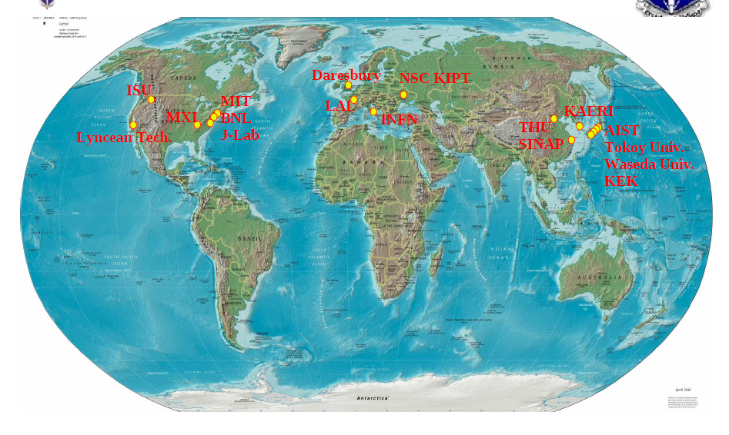
CALA
ELI-NP
HigS
STAR
ICS are the most effective “photon accelerators”
“4γ² boost effect”
Courtesy A. Variola

Slide 5
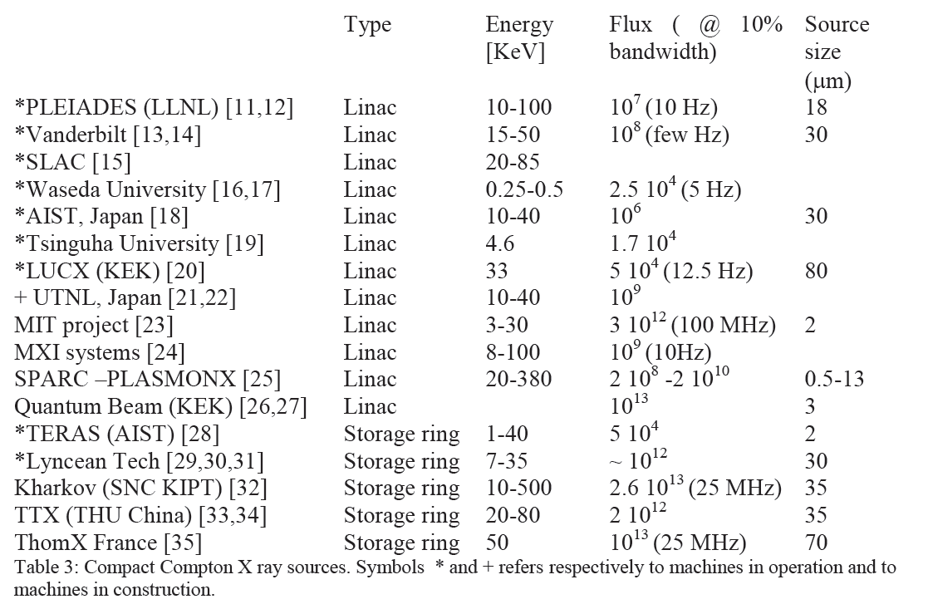
Existing and planned Thomson sources
STAR (Calabria) Linac 20-100 10¹¹ (100 Hz) 18
From THOMX Conceptual Design Report, A.Variola, A.Loulergue, F.Zomer, LAL RT 09/28, SOLEIL/SOU-RA-2678, 2010

Slide 6
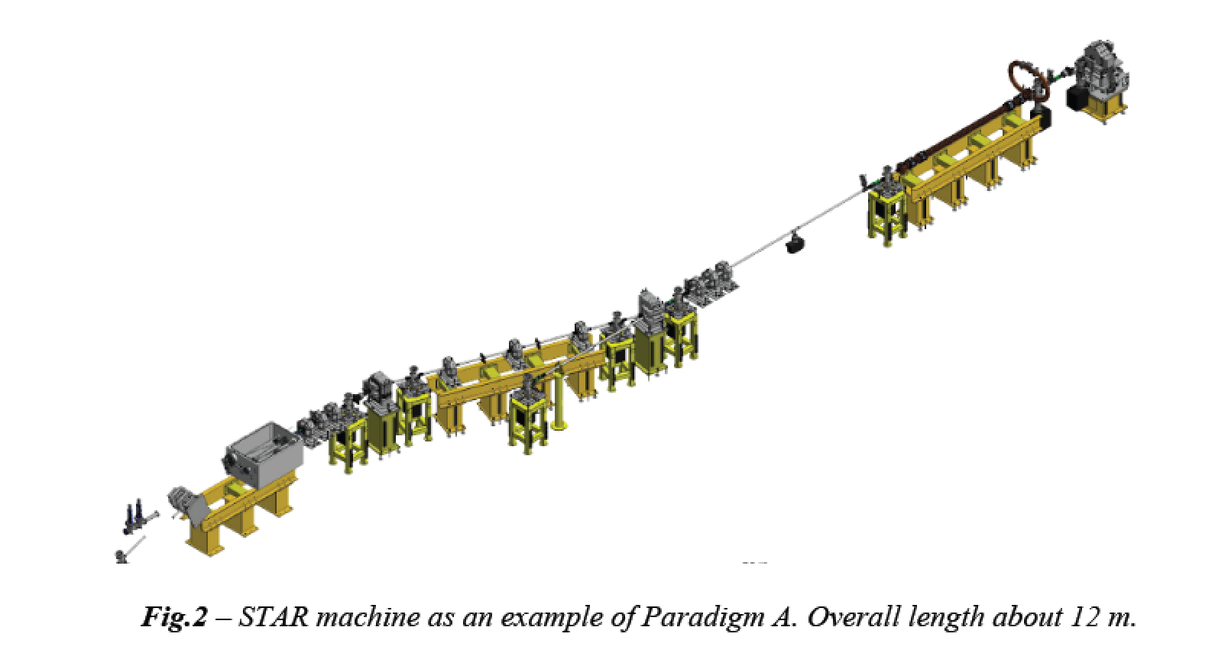
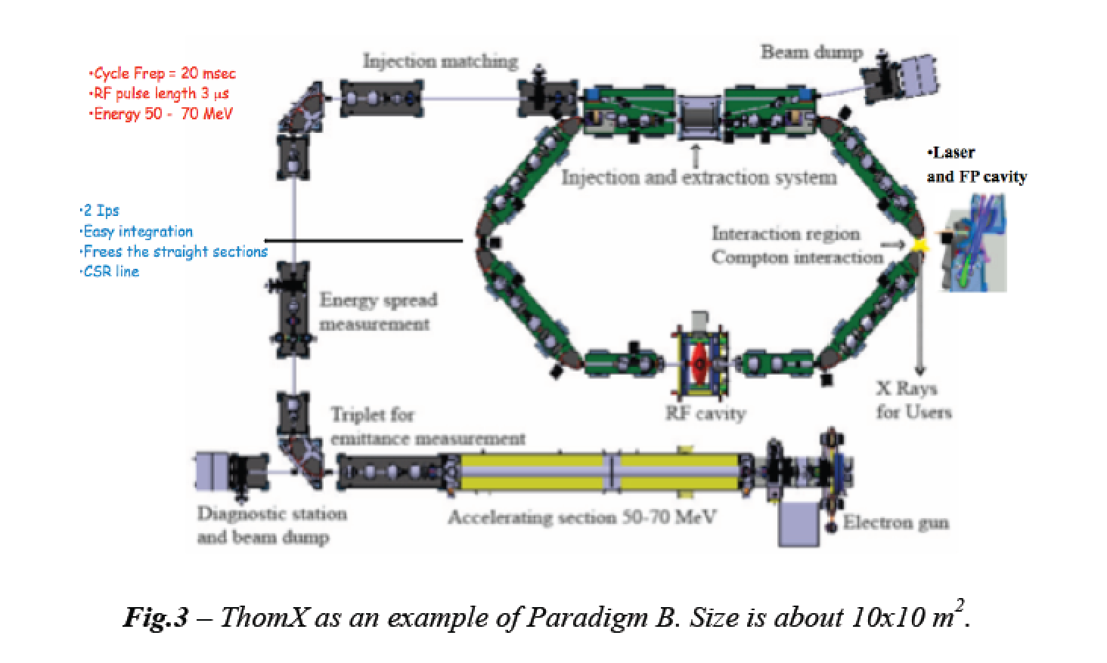
highly asymmetric compact*
electron-photon colliders
*10 m, 10 M$
secondary photon beams via large
lorentz boost of c.m. reference frame
MeV/GeV’s electrons
eV’s photons

Slide 8
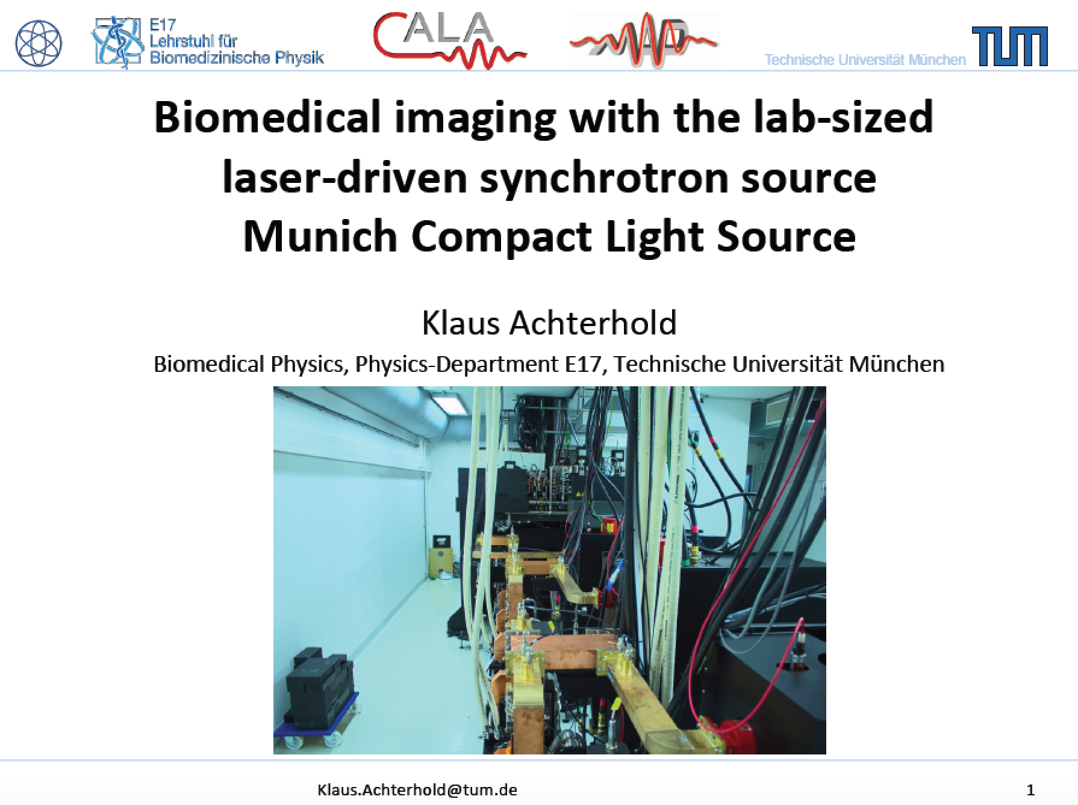
An ICS based X-ray User Facility in operation in Germany
Compact machine
10x10 m²
In operation since
early 2015

Slide 9
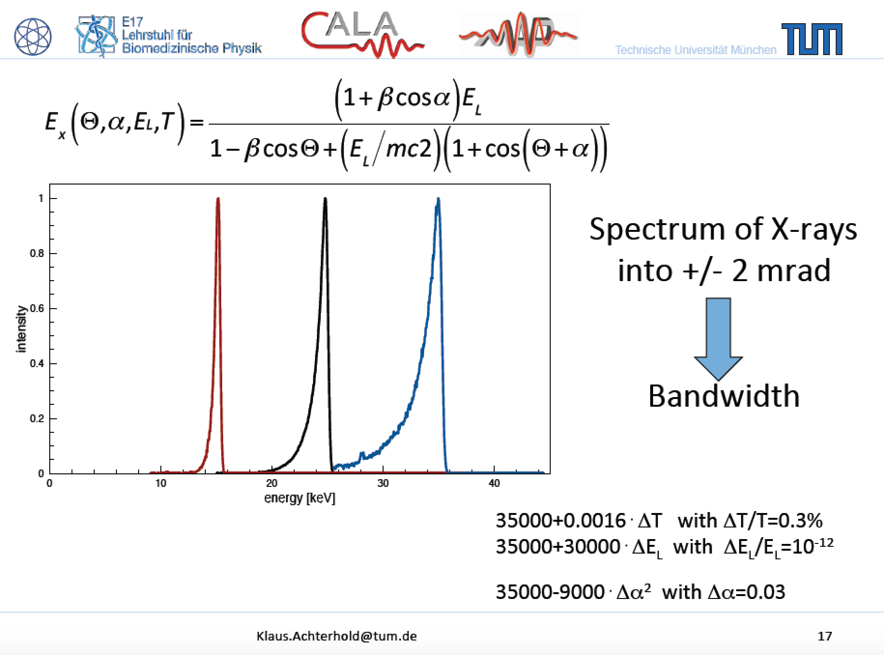
measured
Measured 5.10¹⁰ ph/sec with 20 mA

Slide 10
measured
Measured 5.10¹⁰ ph/sec with 20 mA

Slide 11
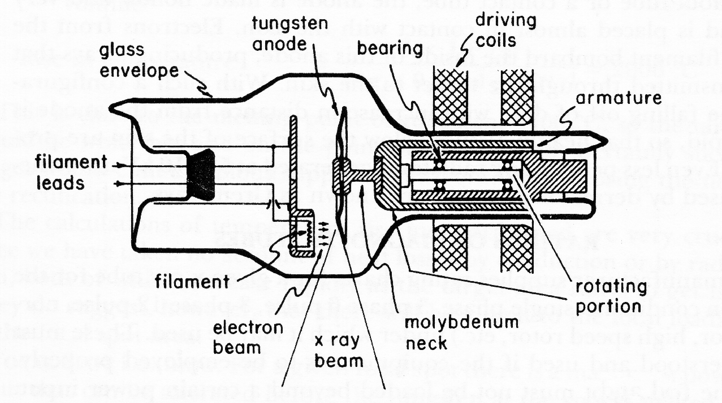
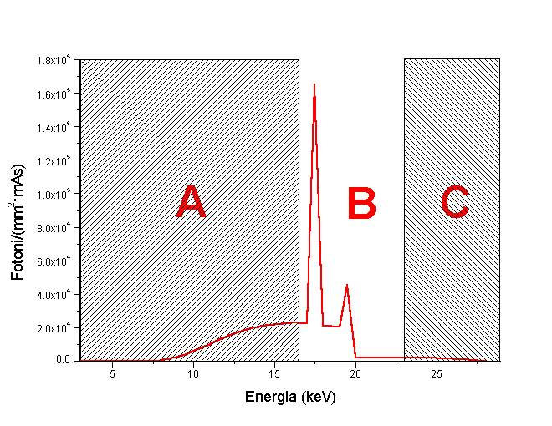
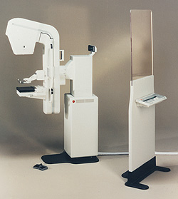
Great example of Radio-logical imaging applied to mass screening over population: mammography
Conventional X-ray tube for mammography
Spatial resolution ~100 μm
High Flux ~10⁷ γ/(mm²s) equivalent to ~5.10¹¹ γ/s over 20x20 cm² area.
Absent in
Thomson
Source
X-ray
spectrum!
65 cm
Low energy photons in the spectrum are absorbed by tissue, delivering radiation dose without bringing informations to detector. Risk of inducing secondary tumors increases without increasing the benefit of detecting early tumors

Slide 12
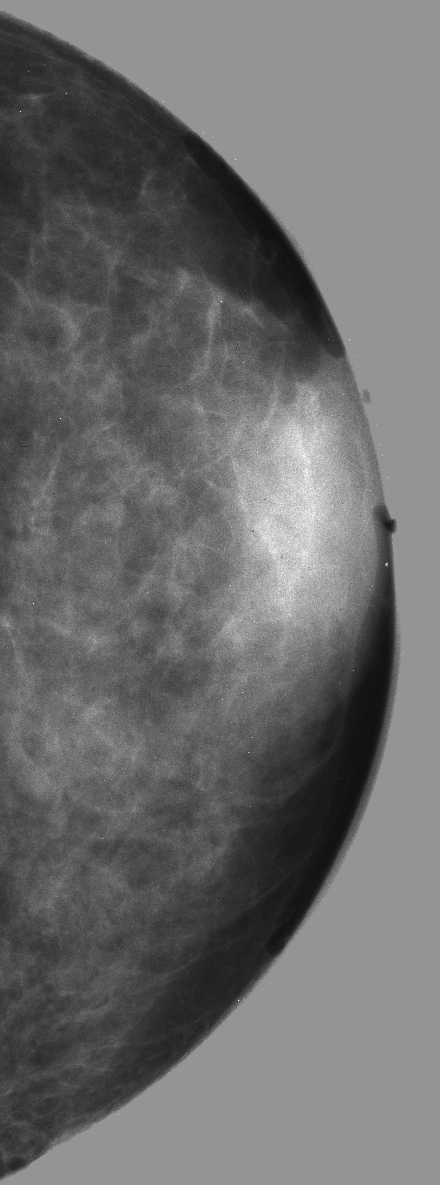
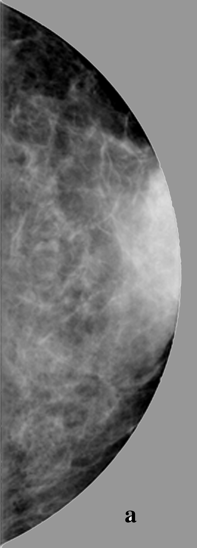

Mammography with Mono-chromatic X-rays at 20 keV has been proven
far superior in Signal-to-Noise-Ratio w.r.t. conventional mammographic tubes,
with a considerably lower radiation dose to the tissue
a) SR digital image
Energy 17 keV
Scan step 100 mm
MGD 1 mGy
Conventional
X-ray tube 26 kVp
MGD 1 mGy
b) SR digital image
Energy 20 keV
Scan step 100 mm
MGD 0.33 mGy
3 cm thick in vitro human breast tissue

Slide 13
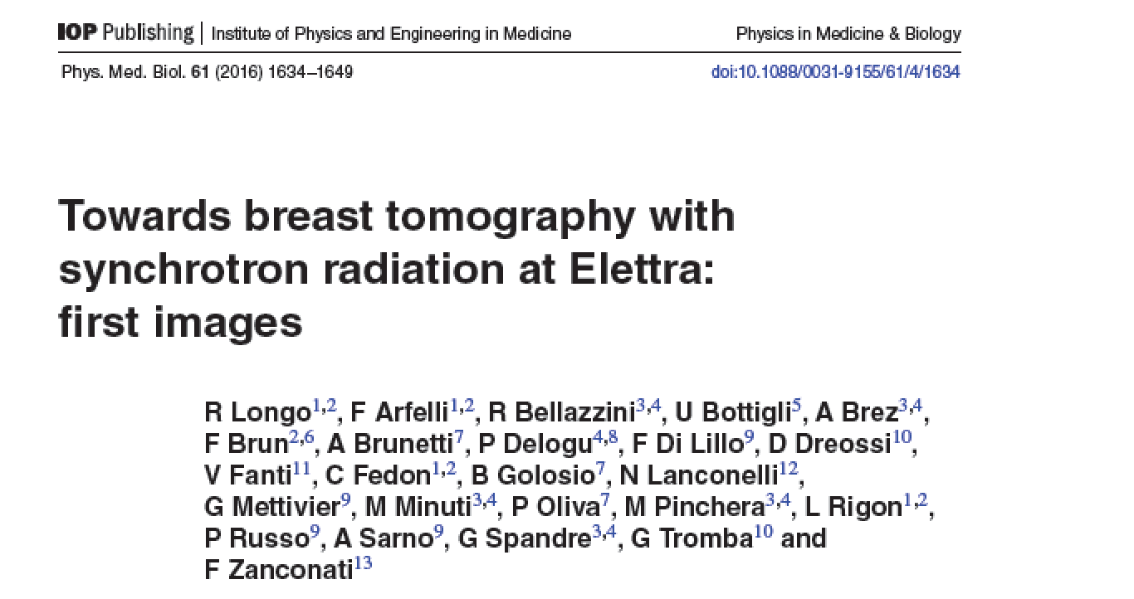
Compact Thomson X-ray Sources could be located inside hospitals to diagnose
and treat patients directly at the hospital site (unlike Synchrotrons…)

Slide 14
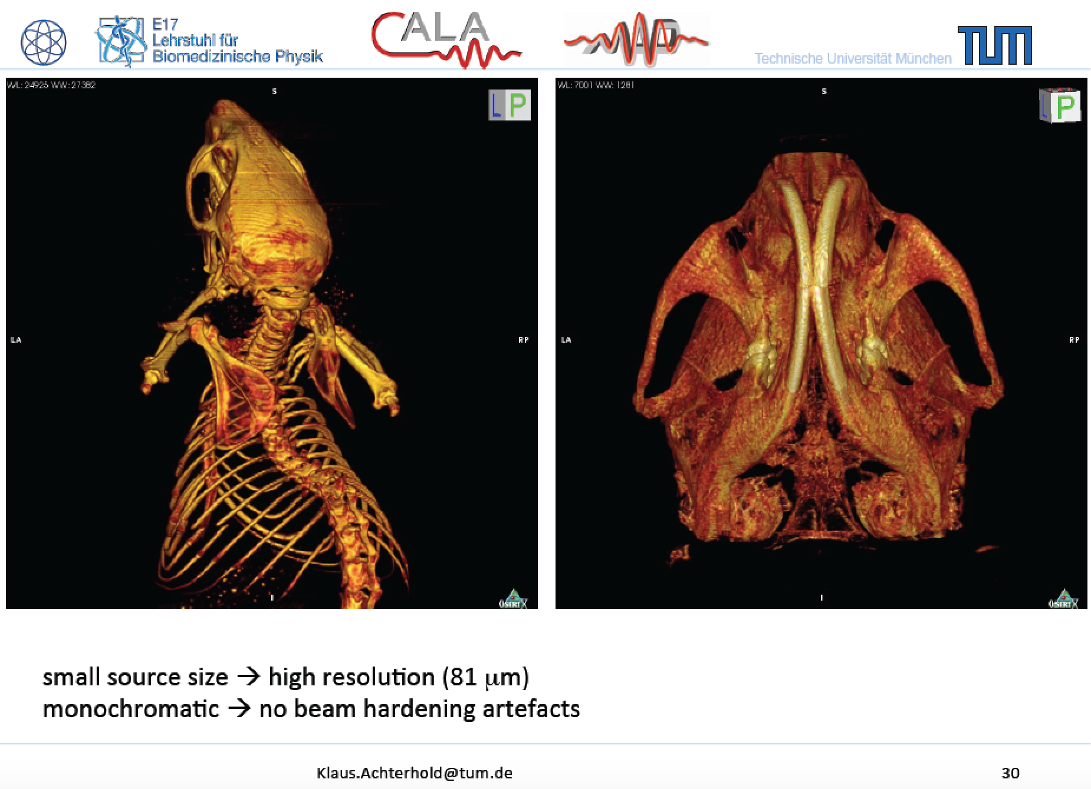
Phase Contrast Imaging made possible
by small round source spot size (< 20 μm)

Slide 15
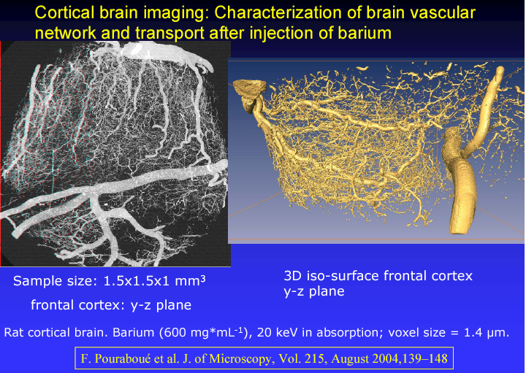
courtesy of A. Bravin (ESRF)
Bio-Medical Advanced Imaging with Mono-chromatic X-rays, demonstrated at
Synchrotrons, is possible also with High Flux Thomson X-ray Sources
in 20 keV-100 keV energy range

Slide 16
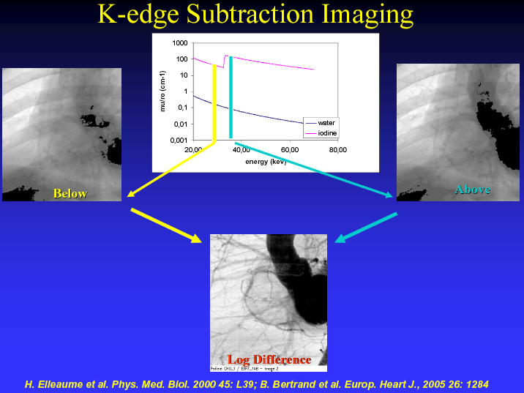
Bio-Medical Advanced Imaging with Digital Subtraction of Mono-chromatic
X-ray shots are also possible with High Flux Thomson X-ray Sources with
picosecond to millisecond time resolution

Slide 17
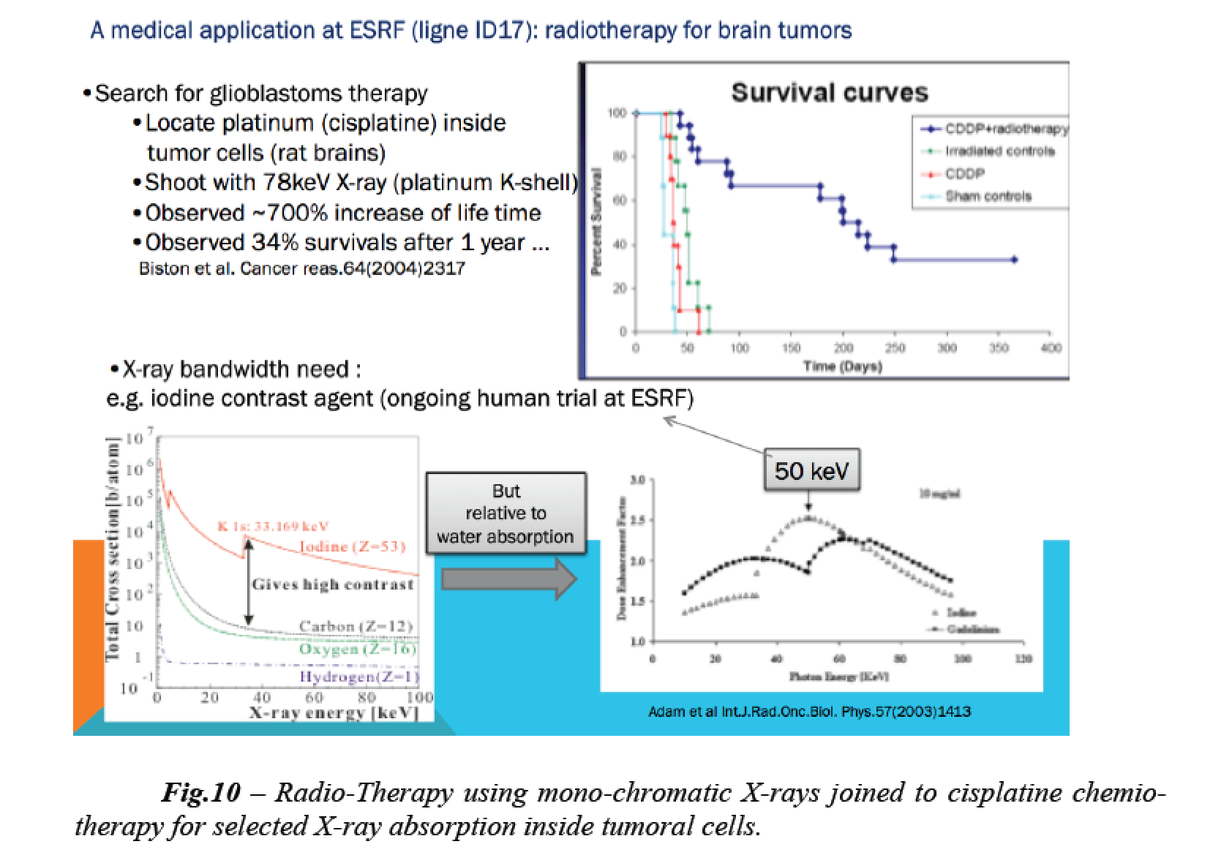
comprehensive overview recently presented at the PAHBB-2016 Workshop (see https://conferences.pa.ucla.edu/hbb/index.html) by A. Variola (INFN-LNF)

Slide 18
Advancing Thomson X Ray Sources for
Bio/Medical Imaging Applications and Matter Science

Slide 19

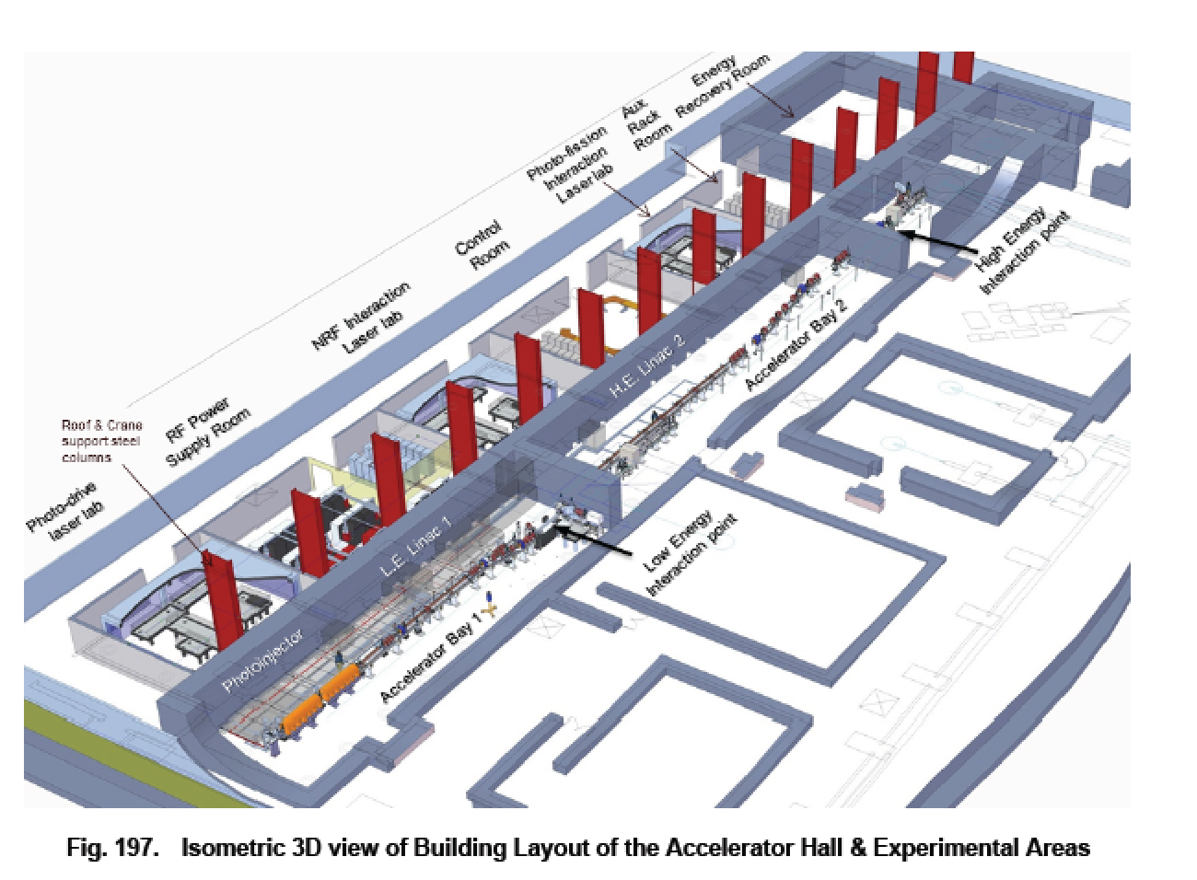
Accelerator and Equipments
in ELI-NP Building
100 m, 100 M$ scale
A γ-ray User Facility in construction in
Romania: ELI-NP-GammaBeamSystem

Slide 20
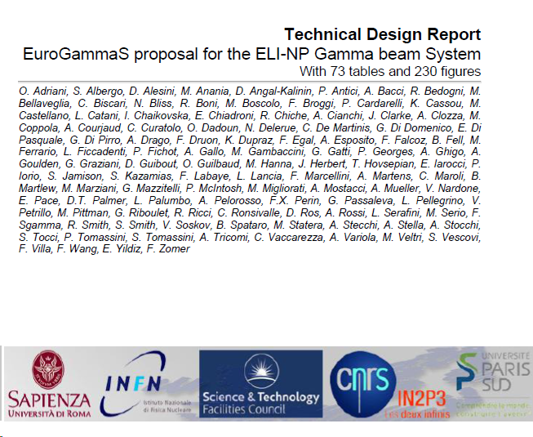
109 Authors, 327 pages
published today on ArXiv
http://arxiv.org/abs/1407.3669

Slide 21

Photonuclear Reactions
γ
What happens?
Sorgenti Thomson/Compton e Collisori Fotonici - Dottorato Roma1 - Oct. 2016

Slide 22
Courtesy C. Barty - LLNL

Slide 23
Photonuclear Reactions
Separation
threshold
~ 8 MeV
Absorption
γ
γ´
γ´
β
^{A´}Y
β
gs
^{A}X
Nuclear Resonance Fluorescence (NRF)
Photoactivation
Photodisintegration
(-activation)

Slide 24
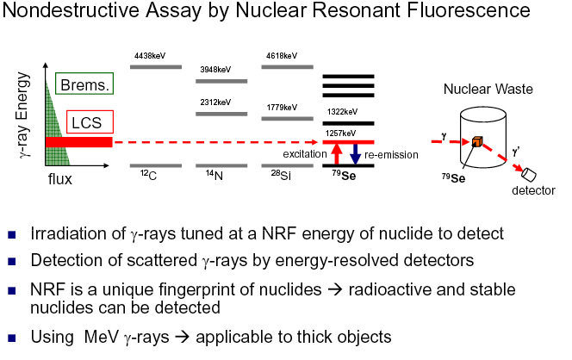
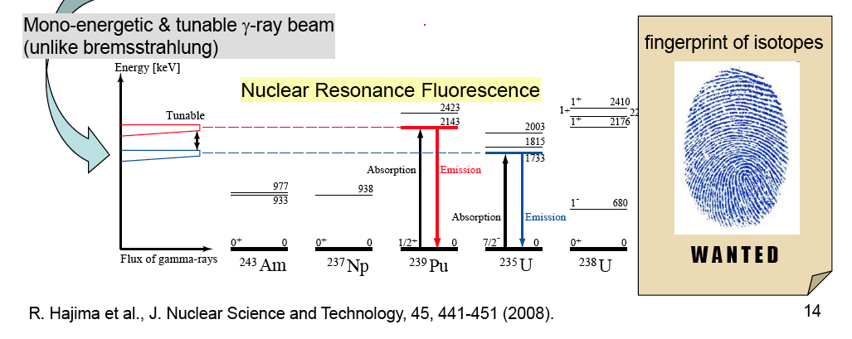

Slide 25
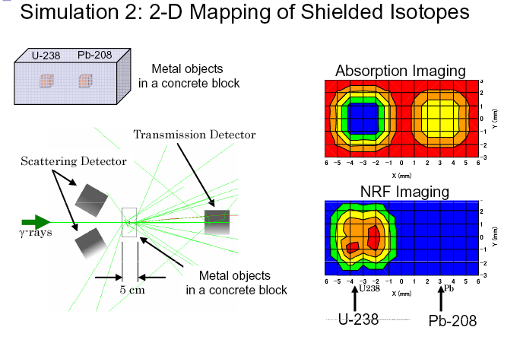

Slide 26
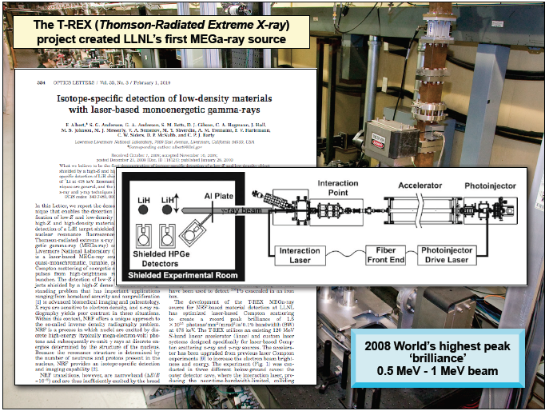
Real experiment with 0.5 MeV photons at LLNL
Sorgenti Thomson/Compton e Collisori Fotonici - Dottorato Roma1 - Oct. 2016
Courtesy C. Barty - LLNL

Slide 27

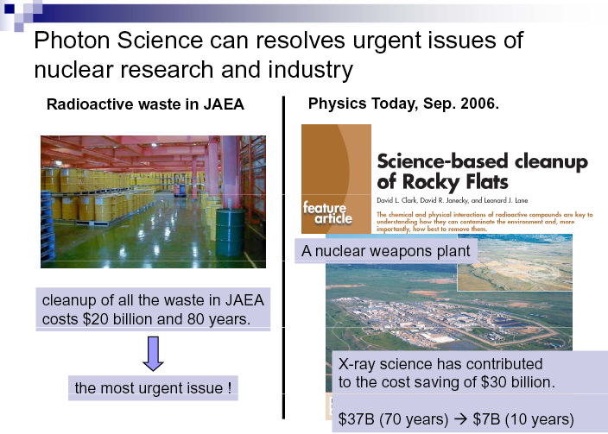
courtesy of R. Hajima (JAEA)

Slide 28
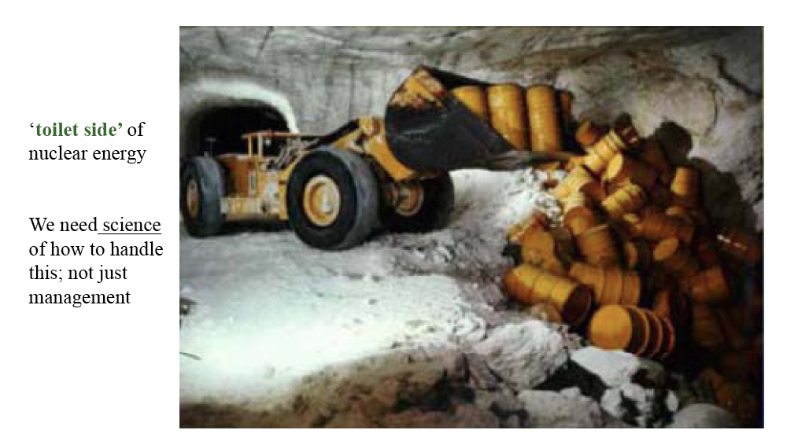
Courtesy T. Tajima

Slide 29
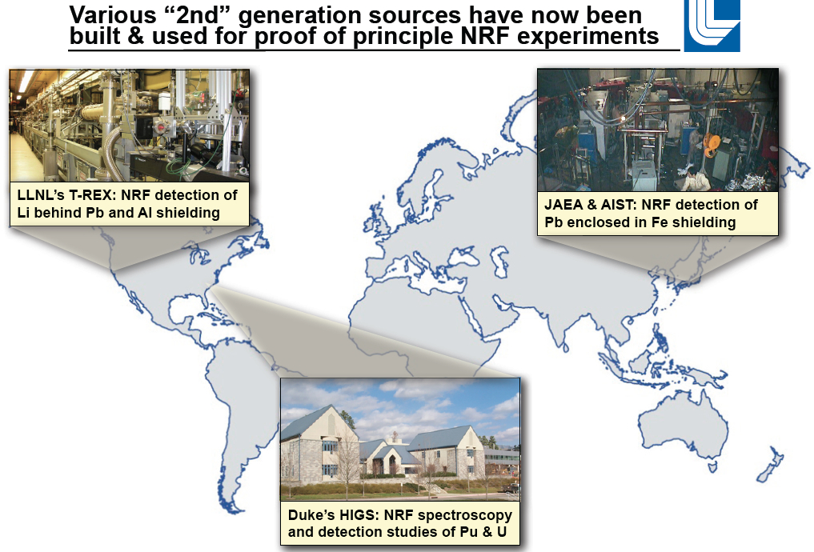
Courtesy C. Barty - LLNL

Slide 30
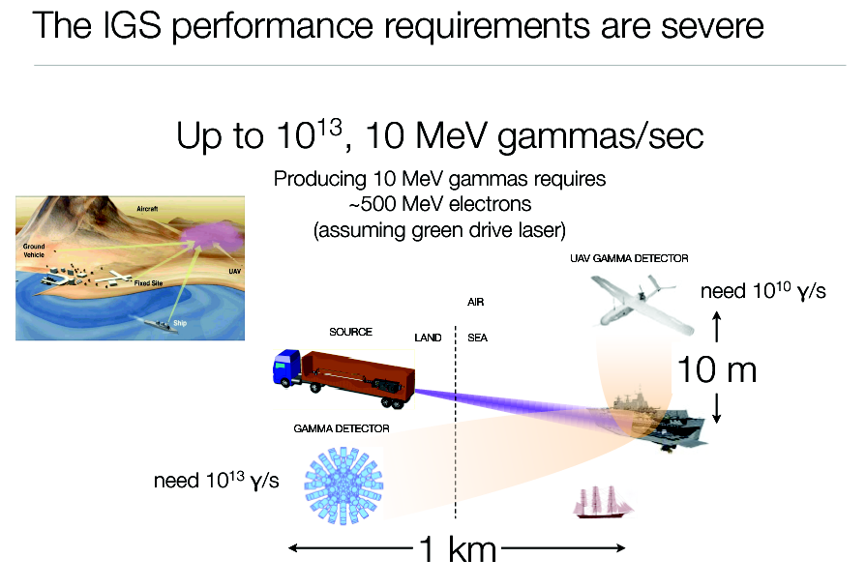
courtesy of G. Travish (UCLA)

Slide 31
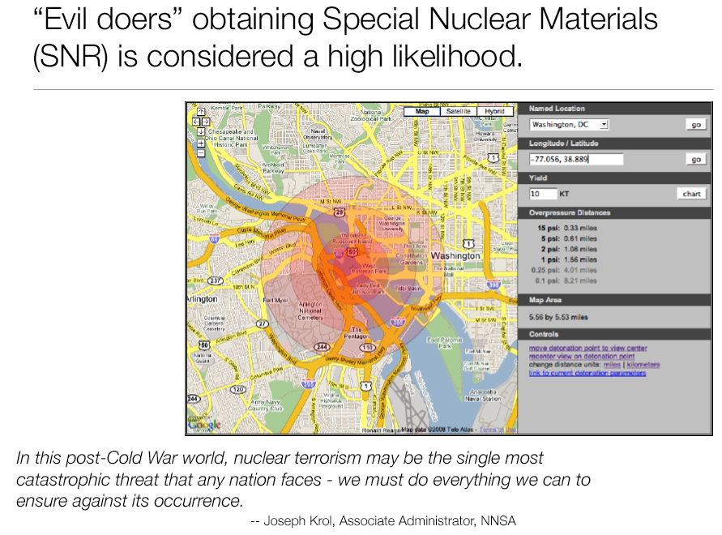
courtesy of G. Travish (UCLA)

Slide 32
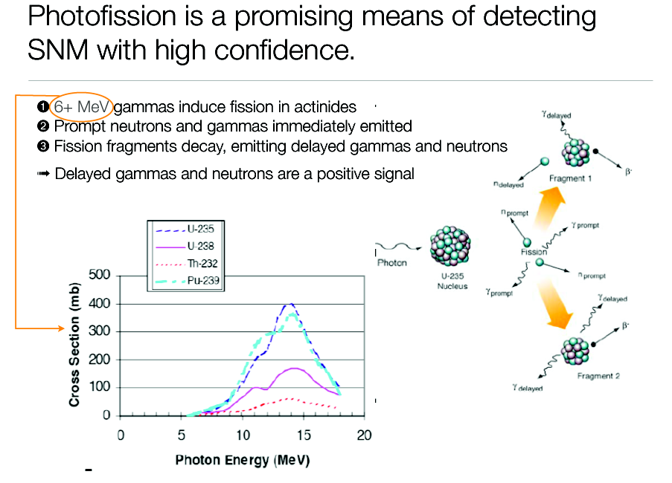
courtesy of G. Travish (UCLA)

Slide 33
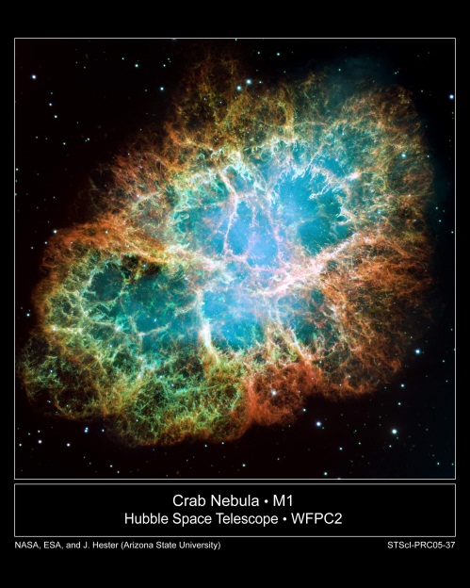
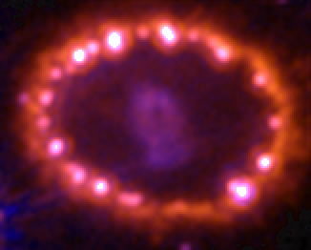
Journey to the „known Unknown“
Crab Nebula
Hubble ST
SN 1987A
Hubble ST
Need well-tested nuclear models
for prediction of astro-relevant
nuclear input.
courtesy of N. Pietralla (Darmstadt)

Slide 34
Challenges of electron-(optical)photon colliders as X/γ beam Sources using Compton back-scattering
Need of high peak brightness/high average current electron beams (cmp. FEL’s drivers) fsec-class synchronized and μm-μrad-scale aligned to high peak/average power laser beams
Main goal for Nuclear Physics and Nuclear Photonics: Spectral Densities > 10⁴ N_{ph}/(s.eV) photon energy range 1-20 MeV, bandwidths 10⁻³ class
Main goal for Medical Applications with X-rays: tunability in the 20-120 keV range, good mono-chromaticity (1-10 %), high flux (10¹¹ min., 10¹² for radio-imaging, 10¹³ for radio-therapy)

Slide 35
Main goal for MeV-class γ − γ and TeV γ - nucleon colliders: Peak Brilliance > 10²¹ N_{ph}/(s.mm^{2.}mrad^{2.}0.1%) 10⁹<N_{ph}<10¹³ Source spot size μm-scale (low diffraction, few μrad) Tunability, Mono-chromaticity, Polarization (H,V,C)
Photon-Photon scattering (+ Breit-Wheeler: pair creation in vacuum) is becoming feasible with this new generation γ-beams: a γ-γ low energy collider

Slide 36
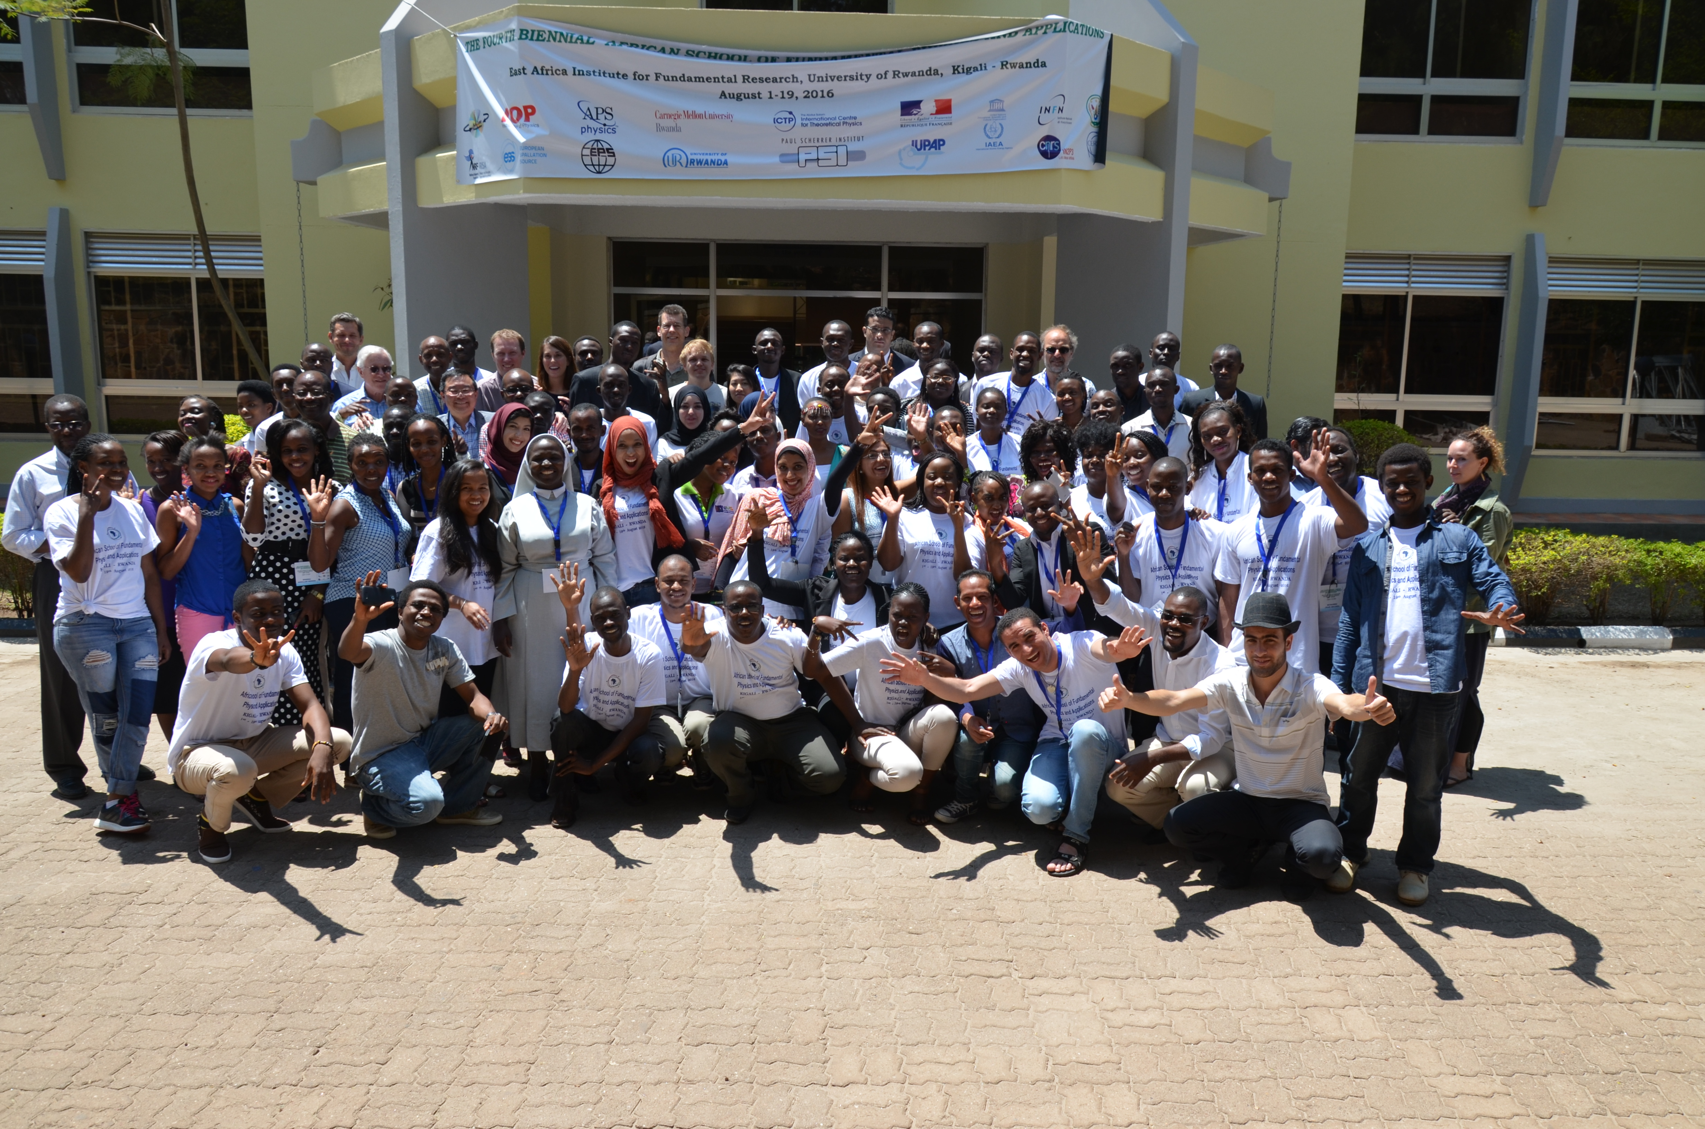
The STAR Project and the BriXS Proposal: the role of Compact Thomson Sources in the spread of Scientific Knowledge and Technological Development
Luca Serafini – INFN-Milan and University of Milan
Can we develop a Univ. Campus based Research Infrastructure aimed at boosting capacities of a developing region?
New generation of Light Sources (Inverse Compton Sources) based on electron-laser beam collisions, falling into the 10m x 10M$ paradigm, producing advanced beams of X rays
Enabling advanced applications in medicine/biology/paleontology/cultural heritage/national security
Now (2016) it is time: moving from R&D phase to serve Users - Several Test-Facilities world-wide, a few User Facilities
Can this program be an Incubator for a larger Initiative involving a network of African Countries (e.g. the African Light Source)?

Slide 37
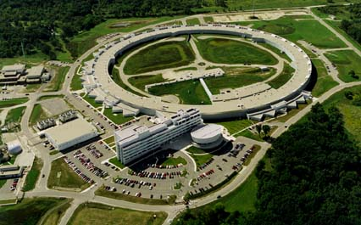
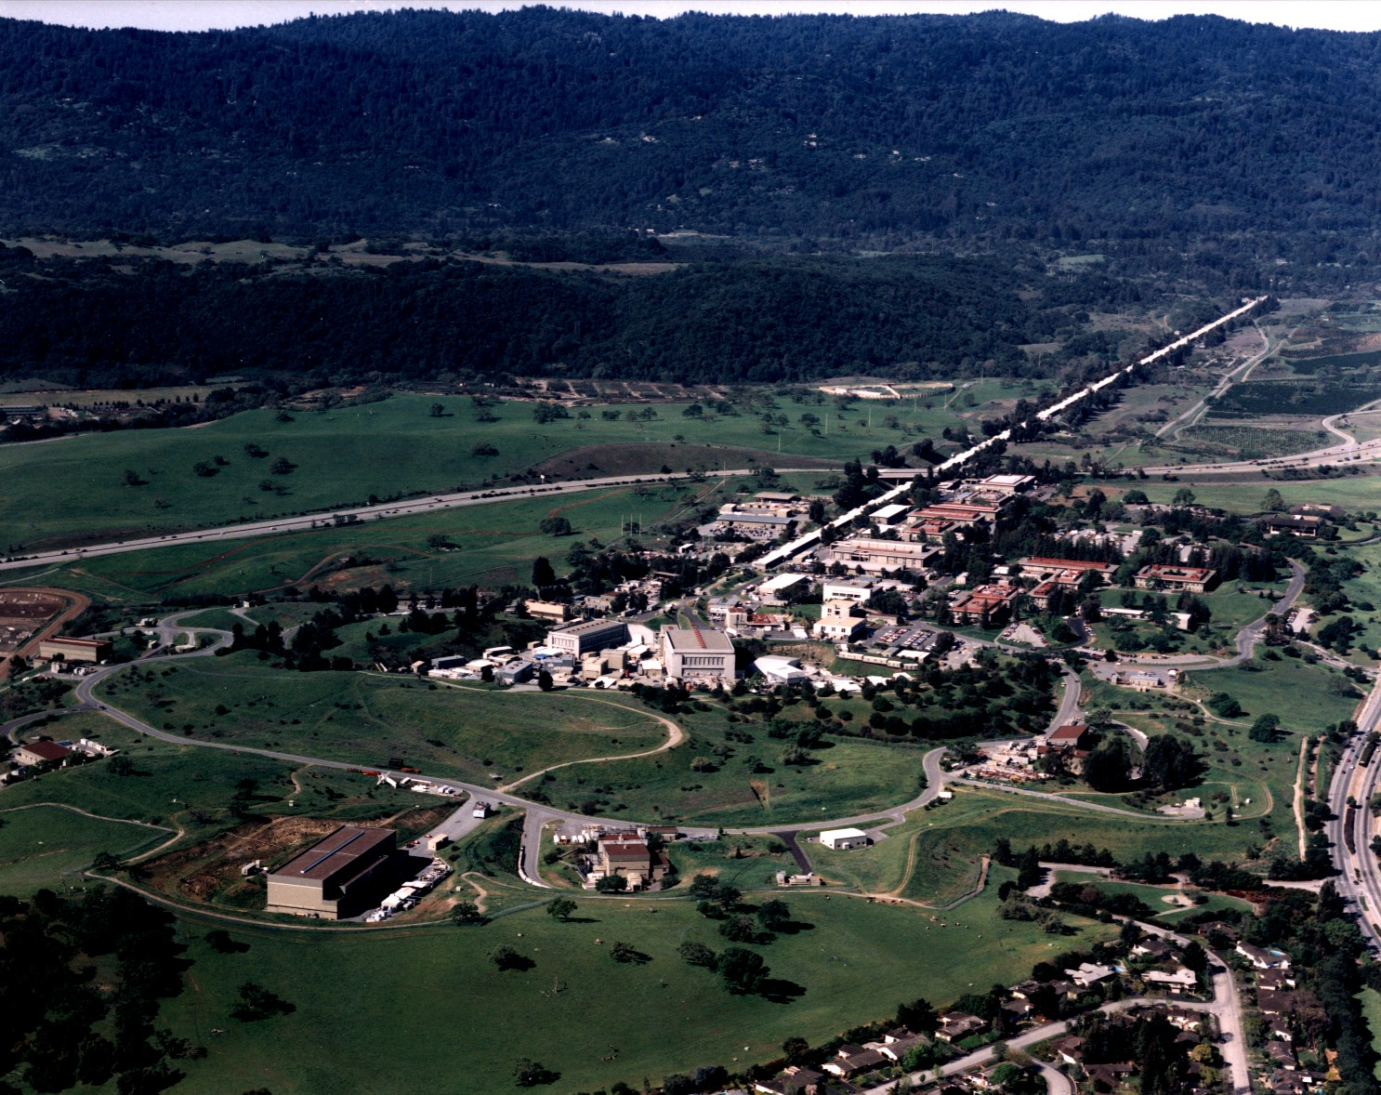
3rd-4th Generation Light Sources
Synchrotron light sources: < 50 keV, > 50 ps (100 m, 300 M$)
X-ray FEL (LCLS): energy ≤25 (50?) keV, 1-100 fs (1 km, 1 G$)
New approach: inverse Compton scattering (ICS) 20-200 keV , sub-ps, (10 m , 10 M$) – sometimes called Laser Synchrotron since a laser pulse substitutes the magnetic undulators

Slide 38
highly asymmetric compact*
elecron-photon colliders
*10 m, 10 M$
secondary photon beams via large
lorentz boost of c.m. reference frame
MeV/GeV’s electrons
eV’s photons

Slide 39
We start doing research with ICS’s that is being done at Synchrotron Light Sources (radiological imaging with Phase Contrast Tomography)
ICS’s, thanks to higher photon energies attainable (>100 keV) have potentialities to enable radio-therapy techniques better than Synchrotron Light Sources
or replicate at a University Campus level (in small laboratory) the research of interest for African Countries in Paleontology

Slide 40
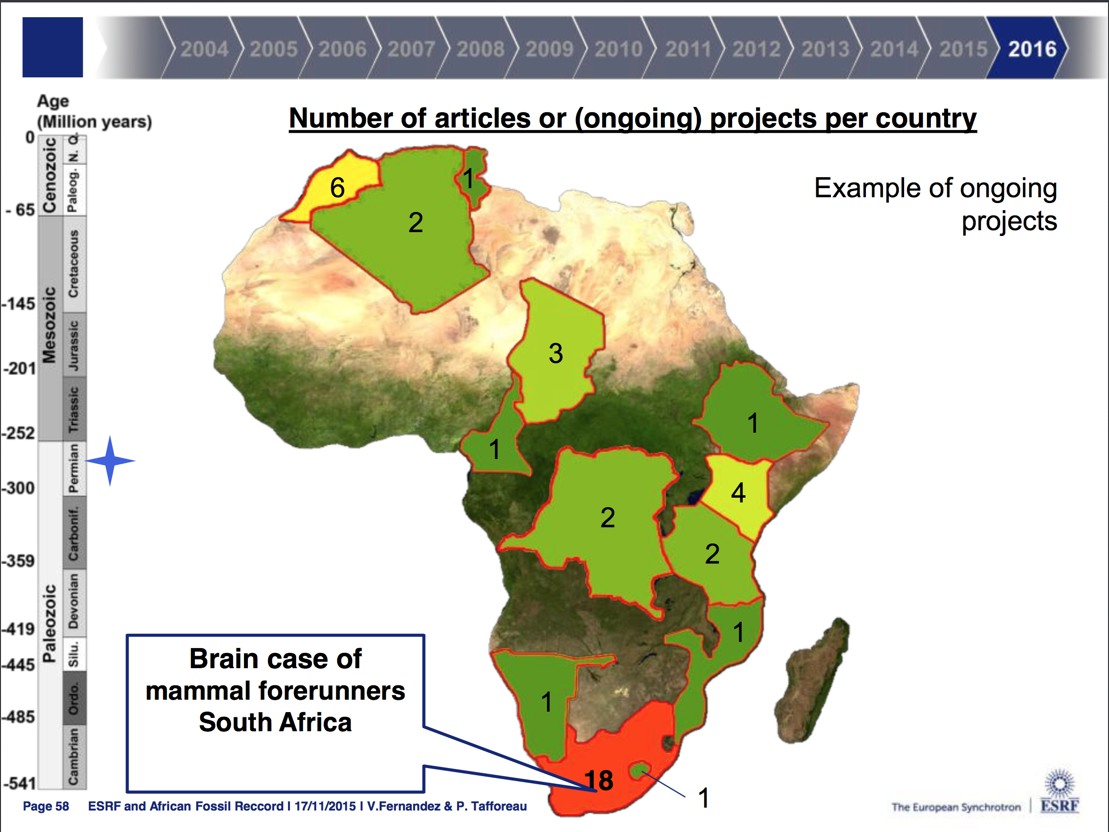
Users for X-ray
beam lines
are there!

Slide 41
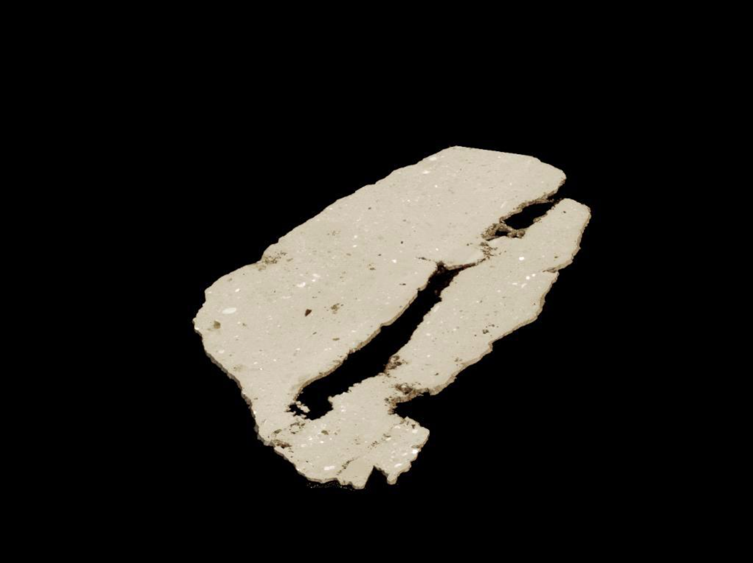


Slide 42
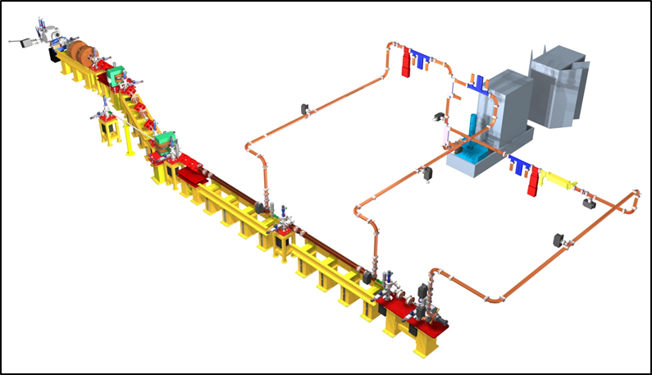
STAR – Southern europe Thomson source for Applied Research
is a good example of research infrastr. based on X-ray beam lines for a regional facility to be built in an developing region/country
10 m

Slide 44
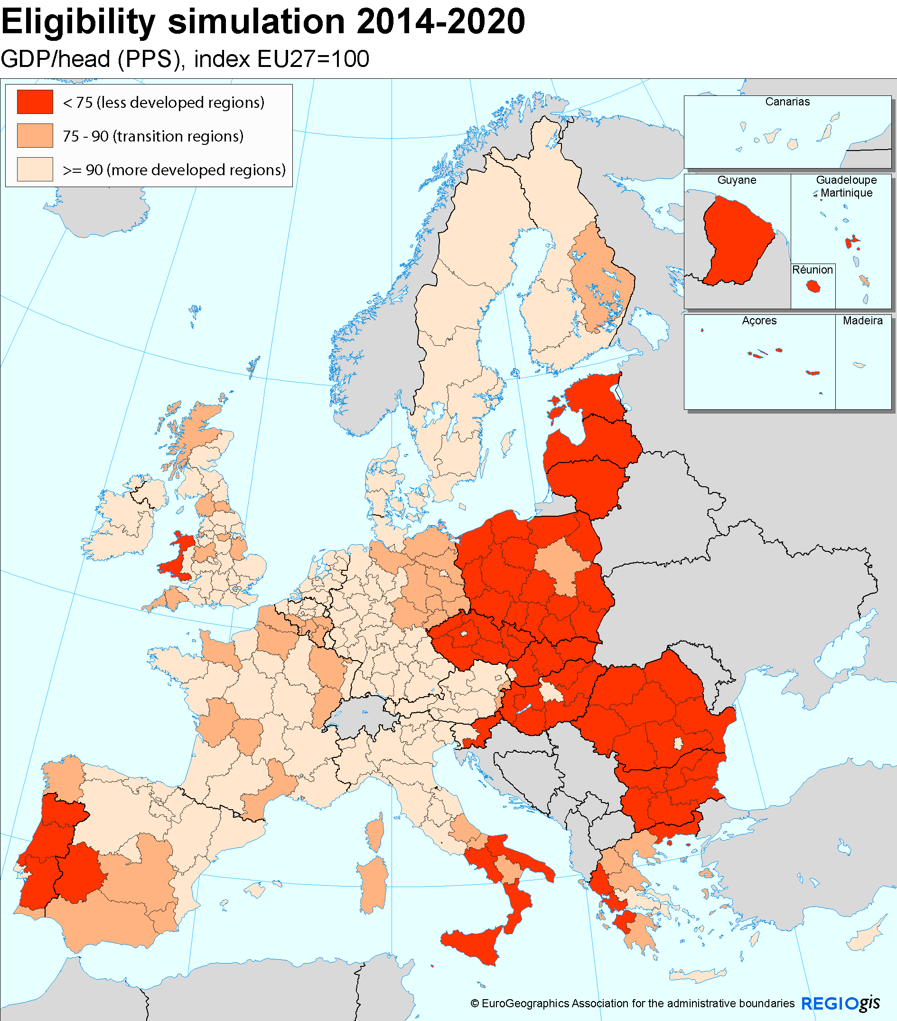
2014-2020
(indicativa)
Regioni meno sviluppate
Regioni in transizione
Regioni piú sviluppate

Slide 47
STAR Hangar and Bunker

Slide 54
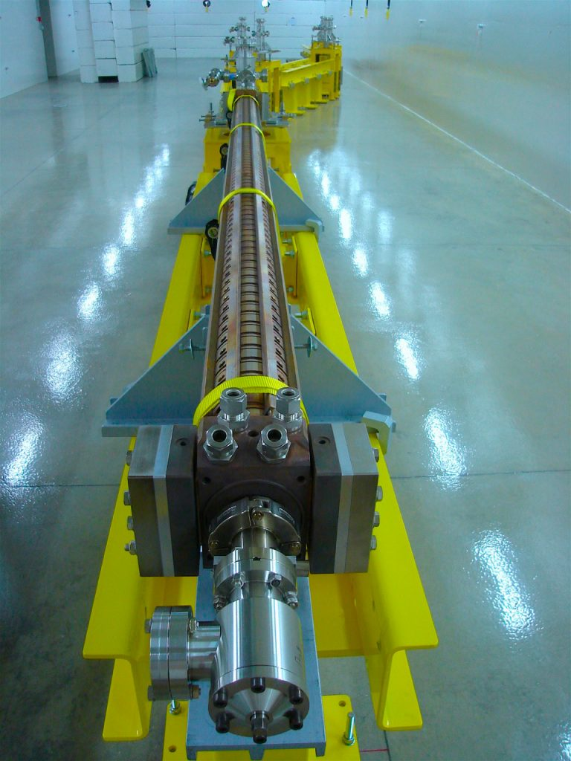

Slide 55
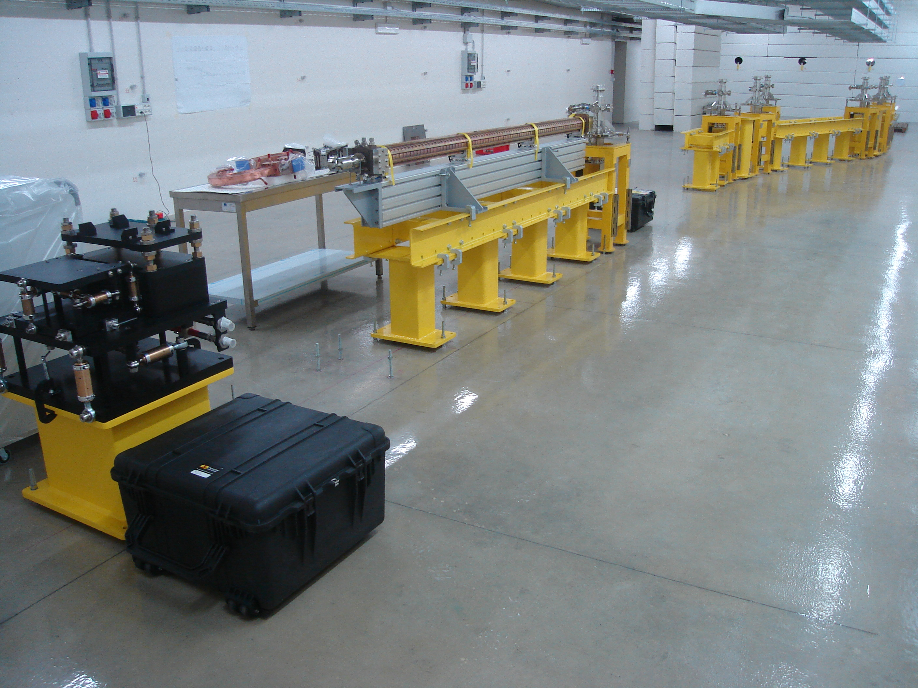

Slide 56
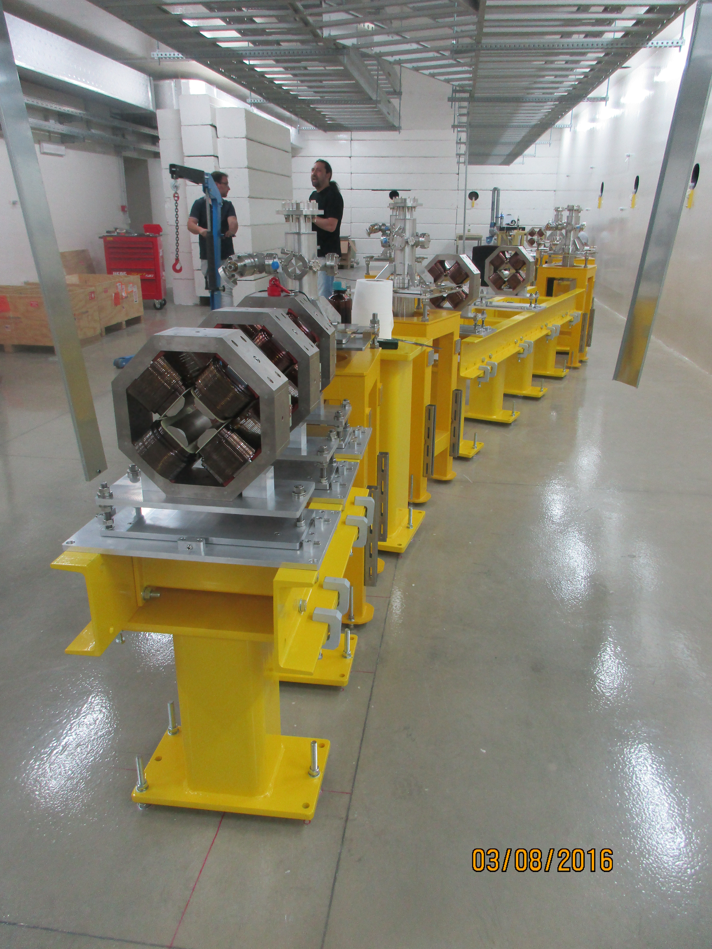
Commissioning of STAR is starting in September!

Slide 57
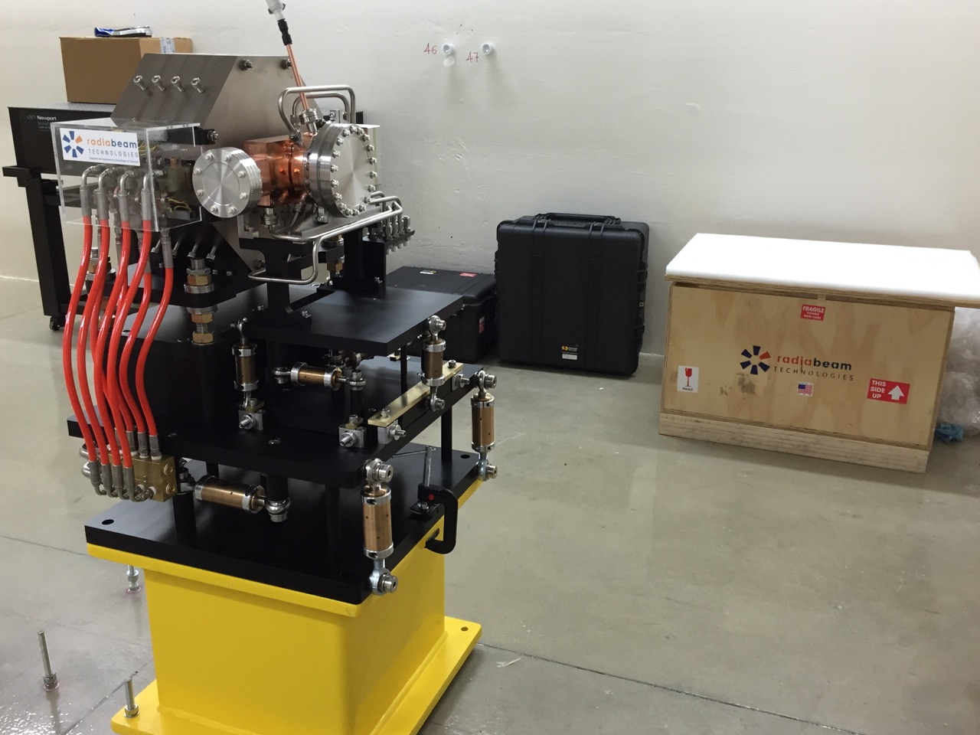
Sept. 7th 2016

Slide 58
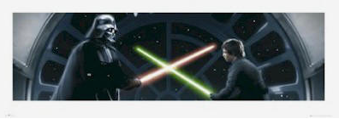
threshold of the
Breit-Wheeler
process
threshold of the
Bethe-Heitler
process
integrated luminosity corresponding to a bare minimum of about 100 scattering events (total).
1 nb⁻¹
E_{CM} ≈
880 keV
E_{CM} ≈
13 MeV
10 pb⁻¹
E_{CM} ≈
630 keV
E_{CM} ≈
140 MeV
courtesy E. Milotti

