Slide 1



MUSE General Meeting
Mu2e Calorimeter Crystals
Raffaella Donghia
on behalf of the Mu2e Calorimeter group

Slide 2
Crystal - Requirements
To match the calorimeter energy and timing resolution requirements a homogeneous calorimeter is the solution with a crystal that should have the following characteristics:
• High LY > 100 p.e./ MeV (with PMT readout)
• Good LRU: < 5%. (uniformity of response along crystal axis)
• Fast signal with small slow component: τ < 40 ns, F/T > 75%
• Radiation hardness with LY loss < 40% for:
• Ionization dose: 100 krad @ 10 krad/year;
• Neutrons: 10¹² n/cm² @ 2 x 10¹¹ n/cm2/year.
• Small RIN: < 0.6 MeV
Undoped CsI is the Mu2e choice!
Notes:
radiation induced readout noise

Slide 3
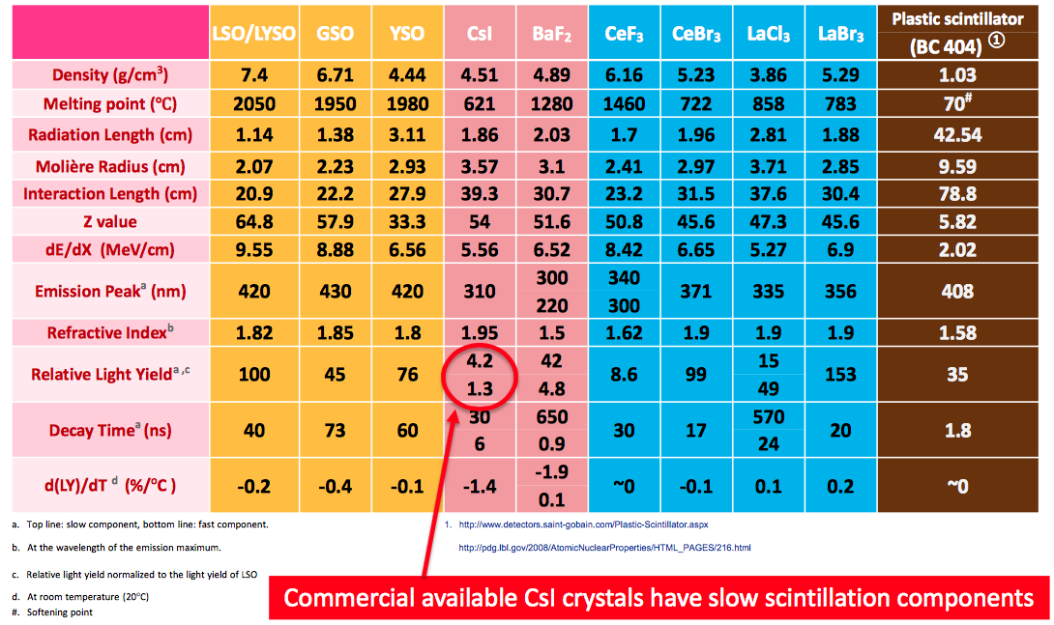
Basic Property of pure CsI

Slide 4
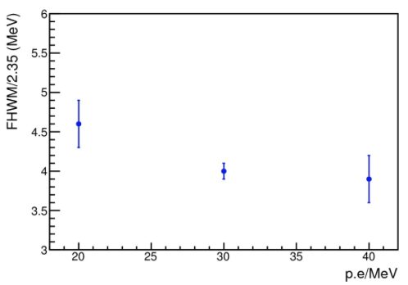
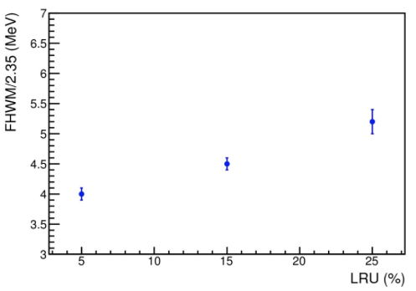
Crystal – simulation
Dependence on the photo-statistics and LRU
Notes:
Resolution dependence on simulation parameters

Slide 5
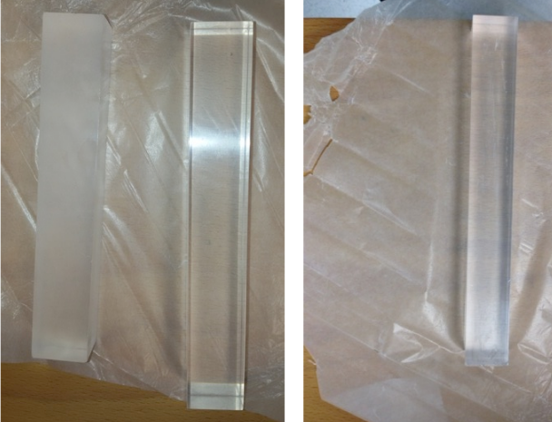



Crystals tested (waiting preproduction)
Siccas
Crystal from 3 different vendors:
  Opto Materials
  SICCAS
  ISMA
Dimension: (30 x 30 x 200)mm³
Measurements:
  LY
  LRU Uniformity along the crystal axis (R.M.S/peak)
  Radiation hardness to ionization dose and neutron flux
Opto
Materials
Kharkov
ISMA

Slide 6
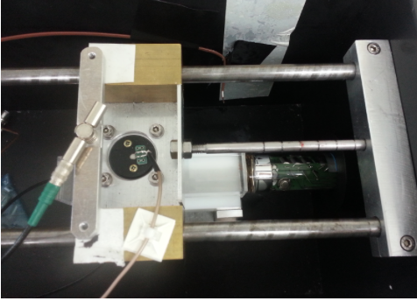
LY and LRU measurements - setup
Monitor
system
Crystal
²²Na Source
PMT
FOTO
Automatized station in progress: source movement by
remote control and automatic fit procedure
Production DB under preparation with FNAL experts
Notes:
Setup:
²²Na source
crystal wrapped with 150 μm thick Tyvek
2’’UV-extended PMT
Measurement repeated at 8 points along the crystal

Slide 7
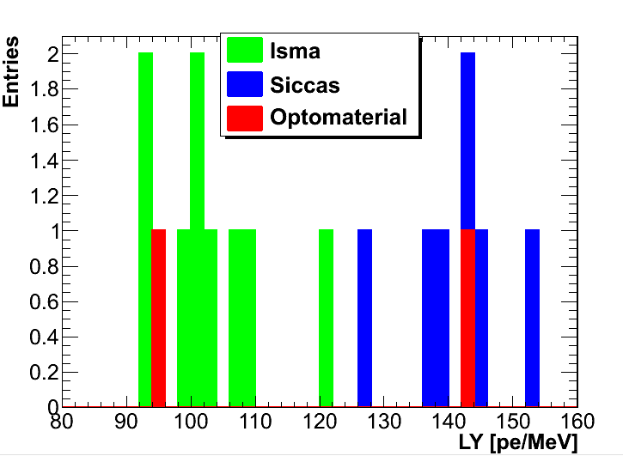
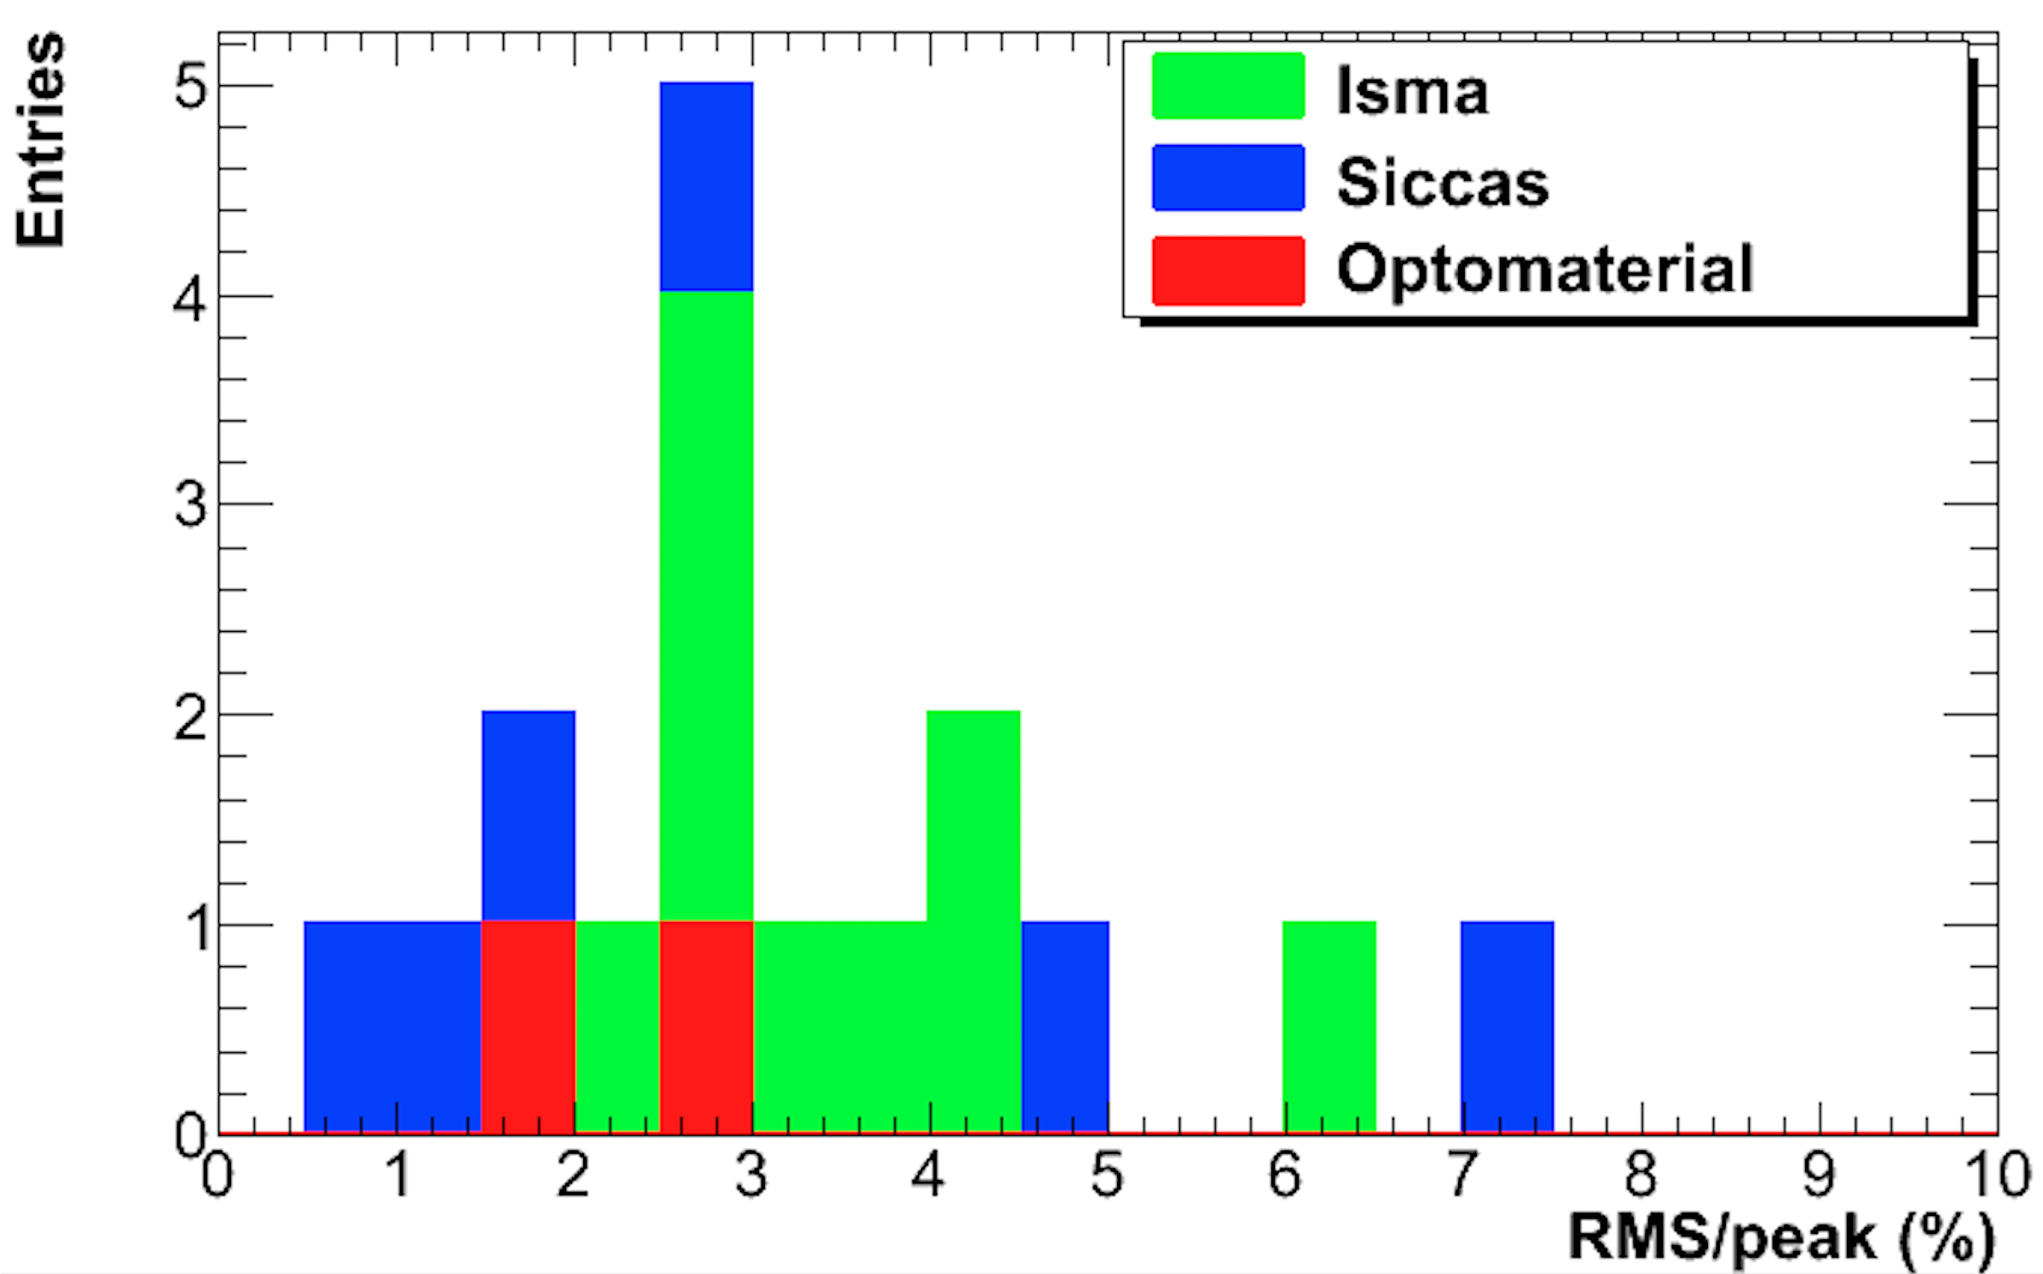
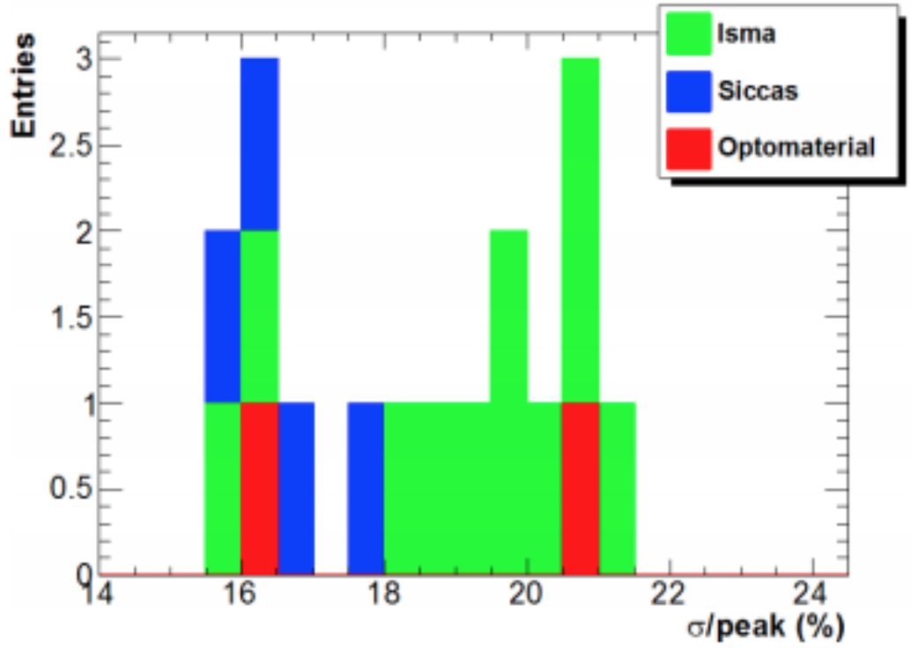
Results
Measurement repeated at 8 points along the crystal
  LY > 100 Np.e./MeV
  LRU < 5 %
  Energy Resolution < 20 %

Slide 8
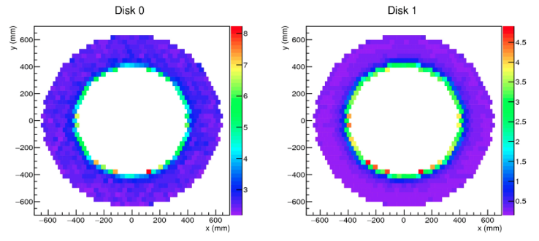
Radiation Hardness - simulation
Radiation dose kRad / year
The average dose is around 3 (0.5) kRad / year for the front (back) disk, with a peak up to 8 (4) kRad / year for the innermost crystals in the front (back) disks
Notes:
Hottest crystal
Ionization dose: 10 krad/year 1.8 rad/h,
Neutron fluence: 2×10¹¹ n/cm²/year 1.0×10⁴ n/cm²/s.

Slide 9
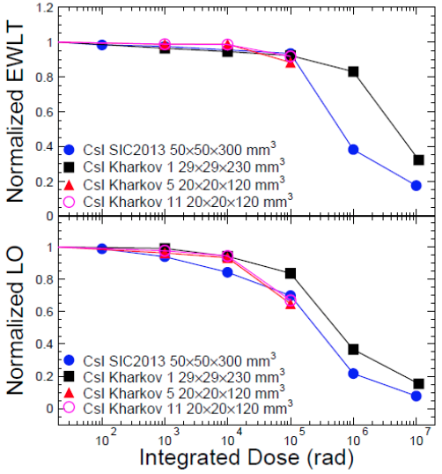
Radiation Hardness damage
Test performed at Caltech
No significant degradation in LY and LRU up to 100 krad, but not beyond
LO Loss < 15/40% after 10/100 krad
Similar test performed @ CALLIOPE (Casaccia facility, ENEA) by LNF group on 1 single SICCAS crystals with similar results
Notes:
Hottest region-> 10 krad/anno

Slide 10
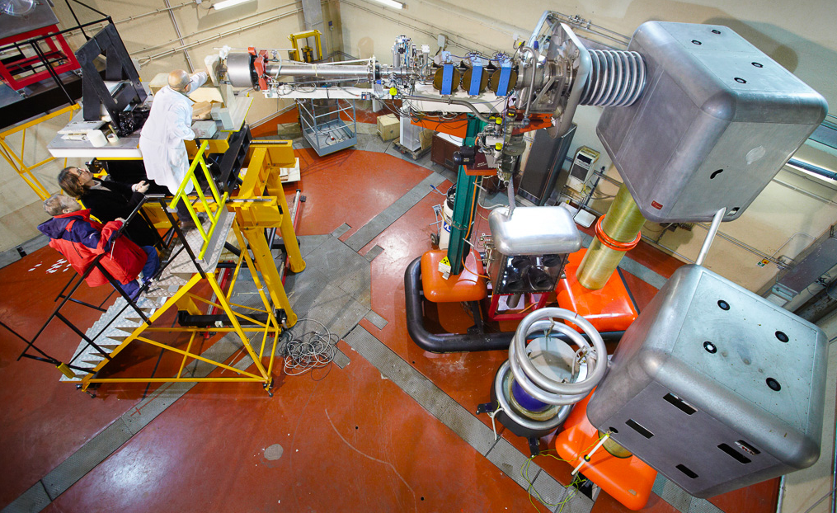
Neutron flux damage
3 CsI crystals tested at FNG (ENEA)
  Siccas, Opto Materials, ISMA
  Up to 9 x 10¹¹ n/cm² (4 days)
No large variation in LY (< 10 %)
LRU stable
Notes:
Hottest region: 2×10¹¹ n/cm²/year
-> 1.0×10⁴ n/cm²/s

Slide 11
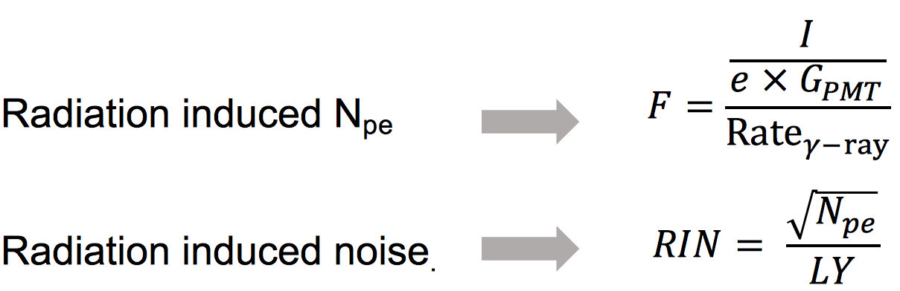
RIN - Radiation Induced Readout Noise
Assuming 230 days’ run (2×10⁷ s) each year, the hottest crystals would see in average the following radiation environment:
• Ionization dose: 1.8 rad/h
• Neutron flux: 10⁴ n/cm²/s
The energy equivalent noise (RIN) is derived as the standard
deviation of photoelectron number (N_{pe}) in the readout gate:
Notes:
• Ionization dose: 10 krad/year -> 1.8 rad/h
• Neutron fluence: 2×10¹¹ n/cm²/year 1.0×10⁴ n/cm²/s

Slide 12
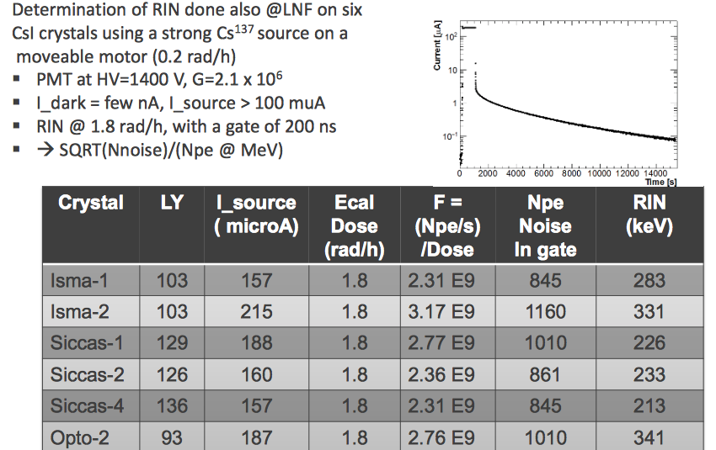
RIN – γ ray
Measured with a ¹³⁷Cs source
Dose rate on table surface = 0.2 rad/h
PMT_{gain}(@1400V) = 2.1 × 10⁶
I_{dark} = few nA
I_{source} > 100 μA
Several hours of run to check the decay
Opto 2
All samples satisfy Mu2e requirement of 0.6 MeV
γ-ray RIN is not an issue for the Mu2e CsI calorimeter

Slide 13
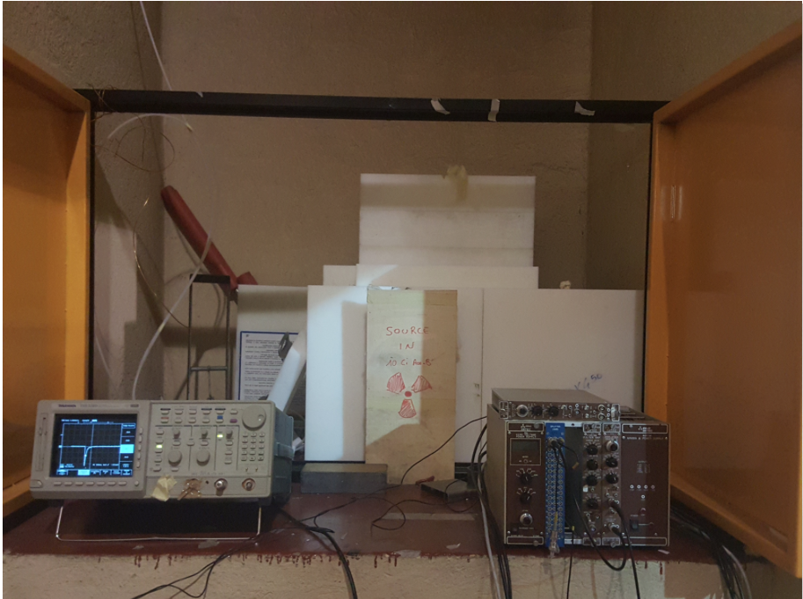
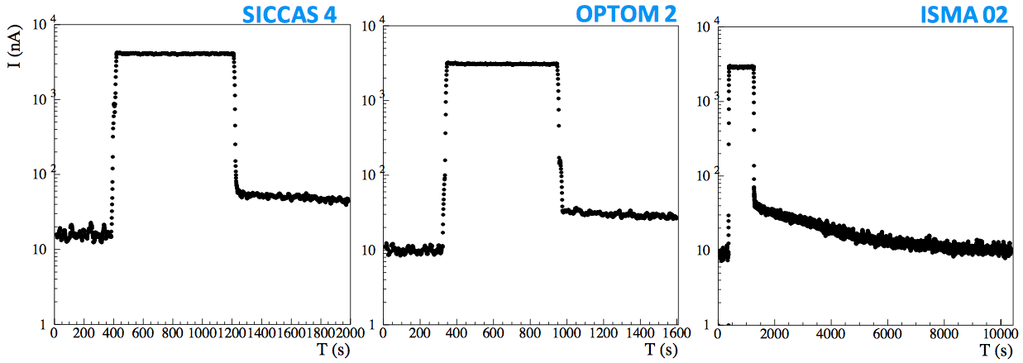
RIN – Thermal neutrons
Thermal neutrons from HOTNES facility (ENEA)
Flux: 700 n/cm²s
PMT_{gain}(@1400V) = 2.1×10⁶
I_{dark} ∼ 10 nA
I_{neutrons}∼ 2-3 μA

Slide 14
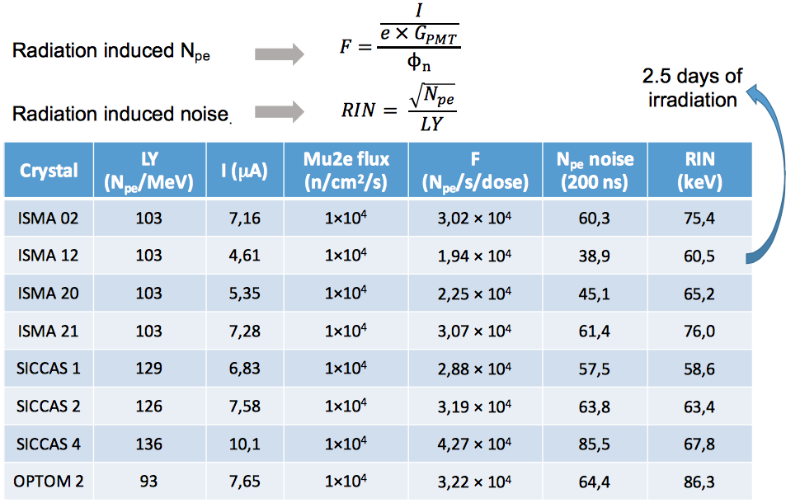
RIN – Thermal neutrons - Summary
Neutron induced readout noise is negligible

Slide 15
Decay Kinetics
Amplitude [mV]
Source
200 ns
Time [ns]
Cosmic
Amplitude [mV]
Time [ns]

Slide 16
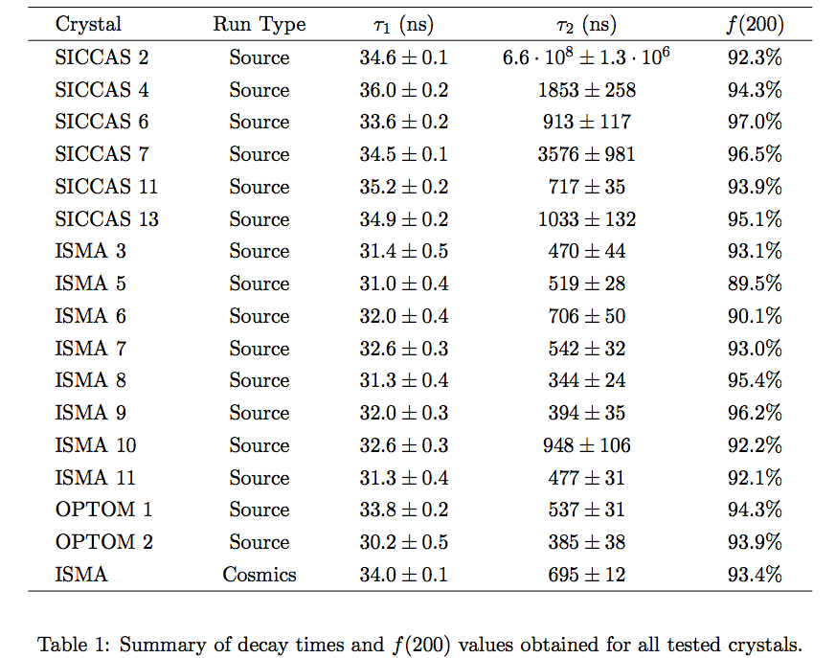
Decay Kinetics - table
Q_{INT}/Q_{TOT} ~ 95% @ 200 ns from signal start using UV-extended PMT readout

Slide 17
Conclusions
Current design meets calorimeter detector requirements
  CsI crystals from 3 different producers have been tested with sizes very close to the final one. Specifications for the Crystals have been decided based on these samples
  Radiation hardness tests have been performed
  Design is 100% complete
  Quality control of the Pre-production crystals is next step. Best crystals will be used to assemble the Module-0.

Slide 18
Thanks!

Slide 19
Spare

Slide 20
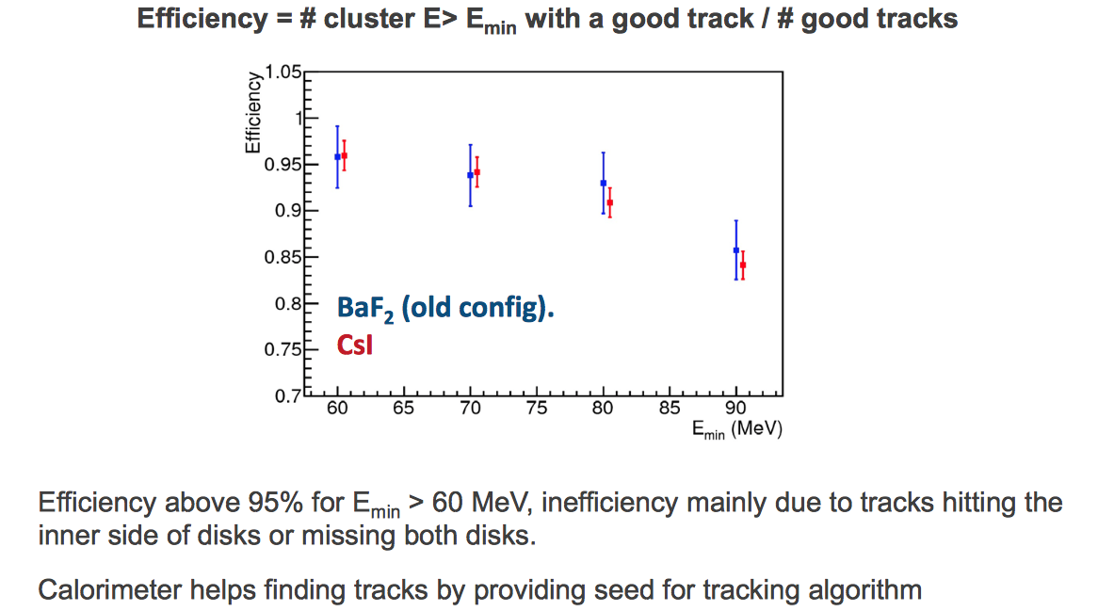
Signal acceptance

Slide 21
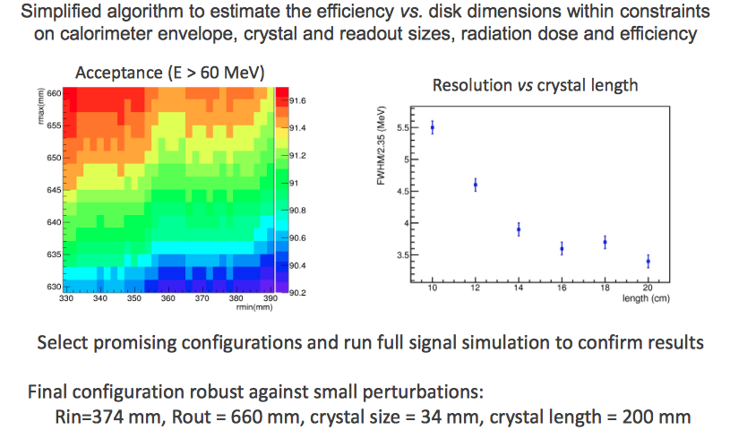
Dimensions optimization

