Slide 1
MU2E Calorimeter System:
An Overview
S.Miscetti
LNF INFN Frascati
MUSE General meeting
28-Sep-2016 Pisa

Slide 2
Physics and Calorimeter Requirements
The Mu2e Calorimeter should:
Provide high e- reconstruction efficiency for μ rejection of 200
Provide cluster-based seeding for track finding
Provide online software trigger capability
Survive in a high radiation environment (100 krad, 10¹¹ n/cm²)
Operate for 1 year w.o. interruption in DS w/o reducing performance
In order to do so the calorimeter should have the following capability
→ Provide energy resolution σ_{E}/E of O(5 %)
→ Provide timing resolution σ(t) < 500 ps
→ Provide position resolution < 1 cm
→ Provide almost full acceptance for Conversion Electron @ 100 MeV
→ Redundancy in FEE and photo-sensors
Solution: A crystal based disk calorimeter

Slide 3
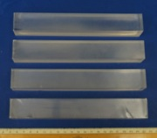

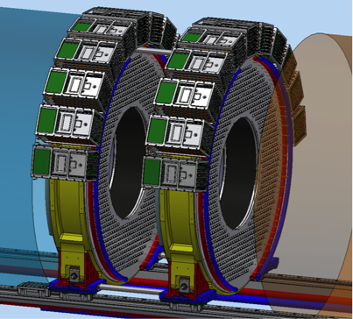
The Mu2e calorimeter
The Calorimeter consists of two disks with 674 34x34x200 mm³ CsI square crystals:
R_{inner} = 374 mm, R_{outer}=660 mm, depth = 10 X₀ (200 mm)
Each crystal is readout by two large area UV extended SIPM’s (14x20 mm²)
Analog FEE is on the SiPM and digital electronics located in near-by electronics crates
Radioactive source and laser system provide absolute calibration and monitoring capability

Slide 4
Long list of reviews on 2015-2016
TCR technology choice review, July 2015
Technical Choice → December 2015 → CsI+SiPM
FDR Final Design Review → Feb 2016
DR for CD3c , Director review for CD3-C → April 2016
CD3c → June 2016
CD3c approval , July 2016
A lot of work in the last 2 years, but we finally arrived to a final decision:
We are freezing the design and proceeding with pre-production,
Module-0 and final engineering.
We will then proceed for slice test and construction period.
Only comments/recommendations from CD-3c:
→ Test the “custom-SIPM” layout
→ Proceed with agreement btw Mu2e-INFN
→ Conduct a Vertical Slice test
→ Prepare detailed assembly and installation procedures

Slide 5
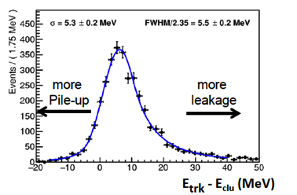
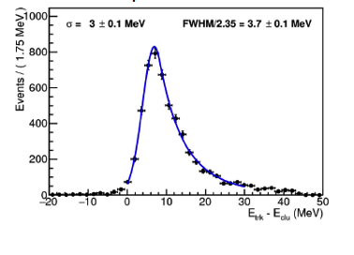
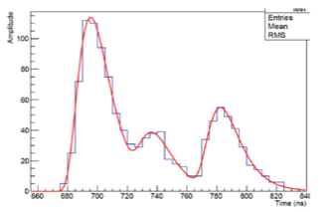
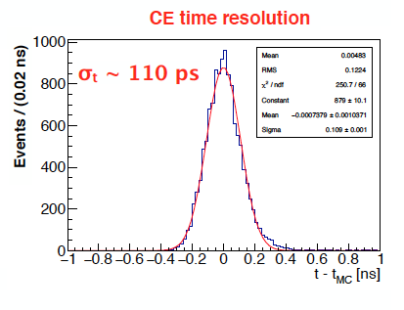
EMC Simulation
Great improvement in simulation with full digitization included.
As expected: CsI + SiPM is a good candidate also for Energy resolution!
A lot of work also on trigger and on in-situ calibration.
@ CD-3, crude hits digitization
Today: with realistic hits digitization

Slide 6
Calorimeter: Design Status Updated 9/16
Calorimeter Subsystem | Design Completion | Remaining Work/Risks
Crystals | 100% | CsI slow component specified.
Photosensors | 90% | SiPM packaging. Have one packaged SiPM from Hamamatsu but want to qualify other vendors
Mechanical Infrastructure | 80% | Finalize cooling design. Optimizing tradeoffs between noise, radiation damage and operating temperature. x2 headroom
Front End Electronics And Digitizer (WFD) | 80% | New pre-amp design for CsI/SiPM WFD board design with 20 channels. Moderate risk that we may have to back off to 18 channel boards. Adds a small amount of complexity.
Calibration | 90% | Integration of source pipes. Finalize laser optics.
Overall Design | 88%

Slide 7
Long list of “upcoming” reviews
Mechanical Review → end of 2016- beginning 2017
Construction Readiness Review 1 (sensors, crystals) →
March 2017
CRR for all calorimeter system ( mech, FEE, installation)
Summer 2017
A clear priority path exists:
- Conclude engineering
Proceed with Module-0, vertical slice test
Prepare Bids for large procurement
Prepare QA / assembly site @ FNAL
Make all tests under vacuum
Complete Irradiation program

Slide 8
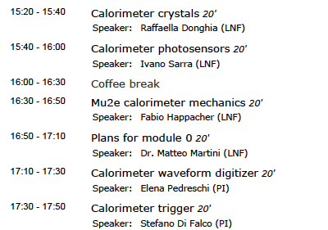
Detailed work report @ MUSE GM

Slide 9
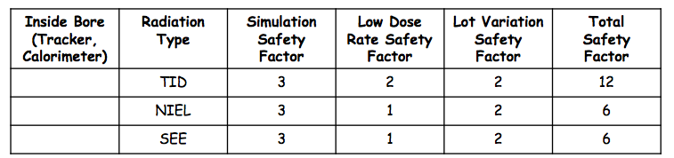
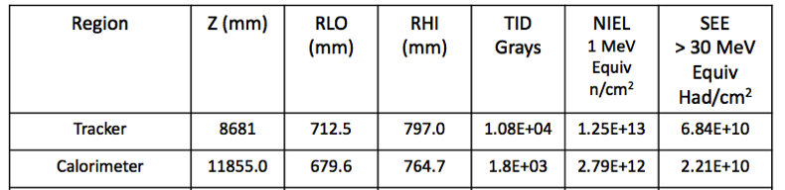
Irradiation plans & implication for Muse
Crystals tested up to 100 krad, 10¹² n @ 14 MeV, slow neutron high rate
SIPMs tested up to 20 krad, 4x10¹¹ n_1MeV eq/cm²
WD (FPGA OK) ADC+DCDC tested up to 20 krad, 6x10¹¹ n_1 MeV eq/cm²
Safety factors
of 3 used so far
Electronics integration group
Increased safety factors value
from 3 to 12 while asking for 10
year lifetime.
So increases for FEE/WD are
10 for TID, 2 for neutrons.
Calculation for SIPM underway
We should see how to maximize these tests @ HZDR

Slide 10
Status of “large” bids (1)
The 2 largest bids are the ones for Crystals and photosensors
Same technique of “competitive bid” used for both bids:
→ Use pre-production to rank the vendors
→ Final selection with 40% cost, 60% technical
For crystals, the bid has been based @ FNAL:
6 vendors participated St.Gobain, Siccas, Amcrys, OptoMaterial, Hilger, Khineng.
3 vendors selected for preproduction
St. Gobain, Siccas, Amcrys
We have required them to provide 24 pieces/each for module-0.
We will receive additional 50 crystals from Amcrys as JINR (Dubna) contribution bringing to 122 crystals the amount we will use for pre-production tests and module-0.
→ Expect delivery end of October.
→ 3 months delay w.r.t. our expected schedule.

Slide 11
Status of “large” bids (2)
For photosensors, the bid has been done @ INFN:
3 vendors participated
3 vendors selected for preproduction of the Custom SIPM
Hamamatsu, SensL, FBK. Each of them will produce 50 pieces.
Expected delivery middle of October
→ We will take < 4 months for the evaluation.
→ Shorter time for QA (< 2 months)
→ Longer time for Irradiation and MTTF
We will reward them with a fixed prize of 22 kEuro/each
(with VAT,Shipping excluded).
Also for the sensors we accumulated 2 months delay w.r.t. schedule.
A lot of tests done in the last months with “home-made” custom SIPM
so that preparation of QA Station in Pisa is proceeding well

Slide 12
Calorimeter: next steps
Statement of Work between DOE and INFN in preparation.
This document will list the work we will commit to do
Engineering should continue in view of 3 reviews at end of 2016 and in 2017:
→ Mechanical review
→ Construction Readiness Reviews (Crystal and sensors + all the rest)
Pre-production + QA + Rad Hard test for crystals … in progress
Pre-production + QA + Rad Hard test + MTTF for SiPMs .. In progress
Pre-production FEE+WFD … in progress
Mockup of Mechanics for FULL SIZE support, CF structure and rear cooling
disk .. In progress
Module-0 construction + tests of Rad-Hard and under vacuum (2017)
Construction Readiness Reviews : SPRING/SUMMER 2017
Larger bids in 2017 for 2017-2018 procurement crystals, SiPMs, mechanics
2018 construction of FEE+ electronics + installation toolings
2019 calorimeter assembly + 2020 installation/commissioning

Slide 13
Calorimeter: MUSE network contribution
Two relevant MUSE network contributions during this first 9 months:
1) Irradiation of Large Area UV extended Hamamatsu SiPM @ HZDR
→ preparation of facility
→ successful test of 1 Hamamatsu SiPM
→ planning under discussion for next steps
2) Improvement of QA for crystals interacting with PRISMA people
seconded at LNF
→ More “Industrial” standard proposed for QA.
Dedicated document in writing
→ Mysql DB + WEB interface for a first version of
CRYSTAL TRAVELER → new DB version under discussion
with FNAL DB group.

Slide 14
Calorimeter: MUSE deliverable
The first deliverable we have as working group on the Mu2e detector is
due to the end of the year:
Calorimeter Technical Design report
Since we have a lot of change/improvements and a lot of engineering done since the 2015 Mu2e TDR
  we will write a dedicated “Calorimeter TDR” with emphasis on engineering
I will discuss this with the TM and the spokes
We will organize the writing in chapters provided by the L3 groups
We will submit the final TEDR on ArXiv and as FNAL publication

Slide 15
ADDITIONAL
MATERIAL

Slide 16
Calorimeter schedule
CD-2
TCR
FDR
CD3
CRR-S
CRR-All
KPP4
Critical Path
Pre
Production
Crystals
M
O
d 0
Fabrication of all Crystals
QC all Crystals
Pre
Production
SiPMs
Fabrication of all SiPMs
R&D
Disk 1 +
Disk 2
Assembly
QC all SiPMs
FINAL Mechanical Drawings +
Cooling Station and Mockup
Support DISK1
Support DISK2
Installation
FEE
DIGI
final design
FEE
Pre-prod
FEE
Production
WFD
Pre-Prod
WFD
Production
CR
Test
Assembly
proto Source
Calibration source
final design
Assembly final source
Final Design LASER
Assembly final flasher
FY15 FY16 FY17 FY18 FY19 FY20
15

Slide 17
Outcome of CD-3c, recommendations

