Slide 1
MUSE Meeting Pisa 30/09/2016
Medical Image Processing
Using Brain Emulation
Calliope-Louisa Sotiropoulou
Marie Curie IAPP Fellow - University of Pisa and INFN

Slide 2
Advanced Image Processing Implementations:
A Multidisciplinary Approach
Advances in sensors, communications, computation speed, size of storage (data centers) etc.
Data increasing in quantity and diversity
What is needed:
Fast and efficient ways to process the data → data traffic reduction with minimal information loss

Slide 3
Advanced Image Processing Implementations:
A Multidisciplinary Approach
Image Processing: Increasing resolutions and frame rates → “Big Data” (currently a “hot topic” in the area of ICT)
Applications
  High Energy Physics
  Biomedical: CAT scans, MRI, several forms of diagnostic equipment
  Security applications (satellite imaging)
  Cognitive imaging: image processing that emulates the way the brain identifies “meaningful” patterns

Slide 4
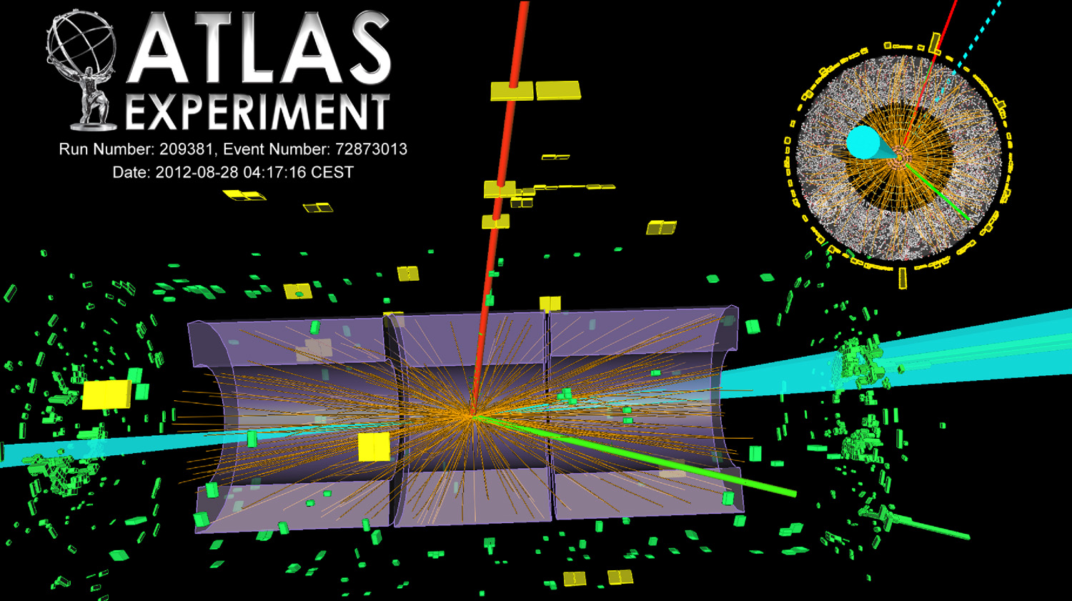
Advanced Image Processing In
High Energy Physics

Slide 5
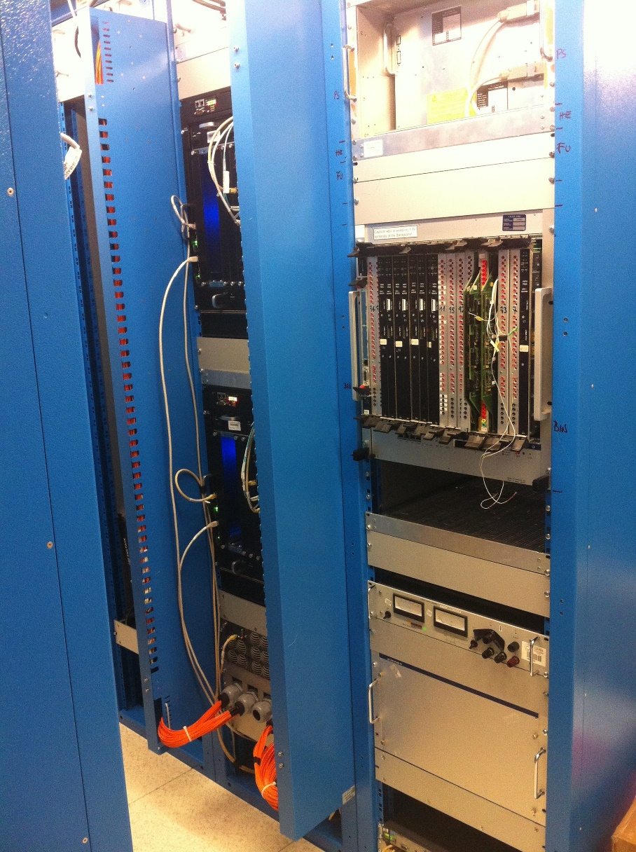
Advanced Image Processing In
High Energy Physics

Slide 6
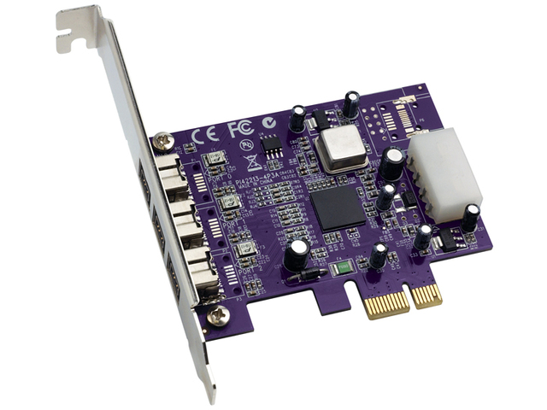
Advanced Image Processing In
High Energy Physics

Slide 7
The Idea → Multidisciplinarity
There is a concept that has been proven to work (algorithm and hardware) → Fast TracKer (FTK)
Looking for alternative scientific and industrial fields to apply what already exists and develop it further → Medical Image Processing

Slide 8
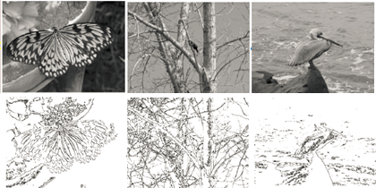
A New Approach to Image Processing
The FTK Processor is a very fast, powerful and efficient pattern matching machine
The particle tracking problem is in fact an image processing problem
HEP
Before Filtering
After Filtering

Slide 9
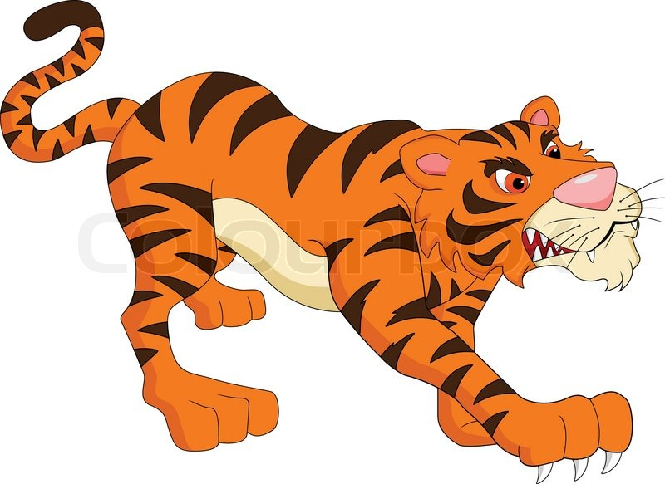

Brain Emulation
When a human is in a situation of stress (danger etc.) his/her brain does not look for the details in the visual stimulus

Slide 10

Brain Emulation
The only single objective is to identify the source of the danger (identify the form)
¹M. Del Viva, G. Punzi, and D. Benedetti. Information and Perception of Meaningful Patterns. PloSone 8.7 (2013): e69154.

Slide 11
Brain Emulation
Studies conducted have demonstrated that the brain uses a “pattern matching” process very similar to the one used by the trigger systems of HEP experiments

Slide 12
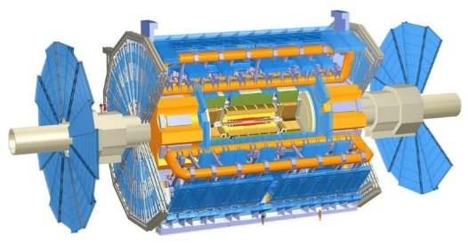
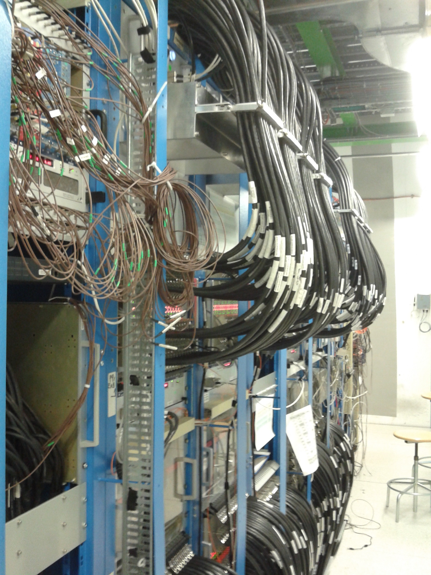
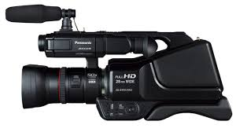
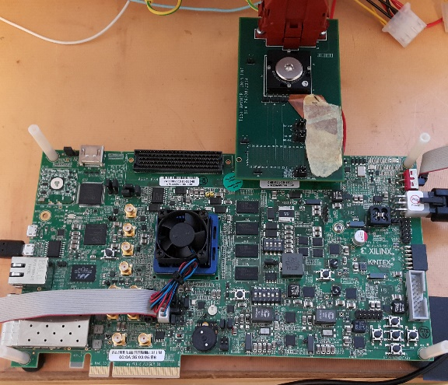
Brain Emulation
We can use hardware developed for HEP adjusted in a “mini version” for Image Processing applications

Slide 13
Brain Emulation
We can use hardware developed for HEP adjusted in a “mini version” for Image Processing applications
Mini FTK for Image Processing

Slide 14
FTK for Image Filtering
Major difference between HEP and Human Brain:
  For HEP we are aware a-priori of the relevant patterns
  The Human Brain is trained in real time
  (we are not aware of the patterns beforehand and we always adjust to new environments)
Target:
Design and prototype a pattern matching machine that executes both training and filtering in real time using high performance embedded systems (FPGAs, ASICs and combination of the two - SiP / System In Package)

Slide 15
Cognitive Image Processing Algorithm
Two phase algorithm and implementation
  Training Phase (Pattern Selection - Training):
  Select an image or video sample and use it to identify the relevant patterns for a specific application with specific parameters.
  Training should be executed in real time in case the environment or application parameters change.
  Pattern Matching (Real Time Execution):
  Real time pattern matching with the preselected patterns from the training phase.

Slide 16


Cognitive Image Processing:
Training Phase
Build small arrays of pixels (3x3 for static images or 3x3x3 for movies – 3rd dimension for time) that are AM patterns (M. Del. Viva, G. Punzi)
B/W 2⁹=512 patterns: 101-010-100, ……. , 111-011-001
4 gray level 2¹⁸= 256 Kpatterns: 00,00,01-00,01,00-11,00,10 …..
B/W + time 2²⁷= 128 Mpatterns: 111,000,000 - 000,111,000 - 000,000,000
Training: Calculate the frequency of each pattern in the sample images/frames
Compute Probability Density Histograms (PDHs)

Slide 17
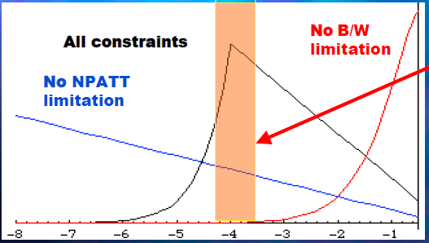
Cognitive Image Processing:
Training Phase
p_{i} : probability pattern “i” in sample image set
N_{tot} : total number of patterns
N : number of stored patterns (available memory space)
W : available bandwidth
H : measure of output information
H = ∑_{i} -p_{i} log(p_{i}) (Boltzmann entropy)
Patterns that are efficient carriers of information given the bandwidth (W) & memory limits (N)
Log(p)
W/N>p
W/N<p
f(p) = -pNlog (p)
f(p) = -Wlog (p)

Slide 18
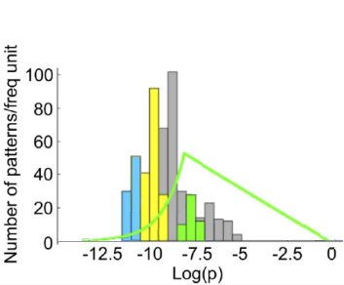
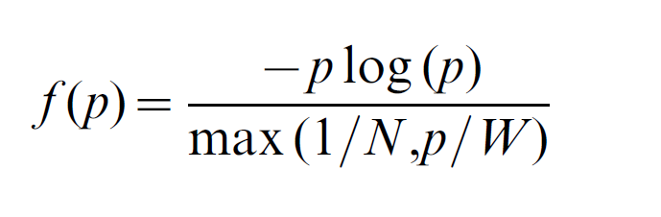
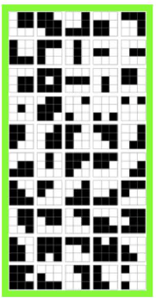

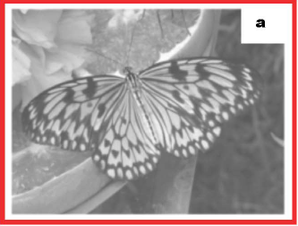
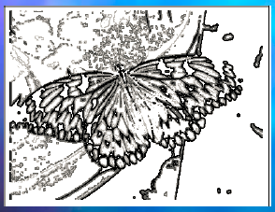
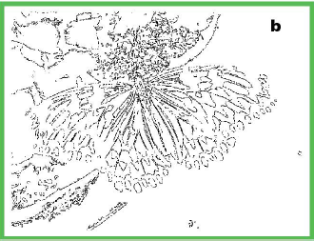
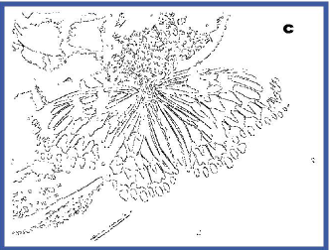
Cognitive Image Processing:
Pattern Selection Impact
Choice of relative patterns: Choose the pattern set that maximizes entropy H under real constraints
Patterns that are efficient carriers of information
given the bandwidth (W) & memory limits (N)
Accepting only
these 50 patterns
Accepting only
these 16 patterns
4 levels of grey:
2¹⁸ patterns
Stored N=2000
9.8%
5.5%

Slide 19
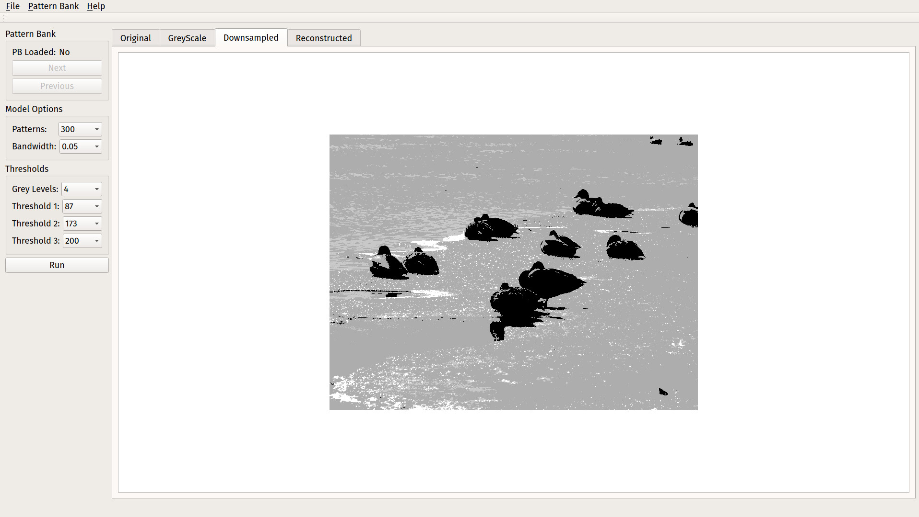
Simulation Demonstrator

Slide 20
Medical Image Processing
The brain emulation algorithm works very well as a contour identification system (edge detection)
We are exploring the use of this filter in Magnetic Resonance Imaging (MRI) for the identification of diseases such as the progression of Mild Cognitive Impairment (MCI) to Alzheimer’s Disease (AD)
In collaboration with the ARIANNA project (INFN)

Slide 21
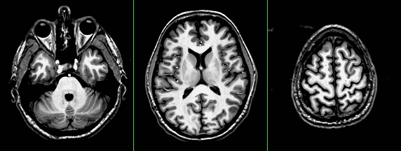
T₁-weighted brain images
Axial slices of a human head with spatial resolution of 1 mm³
Grey Matter (GM)
White Matter (WM)
Cerebrospinal fluid (CSF)
Grey Matter (GM) cortex can by followed and cortical thickness can be evaluated to investigate GM involvement in pathological conditions.
A. Retico

Slide 22
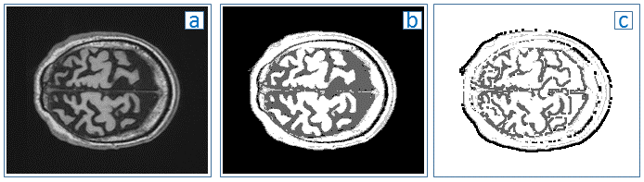
Medical Image Processing
We contacted preliminary studies for the feasibility of the task by using our simulation framework on 2D MRI brain images
A) Input Image B) Thresholded Image C) Filtered Image
We could successfully identify the different regions of the brain

Slide 23
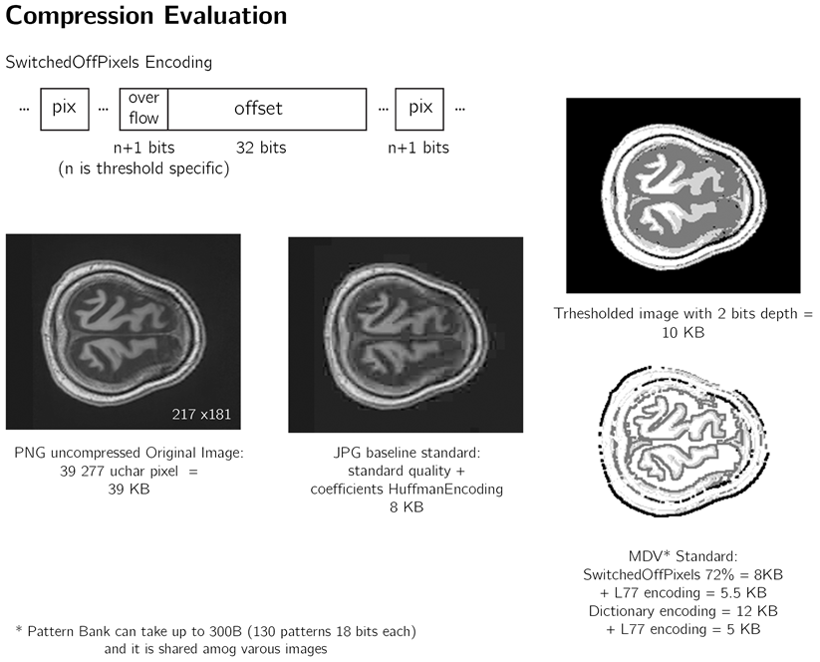
Medical Image Processing
Compression is data dependent

Slide 24
Medical Image Processing
3D edge detection studies

Slide 25
Medical Image Processing
Pearson correlation 0.38 (value over 0.3 is a positive value)

Slide 26
Medical Image Processing
Use the filter for Segmented GM identification for an input to a Support Vector Machine classification method

Slide 27
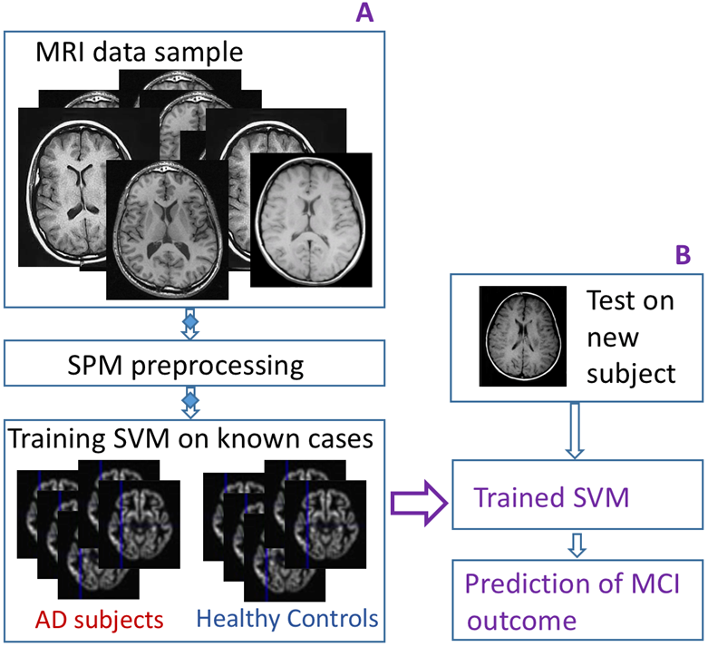
Medical Image Processing
Proposed position of our filter in the data flow

Slide 28
Hardware Implementation
A platform based on FTK hardware is used:
  Combination of powerful FPGAs (Kintex Ultrascale KCU105) with ASICs (the Associative Memory chip – AM)
The filtering is implemented in two phases just like the algorithm
  The Training Phase
  The Pattern Matching Phase
Most of the functions are executed by the FPGA with the only exception being the data taking that is executed by the AM under the FPGA control

Slide 29

Hardware Platform

Slide 30
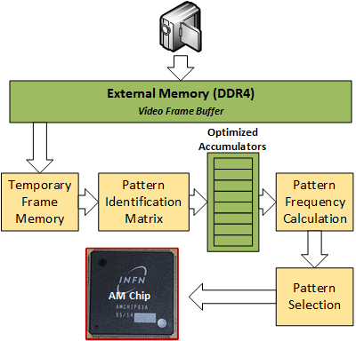
Training Phase Implementation

Slide 31
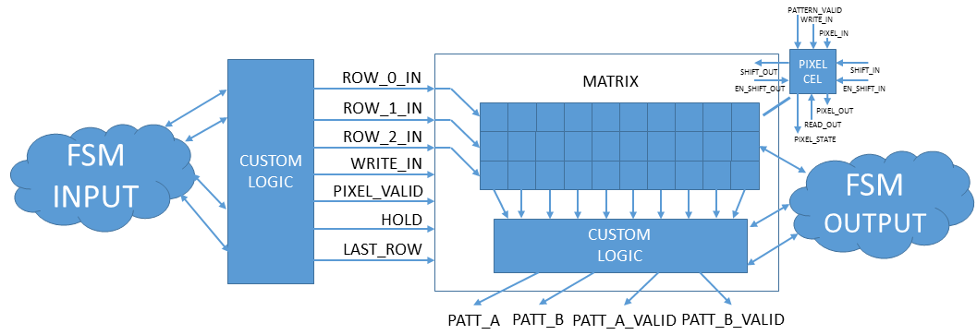
Matrix Identification Module

Slide 32
Pattern Selection Process

Slide 33
Calculate the frequency of each possible pattern
4 Gray levels 2¹⁸= 256 Kpatterns (B/W movement: 2²⁷= 128 Mpatterns)
i. e. pattern = 11,11,11-11,11,11, 01,11,11
Each pattern = its own address
32 b × 256 k
= 500 kB
Pattern = ADDRESS
NumOfAppearances = NoA(pattern)
(movement
32 b ×128 M
= 500MB)
Ext Memory
2 GB
16 bits
18 (or 27) bits
Each Location contains the updated number of appearances of each pattern. When a pattern is identified the specific pattern address is read, contents are increased by one (+1), and written back in the same location - ACCUMULATION

Slide 34
Calculate the frequency of each possible pattern
The Accumulator is optimized to have a throughput of one pattern address per cycle even if the address is the same as the previous one (special design to avoid data corruption)

Slide 35
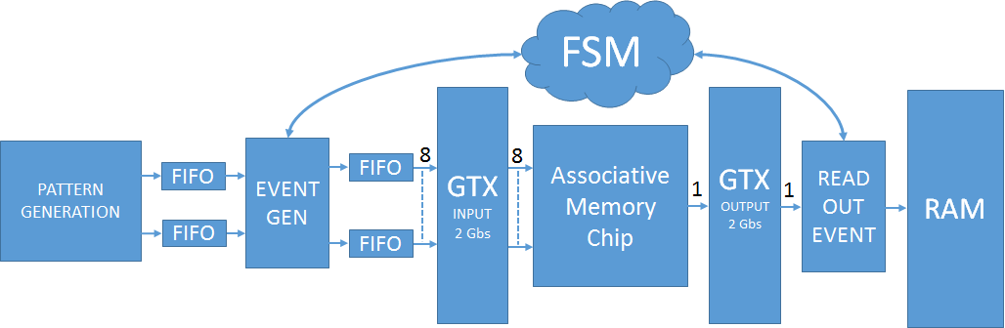
Pattern Matching Phase

Slide 36
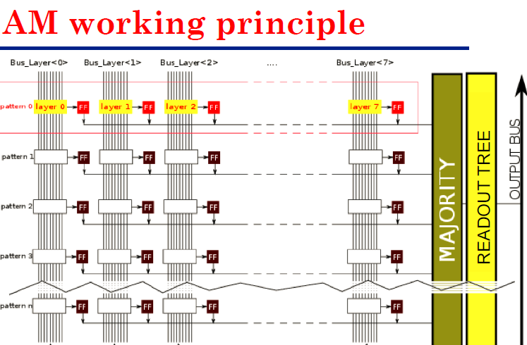
Pattern Matching Phase
4 grey levels $→256 kpatterns→\sim 1\% good kpatterns=2 kpatterns$
GOOD for AM05 used with threshold 1 – same pattern written 8 times in the 8 columns
Each comparison we (1) compare 8 patterns (2) read for each match the bitmap (3) give INIT
………
Patt0 Patt1 Patt2 Patt7
Running Phase
Bus_layer0 Bus_layer1 Bus_layer2 …….. Bus_layer7
layer0
layer1
layer2
pattern0
layer7
layer0
layer1
layer2
pattern1
layer7
pattern2
pattern3

Slide 37
Implementation Results - Training
The training phase has been implemented on a Xilinx Kintex Ultrascale XCU040 of the KCU105
The training phase implementation is generic and the resource requirements change from 2-D to 3-D implementation
2D B/W Images implementation results:
  The implementation requires less than 3% of the FPGA LUTs and 2.5 % of the available BRAMs.
  The clock used in the implementation is 250 MHz.
  To process a sample of 1000 images of 217 x 181 pixel resolution the training hardware requires 116 ms.
  A i7 skylake processor with 8 Gb RAM requires instead more than 32 secs to execute the training algorithm for an image sample of the same size (single thread execution).

Slide 38
Implementation Results – Pattern Matching
The data acquisition phase has been implemented on a Xilinx Virtex V6-240T of the HTG-V6 evaluation board. (Intermediate Step)
The complete data acquisition phase implementation requires 1% of Slice Registers, 1.3% of Slice LUTs, 9 FIFO@36bits logic and 50% of the FPGA device GTX resources.
The clock used in this implementation is 100 MHz.

Slide 39
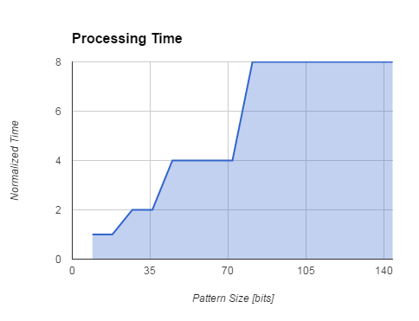
Event Processing Time
Pattern Size [bits] | # of Pattern each Event
9 → 18 | 8
27 → 36 | 4
45 → 72 | 2
81 → 144 | 1

Slide 40
Event Processing Time
(AMBoard Estimation)
We have estimated the processing latency for the data taking exploiting the AM infrastructure of the FTK system
The processing time is ~15,3 ms to filter one 217x181 B/W image (pattern size: 9 bits). The same image when processed by a i7 skylake processor with 8 Gb of RAM requires 170 ms.

Slide 41
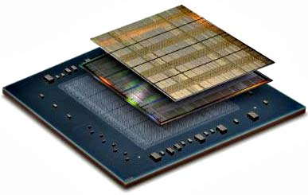
Future Plans
More resources available on the FPGA device → New technology, new design approaches, greater challenges (Ultrascale)
Merge the devices on a single chip (SiP)
Targeting the development of a portable and flexible hardware accelerator (possibly with a PCI type interface) to be easily interconnected with a PC

Slide 42
Acknowledgements
Work funded by Marie Curie IAPP Project Fast TracKer
A big thank you to my group:
  P. Luciano (PhD Student)
  S. Gkaitatzis (PhD Student)
  M. Viti (Master Student)
  And of course to P. Giannetti and M. Dell’ Orso

Slide 43
Thank you!

