Slide 1


Mu2e crystals qualification
I. Sarra
PADME ECal Meeting
8 September 2016

Slide 2
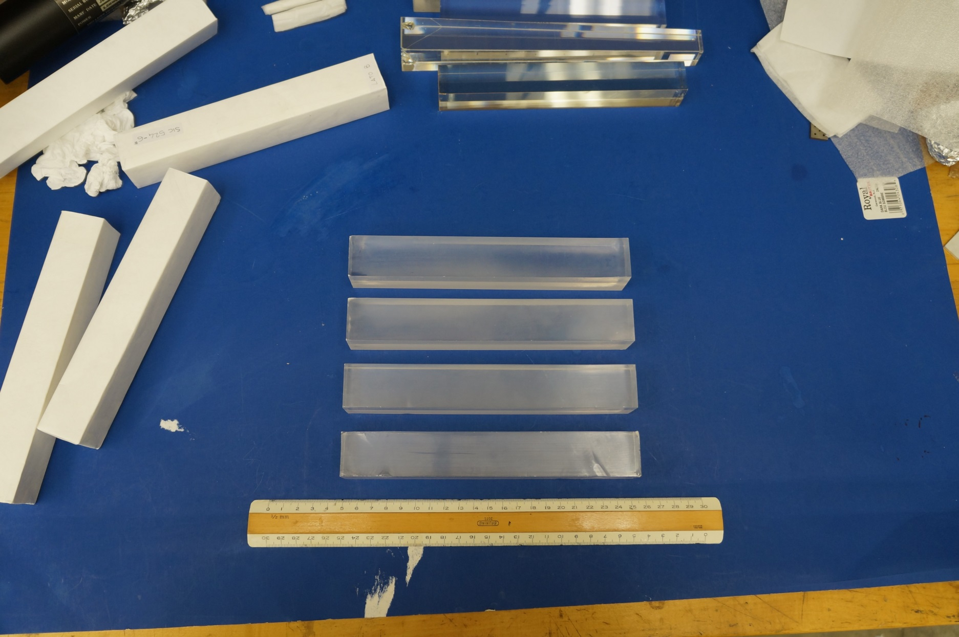
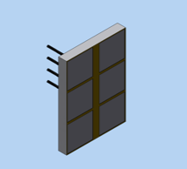
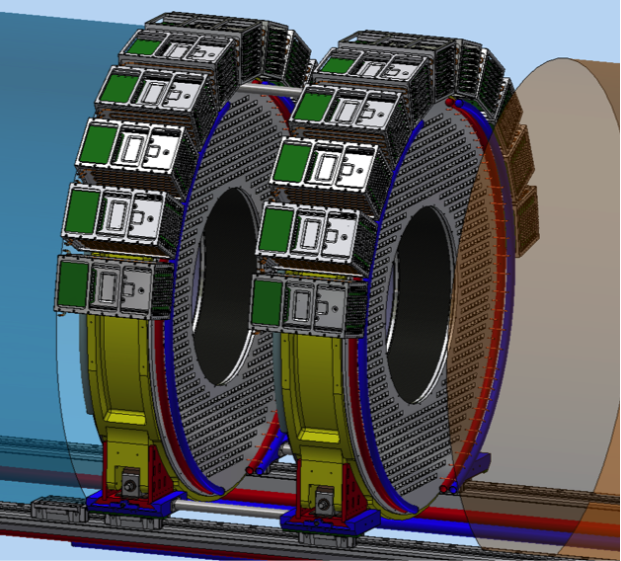
Mu2e Calorimeter: state of the art
The Calorimeter consists of two disks with 674 CsI 34x34x200 mm³ square crystals:
R_{inner} = 374 mm, R_{outer}=660 mm, depth = 10 X₀ (200 mm)
Each crystal is readout by two large area UV extended SiPM’s (14x20 mm²)
Analog FEE is on the SiPM and digital electronics is located in near-by electronics crates
Radioactive source and laser system provide absolute calibration and monitoring capability

Slide 3
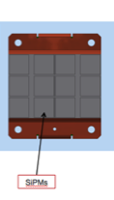
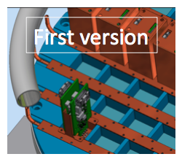
Mu2e Calorimeter: state of the art (2)
High granularity crystal based calorimeter with:
2 Disks (Anuli) geometry to optimize acceptance
for spiraling electrons
Crystals with high Light Yield for timing/energy
resolution → LY(photosensors) > 20 pe/MeV
2 photo-sensors/preamps/crystal for redundancy
and reduce MTTF requirement → now set to 1 million hours/SiPM
Fast signal for Pileup and Timing resolution → τ of emission < 40 ns + Fast preamps
Crystals and sensors should work in 1 T B-field and in vacuum of 10⁻⁴ Torr and:
→ Crystals survive a dose of 100 krad and a neutron fluency of 10¹² n/cm²
→ Photo-sensors survive 20 krad a neutron fluency of 3×10¹¹ n_1MeV/cm²

Slide 4
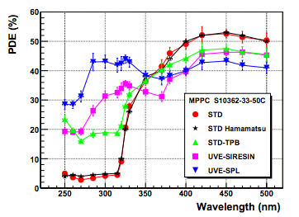
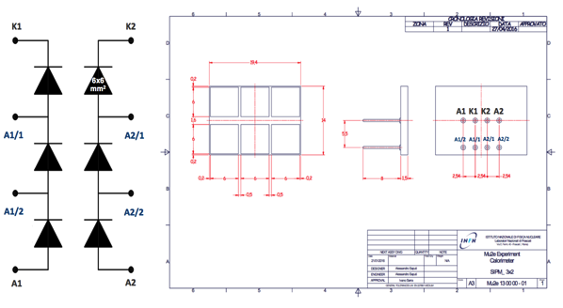
Design: Crystals and Sensors choice
TSV with SPL SiPMs
 | BaF2 | CsI
Radiation Length X0 [cm] | 2.03 | 1.86
Light Yield [% NaI(Tl)] | 4/36 | 3.6
Decay Time[ns] | 0.9/650 | 30
Photosensor | RMD APD | SiPM
Wavelength [nm] | 220/300 | 310
Undoped CsI
Adequate radiation hardness
Slightly hygroscopic
30 ns emission time, small slow component.
Emits @ 310 nm.
Comparable LY of fast component of BaF₂.
Lower cost (6-8 $/cc)
Well know crystal. Mass produced before .. KTeV

Slide 5
Design: meeting the requirements
LNF Test Beam
Energy resolution vs Deposited energies
Mu2e Framework Simulation
Data
MC
Data
MC
σ / E < 7%
dominated by leakage and beam energy spread
LNF Test Beam
Simulation performed as a function of LY and many other variables → CsI+SIPM match requirements.
Test beam with e⁻ @ BTF, LNF 80 to 130 MeV → 3x3 array of 30x30x200 mm³ CsI + MPPC
Good energy ( 7%) and timing ( 110 ps) resolution
Exp tests → Matching EMC requirements

Slide 6
Design: Radiation hardness & cooling
Crystals have been tested up to 100 krad and 10¹² n/cm²
with 14 MeV neutrons i.e. the doses in the experiment with
a safety factor of 3 applied.
→ No major issues/damages observed (LY drop 40% @ 100 krad)
→ Radiation hardness will be part of our QA test procedure
→ Effect of thermal neutrons on Radiation Induced Current
being investigated
Photosensors have been tested up to 20 krad and 3 x 10 ¹¹ n/cm².
→ No problems with dose
→ With neutrons, sensors are still working but
leakage current increases to too high values (a factor ~2000)
→ Cooling photo-sensors to 0 °C is needed.

Slide 7
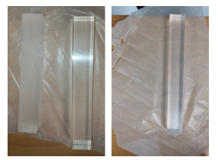
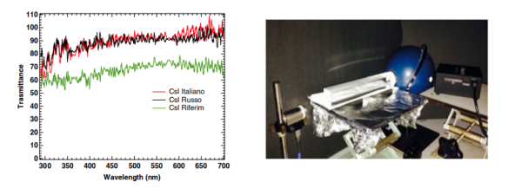
Crystals: Quality Control
Transmittance of the pure CsI has been much improved from 2014
From left to right: SICCAS (2014 sample), Opto Materials and ISMA CsI crystals
D² lamp and diffusive sphere
Spectrometer

Slide 8
Crystals: Quality Control (2)
To study the light yield and longitudinal uniformity of each crystal, we used a low intensity collimated ²²Na source which irradiates them in a region of few mm^{2;}
The source is placed between the crystals and a small tagging system, constituted by a 3×3× 10 mm³ LYSO crystal, readout by a 3×3 mm² MPPC;
One of the two back-to-back 511 keV photons produced by the source is tagged by this monitor while the second photon is used to calibrate the crystal under test, which is readout by means of a 2” UV extended photomultiplier tube (PMT) from ET Enterprises.
The whole system is inside a light tight black box.

Slide 9
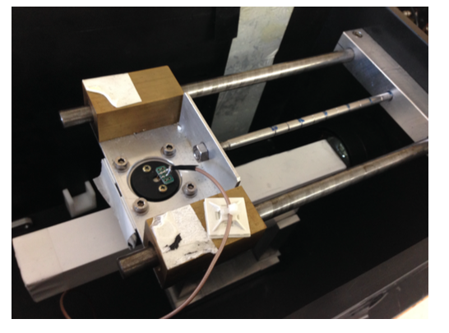
Crystals: Quality Control (3)
For each crystal, a longitudinal scan is done in eight points, with 2 cm steps, with respect to the readout system.
In the scan, the source and the tag are moved together along the axis of the crystal under test with a manual movement.
A complete longitudinal scan takes about 10 minutes. We take 20000 events/point at 500 Hz.
All crystals are tested wrapped with reflector material (Tyvek).

Slide 10
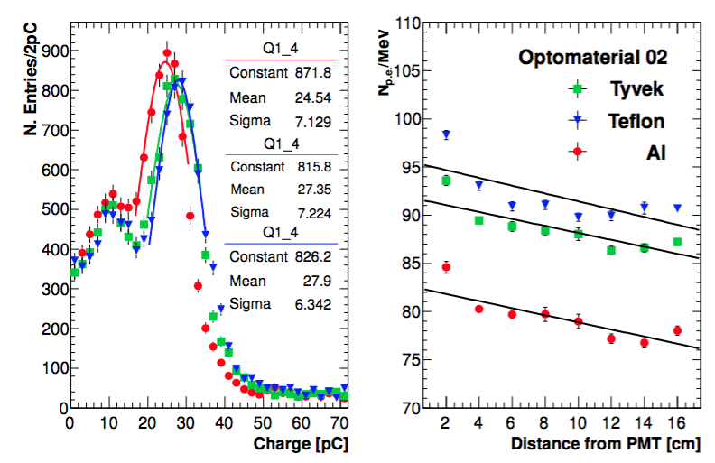

Quality Control: Examples
Charge distributions with the source placed in the central position;
LY, defined as:
To evaluate the longitudinal uniformity, LRU, we plot the light yield as function of the distance of the source from the PMT and we fit the number of photoelectrons produced per MeV with a linear function.

Slide 11
Quality Control: Specifications
Angular coefficients are used to evaluate the LRU.
Specifications are defined according to samples characterized: Kharkov (Ukraine), Opto Materials (Italy), SICCAS (China) and Saint-Gobain (France);
Crystal lateral dimension: ±100 µm, length: ±100 µm.
Scintillation properties measured by a bi-alkali PMT with air gap, coupled to the crystal wrapped with two layers of Tyvek paper:
→ Light output (LO): > 100 p.e./MeV with 200 ns integration gate,
will be defined as XX% of a candle crystal provided;
→ FWHM Energy resolution: < 45% for ²²Na peak;
→ Fast (200 ns)/Total (3000 ns) Ratio: > 75%;
→ Light response uniformity (LRU): < 10%.
Radiation hardness:
→ Normalized LO after 10/100 krad > 85/60%.
→ Radiation Induced Current (RIC) @1.8 rad/h: < 0.6 MeV.

Slide 12
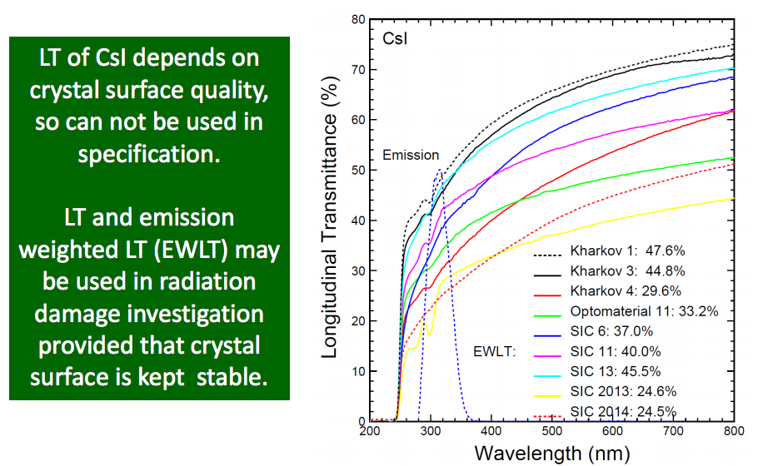
Quality Control: Specifications (2)

Slide 13
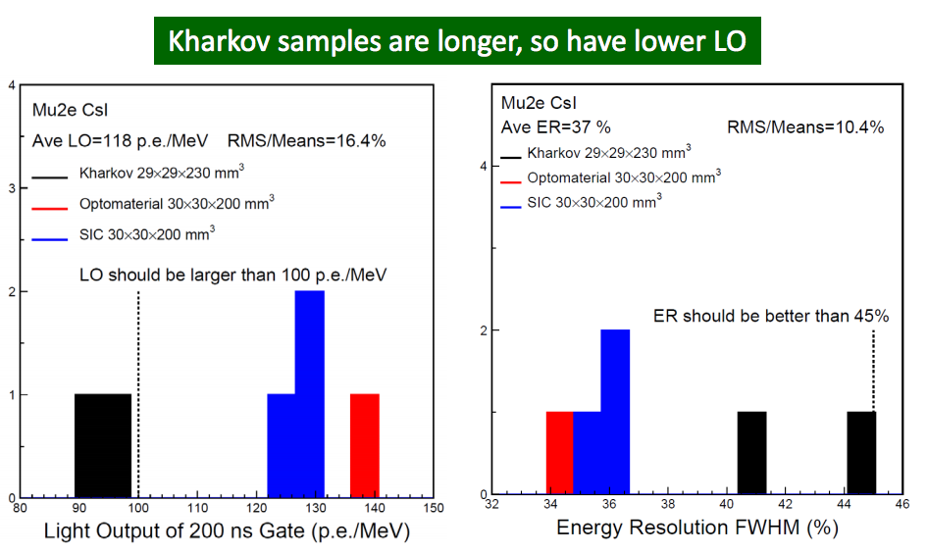
Specifications: LO and FWHM ER Examples

Slide 14
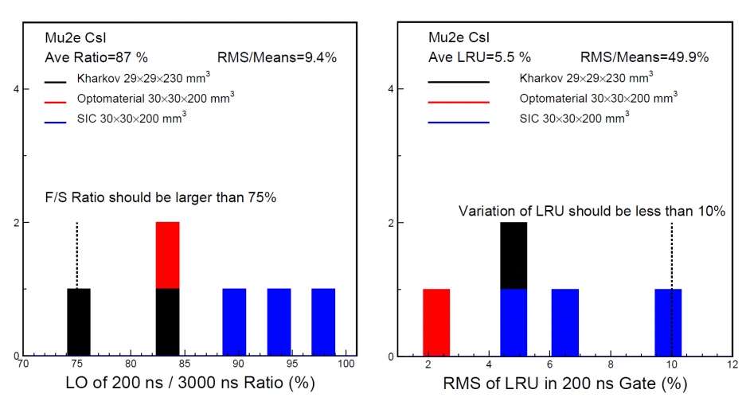
Specifications: F/S Ratio and LRU Examples

Slide 15
SPARES

Slide 16
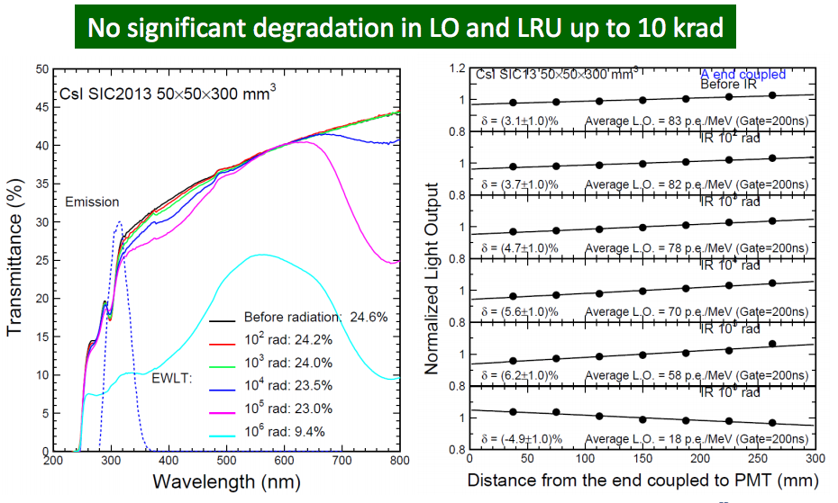
Radiation Damage (1)

Slide 17
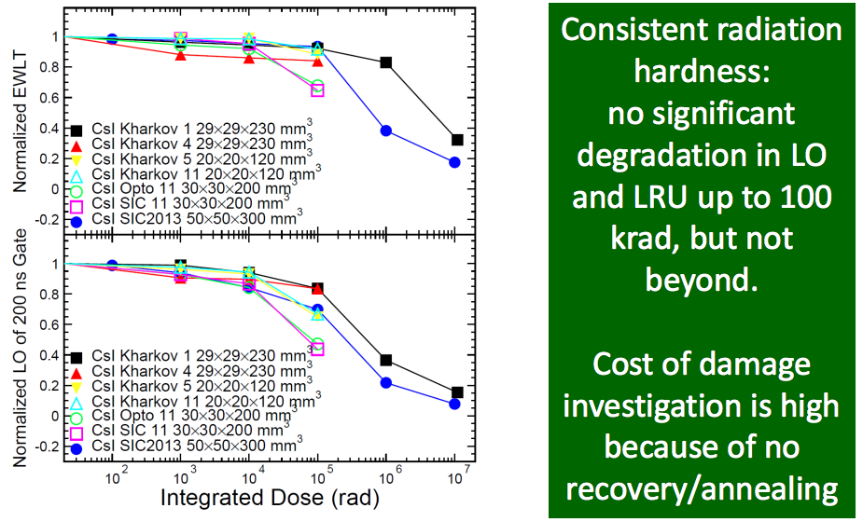
Radiation Damage (2)

Slide 18
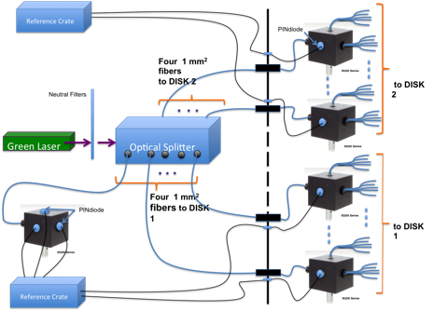
Laser monitoring system -1-
The Mu2e laser system has the main purpose of:
1) Monitor the MPPC Gain
2) Allow fast debugging of FEE + setting (good experience during the last three test beams)
C
B
A

Slide 19
Laser monitoring system -2-
The laser will be split, by means of semi transparent mirrors to 8 beams and focused by optical lens to 1 mm diameter Fused Silica fibers. 1/3 of the light will be sent to a 2” diffusing sphere with 3 pin-diodes for monitoring → A
Eight 60 m long fibers, routed from the counting room to the DS bulkhead brings the light to 8 2” diffusing spheres on the mechanical structure → B
Each sphere, will have 1 pin diode for monitor and 3 bundles of 200 μm silica fibers. Each fiber will be inserted into a lodging in the back of the crystals close to the SIPM holders → C
Laser Trigger will be synchronized with the DAQ
Clock signals and delayed into the beam-off region.
Outside the DS
Feed-throughs for 8 optical fibers
8 Pin Diode cables [coaxial]
Total cross section < 10 cm²
Laser
pulse
Notes:
0.13 mm2 *2400*1.4 = 5 cm2
perche’ non 8?

