Slide 1
First look at test beam data
Mauro Raggi
PADME ECal meeting LNF, 8 september 2016

Slide 2
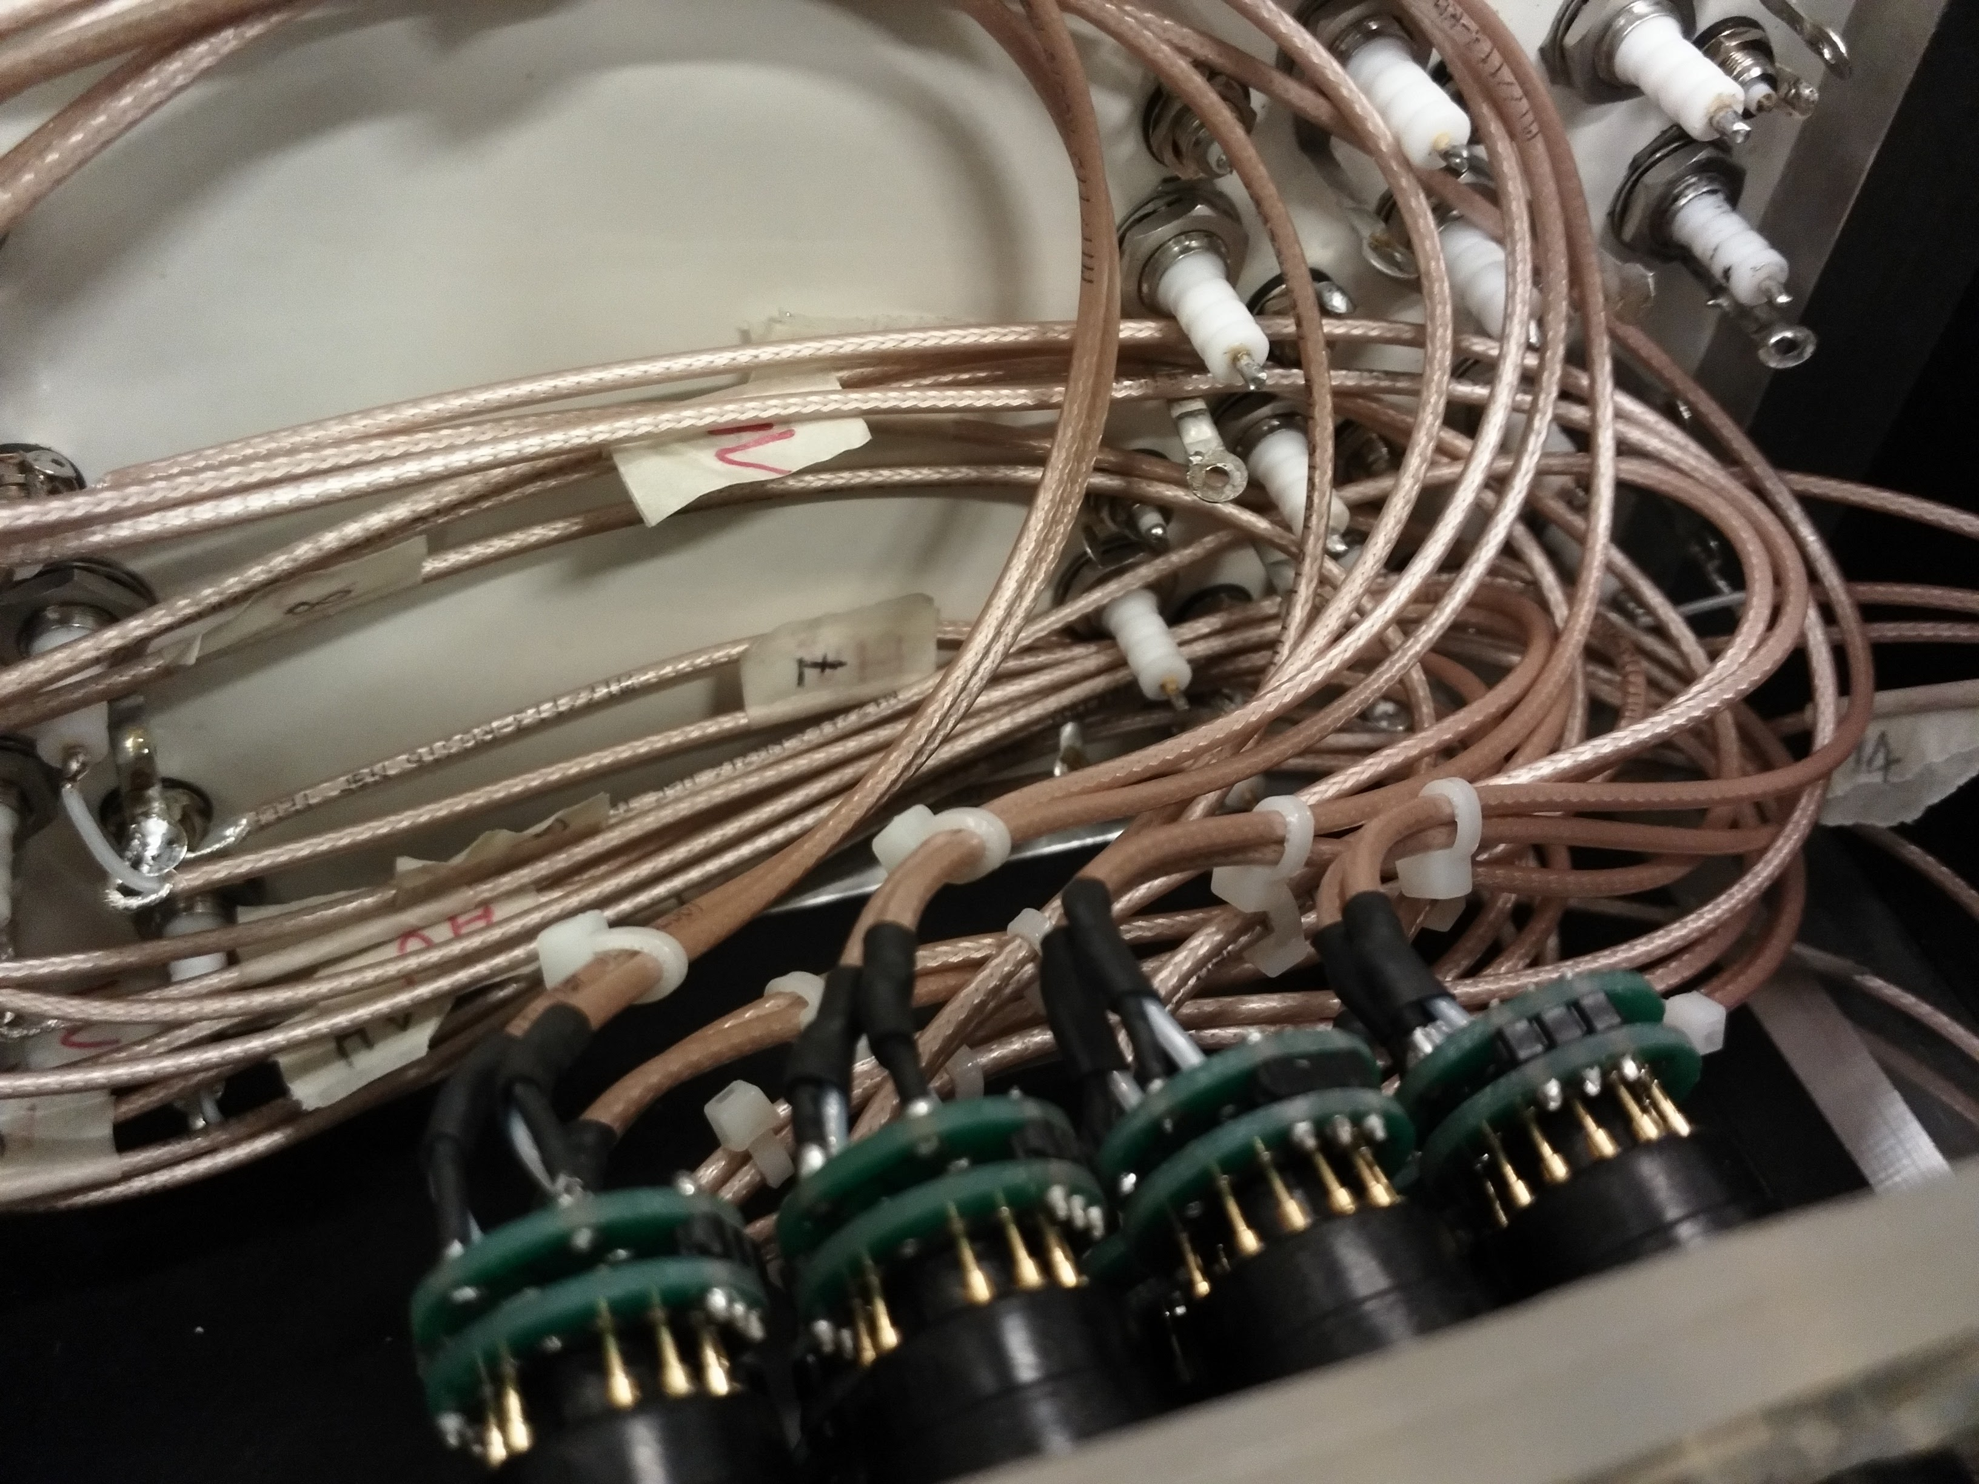
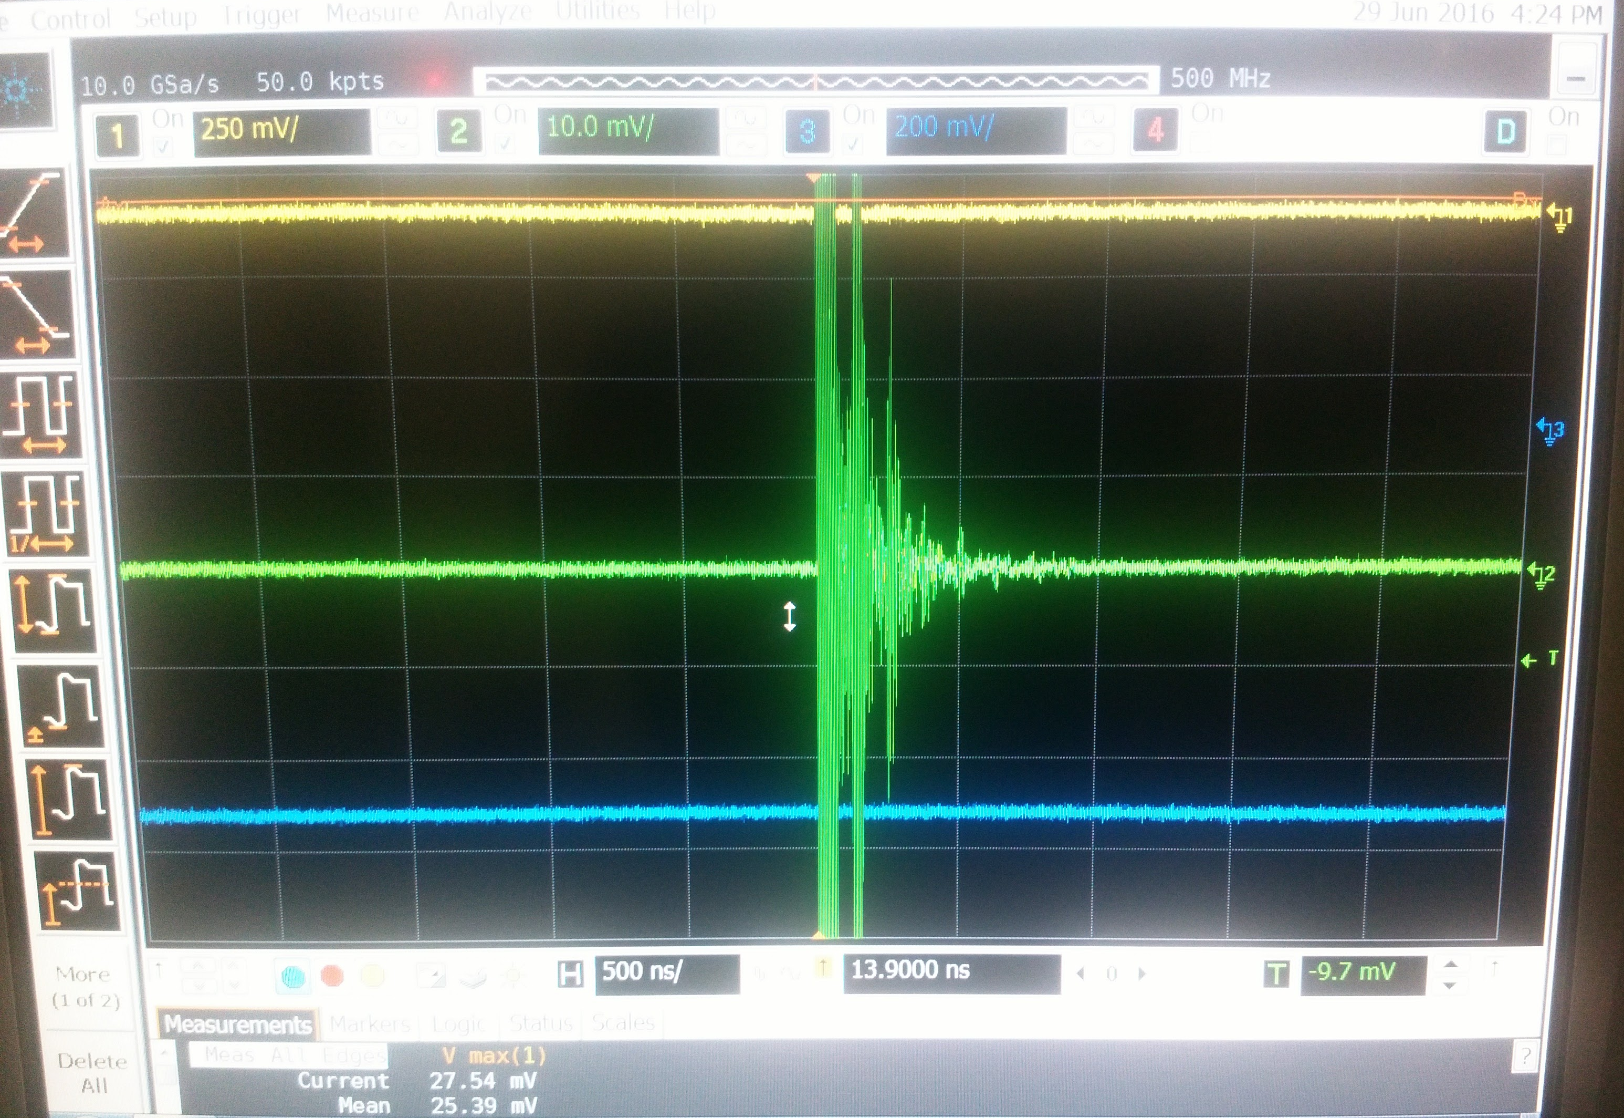
Discharges in HZC PMTs
With naked dividers discharges were observed in the PMTs due to their very small distance (~1mm).

Slide 3
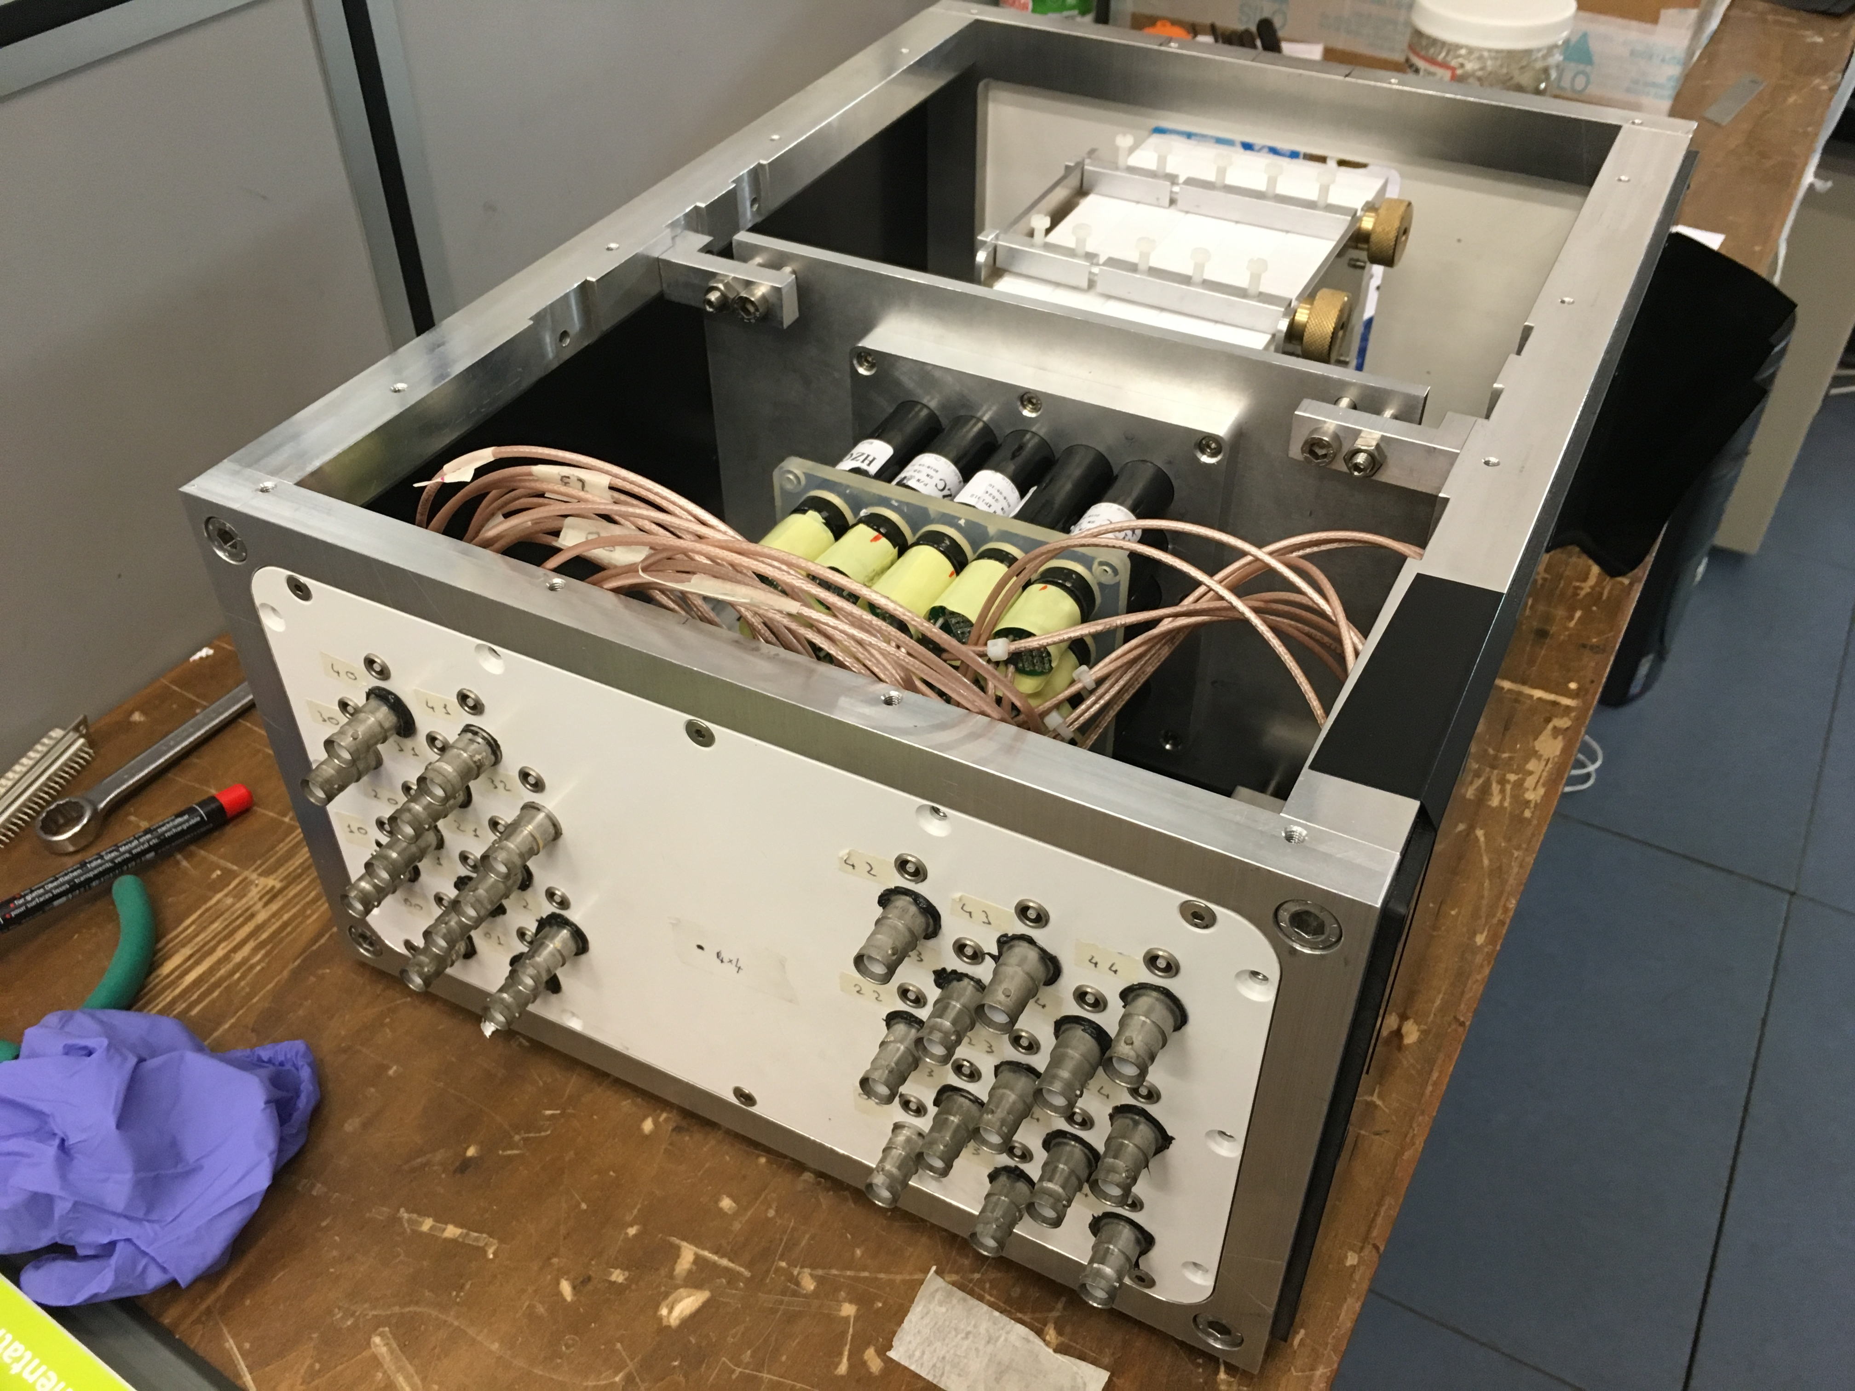
The 25 crystal prototype
Uses 25 20x20x220 mm³ BGO crystals wrapped with Teflon. Coupled to XP911 HCZ photonics PMTs by using optical grease.
PMT high voltage set to the equalization values provided by firm.

Slide 4
Analysis and data samples
By no means official reconstruction used
Basic self made program with no sophisticated treatment of pedestals and saturations
Run 470: 450 MeV ~150K triggers collected
Run 471: 250 MeV ~1M triggers collected
Run 472: supposed to be 150 MeV is in fact 250 MeV

Slide 5
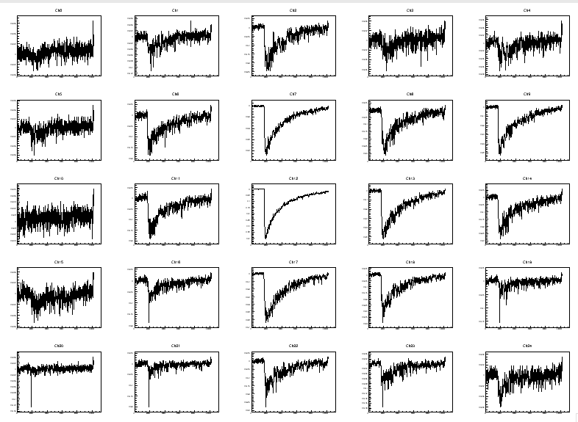
Sample 250MeV event
Seems Off
Do we need some smoothing of the curves?

Slide 6
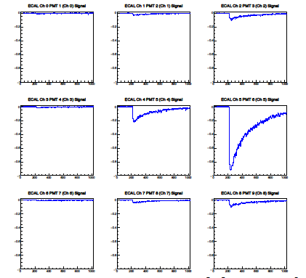
Reconstruction of charge
Pedestal measurement averaging first 100 samples
After reconstructing pedestal average:
Qch=Qch-Ped()

Slide 7
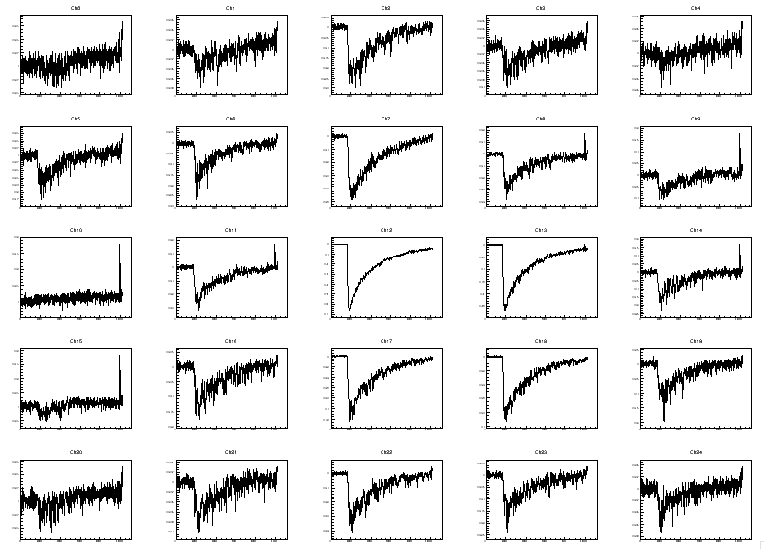
Sample of 450 MeV event
Seems Off

Slide 8
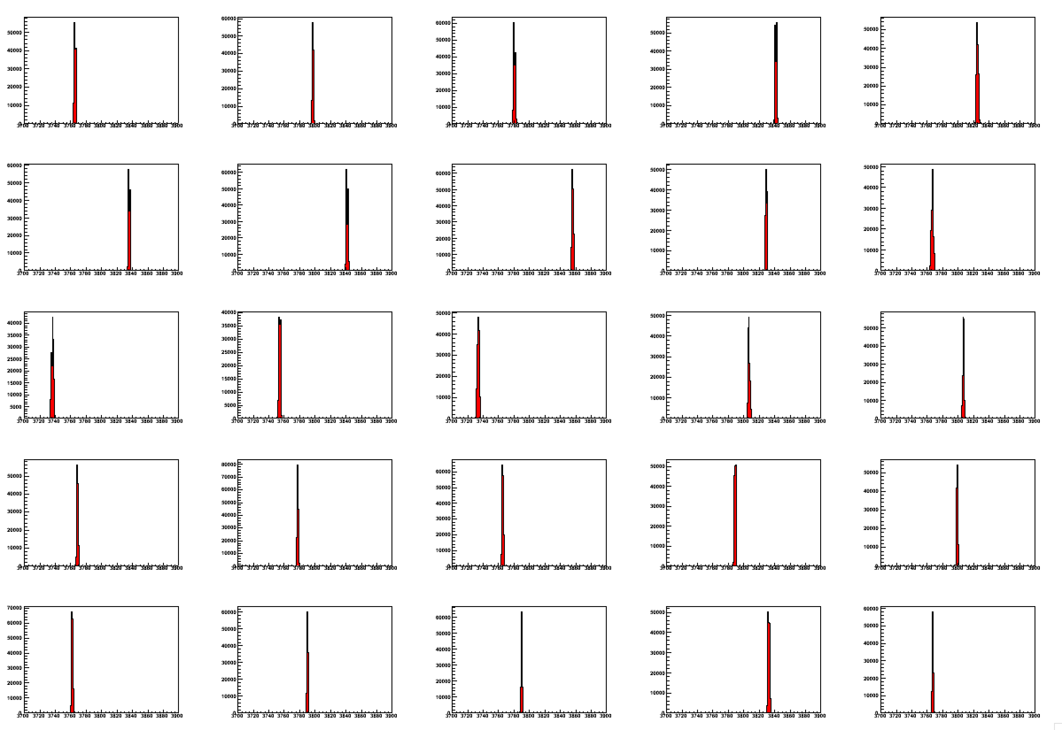
Pedestal average example
QCh(i)=Σ(Sam(i)-Ped_{AVG}(i) )/50*1ns

Slide 9
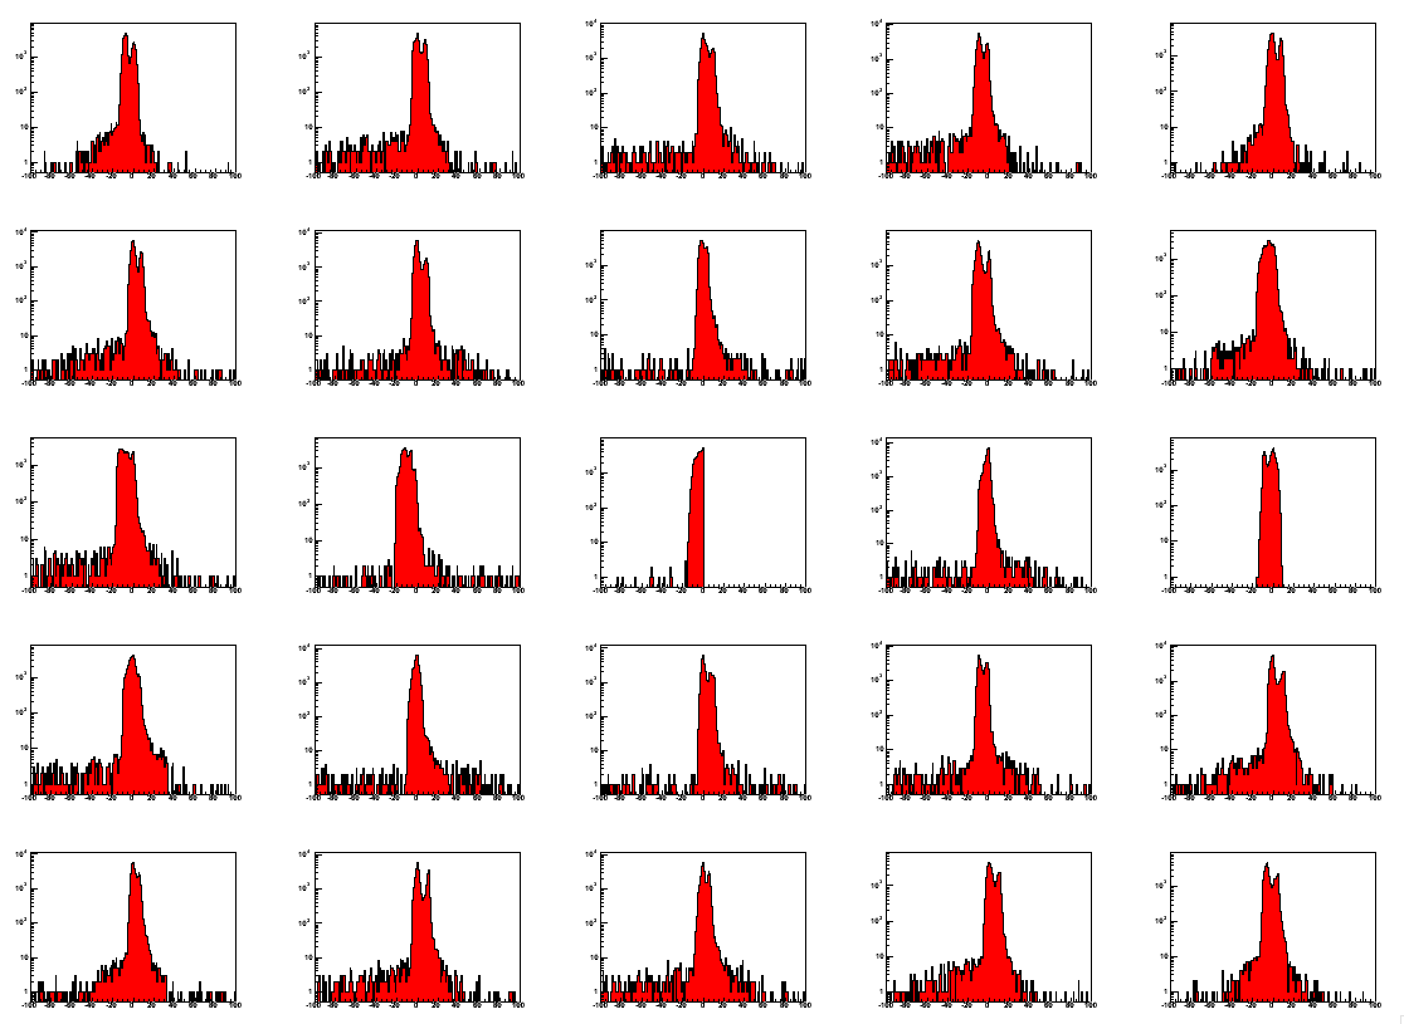
Qch in the pedestal region
Double peaks in the pedestal is a known issue. I get the maximum of this distribution Qped and I subtract it to Qch: Qch(i)=Qch(i)-Qped(i)

Slide 10
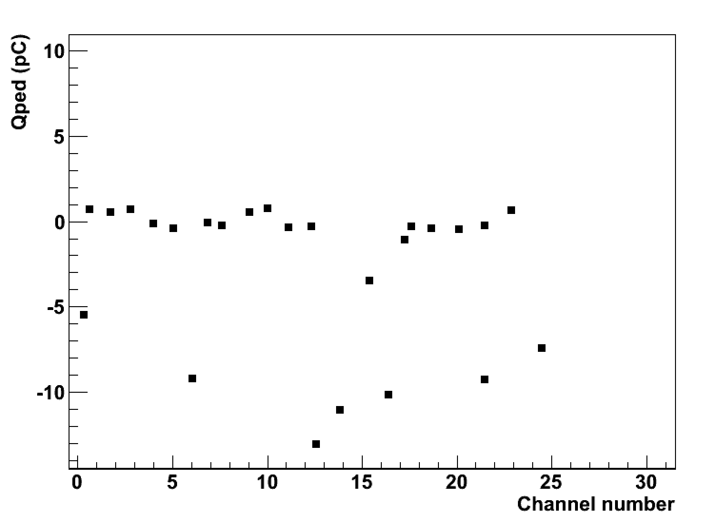
Pedestal after Qch correction
Maximum of the pedestal is now at 0.
Few channels to be fixed

Slide 11
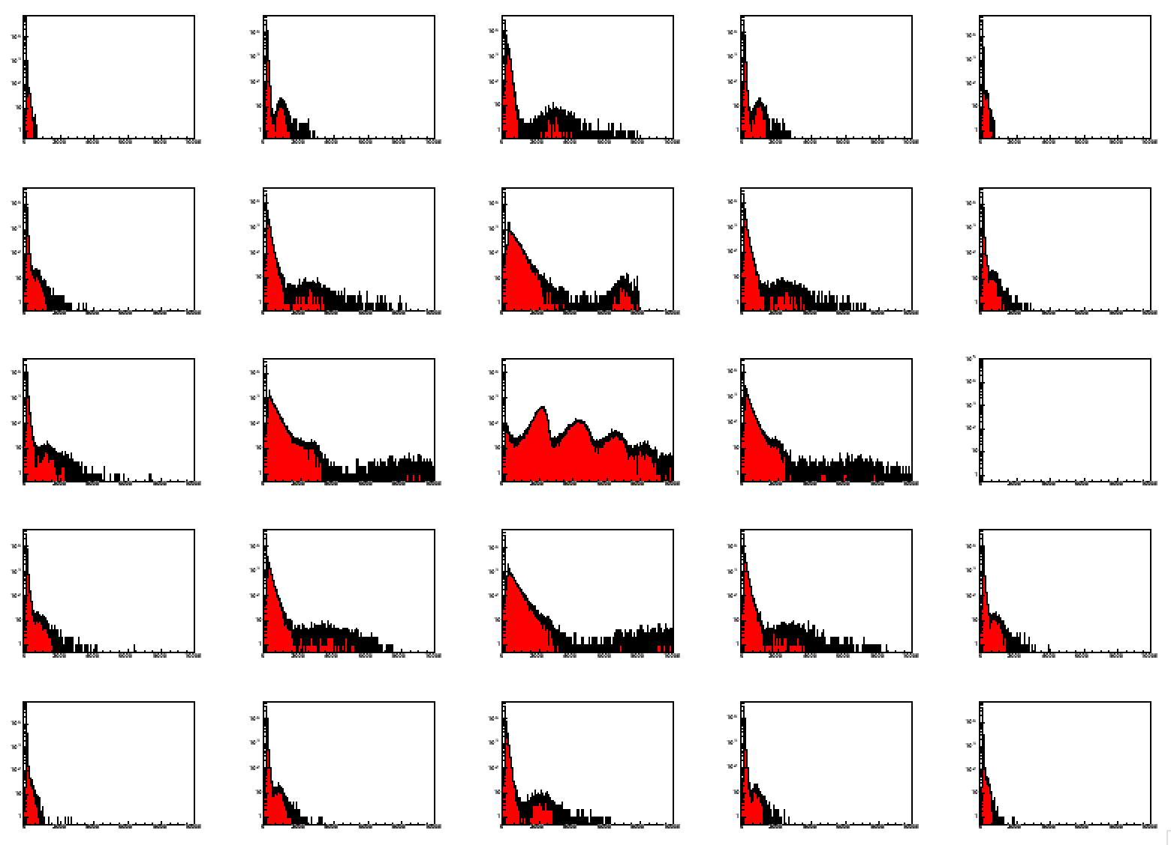
Qch at 250 MeV

Slide 12
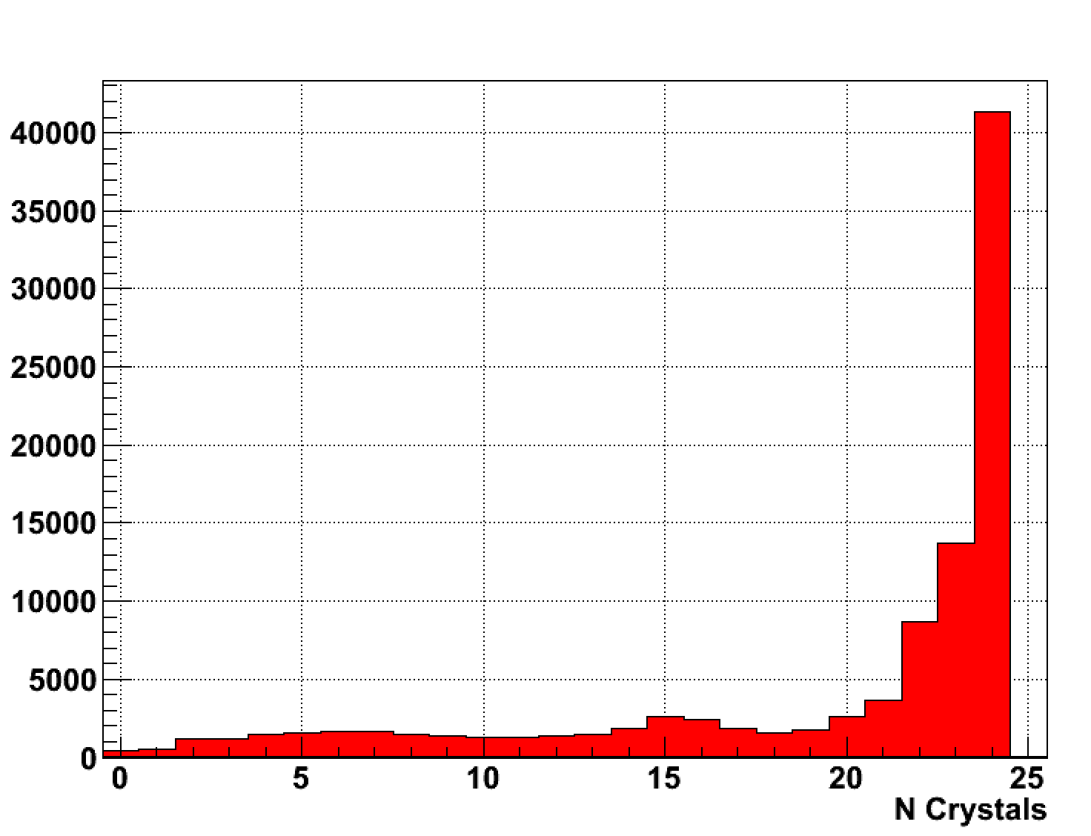
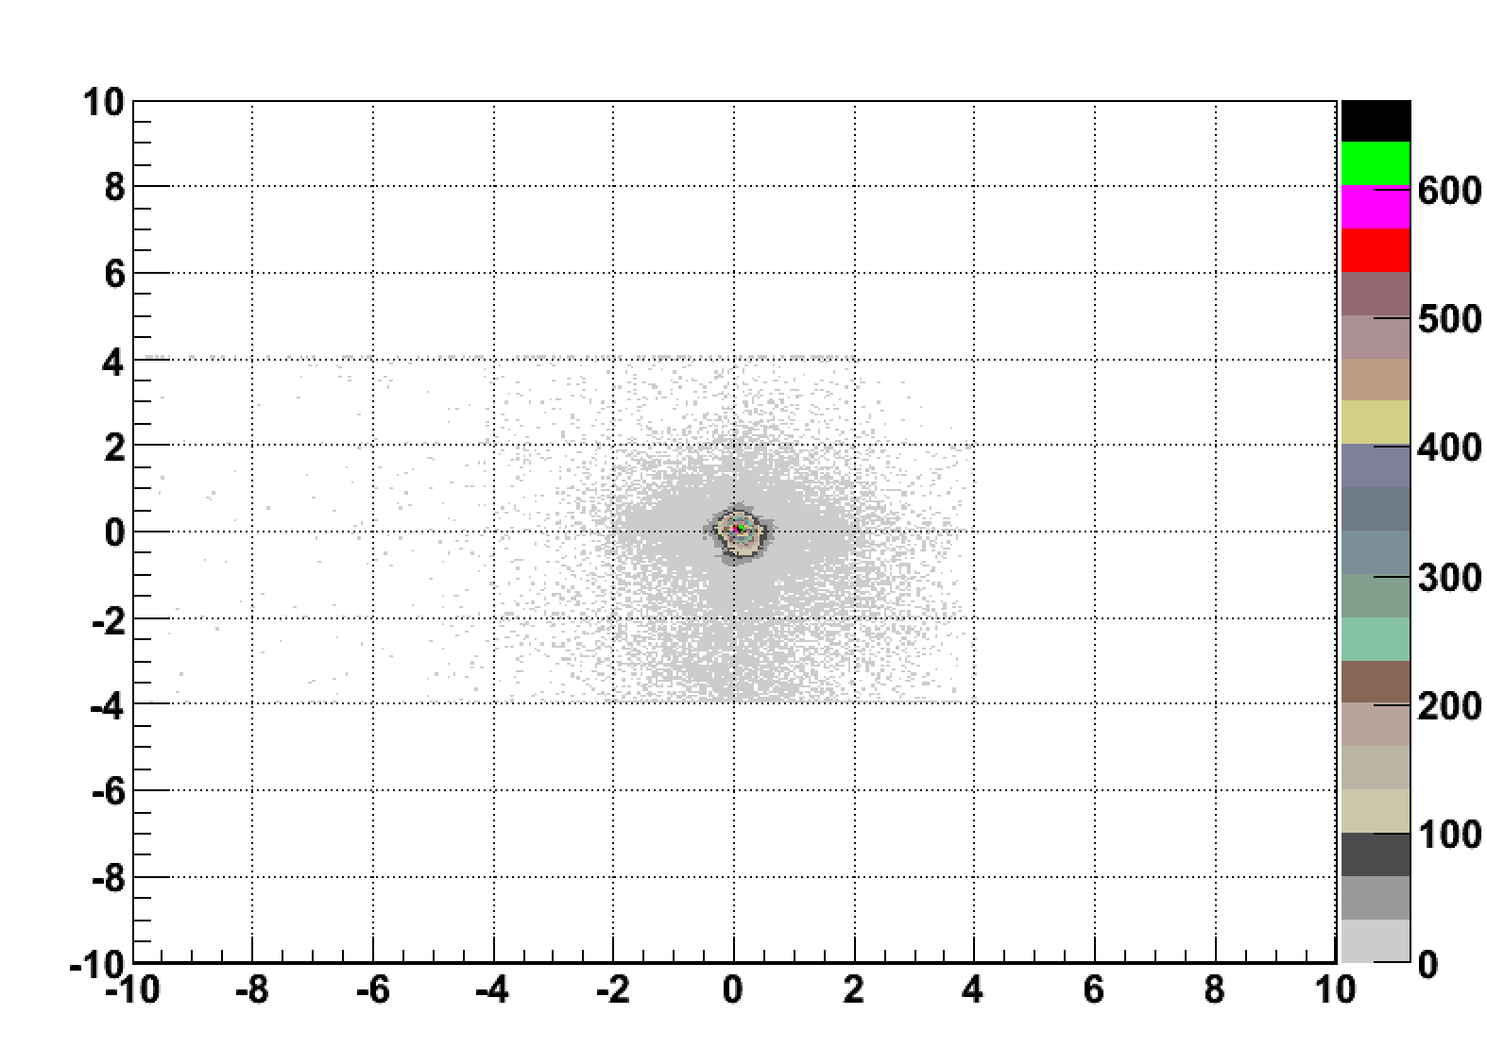
Selection cuts
After reconstructing the charge the following cut are applied
Zero suppression if(QCh(i)>0)
Ncrystals>10
Cluster center radius <5mm
Only events passing the selection enter the Qtot histograms
Can still apply timing cuts to remove accidental low energy photons

Slide 13
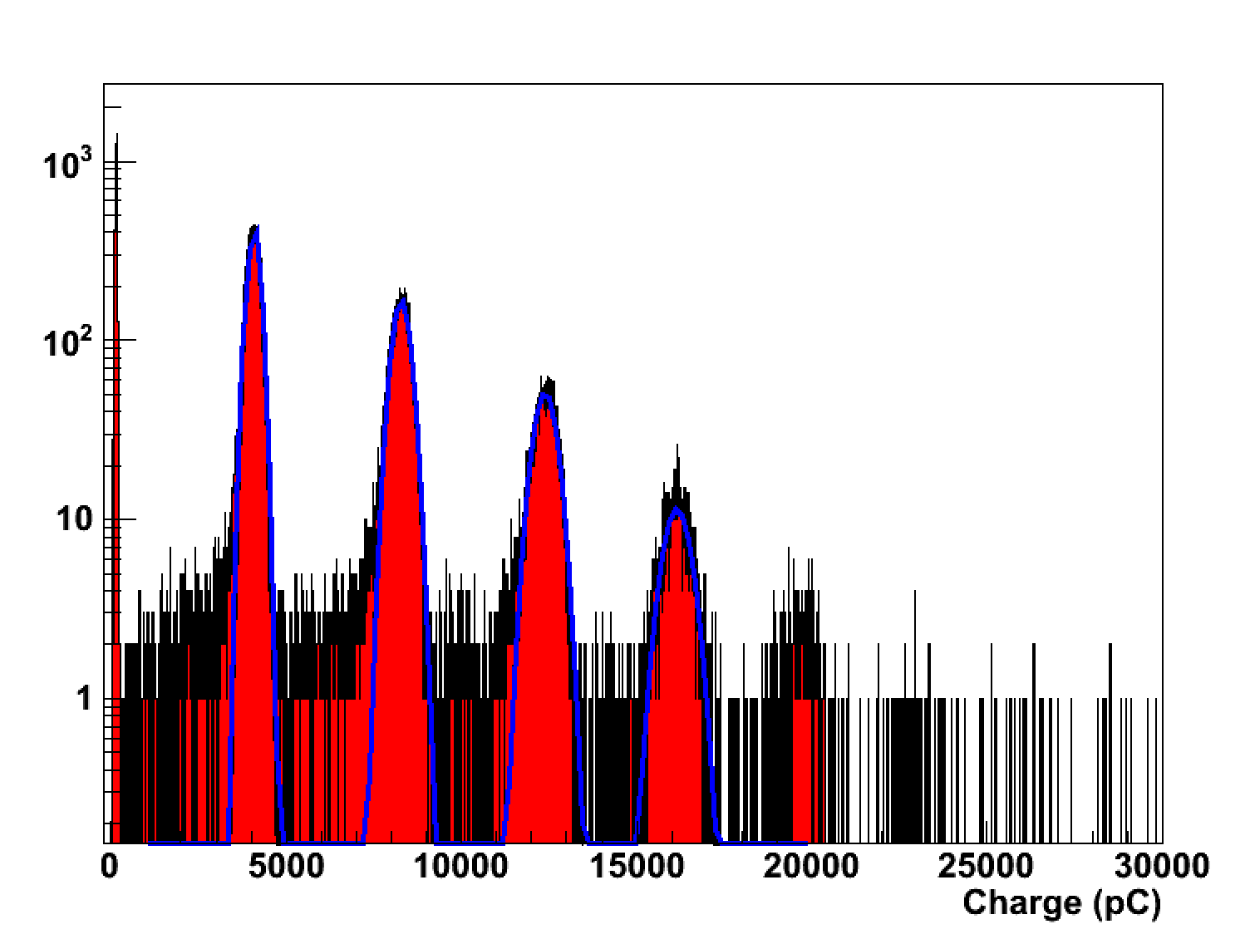
250MeV peaks fit

Slide 14
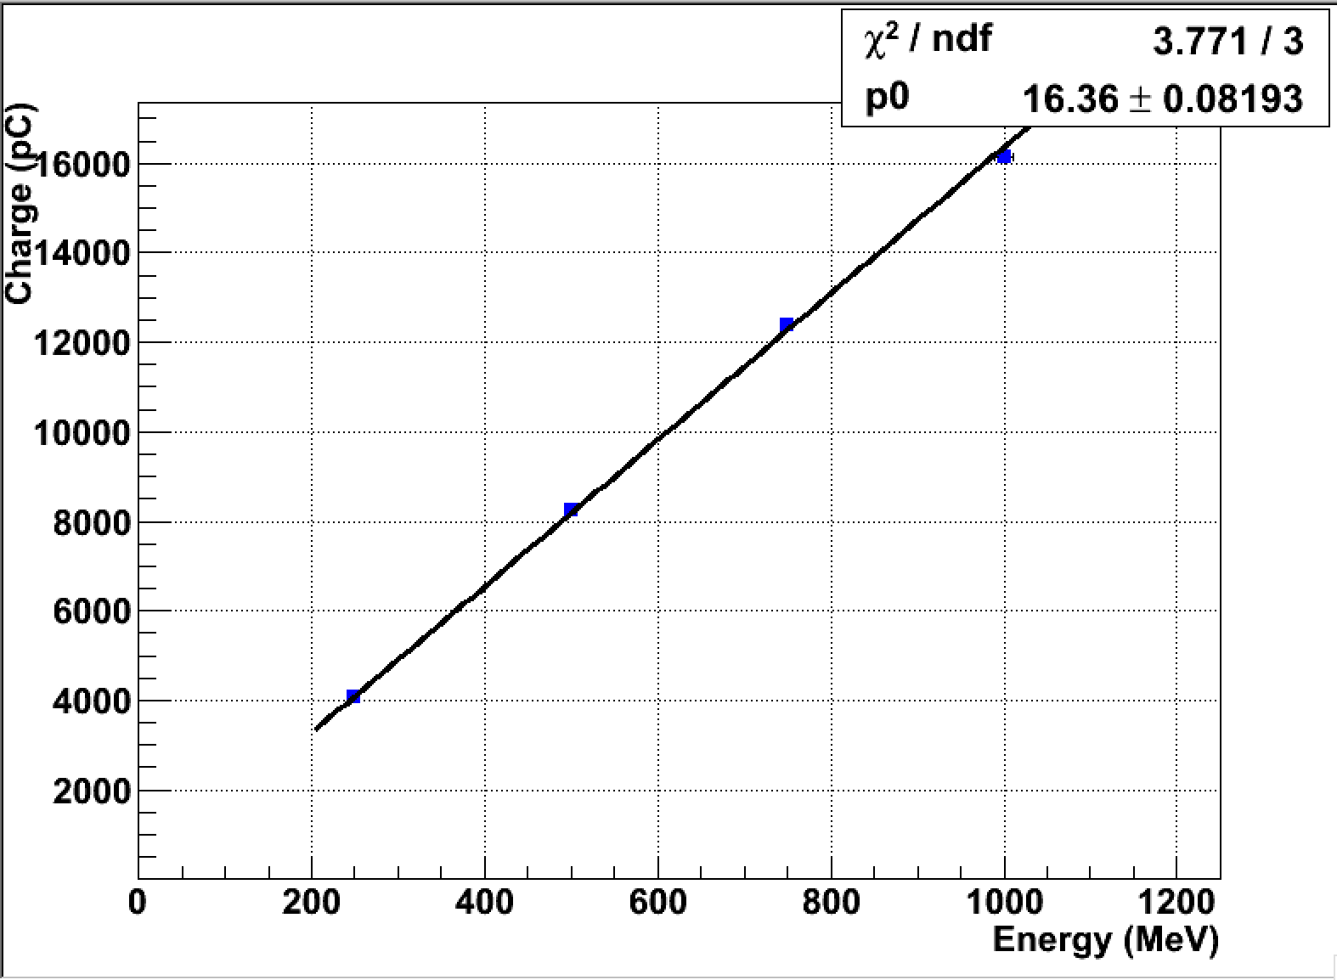
Linearity for the 250MeV series
Good linearity up to 1 GeV!

Slide 15
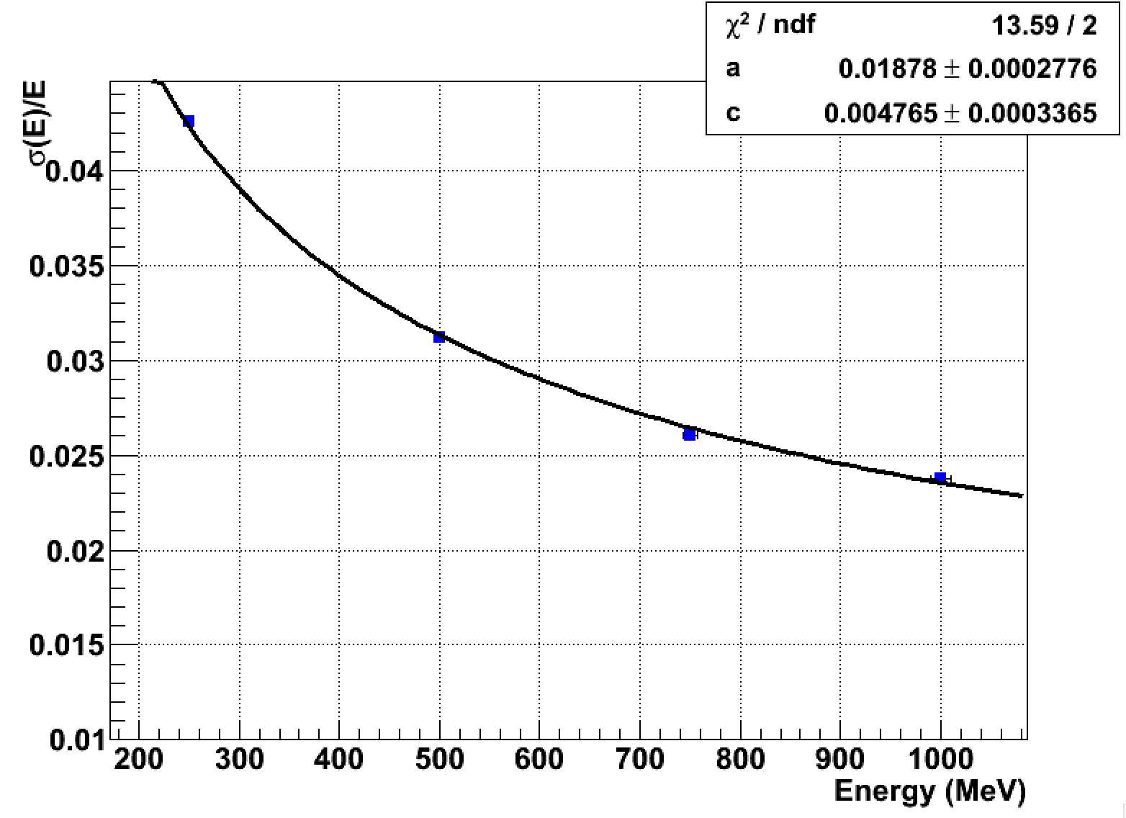
σ(E)/E for the 250MeV run

Slide 16
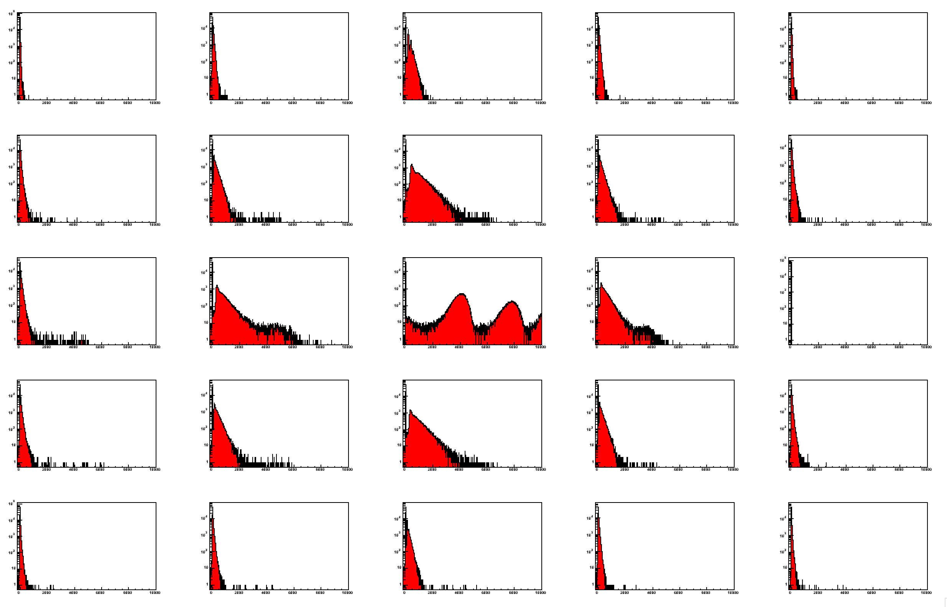
Qch at 450MeV

Slide 17
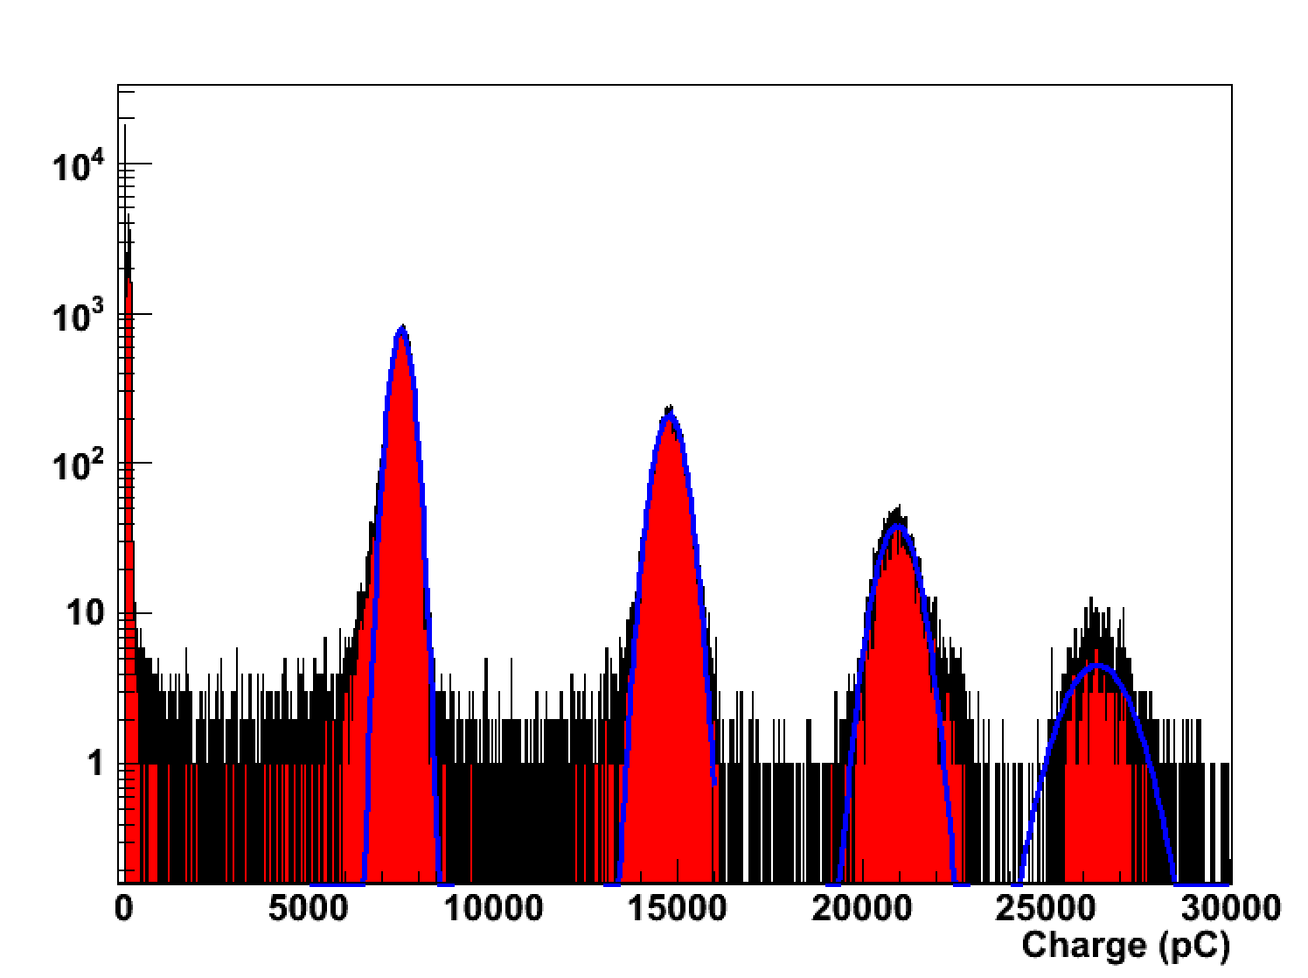
Qtot at 450MeV run

Slide 18
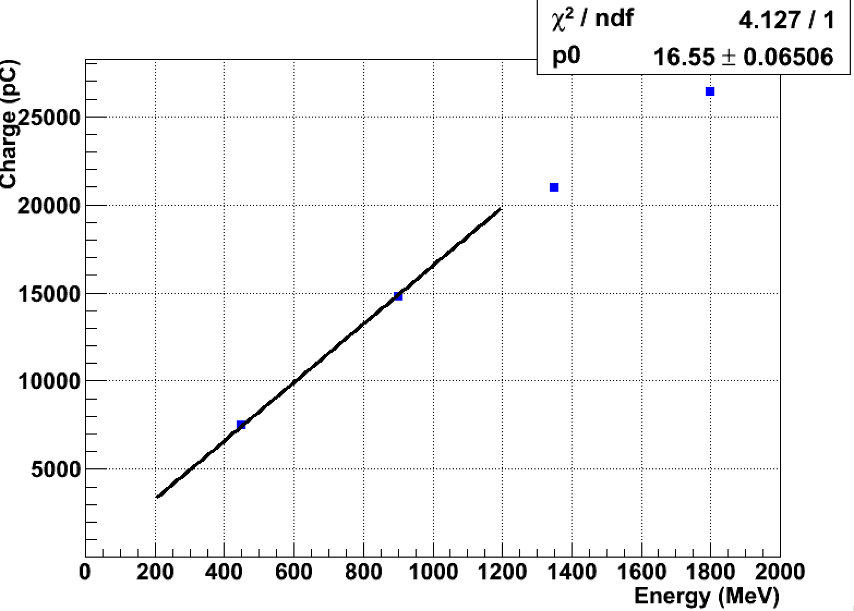
Linearity for 450MeV run
Higly non linear at E>1GeV as expected.
Need larger dynamic range (1V->2V) in the FADC.

Slide 19
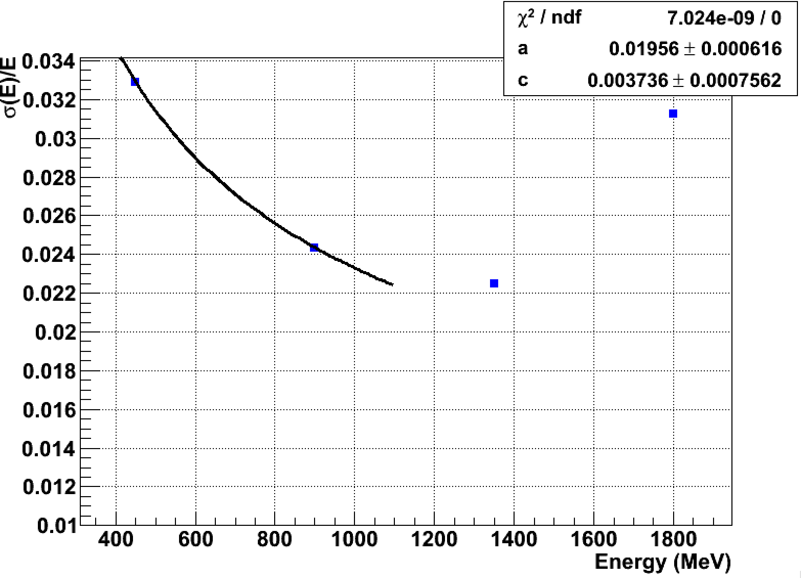
σ(E)/E for the 450MeV run
Non linearity strongly affects energy resolution at E>1GeV as expected.
Can be corrected by fitting the signals?

Slide 20
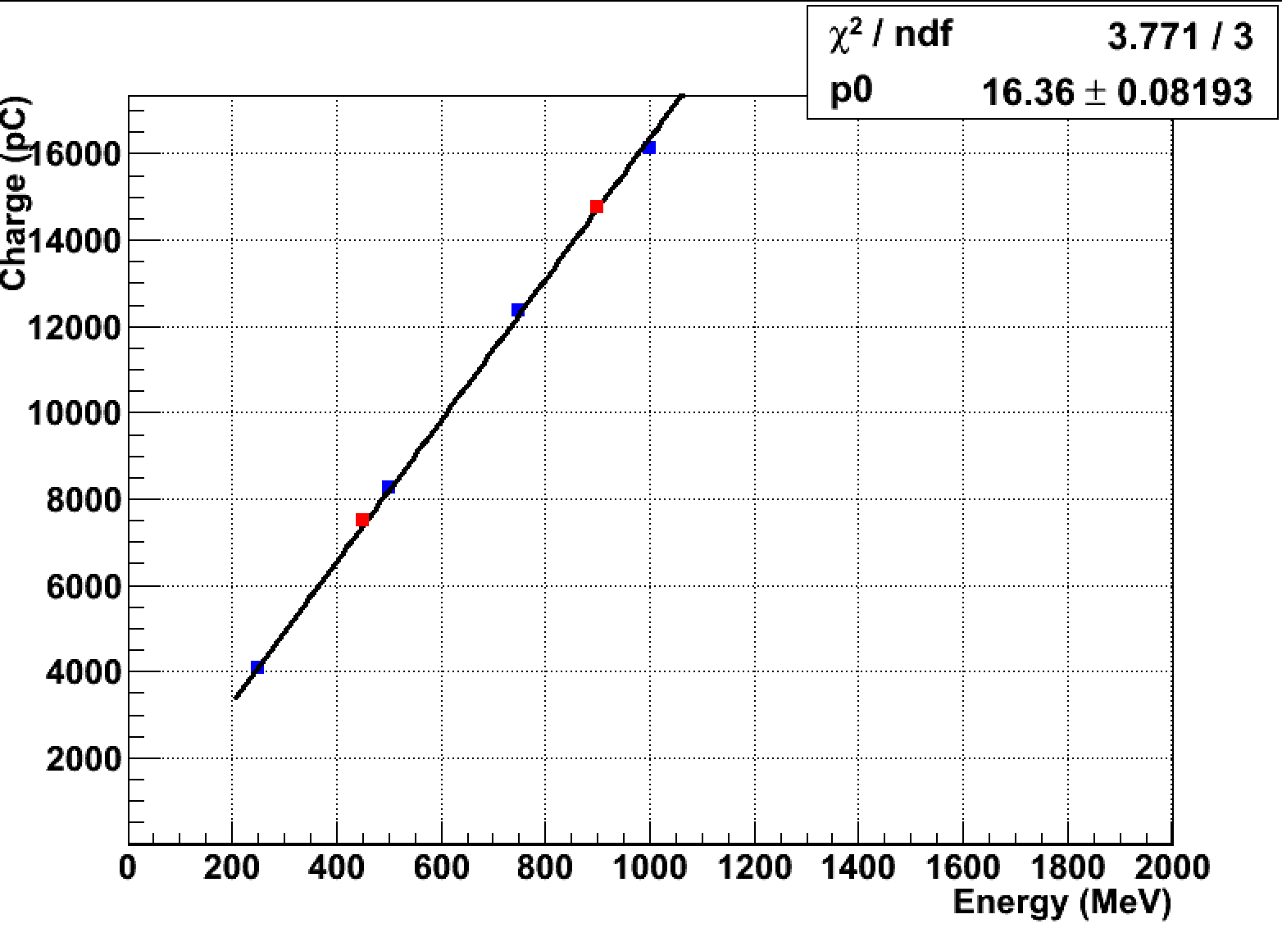
Linearity comparison
Perfect agreement in the linearity fit on blue dots only

Slide 21
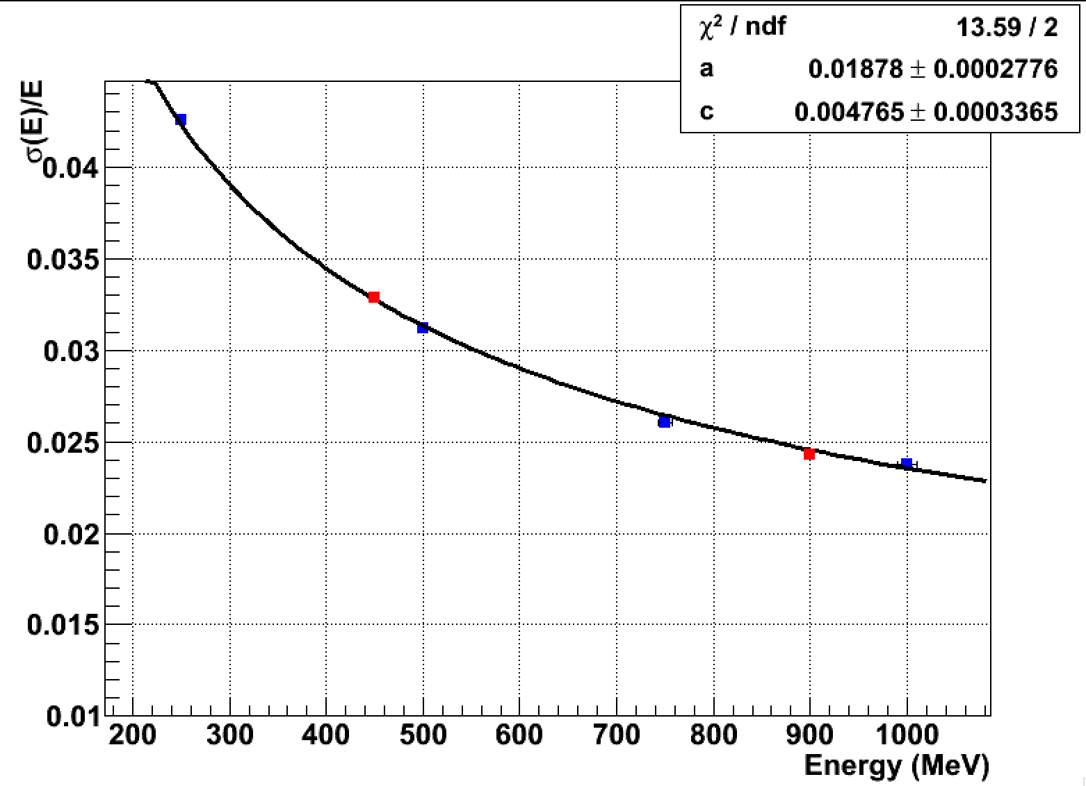
σ(E)/E comparison
Perfect agreement resolution fit on blue dots only

Slide 22
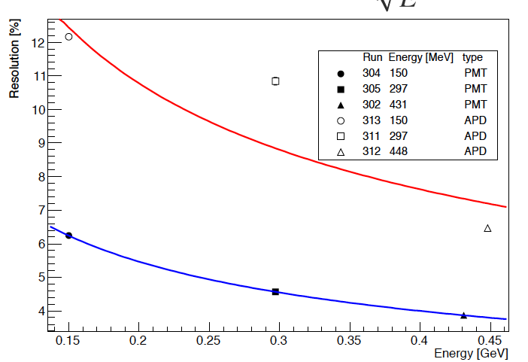
Comparison with old test beam
APD
Ham. S8664-1010
PMT
Ham. 1 inch
Preliminary 3x3

Slide 23
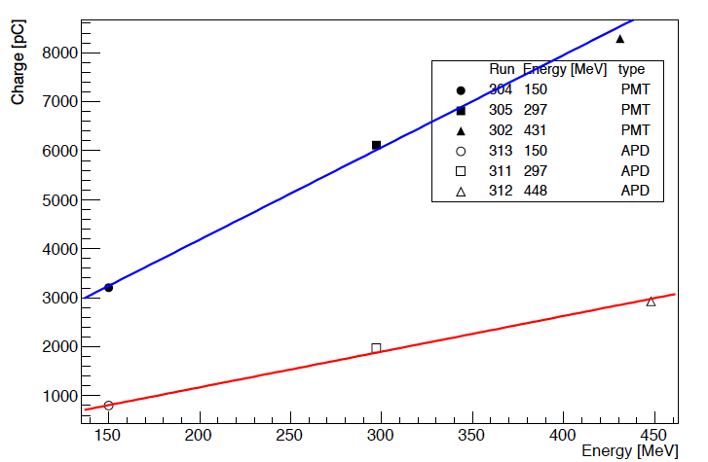
Linearity comparison
PMT HCZ ~16pC /MeV
PMT Hama ~21pC /MeV
APD ~ 5.3pC /MeV
Lower charge collected with respect to Hamamatsu: gain only??

Slide 24
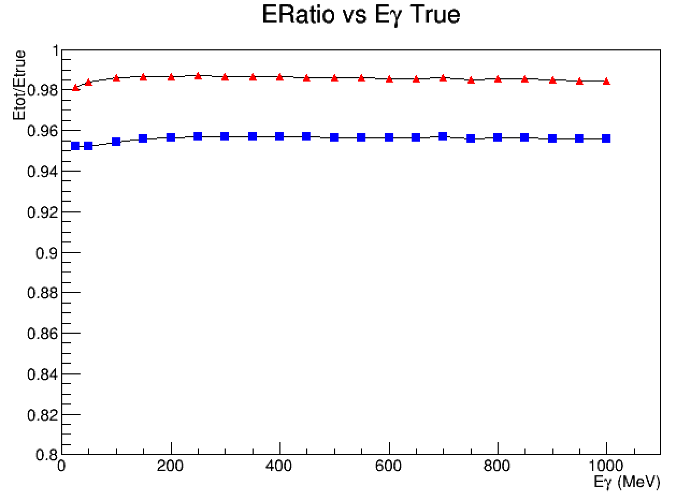
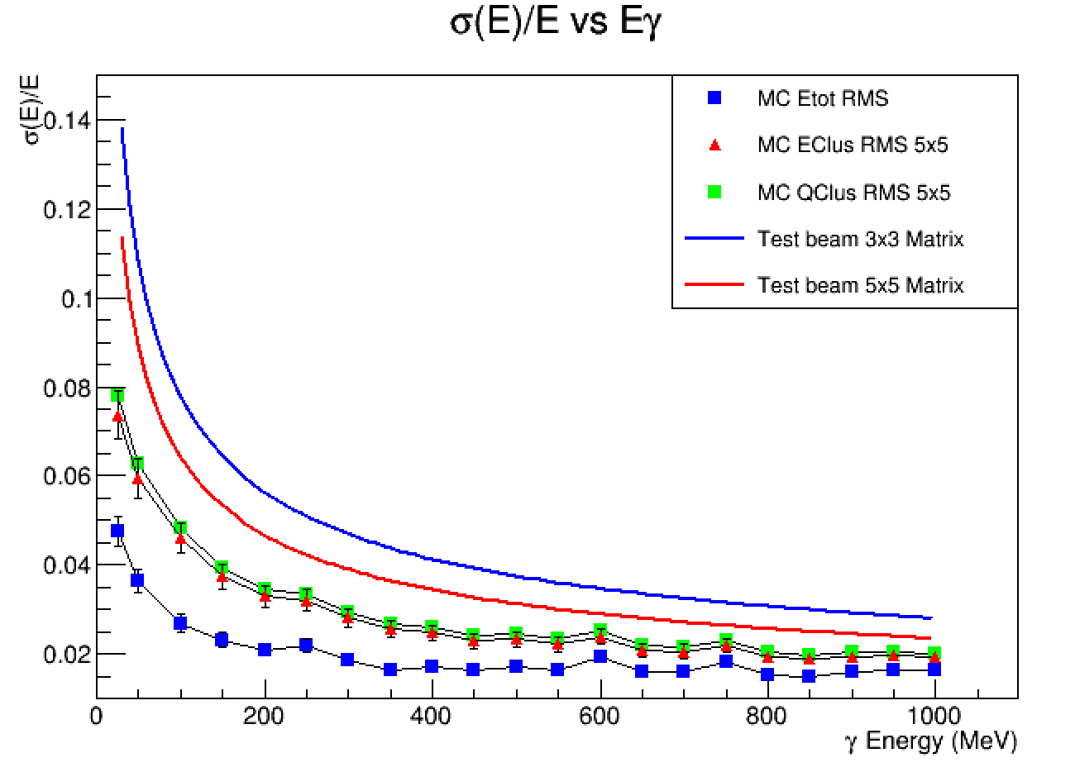
DataMC comparison
Number of photo electrons: 640.
Minimum of the zero suppression in MC: 0.3MeV
Cell to Cell intercalibration errors: None

Slide 25
Data Mc comparison tuning
Measurement of the Np.e.:
NPE: from linearity plot: 16.4pC/MeV
Gain from HZC data sheet ~9x10⁵
Np.e.= 16.4x10⁻¹²/(9x10⁵ x 1.67x10⁻¹⁹)=110 p.e./MeV
Greatest uncertainty on PMT gain (20%-30%)
Minimum of the zero suppression in MC
Minimum visible energy (default per crystal in MC was 0.3 MeV)
Moved to more realistic estimate from data ~1. MeV
Cell to Cell intercalibration
Standard in MC includes no intercalibration errors in cell
Energy scale of single cell in data are different

Slide 26
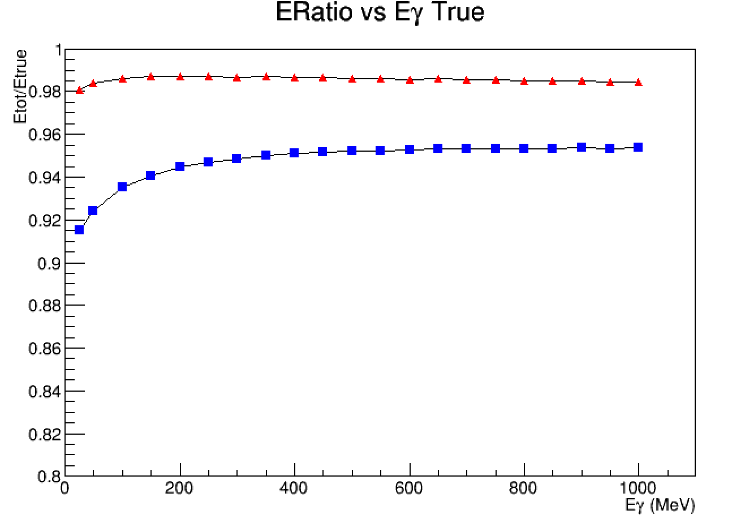
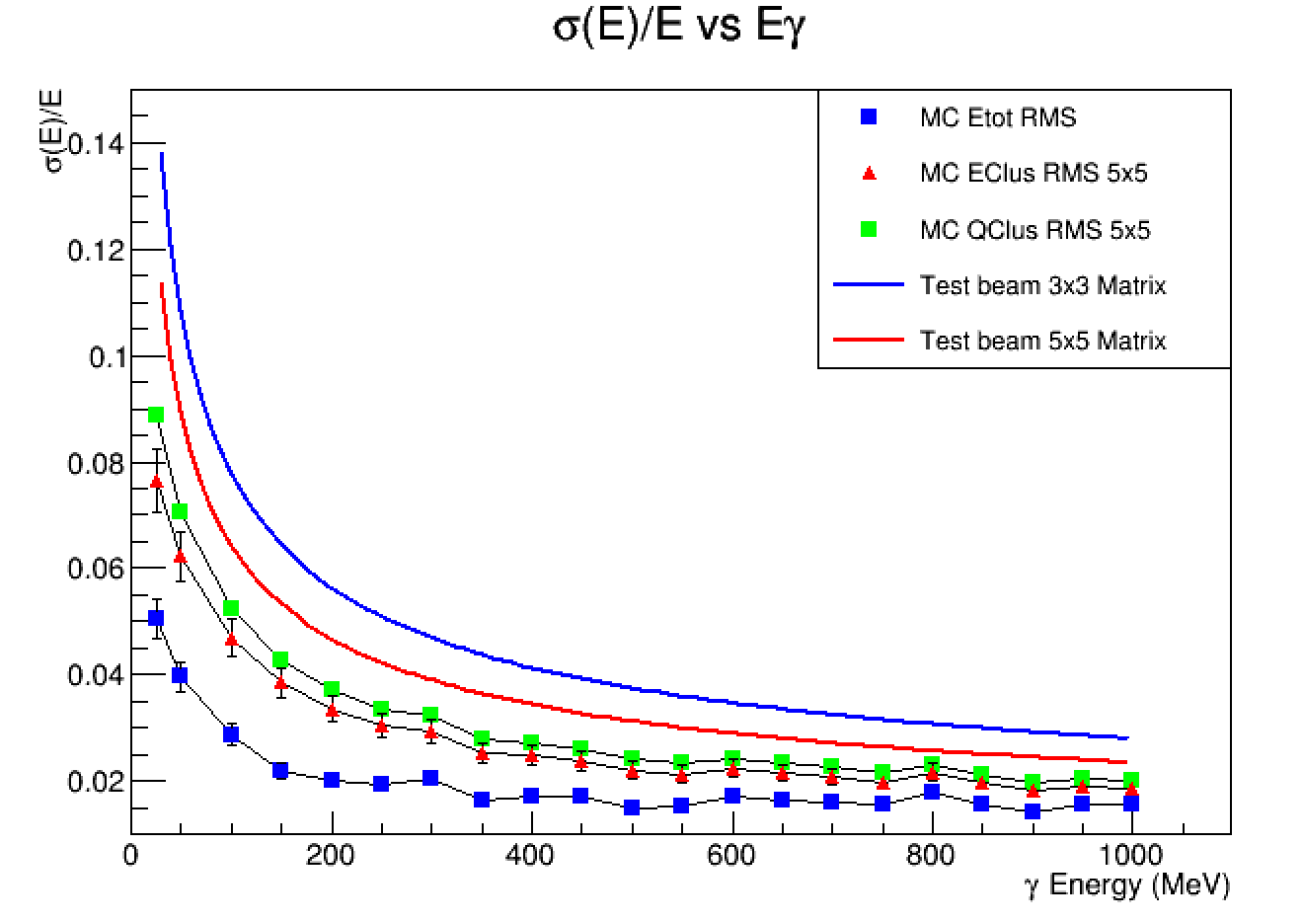
Data MC after tuning
Clear dependence introduced in the energy collection at low energy
Number of photo electrons: 100.
Minimum of the zero suppression in MC: 1MeV
Cell to Cell intercalibration errors: None

Slide 27
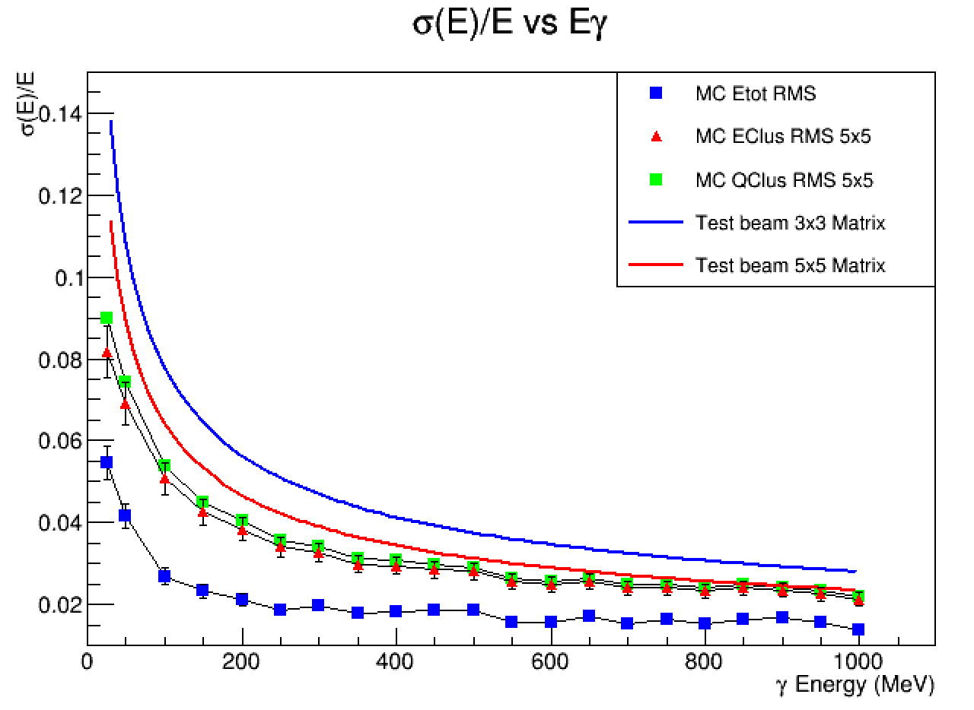
Calibration constant gaus at 10%
Introduced a random gaussian distributed Cij for each crystal.
When summing each single charge or energy value E=Eij*Cij
Result is a different behaviour at high energy where the number of involved cells increases. No changes at low energy.

Slide 28
Conclusions
The test beam data provided a good sample of data to study the 5x5 crystals prototype.
Missing glue and paintings. Partially calibrated crystals.
One of the crystals off
The resolution obtained in ~ 1.9%/sqrt(E)+0.47%
The resolution is understood in term of the PADME MC simulation
Better measurements of minimum energy threshold will help improving the resolution in the low energy part of the spectrum.

