Slide 1
Report on B2TiP activities
Christoph Schwanda (HEPHY Vienna)
JENNIFER Consortium General Meeting
September 22, 2016, QMUL, London UK

Slide 2
B2TiP concept
The “Belle II Theory Interface Platform” is a joint theory-experiment effort to define the Belle II physics program
B2TiP is organized in 9 working groups
The charge of each WG is to identify the “golden modes”, perform simulation studies and finally produce a chapter of the B2TiP report
The activity is driven by a series of workshops

Slide 3
B2TiP WG structure
WG1 | Semileptonic & Leptonic B decays
WG2 | Radiative & electroweak penguins
WG3 | α (φ₂) and β (φ₁)
WG4 | φ₃
WG5 | Charmless hadronic B decays
WG6 | Charm physics
WG7 | Quarkonium-like states
WG8 | Tau, low multiplicity and electroweak physics
WG9 | New Physics (models)

Slide 4
B2TiP workshop series
October 30-31, 2014 @ KEK
April 27-29, 2015 @ Krakow
October 28-29, 2015 @ KEK
May 23-25, 2016 @ Pittsburgh
November 15-17, 2016 @ MIAPP Munich (editorial meeting)
plus the kickoff meeting June 16-17, 2014 @ KEK and a few focused meetings

Slide 5
Achievements (by B2TiP Pittsburgh May 2016)
Identified priority modes and benchmarks for each group
Developed advanced physics analysis framework: capable of full analysis
FEI (B reconstruction), flavour tagging, missing energy software ready
5/ab MC delivered, O(30) analysts preparing sensitivity studies
Accurate feasibility studies performed
Performance of the detector and software measured and iterating
Working versions of trigger tools for low multiplicity analyses available

Slide 6
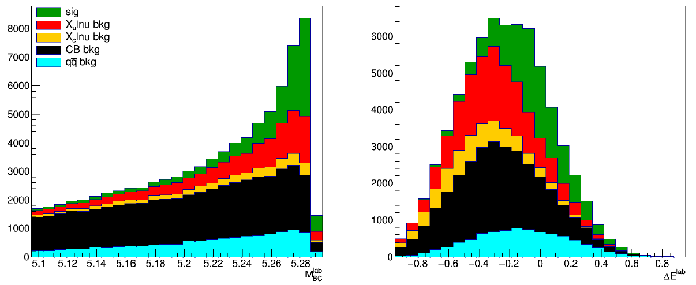
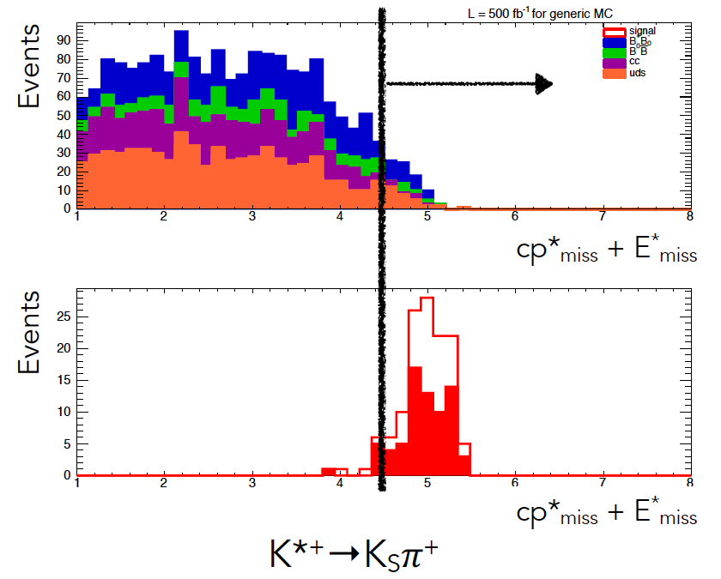
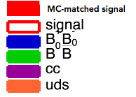
Semileptonic & Leptonic WG 1&2 : 4 Full simulation studies including beam background@B2TiP Pitt
BR Stat Error [%] in 700 fb⁻¹ | Belle/*Babar | B2BII MC | Belle II MC5
B → π l ν untagged, M. Lubej | 1.9 | - | 1.3
Bs → K l ν untagged @Y(5S) A. Zupanc | - | 7.5 | -
B → τ ν Had tag, M. Merola | 38 |  | 34
B → K^{*+} ν ν Had tag Cut&Count, E. Manoni | *<2.9⋅10⁻⁴ |  | <3.7⋅10⁻⁴
Analysis tools: Rest-of-Event, Untagged SL, FEI/Full-recon, optimized γ/π⁰ selection
Notes:
Missing energy decays still work with beam background

Slide 7
WG3 Time Dependent CP Violation
  Full simulation studies of 5 modes @ B2TiP Pitt. Belle II sensitivity improvements.
Stat. Precision with 710 fb⁻¹ | SCP |  | ACP |  | Δt [ps] resol.
 | Belle | Belle II MC5 | Belle | Belle II MC5 | Belle | Belle II MC5
B → KS KS KS, P. Jäger | 0.27 | 0.19 | 0.17 | 0.11
B → η’ (η→γγ) KS, S. Lacaprara | 0.15 | 0.12 | 0.10 | 0.09
B → Φ(KK) KS, A. Gaz |  |  |  |  | NA | 0.75
B → J/ψ KS, L. Li Gioi |  |  |  |  | 0.92 | 0.71
B → π⁰ π⁰ (→eeγ), F. Abudinen |  |  |  |  | NA | 1.5
Analysis tools: mdst KS, flavour tagging, tag-vertex, continuum suppression.
Homework: KL, e tracks, QED background, B2BII direct cross-check
Theory: Penguin pollution needs precision Γ(B⁺)/Γ(B⁰).
Notes:
Smaller errors indicate sensitivity improvements due to better vertexing.

Slide 8
WG4 (Φ₃/γ) and 6 (Charm) 4 full simulation based studies @ B2TiP Pitt
  Φ3 from B → D[KSππ] K±, I. Watson
  D semileptonics, J. Bennett
  D tagging, G. de Pietro
  D mixing and CPV, A. Schwartz, G. Casarosa
Preparation for first data
  L1 Trigger Menu for Low Multiplicity Physics evaluated with L1 emulator.
  https://d2comp.kek.jp/record/314/files/BELLE2-NOTE-PH-2015-011.pdf
  Preparing for systematic uncertainty measurements
  https://d2comp.kek.jp/record/345/files/BELLE2-NOTE-PH-2016-001.pdf
Notes:
Service work, validate physics MC samples.

Slide 9
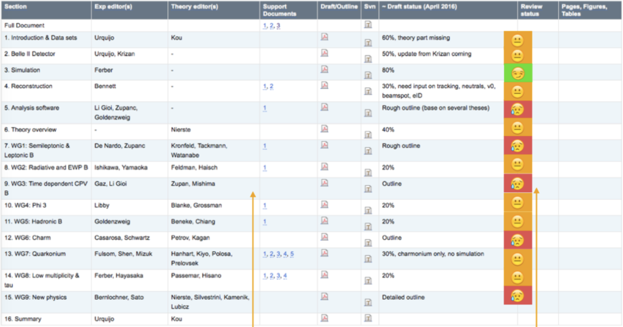
B2TiP report status
(as a B2TiP May 2016)

Slide 10
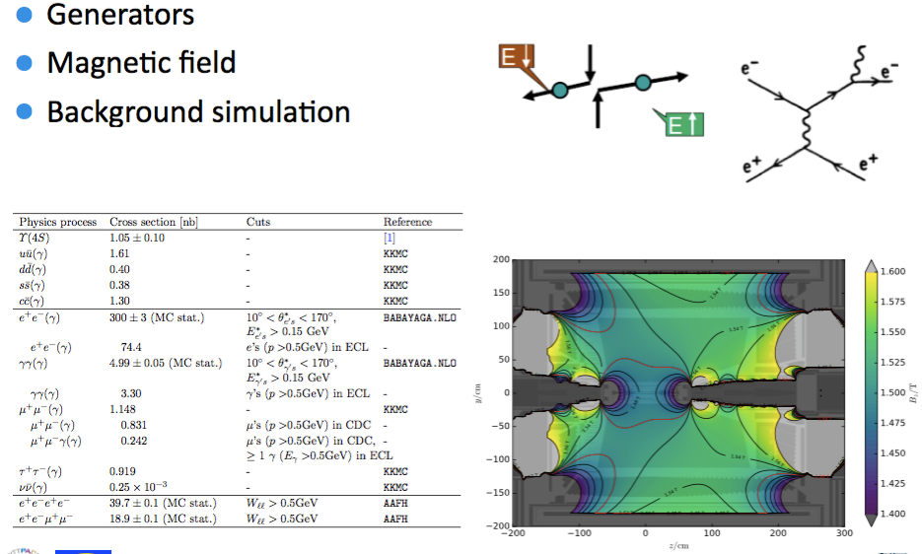
Simulation chapter

Slide 11
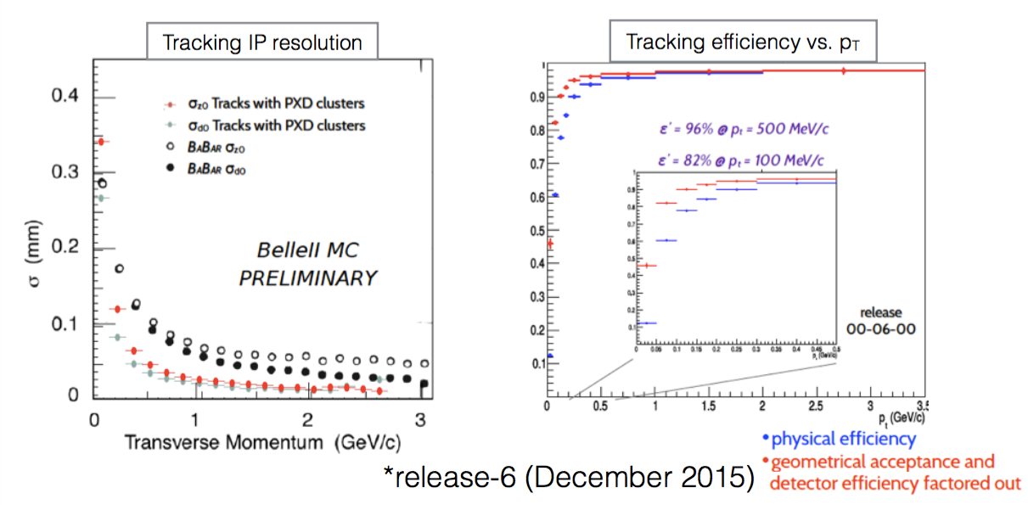
Reconstruction chapter
Tracking, calorimeter reconstruction, charged particle identification, neutral particle identification (γ, π⁰, K_{L})

Slide 12
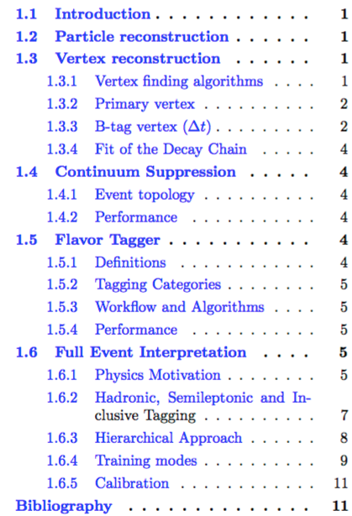
Analysis tools

Slide 13
B2TiP timeline
2016 key dates
  May B2TiP Pittsburgh – presentation of 1/ab to 5/ab studies
  June MC6 production based on software release 7 (removal of legacy tracking, more beam background processes); to be used in some studies
  July First draft of each chapter sent for soft review – VERSION 1
  September Deadline for response from reviewers
  Oct 31 Hard deadline for delivery of chapters for review prior to the MIAPP B2TiP workshop – VERSION 2
  Nov 15-17 B2TiP Editorial meeting
  Dec-Feb Editing and review; we will discourage new contributions in this period – FINAL VERSION
Journal submission: March 31, 2017

Slide 14
Summary
B2TiP is an effort to identify physics opportunities at Belle II together with the theory community
This process has converged in a series of 4 workshops so far
The B2TiP document has evolved a lot between Pittsburg May 2016 and now – soft review process
The final version is expected for the November 2016 workshop in Munich

